Slide 1
Electron Ion Collider News Update RHIC/AGS Users Open Forum DNP Fall Meeting 2019
Berndt Mueller
Brookhaven National Laboratory

Slide 2
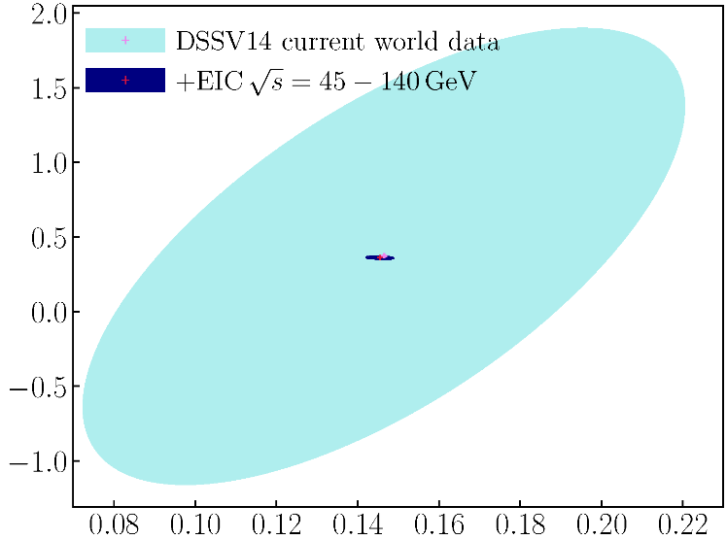
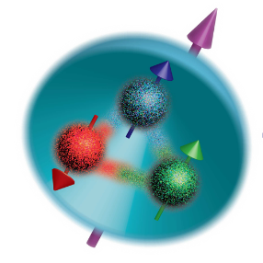
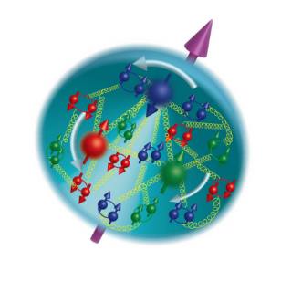
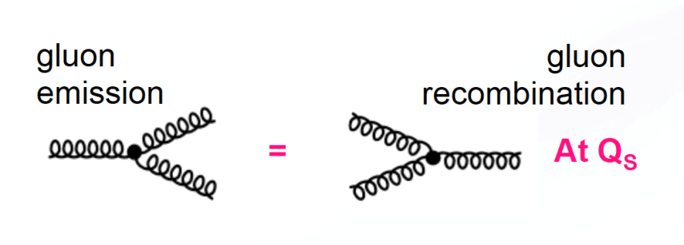
NAS and NSAC science questions
How does the proton get its spin?
Gluons
High E_{CM} for low momentum fraction ‘x’
Quarks
What is the nature of dense gluon matter?
Low energy
High energy
Onset scales
with (A/x)^{1/3}

Slide 3
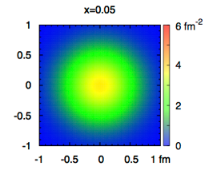
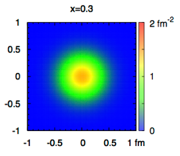
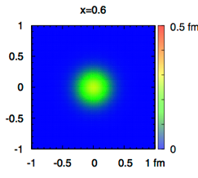
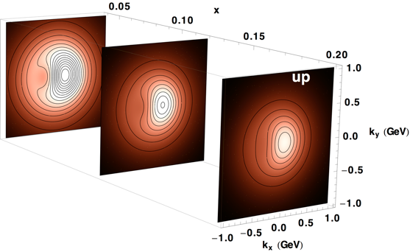
NAS and NSAC science questions
Spatial images
How does the proton get its mass?
Requires detailed understanding of QCD dynamics
How do quarks and gluons form nucleons and nuclei?
Momentum space images
x
The EIC will answer these questions!
Tomographic Imaging

Slide 4
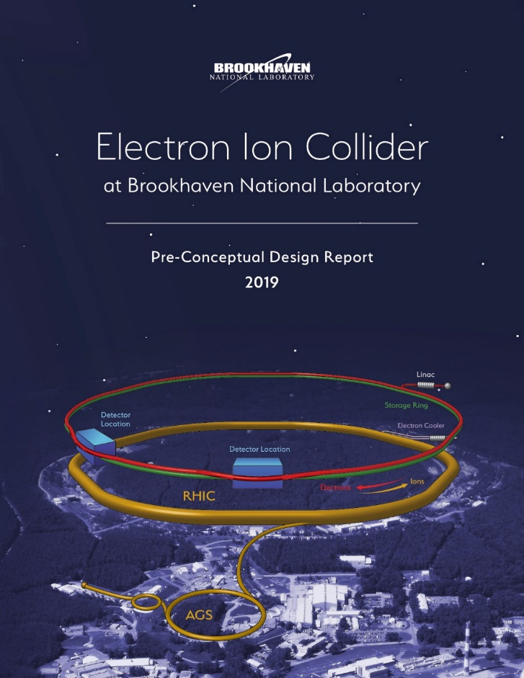
BNL’s EIC Design
Design detailed in a pre-Conceptual Design Report (updated in August 2019)
External Scope, Cost & Schedule Review (April 2019) confirmed the maturity of scope and cost estimate
Repurposing of RHIC anchors design with low technical/cost/schedule risk
Design delivers √s_{ep} = 140 GeV from Day 1; no energy upgrade required

Slide 5
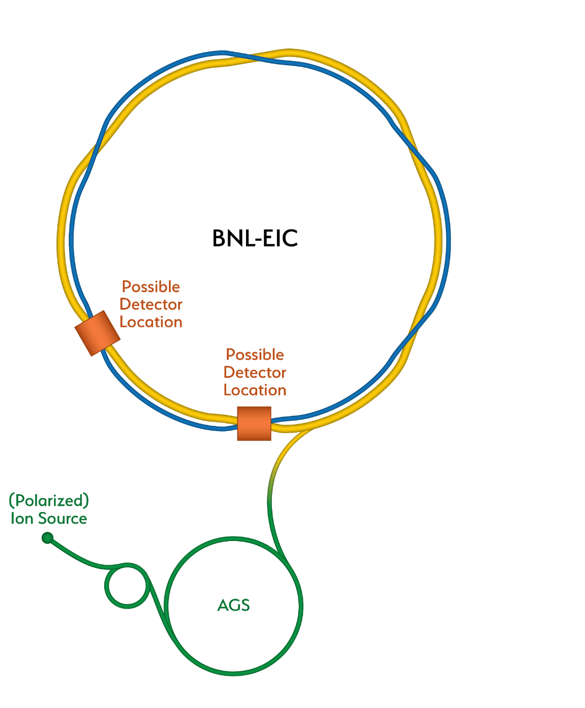
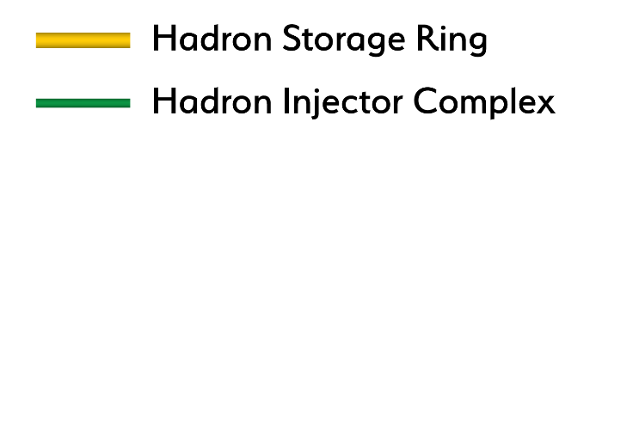
How RHIC is transformed into an EIC
Existing RHIC with blue and yellow rings

Slide 6
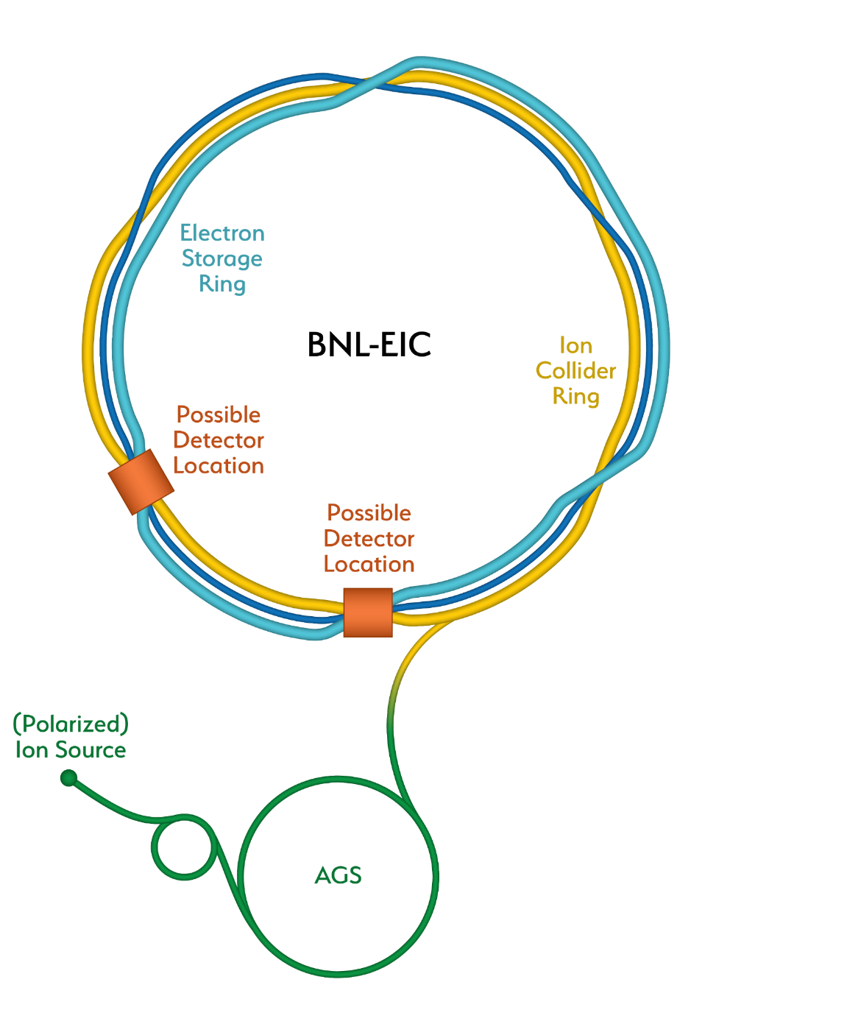
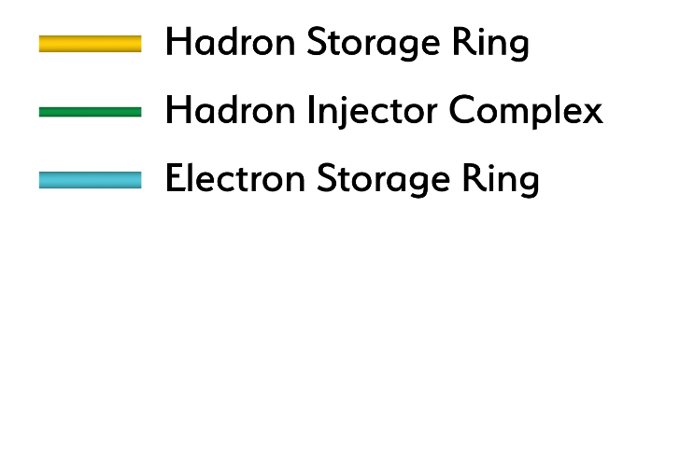
How RHIC is transformed into an EIC
Add electron storage ring

Slide 7
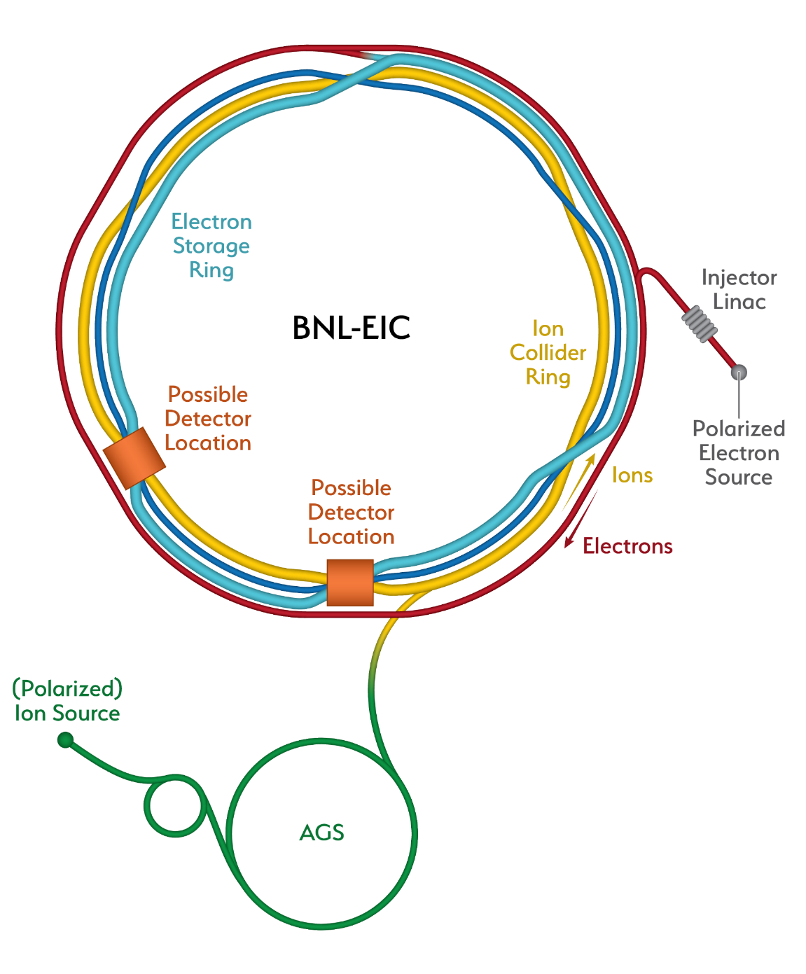
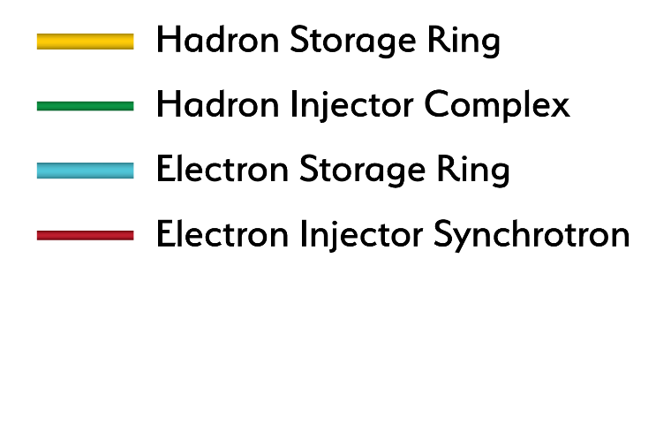
How RHIC is transformed into an EIC
Add an electron injector complex with Rapid Cycling Synchrotron

Slide 8
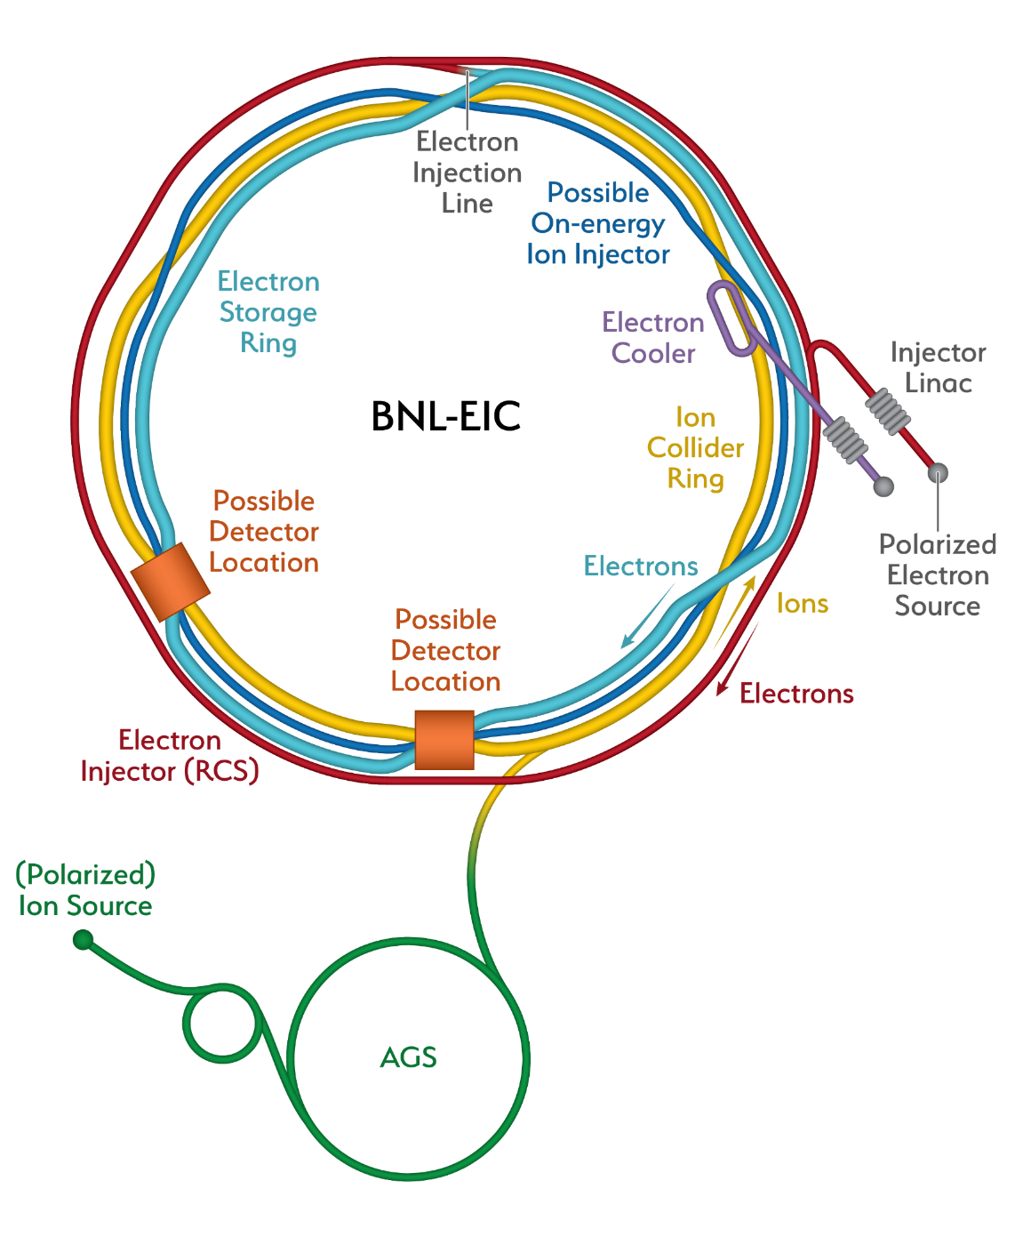
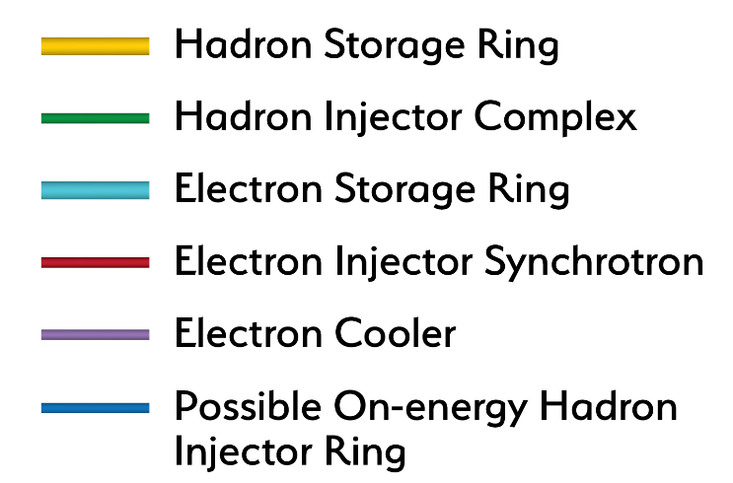
How RHIC is transformed into an EIC
Strong hadron cooling completes the facility
Alternate solution also shown using RHIC blue ring

Slide 9
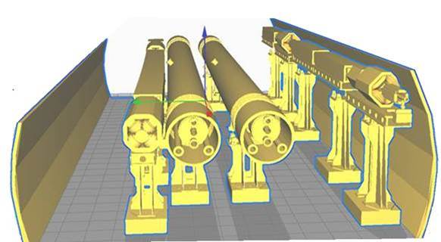
Major additions fit in RHIC tunnel
Rapid Cycling Synchrotron (RCS) for electrons and Electron Storage Ring (eSR) fit into the existing RHIC tunnel
Two detector halls available for interaction regions and detectors; one was included in baseline design
eSR
RHIC
RCS
Existing RHIC
tunnel

Slide 10
Interaction region and detector options
BNL EIC
Pre-CDR
Optimization for high E_{cm}
BNL EIC
Optimization for low E_{cm}
Annual Integrated Luminosity [fb⁻¹]
Peak Luminosity [cm⁻²s⁻¹]
10³⁴
10³³
10³²
100
10
1
Tomography (p/A)
Spin and Flavor Structure of
the Nucleon and Nuclei
Internal
Landscape of the Nucleus
QCD at Extreme Parton Densities-
Saturation
150
Center of Mass Energy E_{cm} [GeV]

Slide 11
NSAC key machine parameters for EIC
Highly polarized (70%) electron and light ion beams
Ion beams from deuteron to the heaviest nuclei (uranium, lead)
Variable center of mass energies from 20 to 100 GeV upgradable to 140 GeV
High luminosity of 10³³-10³⁴ cm⁻²s⁻¹
Possibility of having more than one interaction region
140

Slide 12
CD-0 / Site Selection Process
Independent Cost Review to establish cost range
Doumentation submitted May 1, 2019
Review by video conference May/June 2019
Final Report due August 2, 2019
Site Assessment Panel
Conducted by DOE Office of Science (chaired by James Siegrist, DOE/HEP)
Responses to 6 criteria due August 2, 2019
Lab presentations, Q&A sessions on October 8, 2019
Further decision process internal to DOE

Slide 13
Site Assessment Criteria
Scientific Merit of the Proposal
Technical Maturity
Schedule for Achieving the Full Range of the NSAC Machine Parameters
Proposal Costs Including Consideration of All Major Risks
Assurance of Successful Project Delivery
Value Added for each Site

Slide 14
Electron Ion Collider (EIC) Meeting
Agenda
Tuesday, October 8, 2019
7:30am – 7:45am BNL Access to Meeting Room for Set Up
8:00am – 8:30am Executive session/Continental Breakfast (panel only)
8:30am – 10:30 am BNL presentations
10:30am – 12:30pm Q&A/Discussion
12:30pm – 1:30pm Executive Session/Working Lunch (Panel and DOE participants only)
1:15pm – 1:30pm JLAB Access to Meeting Room for Set Up
1:30pm – 3:30pm JLAB presentations
3:30pm – 5:30pm Q&A/Discussion
5:30pm – 6:30pm Executive Session
Wednesday, October 9, 2019
8:00am – 8:30am Continental Breakfast (panel only)
8:30am – 2:00pm Executive Session/ Working Lunch (Panel and DOE participants only)

Slide 15
EIC Users Group
Annual EIC Users Meeting:
July 22-26, 2019 (Paris, France)
Presentations from DOE, European Institutions, U.S. Labs
IUPAP Working Group 9 (Nuclear Physics) Meeting
August 2-3, 2019 (In camera discussions of funding agencies)
EIC Physics and Detector Conceptual Development
12-18 months study initiated in September 2019
Two working groups: Physics WG, Detector concepts WG
2-day kick-off meeting planned for late 2019 or early 2020
Summaries published as “Yellow Reports” in spring 2021

