Slide 1
Why I remain so excited analyzing phenix data
Julia Velkovska

Slide 2
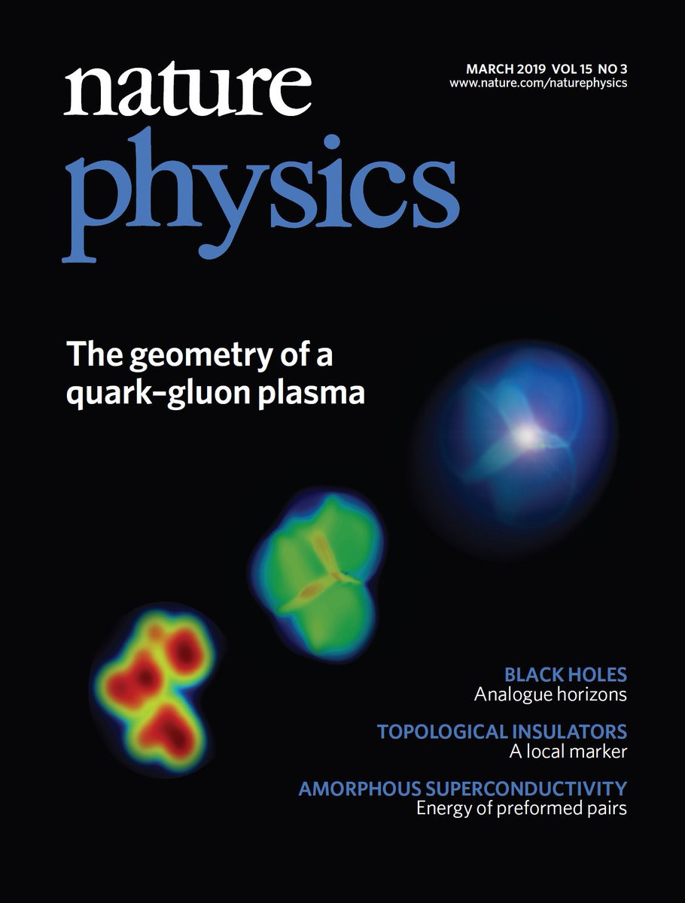
Excitement of Discovery
Enabled by:
RHIC’s unique versatility
PHENIX’s outstanding trigger, DAQ, and broad range detectors

Slide 3
Precision with rare probes
30 B Au+Au events in Run 14 and Run 16
Forward rapidity coverage for quarkonia and heavy flavor unique to PHENIX
Y. Akiba, BNL S&T review , Sept. 2019

Slide 4
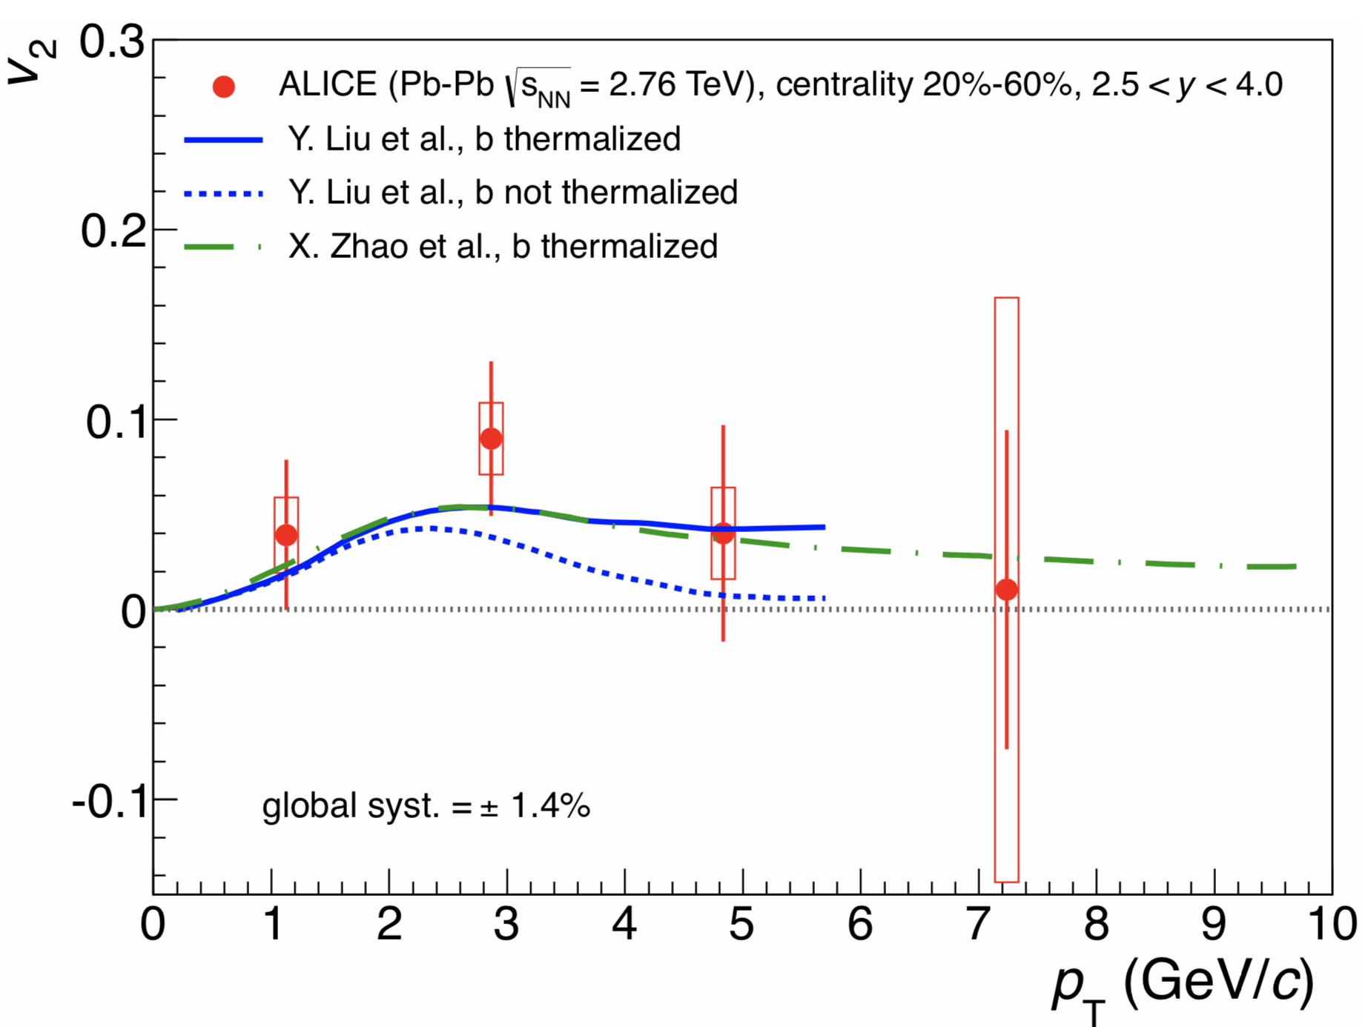
Does J/$ψ$ flow at RHIC ?
STAR Collaboration
Phys. Rev. Lett. 111 (2013) 52301
Run 10; mid-rapidity; 13k J/$ψ$
ALICE Collaboration
Lint ≈ 70 μb−1
forward rapidity (2.5 < y < 4)
PHENIX Run 14 and Run 16 data together can provide
statistically significant measurement of v₂ of J/$ψ$ at forward y
Address questions about thermalization and recombination of charm quarks

Slide 5
Do c and b quarks flow in Au+Au at RHIC?
PHENIX Preliminary Run 14; mid rapidity using VTX

Slide 6
Do c and b quarks flow in Au+Au at RHIC?
Statistically significant measurement of v₂ of b-quarks possible with Run14+16 data
forward rapidity with FVTX unique to PHENIX

Slide 7
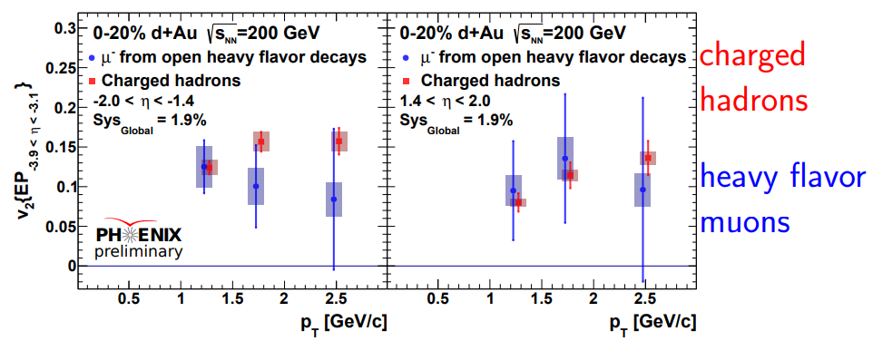
Heavy flavor flow in small systems at RHIC?
PHENIX preliminary
Run 8 d+Au; forward/backward rapidity
First measurement of heavy flavor flow in small systems at RHIC

Slide 8
Heavy flavor flow in small systems at RHIC?
PHENIX preliminary
Run 8 d+Au; forward/backward rapidity
Run 16 data
+
First measurement of heavy flavor flow in small systems at RHIC
= flow of c and b
separated

Slide 9
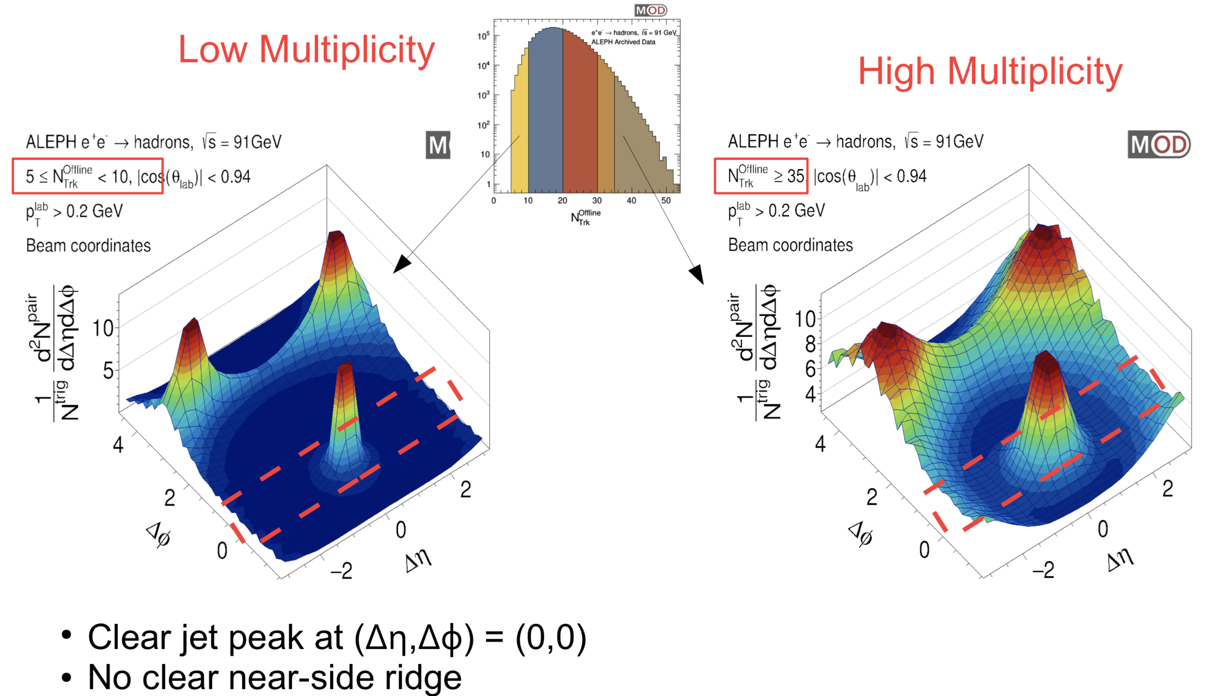
Importance of data preservation
Searching for a ridge in e+e- collisions ; archived ALEPH data from LEP
arXiv:1906.00489
A. Baty , RHIC/AGS User meeting 2019
RHIC unique data sets should be preserved and analyzable in the EIC era for future discoveries!

Slide 10
Thank you

Slide 11
Impact
Y. Akiba, BNL S&T review , Sept. 2019

