Slide 1
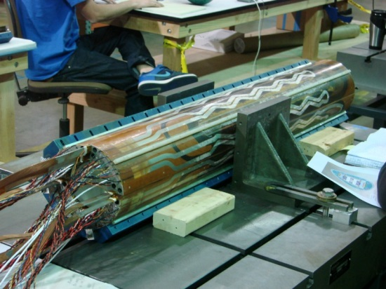
HQ02 Accounting for coil dimension during assembly Collar-pack assembly
Helene Felice – Dan Cheng – Franck Borgnolutti - Daryl Horler – Matt Reynolds

Slide 2
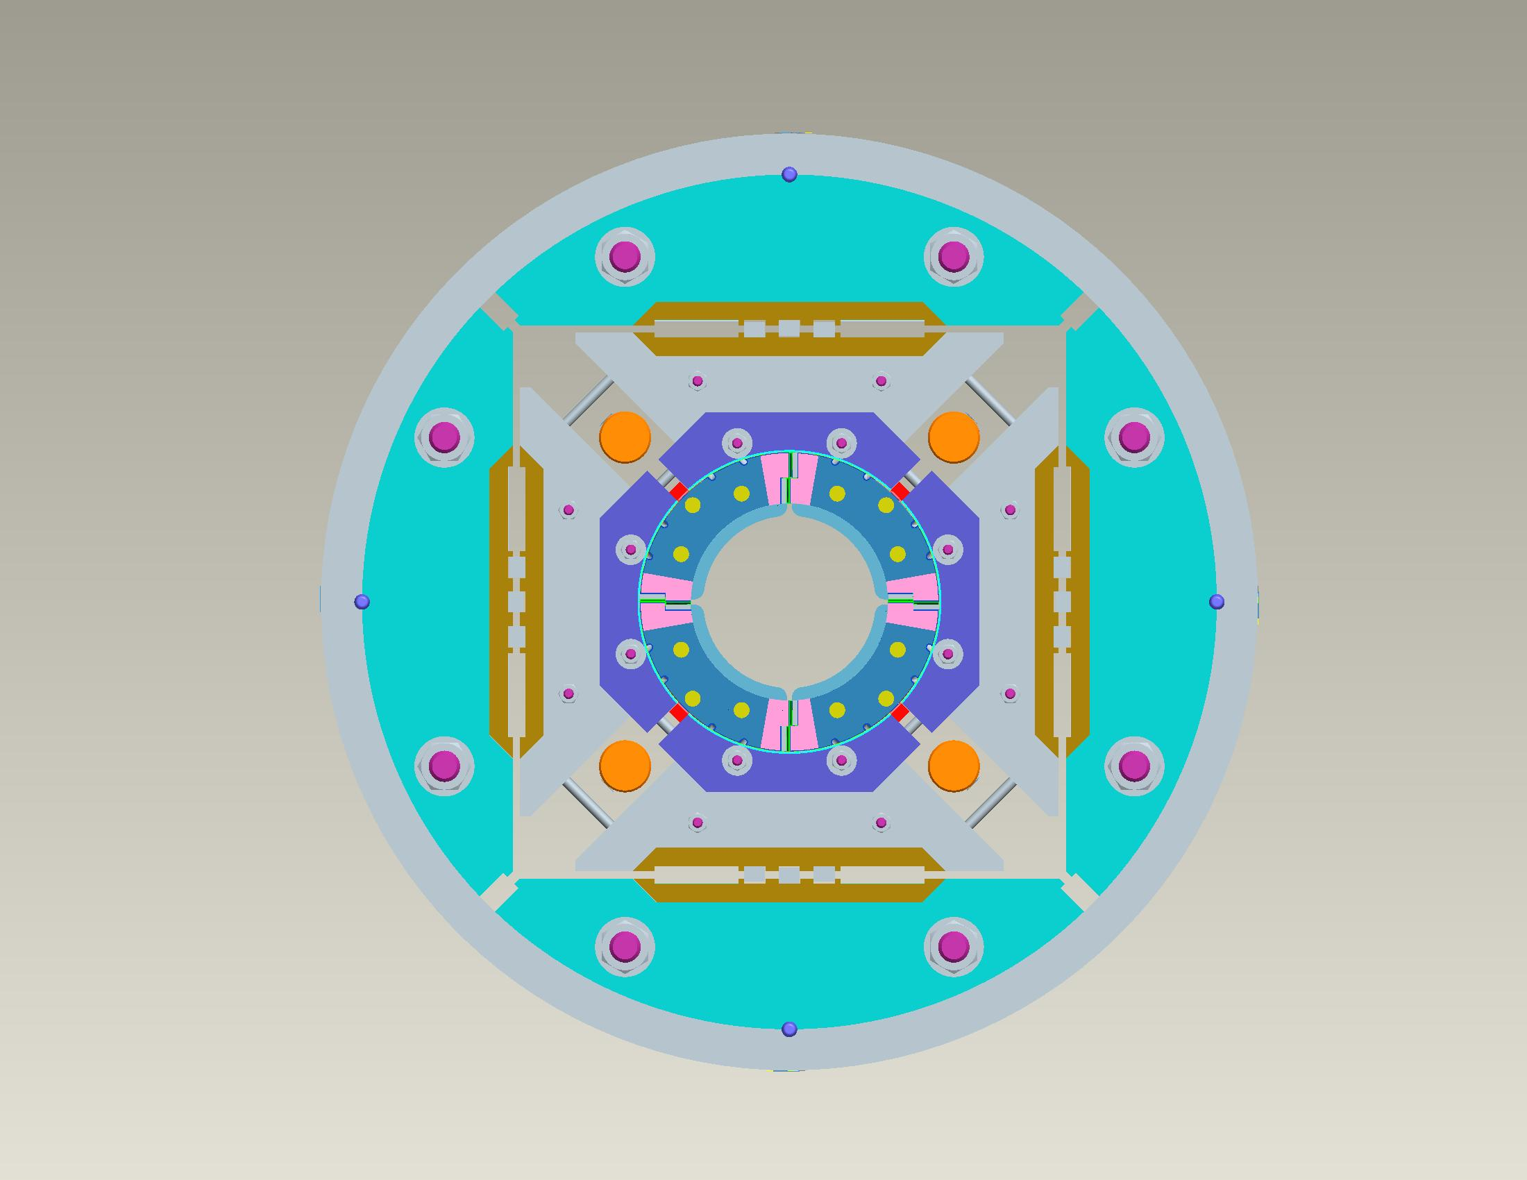
HQ02 layout
A
Sector D
Sector A
COIL 17
COIL 20
D
B
COIL 16
COIL 15
Sector C
Sector B
C
VIEW LOOKING AT
LEAD END

Slide 3
Introduction
Collar pack assembly
General description of the steps toward collar pack assembly
Accommodating the coil size
to optimize collar ID /coil OD matching
Choice of the pole alignment key shims
A glance at HQ03 and QXF collar-pack assemblies
Minimize the number of steps to prepare for QXF
Goal:
Finalize coil CMM measurement s
Ensure compatibility of the assembly with the ground plane insulation

Slide 4
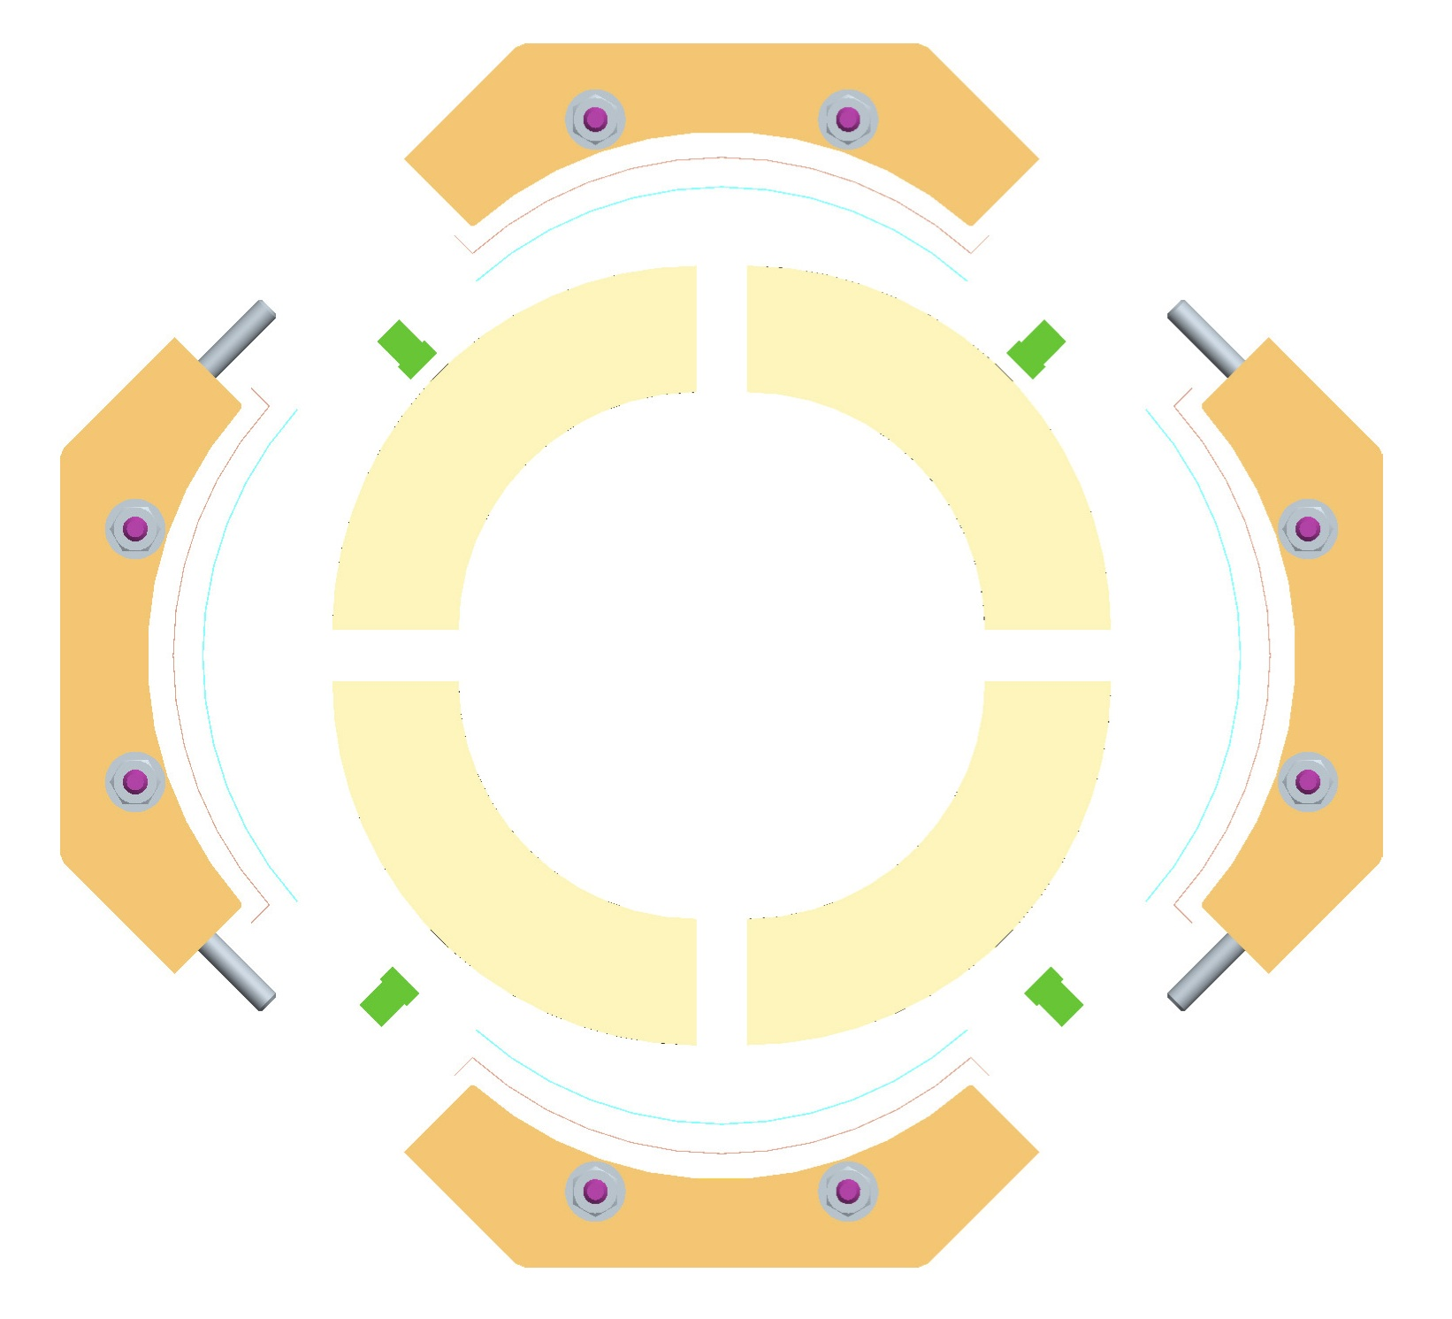
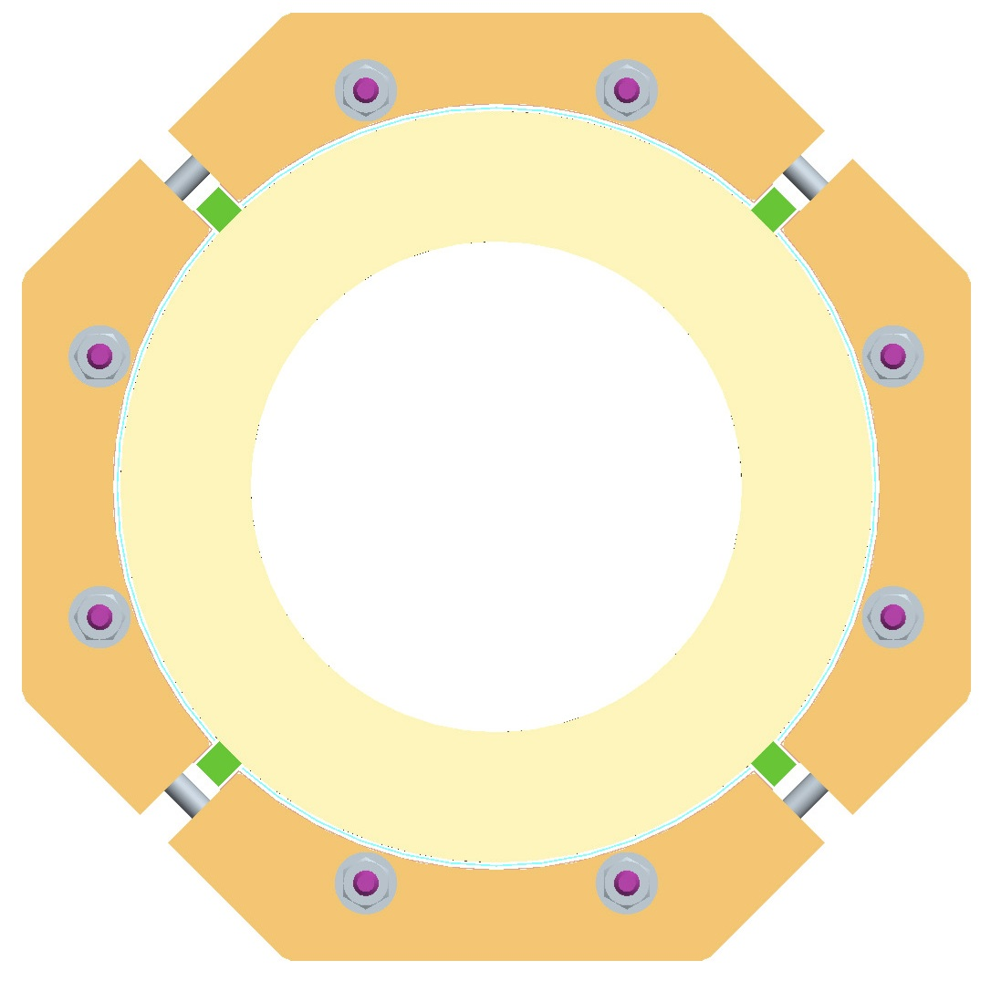
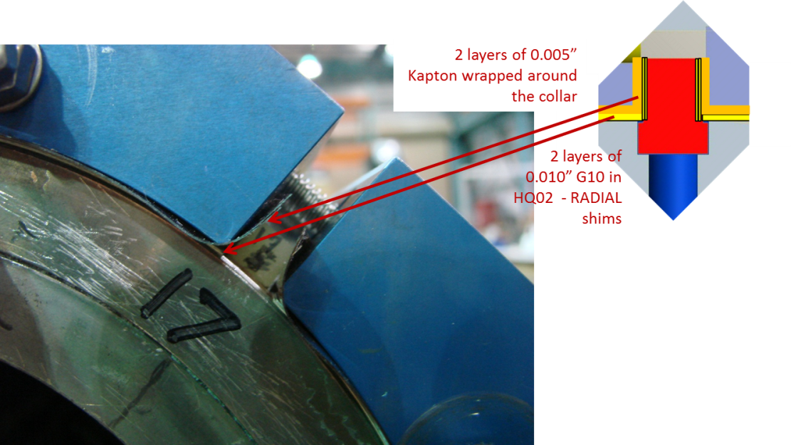
HQ02 Collar-pack Assembly - I
Ground plane insulation layout
Coil CMM measurements
Nominal Radial shims
Nominal pole key shims
Pole key shims
Ground plane insulation made of G10 and Kapton
=> Radial shims
Pole alignment key is full length
Shimmed only in the straight section

Slide 5
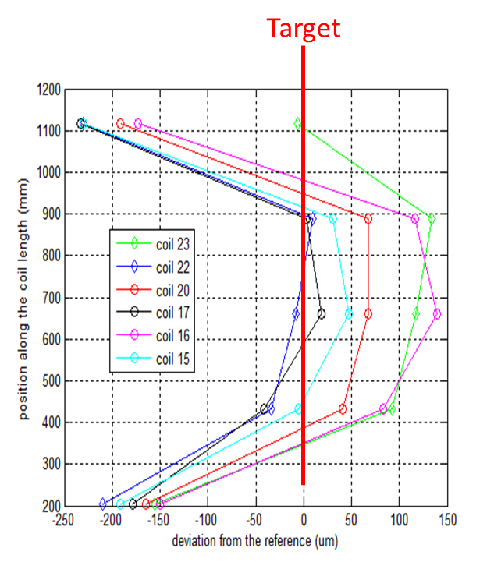
HQ02 Collar-pack Assembly - II
Ground plane insulation layout
Coil CMM measurements
Actual coil OD / actual coil azimuthal size
Nominal Radial shims
Actual radial shims
Nominal pole key shims
Franck Borgnolutti
Based on CMM measurement we estimate an average coil azimuthal size and define the appropriate radial shim thickness to ensure coil OD/collar ID matching

Slide 6
CMM measurements used for HQ02a assembly
8 x δ_{midplane} = 2 π x δR_{shim} = 4 x Gap_{collar}
Based on CMM max deviation in HQ was in average 0.004” (100 μm)
δR_{shim} of 0.005” (125 μm)
Nominal radial Shim in HQ02 = 0.036” (~900 μm)
New shim = 0.031” (~790 μm)
Gap btw collars = 0.375”(9.525 mm)
Effective shims = 0.028” (700 μm)
Actual Collars gap : 0.0375”-2π x 0.003”/4 = 0.370 “(9.4 mm)

Slide 7
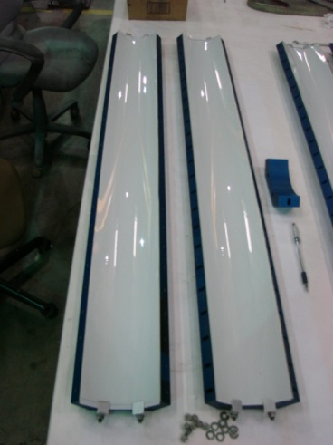
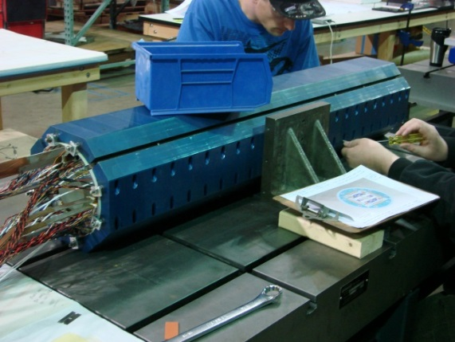
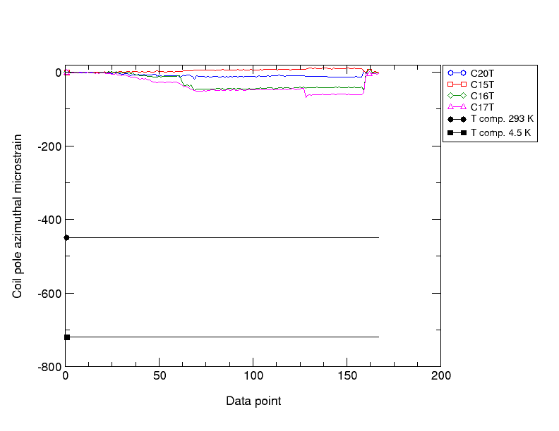
HQ02 Collar-pack Assembly - III
Ground plane insulation layout
Coil CMM measurements
Actual coil OD / actual coil azimuthal size
Nominal Radial shims
Actual radial shims
Assembly with Fuji paper
No shimming of the pole key
Nominal pole key shims
Measurement of pole gap dimensions along the length using measurement pins
Pole SG measurements

Slide 8
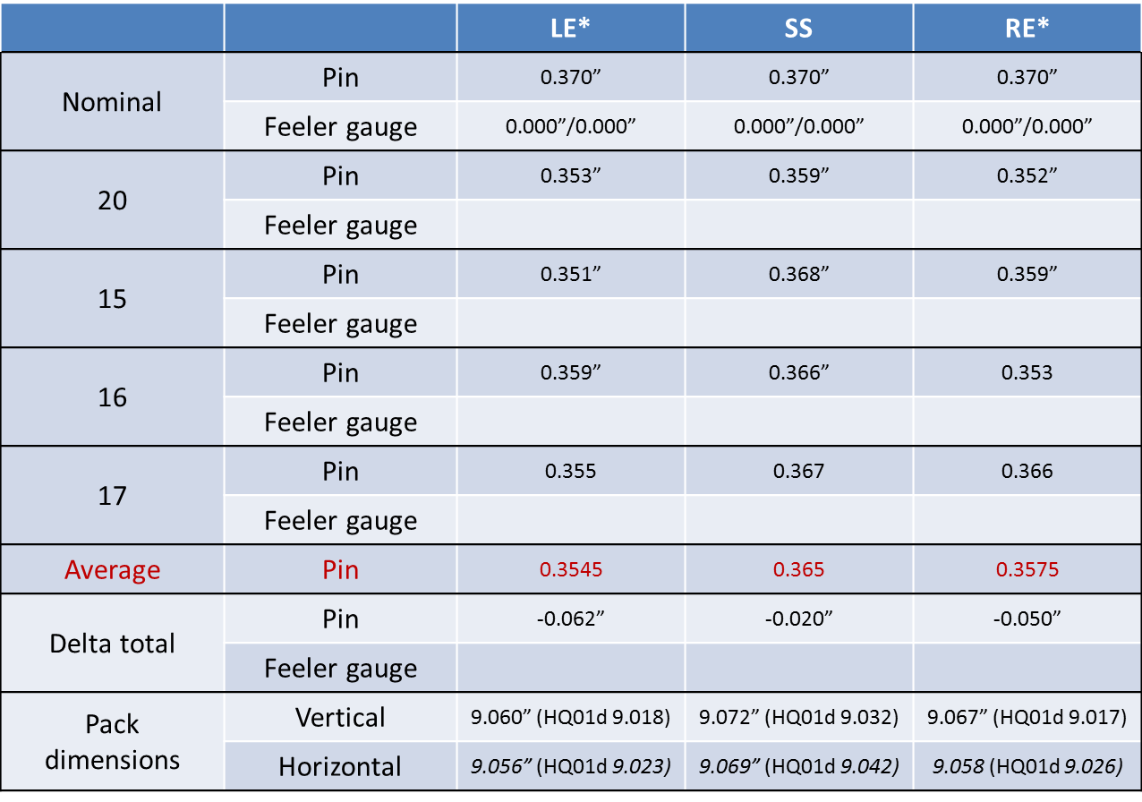
Collar-to-collar spacing
Comparison of the pin measurement with the nominal collar to collar distance
Assess difference between nominal and measured
=> Coils actual azimuthal size smaller than initially considered

Slide 9
CMM measurements used for HQ02a assembly
8 x δ_{midplane} = 2 π x δR_{shim}
Based on CMM max deviation in HQ was in average 0.004” (100 μm)
δR_{shim} of 0.005” (125 μm)
Nominal radial Shim in HQ02 = 0.036” (~900 μm)
New shim = 0.031” (~790 μm)
Gap btw collars = 0.375”(9.525 mm)
Effective shims = 0.028” (700 μm)
Actual Collars gap : 0.0375”-2π x 0.003”/4 = 0.370 “(9.4 mm)
Average measured collar gap= 0.365” (~9.27 mm)
Indicating that coil where in reality smaller than initially accounted for
Only by ~ 0.001/0.002” (25 to 50 microns) mil per mid-plane

Slide 10
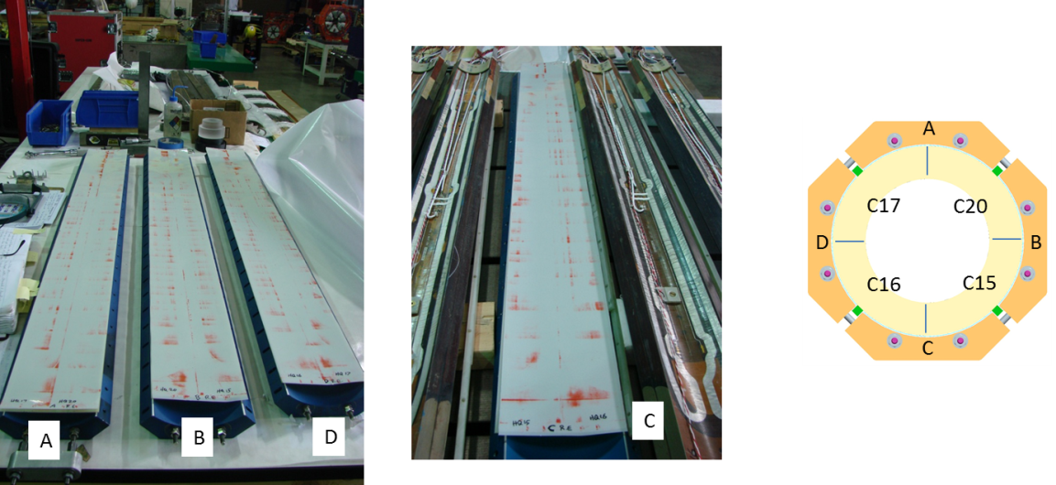
Collar-pack Assembly - IV
Ground plane insulation layout
Coil CMM measurements
Actual coil OD / actual coil azimuthal size
Nominal Radial shims
Actual radial shims
Assembly with Fuji paper
No shimming of the pole key
Nominal pole key shims
Measurement of pole gap dimensions along the length using measurement pins
Fuji paper inspection
OK

Slide 11
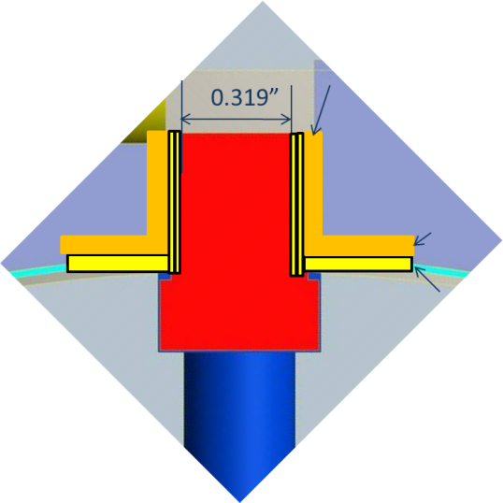
Collar-pack Assembly - V
Ground plane insulation layout
Coil CMM measurements
Actual coil OD
Nominal Radial shims
Actual radial shims
Assembly with Fuji paper
No shimming of the pole key
Nominal pole key shims
Actual pole key shims
Measurement of pole gap dimensions along the length using measurement pins
Fuji paper inspection
OK

Slide 12
Choice of the shims
Collar-to-collar gap
Key way dimension
0.376” =9.55 mm
G10 + kapton stack
2 x 0.005” Kapton wrapped around collar (2 x 125 μm)
G10
Kapton
0.319”
=8.1 mm
2 x 0.005” Kapton wrap
(2 x 125 μm)
2x ~0.010” G10 shim
2 x 250 μm
No shim in the ends
Shim only in the straight section

Slide 13
Collar-pack Assembly - IV
Ground plane insulation layout
Coil CMM measurements
Actual coil OD
Nominal Radial shims
Actual radial shims
Assembly with actual G10 and Kapton radial shims
Nominal pole key shims
Actual pole key shims
Pole shims
Measurement of pole gap dimensions along the length using measurement pins

Slide 14
Set of measurements of final HQ02 collar pack
 |  | LE* | SS |  |  | RE*
Nominal | Pin | 0.363 | 0.363 | 0.363 | 0.363 | 0.363
 | Feeler gauge
20 | Pin | 0.351 | 0.363 | 0.368 | 0.361 | 0.355
 | Feeler gauge | Na | 0 | 0.004 | 0 | Na
15 | Pin | 0.357 | 0.360 | 0.364 | 0.358 | 0.358
 | Feeler gauge | Na | 0 | 0.002 | 0 | Na
16 | Pin | 0.358 | 0.360 | 0.360 | 0.364 | 0.356
 | Feeler gauge | Na | 0 | 0 | 0 | Na
17 | Pin | 0.355 | 0.364 | 0.361 | 0.368 | 0.358
 | Feeler gauge | Na | 0 | 0 | 0 | Na
Average | Pin | 0.355 | 0.362 | 0.363 | 0.363 | 0.356
Delta total | Pin | -0.032 | -0.004 | 0 | 0 | -0.028
 | Feeler gauge |  |  | 0.006
Final HQ02 coil pack assembly

Slide 15
Case of HQ02: summary
In the case of HQ02
Radial shims defined based on coil CMM measurements
Collar pack # 1:
No pole alignment shims (undersized key)
Fuji paper in all quadrants (accounted for in radial shimming stack)
Collar pack # 2
Pole Key in place
With full length shims
Pole key shims defined based on collar pack #1 collar to collar spacing
After assemblies
some gaps observed between collar and key
Some damage on shims observed by technician
Decision to proceed with replacement of shims and measurements of the pole key
Coil pack # 3
Final collar pack assembly with same radial shims and pole shims as coil-pack #2

Slide 16
Plan for next magnets Toward QXF
HQ03
Plan is to use the same procedure and minimize the number of steps
In HQ02: 3 coil packs
In HQ03:
1 Fuji test without keys
New keys and 1 collar pack with appropriate shims
Steps will be reviewed closer to assembly
SQXF and 1st LQXF model
2-step procedure
Radial shims adjustment and Fuji paper collar-pack assembly
Final pole key shim
Moving toward MQXF and assuming reproducible coil dimensions
1 step assembly without Fuji paper step

