Slide 1
LQXF Coil Winding and Curing Cable Re-spooling at FNAL
Miao Yu
05/06/2014

Slide 2
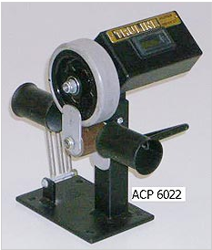
Cable Re-spooling Setup
Tension is provided by payout and respooler
Digital counter, measures in meters and tenths

Slide 3
Tension Control
Tension can be adjusted by tuning the input voltage to both respooler and payout

Slide 4
Re-spooling
Cable total length verification
Insulation and cable inspection visually
Mark the split position for L1 and L2 cable (minimum length, L1 = 184 m; L2 = 233 m)
Take the full spool off the respooler, and put an empty reel on the respooler. Split into two spools.
Use die cart to transfer two spools together.

Slide 5
LQXF Coil Winding and Curing Winding with Rotation Table at FNAL
Miao Yu
05/06/2014

Slide 6
Rotation Table
4.3 m long support frame, need modification. Current frame to tension distance: 1.5 m
Winding table was used for 3.4 m LHQ coil. Need load verification for 4.5 m long LQXF coil at 55 lbs winding tension.
All the work will start this summer.

Slide 7
Frame Modification
4.85 m long frame for 4.5 m LQXF coil
Work including cutting, alignment, welding

Slide 8
Winding Mandrel
For SQXF Coil
Extended for LQXF

Slide 9
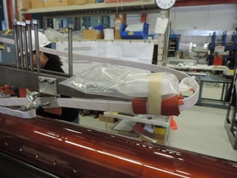
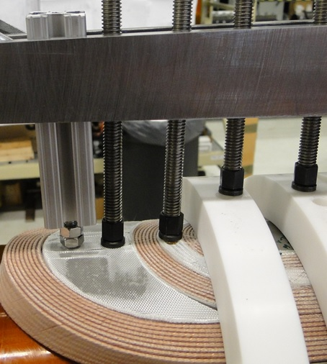
Winding Tooling
For SQXF Coil
Adopted for LQXF

Slide 10
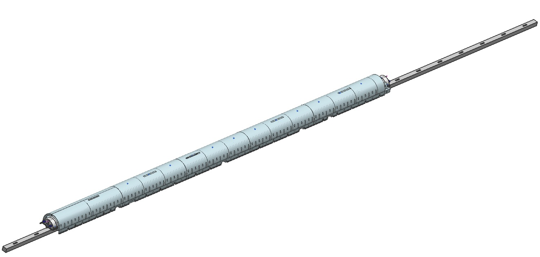
Curing Tooling
SQXF Coil
Duplicate for LQXF
Selva support beam
Winding mandrel support can be bolted to the beam

Slide 11
LQXF Coil Winding and Curing Curing Process at FNAL
Miao Yu
05/06/2014

Slide 12
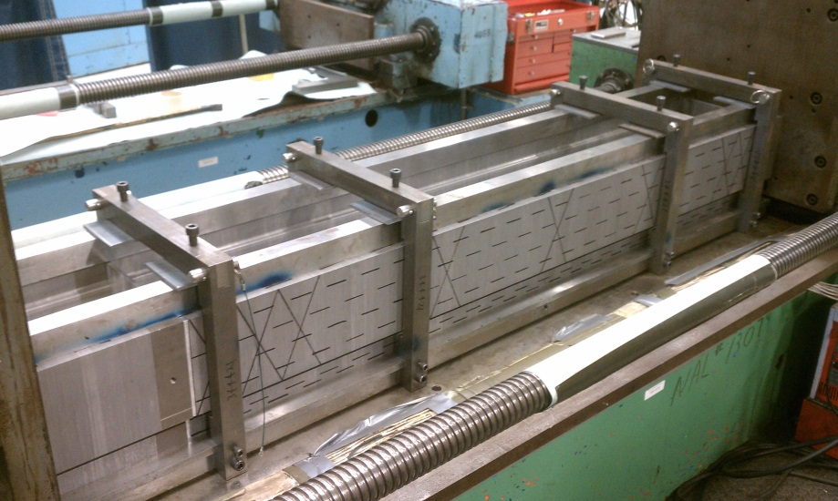
Curing Mold
2.2 m SQXF curing mold is in service
8.8 m LQXF curing mold will be built in the end of this year.

Slide 13
Curing Press
 | Capacity (pump psi) | Max. force/cylinder kN (ton) | Spacing cm(inch) | Unit force kN/m-pump psi (lb/in-pump psi)
Main Cylinders | 10000 | 1780 (200) | 30 (12) | 0.6 (3.34)
Mandrel Cylinders | 10000 | 134 (15) | 15 (6) | 0.09 (0.5)
8.8 m long

Slide 14
Curing Pressure Control
L2
L1
For SQXF Coil, the azimuthal stress is well controlled ~10 MPa

Slide 15
Pressure Control Panel

Slide 16
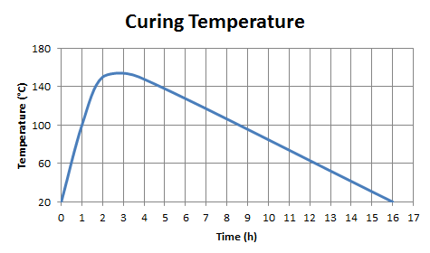
Temperature Control
Once the curing mold is closed, start heating the mold
Keep the hydraulic pressure during the thermal cycle.

Slide 17
Coil Axial Load and Alignment
Both ends are pushed by the rods with or without the rubber before curing.
During curing, no additional action.
L1: one pin through the tooling, to the coil
L2: two screws to the lifting holes in the coil

Slide 18
LQXF Coil Winding and Curing Coil Handling
Miao Yu
05/06/2014

Slide 19
During W&C
For SQXF Coil
For LQXF Coil

Slide 20
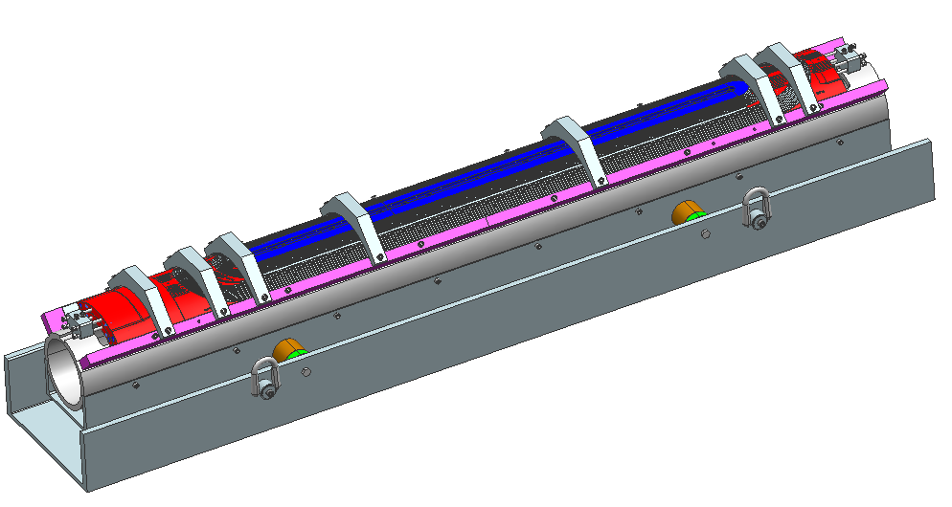
After Curing
For SQXF
LQXF

