Slide 1
SQXF Coil End Part Design LARP-BEND
Miao Yu
05/05/2014

Slide 2
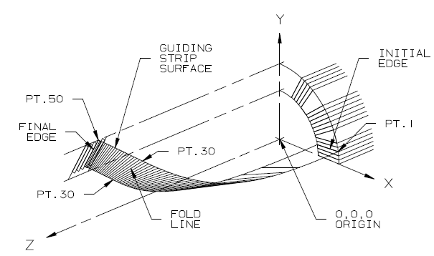
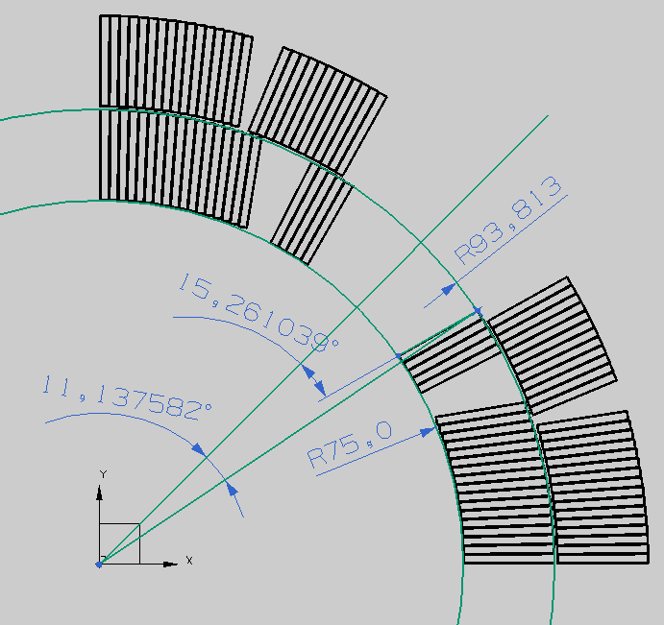
BEND Design Diagram
Define
FAT and KEY
Modify Code
User Design:
Number of cable on each side of guiding strip (0/n)
A-length
Estimated final edge angle
Run
Geometric:
Outer radius
Inner radius
Outer starting angle
Initial edge angle
Cable mid-thickness
Keystone angle
Input
Minimize strain energy
Shift and Blunt
Output
Cable:
4 corner coordinates
50 cross-sections
End parts:
50 points on both OD spline and ID spline
Note:
Shift (-2 to 2): redistribute the twist along the guiding strip.
Blunt (0 to 0.5): relief the sharp nose
CAD

Slide 3
Design Parameters
KEY and FAT
key: keystone angle; fat: mid-thickness; 1/2: midpoint/nose
Defined based on HQ coil inspection.
All conductor group share the same key1=0.6, key2=0.3, fat1=1.09 and fat2=1.07
A-length
Based on Roxie coil end magnetic design
Defined to meet the first cable of each conductor group at the outer radius position
Final Edge Angle
Roughly estimate and input to BEND
BEND automatically calculates the suggested one
Decision by designer
RE
LE

Slide 4
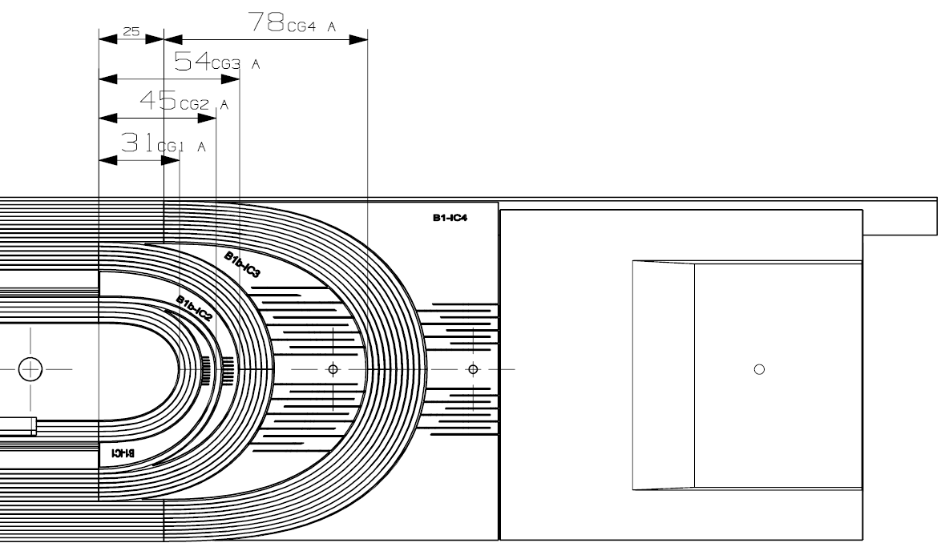
L1 A-length
LE | CG1 | CG2 | CG3 | CG4
A-length (mm) | 31 | 45 | 54 | 78
Shift (mm) | 0 | 0 | 0 | 25
RE | CG1 | CG2 | CG3
A-length (mm) | 27 | 49 | 71
Shift (mm) | 0 | 0 | 38

Slide 5
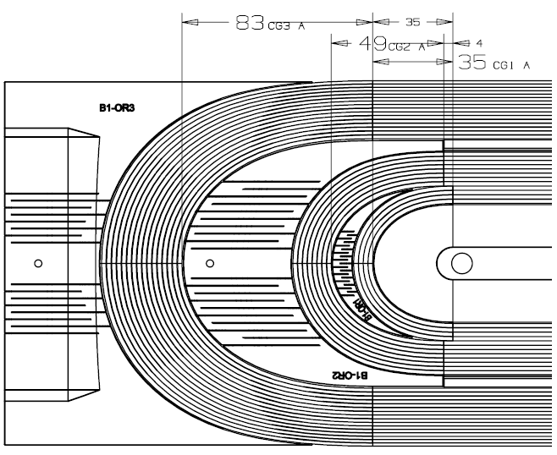
L2 A-length
LE | CG1 | CG2 | CG3 | CG4
A-length (mm) | 35 | 54 | 94 | 94
Shift (mm) | 0 | 0 | 0 | 21
RE | CG1 | CG2 | CG3
A-length (mm) | 35 | 49 | 83
Shift (mm) | 0 | 4 | 35

Slide 6
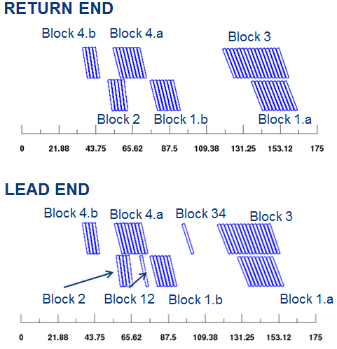
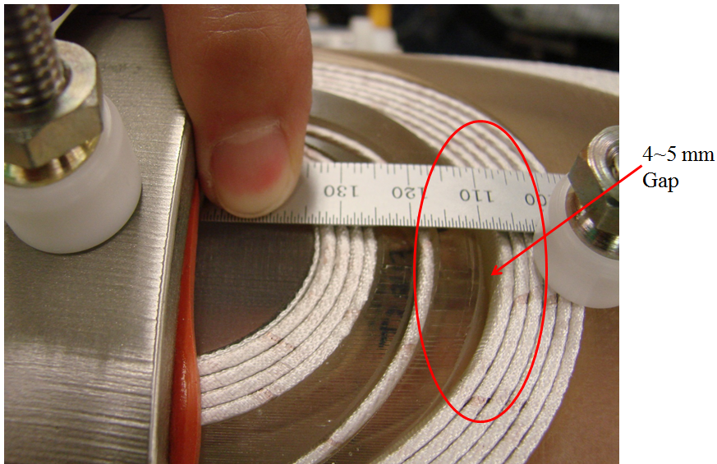
Final Edge Angle
 |  | ROXIE INPUT |  | BEND INPUT |  | Δ
 | Block | # cond | angle | v1 | v1b
RE | 1a | 10 | 71 | 25 (65) | - | 6
 | 1b | 7 | 76 | 20 (70) | 14 (76) | 0
 | 2b | 5 | 82 | 9 (81) | - | 1
 | 3 | 16 | 68.5 | 22.5 (67.5) | - | 1
 | 4a | 8 | 76 | 14 (76) | - | 0
 | 4b | 4 | 81 | 11 (79) | - | 2
* Positive Δ: steeper at CERN
 |  | ROXIE INPUT |  | BEND INPUT |  | Δ
 | Block | # cond | angle | v1 | v1b
LE | 1a | 10 | 71 | 23.5 (66.5) | - | 4.5
 | 1b | 6 | 76 | 20 (70) | 15 (75) | 1
 | 1-2 | 1 | 78 | 13 (77) | - | 1
 | 2 | 4 | 82 | 10 (80) | - | 2
 | 3 | 15 | 68.5 | 22 (68) | - | 0.5
 | 3-4 | 1 | 72 | 19 (71) | - | 1
 | 4a | 8 | 76 | 13 (77) | - | -1
 | 4b | 4 | 81 | 10 (80) | - | 1

Slide 7
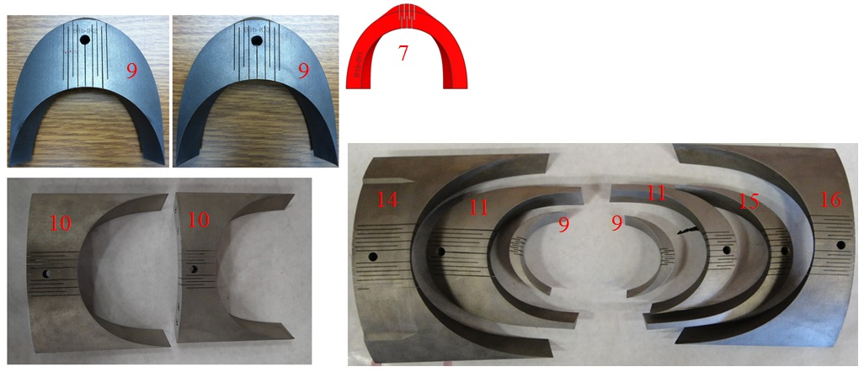
Flexible End Part
Coil 1, LARP received the solid parts and wire cut the slits.
Well fit the coil, although some are a little tight.

Slide 8
1st Practice coil after W&C

Slide 9
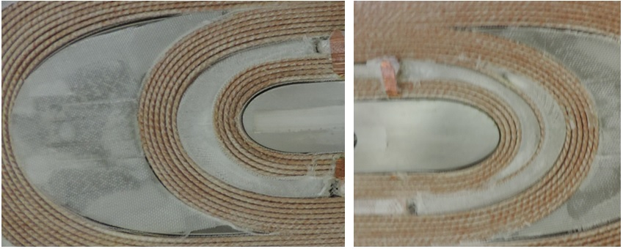
1st Practice coil after W&C

Slide 10
Flexible End Parts for Coil 2
LARP received the parts with slits and bridges
We wire cut the bridges to free the needed slits.
Round the edges, tips and corners
Plasma Coating

Slide 11
Slits Dimension
LARP: 3 mm
LARP: 0.4 mm

Slide 12
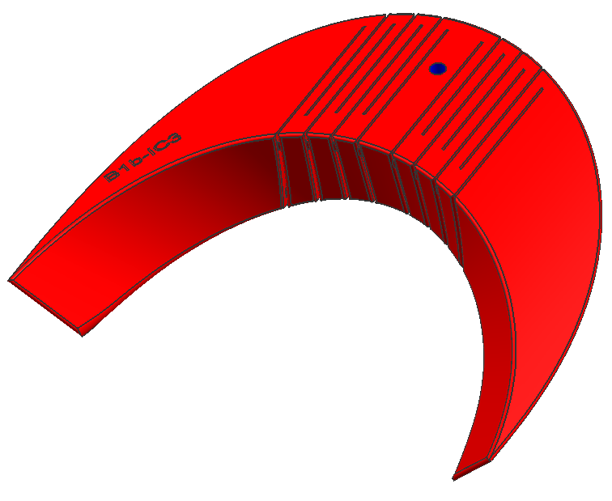
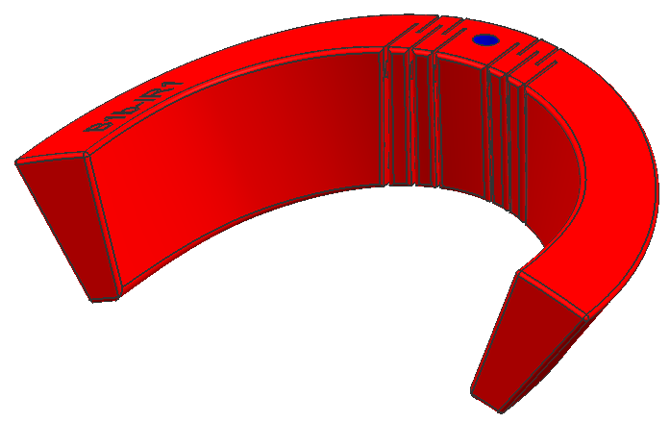
Round tip and edge
~ 1mm
R0.5
R0.5
R3.0
R1.5
R0.5
R0.5
R1.5

Slide 13
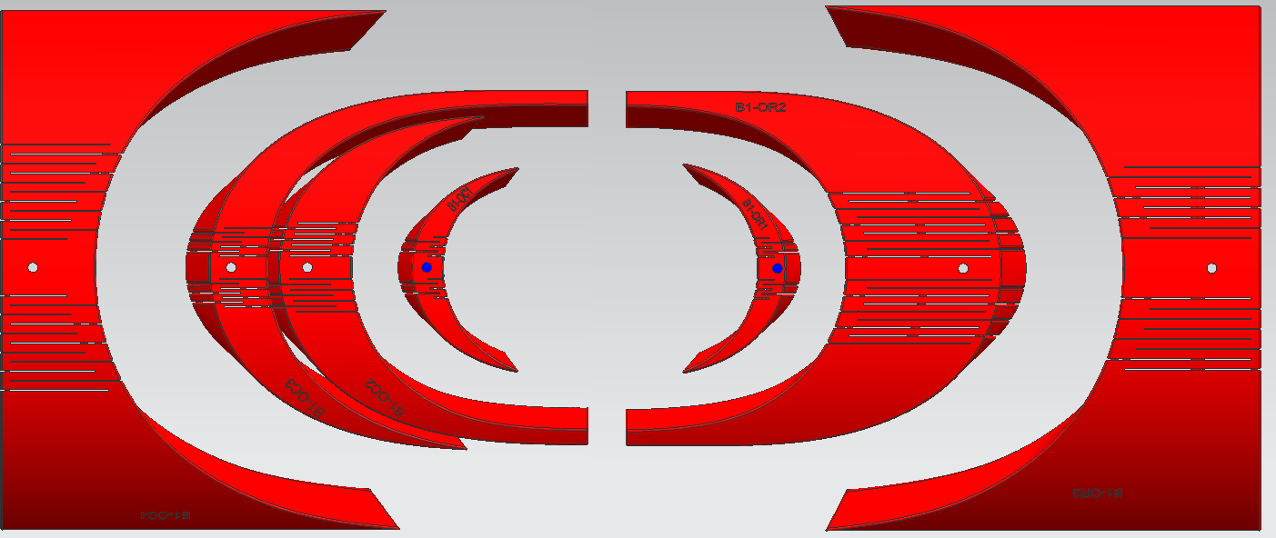
End Parts for Coil 3
16, 14, 10, 0, 10, 14, 18
LARP received the parts with slits and bridges
We wire cut the bridges to free the needed slits.
Saddles w slits will be replaced after curing with the ones w/o slits.
Each part has 3 mm pin hole for alignment during winding.
Pin holes to connect LE saddle and its extension are abandoned. They are connected by two M6 screws.
QA and strain relief tap holes on RE saddles are M4 size.
22, 14, 14, 10, 10, 18, 16

Slide 14
Slits Comparison
L1 | B1b-IR1 | B1b-IR2 | B1-IR3 | B1-IC1 | B1b-IC2 | B1b-IC3 | B1-IC4
Coil 1 | 7 | 9 | 10 | 0 | 0 | 9 | 10
Coil 2 | 9 | 14 | 18 | 0 | 0 | 14 | 16
Coil 3 | 10 | 14 | 18 | 0 | 10 | 14 | 16
L2 | B1-OR1 | B1-OR2 | B1-OR3 | B1-OC1 | B1-OC2 | B1-OC3 | B1-OC4
Coil 1 | 9 | 11 | 14 | 9 | 11 | 15 | 16
Coil 2 | 9 | 14 | 16 | 9 | 14 | 14 | 20
Coil 3 | 10 | 18 | 16 | 10 | 14 | 14 | 22
From SQXF coil 4, the slits design will be finalized.
The vendor will laser sintering the solid part, and then wire cut the slits.

Slide 15
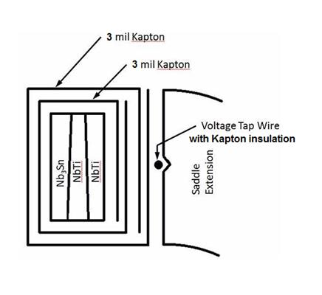
Splice Block
LARP has 3 sets of splice blocks
The splice blocks for coil 1 and coil 2 may be a little tight for the lead.
The splice blocks for coil 3 will be modified by offset the surface by 0.2 mm.
0.175 mm S2 glass tape
0.15 mm cable insulation
Require 4.145 mm for the lead
Sum = 4.235 mm

Slide 16
SQXF Coil Pole
Room for Strain Gauge
LARP has 3 sets of poles. These poles have 6.35 mm pin hole
From LARP coil 4, the pin hole size will be changed to 5 mm
Except pin holes, all the other holes will be used as cooling channels

Slide 17
Summary
The current end parts design worked well on SQXF coil 1. No more optimization needed until after autopsy of coil 1 ( the end of July)
Number of slits will be finalized after coil 2.
In stock, we have poles and splice blocks up to coil 3, and wedges up to coil 4 (more is coming soon). We will procure 3 more sets of poles and splice blocks in early June.

Slide 18
Autopsy of Practice Winding Coils

Slide 19
ROXIE vs. BEND at LE
90 deg.
ROXIE
Coil 1
BEND
Coil 2

Slide 20
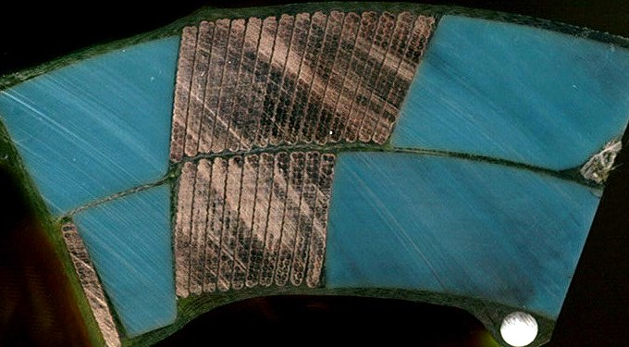
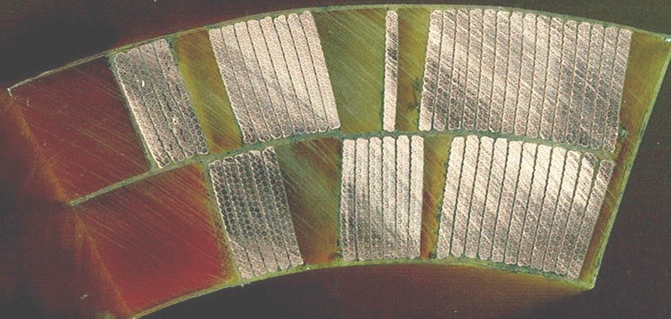
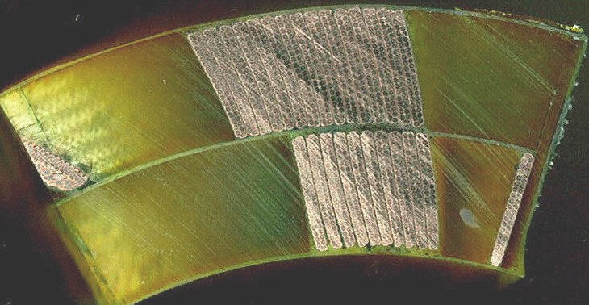
ROXIE vs. BEND at LE
45 deg.
ROXIE
Coil 1
BEND
Coil 2

Slide 21
ROXIE vs. BEND at RE
90 deg.
BEND
Coil 1
ROXIE
Coil 2

Slide 22
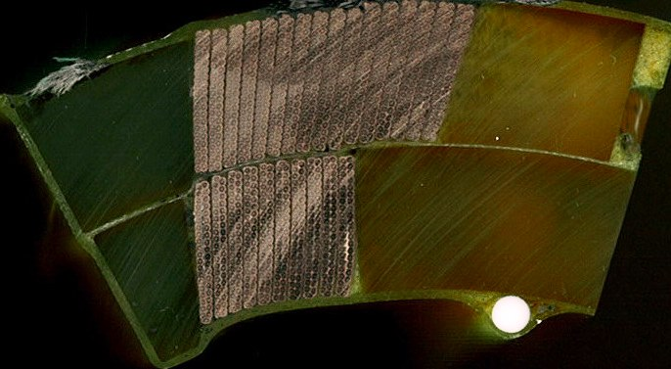
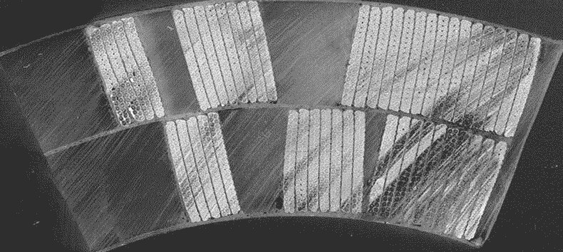
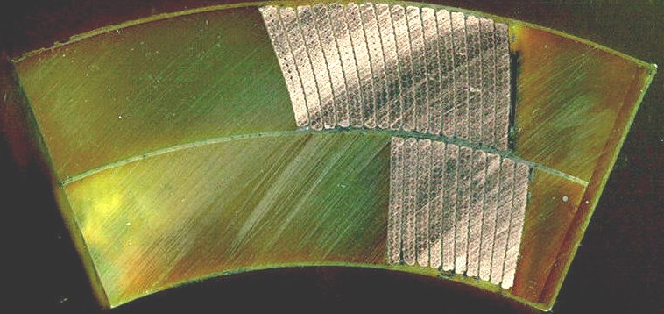
ROXIE vs. BEND at RE
45 deg.
BEND
Coil 1
ROXIE
Coil 2

