Slide 1
SQXF Coil End Parts Design
CERN-ROXIE
Susana Izquierdo Bermudez. 05-05-2014
Joint LARP/HiLumi LHC Meeting (CM22)
QXF Coil Workshop

Slide 2
Contents
Overview of the design process
  ROXIE differential Geometry Ends Module
  Design Parameters
  Design for the first iteration
Evolution of CERN end spacers

Slide 3
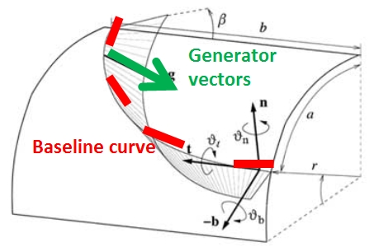


ROXIE differential geometry ends
The strip is modeled by the base curve and the field of Darboux vectors that define the generators of the developable surface.
The mathematical basis to define these vectors are the same in ROXIE and BEND.
Main objective: minimize hard-way
bend squared over entire block.
Main differences among codes:
Base-line curve: ROXIE uses hyper-ellipses on cylinders.
Cable shape changes: ROXIE uses artificial inter-turn spacers. In BEND the cables in a block are packed together with slightly changing cross sections.
Guiding strip: In ROXIE, the guiding surface is the inner surface of the current block but the strain energy minimization can be done considering any conductor of the block.

Slide 4
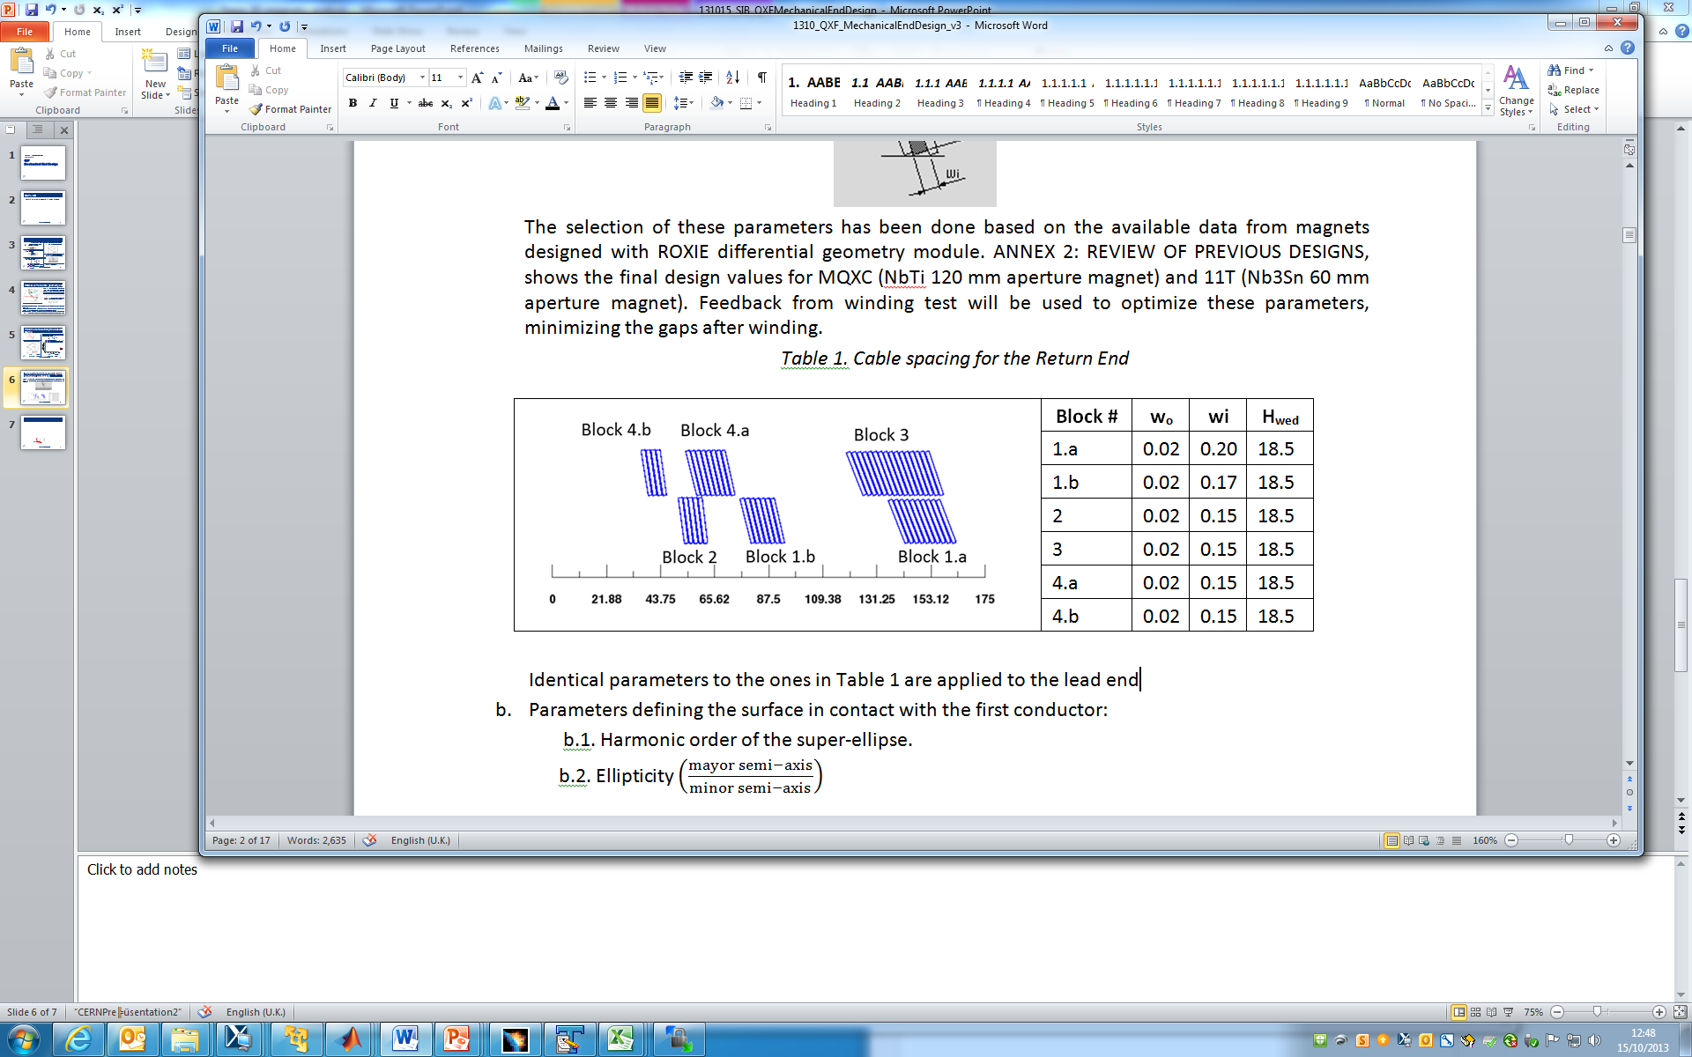
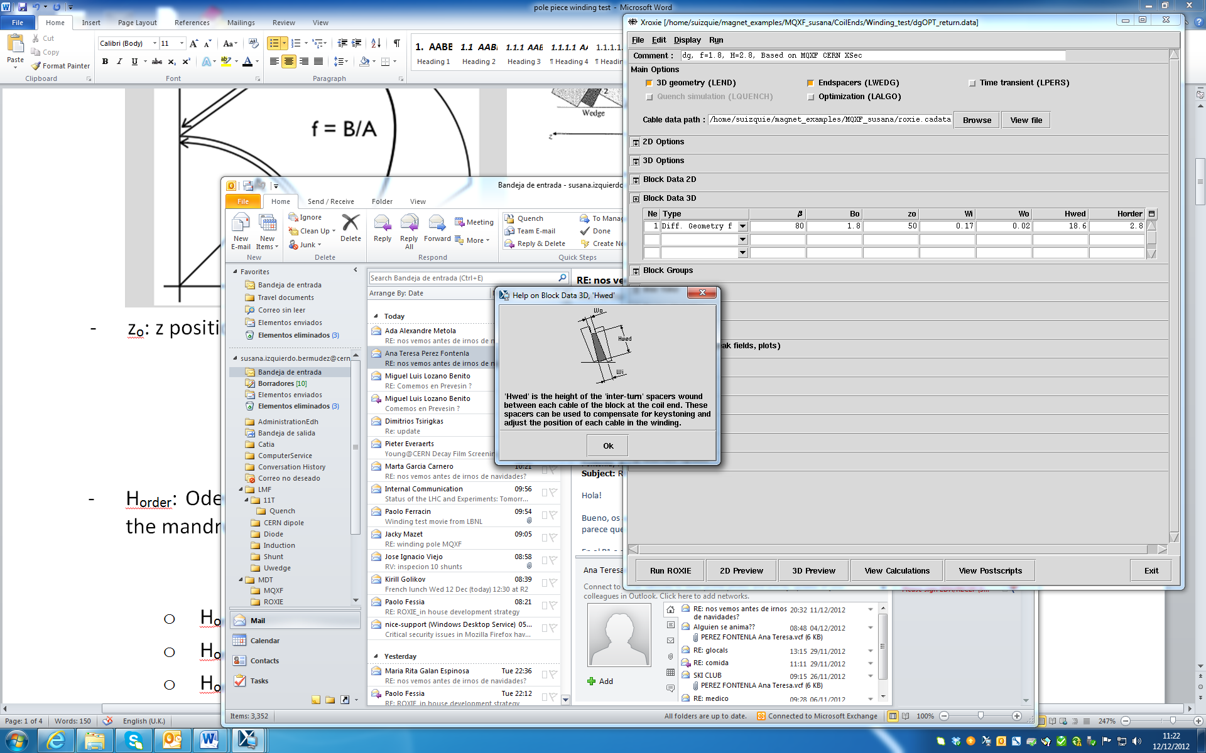
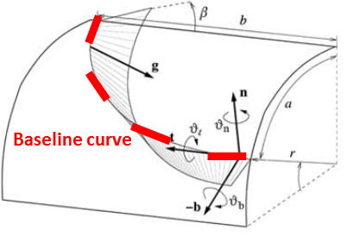
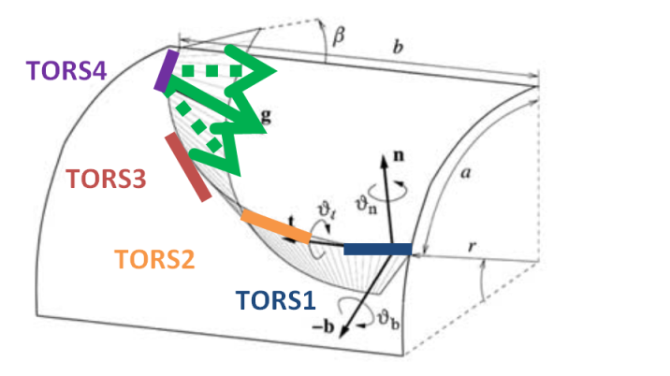
Design parameters
GROUP A
GROUP B
Longitudinal position of each block. Optimize to minimize the multipole content of the integrated field and peak field in the conductor
Inter-turn spacers in between →compensate for de-keystoning
Selection based on the available data from magnets designed with ROXIE differential geometry module. Feedback from winding to optimize these parameters.
GROUP C
β
Natural angle β for the innermost cable turn
Additional twist around the tangent vector (TORS).
Ellipticity (f) of the coil-end baseline
Order of the hyper-ellipse (H_{order}) that defines the baseline
Deterministic optimization algorithm “Extrem” to minimize the geodesic curvature and torsion on each individual block. Explored boundaries
PARAMETER | Upper bound | Lower bound
Order of the Hyper-Ellipse | 3 | 2
Ellipticity | 3 | 1
Inclination angle of the innermost turn | 83 | 60
TORS1/TORS2/TORS3/TORS4 | -2 | 2

Slide 5
Design for the first iteration
1. First optimization of parameters that mainly affect to the strain energy on the cable
2. Optimization of parameters that mainly affect to peak field and field harmonics
3. Re-optimization of parameters that mainly affect to the strain energy on the cable
V1
Ellipticity, β , H_{order}
Number of blocks, distribution of the conductors, z
Ellipticity, β , H_{order}
Details about magnetic optimization (steps 1&2):
LARP CM20-HiLumi: 3D magnetic analysis and coil end design
Details about mechanical optimization (step 3):
End Parts Mini Review: https://plone.uslarp.org/MagnetRD/qxf/meetings/2013/20131015/

Slide 6
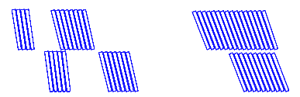
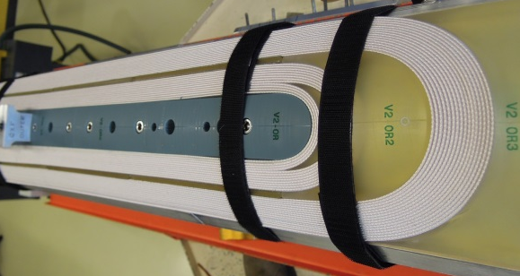
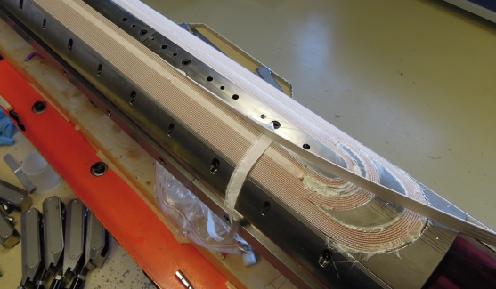
Evolution of CERN spacers
WP3 meeting
Review End Parts Design
Now
CM22
2013 |  |  |  |  |  |  |  |  |  |  | 2014
October |  |  | November |  |  |  | December |  |  |  | January |  |  |  |  | February |  |  |  | March |  |  |  | April |  |  |  |  | May |  |  |  | June |  |  |  |  | July |  |  |  | Aug
42 | 43 | 44 | 45 | 46 | 47 | 48 | 49 | 50 | 51 | 52 | 1 | 2 | 3 | 4 | 5 | 6 | 7 | 8 | 9 | 10 | 11 | 12 | 13 | 14 | 15 | 16 | 17 | 18 | 19 | 20 | 21 | 22 | 23 | 24 | 25 | 26 | 27 | 28 | 29 | 30 | 31 | 32 | 33
 | SPC1 |  |  |  |  |  |  |  |  |  |  |  |  | SPC2 |  |  |  |  | Preparation |  |  |  | SQXF1IL |  |  |  |  | OL |  |  |  |  | SQXF2 |  |  |  |  |  |  |  | SQXF3
V1
SPC1 IL
Cu
Oct-2014
V2
SPC1 OL
Cu
Oct-2014
V3
SPC2 and SQXF1
Cu
Jan 2014 April 2014
V4
SQXF2
Bad Nb3Sn
June 2014
V5
SQXF3
Nb3Sn
End July 2014
Increase de Harmonic Order of the baseline ellipse (more roundish)
Pole converged to BEND design
Change angle last block IL
Minor changes:
Radius on the edges
Flexible features
Modify spacing among cables last block IL
68.5˚→71˚
71.5˚→67.3˚
Shorter coils with plastic end spacers to optimize ends
SQXF coils

Slide 7
Remark!
Short coils with plastic end spacers (SPC1&SPC2) and first SQXF coil (SQXF1) are made with COPPER CABLE
Similar behaviour (in terms of end-spacer fitting, not in terms of cable mechanical stability) was observed in LBNL when using Nb3Sn and Cu cable
https://plone.uslarp.org/MagnetRD/qxf/meetings/2013/2013-12-17/

Slide 8
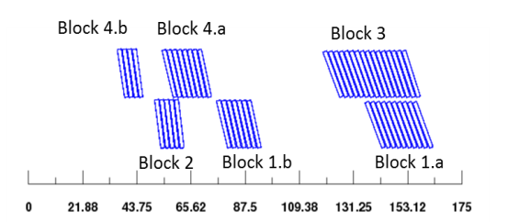

From V1 to V2
1. Modify ROXIE pole to have surfaces as close as possible to BEND design
Lower ellipse
Upper ellipse
Roxie
Bend
Roxie
Bend
Input Parameters | V1 |  | V2
 | IL RE | OL RE | IL RE | OL RE
β | 82 | 81 | 81 | 79
Ellipticity | 1.8 | 1.8 | 2.23 | 1.804
Harmonic Order | 2.1 | 2.1 | 2.8 | 2.3
TORS1 | 0.0991 | 0.8879 | -0.3 | -0.6
TORS2 | -0.0286 | 1.0625 | -1.2 | -2.3
TORS3 | -1.0225 | -1.6606 | -1.8 | -2.3
TORS4 | -0.6854 | -1.1157 | -0.5 | -0.5
IL RE V1
IL RE V2
Roxie
Bend
OL RE V1
Roxie
Bend
OL RE V2
2. Increase the harmonic order of the hyper-ellipse that define the baseline of the inner-most turn on the mandrel (H_{order}) to have more “roundish” spacers
$${\left(\frac{x}{a}\right)}^{Horder}+{\left(\frac{y}{b}\right)}^{2}=1$$
SQXF | IL RETURN |  |  | OL RETURN
 | Block 1.A | Block 1.B | Block 2 | Block 3 | Block 4.A | Block 4.B
Harmonic order V1 | 2.1
Harmonic order V2 | 3.2 | 3.0 | 2.8 | 3 | 2.8 | 2.3

Slide 9
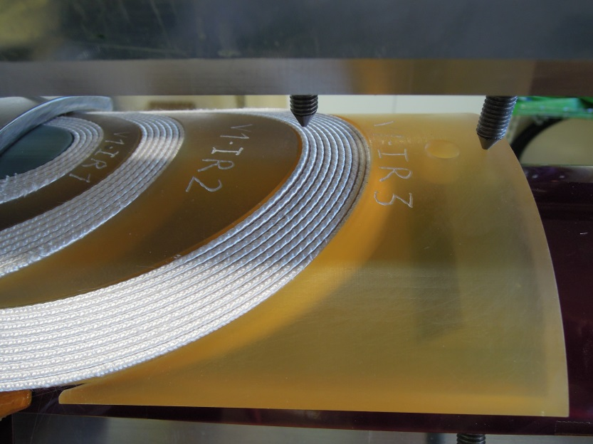
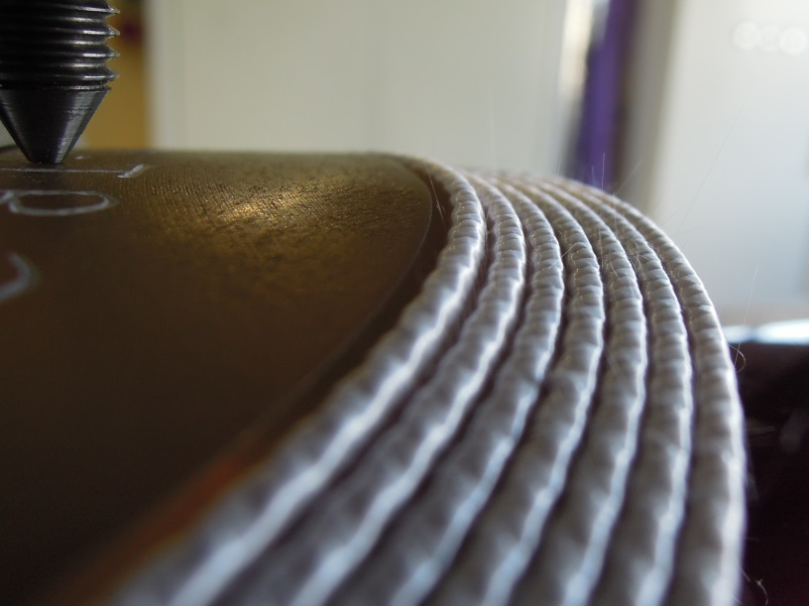
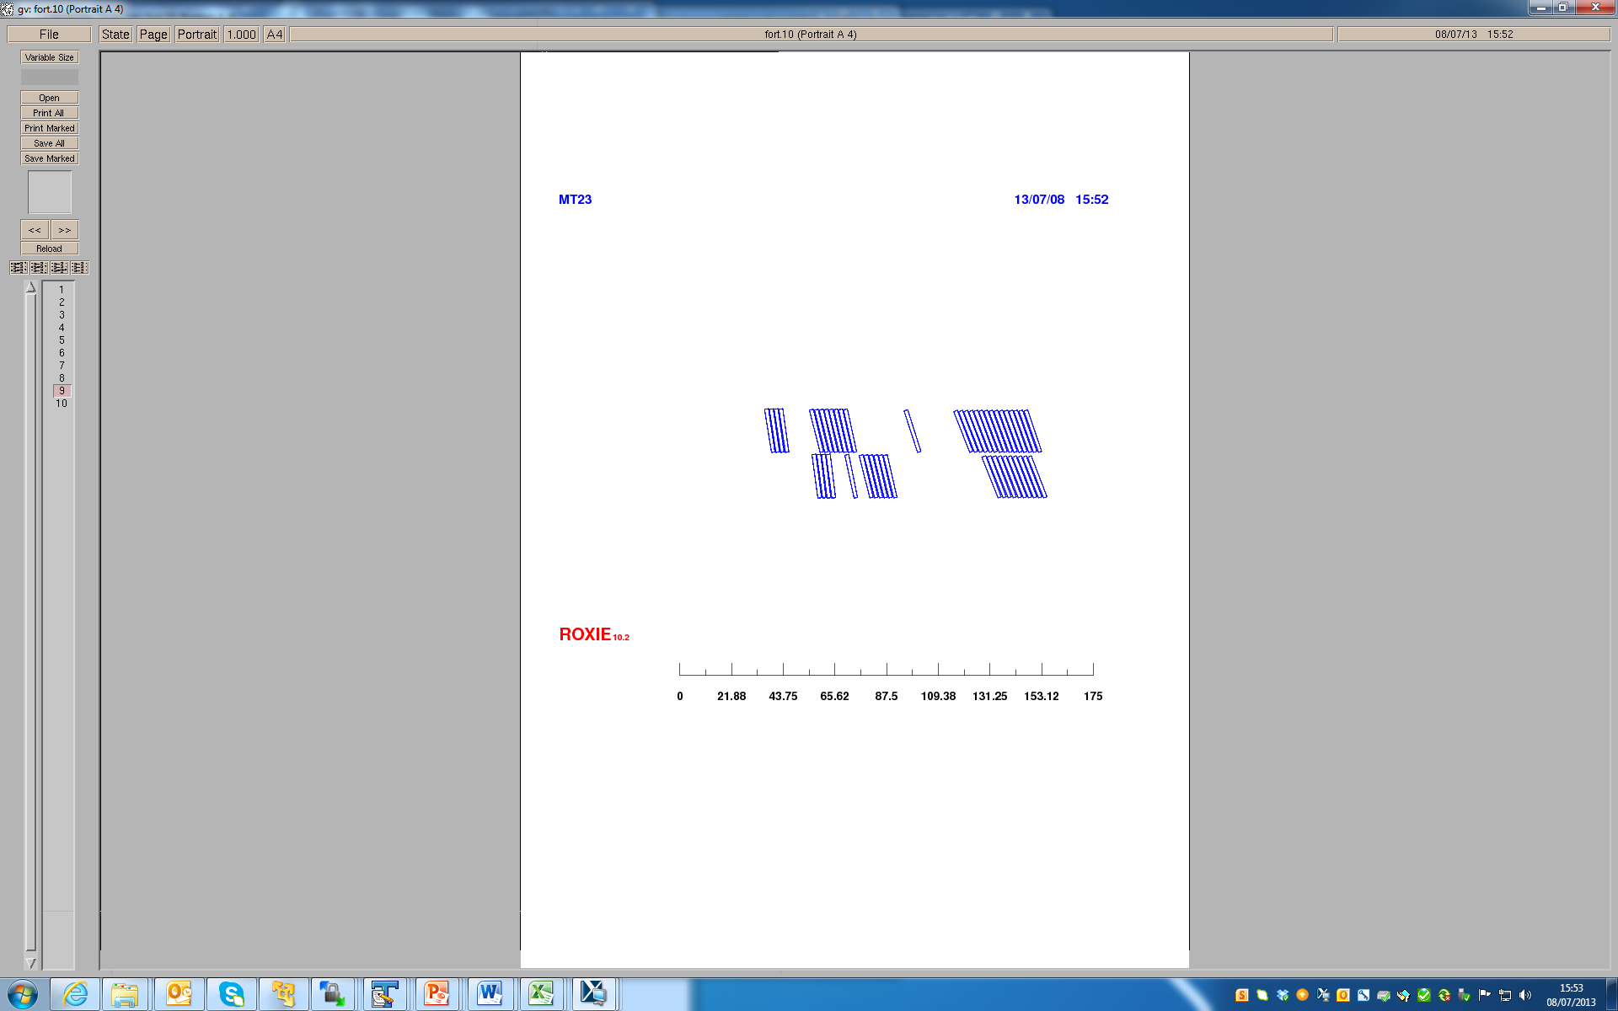
From V2 to V3
During the winding of the first short coil (SPC1) made with plastic spacers, there was a small gap (about 1 mm)
zoom
We decided (based on what we see and feedback from Shlomo) to increase the angle from 68.5° to 71° → 0.65 mm steeper spacer
(both in lead and return end)

Slide 10
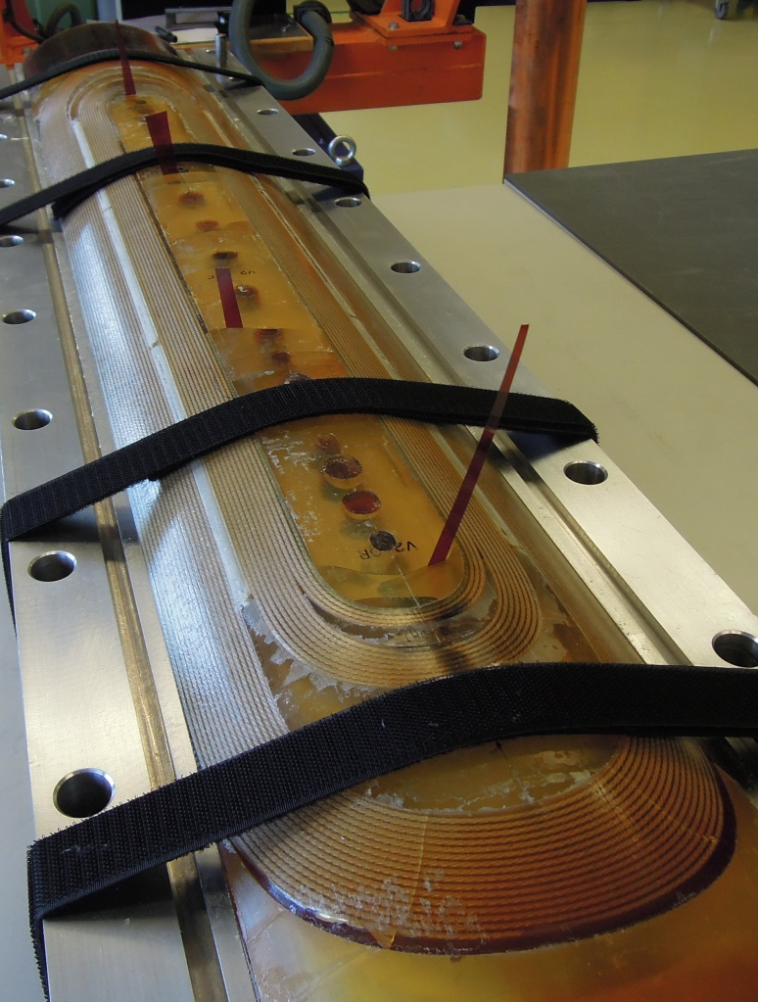
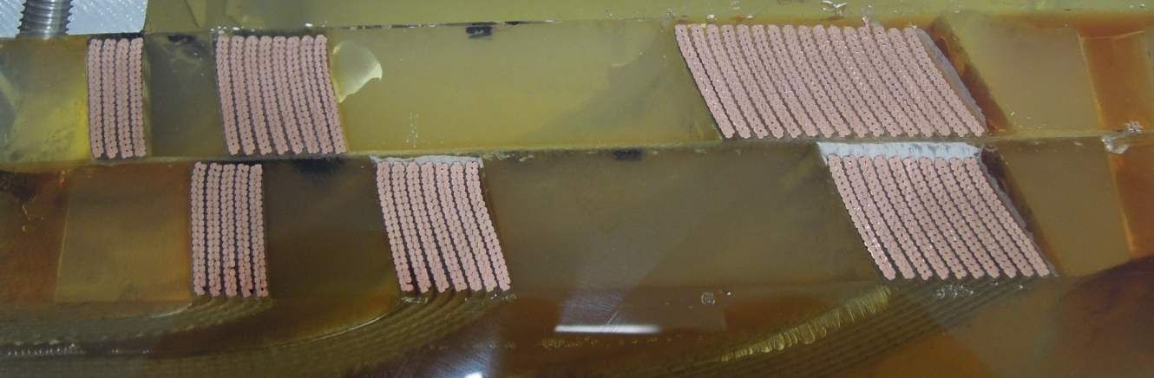
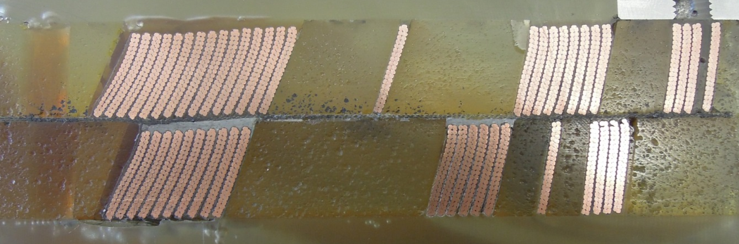
V3
V3 was used in:
Second CERN short with plastic spacer (SPC2)
First (LE) and Second (RE) LARP coil with plastic spacers
First CERN SQXF coil (SQXF1)
Autopsy Second Short CERN coil with plastic spacers
Autopsy Second Short CERN coil with plastic spacers

Slide 11
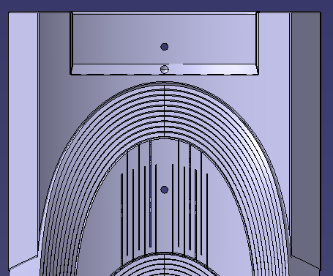
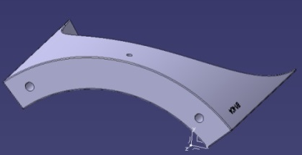
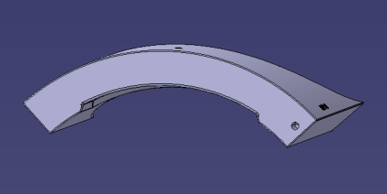
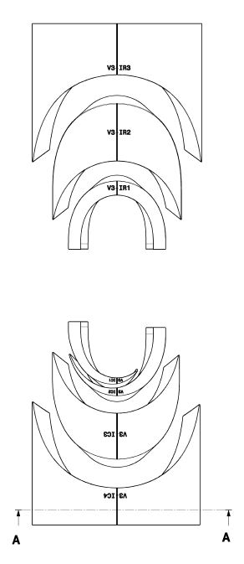
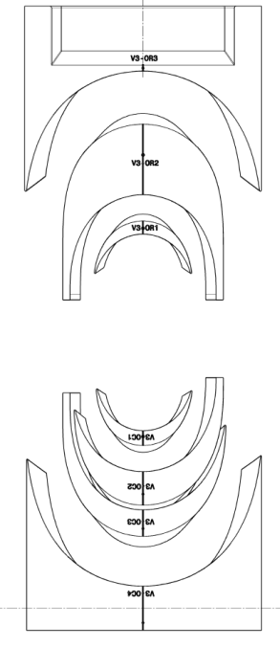
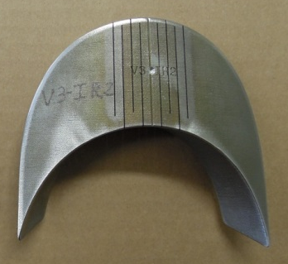
From V3 to V4
Alignment pins, holes and pockets for instrumentation → LARP design
Strain relief hole M4
Threaded holes M6
Alignment pin D=3 mm
QA hole M4
Flexibility
Radius on the edges
Number of cuts were defined based on SQXF1. SLS vendor to perform the cuts (from V4 on) instead of CERN
6
V3
V4
6
R = 0.2 mm
R = 0.5 mm
8
8
0
0
IL
OL
0
0
8
6
R = 0.5 mm
R = 0.5 mm
0
6
6

Slide 12
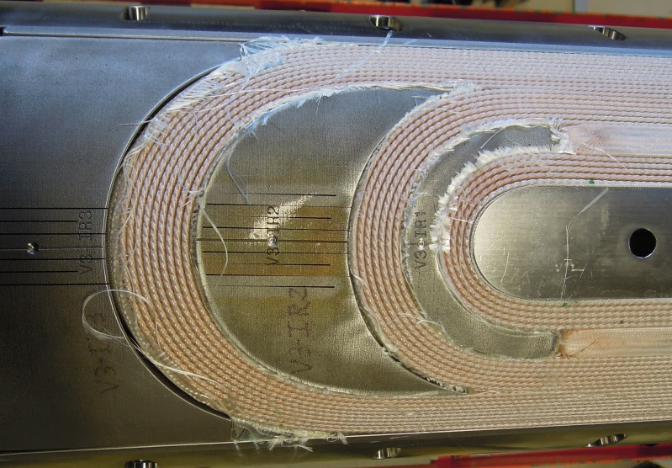
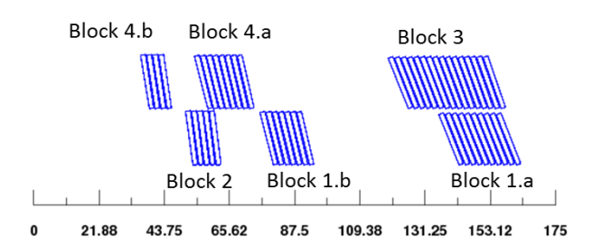
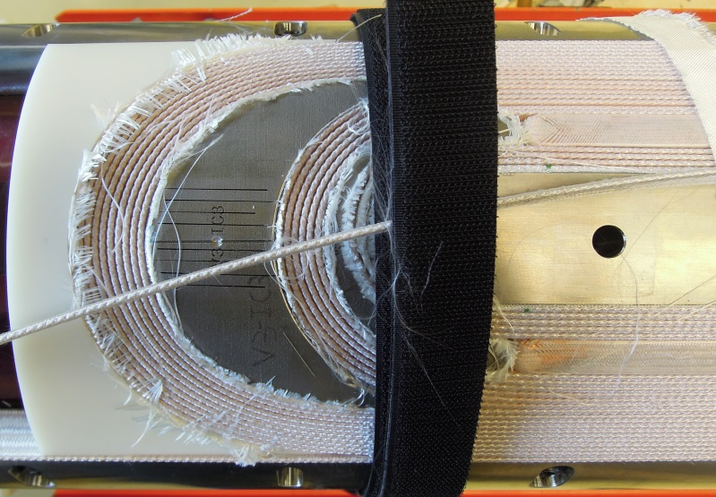
From V4 to V5
Feedback from IL winding with V3 end spacers:
End saddles: small gap close to the straight section, big gap in the tip
V3-IR2: non negligible gap in one side
Change the spacing between conductors in the last block to adapt spacer to the measured cable angle
Block # | w_{o} | wi | H_{wed}
1.a V4 | 0.02 | 0.2 | 18.5
1.a V5 | 0.02 | 0.35 | 18.5
Original End Saddle (V4)
Test V5 (in-house printed end saddle)

Slide 14
REFERENCES
Strain energy minimization in SSC magnet winding. J. M. Cook. IEEE transactions on magnetics, vol. 27, no. 2, march 1991
Coil End Design for Superconducting Magnets Applying Differential Geometry Methods. B. Auchmann and S. Russenschuck. IEEE transactions on magnetics, vol. 40, no. 2, march 2004
Field Computation for Accelerator Magnets: Analytical and Numerical Methods for Electromagnetic Design and Optimization. S. Russenschuck. Wiley-VHC 2010
Summary of the end part design process using BEND. R. Bossert. February 14, 2013. QXF WG meeting. https://plone.uslarp.org/MagnetRD/DesignStudies/QX-CD/Meetings/14022013/

Slide 15
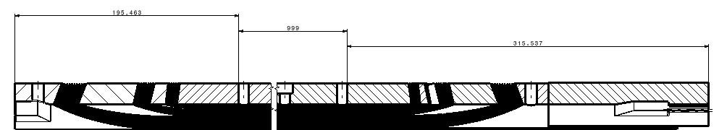
Coil length
L_total = L1+L2+L3=1510-2*0.250=1509.5
L1
L2
L3
Distance between end saddle and splice box = 2*0.250=0.500mm
 | Length (mm)
L1 | 195.463-0.250 = 195.213
L2 | 999
L3 | 315.537-0.250 = 315.287

Slide 16
V1

Slide 17
GROUP b: Inter-turn spacer
Selected parameters
Parameters selected based on data available from MQXC and 11T:
Block | # cond | w_{i} | w_{o} | H_{wed}
2.a | 2 | 0.17 | 0.02 | 15.00
2.b | 3 | 0.18 | 0.02 | 15.00
1.a | 6 | 0.20 | 0.02 | 15.00
1.b | 6 | 0.20 | 0.02 | 15.00
4 | 2 | 0.15 | 0.02 | 15.00
3.a | 7 | 0.15 | 0.02 | 15.00
3.b | 10 | 0.15 | 0.02 | 15.00
Block | # cond | w_{i} | w_{o} | H_{wed}
4 | 2 | 0.17 | 0.02 | 14.70
3 | 3 | 0.18 | 0.02 | 14.70
2 | 8 | 0.20 | 0.02 | 14.70
1 | 9 | 0.20 | 0.02 | 14.70
6.a | 8 | 0.15 | 0.02 | 14.70
6.b | 10 | 0.15 | 0.02 | 14.70
5 | 16 | 0.15 | 0.02 | 14.70
MQXC, final parameters
11T, as in v29

Slide 18
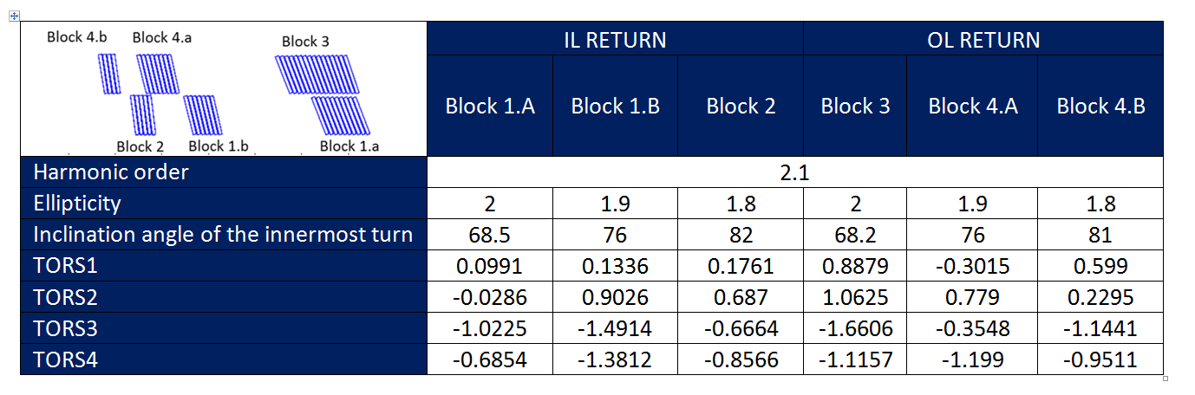
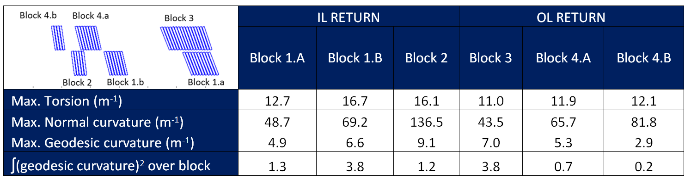
GROUP C Parameters
Objectives of the optimization: minimize hard-way bending and torsion.
SELECTED PARAMETERS
MAXIMUM CURVATURE VALUES FOR EACH BLOCK
Minimum Hard-way bending radius:
Inner Layer -> 11 cm
Outer Layer -> 14 cm

Slide 19

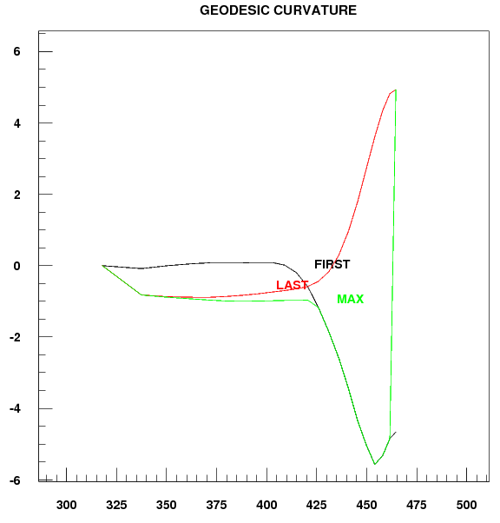
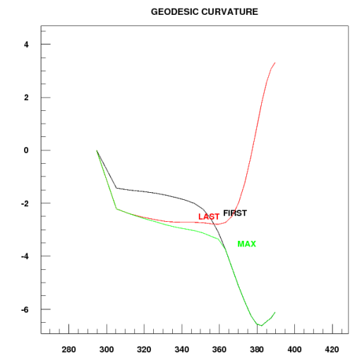
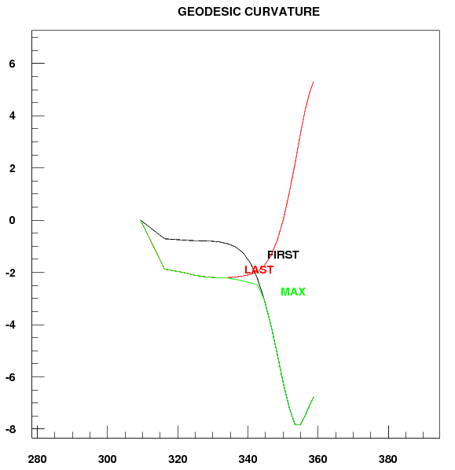
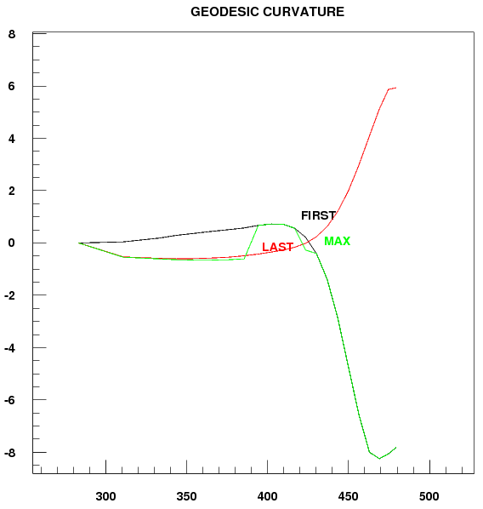
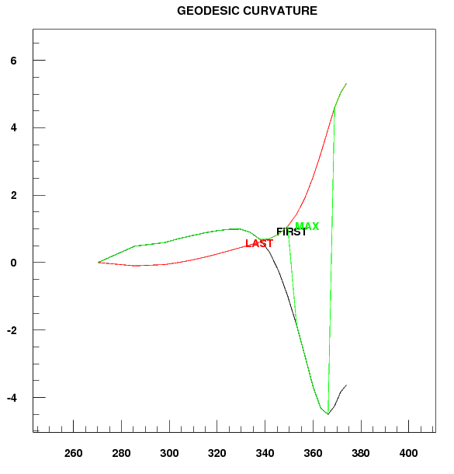
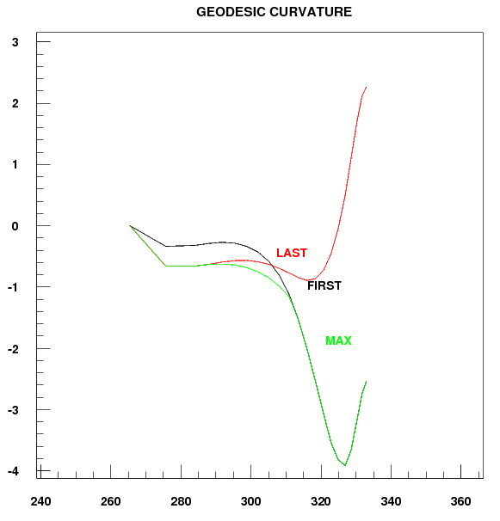
Hard-way bend on each block
Arc length of the conductor vs. geodesic curvature for the first and last conductor of each block
Block 1.a
Block 1.b
Block 2
Block 3
Block 4.a
Block 4.b
Additional plots available in the report 1310_QXF_MechanicalEndDesign_v3

Slide 20
V3

Slide 21
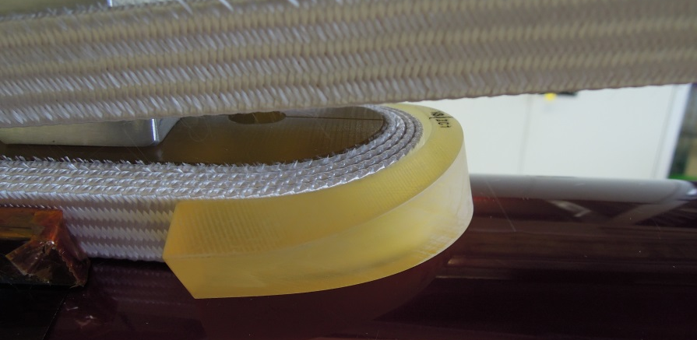
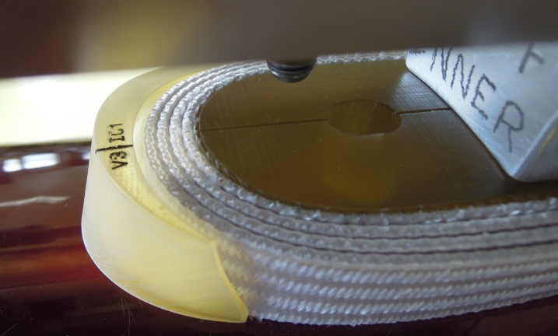
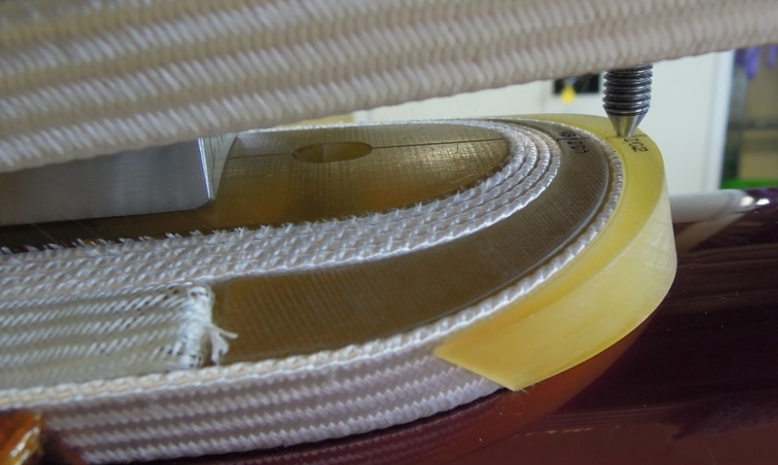
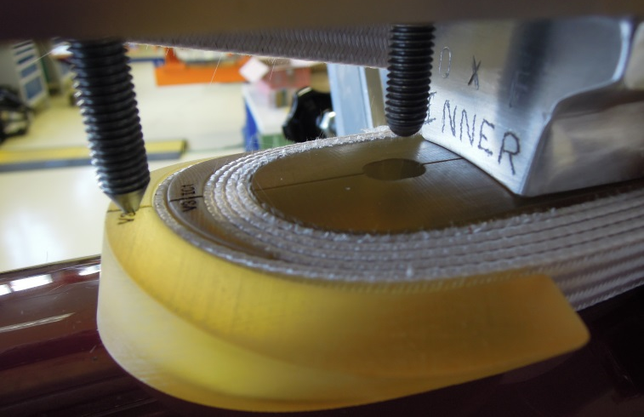
Winding IL
V3-IC1: Easy to place, nothing done on the spacer (it was slightly broken)
Broken
V3-IC2: Easy to place, corners rounded

Slide 22
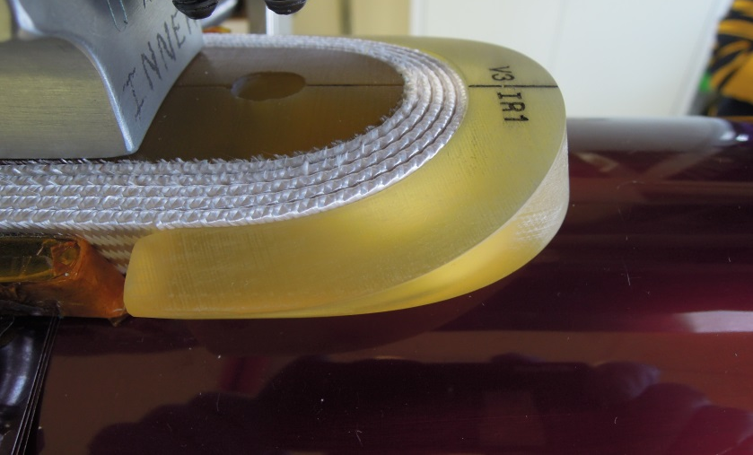
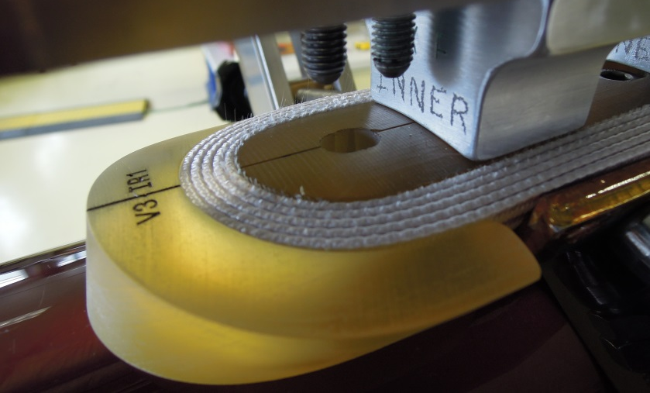
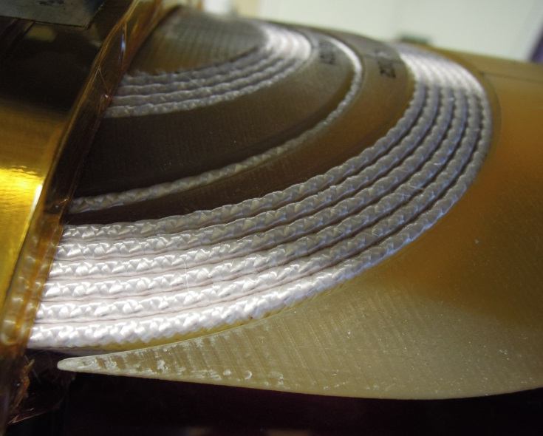
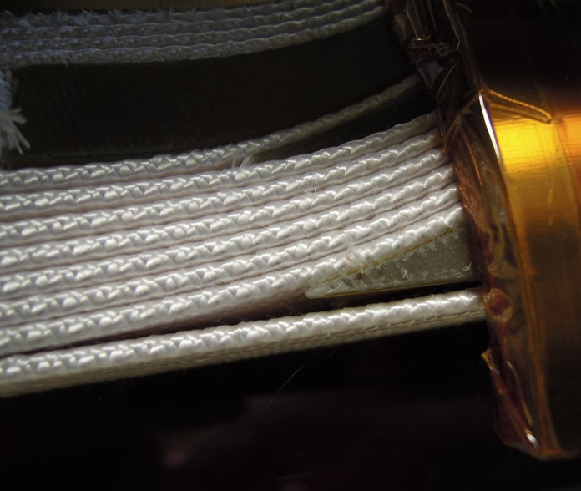
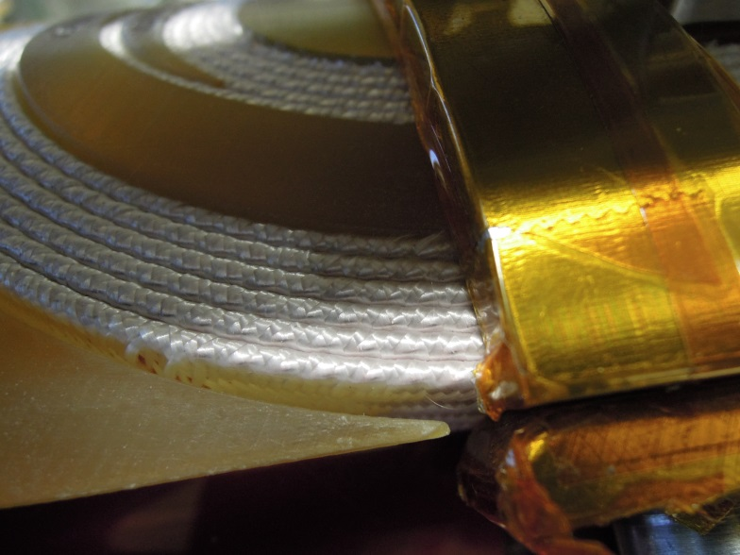
Winding IL
V3-IR1: The spacer wets in contact with the lower edge of the cable. A bit of material was removed and the corners were rounded
V3-IC3: Corners slightly rounded (negligible material removal)
22

Slide 23
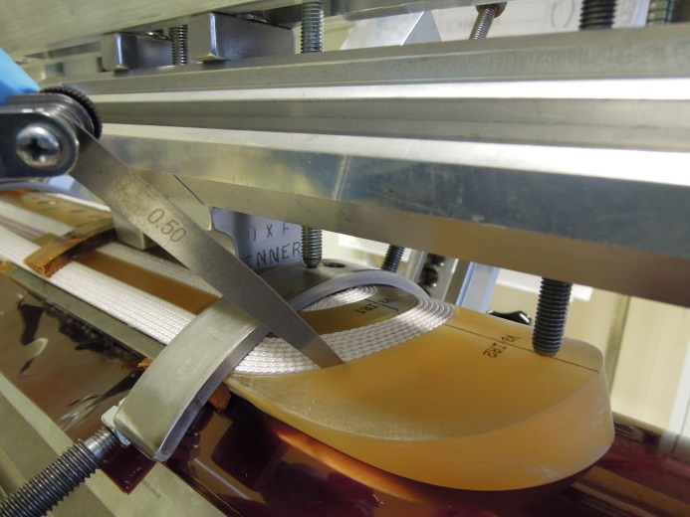
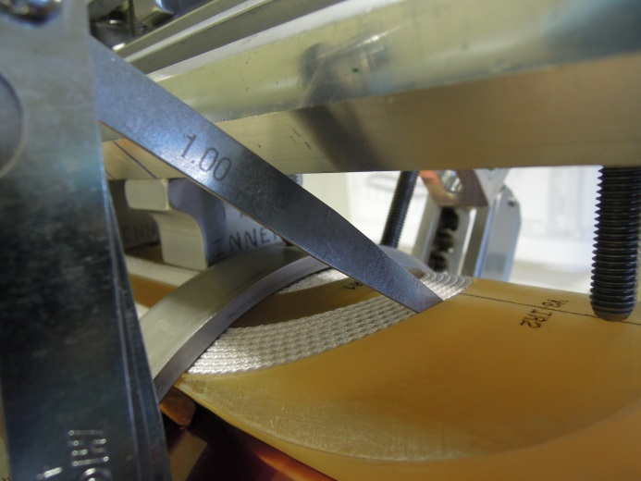
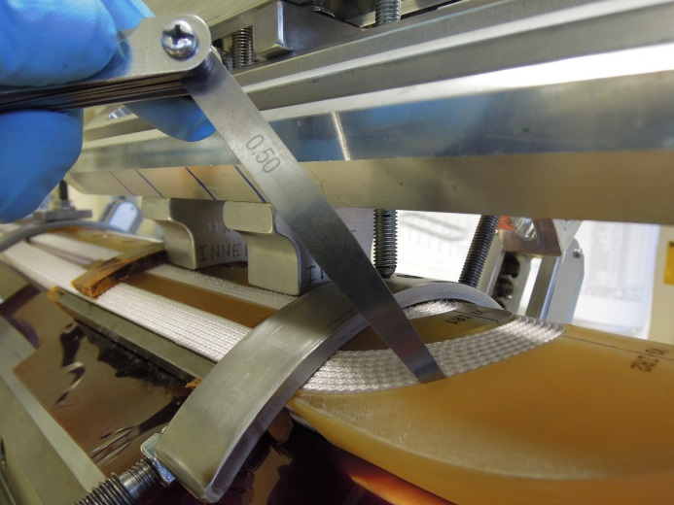
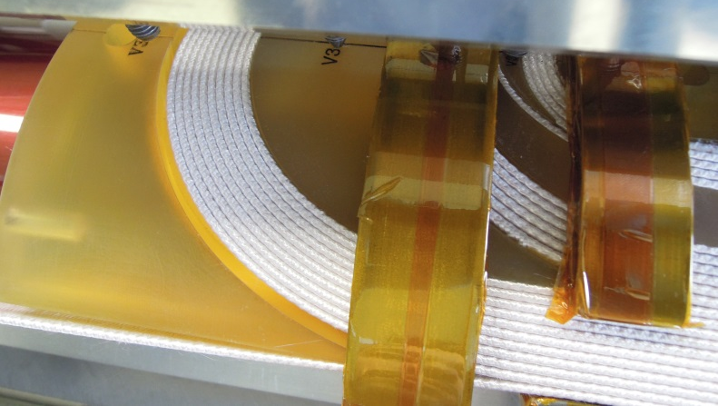
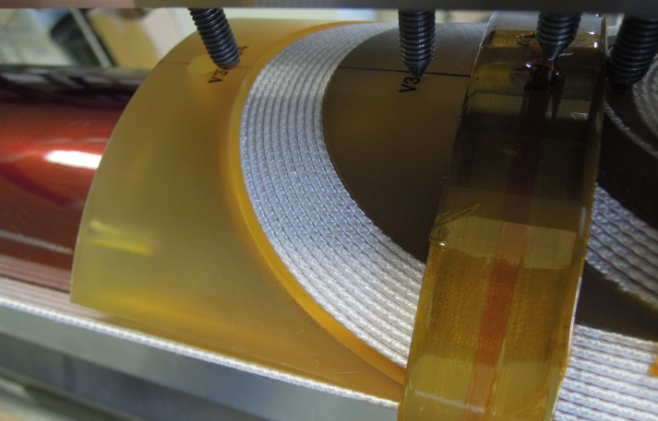
Winding IL
V3-IR2: The spacer wets in contact with the cable in the lower edge. A bit of material was removed and the corners were rounded
V3-IC4 No material removed. Non-negligible gap but it seems to be because we are not pushing enough the coil in the mid-plane (the surface of the spacer ≈ parallel to the cable)

Slide 24
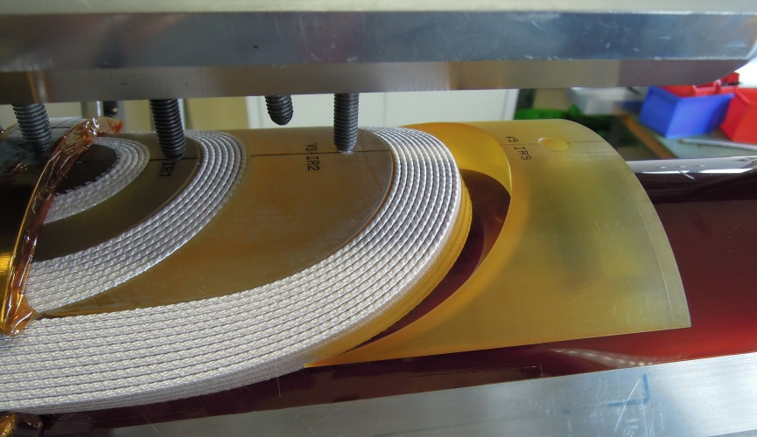
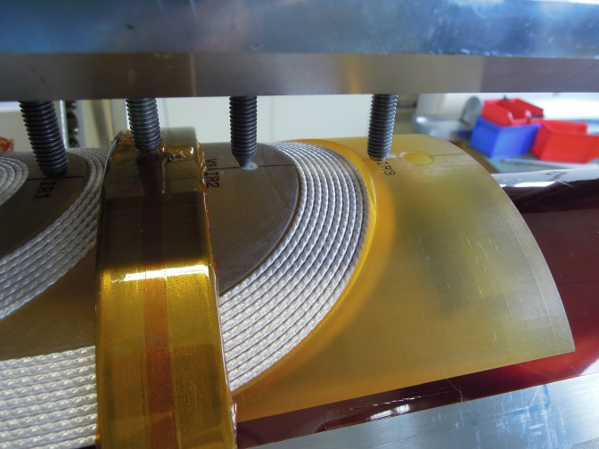
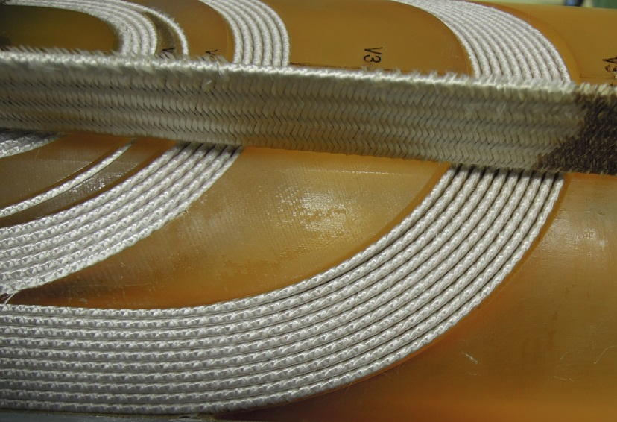

Winding IL
V3-IR3: No material removed. Non-negligible gap but it seems to be because we are not pushing enough the coil in the mid-plane (the surface of the spacer ≈ parallel to the cable)
General Overview lead end before curing

Slide 25





IL, outer radius after curing
Small gaps except in the end saddle

Slide 26




IL, inner radius after curing
Big gaps…the coil is not compacted enough during curing?

Slide 27




IL, inner radius after curing

Slide 28




Winding OL
V3-OC1:No material removed
V3-OR1:No material removed

Slide 29





Winding OL
V3-OC2:Corners rounded
V3-OR2:Corners rounded

Slide 30




Winding OL
V3-OC3:Corners rounded on the wedge side, very easy to place
V3-OR4 No material removed. Non-negligible gap but it seems to be because we are not pushing enough the coil in the mid-plane (the surface of the spacer ≈ parallel to the cable)

Slide 31


Winding OL
V3-OC4 No material removed. Non-negligible gap but it seems to be because we are not pushing enough the coil in the mid-plane (the surface of the spacer ≈ parallel to the cable)

Slide 32




OL, outer radius after curing

Slide 33




OL, outer radius after curing

Slide 34

3
2
1
2
3
4
V3-IC1: Easy to place, nothing done on the spacer (it was slightly broken [1])
V3-IR1: The spacer gets in contact with the cable in [2], lower edge. A bit of material was removed and the corners were rounded
V3-IC2: Easy to place, corners rounded
V3-IC3: Corners slightly rounded (negligible material removal)
V3-IR2: The spacer wets in contact with the cable in [3], lower edge. A bit of material was removed and the corners were rounded
V3-IC4: No material removed.
V3-IR3: No material removed.

Slide 35

Second short Cu cable coil
LE, right

Slide 36

Second short Cu cable coil
LE, left

Slide 37

Second short Cu cable coil
RE, right

Slide 38

Second short Cu cable coil
RE, right

