Slide 1
SQXF Coil QA and Measurement during Winding and Curing
Miao Yu
05/05/2014

Slide 2
QA and Measurement for Coil1
Monitoring coil to ground short
Coil to parts electrical short test
Coil electrical measurement after winding and curing (R, Ls, Q)
Winding mandrel rotation angle
Each turn cable measurement during winding (angle and location at the end nose)
Coil measurement after winding and after curing (coil length, coil end)
Pole gap and wedge gap

Slide 3
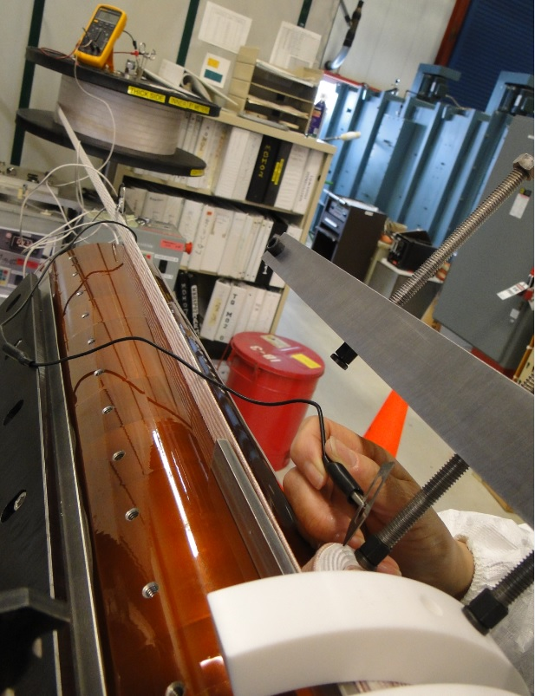
Coil to Ground/Part Short Test
Ω meter is set up to monitor cable to ground short through the winding
Connect each end part to ground to check part to cable short
After installing wedges
After finishing winding
After finish curing

Slide 4
Coil Electrical Measurement
Resistance: from IL lead to OL lead
SQXF coil 1: 0.164 Ω
Inductance and Q value
SQXF Coil 1
 | 20 Hz | 120 Hz | 1 kHz
Ls (mH) | 3.298 | 3.085 | 2.305
Q | 2.26 | 5.32 | 3.02

Slide 5
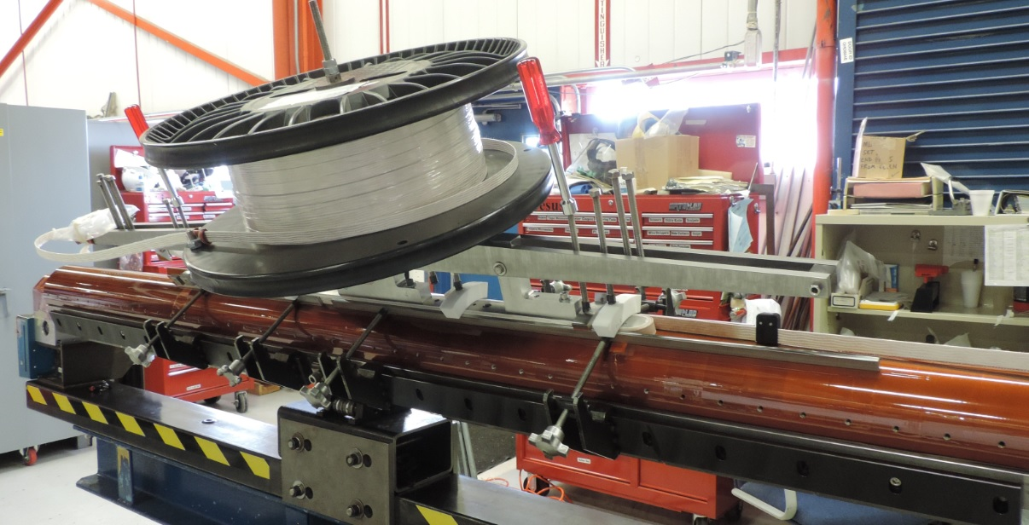
Winding Mandrel Rotation
The mandrel angle is measured at exit position when the cable wind around the end
This angle remain constant when the cable wind along the straight section

Slide 6
Each turn cable measurement

Slide 7
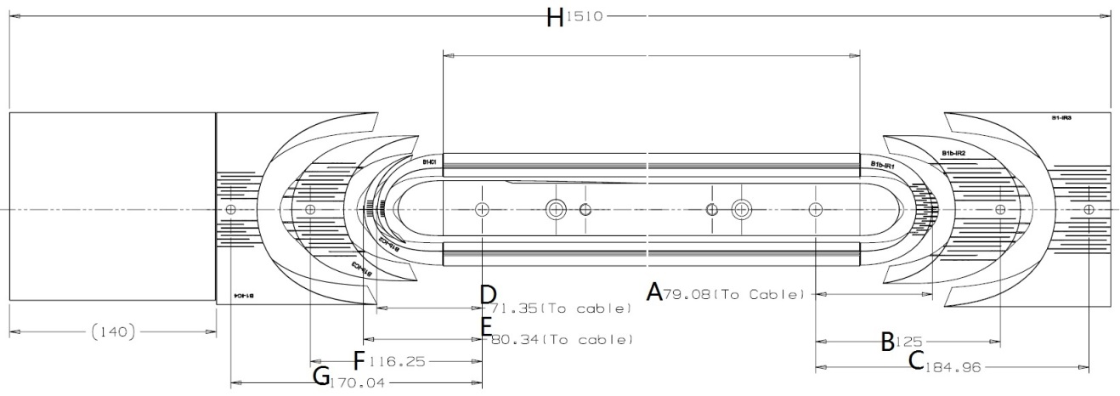
Coil measurement
Coil end measurement
Install pins
Measured with caliper between the edges of pins
Subtract by the radii of the pins
Record the distance
IL
Coil length
Measure the overall length of the winding mandrel
Measure the distance between RE saddle and RE of the winding mandrel
Measure the distance between LE splice block and LE of the winding mandrel
Subtract 1 by 2 and 3
Record the coil length
OL

Slide 8
Pole Gap and Wedge Gap
Measured with caliper
Pole gap
Original gap (L1)
After winding (L1 and L2)
After curing (L1 and L2)
After release tension (L2)
After reaction (L2)
Wedge gap
Original gap = minimum pole gap + 3 mm
After winding
After curing
After release tension
After reaction

