Slide 1
Fun4All + G4 + QT

Slide 2
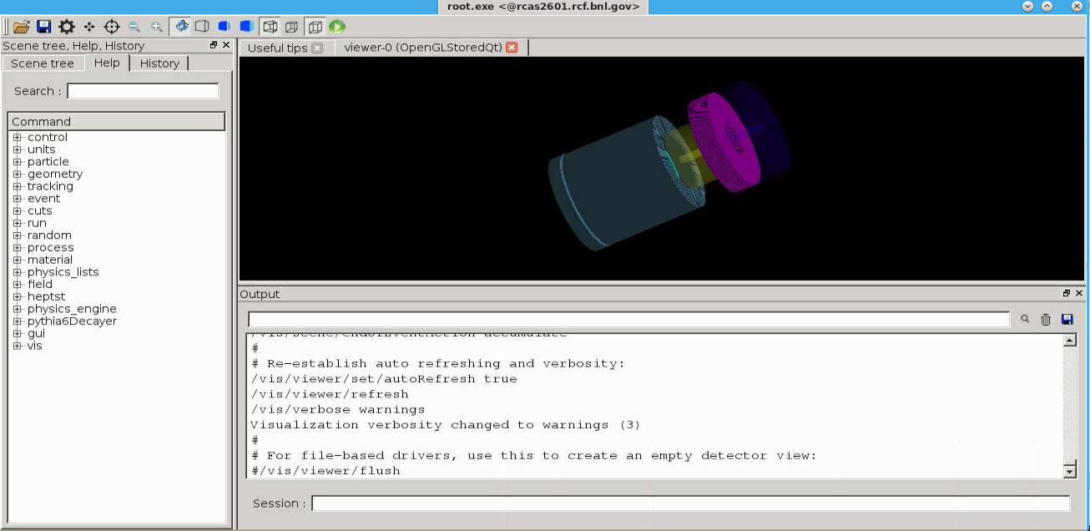
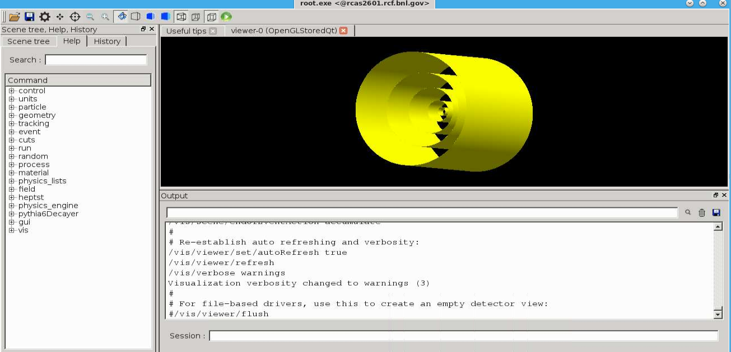
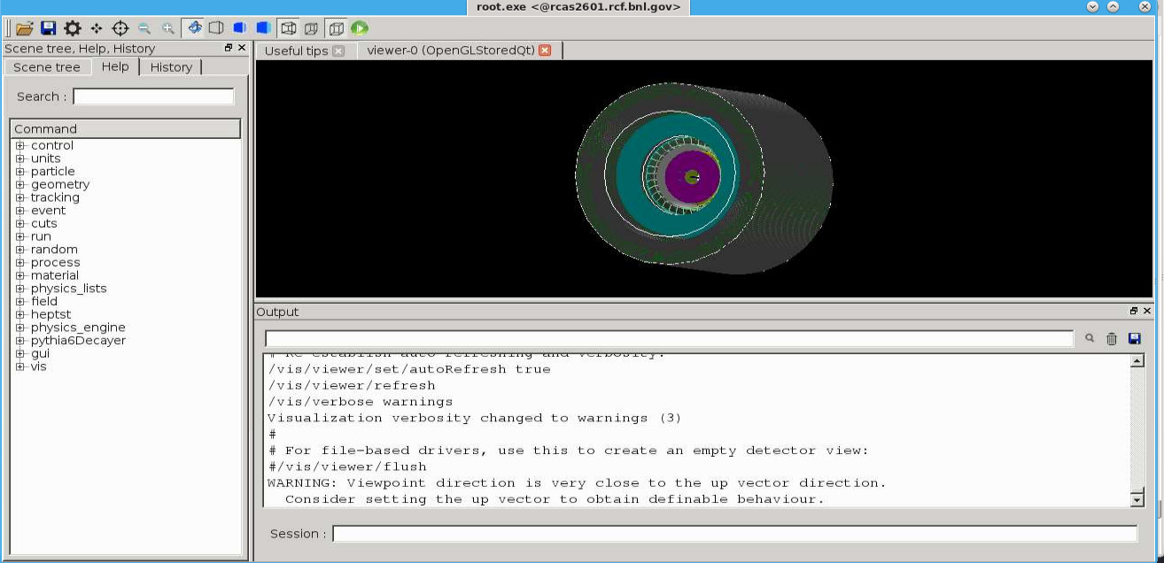
JLeic
Vtx Mockup
Yulias last concern was the missing QT interface for G4
QT has to run in the main thread
Makes creating event displays less painful
Fun4All messenger dispatching Fun4All commands via G4 cmd line
Caveat: Very slow for complex detectors
sPHENIX

