Slide 1
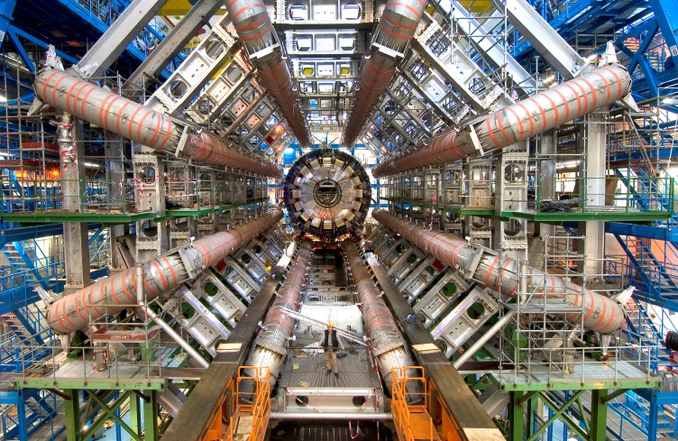
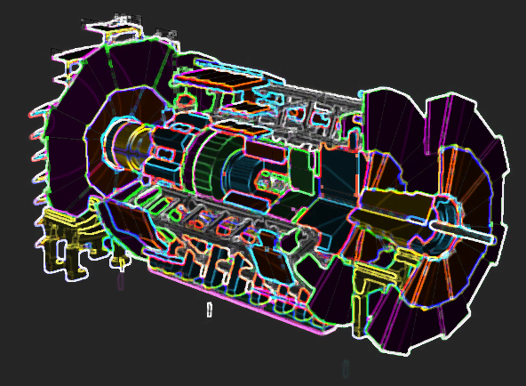
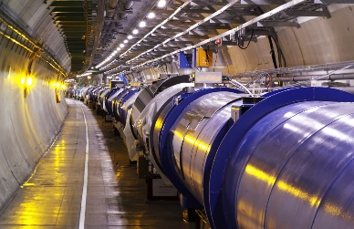
Hidden Valley Searches At ATLAS
G. Watts (UW/Seattle) on behalf of the ATLAS Collaboration

Slide 2
What Is A Hidden Valley?
SM
Hidden Sector
Scalar
$$Φ_{HV}$$
$$Z^{′},H,…$$
Phenomenology as complex as you wish
Decay back to SM particles

Slide 3
What Is A Hidden Valley?
Hidden Sector
Decay back to SM particles
Notes:
Draw a SM, an hidden sector, and the scalar

Slide 4
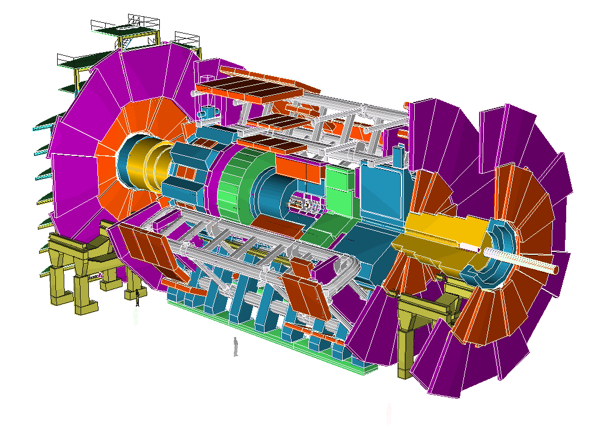
Final State(s)
Hidden Sector
Phenomenology
Particles do not interact with SM matter
Proper Lifetime of HS particles
Decay depends on particles in HS
Quarks (usually heavy)
Leptons
Decay back to SM particles

Slide 5
The Hidden Sector
Is really an excuse to generate long lived particles
Top quark ~ ${10}^{−25}$ s
Proton $>{10}^{41}$ s
The SM already has quite the variety!
RPV SUSY
Split SUSY
GMSB
Etc.
Easy to generate
Squeezed phase space
Small coupling
Conserved quantum number
Many other models contain structures that give long lived particles
Strong motivation to make search as model independent as possible.
In many cases some of the most likely models now contain long lived particles

Slide 6
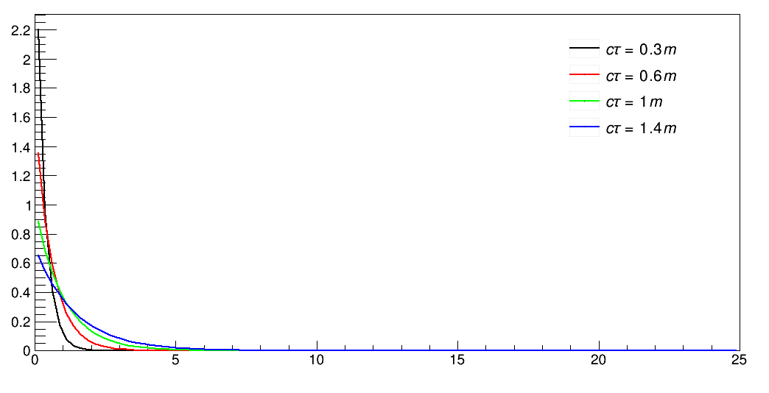
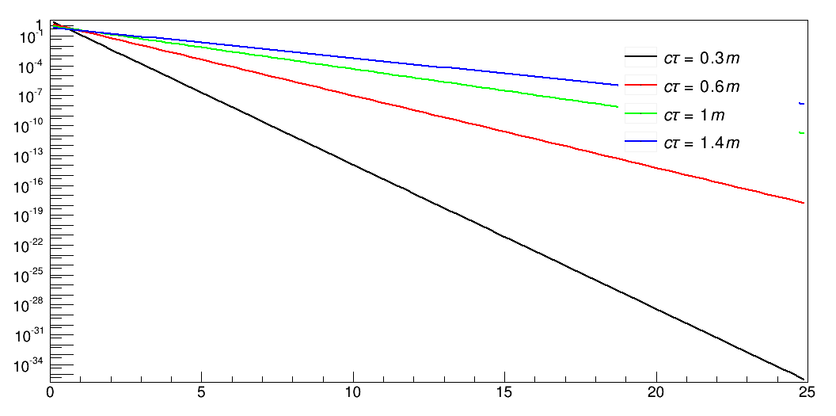
Proper lifetime
Decay probability is a falling exponential
ID
All parts of detector are sensitive for varying proper lifetimes
Cal
Muon Spectrometer
Makes sense to include all detector signatures possible, from very short range decays to very long range decays.
B-Meson like
Missing $E_{T}$
Notes:
Plot showing decays through out the detector for a given liftime

Slide 7
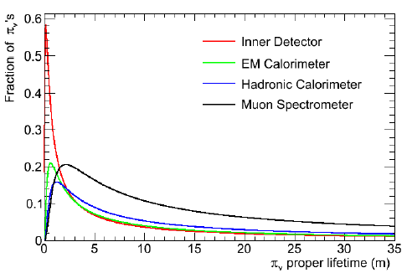
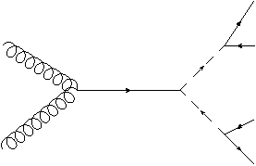
the benchmark models
$m_{h}=120$ GeV, 140 GeV
$m_{π_{v}}=20$ GeV, 40 GeV
Phys.Lett.B651:374-379,2007 (M. Strassler, K. Zurek)
$$b$$
g
$$\overline{b}$$
$$π_{v}$$
$$π_{v}$$
$$\overline{b}$$
g
$$b$$
$h$/$h_{v}$ mixing
$Z$/$Z_{v}$ mixing
Simulate at a unique proper lifetime
Calculate efficiencies as a function of decay length
Phys.Lett.B651:374-379,2007 (M. Strassler, K. Zurek)

Slide 8
Final State(s)

Slide 9
DECAYS Topologies
electrons
muons
tau’s
$$E_{T}^{missing}$$
jets
Detector is designed for prompt
Detector is not designed for non-prompt

Slide 10
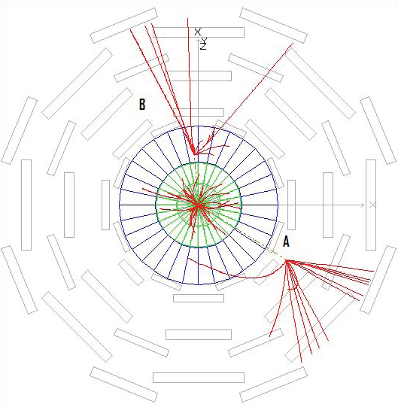
calorimeter
Different techniques are required for each section of the detector
muon spectrometer

Slide 11
Final State(s)
Position of Decay
Each detector requires a new strategy
Missing $E_{T}$ is possible, but…
Decay Products
Jets – Many charged particle tracks
Leptons – usually a lepton-jet
Stefano’s talk!

Slide 12
Producing & Capturing The HV Signal
1
Traditional Trigger: Associated Production
Look for $WH→ℓνπ_{v}π_{v}$
Trigger on the W decay
Lower cross section
Well understood signature
(see WH with lepton jets)
2
Custom Trigger: Direct Production
Look for $H→π_{v}π_{v}$
Develop custom triggers for each detector decay signature
High cross section
Trigger development and constraints are hard!

Slide 13
triggering is grim…
Physics
specially designed triggers
level 1 is typically hardware – restricted!!
mostly designed at upper levels
Level 1
Level 2/High level triggers
Level 2/HLT
room for innovation
full event in HLT
some hardware restrictions in Level 2 (ATLAS).
Offline Analysis
Discovery

Slide 14
long lived particle triggers
b-tagging triggers
good for a decay a few millimeters from primary vertex
huge backgrounds from QCD $b\overline{b}$ production
long lived neutral particle triggers
neutral particle decays mid-detector
appearance trigger
Introduced in the 2011 run

Slide 15
3 triggers
decays late in inner detector
trackless jet trigger
jet $E_{T}>35$ GeV
no tracks with $p_{T}>1$ GeV near jet
muon spectrometer activity
low efficiency
log($E_{had}/E_{EM})$
decays beyond the EM calorimeter
jet $E_{T}>35 GeV$
no tracks with $p_{T}>1$ GeV near jet
log($E_{had}/E_{EM})>1.0$
very good efficiency
muon spectrometer cluster trigger
decays beyond the calorimeter
three muon clusters all close by no jets, no tracks
very good efficiency

Slide 16
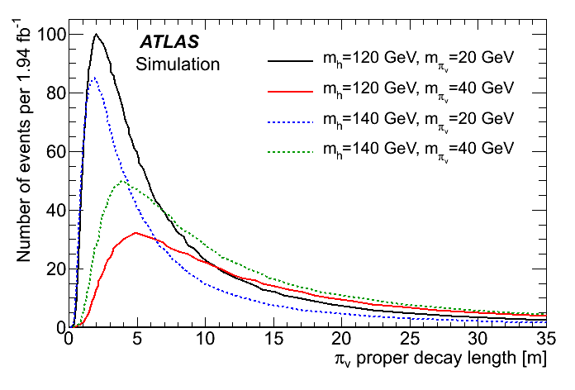
What do we expect in the Muon Spectrometer?
$$BR\left(H→π_{v}π_{v}\right)=1.0$$

Slide 17
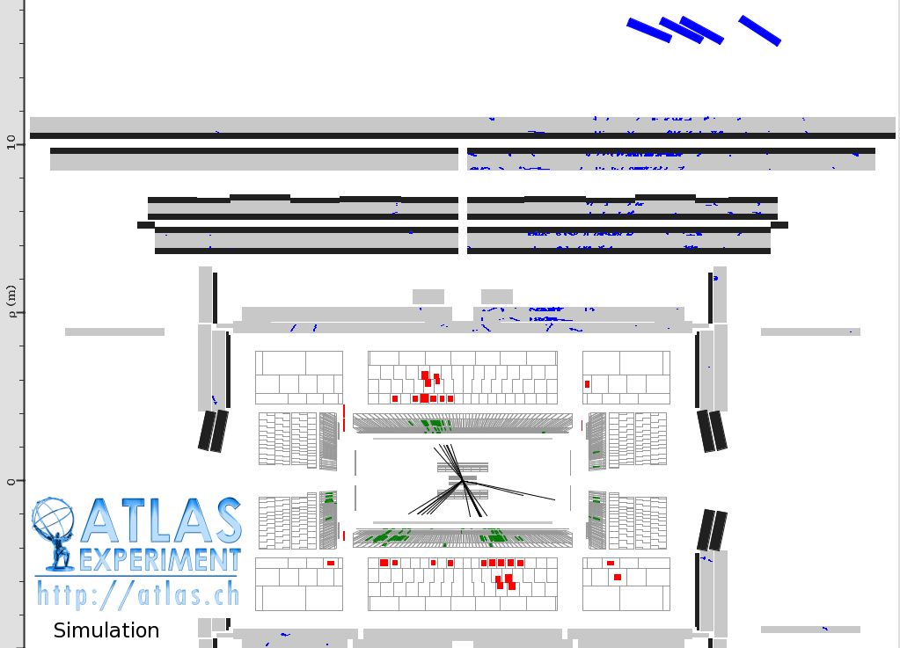
“Typical” Signal Event Topology
Displaced Decay

Slide 18
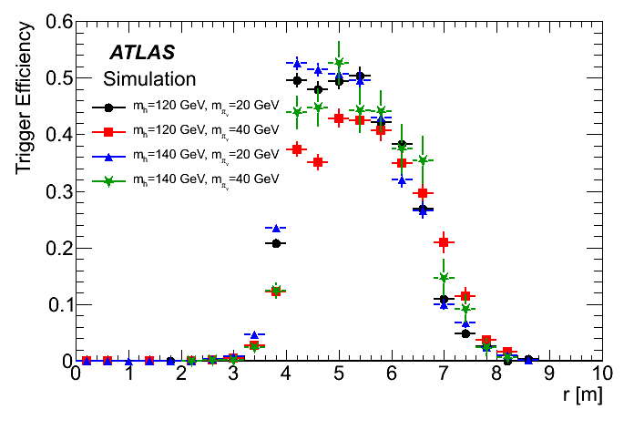
MS Trigger
Require 3 clusters of muon segments (RoI’s)
No jets pointing to the clusters
No tracks pointing to the clusters

Slide 19
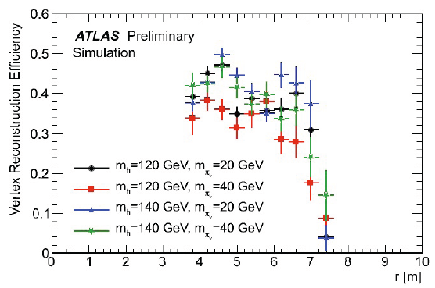
muon spectrometer vertex
The ATLAS muon spectrometer is designed to reconstruct muon tracks stand alone
It can do more than particle ID!
Efficiency x-checked with punch-thru jets
Muon reconstruction algorithm
Traditional Vertexing Algorithm
Custom Muon Segment Builder
Allows for very large segment impact parameters!!
Notes:
Fix up this slide

Slide 20
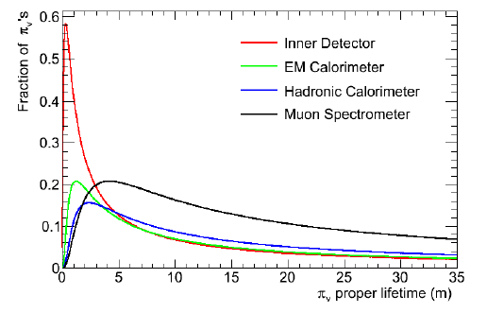
backup: evolution of the models
$$m_{h}=120 GeV, m_{π_{v}}=20 GeV$$
$$m_{h}=140 GeV, m_{π_{v}}=40 GeV$$

Slide 21
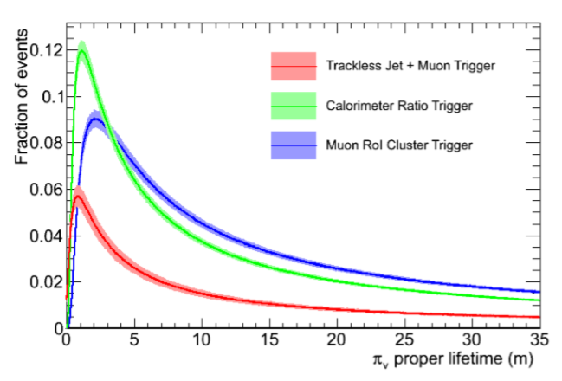
pass fraction vs. $cτ$

Slide 22
Analysis Strategy
>= 1 Muon Cluster Trigger
2 back-to-back Vertices found in the Muon Spectrometer
No Jet or Track activity near the vertex
$ΔR\left(jet,vertex\right)≥0.7$
$ΔR\left(5 GeV Track, vertex\right)≥0.4$
In 1.94 $fb^{−1}$ of data $0$ events seen
Expected Backgrounds:
1 Trigger
1 Vertex
P(2nd Vertex|No Trigger)
1 Trigger 2011 Data
($15543$)
$$(9.7±6.9)×{10}^{−7}$$
$$0.03±0.02$$
2 Trigger
1 Vertex
P(2nd Vertex|Trigger)
(1)
$$(1.11±0.01)×{10}^{−2}$$
arXiv:1203.1303v1

Slide 23
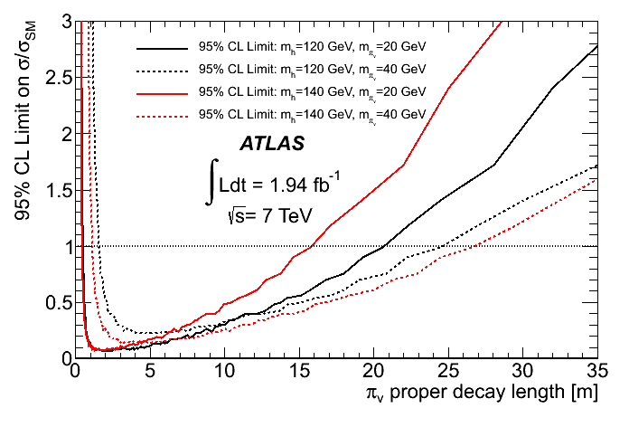
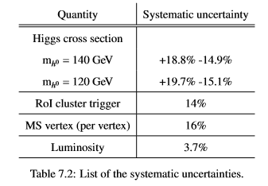
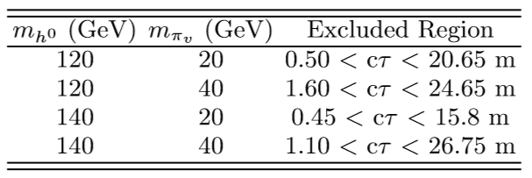
limits
equal systematic error contributions from theory and efficiency verification for our signals.

Slide 24
LHC Run 2
Opportunity
Challenge
Pile-up will foul isolation requirements
Larger datasets will improve sensitivity
Increased $ℒ$
Trigger single object thresholds increase
Turn on of other LLP production
Higher boost more narrow objects (detector resolution)
Higher boost means shorter lifetime sensitivity
Increased $\sqrt{s}$
8 TeV $→$ 13 TeV

Slide 25
LHC Run 2
Major work underway to improve custom triggers
MS Vertex Finder will run in Reconstruction
Will be available with all topologies
Hopefully incorporated with other search strategies

Slide 26
Conclusion
HV provides a rather generic benchmark model to look for displaced decays.
New techniques were developed to search in the ATLAS Muon Spectrometer
Trigger
Object ID (MS Vertex)
 | e | $$μ$$ | $$τ$$ | Quarks
e
$$μ$$
$$τ$$
Quarks
SUSY searches with displaced vertices have been performed the inner detectors
Other detectors coming
Lots of combinations to go.
Run 2 preparations well underway
Displaced
Prompt

