Slide 1
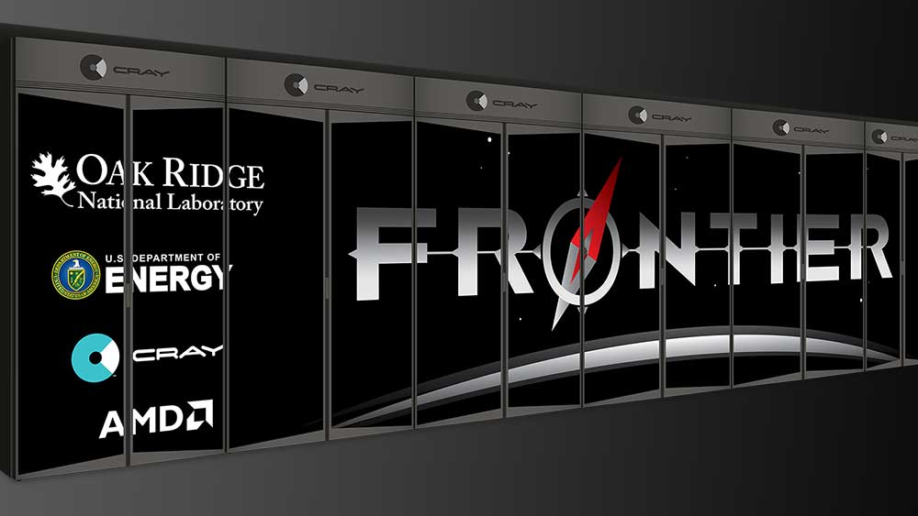
Oak Ridge Leadership Computing Facility JETSCAPE Collaboration Meeting
Bronson Messer
Acting Director of Science
Oak Ridge Leadership Computing Facility

Slide 2
National Center for Computational Sciences Home to the OLCF and the Summit Supercomputer
65K ft² data space
Distributed across 4 controlled-access areas
31K ft² Very high load bearing (> 625 lb/ft²)
40 MW of high-efficiency highly reliable power
Tightly integrated into TVA’s 161 KV Transmission system
High-efficiency 3.0/4.0 MVA transformers
6,600 tons chilled water
20MW cooling capacity at 21C/70F
7,700 tons evaporative cooling
Expansion potential:
Power infrastructure to 60MW,
Cooling infrastructure to 70MW.
Notes:
Approximately 60,000 square feet of unclassified data center floorspace
Approximately 30MW of available power and cooling to these data centers
Titan Data Center-
20,000 sq.ft. data center (Titan is roughly 4,500 sq.ft.)
3 foot raised floor
42 degree chilled water supply loop
20 air handlers providing cooling to the equipment
Operates around 1.25 PUE as a year-round measure
Titan uses 3 cooling mediums to cool its components: air, R134A, and 42 degree water
Summit Data Center-
9,000 sq.ft. data center (Summit is roughly 5,000 sq.ft.)
Concrete slab flooring with all infrastructure overhead
72 degree medium-temperature water supply loop
Has operated as low as 1.02 PUE within this data center
Chiller-less operation for ~75% of the year
Summit uses water cooling with direct-to-chip 72 degree water and the remaining heat is picked up by a rear-door heat exchanger that is mounted on each cabinet of compute, storage, and infrastructure inside this data center.
Summit cabinets can operate as high as 47kW per cabinet
Other data center space (~32,000 sq. ft.) is capable of housing a limited amount of sensitive systems

Slide 3
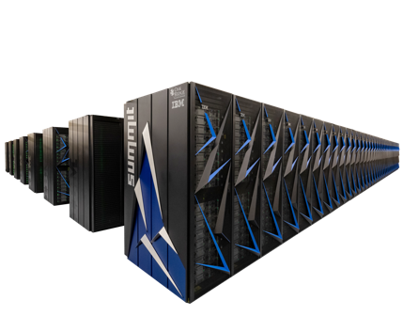
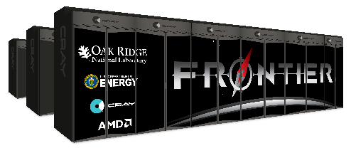
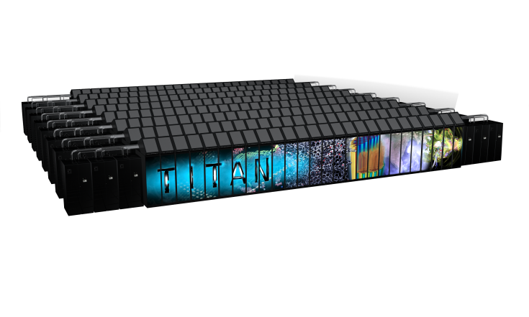
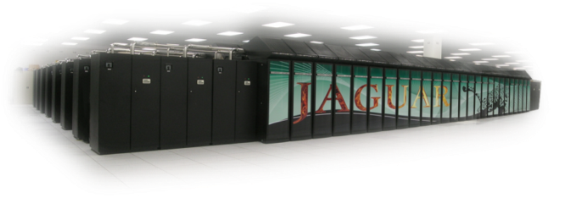
Oak Ridge Leadership Computing Facility – a DOE Office of Science User Facility
Mission: Providing world-class computational resources and specialized services for the most computationally intensive global challenges | Vision: Deliver transforming discoveries in energy technologies, materials, biology, environment, health, etc.
Roadmap to Exascale
10¹⁸
10¹⁷
10¹⁶
10¹⁵
Frontier
>1,500 PF
Hybrid GPU/CPU 29 MW
Summit
200 PF Hybrid GPU/CPU 13 MW
Titan: 27 PF Hybrid GPU/CPU 9 MW
Jaguar
2.3 PF Multi-core CPU 7 MW
2009
2012
2017
2021

Slide 4
ORNL Summit System Overview
System Performance
The system includes
Each node has
Peak of 200 Petaflops (FP₆₄) for modeling & simulation
Peak of 3.3 ExaOps (FP₁₆) for data analytics and artificial intelligence
4,608 nodes
Dual-rail Mellanox EDR InfiniBand network
250 PB IBM file system transferring data at 2.5 TB/s
2 IBM POWER9 processors
6 NVIDIA Tesla V100 GPUs
608 GB of fast memory
(96 GB HBM2 + 512 GB DDR4)
1.6 TB of non-volatile memory

Slide 5
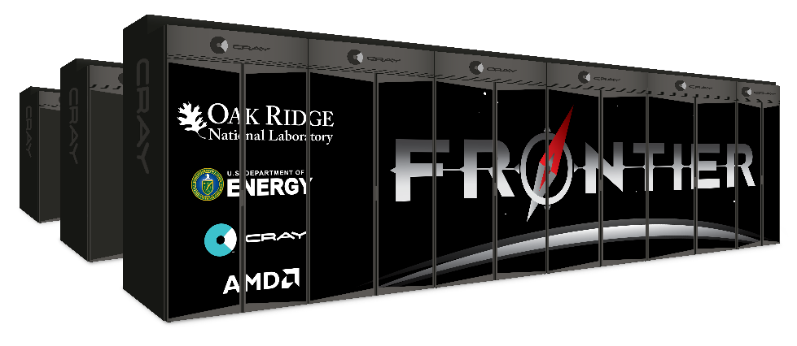
Frontier Overview
Partnership between ORNL, Cray, and AMD
The Frontier system will be delivered in 2021
Peak Performance greater than 1.5 EF
Composed of more than 100 Cray Shasta cabinets
Connected by Slingshot™ interconnect with adaptive routing, congestion control, and quality of service
Node Architecture:
An AMD EPYC™ processor and four Radeon Instinct™ GPU accelerators
purpose-built for exascale computing
Fully connected with high speed AMD Infinity Fabric links
Coherent memory across the node
100 GB/s injection bandwidth
Near-node NVM storage
Researchers will harness Frontier to advance science in such applications as systems biology, materials science, energy production, additive manufacturing and health data science.

Slide 6
Comparison of Titan, Summit, and Frontier Systems
System Specs | Titan | Summit | Frontier
Peak | 27 PF | 200 PF | ~1.5 EF
# cabinets | 200 | 256 | > 100
Node | 1 AMD Opteron CPU 1 NVIDIA K20X Kepler GPU | 2 IBM POWER9™ CPUs 6 NVIDIA Volta GPUs | 1 HPC and AI Optimized AMD EPYC CPU 4 Purpose-Built AMD Radeon Instinct GPU
On-node interconnect | PCI Gen2 No coherence across the node | NVIDIA NVLINK Coherent memory across the node | AMD Infinity Fabric Coherent memory across the node
System Interconnect | Cray Gemini network 6.4 GB/s | Mellanox Dual-port EDR IB network 25 GB/s | Cray four-port Slingshot network 100 GB/s
Topology | 3D Torus | Non-blocking Fat Tree | Dragonfly
Storage | 32 PB, 1 TB/s, Lustre Filesystem | 250 PB, 2.5 TB/s, IBM Spectrum Scale™ with GPFS™ | 2-4x performance and capacity of Summit’s I/O subsystem.
Near-node NVM (storage) | No | Yes | Yes

Slide 7
Frontier Programming Environment
To aid in moving applications from Titan and Summit to Frontier, ORNL, Cray, and AMD will partner to co-design and develop enhanced GPU programming tools designed for performance, productivity and portability.
This will include new capabilities in the Cray Programming Environment and AMD’s ROCm open compute platform that will be integrated together into the Cray Shasta software stack for Frontier
In addition, Frontier will support many of the same compilers, programming models, and tools that have been available to OLCF users on both the Titan and Summit supercomputers
For CUDA programmers, the obvious course is to switch to HIP.
Summit is a premier development platform for Frontier
…but not for CUDA…

Slide 8
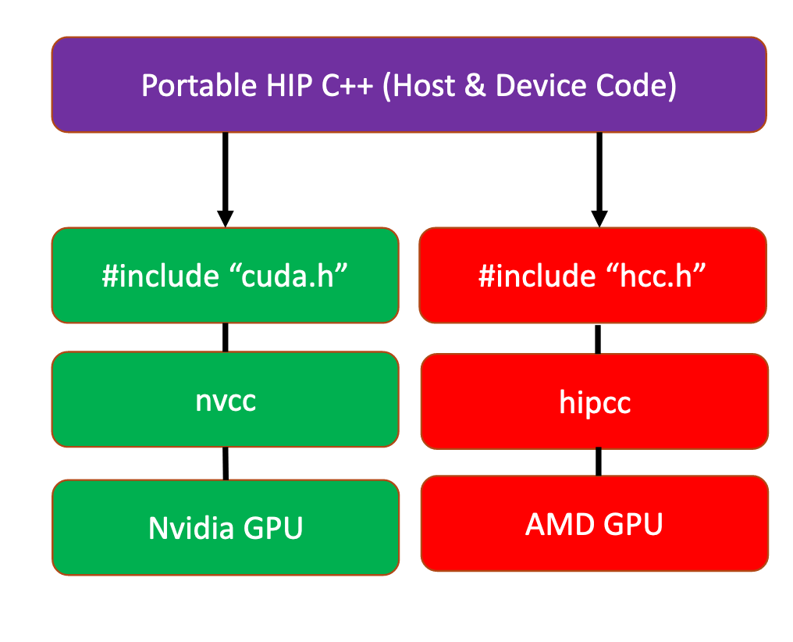
What is HIP?
AMD’s Heterogeneous-compute Interface for Portability, or HIP, is a C++ runtime API and kernel language that allows developers to create portable applications that can run on AMD’s accelerators as well as CUDA devices.
HIP:
Is open-source.
Provides an API for an application to leverage GPU acceleration for both AMD and CUDA devices.
Syntactically similar to CUDA. Most CUDA API calls can be converted in place: cuda-> hip
Supports a strong subset of CUDA runtime functionality.

Slide 9
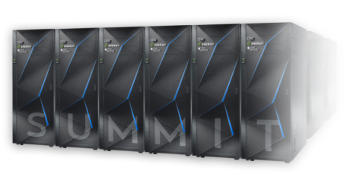
How to Get Time on Summit
ALCC
The US Department of Energy provides access to leadership supercomputers to facilitate capability-limited research for significant advances in science and engineering through the INCITE and ALCC User Programs
Access is awarded via annual competitive-proposal calls (requests greatly exceed availability)
Innovative and Novel Computational Impact on Theory and Experiment (INCITE) aims to accelerate scientific discoveries and technological innovations by awarding, on a competitive basis, time on supercomputers to researchers with large-scale, computationally intensive projects that address “grand challenges” in science and engineering (http://www.doeleadershipcomputing.org/incite-program).
ASCR Leadership Computing Challenge (ALCC) supports projects of interest to the Department of Energy (DOE) with an emphasis on high-risk, high-payoff simulations in areas directly related to the DOE mission and for broadening the community of researchers capable of using leadership computing resources (https://science.energy.gov/ascr/facilities/accessing-ascr-facilities/alcc/)

Slide 10
Four primary user programs for access to LCF Distribution of allocable hours
10% Director’s Discretionary
Up to 20% ECP
Exascale Computing Project
50% INCITE
20% ALCC
ASCR Leadership Computing Challenge

