Slide 1
How and Why to Address the Invisible Problems of Bias in Physics
Stephanie A. Bohon, PhD
Director, Center for the Study of Social Justice &
Professor & Associate Head, Department of Sociology
University of Tennessee

Slide 2
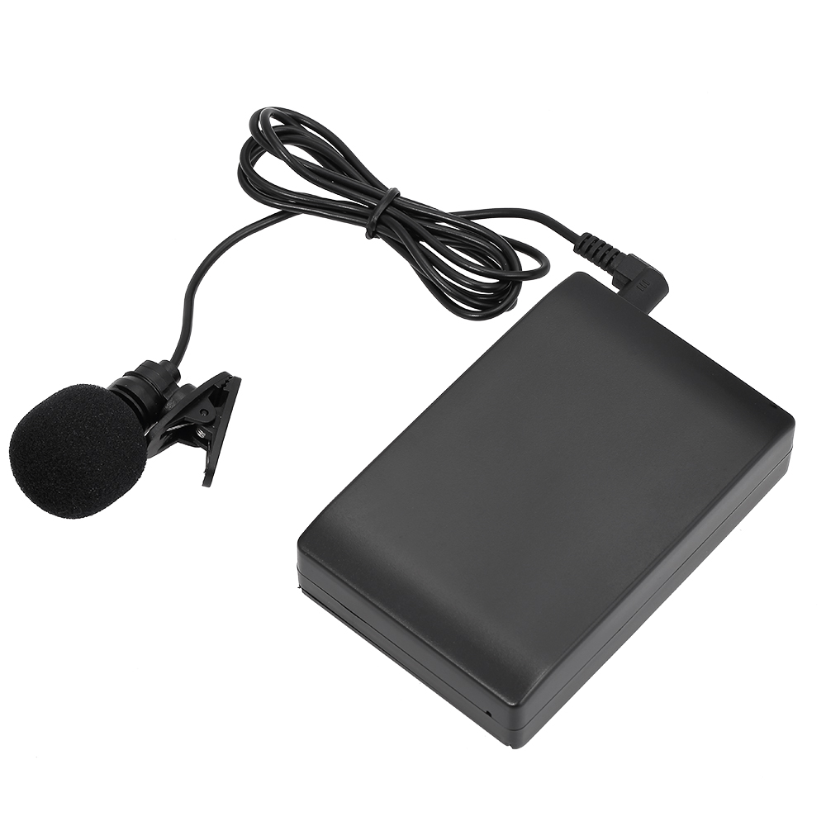

Slide 4
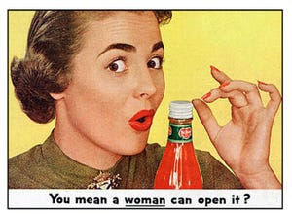

Slide 5
Actual reviewer comments
“The first author is a woman. She should be in the kitchen, not writing papers.”
“Despite being a woman, the PI was trained by several leading men in the field and is thus likely adequately prepared to lead the proposed research.”
“The author’s status as a trans person has distorted his view of sex beyond the biological reality.”
From Silbiger, NJ and AB Stubler (2019)

Slide 8
“I don’t know why a woman from the University of Tennessee is leading this initiative when there are powerhouse men like XXX and XXX on the team.”
--Actual reviewer comments on one of my NSF proposals

Slide 9
Invited panels APS 2020

Slide 10
Invited panels APS 2020

Slide 11
All-women invited APS panels

Slide 12
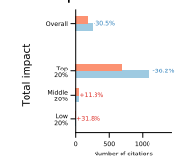
From Huang et al. (2019)

Slide 14
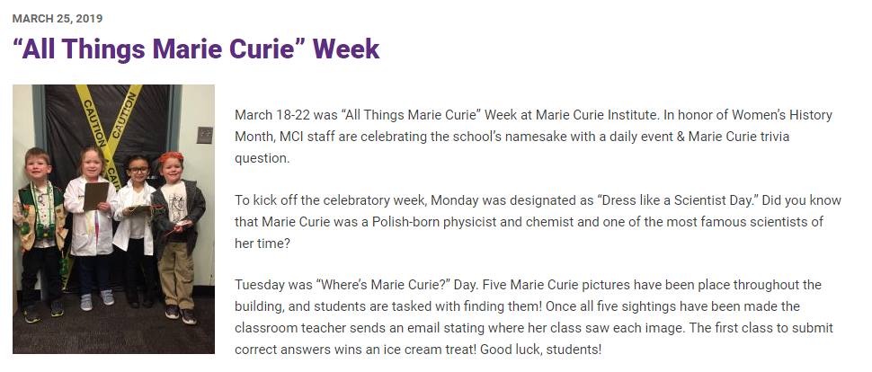

Slide 15
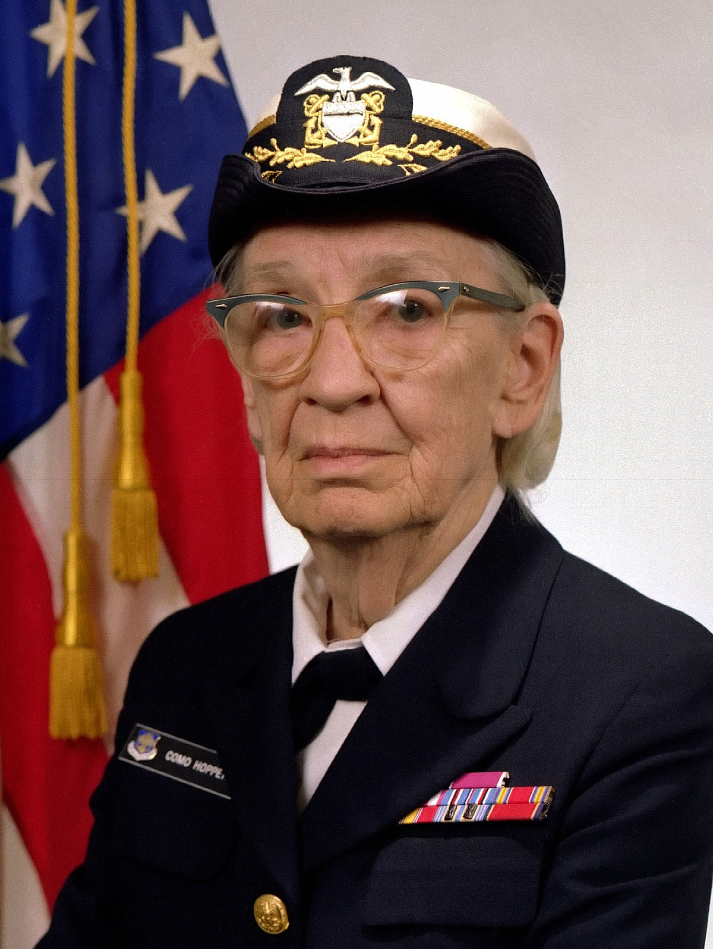

Slide 16
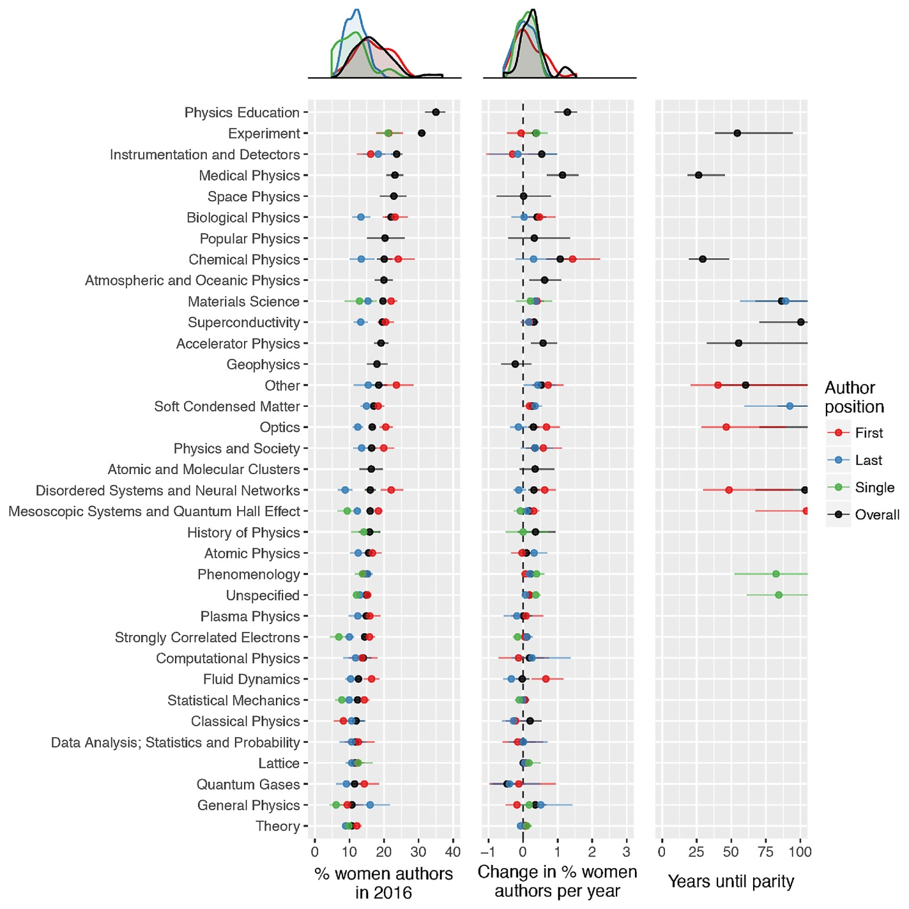

Slide 17
258 years

Slide 18
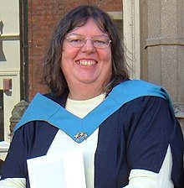
Dr. Angela Helen Clayton, MBE (1959-2014) nuclear physicist

Slide 19
Make changes!
Be aware of the invisible. Look to other fields for guidance to build supportive conferences;
Don’t create manels, and don’t serve on them.
Cite women.
Add women to your syllabus.
Invite women to your department to give invited talks
Critically evaluate your own department to ensure that it’s welcoming to all.

