Slide 1
Prompt gamma-jet and di-jet via correlations in Heavy Ion Collisions in large and small systems
Justin Frantz
Ohio University
3/20/2019
Jetscape Workshop 3/20/2020

Slide 2
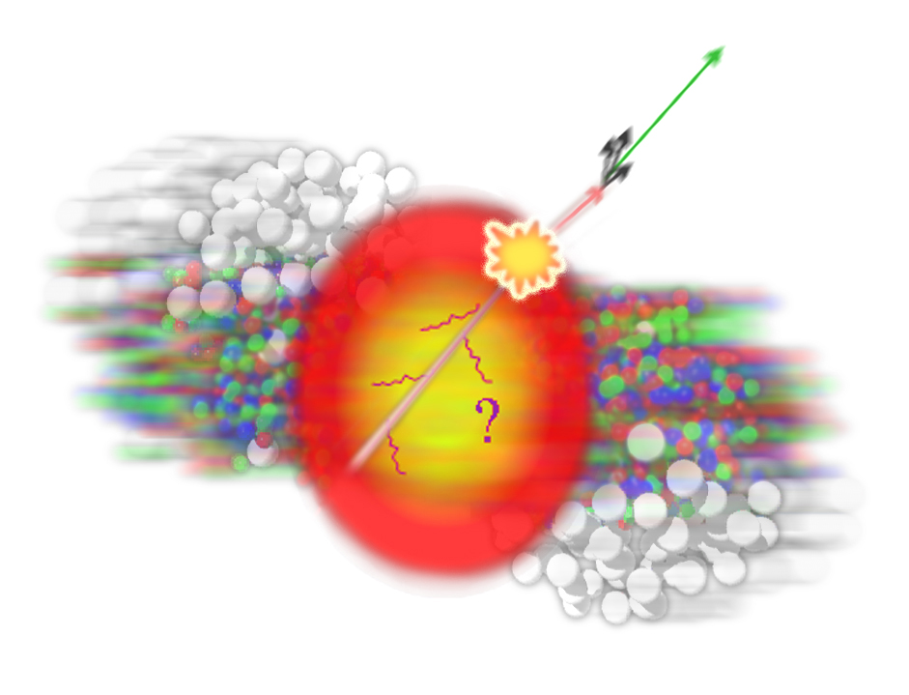
Two particle ANGULAR (mostly $Δφ$) correlation
Jets must be produced in back to back pairs to conserve momentum
Trigger particle → high momentum pi0 → proxy for jet
Partner (Associated) particle → charged hadron from same jet or “awayside” jet
Correlation function: C(∆Φ)
Source: http://puma.uio.no/trine/ALICE-Oslo/angular_correlations.html
Awayside suppression
Corrects
for imperfect detector

Slide 3
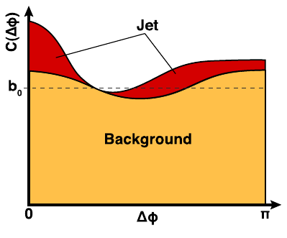
2-p Correlation Analyses - Methods
Statistical Methods: subtraction: Not EvByEv
Need to measure per-trigger yield (aka jet function)
Correlation Function – bkgd (Flow)
+ v_{n> 3}

Slide 4
2-particle Correlation Analyses – Methods -- Many Statistical Subtractions- not EvByEv
g-h: double subtraction of 2-particle measurements
Norm
Bkgd(Flow)
For isolation cut - Y_{inclusive} = Y_{isolated}
For p+p – no flow background subtraction
No flow subtracted in small systems (e.g. p+Au and d+Au)

Slide 5
Two-Particle vs Reco’d Jets
Jet Reconstruction Observables Becoming More and More Varied and Sophisticated
“Jet Substructure” Observables with Found-jet Q/Jet E Scale Good progress in theory/experiment exploring Jet & Jet Substr. relation
Fragmentation Function combine particles w/ jets
Di-jet Two Particle Correlations Are Less Constrained
They are related to the above observables but integrate over possibly wide Jet E ranges – and lately revealed different shower properties
Still they are still very useful where Jet Reco still cannot go:
Particularly:
at the lowest jet E’s ~ 5-15 GeV
when prompt photons are one of particles is prompt $γ$ (provides jet scale)
at large angles w.r.t. jets
…which helps especially when viewing complex geometrical e.g. event plane, event engineering, peripheral dependences
Lot’s of theory development focused rightly on reco jets, but many theory frameworks can still address 2PC

Slide 6
Example 1
Jet Imbalance A_{J} @ RHIC rebalanced within R $≤$ 0.4?
Slide from Y.J. Lee at Santa Fe several months ago
The shape parameters being varied here are still ~small angles < 0.4
Obviously AJ within this radius is not sensitive enough to feel this?

Slide 7
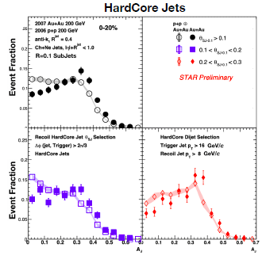
Example I (continued)
The recovered STAR result is for matched jets, to be compared to Hard core jets– very subtle modification there
This is an example of why it will be great to get more precision and another independent check with sPHENIX!!!

Slide 8
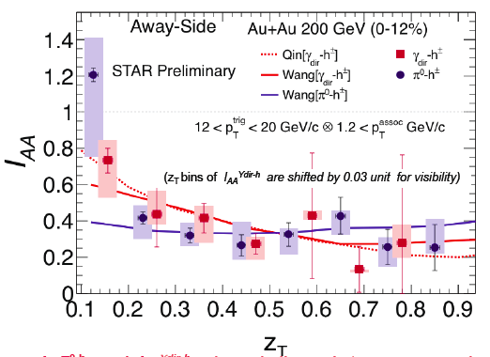
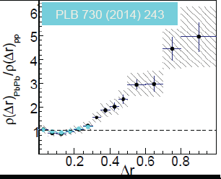
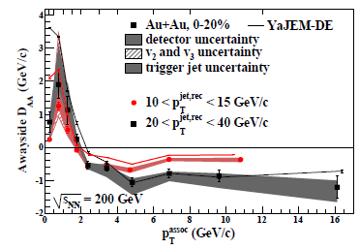
Energy flow @ large Angles
As speaker pointed out, energy flow is well established out to very large angles/values
Jet’s (LHC) and at RHIC STAR Jet-h/$γ$-h…
STAR 1302.6184
Recall CMS Result

Slide 9
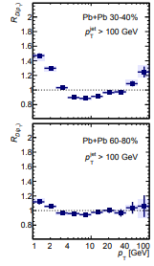
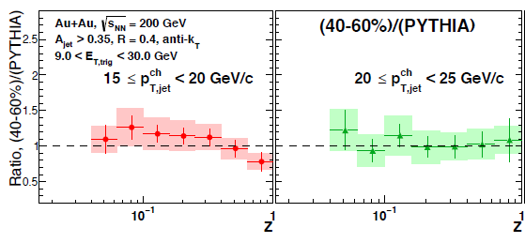
(No) Disagreement Recent STAR data?
Many caveats already stated by STAR when presented (recoil vs inclusive jets, ratio to PYTHIA(!) etc.)
But magnitude/pt of mods also
not large from LHC data ---no tension here
ATLAS “OVERLAY”

Slide 10
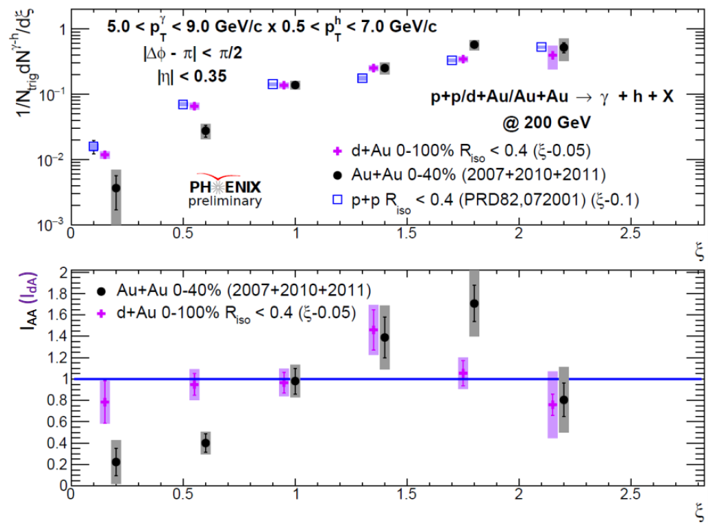
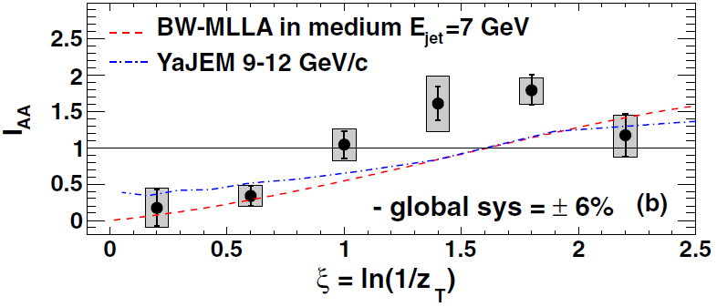
In $γ$-h, PHENIX Measured/Reconfirmed Several Ways
0-40% events – Most central Au+Au
No clear modification in d+Au
Enhancement in Au+Au
Run 7+10+11 Au+Au more precise than previous measurement (Run 7+Run 10)
z increasing
ξ=ln(1/z_{T})
PRL 111, 032301 (2013)
How does enhancement behave with centrality?

Slide 11
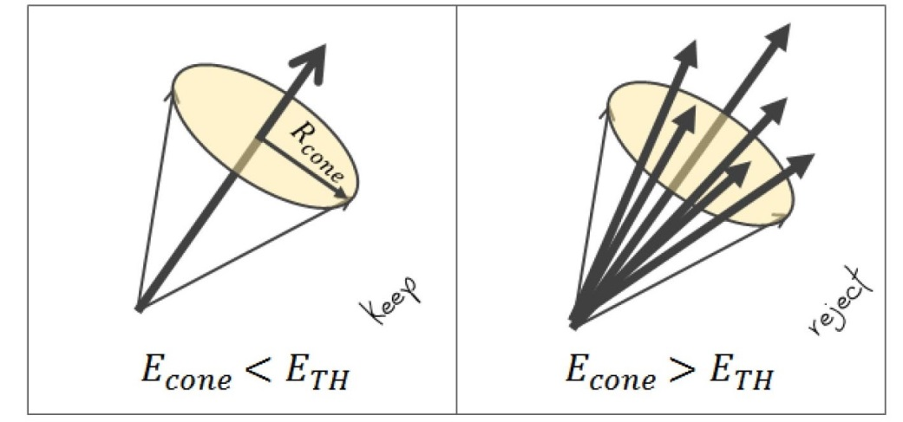
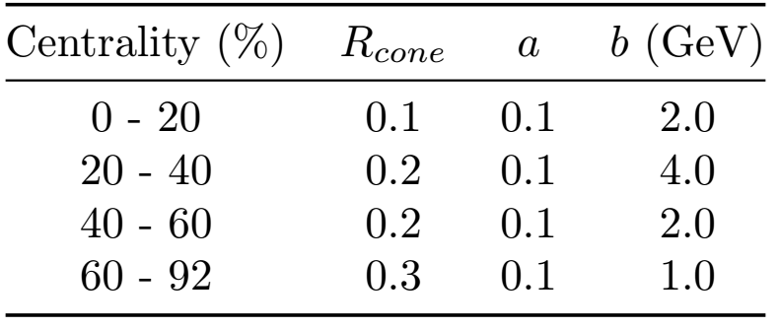
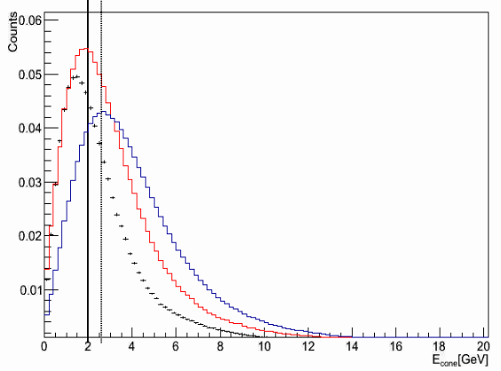
Updated Method - Isolation Cut in Au+Au
Use cone method
Sum energy in cone around particle, if less than threshold, particle is isolated
Optimal threshold depends on centrality, background event energy, and central photon energy
N. Riveli,, Ph.D. thesis, Ohio University (2014).
p_{Tγ}= 5-7 GeV/c 0-20% R = 0.1
Solid line - b
Dashed line -
$\left\langle E_{TH}\right\rangle$=0.1*$\left\langle p_{Tγ}\right\rangle$+b
Causes complications
Measuring isolated particle v₂ for 2-p background subtraction
Background level – using abs norm method
Decay photon statistical subtraction
Underlying event
Decay Photon
$π^{0}$
Underlying event figure

Slide 12
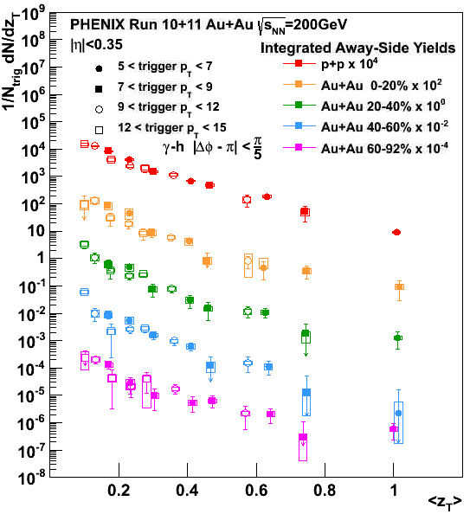
Away-side Prompt $γ$-h Yield
Integrate away-side of per-trigger yield
Seems to scale with z_{T} = p_{Th}/p_{Tγ}

Slide 13
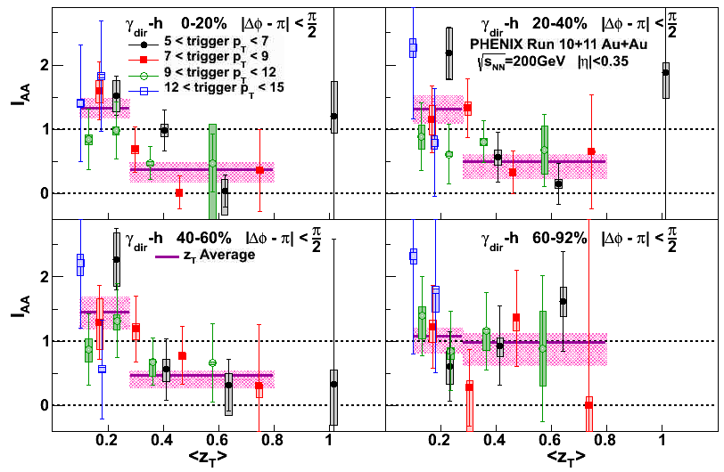
I_{AA} as a function of z_{T}
Fit all I_{AA} points in two z_{T} regions to a constant to extract the average I_{AA} for each z_{T} region and centrality bin
z_{T} = p_{Th}/p_{Tγ}

Slide 14
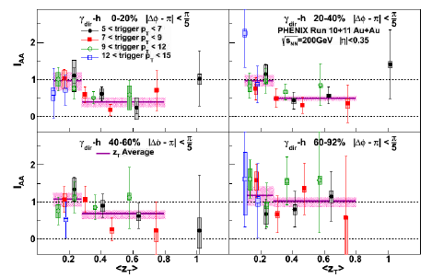
Better bin for STAR comparison : I_{AA} as a function of z_{T}
THIS BIN HAS AN INTEGRATION RANGE OF pi/5 ~ 0.6 cone size
Note for 2PC must judge relative difference high vs low zt
z_{T} = p_{Th}/p_{Tγ}

Slide 15
Average I_{AA} vs. Centrality
Low z_{T} and High z_{T} behaviors different.
High z_{T} suppression for all centrality bins
Low z_{T} NOT SUPPRESSED, relatively flat with centrality-- E_{loss} Recovery
Isolation cut allows more precise analysis of the semi-peripheral and peripheral centralities

Slide 16
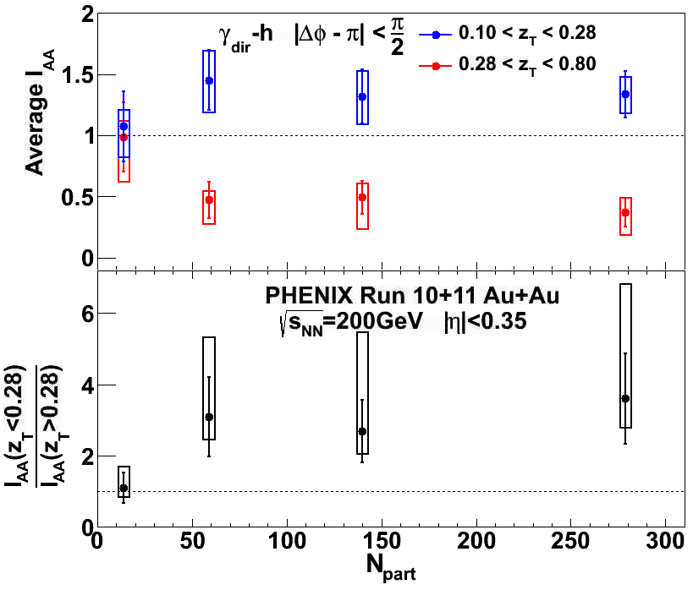
Average I_{AA} – π/2 away-side
High z_{T} energy loss enhances low z_{T} production
1st measurement of centrality dependence of low z_{T} enhancement
To judge true centrality dependence of enhancement, must account for overall reduction of jets due to suppression
Energy recovery factor – High z_{T}/ low z_{T} ratio – shows monotonic increase toward central events

Slide 17
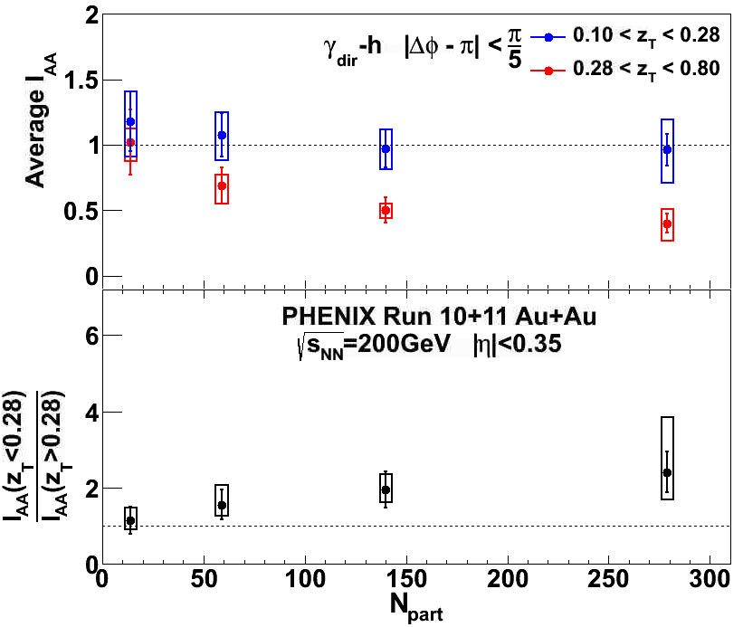
Average I_{AA}
Enhancement and suppression for all away-side regions!
Increasing low z enhancement for wider integration regions (blue points right to left)
Seen by previous gamma-jet and LHC jet reconstruction analyses
Both high z suppression and low z enhancement
Enhancement above suppressed jet level (black ratio) monotonically increasing towards central events for all away-sides

Slide 18
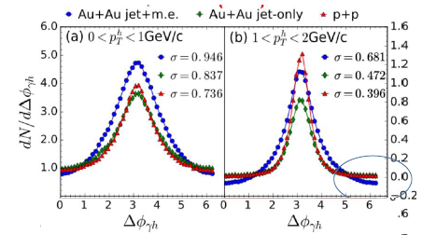
Quick Aside What’s Next?
What’s next here? Go WAY WIDER!!!!!
Chen, XN Wang: et. al. Take awayside yield all the way to nearside!
This will be hard in small PHENIX acceptance
STAR → sPHENIX!
arXiv:1704.03648v4

Slide 19
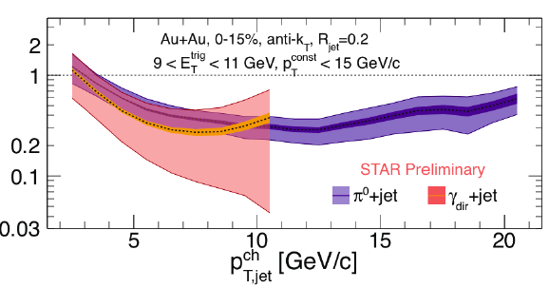
STAR h-Reco Jet, $γ$-Reco Jet: RECOIL
STAR Prompt $γ$-h/jet Analyzers busy with first $γ$-Reco’d Jet Result at RHIC!
Fragmentation Fn IAA (and other Substructure) Using Jet Angle will help with many of the previous studies
IAA of
Number of Awayside Jets

Slide 20
The lesson
With two particles in Au+Au, can access larger opening angles, lower jet E, where specifics of jet findings would be less important anyway
…and thus we can still gain valuable insight into Jet Eloss

Slide 21
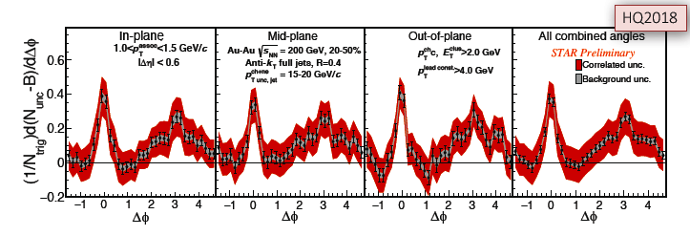
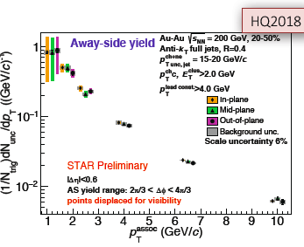
Example II: STAR Event-Plane Dep. Jet-h “2PC”
No event plane dependence?
(Similar results seen in regular 2PC also)
Talk by
S. Oh
WWND 19

Slide 22
More Differential w/ 2PC
2PC correlations where trigger and partner NOT symmetrized and measured w.r.t “handed” direction reveals hidden dependence!
Awayside suppressed in direction of longer path length direction, which moves and thus washes out in inclusive

Slide 23
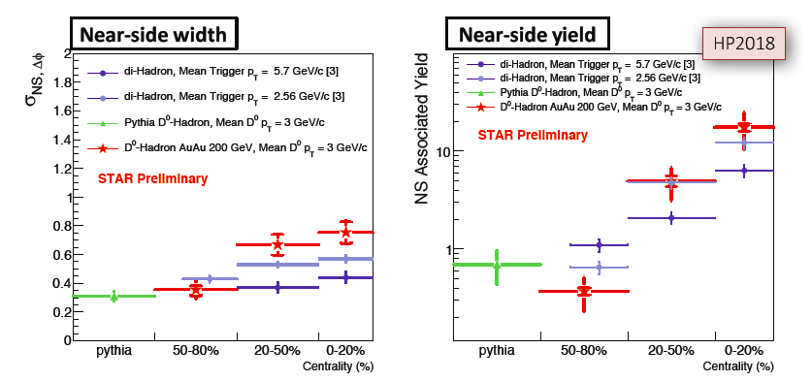
Example III: STAR D₀-h 2PC:
Charm-jet 2PC have similar behavior to light di-hadrons
Here, c quark, like for $γ$ provides interesting momentum direction / Scale even w/o Jet Reco

Slide 24
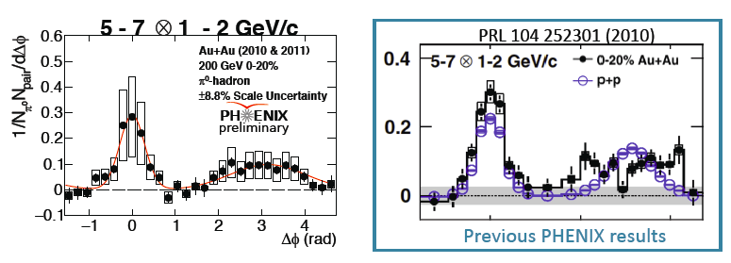
Jet Corr. Widths from 2PC: A Recent focus (reason in a moment)
Finally PHENIX re-analysis with full vn:
Especially towards low pT (closely related to the enhancement)
A serious width broadening is present even after vn

Slide 25
Jet Corr. Widths from 2PC: A Recent focus (reason in a moment)
Finally PHENIX re-analysis with full vn: (Run 10/11)
A serious width broadening is present even after vn
Centrality dependence
This is the thing we are after –> go more peripheral…

Slide 26
…Because of small system results
Width results: different variable:

Slide 27
Small System Broadening of Jet Corr
Of course this cannot be yet asserted to be due to Eloss, but we need to investigate

Slide 28
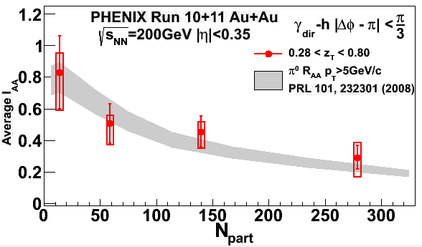
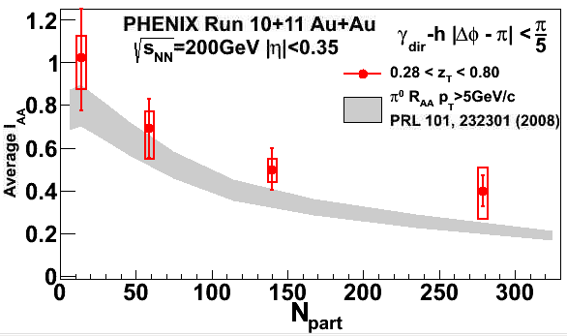
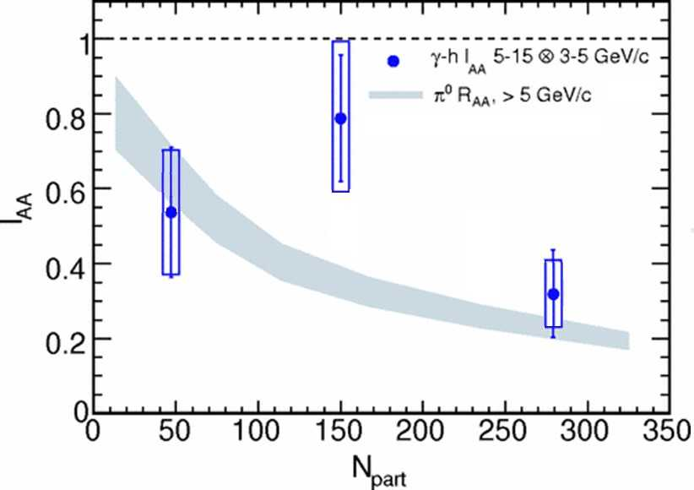
Back to $γ$-hYields High z_{T} Average I_{AA} Centrality Dependence
Isolation cut/New stats substantial improvement in precision
Detailed centrality shape of suppression
High z_{T} Average I_{AA} and π⁰ R_{AA} approximately match
Photon tagged jet geometric distribution (E_{loss} geometry) is exactly the same as single inclusive jet geometric distribution - so R_{AA} ≈ γ-jet I_{AA} expected
PREVIOUS
PHENIX
RESULT
PRC 80, 024908 (2009)

Slide 29
Ultimate Goal Eloss Turn-off? Eloss in Small systems?
We want to focus on region where Eloss is small in A+A to study whether it may be expected in small systems and how large does a system have to be?
Isolation cut helps most in mid-central to periph: but low statistics we need analyze Run14/Run16 statistics to gain sufficient statistical precision

Slide 30
Ultimate Goal Eloss Turn-off? Eloss in Small systems?
Alternative solution:
Using pi0-h correlation to gain statistical precision.
Finding new observable other than IAA to take care of systematic errors.

Slide 31
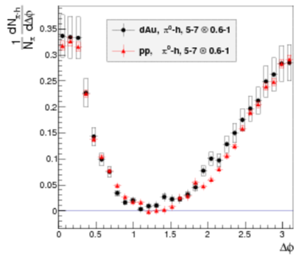
NS/AS Ratios: A Nice Observable for searching for small E_{loss} ?
Assume well-known surface bias picture for Au+Au should apply as the system goes peripheral—possibly even in “small systems” p+Au, d+Au, He+Au
Look for Differences in Awayside Modification compared to Nearside
A+A plasma
trigger
p+A?
$$RI= \frac{Y_{away}^{AA}/Y_{near}^{AA}}{Y_{away}^{pp}/Y_{near}^{pp}}$$
Black
Red

Slide 32
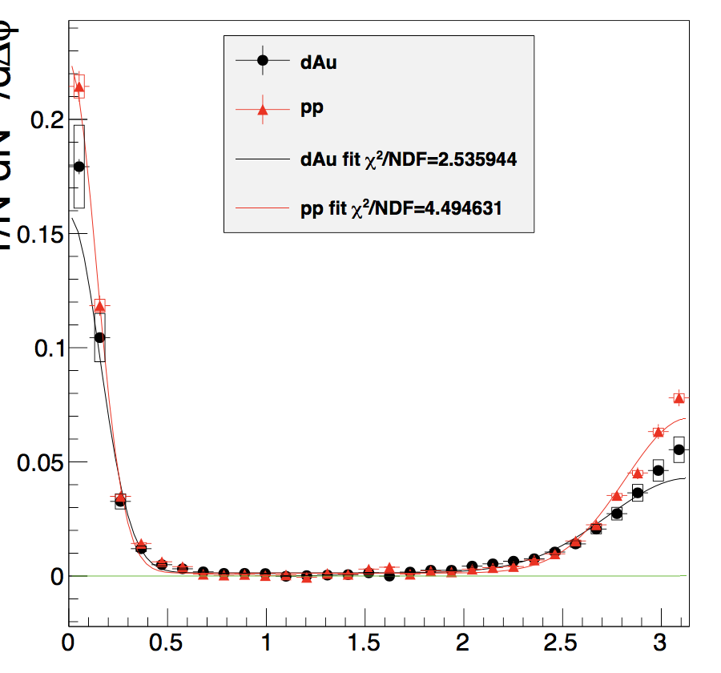
Jet Pair Quantification
PTY Nuclear Modification Factor (I_{AA} ) =Y^{AA} /Y^{pp} (Away side)
Y roughly represents the number of particles produced per jet
Y is Per Trigger: any deviation from unity represents modification
AA/pp Partner h$±$ SINGLES EFFICIENCIES vs p_{T} NEEDED
Uncertainty dominated by singles charge hadron efficiency
𝜋⁰-h: 5-7 x 3-5 GeV
JF
Source: B. Xia, Ph.D. thesis, Ohio University (2014)
∆Φ= 𝜋/2
Y (nearside)
Y (away-side)
∆Φ
Double Ratio: $RI= \frac{Y_{away}^{AA}/Y_{near}^{AA}}{Y_{away}^{pp}/Y_{near}^{pp}}$
NO EFFICIENCIES NEEDED (Cancels in AS/NS)
Dominant systematic errors due to single charge hadron efficiency are completely removed
Surface Bias: levels of modification mostly unchanged (going from IAA to RI)
Contribution of v_{2n} even harmonics from hydrodynamic flow is zero (e.g. v₂)
Contribution of higher order odd harmonics (>= v₃) can be neglected--only sensitive to v₁
ZYAM systematic is also small since residual mis-subtraction contribute to both NS and AS.

Slide 33
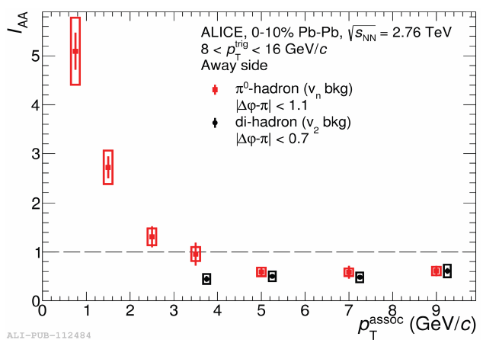
Energy loss + Suppress ?: IAA (/RI) Most Sensitive Observable?
Reminder 2PC IAA (LHC):
relative rise from high pta (RI = ~0.5) to low pta (RI= 5) is factor of 10!
MUCH BIGGER FACTOR THAN RAA SUPPRESSION!!! (better signature? )
More sensitive then jet reco measurements because no “found-jet-only” bias

Slide 34
Other end of spectrum: Small Systems:?
No Eloss in p+Pb at LHC? –LHC only very high energy observables.
ndpfs account for ALL jet modifications?
LHC focus on found jets, observables like x.s. excludes largest modification e.g. for A+A jets ($Δ$R > 1 enhancement)
Greater sensitivity in low Ejet?
lowest possible “jet” pt: 5-15 GeV.
Exploit enhancement—Exploit trigger bias for sensitivity: 2PC/RI can do both

Slide 35
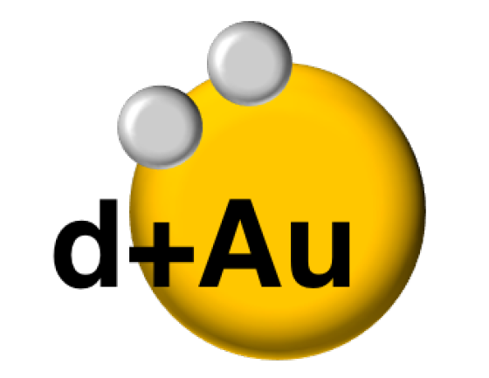
d+Au: pi0-h correlation
In PHENIX we put all these ideas together a few years ago which can demonstrate
$$\sqrt{{\text{s}}_{\text{NN}} }\text{= 200 }\text{GeV}$$

Slide 36
I_{AA} vs RI
Clear improvement of uncertainties in RI compared to I_{AA}
RI can be more sensitive to small levels of suppression or small cold nuclear effects
Shows small high z suppression and low z enhancement in d+Au
Away Side I_{dAu}, 0-20 % centrality
Run8 d+A at $\sqrt{s_{NN}}=200 GeV$
RI, 0-20 % centrality,
Run8 d+A at $\sqrt{s_{NN}}=200 GeV$
Source: B. Xia, Ph.D. thesis, Ohio University (2014)

Slide 37
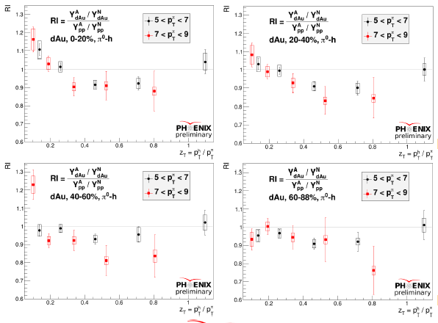
dAu RI Ratio Centrality Dependence
System size evolution in d+Au? Peripheral to Central? More low z enhancement at low zT → High pt suppression? Not clear? Can we confirm this with another system?

Slide 38
Causes?
We investigated a lot of trivial “COLD NUCLEAR” effects
None of these could reproduce the effect
But this is (WAS) only one channel in one system, can we confirm the result in other data ?

Slide 39
Newer Datasets
³He+Au
2014 Run (He3+Au)
2015 Run (p+p)
2016 Run (new d+Au)
He3+Au
Centrality: 0-20%
$\sqrt{s_{NN}}=$200 GeV
No. of pi0 triggers: 386 k (vs. Run8 d+Au: 5 m) [386308 vs 4942516 ]
Run 15 p+p improves statistics of previous d+Au result and HeAu result
No. of pi0 triggers in Run 15 p+p: 6.9 m (vs . Run6 p+p: 1.5 m) [6883699 vs 1458711]
Thus better to use Run15 p+p for better statistics
Run 16 d+Au data also available
Initial rough (pre-) re-analysis also confirms 2008 result TBA

Slide 40
Correlation Functions
As in 2008 d+Au Analysis:
Run14 He3+Au at $\sqrt{s_{NN}}=$200 GeV
Background level: ZYAM method
Trigger bins: [5-7, 7-9] GeV/c
Partner bins:[ 0.6-1, 1-2, 3-5, 5-7] GeV/c
Abinash Pun: Recent Dissertation

Slide 41
Correlation Functions
As in 2008 d+Au Analysis:
Run15 p+p at $\sqrt{s_{NN}}=$200 GeV
Background level: ZYAM method
Trigger(𝜋⁰) bins: [5-7, 7-9] GeV/c
Partner(h±) bins:[ 0.6-1, 1-2, 3-5, 5-7] GeV/c
Excellent p+p statistics for comparison in Run8 d+Au

Slide 42
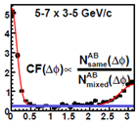
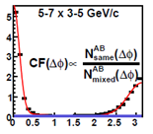
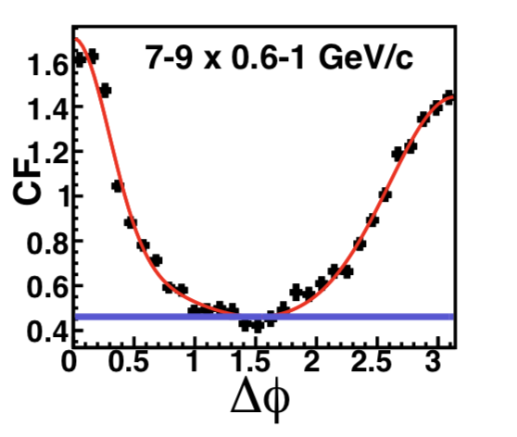
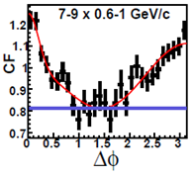
Similar Modifications in HeAu?
By eye can see suppression in the AS Shape
He3+Au
p+p
At low z statistical precision of He+Au is limited:
p+p
He3+Au
cut out p+p

Slide 43
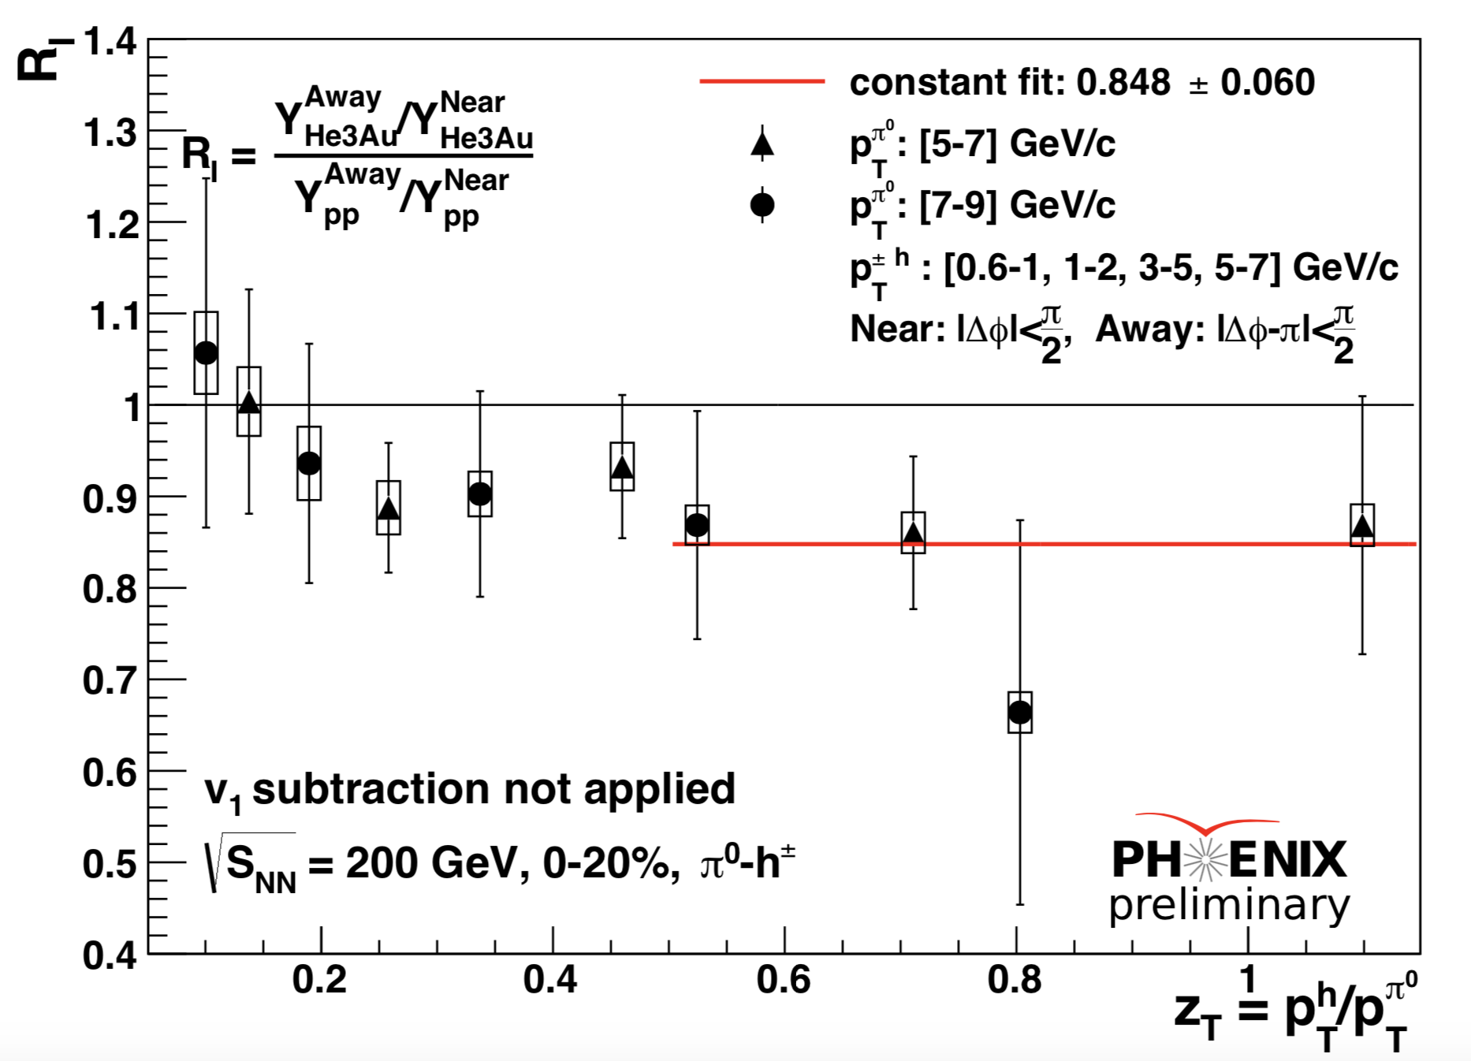
RI: He3+Au
Significant Suppression at high z_{T} in He3+Au
Shape similar to d+Au, w/rise at low z, although unlike d+Au, uncertainties too large to confirm low z shape with significance

Slide 44
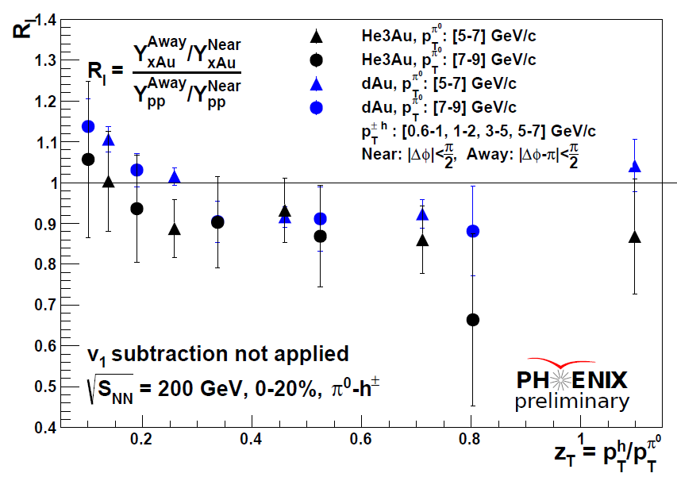
Comparison of He3+Au and d+Au RI
He+Au confirms behavior of d+Au: similar shape overall, and suppression at high z_{T}
How statistically significant is the suppression level?

Slide 45
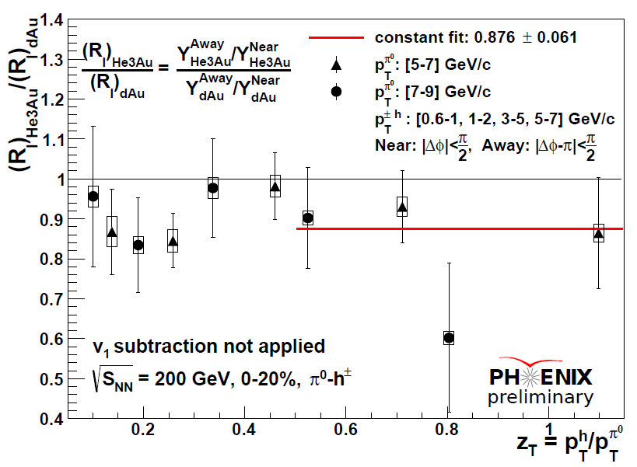
Ratio of RI’s of He3+Au
to that of d+Au
High z_{T} suppression in He+Au is about 12% larger than d+Au with at least 2-sigma significance.

Slide 46
“Trivial” Causes?
Strategy: address all “trivial” explanations we can test:
“Hydro” v3, v1 Jet S/B STILL TOO HIGH- NEGLIGIBLE
Enhanced Nuclear k_{T}
Initial State nPDF effects
Trivial Rapidity Distributions Mismatching p+p vs d+Au?
HIJING show anything like this?
If none of above → INTERESTING
Looking for other ideas?

Slide 47
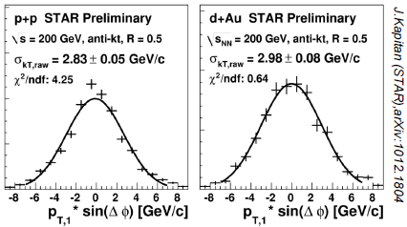
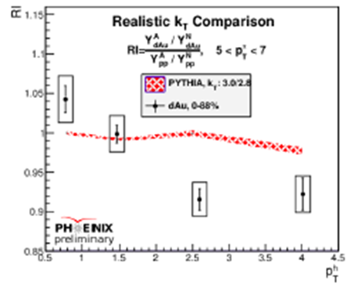
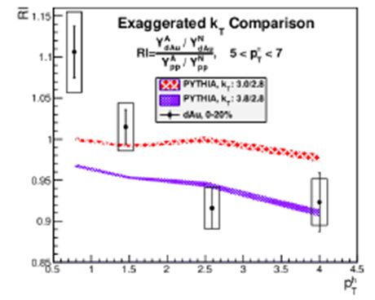
OLD PYTHIA6 Nucl k_{T} Test
Using k_{T} constraints from STAR jet measurements → No effect for 0-100% Minbias
However, k_{T} smear larger in Central?
Using STAR k_{T} Increase (Minbias)

Slide 48
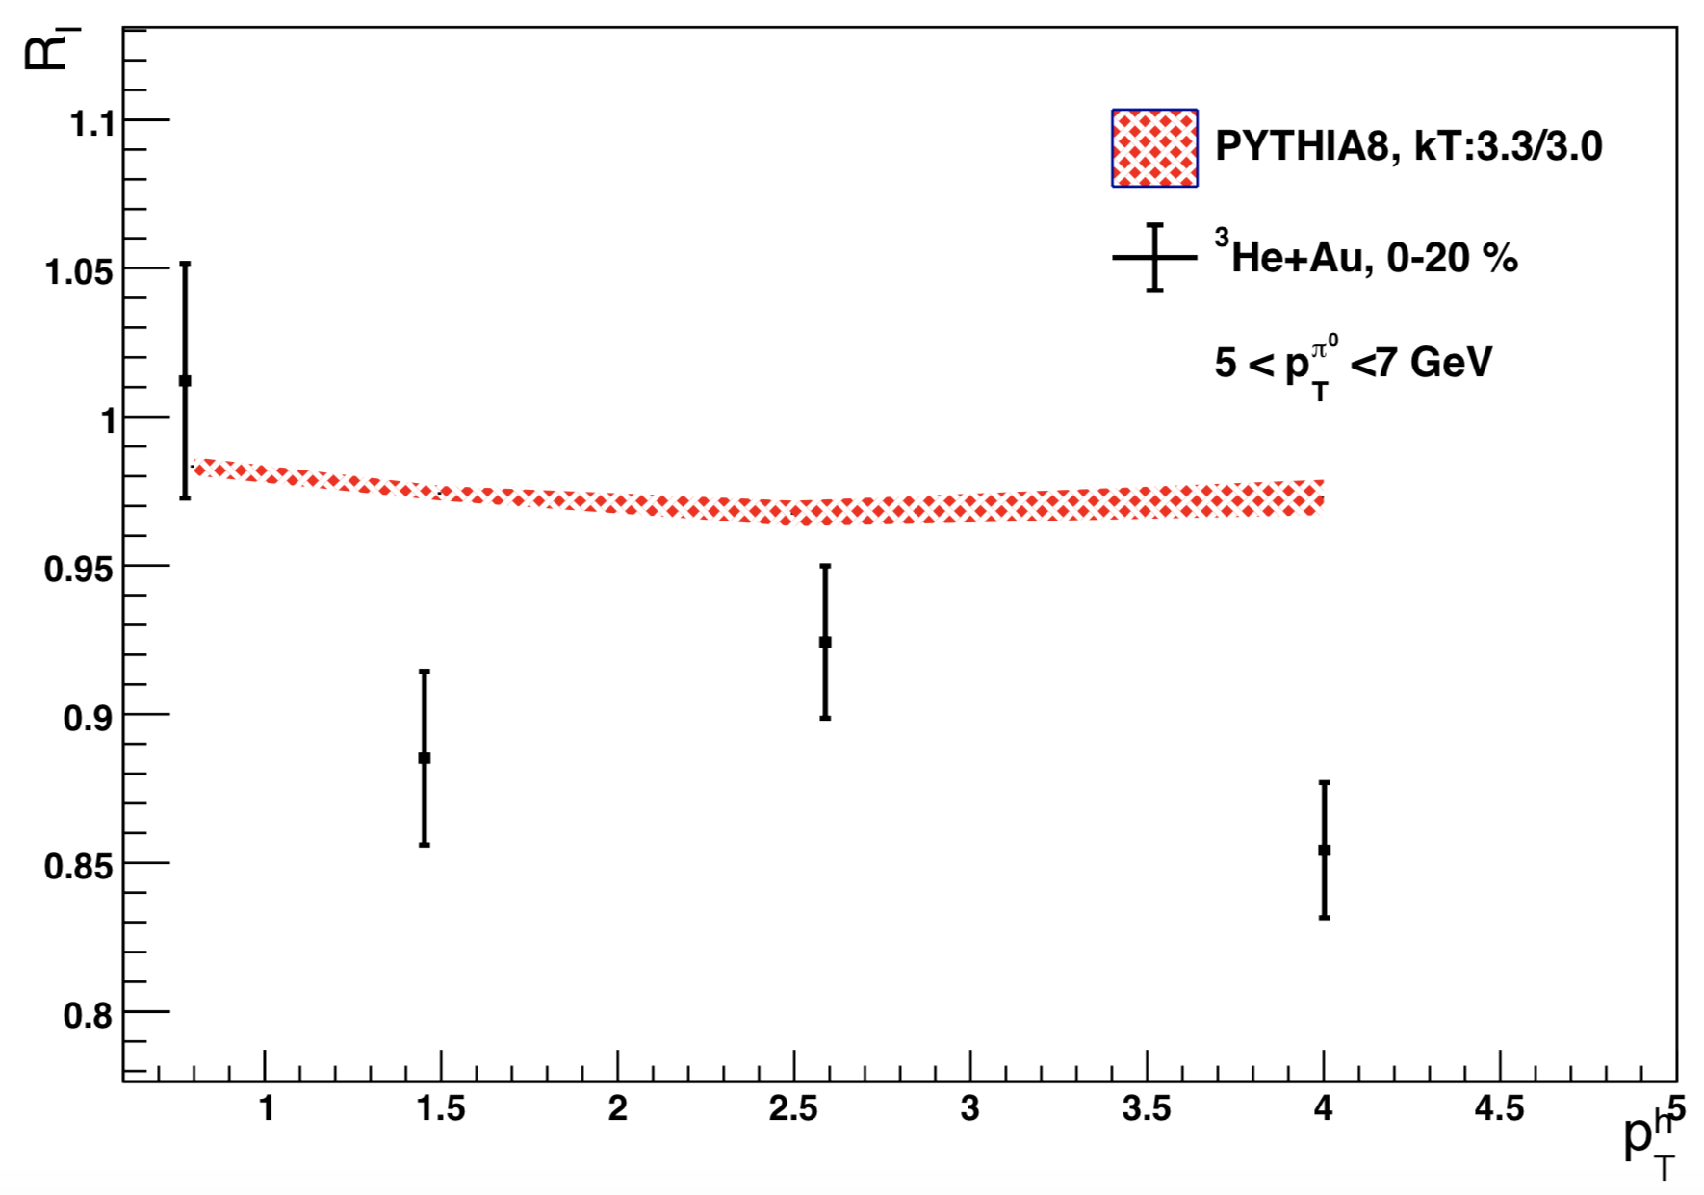
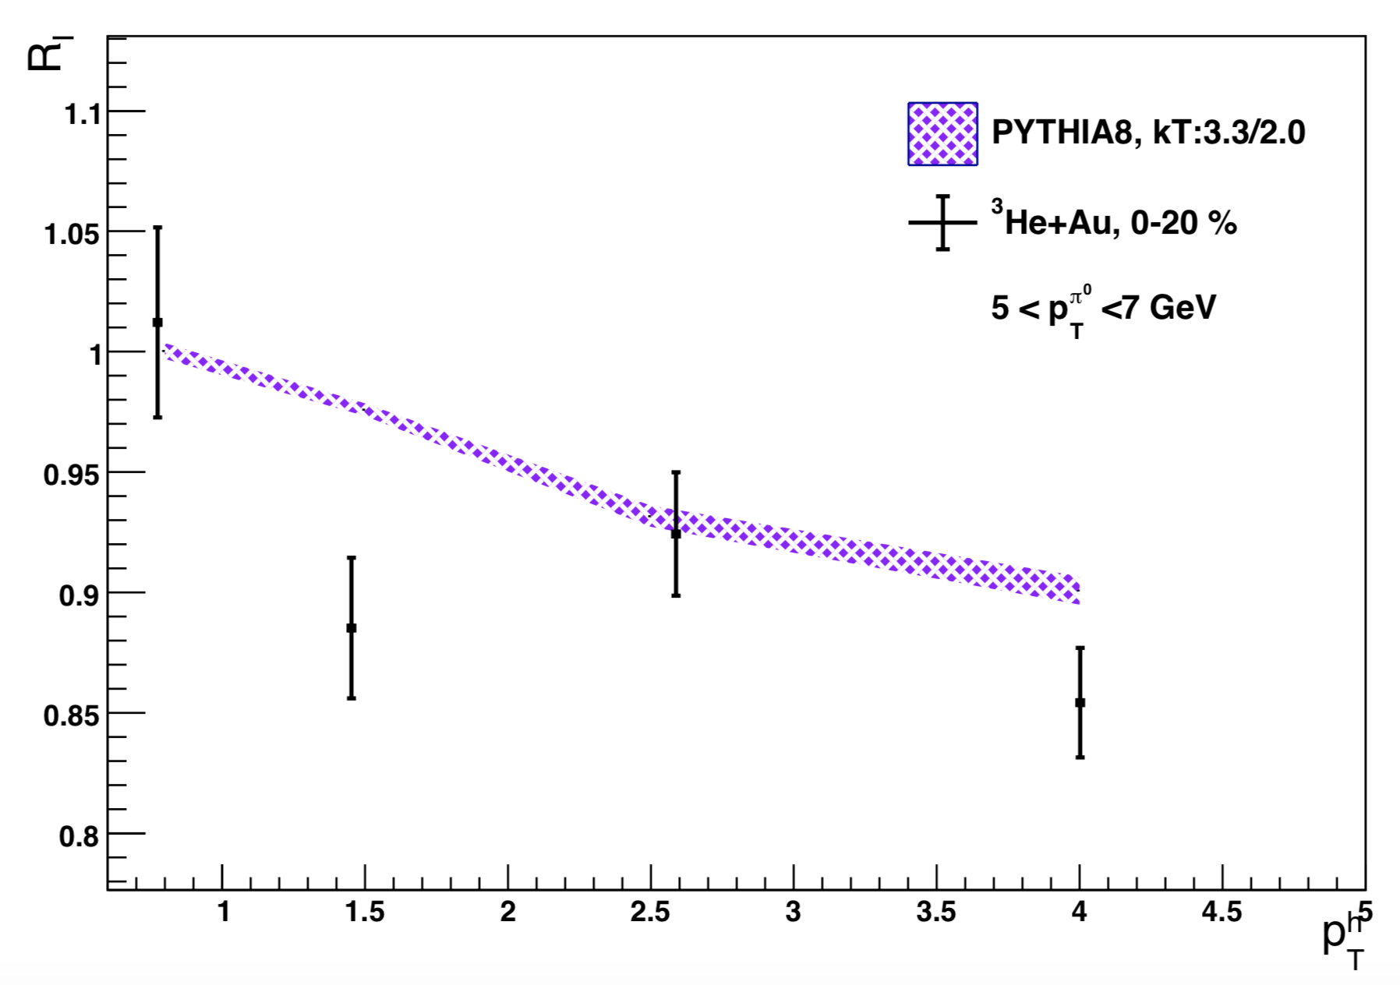
INTRODUCTION
EXPERIMENT
QGP SIGNATURE
MOTIVATION
ANALYSIS TECHNIQUE
RESULT
UPDATED PYTHIA 8 Nuclear k_{T} test
Using k_{T} constraints from STAR jet measurements → No effect for 0-100% Minbias
However, k_{T} smear larger in Central HeAu→ Exaggerated has some shape similarity but this is very large kT
Realistic k_{T} Comparison
Exaggerated k_{T} Comparison

Slide 49
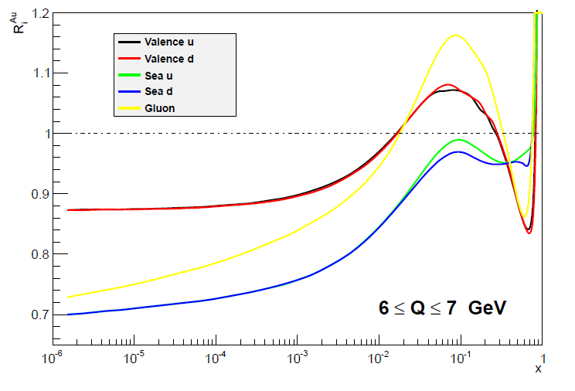
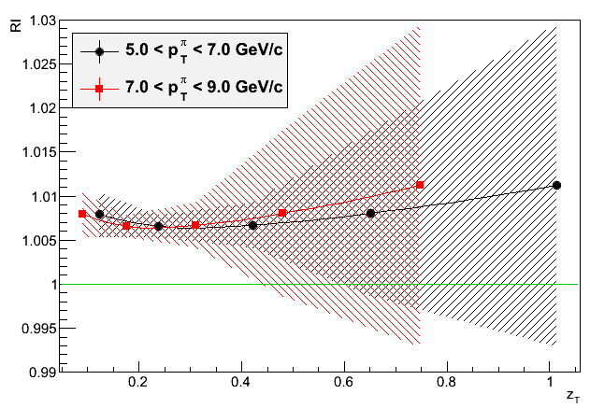
OLD EPS09 Initial State Nuclear PDF’s?
nPDF effects would seem unlikely to cause this, since they probably often affect both jets in a di-jet
Studies with EPS09 (and 09s) confirm this expectation
NOTE UNITS: << 1% negligible effect
RI Extracted from EPS09 Study
Au nPDF extracted from EPS09 code

Slide 50
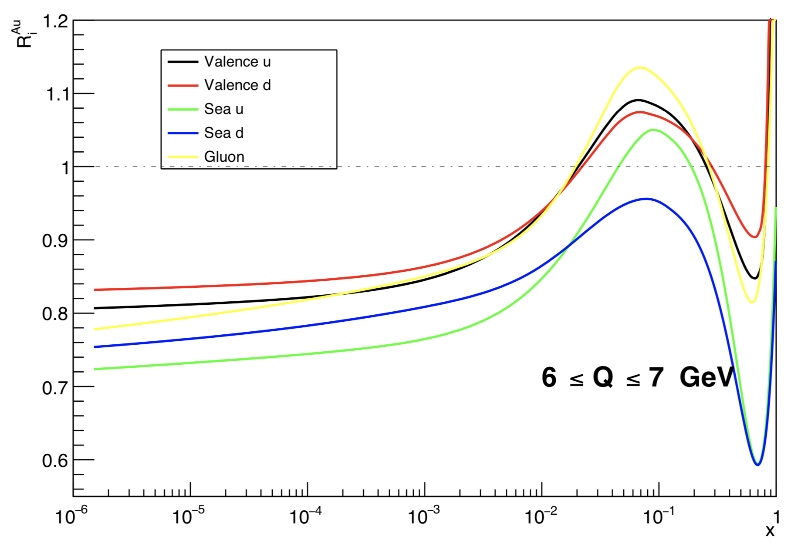
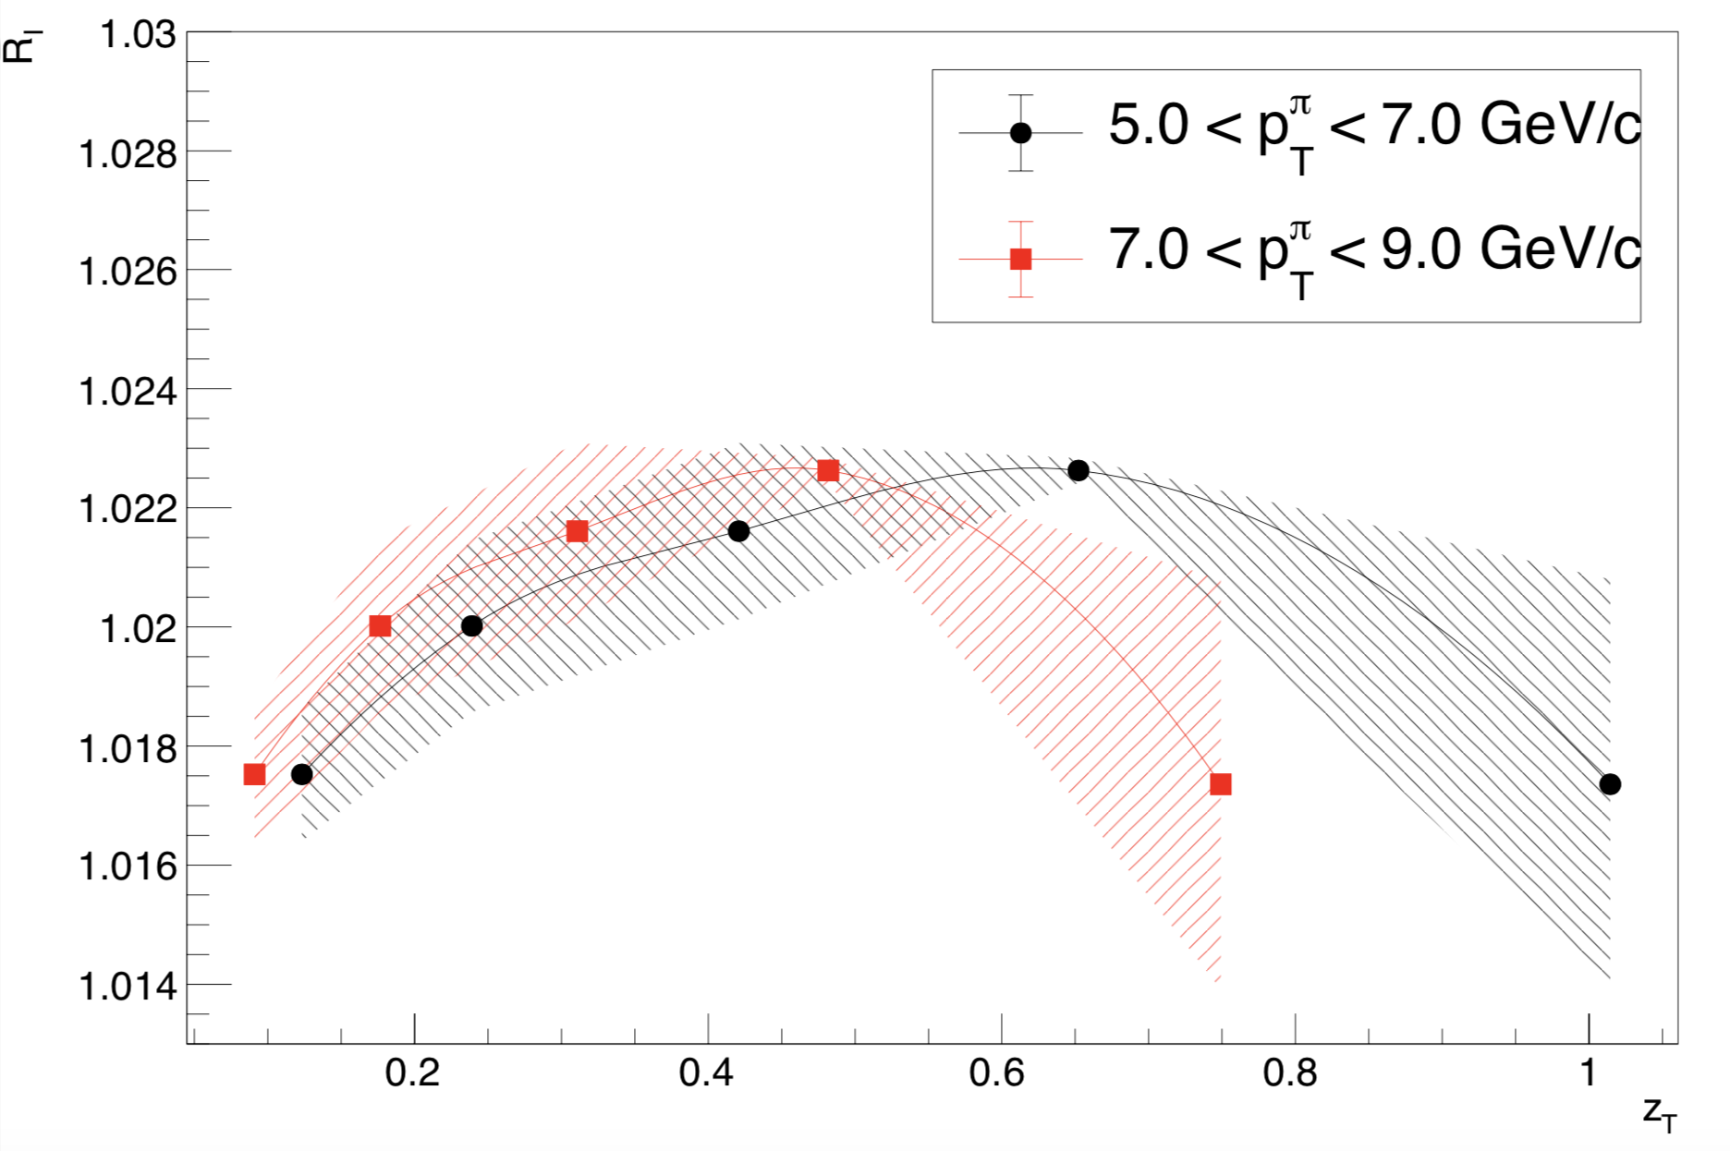
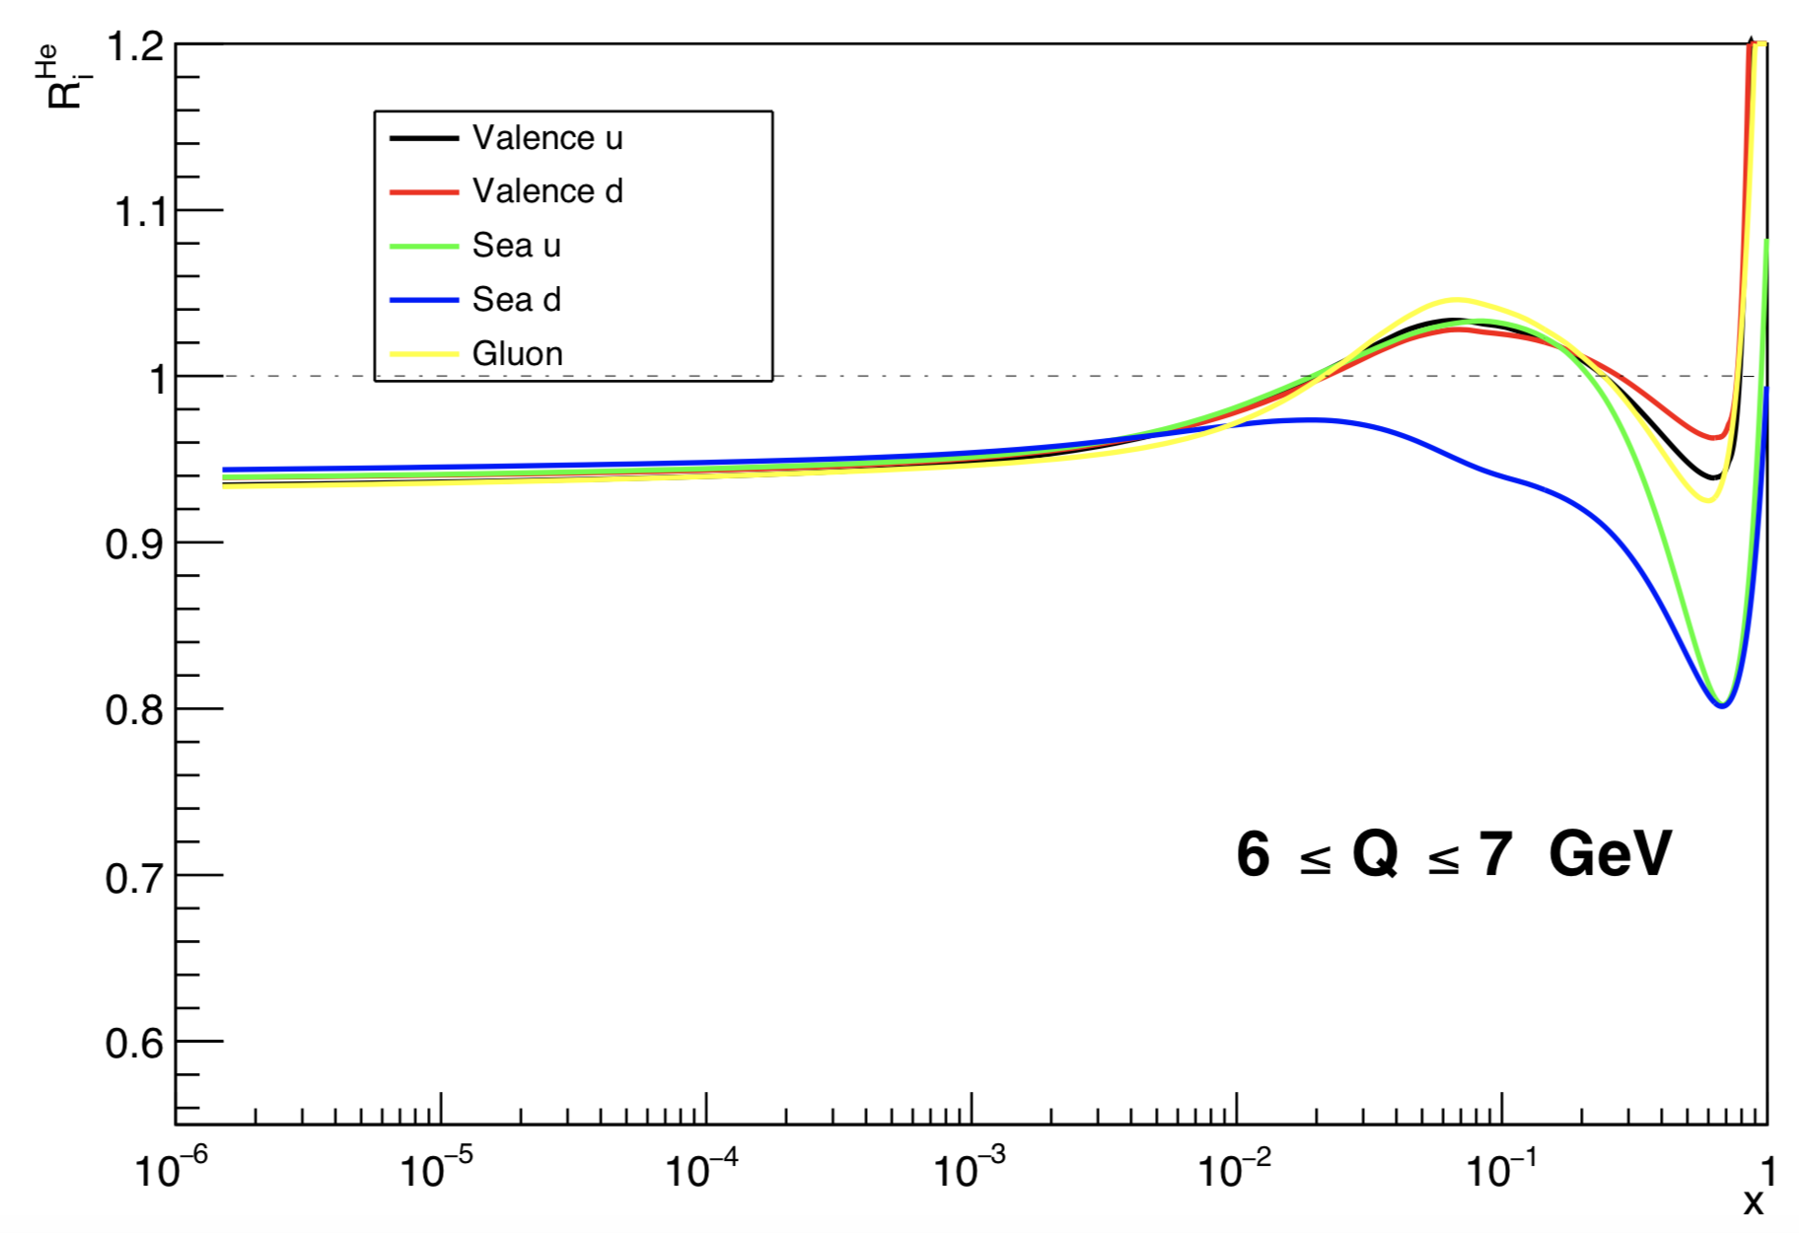
UPDATED EPPS16 & “Real” He+Au nPDF
RESULT
nPDF extracted from EPPS16 code
Au¹⁹⁷
Previously only p+Au test for scale – He Wave Fn make a difference?
Studies with EPPS16 and full HeAu
Still negligible
Again
NOTE UNITS
He⁴
R_{I} Extracted from EPPS16 Study

Slide 51
Conclusion HeAu I_{AA}:
He3+Au shows similar behavior to d+Au: Suppression at high zT and possible rise at low zT
Ordering of increase in suppression with volume/system size is confirmed
HeAu RI is more suppressed than dAu RI in high zT
Ratio of HeAu to dAu at high z_{T} (>0.48) is more than 2 sigma below the unity
Motivations to theorists to determine possible explanations : whether they be Cold Nuclear to evaluate the likeliness whether could they also be consistent with Hot QGP Eloss?

Slide 52
Implication: Causes?
Results are pretty well tested and confirmed in He+Au – Need Theory Input—Important Question!
Many potential Trivial or Cold Nuclear Explanations—but also shares qualitative features of Eloss
“Trivial” explanations we could test:
“Hydro” v3, v1
Trivial Rapidity Distributions Mismatching p+p vs d+Au?
HIJING show anything like this?
“Cold Nuclear Effects”:
Enhanced Nuclear k_{T}
Initial State nPDF effects (partial—EPS09(s) only checked)
Check other npdf’s?
Get bonafide theory calcs from theorists (need input from theorists)
Could QGP/Hot Eloss Cause This?
Get bonafide theory calcs from theorists (need input from theorists)
None of these could reproduce the effect

Slide 53
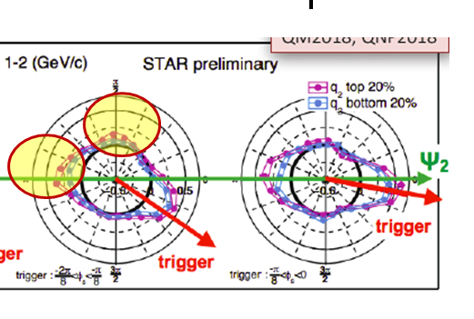
Final Note Centrality Dep: Event Engineering needed in “turn on region”
Something that Jet Reco will have a harder time doing than 2PC
For these small multiplicity, event fluctuations need controlled
STAR EVENT PLANE RESULT WAS ALSO EVENT ENGINEERED!

Slide 54
What about shower dependence of Eloss?
Obviously this is one thing 2PC can’t access
However sophistocated MC tools like Jetscape can let us now assess sensitivity
Effects aren’t huge so far?
Should be studied for 2PC

Slide 55
Conclusions
Good progress being made in Jet-related 2PC at RHIC
Still plenty of space that is complementary to reconstructed jet results and new jet observables
$γ$-h : e.g. Studying Eloss E-flow at Large Angle/Smallest Jet E (Large Systems)
Event Plane Dependent h-h: allows new tools such as event plane engineering
h-jet, $γ$-jet, charm-h….
Especially promising for sorting out Eloss and competing effects in Small Systems
He+Au RI result confirms d+Au Suppression/Enhancement – need theory input!!! especially hot Eloss in Small System

Slide 56
BACKUP
BACKUP

Slide 57
Enhanced Nuclear k_{T} ?
kT == Acoplanarity of di-jets
Smears Awayside → Known part of the 2pc AS width
If d+Au had long sought after enhanced nuclear k_{T}, could this cause this effect in RI?

Slide 58
“Trivial” Causes?
Strategy: address all “trivial” explanations we can test:
“Hydro” v3, v1
Enhanced Nuclear k_{T}
Initial State nPDF effects
Trivial Rapidity Distributions Mismatching p+p vs d+Au?
HIJING show anything like this?
If none of above → INTERESTING
Looking for other ideas?

Slide 59
OLD PYTHIA6 Nucl k_{T} Test
Using k_{T} constraints from STAR jet measurements → No effect for 0-100% Minbias
However, k_{T} smear larger in Central?
Using STAR k_{T} Increase (Minbias)

Slide 60
INTRODUCTION
EXPERIMENT
QGP SIGNATURE
MOTIVATION
ANALYSIS TECHNIQUE
RESULT
DISCUSSION
UPDATED PYTHIA 8 Nuclear k_{T} test
Using k_{T} constraints from STAR jet measurements → No effect for 0-100% Minbias
However, k_{T} smear larger in Central?
Realistic k_{T} Comparison
Exaggerated k_{T} Comparison

Slide 61
OLD EPS09 Initial State Nuclear PDF’s?
nPDF effects would seem unlikely to cause this, since they probably often affect both jets in a di-jet
Studies with EPS09 (and 09s) confirm this expectation
NOTE UNITS: << 1% negligible effect
RI Extracted from EPS09 Study
Au nPDF extracted from EPS09 code

Slide 62
UPDATED EPPS16 & “Real” He+Au nPDF
INTRODUCTION
EXPERIMENT
QGP SIGNATURE
MOTIVATION
ANALYSIS TECHNIQUE
RESULT
nPDF extracted from EPPS16 code
Au¹⁹⁷
Previously only p+Au test for scale – He Wave Fn make a difference?
Studies with EPPS16 and full HeAu
Still negligible
Again
NOTE UNITS
He⁴
R_{I} Extracted from EPPS16 Study

Slide 63
“Trivial” Causes?
Strategy: address all “trivial” explanations we can test:
“Hydro” v3, v1
Enhanced Nuclear k_{T}
Initial State nPDF effects
Trivial Rapidity Distributions Mismatching p+p vs d+Au?
HIJING show anything like this?
If none of above → INTERESTING
Looking for other ideas?

Slide 64
HIJING
We ran HIJING with default settings
First, this can test for very trivial effects e.g. due to the 2p method and to the mismatch in rapidity distributions
More importantly any other “cold” nuclear physics embedded in HIJING (mini-jets, momentum conservation (?), etc…)

Slide 65
HIJING RI
With default settings, HIJING does not reproduce the effect
Small enhancement at low z_{T} appears to be due to default nuclear k_{T} in HIJING consistent with PYTHIA study

Slide 66
Tyler’s Back up

Slide 67
Illustration of v₂ Measurement With Isolation Cone
Underlying event shape
Underlying event

Slide 68
Illustration of v₂ Measurement With Isolation Cone
Underlying event shape
Isolation cone
Underlying event

Slide 69
Illustration of v₂ Measurement With Isolation Cone
Underlying event shape
Isolation cone
Accept more particles when number of underlying event particles is low
Underlying event
Accepted isolated particles

Slide 70
Illustration of v₂ Measurement With Isolation Cone
Underlying event shape
Isolation cone
Accept more particles when number of underlying event particles is low (out of event plane)
Underlying event
Accepted isolated particles

Slide 71
Illustration of v₂ Measurement With Isolation Cone
Underlying event shape
Isolation cone
Accept less particles when number of underlying event particles is high
Underlying event
Accepted isolated particles

Slide 72
Illustration of v₂ Measurement With Isolation Cone
Underlying event shape
Isolation cone
Accept less particles when number of underlying event particles is high (in event plane)
Must correct for this bias.
Underlying event
Accepted isolated particles

Slide 73
Complications of v₂ Measurement with Isolation Cut
Isolation cut efficiency
How does it effect the trigger particle’s distribution?
How does the event plane resolution effect this distribution?
How does it effect the correlation function background distribution?
For 2 particle correlations, only need sum v_{2iso} = v_{2T} + v_{2E} which is what is ~directly measured from isolated triggers using ‘typical’ event plane method
These equations have been verified using toy MC simulation

