Slide 1

Status of the FCC(ee)
OUTLOOK
Alain BLONDEL
LPNHE Paris, University of Geneva and CERN
With many thanks to all in the FCC collaboration!

Slide 2
Particle physics has arrived at an important moment of its history

Slide 3
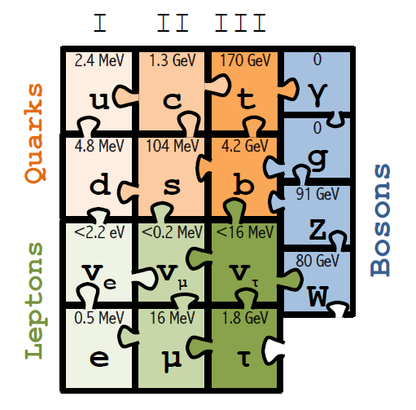
1989-1999: top mass predicted (LEP, mostly Z mass&width)
top quark discovered (Tevatron)
t’Hooft and Veltman get Nobel Prize 1999
(c) Sfyrla

Slide 4
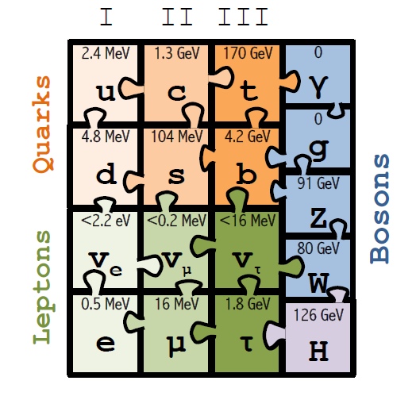
1997-2013 Higgs boson mass cornered (LEP H, M_{Z} etc +Tevatron m_{t} , M_{W})
Higgs Boson discovered (LHC)
Englert and Higgs get Nobel Prize 2013
IT LOOKS LIKE THE
STANDARD MODEL
IS COMPLETE.....
(c) Sfyrla
NB in fact we know from oscillations and cosmology
that all 3 neutrino masses are less than ~0.1 eV

Slide 5
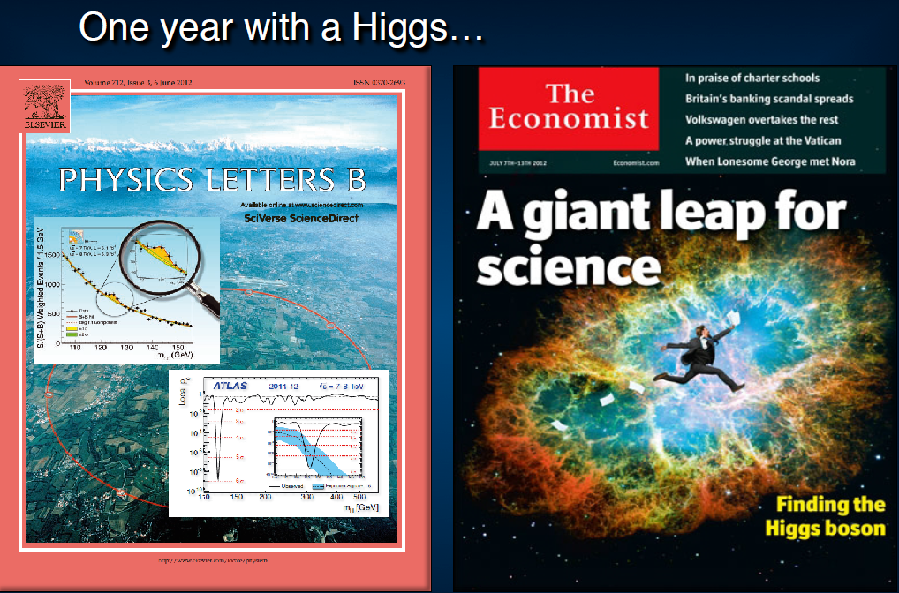
SEVEN YEARS AGO ALREADY

Slide 6
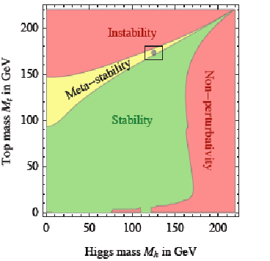
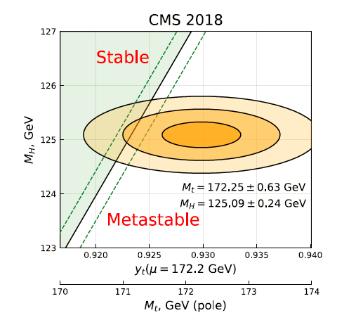
The Standard Model is a very consistent and complete theory.
It explains all known collider phenomena and almost all particle physics (except ν’s)
– this was beautifully verified at LEP, SLC, Tevatron and the LHC.
-- the EWPO radiative corrections predicted top and Higgs masses
assuming SM and nothing else
we can even extrapolate the Standard Model all the way to the the Plank scale :
FCC 2048

Slide 7
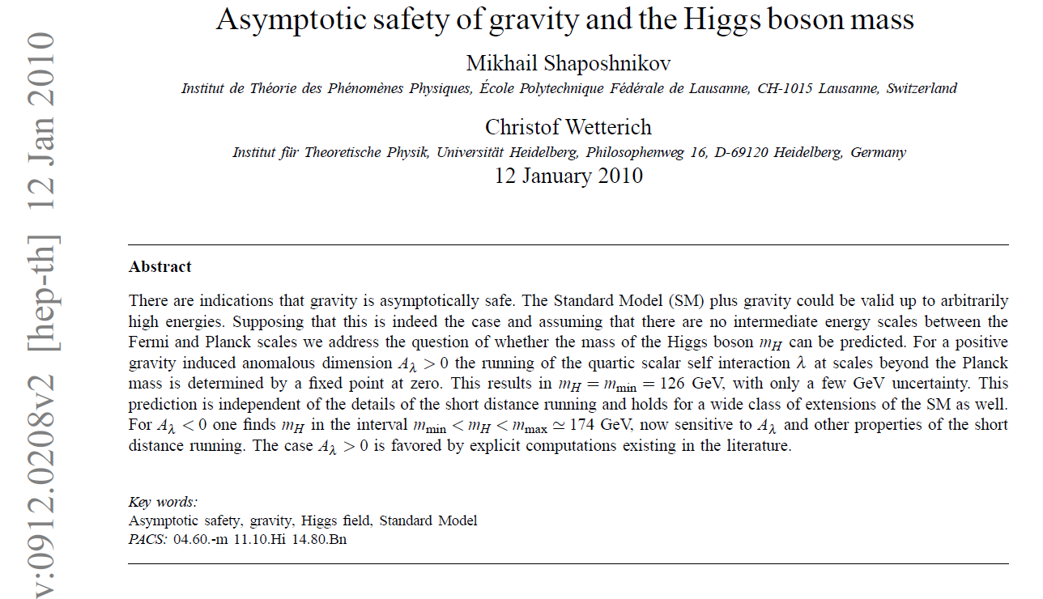
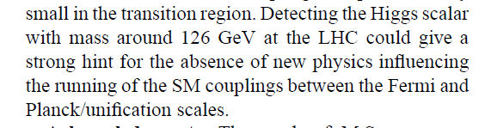
Is it the end?
Is it the end?

Slide 8
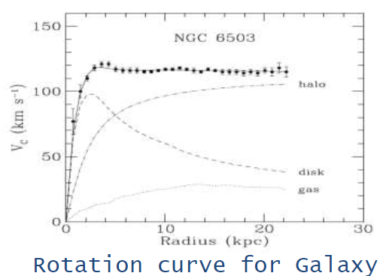
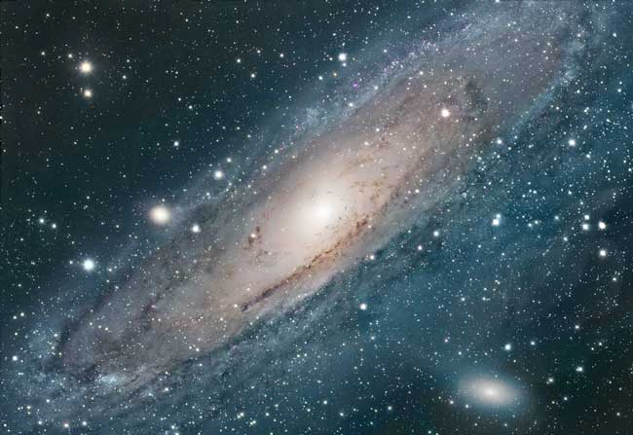
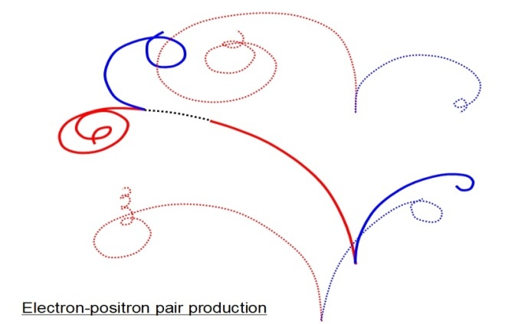
We cannot explain:
Dark matter
Standard Model particles constitute only 5% of the energy in the Universe
Were is antimatter gone?
What makes neutrino masses?
Not a unique solution in the SM --
Dirac masses (why so small?)
Majorana masses (why not Dirac?)
Both (the preferred scenarios, see-saw...) ?
➔ heavy right handed neutrinos?

Slide 9
Is it the end?
Certainly not!
-- Dark matter
-- Baryon Asymmetry in Universe
-- Neutrino masses
are experimental proofs that there is more to understand.
We must continue our quest, but HOW?
Direct observation of new particles (but not only!)
New phenomena (ex: Neutral currents, neutrino oscillations, CP violation.. )
Deviations from precise predictions
(ref. Uranus to Neptune, Mercury’s perihelion,
top and Higgs predictions from LEP/SLC/Tevatron/B factories, g-2, etc…)
To which one can add many theoretical questions on the SM
These facts require
particle physics explanations.

Slide 10

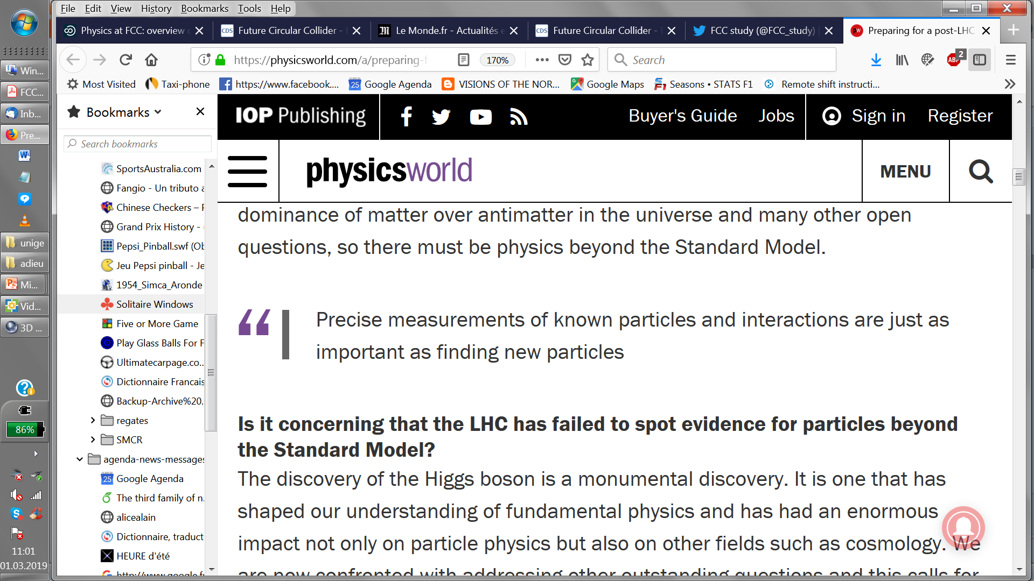
“Discoveries make the front pages of the newspapers, while precise measurements of known particle don’t, but scientifically they are just as important."

Slide 11
The Physics Landscape
We are in a fascinating situation: where to look and what will we find?
For the first time since Fermi theory, WE HAVE NO SCALE
The next facility must be versatile with as broad and powerful reach as possible,
as there is no precise target
➔ more Sensitivity, more Precision, more Energy
FCC , thanks to synergies and complementarities, offers
a most versatile and adapted response to today’s physics landscape

Slide 12






Future Circular Collider Study
LHC
HE-LHC
PS
SPS
FCC
http://cern.ch/fcc
Work supported by the European Commission under the HORIZON 2020 projects EuroCirCol, grant agreement 654305; EASITrain, grant agreement no. 764879; ARIES, grant agreement 730871; and E-JADE, contract no. 645479
photo: J. Wenninger
photo: J. Wenninger

Slide 13
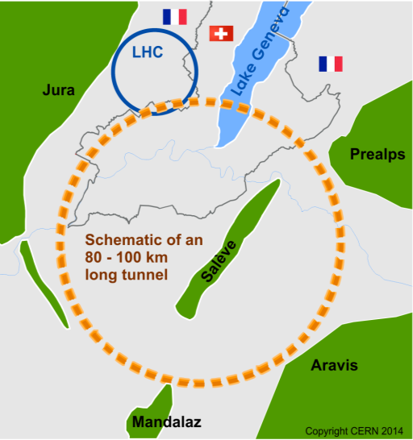
The Future Circular Colliders
CDR and cost review Q4 2018 for ESU
International collaboration to Study Colliders fitting in a new ~100 km infrastructure in the Genevois
Ultimate goal:
≥100 TeV pp-collider (FCC-hh)
→ defining infrastructure requirements
cannot be proposed today
Possible first steps:
e⁺e⁻ collider (FCC-ee)
High Lumi, E_{CM} =90-400 GeV
HE-LHC 16T ⇒ 27 TeV in LHC
or LE-FCC (6T, 37TeV) in FCC
(impractical or costly)
≥16 T magnets
The way by FCC-ee is the fastest and cheapest way to 100 TeV,
also produces the most physics.
Preferred scenario presented in the CDR.
https://cerncourier.com/cern-thinks-bigger/
FCC-ee: cheapest and
fastest way to 100 TeV!
+ p-e (FCC-he) option
and a good start for a μμC!

Slide 14


The Global FCC Collaboration
EC
H2020
133
Institutes
25
Companies
34
Countries

Slide 15
CDR is PUBLISHED
FCC-Conceptual Design Reports:
  Vol 1 – Physics
  Vol 2 – FCC-ee,
  Vol 3 – FCC-hh,
  Vol 4 – HE-LHC
  1338 authors
  Preprints since 15 January 2019 on http://fcc-cdr.web.cern.ch/ and INSPIRE
  CDRs to be published in European Physical Journal C (Vol 1) and ST (Vol 2 – 4)
Summary documents provided to EPPSU SG in December 2018
  FCC-integral (ee-hh), FCC-ee, FCC-hh, HE-LHC
  http://fcc-cdr.web.cern.ch/
  FCC-ee Your questions answered: https://arxiv.org/abs/1906.02693v1
A public presentation of the CDR was given on 4-5 March
at CERN https://indico.cern.ch/event/789349/
→ many further details can be found there!

Slide 16
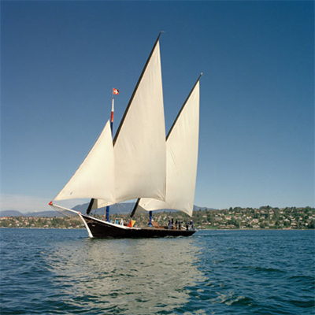
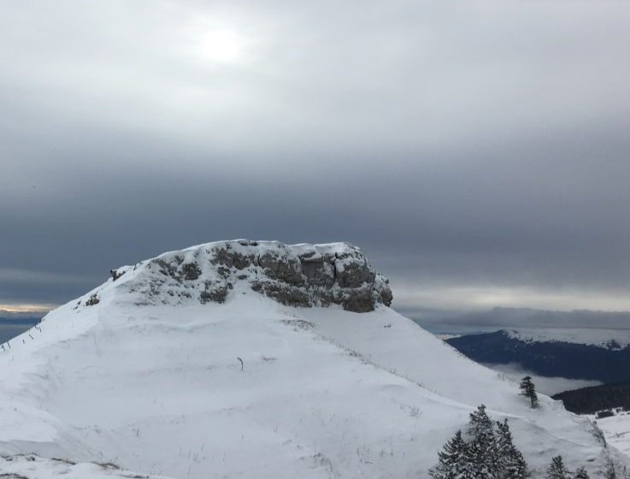
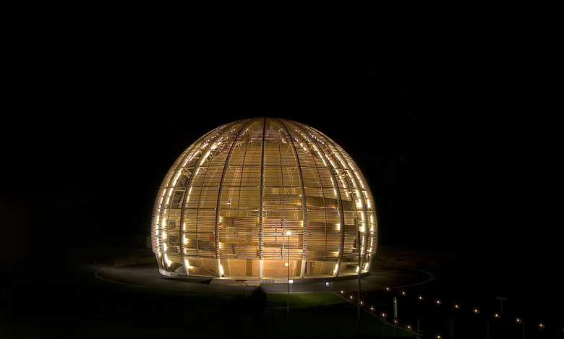
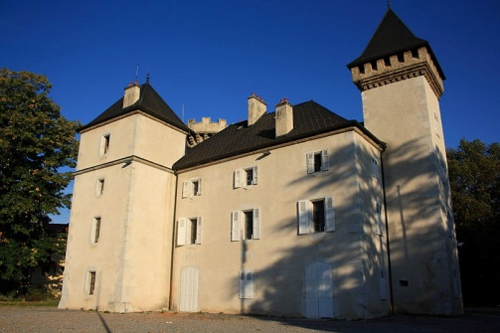

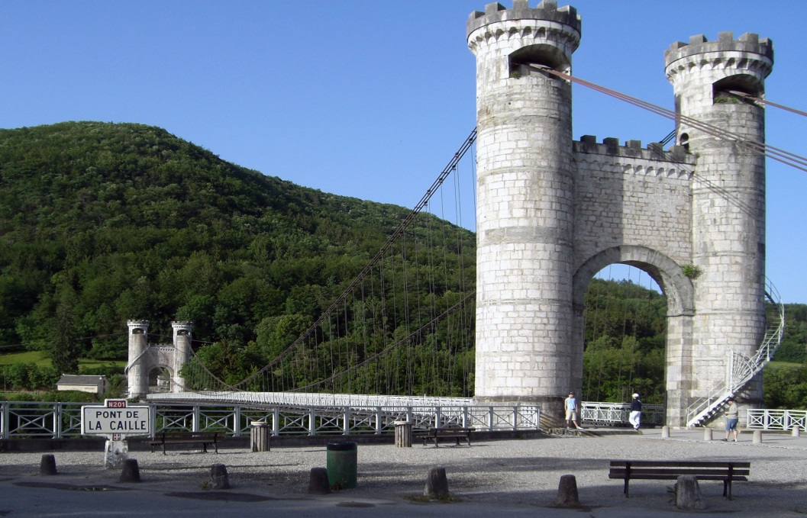
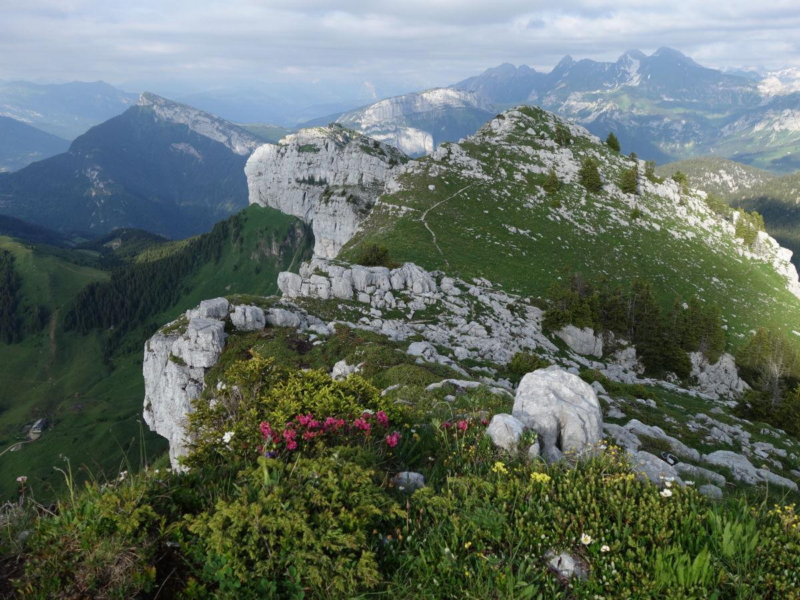

Slide 17
SYNERGY

Slide 18
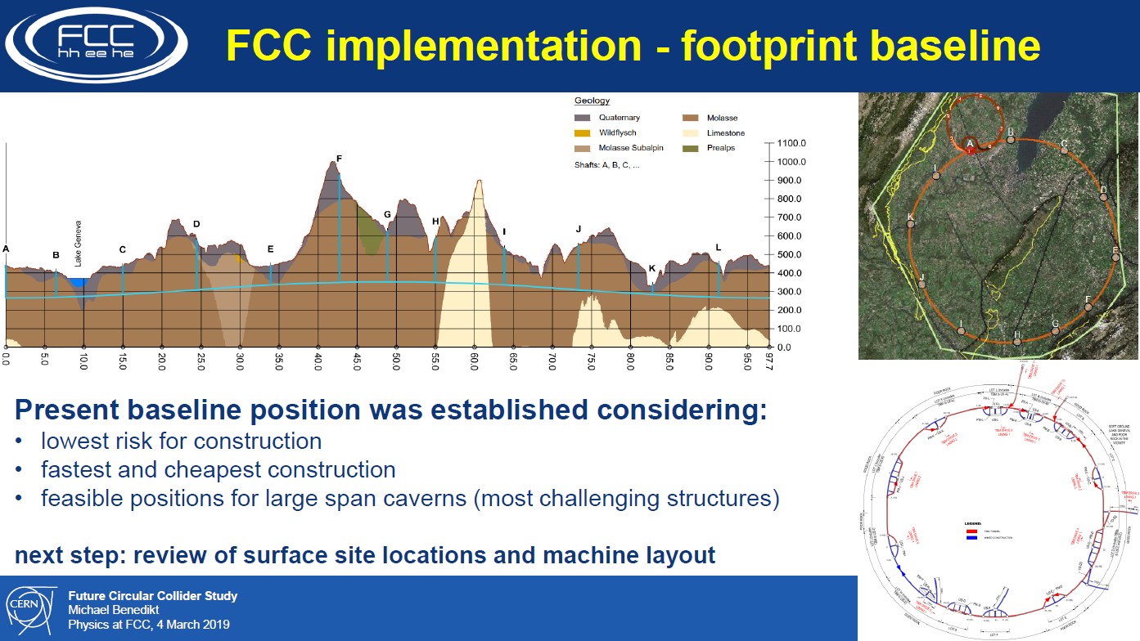

Slide 19
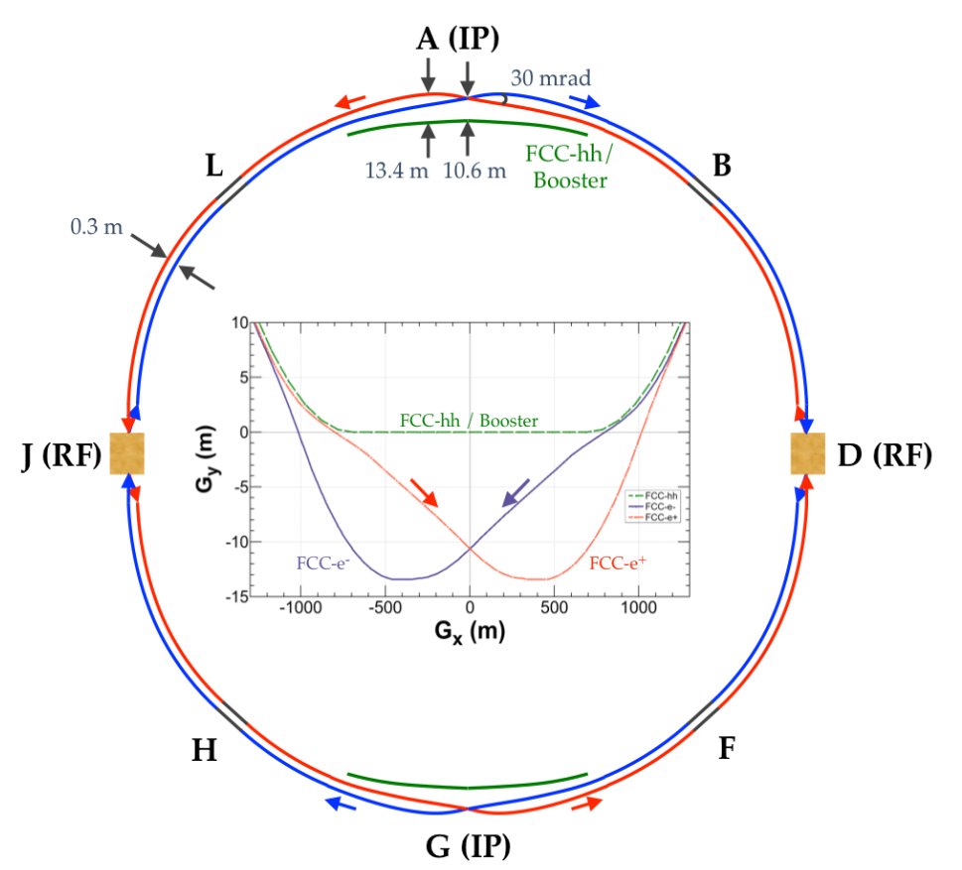
FCC-common layouts
FCC-hh
Common footprint except around IPs
Asymmetric IR layout to limit synchrotron radiation
FCC-ee

Slide 20
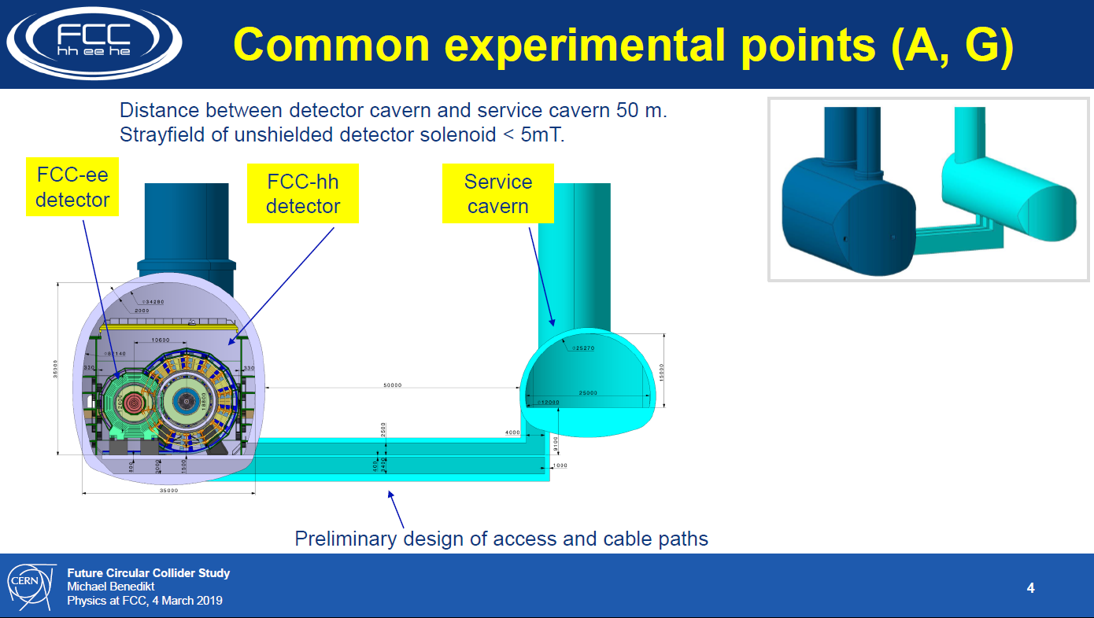

Slide 21
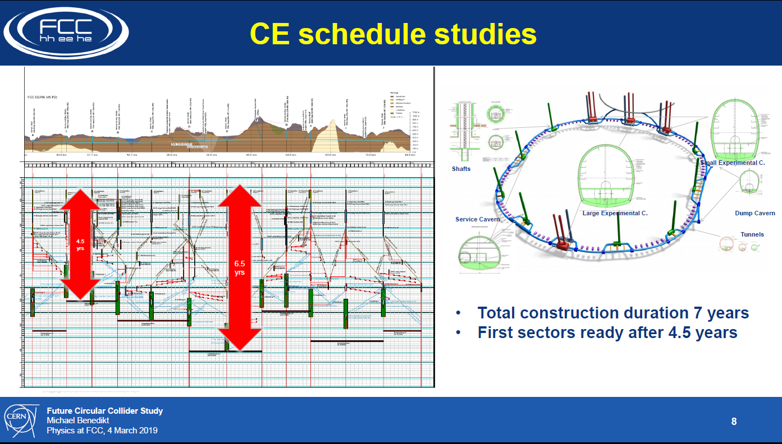

Slide 22
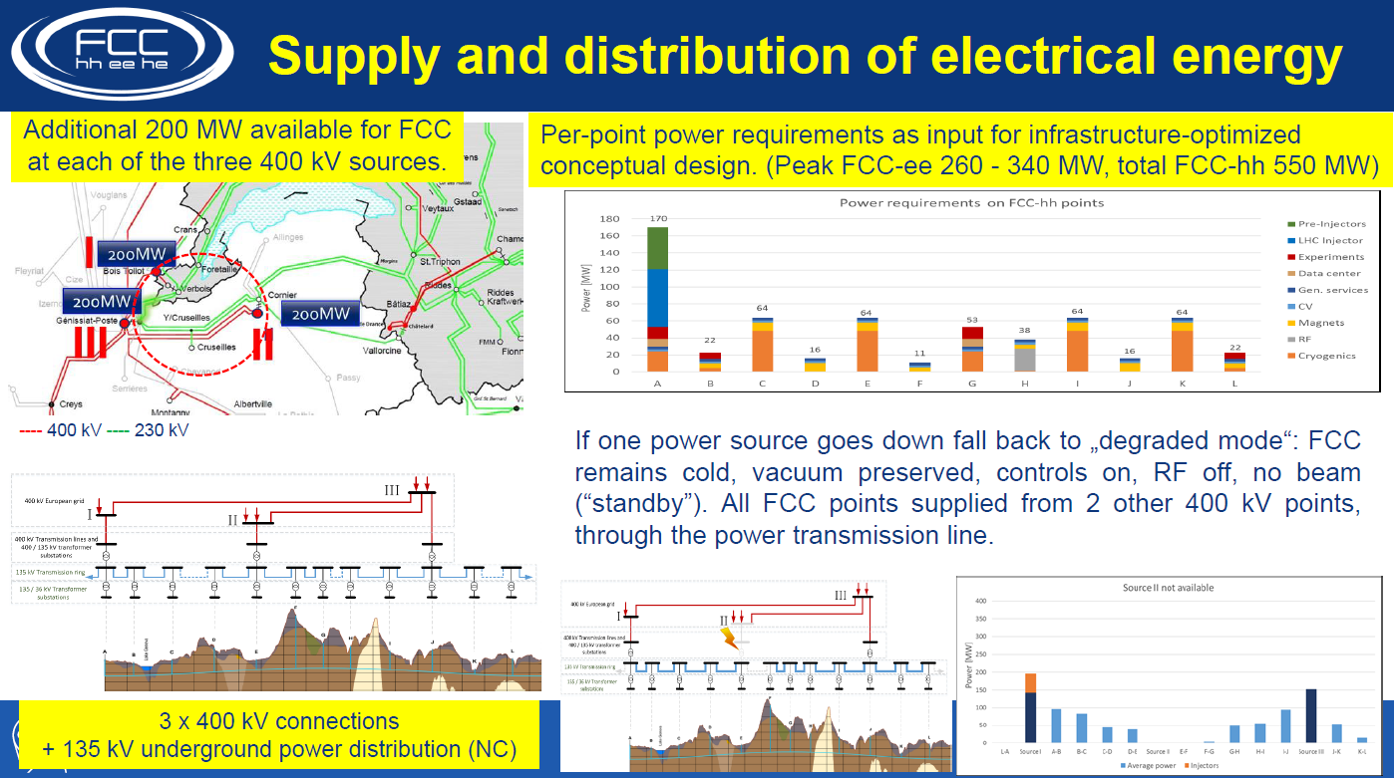

Slide 23
1st Step : the e+e- collider FCC-ee for Z, W, Higgs & top
«Higgs and Electroweak Factory»
-- Very High Luminosities in 100 km tunnel
-- Centre-of-mass energy calibration for Z W, based on resonant depolarization (100keV)
-- possible monochromatization (ee→ H)
-- Very small beams and clean experimental conditions
-- Very mature technology
We know how to do this, we also know how we should improve it.
– no significant risk.

Slide 24

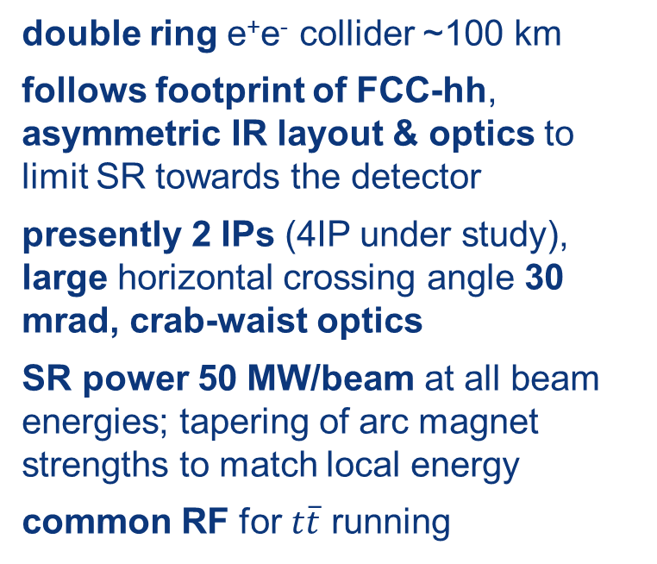
FCC-ee basic design choices
double ring e⁺e⁻ collider ~100 km
follows footprint of FCC-hh, asymmetric IR layout & optics to limit SR towards the detector
presently 2 IPs (4IP under study), large horizontal crossing angle 30 mrad, crab-waist optics
SR power 50 MW/beam at all beam energies; tapering of arc magnet strengths to match local energy
common RF for $t\overline{t}$ running
top-up injection requires booster synchrotron in collider tunnel
K. Oide et al.

Slide 25
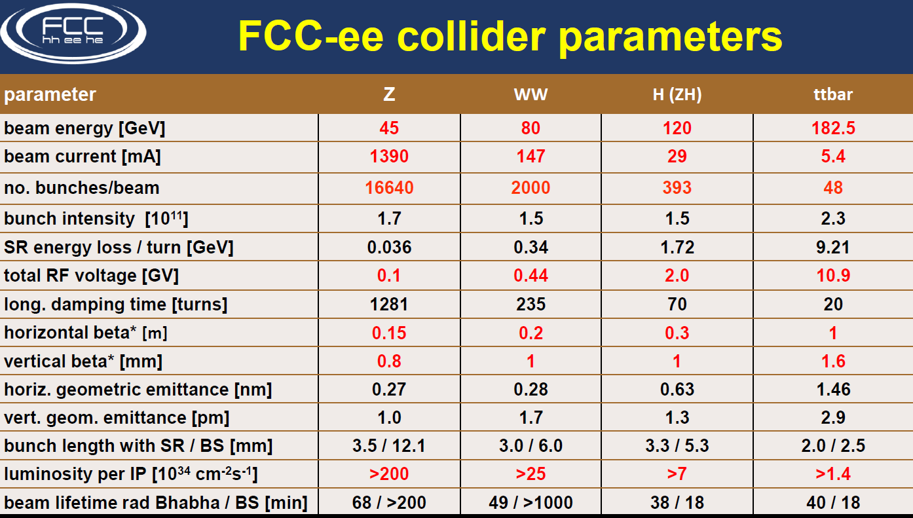

Slide 26
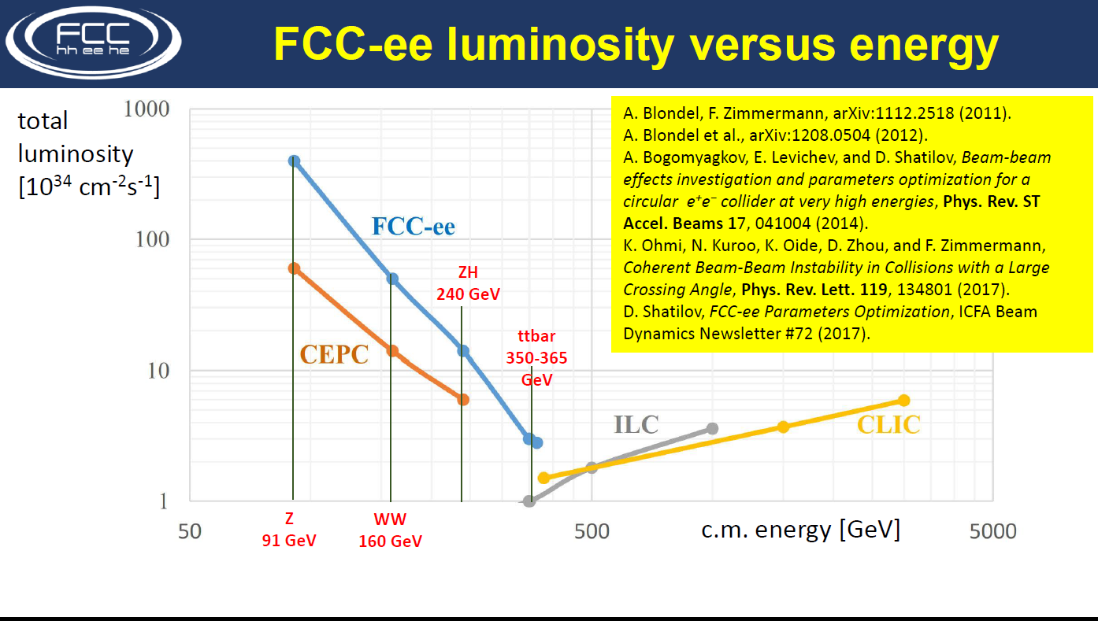
TLEP→ ESPP2012

Slide 27
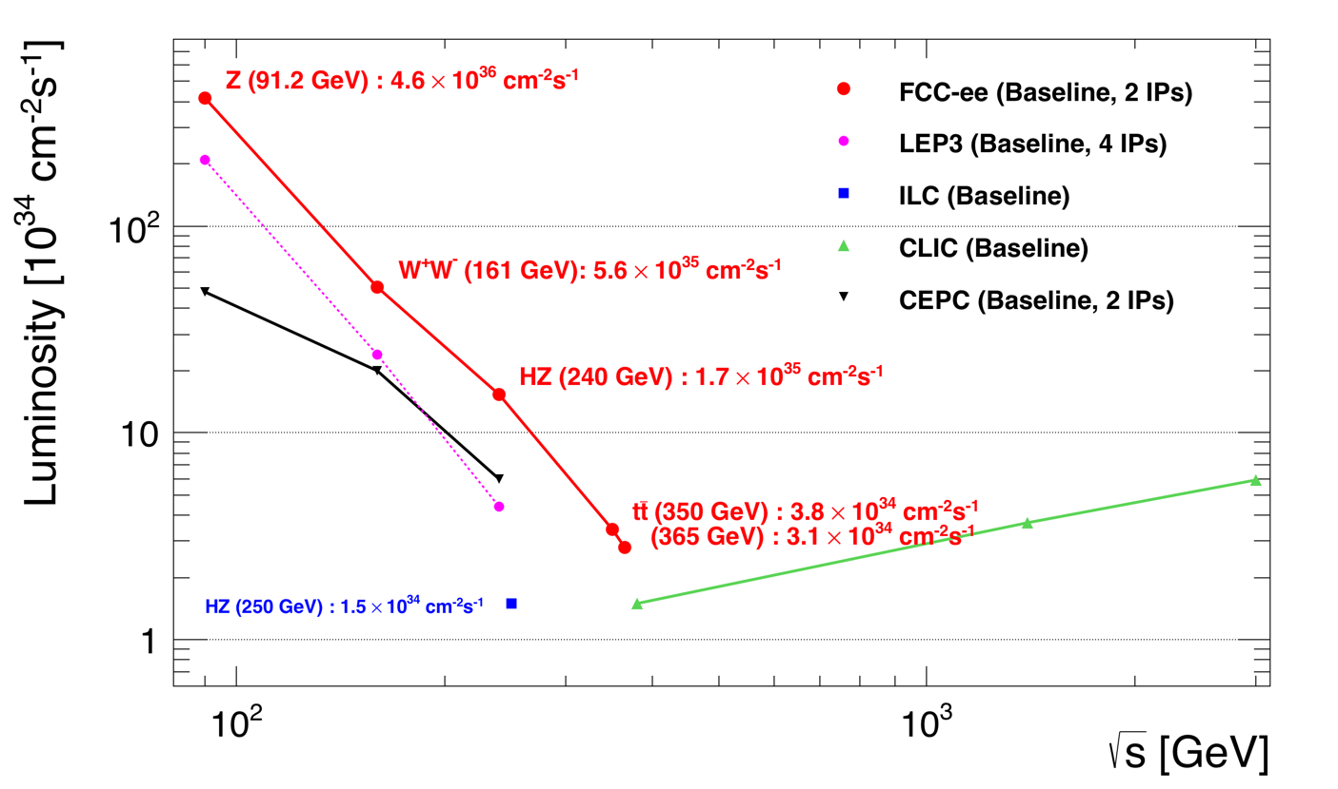
Z WW HZ tt
FCC-ee
LEPx10⁵!
Event
statistics :
E_{CM} errors:
Z peak E_{cm} : 91 GeV 5 10¹² e+e- → Z
WW threshold E_{cm} : 161 GeV 10⁸ e+e- → WW
ZH threshold E_{cm} : 240 GeV 10⁶ e+e- → ZH
‾tt threshold E_{cm} : 350 GeV 10⁶ e+e- →‾tt
LEP x 10⁵
LEP x 2.10³
Never done
Never done
<100 keV
<300 keV
2 MeV
5 MeV

Slide 28
Great energy range for the heavy particles of the Standard Model
COMPLEMENTARITY WITH LINEAR COLLIDERS (ILC, CLIC) overlap 300-400 GeV
certainly could imagine a world with 1 circular lab and 1 linear lab!

Slide 29
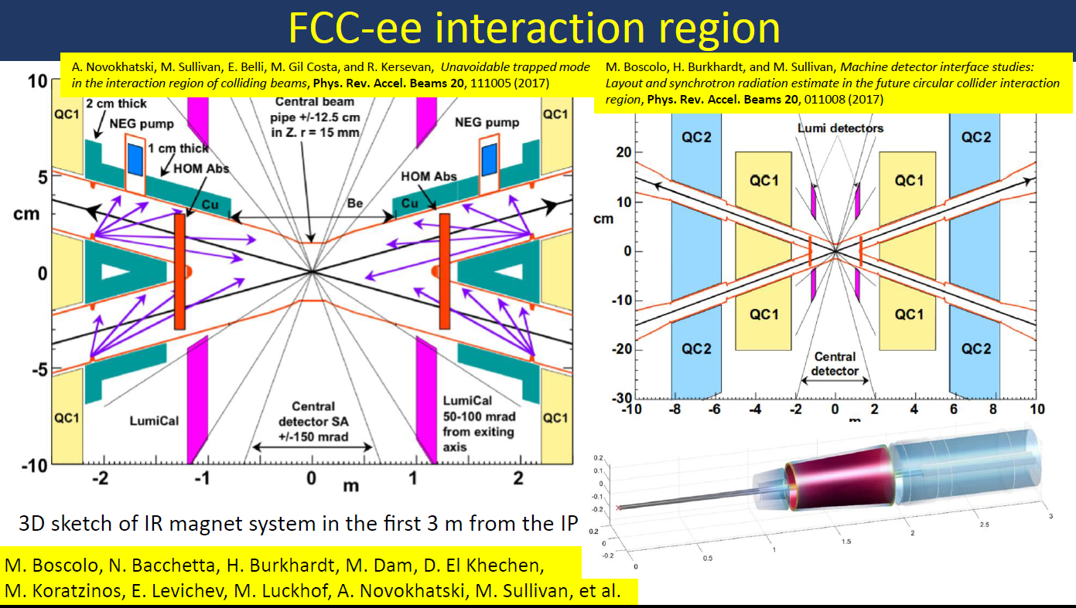
*) reduction to r=10mm OK

Slide 30
FCC-ee with 4 IPs?
almost 2x higher total lumi., (or equal lumi at 2/3 to 3/4 the power
baseline w 2 IPs
periodic alternative
with 4 IPs
less symmetric alternative
with 4 IPs
IP1
RF
(W,Z,H,t)
IP1
RF
(H,t)
IP1
IP3
IP4
RF
(W,Z,H,t)
RF
(W,Z,H,t)
RF
(H,t)
RF
(H,t)
IP4
IP3
RF
(H,t)
RF
(H,t)
IP2
IP2
IP2
works fine
so far OK for lattice
and beam-beam
not yet studied,
but considered challenging
K. Oide,
D. Shatilov
impact on layout!

Slide 31
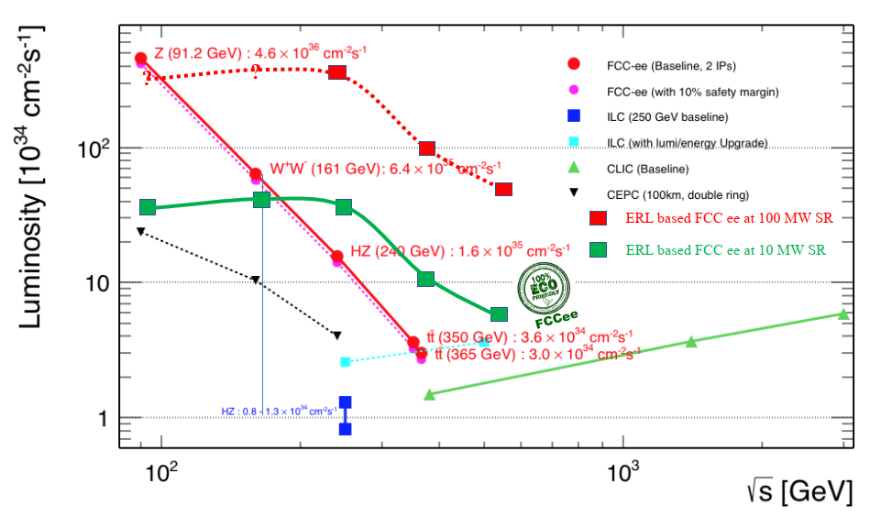
”Future High Energy Circular e⁺e⁻ Collider using Energy-Recovery Linacs,” presented at FCC Week 2019 and submitted to ESU process, similar to former ERL eRHIC design
FCC-ee ERL option for highest energy?
Vladimir N Litvinenko, Thomas Roser, Maria Chamizo Llatas, BNL
http://arxiv.org/abs/1909.04437
We love this!
In Z,W region
we need to keep beam energy
calibration at <100 keV level
Assuming E_{CM} >550
we love this!
basic feasibility, cost, and physics case to be studied

Slide 32
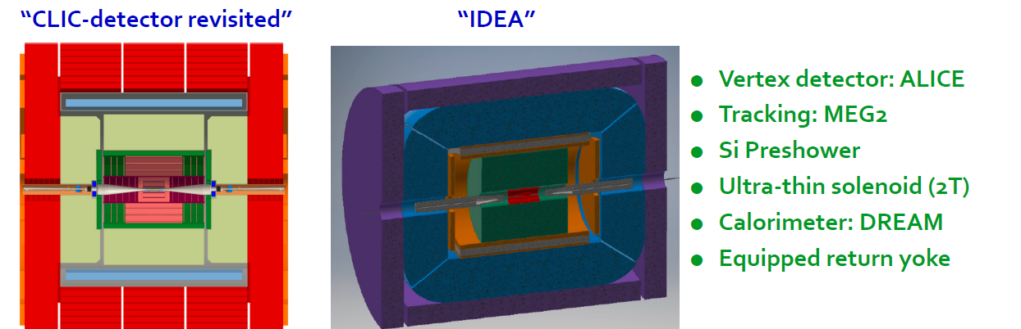
FCC-ee Detectors
Two integration, performance and cost estimates:
-- Linear Collider Detector group at CERN has undertaken the adaption of
CLIC-SID detector for FCC-ee
-- IDEA, detector specifically designed for FCC-ee (and CEPC)
MAPS

Slide 33
Important features for precision measurements
STATISTICS
-- very high statistics at the Z! (70hHz of visible Z decays)
-- expect running without trigger
-- beamstrahlung and beam baclkgrounds are very mild compared to linear colliders
-- CW running might be an issue for cooling detector (but LHC experiments cope well)
FLAVOUR TAGGING
-- small beam pipe (10mm → first layer of vertex detector is at 12 mmm)
-- impact parameter resolution : 3-5 microns (cf 89 microns for tau and more for Bs)
-- SLD had 62% b-tagging efficiency at 98% purity
-- new CEPC studies claim P.eff = 97% for H→ bb
LUMINOSITY MEASUREMENT
-- aim at 10⁻⁴ fast measurement (small angle bhabhas) → requires micrometer precision
-- and 10⁻⁵ absolute from ee→ γγ
Center-of-mass energy calibration
-- 50 keV instantaneous error on beam energy measurement with resonant depolarization
-- powerful cross-checks from lepton acollinearity

Slide 34
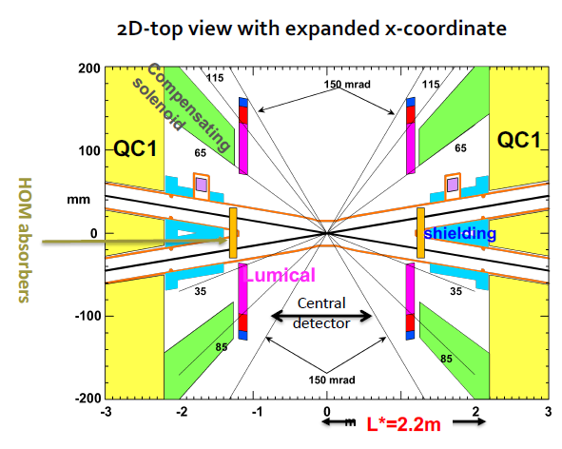
FCC-ee detector challenges…
No pileup, no underlying event, and demonstrated to be feasible but:
Extremely large statistics / statistical precision
…need small systematics (10 ⁻⁵ !) to match
Physics event rates up to 100 kHz
Bunch spacing down to 20 ns
Continous beams, no power pulsing
Complex interaction region
beam pipe ∅ 2-3 cm
Optimization to be done for extremely rich
physics capabilities, especially at the Z pole
10¹² bb, cc, 2 10¹¹ ττ, etc…
-- search for rare processes → excellent acceptance closure, sensitivity to displaced vertices
-- luminosity measurement at 10⁻⁴ (rel), 10⁻⁵ (abs)
-- acceptance definition at ≤ 10⁻⁵
-- optimal b/c/gluon separation
-- PID (TOF, dE/dx, Ckov?)
-- determination of point-to-point scan energies at 10 keV level
NEW challenges. design, technology, metrology, stability, monitoring

Slide 35

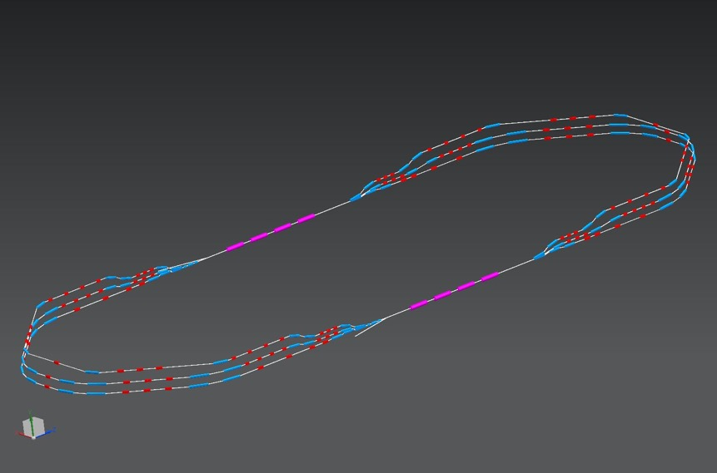
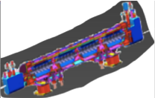
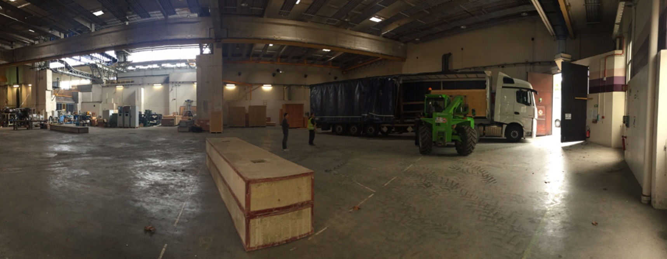
FCC-eh: lepton-hadron collider based on ERL
Superconducting Recirculating Linac with Energy Recovery
60 GEV e- : ERL ~9 km circ.
two 1 km long, 10 GeV SC linacs with 3 accelerating and 3 decelerating passes in cw operation
SRF sees 6 times IP beam current (≈ 4 ns spacing)
➔ Q₀ > 10¹⁰ required
FCC-hh
1 : 3 : 5
944 cavities; 59 cryo modules/linac, >4500 magnets
Multi-pass high-current ERL test facility for
FCC-eh (and FCC-ee-ERL) under construction at LAL
injector
7 MeV
ΔE = 80 MeV
dump
2 : 4 : 6
7 MeV
ΔC = λ_{RF}/2

Slide 36
100 TeV
Hadron colliders will remain for the foreseable future the most efficient way
to reach high energy (> 10 TeV) parton-parton collisions

Slide 37
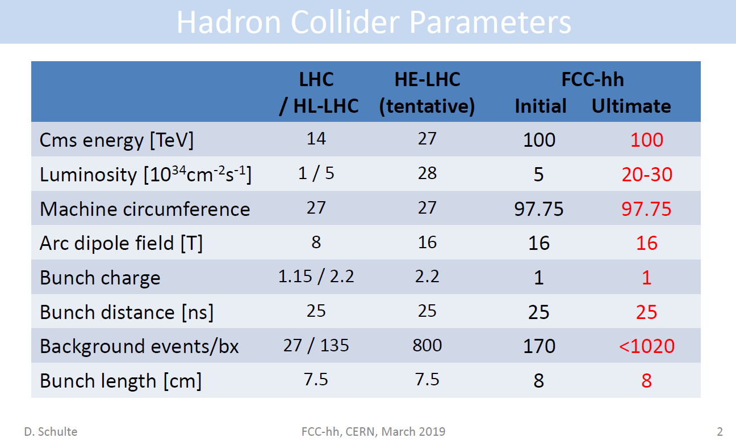

Slide 38
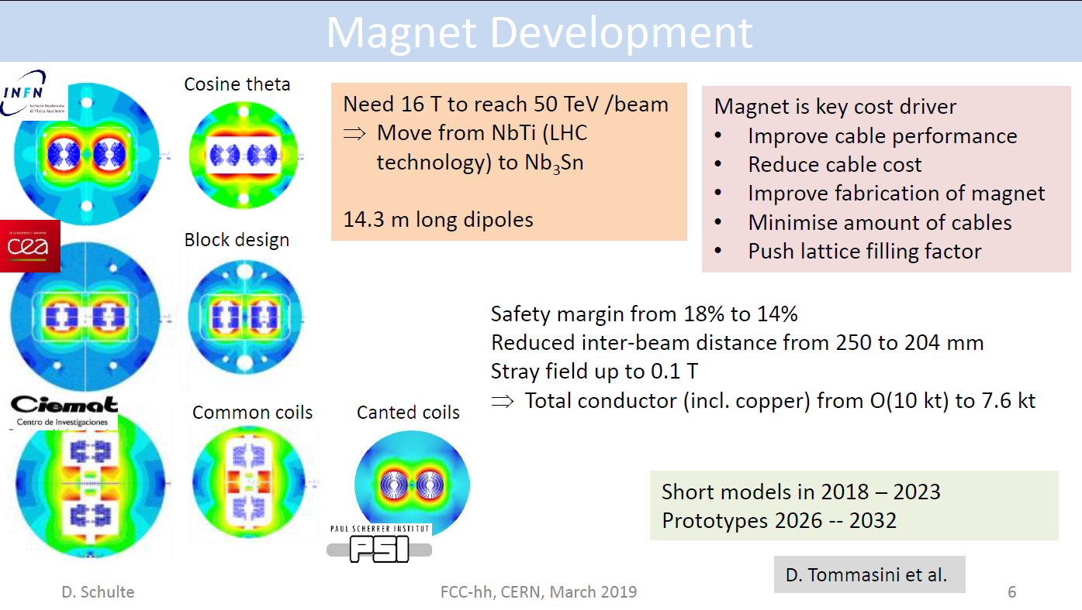

Slide 39
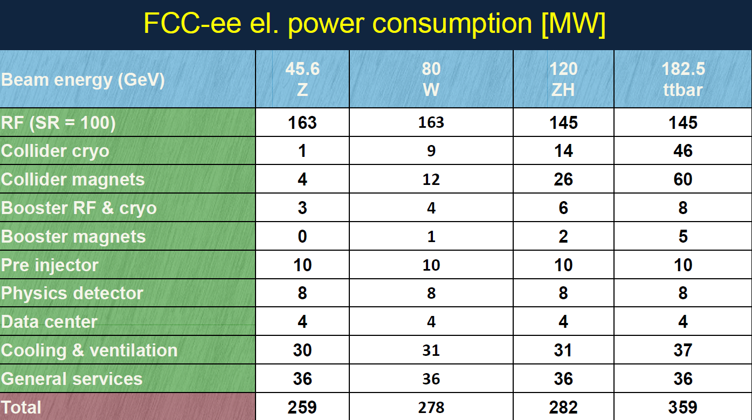

Slide 40
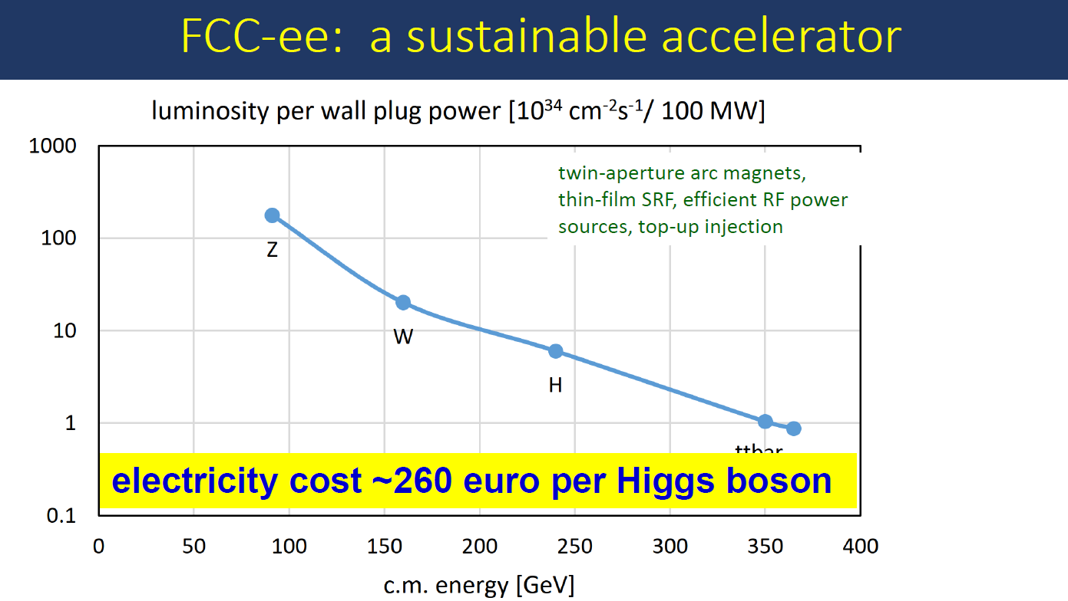
Zimmermann

Slide 41
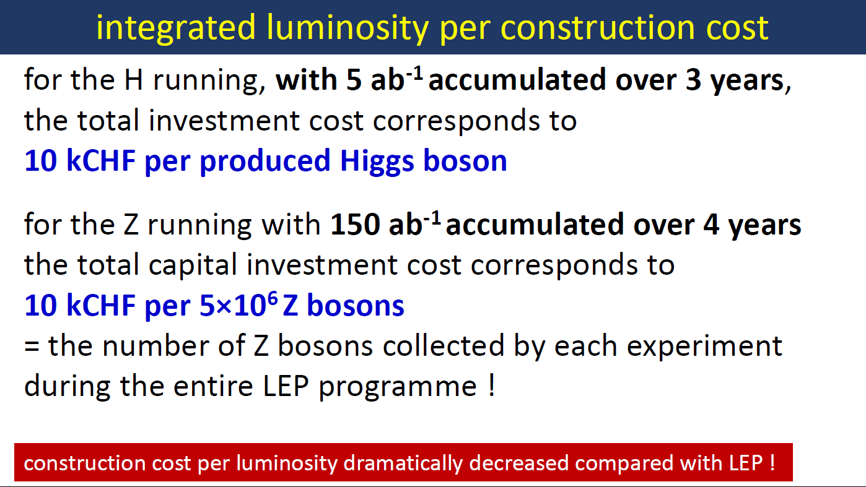

Slide 42
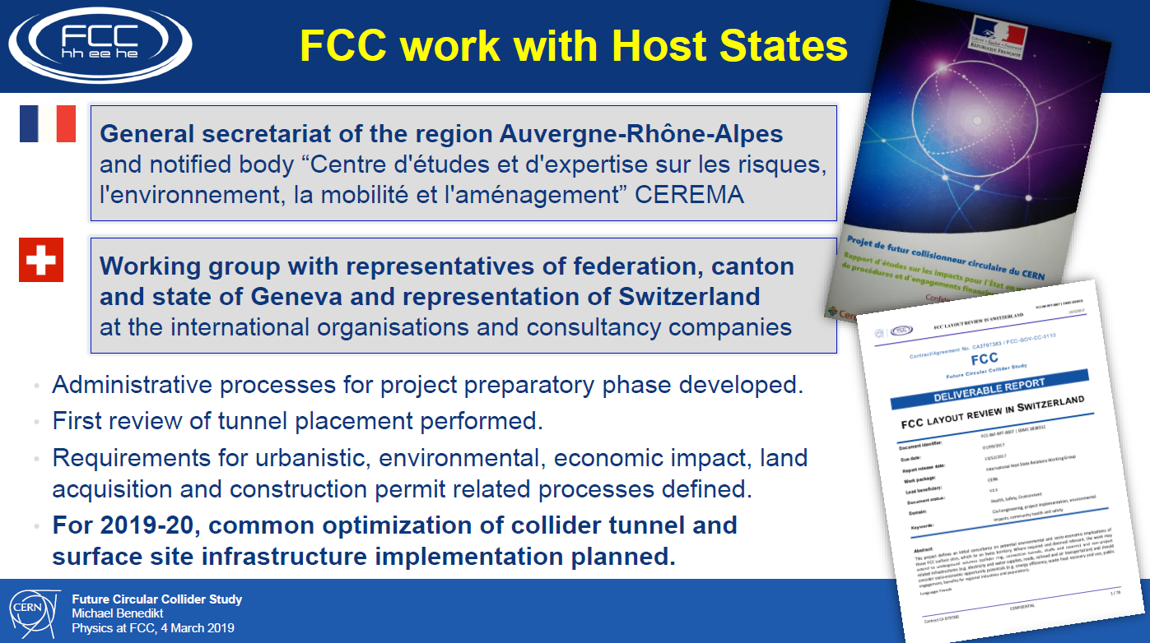

Slide 43
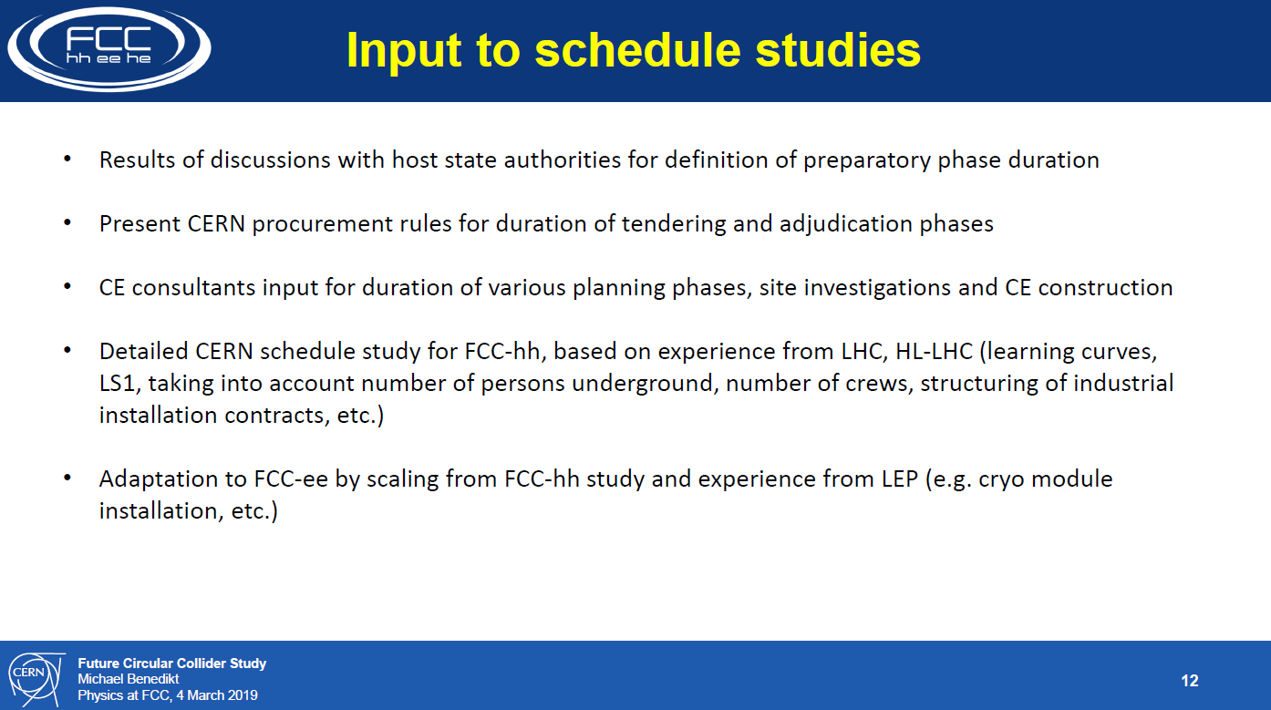

Slide 44
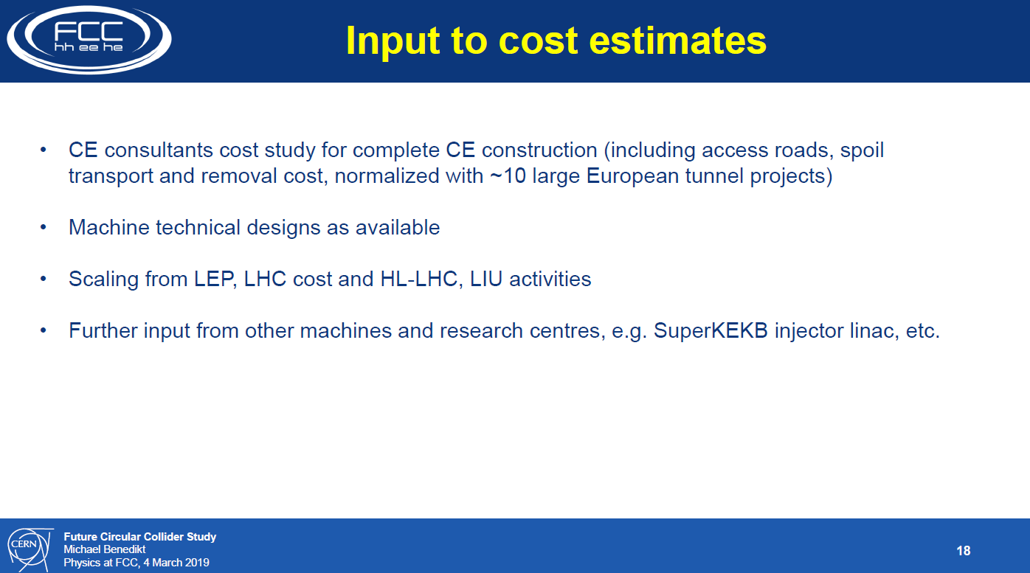

Slide 45
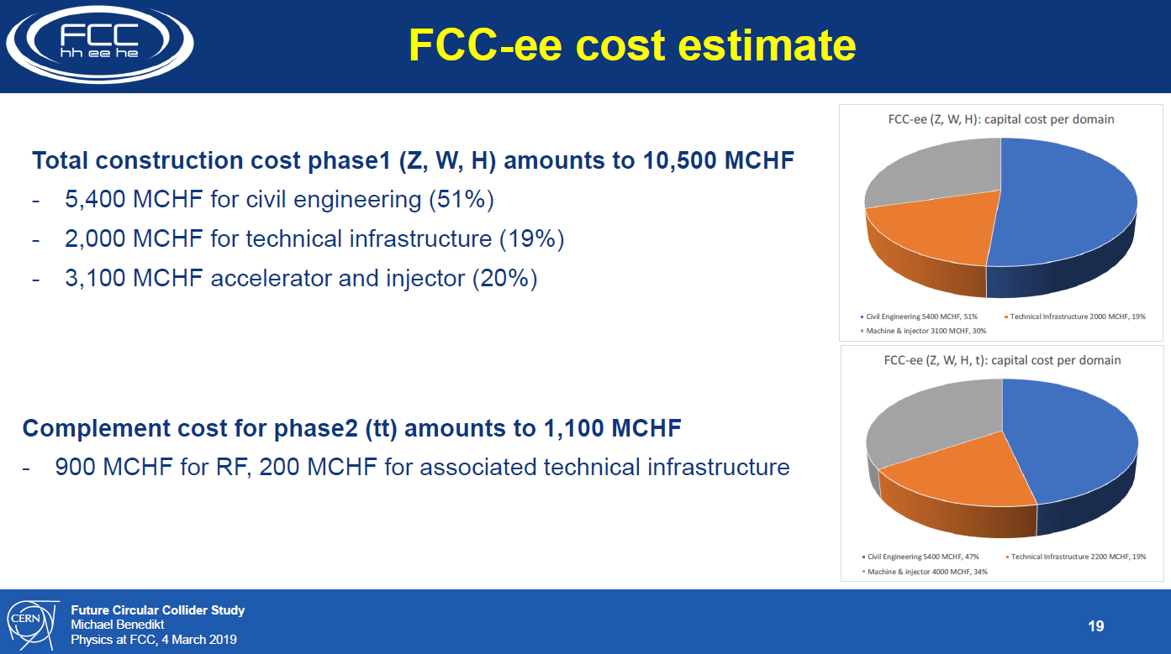
most of this to be
recuperated for
FCC-hh!

Slide 46
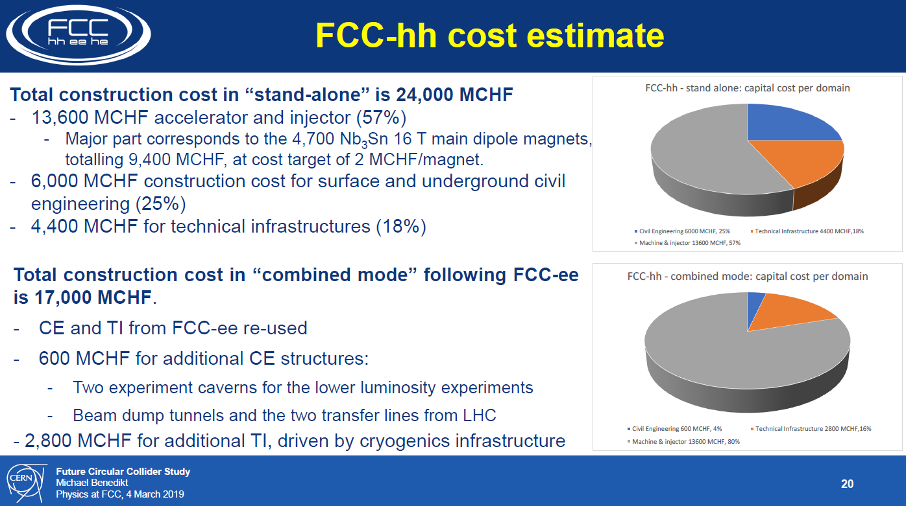

Slide 47
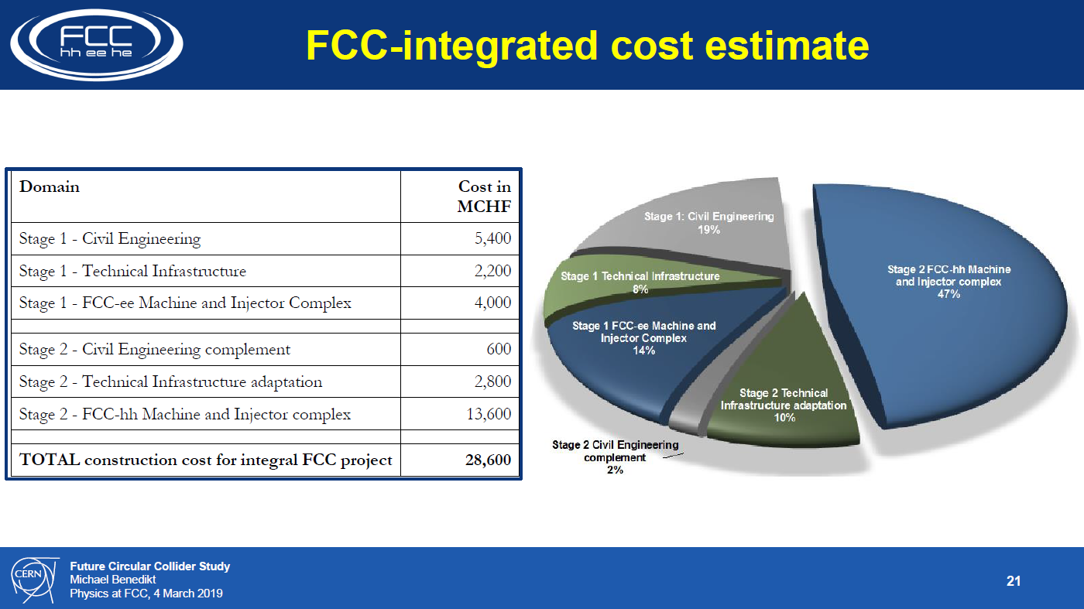

Slide 48
AND THE WINNER IS…..

Slide 49
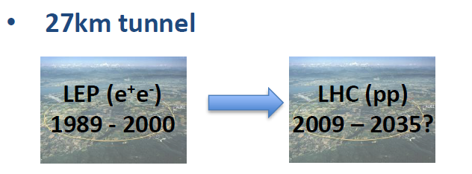
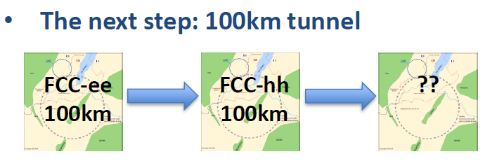
M. Aleksa
a 10-20 TeV muon collider using the
45 GeV stored e+ as LEMMA SOURCE?
FCC data taking starts at the end of HL-LHC

Slide 50
FCC integrated project timeline
1
2
3
4
5
6
7
8
9
10
11
12
13
14
15
16
17
18
FCC-ee 15 yrs operation
34
35
36
37
38
39
40
41
42
43
FCC-hh~ 25 years
70
Project preparation &
administrative processes
Permis-sions
Update
Permissions
Funding strategy
Funding and
in-kind contribution agreements
Funding and
in-kind contribution agreements
Geological investigations, infrastructure detailed design and tendering preparation
Tunnel, site and technical infrastructure construction
FCC-ee dismantling, CE & infrastructure adaptations FCC-hh
Superconducting wire and magnet R&D
SC wire and 16 T magnet R&D, model magnets, prototypes, preseries
16 T dipole magnet
series production
FCC-ee accelerator R&D and technical design
FCC-ee accelerator construction, installation, commissioning
FCC-hh accelerator R&D and technical design
FCC-hh accelerator construction, installation, commissioning
Set up of international experiment collaborations, detector R&D and concept development
FCC-ee detector technical design
FCC-ee detector
construction, installation, commissioning
FCC-hh detector R&D,
technical design
FCC-hh detector
construction, installation, commissioning
work is cut out for physics and detectors
ESPP
70 years seems like a long time!

Slide 51
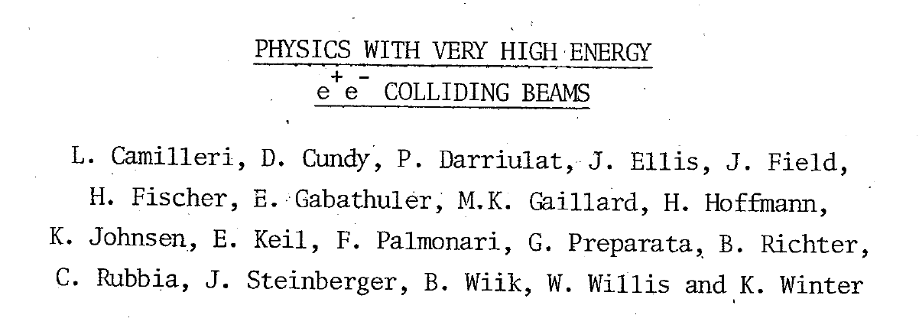
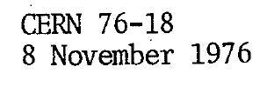
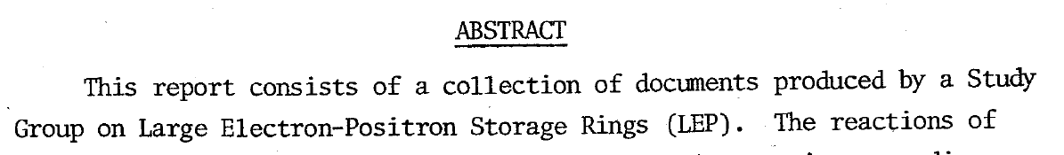


Did these people know that we would be running HL-LHC in that tunnel >60 years later?
Let’s not be SHY!

Slide 52
We have gone a long way!
2010-11-12 : ideas, wishes, basic concepts, (VHE-LHC, LEP3, TLEP), Higgs discovery
2013 ESPP2013 wants «ambitious post-LHC accelerator projcet »
2014 Kick-off meeting
ESPP contributions and CDR submitted
FCC can be done!
Starting with the e+ e- collider.
➔ Start of a new era towards realization
(15 January) CERN directorate New Year Presentation
https://indico.cern.ch/event/779524/
Press release on FCC CDR release
FCC CDR physics presentation 4-5 March at CERN;
Plenary Meeting (ESPP) Granada 13-17 May
FCC General meeting in 24-28 June in Brussels https://indico.cern.ch/event/727555

Slide 53



The FCC integrated program FCC (ee and hh, ep) by way of
synergy and complementarity
will provide the most complete and model-independent studies of the Higgs boson
pp provides 2.10¹⁰ Higgs !
(Using ee ‘candle’) will provide
-- model-independent ttH coupling to <1%
-- rare decays (μμ, γγ, Ζγ …)
-- invisible width to 5 10⁻⁴ BR
-- Higgs self coupling g_{HHH} to 5%
ep will produce 2.5 10⁶ Higgs
(using ee ‘candle’) further improves
on several measurements esp. g_{HWW} coupling
ee provides 10⁶ ZH + 10⁵ Hvv evts
-- Model-Independent Γ_{H} determination
-- g_{HZZ} Higgs coupling to Z at 0.17%
→fixed candle for all measurements
(WW, bb, ττ, cc, gg etc… <% level)
→ even possibly Hee coupling!
also first 40% effect of g_{HHH} from loop effect
(22% with 4 IPs)
Superb complementarity!

Slide 54


Pecision EW measurements:
is the SM complete?
-^- EFT D6 operators (some assumptions)
-^- Higgs and EWPOs are complementary
-^- top quark mass and couplings essential!
(the 100km circumference is optimal for this)
<-- many systematics are preliminary
and should improve with more work.
<-- tau b and c observables still to be added
<-- complemented by high energy FCC-hh
Theory work is critical and initiated

Slide 55

FCC proposes a HUGE step in statistical precision w.r.t. LEP/SLC/Tevatron/LHC
(up to factor sqrt(N)~400 improvement)
Also rare processes at the level of <10⁻¹² of Z decays (10⁻⁸ for W, 10⁻⁶ for H and top)
→ need to know rare SM processes at that kind of level!
Experiment (i.e. accelerator physics + experimental physics) will work hard to make sure
that this is matched by experimental systematics and experimental backgrounds
This is a huge challenge for the theoretical community!
QED
QCD (incl. quark masses)
EW
Multi-loop calculations and exponentiation
THIS IS EXPLICITELY INSCRIBED IN THE ESPP SUBMISSIONS AS CRITICAL CHALLENGE
Theoretical challenges

Slide 56


Nima
At higher masses -- or at smaller couplings?

Slide 57

Dark Matter exists. It is made of very long lived neutral particle(s).
Plausible candidates:
indirect detection
direct detection
Particle physics
sterile neutrino
WIMP
UL scalar, axion
Systematic Errors on the Centre-of-mass Ene
Systematic Errors on the Centre-of-mass Ene
Systematic Errors on the Centre-of-mass Ene
Cirelli

Slide 58


DM neutralino search at the FCC-hh
FCC-ee Z Axion-like particle
LHC
FCC-ee
“FCC-hh covers the full mass range for the
discovery of these WIMP Dark Matter candidates”
Z→ γa with a→γγ
FCC-ee (solid lines)
Run-2 of the LHC with 300 fb⁻¹ (dashed)
«The Z run of FCC-ee is particularly fertile for
discovery of particles with very small couplings»

Slide 59



Direct discovery of Very rare events
should be somewhat improved
at FCC-ee (5 TeraZ)

Slide 60


at least 3 pieces are still missing
Since 1998 it is established that neutrinos have mass (oscillations)
and this very probably implies new degrees of freedom
➔ «sterile», very small coupling to known particles
completely unknown masses (eV to ZeV), nearly impossile to find.
.... but could perhaps explain all: DM, BAU,ν-masses

Slide 61


Slide 62






Heavy neutrinos
FCC-ee Z
+
or$l$±ν
(*)
-
FCC-hh
FCC-ee
-- EWPO : sensitivity 10⁻⁵ up to very high masses
-- high sensitivity to single N(→ $l2$± W) in Z decay
FCC-hh
-- production in W-> $l1$± + N(→ $l2$± W) (LNV+LFV)
with initial and final lepton charge and flavour
FCC e-p
-- production in CC e± p → X N(→ $l$±W) high mass
Complementarity:
discovery + studies of FNV and LFV!
Detached
vertices
Massive neutrino mechanisms for generating the matter-antimatter asymmetry in the Universe should be a central consideration in the selection and design of future colliders. (neutrino town meeting report to ESPP)

Slide 63

FCC-ee discovery potential and Highlights
Today we do not know how nature will surprise us. A few things that FCC-ee could discover :
EXPLORE 10-100 TeV energy scale (and beyond) with Precision Measurements
-- ~20-100 fold improved precision on many EW quantities (equiv. to factor 5-10 in mass)
m_{Z,} m_{W}, m_{top} , sin² θ_{w}^{eff} , R_{b} , α_{QED} (m_{z}) α_{s} (m_{z} m_{W} m_{τ}), Higgs and top quark couplings
model independent «fixed candle» for Higgs measurements
DISCOVER a violation of flavour conservation or universality and unitarity of PMNS @10⁻⁵
-- ex FCNC (Z --> μτ , eτ) in 5 10¹² Z decays and τ BR in 2 10¹¹ Z→ τ τ
+ flavour physics (10¹² bb events) (B→s τ τ etc..)
DISCOVER dark matter as «invisible decay» of H or Z (or in LHC loopholes)
DISCOVER very weakly coupled particle in 5-100 GeV energy scale
such as: Right-Handed neutrinos, Dark Photons, ALPS, etc…
+ and many opportunities in – e.g. QCD (α_{s} @ 10⁻⁴, fragementations, H→ gg) etc….
NB Not only a «Higgs Factory»! «Z factory» and «top» are important for ‘discovery potential’

Slide 64

FCC-ee | ILC
Z pole 5 10¹² events and WW pair thresh. (3 10⁸ WW) Precision measurements with resonant depolarization ΔE_{CM} = 100keV (abs) 40 keV (ptp) | Can reach E_{CM} above 365 GeV + longitudinal polarization for e- and for e+
EWPOs: m_{Z} , Γ_{Z} , sin²θ^{eff}_{W} , $α_{QED}$(m_{Z}), $α_{s}$(m_{Z}), b and c rates and asymmetry | top CP EW violating coupling (?), High energy search for contact interactions in ee →μμ
e/μ/τ universality tests at 10⁻⁵ in both NC and CC couplings
indirect sensitivity to SM coupled new physics up to 70 TeV. | indirect sensitivity to Z’ etc. similar with different method
direct searches for feebly coupled long lived particles: RH neutrinos, dark photons and ALPs in Z decay | direct searches for SUSY in LHC «holes»
Flavour physics 10¹² Z→ bb evts rare B decays etc.. (Belle II x 30)
Higgs ee→ H in s-channel g_{Hee} at ±30% g_{HHH} from single H (±35/22%) | study of e+e- → HHX g_{HHH} at +- 30% (500 GeV) +- 10% (1 TeV)

Slide 65
status as of briefing book
still based on very conservative
experimental and theory errors:
our goal: work out systematics
until we reach statistical level:
(a lot of work to do!)

Slide 66


Slide 68
More complementarity
2/4 experiments vs 1 (eliminates push-pull need of ILC)
confirmations with two different colliders (cross-check if effect seen)
may save 1BCHF for FCC-ee (skip 350/365 GeV point, and do more Z, ee->H instead)
ILC→ CLIC or wakefield acceleration in the linear tunnel to upgrade energy
FCC-ee upgrade to FCC to hh (100-150 TeV)
(Synergy) e+ booster for muon collider in the circular tunnel
can be based on e+ source developments in the linear collider

Slide 69
FCC-hh discovery potential and Highlights
FCC-hh is a HUGE discovery machine (if nature …), but not only.
FCC-hh physics is dominated by three features:
-- Highest center of mass energy –> a big step in high mass reach!
ex: strongly coupled new particle up to >30 TeV
Excited quarks, Z’, W’, up to ~tens of TeV
Give the final word on natural Supersymmetry, and WIMPS
extra Higgs etc.. reach up to 5-20 TeV
Sensitivity to high energy phenomena in e.g. WW scattering
-- HUGE production rates for single and multiple production of SM bosons (H,W,Z) and quarks
-- Higgs precision tests using ratios to e.g. γγ/μμ/ ττ/ZZ, ttH/ttZ @<% level
-- Precise determination of triple Higgs coupling (~3% level) and quartic Higgs coupling
-- detection of rare decays H→ Vγ (V= ρ, ϕ, J/ψ, ϒ, Z …)
-- search for invisibles (DM searches, RH neutrinos in W decays)
-- renewed interest for long lived (very weakly coupled) particles.
-- rich top and HF physics program
-- Cleaner signals for high Pt physics
-- allows clean signals for channels presently difficult at LHC (e.g. H→ bb)

Slide 70
FCC-eh Discovery Potential and Highlights
FCC-ep explores hitherto untouched domain of (x,q2 ) DIS plane and provides
production of high mass SM particles (H, top) in cleaner conditions than pp.
-- extremely precise structure function work
important input on structure functions for FCC-hh
complete resolution of the partonic contents of the proton, for the first time
high precision α_{s} O(10⁻⁴) similar to FCC-ee from totally different source
-- 2 10⁶ Higgs produced from from W & Z to deliver precise H couplings
complementary to ee -- esp (g_{HWW})
-- Searches for new physics (Leptoquarks, RH neutrinos, etc...)
in new domain of mass and couplings
-- rich top (Vtb @% level, FCNC) and HF physics program
-- Discovery in QCD: non-linear parton evolutions, instantons?, ..
-- Unique electron-ion physics related to QGP physics

Slide 71
CONCLUSIONS
CONCLUSIONS
-- The FCC design study has established the feasibility -- or the path to feasibility -- of an ambitious set of colliders after LEP/LHC, at the cutting edge of knowledge and technology. FCC (ee and hh) can be done!
-- FCC-ee and FCC-hh have outstanding physics cases
-- each in their own right
-- the sequential implementation of FCC-ee, FCC-hh with eh option
offers the broadest physics reach proposed today
big jumps in Sensitivity, Precision, Energy
The discussions within the community (European Strategy for Patricle Physics 2010)
as well as with the host states (France and Switzerland) are in taking place
-- An attractive scenario of staging and implementation covers 70 years
of exploratory physics, taking full advantage of the synergies and complementarities.
FCC (ee) can start seamlessly at the end of HL-LHC

Slide 72
SPARES

Slide 73
FINAL WORDS
The proposed integrated FCC is a large, ambitious, expensive facility
The size is optimal for studying the heavy particles of the Standard Model with an e+e- collider, using them to search for new physics;
It guarantees a big jump in energy reach for the hadron collider, which is itself a formidable heavy particle factory.
Alternative facilities that are proposed to provide e.g. the same table of Higgs properties
are 1) less precise 2) not much cheaper and 3) considerably less broad in physics ability.
The other routes to 100 TeV are less precise, less complete, and more expensive.
CERN is the best place for such a challenging enterprise, given its demonstrated extraordinary competence, its international membership, and the CERN existing infrastructure: accelerator complex, including the injectors, cryogenics, etc.
(Building FCC in a green field would be much more challenging and risky)

Slide 74
Particle physics has arrived at an important moment of its history

Slide 75
1989-1999: top mass predicted (LEP, mostly Z mass&width)
top quark discovered (Tevatron)
t’Hooft and Veltman get Nobel Prize 1999
(c) Sfyrla

Slide 76
1997-2013 Higgs boson mass cornered (LEP H, M_{Z} etc +Tevatron m_{t} , M_{W})
Higgs Boson discovered (LHC)
Englert and Higgs get Nobel Prize 2013
IT LOOKS LIKE THE
STANDARD MODEL
IS COMPLETE.....
(c) Sfyrla
NB in fact we know from oscillations and cosmology
that all 3 neutrino masses are less than ~0.1 eV

Slide 77
SEVEN YEARS AGO ALREADY

Slide 78
The Standard Model is a very consistent and complete theory.
It explains all known collider phenomena and almost all particle physics (except ν’s)
– this was beautifully verified at LEP, SLC, Tevatron and the LHC.
-- the EWPO radiative corrections predicted top and Higgs masses
assuming SM and nothing else
we can even extrapolate the Standard Model all the way to the the Plank scale :
FCC 2048

Slide 79
Is it the end?
Is it the end?

Slide 80
We cannot explain:
Dark matter
Standard Model particles constitute only 5% of the energy in the Universe
Were is antimatter gone?
What makes neutrino masses?
Not a unique solution in the SM --
Dirac masses (why so small?)
Majorana masses (why not Dirac?)
Both (the preferred scenarios, see-saw...) ?
➔ heavy right handed neutrinos?

Slide 81
Is it the end?
Certainly not!
-- Dark matter
-- Baryon Asymmetry in Universe
-- Neutrino masses
are experimental proofs that there is more to understand.
We must continue our quest, but HOW?
Direct observation of new particles (but not only!)
New phenomena (ex: Neutral currents, neutrino oscillations, CP violation.. )
Deviations from precise predictions
(ref. Uranus to Neptune, Mercury’s perihelion,
top and Higgs predictions from LEP/SLC/Tevatron/B factories, g-2, etc…)
To which one can add many theoretical questions on the SM
These facts require
particle physics explanations.

Slide 82
The Physics Landscape
We are in a fascinating situation: where to look and what will we find?
For the first time since Fermi theory, WE HAVE NO SCALE
The next facility must be versatile with as broad and powerful reach as possible,
as there is no precise target
➔ more Sensitivity, more Precision, more Energy
FCC , thanks to synergies and complementarities, offers
the most versatile and adapted response to today’s physics landscape,

Slide 83
“Discoveries make the front pages of the newspapers, while precise measurements of known particle don’t, but scientifically they are just as important."

Slide 84
The FCC integrated program FCC (ee and hh, ep) by way of
synergy and complementarity
will provide the most complete and model-independent studies of the Higgs boson
pp provides 2.10¹⁰ Higgs !
(Using ee ‘candle’) will provide
-- model-independent ttH coupling to <1%
-- rare decays (μμ, γγ, Ζγ …)
-- invisible width to 5 10⁻⁴ BR
-- Higgs self coupling g_{HHH} to 5%
ep will produce 2.5 10⁶ Higgs
(using ee ‘candle’) further improves
on several measurements esp. g_{HWW} coupling
ee provides 10⁶ ZH + 10⁵ Hvv evts
-- Model-Independent Γ_{H} determination
-- g_{HZZ} Higgs coupling to Z at 0.17%
→fixed candle for all measurements
(WW, bb, ττ, cc, gg etc… <% level)
→ even possibly Hee coupling!
also first 40% effect of g_{HHH} from loop effect
(22% with 4 IPs)
Superb complementarity!

Slide 85
Pecision EW measurements:
is the SM complete?
-^- EFT D6 operators (some assumptions)
-^- Higgs and EWPOs are complementary
-^- top quark mass and couplings essential!
(the 100km circumference is optimal for this)
<-- many systematics are preliminary
and should improve with more work.
<-- tau b and c observables still to be added
<-- complemented by high energy FCC-hh
Theory work is critical and initiated

Slide 86
FCC proposes a HUGE step in statistical precision w.r.t. LEP/SLC/Tevatron/LHC
(up to factor sqrt(N)~400 improvement)
Also rare processes at the level of <10⁻¹² of Z decays (10⁻⁸ for W, 10⁻⁶ for H and top)
→ need to know rare SM processes at that kind of level!
Experiment (i.e. accelerator physics + experimental physics) will work hard to make sure
that this is matched by experimental systematics and experimental backgrounds
This is a huge challenge for the theoretical community!
QED
QCD (incl. quark masses)
EW
Multi-loop calculations and exponentiation
THIS IS EXPLICITELY INSCRIBED IN THE ESPP SUBMISSIONS AS CRITICAL CHALLENGE
Theoretical challenges

Slide 87
Nima
At higher masses -- or at smaller couplings?

Slide 88
Dark Matter exists. It is made of very long lived neutral particle(s).
Plausible candidates:
indirect detection
direct detection
Particle physics
sterile neutrino
WIMP
UL scalar, axion
Systematic Errors on the Centre-of-mass Ene
Systematic Errors on the Centre-of-mass Ene
Systematic Errors on the Centre-of-mass Ene
Cirelli

Slide 89
DM neutralino search at the FCC-hh
FCC-ee Z Axion-like particle
LHC
FCC-ee
“FCC-hh covers the full mass range for the
discovery of these WIMP Dark Matter candidates”
Z→ γa with a→γγ
FCC-ee (solid lines)
Run-2 of the LHC with 300 fb⁻¹ (dashed)
«The Z run of FCC-ee is particularly fertile for
discovery of particles with very small couplings»

Slide 90
at least 3 pieces are still missing
Since 1998 it is established that neutrinos have mass (oscillations)
and this very probably implies new degrees of freedom
➔ «sterile», very small coupling to known particles
completely unknown masses (eV to ZeV), nearly impossile to find.
.... but could perhaps explain all: DM, BAU,ν-masses

Slide 91
Heavy neutrinos
FCC-ee Z
+
or$l$±ν
(*)
-
FCC-hh
FCC-ee
-- EWPO : sensitivity 10⁻⁵ up to very high masses
-- high sensitivity to single N(→ $l2$± W) in Z decay
FCC-hh
-- production in W-> $l1$± + N(→ $l2$± W) (LNV+LFV)
with initial and final lepton charge and flavour
FCC e-p
-- production in CC e± p → X N(→ $l$±W) high mass
Complementarity:
discovery + studies of FNV and LFV!
Detached
vertices
Massive neutrino mechanisms for generating the matter-antimatter asymmetry in the Universe should be a central consideration in the selection and design of future colliders. (neutrino town meeting report to ESPP)

Slide 92
FCC-ee discovery potential and Highlights
Today we do not know how nature will surprise us. A few things that FCC-ee could discover :
EXPLORE 10-100 TeV energy scale (and beyond) with Precision Measurements
-- ~20-100 fold improved precision on many EW quantities (equiv. to factor 5-10 in mass)
m_{Z,} m_{W}, m_{top} , sin² θ_{w}^{eff} , R_{b} , α_{QED} (m_{z}) α_{s} (m_{z} m_{W} m_{τ}), Higgs and top quark couplings
model independent «fixed candle» for Higgs measurements
DISCOVER a violation of flavour conservation or universality and unitarity of PMNS @10⁻⁵
-- ex FCNC (Z --> μτ , eτ) in 5 10¹² Z decays and τ BR in 2 10¹¹ Z→ τ τ
+ flavour physics (10¹² bb events) (B→s τ τ etc..)
DISCOVER dark matter as «invisible decay» of H or Z (or in LHC loopholes)
DISCOVER very weakly coupled particle in 5-100 GeV energy scale
such as: Right-Handed neutrinos, Dark Photons, ALPS, etc…
+ and many opportunities in – e.g. QCD (α_{s} @ 10⁻⁴, fragementations, H→ gg) etc….
NB Not only a «Higgs Factory»! «Z factory» and «top» are important for ‘discovery potential’

Slide 93
FCC-hh discovery potential and Highlights
FCC-hh is a HUGE discovery machine (if nature …), but not only.
FCC-hh physics is dominated by three features:
-- Highest center of mass energy –> a big step in high mass reach!
ex: strongly coupled new particle up to >30 TeV
Excited quarks, Z’, W’, up to ~tens of TeV
Give the final word on natural Supersymmetry, and WIMPS
extra Higgs etc.. reach up to 5-20 TeV
Sensitivity to high energy phenomena in e.g. WW scattering
-- HUGE production rates for single and multiple production of SM bosons (H,W,Z) and quarks
-- Higgs precision tests using ratios to e.g. γγ/μμ/ ττ/ZZ, ttH/ttZ @<% level
-- Precise determination of triple Higgs coupling (~3% level) and quartic Higgs coupling
-- detection of rare decays H→ Vγ (V= ρ, ϕ, J/ψ, ϒ, Z …)
-- search for invisibles (DM searches, RH neutrinos in W decays)
-- renewed interest for long lived (very weakly coupled) particles.
-- rich top and HF physics program
-- Cleaner signals for high Pt physics
-- allows clean signals for channels presently difficult at LHC (e.g. H→ bb)

Slide 94
FCC-eh Discovery Potential and Highlights
FCC-ep explores hitherto untouched domain of (x,q2 ) DIS plane and provides
production of high mass SM particles (H, top) in cleaner conditions than pp.
-- extremely precise structure function work
important input on structure functions for FCC-hh
complete resolution of the partonic contents of the proton, for the first time
high precision α_{s} O(10⁻⁴) similar to FCC-ee from totally different source
-- 2 10⁶ Higgs produced from from W & Z to deliver precise H couplings
complementary to ee -- esp (g_{HWW})
-- Searches for new physics (Leptoquarks, RH neutrinos, etc...)
in new domain of mass and couplings
-- rich top (Vtb @% level, FCNC) and HF physics program
-- Discovery in QCD: non-linear parton evolutions, instantons?, ..
-- Unique electron-ion physics related to QGP physics

Slide 95
SYNERGY

Slide 96

Sharing the same tunnel

Slide 97


common layouts for hh & ee
11.9 m
IP
30 mrad
FCC-hh/
ee Booster
9.4 m
0.6 m
Lepton beams must cross over through the common RF to enter the IP from inside.
Only a half of each ring is filled with bunches.
Common
RF (tt)
Common
RF (tt)
Max. separation of 3(4) rings is about 12 m:
wider tunnel or two tunnels are necessary around the IPs, for ±1.2 km.
IP
FCC-ee 1, FCC-ee 2,
FCC-ee booster (FCC-hh footprint)
Asymmetric IR for ee, limits SR to expt
2 main IPs in A, G for both machines
Notes:
Check with Katsunobu to have latest layout.
Check with detector people if 9 m offset is acceptable for ee detector

Slide 98


Slide 99

The same caverns

Slide 100
M. Aleksa
a 10-20 TeV muon collider using the
45 GeV stored e+ as LEMMA SOURCE?
FCC data taking starts at the end of HL-LHC

Slide 101
We have gone a long way!
2010-11-12 : ideas, wishes, basic concepts, (VHE-LHC, LEP3, TLEP), Higgs discovery
2013 ESPP2013 wants «ambitious post-LHC accelerator projcet »
2014 Kick-off meeting
ESPP contributions and CDR submitted
FCC can be done!
Starting with the e+ e- collider.
➔ Start of a new era towards realization
(15 January) CERN directorate New Year Presentation
https://indico.cern.ch/event/779524/
Press release on FCC CDR release
FCC CDR physics presentation 4-5 March at CERN;
Plenary Meeting (ESPP) Granada 13-17 May
FCC General meeting in 24-28 June in Brussels https://indico.cern.ch/event/727555

Slide 102
CONCLUSIONS
CONCLUSIONS
-- The FCC design study has established the feasibility -- or the path to feasibility -- of an ambitious set of colliders after LEP/LHC, at the cutting edge of knowledge and technology. FCC can be done!
-- FCC-ee and FCC-hh have outstanding physics cases
-- each in their own right
-- the sequential implementation of FCC-ee, FCC-hh with eh option
offers the broadest physics reach proposed today
big jumps in Sensitivity, Precision, Energy
-- An attractive scenario of staging and implementation cover 70 years
of exploratory physics, taking full advantage of the
synergies and complementarities.
FCC (ee) can start seamlessly at the end of HL-LHC

Slide 103
FINAL WORDS
The proposed integrated FCC is a large, ambitious, expensive facility
The size is optimal for studying the heavy particles of the Standard Model with an e+e- collider, using them to search for new physics,
It guarantees a big jump in energy reach for the hadron collider, which is itself a formidable heavy particle factory.
Alternative facilities that are proposed to provide e.g. the same table of Higgs properties
are 1) less precise 2) not much cheaper and 3) considerably less broad in physics ability.
The other routes to 100 TeV are less precise, less complete, and more expensive.
CERN is the best place for such a challenging enterprise, given its demonstrated extraordinary competence, its international membership, and the CERN existing infrastructure: accelerator complex, including the injectors, cryogenics, etc.
(Building FCC in a green field would be much more challenging and risky)

