Slide 1
sPHENIX MIE Overview
TPC | Project Director | Last CD Achieved | % Complete | CPI | SPI
$27.0M | Edward O’Brien | PD-2/3 | 29.3% BCWP/BAC @ 9/30/2019 | 1.04 | 0.98
Scope
  Detector systems produced, tested and ready for installation: Time Projection Chamber w/ electronics, Electromagnetic Calorimeter w/ electronics, Hadronic Calorimeter w/ electronics, DAQ/Trigger, Minimum Bias Detector, Project Management
Not in scope
  SC-Magnet, Bldg/Det Infrastructure, Installation and System Commissioning
Schedule
  CD-0 received Sept 2016
  CD-1/3A received Aug 2018
  PD-2/3 received Sept 2019
  Early completion Oct 2021
  PD-4 Dec 2022
Cost
  $27.0M AY TPC 31.1% contingency on ETC

Slide 2
1008 Infrastructure & Facility Upgrade
TPC | Project Director | % Complete | CPI (practice) | SPI (practice)
$33.4 M AY | Edward O’Brien | 31.2% BCWP/BAC @ 9/30/2019 | 0.99 | 1.01
Scope
  SC-Magnet support including the Flux Return, Cryogenics into Bldg 1008, Detector Carriage/Cradle, other Bldg 1008 Infrastructure improvements
  sPHENIX Installation, Integration and Subsystem Commissioning is part of the scope
Not in Scope
  PreOps prior to RHIC collisions
Schedule
  sPHENIX Ready for Operations Nov 2022
  First RHIC run of sPHENIX Feb 1, 2023
Cost
  $33.4 M AY Total Project Cost (practice baseline) with 24.7% contingency on ETC

Slide 3
sPHENIX Update
We just passed our 6th review in 6 months: April Director’s review, PD-2/3 Review, MVTX Review, PD-2/3 Response/Approval review, DOE S&T Review, I&F Review
  This doesn’t include the sPHENIX Software and Computing review organized by the collaboration
Cryogenic components order placed with Ability
  First parts delivery April 2020
SBU placed the SAMPA v5 engineering run order with IMEC

Slide 4
sPHENIX Project Calendar
PD-2/3 Approval Committee meeting Sept 3
sPHENIX Computing and Software Review Sept 5-6
RHIC Program S&T (DOE-ONP) Review Sept 17-19
sPHENIX PD-2/3 Approval Sept 20
Report to the BNL Project Oversight Board Sept 27
2.X Cost and Schedule Review Oct 16-17
DOE Monthly report meeting Oct 30
iHCal Review Nov 14

Slide 5
sPHENIX Project Priorities
Continue fab/assembly preproduction work for EMCal, HCal, TPC electronics, Calorimeter electronics, DAQ/Trigger components.
Continue R&D on TPC detector, MBD electronics and LL1 Trigger electronics
Place sPHENIX Orders, especially for items on/near the critical path:
  EMCal SiPM daughter cards (sectors 1-12)
  EMCal power/signal cables (sectors 1-12)
  University contracts for 2020 with UIUC, SBU, WSU
  All production EMCal light guides
  HCal splice plates
  Carriage/Cradle
  MVTX orders for 2020 (LANL, LBNL, MIT, UT-Austin)
Continue monthly status, EV, PCR for both 1.X and 2.X
Get MVTX final approval from BNL.
  Open MVTX capital accounts

Slide 6
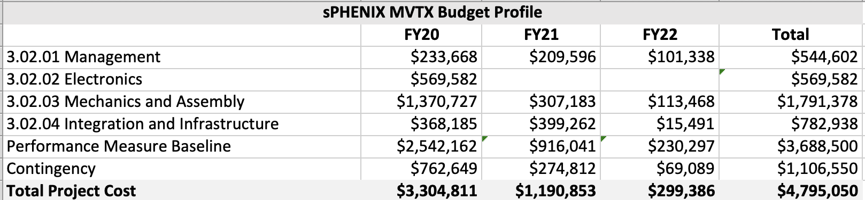
MVTX Capital Project
Both the MVTX PMP and Review Response document is submitted for BNL approval.
  DOE-NP does not need to approve or concur
The MVTX accounts should be opened by next week
  LANL, LBNL, MIT and UT-Austin anxious to get started

Slide 7
sPHENIX Project Management Activities
September activities focused on getting BNL approval and DOE concurrence of PD-2/3.
Monthly EVMS process and Change Control are going well.
Baseline change request granted for updating the HCal tiles LLP (CD-3A) delivery schedule.
Electrical engineer hired to replace engineer that retired in January 2019.
Continue to place preproduction orders, prepare to place production (PD-3) orders and monitor procurements.

Slide 8
sPHENIX Technical Accomplishments
All 32 Outer Magnet Steel/HCal sectors at BNL.
All LLP’s approved at CD-3A have been placed. They are: 100k SiPMs, 2500km of Scintillating fiber for EMCal, 6400 Scin tiles for HCal, 19 metric tons of tungsten powder for EMCal.
Partial delivery of LLP-1 orders, 68k/100k SiPMs, have arrived at Univ. of Michigan. Partial deliver of LLP-2 scintillating fibers, 700/2500 km, have arrived at UIUC. Partial delivery of LLP-3 1600/6400 tiles have arrived at GSU. Expect 5.8 tons of tungsten powder, LLP-4, at UIUC this week.
Instrumentation of 6 of 32 Outer Magnet Steel sectors (OHCal sectors) begun with preproduction parts.
  Goal is to have 1st OHCal sector fully instrumented and reading out cosmics events within the next 3 weeks
SAMPA v5 (TPC ASIC) engineering run chip order placed with vendor. FDR complete.
EMCal preproduction Sector 0 assembly complete, and testing advanced. All mechanics orders and most electronics orders for Sectors 1-12 placed. Sector 1 blocks nearing completion at UIUC.
MBD Prototype Discriminator/Shaper Board completed at Nevis Labs. At BNL for further testing.
Order for LHe cryo (2.X) components of SC-Magnet cryo system awarded
R&D work progressing on all sPHENIX detector components.

Slide 9
EMCal Block Production at UIUC
All fibers filled for sectors 1-12. Begun fiber filling for sectors 13-64 production blocks.
Need approximately 5000 fiber sets total.
Complete blocks at UIUC for Sector 1. The remainder are in various stages of completion.
Expect supply of tungsten powder sufficient to build blocks for sectors 5 – 39 at UIUC by early December. Balance of tungsten powder to be ordered late spring 2020

Slide 10
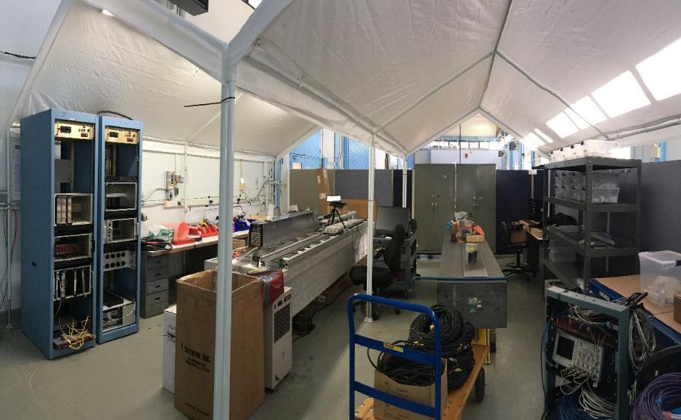
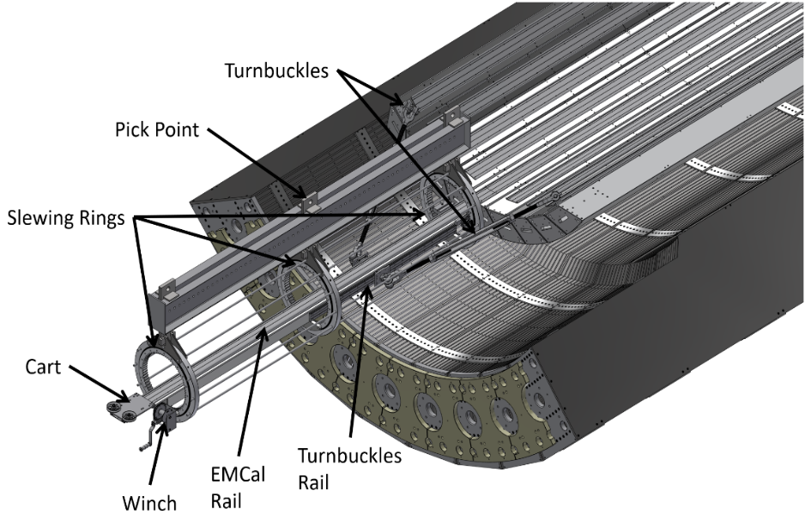
EMCal Sector Testing
Sector Update
Sector 0 test progressing well. Full cabled. Ready to finalize revised cooling loop design.
BNL area is set-up for sector fabrication
Advanced design for EMCal sector insertion in the sPHENIX detector.
  Plan to test the insertion scheme with the preproduction sectors.

Slide 11
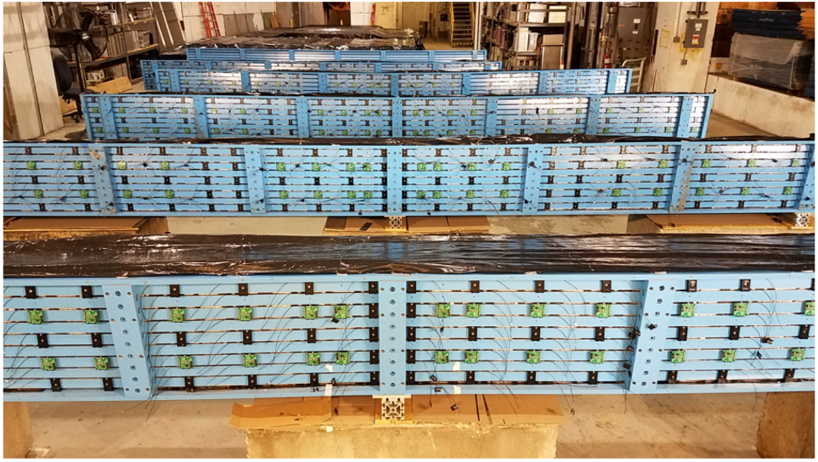
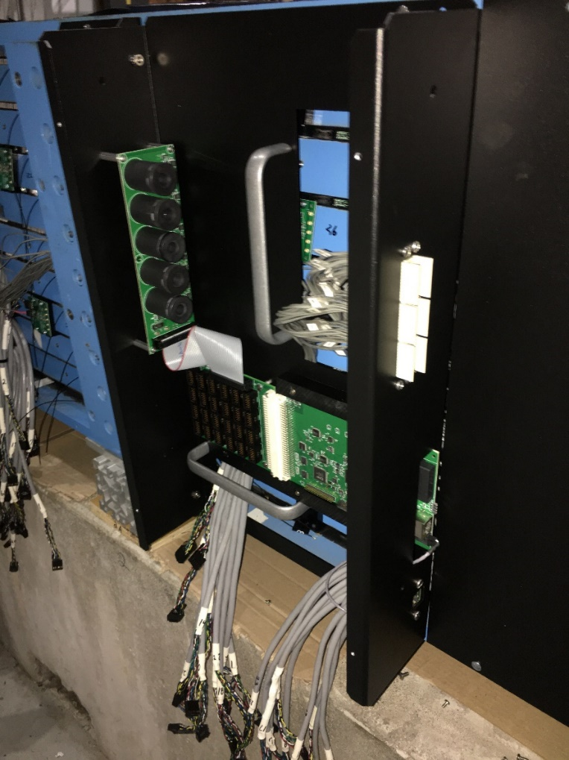
OHCal Instrumented Sectors
Six sectors instrumented with scintillating tiles & SiPMs
HCal electronics boxes to be mounted on each sector. The boxes carry power supplies, power distribution, interfaces cards for each sector.

Slide 12
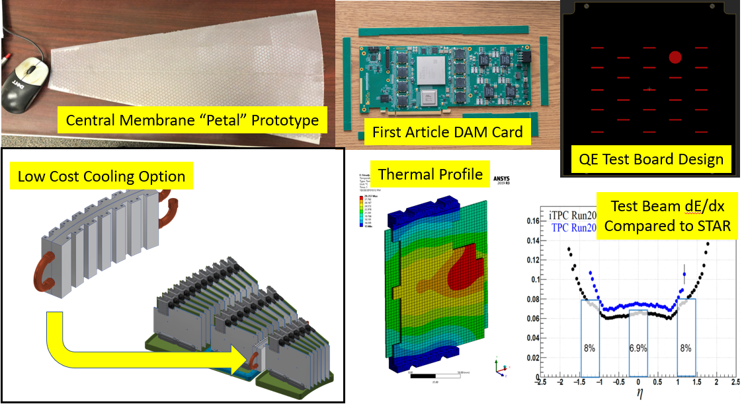
TPC Progress
Prototype of TPC central membrane work continues at SBU
First article of the preproduction FELIX 2.0 (DAM) card
Test board design for TPC Quantum Efficiency measurement
dE/dx particle ID capability of the sPHENIX TPC prototype based on test beam data
Finite element study of thermal performance of TPC FEE cooling
3-D model of TPC Fee cooling scheme.

Slide 13
TPC Progress
Simulation, design and prototyping on the plan to use laser light shining on an aluminum-coated central membrane to measure the TPC quantum efficiency during detector operation.
Engineering run for SAMPA v5 chips have been placed with IMEC/TSMC. We expect the first 21 wafers to be available within 3 months.
  U Sao Paulo will do the initial testing with Lund University testing all of the 2000+ chips
  A successful engineering run would be followed by the production of 30+ wafers that would supply all the required production SAMPA v5 chips.
The TPC Fee board cooling system has been redesigned to allow easy manufacture of components in the SBU shops.
  Thermal FEA studies show that the cooling fixtures meet performance specs

Slide 14
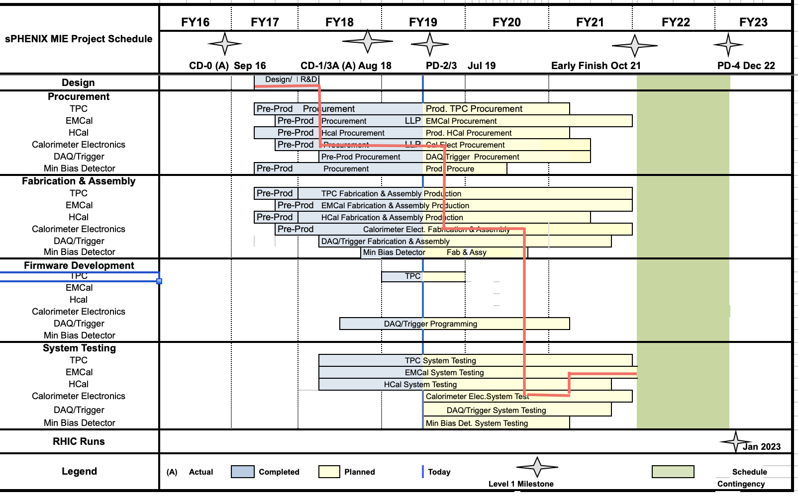
MIE Critical Path

Slide 15
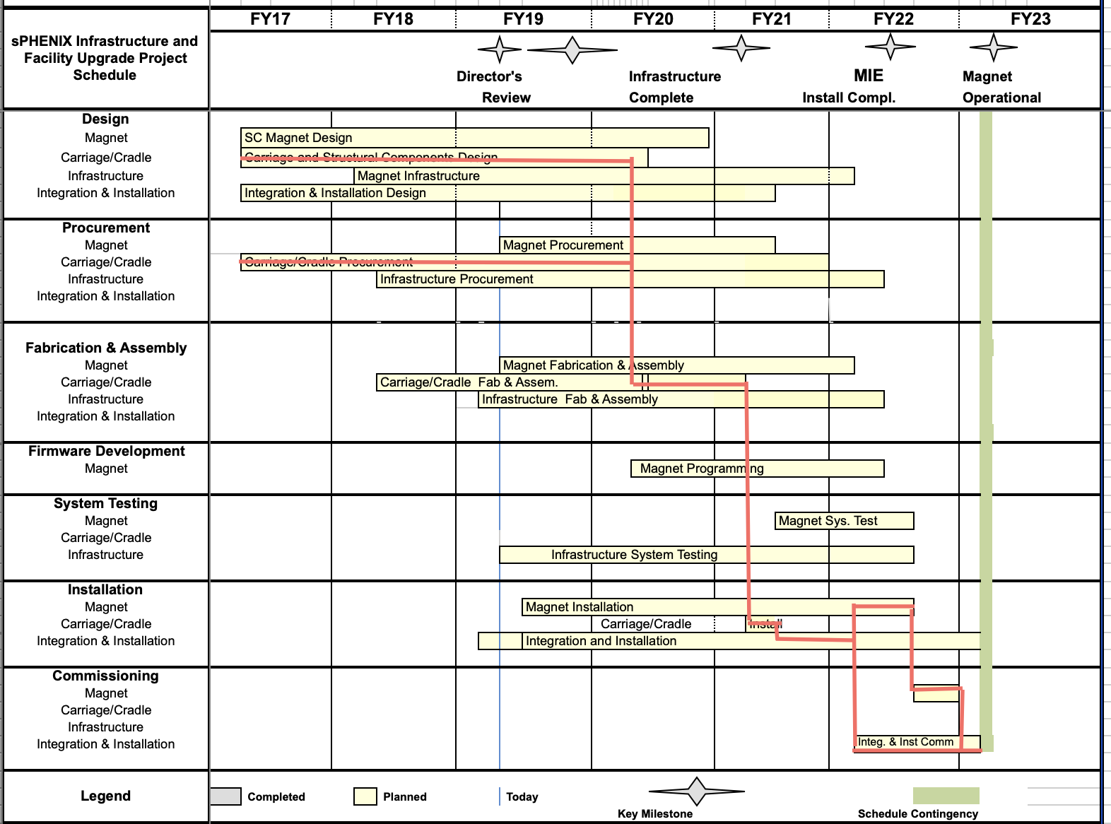
2.X Critical Path

Slide 16
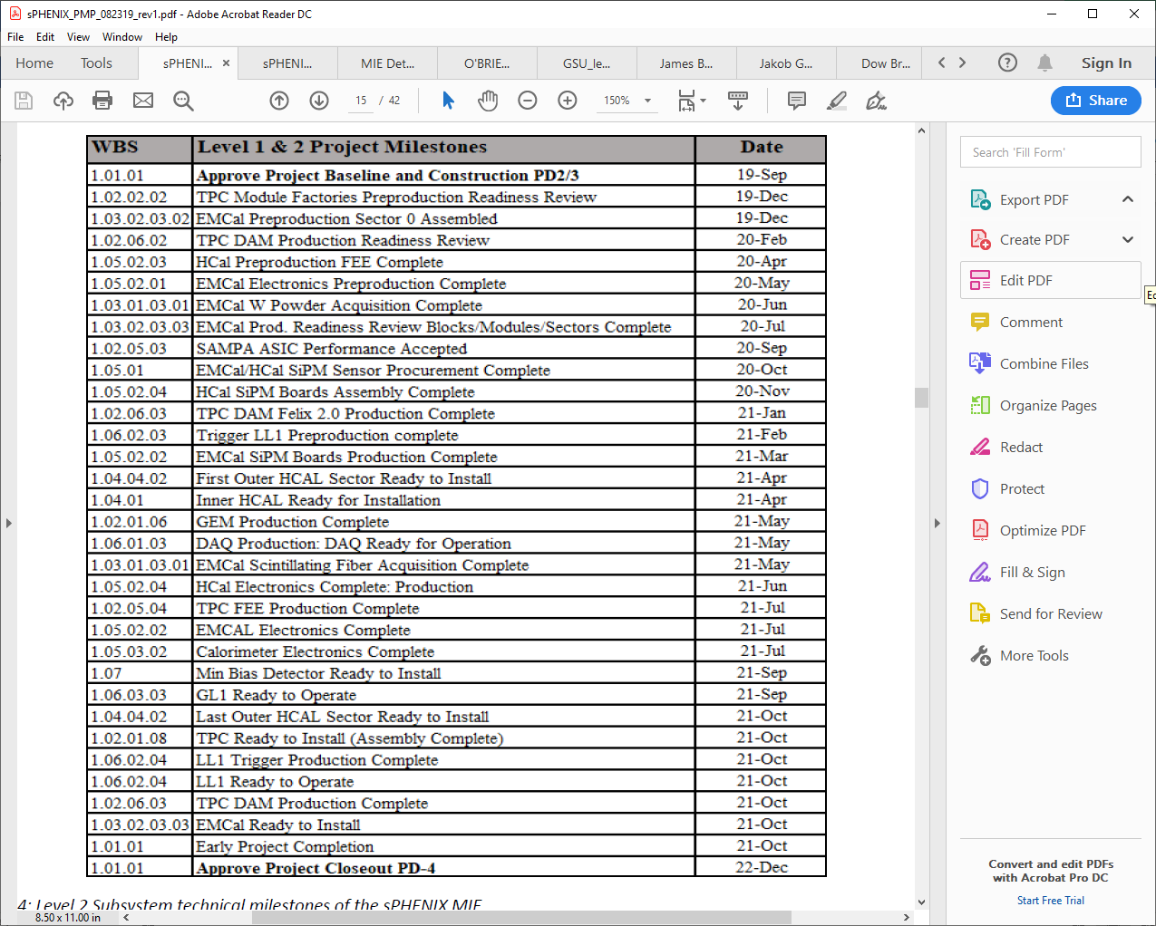
MIE Milestones

Slide 17
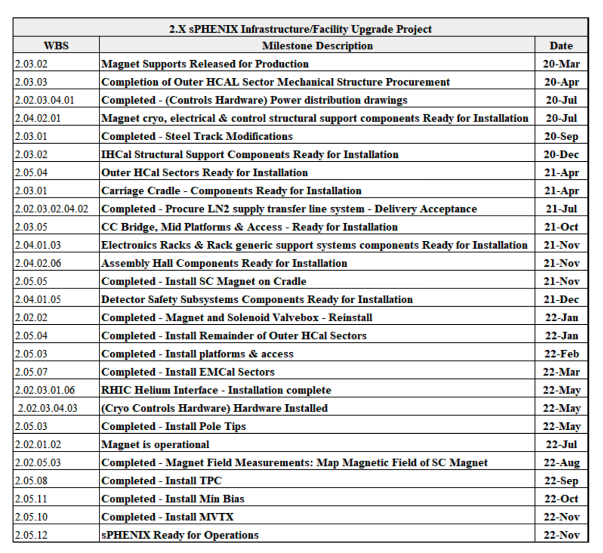
2.X Milestones

Slide 18
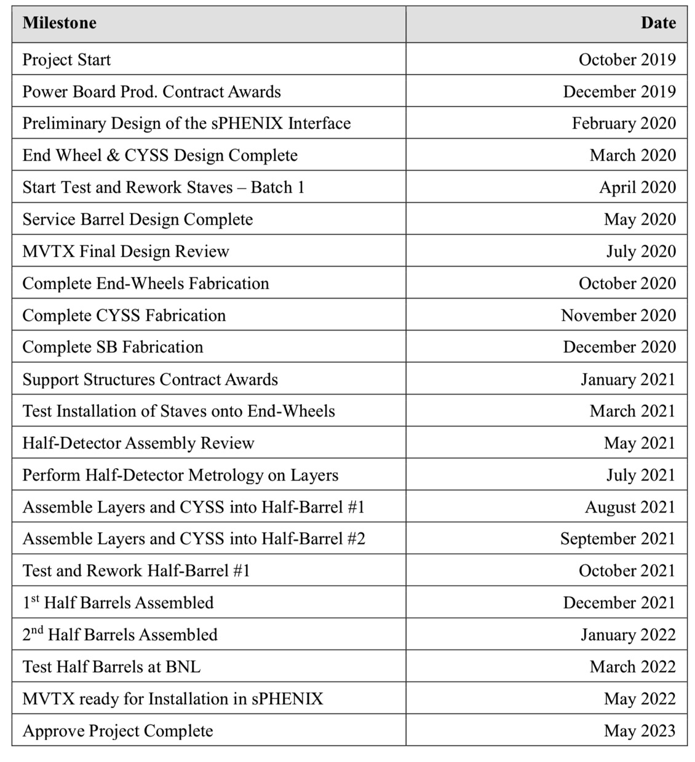
MVTX Milestones

Slide 19
Summary
sPHENIX has received BNL PD-2/3 Approval as of September 20
sPHENIX MIE continues to have good cost and schedule performance as measured by EV.
MIE preproduction and CD-3A production is speeding up. A lot of technical progress.
R&D and engineering design continues to advance.
The 1008 LHe cryo parts order has been awarded (2.X). Next big 2.X order is the Carriage/Cradle which we plan to have submitted to BNL for approval in November.

Slide 20
Back Up

Slide 21
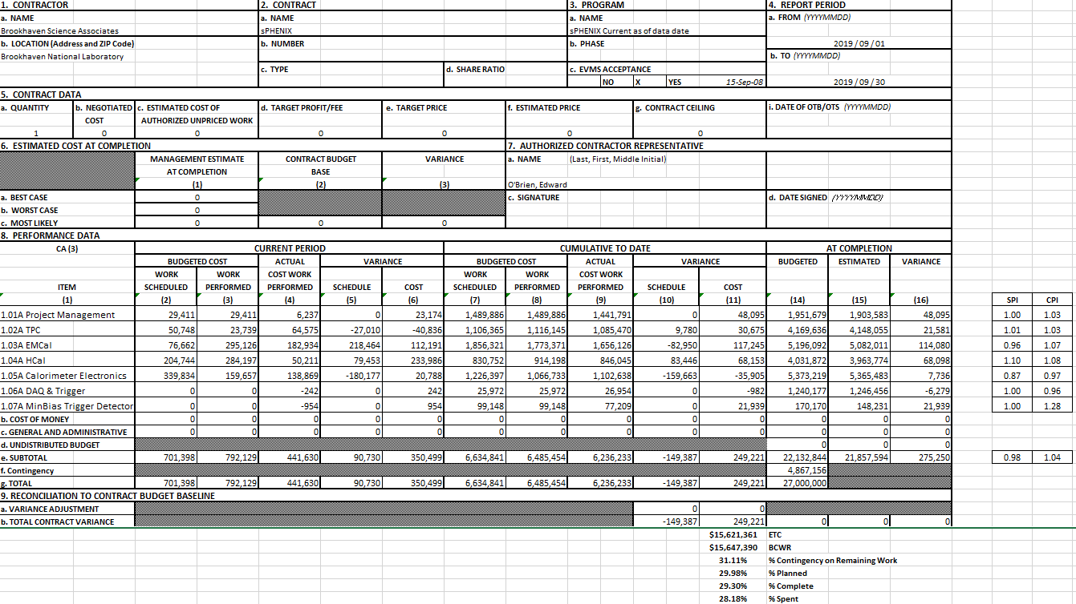
MIE Cost Performance Report as of 9/30/19

Slide 22
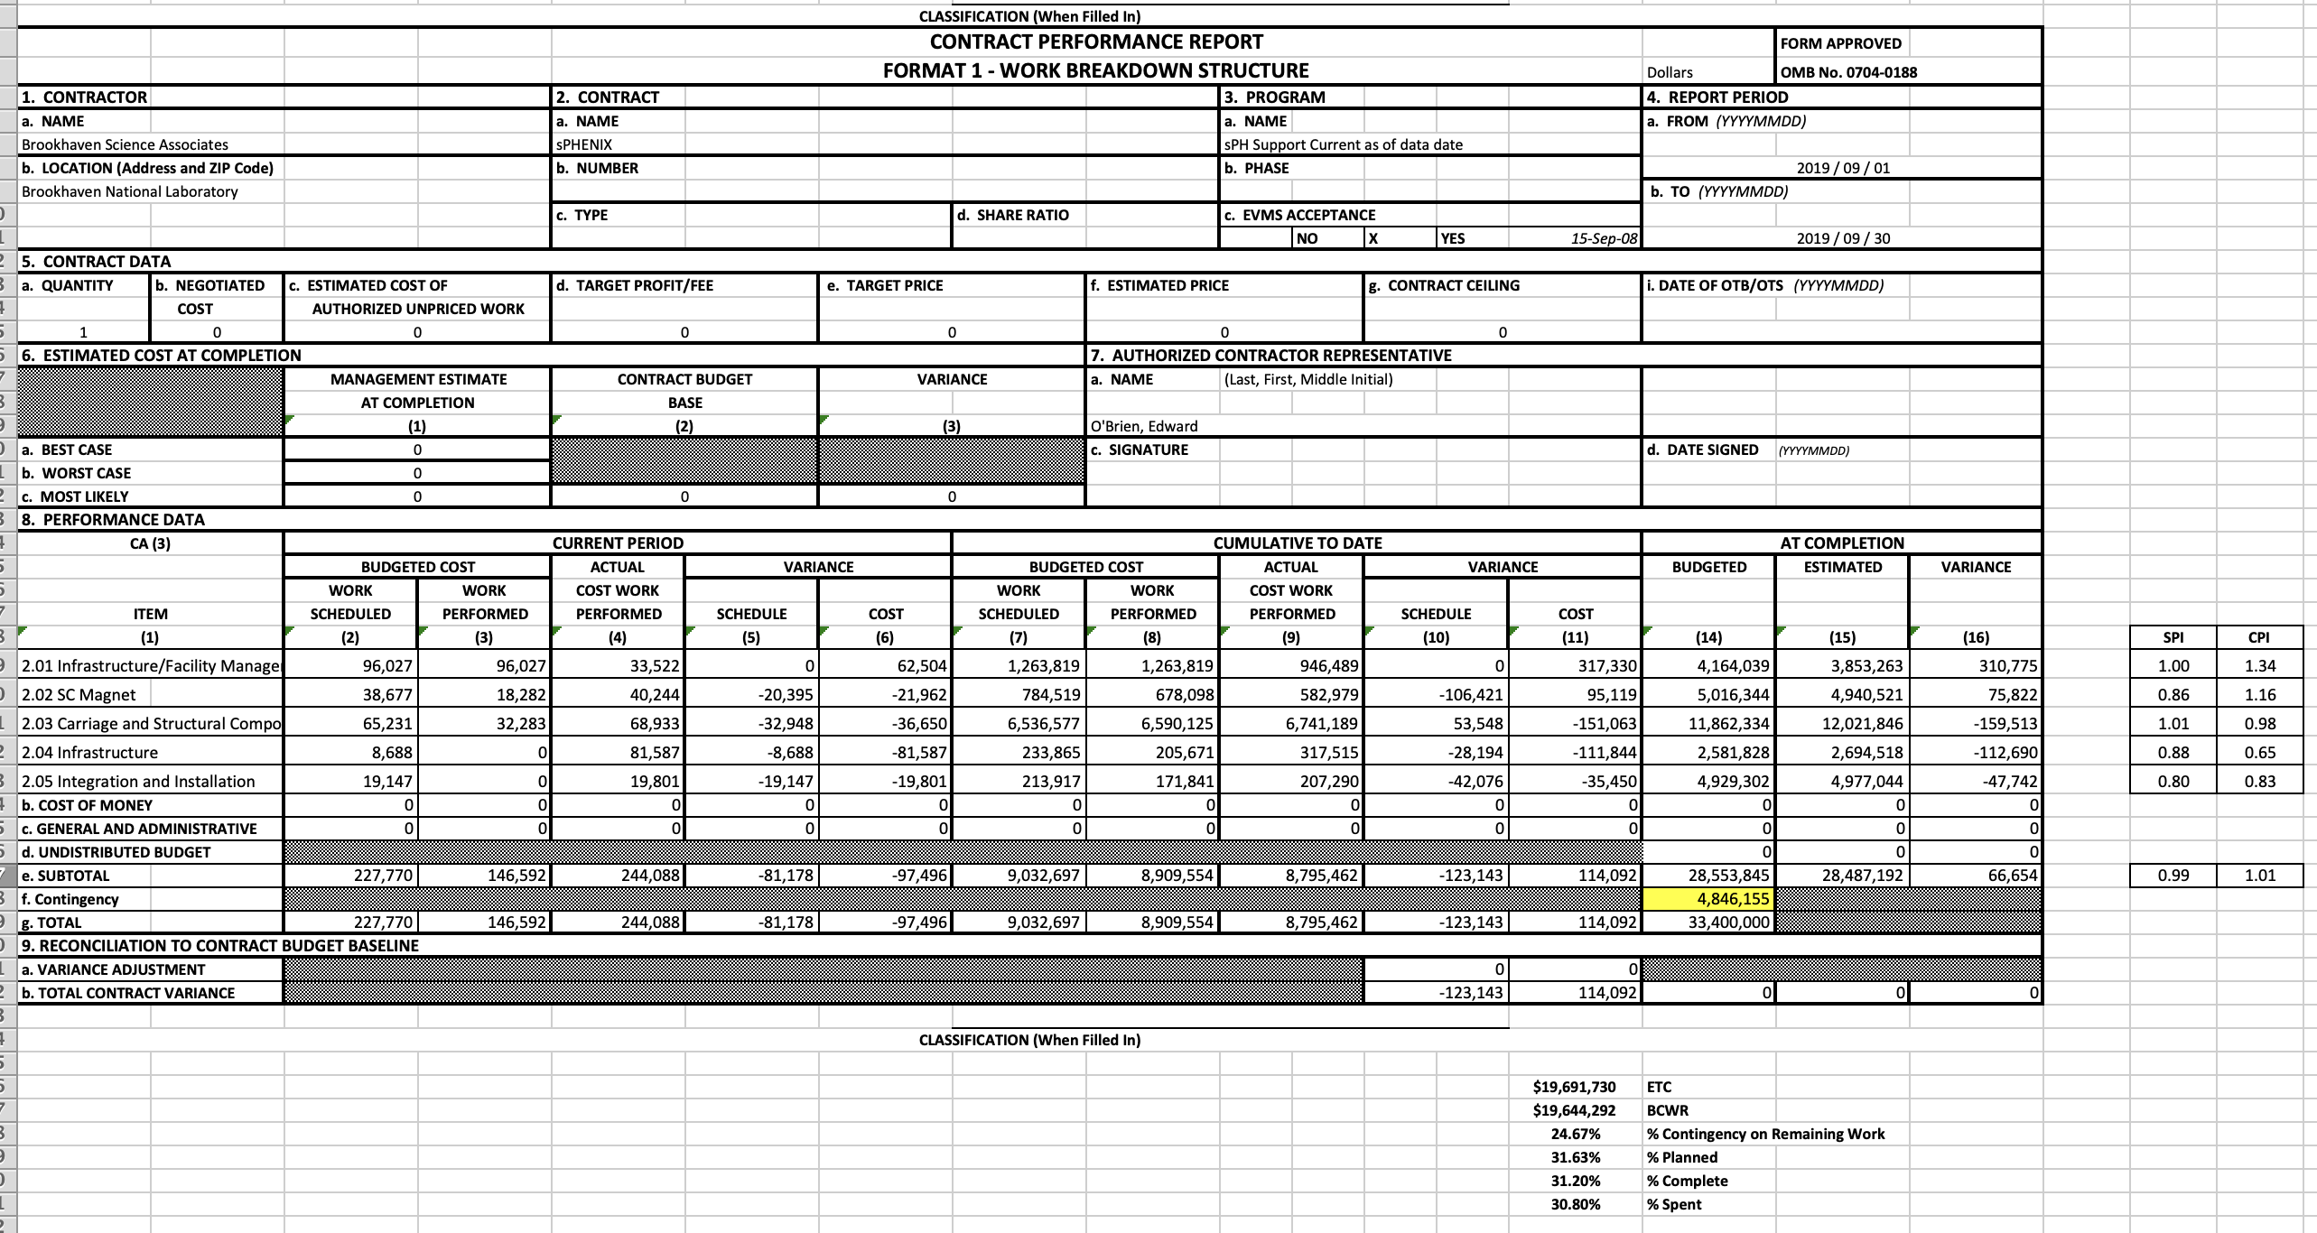
2.X Cost Performance Report as of 9/30/19

Slide 23
sPHENIX Project Priorities
Place sPHENIX Orders, especially for items on/near the critical path:
  Carriage/Cradle
  EMCal SiPM daughter cards (sectors 1-12)
  EMCal power/signal cables (sectors 1-12)
  University contracts for 2020 with UIUC, SBU, WSU
  All production EMCal light guides
  MVTX orders for 2020 (LANL, LBNL, MIT, UT-Austin)
  HCal splice plates
Continue monthly status, EV, PCR for both 1.X and 2.X

