Slide 1
NoMachine (NX) Infrastructure Upgrade

Slide 2
Current Implementation
NoMachine/NX is X Window system acceleration technology that improves the usability of X based applications over the wide area network
NX servers on the RHIC side:
nx01/nx02/nx06/nx07.rcf.bnl.gov
NX servers on the ATLAS side:
atlasnx01/atlasnx02.usatlas.bnl.gov
BNL Campus Zone/Science Zone – rcf3.rhic.bnl.gov (changes in implementation)
- tex.sdcc.bnl.gov,cups01.sdcc.bnl.gov,cterm.sdcc.bnl.gov
These are NoMachine Terminal Servers – standalone server/unlimited concurrent virtual desktops - control, scalability and secure access.

Slide 3
Science Zone
NX terminal servers:
RHIC NX servers
ATLAS NX servers
BNL Campus Zone
rcf3.rhic.bnl.gov
Authentication via SSH tunnel through gateway servers and Kerberos credentials

Slide 4
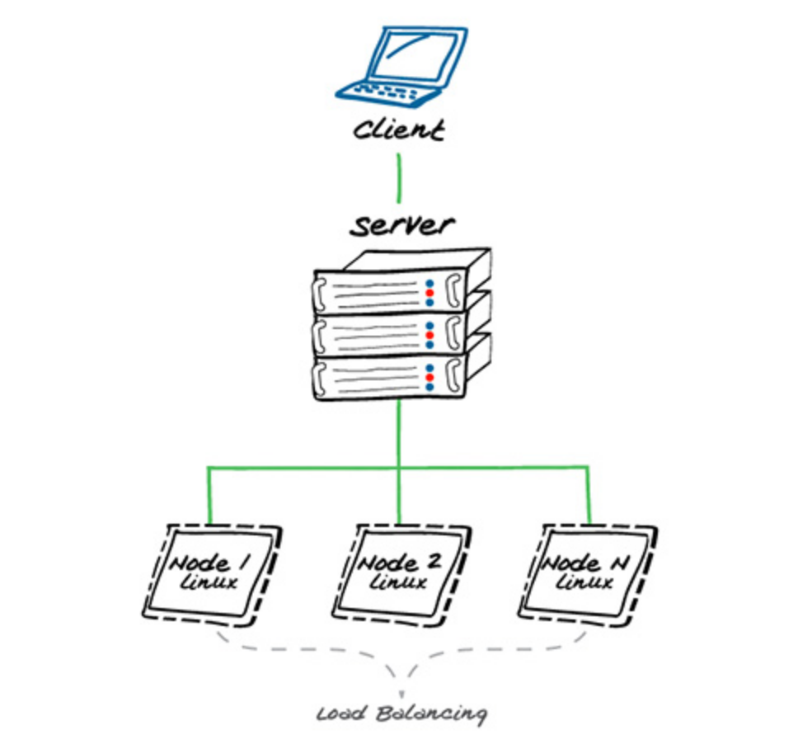
Future Implementation
SDCC NX servers – Integration made possible after IPA migration
Multi Node Environment – Federate all desktop nodes under a single server
NoMachine Enterprise Terminal Server – Terminal Server Nodes
- Enterprise Terminal Server - accepts connections and acts as a single point of access to the nodes
- A Terminal Server Node is not a server, it refuses all direct connections and can work only behind
an Enterprise Terminal Server.
nxserver --nodelist
Node Protocol Label Status Load-B Manual-S Weight
--------------------------- -------- ----- ------- ------ -------- ------ -----
term01:4000 NX running yes yes
term02:4000 NX running yes yes
localhost:4000 NX running no no

Slide 5
NX Client
NoMachine Client – setup with SSH protocol – currently used
Protocols – NX – native protocol used by NoMachine and is optimized for multimedia data
SSH – industry standard for accessing computing
resources from external networks
NX session connections by Web Browser -
https://myserver.com:4443/nxwebplayer
Program | Default port | Scope
nxd | 4000 | Accept connections by NX protocol
nxhtd | 4080 and 4443 | Accept connections by HTTP protocol (connections by the web)

Slide 6
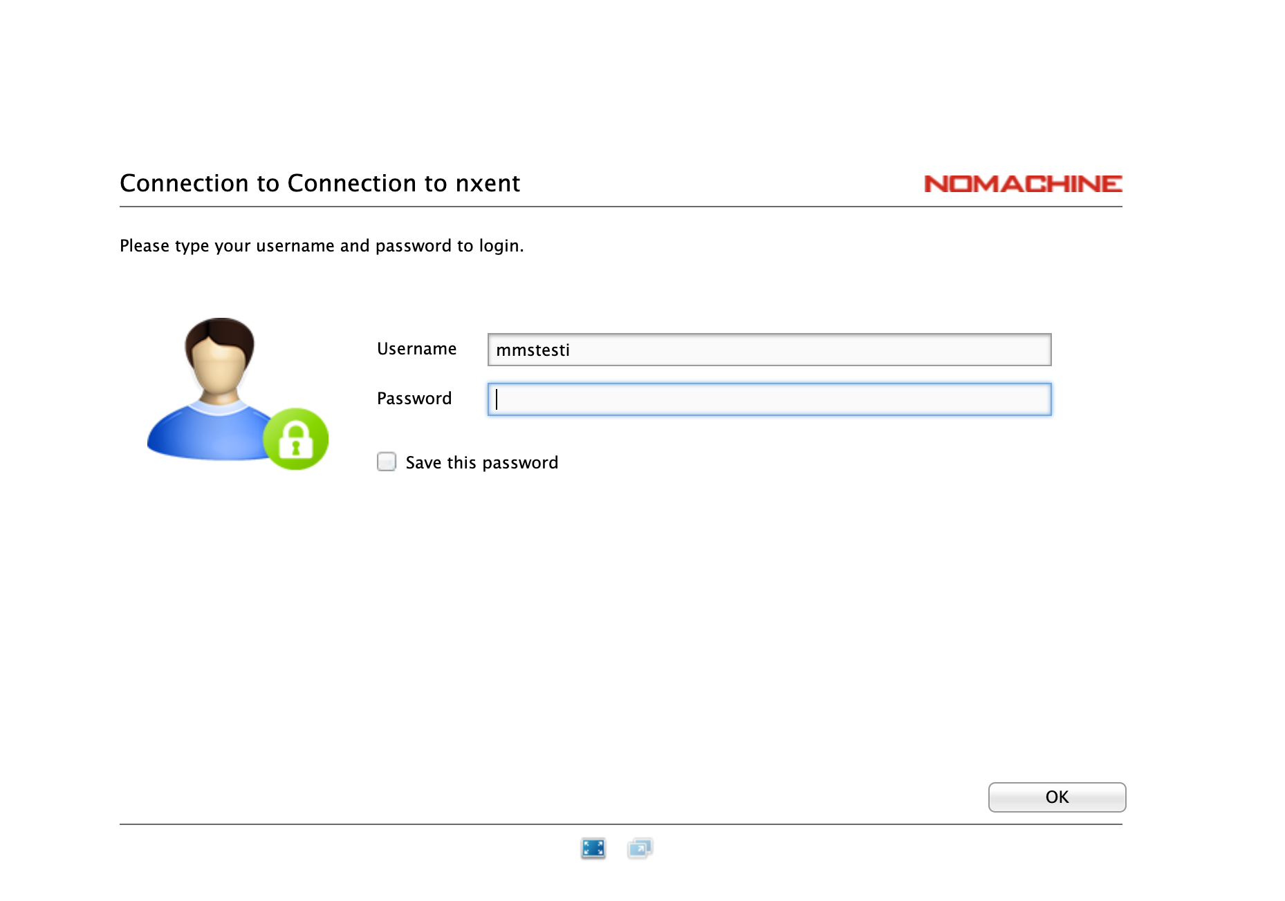
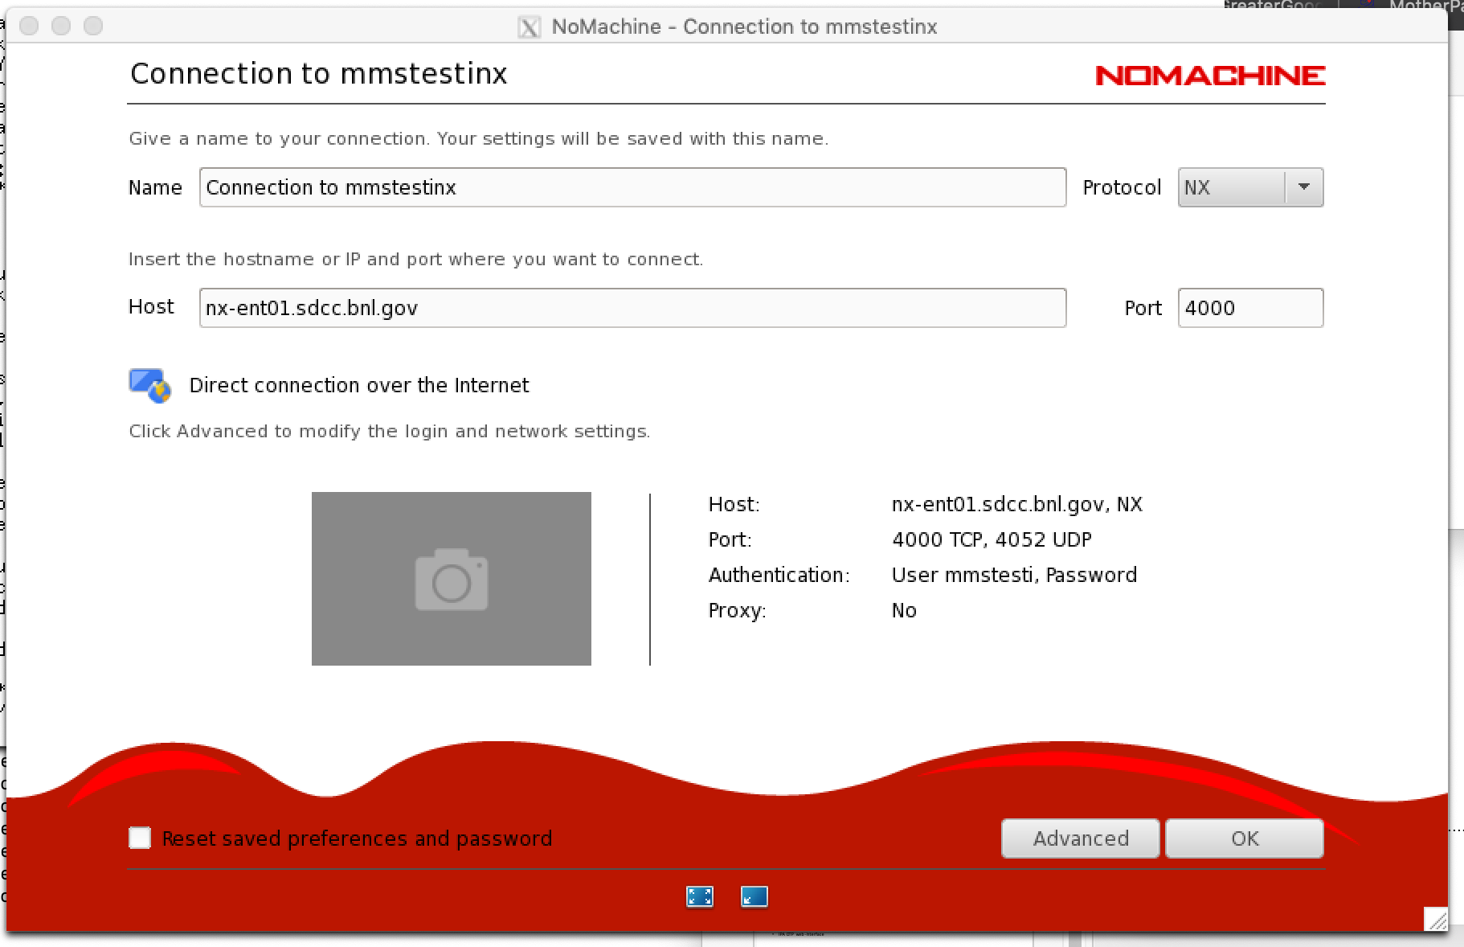
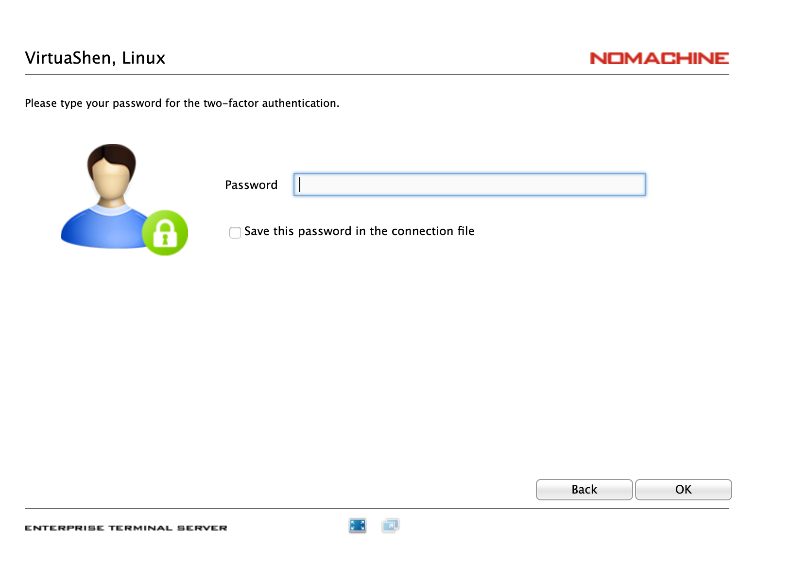
Authentication for NX web browser sessions and NX clients
– Kerberos credentials and IPA OTP method tested

Slide 7
NX/HTTPS Protocol
NoMachine Enterprise Terminal Server
(Science DMZ zone)
NoMachine Client/ Web Browser
Authentication – Kerberos & IPA OTP method
NX protocol
NX protocol
NX protocol
NX protocol
To Do:
Logistics
IPA OTP web-interface – user access
BNL Campus Zone Terminal Server Nodes Science Zone

