Slide 1
Software and Computing Status and Goals
https://indico.bnl.gov/event/7096/

Slide 2
2023

Slide 3
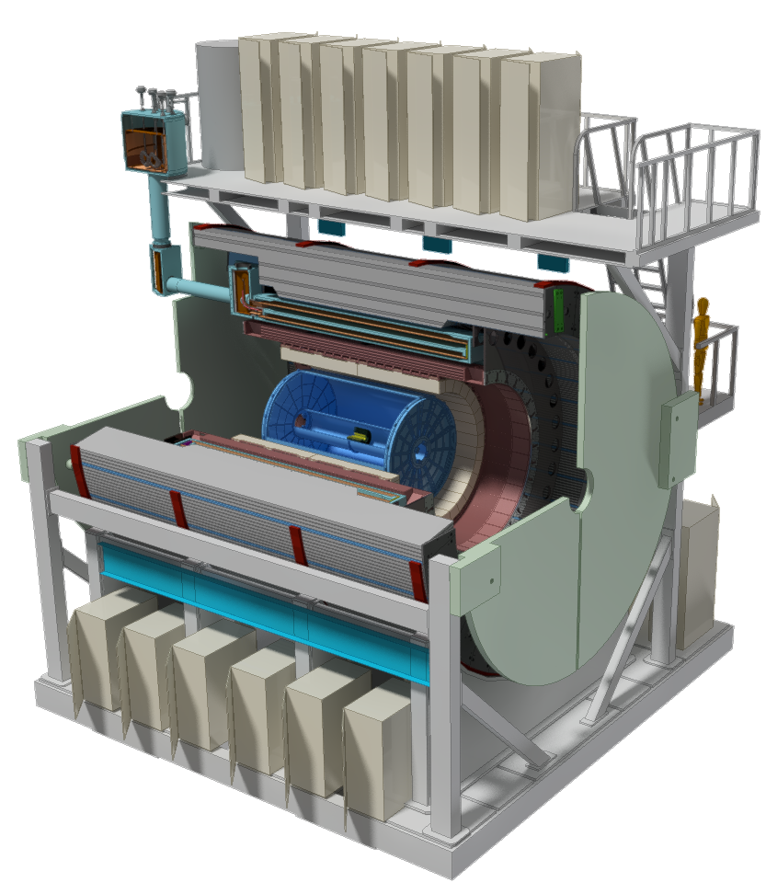
sPHENIX Detector Overview
Hadronic Calorimeters
Electromagnetic Calorimeter
Time Projection Chamber (TPC)
Intermediate Tracker (INTT)
Minimum Bias Detector (MDB)
MicroVertex Detector (MVTX)
Standard Collider Detector

Slide 4
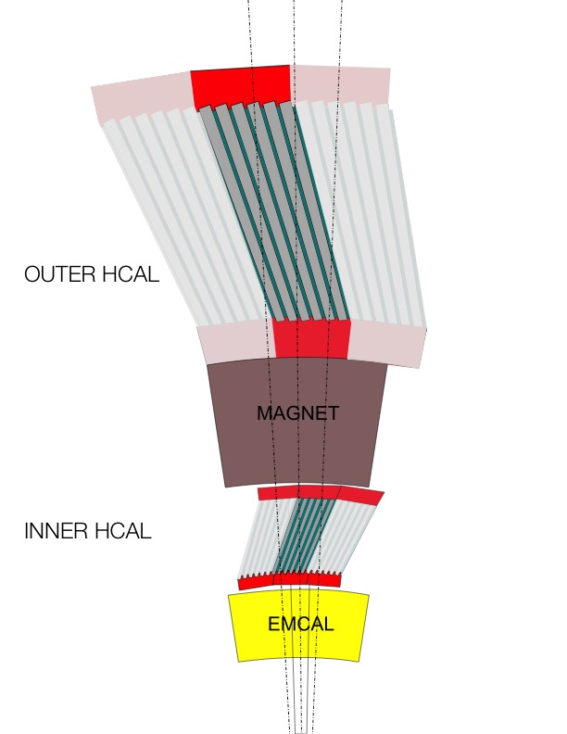
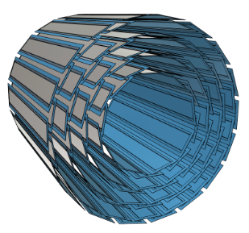
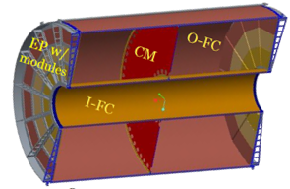
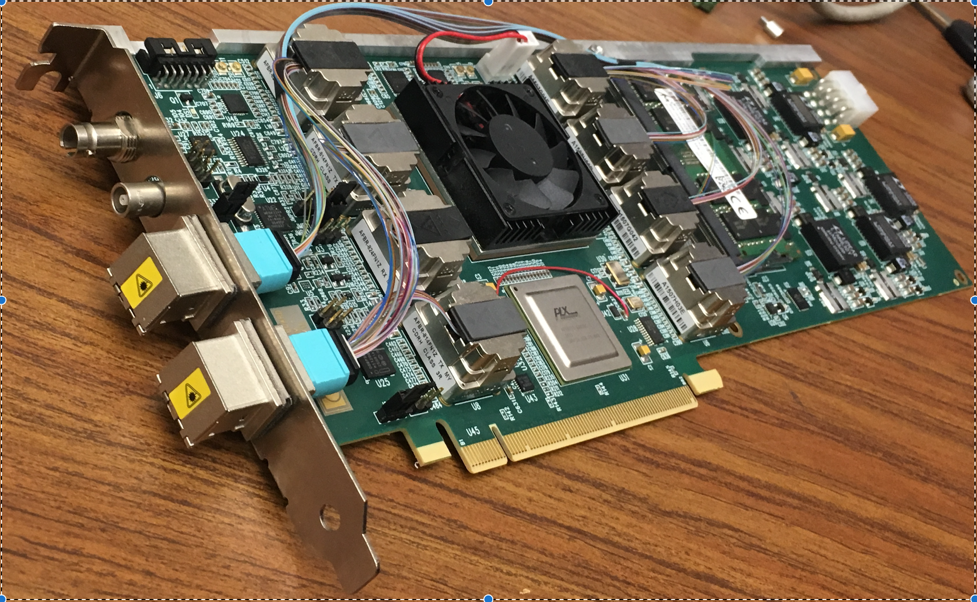
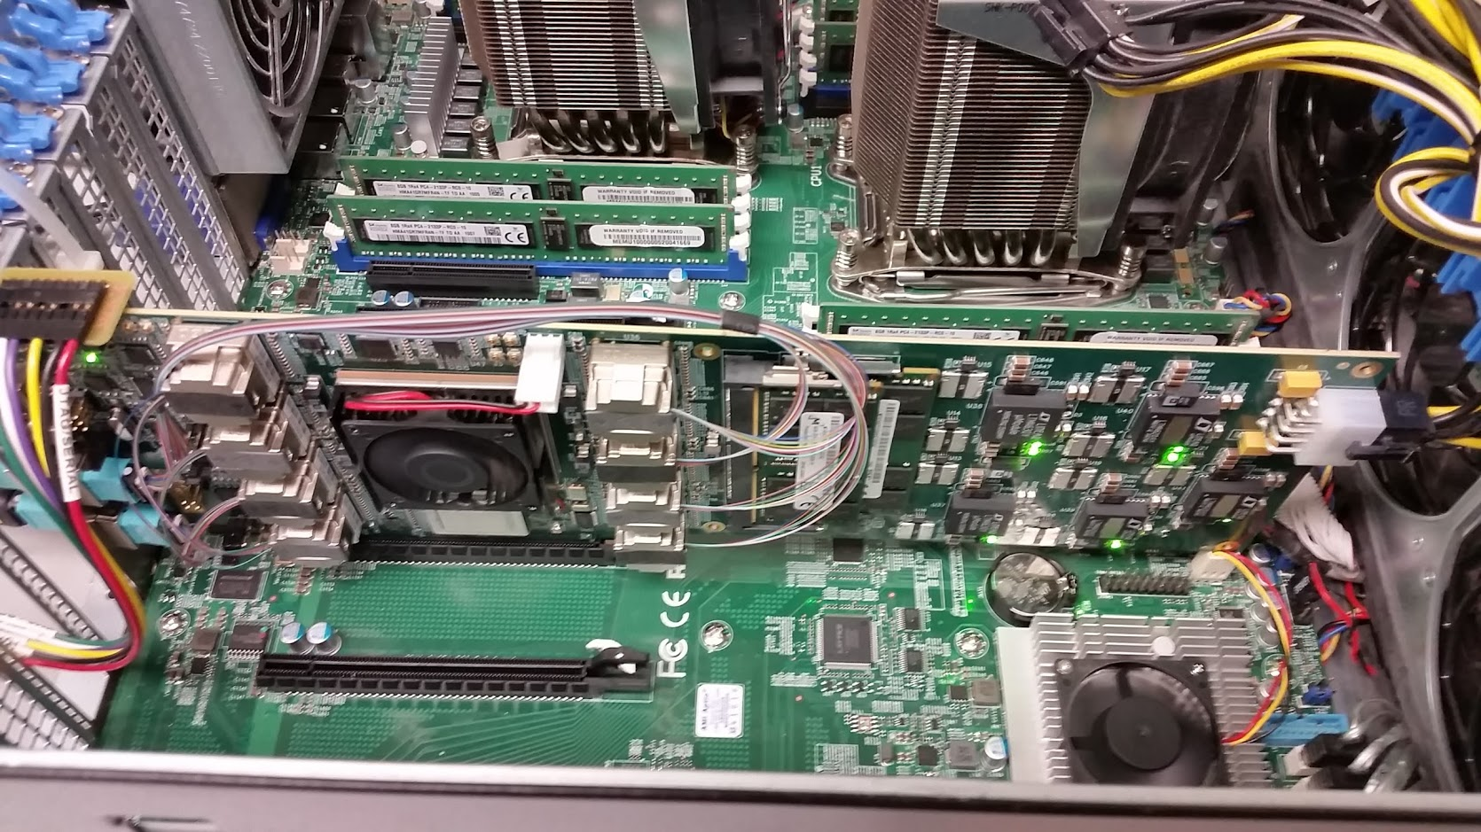
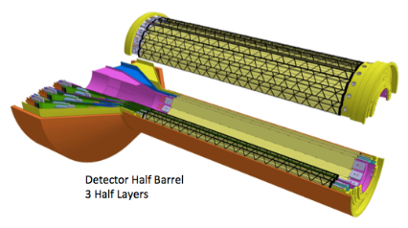
Two Classes of Front-end Hardware
The calorimeters, the INTT, and the MBD re-use the PHENIX “Data Collection Modules” (v2)
FEM
DCM
DCM2
DCM
DCM
DCM
DCM
FEM
DCM
DCM
DCM
DCM2
DCM
DCM
DCM
Triggered readout
FEM
DCM
DCM
DCM
DCM
DCM2
Calorimeters,
INTT, MBD
DCM
DCM
DCM
The TPC and the MVTX are read out through the ATLAS “FELIX” card directly into a standard PC
FEE
DCM
DCM
FELIX
PC
DCM
FEE
DCM
DCM
FELIX
PC
DCM
FEE
DCM
FELIX
PC
DCM
Streaming readout
TPC, MVTX
DCM
Rack Room
ATLAS FELIX Card
Installed in a PC
All events selected by Lvl1 triggers are archived
no high level triggers → No need for online event building → Event building done Offline

Slide 5
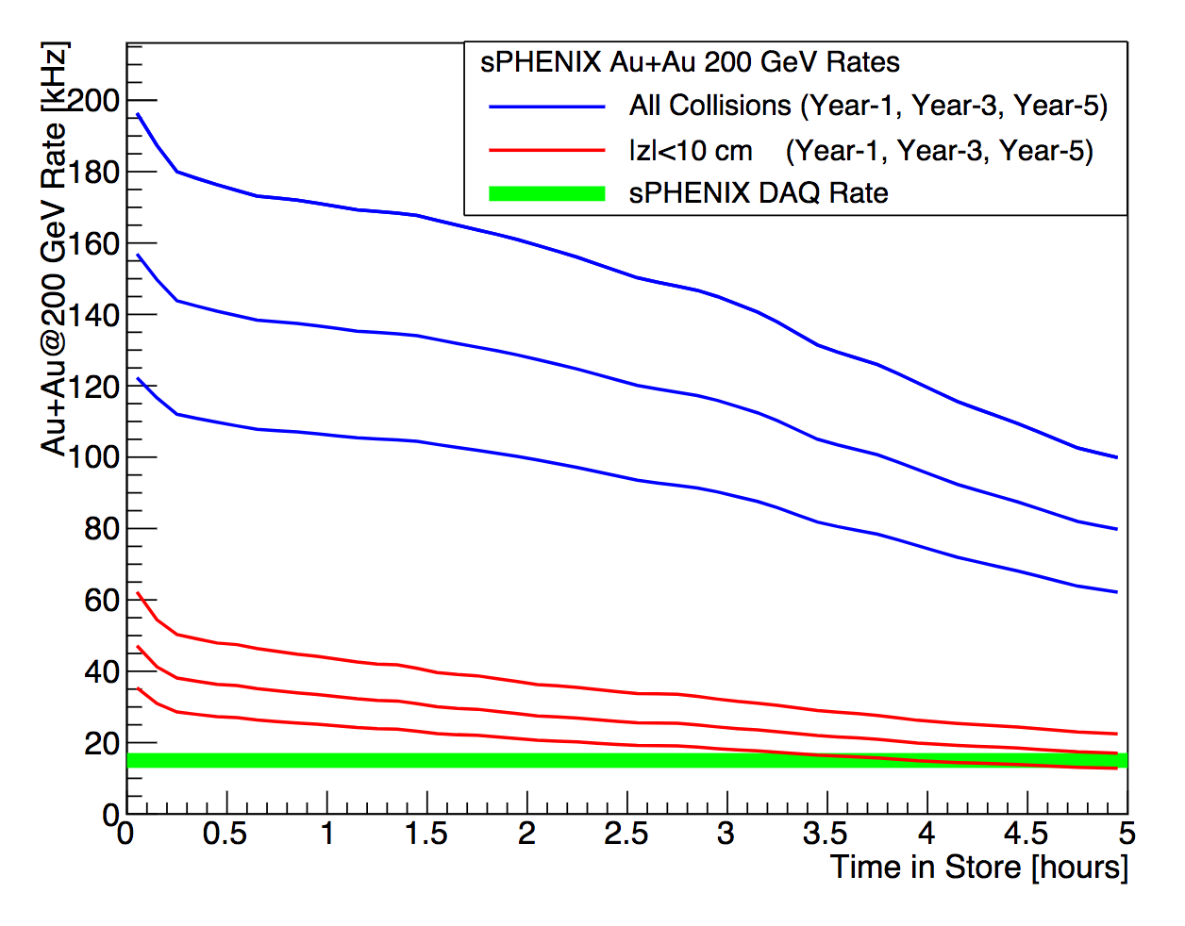
Data rates (Au + Au)
Unlike many other experiments sPHENIX will be exposed to collision rates from a collider with 20 years of experience and optimization
All Vertices
Year 5 (2027)
Year 3 (2025)
Year 1 (2023)
|Z| < 10cm
Year 5 (2027)
Year 3 (2025)
Year 1 (2023)
15KHz DAQ rate
Even at the end of a store we can saturate the DAQ rate with collisions in the narrow Z range, the TPC will see the full rate as pileup
This plot show the advertised collision rates as a function of Time in Store
Notes:
The point to make is that with current RHIC projections, we can always acquire events at 15 kHz.

Slide 6
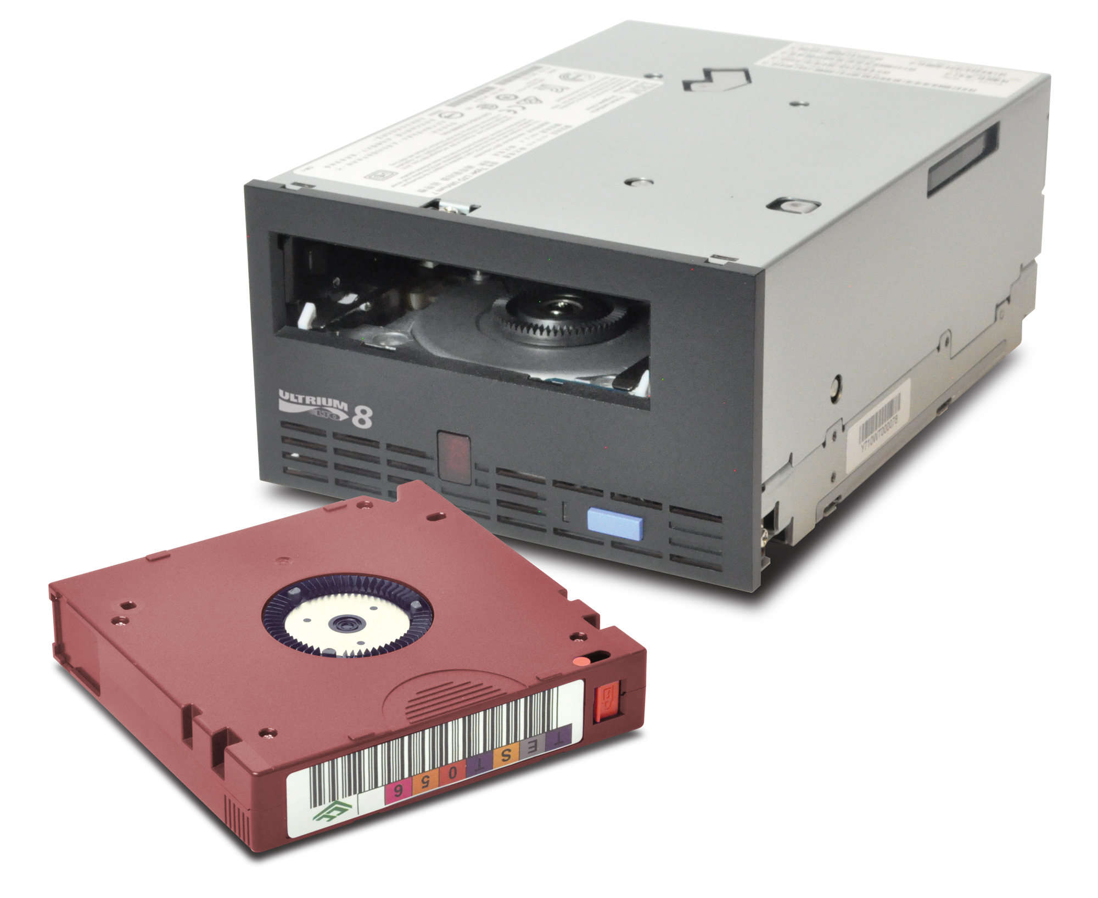
Total Data volumes
Au + Au
Year 1: 47 billion events * 1.7 MB = 75 PB
LTO-9: 75 * 1024 TB / 20TB = 3840 tape cartridges
LTO-10: 75 * 1024 TB / 48TB = 1600 cartridges
Year 2: 96 billion events * 1.6 MB = 143 PB
LTO-9: 143 * 1024 TB / 20TB = 7300 tape cartridges
LTO-10: 143 * 1024 TB / 48TB = 3500 cartridges
Year 3: 96 billion events * 2.3 MB = 205 PB
LTO-10: 205 * 1024 TB / 48TB = 4400 cartridges
The 2023-era tape drives (“LTO-9”) can sustain about 4.5GBit/s real-world throughput (20TB capacity)
Next-gen LTO-10 has 8GBit/s throughput (48TB)
p + p
p + Au
Au + Au
Current-generation LTO-8

Slide 7
CPU Projections
CPU-cores | year-1 | year-2 | year-3 | year-4 | year-5
calorimetry | 1.6E+04 | 2.4E+04 | 3.2E+04 | 2.4E+04 | 3.2E+04
tpc-calibration | 1.9E+04 | 2.0E+04 | 4.0E+04 | 2.4E+04 | 4.0E+04
reconstruction | 5.8E+04 | 7.9E+04 | 1.2E+05 | 7.9E+04 | 1.2E+05
analysis | 1.9E+03 | 2.4E+03 | 4.0E+03 | 2.4E+03 | 4.0E+03
total (no ana) | 9.3E+04 | 1.2E+05 | 1.9E+05 | 1.3E+05 | 1.9E+05
Current estimate = 100k (Year-1) to 200k (Year-3) CPU-core required
on current hardware
Incl. 10k cores for TPC calibration current inversion
Depends on reaching 24 core-sec/ev milestone
Further improvement to tracking times will reduce CPU requirements below these numbers

Slide 8
Reconstruction + Analysis Flow
Hpss
Buffer
boxes
135Gb/s
HPSS
disk cache
Raw
HPSS
disk cache
DST
Tape
Raw Disk cache
20PB (2 weeks)
DST Disk cache
Calibration + Q/A
Size reduction + calibration pass
1st pass TPC tracking
Conditions DB
Analysis
Taxi
2nd pass TPC tracking + reconstruction
Online monitoring
Data
Calibrations

Slide 9
Software and Framework
https://github.com/sPHENIX-Collaboration/coresoftware
Development started in 2002, in use by PHENIX from 2003 on
Purely C++, ported to C++17 including all 3rd party libraries
Needed to get many subsystems who developed their code independently and without coordination under one umbrella
Modularity is key – components can be added/modified/removed without having to modify bits and pieces all over the place
Used for reconstruction, simulation, embedding of many PB of data and billions of events
Containerized (Singularity), distributed via /cvmfs, running on desktops, at CERN and (so far untested) likely on the OSG: https://github.com/sPHENIX-Collaboration/Singularity
Chat (Mattermost): https://chat.sdcc.bnl.gov/sphenix/channels/sphenix-software-help

Slide 10
Computing resources for workfest
Temporary high performance interactive hosts: rcas2001 to rcas2010, (needs an rcf account)
100TB disk space under /sphenix/data/data03/sphnxpro/user
SL7 builds (stock gcc 4.8.2) and gcc 8.3.1 builds
Rebuilding new distribution takes an hour from scratch
New 3rd party packages can be added instantaneously (if they build)
Chat: https://chat.sdcc.bnl.gov/sphenix/channels/2020-mega-workfest (non BNL accounts need invite, talk to us)

Slide 11
Workfest goals/subjects/logistics
2 Tracks:
Tracking (including distortion correction)
Everything else:
Simulations
Verification
Better CI integration
Calorimetry
Calibration
Offline Event building
Physics Analysis
Jets
Heavy Flavor
Computing Plan
Emphasis on getting actual work done
Few presentations in the morning
Work in small groups, involve new users and get them up to speed
Lots of time for discussions
One on one support for new users
Last ½ hour daily report from teams

Slide 12
2023

