Slide 1
Project Status
John Haggerty

Slide 2
sPHENIX Management Accomplishments
The sPHENIX MIE Project and the Infrastructure and Facility Project continues to perform well each month on the Earned Value parameters (work accomplished vs. work planned)
  This is due to the excellent work of the L2/L3 managers, cognizant engineers and project management experts.
The 2020 Federal budget has been passed and includes our planned FY20 sPHENIX MIE budget allocation of $9.5M.
  We will have the majority of the funds needed to complete the MIE
  We want to adopt an aggressive procurement plan
  We will exploit places where we can get ahead of schedule by making procurements as soon as we are ready.
  This approach improves the schedule, reduces risk and reduces the ETC.
MVTX Project Management Plan has been approved and signed by BNL
  Working to get contracts in place w/ LANL, LBNL, MIT and UT-Austin
  MVTX Readout units complete and available at CERN
  MVTX stave production is ongoing at CERN.

Slide 3
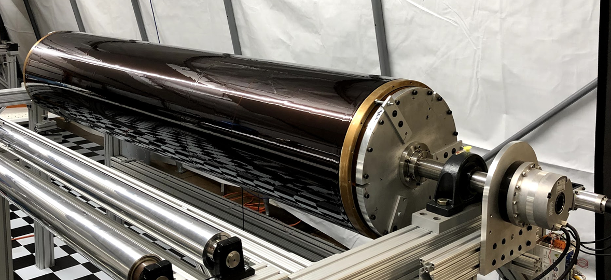
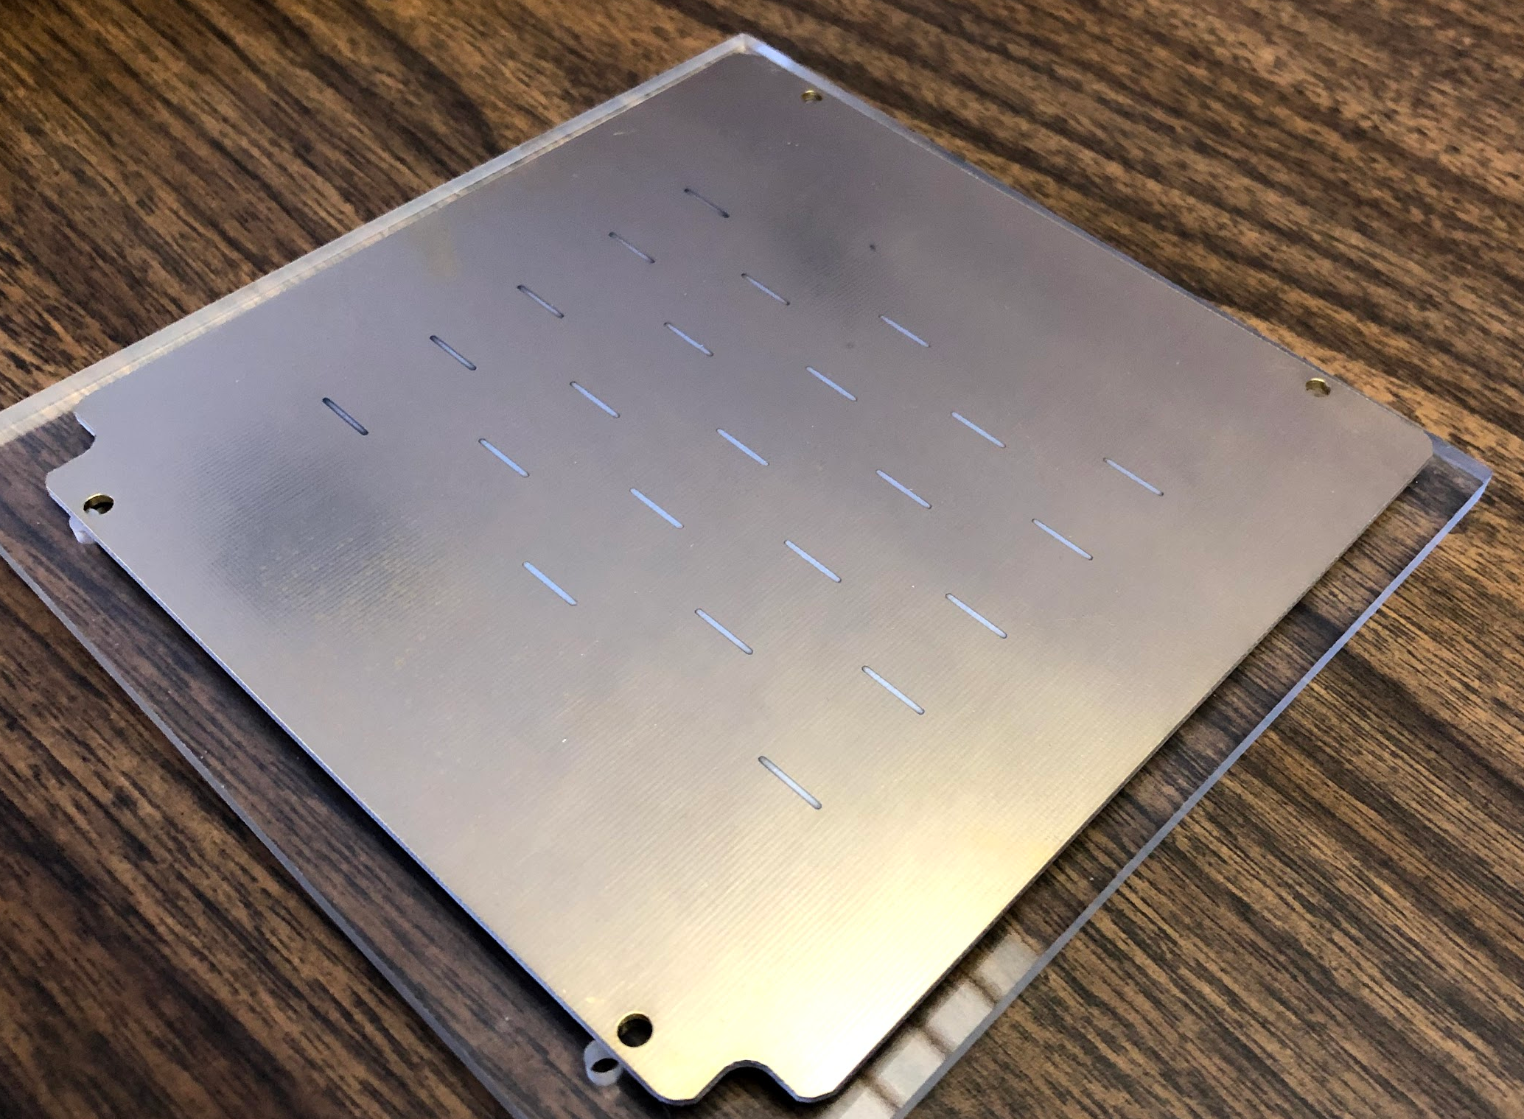
TPC Technical Progress
Evaporated CM Sample
HV test of the inner field cage
Test of evaporated photo-cathode small central membrane sample
SAMPA v5 first 4 wafers produced for engineering run and out for dicing and packaging, plan for testing worked out between USP and Lund

Slide 4
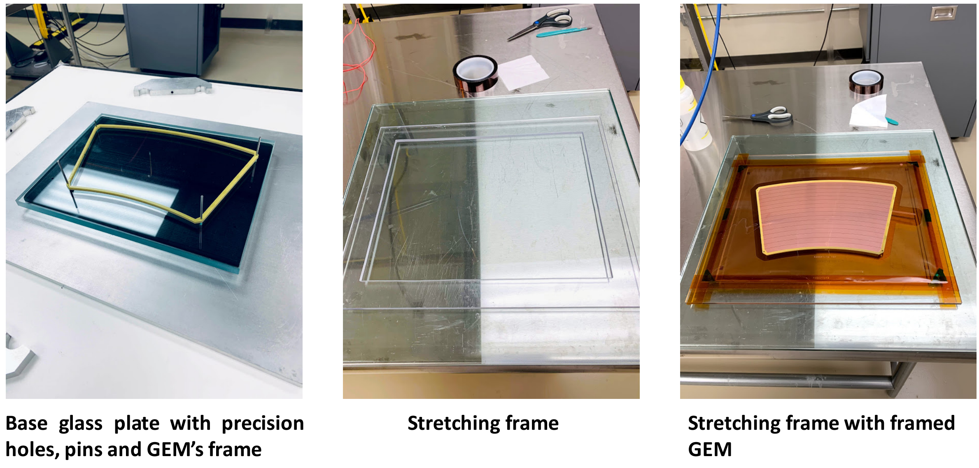
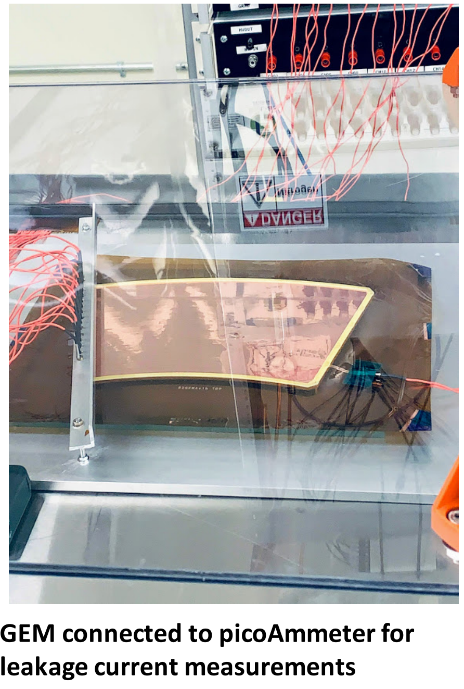
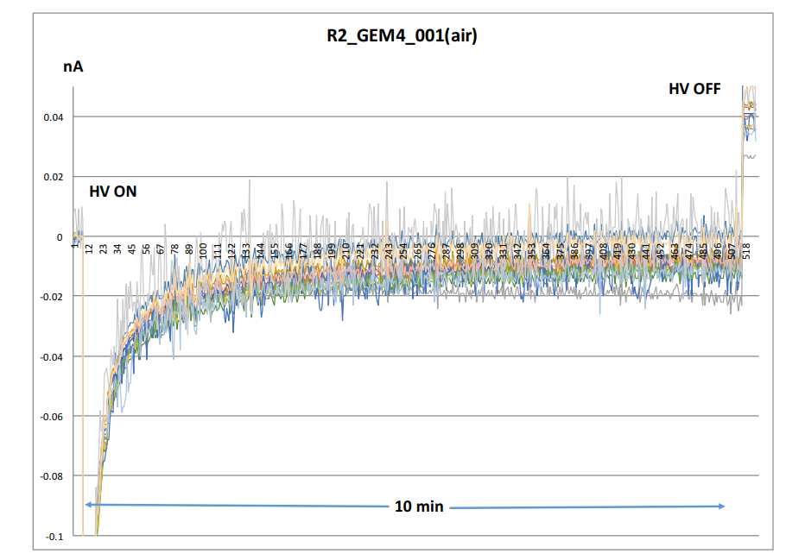
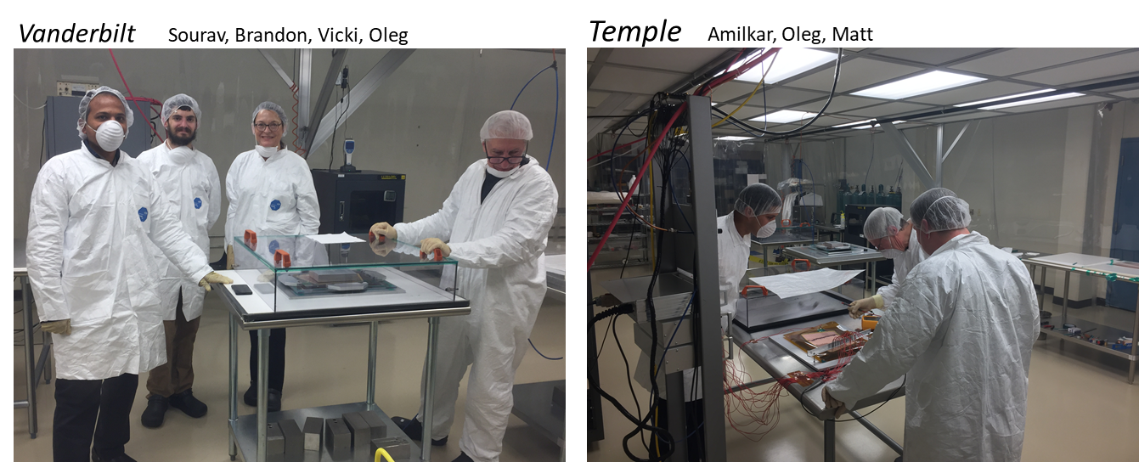
TPC GEM Production at WSU
Smooth operation ongoing.
Two modules-worth complete.
GEM currents 20 pA (great!)
Reviewed GEM design and
factory in December
Trained other factories:
  Vanderbilt
  Temple

Slide 5
EMCal Block production at UIUC and Fudan
UIUC
Block production at for Sectors 1 -12 is on or close to schedule. As of the end of December:
  282 blocks produced
  200 blocks tested
  144 blocks shipped to BNL
Fiber filling for Sectors 13-64 is ahead of schedule.
Fudan
Fiber filling for outer rapidity blocks is under way using student labor
Additional prototype blocks are being produced using a new W powder supplier
Plan is to have Fudan produce enough large rapidity blocks in time to install them into one or more of Sectors 1-12.
First two blocks from Fudan arrived at UIUC
Block production and fiber filling at UIUC
Fiber filling at Fudan

Slide 6
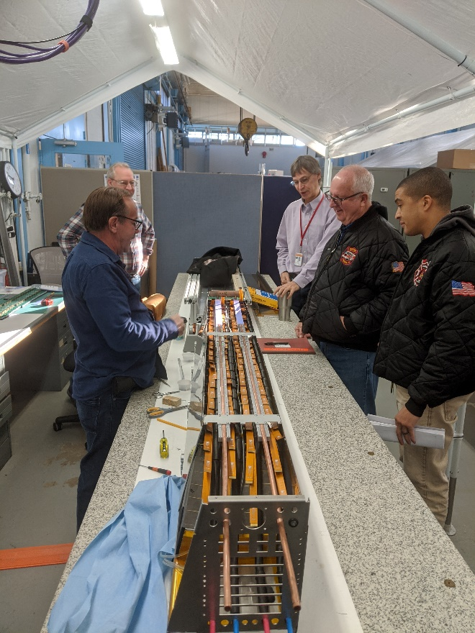
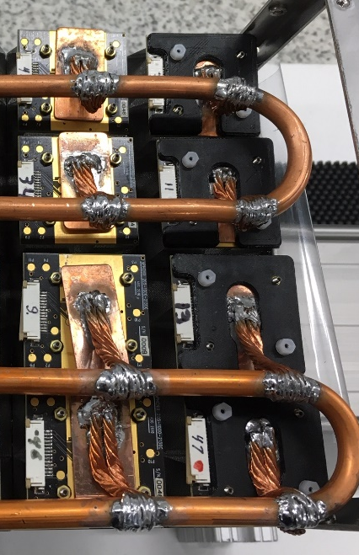
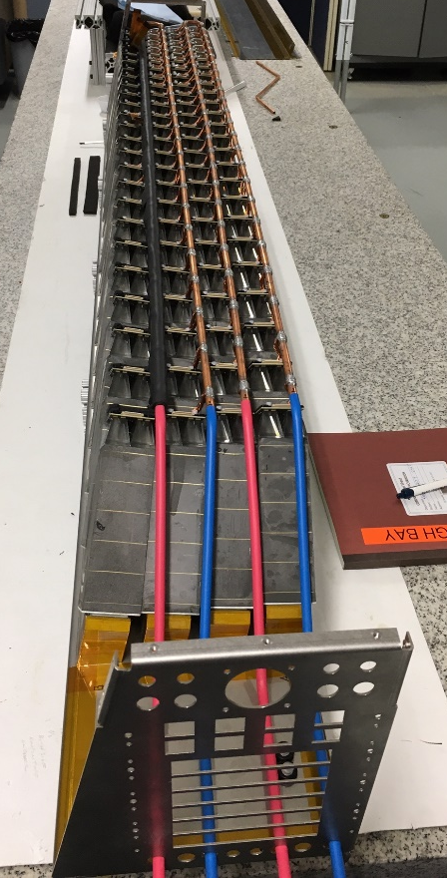
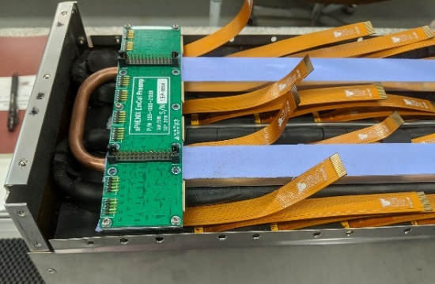
EMCal Sector Assembly at BNL
Sector 0 is being used to optimize the final sector assembly as we determine how to install the final cooling system and insulation.
Cooling loops and cooling plates for SiPM daughter boards.
Cooling loop and cables for preamp boards.
Dual cooling loops for SiPM daughter cards.
All cooling loops and premp cables installed .

Slide 7
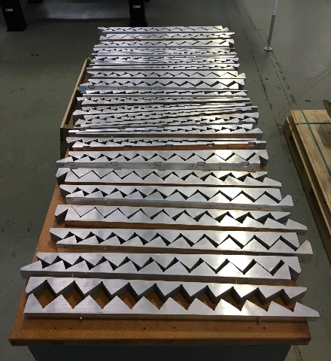
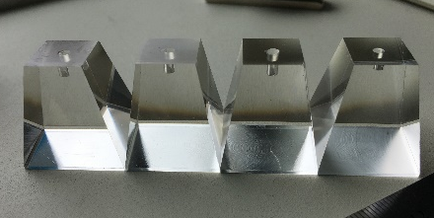
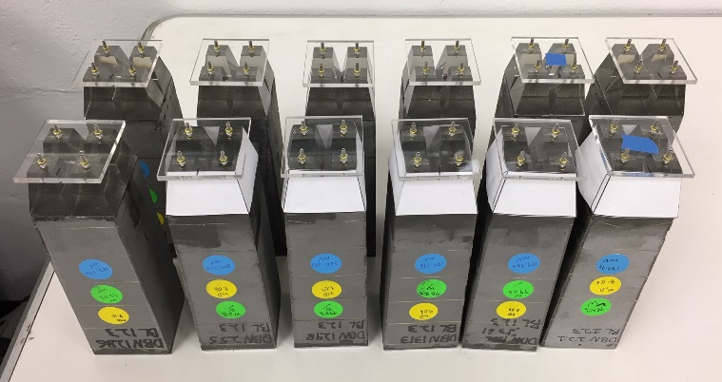
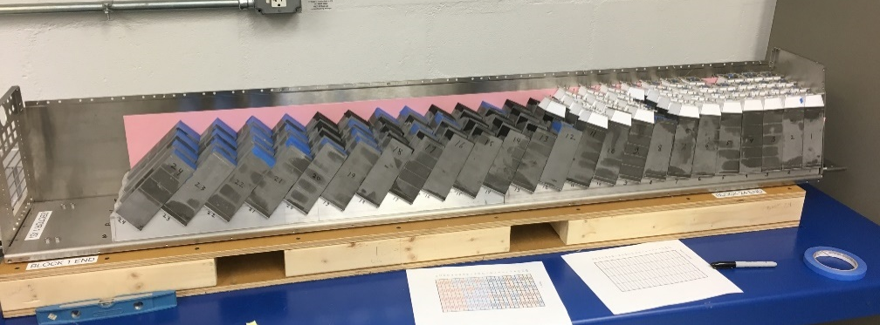
EMCal Sector Assembly at BNL
Pre-assembly testing of Sector 1 has begun.
Materials for Sectors 2-12 are arriving
  200 light guides have been installed on Sector 1 blocks. 400 more were shipped this week and 200 more are ready to ship. Company estimates they can make 180 parts per day.
  Sawteeth for 6 south sectors have been delivered to BNL. After a pause to do another job at the Stony Brook shop, the remaining north sectors will be machined. However, we are still waiting for the survey results of the first north sector that was surveyed.
6 sets of sawteeth for south sectors
Light guides for Sector 1
Test fit of blocks onto strongback for Sector 1

Slide 8
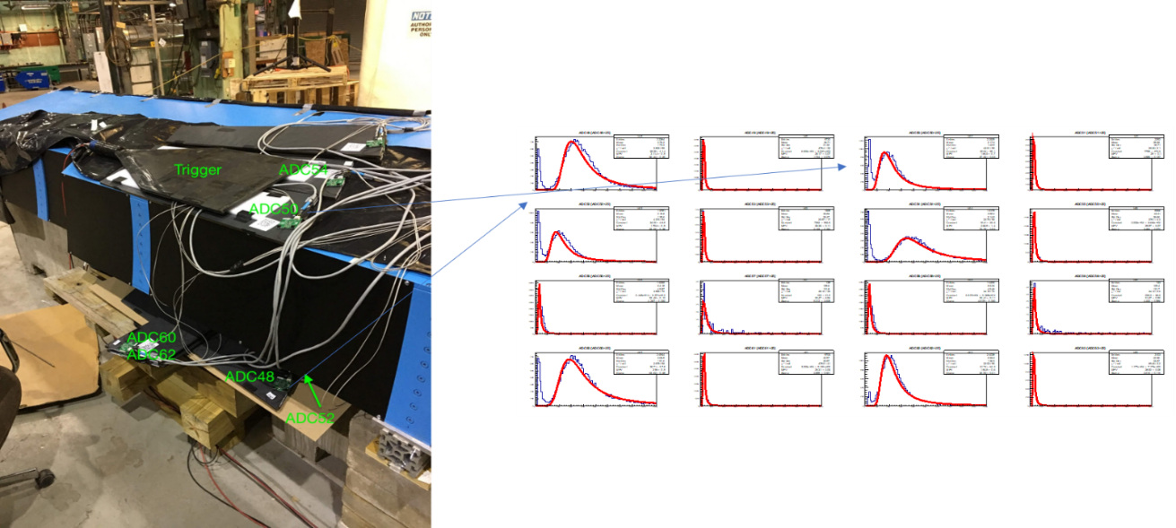
HCAL Status
oHCAL Tiles:
  Received two shipments of production tiles from Uniplast
  1577 tiles received so far (incl. B25’s)
    Four shipments (720 tiles) sent to BNL; New GSU shipping agreement (UPS)
  Expect between 1-1.2k tiles to be shipped from Uniplast early next week
    Lump shipment should catch us up with batches 3-4 (and part of batch 5)
oHCAL Sector Assembly
  Testing rack “freshened up”
  LED testing down to one bad LED due
  to crushed fiber & some half-height
  signals
    Developing cosmics trigger
  Further sector assembly waiting on:
    Cables
    Skins and electronics boxes
  Plans underway for UTK ugrads visit
  (May-June 2020, 12+ students)
    Need to discuss support for
    housing/local costs (budgeted)

Slide 9
IHCAL
The IHCAL funding is available to proceed
We are moving ahead on the IHCAL design
  Absorber
  Scintillating tiles

Slide 10
Calorimeter Electronics Status
SiPM delivery & testing ongoing (U Michigan, Debrecen, Augustana)
  11 Deliveries received, 93500 Devices
  12th Delivery due first week of Feb 2020
  Order for 16K more devices received by Hamamatsu
  Testing in on going. Testing has been reduced to ~25% of a tray
EMCal Sector 1-12 electronics orders placed.
  Sector 1 Daughter Boards are being assembled- Waiting for SMT machine to be available
  EMCal Preamps and Interface boards to be delivered by end of Jan
  Power harness assemblies complete
  Internal signal cables being assembled (end of Feb)
  SiPM daughter board order in progress
HCal Module 1-6 assembly in progress,
  Preamp power/control cable order placed
  Internal signal cables being assembled
Parts for 7-Crate digitizer system have been received, PCBs order in progress (Columbia U/Nevis)
Orders for Bias supplies in progress, working on LV power system

Slide 11
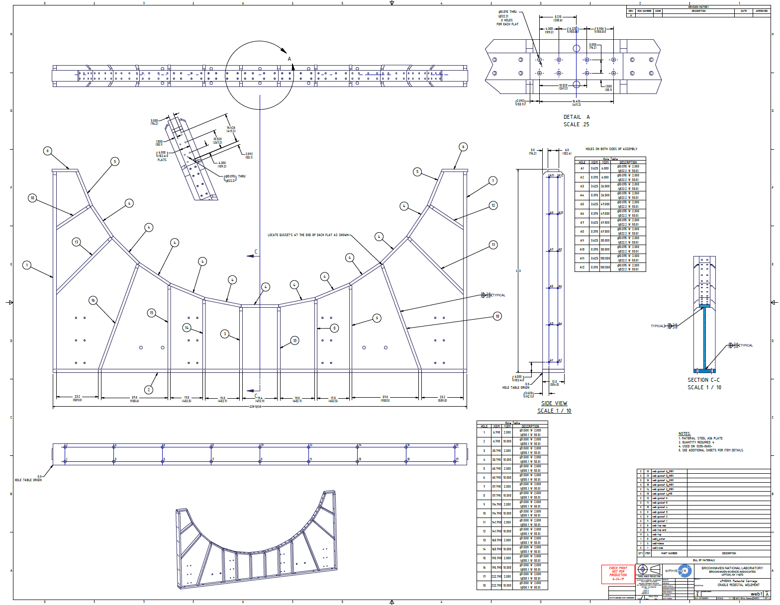
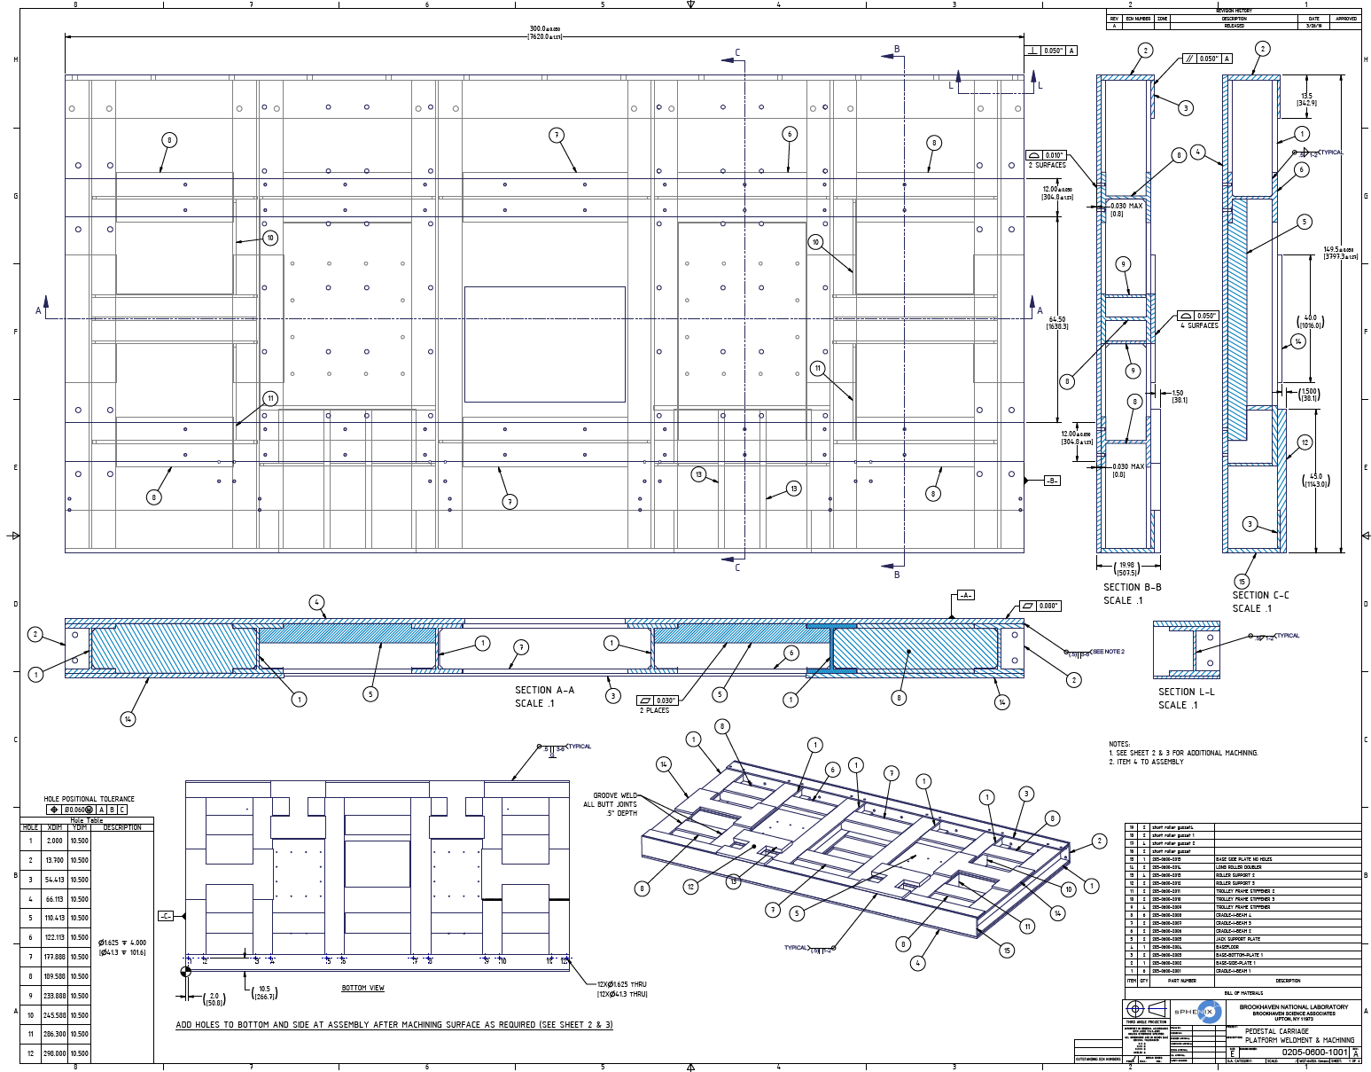
Carriage & Structural Components Status
  Cradle/Carriage
    Procurement has the signed requisition/SOW/list of vendors and it has been pinned
      Option 1 revised drawing package will be updated and signed by end of week
      Option 2 drawing package has been checked by CAD
  Drive System is being worked on by CAD
    X,Y Table, Vertical jacks, Controls, and Main Drive system
    Good progress on engineering/design
    Meeting next week to discuss next steps
  Seismic Restraints
    Change request will be submitted to push out the schedule of this section of the WBS

Slide 12
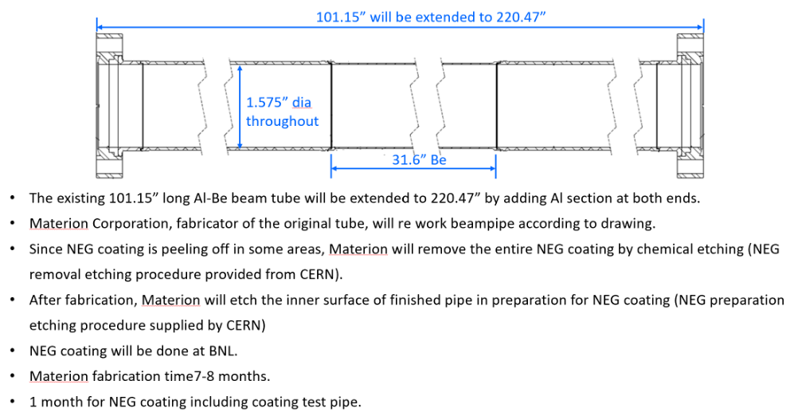
sPHENIX Beam Pipe Extension
To be reviewed at CAD on Tuesday

Slide 13
MVTX Stave Production at CERN
In good progress, on schedule
  ~10 HICs/month, used up all good chips in December
  3 wafers delivered in mid December, 45 chips available now, expect 10 more chips
  Next chips delivery expected in late January, 8 wafers,
    ~120 gold chips, good for 13 weeks of assembly, last wafers by April 2020
  23 FPCs available for assembly
Plan
  Resume HIC production in week 2 of 2020
  Bond 4 HICs as soon as the bond lab available in January
  1st set of 10~12 staves ready for shipping to LBNL in mid Feb
    Are we ready? Shipping – a batch of ~10 staves or ~20?
Bi-weekly meeting with CERN
  Last meeting, 12/19/2020
  Next one, 1/16/2020

Slide 14
The urgency of now
The first sPHENIX run begins in 150 weeks
Everything we are building has to be completed and installed and functioning at that time
Every system can use full time help starting immediately
  Software! Simulation! Reconstruction! Event building! (see megaworkfest agenda)
  Data acquisition and triggering
  EMCAL construction and testing
  HCAL construction and testing
  Calibration

Slide 15
Overview of installation schedule (Russ Feder)
Sequential Build Steps | Concurrent Work Streams | CY 2021 |  |  |  | 2022 |  |  |  | 2023
Cradle-Base | WBS 2.5.2 Work Wiring, Piping, Cabinets Other AH and IR work QC and Safety Checks
oHCAL Sector 1-13
Magnet Install
Inner Support Rings
oHCAL Sector 14-32
iHCAL
EMCAL
Open Shield Wall
Carriage and pole tips
Move sPHENIX to IR
Magnet connect, map | WBS 2.5.2 Work Infrastructure connections to Cradle/Carriage Magnet work Wiring, Piping, Cabinets Other AH and IR work QC and Safety Checks
TPC
INTT support structure
Beam pipe insert & bake
INTT device
MVTX device
Final beam pipe
MBD device
ORR Prep and ORR
`
Start: March 21’
Key Predecessors
AH/IR Rail Mods
Cradle-Base Ready
ORR
01-Nov-22
Start RHIC
30-Jan-23
FY21 RHIC Run
1/4/21 to 5/13/21
FY22 RHIC Run
9/1/21 to 12/30/21

Slide 16
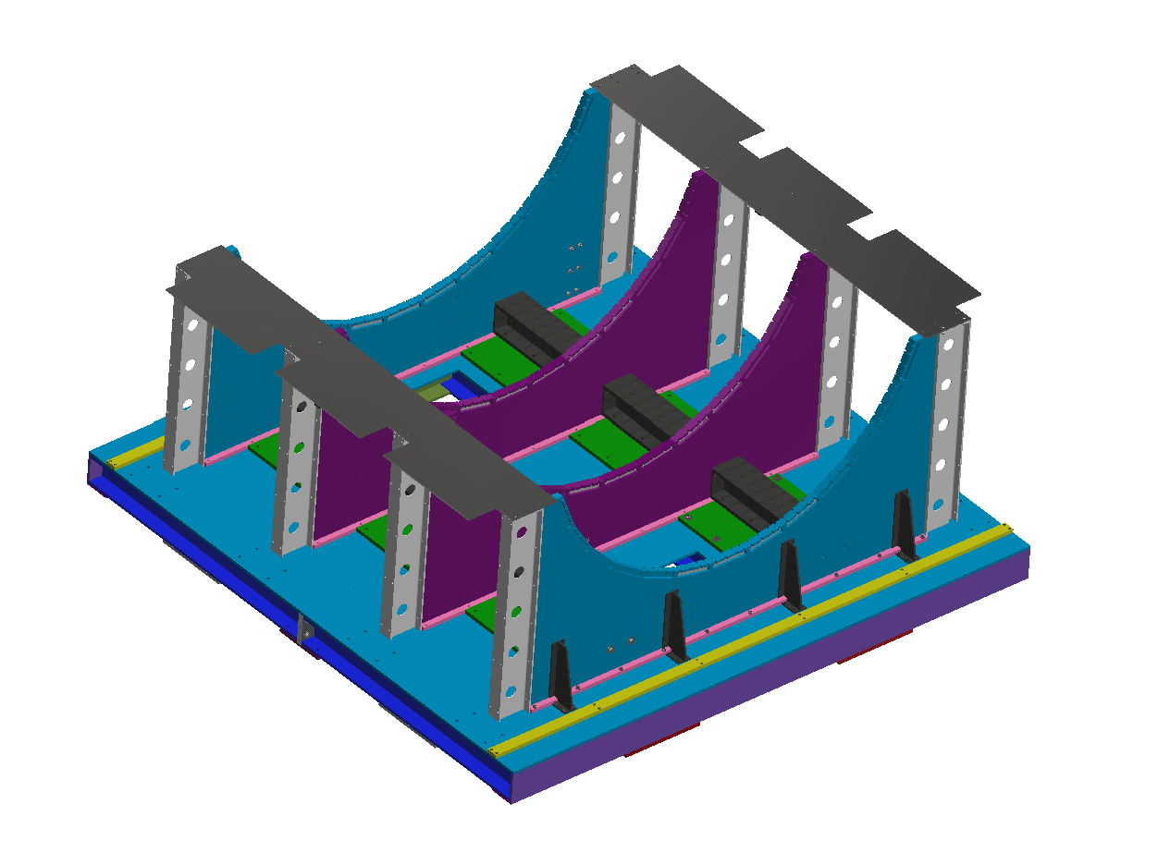
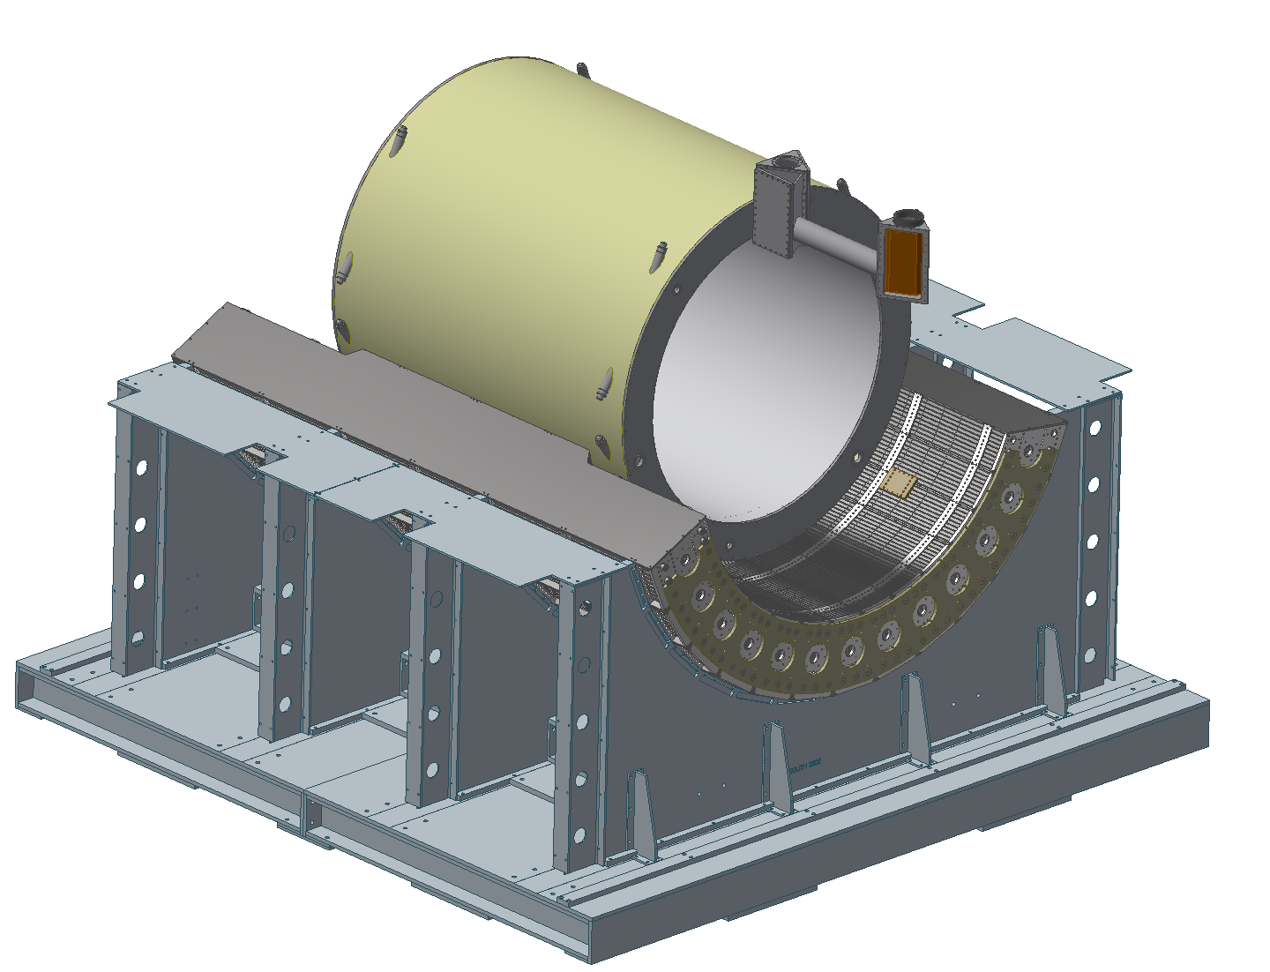
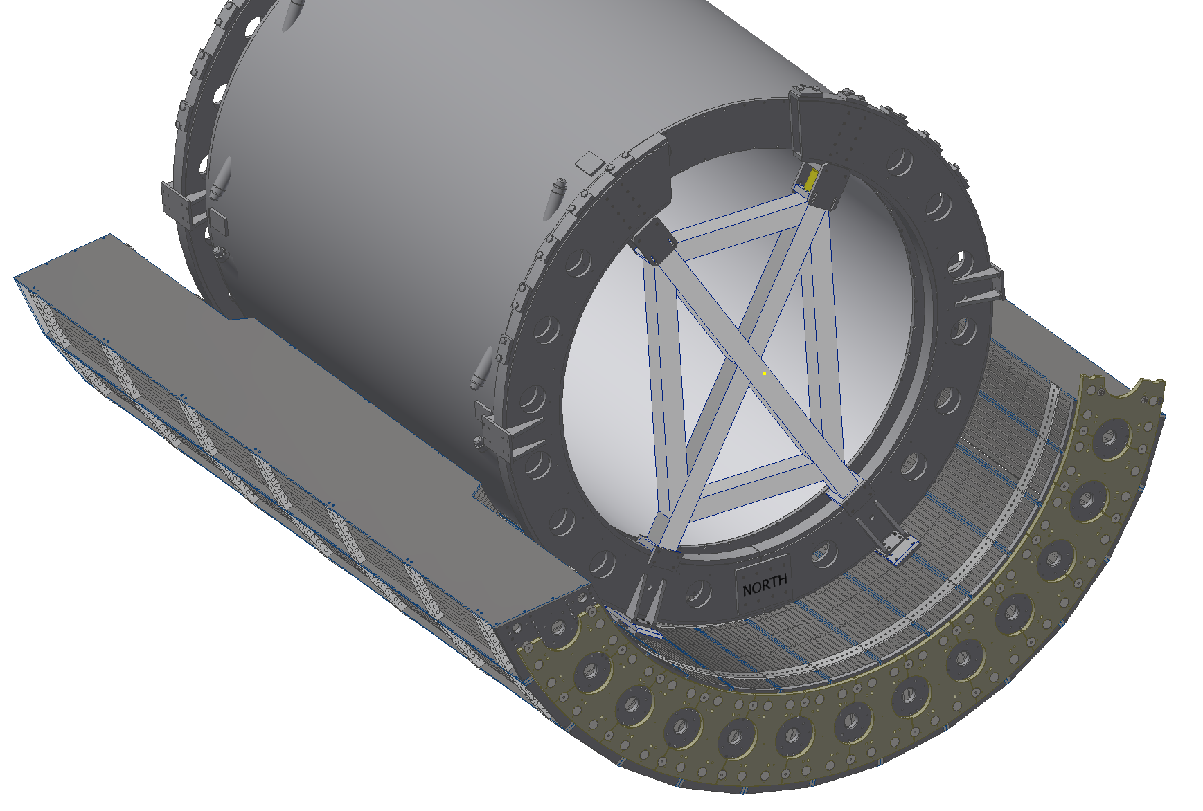
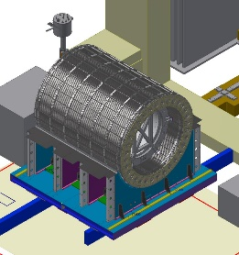
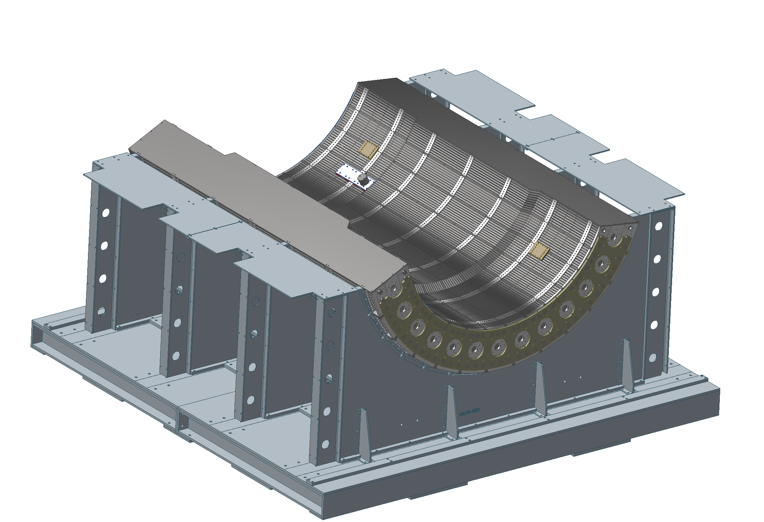
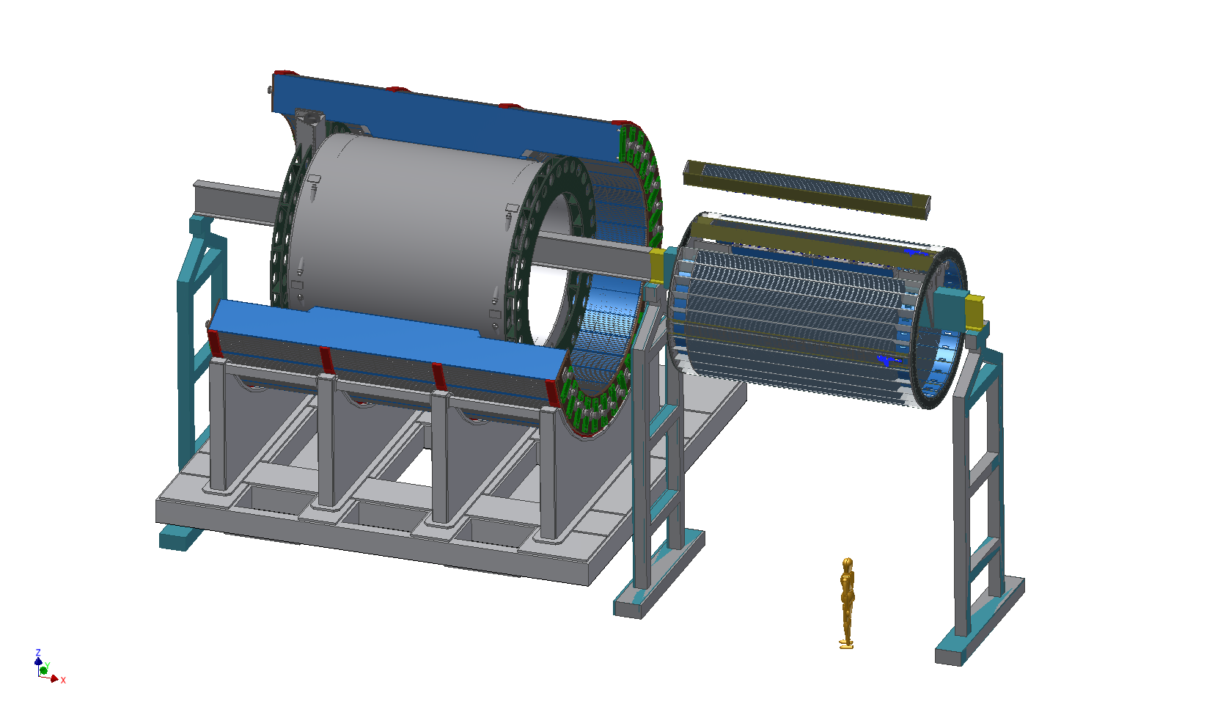
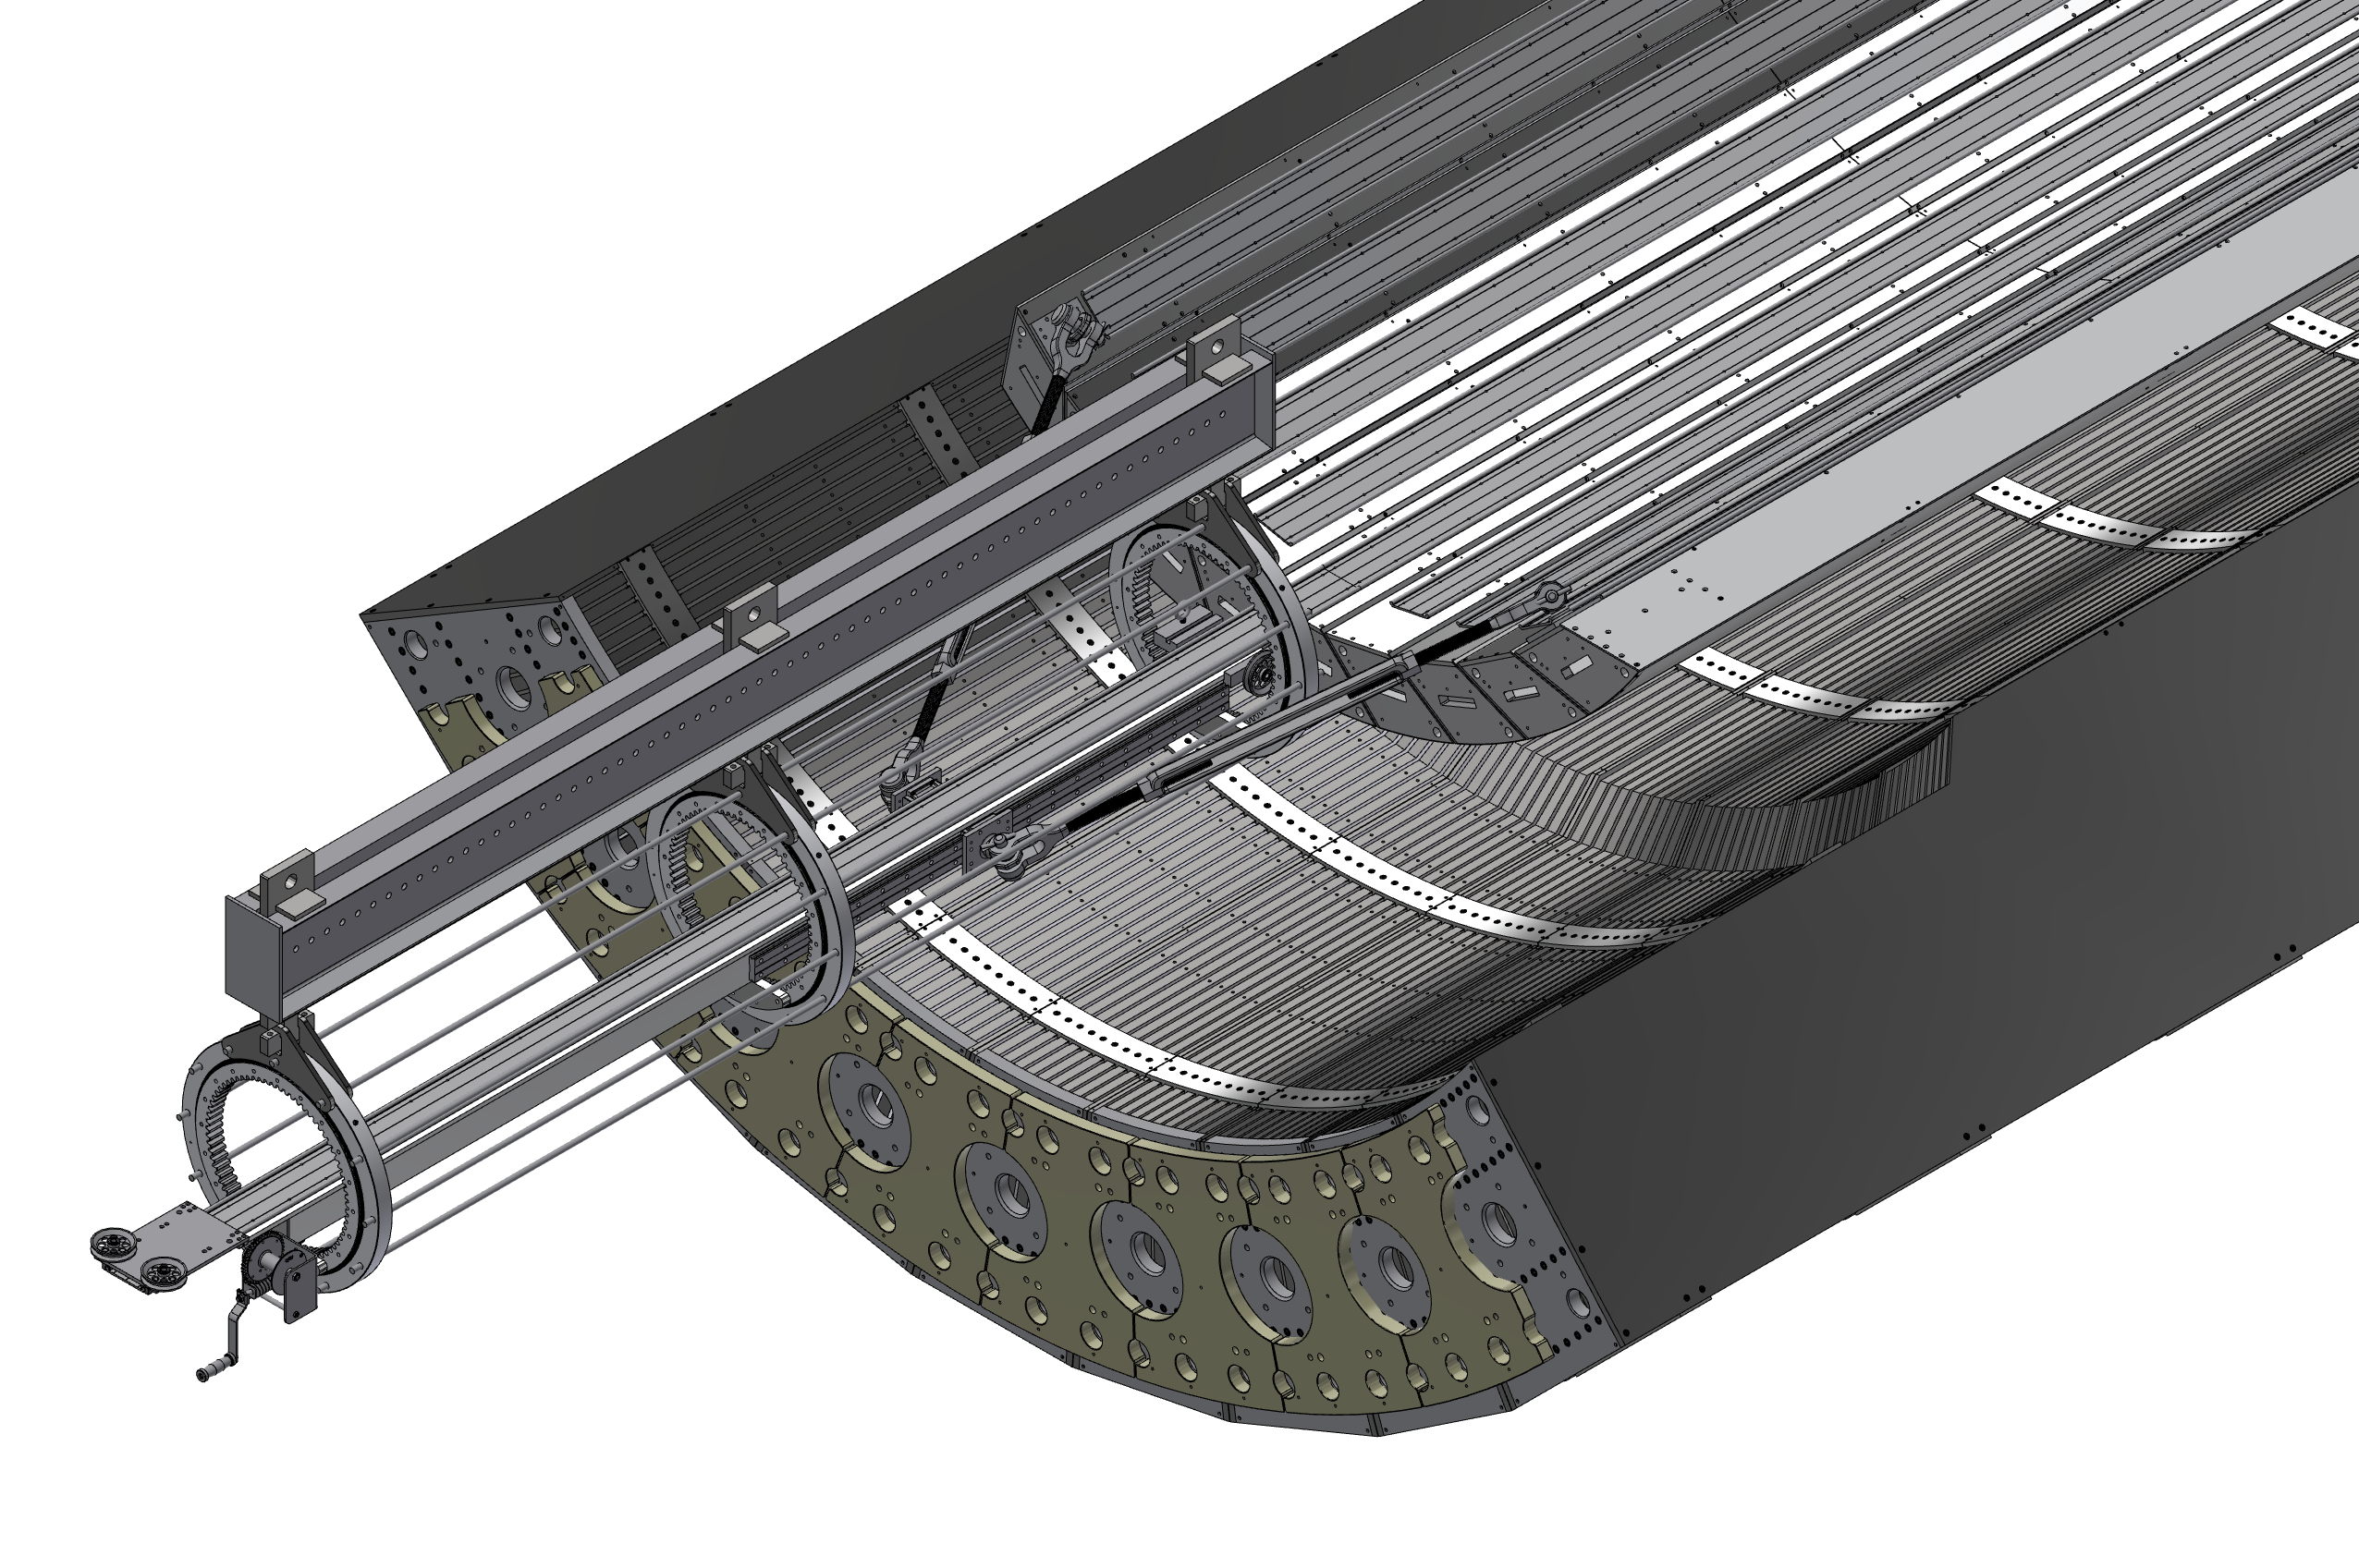
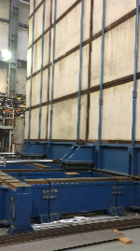
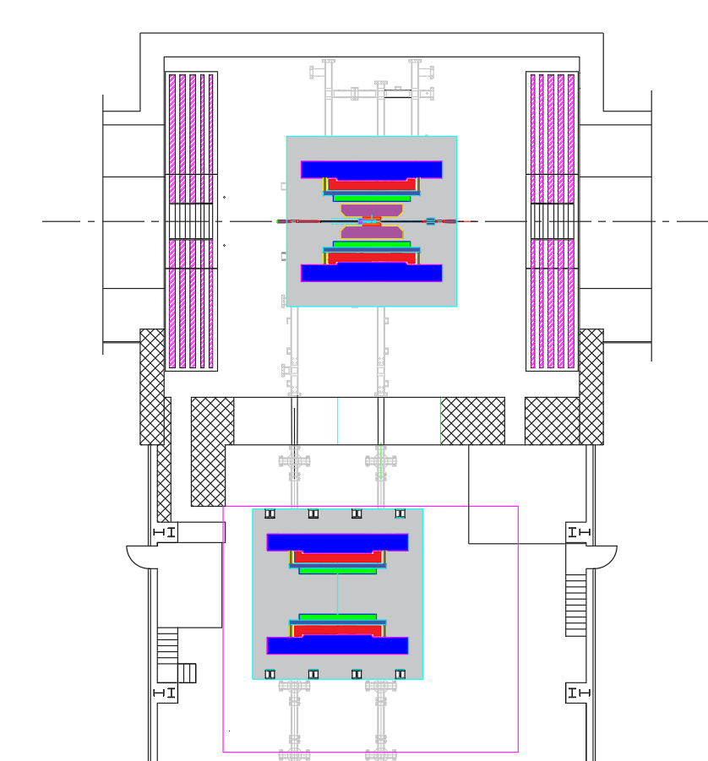
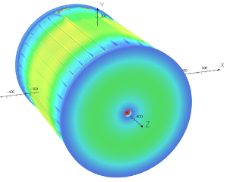
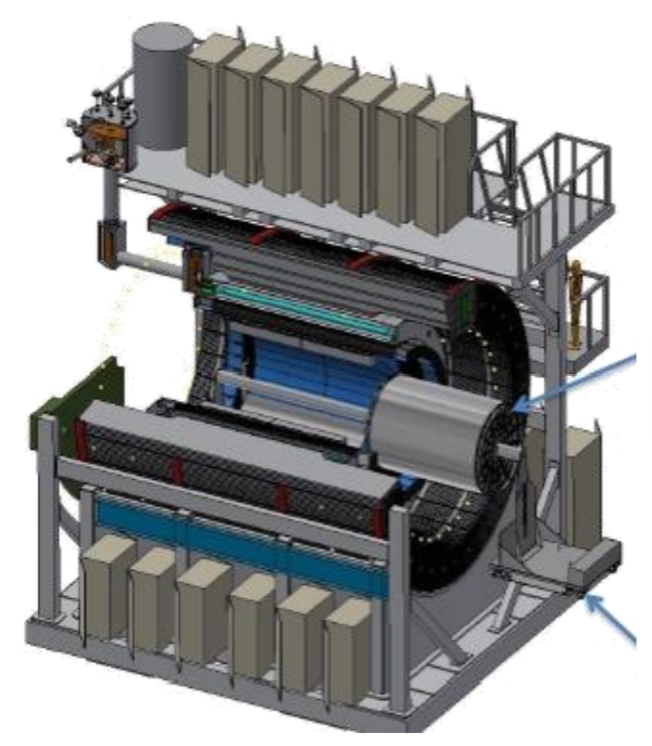
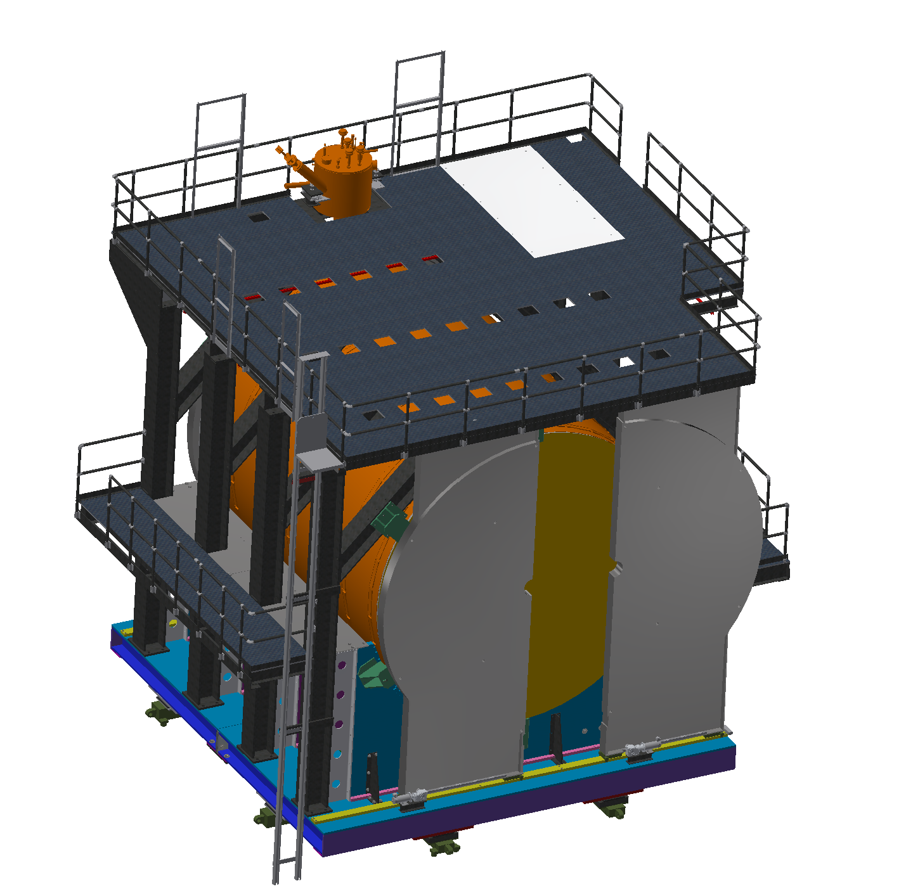
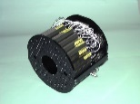
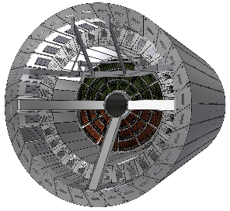
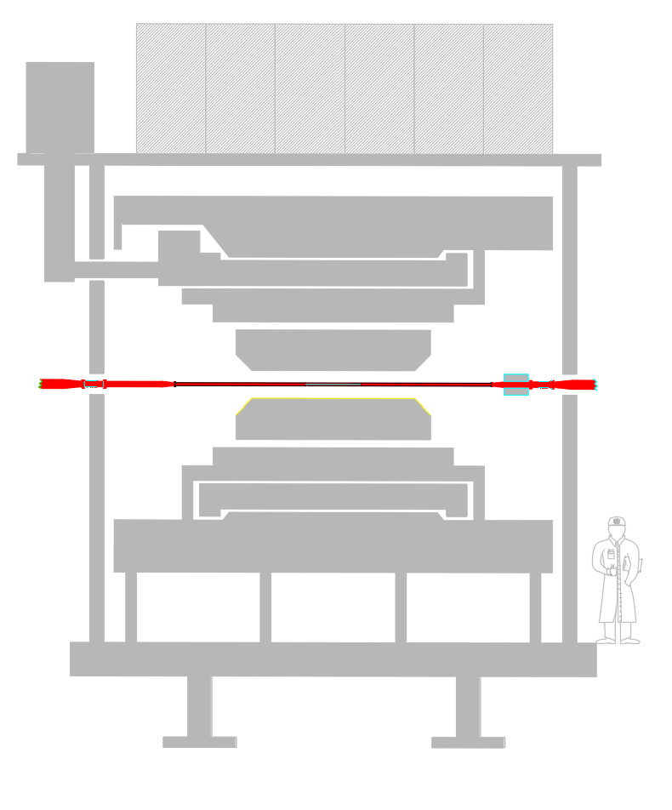
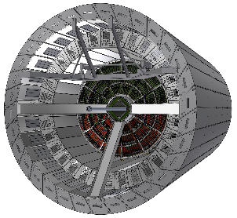
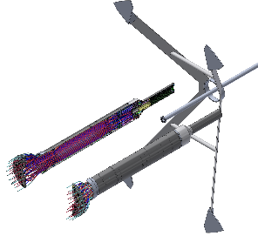
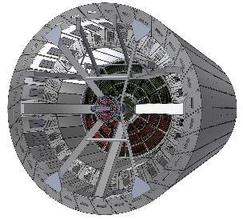
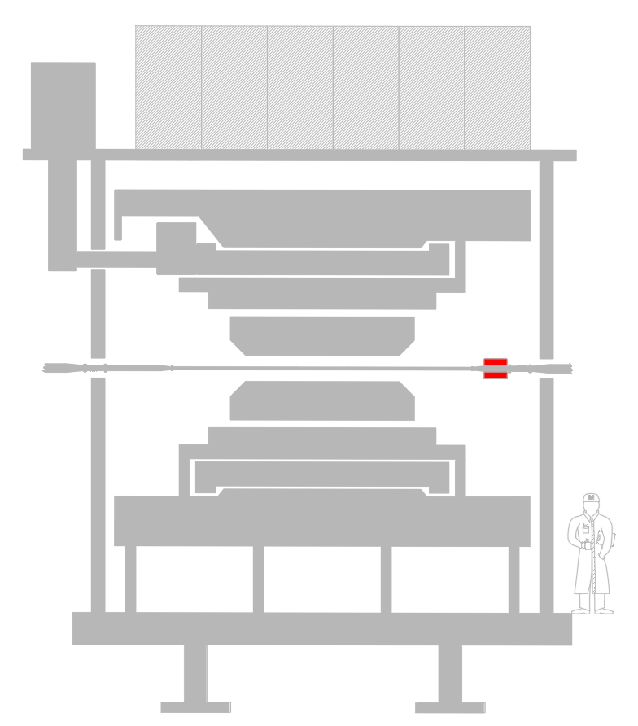
WBS 2.5.3-2.5.12 sPHENIX Installation
(1) Cradle Base, AH | (2) oHCAL Sector 1-13, AH | (3) Magnet mount, AH | (4) Inner Rings, AH | (5) oHCAL Sector 14-32, AH | (6) Inner HCAL
(7) EMCAL | (8) Open Shield Wall | (9) Carriage, platforms, Pole Tips, AH | (10) Move sPHENIX to IR | (11) Connect, Map Magnet | (12) TPC, IR
(13) INTT Supports, IR | (14) Beam Pipe Install. IR | (15) INTT Device, IR | (16) MVTX, IR | (17) Secure Beam pipe, IR | (18) MBD, IR
The base will be built on top of the AH rails
Magnet mount hardware is also attached
The magnet is lowered in to the oHCAL bore
The rings also work to stabilize the magnet
The full oHCAL barrel weighs ~480 tons
The iHCAL barrel slides in from the North
TPC
There are 64 EMCAL sectors each installed one at a time with a special tool
Work on sPHENIX will stop for the time needed to remove the shield wall
There is a 5-foot move North in the IR
TPC slides in the EMCAL bore from North
Results from an sPHENIX OPERA EM FEA
Beam pipe is supported temporarily as a few locations for MVTX installation
MVTX has a 2mm clearance to the beam pipe
iHCAL, EMCAL, TPC and INTT Supports

Slide 17
Great progress, much to come
The EIC coming to BNL is both a great opportunity and a great challenge
The best way to be prepared is to continue to do a great job in making sPHENIX a reality

