Slide 1
New sPHENIX Institutions : Lund University (Sweden)
Who are we?
Current Activities
sPHENIX Plans
David Silvermyr

Slide 2
Lund Heavy-Ion Group
Member of the ALICE Collaboration at the LHC, and PHENIX at RHIC
3 Seniors
Peter Christiansen, David Silvermyr, Alice Ohlson
Emeriti: Anders Oskarsson, Evert Stenlund
1 Postdoc
Tuva Richert (VR international postdoc, at NBI)
4 Ph.D. Students
Jonatan Adolfsson, Adrian Nassirpour, Omar Vazquez Rueda, Oliver Matonoha

Slide 3
Collaboration with theorists
Lund theory group developing Angantyr – extending Pythia to heavy-ion collisions, no QGP
5-year KAW grant (exp. + theory): “Pinning down the origin of collective effects in small collision systems”
CLASH workshop
19-23 August 2019
40 participants in 6 working groups
almost entirely discussion-based
purpose : to identify/clarify open questions and propose key experimental measurements and theoretical calculations

Slide 4
Lund activities in PHENIX
Active member from the formation of the collaboration to end of data-taking
Analysis by group members (past & present): global observables, UPC, J/ψ, …
Hardware : One of the main groups involved in the Pad Chambers (Anders, Hans-Åke et al.)
From concept/idea to operations
TGLD / ROCs part of FEE
Hoping to collaborate with many PHENIX friends again, in sPHENIX!

Slide 5
Current Lund activities in ALICE
Analysis : exploring the origins of collective effects in small systems and strangeness production
How do our measurements of pp collisions inform our understanding of AA, and vice versa?
Hardware : participation in TPC upgrade
SAMPA chip campaign successfully completed
FEC installation done, pre-commissioning ongoing
Coordination : Convenor of PWG-CF (A. Ohlson), Convenor of PWG-MM (P. Christiansen), Member of MB (D. Silvermyr)
All our current research funding dedicated to ALICE

Slide 6
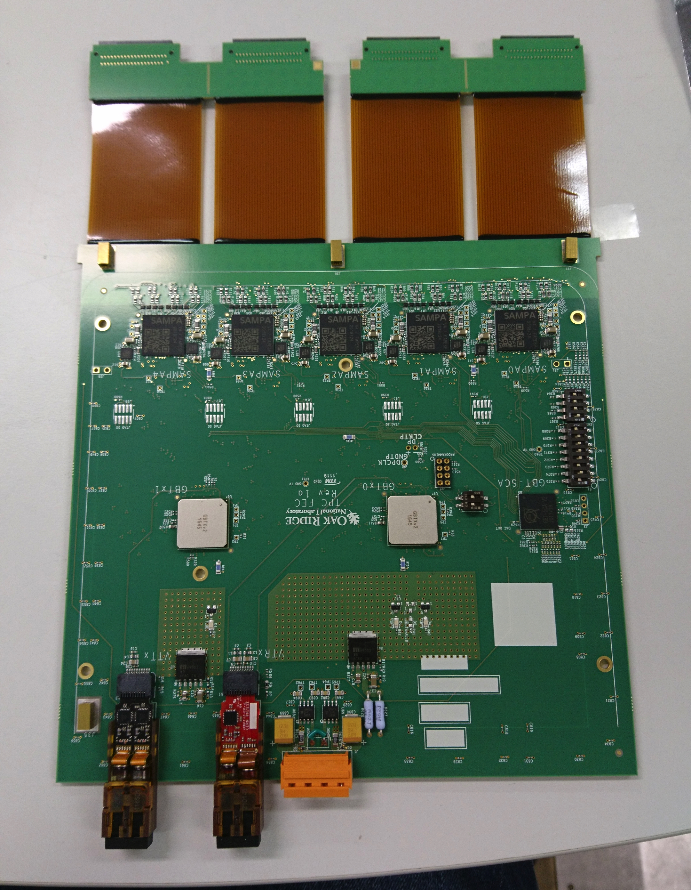
Readout electronics for ALICE Upgrade
Testing/characterization of SAMPA chip for the TPC FECs at Lund
Completed (2018-2019) robotic test s of 30k (TPC) + 60k (MCH) chips
Also tested smaller amounts (or for a nominal fee) for
STAR, NICA, FAIR, …
✓

Slide 7
Hardware Contribution for sPHENIX
Perform similar robotic testing for sPHENIX TPC as for ALICE TPC
sPHENIX uses new SAMPA version (V5). First chips available late Feb. All (~12k) available in April.
Lund goal (if delivery schedule holds): finish testing by June – few months before start of FEC production.
Some numbers for interested folks:
Chip yield from V4 production for ALICE: ~80%
With 8 chips per sPHENIX FEC => low probability (0.80⁸ ~= 17%) to get working FECs with random untested chips…

Slide 8
Summary
Lund (David Silvermyr & Anders Oskarsson) would like to join sPHENIX
Hardware contribution happening soon (sPHENIX TPC SAMPA testing)
Exact future analysis contributions, possible additional (wo)manpower (PhD student?) etc., TBD – dependent on future research funding
Particular interest in confronting collective effects/correlations, strangeness and heavy flavor production in experimental data vs Pythia & Angantyr predictions

Slide 9
Extras

Slide 10
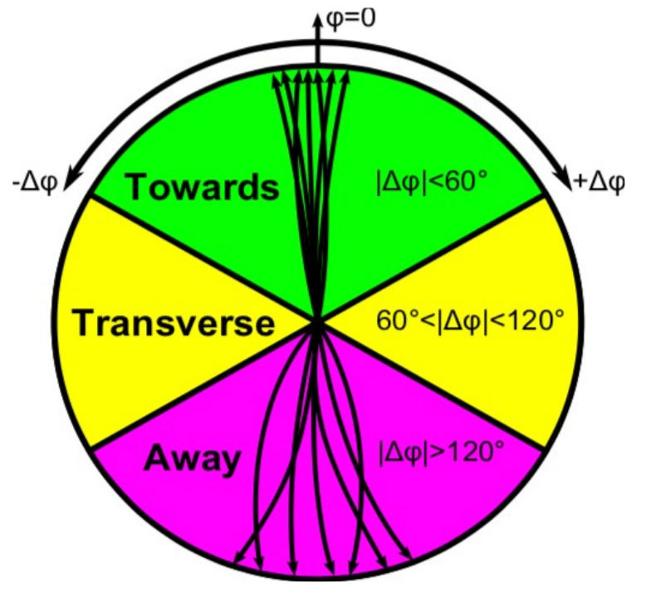
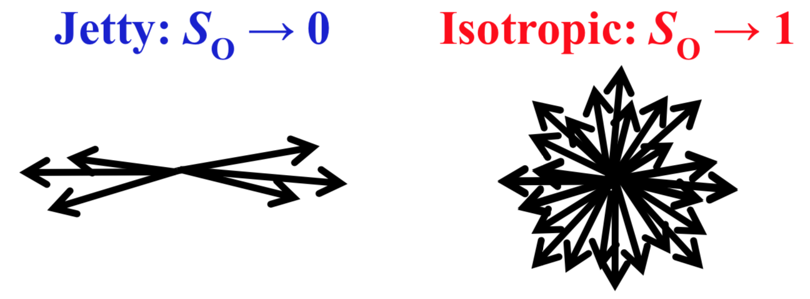
Event shape studies
What is the origin of strangeness enhancement and collective effects in small systems?
Select pp collisions that are dominated by soft particle production
Spherocity R_{T} = N_{T}/<N_{T}>

Slide 11
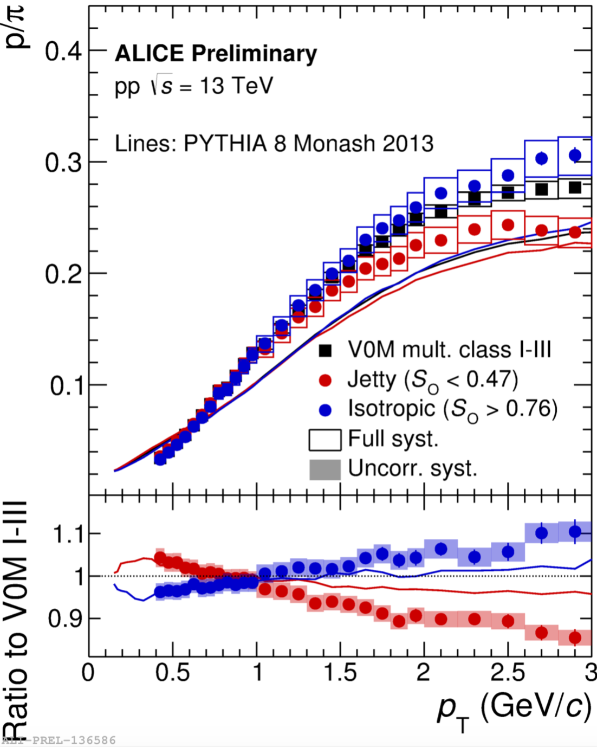
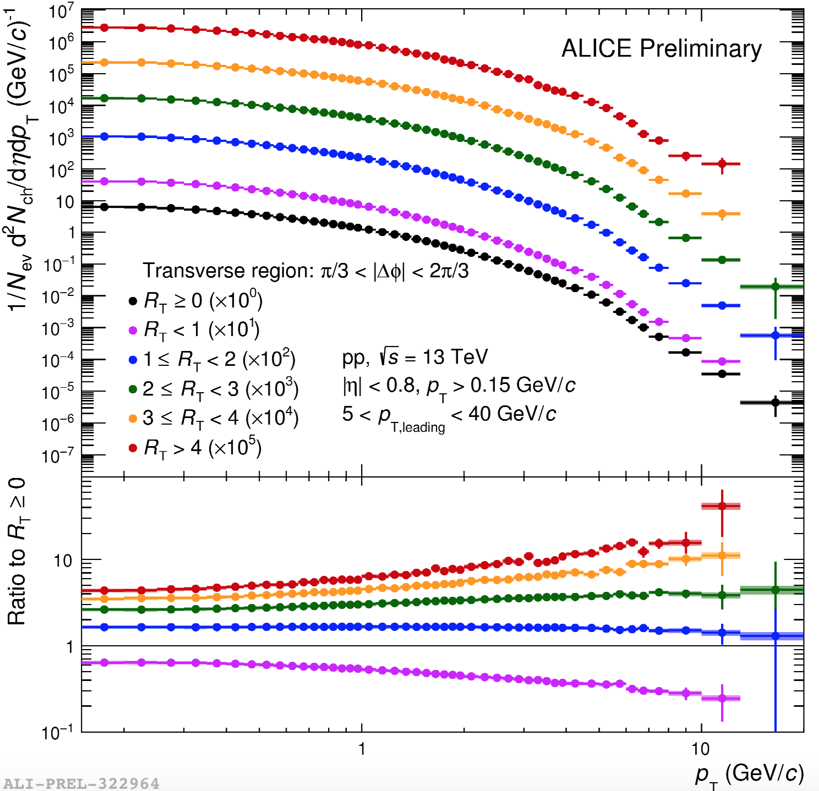
Spherocity and R_{T}
p/π ratio vs S_{O}
spectra vs R_{T}
Identified particle spectra vs S_{O} and R_{T} → QM19: π, K, p (O. Vazquez Rueda), K⁰_{S}, Λ (O. Matonoha), ϕ (A. Nassirpour), Ξ (P. Christiansen)

Slide 12
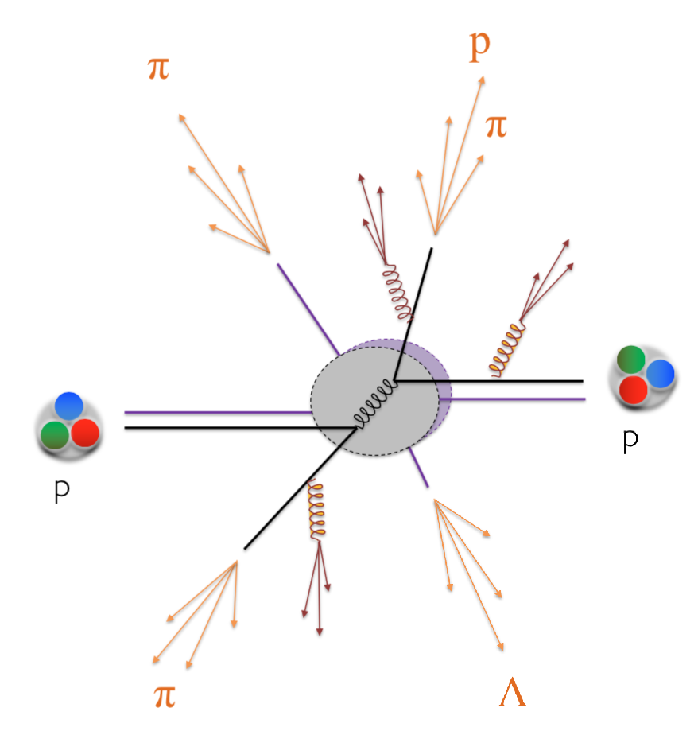
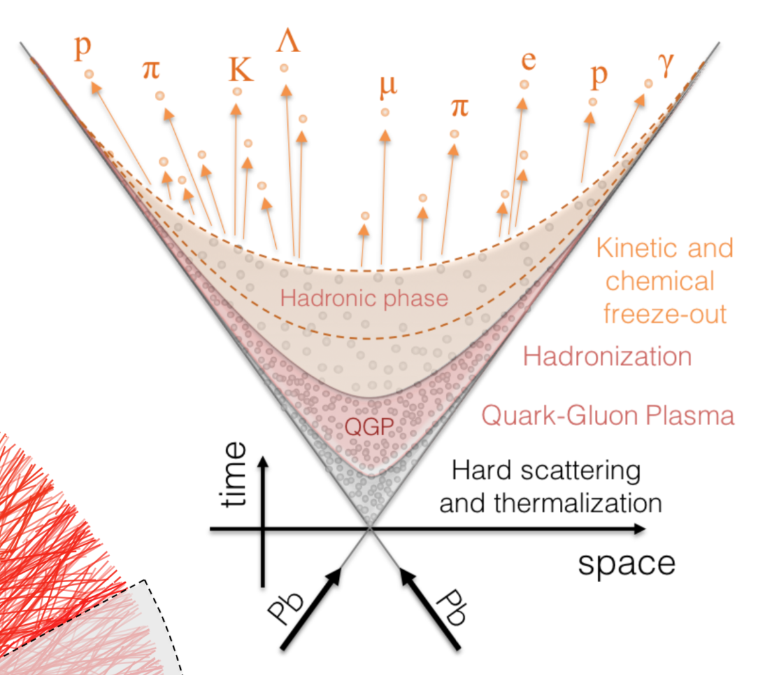
Strangeness production
Is strangeness produced locally or globally in small systems?
Ξ-π, Ξ-K, Ξ-p correlations (J. Adolfsson) → QM19
Correlated fluctuations of net-strangeness number and net-baryon number
Net-Λ fluctuations in PbPb collisions (A. Ohlson)
or

