Slide 1
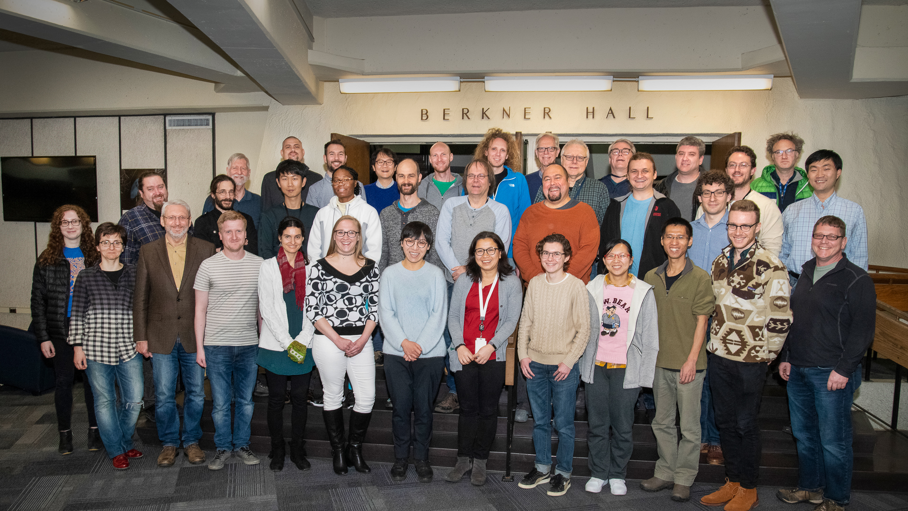
sPHENIX Software Mega-workfest
sPHENIX Software Mega-workfest

Slide 2
Track 1: Tracking

Slide 3
Track 2: Calorimeter

Slide 4
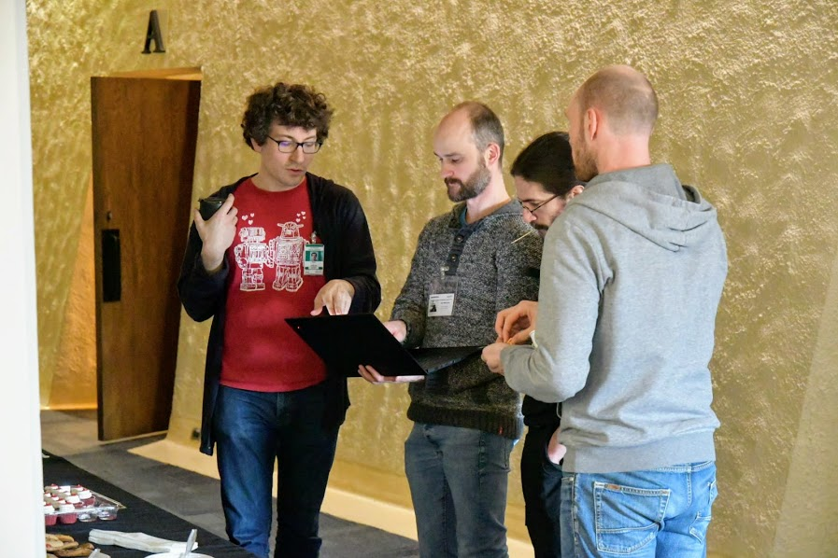
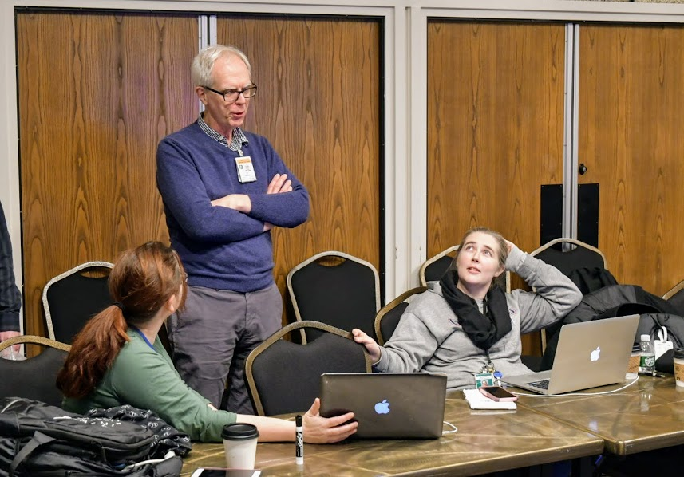
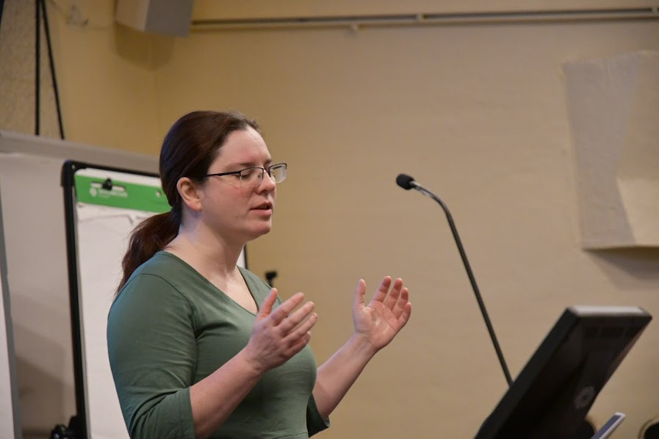
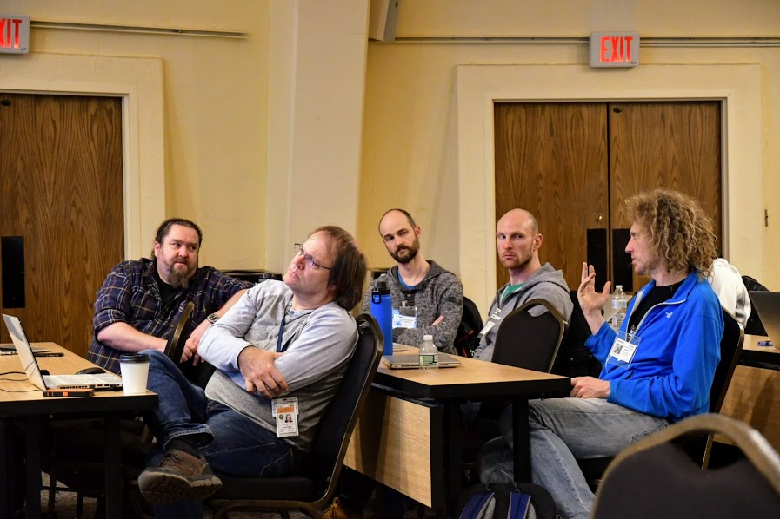
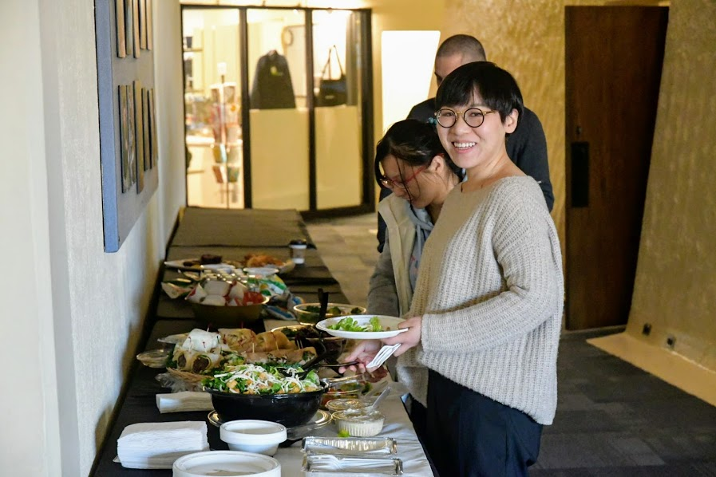
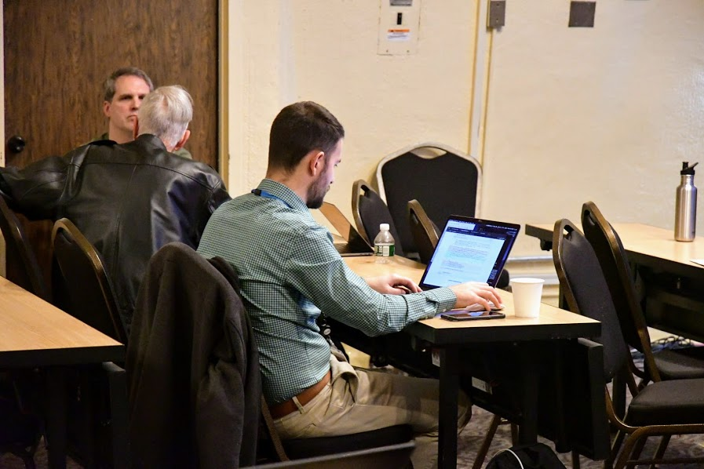
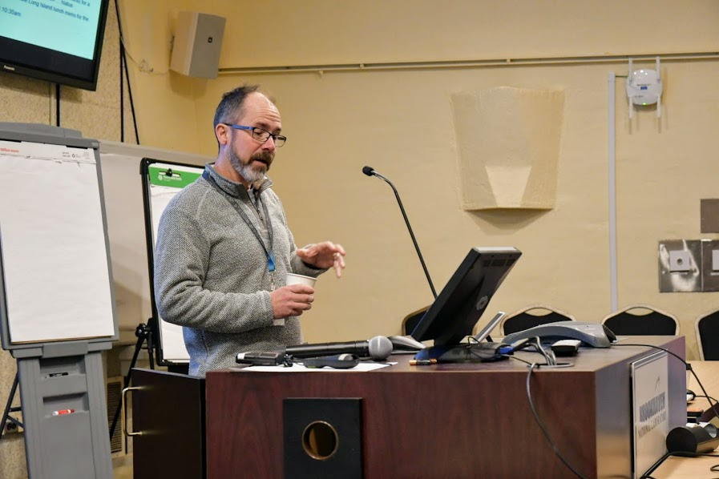
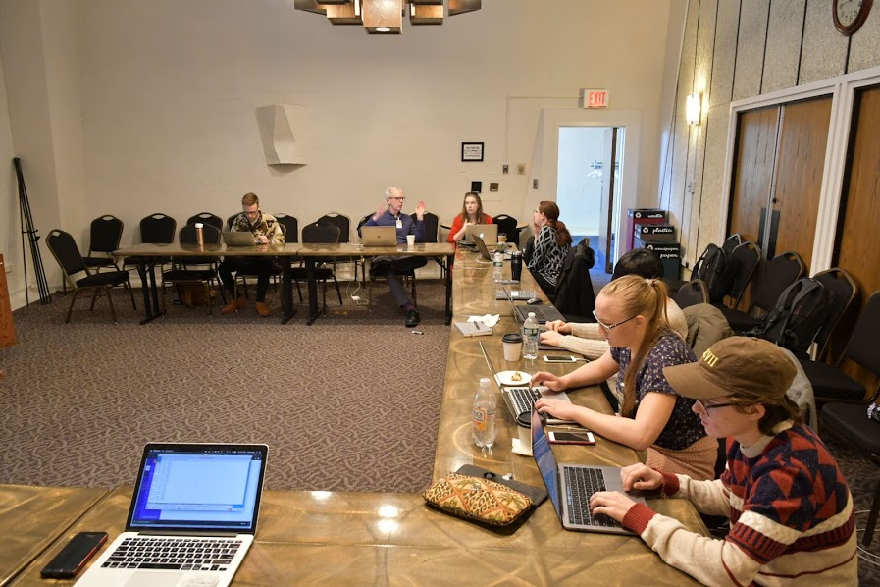
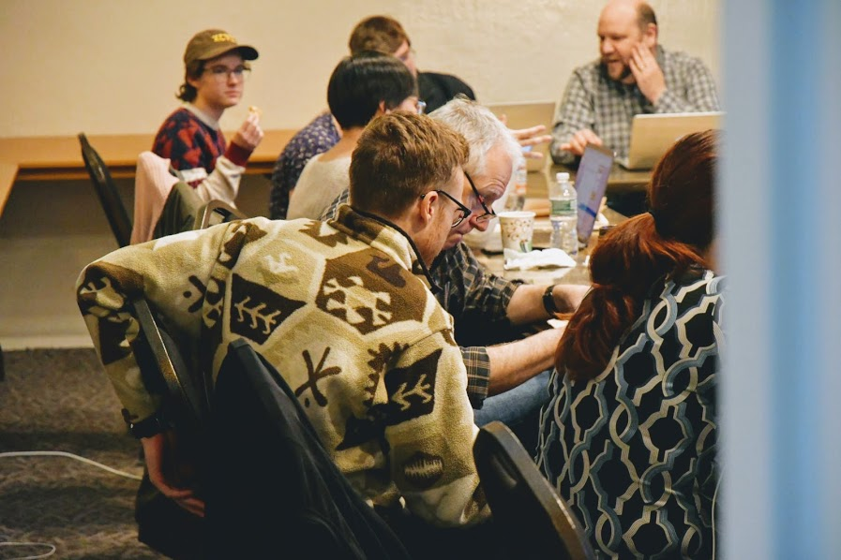
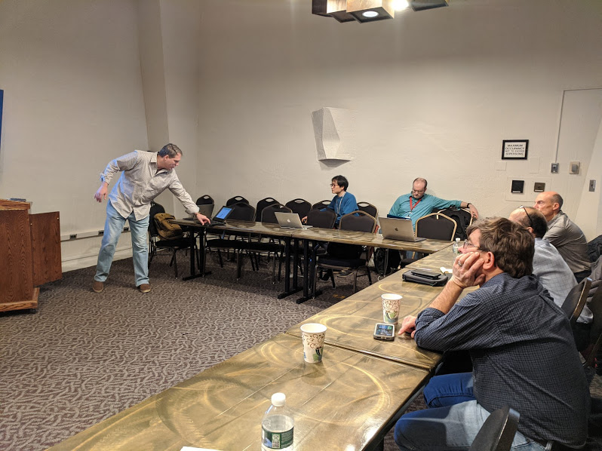
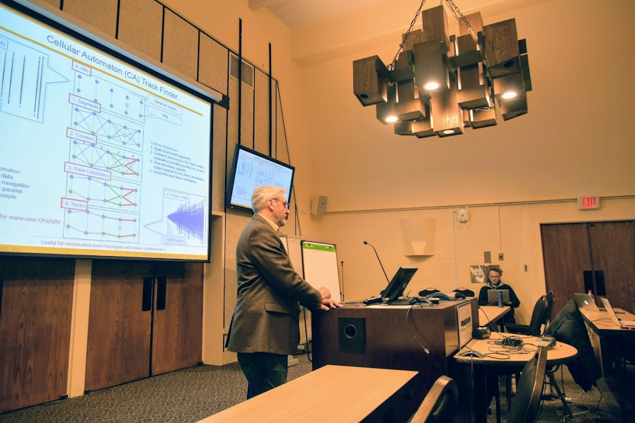
Goal: Get people to talk and get actual work done

Slide 5
Goal: Get people to talk and get actual work done
And are still talking and working – the summary slides will be brief

Slide 6

Thank you for attending, I hope you had a good time
(working without the usual distractions)
My personal takeaway:
New users got up to speed really fast
I didn’t hear that new features are impossible to implement
  (Fun4All not preventing their implementation)
Documentation a sore point
2023
looks a lot less scary now even though we are a week closer

