Slide 1
sPHENIX Issues
Cost and Schedule Data
1.X, 2.X, 3.X

Slide 2
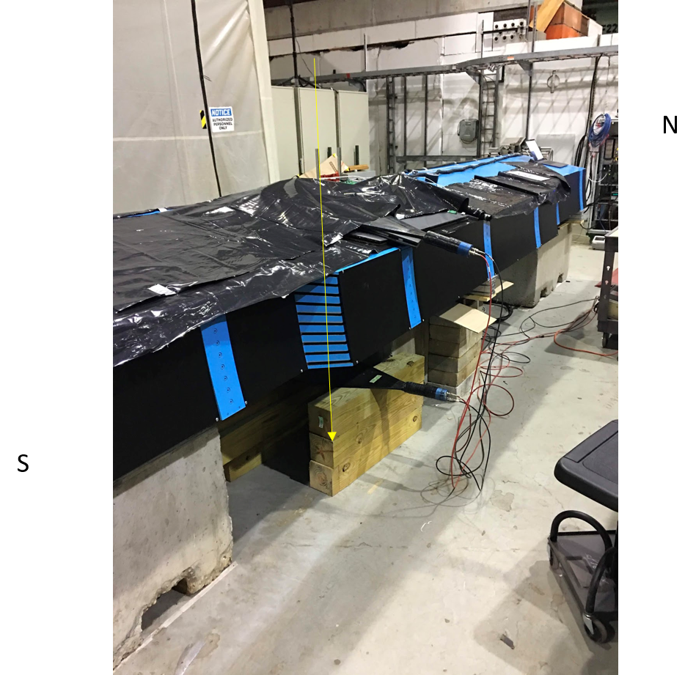
OHCal Testing in Building 912
First production sPHENIX detector element to be taking test data.
OHCal Sector 1 is instrumented and taking cosmic ray events in Building 912.

Slide 3
sPHENIX Issues
Issues where we can benefit from the help of Management
Need to order the SiPMs for the high eta EMCal blocks being made by our international partners.
If we bundle the new order with the existing 100k+ SiPM order we will get a 50% price savings
We need to order 16k SiPM this month to get the price break, ~$140k savings
The Carriage/Cradle WebReq will be submitted this week.
WR price will be ~$950k. Need the full signature chain including Berndt’s approval
When the time comes to make the award in 6-8 weeks may need help getting BNL Legal to expedite
We need the MVTX accounts open
Have been trying to get the capital accounts open for ~3 weeks.
Once the accounts are open we will want to sent funds to MIT, LBNL and LANL. They are preparing paperwork.
Need to finalize the MVTX PMP and sign it. The Review Response Recommendation doc has been submitted to Maria. Needs Concurrence by Jamie and Maria , and approval by Berndt.
CAD labor will be critical to staying on the 2.X schedule
The schedule for 1008 Track reinforcement next RHIC shutdown is near the critical path
We will start using the Resource Tracker developed by Diane H. as a management tool to help keep the 2.X tasks on schedule.

Slide 4
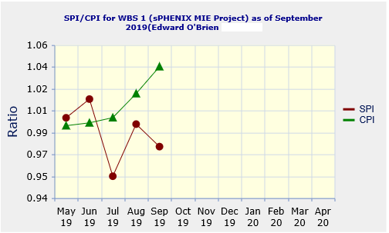
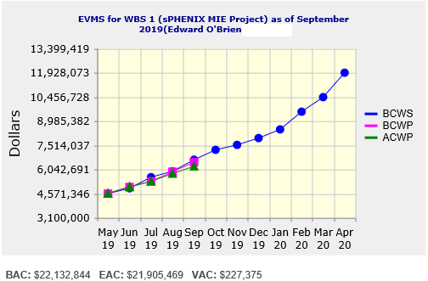
1.X Performance Indices and EV data – September 2019
Cumulative SPI | Cumulative CPI
0.98 | 1.04
Cumulative BCWS (Scheduled) | $6,634,841
Cumulative BCWP (Performed) | $6,485,454
Cumulative ACWP (Actual) | $6,236,233
DOE SPI or CPI Value Thresholds
0.90 to 1.15
0.85 to 0.89 or 1.16 to 1.25
<0.85 or >1.25

Slide 5
1.X Cost Performance Report (CPR) - September 2019
DOE SPI or CPI Value Thresholds
0.90 to 1.15
0.85 to 0.89 or 1.16 to 1.25
<0.85 or >1.25

Slide 6
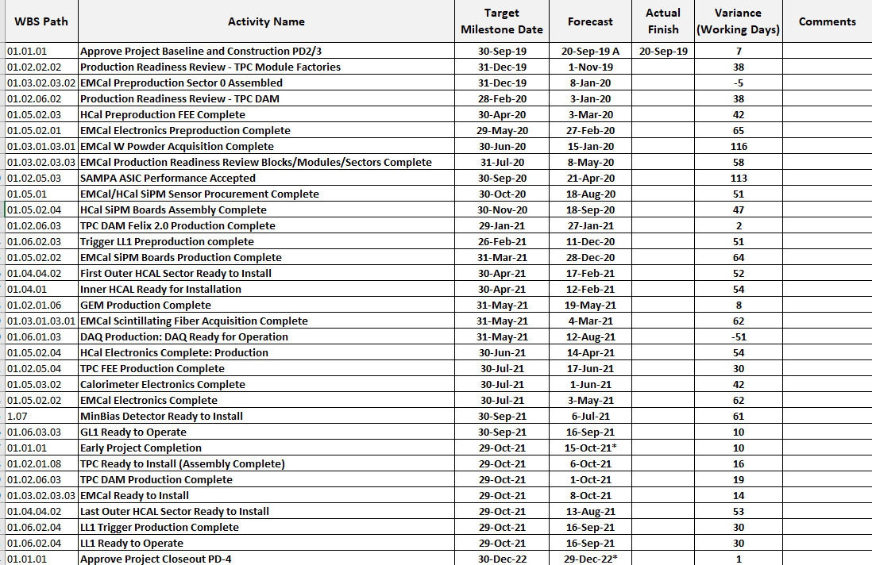
1.X Milestones – September 2019

Slide 7
Baseline/Contingency Log - September 2019

Slide 8
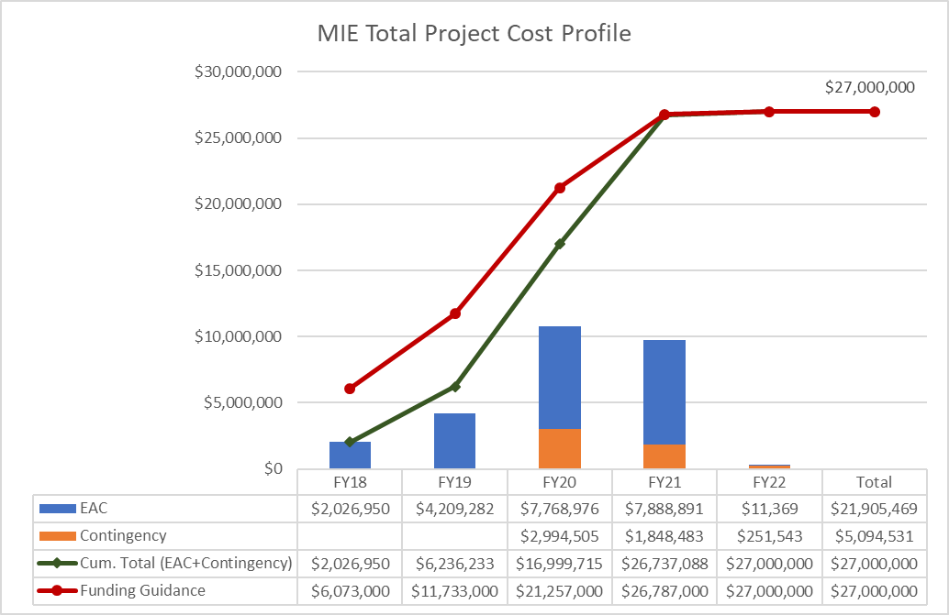
TPC Profile – sPHENIX MIE September 2019

Slide 9
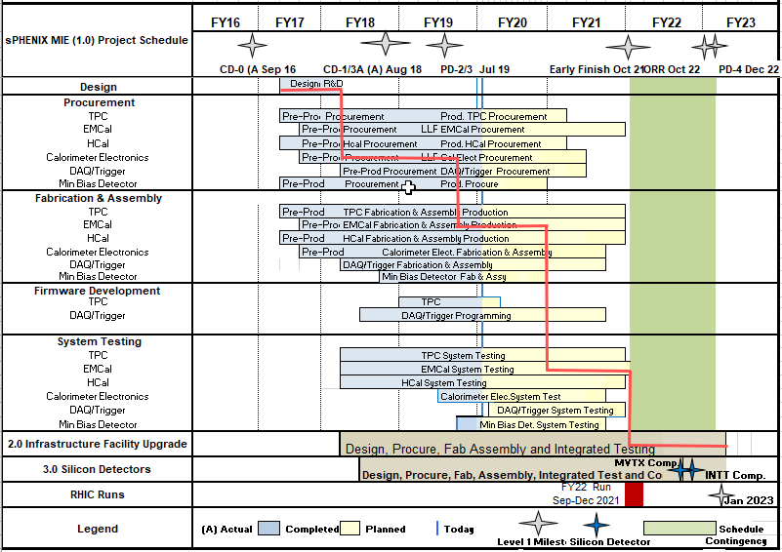
Summary Schedule: PHENIX MIE+1008 Infra & Facility Upgrade Combined
Updated as of September 2019

Slide 10
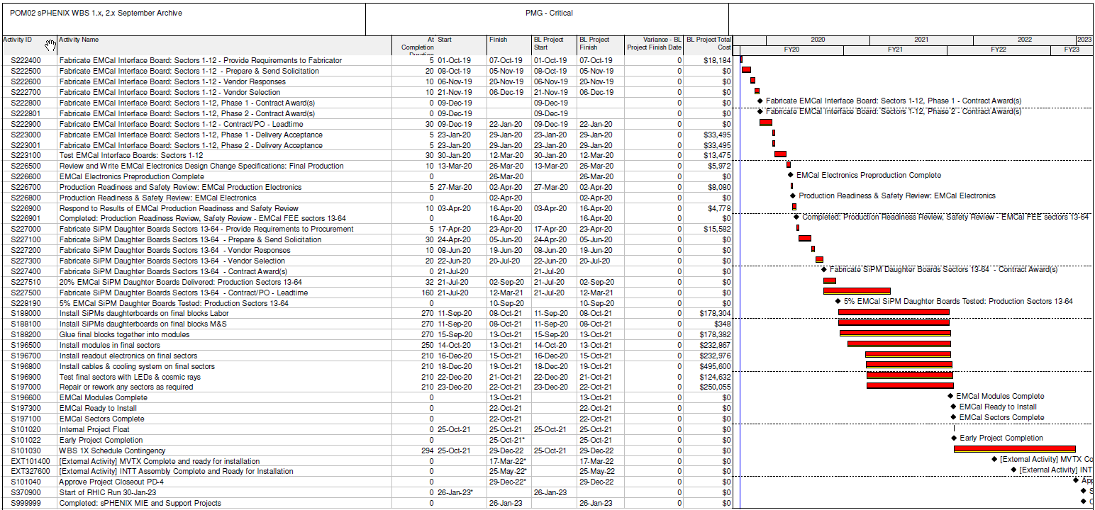
Critical Path – sPHENIX MIE and 1008 Infrastructure and Facility Upgrade Combined

Slide 11
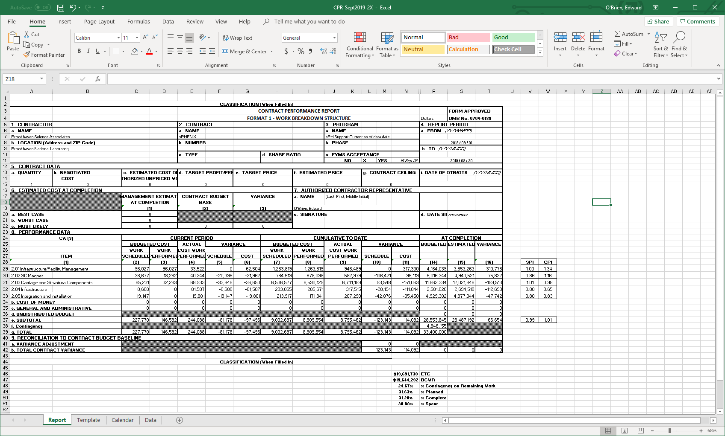
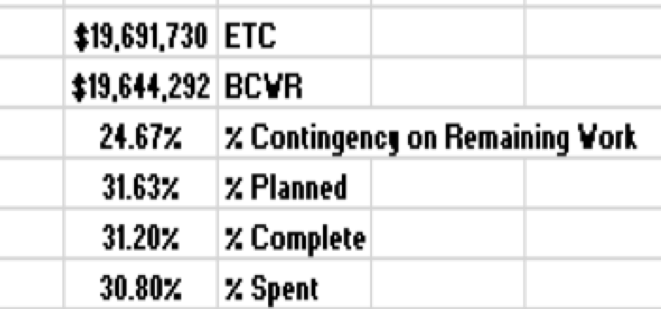
2.X Cost Performance Report (CPR) – September 2019
Pre - baseline

Slide 12
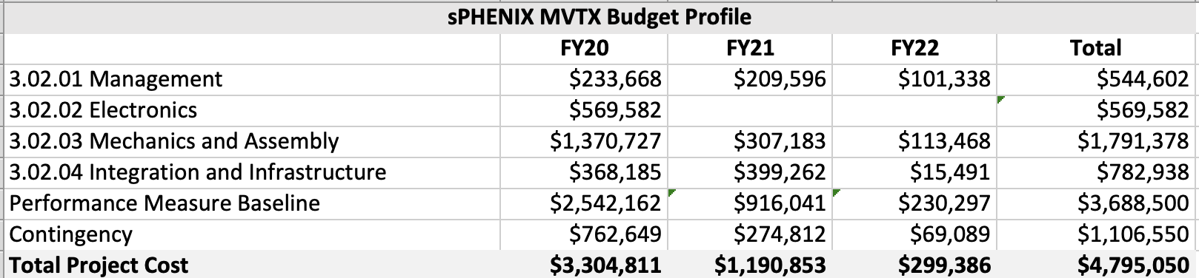
3.X MVTX Capital Project Budget Profile
Both the MVTX PMP & Review Response document has been submitted to BNL.
I’ve asked LBNL, LANL and MIT to produce contract documents for FY2020 funding. MIT and UT-Austin will also be asked to produce FY20 contract information.
PMG would like monthly status reports on MVTX. DOE wants quarterly reports.
MVTX Requested Budget Profile

Slide 13
sPHENIX MVTX Stave Production at CERN – December 2019
sPHENIX MVTX Stave production bi-weekly BNL indico page:
https://indico.bnl.gov/event/7112/
Production Status:
10 HICs produced, only GOLD chips are used;
4 HICs to be bonded in 1/2020
1 HIC not OK due to a broken chip (damaged during the gluing process)
4 staves (all GOLD)
Will continue to produce HICs in 2019
The CERN Bondlab is temporarily unavailable to sPHENIX due to other activities. It becomes available again later in December

Slide 14
Stave -production summary
IBSTAVE ID | Ins. after glue | Bonding | Ins. after bonding | Power test | Qualification test | HIC+SF+CP →Stave | Stave test | Test after PWR extn. soldering
A201 | YES | YES | YES | YES | YES | YES | YES
A202* | YES | YES | YES | YES | YES
A203 | YES | YES | YES | YES | YES | YES | YES
A204 | YES | YES | YES | YES | YES | YES | YES
A205 | YES | YES | YES | YES | YES | YES | YES
A206 | YES
B201 | YES
B202 | YES
B203 | YES
B204 | YES
* Broken chip ID-5
Continue Hybrid Integrated Circuit (HIC) production to create a stock of 10-12 modules to be bonded in 12/2019
First batch of ~ 20 STAVES could be ready by the end of March

Slide 15
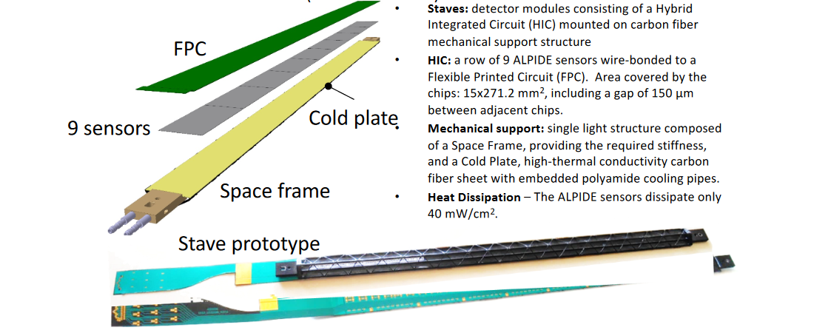
MVTX Staves – Assembly components

Slide 16
Back Up

Slide 17
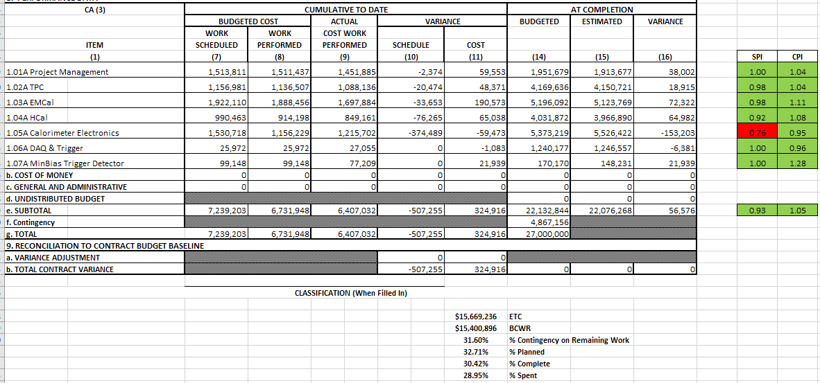
1.X Cost Performance Report (CPR) - October 2019
DOE SPI or CPI Value Thresholds
0.90 to 1.15
0.85 to 0.89 or 1.16 to 1.25
<0.85 or >1.25

Slide 18
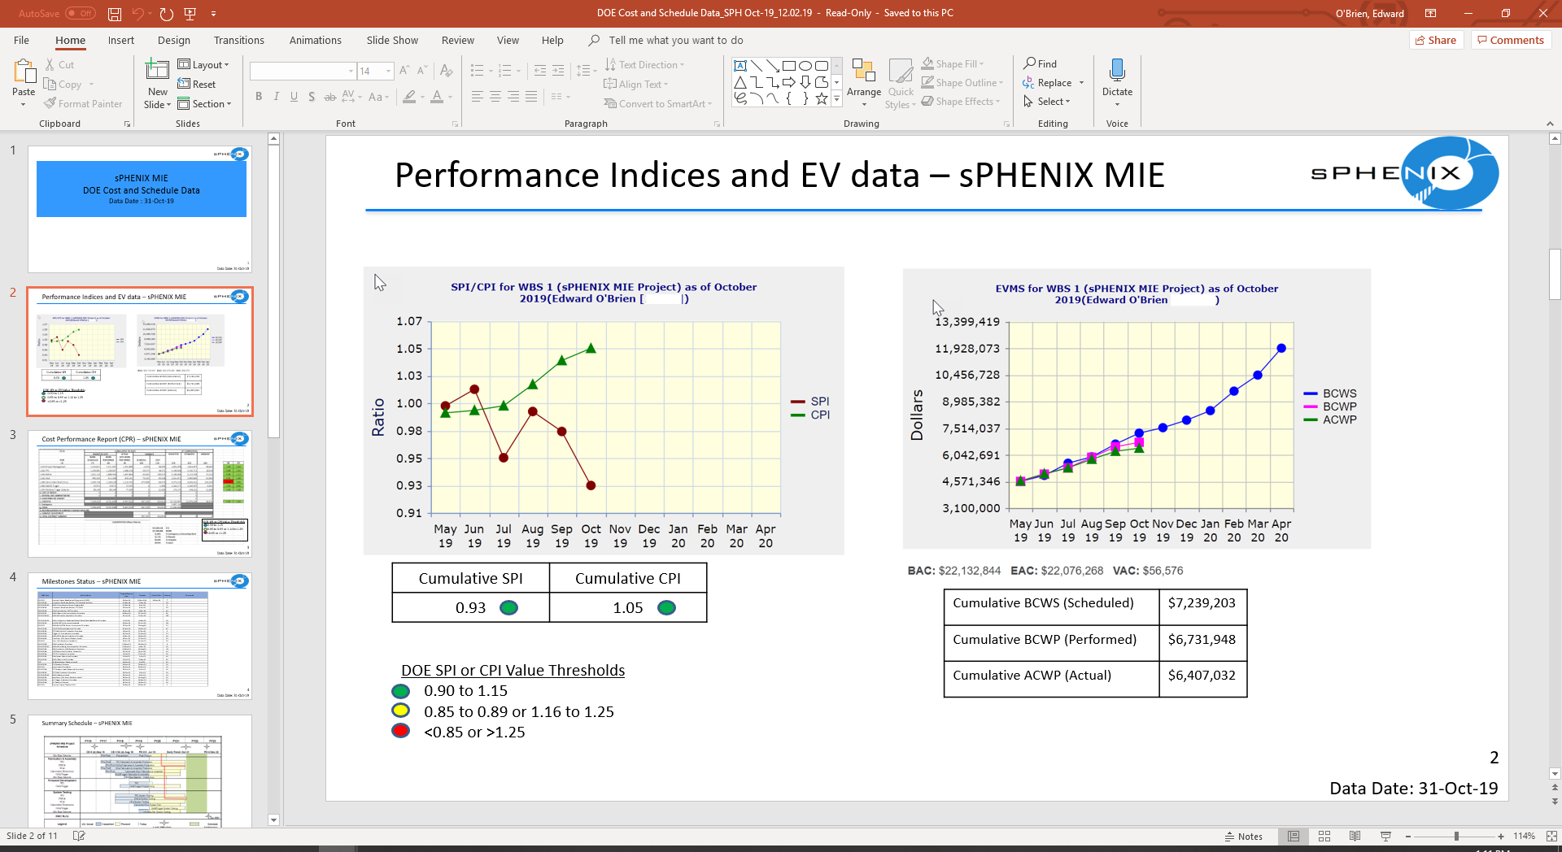
1.X Performance Indices and EV data – October 2019

Slide 19
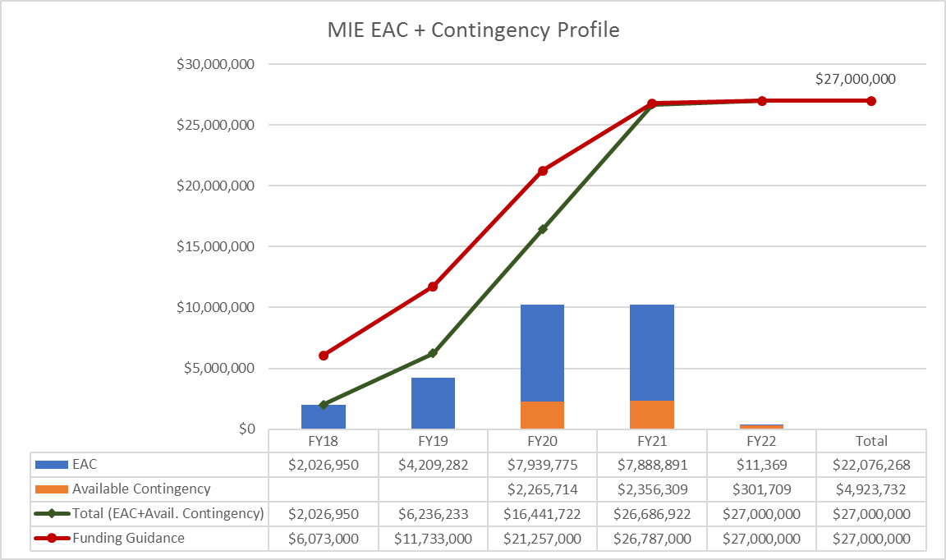
TPC Profile – sPHENIX MIE October 2019

