Slide 1
SDCC site changes

Slide 2
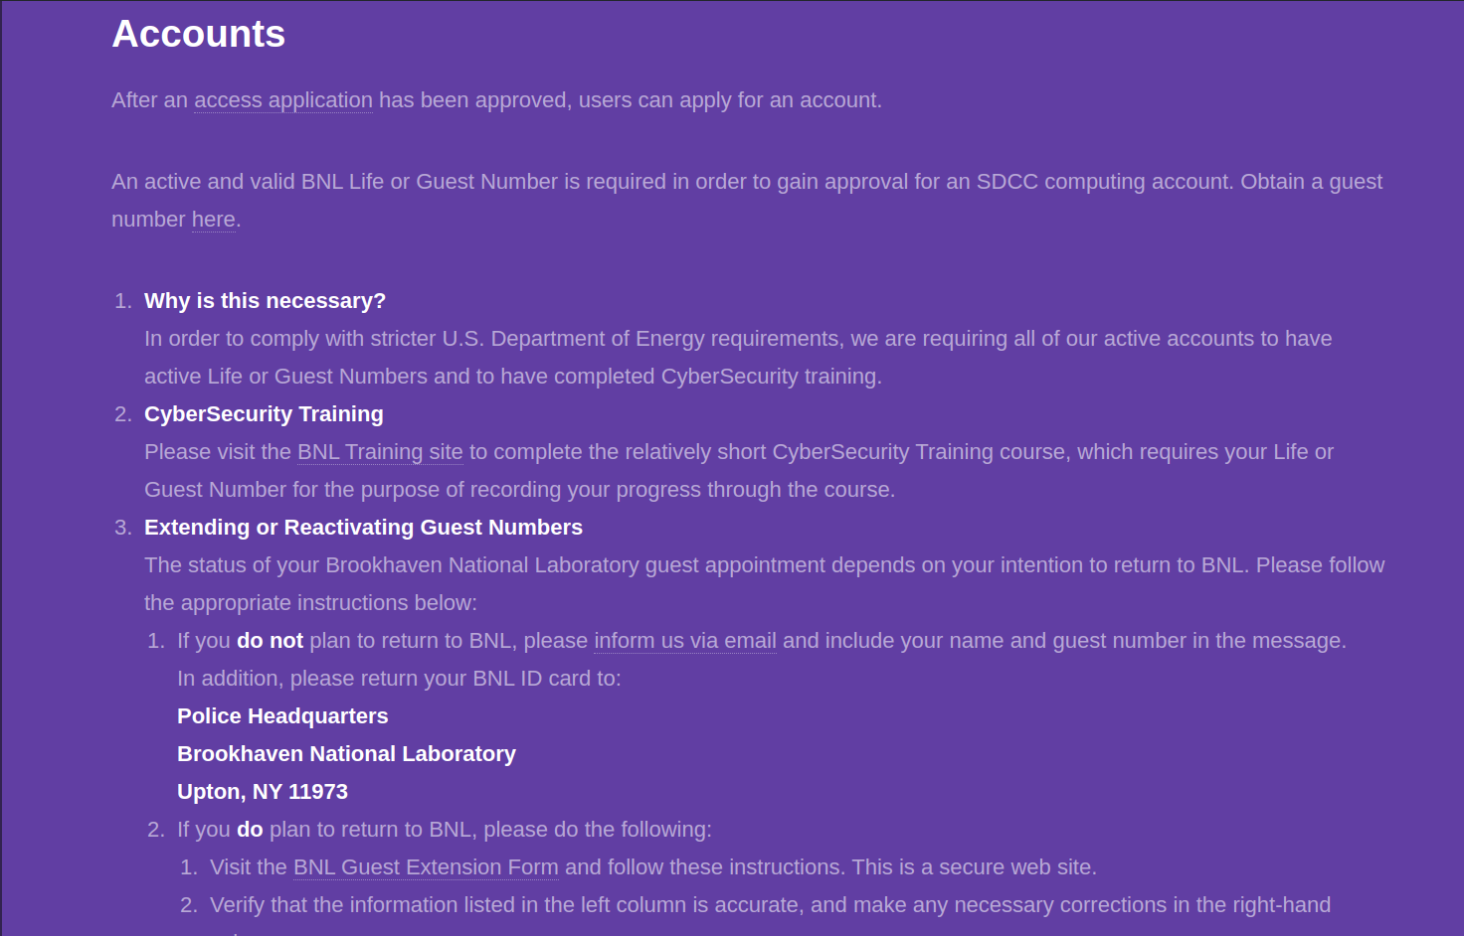
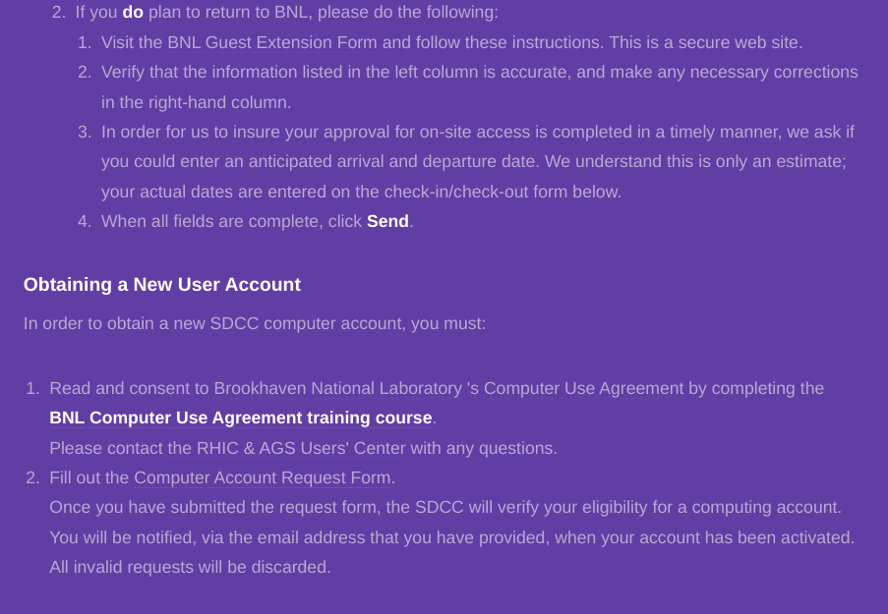
Current accounts section

Slide 3
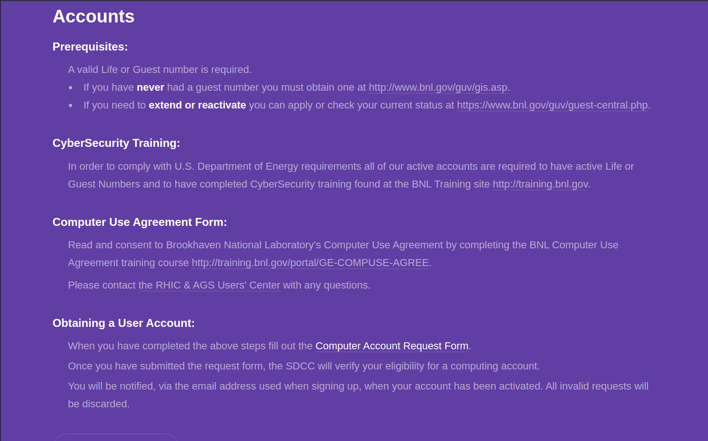
Proposed changes to accounts
Section will be compressed
Link to form more clearly visible

Slide 4
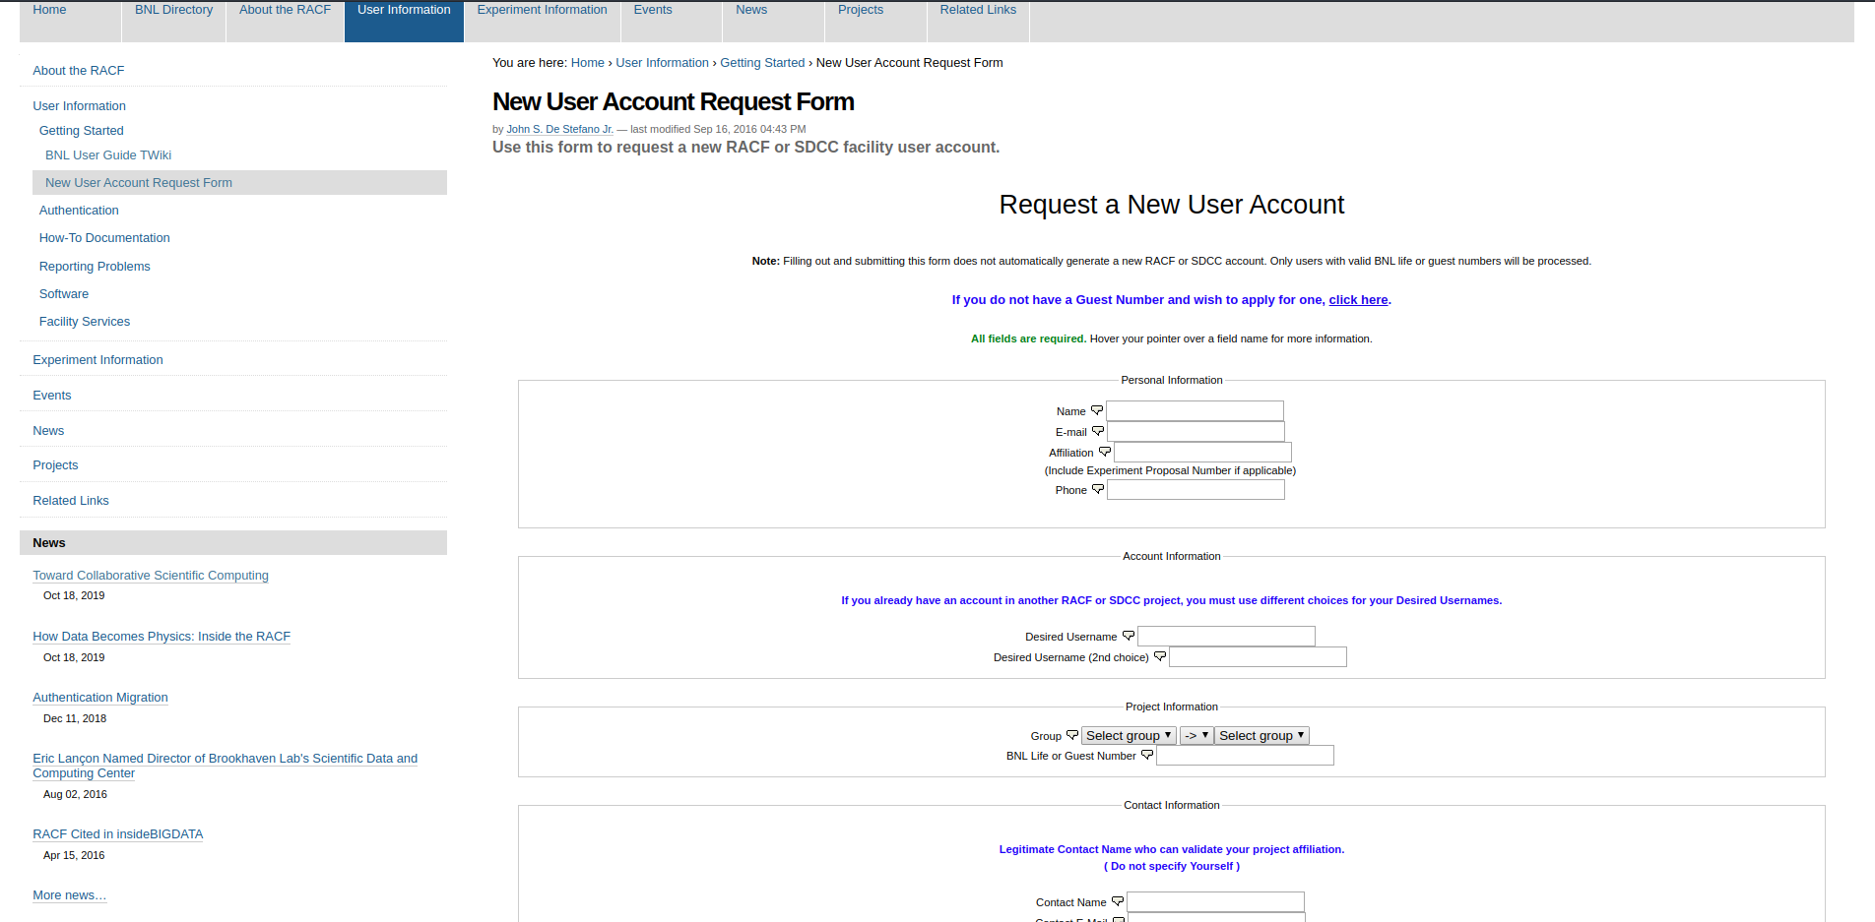
Current form
Current site links to form on separate site

Slide 5
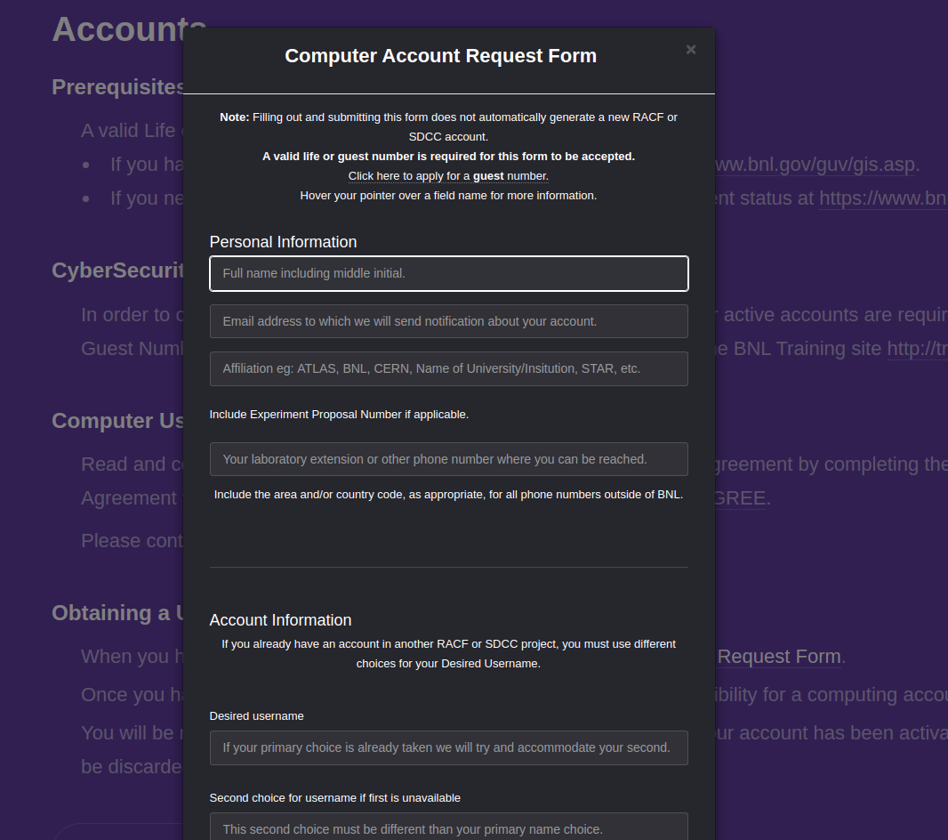
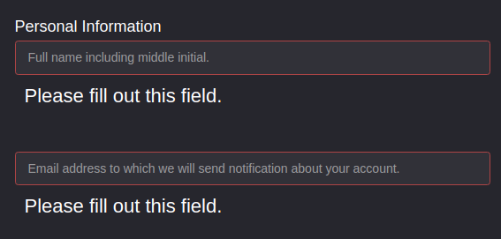
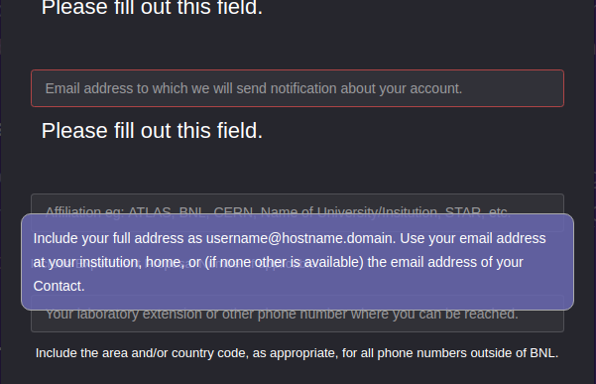
Proposed form change
New form displays on same page
In certain browsers, Chrome, form will display visual validation
Tooltips adjusted where needed
Placeholders to explain field requirement

Slide 6
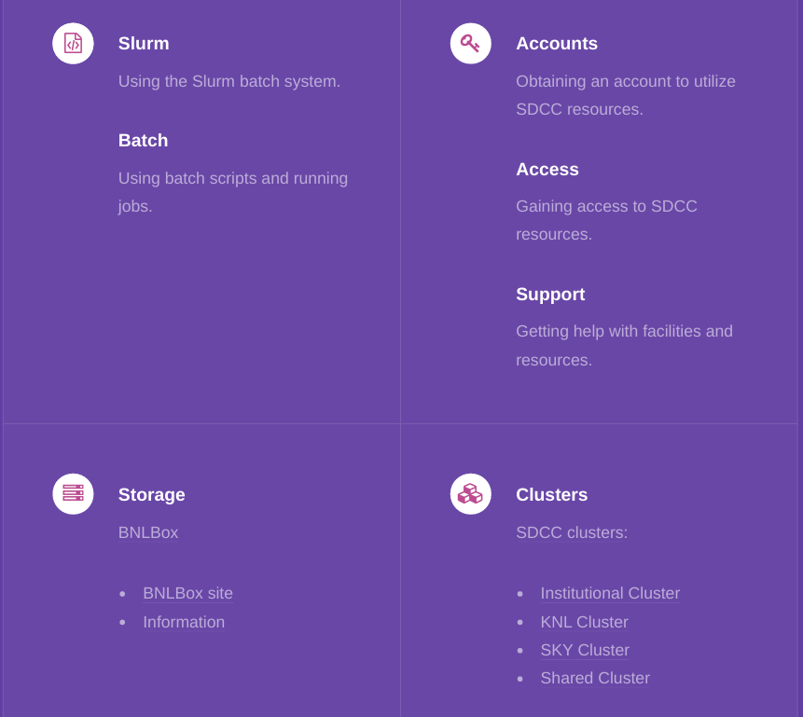
Information section adjustments
Information section compressed to 4 boxes with relevant links

Slide 7
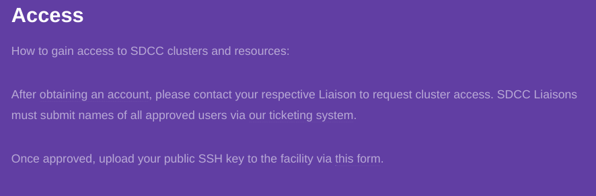
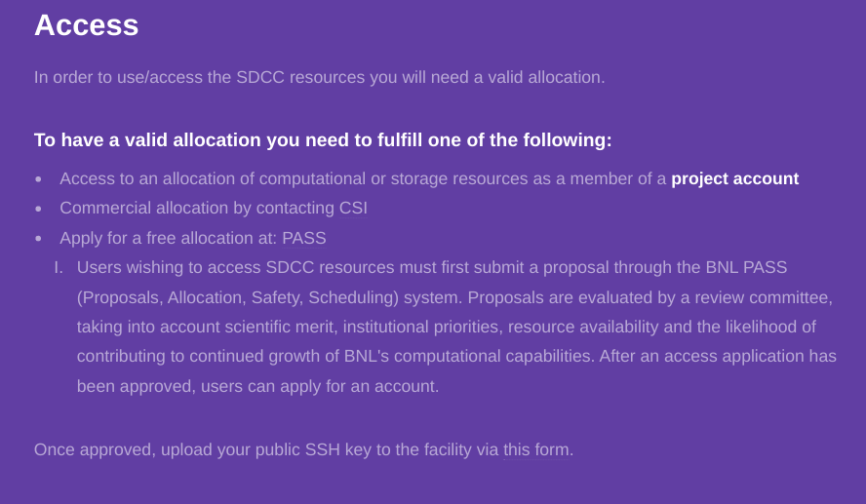
Access section adjustments
Current access section
Proposed adjustments

Slide 8


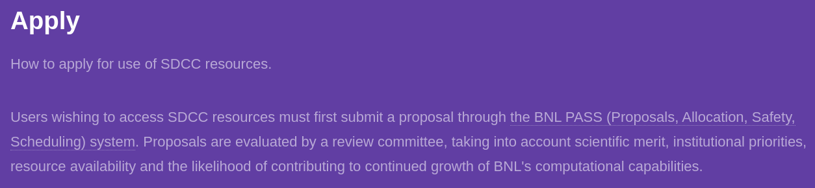
Apply removed from menu
Apply section information was moved into access to be more clear
Current
Proposed

