Slide 1
PMG Agenda
Issues
Status Carriage/Cradle contract
Status of PMP for the I&F and MVTX
Status of milestones expected to be accomplished in Dec 2019
Discussion FY20 milestones for PEMP
Upcoming procurements
EV for November 1.X and 2.X

Slide 2
Issues for BNL Management
Thanks to action from Phys Dept & sPHENIX we have ordered 16k additional SiPMs for high eta EMCal. Change request has gone from BNL PPM to Hamamatsu.
MVTX capital accounts are now open. We’re in active discussion with LANL, LBNL, MIT and UT-A on contract documentation. Negotiating the final FY20 contract numbers consistent with the RLS.
Three large (>$250k) sPHENIX contracts with PPM and 3 more on the way in the next 4 weeks.
At PPM: SBU, UIUC (about to be awarded), Carriage/Cradle
Contracts being prepared: LANL, LBNL, MIT (all MVTX)

Slide 3
Status of Carriage/Cradle Order
All documents with PPM except the two packages of final signed drawings.

Slide 4
Status of PMP for MVTX and I&F
MVTX PMP has been through a number of revisions from both the sPHENIX project team and BNL Management. The only item left to revise is the MVTX milestone table to reflect the fact that funding is flowing two months later than originally expected.
Finalize the milestone table this week and release to sign.
We have told DOE-NP that we will share the MVTX PMP with them once it is ready to sign. However they are not interested in signing themselves.
I&F PMP is also in an advanced draft. We are doing EV presuming that the baseline that we presented at the October I&F review is the approved baseline. As with the MVTX PMP, we will review the milestone table one last time prior to signing.
I recommend that the I&F PMP should not be shared outside the Lab. It is an internal BNL document.

Slide 5
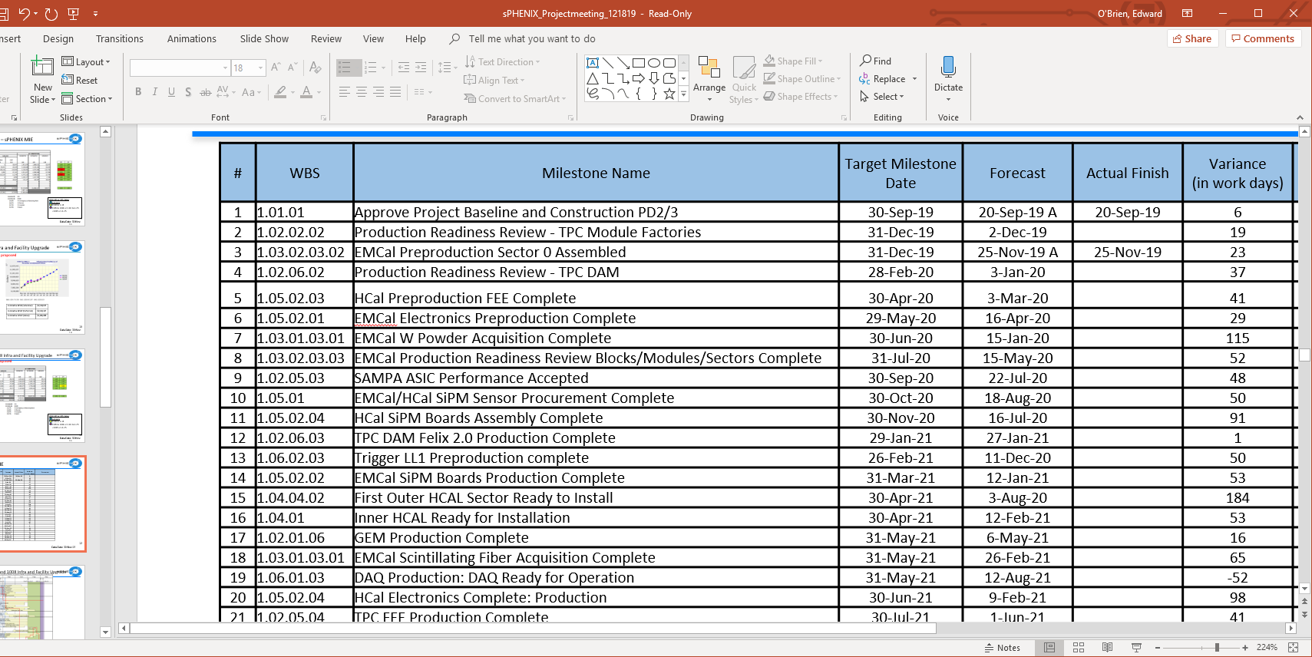
FY20 MIE Milestones
10 sPHENIX MIE milestones in FY20. Milestones 1, 2 and 3 now complete.
Milestone 2: Production Readiness Reviews of TPC GEM Module factories was successfully completed on Dec 17.
The milestone most at risk is Milestone 6: EMCal electronics preproduction complete. We can meet it but it will require the first article EMCal SiPM daughter card currently being produced by the vendor to be good. We expect the first article to arrive at BNL for testing between the last week of January and the first week of February.

Slide 6
sPHENIX Procurements Next Six Months
Award Orders submitted to BNL PPM
Carriage/Cradle (MIE) $950,000
University contracts for 2020 with UIUC ($590,000) and SBU ($500,000)
Prominent Orders for the next six months
MVTX contracts with MIT, LANL, LBNL and UT-A (non-MIE)
MIT $440,000 to be submitted Jan 2020
LANL $510,000 to be submitted Jan 2020
LBNL $980,000 to be submitted Jan 2020
UT-Austin $90,000 to be submitted Jan 2020
All production EMCal light guides $250,000 to be submitted Feb 2020
HCal Splice plates & high strength steel HCal end plates $400,000 to be submitted Feb 2020
EMCal SiPM daughter cards (sectors 2-12) $100,000 to be submitted Mar 2020
2nd half of W powder order for EMCal $500,000 to be submitted Mar 2020
iHCal scintillating tiles (non-MIE) $750,000 to be submitted Mar 2020

Slide 7
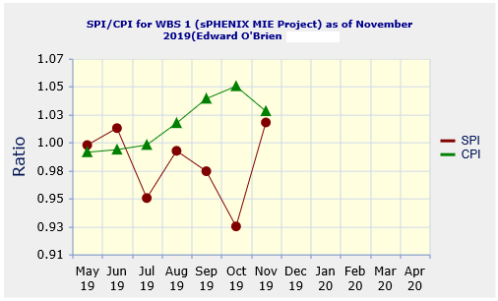
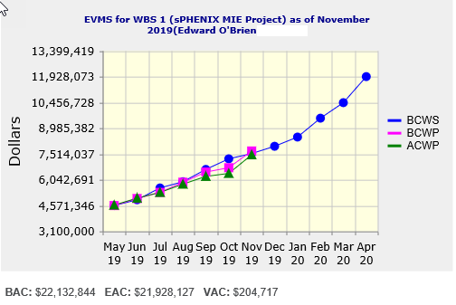
Performance Indices – sPHENIX MIE
Cumulative SPI | Cumulative CPI
1.02 | 1.03
Cumulative BCWS (Scheduled) | $7,539,613
Cumulative BCWP (Performed) | $7,686,704
Cumulative ACWP (Actual) | $7,468,749
DOE SPI or CPI Value Thresholds
0.90 to 1.15
0.85 to 0.89 or 1.16 to 1.25
<0.85 or >1.25

Slide 8
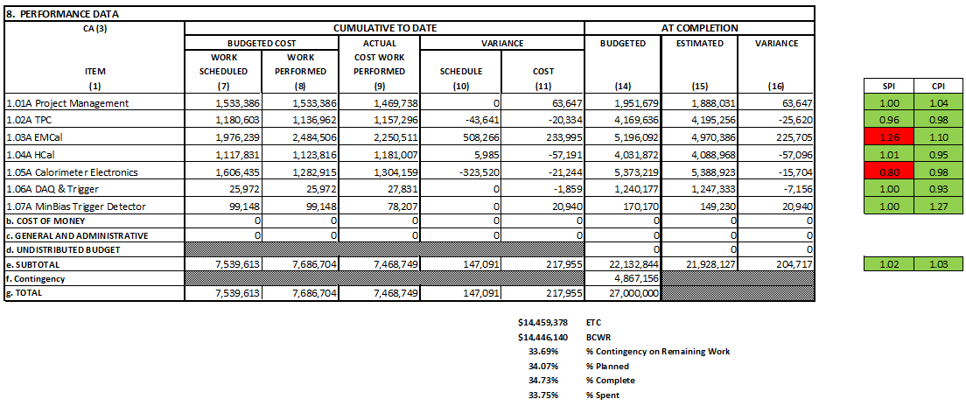
Cost Performance Report (CPR) – sPHENIX MIE
DOE SPI or CPI Value Thresholds
0.90 to 1.15
0.85 to 0.89 or 1.16 to 1.25
<0.85 or >1.25

Slide 9
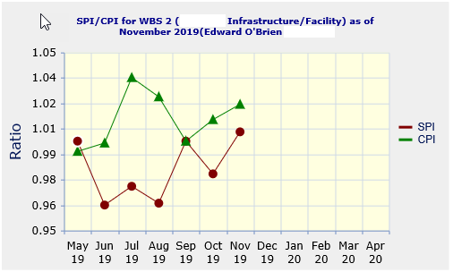
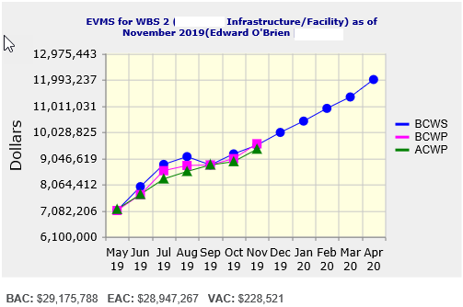
Performance Indices – 1008 Infra and Facility Upgrade
Based on proposed Baseline
Cumulative SPI | Cumulative CPI
1.01 | 1.02
Cumulative BCWS (Scheduled) | $9,538,025
Cumulative BCWP (Performed) | $9,590,337
Cumulative ACWP (Actual) | $9,386,408
DOE SPI or CPI Value Thresholds
0.90 to 1.15
0.85 to 0.89 or 1.16 to 1.25
<0.85 or >1.25

Slide 10
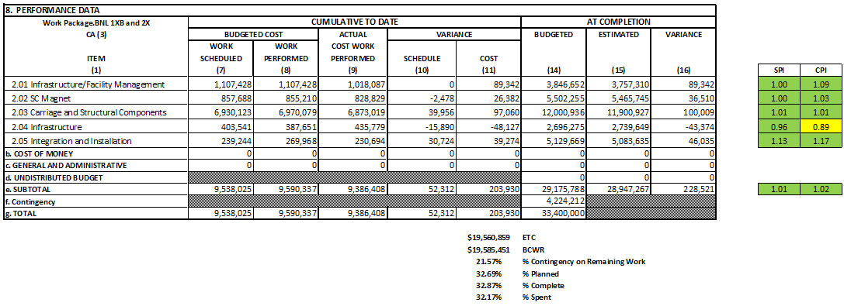
Cost Performance Report (CPR) – 1008 Infra and Facility Upgrade
Based on proposed Baseline
DOE SPI or CPI Value Thresholds
0.90 to 1.15
0.85 to 0.89 or 1.16 to 1.25
<0.85 or >1.25

Slide 11
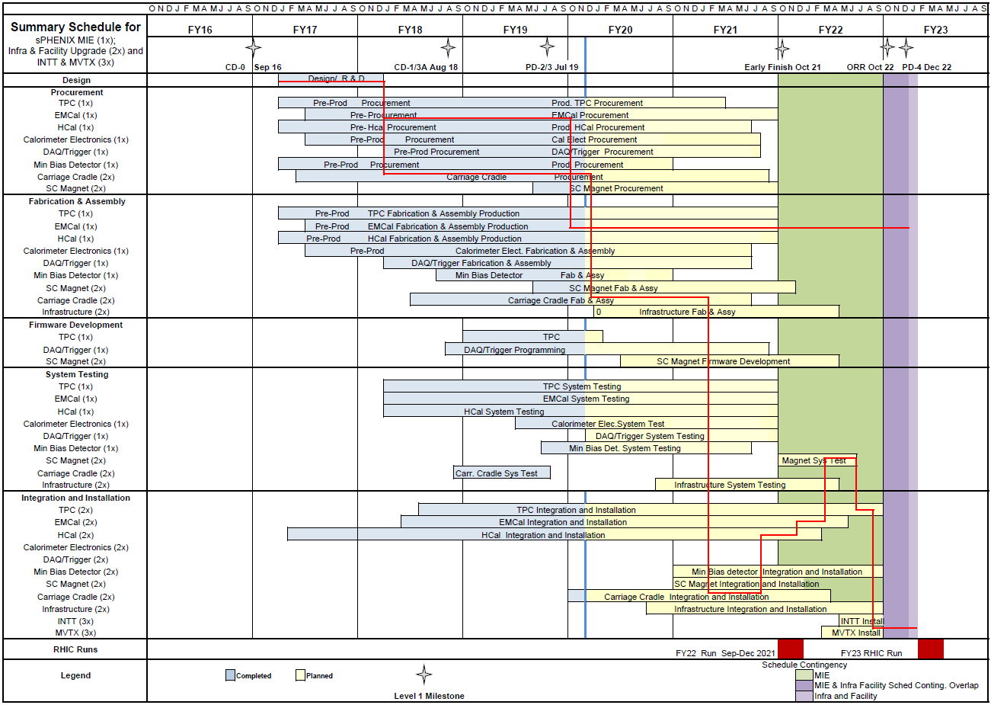
Summary Schedule – sPHENIX MIE and 1008 Infra and Facility Upgrade
1.X
2.X

Slide 12
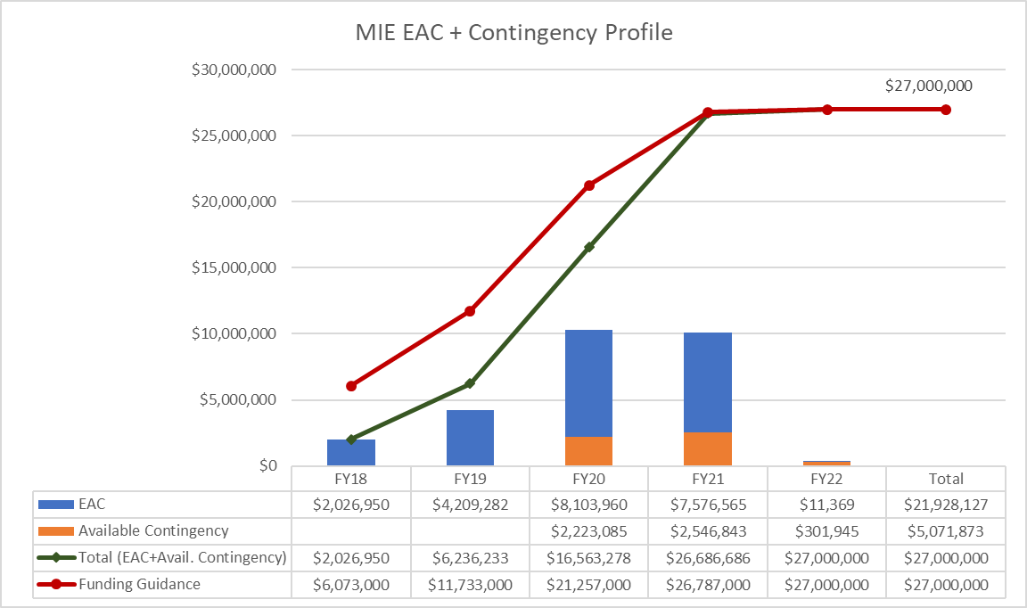
EAC and Contingency Profile – sPHENIX MIE

Slide 13
Baseline/Contingency Log - MIE

Slide 14
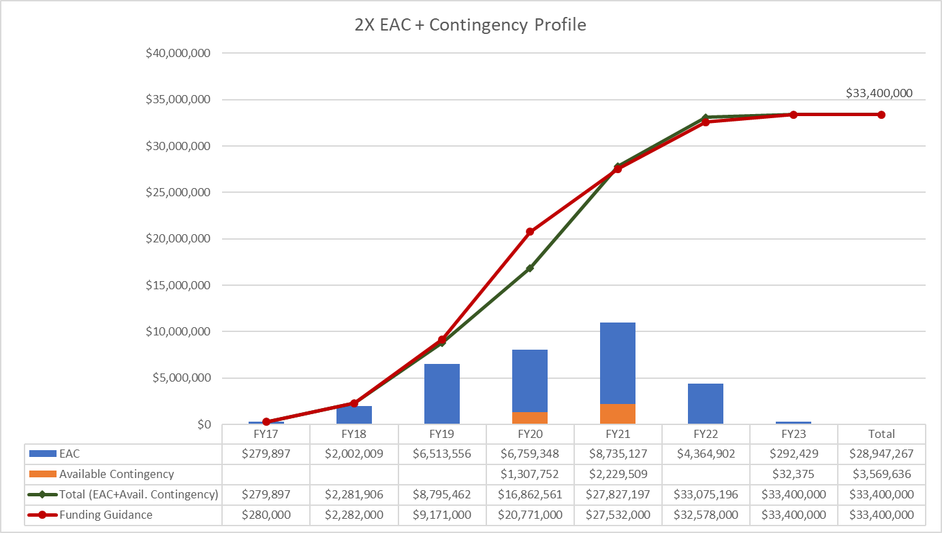
EAC and Contingency Profile – 1008 Infra and Facility Upgrade
Based on proposed Baseline

Slide 15
Baseline/Contingency Log - 1008 Infra and Facility Upgrade
Based on proposed Baseline

Slide 16
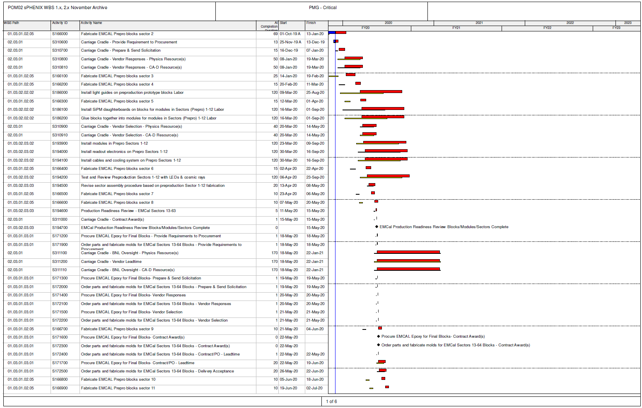
Critical Path (1x, 2x and 3x Combined)

Slide 17
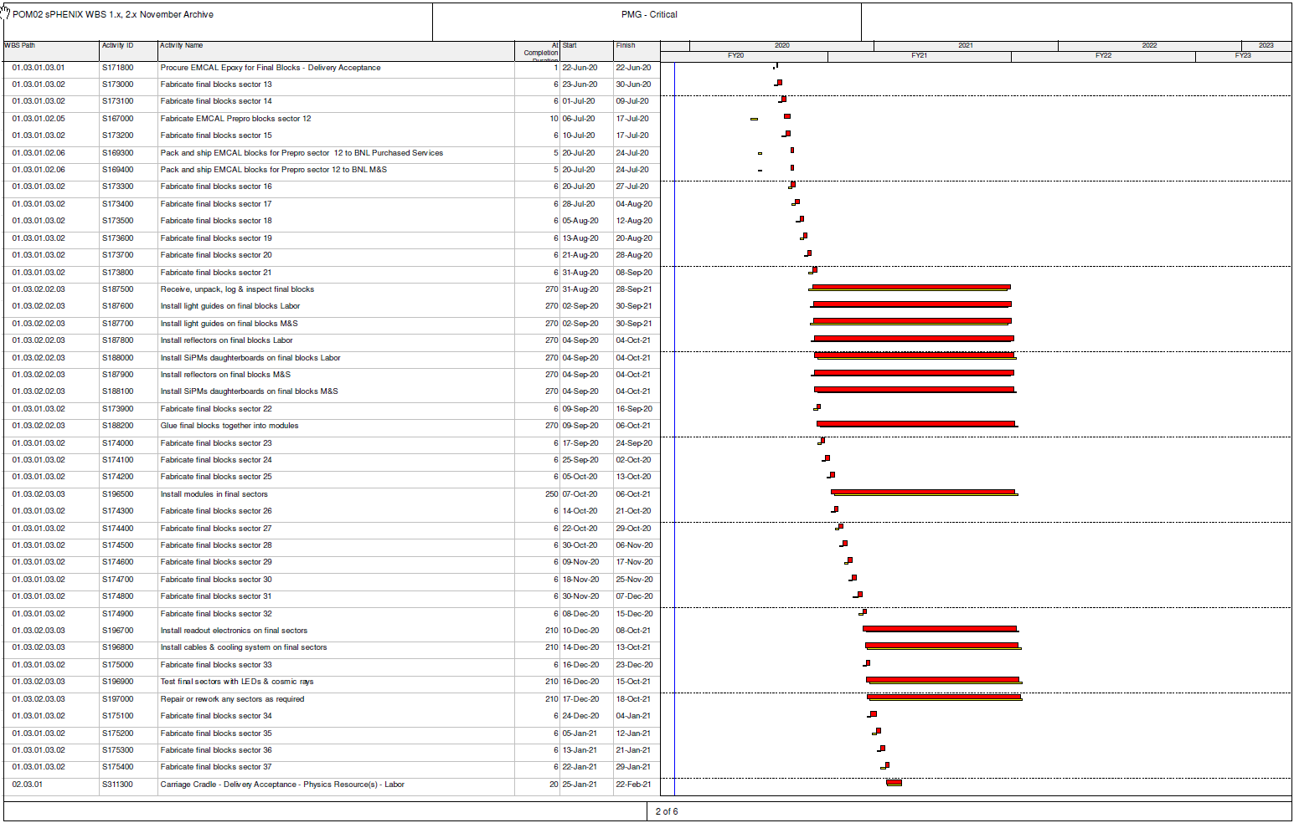
Critical Path (1x, 2x and 3x Combined)

Slide 18
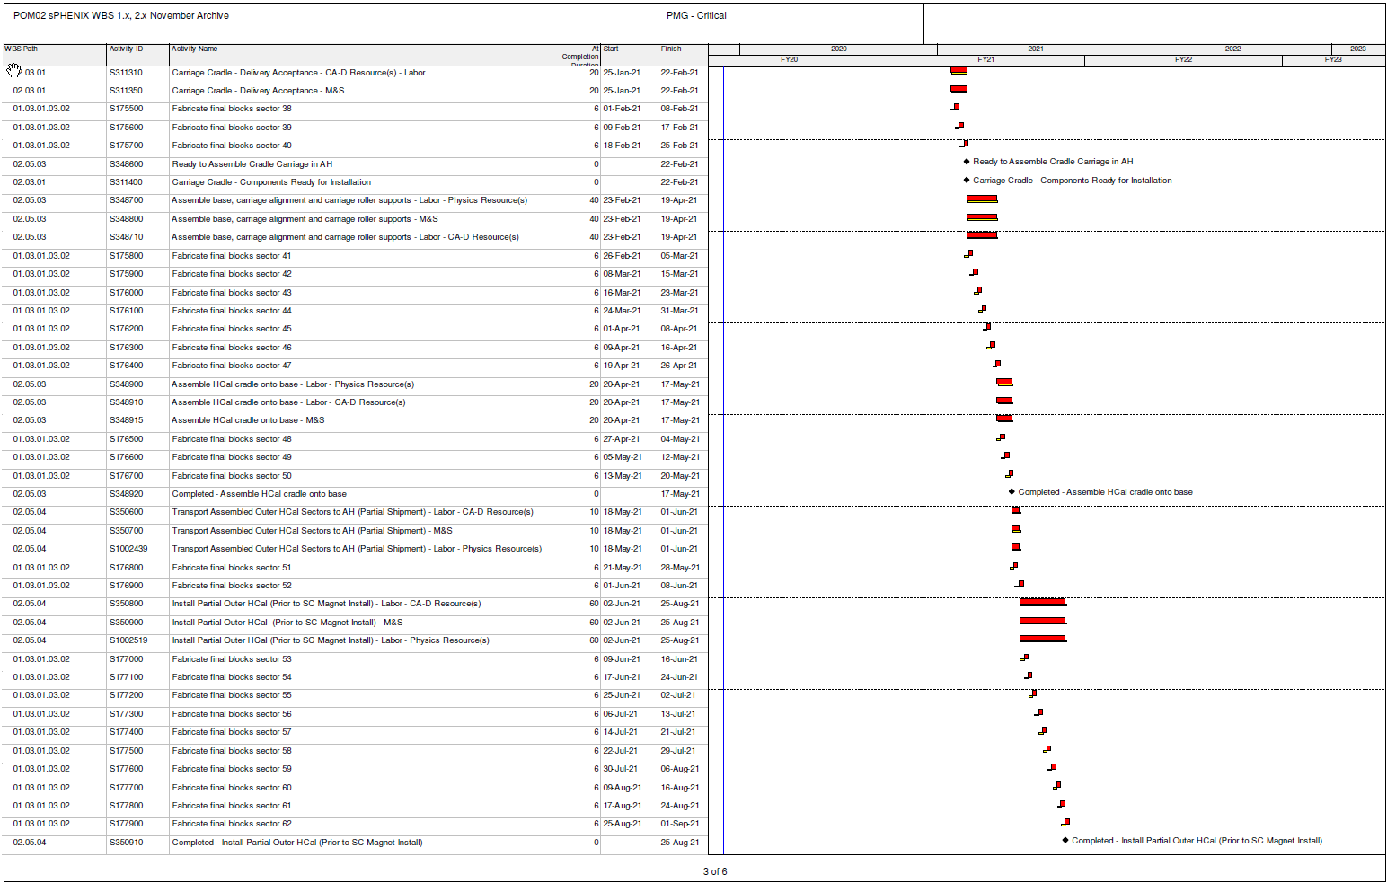
Critical Path (1x, 2x and 3x Combined)

Slide 19
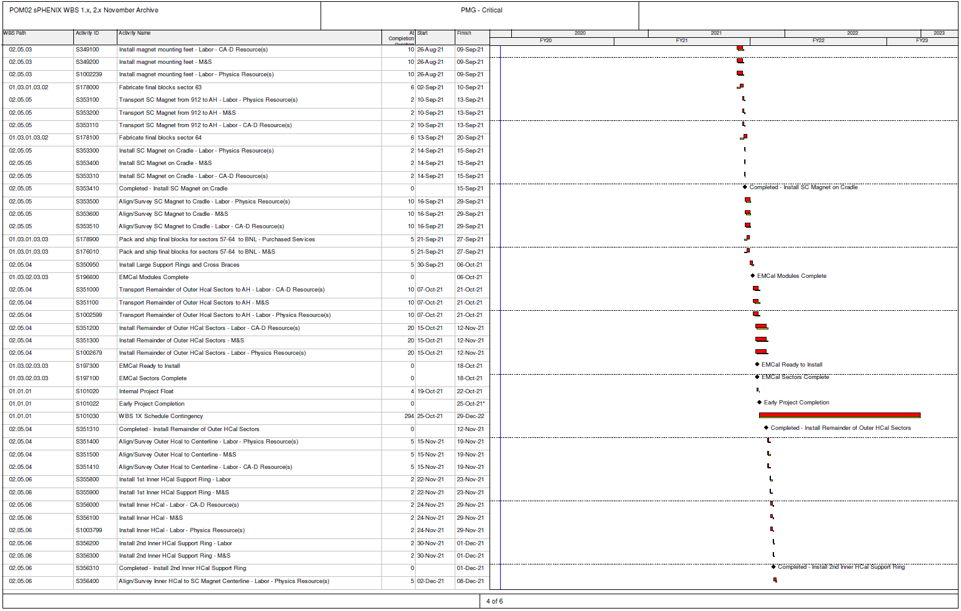
Critical Path (1x, 2x and 3x Combined)

Slide 20
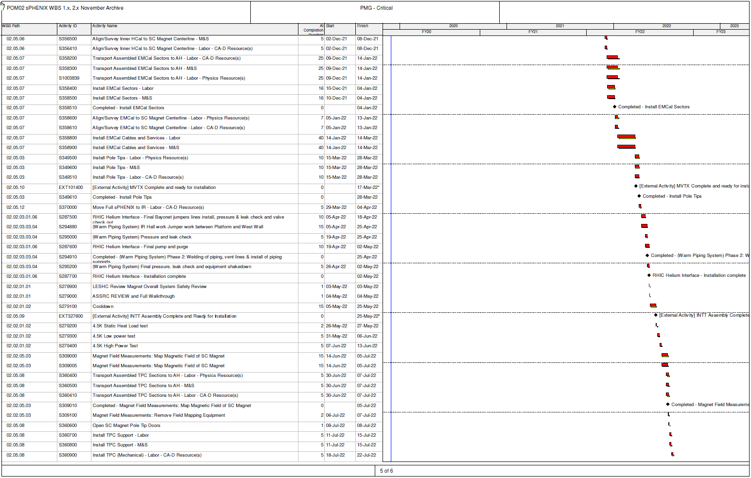
Critical Path (1x, 2x and 3x Combined)

Slide 21
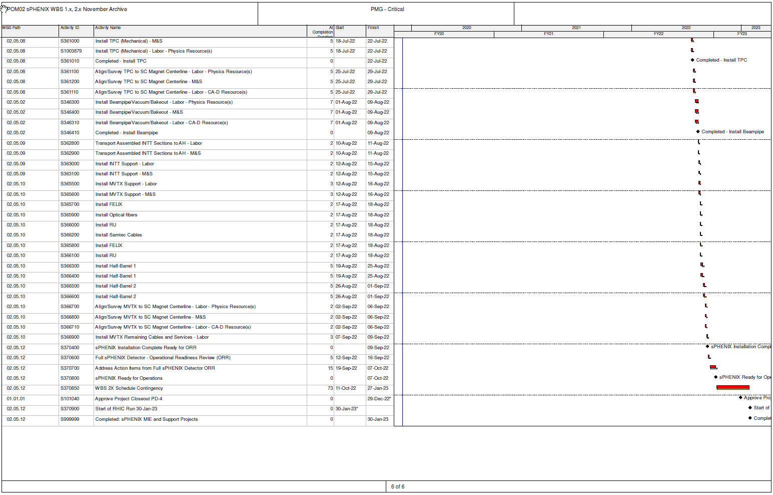
Critical Path (1x, 2x and 3x Combined)

Slide 22
Back Up

Slide 23
I&F Upgrade Review Recommendations
Include in P6 the appropriate amount of time and effort associated with preparing for the Operational Readiness Review (ORR) and any other reviews that need to take place between now and January 2023. Done
Evaluate the schedule to see where activities can be advanced to create more schedule contingency. Present a plan to create additional schedule contingency to BNL NPP management by December 2nd, 2019. Done
Consider assigning a project team member to provide oversight and be in close contact with the Procurement and Property Management Division (PPM) for all strategic procurements going forward. There will be a significant number of procurements to place and monitor throughout the life of the project ($9M over this next year alone). Done. A sPHENIX teams meets with PPM weekly
Utilize Laboratory management if key procurements appear to languish in the procurement office. Met with head of PPM and discussed this issues with Berndt. Will continue to discuss procurement issues with PPM head and ALD as issues arise.
Evaluate the benefit of adding resources to support the Office of System Integration as well as mechanical engineering for the purpose of performing Finite Element Analysis (FEA) on current and future designs. Will follow up with Phys Dept

Slide 24
I&F Upgrade Review Recommendations
Complete the Unreviewed Safety Issue (USI) determination and subsequent changes to the safety Assessment Document (SAD) and Accelerator Safety Envelope (ASE) no later than 6 months prior to bringing cryogens into the 1008 Experimental Hall. The sPHENIX ESH Liaison will work with the sPHENIX project manager and C-AD ESSHQ Division Head to formalize the positive USI evaluation according to the C-AD OPM 1.10.1, Procedure for Identifying Unreviewed Safety Issues for the sPHENIX detector, and in particular, the planned cryogen system for the SC magnet. This evaluation will be completed at least 6 months prior to introducing cryogens or any hazards that may require a change to the Safety Assessment Document.
Confirm the Accelerator Safety Order requirements associated with this project with the BNL Accelerator Safety Officer, including the need for an Accelerator Readiness Review. This should be done by November 30, 2020. The sPHENIX project will undergo reviews in accordance with the SBMS subject area ‘Accelerator Safety’ and will coordinate and schedule readiness reviews with BHSO (IRR and/or ARR) as required by the Accelerator Safety Order. The review requirements will be determined by November 30th, 2020.

Slide 25
I&F Upgrade Review Recommendations
Review the magnetic mapping schedule activities and determine if they can be modified to reduce the impact to the overall schedule. Done
Develop a plan to perform a magnetic survey of the as-built structure in the IR hall with the solenoid energized. Time has been put in the RLS for this. A Magnet Mapping plan is being drafted and will include a magnetic survey of the IR with the solenoid powered.
Review the procurement schedule activities for the Cradle Carriage to determine if the durations for Vendor Responses and Vendor Selection are too conservative. The current schedule gives us time to react if the bids come in too high. A success-oriented plan would require us to add additional cost risk to the project plan.
Review the plans for the shipment of the Cradle Carriage to ensure there is adequate cost and schedule for shipping the extra-wide load from the vendor to BNL. Done. Included in signed SOW and will be part of RFQ being prepared by PPM

