Slide 1
INDEN evaluation of Fe isotopes
and the ⁵⁵Mn update
R. Capote (IAEA) and A. Trkov (JSI, Slovenia)
Nuclear Data Section, International Atomic Energy Agency
On behalf of the INDEN collaboration
@ https://www-nds.iaea.org/INDEN
Nuclear Data Week - CSWEG 2020 (virtual)
30 November –December 4, 2020, BNL, US NNDC

Slide 2
Problems identified in inelastic/capture gammas of many ENDF/B-VIII.0 evaluations
Similar problems:
Si(n,n’γ),
Fe(n,γ), Fe(n,n’γ),
Mg(n,γ), Mg(n,n’γ), Ti(n,γ), Ti(n,n’γ)
Hint:
ENDF/B-VI.8
was better for gammas
Marie-Laure Mauborgne et al, CSWEG 2019 & EPJ WoC 239 (2020) 20007 (ND2019)

Slide 3
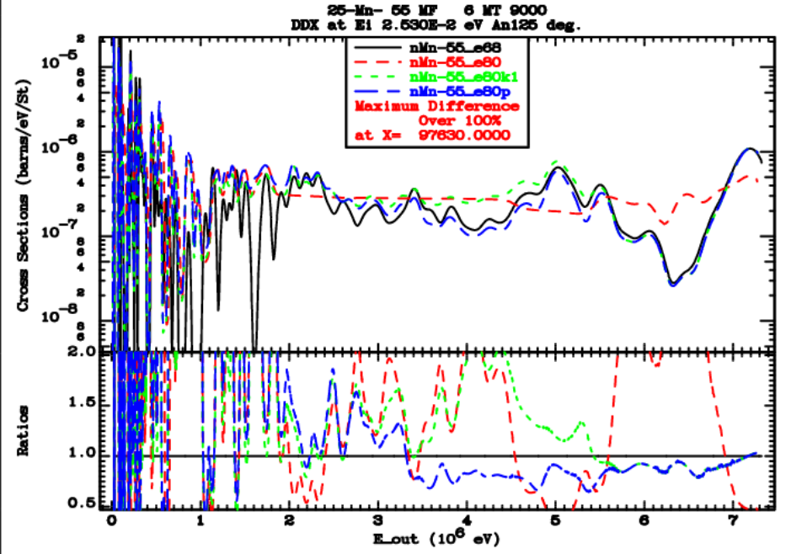
⁵⁵Mn update of thermal (n,γ) gammas
New INDEN files
⁵⁵Mn - case study of the problem

Slide 4
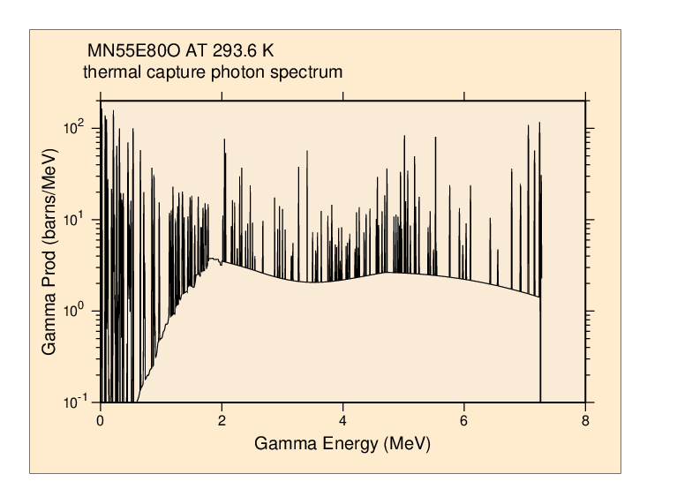
⁵⁵Mn update of thermal (n,γ) gammas
Thermal capture photon spectrum updated
EGAF IAEA database:
Measured thermal capture γ
Quite challenging to
reproduce via modelling
But very well measured ☺,
Let’s use it.
EGAF lines superimposed on a
calculated continuum
See description in INDC(NDS)-0810, performance restored

Slide 5
⁵⁵Mn update of thermal (n,g) gammas
Mn-55 evaluation in ENDF/B-VIII.0 was criticized for poor prediction of capture gamma spectra (Marie-Laure Mauborgne, CSEWG-2019, EPJ WoC 239, 20007 (2020).
The data are important for oil-well exploration.
Using the information in the EGAF library and EMPIRE nuclear model calculations the gamma production data were improved. High resolution energy bins (~5 keV/bin)
Good performance of updated file mn55e80p on proprietary benchmark was confirmed by Marie-Laure Mauborgne
Documented in INDC(NDS)-0810 on "Evaluation of thermal capture gamma spectra"

Slide 6
Problems with ENDF/B-VIII.0 (CIELO) ⁵⁶Fe
Up to 30% underestimation of neutron leakage for En=1-4 MeV
Fig. 32, 35, Nuclear Data Sheets,148 (2018) 214-253

Slide 7


Fe 14 MeV – problem
Indep. confirmation
Polyethylene (C₂H₄)_{n}
Fe
Ф13 cm×6 cm
Ф13 cm×6 cm
Fe
Ф13 cm×6 cm
Y. Ding et al, EPJ WoC 239 (2020) 18010 (ND2019)

Slide 8
²⁵²Cf(sf) neutron leakage: 100 cm sphere
Up to 30% overestimation of neutron leakage for En~300 keV
B. Jansky et al., CVR, Rez, Czechia,EPJ WoC 239 (2020) 18005 (ND2019)
H-proportional detector (HPD)
stilbene detector
Note that ENDF/B-VIII.0 Fe = CIELO

Slide 9
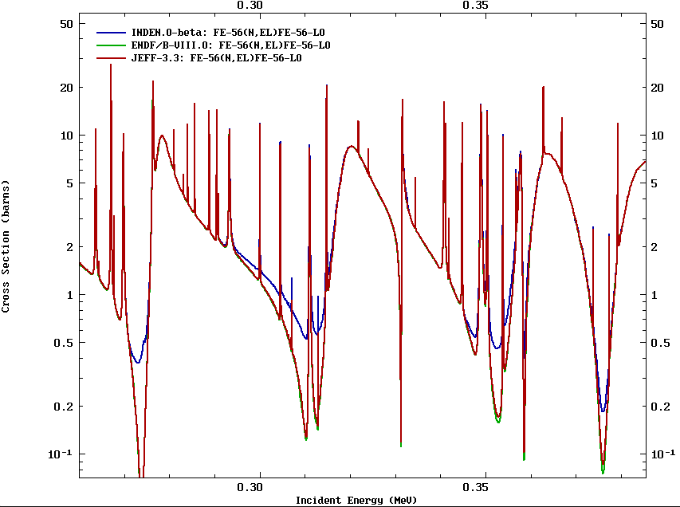
Patching the Fe-56 evaluation: EL (1)
Adhoc increase, NO fit
(n,el) minima poorly described (27 keV,~300keV, ...)
Sensitive to transmission through thick samples (>5 cm)

Slide 10
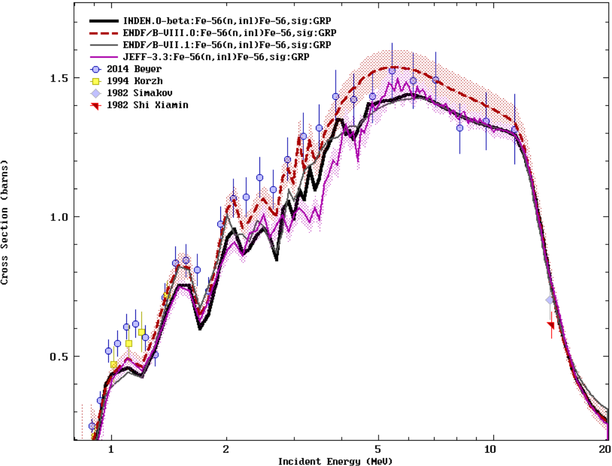
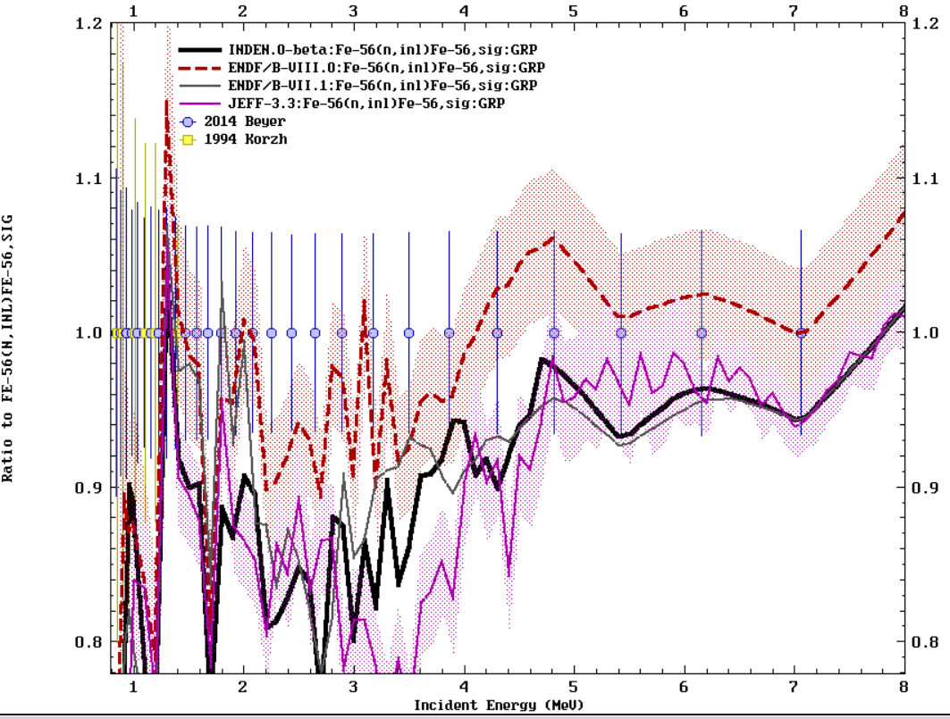
Patching the Fe-56 evaluation: INEL (2)
New INDEN files

Slide 11
Improvements to ⁵⁶Fe evaluation
Total cross sections are trusted
New measurements by E. Pirovano at IRMM support a higher elastic cross section
Capture is too small to play a role
→Conclusion: measured inelastic likely too high
Inelastic cross section was scaled down by 10-15%, assigning the difference to elastic (exact comparison of cross sections is difficult due to strong fluctuations)
Elastic minima were filled to reproduce observed transmission. A proper R-matrix fit will be appreciated.

Slide 12
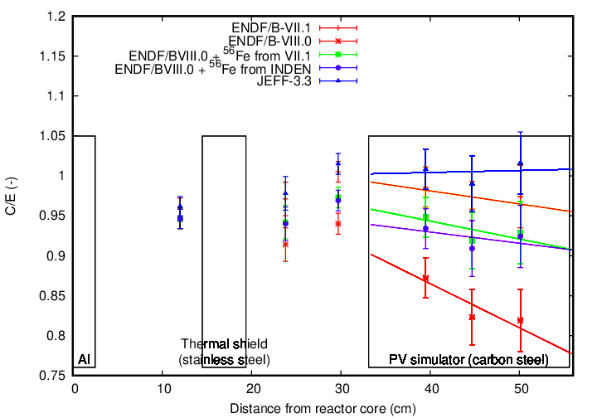
PCA reactor benchmark
Courtesy of Steven van der Marck (priv. comm.)
New INDEN file
Sensitivity
¹⁶O(n,α)?
High Sensitivity to Fe
n
water
water

Slide 13
Conclusions
INDEN interactions strongly helped to find deficiencies in existing evaluations and highlight potential solutions to existing challenges: https://www-nds.iaea.org/INDEN/
Updated evaluations for Mn-55, Fe-56, and Fe-57 (inelastic) are available for testing.
Reduced inelastic in Fe-56 deserves further experimental and/or theoretical investigations
New R-matrix fit that reproduces fitted minima of the elastic cross-section of Fe-56 desirable.
Mn-55 updated evaluation was tested on a relevant proprietary benchmark. Significant improvement was demonstrated.
See Trkov/Capote presentation tomorrow for additional validation

Slide 14
Back-up

Slide 15
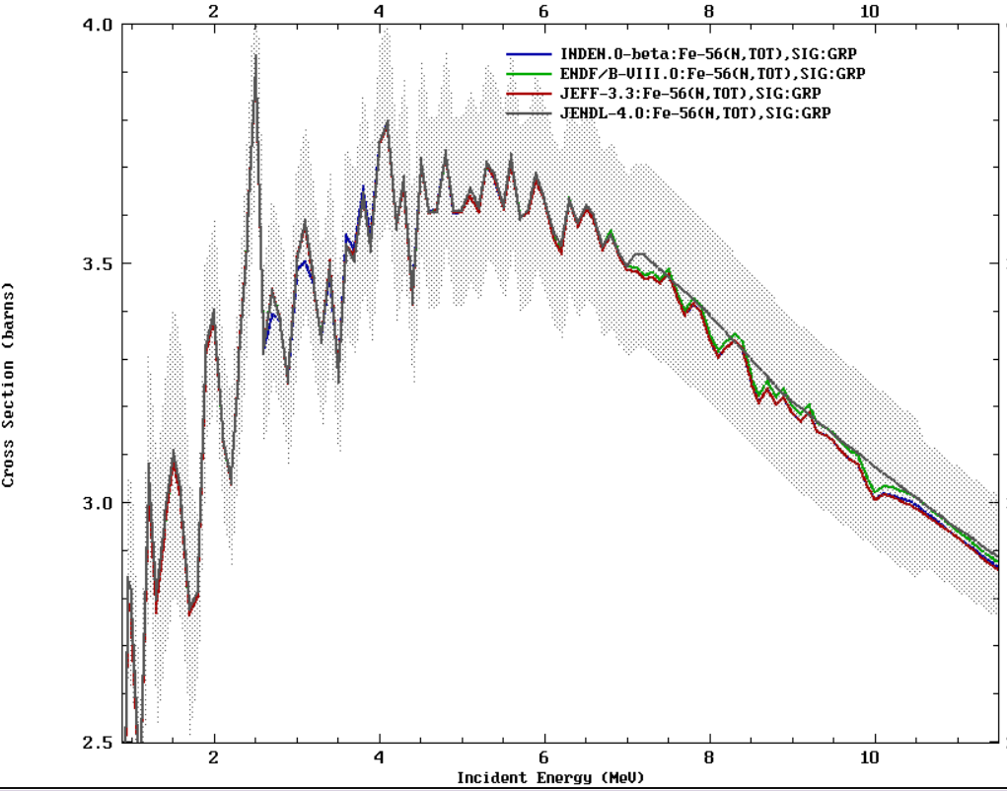

Slide 16
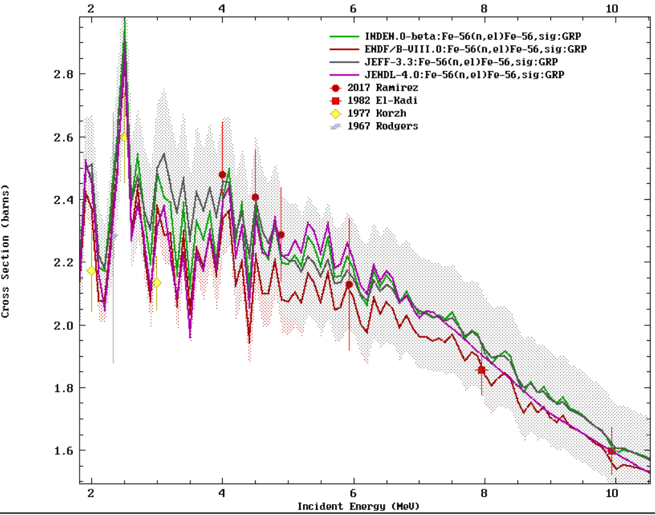

Slide 17
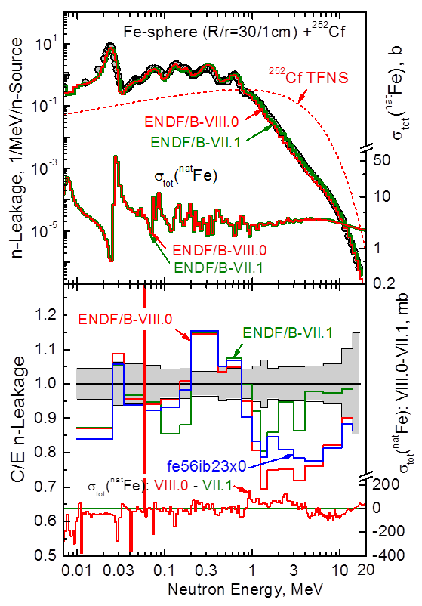
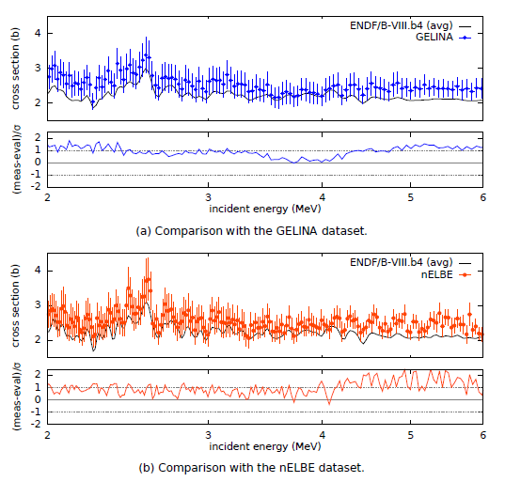
⁵⁶Fe evaluation
New measurements ⁵⁶Fe(n,el)
E. Pirovano et al, JRC Geel

