Slide 1

New and Revised Benchmarks in the ICSBEP and IRPhEP Handbooks
John D. Bess
Idaho National Laboratory
Key
Highlights
Only
This presentation was prepared at Idaho National Laboratory for the U.S. Department of Energy under Contract Number (DE-AC07-05ID14517)

Slide 2
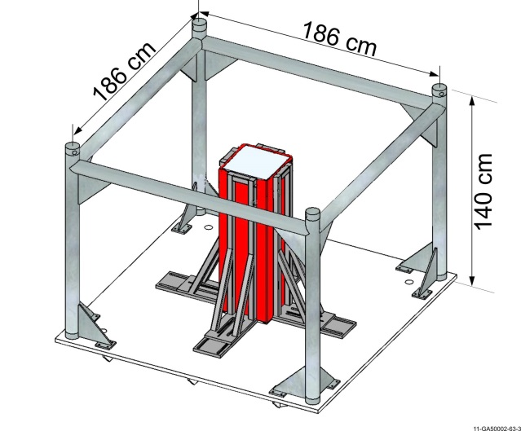
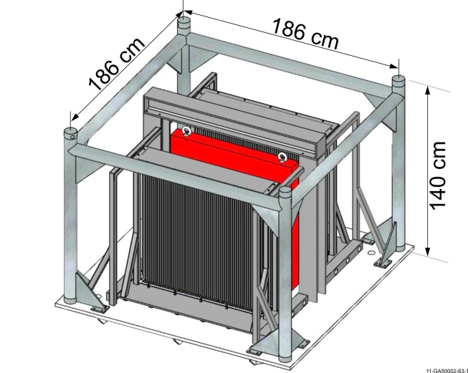
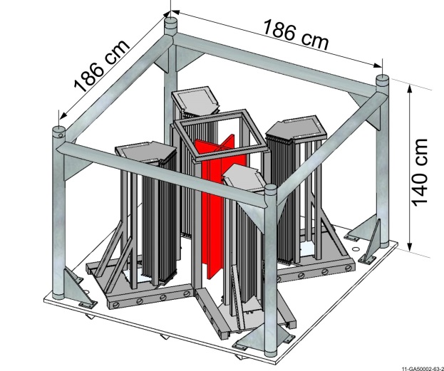
ICSBEP 2020 Handbook:
LEU-COMP-THERM-074
MIRTE-1
  Valduc (CEA)
  Complete series now available
  28 benchmark experiments
    Screens
    Al, concrete, Cu, glass, Fe, Pb, Ni, Ti, Zr
Most sample calculations within 3σ of benchmark values

Slide 3
LEU-COMP-THERM-074 Sample Results

Slide 4
ICSBEP 2020 Handbook:
LEU-COMP-THERM-101
7uPCX @ SNL
  22 experiments
  0.52 fuel-to-water volume ratio
    0.855 cm pitch
  6.90 % ²³⁵UO₂ rods
  Evaluated critical water heights for various rod loadings
    Including gaps between arrays

Slide 5
LEU-COMP-THERM-101 Sample Results

Slide 6
ICSBEP 2020 Handbook:
PU-SOL-THERM-041
Valduc (CEA)
  40 configurations
  1964 – 1965
  Annular cylinder
    50 (OD) & 20 (ID) cm
    Central air or water
  20 – 190 g/L Pu
    ~3 % ²⁴⁰Pu
  k_{eff} = 1.0000
    1σ: 110 – 330 pcm

Slide 7
PU-SOL-THERM-041 Sample Results
Trending Unclear

Slide 8
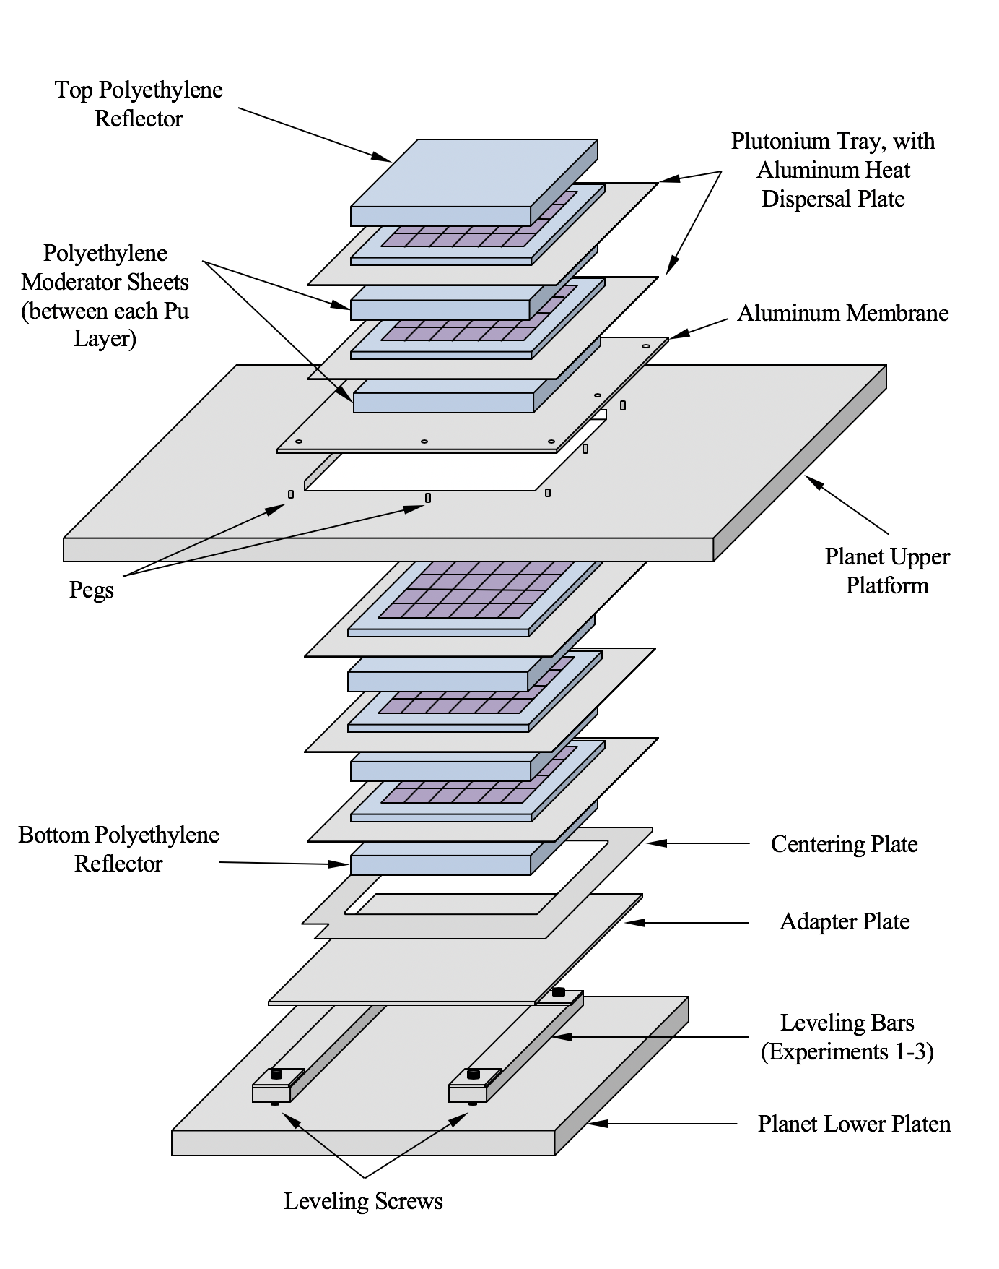
ICSBEP 2020 Handbook:
PU-MET-MIXED-002,
(PU-MET-THERM-002) & (PU-MET-FAST-048)
Thermal/Epithermal eXperiments (TEX)
  Planet (2017-2018) @ NCERC
  ZPPR plates
  5 experiments
    1 case PMT002
    2 cases PMM002
    2 cases PMF048
Most sample calculations within 2σ of the benchmark values

Slide 9
PU-MET-MIXED-002 Sample Results

Slide 10
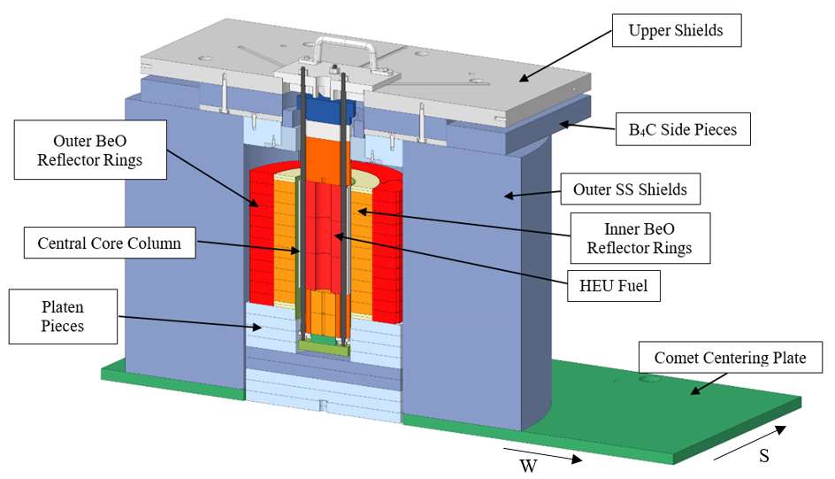
ICSBEP 2021 Handbook:
HEU-MET-FAST-101 (Draft #’s)
Kilopower Reactor Using Stirling TechnologY (KRUSTY)
  Comet (2017-2018) @ NCERC
  HEU-Mo, BeO, SS
  5 similar configurations
Great sample calculation agreement

Slide 11
HEU-MET-FAST-101 Draft Results

Slide 12
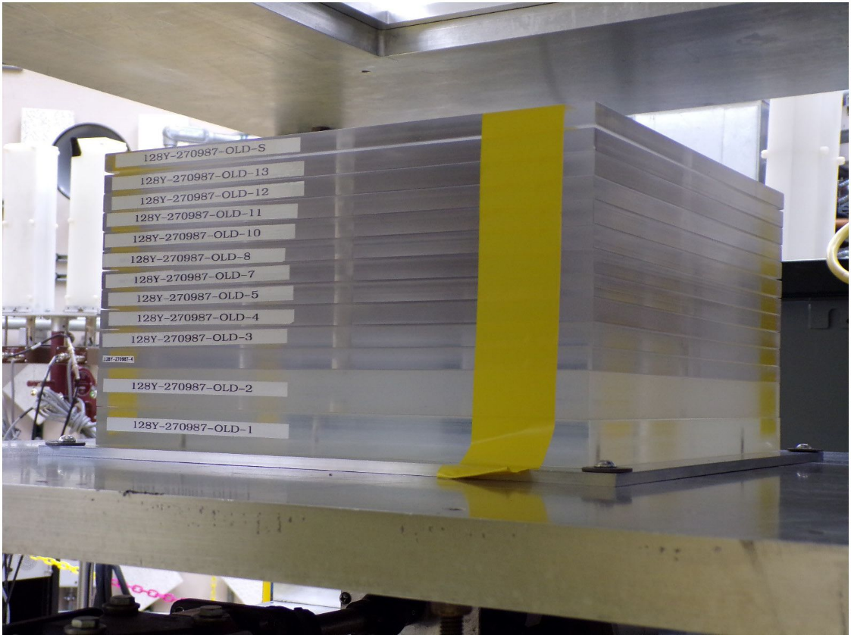
ICSBEP 2021 Handbook:
HEU-MET-THERM-004 (Draft #’s)
HEU foils moderated and reflected by Lucite
  Planet (2019) @ NCERC
  2 configurations
MCNP6.2 w/ ENDF/B-VIII.0 sample calculations are high by ~1.2 %, ~5σ

Slide 13
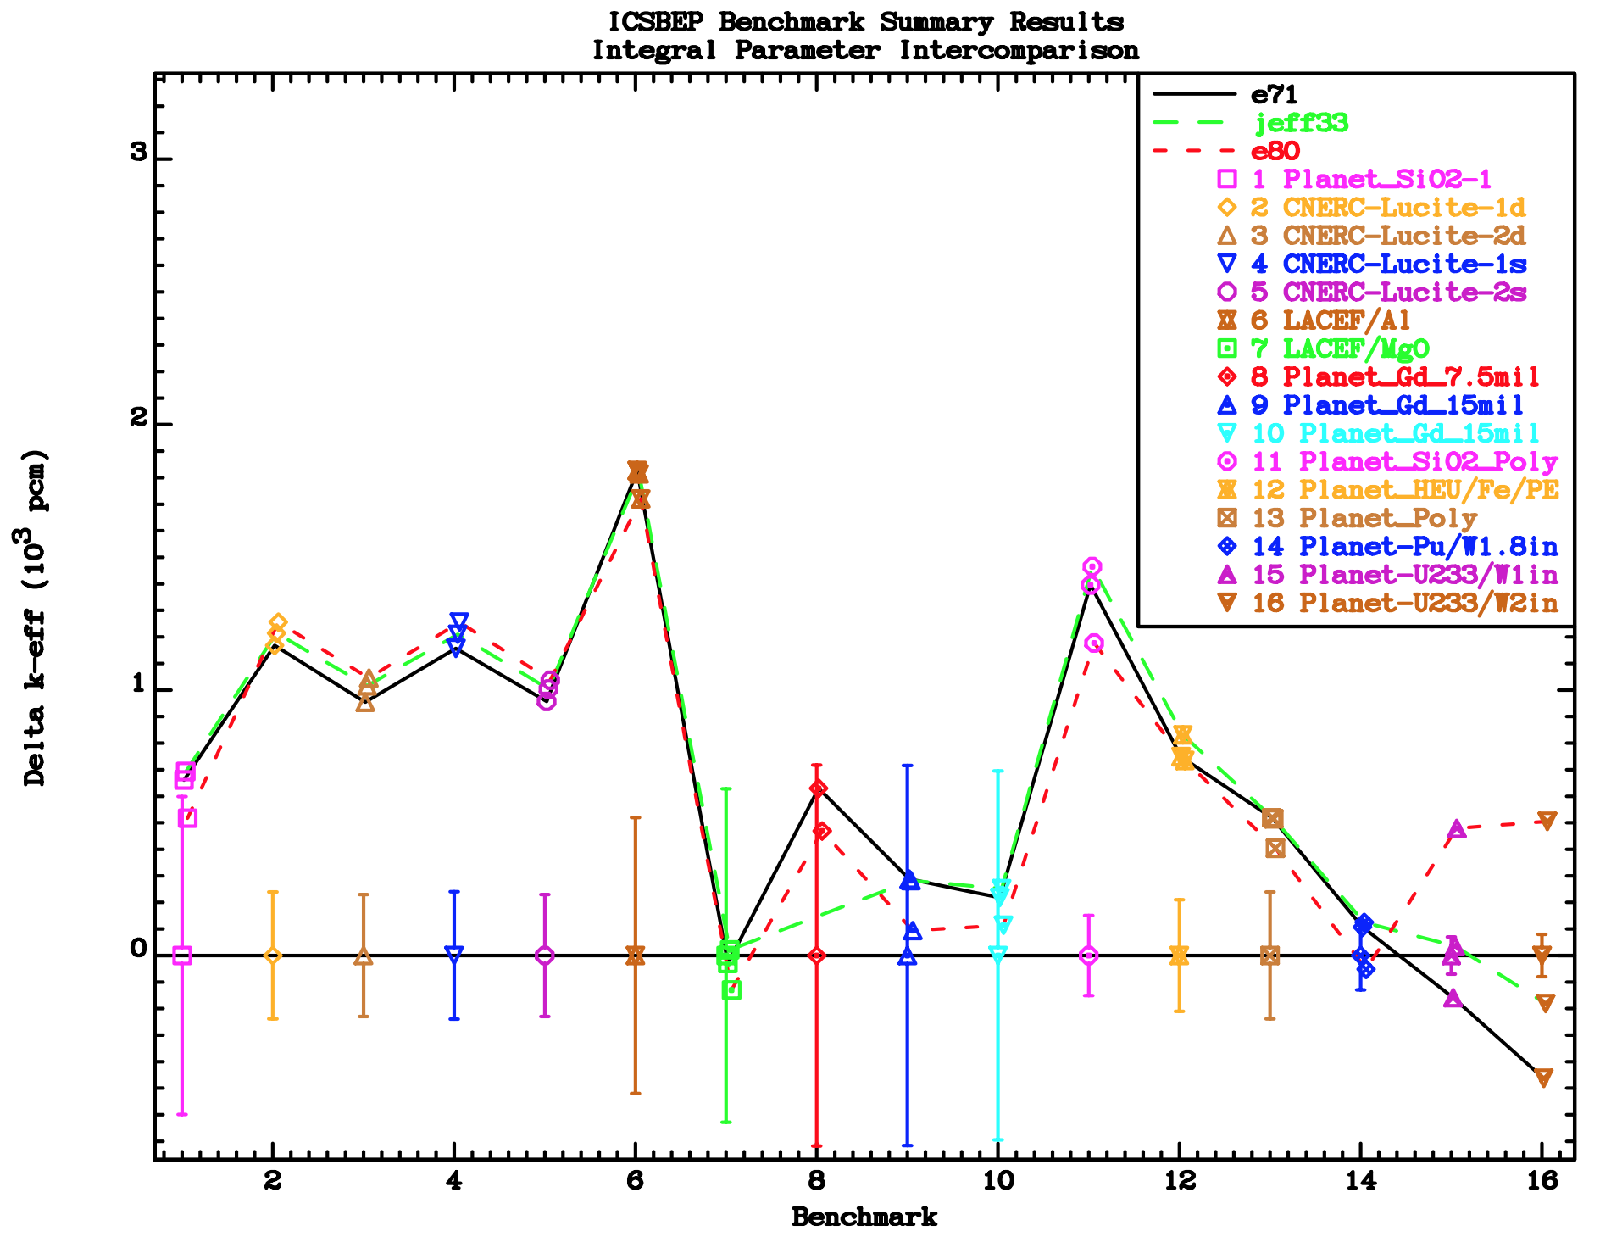
Comparison of Planet Benchmarks (Andre Trkov)

Slide 14
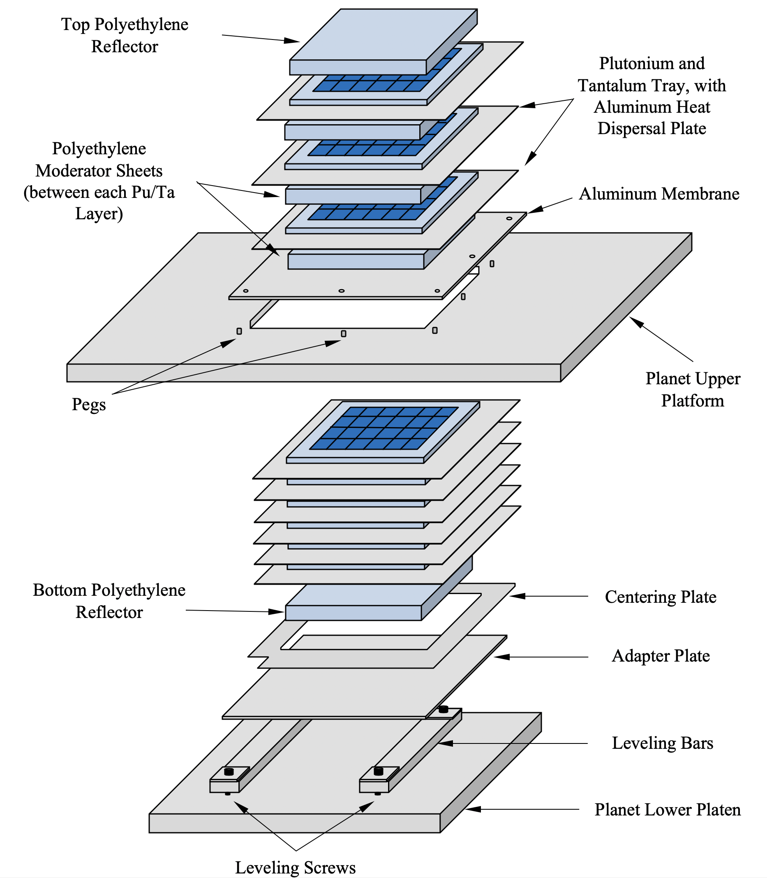
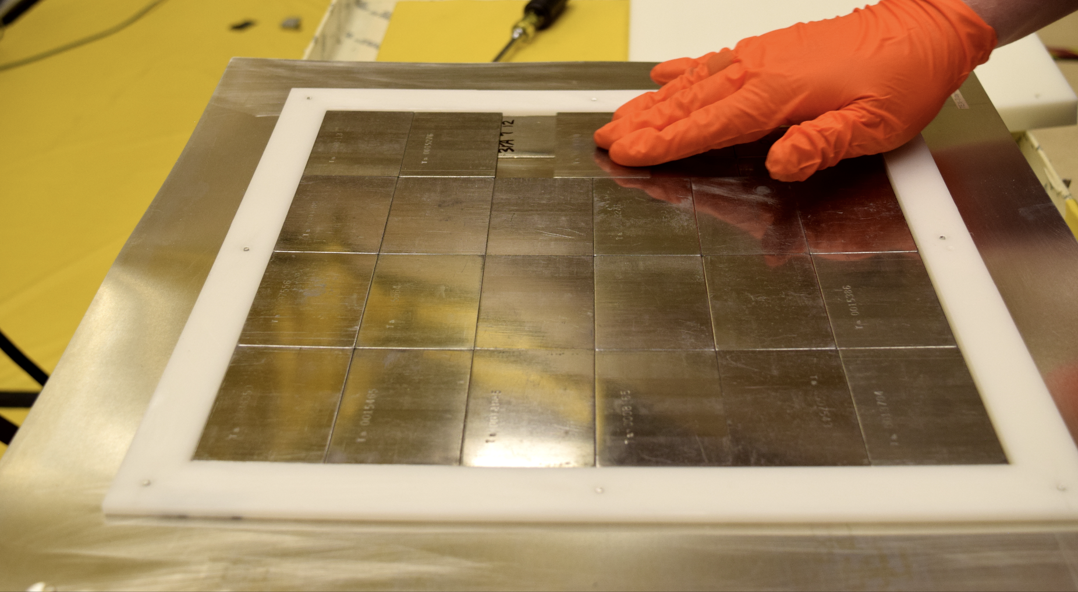
ICSBEP 2021 Handbook:
PU-MET-MIXED-003
(PU-MET-FAST-049) & (PU-MET-THERM-003)
TEX w/ Ta
  Planet (2018) @ NCERC
  5 configurations

Slide 15
PU-MET-MIXED-003 Draft Results

Slide 16
ICSBEP 2021 Handbook:
LEU-COMP-THERM-106
MIRTE-2.2
  Valduc (CEA)
  28 benchmark experiments
    Screens
    NaCl
    Rh (rhodium sulfate)
    PVC (Cl)
    Mo
    Cr (chromium resin)
    Mn (manganese resin)

Slide 17
LEU-COMP-THERM-0106 Draft Results

Slide 18
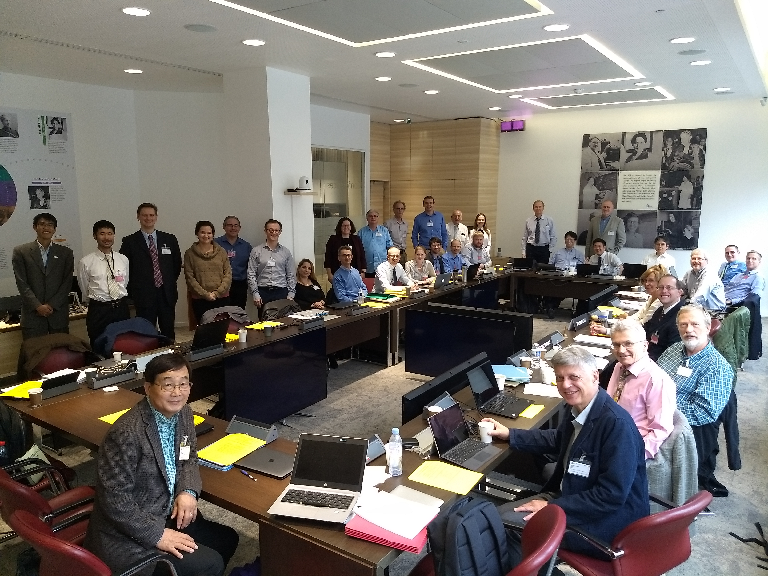

¿Questions?

Slide 19
This Slide Intentionally Left Blank

Slide 20
Extra Slides

Slide 21
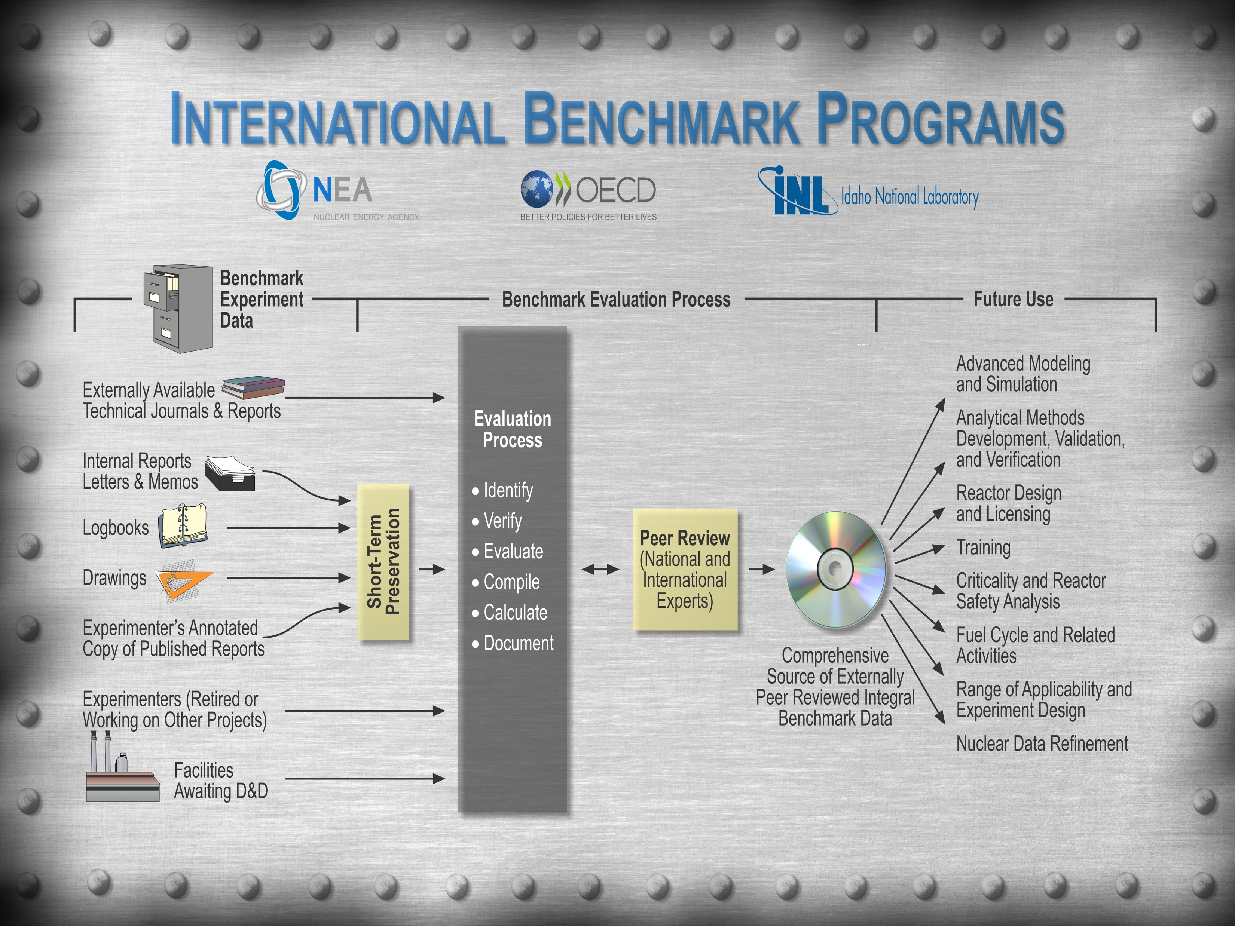
Benchmark Evaluation Process
Notes:
Overview of the benchmark process with the quantity of work it entails to prepare benchmark quality evaluations for use in various aspects of the nuclear field.

Slide 22

Countries Participating in the ICSBEP & IRPhEP
Argentina
Belgium
Brazil
Canada
People’s Republic of China
Czech Republic
France
Germany
Hungary
India
Israel
Italy
Japan
Kazakhstan
Poland
Republic of Korea
Russian Federation
Serbia
Slovenia
South Africa
Spain
Sweden
Switzerland
United Kingdom
United States of America
Notes:
Countries that have contributed data to the ICSBEP and IRPhEP.

Slide 23
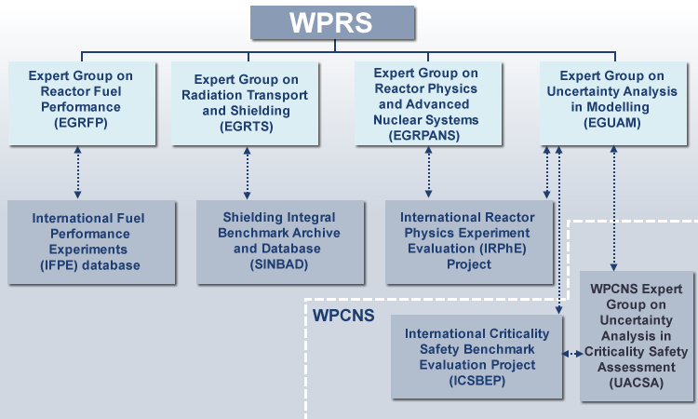
Directed and Distributed via the OECD NEA
Managed by an Elected Chair
Notes:
The ICSBEP is under the WPNCS of the OECD NEA. The IRPhEP is under the WPRS of the OECD NEA.

Slide 24


Current OECD/NEA Member Countries
Argentina | France | Latvia | Russia
Australia | Germany | Luxembourg | Slovak Republic
Austria | Greece | Mexico | Slovenia
Belgium | Hungary | Netherlands | Spain
Canada | Iceland | New Zealand | Sweden
Chile | Ireland | Norway | Switzerland
Czech Republic | Israel | Poland | Turkey
Denmark | Italy | Portugal | United Kingdom
Estonia | Japan | Romania | United States
Finland | Korea
Available to Member Countries
and Active Participating Facilities
Notes:
OECD and OECD NEA member countries.

Slide 25

Acknowledgments
The ICSBEP and IRPhEP are a collaborative effort
  Scientists, engineers, administrative support, program sponsors
  26 different countries have participated
    23 in ICSBEP
    23 in IRPhEP
  Without these dedicated individuals, these benchmark projects would not exist.
Notes:
There are innumerable participating individuals and countries to individually thank them all. Without them though these benchmark projects would not exist.

Slide 26
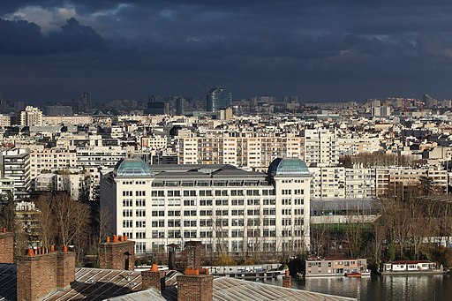
IRPhEP, ICSBEP, & SINBAD
Annual Technical Review Group (TRG) Meetings
ICSBEP Only
19-23 October 2020
OECD NEA, Paris, France
Virtual
Ideally All Three
11-15 October 2021
OECD NEA, Paris, France
Hopefully In-Person

Slide 27
International Handbook of Evaluated Criticality Safety Benchmark Experiments
December 2020 Edition
23 Contributing Countries
~70,000 Pages
582 Evaluations
  5,053 Critical, Near-Critical, or Subcritical Configurations
  45 Criticality-Alarm-Placement/Shielding Configurations
  237 Configurations with Fundamental Physics Measurements
  838 Unacceptable Experiment Configurations
http://icsbep.inl.gov/
https://www.oecd-nea.org/science/wpncs/icsbep/

Slide 28
Breakdown of Current ICSBEP Benchmark Specifications
773 plutonium experiments
  36 compound
  128 metal
  609 solution
1426 highly enriched uranium experiments
  291 compound
  601 metal
  527 solution
  2 mixed compound/solution
  5 mixed metal/solution
274 intermediate- and mixed-enrichment uranium experiments
  156 compound
  53 metal
  65 solution
1780 low enriched uranium experiments
  1518 compound
  82 metal
  120 solution
  60 mixed compound/solution
244 ²³³U experiments
  6 compound
  11 metal
  227 solution
536 mixed plutonium-uranium experiments
  301 compound
  52 metal
  86 solution
  76 mixed compound/solution
  21 mixed metal/compound
20 special isotope experiments
  metal (²³⁷Np, ²³⁸Pu, ²⁴²Pu, & ²⁴⁴Cm)
7 criticality-alarm/shielding experiments
  45 unique configurations with numerous dose points
10 fundamental physics experiments
  237 unique measurements such as fission rates, transmission measurements, and subcritical neutron multiplication measurements
Notes:
Quite a selection of benchmarks available but mostly HEU, LEU, and Pu. Definite need for IEU benchmarks and those sufficient to test minor actinides.

Slide 29



New Content in the Handbook 2020 Edition
11 Revised Evaluations
  7 Minor
  3 Significant
  1 Replaced
5 New Evaluations

Slide 30

Minor Revisions to the Handbook 1-3:
LEU-COMP-THERM-104
  Evaluation report was missing from the 2019 release of the Handbook.
MIX-COMP-THERM-004
  MCNP sample input decks provided in benchmark subdirectory.
PU-MET-FAST-001
  On page 79, replaced the text defining full insertion of the rectangular part as being centered within the length of the channel within “upper part M2” to indicate correctly “upper part M3”.
  Replaced the “-6” exponents with “6” in the EALF and AFGE columns of Table C.2.

Slide 31
Minor Revisions to the Handbook 4-6:
PU-SOL-THERM-023
  MCNP input decks providing in the benchmark subdirectory were incorrect, and they have been removed.
PU-SOL-THERM-028 and
PU-SOL-THERM-029
  On page 2, replaced "- 50/20 cm diam., 3.0 % ²⁴⁰Pu : PU-SOL-THERM-041," with "- 50/20 cm diam., 19 % ²⁴⁰Pu : PU-SOL-THERM-031,".
  The hyperlink also points to the correct benchmark.

Slide 32
Minor Revisions to the Handbook 7:
IEU-SOL-THERM-001
  Table 18 was added to Section 4 on page 30 to provide sample MCNP calculations attributed to Kermit Bunde (DOE-IE).
  MCNP sample input decks now provided in the benchmark subdirectory.
Benchmark
  k_{eff} = 1.0000 + 0.0052
MCU
  0.9735 to 0.9855
  + 0.0014
MCNP
  0.9834 to 0.9932
  + 0.0002

Slide 33
Significant Revisions to the Handbook 1-3:
FUND-NCERC-PU-HE3-MULT-003
  Female polyethylene hemishell atom densities corrected in Table 113.
FUND-LLNL-ALPHAN-HE3-MULT-001
  Updated uncertainty analysis. Reduced uncertainty in aluminum components and total uncertainty.
LEU-SOL-THERM-012
  Errors in the tank geometry uncertainty analysis were identified during the review of LEU-SOL-THERM-013. They were found common to this evaluation and corrected.

Slide 34
Replaced Evaluation 1:
LEU-COMP-THERM-074
MIRTE-1
  Valduc (CEA)
  Complete experiment series now available
  28 benchmark experiments
    Screens
    Al, concrete, Cu, glass, Fe, Pb, Ni, Ti, Zr
Most sample calculations within 3σ of benchmark values

Slide 35
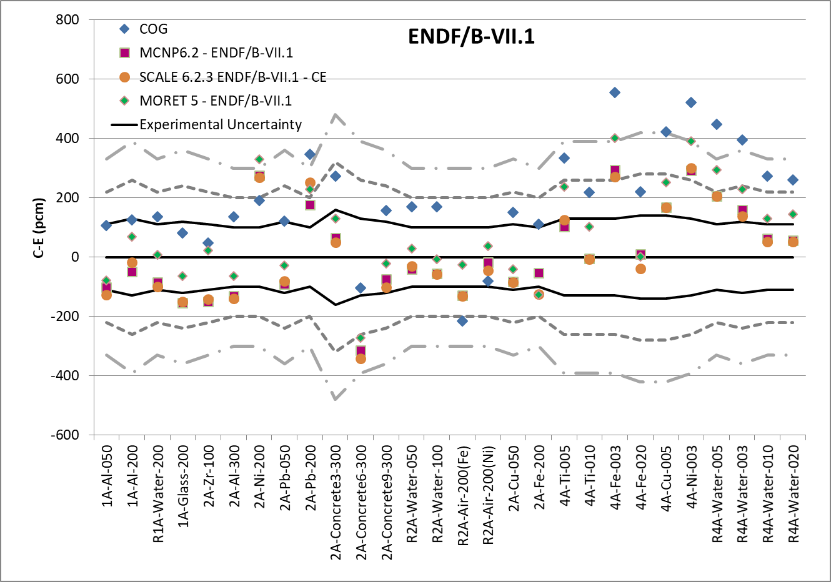
LEU-COMP-THERM-074 Sample Results

Slide 36
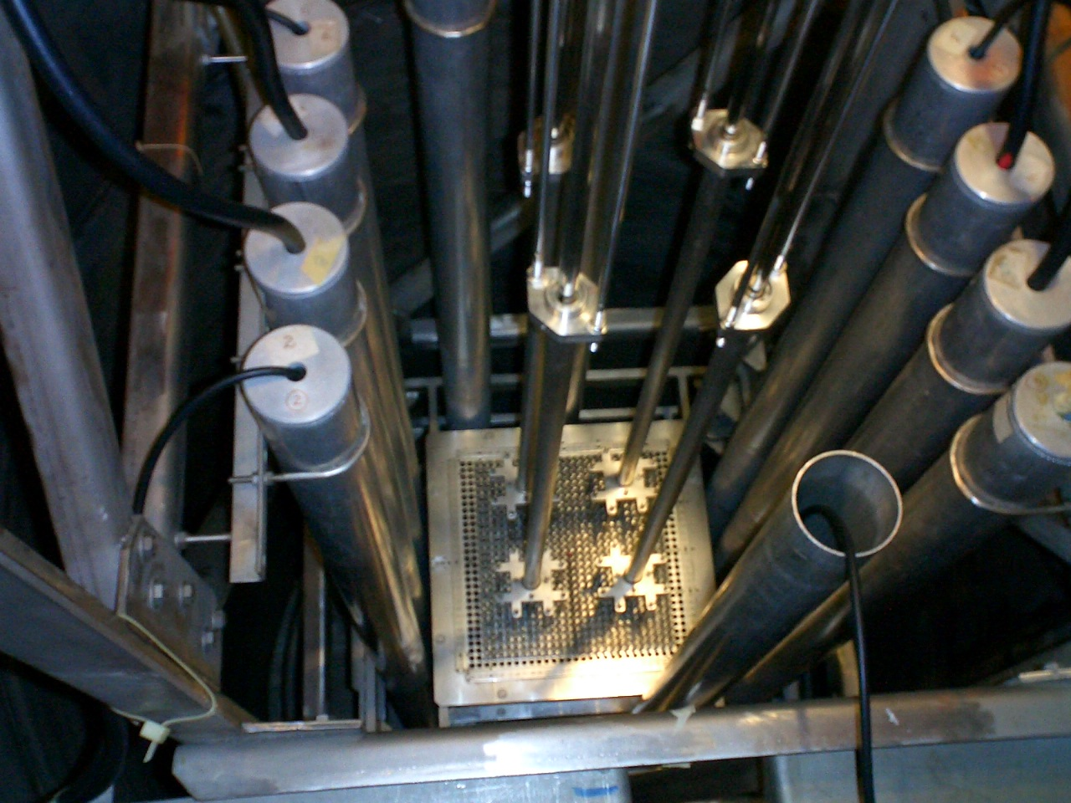
New Evaluation 1:
SUB-LEU-COMP-THERM-003
IPEN/MB-01 Reactor (Brazil)
  Boric acid in water to achieve subcriticality
    50 – 300 ppm
  1 critical & 7 subcritical experiments
Sample calculations within 2σ of the benchmark values
  MCNP5
  ENDF/B-VII.0

Slide 37
New Evaluation 2:
LEU-COMP-THERM-101
7uPCX @ SNL
  22 experiments
  0.52 fuel-to-water volume ratio
    0.855 cm pitch
  6.90 % ²³⁵UO₂ rods
  Evaluated critical water heights for various rod loadings
    Including gaps between arrays

Slide 38
LEU-COMP-THERM-101 Sample Results – I

Slide 39
LEU-COMP-THERM-101 Sample Results – II

Slide 40
New Evaluation 3:
LEU-SOL-THERM-013
TRACY
  Tokai Research Establishment (JAEA)
Critical configuration supporting pulse withdrawal supercritical experiment
Uranyl Nitrate
  10 % enriched
  B₄C transient rod inserted
All sample calculations overpredict by > 3σ
  k_{eff} = 1.0024 + 0.0007

Slide 41
New Evaluation 4:
PU-SOL-THERM-041
Valduc (CEA)
  40 configurations
  1964 – 1965
  Annular cylinder
    50 (OD) & 20 (ID) cm
    Central air or water
  20 – 190 g/L Pu
    ~3 % ²⁴⁰Pu
  k_{eff} = 1.0000
    1σ: 110 – 330 pcm

Slide 42
PU-SOL-THERM-041 Sample Results – I

Slide 43
PU-SOL-THERM-041 Sample Results – II

Slide 44
New Evaluation 5:
PU-MET-MIXED-002,
(PU-MET-THERM-002) & (PU-MET-FAST-048)
Thermal/Epithermal eXperiments (TEX)
  Planet (2017-2018) @ NCERC
  ZPPR plates
  5 experiments
    1 case PMT002
    2 cases PMM002
    2 cases PMF048
Most sample calculations within 2σ of the benchmark values

Slide 45
Potential Future Benchmark Evaluations – I
Belarus
  GIACINT
Brazil
  IPEN/MB-01 with Boric Acid
Czech Republic
  Fast Neutron Leakage from Iron Spheres
  SiO₂, Graphite, and Molten Salt Experiments
France
  MIRTE-2 w/ Fe & Cu Dleeves
  UO₂ Rods in NaCl Solution
  UO₂ Rod Lattices with Mo Dleeves
Japan
  TRACY Transients
  Zeus LEU/Pb
  DCA (Natural and LEU)
  STACY w/ Debris
Russia
  BFS Fe with H₂O
Slovenia
  Lucite-Moderated and -Reflected HEU Foils
  ASPIS-Fe shielding benchmark
Notes:
Current list of benchmark evaluations planned for review and inclusion in the ICSBEP Handbook over the next few years.

Slide 46
Potential Future Benchmark Evaluations – II
  HPRR Sulfur Fluence Measurements
  BeRP Ball with CH₂/Ni Composite Reflector
  TRX Critical Experiments
  Fast Neutron Die Away Measurements
  DCTF
  ORELA Experiment
  Organic-Moderated FFTF MOX Fuel Pins
  New Flattop Evaluation
  RPI RCF Neutron Clustering Experiments
  Alpha Transport Shielding Benchmark
  Music: Bare HEU
  CURIE: ²³⁵U Unresolved Resonance Region
  ²⁵²Cf Benchmark
  MUSIC: Bare HEU Experiments
  Hexagonal Ice TSL Evaluation
United States
  7UpCX Experiments
  GODIVA-IV Revision
  ISSA Lite
  KRUSTY
  Pulsed Spheres Experiments
  BAPL Solution Criticals
  Zeus HEU/Pb
  Jupiter Pu/Pb
  UNM & ISU AGN Reactors
  NeSO: Subcritical Measurements
  HOTBOX
  TEX Pu with Ta, HEU, HEU with Hf, & ²³³U
  ORCEF HEU Experiments
Notes:
Current list of benchmark evaluations planned for review and inclusion in the ICSBEP Handbook over the next few years.

Slide 47
International Handbook of Evaluated Reactor Physics Benchmark Experiments
December 2020 Edition
23 Participating Countries
56 Reactor Facilities
Data from 167 Experimental Series
  163 Approved Benchmarks
  4 DRAFT Benchmarks
Available Late 2020
http://irphep.inl.gov/
http://www.oecd-nea.org/science/wprs/irphe/

Slide 48
New Content in the Handbook 2020 Edition
1 Revised Evaluation
  FFTF-LMFR-RESR-001
    Sample Spectral Calculations
1 New Evaluation
  TREAT-FUND-RESR-003
    Criticality
    New graphite TSL x-sec
New version of IRPhE Database and Analysis Tool (IDAT) released in 2019
  Web application and version on IRPhEP DVD
Notes:
revisions to the handbook: addition of newly evaluated data, update to uncertainty analyses, and minor corrections to tables/figures. Discussed briefly on following slides.

Slide 49
Breakdown of Current Reactor Facilities on IRPhEP Handbook
7 Pressurized Water Reactor (PWR)
  BEAVRS, DIMPLE, DUKE, EOLE, OTTOHAHN, SSCR, VENUS
3 Vodo-Vodynaoi Energetichesky Reactor (VVER)
  LR-0, P-Facility, ZR-6
0 Boiling Water Reactor (BWR)
10 Liquid Metal Fast Reactor (LMFR)
  BFS-1, BFS-2, BR2, EBR-II, FFTF, JOYO, SNEAK, ZEBRA, ZPPR, ZPR
5 Gas Cooled (Thermal) Reactor (GCR)
  ASTRA, HTR10, HTTR, PROTEUS, VHTRC
1 Gas Cooled Fast Reactor (GCFR)
  PROTEUS
5 Light Water Reactor (LWR)
  CROCUS, DIMPLE, IPEN(MB01), KRITZ, TCA
3 Heavy Water Reactor (HWR)
  DCA, ETA, ZED2
1 Molten Salt Reactor (MSR)
  MSRE
1 Reaktor Bolshoy Moshchnosti Kanalniy (RBMK)
  RBMK(CF)
6 Space Reactor (SPACE)
  ORCEF, SCCA, TOPAZ, UKS1M, ZPPR, ZPR
23 Fundamental Physics Reactor Measurements (FUND)
  ATR, BFS-1, BFS-2, CORAL(1), FCA, FR0, HECTOR, IGR, KUCA, LAMPRE, LR-0, MINERVE, NRAD, ORCEF, ORSPHERE, PBF, RA-6, RB, RHF, TREAT, TRIGA, ZEBRA, ZPR
Notes:
Growing availability of varying reactor types and measurements. Currently lacking BWR and MSR, not to mention unique reactor types developed that do not fit within the current specifications. Currently no transient reactor benchmark data.

Slide 50
Revision: FFTF-LMFR-RESR-001
Error in vertical and lateral placement of the simulated detectors for spectra measurements
Fairly close to correct lateral positions within the models
However, both neutron detectors were located in-core, whereas one should have been placed below the active fuel zone

Slide 51
Results: Midplane
Neutron Spectra Measurements
OLD
NEW
Excellent Agreement

Slide 52
Results: 80-cm Below Midplane
Neutron Spectra Measurements
OLD
NEW
Improved Agreement

Slide 53
Results: Midplane
Gamma Spectra Measurements
OLD
NEW
~ >37 %
~ <11 %
Improved Agreement

Slide 54
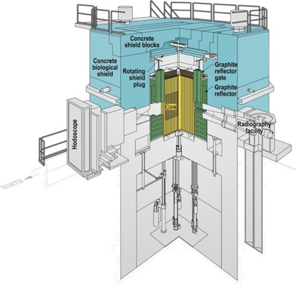
New:
TREAT-FUND-RESR-003
Transient Reactor Test Facility – INL
  NCSU (US)
  M2CAL Series
Evaluated
  Criticality

Slide 55
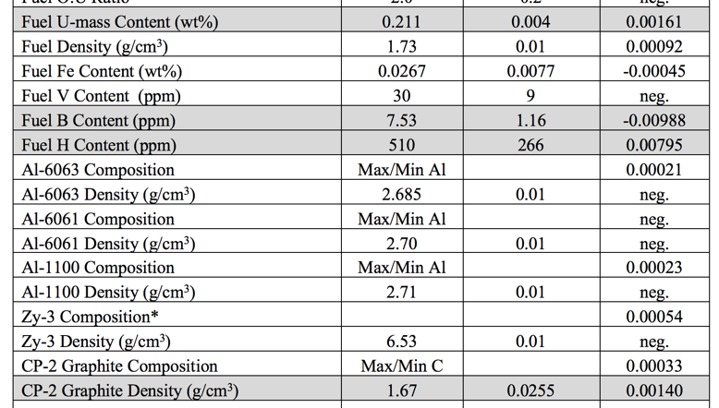
TREAT: Dominant Uncertainties
Final
Values

Slide 56
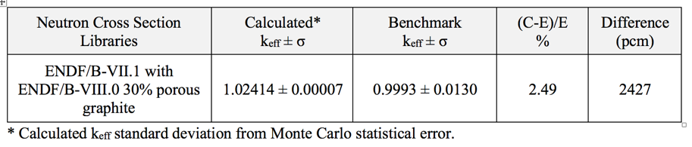
TREAT: Criticality
Serpent 2.1.29
  ENDF/B-VII.1
  ENDF/B-VIII.0 S(α,β) graphite
Final
Values

Slide 57
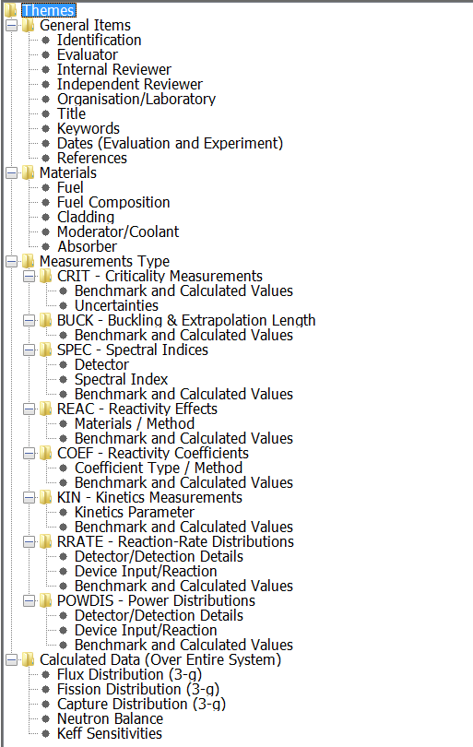
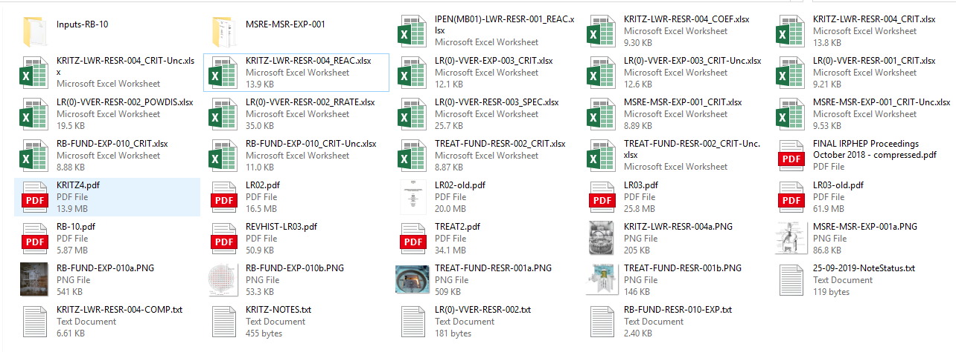
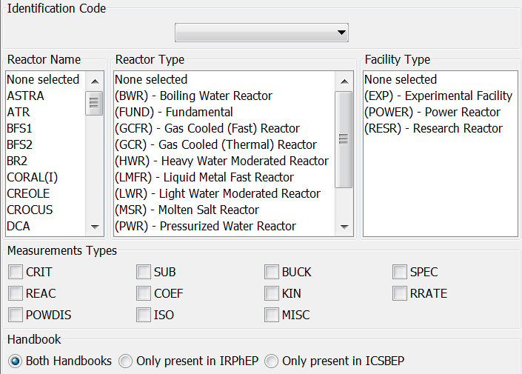
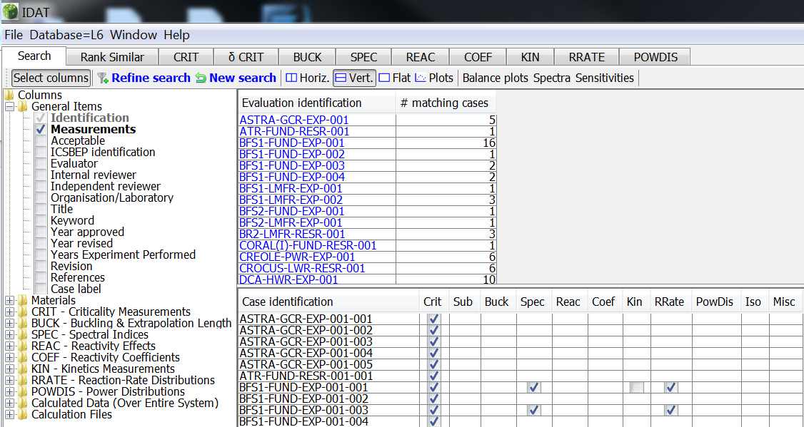
International Reactor Physics Handbook Database and Analysis Tool (IDAT)
New 2019 Evaluation Loading into IDAT
New Neutron Balance and Sensitivity (k-eff) computed
Upgraded search on reactivity effect measurements
Upgraded search on keywords (dictionary vs free text)
https://www.oecd-nea.org/science/wprs/irphe/irphe-handbook/

Slide 58

Benchmarks with Delayed Publication
1 Revised Evaluation
  MSRE-MSR-RESR-001
    Control rod worths
    Fuel coefficients
1 New Evaluations
  ZPR-GCFR-EXP-001
    Criticality
    Neutron spectra
    Control rod worths
    Doppler sample worth
To Be Published in 2021 Edition of the IRPhEP Handbook

Slide 59

Revision 2021: MSRE-MSR-RESR-001
Molten Salt Reactor Experiment – ORNL
  U.C. Berkeley & ORNL (US)
  62.5LiF-31.6BeF₂-5.1ZrF₄-0.8UF₄
  1.408 wt.% ²³⁵U
  Graphite moderated
Additional measurements
  Reactivity effects measurements
  Reactivity coefficient measurements

Slide 60
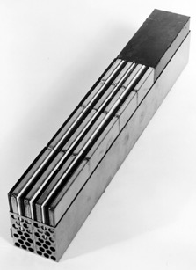
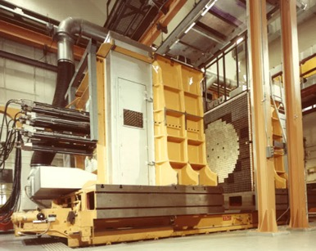
New 2021: ZPR-GCFR-EXP-001
ZRP-9/29
  GCFR – Phase II
  ANL
Evaluated
  Criticality
  Neutron spectra
    Results within ~5%
  Control rod worths
  Doppler sample worth
    Results pending

Slide 61
New ICSBEP 2021:
KRUSTY (HEU-MET-FAST-101)
Kilopower Reactor Using Stirling Technology (KRUSTY) demonstration
  Nov 2017 – Jan 2018
  HEU annulus
  BeO reflected
  Comet vertical lift assembly
  NCERC/LANL
First benchmarks for 5 critical configurations
  Future benchmarks expected covering other aspects of experimental series

Slide 62
KRUSTY:
MCNP Models

Slide 63
Potential Future Benchmark Evaluations – I
Brazil
  IPEN/MB-01 experiments to test delayed neutron data
Canada
  ZED-2 Experiments
China
  CEFR
Czech Republic
  N-transport Si-beam in Pb, or Fe
  RPV configuration
  VR1 with IRT-4M Fuel
  VVER-1000 w/ SiO₂ or graphite core
  SiO₂ space reactor
  Molten salt
France
  BERENICE
  ERMINE I-V
  SEFOR
  SNEAK 12A & 12B
Japan
  FCA IX-1 or IX-6 CRIT
  FCA IX MA measurements
  Pb/Void measurements
  TCA Am-241
  KUCA experiments
Russia
  ASTRA U-235 RRATE measurements
Notes:
Current list of benchmark evaluations planned for review and inclusion in the IRPhEP Handbook over the next few years.

Slide 64
Potential Future Benchmark Evaluations – II
Serbia
  RB Reactor
Slovenia
  TRIGA Au(n,g) RRATE
Sweden
  KRITZ-1/-2 BWR data
Switzerland
  CROCUS measurements
  HCLWR-PROTEUS
  PETALE: SS
UK
  DIMPLE CERES II
  PFR MA measurements
US
  AGN reactor
  ATR CIC 2022
  KRUSTY measurements
  LWBR program
  TREAT measurements
  TRIGA 3D n-flux and temperature *
  TSL FLiBe: TBD *
  TSL Graphite: ORELA *
  TSL Water: TBD *
  TVA Watts Bar HZP ZPPT
* DOE-NE NEUP MS-NE-1 Activities
Notes:
Current list of benchmark evaluations planned for review and inclusion in the IRPhEP Handbook over the next few years.

Slide 65
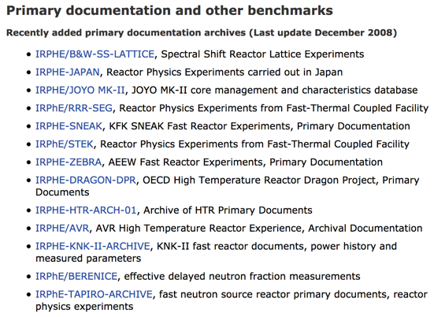
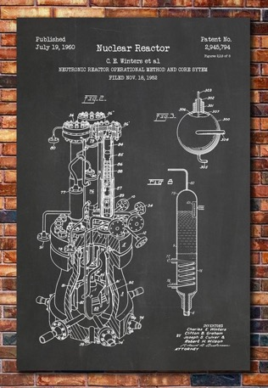
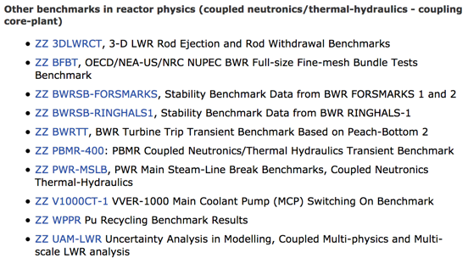
Other IRPhEP
Archives

Slide 66
TIC VVER Documents Will Also be Archived
Temporary International Collective (TIC) for Joint Research into the Physics of VVER-Type Reactors
Published in Budapest in 1985
Primary reference for some of
the VVER benchmarks
5 volumes, supplemental report,
and journal article
Recommended to create
OECD NEA IRPhEP archive
  https://www.oecd-nea.org/science/wprs/irphe/documentation.html

Slide 67

Conclusions
The IRPhEP and ICSBEP continue to provide high-quality integral benchmark data
Valuable for nuclear data testing, uncertainty reduction, criticality safety, reactor physics, advanced modeling and simulation
Data contributed from 26 countries
Enable current and future
activities supported by
experimental validation

