Slide 1
FY20 Thermal Neutron Scattering Measurements at the ORNL Spallation Neutron Source
Chris W. Chapman¹, Xunxiang Hu¹, Jesse Brown¹, Goran Arbanas¹, Kemal Ramić², Alexander I. Kolesnikov¹, Yongqiang Cheng¹, Luke Daemen¹, Anibal Ramirez Cuesta¹, Doug Abernathy¹, Li (Emily) Liu², Yaron Danon²
¹Oak Ridge National Laboratory
²Rensselaer Polytechnic Institute
CSEWG – US National Nuclear Data Week 2020
30 November – 2 December 2020 - Online

Slide 2
Overview
Spallation Neutron Source (SNS)
  Facility layout
  Instruments used
Measured materials
  Yttrium hydride
  Polystyrene
Conclusions

Slide 3
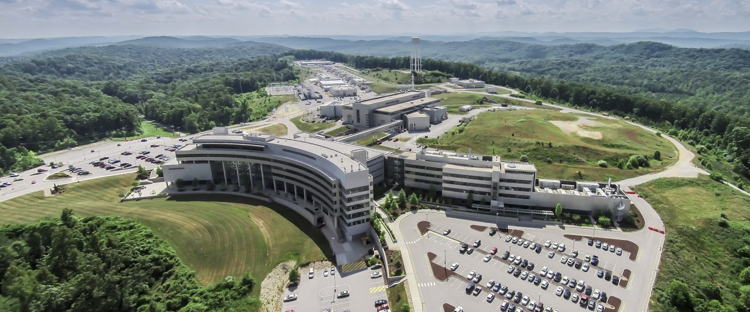
SNS Overview
High-energy protons
accelerated to 1 GeV
  1.4 MW LINAC
Neutron produced
by spallation with
mercury target
  Pulsed neutrons produced at 60 Hz
Neutrons thermalized by passing through water moderator
Peak brightness: ~1 × 10¹³ n/cm²/sr/Å/s

Slide 4
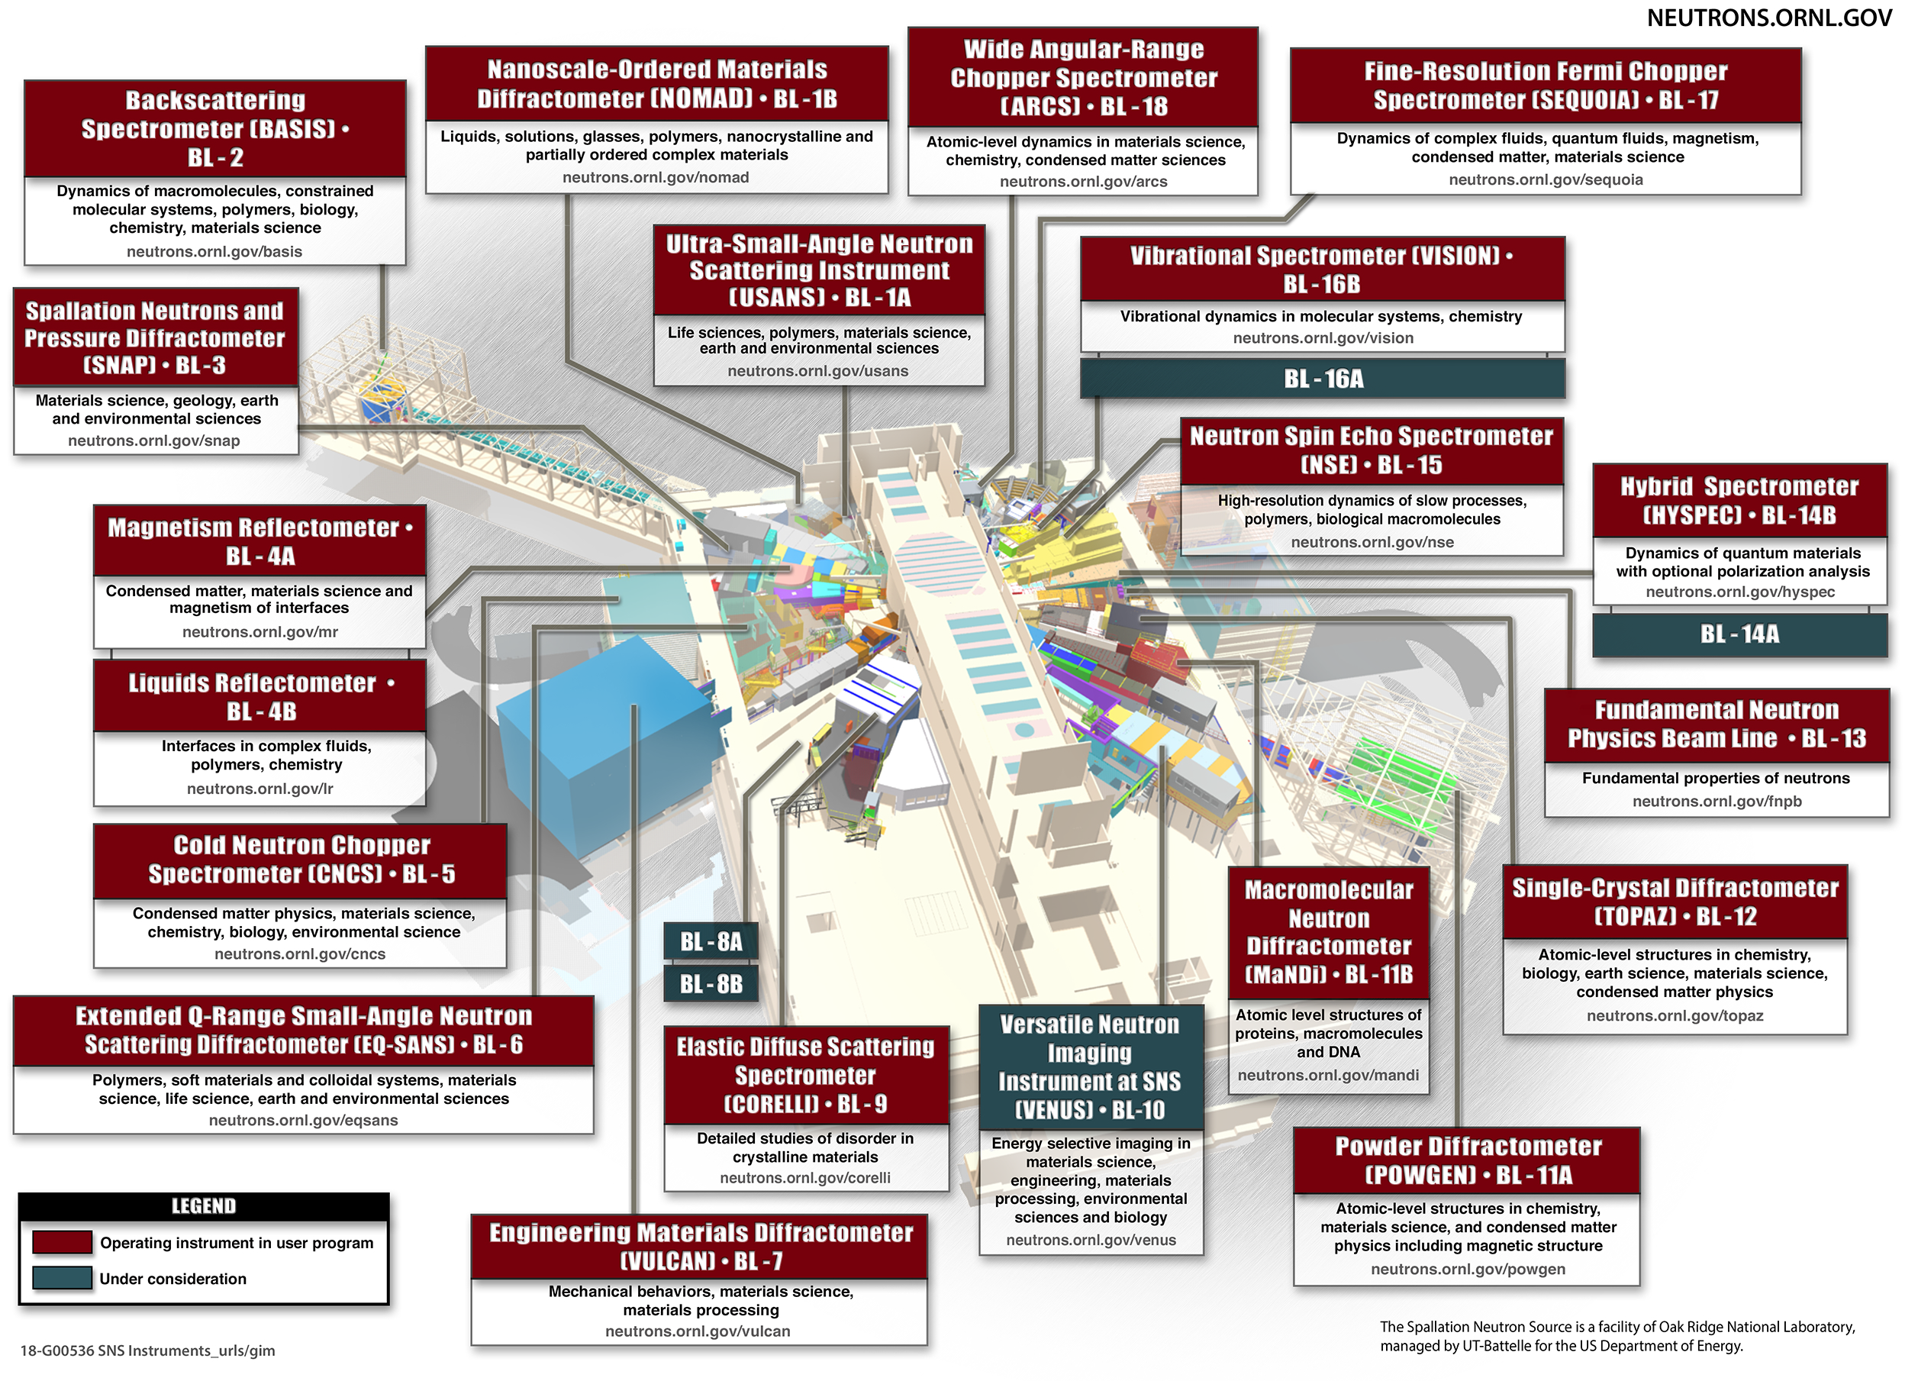
SNS Overview

Slide 5
SNS Overview

Slide 6
SNS: ARCS & SEQUOIA
Time-of-flight direct geometry spectrometer
User chooses incident energy; Fermi choppers rotate to collimate white beam to selected energy
Detector setup measures final energy and scattering angle
  SEQUOIA: slightly better energy resolution
  ARCS: larger angular range

Slide 7
SNS: VISION
Indirect geometry vibrational spectrometer
White beam of neutrons hits target
Scattered neutrons reflected off graphite blocks to two detectors for forward- and backward-scattering angles
Graphite blocks configured to scatter neutrons at 4 meV
Constant relative energy resolution

Slide 8
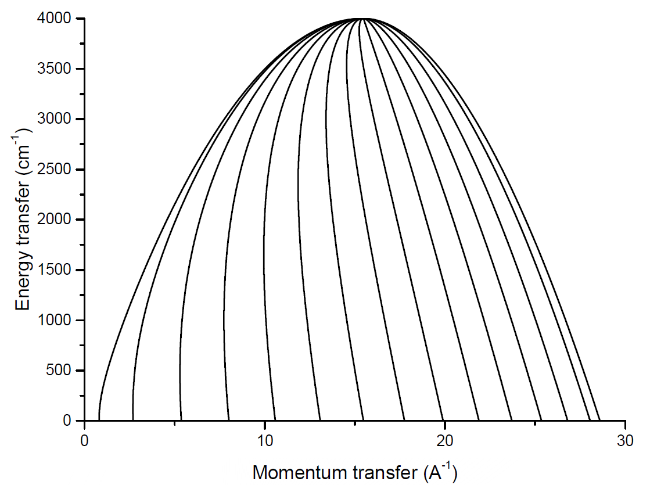
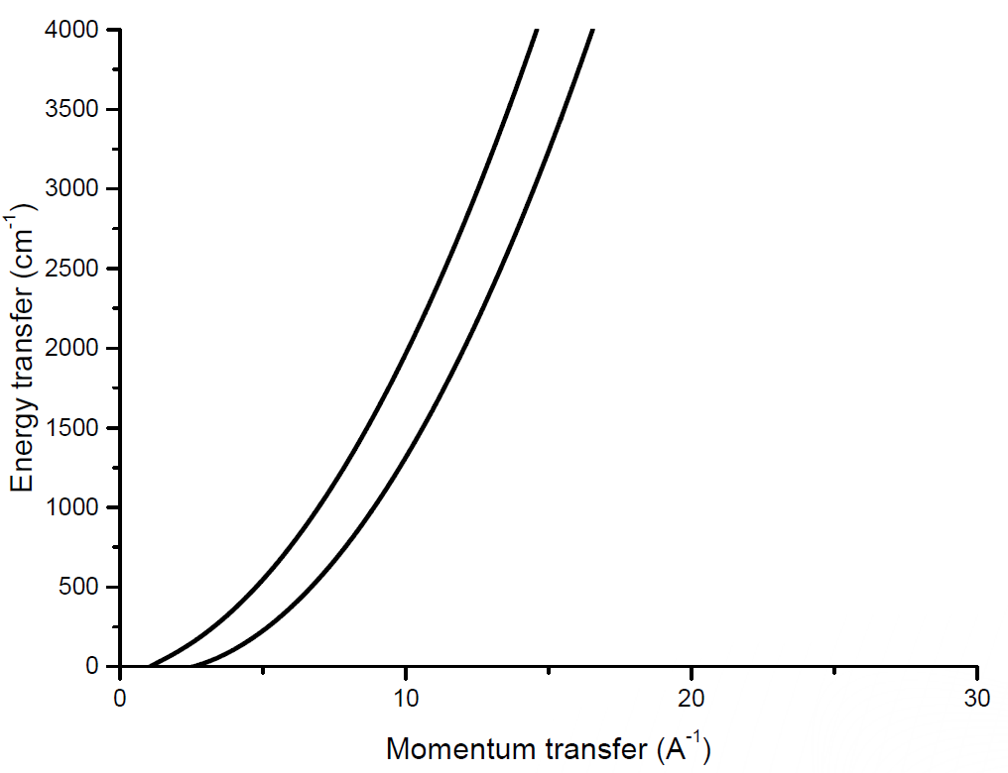
SNS: (Q,E) Grid of Direct and Indirect Spectrometers
Direct Geometry Spectrometer (ARCS)
Indirect Geometry Spectrometer (VISION)

Slide 9
YH_{x} Overview
Moderator of choice for Oak Ridge National Laboratory (ORNL) Transformational Challenge Reactor (TCR)
Measurement is two-fold:
  Hydrogen concentration
  Anharmonicities at high temperatures
Modeling efforts in corresponding talk
  “Modeling of Anharmonic Effects and Temperature Depencency of the YH₂ Phonon Spectrum,” by Kemal Ramić

Slide 10
YH_{x} Overview
SNS instrument | Samples | Sample form | Sample fixture | Mass (g) | Incident neutron energy (meV) | Temperature (K)
SEQUOIA | YH_{1.62} | Powder | Aluminum plate and cover | 0.6966 | 45, 180, 600 | 5
 | YH_{1.86} |  |  | 0.702 |  | 5, 295, 550, 800
VISION | YH_{1.62} |  |  | 0.6966 | N/A | 5, 293
 | YH_{1.74} |  |  | 0.6684
 | YH_{1.86} |  |  | 0.702
 | YH_{1.90} |  |  | 0.7696
ARCS | YH_{1.68} | 0.1 mm hydride foil | Thin-wall quartz tube | 1.6681 | 45, 180, 600 | 295, 550, 800, 900, 1,000, 1,100, 1,200
 | YH_{1.87} |  |  | 1.8937

Slide 11
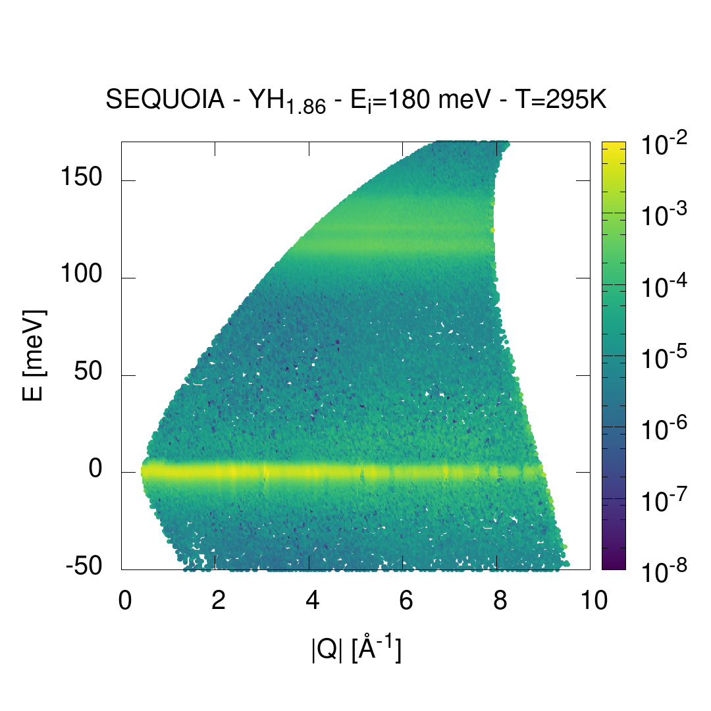
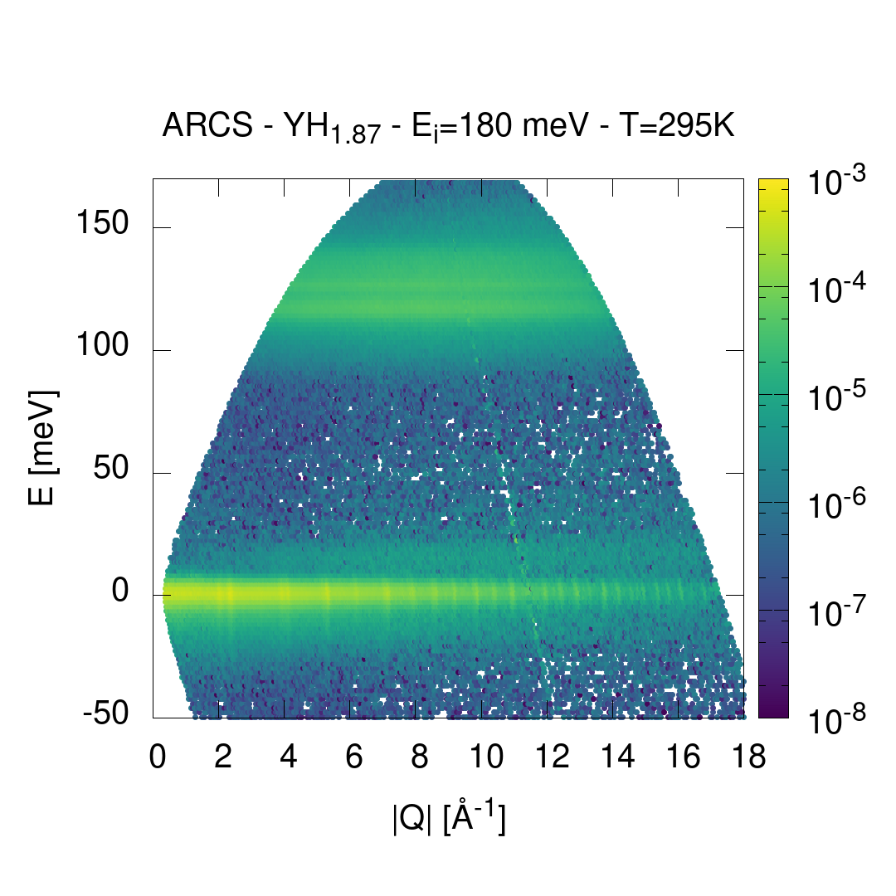
YH_{x}: ARCS/SEQUOIA Comparison

Slide 12
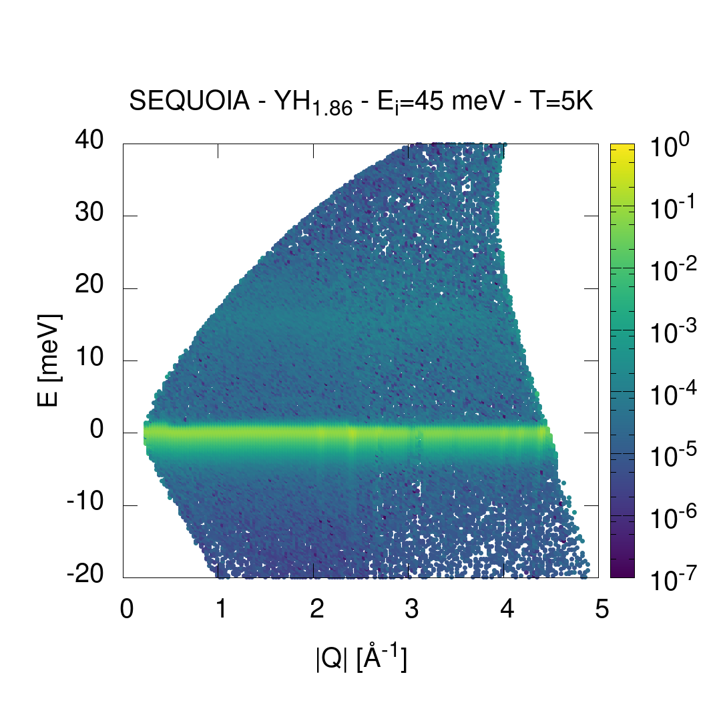
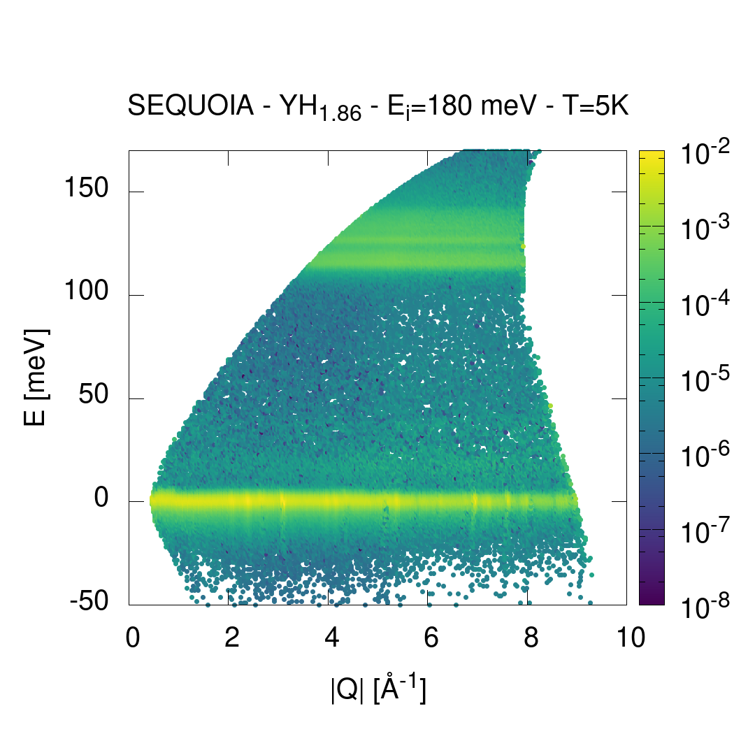
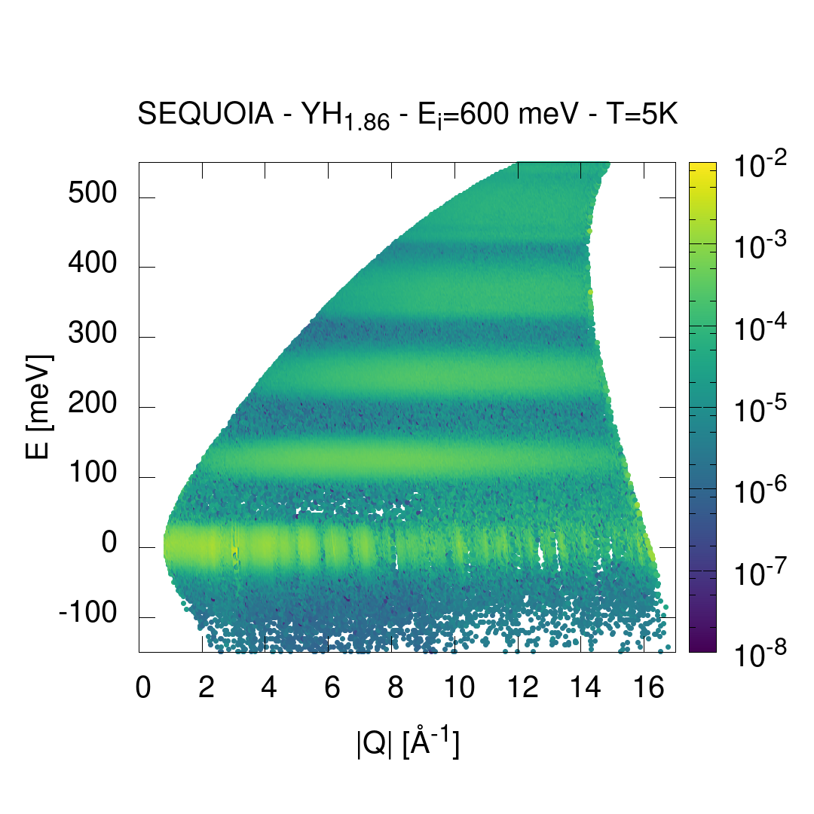
YH_{x}: SEQUOIA measurements

Slide 13
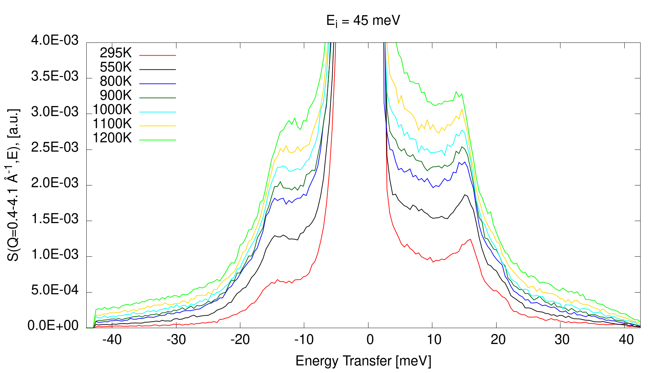
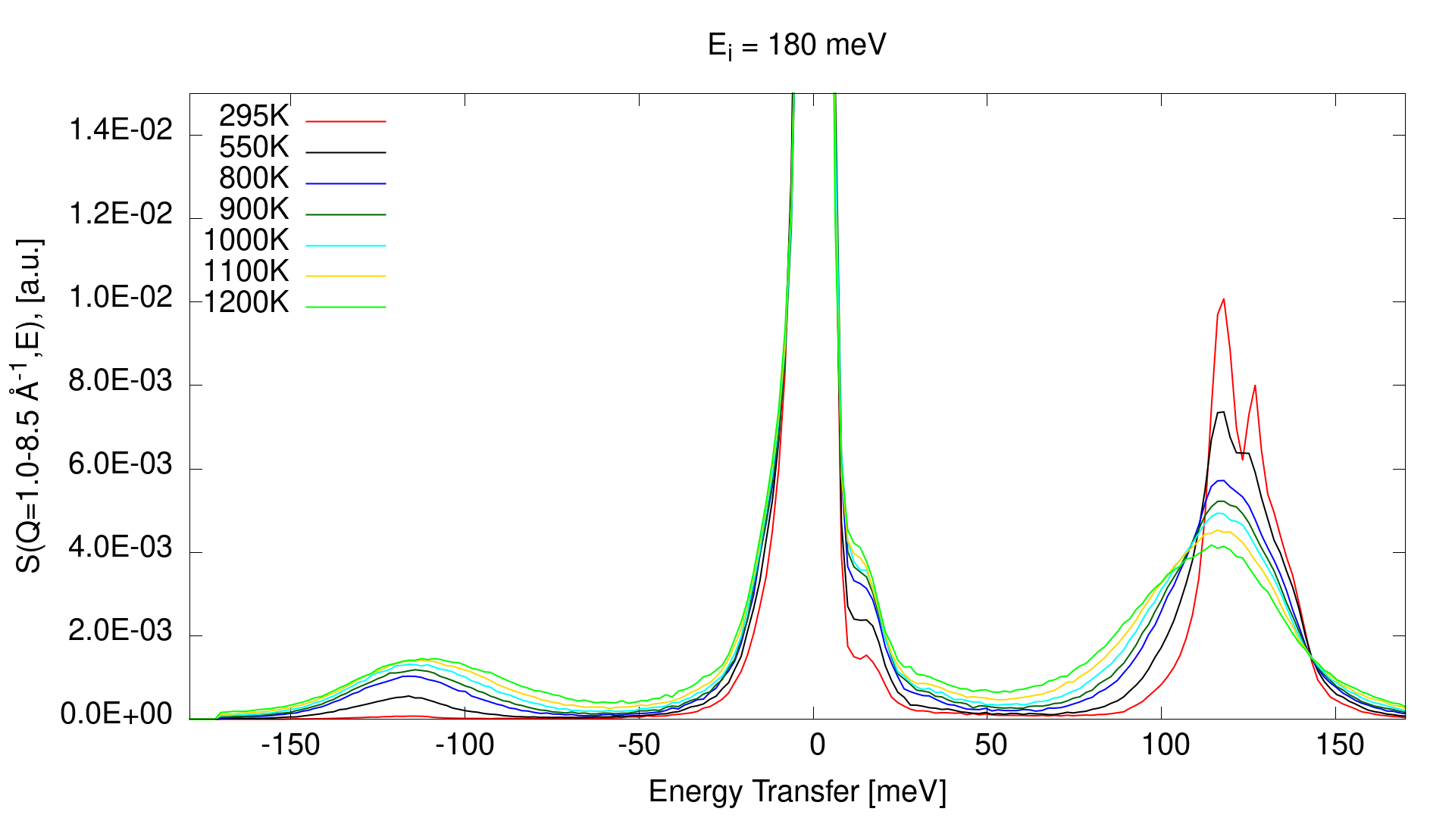
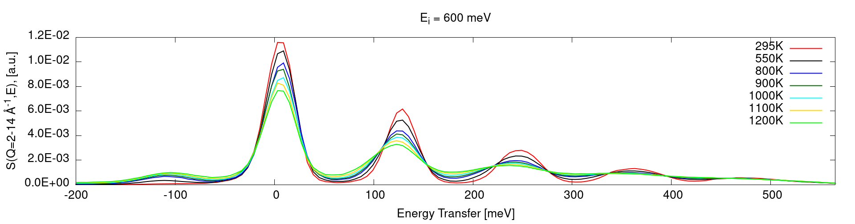
YH_{x}: ARCS Measurements—Temperature Comparison

Slide 14
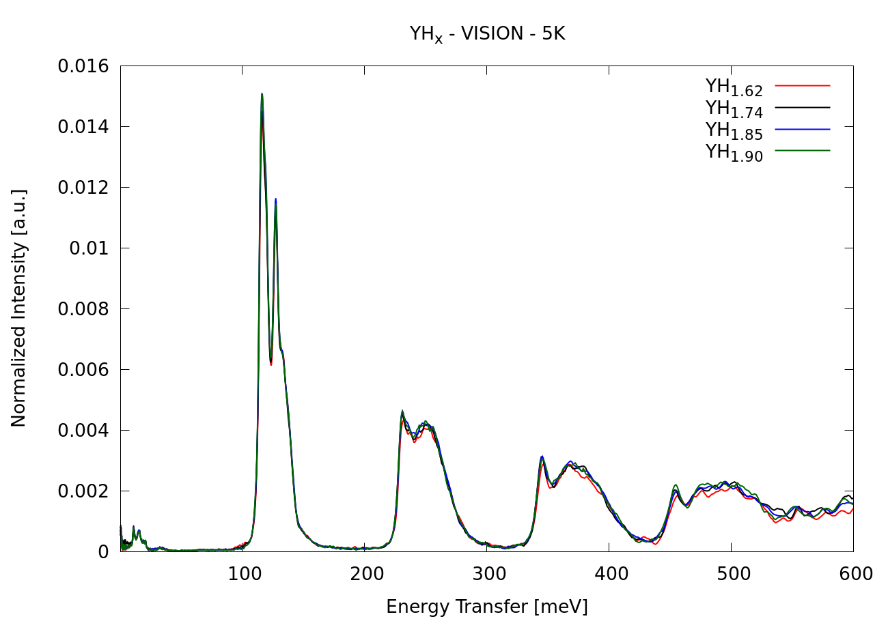
YH_{x}: VISION Measurements

Slide 15
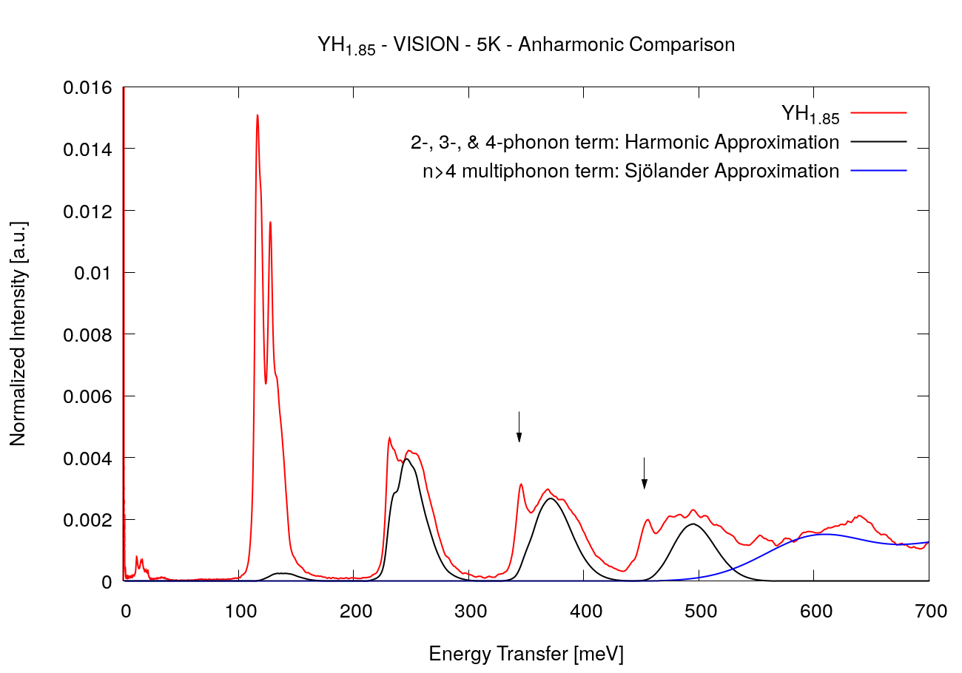
YH_{x}: VISION Measurements

Slide 16
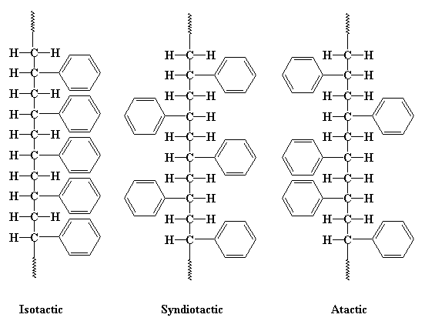
Polystyrene Overview
Nuclear Criticality Safety Program material of interest; used in several International Criticality Safety Benchmark Evaluation Project benchmarks
Previously used polyethylene as a
surrogate
Scientific merit:
  Molecular weight
  Tacticity
  Crystal vs. amorphous

Slide 17
Polystyrene Overview
Material | MW | Incident neutron energy (meV) | Temperature (K)
Syndiotactic Polystyrene (sPS) | 6,400 | 40, 100, 225, 500 | 5, 293
 | 31,600 | 40, 100, 225 | 5
 | 171,000
 | 965,000 | 40, 100, 225, 500 | 5, 293
Atactic Polystyrene (aPS) | 5,800 | 40, 100, 225, 500 | 5
 | 25,000
 | 170,000
 | 650,000

Slide 18
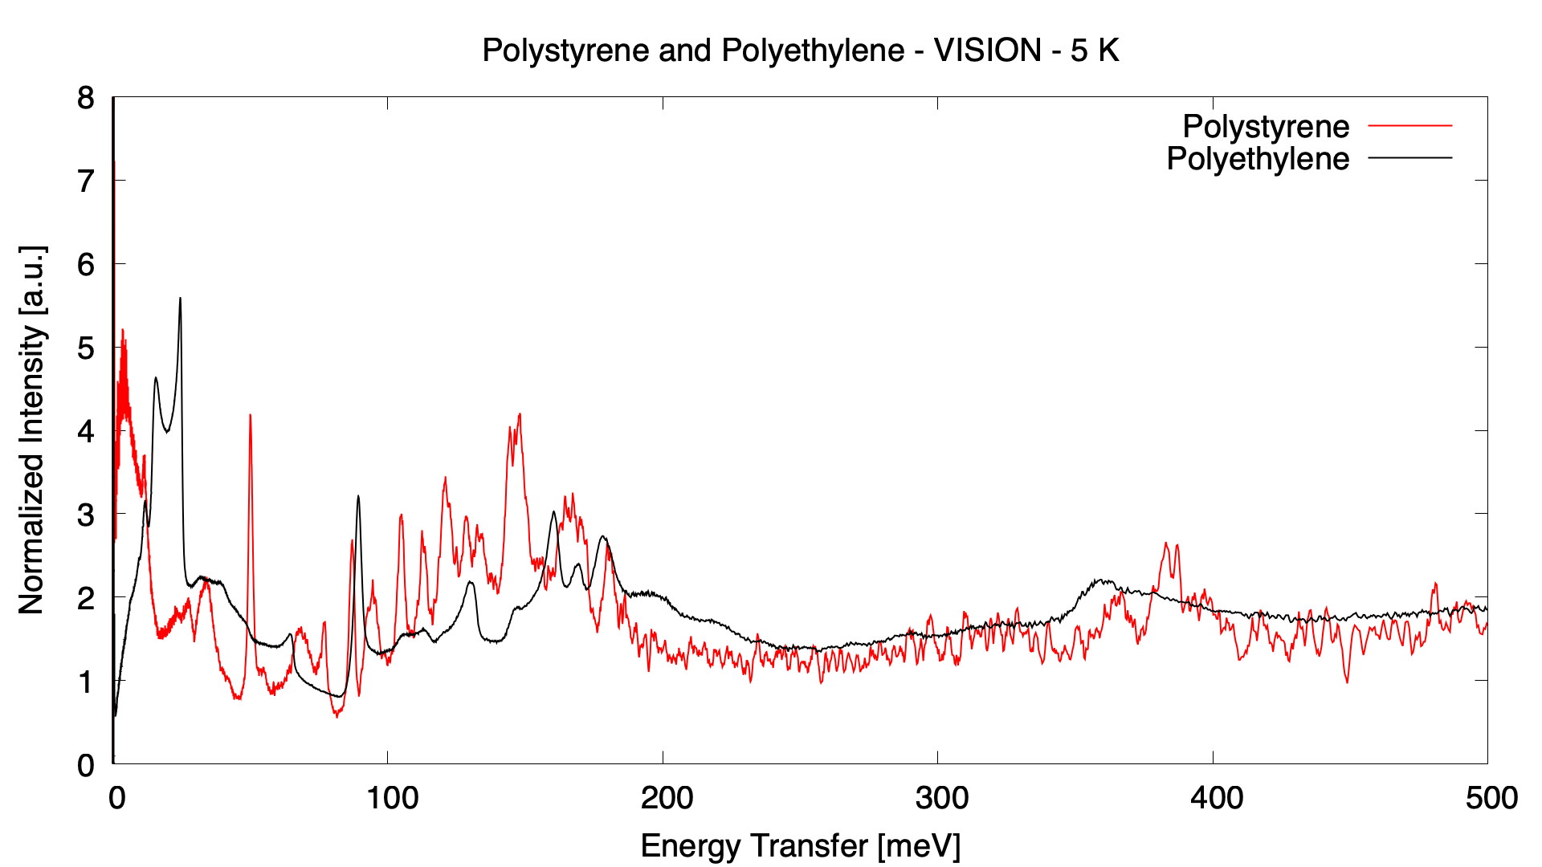
Polystyrene: Comparison with Polyethylene

Slide 19
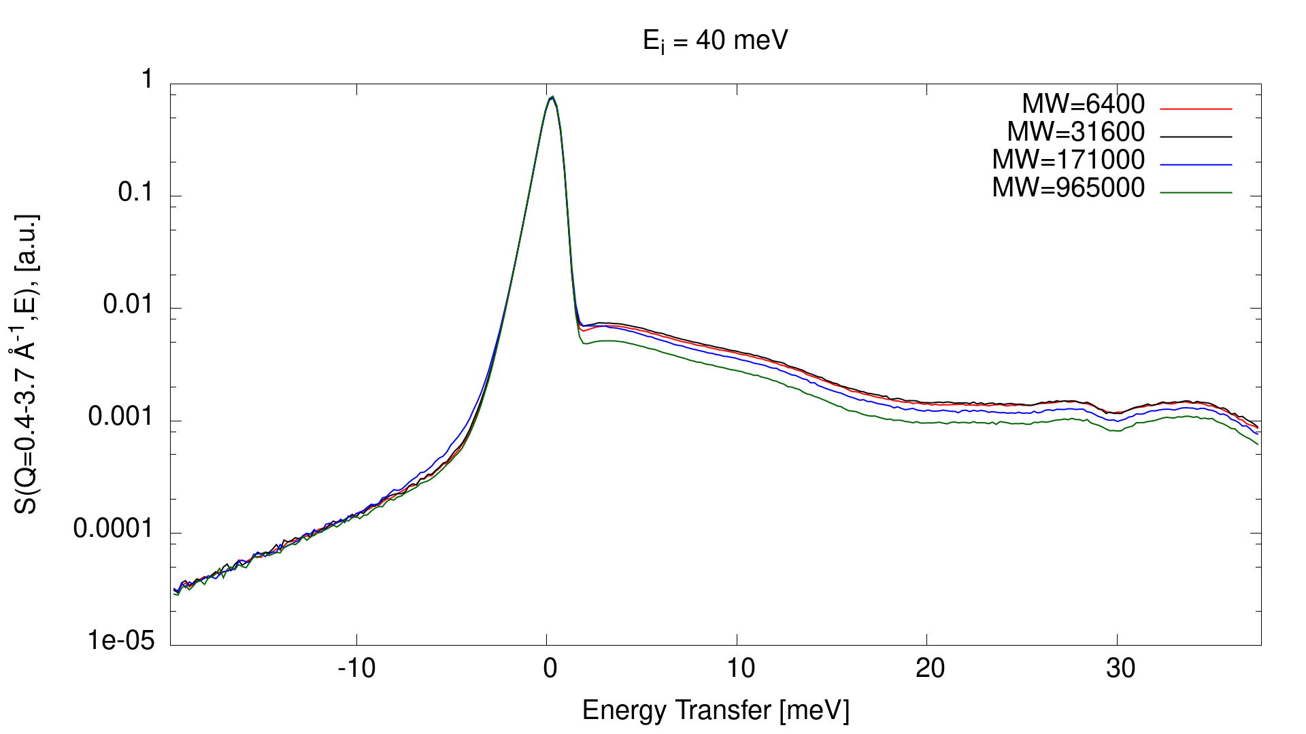
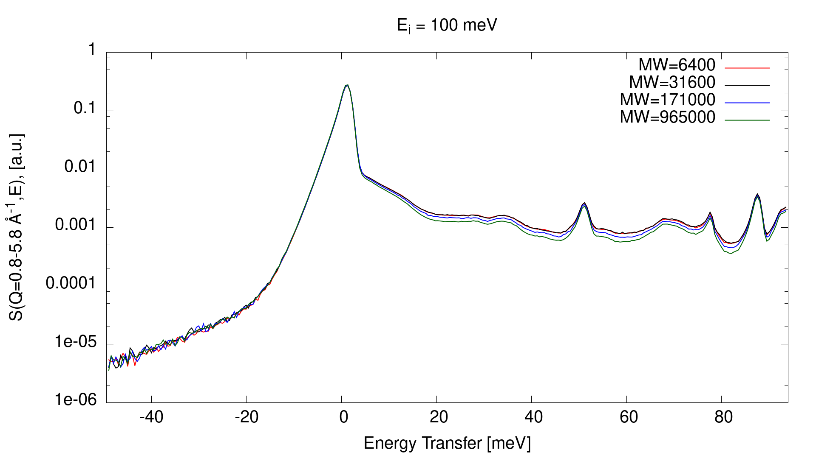
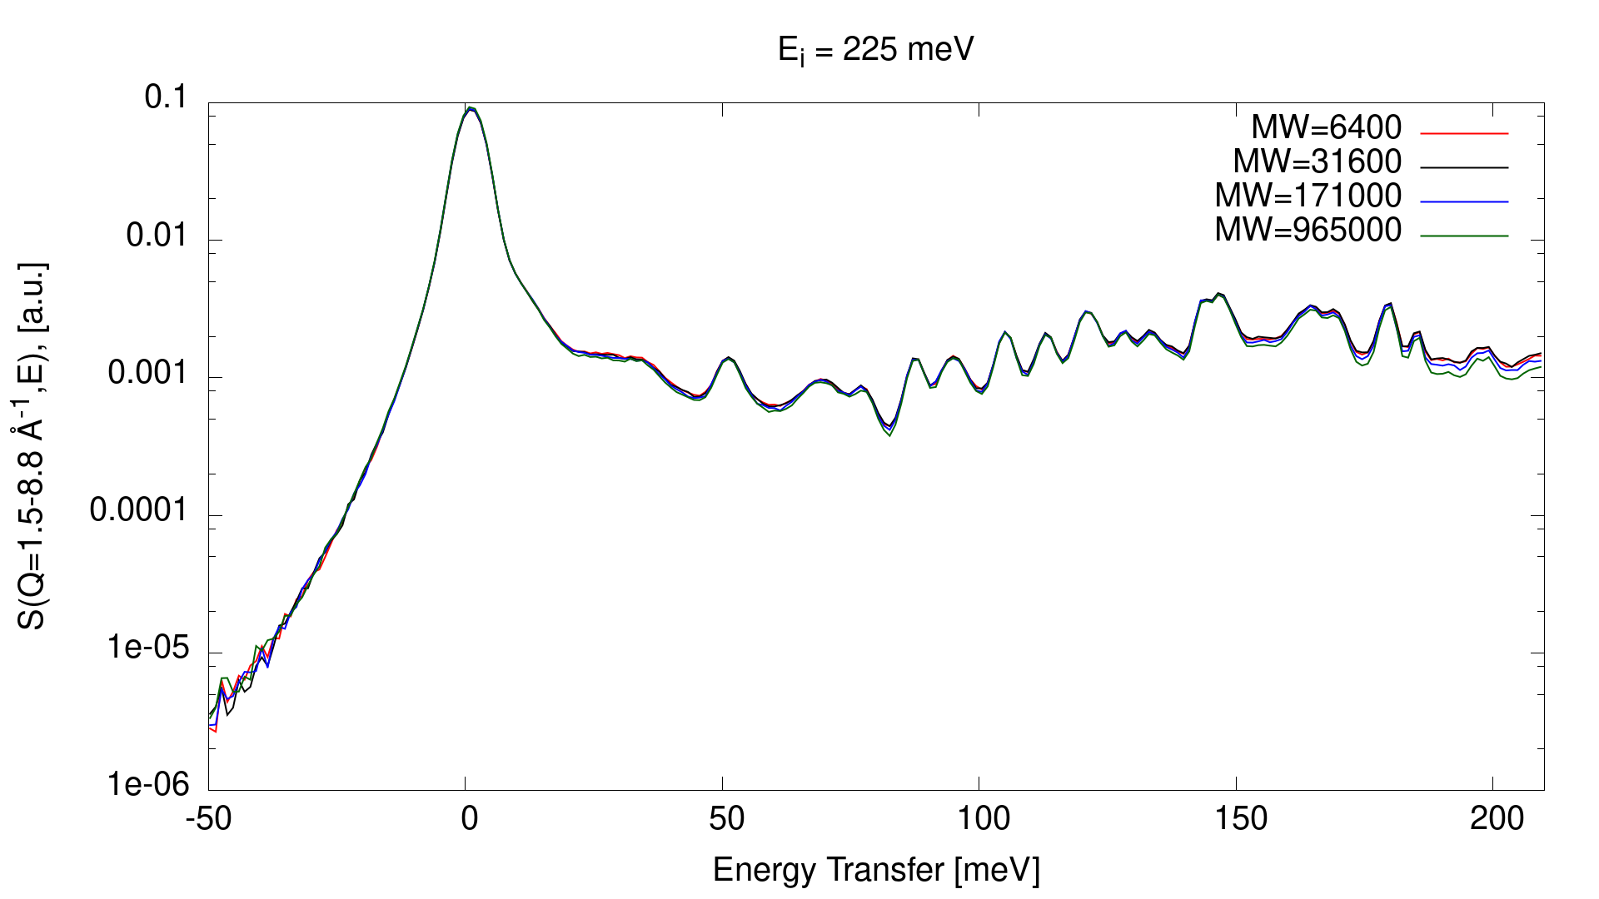
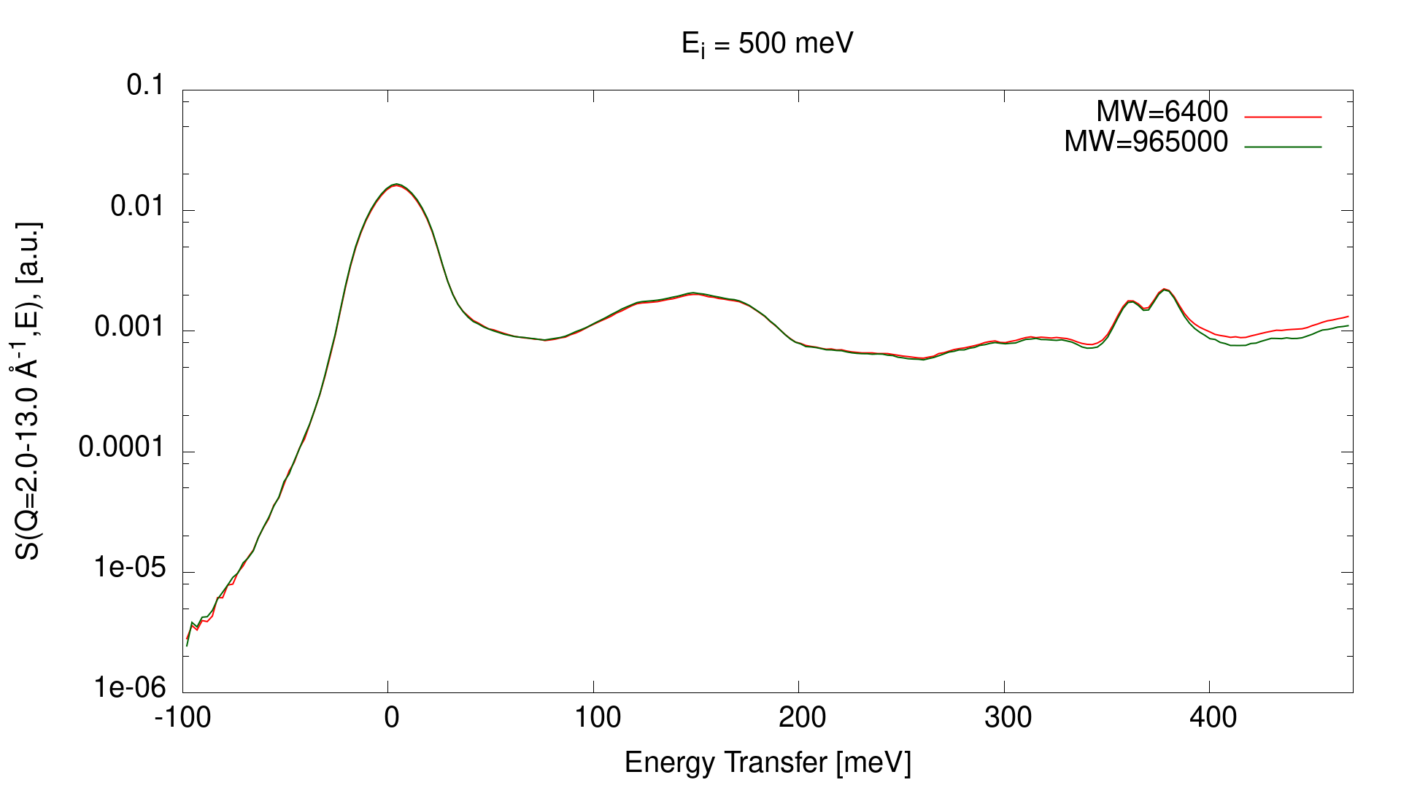
Polystyrene: sPS Molecular Weight Comparison

Slide 20
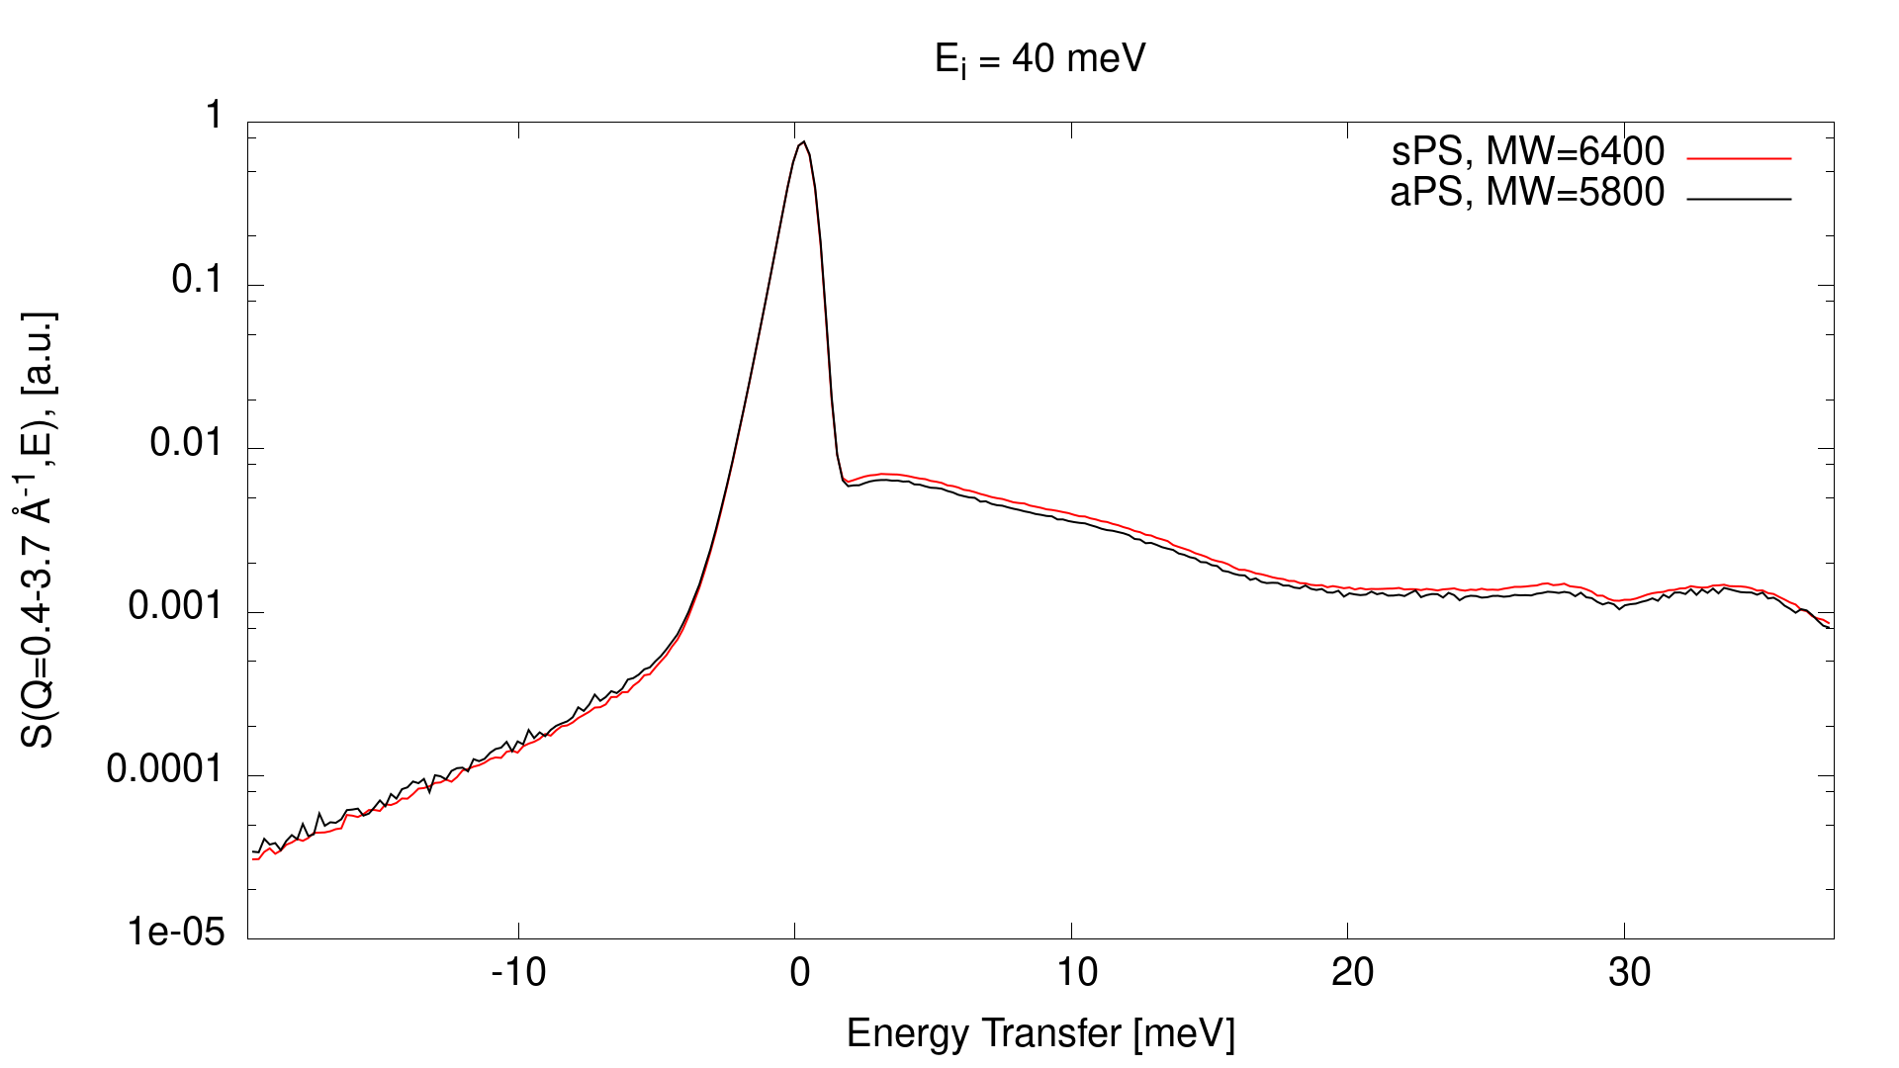
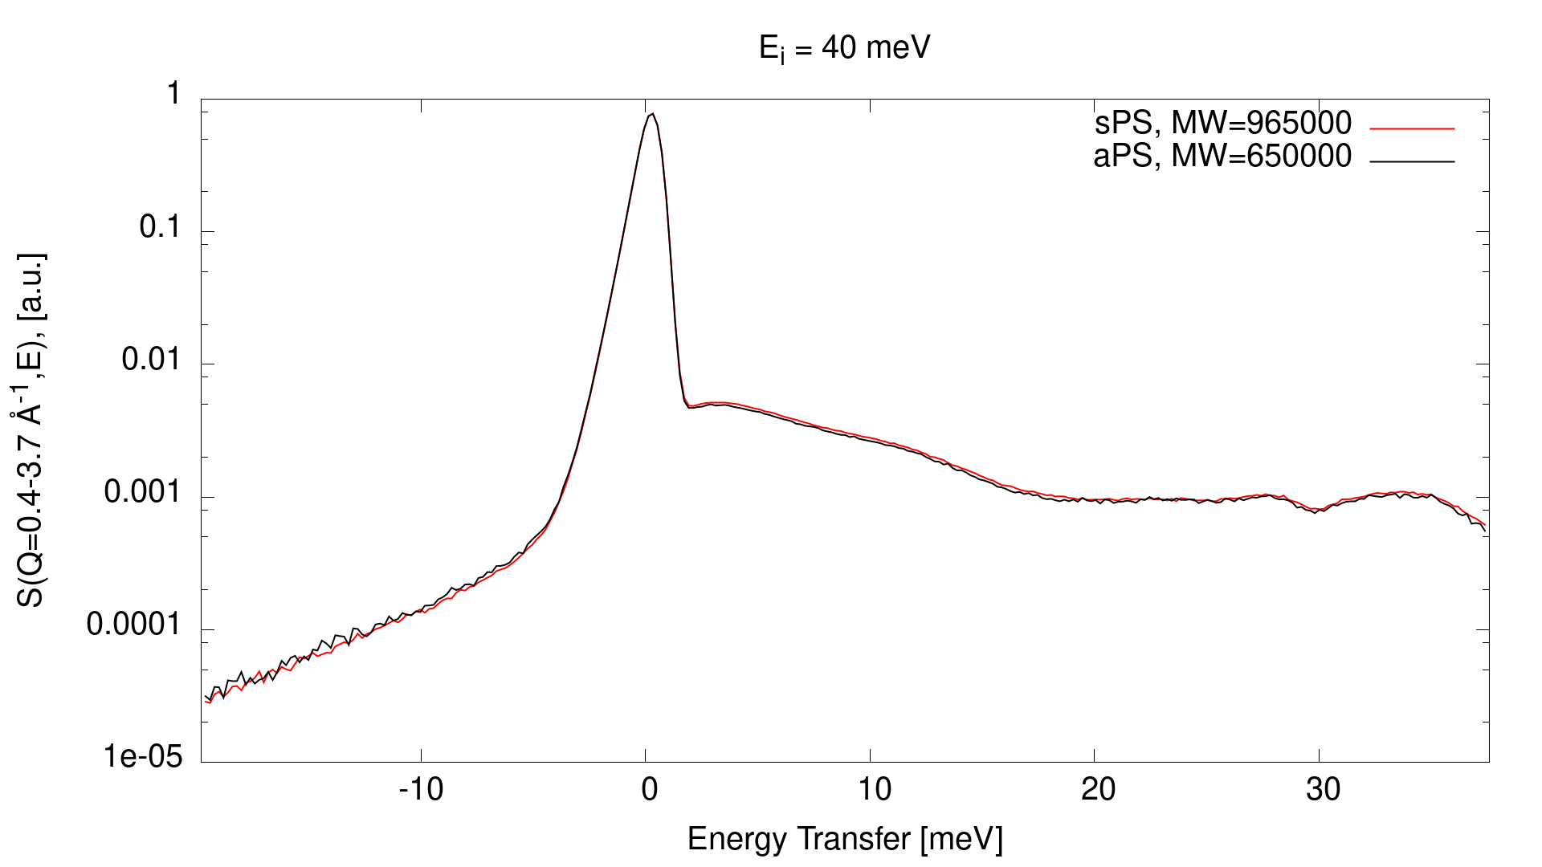
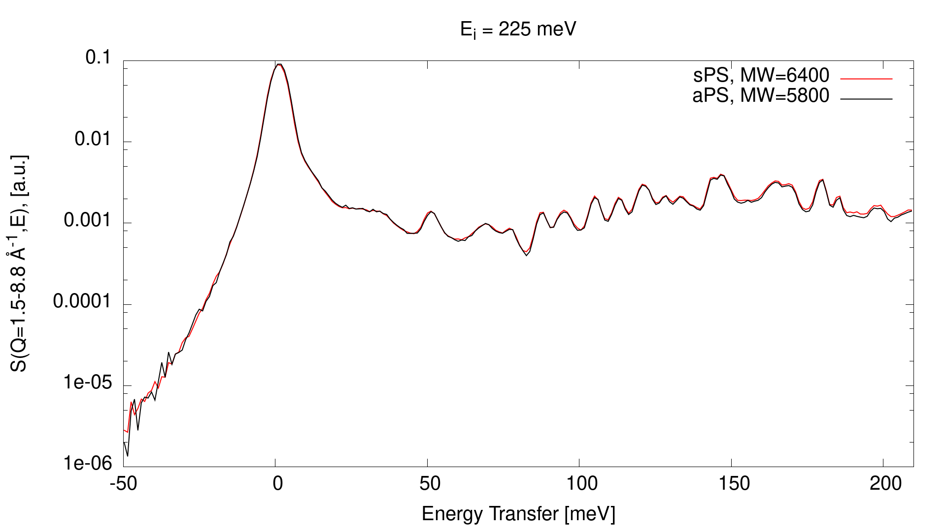
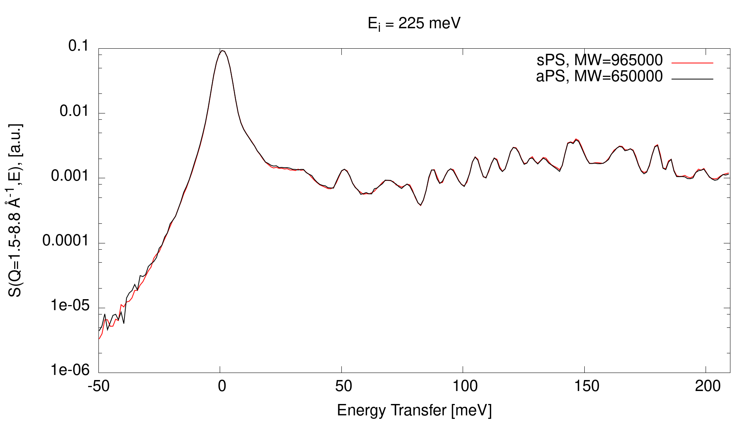
Polystyrene: Tacticity Comparison

Slide 21
Conclusions
YH_{x}
  Anharmonicities play significant role in inelastic spectra
Polystyrene
  Inelastic spectra different from polyethylene
  No noticeable difference in inelastic scattering as a function of MW or tacticity for amorphous samples
  Further measurements planned to determine effect of crystallinity

Slide 22
Acknowledgments
This research was sponsored by the TCR program of the US Department of Energy’s (DOE’s) Office of Nuclear Energy.
This work was supported by the Nuclear Criticality Safety Program, funded and managed by the National Nuclear Security Administration for the Department of Energy
This research used resources at the SNS, a DOE Office of Science User Facility operated by ORNL.

Slide 23
Questions?

