Slide 1
For Facilitating ENSDF Evaluation: Code Developments at MSU
Jun Chen
2020 USNDP meeting
December 3, 2020

Slide 2
Code developments for ENSDF
Make computer do the tedious work efficiently
Leave evaluators to concentrate on “evaluation”
KeynumberCheck
ConsistencyCheck
Validation
GLSC (Gamma to Level Scheme Computation)
ConsistencyCheck
Evaluation
EXCEL2ENSDF (ENSDF2ENSDF)format conversion
Compilation
Dissemination
Java-NDS
Java-RULER
FMTCHK (legacy code)
New codes developed in Java
Listed legacy codes will be replaced by new codes under development
ENSDF file
Goal: an Easy TOOLkit “E2” (ENSDF Evaluation) for streamlining evaluation process
“E2”=“EZ” for easy

Slide 3
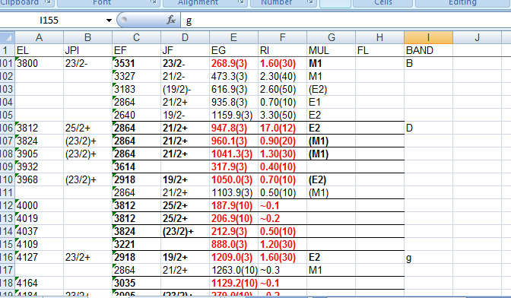
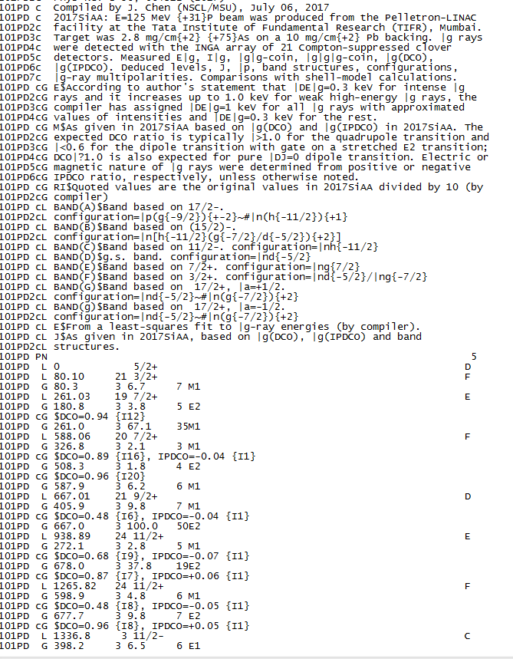
Code developments for ENSDF: Compilation
Compilation
EXCEL2ENSDF (ENSDF2ENSDF)format conversion
Excel2ENSDF OR ENSDF2Excel
ENSDF file
Excel file
Easy conversion between Excel format and ENSDF format
Convenient and efficient for arithmetic and string operations, checking, merging, data extracting, etc., on batches of data values
Example usage:
Converting tabulated E(n)(lab) to E(level) in ENSDF: multiplier and offset=S(n) needed once
Adding new data fields to existing ENSDF:
convert ENSDF to Excel
add new columns for new data fields
convert Excel back to ENSDF
Extracting gammas by order of E(gamma) to Excel column from Adopted Gammas dataset

Slide 4
Code developments for ENSDF: Evaluation
Adopted Levels &Gammas
Reactions
Levels
Decays
Gammas
Levels
Gammas
Radiations
Evaluation
ConsistencyCheck
Java-RULER
GLSC (Gamma to Level Scheme Computation)
ConsistencyCheck (need name change since it is much more than checking consistency):
Group all information (data&comments) of same levels and gammas from multiple datasets into one place in one view
Automatically average EG, RI, T1/2 from input datasets based on grouping
Generate a new Adopted dataset from input datasets based on grouping and averaging and add Q records based on AME-2016
View grouped levels and gammas in a graphical window for customized averaging
Set up evaluation folders, sort, merge/split datasets, and more.
Java-RULER:
calculate and insert gamma transition strengths into an ENSDF dataset
GLSC (Gamma to Level Scheme Computation): NEW
Compute E(level) from E(gamma) with customized settings, e.g.,
Setting ΔEγ based on decimal digits in Eγ or intensity ranges
Automatically adjusting&optimizing ΔEγ of poor-fit Eγ to reduce χ²
Compute level feedings from gamma-ray intensities

Slide 5
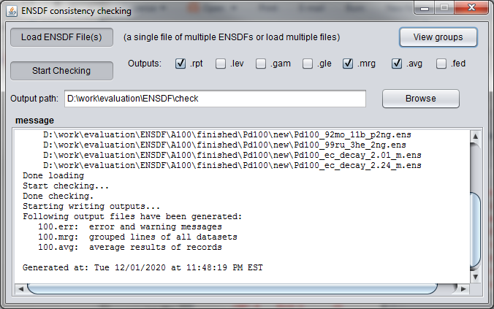
Code developments for ENSDF: ConsistencyCheck code
Open a graphical window to view grouped levels and gammas for customized averaging

Slide 6
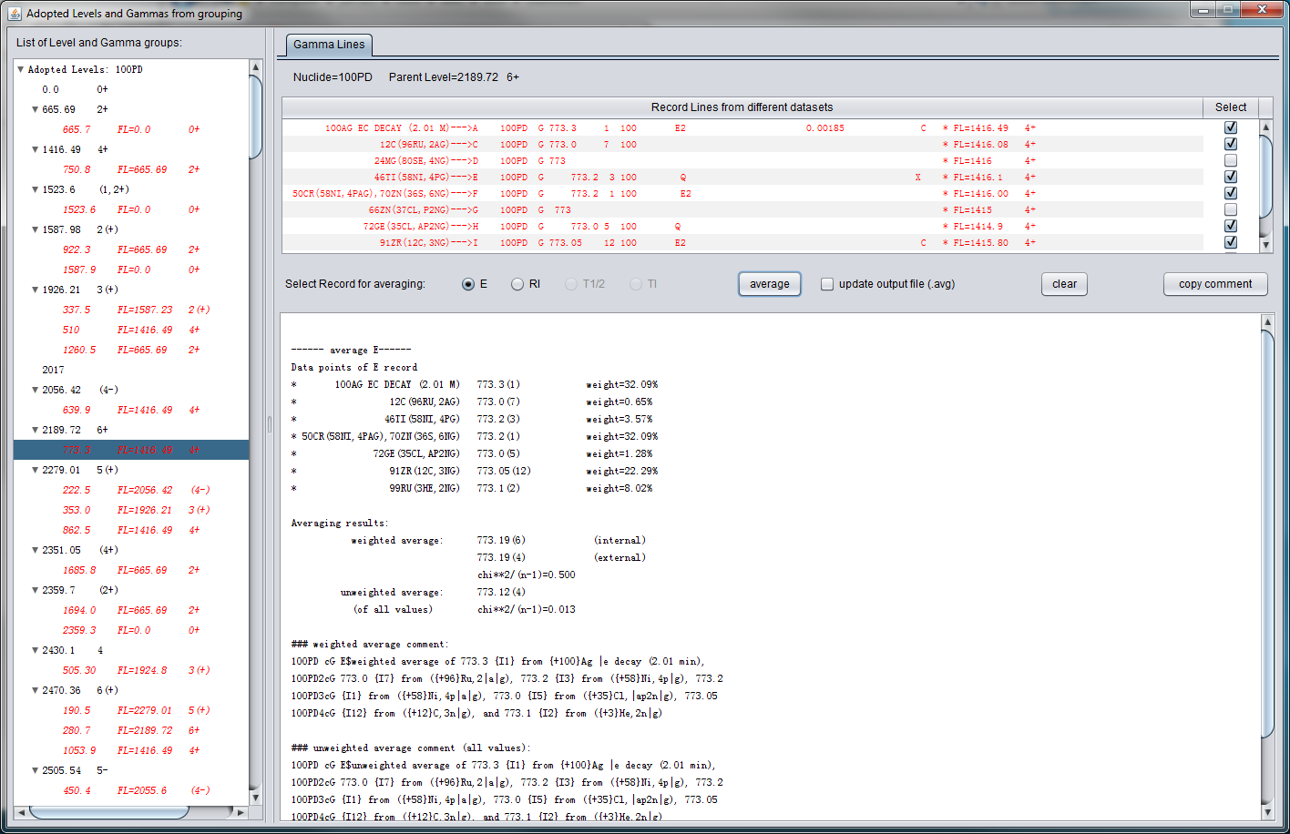
Code developments for ENSDF: ConsistencyCheck code
View grouped levels and gammas
record lines from different datasets
select what record for averaging
select source datasets to be included for averaging
average
results
Select level or gamma
here
automatically-generated averaging comments that can be directly copied to ENSDF file

Slide 7
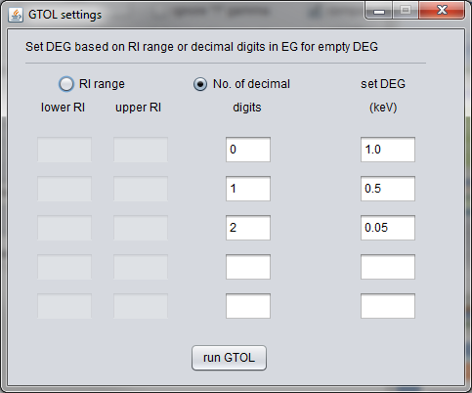
Code developments for ENSDF: GLSC (Gamma to Level Scheme Computation) code
automatically adjust&optimize uncertainties of poor-fit Eγ to reduce χ² to below the given limit,
instead of tedious, repeated, frustrating, and non-optimal setting and changing of ΔEγ by hand, in case of multiple poor-fit gammas

Slide 8
Code developments for ENSDF: GLSC (Gamma to Level Scheme Computation) code
compute level feedings from gamma intensities like GABS at the same time for decay dataset
set normalization factor for total gamma+ce g.s. feeding

Slide 9
Code developments for ENSDF: Validation
Adopted dataset
Decay datasets
Particle transfers
In-beam γ spectroscopy
Miscellaneous reactions
Inconsistencies in ENSDF evaluation:
Lower the evaluation quality and reliability
Unavoidable due to inconsistent data themselves or from evaluator’s errors
Very time-consuming to catch and easy to miss by evaluator’s eyes
Computation or deduction needed for finding high-level inconsistencies
There is a long list of items to be automatically checked
and it keeps growing
to transform manual checking to auto checking as much as possible
Validation
ConsistencyCheck
KeynumberCheck
FMTCHK (legacy code)
ConsistencyCheck: check data consistency among all datasets in a mass chain evaluation and can find most of common inconsistencies, like JPI, MULT, MR, etc.
KeynumberCheck: check all NSR keynumbers in datasets for format errors, irrelevant or non-existent keynumbers, etc.

Slide 10
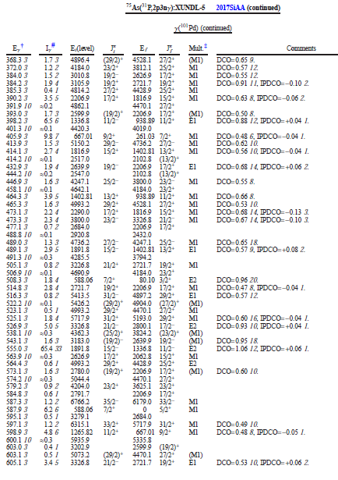
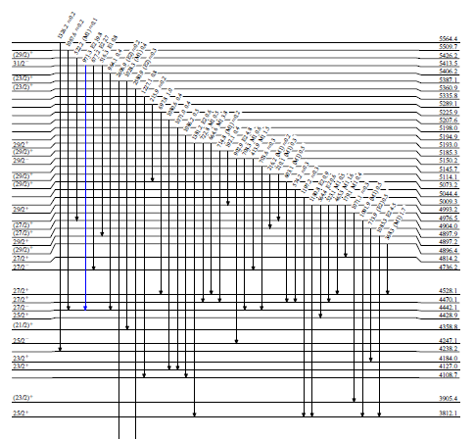
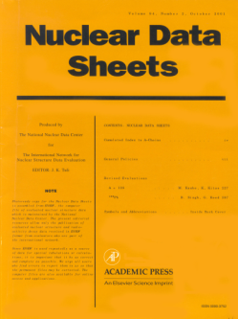
Code developments for ENSDF: Dissemination
ENSDF file
Dissemination
Java-NDS
PDF
output
Java-NDS
Java-NDS
generating publish-ready PDF output for the production of the Nuclear Data Sheet journal and for web-display of ENSDF and XUNDL databases at NNDC retrieval website.

Slide 11
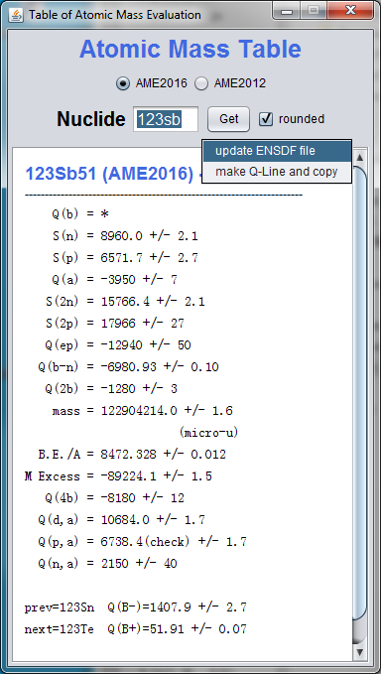
Code developments for ENSDF: Other code
Easy retrieval of AME entries
Automatically update Q record in an input ENSDF file
Generate an ENSDF Q-record line and automatically copy it to system clipboard, ready to paste
popup from right-click

Slide 12
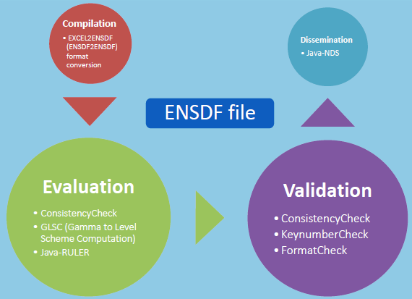
Code developments at MSU
Goal: an Easy TOOLkit “E2” (ENSDF Evaluation) by incorporating all the codes
To streamline evaluation process, ensure evaluation quality and improve evaluation efficiency
(by up to ~100% case by case)
Codes developed at MSU (>100,000 lines):
Java-NDS
ConsistencyCheck
KeynumberCheck
Java-RULER
Excel2ENSDF
GLSC (Gamma to Level Scheme Computation)
AME
Next: FormatCheck in Java

