Slide 1
Texas A&M Evaluation Center Strategic Priorities
Continuing ENSDF Mass Chain Evaluation (1 FTE)
First Strategic Priority according to the Mission Statement.
All other priorities will be strictly subordinated to this purpose
Produce experimental nuclear data to aid data evaluation
Precision Internal Conversion Coefficients Measurements at Cyclotron Institute, Texas A&M University to give USDNP the best approach for ENSDF ICC-calculated values (concluding cases pending on conditions)
Experimental studies of Medical Isotopes
Invers kinematics methodology, Cyclotron Institute, Texas A&M University
Reevaluation of data procedures for basic science and data evaluation
Level scheme re-concept based on Repeatability, a newly revealed experimental data evidence

Slide 2
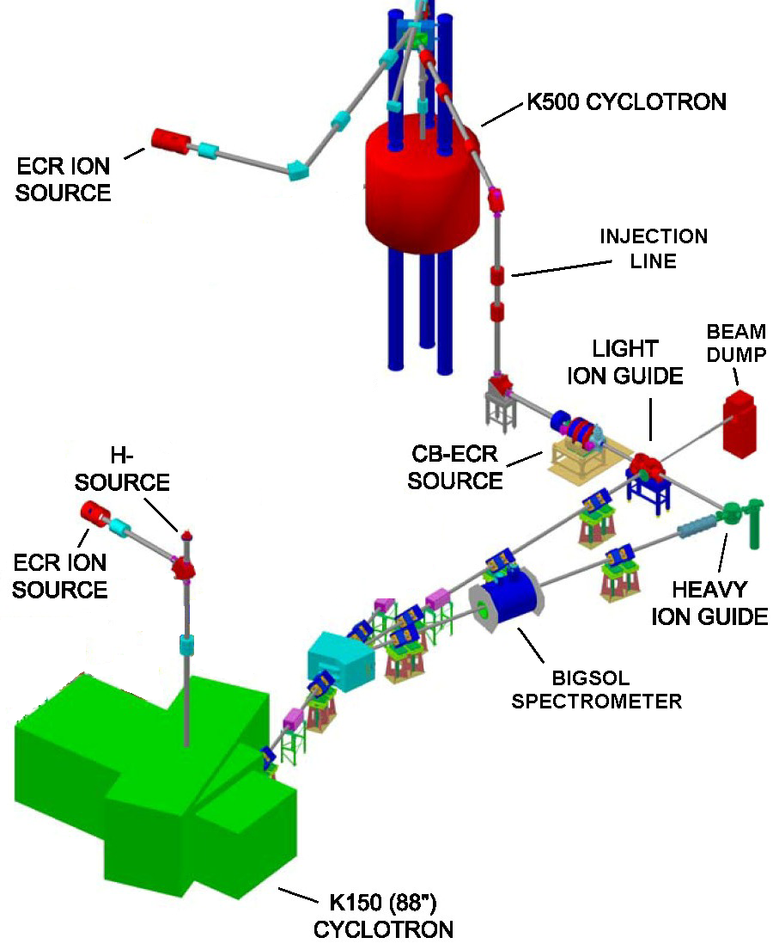
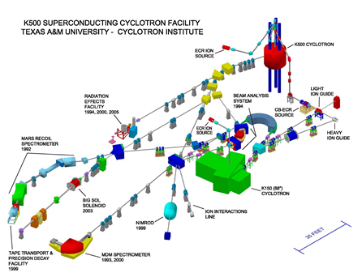
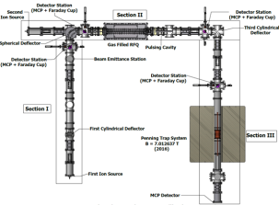
Texas A&M Evaluation Center: Data Evaluation Station at Cyclotron Radioactive Ion Beam Facility to assist experiments and pre-evaluate data
Focus on the Light-Ion Guide (LIG), the Heavy Ion Guide (HIG) and the Charge-Breeding Electron-Cyclotron-Resonance ion source (CB-ECRIS).
TAMUTRAP

Slide 3
Texas A&M Evaluation Center Expanded Involvement in Applied Measurements of Precision Internal Conversion Coefficients
Theme: Precision Measurements for USNDP
Texas A&M Center implied decisively by decade-long program of Internal Conversion Coefficient (ICC) Precision Measurements to guide USNDP for best approach of theoretical ENSDF database ICC values
 |  |  |  |  | Calculated α_{K} values:
 | Parent |  | Transition | Measured | No | “Frozen | SCF
 | State | Multipolarity | Energy (keV) | α_{K} | vacancy | Orbitals"
1 | ^{93m}Nb | M4 | 30.760(5) | 25600(900) | 23960 | 25990 | 25440
2 | ^{103m}Rh | E3 | 39.752(6) | 141.1(23) | 131.3 | 139.4 | 137.2
3 | ^{111m}Cd | E3 | 150.825(15) | 1.449(18) | 1.425 | 1.451 | 1.446
4 | ^{119m}Sn | M4 | 65.660(10) | 1621(25) | 1544 | 1618 | 1603
5 | ^{125m}Te | M4 | 109.276(15) | 185.0(40) | 179.5 | 185.2 | 184.2
6 | ^{127m}Te | M4 | 88.23(7) | 484(6) | 468.6 | 486.4 | 483.1
7 | ^{134m}Cs | E3 | 127.502(3) | 2.742(15) | 2.677 | 2.741 | 2.73
8 | ^{137m}Ba | M4 | 661.659(3) | 0.0915(5) | 0.09068 | 0.0915 | 0.091
9 | ^{193m}Ir | M4 | 80.22(2) | 103.0(8) | 92.0 | 103.3 | 99.7
10 | ^{197m}Pt | M4 | 346.5(2) | 4.23(7) | 4.191 | 4.276 | 4.265
 |  |  |  | χ²: | 252 | 1.5 | 21.5

Slide 5
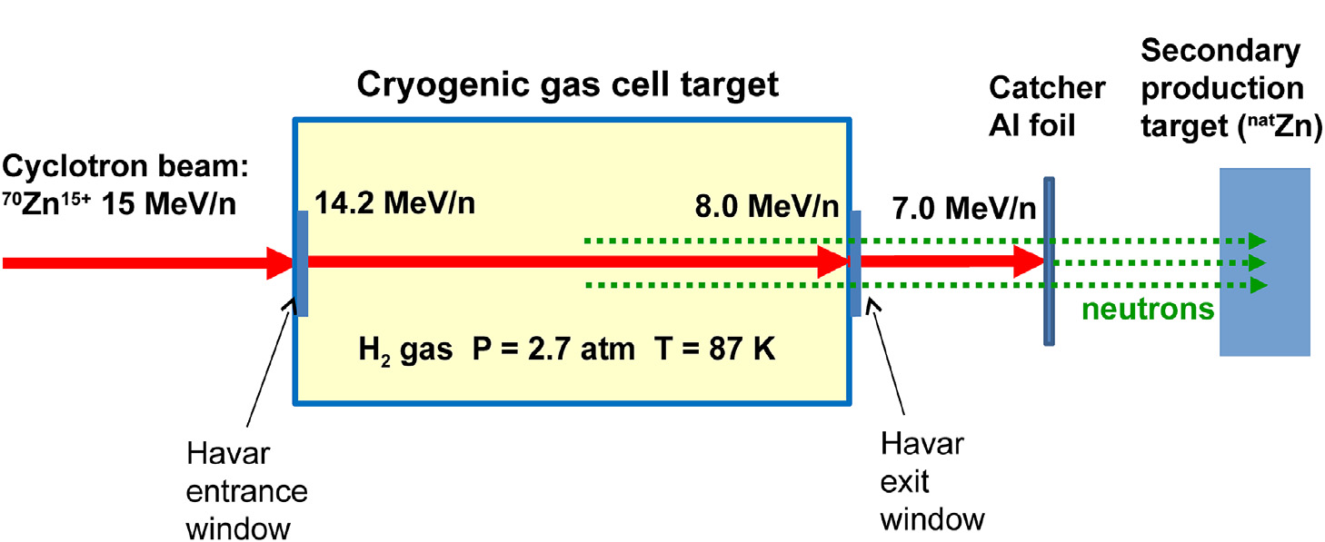
Texas A&M Evaluation Center Expanded Involvement in Applied Measurements for Medical Isotopes Production by Inverse Kinematics
Theme: Research for Medical Isotopes Production by Inverse Kinematics
Innovative method for the production of important medical radioisotopes based on the nuclear reaction in inverse kinematics, by:
Directing a heavy ion beam of appropriate energy on a light target (e.g., H, d, He) and
Collecting the isotope of interest on an appropriate catcher after the target.
e.g.

Slide 6
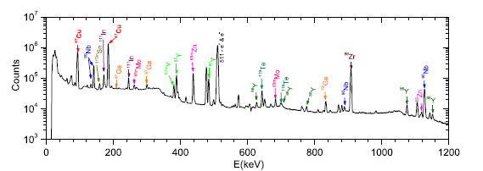
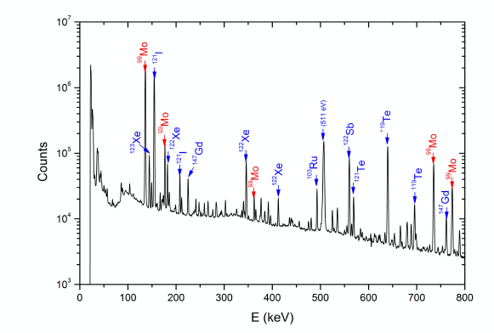
Case Studies (at this stage beyond the proof-of-principle):
⁶⁷Cu (T_{1/2} = 62 h) via the reaction of ⁷⁰Zn beam of 15 MeV/nucleon with a cryogenic hydrogen gas target
⁹⁹Mo (T_{1/2} = 66 h) via the reaction of ¹⁰⁰Mo of 12 MeV/nucleon with a cryogenic ⁴He cryogenic gas target
Secondary neutrons from the primary reaction were used to irradiate a secondary target for further radioisotope production (to be further developed)
At K500 Cyclotron & MARS spectrometer of Texas A&M Cyclotron Institute
Radioactive isotopes identified by γ-ray spectroscopy:
(a) ⁶⁷Cu run
(b) ⁹⁹Mo run
(a)
(b)

Slide 7
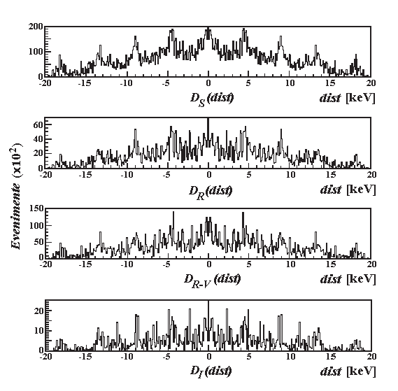
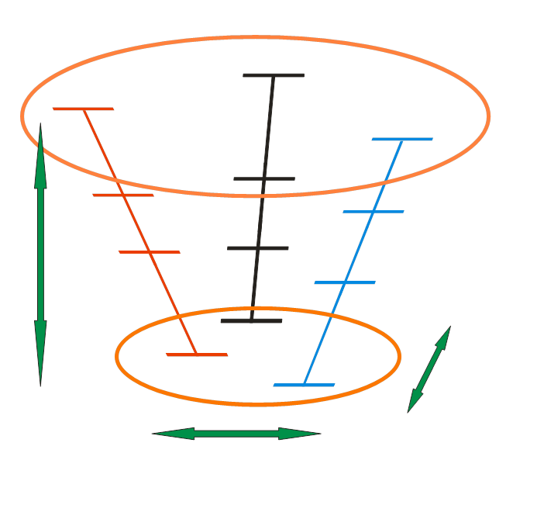
Texas A&M Evaluation Center New Initiatives & Directions
Theme: Data Evaluation for Basic Physics
Reevaluation of data procedures for basic science and data evaluation
Level scheme re-concept based on Repeatability, a newly revealed experimental evidence
Regular E_{γi-}E_{γj} Distributions D(dist) 3D Correlations
(high spin data) in the Level Scheme

