Slide 1
Texas A&M Evaluation Center
Strategic Priorities
Continuing ENSDF Mass Chain Evaluation (1 FTE)
First Strategic Priority according to the Mission Statement.
All other priorities will be strictly subordinated to this purpose
Produce experimental nuclear data to aid data evaluation
Precision Internal Conversion Coefficients Measurements at Cyclotron Institute, Texas A&M University to give USDNP the best approach for ENSDF ICC-calculated values (concluding cases pending on conditions)
Experimental studies of Medical Isotopes
Invers kinematics methodology, Cyclotron Institute, Texas A&M University
Reevaluation of data procedures for basic science and data evaluation
  Level scheme re-concept based on Repeatability, a newly revealed experimental data evidence

Slide 2

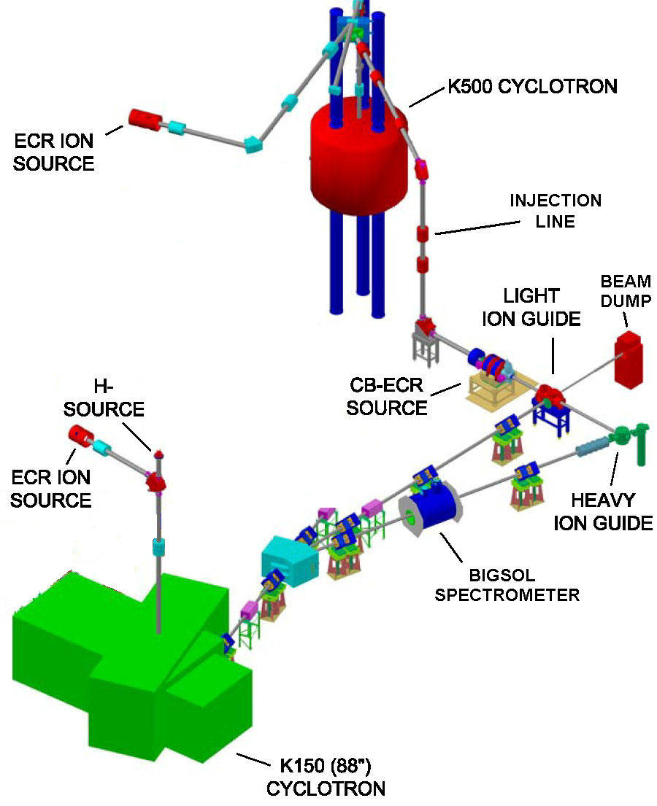
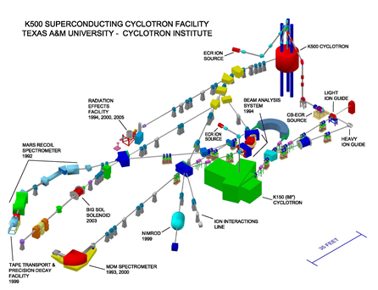
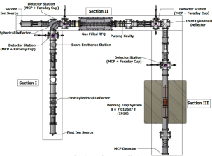
Texas A&M Evaluation Center:
Data Evaluation Station at Cyclotron Radioactive Ion Beam Facility to assist experiments and pre-evaluate data
Focus on the Light-Ion Guide (LIG), the Heavy Ion Guide (HIG) and the Charge-Breeding Electron-Cyclotron-Resonance ion source (CB-ECRIS).
TAMUTRAP

Slide 3
Texas A&M Evaluation Center
Expanded Involvement in Applied Measurements of
Precision Internal Conversion Coefficients
Theme: Precision Measurements for USNDP
Texas A&M Center implied decisively by decade-long program of Internal Conversion Coefficient (ICC) Precision Measurements to guide USNDP for best approach of theoretical ENSDF database ICC values
 |  |  |  |  | Calculated α_{K} values:
 | Parent |  | Transition | Measured | No | “Frozen | SCF
 | State | Multipolarity | Energy (keV) | α_{K} | vacancy | Orbitals"
1 | ^{93m}Nb | M4 | 30.760(5) | 25600(900) | 23960 | 25990 | 25440
2 | ^{103m}Rh | E3 | 39.752(6) | 141.1(23) | 131.3 | 139.4 | 137.2
3 | ^{111m}Cd | E3 | 150.825(15) | 1.449(18) | 1.425 | 1.451 | 1.446
4 | ^{119m}Sn | M4 | 65.660(10) | 1621(25) | 1544 | 1618 | 1603
5 | ^{125m}Te | M4 | 109.276(15) | 185.0(40) | 179.5 | 185.2 | 184.2
6 | ^{127m}Te | M4 | 88.23(7) | 484(6) | 468.6 | 486.4 | 483.1
7 | ^{134m}Cs | E3 | 127.502(3) | 2.742(15) | 2.677 | 2.741 | 2.73
8 | ^{137m}Ba | M4 | 661.659(3) | 0.0915(5) | 0.09068 | 0.0915 | 0.091
9 | ^{193m}Ir | M4 | 80.22(2) | 103.0(8) | 92.0 | 103.3 | 99.7
10 | ^{197m}Pt | M4 | 346.5(2) | 4.23(7) | 4.191 | 4.276 | 4.265
 |  |  |  | χ²: | 252 | 1.5 | 21.5

Slide 5
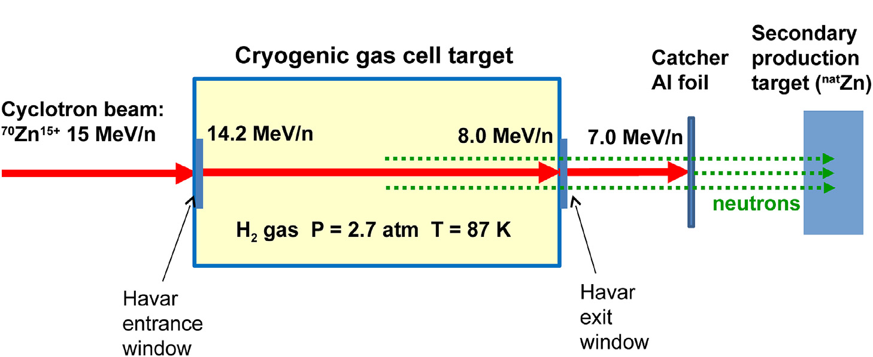
Texas A&M Evaluation Center
Expanded Involvement in Applied Measurements for Medical Isotopes Production by Inverse Kinematics
Theme: Research for Medical Isotopes Production by Inverse Kinematics
Innovative method for the production of important medical radioisotopes based on the nuclear reaction in inverse kinematics, by:
  Directing a heavy ion beam of appropriate energy on a light target (e.g., H, d, He) and
  Collecting the isotope of interest on an appropriate catcher after the target.
e.g.

Slide 6
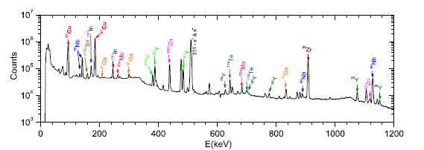
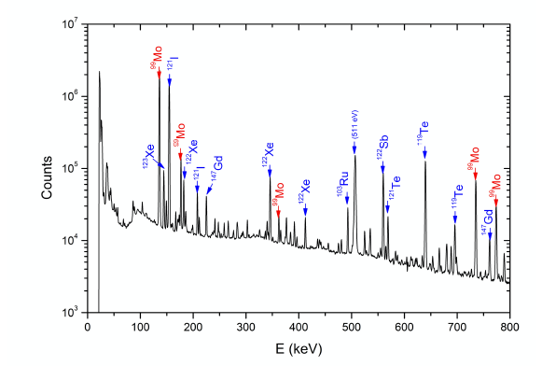
Case Studies (at this stage beyond the proof-of-principle):
  ⁶⁷Cu (T_{1/2} = 62 h) via the reaction of ⁷⁰Zn beam of 15 MeV/nucleon with a cryogenic hydrogen gas target
  ⁹⁹Mo (T_{1/2} = 66 h) via the reaction of ¹⁰⁰Mo of 12 MeV/nucleon with a cryogenic ⁴He cryogenic gas target
  Secondary neutrons from the primary reaction were used to irradiate a secondary target for further radioisotope production (to be further developed)
  At K500 Cyclotron & MARS spectrometer of Texas A&M Cyclotron Institute
  Radioactive isotopes identified by γ-ray spectroscopy:
    (a) ⁶⁷Cu run
    (b) ⁹⁹Mo run
  (a)
  (b)

Slide 7
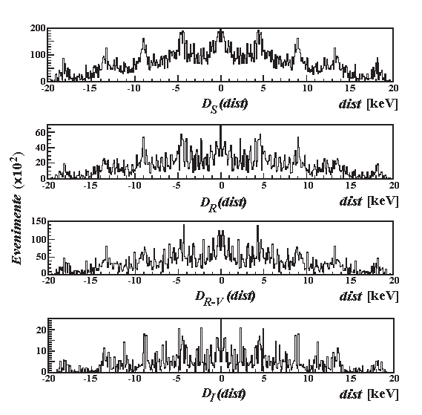
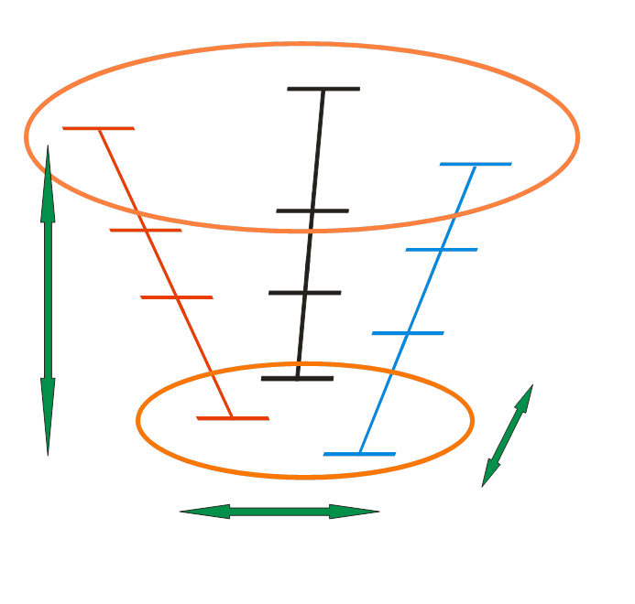
Texas A&M Evaluation Center
New Initiatives & Directions
Theme: Data Evaluation for Basic Physics
Reevaluation of data procedures for basic science and data evaluation
  Level scheme re-concept based on Repeatability, a newly revealed experimental evidence
  Regular E_{γi-}E_{γj} Distributions D(dist) 3D Correlations
  (high spin data) in the Level Scheme

Slide 8
Texas A&M Evaluation Center
Precision Internal Conversion Coefficients
Measurements Follow-up
Theme: Precision Measurements for USNDP
Texas A&M Center implied decisively by decade-long program of Internal Conversion Coefficient (ICC) Precision Measurements to guide USNDP for best approach of theoretical ENSDF database ICC values
 |  |  |  |  | Calculated α_{K} values:
 | Parent |  | Transition | Measured | No | “Frozen | SCF
 | State | Multipolarity | Energy (keV) | α_{K} | vacancy | Orbitals"
1 | ^{93m}Nb | M4 | 30.760(5) | 25600(900) | 23960 | 25990 | 25440
2 | ^{103m}Rh | E3 | 39.752(6) | 141.1(23) | 131.3 | 139.4 | 137.2
3 | ^{111m}Cd | E3 | 150.825(15) | 1.449(18) | 1.425 | 1.451 | 1.446
4 | ^{119m}Sn | M4 | 65.660(10) | 1621(25) | 1544 | 1618 | 1603
5 | ^{125m}Te | M4 | 109.276(15) | 185.0(40) | 179.5 | 185.2 | 184.2
6 | ^{127m}Te | M4 | 88.23(7) | 484(6) | 468.6 | 486.4 | 483.1
7 | ^{134m}Cs | E3 | 127.502(3) | 2.742(15) | 2.677 | 2.741 | 2.73
8 | ^{137m}Ba | M4 | 661.659(3) | 0.0915(5) | 0.09068 | 0.0915 | 0.091
9 | ^{193m}Ir | M4 | 80.22(2) | 103.0(8) | 92.0 | 103.3 | 99.7
10 | ^{197m}Pt | M4 | 346.5(2) | 4.23(7) | 4.191 | 4.276 | 4.265
 |  |  |  | χ²: | 252 | 1.5 | 21.5

Slide 10
Texas A&M Evaluation Center
Precision Internal Conversion Coefficients
Measurements Follow-up
Covered the interval 93<A<197 of nuclear chart and concluded that the “frozen orbitals” hole calculations are best describing the results.
However the calculation methodology is an approximate description of reality with no obvious reason, other than the empirical evidence, that it is universally valid.
Game changer: the last studied case, ^{93m}Nb, was done with a Si(Li) detector that was painstakingly efficiency calibrated and it is now fit to explore for ICC measurements in the underrepresented region A<100.
There are but two measurements close to A~200 limit and one can use the HPGe detector for more measurements in this region (and higher)
- Conclusion: it is still possible to improve the ICC test by extending the A range
- Possible candidates: ^{58m}Co, ^{198m}Au

Slide 11
₂₇^{58m}Co
₂₇^{58m}Co, Δ_{K}=4.7%, α_{K}(exp)=1860(100) (ENSDF), %unc=5.4% ; 2030(90) (2002RA45)
24.9-keV M4, single IT γ , T_{1/2}=9.1 h,
α_{K}(FO)=1840, α_{K}(NH)=1754
⁵⁸Co g.s. ε, T_{1/2}=70.9 d, (λ×I_{Kx})(g.s./m.s.)= 0.51(3)%
ONLY Si(Li) detector
ENSDF list of reactions:
a) There are many reactions used for prompt studies:
With γ measured: (α,nγ), (p,γ), (p,nγ), (n,2nγ), (d,nγ);
Only particles: (p,n), (p,d), (d,t), (d,n), (d,α), (³He,d), (α,d)
that generally did not observed the 24.9γ, nor give relevant cross sections.
b) Most promising ⁵⁸Co IT decay dataset were considered:
1. ⁵⁸Ni(n,p)⁵⁸Co in n flux Φ=10¹⁴ n/cm²s (1971Pl02)
- “spectroscopically pure” NiO activated for 24 h;
- ^{58m}Co was separated from NiO with anion-resin (Dowex-2, X-10, 200-400 mesh);
- Ni was washed out with 7N HCl solution => separation factor ~10⁵
- The elude was dried and dissolved in aqua destillata from which it was electroplated on Pt foil
- 99.9% enriched (from 68%) ⁵⁸Ni (metal, oxide) is available from Isoflex, Trace
Texas A&M Nuclear Science Center reactor activation estimation
- NSC fast neutron: Φ(integrated) ~ 5.1x10¹⁰ n/cm²s (…)
- EXFOR V0002009: σ_{aver}(n,p,E_{n})=1.1-14 MeV=478 mb (should be divided in between m.s. and g.s…)
- 2 mg of ⁵⁸Ni activated for 1 h give about 1 μCi of ⁵⁸Co

Slide 12
₇₉^{198m}Au
₇₉^{198m}Au, Δ_{K}=5.0%, α_{K}(exp)= , %unc= ;
115.2 -keV M4, multiple IT γ , T_{1/2}=2.3 d,
α_{K}(FO)=185, α_{K}(NH)=176
^{198m}Au IT vs. g.s.
811.715 (12-) 2.272 d 16 IT
0.0 2- 2.6941 d 2 ß-: 100 %
ONLY HPGe detector
ENSDF list of reactions to populate the IT state:
²⁰⁰Hg(d,α) (1972Cu06), ¹⁹⁷Au(d,p) (1968Bo30,1973Pa08), ¹⁹⁸Hg(n,p) (1973Pa08),
¹⁹⁶Pt(α,pn)(1975Ma30),¹⁹⁸Pt(d,2n) (1975Ma30),
¹⁹⁷Au(n,γ) (1990Pi08).

