Slide 1
Mixed Elastic Scattering Format Proposal
M. L. Zerkle
CSEWG – Formats & Processing Committee
November 30, 2020

Slide 2
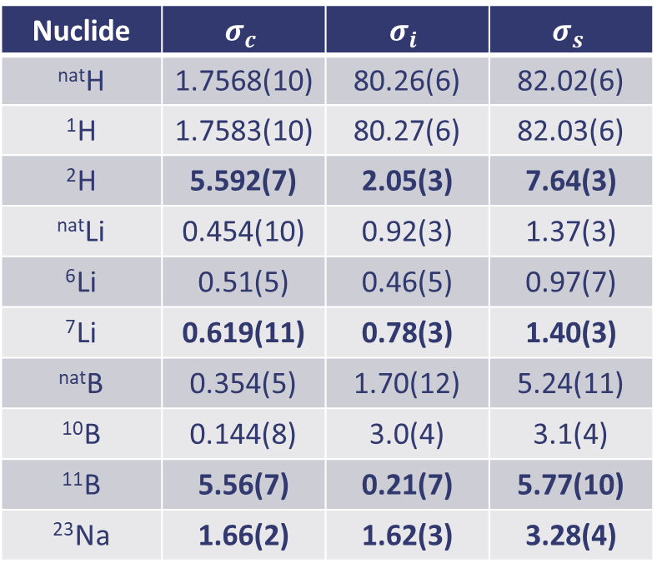
Motivation
Selected nuclides exhibit both coherent and incoherent elastic scattering effects in the thermal energy range
More rigorous thermal elastic scattering treatment needed to support advanced moderator development
  Without treatment Bragg peaks either neglected (incoherent approximation) or to deep (coherent approximation)
Mixed Elastic Scattering format is a simple extension to ENDF-6 format
  Provides support for new capability in GNDS
No impact on existing TSL evaluations
Implementation
  ⁷LiD and ⁷LiH TSL evaluations
  FLASSH TSL evaluation code (to be released)
  NDEX nuclear data processing code
  MC21 neutron transport code
Bound Scattering Cross Sections for Selected Nuclides (b)
Nuclide | $$σ_{c}$$ | $$σ_{i}$$ | $$σ_{s}$$
^{nat}H | 1.7568(10) | 80.26(6) | 82.02(6)
¹H | 1.7583(10) | 80.27(6) | 82.03(6)
²H | 5.592(7) | 2.05(3) | 7.64(3)
^{nat}Li | 0.454(10) | 0.92(3) | 1.37(3)
⁶Li | 0.51(5) | 0.46(5) | 0.97(7)
⁷Li | 0.619(11) | 0.78(3) | 1.40(3)
^{nat}B | 0.354(5) | 1.70(12) | 5.24(11)
¹⁰B | 0.144(8) | 3.0(4) | 3.1(4)
¹¹B | 5.56(7) | 0.21(7) | 5.77(10)
²³Na | 1.66(2) | 1.62(3) | 3.28(4)

Slide 3
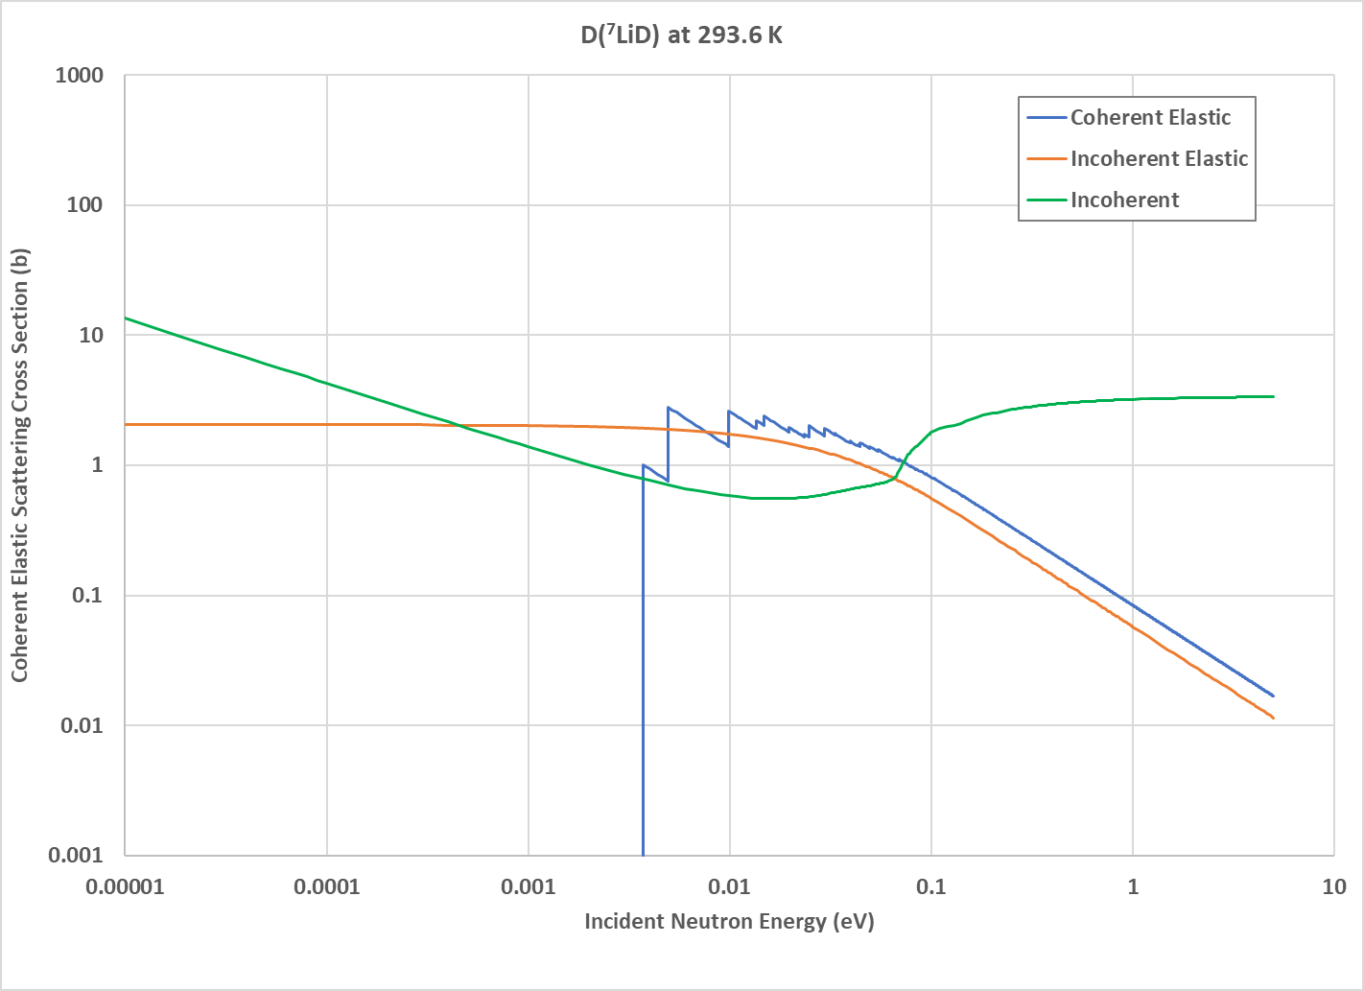
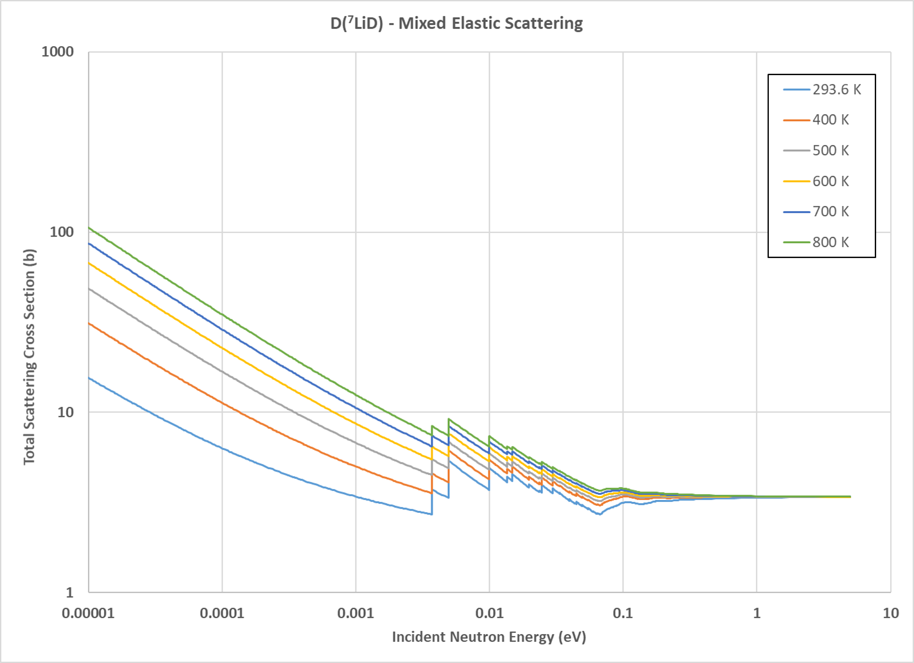
D(⁷LiD) Mixed Elastic Scattering TSL Evaluation
⁷LiD coherent and D incoherent elastic scattering
cross sections approximately the same magnitude
Both coherent and incoherent elastic scattering effects captured in NDEX total elastic scattering cross sections

Slide 4
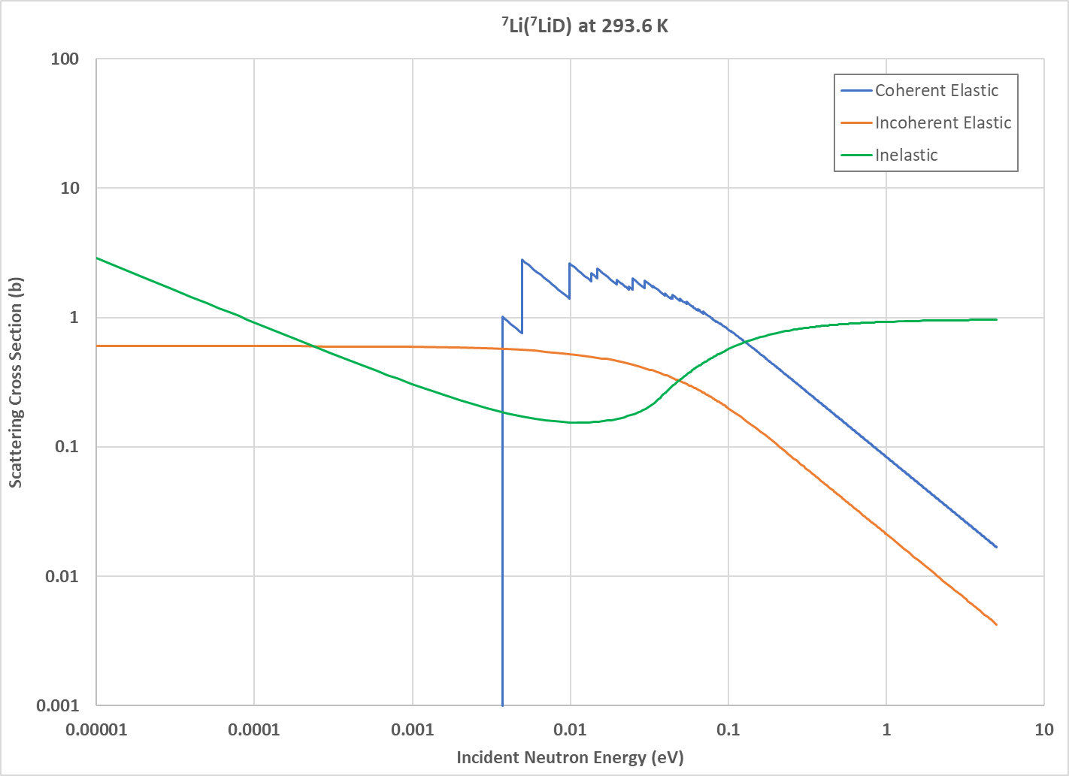
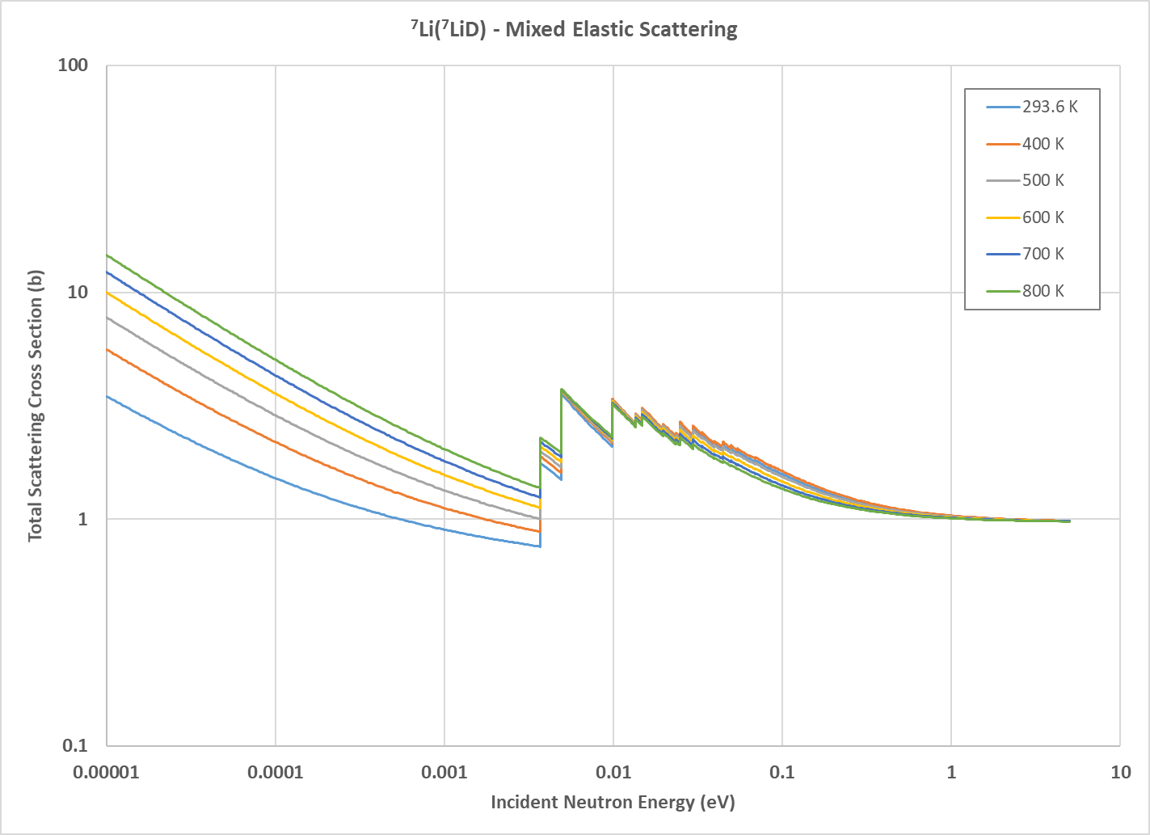
⁷Li(⁷LiD) Mixed Elastic Scattering TSL Evaluation
⁷LiD coherent elastic scattering component larger than ⁷Li incoherent elastic scattering
⁷LiD Bragg scattering more prominent in ⁷Li(⁷LiD) total scattering cross sections from NDEX

Slide 5
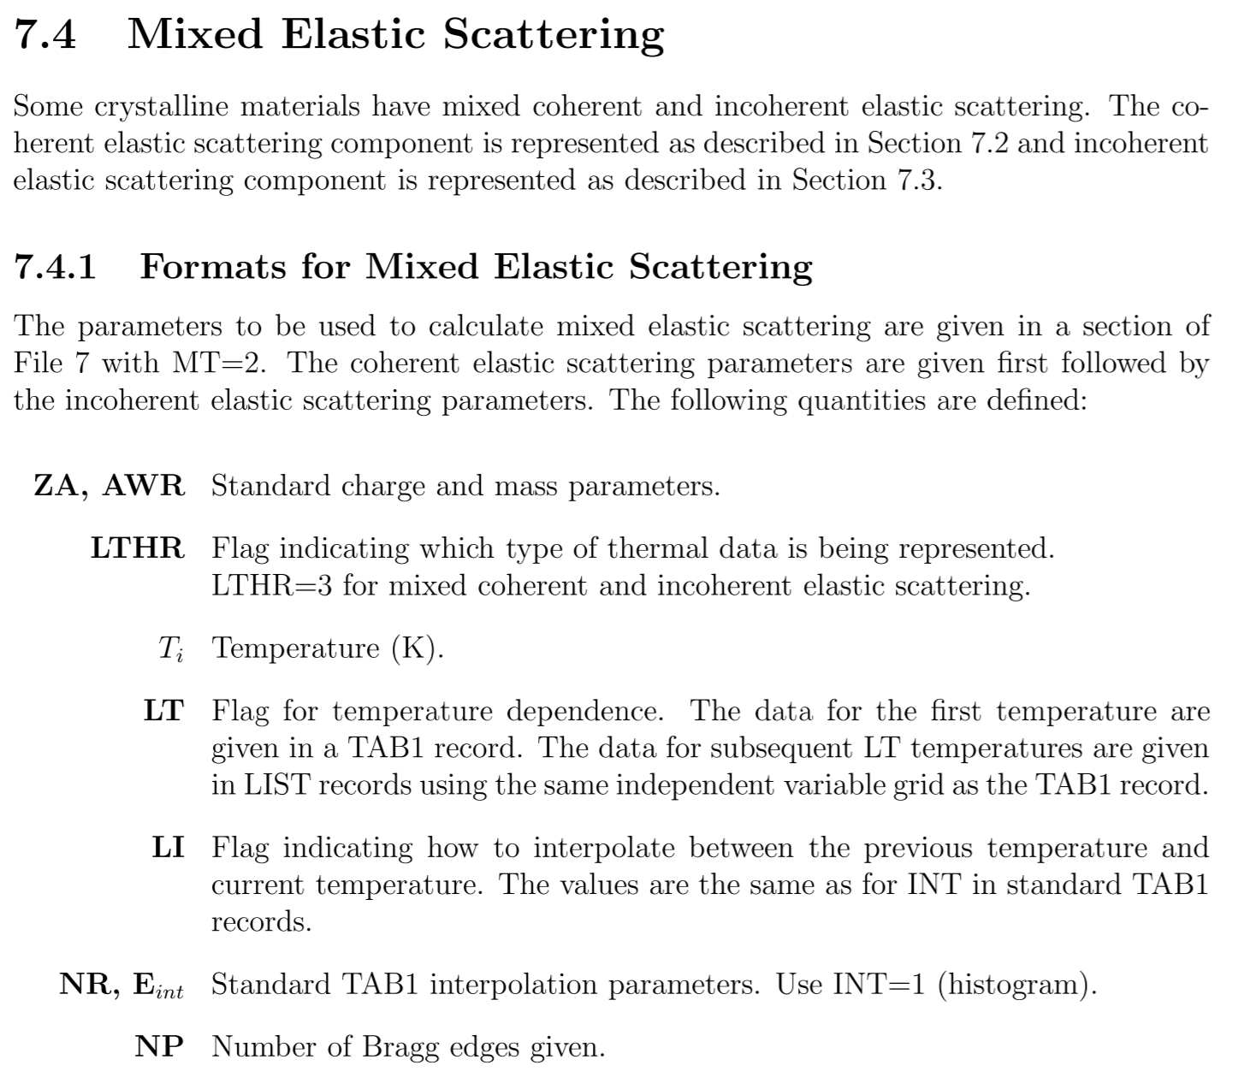
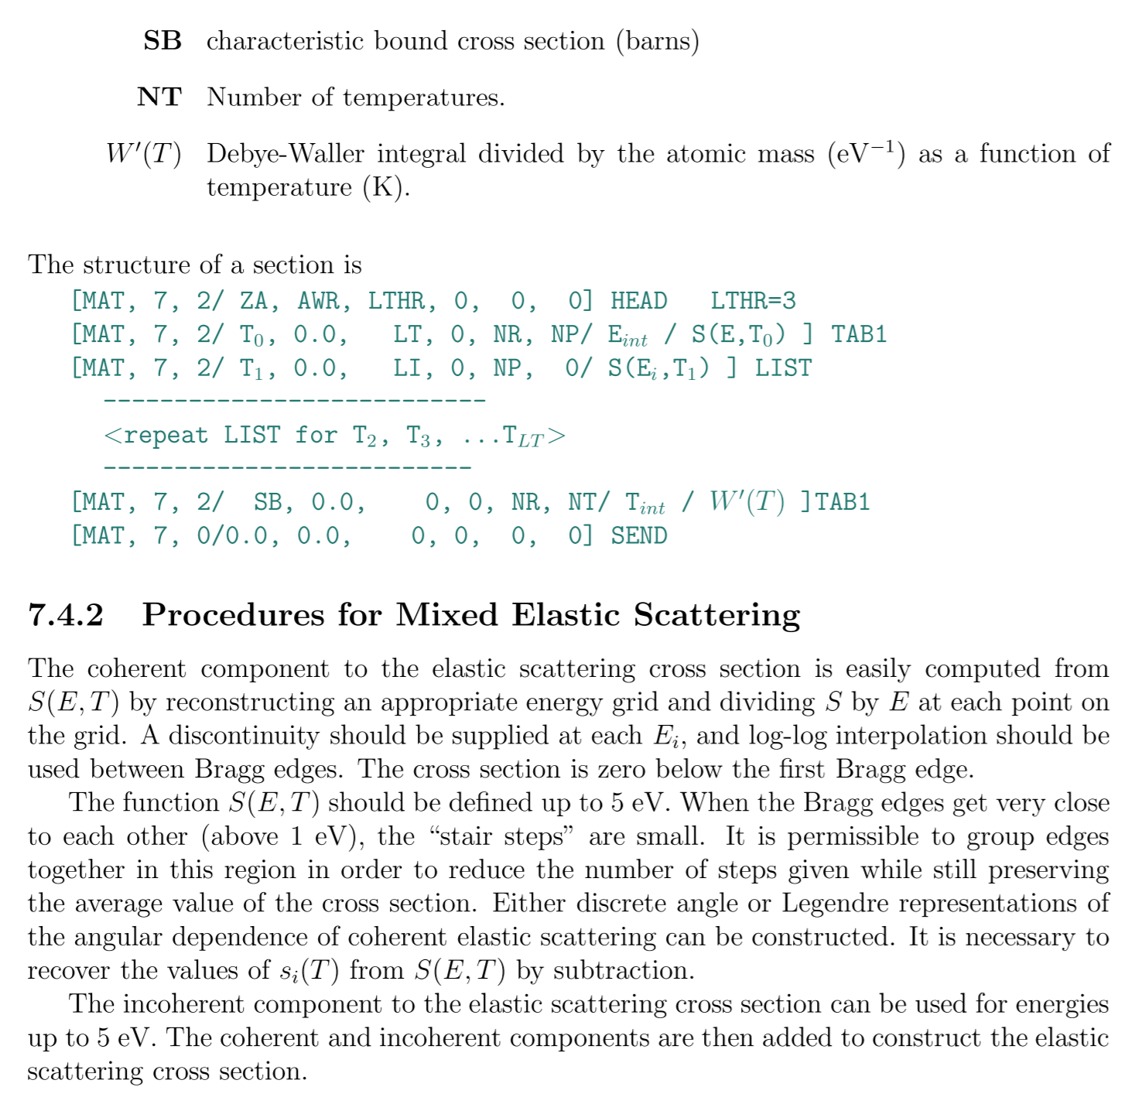
ENDF-6 Format Proposal

Slide 6
D(7LiD) Mixed Elastic Scattering Example
LTHR=3
1.150000+2 1.996800+0 3 0 0 0 15 7 2
2.936000+2 0.000000+0 5 0 1 3374 15 7 2
3374 1 15 7 2
1.235573-3 2.67690-34 2.471146-3 5.24780-34 3.706719-3 3.757353-3 15 7 2
4.942291-3 1.386287-2 6.177864-3 1.386287-2 7.413437-3 1.386287-2 15 7 2
9.884583-3 2.595574-2 1.112016-2 2.595574-2 1.235573-2 2.595574-2 15 7 2
1.359130-2 2.992438-2 1.482687-2 3.549502-2 1.606245-2 3.549502-2 15 7 2
⁞
4.399400-2 4.399400-2 4.399400-2 4.399400-2 4.399400-2 4.399400-2 15 7 2
4.399400-2 4.399400-2 15 7 2
2.054202+0 0.000000+0 0 0 1 6 15 7 2
6 2 15 7 2
2.936000+2 8.937898+0 4.000000+2 1.047985+1 5.000000+2 1.213545+1 15 7 2
6.000000+2 1.390890+1 7.000000+2 1.575652+1 8.000000+2 1.765328+1 15 7 2
0.000000+0 0.000000+0 0 0 0 0 15 7 0
1.150000+2 1.996800+0 0 1 0 0 15 7 4
0.000000+0 0.000000+0 0 0 6 0 15 7 4
3.395004+0 1.976285+2 1.996800+0 5.000000+0 0.000000+0 1.000000+0 15 7 4
0.000000+0 0.000000+0 0 0 1 300 15 7 4
300 4 15 7 4
2.936000+2 0.000000+0 5 0 1 200 15 7 4
200 4 15 7 4
2.059042-2 4.931327-4 2.163677-2 5.181545-4 2.273629-2 5.444438-4 15 7 4
2.389168-2 5.720646-4 2.510579-2 6.010840-4 2.638160-2 6.315727-4 15 7 4
⁞
Coherent Elastic
Bound incoherent scattering cross section
Incoherent Elastic
Inelastic

