Slide 1
WANDA 2021
Connecting the humans behind the nuclear data

Slide 2
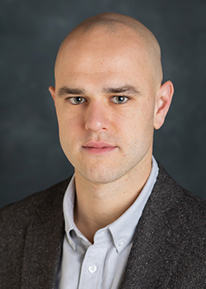
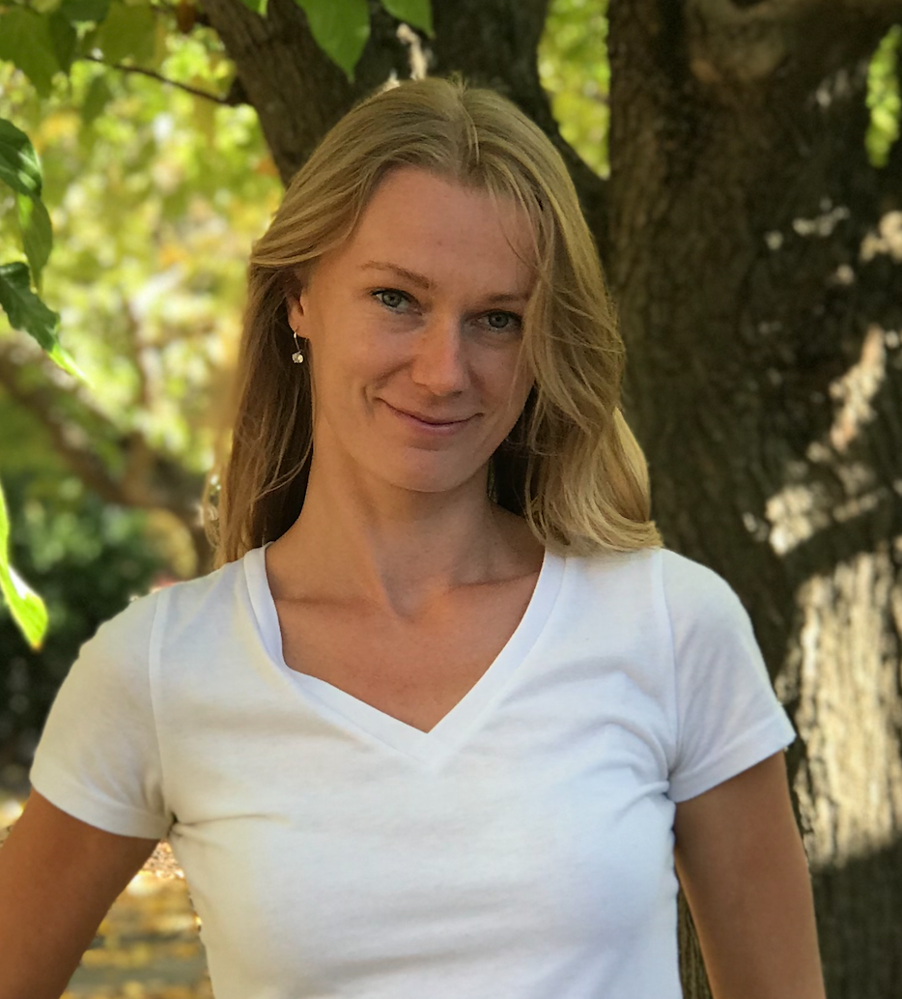
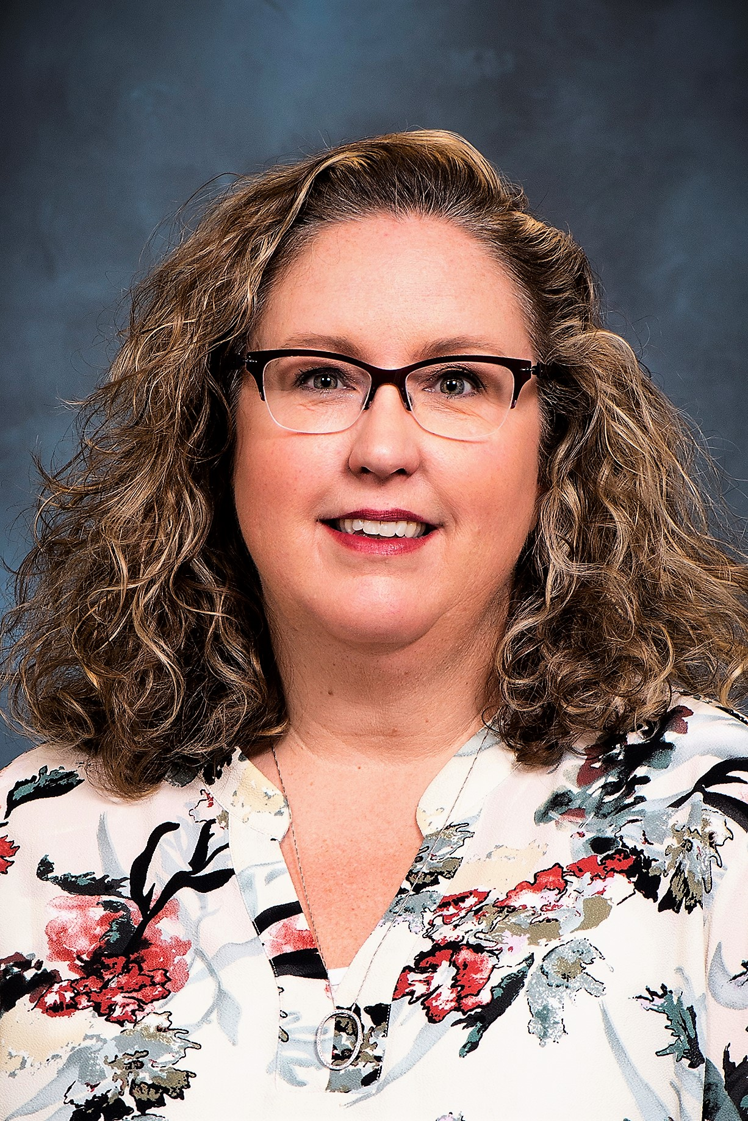
WANDA team
Vladimir Sobes Assistant Professor
Department of Nuclear Engineering
University of Tennessee, Knoxville sobesv@utk.edu
Karolina (Kay) Kolos
Staff Scientist
NPP Group/NACS Division
Lawrence Livermore National Laboratory kolos1@llnl.gov
Julie Marchand NPRD Program Administrator
Lawrence Livermore National Laboratory marchand4@llnl.gov

Slide 3
WANDA 2021
Experiment
Application
Nuclear Data
Compilation
Evaluation
Processing
Validation

Slide 4
Logistic considerations
January 25 – February 3, 2021
Monday – Wednesday – Friday, Monday – Wednesday
(1-2)x(15-30) minute breaks for side meetings TBD by sessions chairs
Online platform Webex
Presentation slides will be posted online: require presentation to be unclassified, unlimited distribution.
Participant video recording will be turned off
Program Managers can host breakout rooms for discussions after the sessions
Proposal to publish session summaries in a peer-reviewed journal article
Editor R. Vogt (LLNL), other volunteers?
From PRR editors: We anticipate that articles will consist of a review section to set the stage followed by a summary of current activities in the field, with the main part of the manuscript elaborating on the open question and suggesting routes to tackle it.

Slide 5
WANDA 2021 Connecting the humans behind the nuclear data
Day | Time EST | Time PDT | Session
Monday January 25 | 11:00 am 2:15 pm | 8:00 am 11:15 am | Opening Plenary
 | 2:45 pm 6:00 pm | 11:45 am 3:00 pm | Nuclear Data 101 Lecture WANDA 2020 Session Reports?
Wednesday January 27 | 11:00 am 2:15 pm | 8:00 am 11:15 am | Predictive codes for isotope production Chairs: O’Brien (LANL), Voyles (LBNL), Hogle (ORNL)
 | 2:45 pm 6:00 pm | 11:45 am 3:00 pm | Expanded Benchmarks & Validation for Nuclear Data Chairs: Hutchinson (LANL), Percher (LLNL), Zerkle (NNL)
Friday January 29 | 11:00 am 2:15 pm | 8:00 am 11:15 am | Vision for HPC for Nuclear Data Chairs: Schunck (LLNL), Mumpower (LANL), Smith (ORNL), Goldblum (LBNL), Brown (BNL), Loer (PNNL)
 | 2:45 pm 6:00 pm | 11:45 am 3:00 pm | Intro to Nuclear Data for Space Application Chairs: Heilbronn (UTK), Burkey (LLNL), Peplowski (JHUAPL)
Monday February 1 | 11:00 am 2:15 pm | 8:00 am 11:15 am | Nuclear data for advanced reactors and security applications Chairs: Wieselquist (ORNL), Elsawi (PNNL), Thompson (LANL)
 | 2:45 pm 6:00 pm | 11:45 am 3:00 pm | The Human Pipeline for Nuclear Data Chairs: Bernstein (UCB/LBNL), Danon (RPI), McCutchan (BNL), Ressler (LLNL)
Wednesday February 3 | 11:00 am 2:15 pm | 8:00 am 11:15 am | Funded Project Reports
 | 2:45 pm 6:00 pm | 11:45 am 3:00 pm | WANDA 2021 Session Reports

Slide 6
Predictive codes for isotope production Chairs: O’Brien (LANL), Voyles (LBNL), Hogle (ORNL)

Slide 7
WANDA Session: Predictive Codes for Isotope Production
Chairs: Susan Hogle (ORNL), Ellen O'Brien (LANL), Andrew Voyles (LBNL)
[Advisor: Etienne Vermeulen (LANL)]
Session Highlights
Predictive codes for estimating isotope yields rely on data which may be limited, poor, or entirely non-existent.
Accurate modeling of even moderately high-energy reactions is difficult.
The lack of an acceptable predictive capability in modern reaction codes presents a cross-cutting need for the nuclear data community.
Impact to users, data evaluation pipeline, and application spaces (isotope production, neutronics, shielding, and detection).
Emphasis will be on the current state of predictive codes, planned improvements, and data/observables needed by code developers.
Session Goal: Identify a path forward to improve the predictive capabilities of these codes.

Slide 8
Tentative Schedule Wednesday, January 27th 0800 – 1115 (PST)/ 0900 – 1215 (MST)/1100 – 1415 (EST)
Start Time (PST) | End Time (PST) | Duration | Description
0800 | 0805 | 5 | Introduction
0805 | 0820 | 10 + 5 | Ethan Balkin, DOE Isotope Production R&D Program Manager
0820 | 0835 | 10 + 5 | TALYS – Arjan Koning – The Predictive Power of TALYS
0835 | 0845 | 5 + 5 | EMPIRE – Dave Brown
0845 | 0855 | 5 + 5 | ALICE – Marshall Blann – Physics Improvements for ALICE21
855 | 905 | 5+5 | CoH
0905 | 0925 | 20 | Discussion
0925 | 0940 | 15 | Bio Break
0940 | 0955 | 10 + 5 | FLUKA – Alfredo Ferrari / Alberto Fasso
0955 | 1015 | 15 + 5 | MCNP - Michael Rising - charged particle, photonuclear, and neutron transport
1015 | 1030 | 10 + 5 | SCALE - How AMPX processes ENDF data
1030 | 1040 | 5 + 5 | SCALE/MCNP Coupling for depletion
1040 | 1055 | 10 + 5 | LISE++ - Oleg Tarasanov
1055 | 1115 | 20 | Discussion

Slide 9
Expanded Benchmarks & Validation for Nuclear Data Chairs: Hutchinson (LANL), Percher (LLNL), Zerkle (NNL)

Slide 10
Expanded Benchmarks and Validation for Nuclear Data
Overview
Many programs would benefit from the development of well-characterized and documented benchmarks
A broader suite of benchmarks (beyond critical benchmarks) are needed
More complete validation of nuclear data and physics important for other applications
Leverage the framework used by the criticality safety and reactor physics communities
This session will
Explore new and historical experiments that could be turned into benchmarks
Focus on application areas and what data is used, how they currently validate, and integral needs
Investigate simulation capabilities and needs to model measurement responses and sensitivities for these experiments

Slide 11
Expanded Benchmarks and Validation for Nuclear Data Preliminary Topics and Speaker List
Overview of Benchmarks and their Uses for Nuclear Data
Jesson Hutchinson (LANL), Catherine Percher (LLNL), Michael Zerkle (NNL)
Past, Present, and Future Benchmark Efforts for Nuclear Data Validation
Skip Kahler (LANL retired), Ian Hill (OECD/NEA)
Experimental Measurements that Could Become Benchmarks
Sara Pozzi (UM), Jesse Holmes (NNL), Yaron Danon (RPI)
The Nuclear Criticality Safety Validation Model
Jerry McKamy (DOE NCSP, retired)
Application Areas- Nuclear Data, Validation Methods, and Integral Needs
John Mattingly (NCSU), Thomas Miller (ORNL), Brad Reardon (X-Energy), David Matters (NA-22)
Data Evaluation and Sensitivity and Uncertainty Methods Development
Denise Neudecker (LANL), Michael Rising (LANL)

Slide 12
Vision for HPC for Nuclear Data Chairs: Schunck (LLNL), Mumpower (LANL), Smith (ORNL), Goldblum (LBNL), Brown (BNL), Loer (PNNL)

Slide 13
Advanced Computing for Nuclear Data
D. Brown (BNL), B. Goldblum (LBNL), B. Loer (PNNL), M. Mumpower (LANL), N. Schunck (LLNL), M. Smith (ORNL)
Computing plays a critical role throughout the applied nuclear data field, ranging from running high-fidelity physics models that form the backbone of data evaluations and experiment interpretation, to propagating uncertainties through a complex chain of heterogeneous codes, to processing large training datasets through supervised machine learning algorithms. Resources for these activities include hardware from clusters to supercomputers, scalable algorithms, and extensive effort in coding, applied mathematics, and domain-specific applications. Speakers in this session will cover recent computing developments and highlight the challenges of adapting complex, legacy, or mission-critical codes to the latest (and next) generation of rapidly evolving architectures. Our session will also feature machine learning opportunities for emulating computationally-expensive physics models, validating them, and quantifying uncertainties. Finally, we will describe developments needed now to realize the potential of quantum computing for this field to go far beyond the bounds of classical computing.

Slide 14
Advanced Computing for Nuclear Data
Preliminary Agenda (Additional Speakers Pending)
Overview: State of the Field and Future Prospects
High-Fidelity Simulations with HPC
Kostas Kravvaris, LLNL
Ionel Stetcu, LANL
Trevor Sprouse, LANL
AI/ML Enabling Capabilities
Mateusz Ploskon, LBNL
Walid Younes, LLNL (retired)
Christian Brazell, TAMU
Quantum Information Science
Kyle Wendt, LLNL

Slide 15
Intro to Nuclear Data for Space Application Chairs: Heilbronn (UTK), Burkey (LLNL), Peplowski (JHUAPL)

Slide 16
Intro to Nuclear Data for Space Application
• Friday, January 29th 12:00/15:00 – 15:00/18:00 PST/EST
• Co-chairs: Lawrence Heilbronn (UTK), Patrick Peplowski (JHUAPL), Mary Burkey (LLNL)
• Summary:
The space radiation environment is a complex mix of photons, electrons, protons, and heavy ions with energies ranging from several eV to several TeV per nucleon. Characterization of the primary environment’s interactions is important in a number of areas critical for research and exploration in space due to the secondary radiation field they create. For example, creating effective shielding for crew and electronics requires fundamental cross section data on high-energy heavy-ion interactions that produce a complex secondary radiation field. Similarly, the secondary neutrons and gamma rays that are produced in the surfaces of planets, moons, and asteroids also enable the use of nuclear spectroscopy to characterize the chemical composition of these surfaces. Converting measurements to elemental information requires knowledge of relevant neutron inelastic and capture cross sections and gamma-decay intensities. As space agencies around the world prepare for human exploration beyond low-Earth orbit, there is renewed interest in fission power systems and radioisotope systems. These systems introduce an additional source of radiation that can impact instrument response and crew health. Nuclear data relevant to the performance of man-made radiation environments and their interaction with surrounding materials is necessary to understand their impacts.
• Extra topics: planetary defense and nuclear detonation detection via satellites

Slide 18
Nuclear data for advanced reactors and security applications Chairs: Wieselquist (ORNL), Elsawi (PNNL), Thompson (LANL)

Slide 19
Nuclear Data for Advanced Reactors and Security Applications
Session Chairs:
William Wieselquist (ORNL), Mohamed Elsawi (PNNL), Nicholas Thompson (LANL)
Nuclear data impacts design, efficiency and operations of advanced reactors and security applications. With new advanced reactors and micro-reactors being designed using different fuels, coolants, and moderators than the current fleet, there is a potential need for improved nuclear data, including new differential and integral measurements, as well as new evaluations. Security applications are even more diverse, covering a large range of detectors, systems, and interactions. However, there is also a large overlap between the nuclear data needs of the two areas, especially given the DoD’s interest in microreactors. This session will explore the nuclear data needs of advanced reactors and security applications, with the goal to highlight where refined nuclear data can increase safety, reliability, and economic viability.

Slide 20
Nuclear Data for Advanced Reactors and Security Applications
Current plan for the session
Two sub-sessions, one on Advanced Reactors (50 minutes), one on Security Applications (50 minutes) followed by combined discussion of needs for both topics (rest of the time)
Advanced Reactors
Speakers from DOE-NE, NRC, ORNL, Argonne and private companies
Security Applications
Speakers from LANL, other labs, defense agencies
If you have particular speakers in mind, please reach out to us!

Slide 21
The Human Pipeline for Nuclear Data Chairs: Bernstein (UCB/LBNL), Danon (RPI), McCutchan (BNL), Ressler (LLNL)

Slide 22
The Human Pipeline for Nuclear Data
In this session, we will be discussing human participation in the nuclear data pipeline – what roles exist today, where we will have needs tomorrow, and how to prepare the next generation to meet these needs
Education: Understanding the Human Role in Nuclear Data
How do we ensure the next generation of nuclear scientists understands their contributions to the pipeline? What educational opportunities do we have today and what do we need?
How can we build stronger data producer and user collaborations?
Pipeline: Human intervention vs. automation
What parts of the pipeline need human oversight or active engagement?
What activities could be automated? What advancements are needed?
Where is mentorship needed: How do we ensure the human roles get filled?
We encourage an active discussion at WANDA and beyond, with contributors from all backgrounds!

Slide 23
The Human Pipeline for Nuclear Data: Draft Agenda
We are proposing a series of 15-minute presentations followed by 3 minutes of discussion:
PST/EST - start | Duration (min) | Proposed Speaker
8:00/11:00 | 5 | Welcome and overview
8:05/11:10 | 18 | Artemis Spyrou, Michigan State University
 | 18 | Jasmine Vujic, University of California, Berkeley
 | 18 | Warren Rogers, Wesleyan University
 | 18 | Perry Chodash, LLNL +
 | 18 | Sherry Yennello, Texas A&M
9:35/12:35 | 10 | Education discussion
9:45/12:45 | 15 | BREAK
10:00/13:00 | 18 | Dave Brown, BNL/NNDC
 | 18 | Denise Neudecker, LANL
 | 18 | Ayman Hawari, North Carolina State University
10:54/13:54 | 10 | Automation discussion
11:04/14:04 | 11 | Final discussion and wrap-Up
Speaker order is notional

