Slide 1
LLNL Report
Presented (on-line) to the Nuclear Data Advisory Group on December 3, 2020
Bret Beck
Dave Heinrichs
Soon Kim
Ed Lent
Caleb Mattoon
Catherine Percher
Lucas Snyder
Ching-Yen Wu
Alan Yamanaka

Slide 2
Outline
TPC
PPAC
TSL issues
Photon production from thermal neutron radiative capture in Cadmium
LLNL Pulsed Spheres
NCSP AM Benchmark Intercomparison
TEX Update
PDV
ND2022

Slide 3
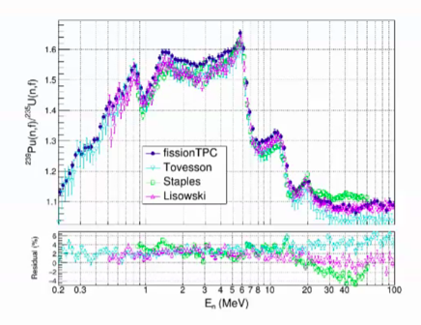
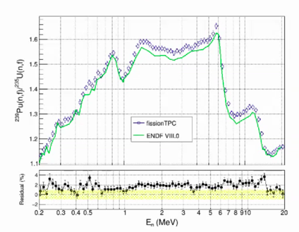
New fission TPC ²³⁹Pu(n,f)/²³⁵U(n,f) data
Shape looks good !! An additional absolute normalization measurement planned for 2021.

Slide 4
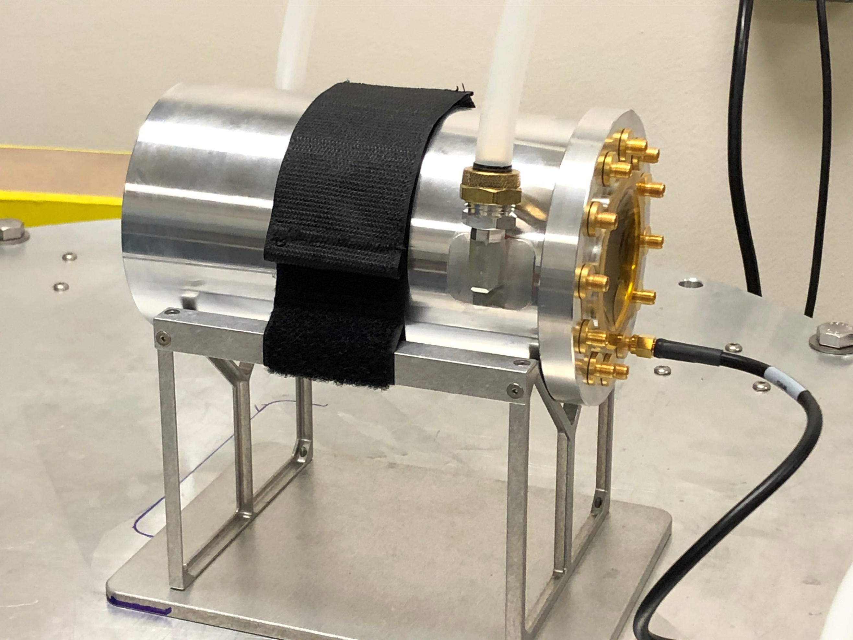
²⁴⁰Pu Fission Parallel Plate Avalanche Counter
Current status:
Roger Henderson has demonstrated successfully that the fragile Al foil can stand multiple cycles of attach and detach from the electroplating cell without damaging the foil integrity. This cell is shown in Fig. 1. We expect to begin the electroplating of ²⁴⁰Pu on the thin aluminum foil of 2.5 μm in Jan/Feb 2021 and be completed by June 2021.
All procured parts, including the chamber, target frames, thin metal foils, and cables, have arrived. Mounting the metal foils to the target frames has been completed and they are now ready for electroplating. Cable creation is in progress. The PPAC fission chamber has been successfully tested for vacuum integrity, shown in Fig. 2.
Fig. 1 The exploded view of the electroplating cell. The target frame can be seen in green with a seal O-ring shown in red.
Fig. 2 The PPAC fission chamber on the bench for a vacuum test. Isobutane connection to the chamber is through the Poly-Flow tubing attached to the top. PPAC signals are transmitted through the 12 electric vacuum feedthroughs shown in the front cover (right side of the picture).

Slide 5
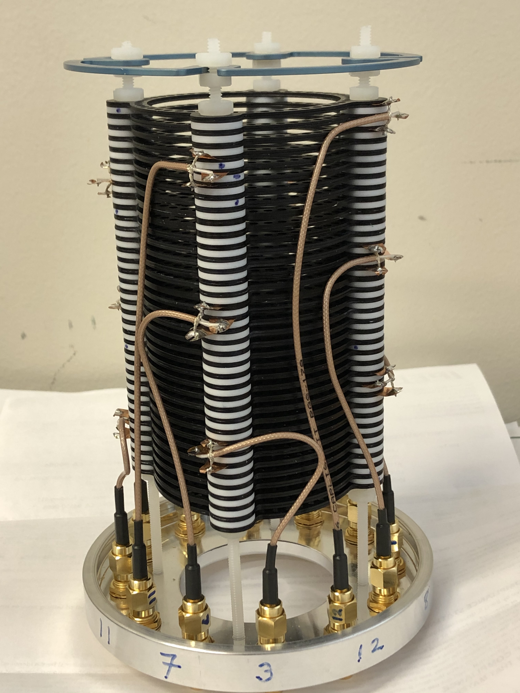
²⁴⁰Pu Fission Parallel Plate Avalanche Counter
Fig. 3 Photo showing the wiring inside the PPAC chamber (fabricated by Sean McLaughlin).

Slide 6
Processing Thermal Neutron Scattering Laws
Discrepancies due to different interpolation and extrapolation assumptions in processing codes

Slide 7
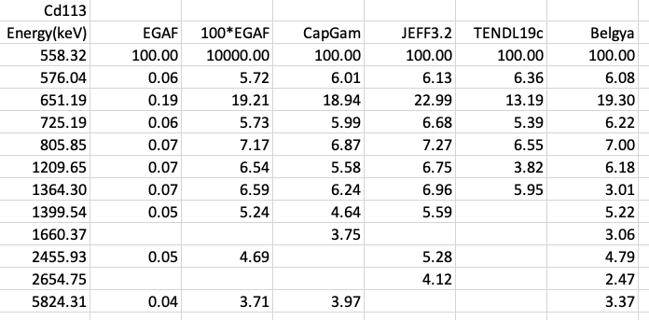
¹¹³Cd(n,g) Major Lines
EGAF normalization error

Slide 8
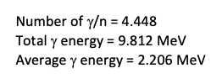
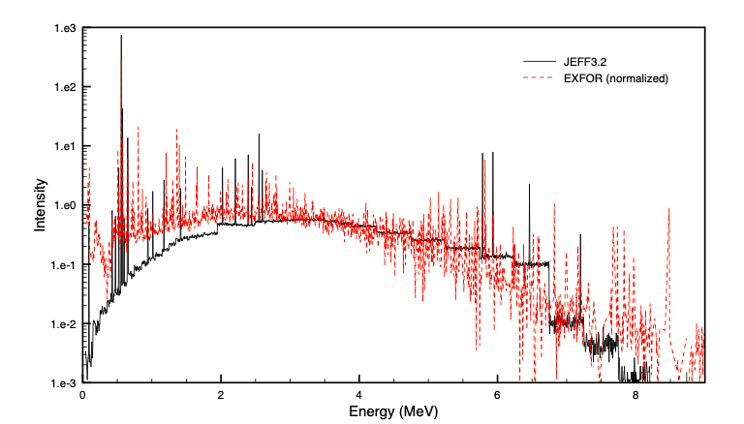
¹¹³Cd(n,g) Spectrum
Belgya data normalized to ¹¹³Cd thermal (n,g) cross section of 19959.758 barns in ENDF/B-VIII.0.

Slide 9
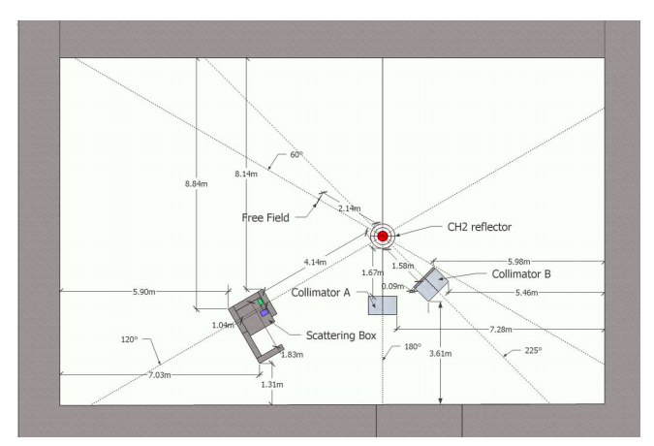
Silene CAAS Benchmark
Cd lined
ALARM-TRAN-CH2-SHIELD-002

Slide 10
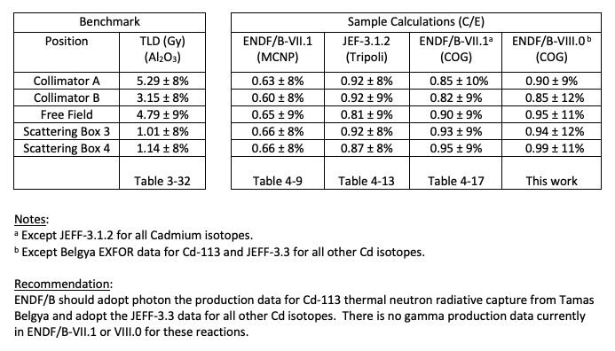
Silene CAAS Benchmark Results

Slide 11
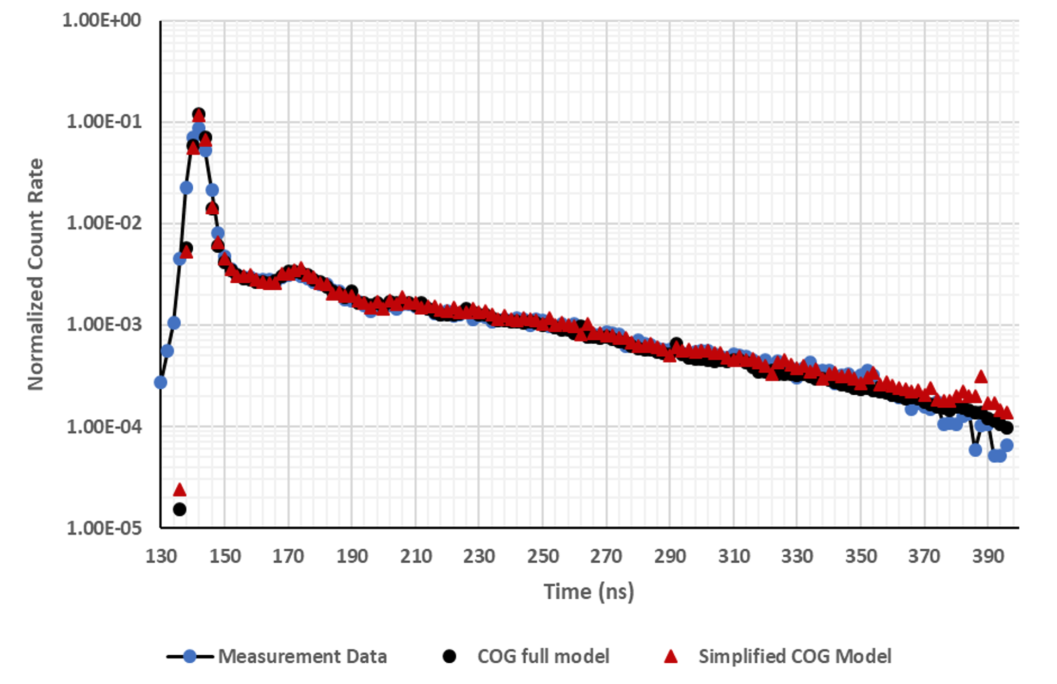

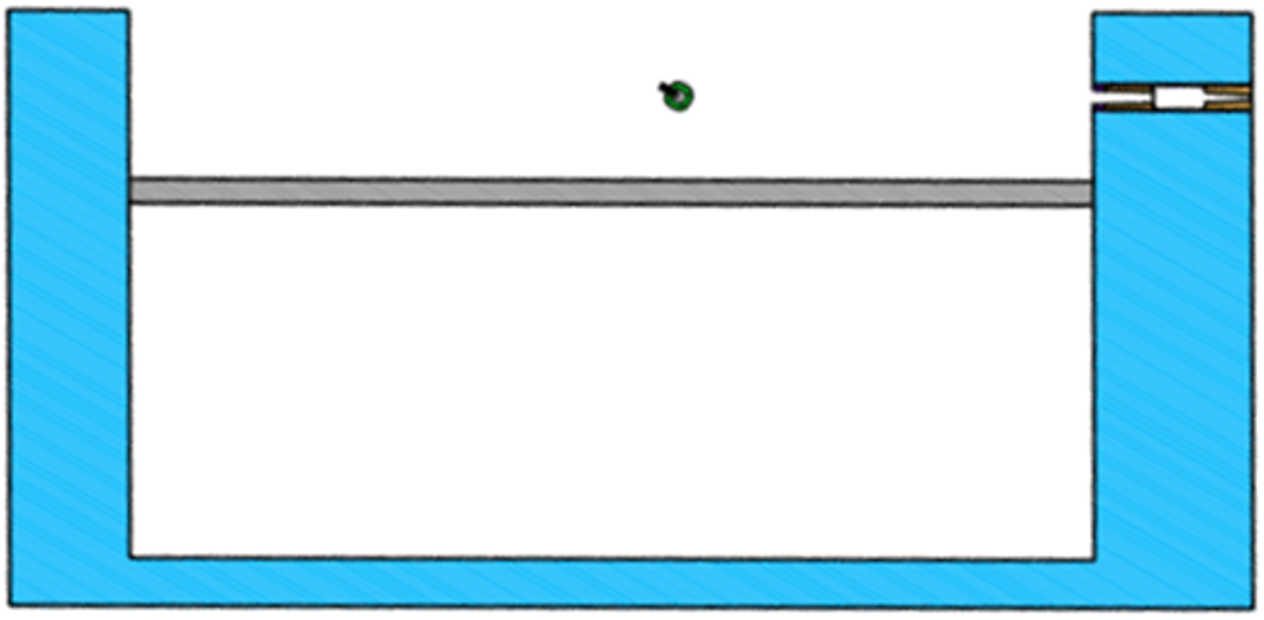
LLNL Pulsed Spheres – CH₂
Simplified Detailed
Model Model

Slide 12
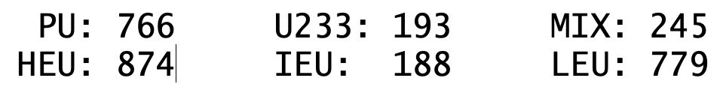
NCSP Benchmark Intercomparison Study
As part of this project, LLNL is increasing our suite of criticality benchmarks to increase the overlap with MORET (IRSN), VALID (ORNL) and WHISPER (LANL) results. To date, 3,045 high-precision COG results are available for the following ICSBEP benchmarks using ENDF/B-VII.1, ENDF/B-VIII.0 and JEFF-3.3 libraries:
These benchmarks have been provided to the LLNL ARDRA and MERCURY groups to assist in expanding their benchmark suites.

Slide 13

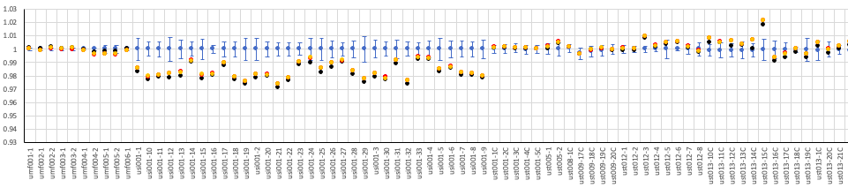
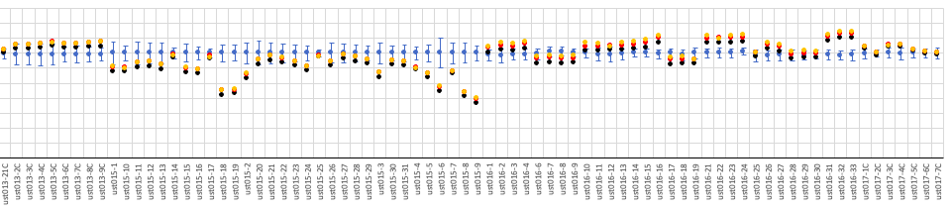
Example: LLNL COG and MCNP Results for U-233

Slide 14
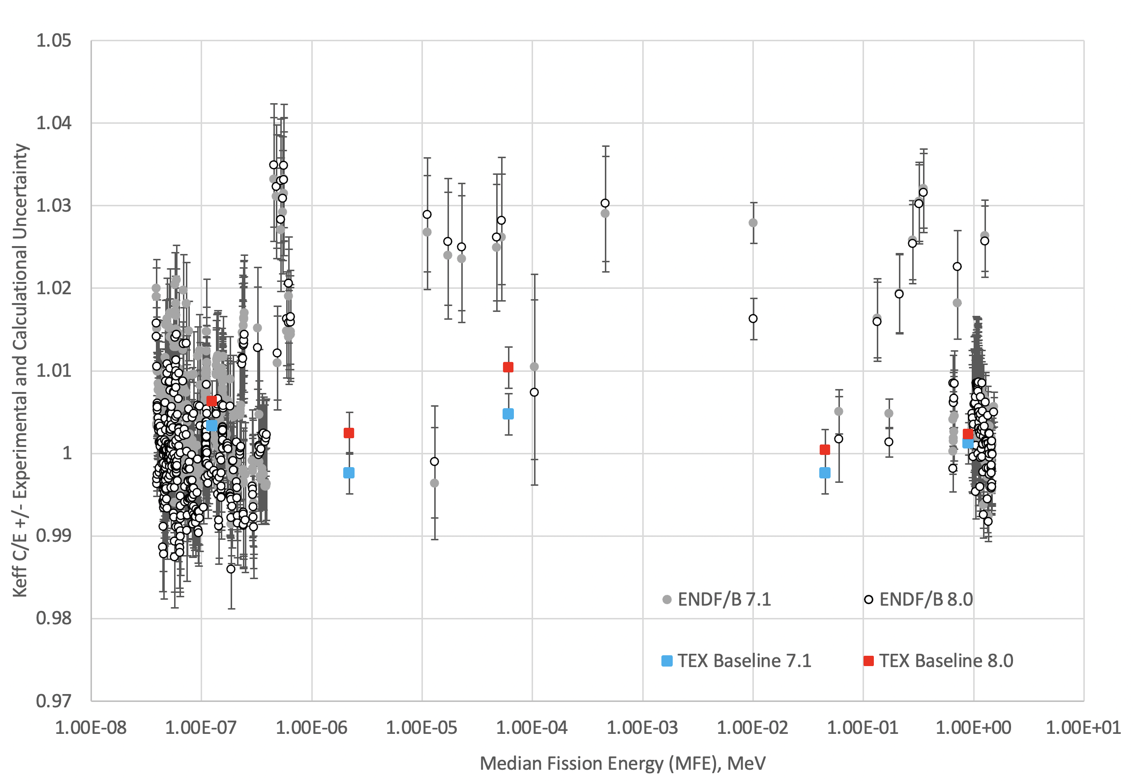
PMM-002 Results- TEX Pu Baselines

Slide 15
PMM-002 Results and Additional Work
TEX-TSL
FY21 Experiments
Additional TEX Baselines
NCSP Proposal

Slide 16
Planned Work for TEX
TEX-Pu
Five variations on the baseline configurations, including tantalum diluent, will be published as PU-MET-MIXED-003 in 2021
Experiments with thicker polyethylene and Lucite moderators to provide more testing for NCSU TSLs planned for execution in 2021
Additional variants under design to investigate ²⁴⁰Pu and address Hanford/SRS tank farm validation needs
TEX-HEU
Baseline experiments with HEU Jemima plates and poly executed in 2020 and will be benchmarked in 2021, for publication in 2022
Low Temperature experiments at -40C (-40F) with HEU final design underway, address transportation and unheated facility validation needs with the UK’s NNL
⁶Li and chlorine diluted experiment design underway, address validation need from Y-12 (electrorefining) and LANL (solutions) and provide a test for ORNL ³⁵Cl evaluation

Slide 17
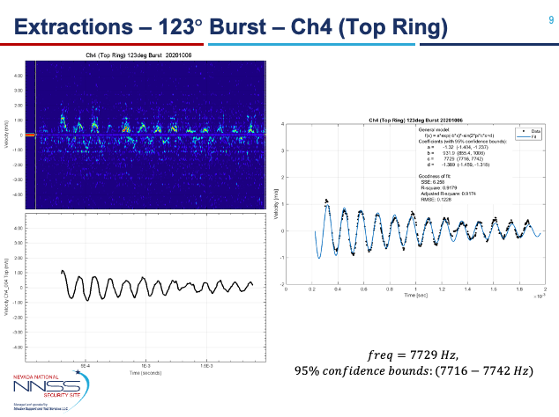
PDV – Second try is a winner !!
Godiva-IV Surface Velocity

Slide 18
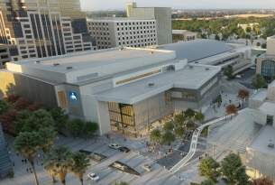
ND2022 International Nuclear Data Conference: July 24 – 29, 2022 in Sacramento, CA
Held at the (renovated) SAFE Credit Union Convention Center
  – Near state capitol & downtown Sacramento
15 min. from Sacramento airport – 2 hours from OAK / SF / Tahoe
Room blocks reserved at Sheraton, Residence Inn & Best Western hotels

