Slide 1
Overview of Cryomodule Issues & Feasibility
Ofelia Capatina, CERN
on behalf of the LHC-CC collaboration

Slide 2

General
SM18 area
Cold tests and clean room facilities – cold test of cryomodules prior tunnel installation
SPS BA4 (vertical or horizontal crabbing)
One or two cryomodules with 2 identical cavities to be tested before LS2
LHC Point 1 (vertical crabbing)
4 cavities / IP side/ beam
to be installed during LS3
LHC Point 5 (horizontal crabbing)
4 cavities / IP side/ beam
to be installed during LS3

Slide 3
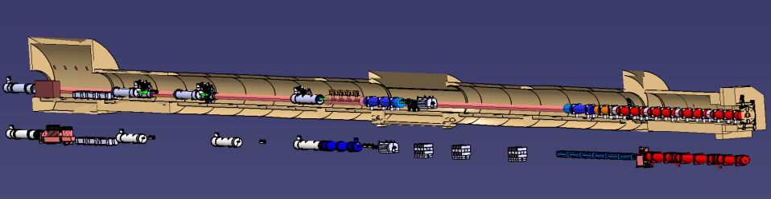
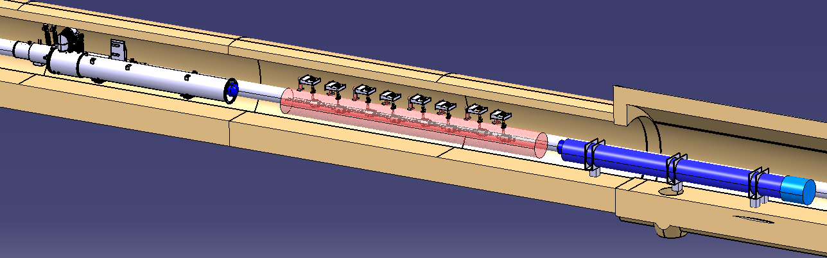
LHC
LHC environment
4 cavities / IP side / beam between D2 and Q4
=>
Total 32 cavities in LHC
Paolo Fessia

Slide 4
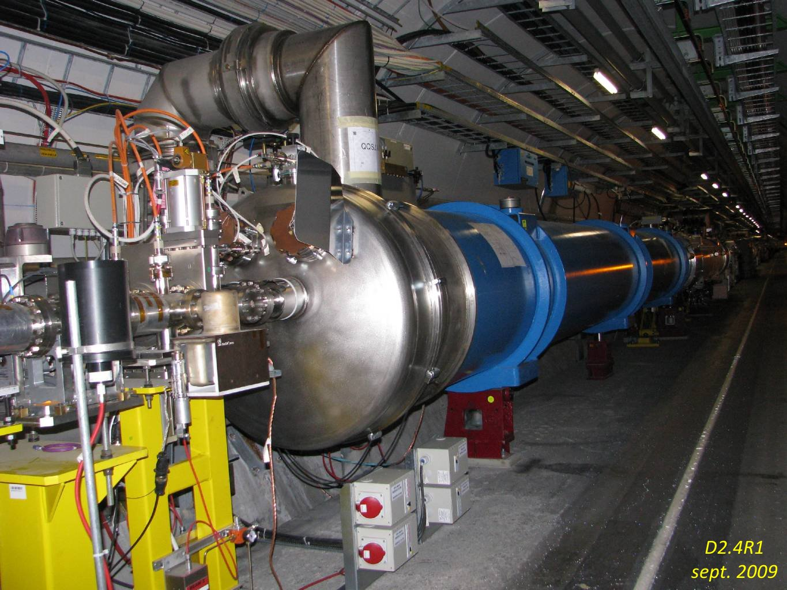
LHC
LHC environment

Slide 5
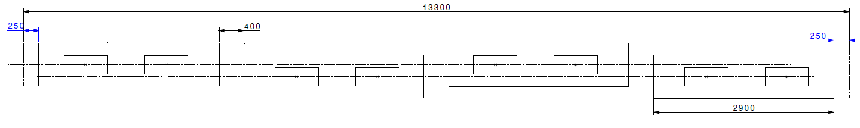
LHC
LHC layout
  4 “SPS like” cryomodules x 2 cavities each / IP side

Slide 6
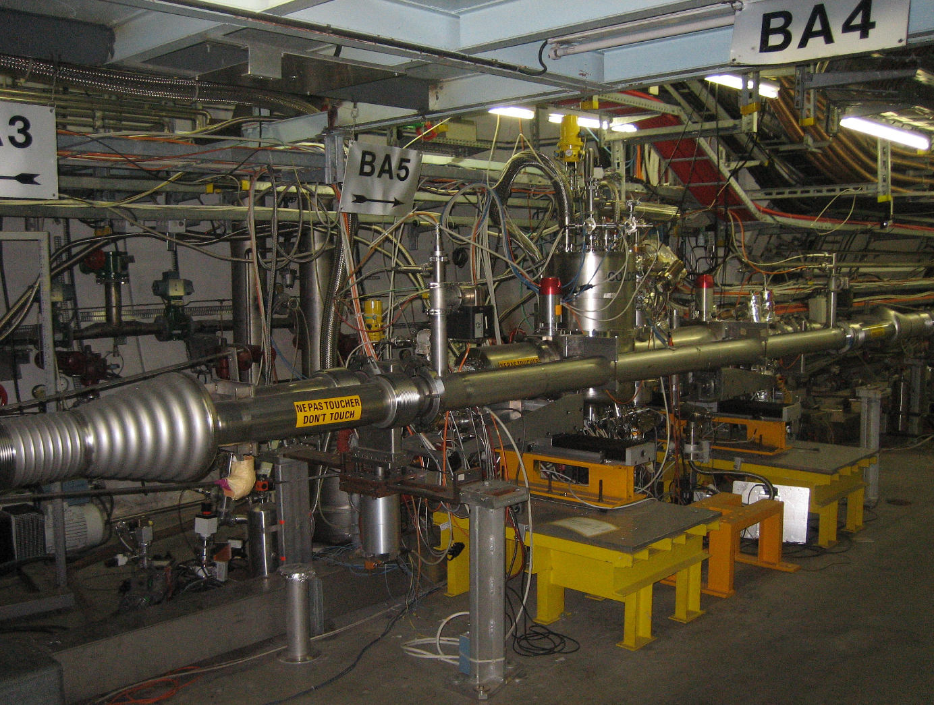
SPS
SPS environment
Alick Macpherson talk tomorrow

Slide 7
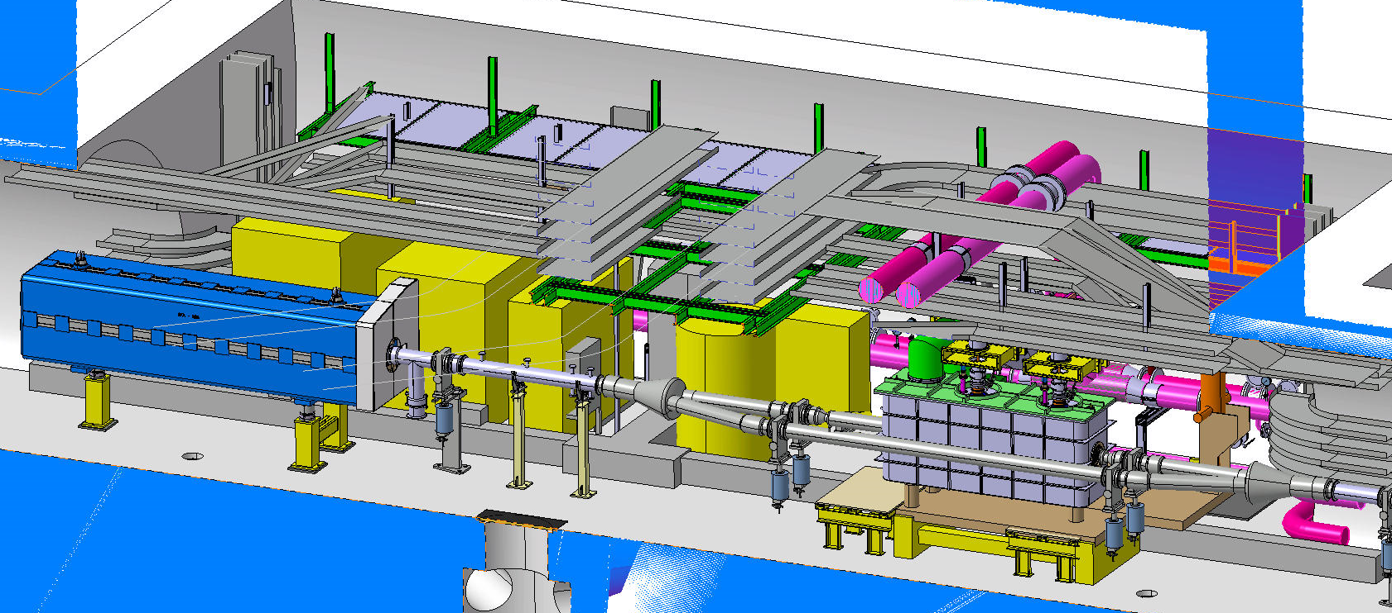
SPS
SPS environment

Slide 8
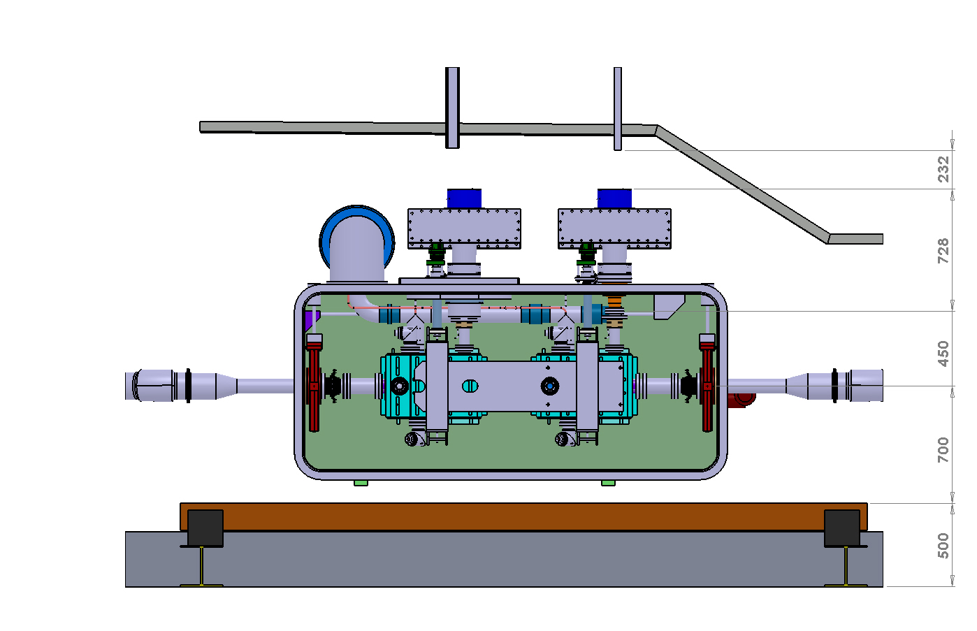
SPS
SPS environment

Slide 9
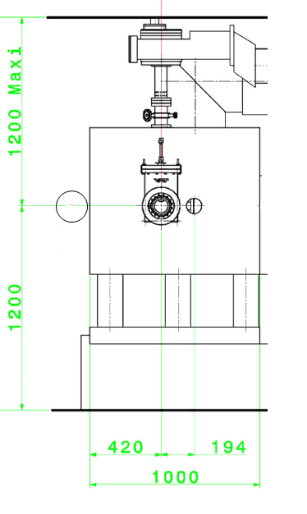
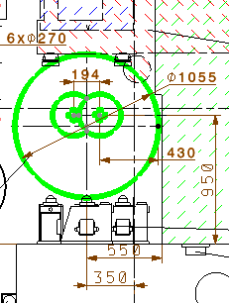
LHC / SPS
LHC configuration
SPS configuration

Slide 10
LHC / SPS
  LHC CM foreseen to be based on SPS solutions:
    Same
      MFA (as far as validated by SPS)
      CM basic mechanical choices
      2K circuit
    Different
      Circuits for heat intercepts
        80K nitrogen for SPS
        TBC 4.5K and 50K helium for LHC
    Additional to be addressed for LHC
      Beam lines meeting LHC needs (beam screens, …)
      Active alignment ?

Slide 11
SPS
SPS
  Timeline / planning - probably the most critical issue
  A maximum of 2 CM can be tested in SPS
  Up to now 4 CM configurations have been developed (4 Minimum Function Assemblies)
    Still work to be done!

Slide 12
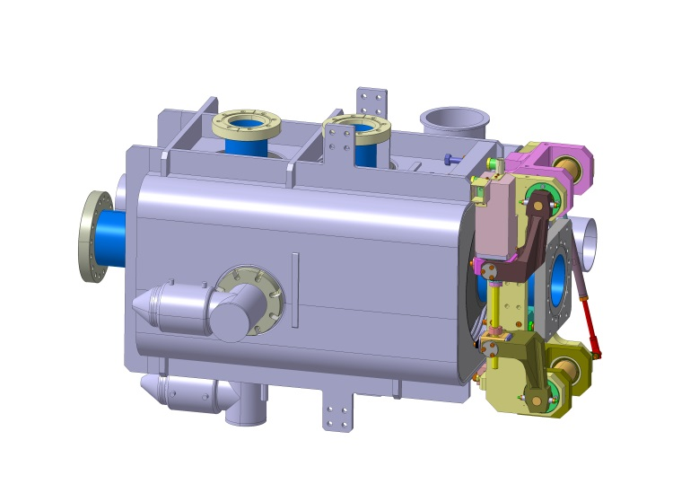
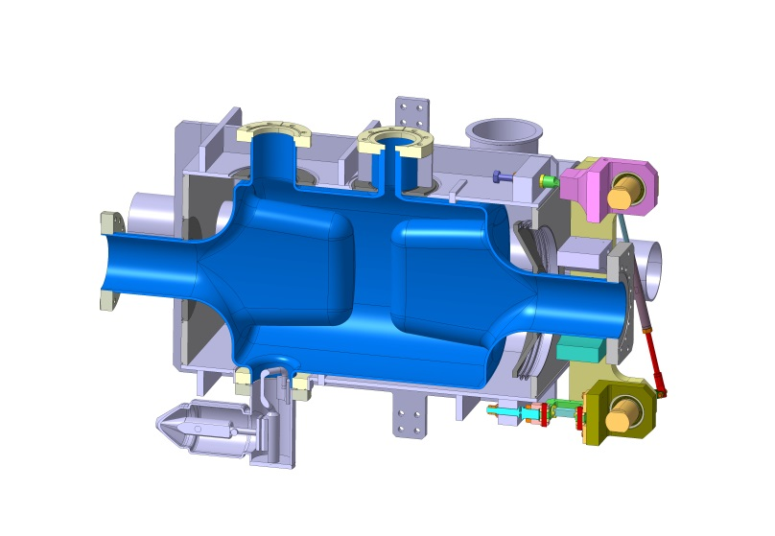
Minimum Function Assemblies
4 Different types have been developed
4-rod (UK)

Slide 13
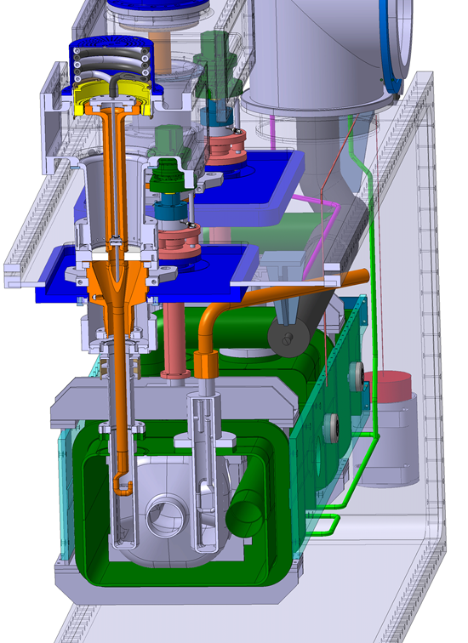
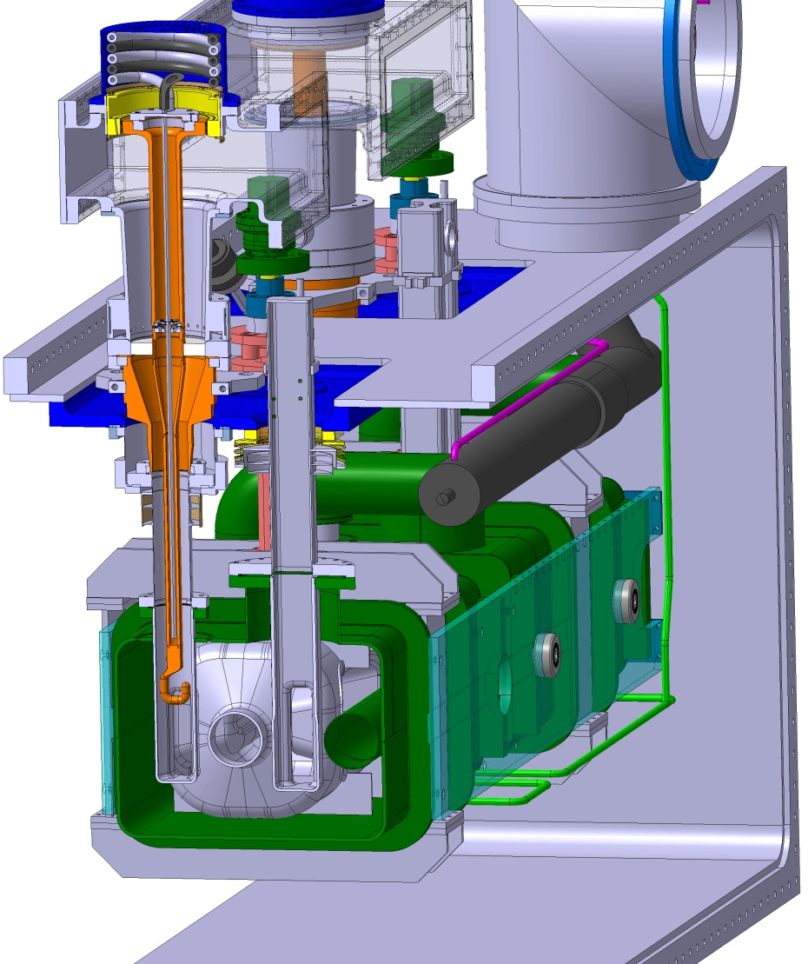
Minimum Function Assemblies
4 Different types have been developed
Coax HOM
Waveguide HOM
RF Dipole (ODU)

Slide 14
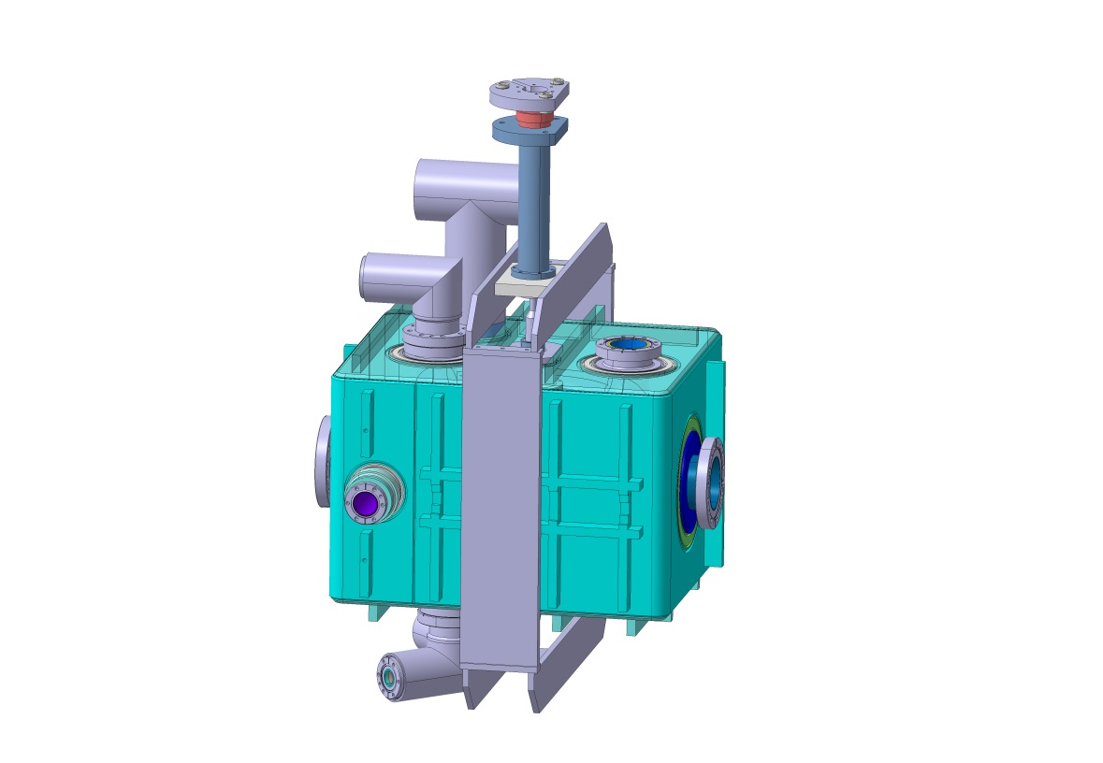
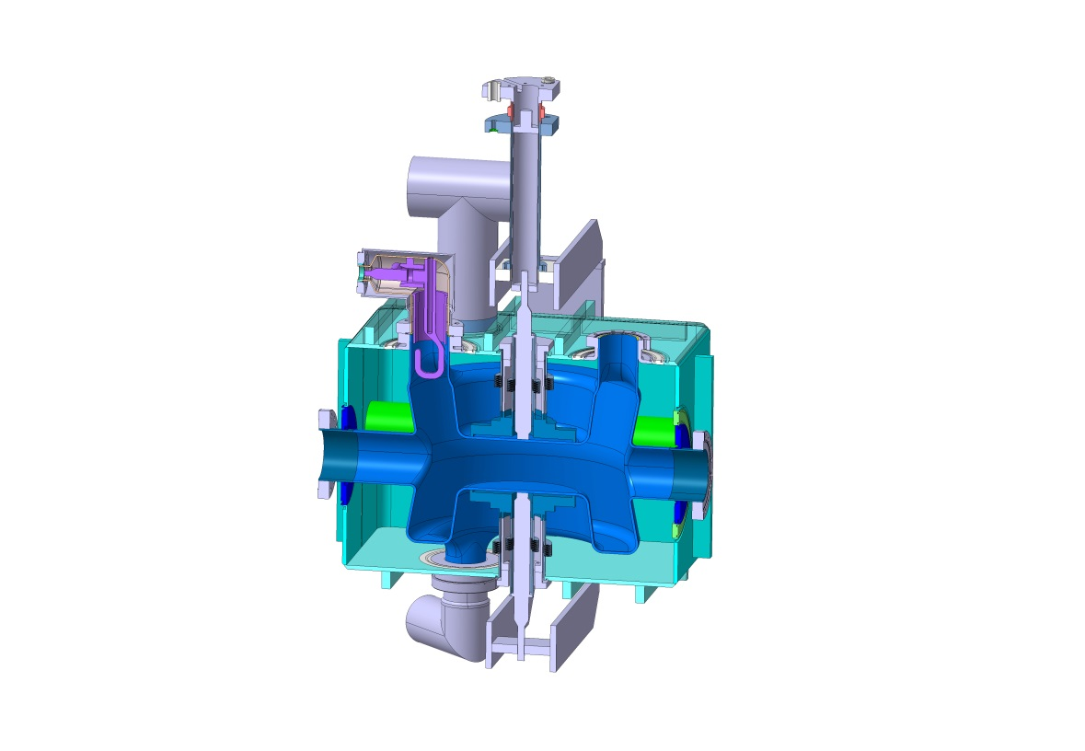
Minimum Function Assemblies
4 Different types have been developed
Double ¼-wave (BNL)

Slide 15
Minimum Function Assemblies
  Remark:
    MFA configuration have a direct impact on cavity performance
    We have seen for the 3 PoP cavities that at some point the performance during the cold tests has been limited not by the cavity performance but by the “ancillaries” (not coated flanges, SS coupler, …)

Slide 16
Minimum Function Assemblies
  Couplers:
    HOMs, LOMs are critical devices, they all need further detailed studies
    Thermal dissipation to be consolidated for each type of coupler, induced ports positions and additional solutions (ex thermal dissipated in gaskets identified for BNL, not addressed by ODU and UK yet)
    Impact of fabrication tolerances on performance?

Slide 17
Minimum Function Assemblies
  Helium vessel:
    Requirements to limit amount of helium:
      From cryo infrastructure to limit amount of helium for SPS tests
      Risk criteria assessment for pressure equipment safety requirements
    Filler materials foreseen inside helium vessels – concept still to be detailed

Slide 18
Minimum Function Assemblies
  Tuners
    Mechanical concepts identified no show-stoppers; new concepts to be validated in dedicated set-up (on PoP cavities)
    Risk mitigation of unexpected warm-up of cavities has to be carried-out (risk of plastic deformation/failure of cavities, etc)

Slide 19
SPS Cryomodule
SPS cryomodule design:
  Common approach
  Integration into the general available space ok
  Shrikant’s talk

Slide 20
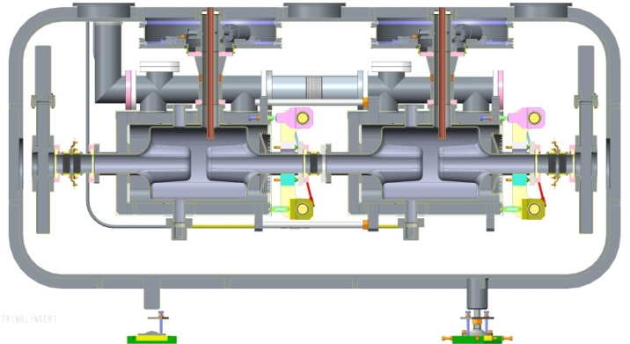
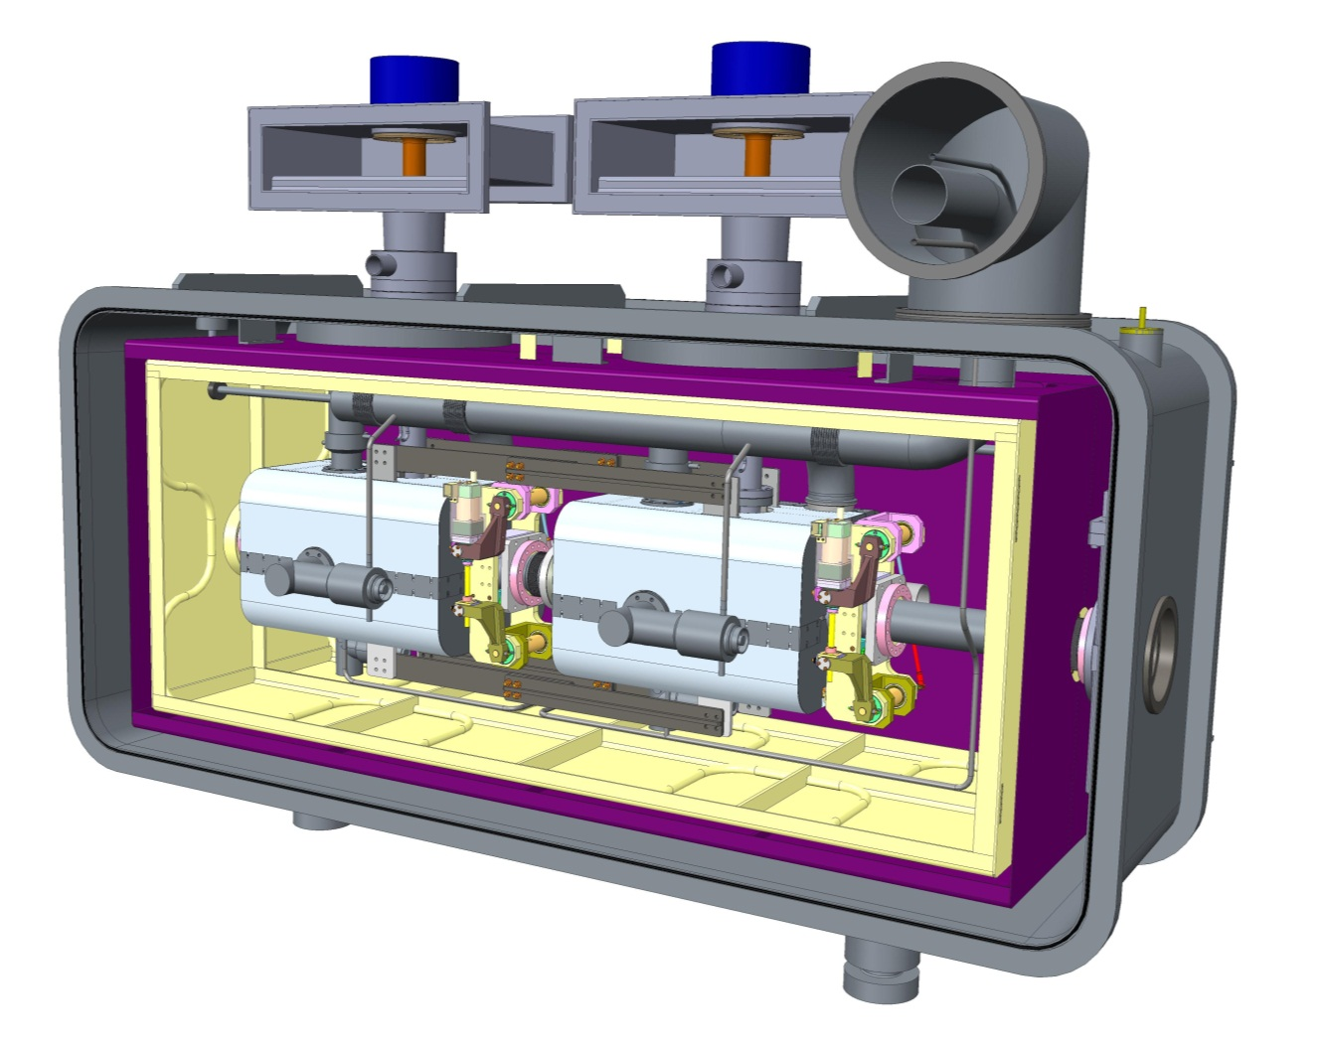
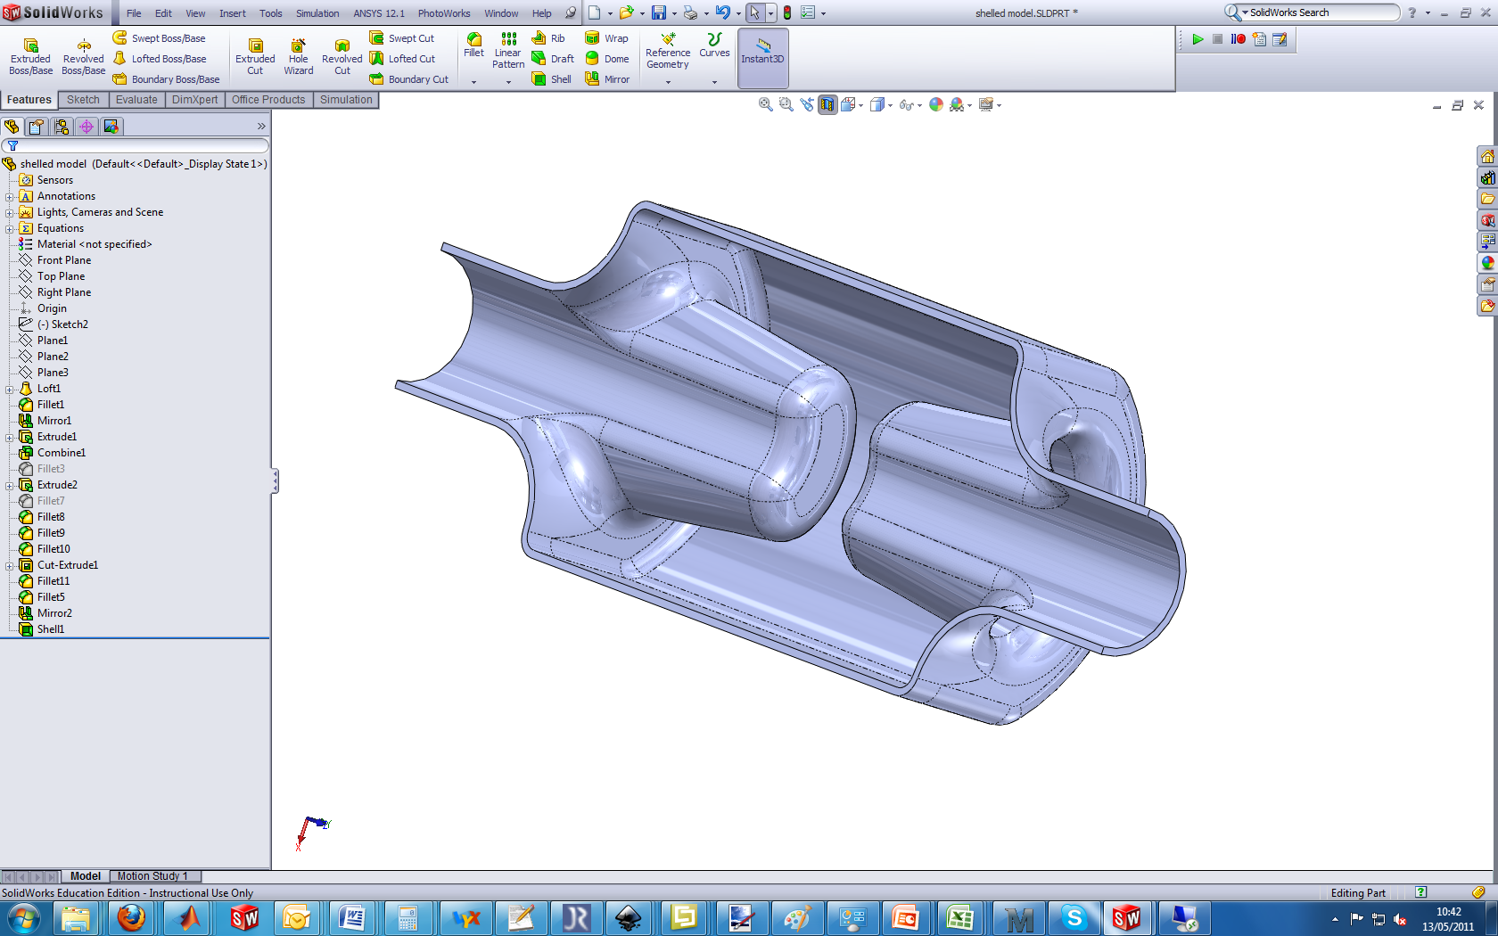
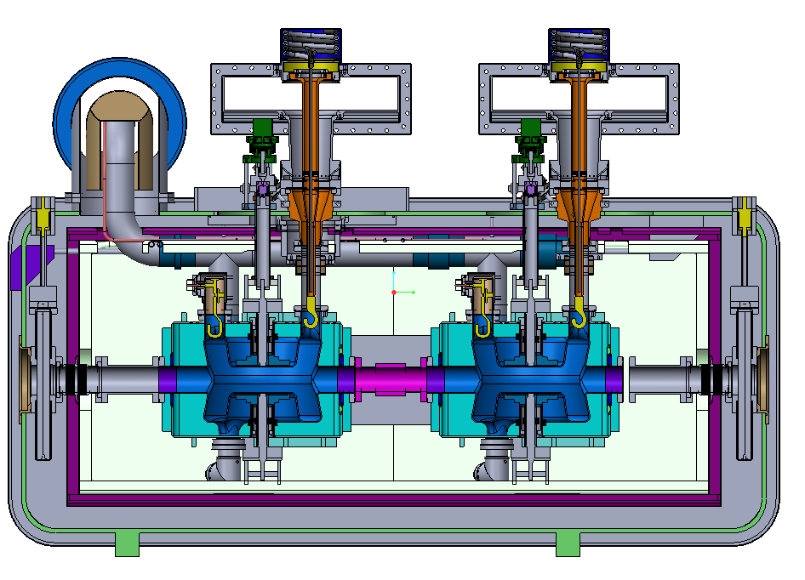
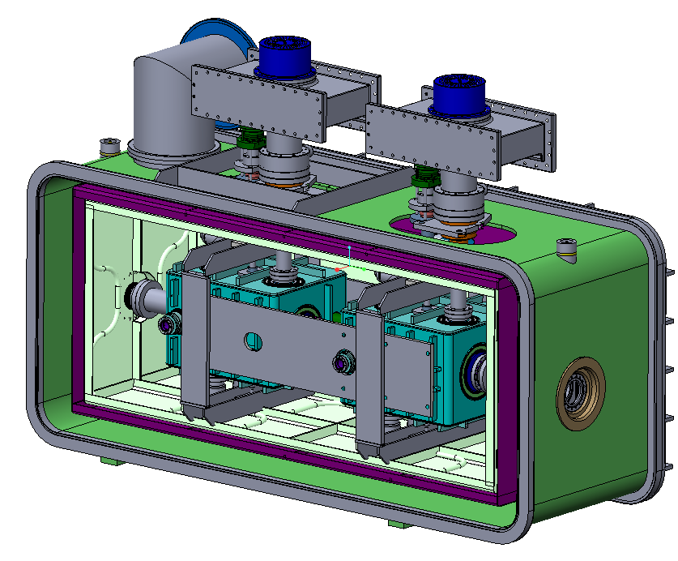
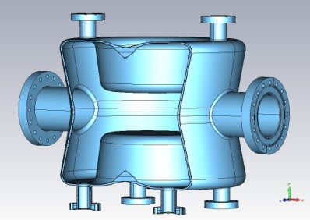
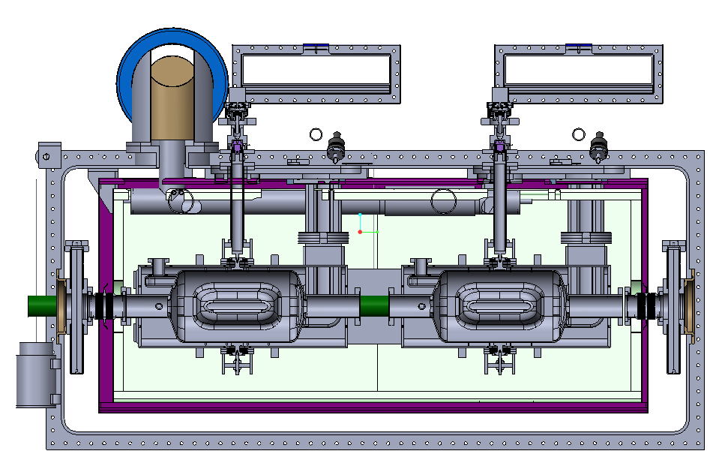
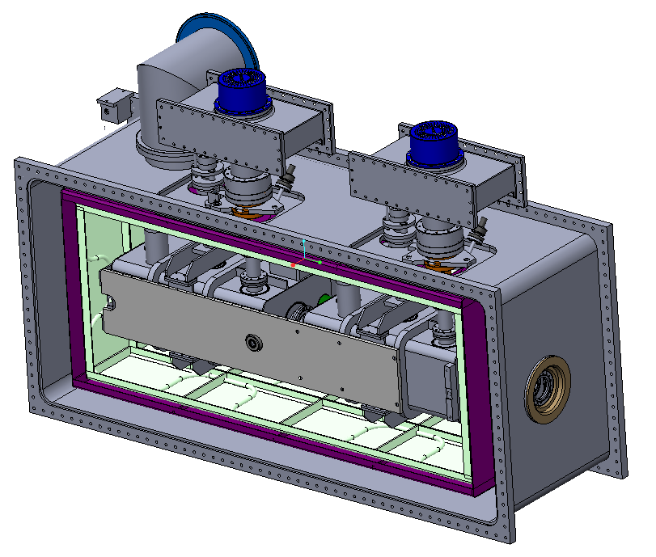
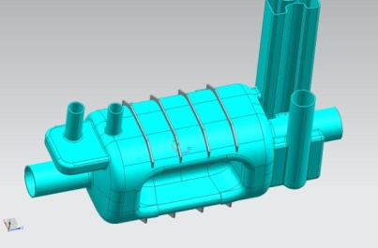
Common Design Approach
4-Rod
Double QW
Dipole

Slide 21
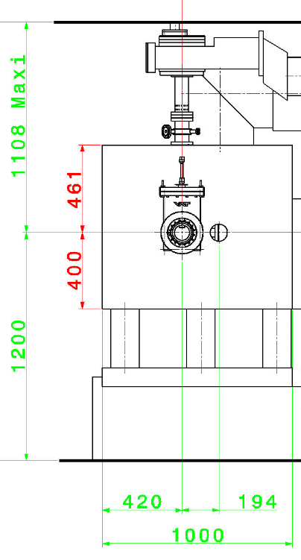
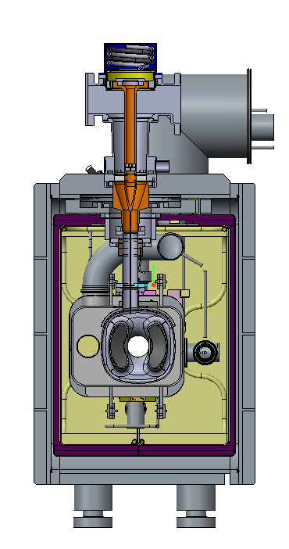
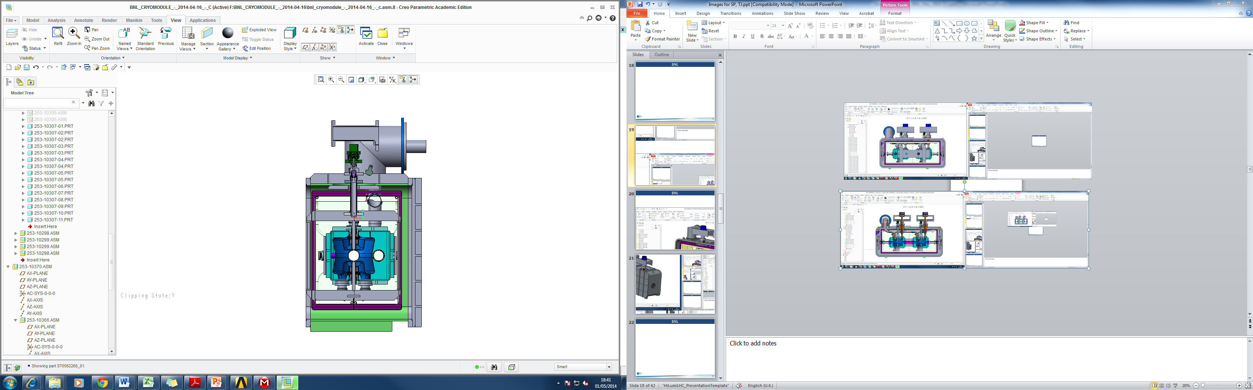
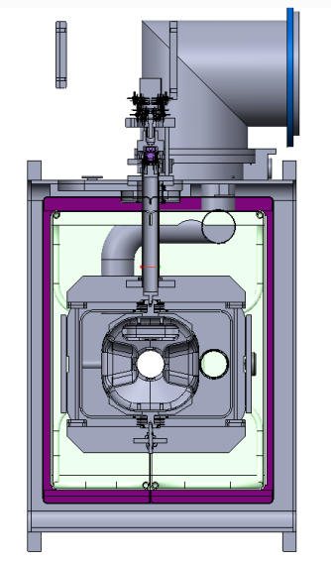
Common Design Approach
Requirements
4-Rod
Dipole
Double QW
1200
Conclusion
First level constraints defined by SPS layout have been successfully overcome

Slide 22
SPS Cryomodule
Developing cryomodules for 3 different cavities, 4 different MFA, aiming at standardization
  Big effort
  Some choices made for collective best configuration, not for individual optimum solution (ex overall dimensions)
    If increased number of types => increase nb of constraints, final solution different from each individual optimum solution

Slide 23
SPS Cryomodule
    Considerations for BNL, UK, ODU dimensions
      FPC position (central in transverse direction BNL & UK, off-centered ODU)
      Length (ODU driven)
      Height (BNL determine the downwards, ODU upwards)
      Transverse (UK the less critical / tuner)

Slide 24
SPS Cryomodule
  Supporting system
    The conceptual studies have not identified any show-stopper for the 3 cavity types
    All cavities need more detailed studies to finalize the solutions
      UK & BNL dimensions and FPC configuration make them easier to support
      ODU cavities will probably be more complex but feasible
        Remark: 2 ODU configurations involve
        2 different supporting solutions

Slide 25
SPS Cryomodule
Still to be considered for the 3 cavity types
  Alignment:
    No active alignment of cavities has been foreseen for SPS cryomodule; could be studied in a dedicated set-up
    Alignment monitoring will be integrated to the SPS cryomodule
      Approach under development at CERN by survey people, for magnets-cavities common requirements in the frame of HL-LHC

Slide 26
SPS Cryomodule
    RF connection from 2K to 300K:
      To be further optimized to reduce heat load to 2K
      Adapt the solutions for each cavity type / coupler geometry, available space

Slide 27
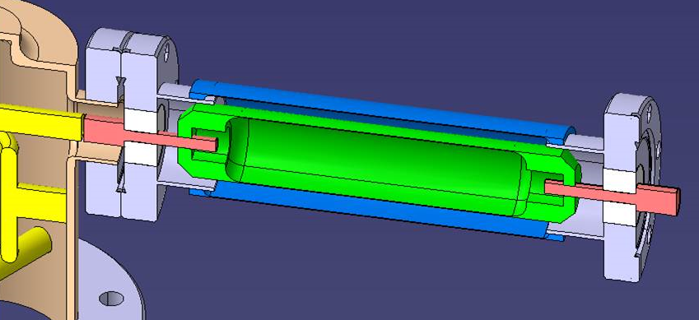
SPS Cryomodule
  Transitions 2K to 300K for HOM
      LHC type rigid coax:
        Little flexibility for orientation
        Need to integrate cooling at 80K to reduce thermal losses

Slide 28
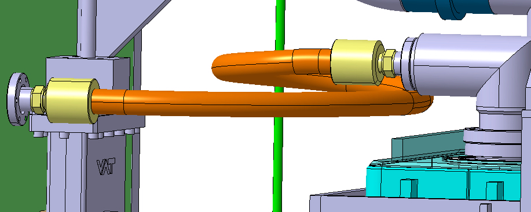
SPS Cryomodule
  Transitions 2K to 300K for HOM
      “Flexible” coax cable:
        Length to be maximize to limit static heat load
        Need to integrate cooling at 80K to reduce thermal losses

Slide 29
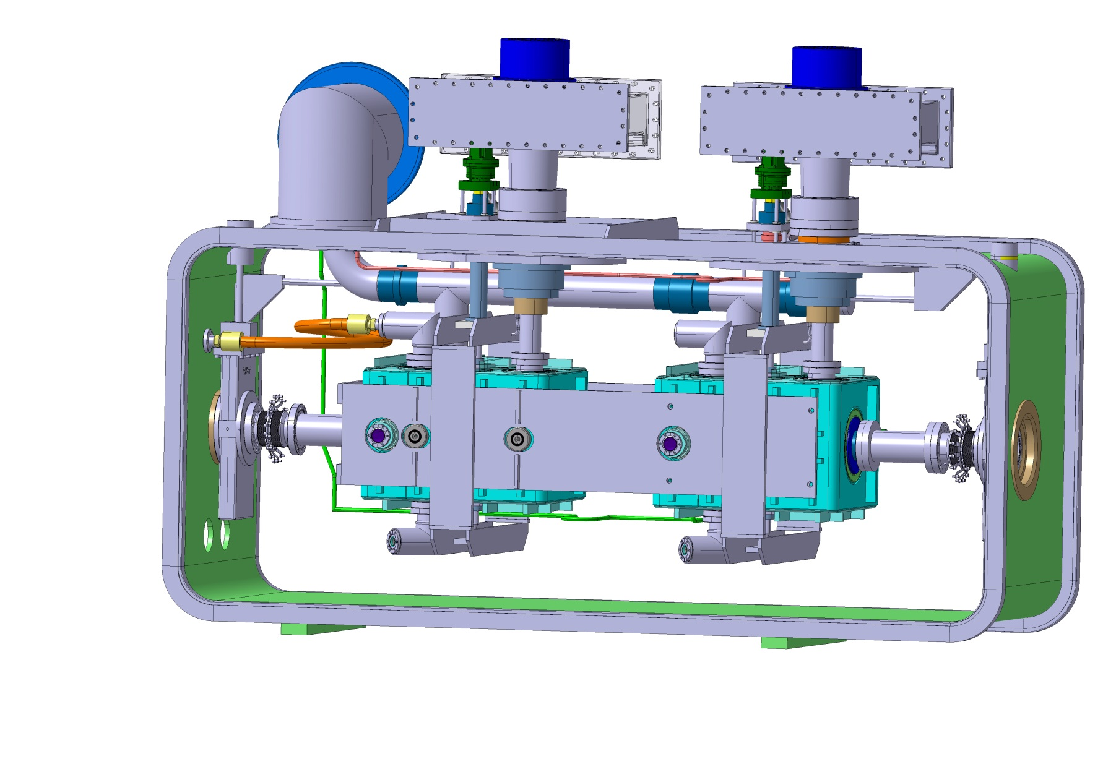
SPS Cryomodule
  Transitions 2K to 300K for HOM
    Adapt the solutions for each cavity type / coupler geometry, available space
BNL

Slide 30
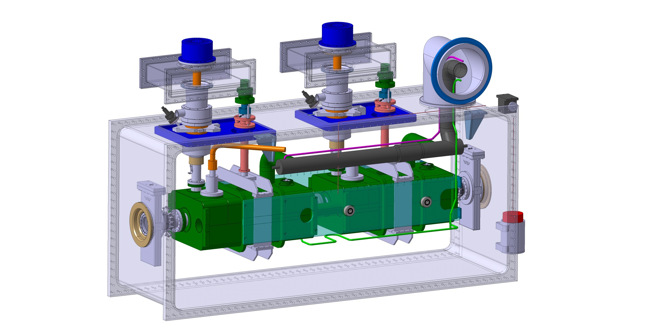
SPS Cryomodule
  Adapt the solutions for each cavity type / coupler geometry, available space
ODU
coax

Slide 31
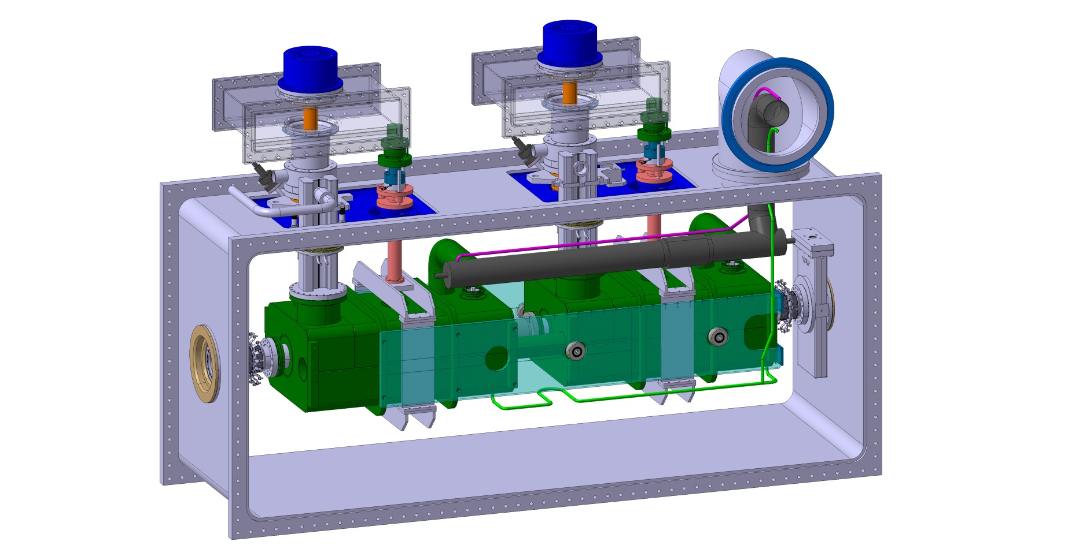
SPS Cryomodule
  Transitions 2K to 300K for HOM
      ODU waveguide:
        Feasibility, impact of geometrical tolerances on performance, …?
ODU
waveguide

Slide 32
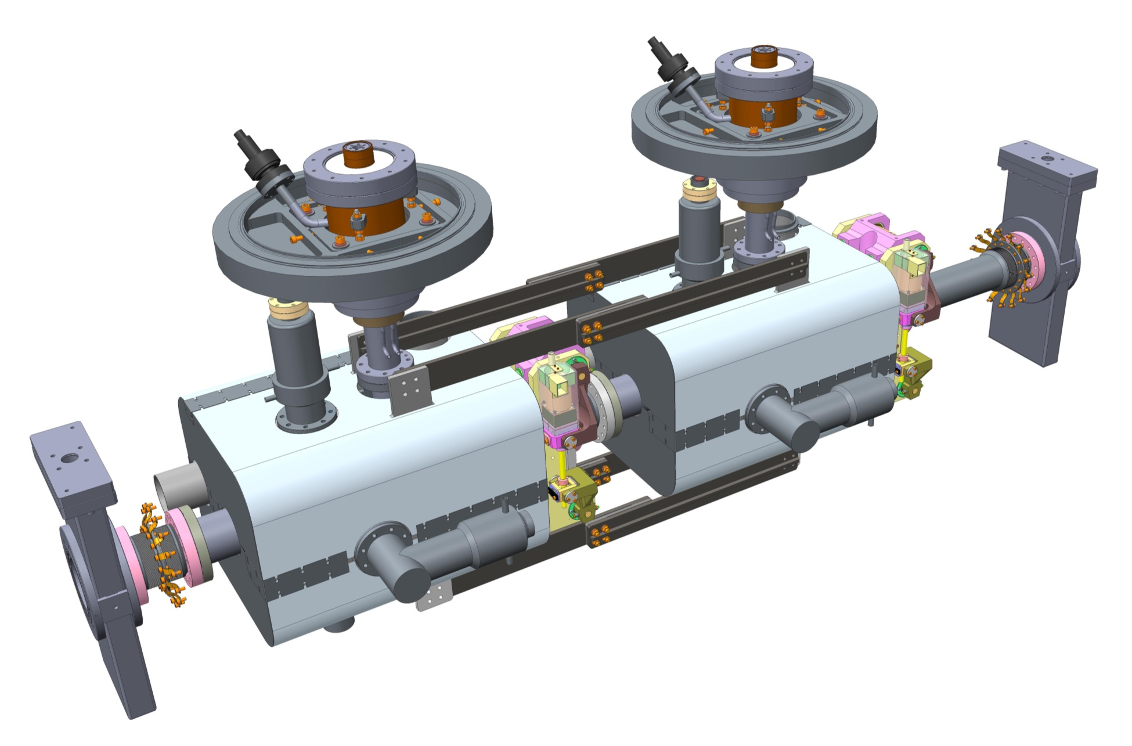
SPS Cryomodule
  Adapt the solutions for each cavity type / coupler geometry, available space
UK

Slide 33
SPS Cryomodule
Magnetic shielding to be addressed in detail for all cavities
Thermal and magnetic shielding to be designed (UK has concept to be developed in more detail; agreed to be applied consistently for the other cryomodules)
Heat loads have to be further consolidated

Slide 34
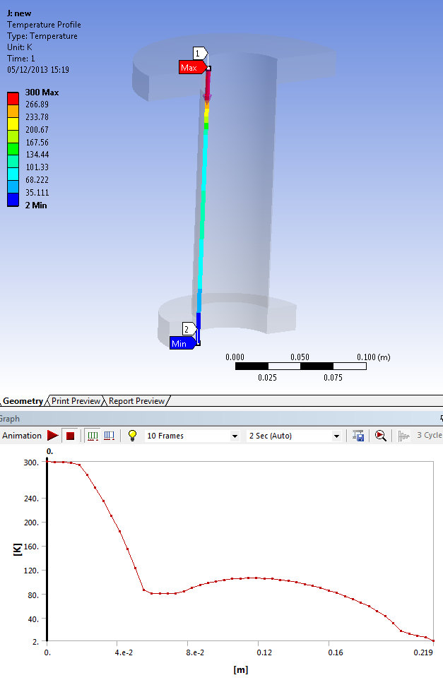
Crab cavity cryomodules: thermal calculations
BNL power coupler: Numerical (HFSS/ANSYS coupling) Results:
Temperature along the coupler with one heat intercept @80K
Temperature along the coupler with one heat intercept @80K
Upper flange
80K intercept
Lower flange
Thermal losses (W) with and without 80K heat intercept (Wall Thickness = 1 mm, L=219mm)
 | RF off | RF on (P = 30 kW, f = 400 MHz)
No cooling | 4.1 W @2K | 6.3 W @2K
Cooling with 1 Heat intercept (80K) x/L=26% | ~1.3 W @2K 14.4 W @80K | ~2.3 W @2K 19.2 W @80K

Slide 35



Crab cavity cryomodules: thermal calculations
ODU high-order mode coupler: Semi-analytical
Contributions considered: conduction + dissipated power (when RF is on)
x_{i} = coordinate of i-node
dx = element length; A = conducting section
k = equivalent thermal conductivity of the section
R_wall = electrical resistivity of the inner face (copper)
Thermal losses (W) with and without 80K heat intercept (Wall Thickness = 3 mm, L=340mm)
 | RF off | RF on (P = 3 kW, f = 1000 MHz)
No cooling | 12.8 W @2K | 13 W @2K
Cooling with 1 Heat intercept (80K) x/L=26% | ~2 W @2K 45 W @80K | ~2 W @2K 49 W @80K

Slide 36
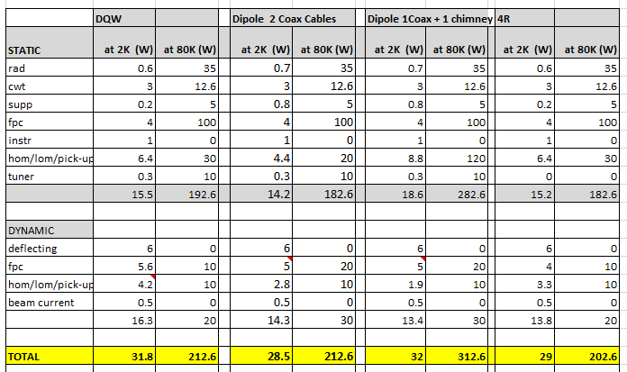
Heat Load Budget
This is still ‘work in progress’ but we have an idea of what we will have to deal with !

Slide 37
SPS Cryomodule
  Detailed studies done for each of the cavity for one crabbing direction
  Changing the crabbing direction implies basically new cryomodules designs
    FPC position from vertical to horizontal
      Difficult for LHC configuration / space&interfaces
      Completely new supporting system
    Tuners
      Tuning at different locations for BNL and ODU

Slide 38
SPS Cryomodule
  Developing cryomodules for 3 different devices, aiming at standardization
    Each individual lab has brought know-how, ideas, solutions that benefited to the others like for example:
      Cryomodule lateral loading from UK
      FPC thermal dissipation pb & solution identified by BNL
      Tuning actuation concept from ODU

Slide 39
Conclusive considerations
  We need:
    To have a valid solution for the LHC !
    To meet deadlines
  Complicated devices, with many difficult issues identified
    Did we identified all of them ?
    Do we need to continue exploring several different configurations ?
      If yes - impact on schedule ?
      If no – impact on valid solution ?

Slide 40
  Regardless the outcome of this review, CERN strongly hopes we will continue this fruitful and nice collaboration spirit

