Slide 1
HiLumi-LHC/LARP Crab Cavity System External Review
5-6 May 2014, BNL
SPS - RF Power and Coupler status
Erk Jensen, Eric Montesinos, CERN BE-RF
on behalf of all people involved, great thanks to all of them !

Slide 2
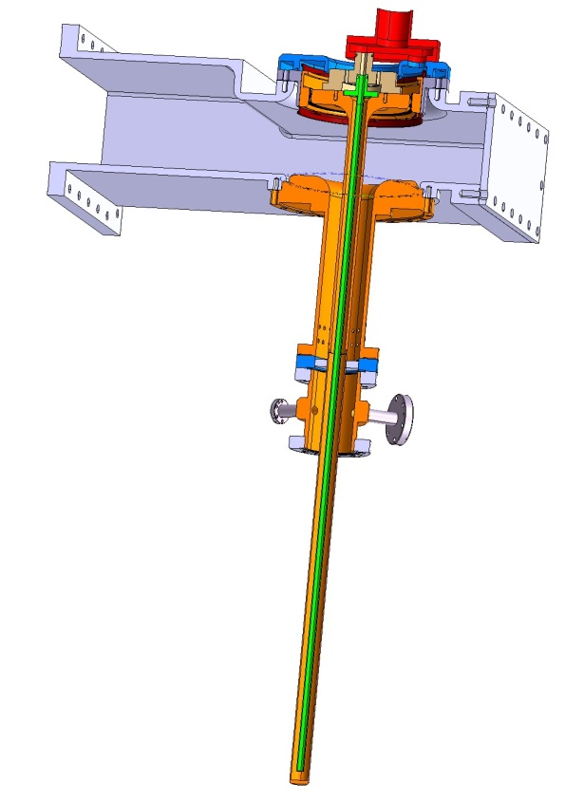
FPC – initial design
400 MHz 50 kW CW FPC
full reflection all phases
Agreed coaxial line
OD 62 mm - ID 27 mm
Coaxial disk window
  Outer titanium flange
  Al2O3 97.6% ceramic
  Inner copper tube
Coupler body
  Massive copper
  316 LN Stainless Steel flanges on both sides

Slide 3
FPC – initial design
Monitoring ports
  1 port for vacuum gauge
  1 port for e- monitoring
  1 port for arc detector
Coaxial to WG WR2300½H transition without doorknob
DC capacitor included for DC polarization

Slide 4
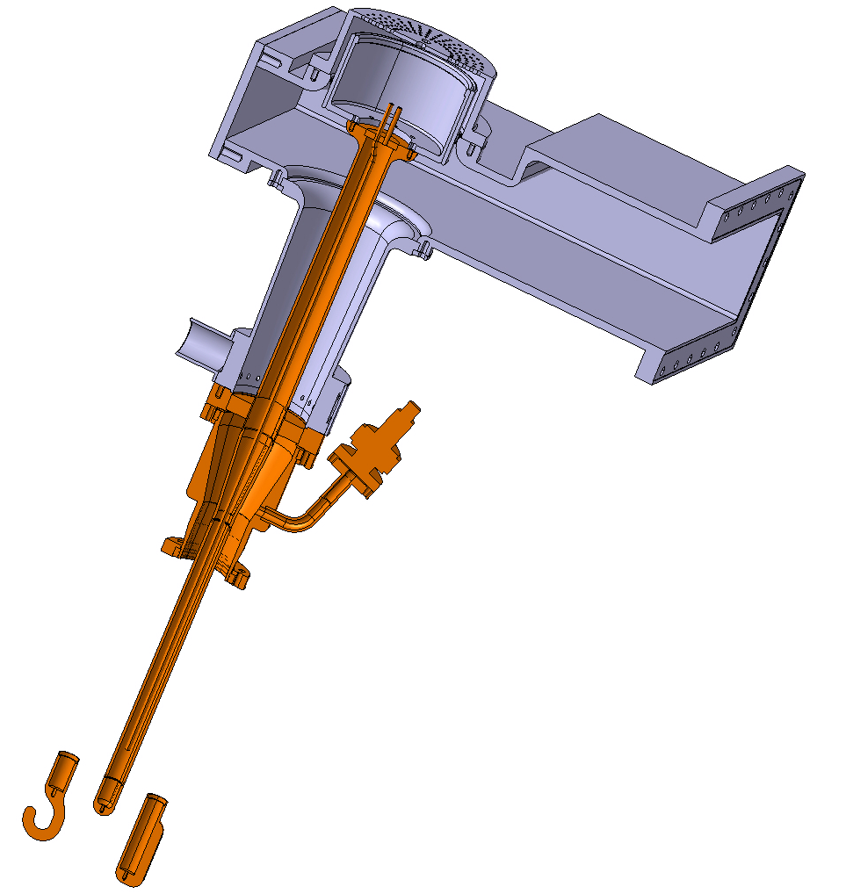
FPC – new design
Still agreed sizes on cavity side
OD 62 mm - ID 27 mm
Conical vacuum line to increase the diameter of the ceramic in order to avoid arcing on the air side
Ceramic & Air coaxial line increased
OD 100 mm – ID 43.5 mm
Robust ceramic
Thickness 20 mm

Slide 5
FPC – new design
Pseudo-conical air extension cooled with forced air
Even if against CERN’s rules regarding joining, as no other way to do it, water cooled antenna
Mandatory vacuum gauge for coupler protection
No more arc detector window neither e- antenna to ease integration

Slide 6
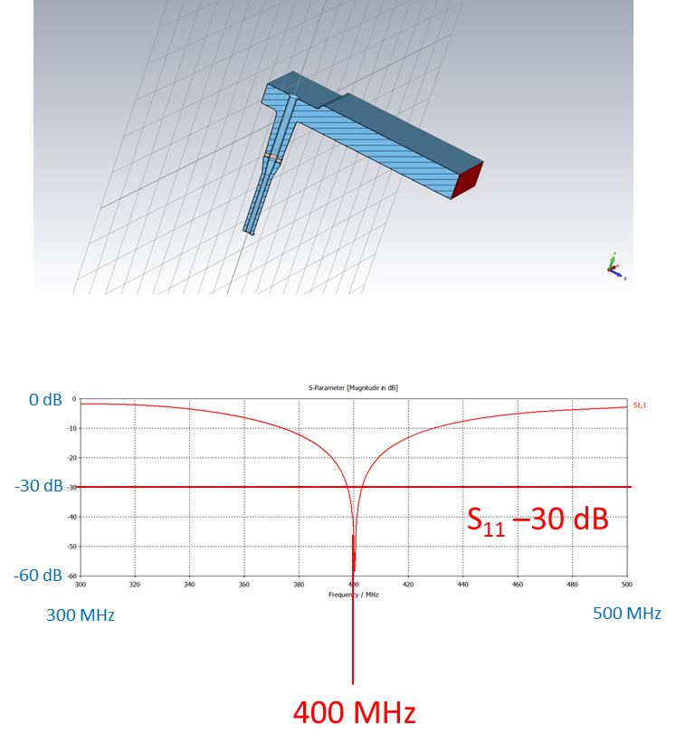
FPC – new design

Slide 7
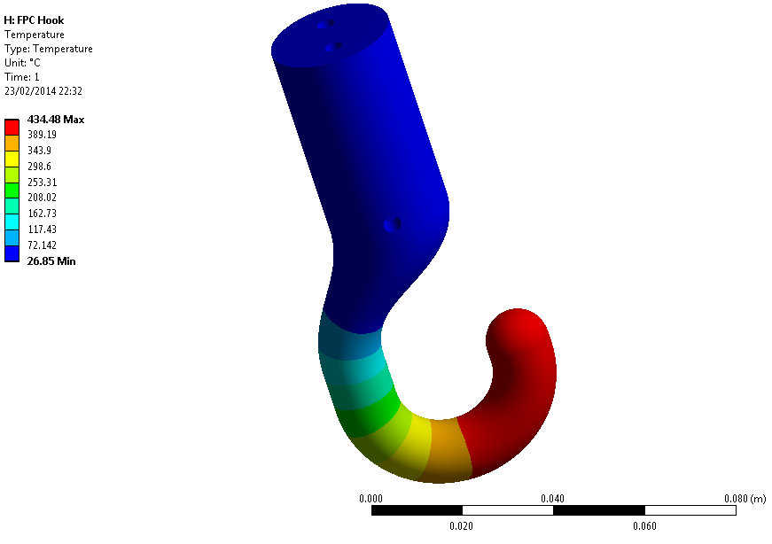
Antenna overheating
Looking at the size of the hook, no way to design a cooling circuit which also cools down the curved part of the hook
Initial design of coupling elements (BNL-ODU) shown overheating up to an unacceptable temperature
New coupling element shapes have been designed allowing acceptable temperature for the three couplers

Slide 8
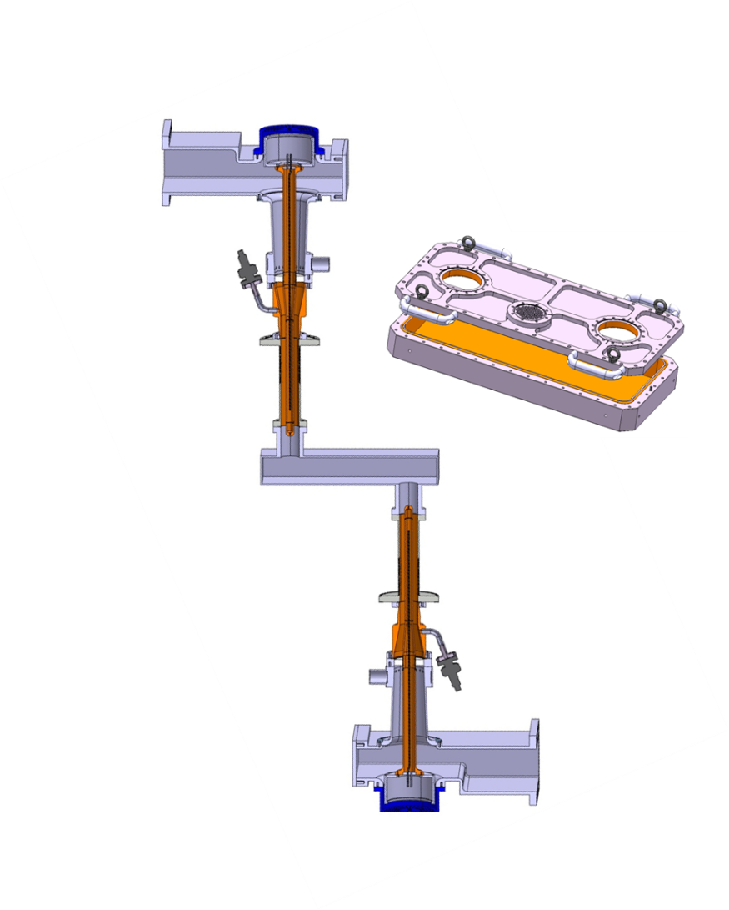
Test boxes
Three test boxes will be built allowing the preparation of pair of couplers
They will be made with two plates of Stainless Steel, not copper plated (easier and quicker), and will be water cooled
They will be customized regarding the coupling element for each cavity design

Slide 9
Schedule May 2014
2013
2014
2015
2016
2017
DT → →
FPC RF processing
SPS-LSS4
Cavities to be installed in the SPS in December 2016
Couplers processed 50 kW SW CW all phases Q2-2015
FPC design is missing DT & coupling shape & position
(additional delay will impact FPC schedule)

Slide 10
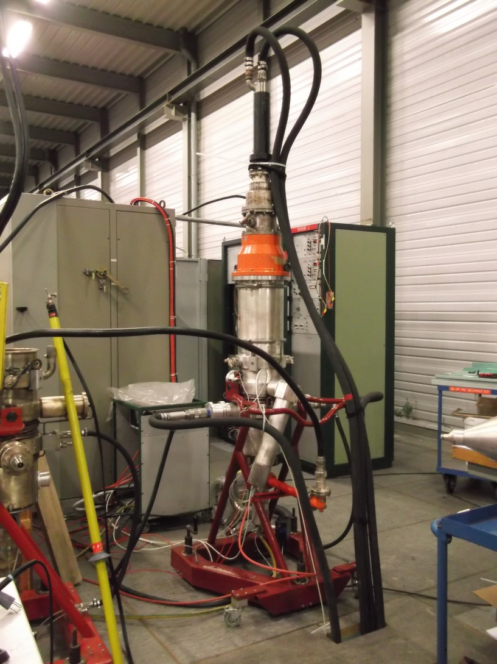
Tetrode Amplifiers
No progress, still no water due to LS1 until May 2014
Was operated at 40 kW maximum in 1999
Should be able to provide 50 kW (not guaranteed)

Slide 11
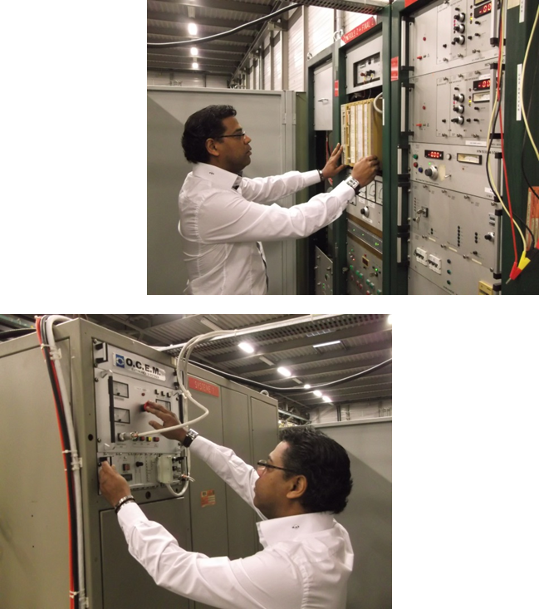
Power supplies
Existing one will be for the test stand
Two new systems will be bought for SM18 & BA4
Will be one HV power converter for two amplifiers to reduce the cost

Slide 12
Driver amplifiers,
Circulators & Power Loads
Offers received from 10 companies, off the shelves SSA
On-hold awaiting Tetrode amplifier test results in order to correctly define the output power level regarding tetrode amplifier gain
They will be close to the LLRF racks in ECX4
Three sets of LHC 400 MHz 330 kW circulators & LHC loads have been ordered
Loads will be shorten to allow integration onto the table

Slide 13
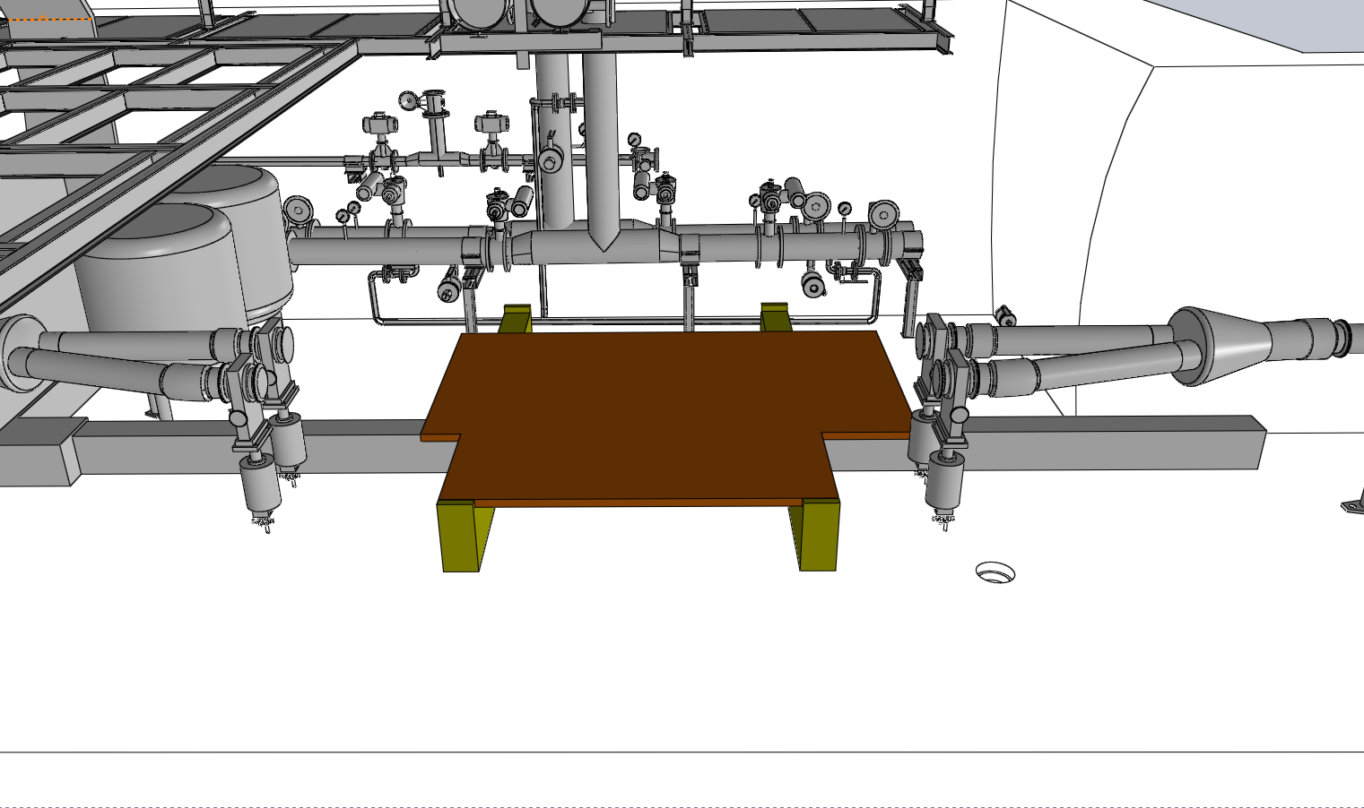
Movable table
Phoevos Kardasopoulos

Slide 14
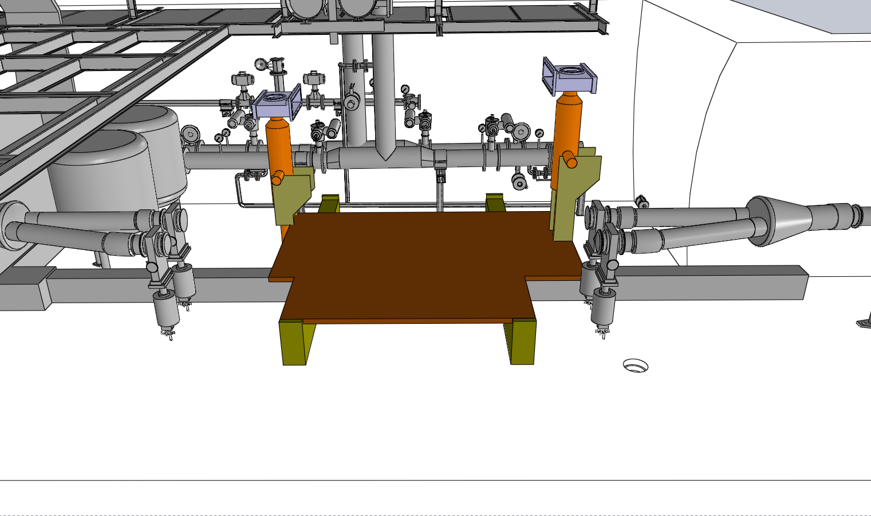
Tetrodes Amplifiers onto the table
Phoevos Kardasopoulos

Slide 15
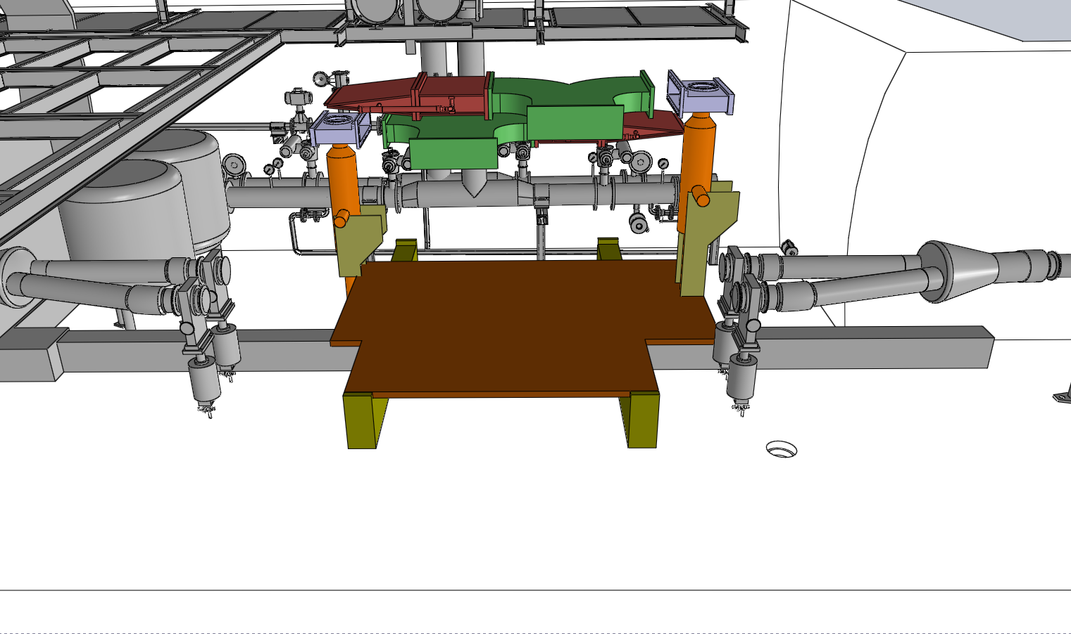
Circulators & power Loads (with adjustable supporting system for integration of all three designs)
Phoevos Kardasopoulos

Slide 16
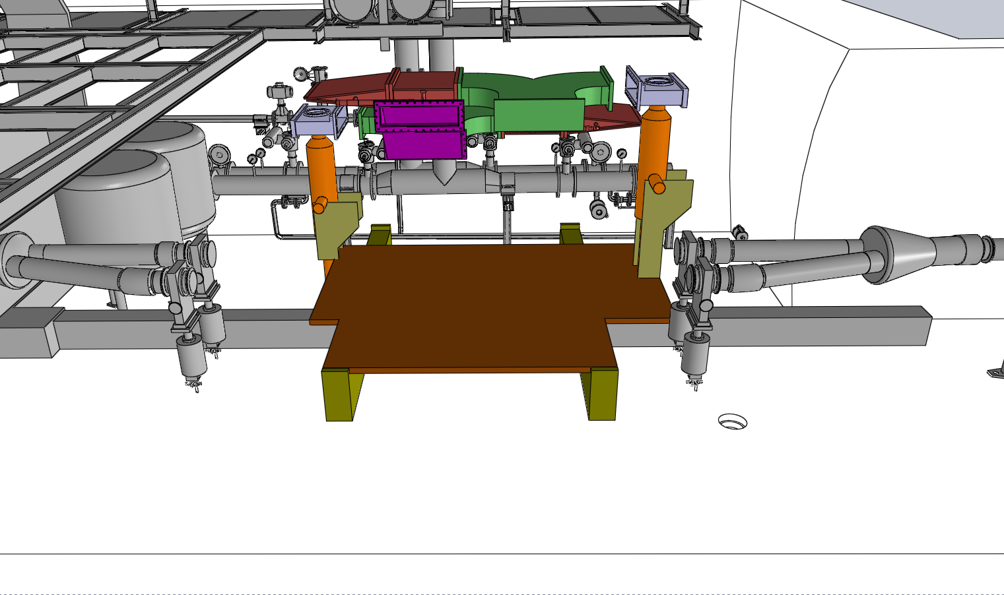
Waveguides to FPC
Phoevos Kardasopoulos

Slide 17
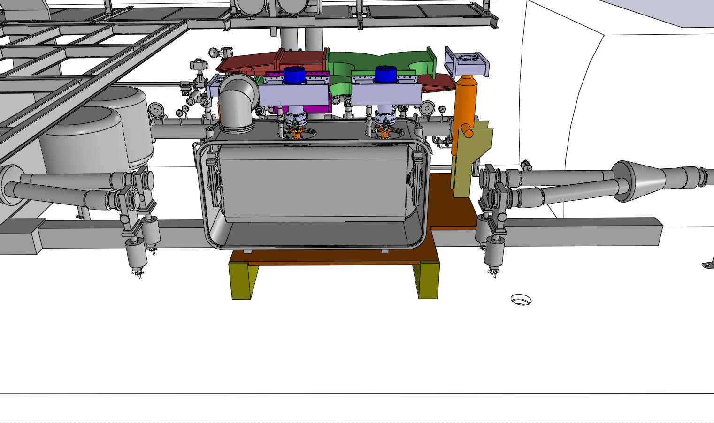
Cryomodule with FPC
Phoevos Kardasopoulos

Slide 18
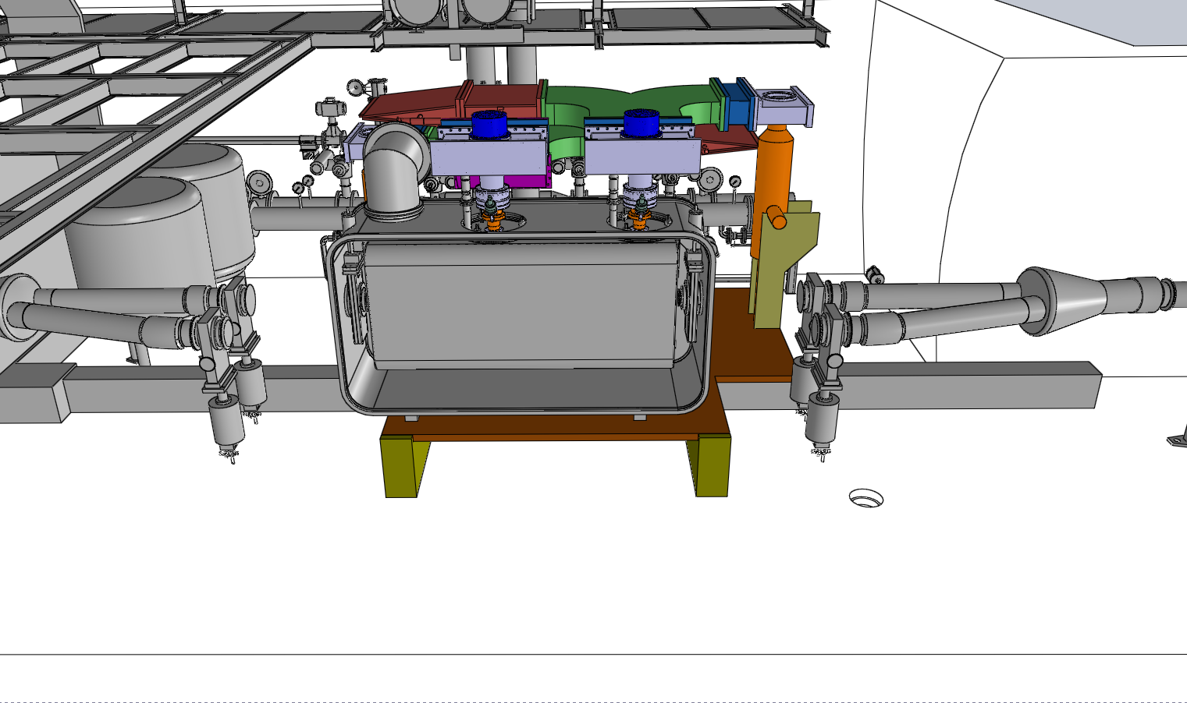
Flexible WG
(allowing integration of all three designs)
Phoevos Kardasopoulos

Slide 19
Conclusion
Coupler designs almost completed & test boxes simulations to be completed
  Hook position to be defined
  DT length still to be defined
Tetrode amplifier still to be tested
Integration pre-study of power system completed → ok
Schedule … more and more optimistic if no decisions are taken regarding DT & Antennas !

Slide 20
Thank you

