Slide 1
Double Quarter Wave Crab Cavity
− Cryomodule Design and Integration.
John Skaritka
on behalf of the DQWCC team
May 6, 2014

Slide 2
Outline
Cryomodule design requirements
Cryomodule description
Cryomodule heat load estimates
Cryomodule analysis
Cavity tuning mechanism
Cryomodule assembly and integration
Summary

Slide 3
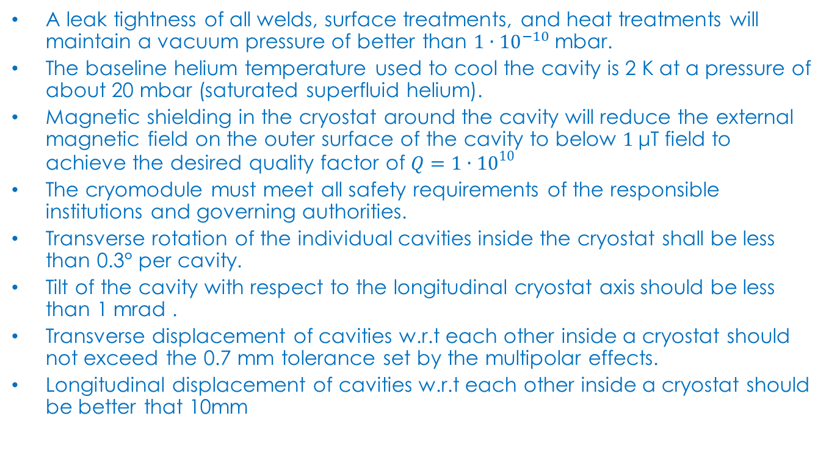
Cryomodule Operational and Geometric Requirements
A leak tightness of all welds, surface treatments, and heat treatments will maintain a vacuum pressure of better than $1∙{10}^{−10} \text{mbar}\text{.}$
The baseline helium temperature used to cool the cavity is 2 K at a pressure of about 20 mbar (saturated superfluid helium).
Magnetic shielding in the cryostat around the cavity will reduce the external magnetic field on the outer surface of the cavity to below $1 \text{μT}$ field to achieve the desired quality factor of $Q=1∙{10}^{10}$
The cryomodule must meet all safety requirements of the responsible institutions and governing authorities.
Transverse rotation of the individual cavities inside the cryostat shall be less than 0.3° per cavity.
Tilt of the cavity with respect to the longitudinal cryostat axis should be less than 1 mrad .
Transverse displacement of cavities w.r.t each other inside a cryostat should not exceed the 0.7 mm tolerance set by the multipolar effects.
Longitudinal displacement of cavities w.r.t each other inside a cryostat should be better that 10mm

Slide 4
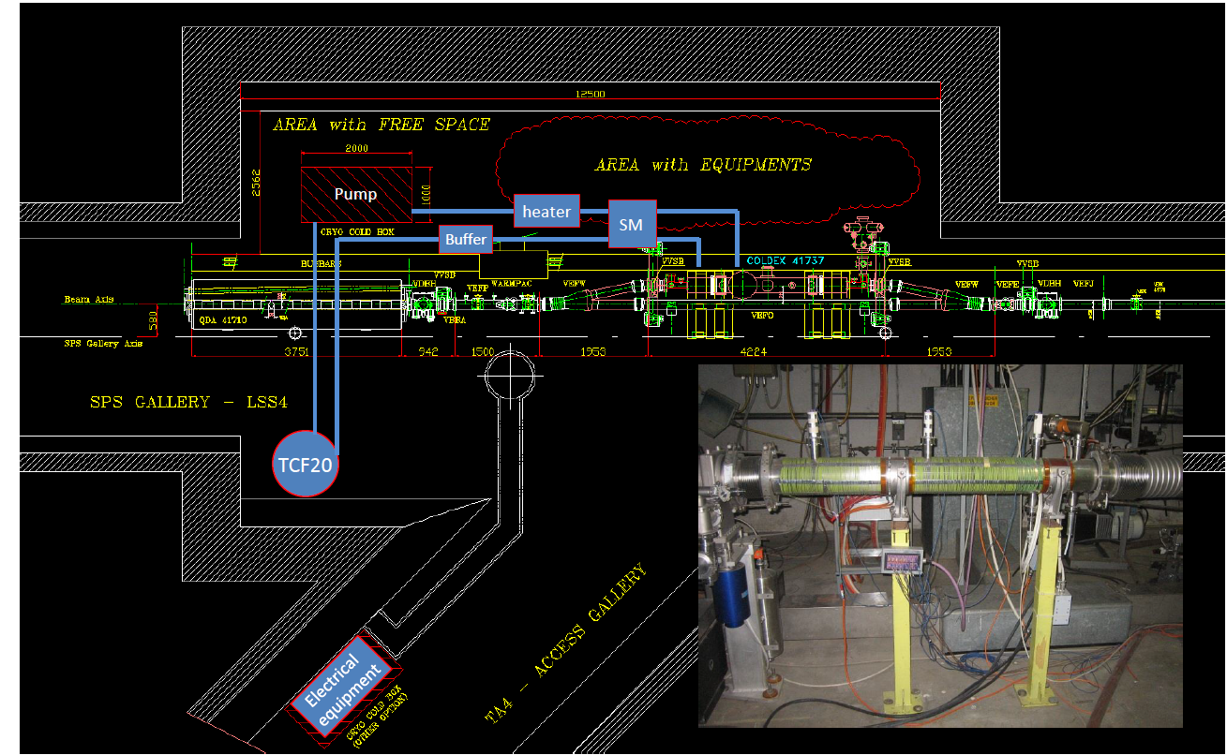
Cryomodule system location at SPS

Slide 5
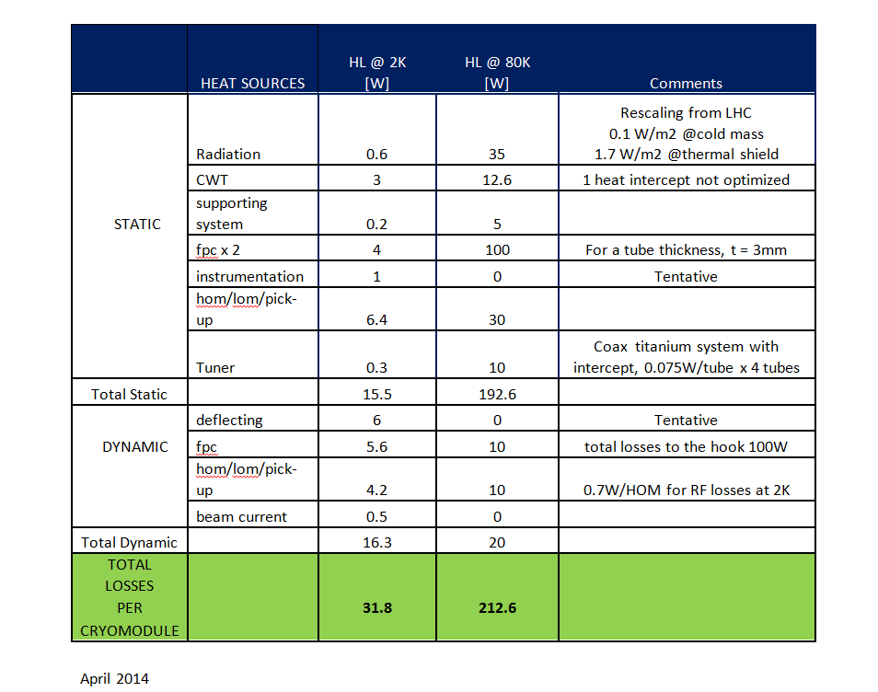
Summary of heat loaded on the Crab Cavities cryomodule for the SPS tests

Slide 6
Crab Cavity Cryomodule Concept
The cryostat interface will consist of four lines: 2 K supply, 2 K pumping, 80 K inlet and 80 K outlet, the basic scheme of the cryostat circuits is presented below.
The helium tanks for two cavities will be separate but have a common pumping collector manifold.
The pumping collector is the only hydraulic link between the two helium tanks so that under quench conditions the cavities are only indirectly coupled.

Slide 7
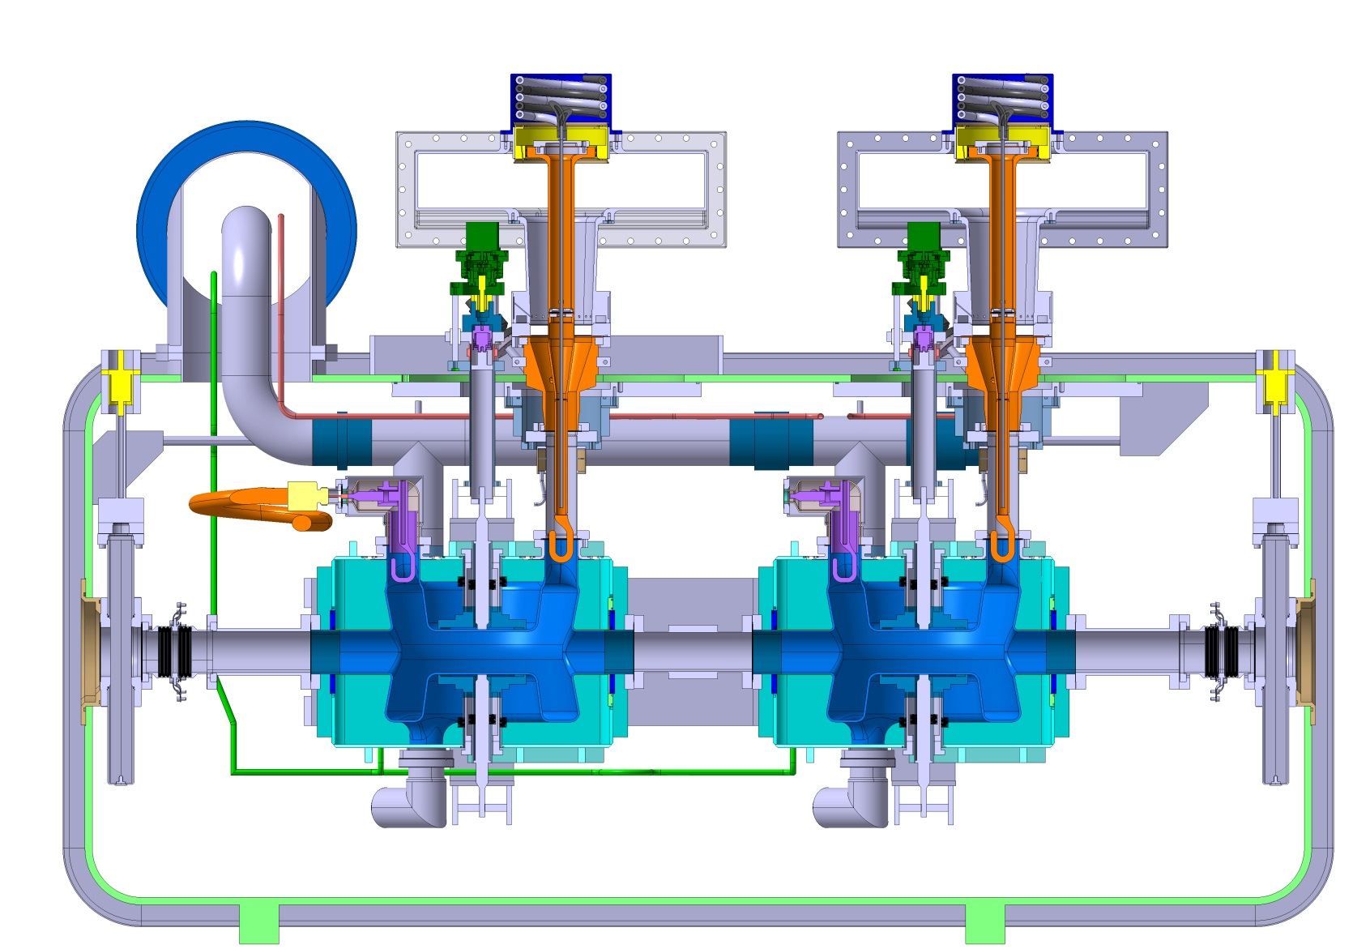
BNL Crab Cavity Cryomodule
Helium pumping manifold
Tuner actuator
FPC
80K shield
2K Helium line
Cavity tuner reaction cage

Slide 8
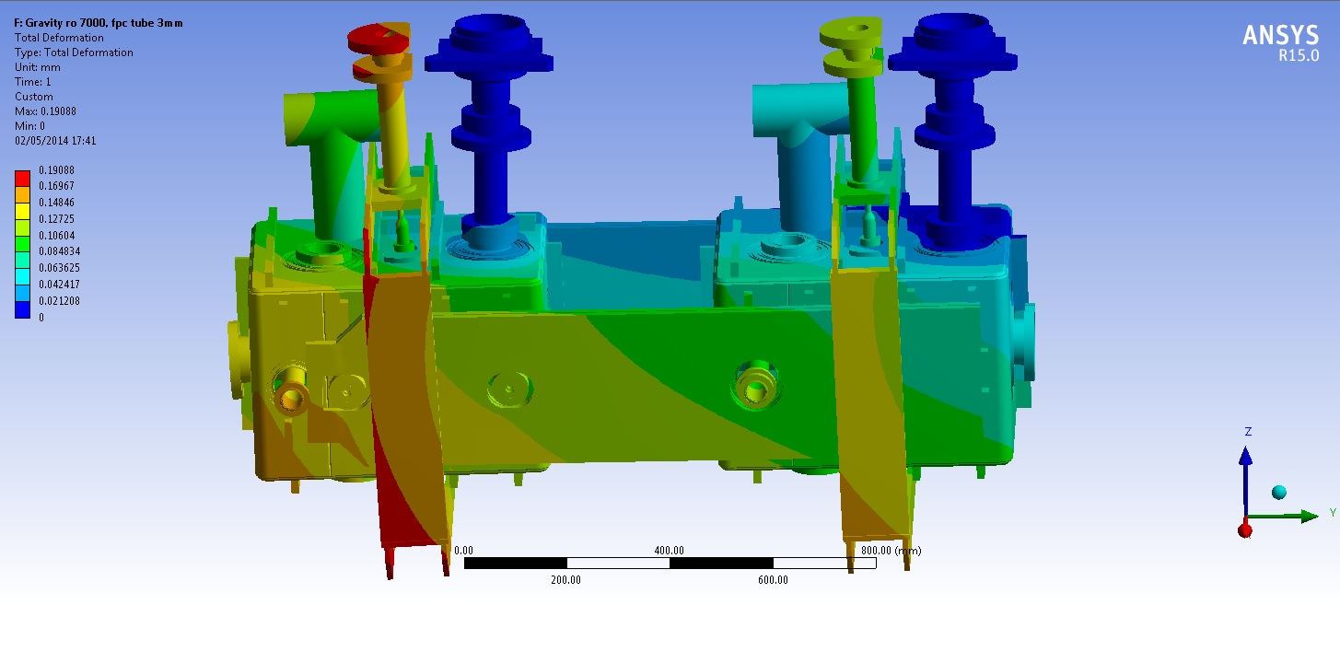
Analysis of Supporting System for gravity induced loads
FPC
FPC
Fixed support
Fix support
Cold mass is supported primarily by the rigid connection to the FPC
Rotation of the cold mass is constrained by rigid plates attached between the two cold masses

Slide 9
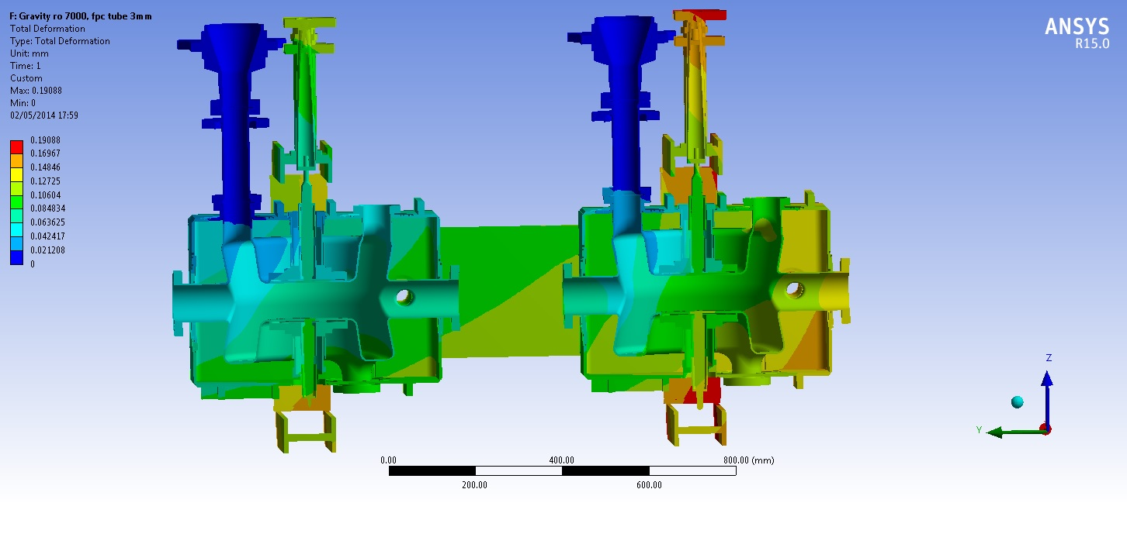
Section view of reaction frame and the cold mass assembly
Max. Cavity deflection of
about 0.10mm
Analysis shows the FPC assemblies do provides adequate support for the cold mass with in the vacuum vessel.

Slide 10
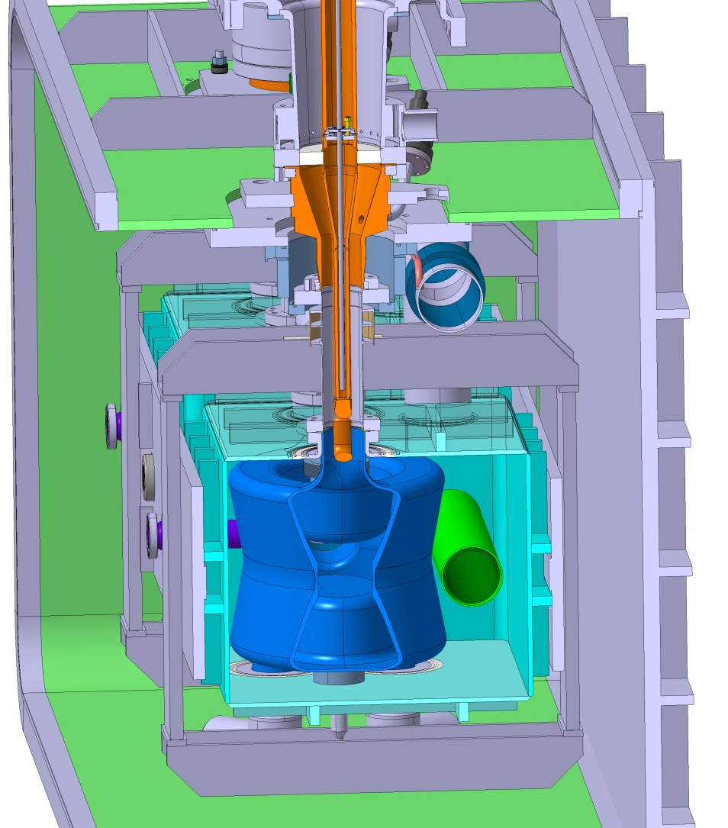
Crab Cavity Cryomodule
The vacuum vessel is designed to provide ease of assembly.
The two large openings provide a high degree of access to either side of the cold mass.
The stainless shell and end flanges are stiffened using a ribbed matrix

Slide 11
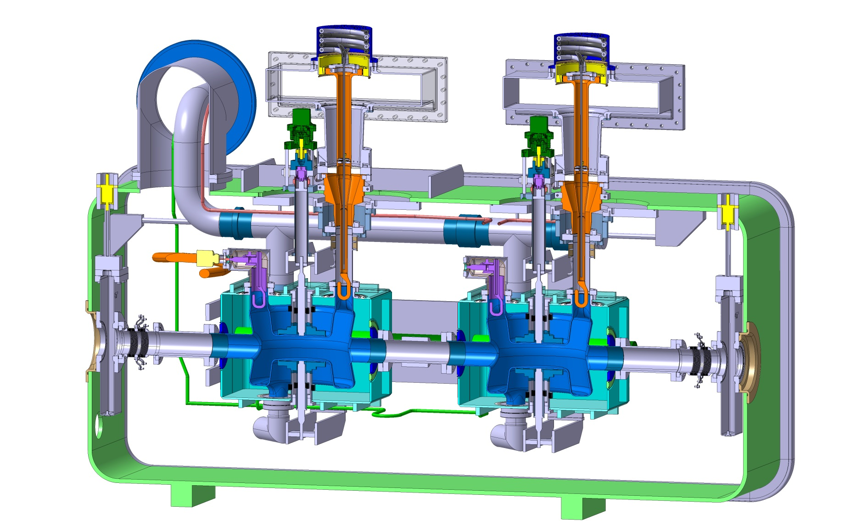
Section of Cavity Cryomodule showing tuning Mechinisms
The tuner drive systems are externally located.
This provides serviceability and the use of semi-standard components

Slide 12
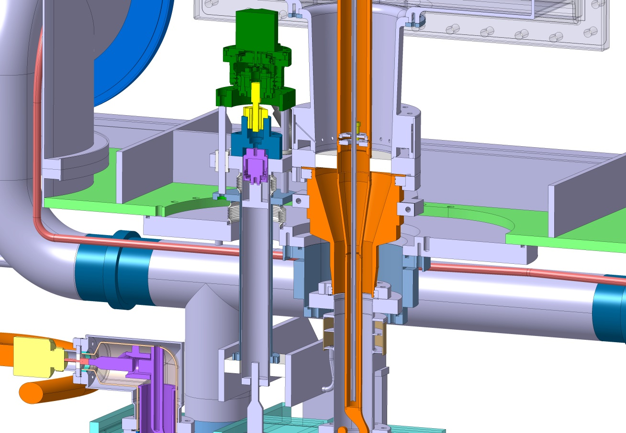
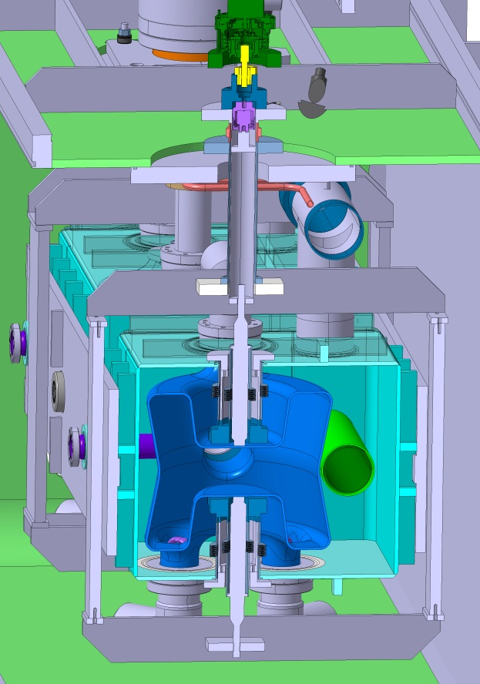
BNL Crab Cavity Cryomodule Tuner Mechanism Assembly
1000 microstep stepper motor
160 reduction harmonic gearbox
1 mm per turn roller screw
30 micron range piezoactuator
Bellows form vacuum barrier
Inner tube ties to cavity
Outer tube ties to Frame
Frame transfers force to opposite side of cavity.
Tuner resolution is expected to be 0.01 micron or better over a range of a several millimeters. Heat stationed thin wall titanium tubes provides acceptable rigidity with a minimum heat leak.

Slide 13
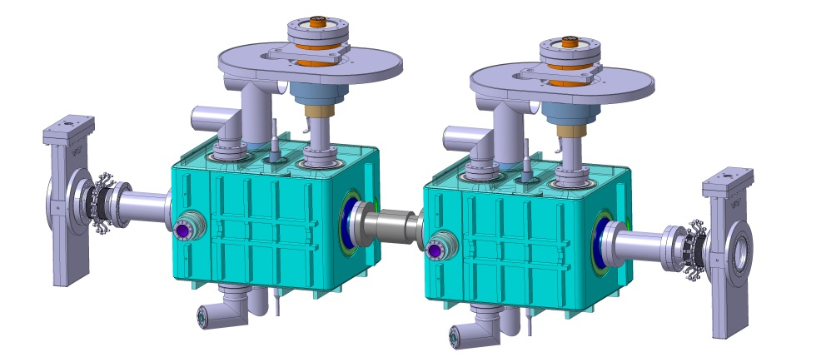
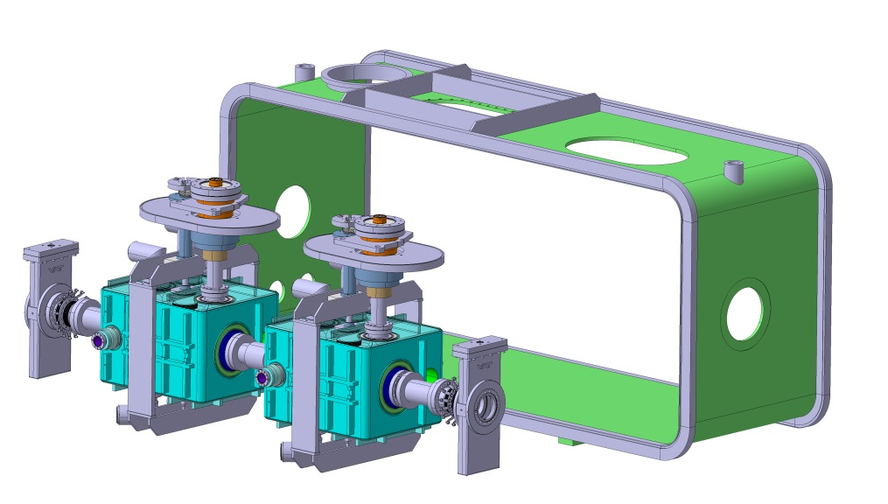
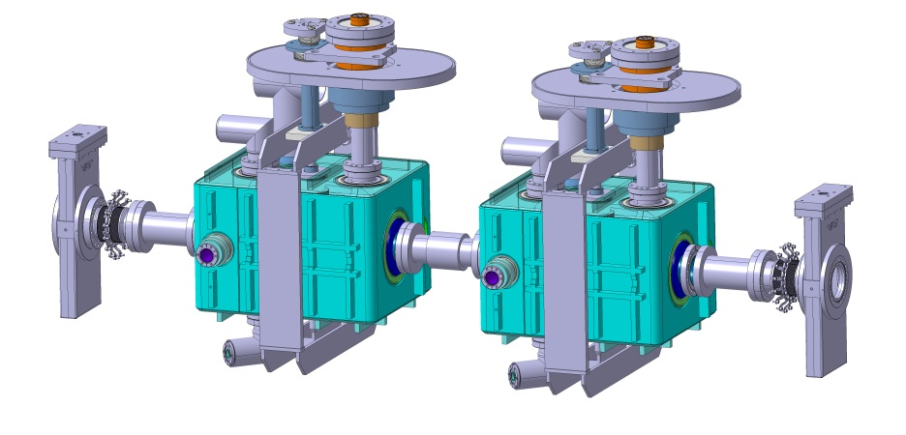

Crab Cavity Cryomodule Assembly
The cavity, FPC, HOM’s and vacuum chamber components are clean room assembled into the cold mass.
The cold mass is secured to a fixture, then installed into the vacuum vessel.

Slide 14
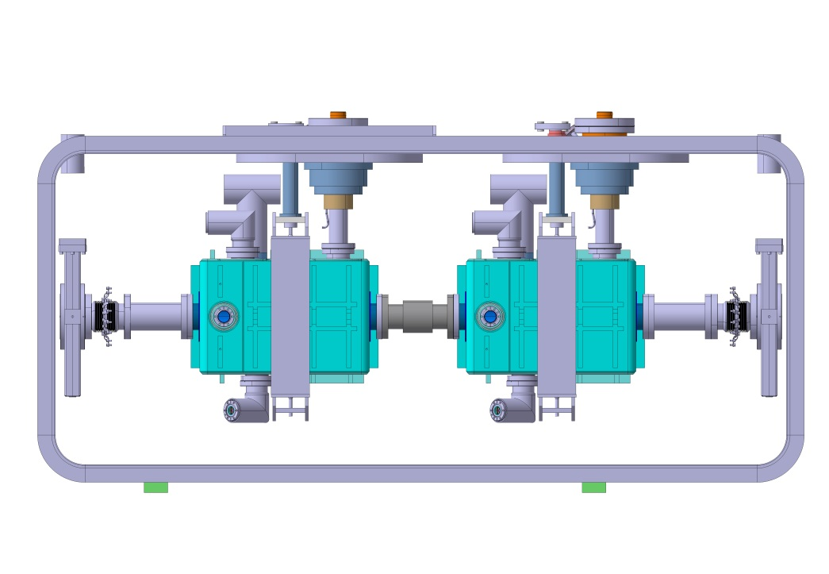
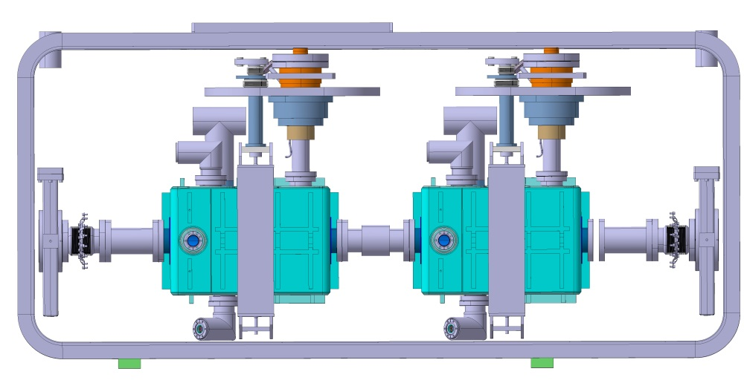
Crab Cavity Cryomodule Assembly
The Helium pumping manifold contains about 3.9L
Each helium vessel contains about 34L
The weight of each cavity/helium vessel assembly is about 96kg.
The vacuum vessel is designed to contain the entire cold mass assembly.
The cold mass is moved up in the vessel and hung from the FPC/Elliptical tuner flanges

Slide 15
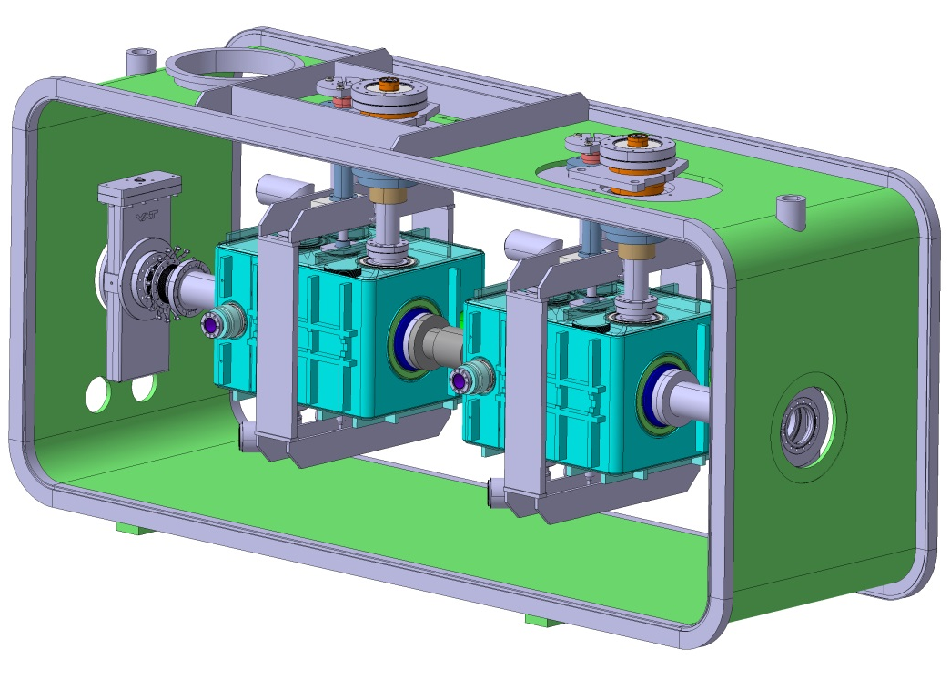
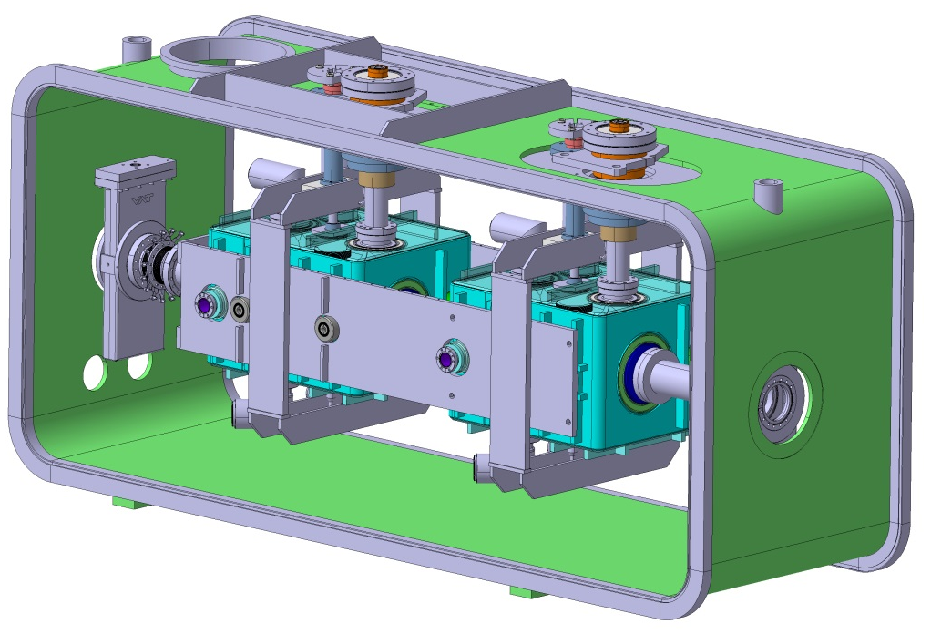
Crab Cavity Cryomodule Assembly
FPC/Elliptical tuner flanges and vacuum chambers are sealed to the vacuum vessel chamber inner wall.
Titanium cold mass stiffening plates are attached to either side of the cavity helium vessel
*Stiffening plates could be installed earlier if they can be used to help support the cold mass during installation into the cryomodule

Slide 16
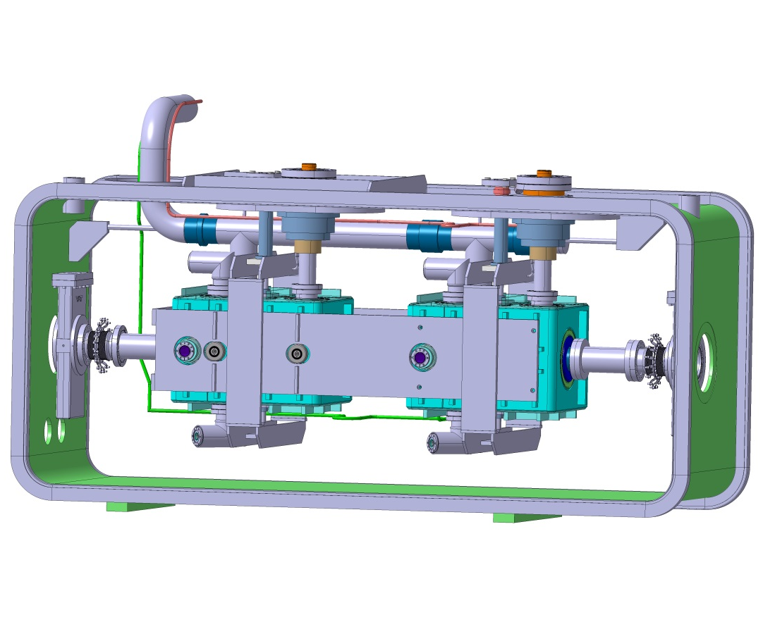
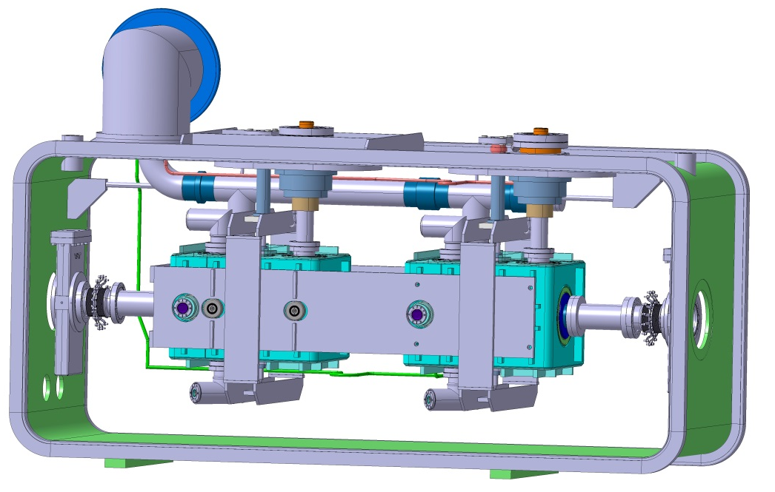
Crab Cavity Cryomodule Assembly
Install and weld 2K Helium manifold.
Install vessel elbow
Install Helium fill lines

Slide 17
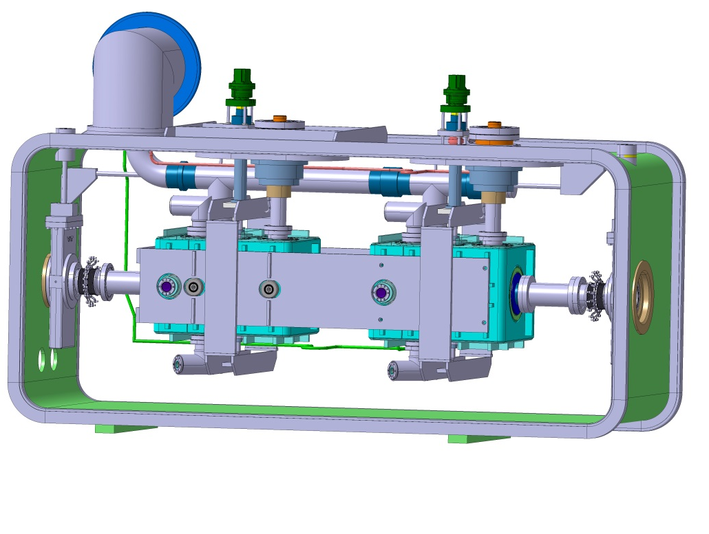
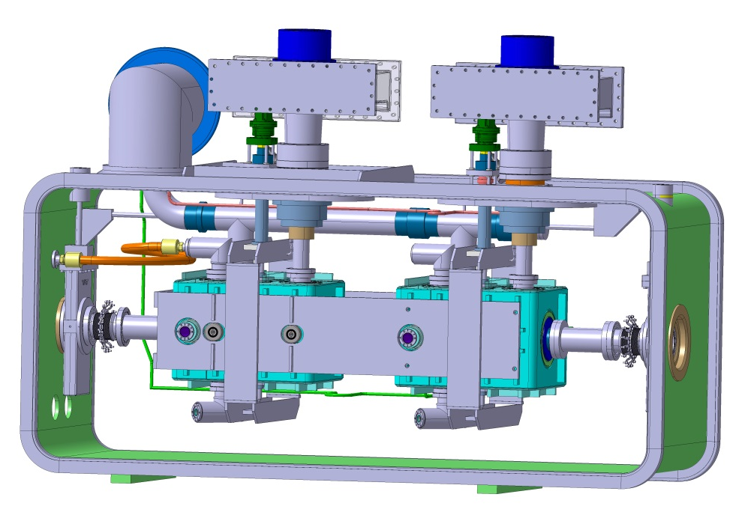
Crab Cavity Cryomodule Assembly
Tuner shaft and drive mechanism installed
HOM Coupler cables are made up and installed.
FPC wave guide installed
Blankets of MLI superinsulation applied
over cold mass and cryo-lines

Slide 18
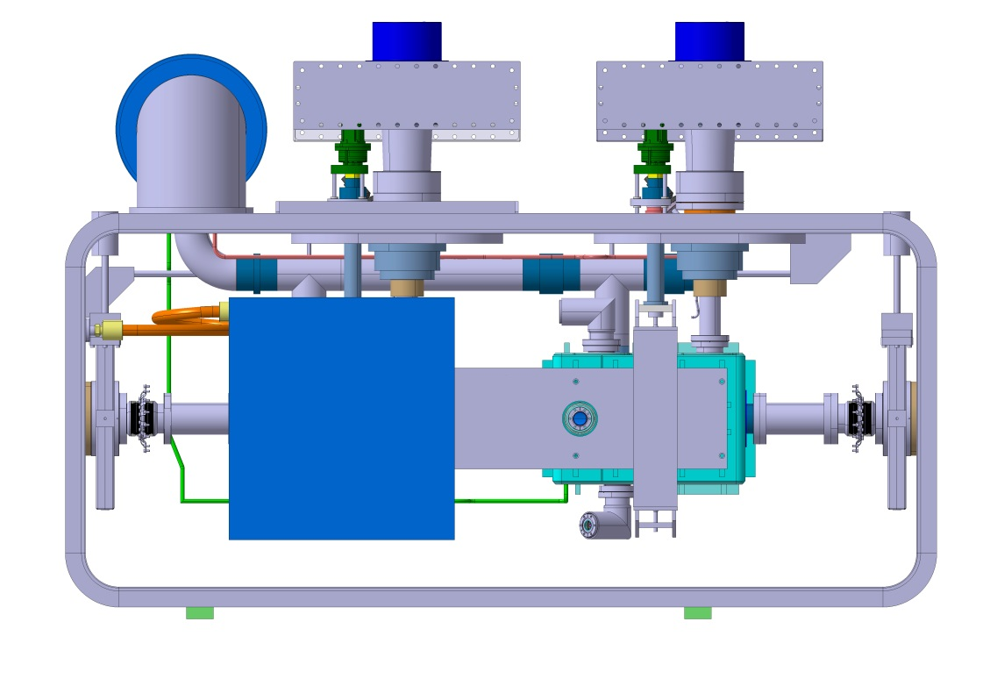
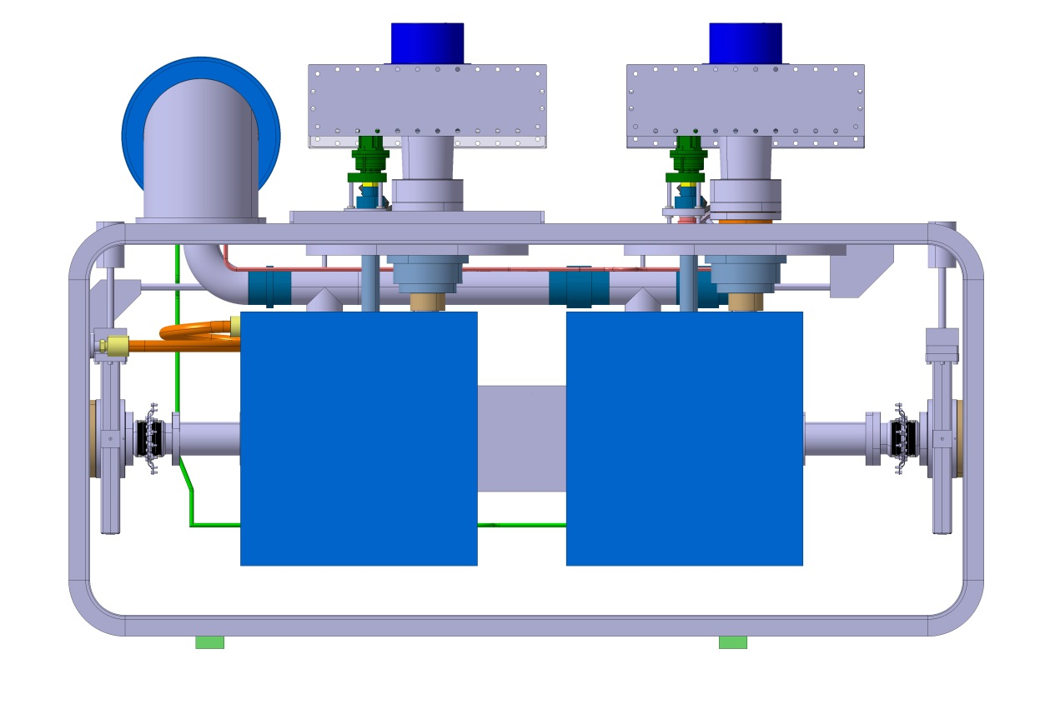
Crab Cavity Cryomodule Cold Magnetic Shield Assembly
Cryo-perm Magnetic Shield assembled around Cavity 2
Cryo-perm Magnetic Shield assembled around Cavity 1
Blankets of MLI superinsulation
Applied over the Cryo-perm shields.

Slide 19
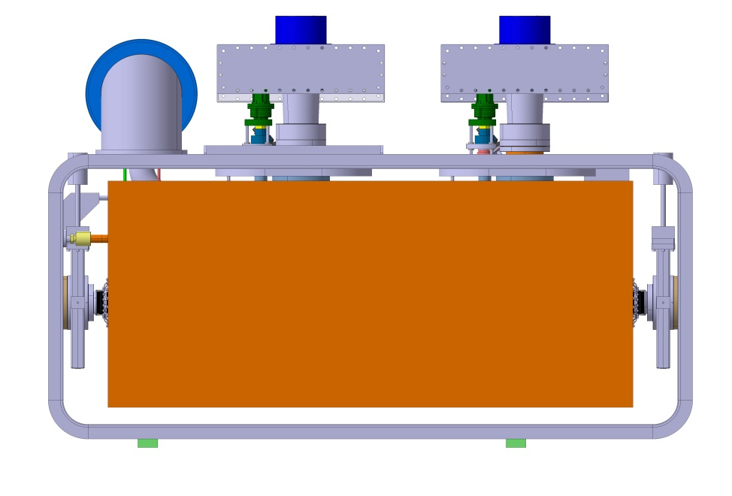
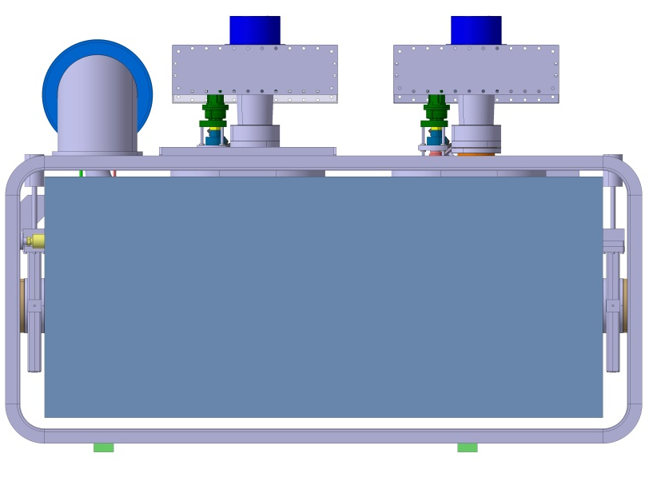
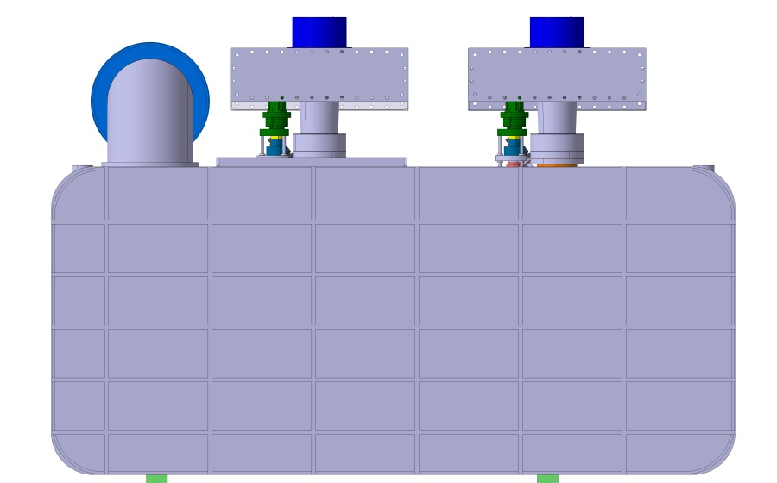
Crab Cavity Cryomodule Shield Assembly
80K Copper Heat Shield
and MLI Superinsulation
Warm µ-metal Shield
Ribbed reinforced stainless covers secured to either side of chamber.
Insulating vacuum is maintained by O-rings between the sealing services either cover of the Cryomodule.

Slide 20
Crab Cavity Cryomodule
Tasks to still be performed
Detailed Process and Instrumentation Diagram (P&ID)
Modal analysis and optimization of the dual cold mass assembly as supported in the cryomodule
Exact sequence of the assembly of stiffing plates onto cold mass.
HOM and pickup cable design optimization.
Interface with movable stand in SPS tunnel.
Means of survey targeting
Means of vessel rigging

Slide 21
DQWCC Cryomodule Summary
Cryomodule design requirements were presented
The cryomodule design for the BNL crab cavity has been described and heat load estimates have been presented.
Cryomodule design and analysis indicate that the system as presented will meet the requirements.
BNL cavity tuning mechanism has been presented.
Cryomodule assembly and integration for the BNL Crab cavity has been presented.
Additional tasks have been presented.

Slide 22
Back up slides

Slide 23
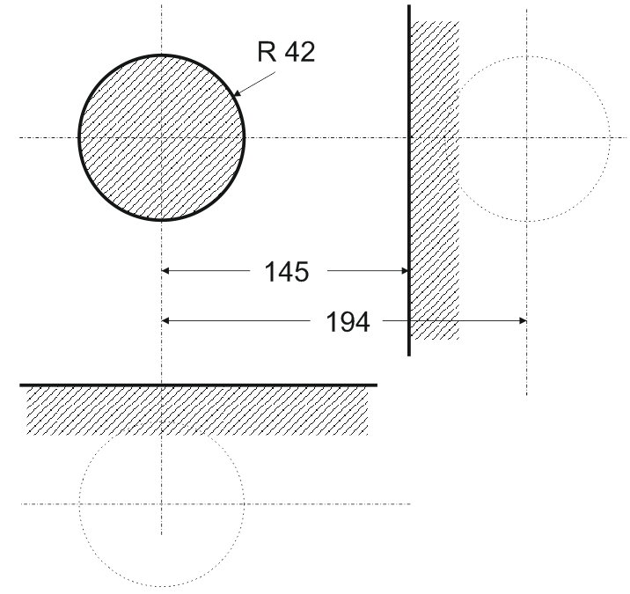
Beam Tube Configuration
In LHC The beam tube at both ends of the cavity must leave a clear radius of 42 mm. This will allow the transverse alignment of the cavity without reducing the aperture for the beam. A transverse distance of >145 mm between electric centre lines are kept clear for the passage of the 2nd beam tube.
The cryomodule for the SPS test has two in line cavities but the cavities will have the 2nd beam tube is at a distance of 194 mm horizontally for both cases,

Slide 24
Supporting system calculations for gravity induced loads
Tuner: inner to outer tubes blocked with respect to each others but no additional constraints; In the cryomodule a spring added at that connection between the tuner and the vacuum tank will decrease the weight applied on the cavity (not taken into account in this calculation).
Fix support
Fix support

Slide 25
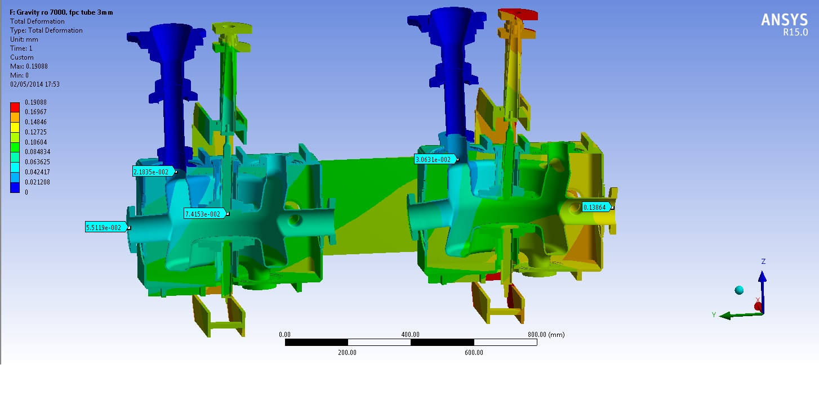
Total deformation
x 600 magnification factor

Slide 26
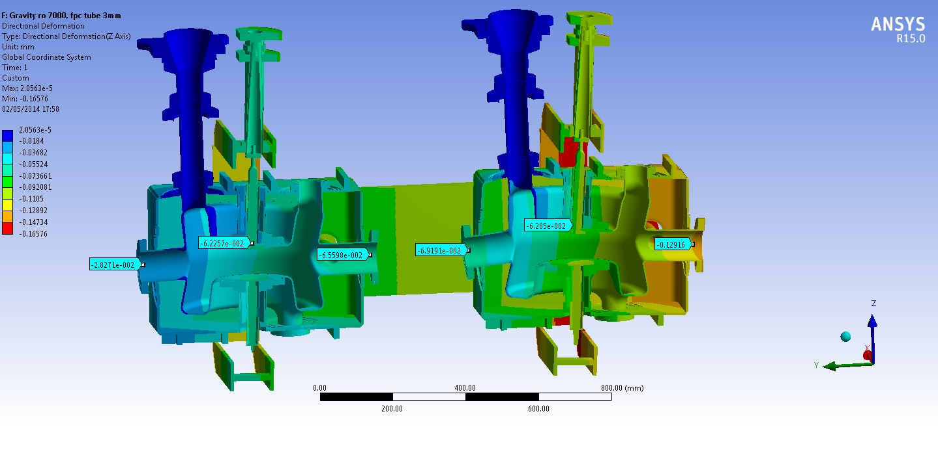
Total deformation
True scale

Slide 27
Vertical deformation
x 600 magnification factor

Slide 28
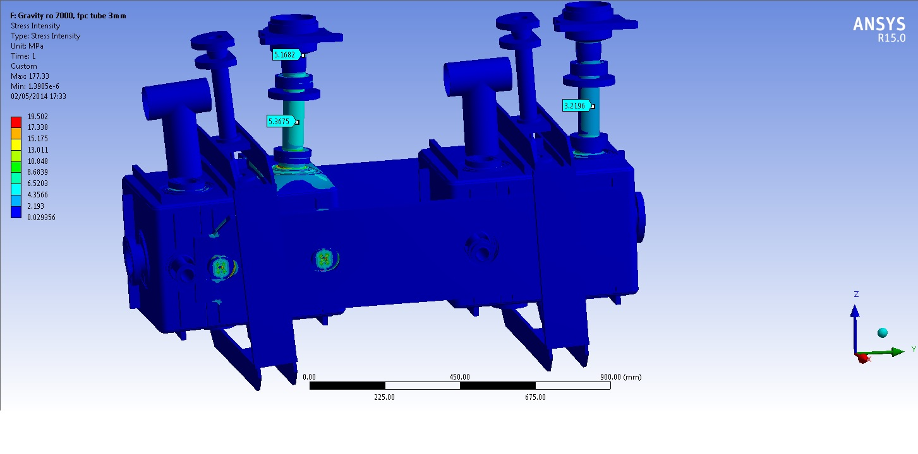
Stress intensity

Slide 29
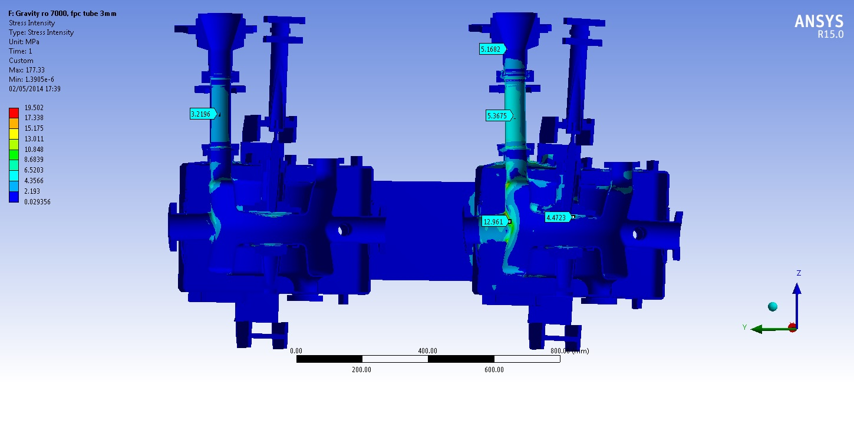
Stress intensity

Slide 30
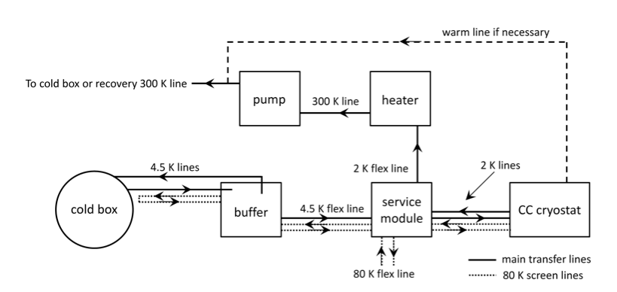
Cryogenic System
Cryogenic infrastructure in SPS BA4, is currently limited 4.5 K cooling capacity, will be modernized and modified to provide cooling power at level of 2 K.
The planned configuration of the helium distribution between TCF20 cold box and the cryostat will consist of cryogenic transfer lines, liquid helium buffer tank and service module equipped with sub-cooling heat exchanger and expansion valve.
The return line of 2 K helium gas will go from the cryostat to service module to heater and then to the pumping unit, and then back to either the cold box or a He recovery line.

