Slide 1
Side-loaded Cryomodule for UK 4-Rod tests on SPS
Thomas Jones, STFC, Daresbury Laboratory

Slide 2
Contents
Module overview
Cavity String
Inter-cavity supports
Thermal shield
OVC pressure analysis
SPS integration

Slide 3
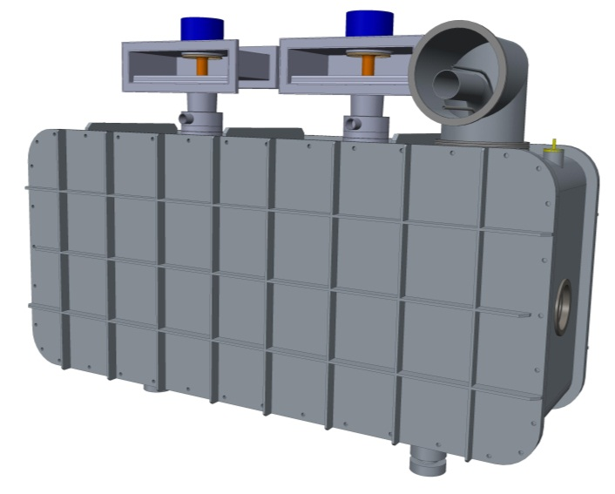
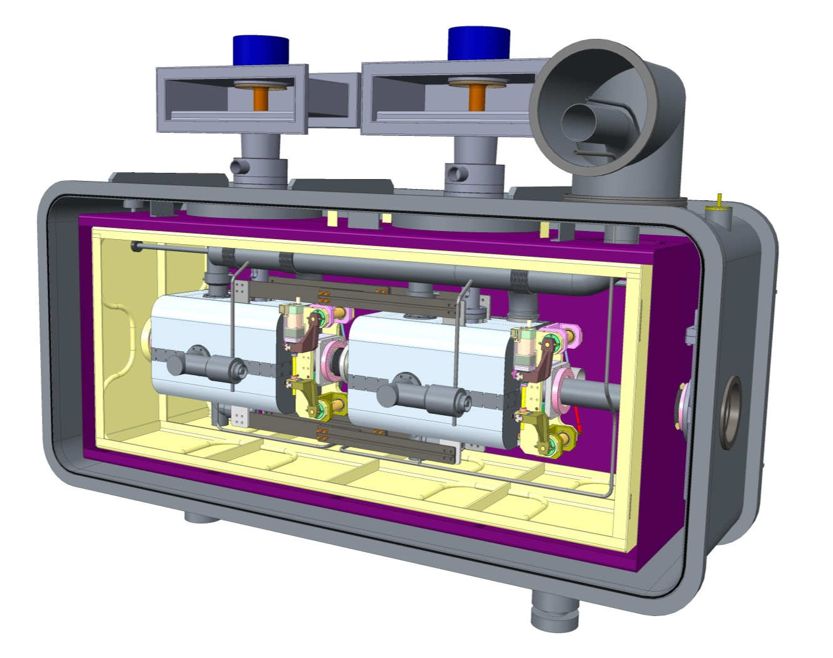
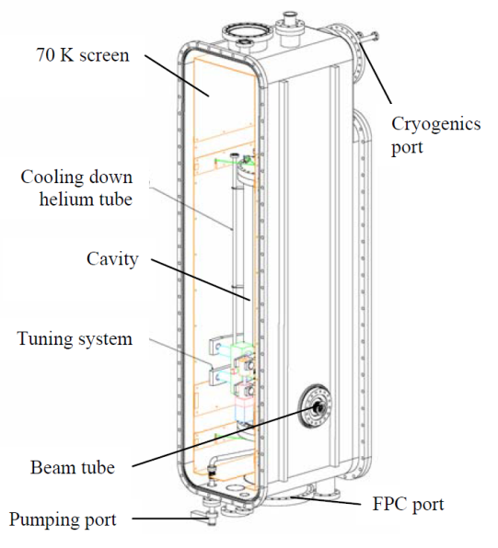
4ROD cryomodule design overview
Fundamental power coupler waveguides
Cryogenics interface
1720mm
Outer Vacuum Chamber, made from Carbon Steel for additional magnetic shielding
2590mm
860mm
SPIRAL 2 Quarter wave resonator cryomodule (Bernaudin et al.)
2mm thick Mu
Metal Magnetic shield
1050 Aluminium
Thermal shield (80K)
Additional length added to module to allow compatibility with other cavities.
Module positioning system
Same as used on other SPS equipment.
Ref : Design of the Low-Beta, Quarter-wave Resonator and its Cryomodule for the SPIRAL 2 Project. Bernaudin et al.

Slide 4
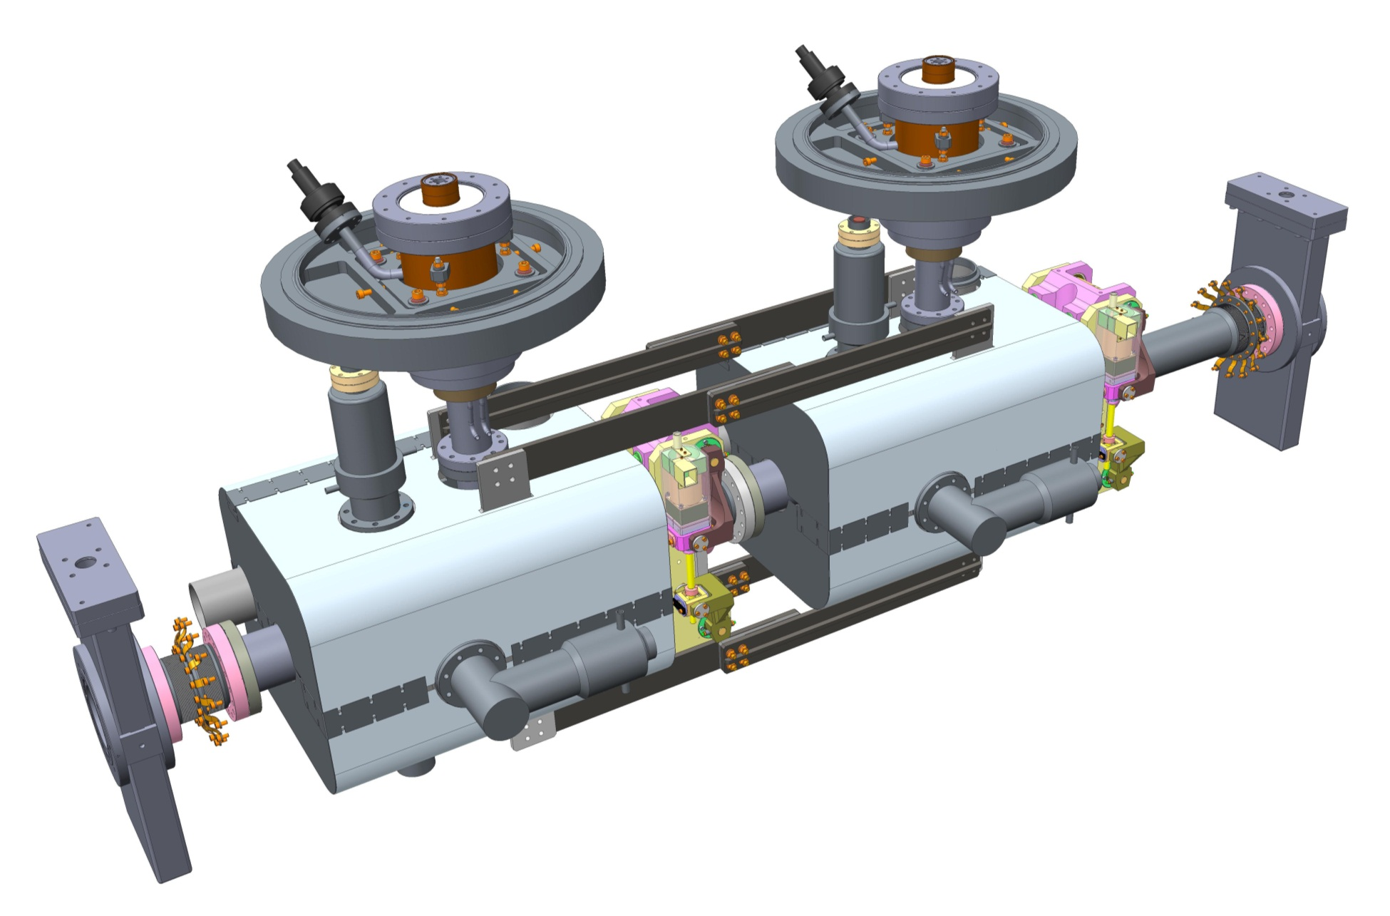
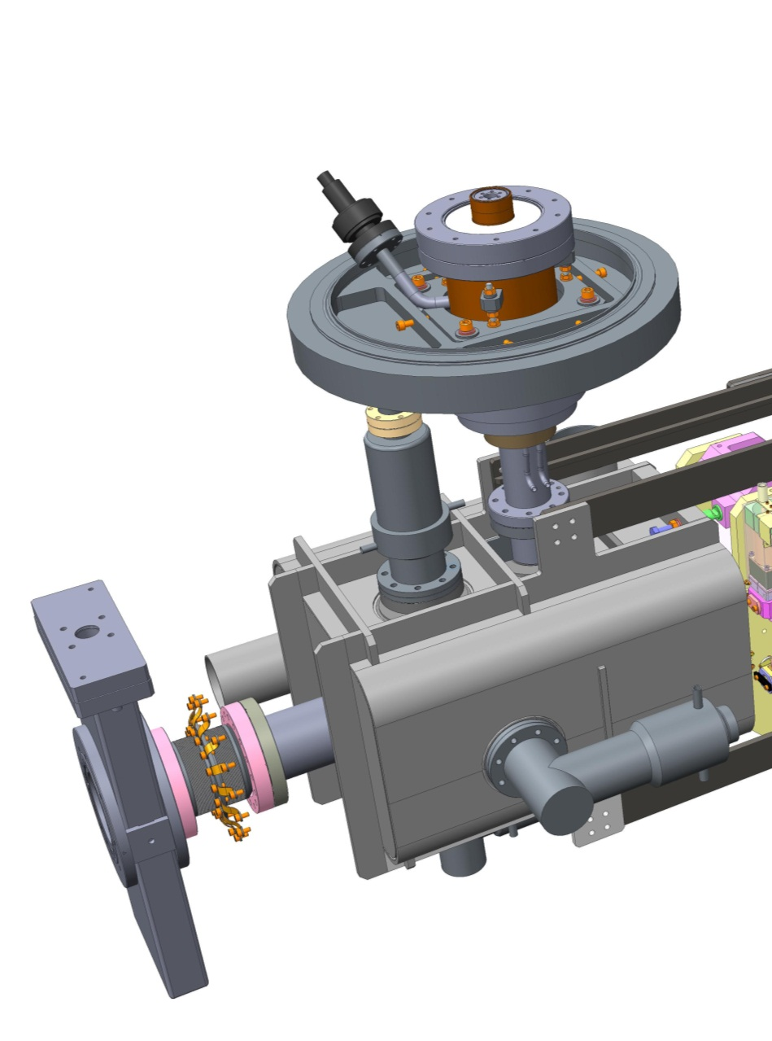
Cavity String
FPC support system
Fundamental Power Coupler
LOM absorber
Cavity in Helium Vessel
End lever tuning system
1mm thick Cryoperm magnetic shielding
Inter-cavity support
In vacuum all metal valve
Horizontal HOM absorber
Vertical HOM absorber
Total mass supported by outer wall of FPC = ~250Kg
2K – 300K transition bellows with 80K intercept

Slide 5
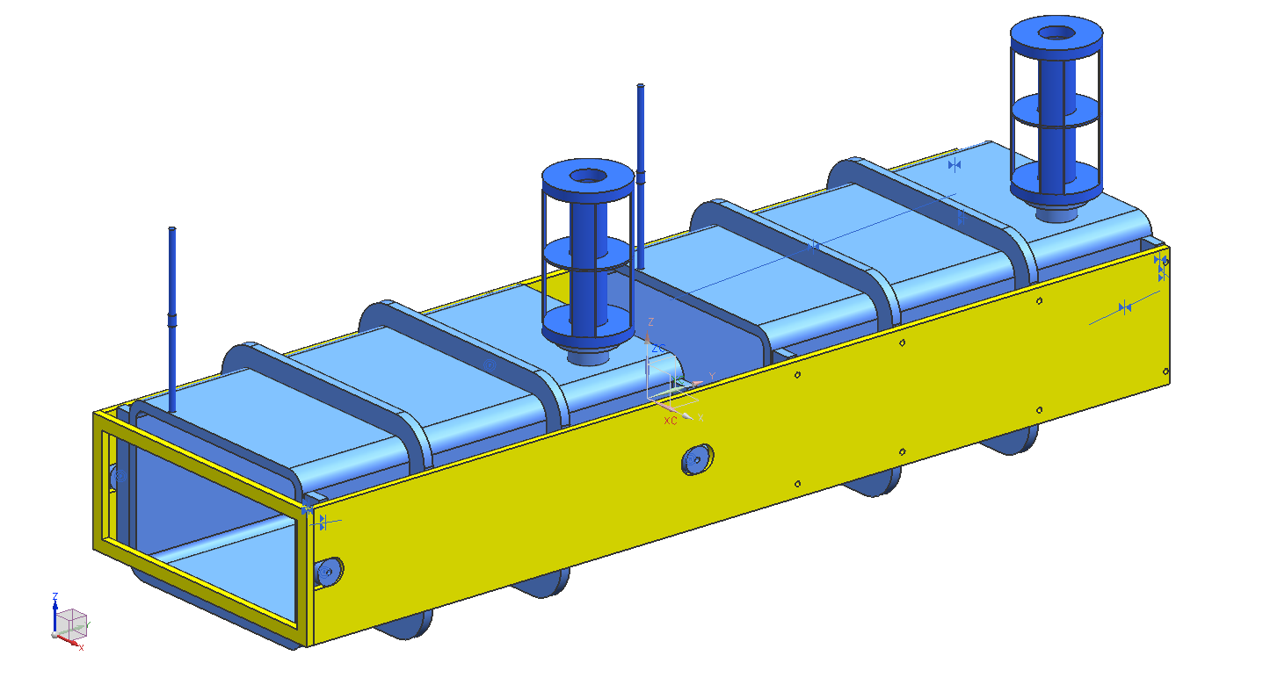
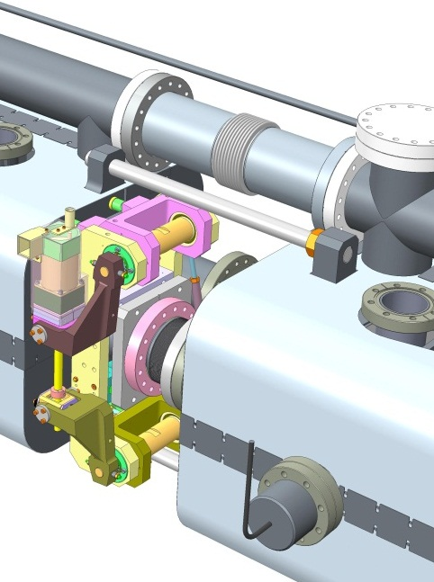
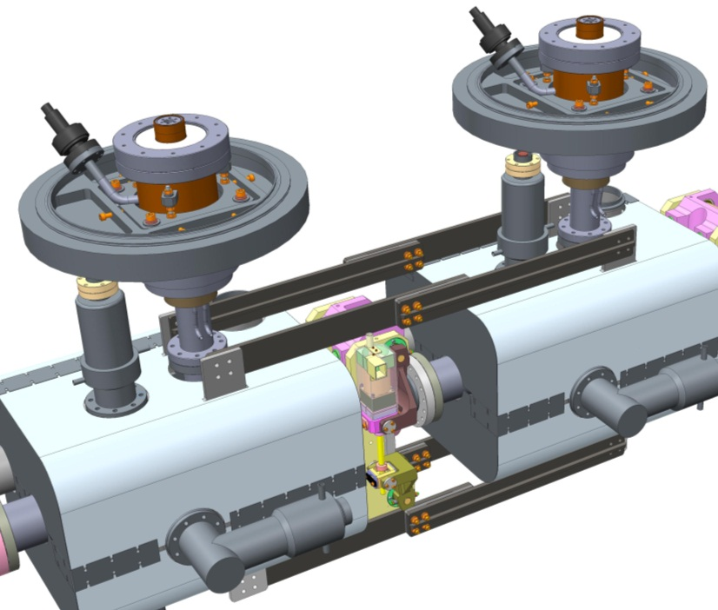
Inter-cavity support options
Side support: fixed at one end, rollers incorporated at the other.
Shaft system: Fixed at one end with linear bearings at the other.
Thermally neutral rigid supports.

Slide 6
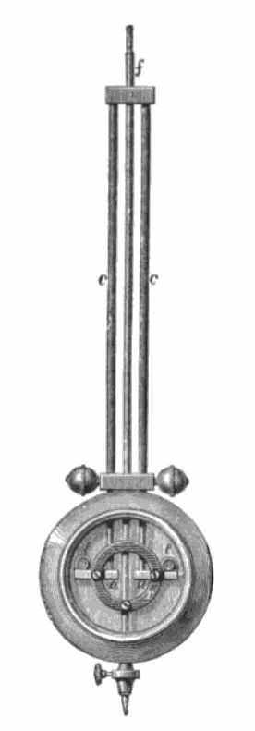
Thermally Neutral Inter-cavity support
Invar integrated contraction from room temperature to 2K is L_{i} x (0.037/100)
304 Stainless steel contraction from room temperature to 2K is L_{ss} x (0.306/100)
Therefore;
2L_{i} x (0.037/100) = L_{ss} x (0.306/100)
AND
2L_{i} – L_{ss} = 903mm (distance between fixed points)
So, 2Li x (0.037/100) = (2Li – 903) x (0.306/100)
Solving the simultaneous equation gives L_{i} = 513.6mm and Lss = 127.2mm

Slide 7
Thermally Neutral Inter-cavity support
Invar integrated contraction from room temperature to 2K is L_{i} x (0.037/100)
304 Stainless steel contraction from room temperature to 2K is L_{ss} x (0.306/100)
Therefore;
2L_{i} x (0.037/100) = L_{ss} x (0.306/100)
AND
2L_{i} – L_{ss} = 903mm (distance between fixed points)
So, 2Li x (0.037/100) = (2Li – 903) x (0.306/100)
Solving the simultaneous equation gives L_{i} = 513.6mm and Lss = 127.2mm

Slide 8
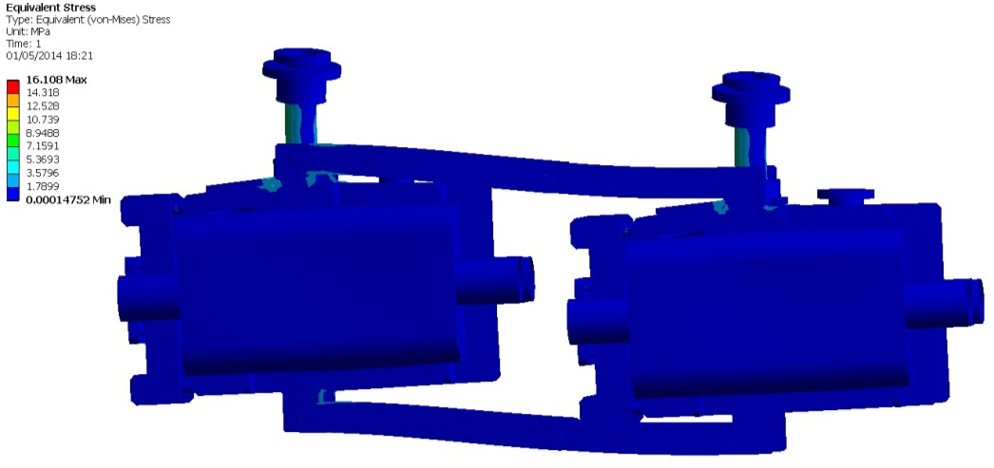
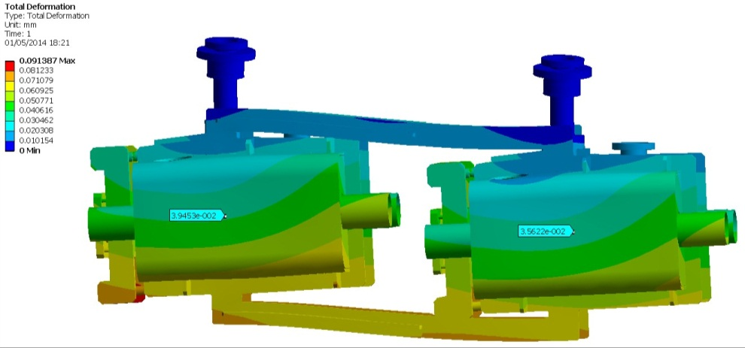
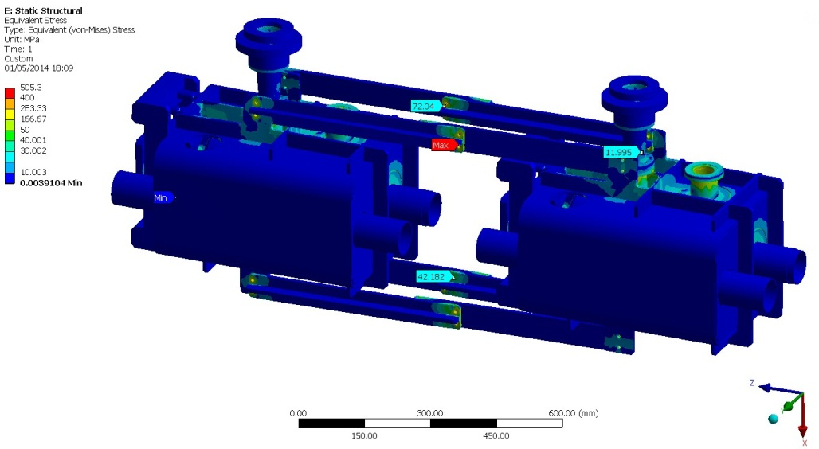
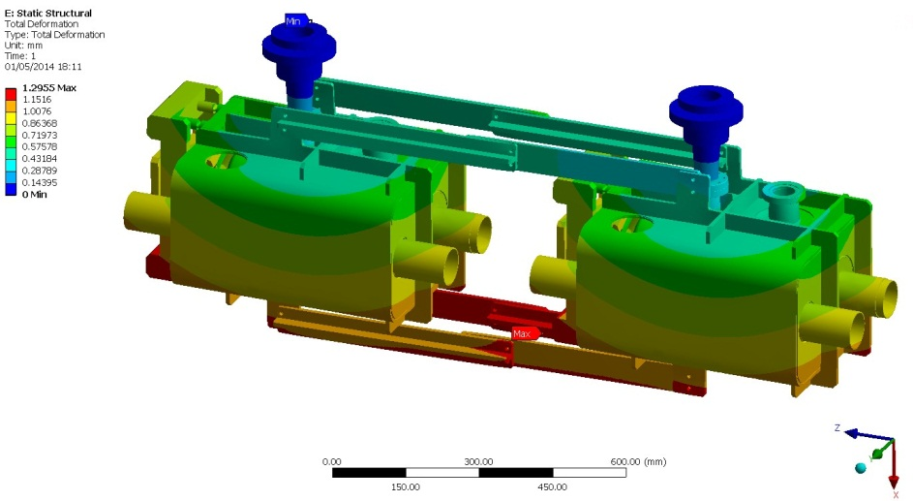
FEA of support system
With the mass of the cavity string the maximum stress in the support structure is 16MPa, deflections are all <100μm with cavity centres deflection by <40μm.
Stress anomaly at bolted interface
After cool down stresses remain low, at around 12MPa in the support structure. (Note lower stress than room temperature, likely due to increased stiffness of materials).

Slide 10
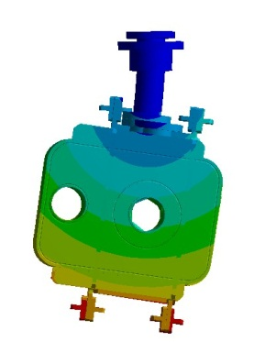
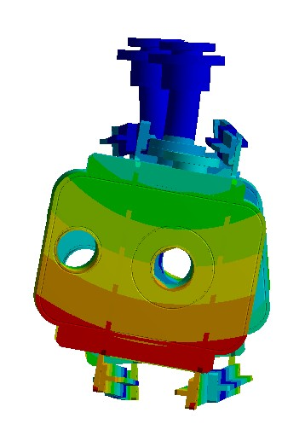
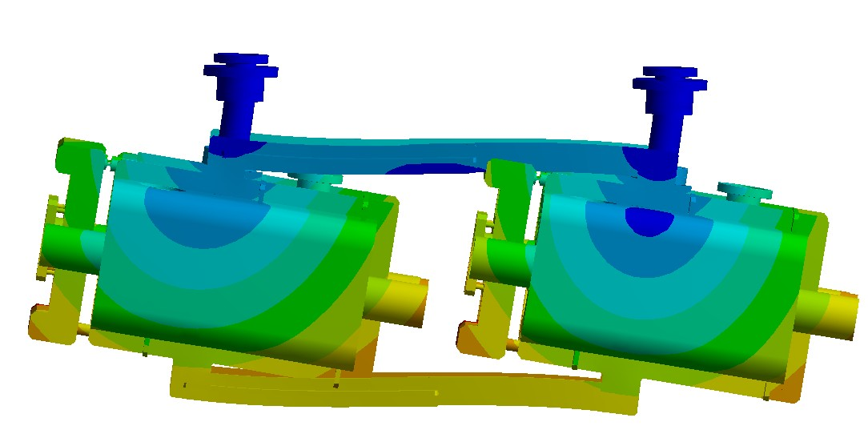
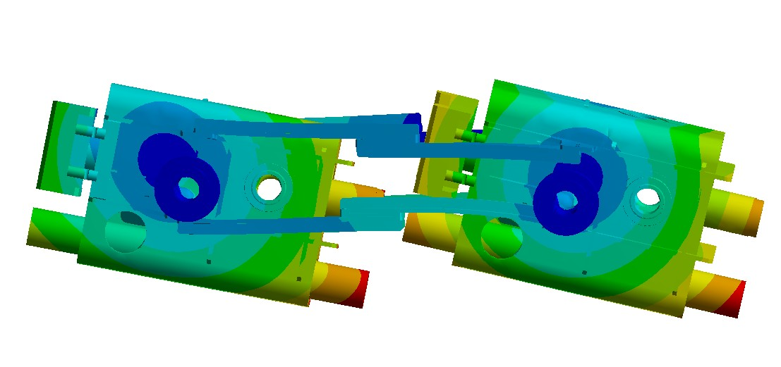
Deformation and vibration
Mode 1.
Mode 2.
Mode | Case 1. (Hz) | Case 2. (Hz)
1 | 15.3 | 16.0
2 | 15.3 | 21.6
3 | 16.9 | 29.2
4 | 16.9 | 32.8
5 | 23.2 | 87.7
6 | 23.2 | 89.9
Max Def | 0.23mm | 0.09mm
Max Stress | 21MPa | 16MPa
Mode 3.
Mode 4.
Case 1. Cavities on couplers as designed with no inter-cavity supports.
Case 2. Thermally neutral supports with couplers as designed

Slide 11
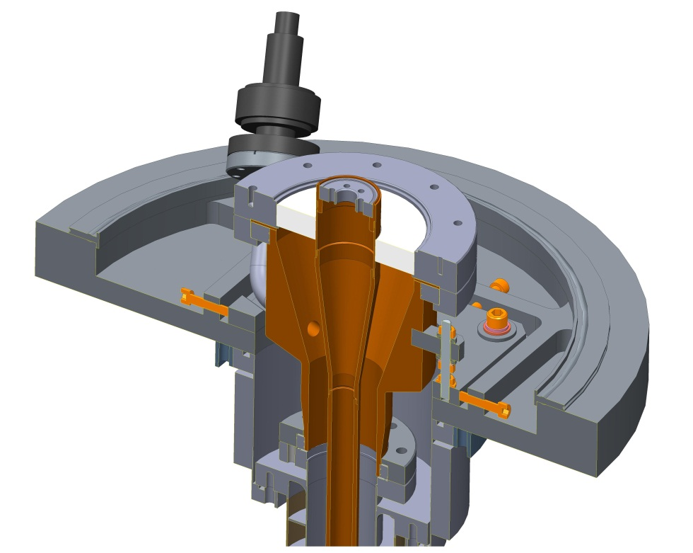
Input Coupler integration
Input coupler is the responsibility of CERN.
The adjustment system shown would position the cavities prior to fitting the inter-cavity support.
The mounting points for the inter cavity support could then be measured and the inter cavity support structure holes drilled to suit.
80K intercept
Ceramic
Thermal contraction
OVC mounting flange, based on ISO K 500 dimensions.
Support ribs
Beam vacuum
Water cooling channel

Slide 12
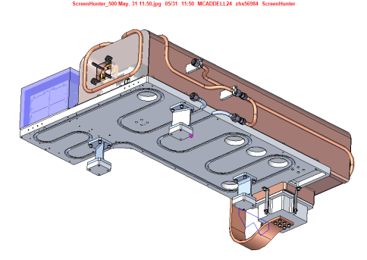
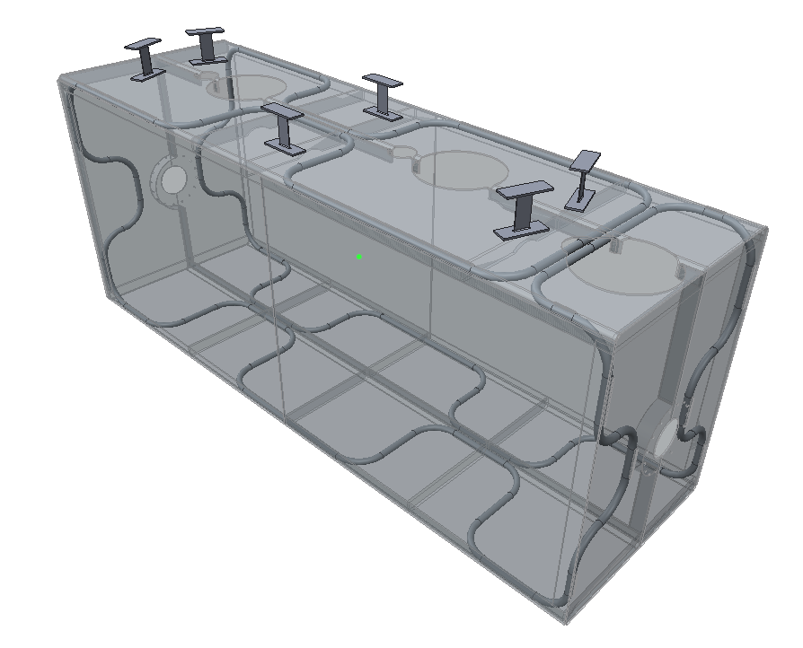
Thermal shield overview
Flexures optimised for maximum stiffness at 1W heat leak – 2mm thick x 40mm chosen
Flexure mounts arranged such that they create a fixed point at the centre of the shield.
Ref: Thomas Jones SPICE thermal test design
Thermal shield “Window frame”
Entire shield = 116Kg
Aluminium alloy tubing
1050 Aluminium shield
Removable side panels (fitted to frame during initial assembly)
Work performed by Manchester University undergraduate Andy May
Panel mass = 14Kg each at 6mm thick

Slide 13
Thermal shield analysis – Steady state
Pipes set at 80K
Calculated radiation load of 5 W/m2 applied to outer surfaces
5W to beam pipe intercepts
Convection coefficient of 5 W/m2K @300K to OVC (not shown)
Heat leak ~1W per flexure

Slide 14
Thermal and gravitational load applied
Maximum deformation 2.9mm
Uniform shrinkage

Slide 15
Very localised max stress in shield following cool down 116MPa which is still below 80K yield for tempered 1050 Aluminium (120MPa)
Real stress in shield looks far lower ~30MPa

Slide 16
Flexure design
Yield of Grade 5 at RT.
Maximum stress in flexures at 2mm thick by 40mm wide – 521MPa
Yield of Grade 5 Titanium at 300K is 868MPa

Slide 17
Cool down stresses
A full transient analysis of the shield will be performed.
However, as an initial estimation an analysis was run with one end of the shield at 80K and the other set to 300K
Maximum stress of 612MPa is in flexures and is acceptable.
Stresses in Aluminium panels are also at acceptable levels at ~40MPa.

Slide 18
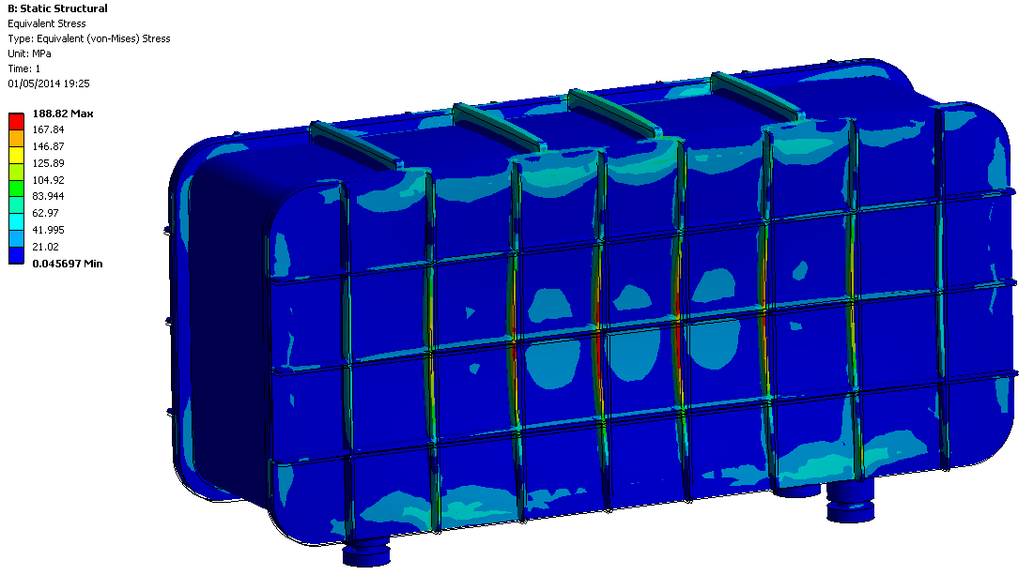
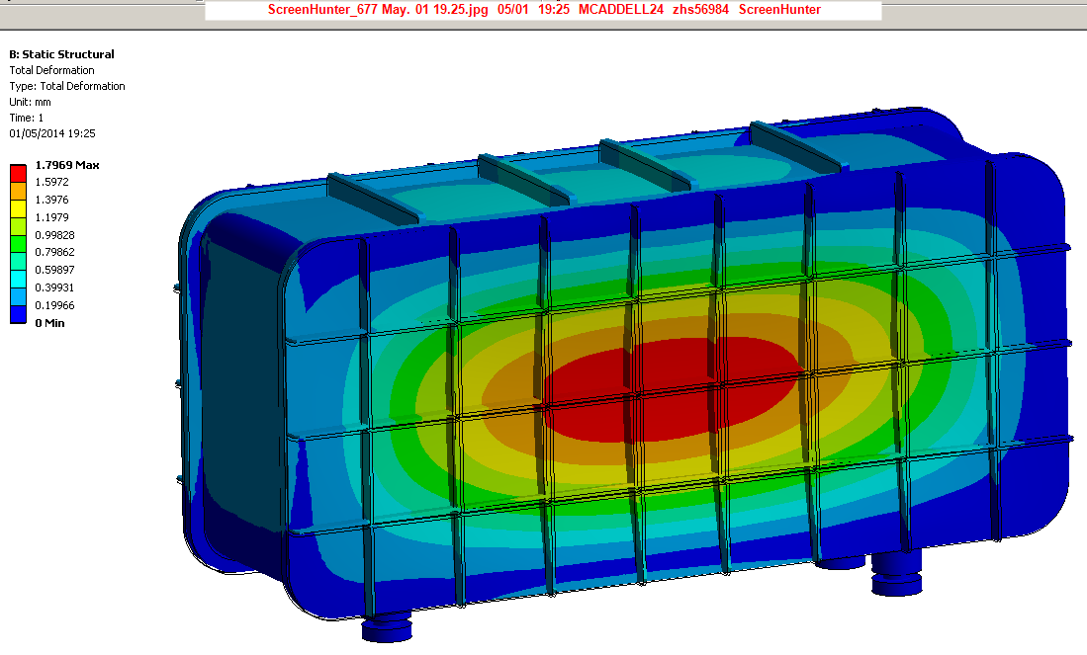
OVC Pressure analysis – Atmospheric pressure
0.1MPa applied to external surfaces, gravity and cavity string mass also applied.
Max stress 189MPa
Yield strength of S355 is 355MPa
Acceptable stress 355/1.5 = 237MPa
Max deformation = 1.8mm
Max deformation on coupler mounting points = 0.1mm
However, analysis does not include adjustment plates which would add additional stiffness.
Total mass = 1770Kg

Slide 19
Module in SPS
Cryo services
RF Input
Sliding support table

Slide 20
Specification
CERN-ACC-NOTE-2013-003:Table 9 |  | DL Cryomodule
Cryomodule Z length | 3000mm | 2590mm (For 4ROD this could be reduced)
Cavity axis to inner module edge | 420mm | 405mm
Cavity axis to outer module edge | 680mm | 455mm
Cavity axis to underside of module | 700mm | 540mm (remaining 160mm for X,Y,Z positioning assembly).
Cavity axis to top of coupler | 800mm | 1175mm (is this acceptable? It appears in the SPS CAD model that this may be feasible).
Cavity axis to SPS floor | 1200mm | 1200mm

Slide 21
Conclusions and Further work
A conceptual cryomodule for the UK 4-Rod cavity has been developed.
The side loaded approach improves access during assembly, operation and commissioning, which has been considered advantageous for this technology demonstrator module.
A novel thermally neutral inter-cavity support concept has been designed.
The thermal shield design has advanced to include initial thermal simulations and design of the flexure mounting system.
Further work may be required to stiffen the outer wall of the coupler if cavity string stiffness is deemed too low.
The outer vacuum vessel has been studied to ensure it can withstand its operational load, however, the feasibility of using it as a magnetic shield needs to be studied.
The mass of the OVC is high, further studies will be performed to try to reduce mass without affecting performance.
The cryomodule fits within the SPS envelope except for the overall height.

