Slide 1
RF Dipole Cavity
Integration in Cryomodule
Crab Cavity System External Review
BNL, 5-6 May 2014

Slide 2
Cryomodule is a collective engineering work of
CERN Engineering Team
Tom Nicol (Fermilab)
Zenghai Li (SLAC)
Shrikant Pattalwar, Tom Jones (STFC)
ODU

Slide 3
Outline
Helium vessel
  Material
  Design
  Pressure vessel analysis
Cryomodule design
  Design optimization efforts
  Assembly and alignment
Heat losses
Summary

Slide 4
Helium Vessel
RF Dipole Dressed Cavity Material Study : Tom Nicol/Fermilab
Purpose of the study : To evaluate the relative levels of cooldown-induced mechanical stress
HOM waveguide
Helium vessel
Input coupler port
HOM damper
Dummy beam tube
Tuner bellows
Case | Material configuration
1 | Stainless steel helium vessel with stainless steel flanges.
2 | Stainless steel helium vessel with Nb/Ti flanges.
3 | Stainless steel helium vessel with Nb/Ti flanges. HOM, coupler, and HOM damper ports have bellows connections where they exit the helium vessel.
4 | Titanium Grade 2 helium vessel with Nb/Ti flanges.
Downstream end
Upstream end
Results
*: Von Mises equivalent stress. | Config 1 | Config 2 | Config 3 | Config 4
Total deformation (mm) | 2.87 | 2.86 | 2.86 | 1.66
Sige* - helium vessel (MPa) | 192 | 189 | 175 | 71
Sige - cavity only (MPa) | 362 | 350 | 351 | 93
Sige - all flanges (MPa) | 335 | 168 | 47 | 47
dx (mm) (lateral) | 0.81 | 0.81 | 0.73 | 0.41
dy (mm) (axial) | 2.56 | 2.55 | 2.73 | 1.56
dz (mm) (vertical) | 1.56 | 1.56 | 1.18 | 0.84

Slide 5
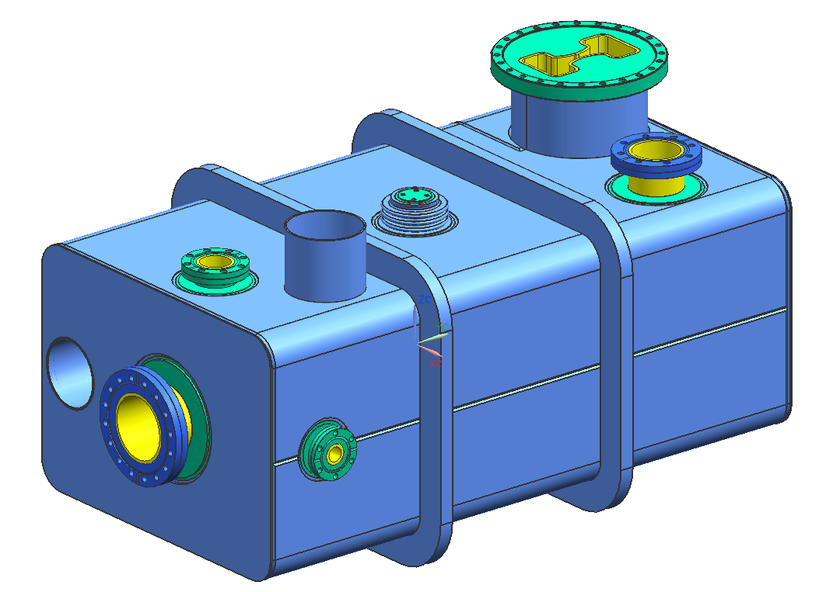
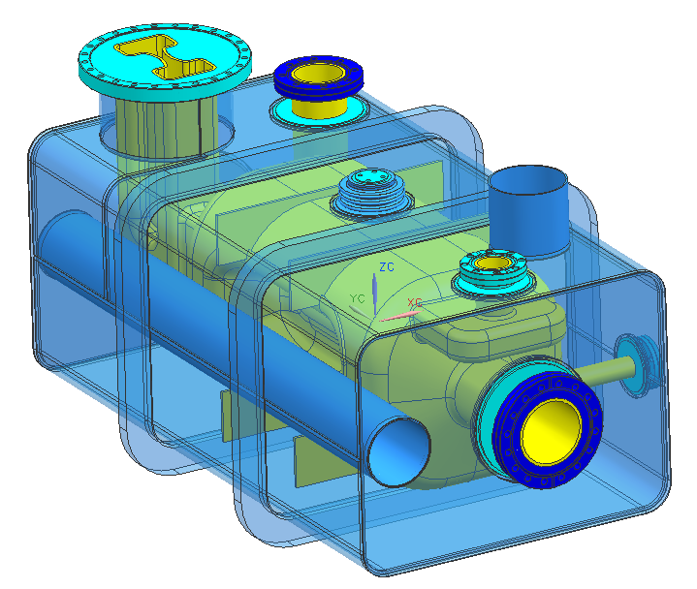
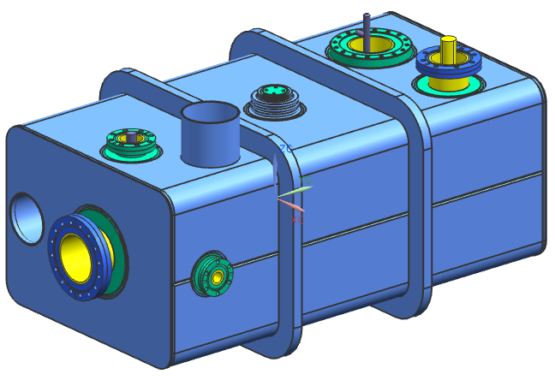
Helium Vessel
Tom Nicol - Fermilab
Total weight : 105 kg (for WG)
Helium volume : 54.47 L (for WG)
Materials
Light blue : Titanium grade 2
Blue : Stainless steel 316LN
Cyan : Niobium-titanium
Yellow : Niobium
330 mm
450 mm
835 mm

Slide 6
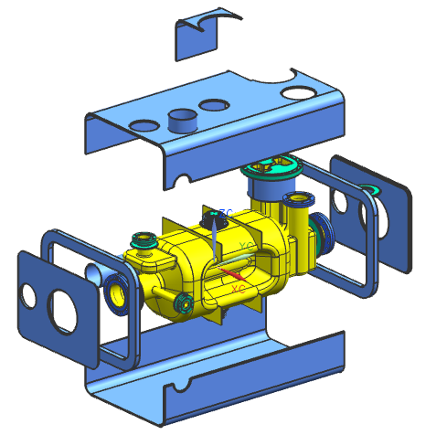
Helium Vessel Assembly
Assembly procedure and view
Nb/Ti flanges are welded to the ports during cavity welding.
Stainless flanges are brazed to the beam ports and coupler port before final welding.
Fit all the titanium helium vessel components and tack.
Final weld all titanium joints.

Slide 7
Pressure Vessel Analysis
Followed guideline of European Pressure Vessel Code
Design by analysis : EN 13445-3:2002 Annex C
Material properties (room temperature) provided by CERN engineering
Modulus of elasticity : 100 GPa
Poisson’s ratio : 0.4
Loads : Gravity + 1.8 bar Pressure
Allowable design stress : 50 MPa (≡ f) for Niobium
Criteria
  General membrane stress ≤ f
  Membrane stress + bending stress ≤ 1.5f
Use the dressed cavity model

Slide 8
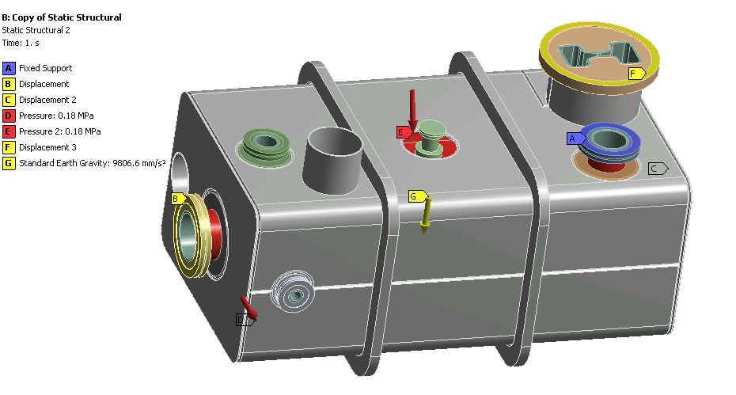
Pressure Vessel Analysis
Boundary conditions

Slide 9
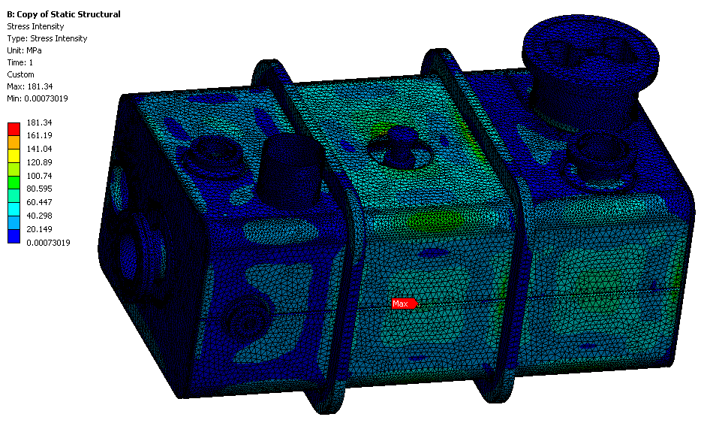
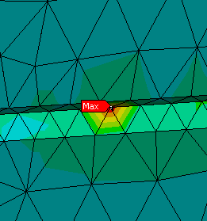
Pressure Vessel Analysis
Titanium grade 2 yield strength min 275 MPa

Slide 10
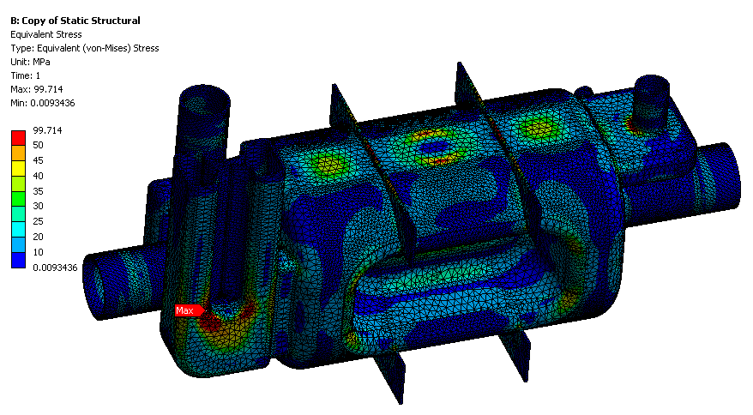
Pressure Vessel Analysis
Peak stress areas over 50MPa

Slide 11
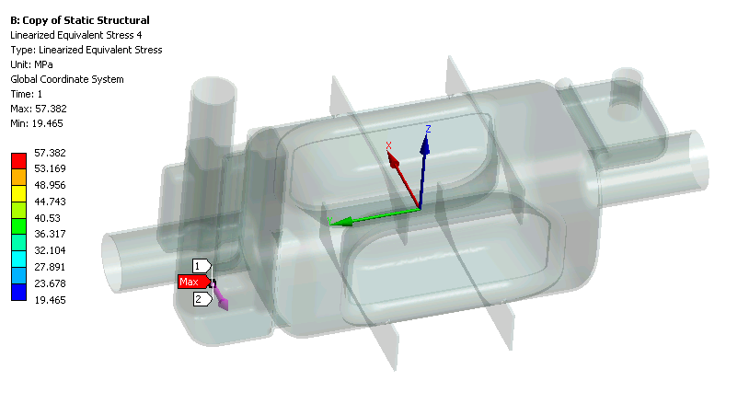
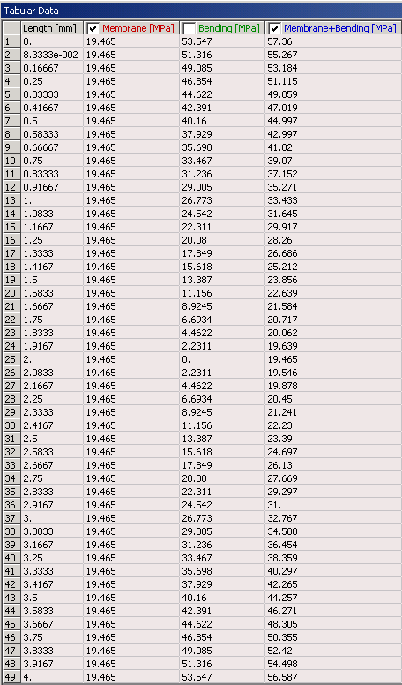
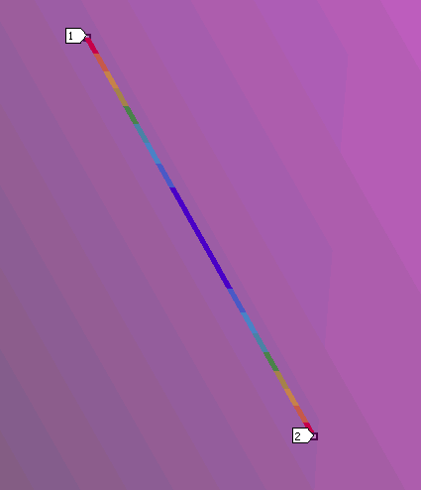
Pressure Vessel Analysis
General membrane stress below 50 MPa throughout the cavity.
Peak stress areas over 50 MPa still satisfies the criteria.

Slide 12
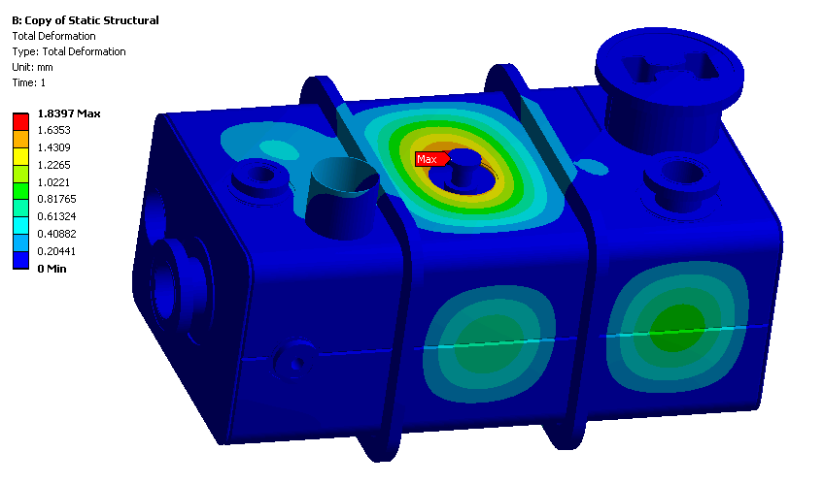
Deformation – Helium Vessel

Slide 13
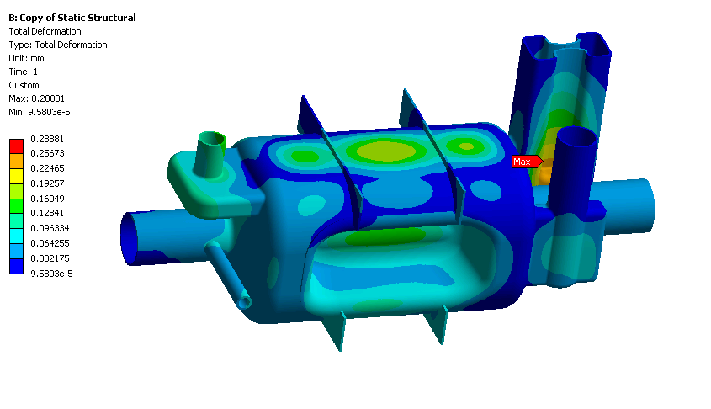
Deformation – Cavity

Slide 14
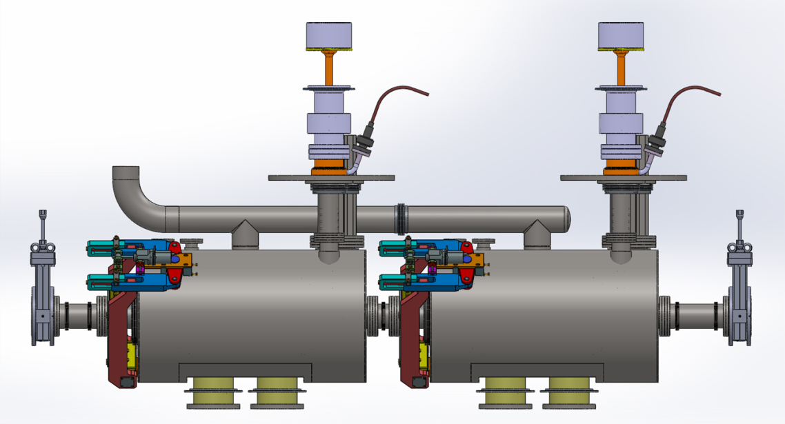
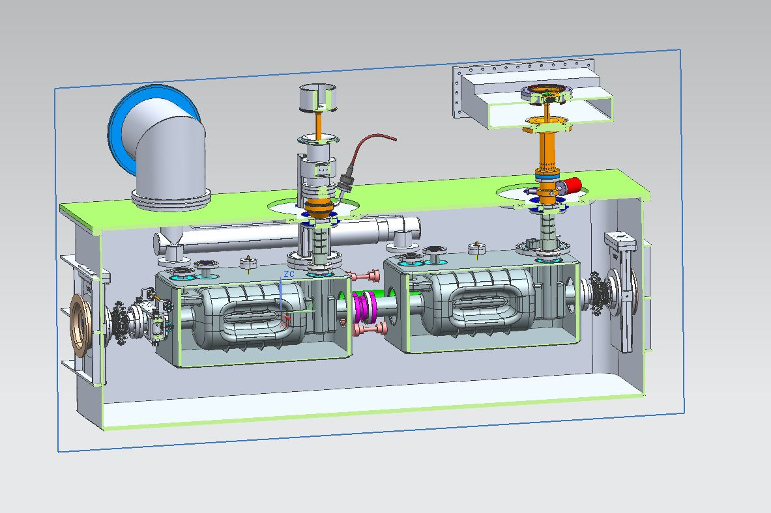
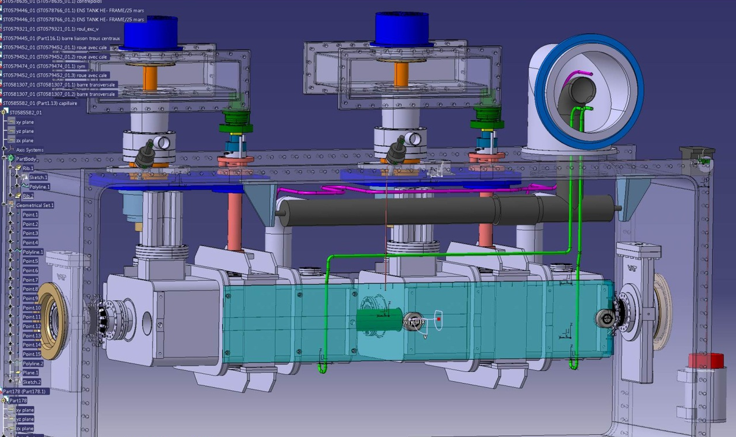
Cryomodule Design Evolution

Slide 15
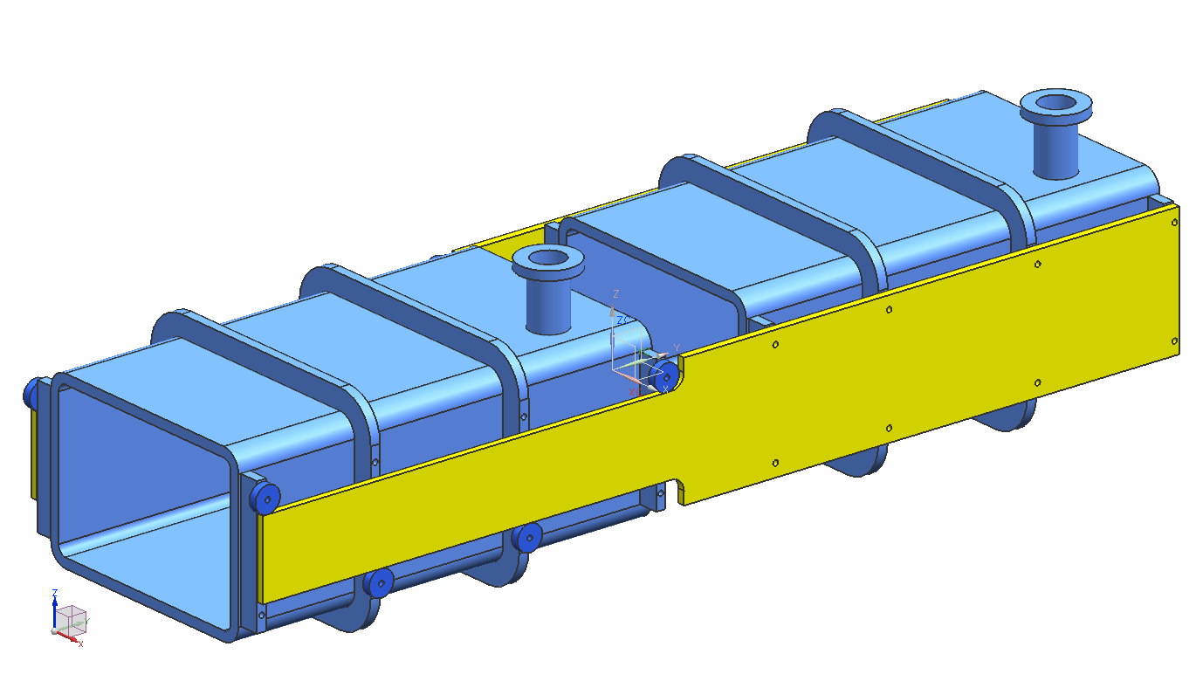
Cryomodule Support Analysis
Model of the dressed cavity to simulate the size, shape, material and weight.
The support rails are fixed to the downstream helium vessel at the reinforcing rings and two additional attachment rails on each side.
The upstream cavity is supported vertically using frictionless wheels and laterally by frictionless contacts with the rails at two places on each side.
The top surface of both coupler flanges is a fixed support.
The loads are standard gravity in the -z direction and cooldown to 2 K.
Different boundary cases are repeated.
Fixed supports
Downstream (DS) dressed cavity
Tom Nicol/Fermilab
Upstream (US) dressed cavity
Gravity load
Side rail guided on US cavity by frictionless wheels and buttons
Side rail fixed on DS cavity

Slide 16
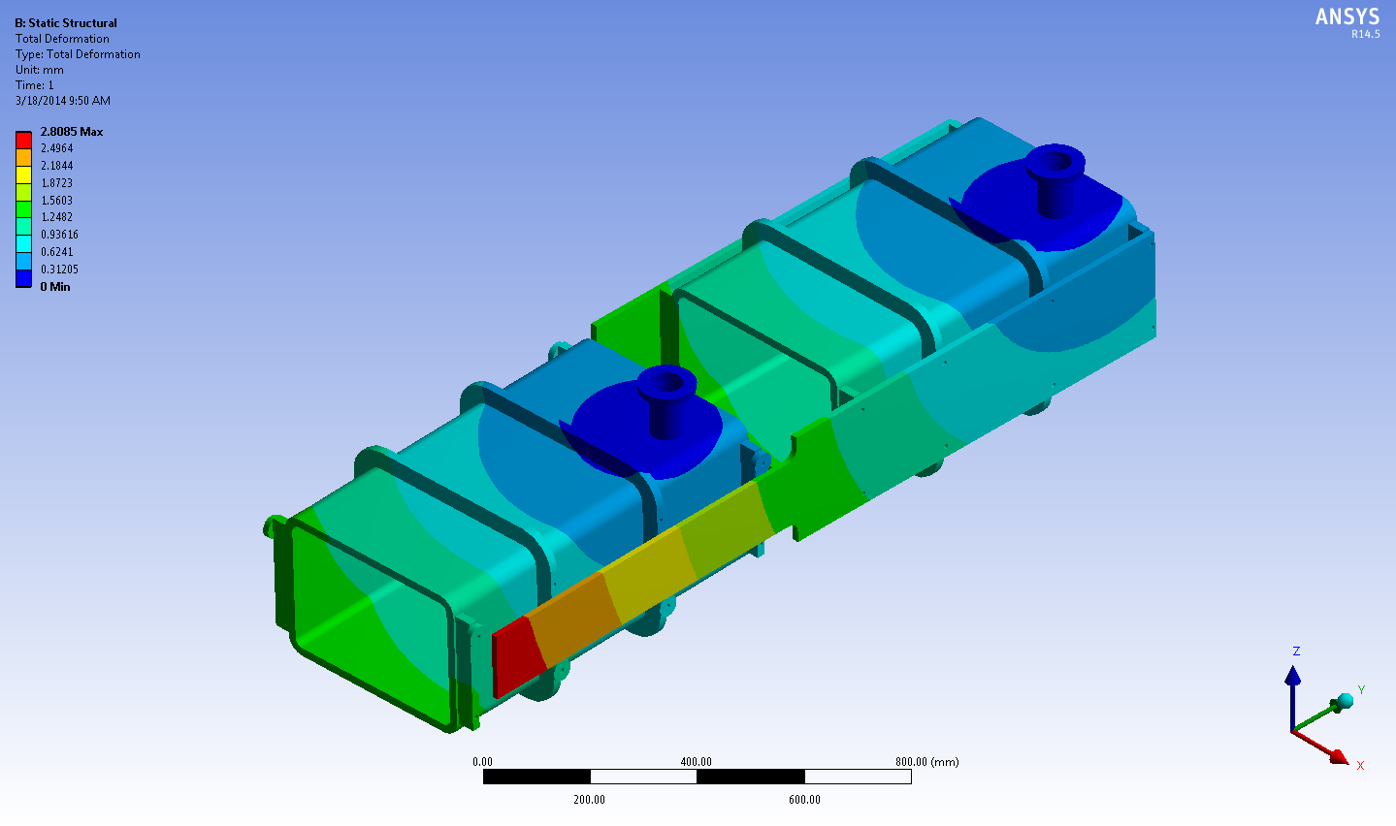
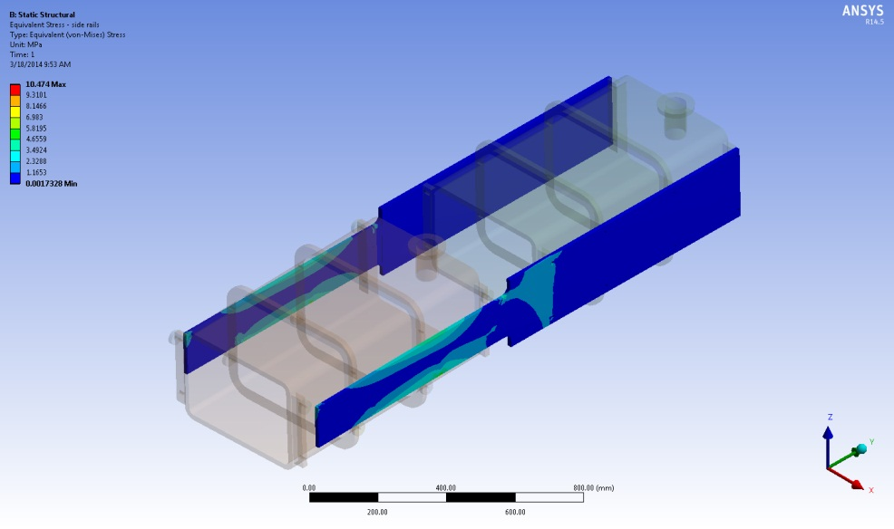
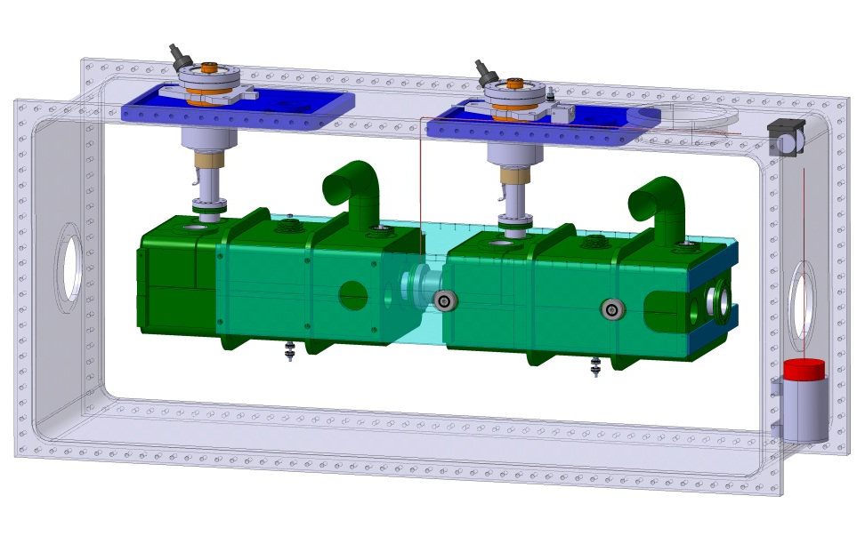
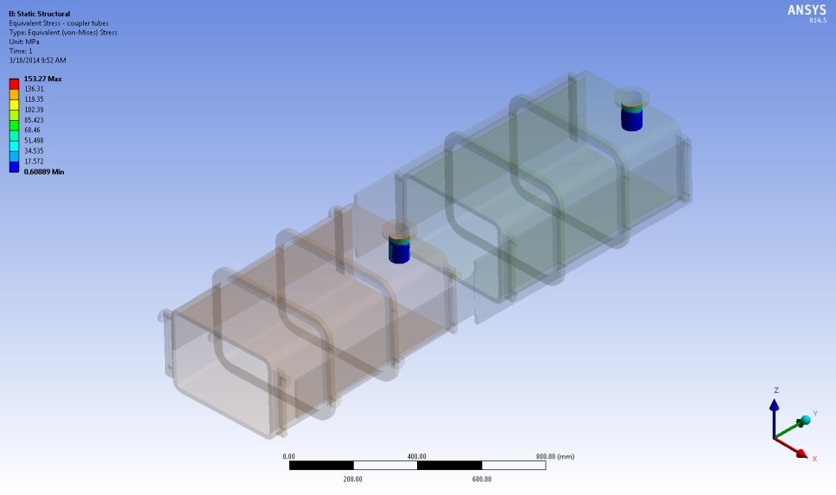
Cryomodule Support Analysis
Deflection 1mm not OK
Support rail stress OK
Coupler body stress OK
Support added to limit the deflection

Slide 17
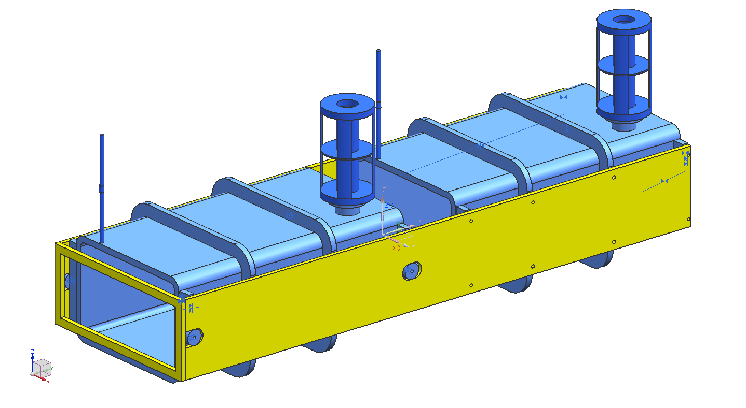
Cryomodule Modal Analysis
Tom Nicol/Fermilab
Downstream hanger
Fixed supports
Dressed cavity weight ~ 121 kg each
All materials: Titanium Grade 2
Gravity load
500 mm
Entire structure at 2 K
Upstream hanger
Side rails fixed to DS cavity
Due to the long geometry low frequency mode present.
Solution (damper or …) is being sought
Frictionless rollers, 2 each side
Frictionless lateral supports, 2 each side (not visible)

Slide 18
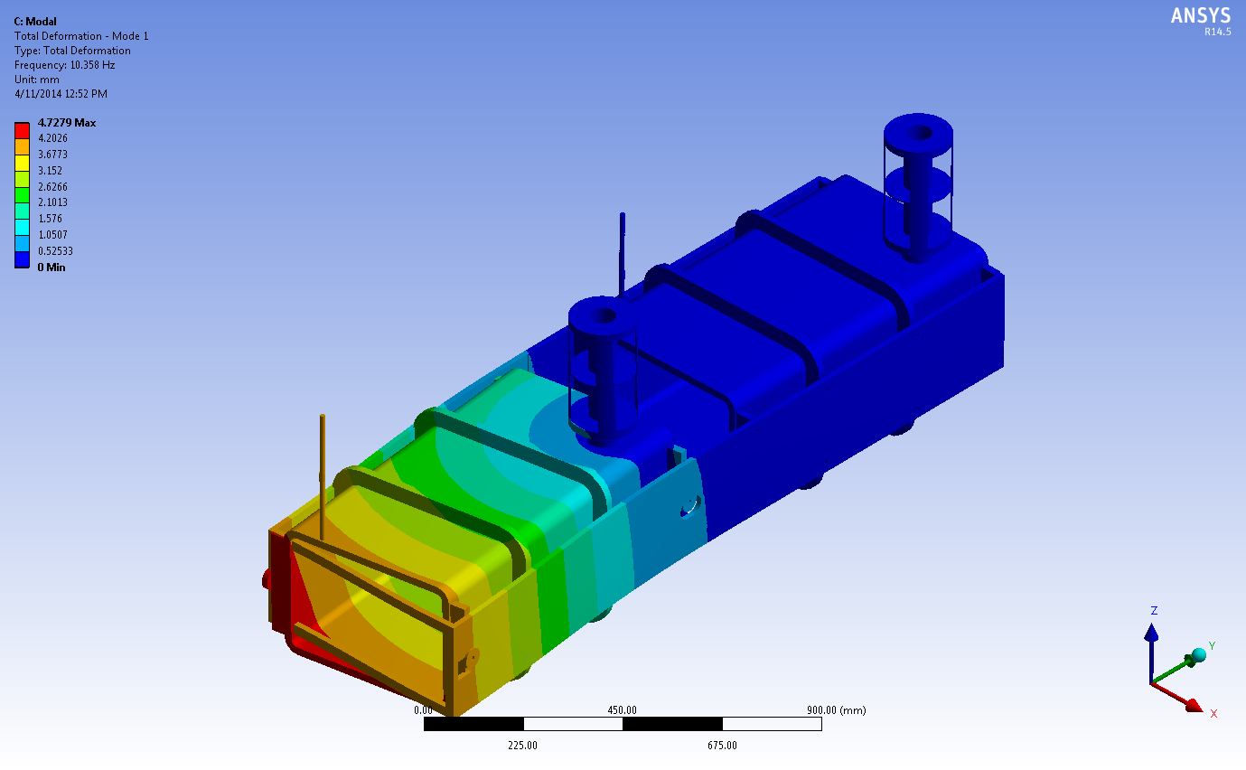
Cryomodule Modal Analysis
Tom Nicol/Fermilab
1st mode 10 Hz
Worst case: Latest side rail design without free ends connected
Mechanical mode separation between cold mass and cavity.

Slide 19
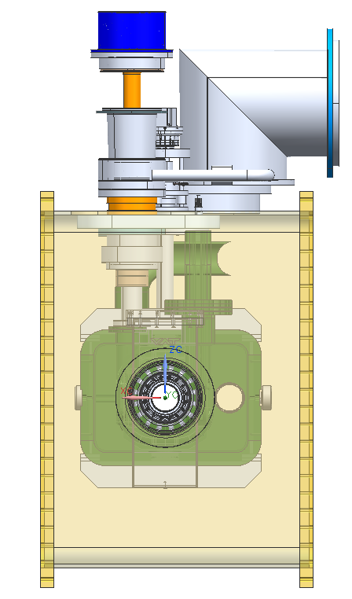
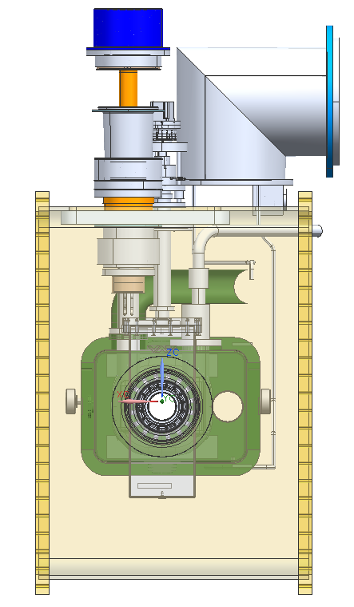
Dimensions
622 mm
1194 mm
637 mm
Waveguide
Coaxial
820 mm
820 mm

Slide 20
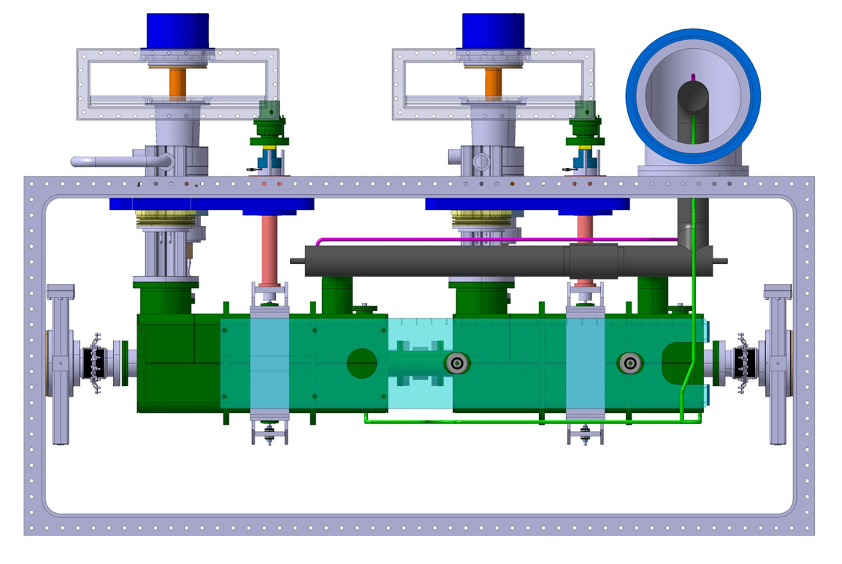
Cryomodule Design
Waveguide HOM coupler
2630 mm

Slide 21
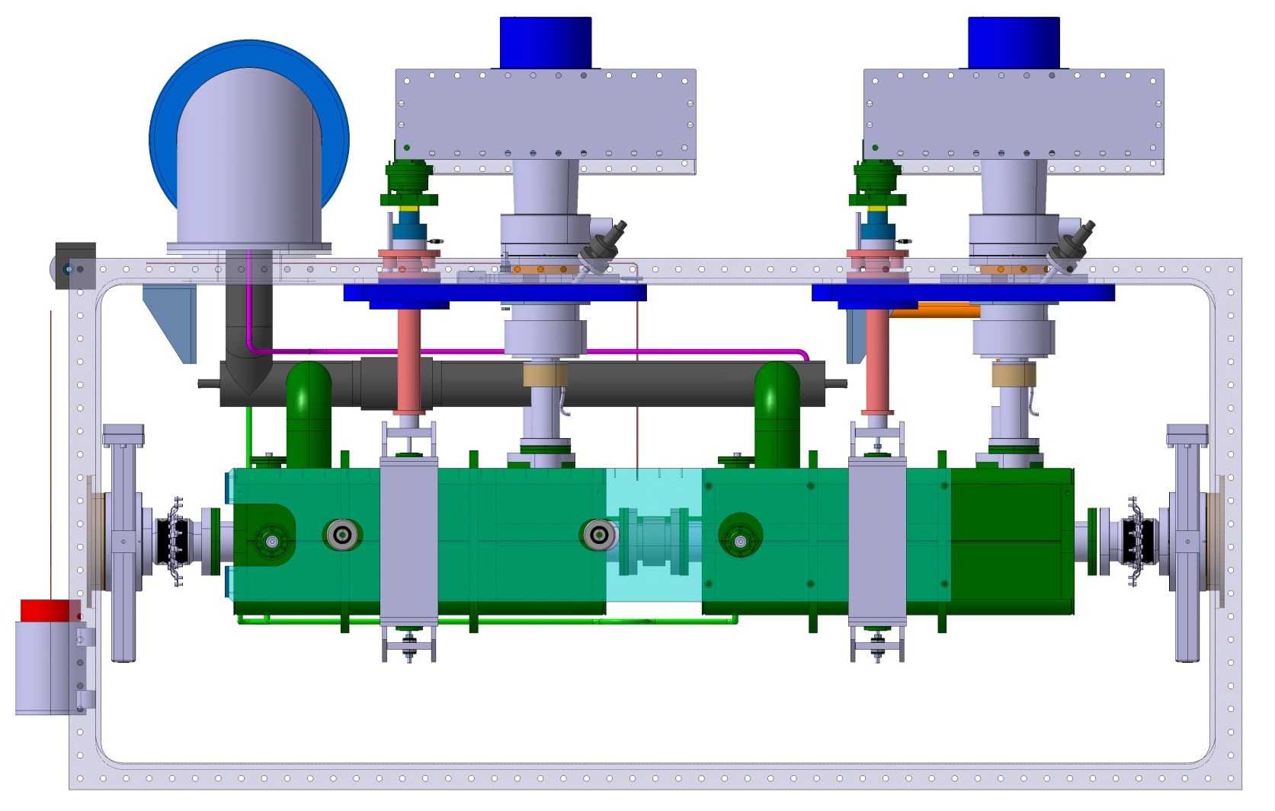
Cryomodule Design
Coaxial HOM coupler
2630 mm

Slide 22
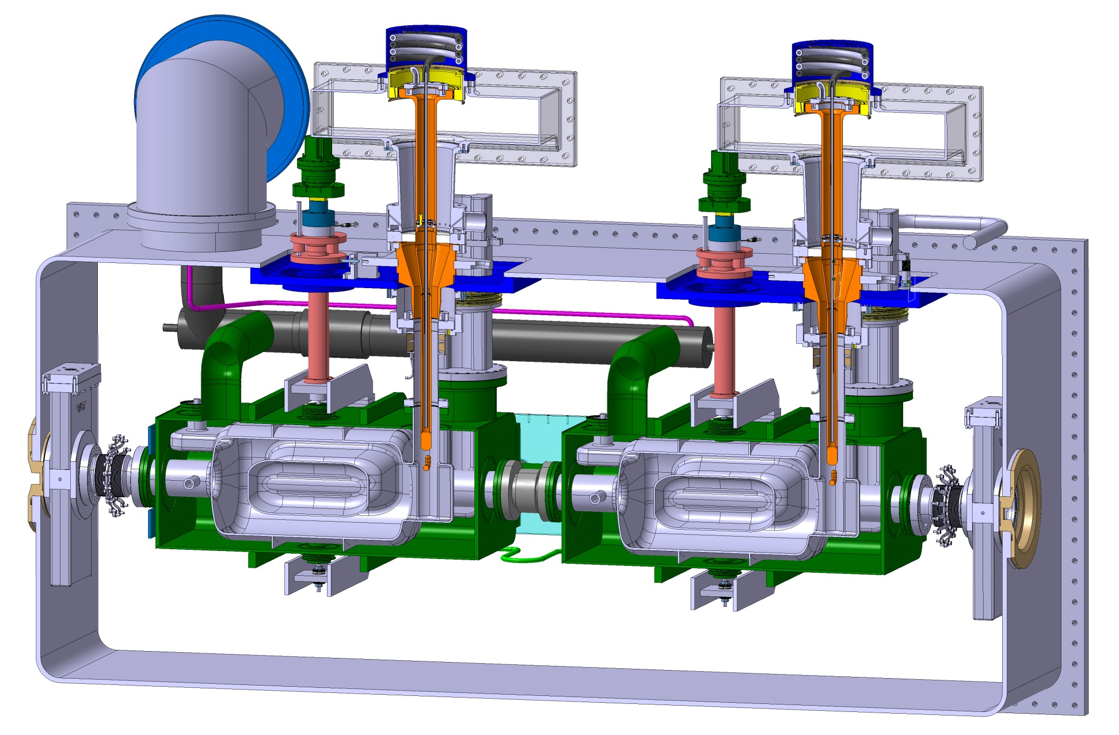
Cryomodule Design
Waveguide HOM coupler

Slide 23
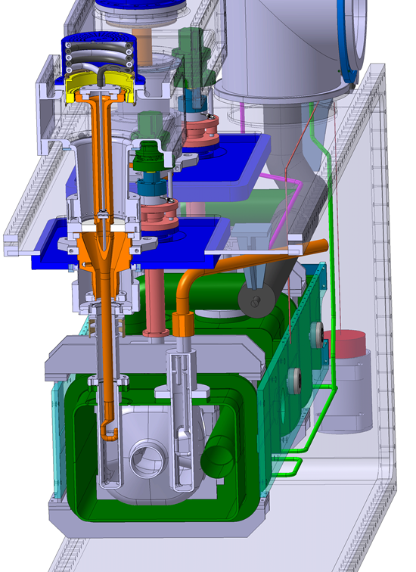
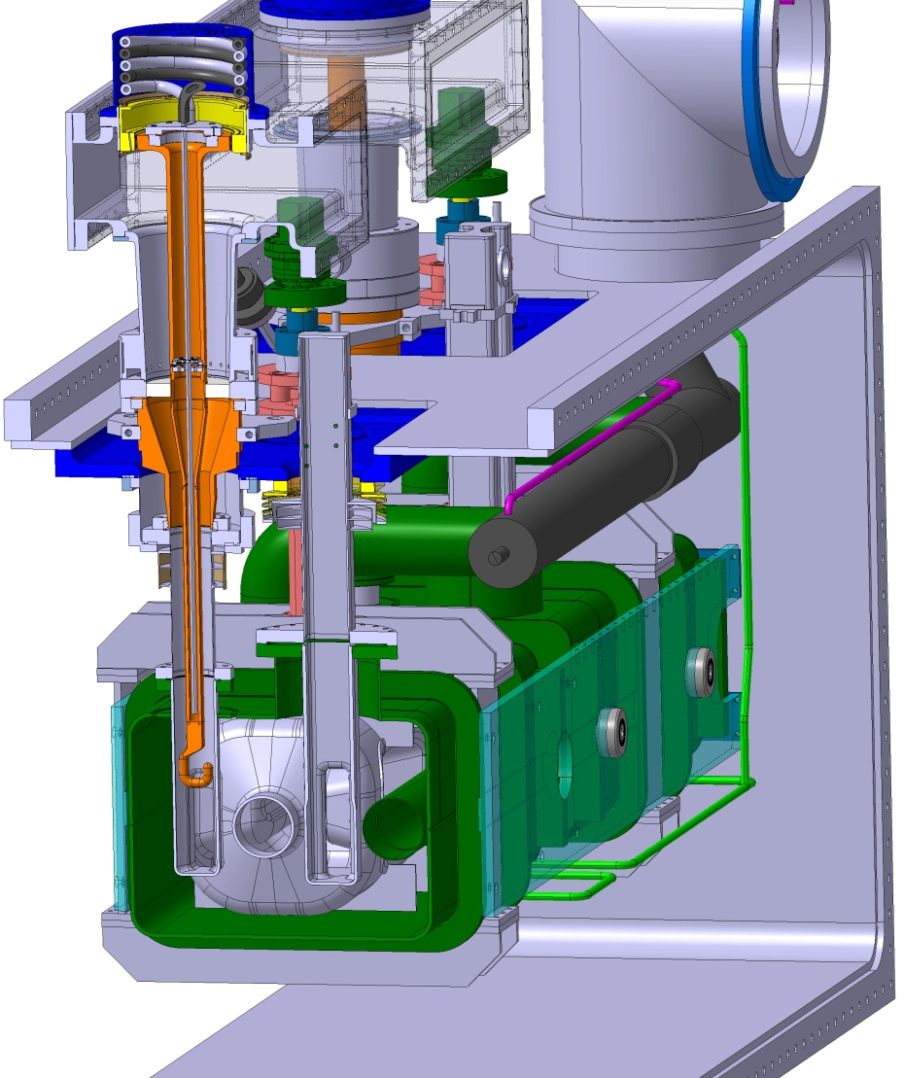
Cryomodule Design
Coaxial HOM coupler
Waveguide HOM coupler

Slide 24
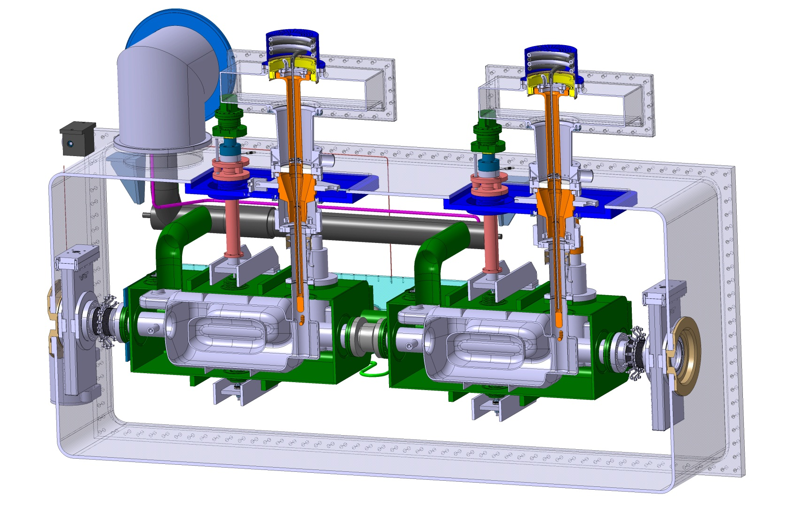
Cryomodule Design
Coaxial HOM coupler

Slide 25
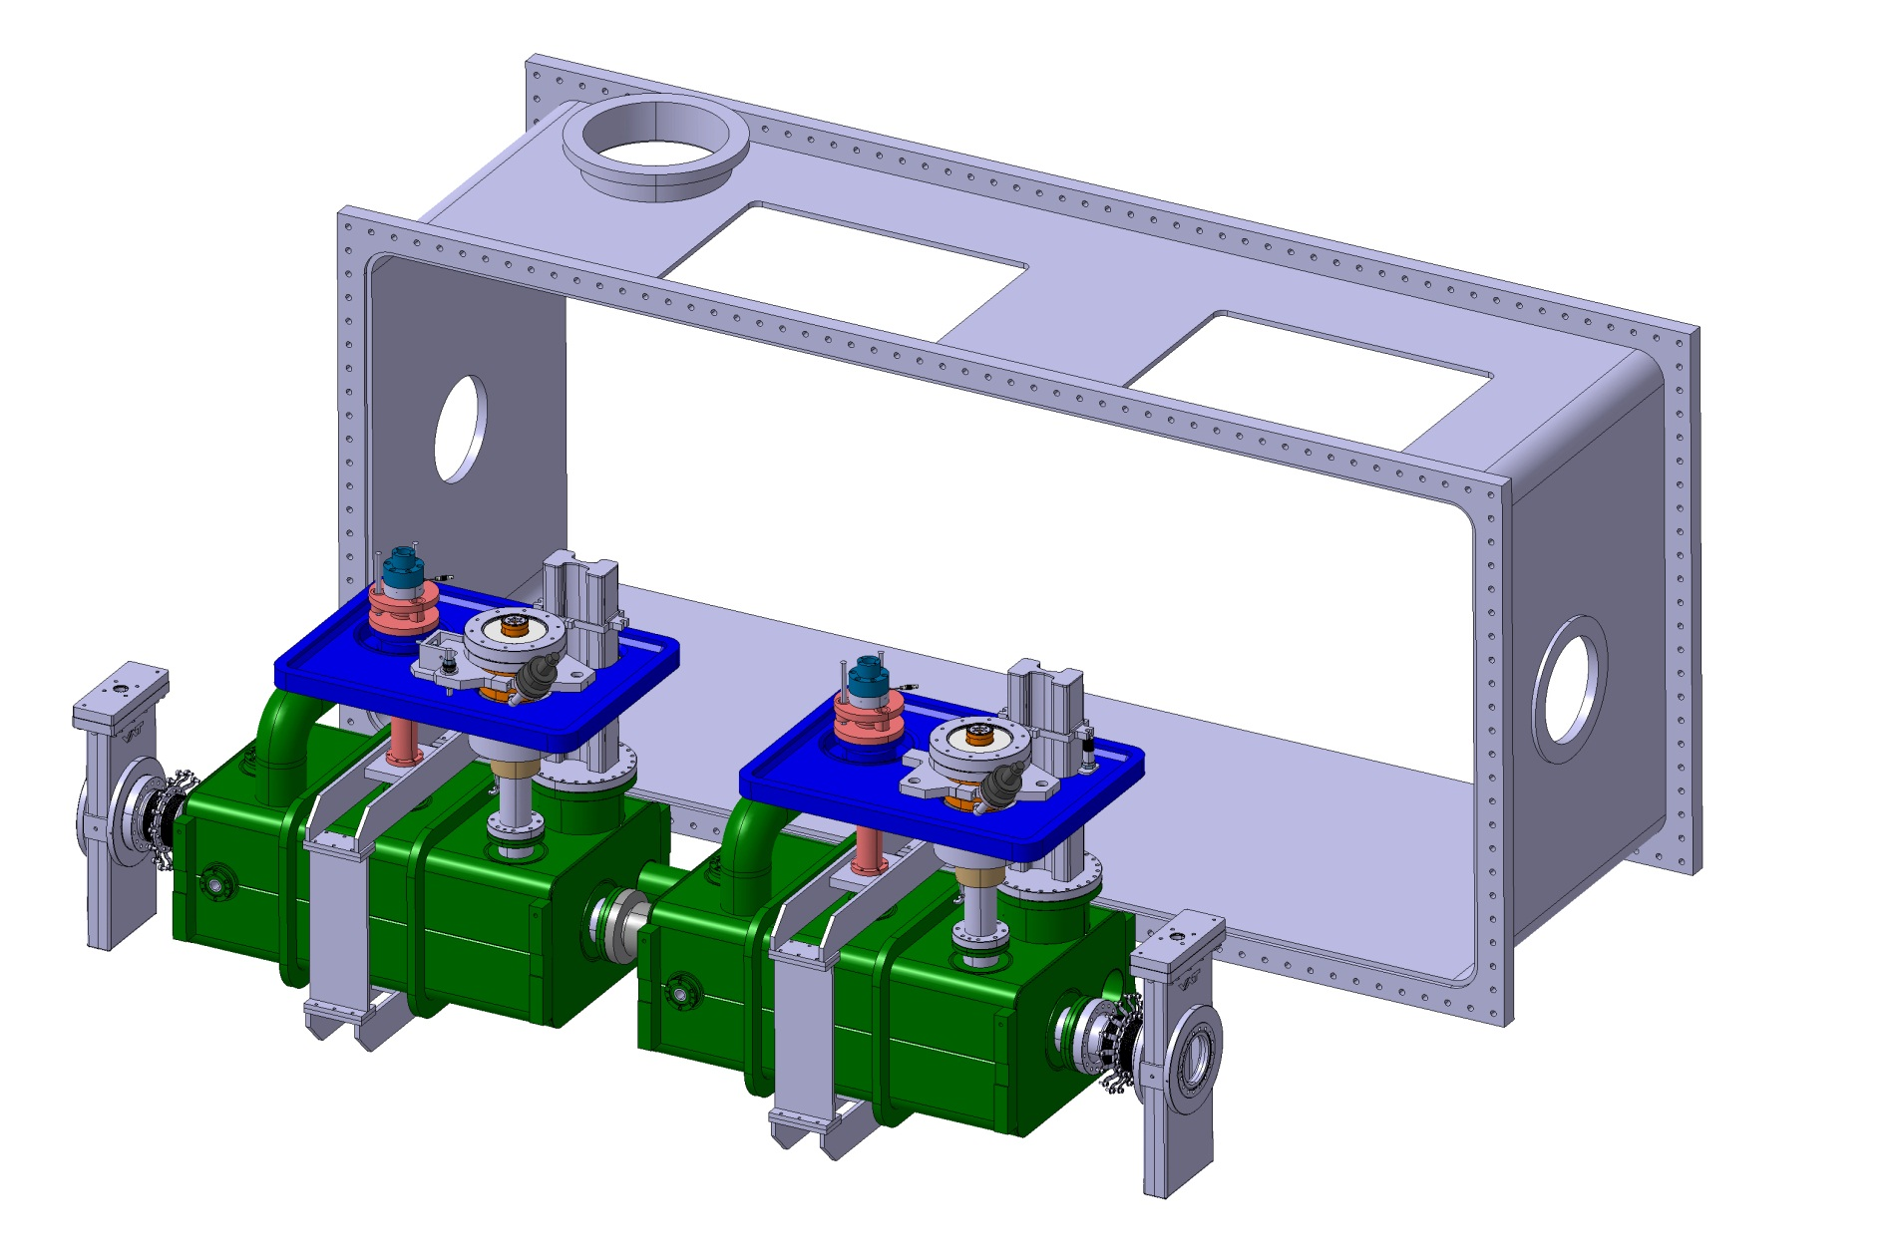
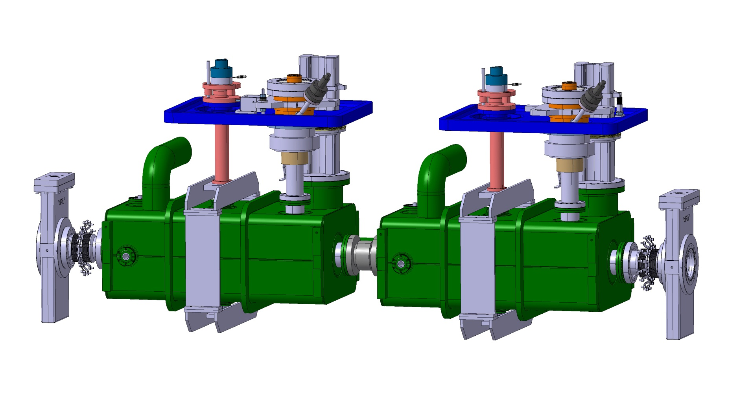
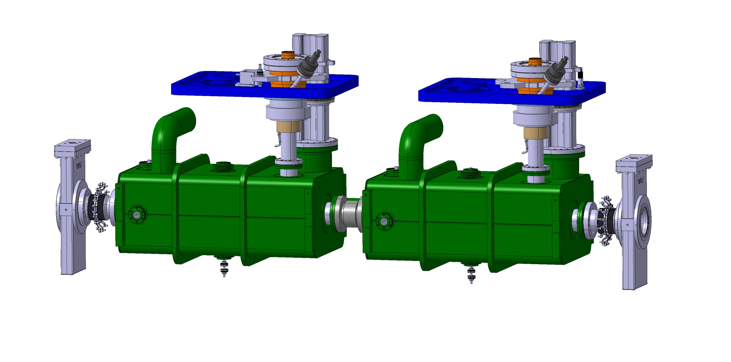
Cryomodule Assembly

Slide 26
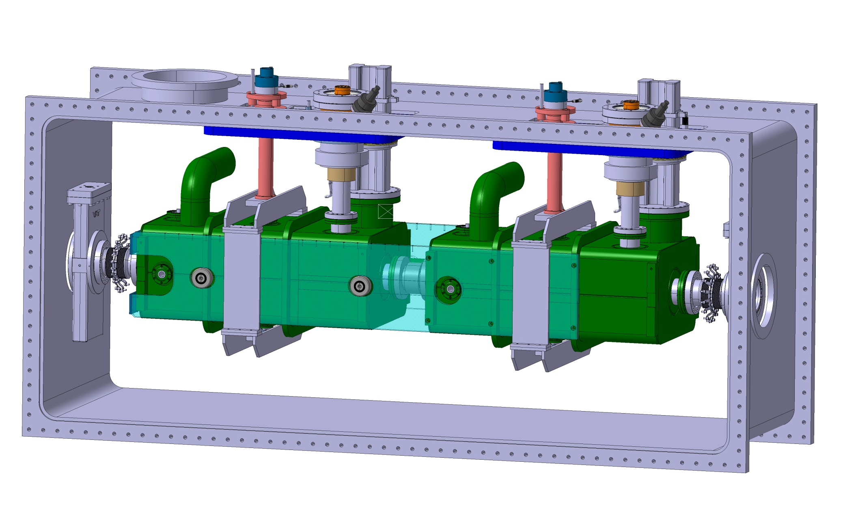
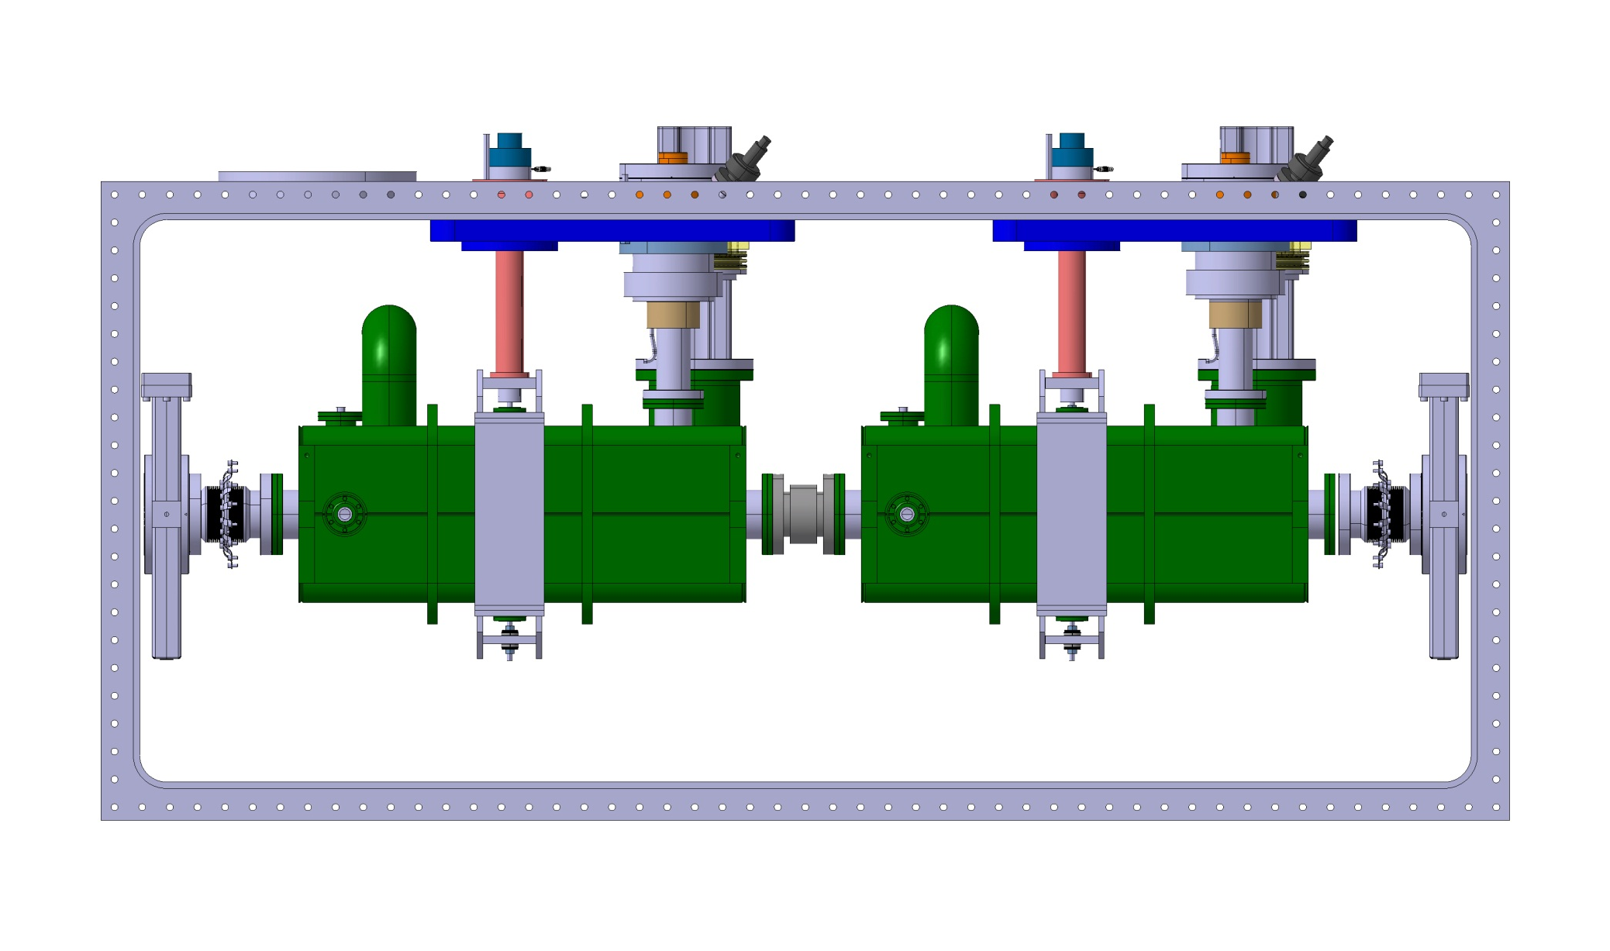
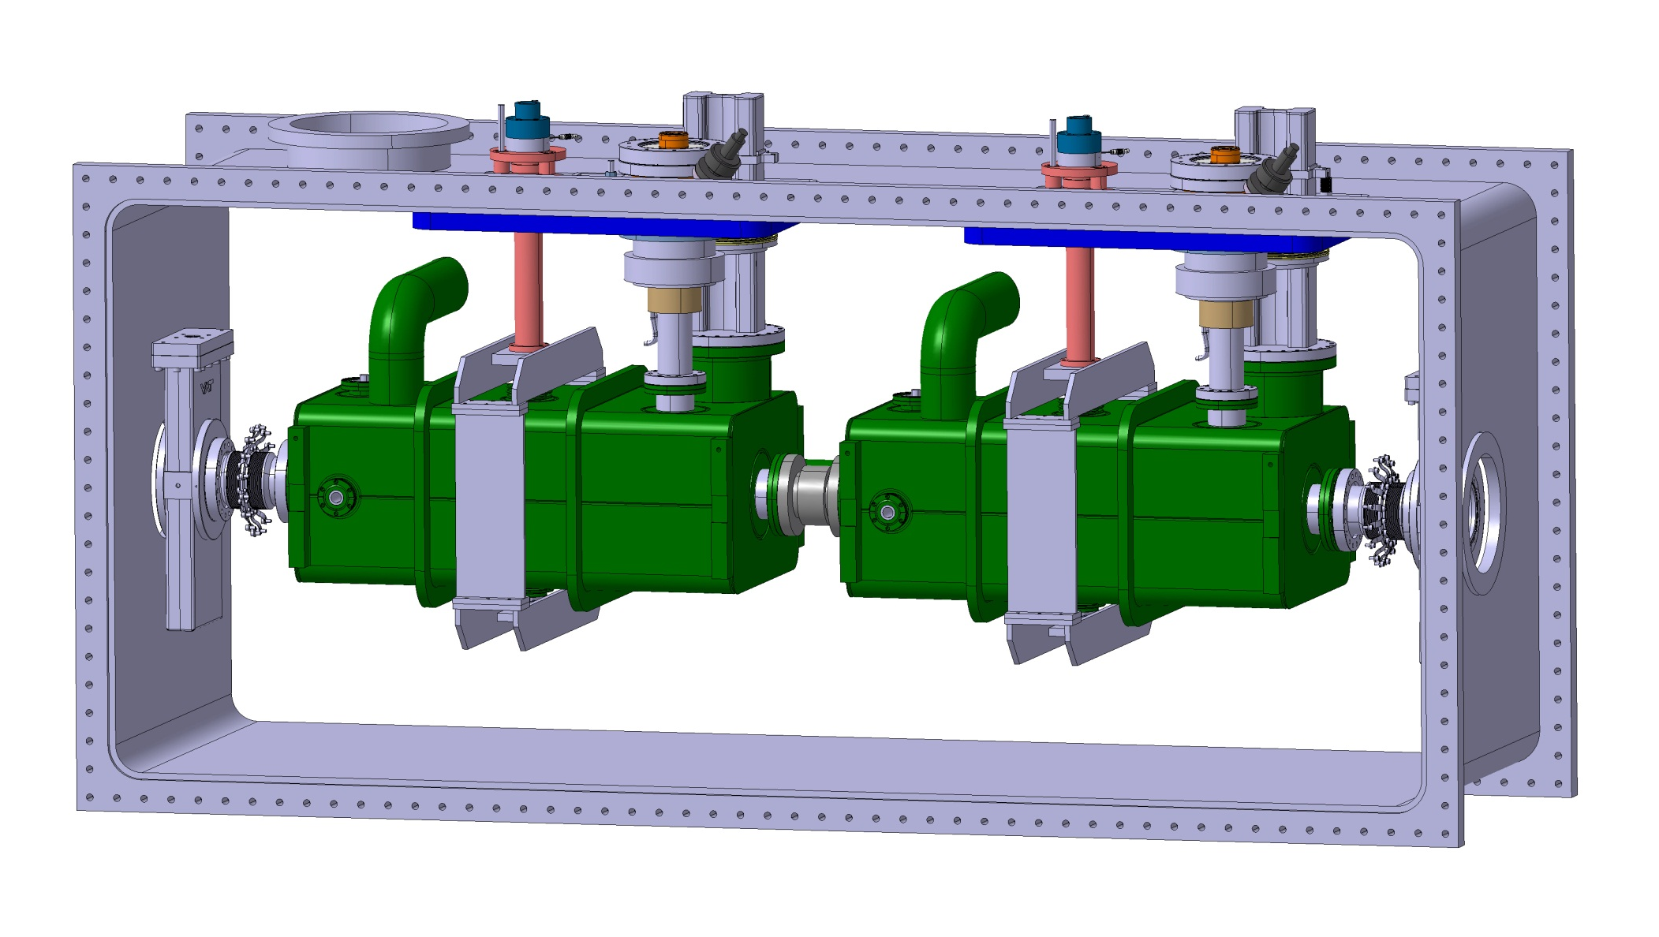
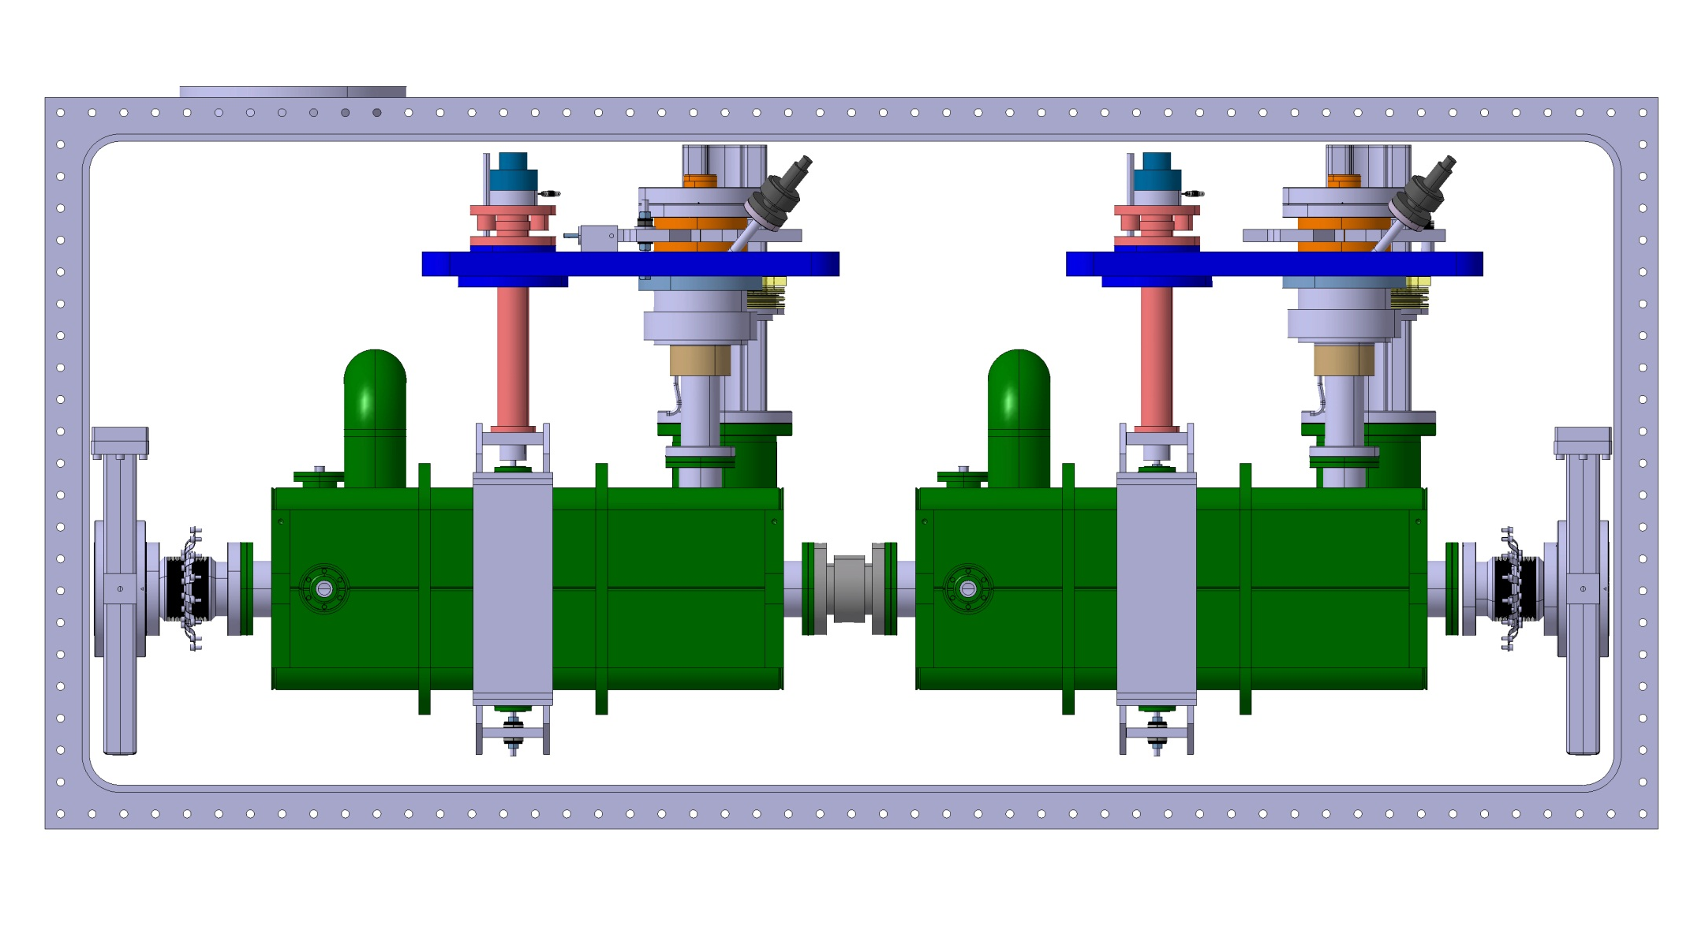
Cryomodule Alignment

Slide 27
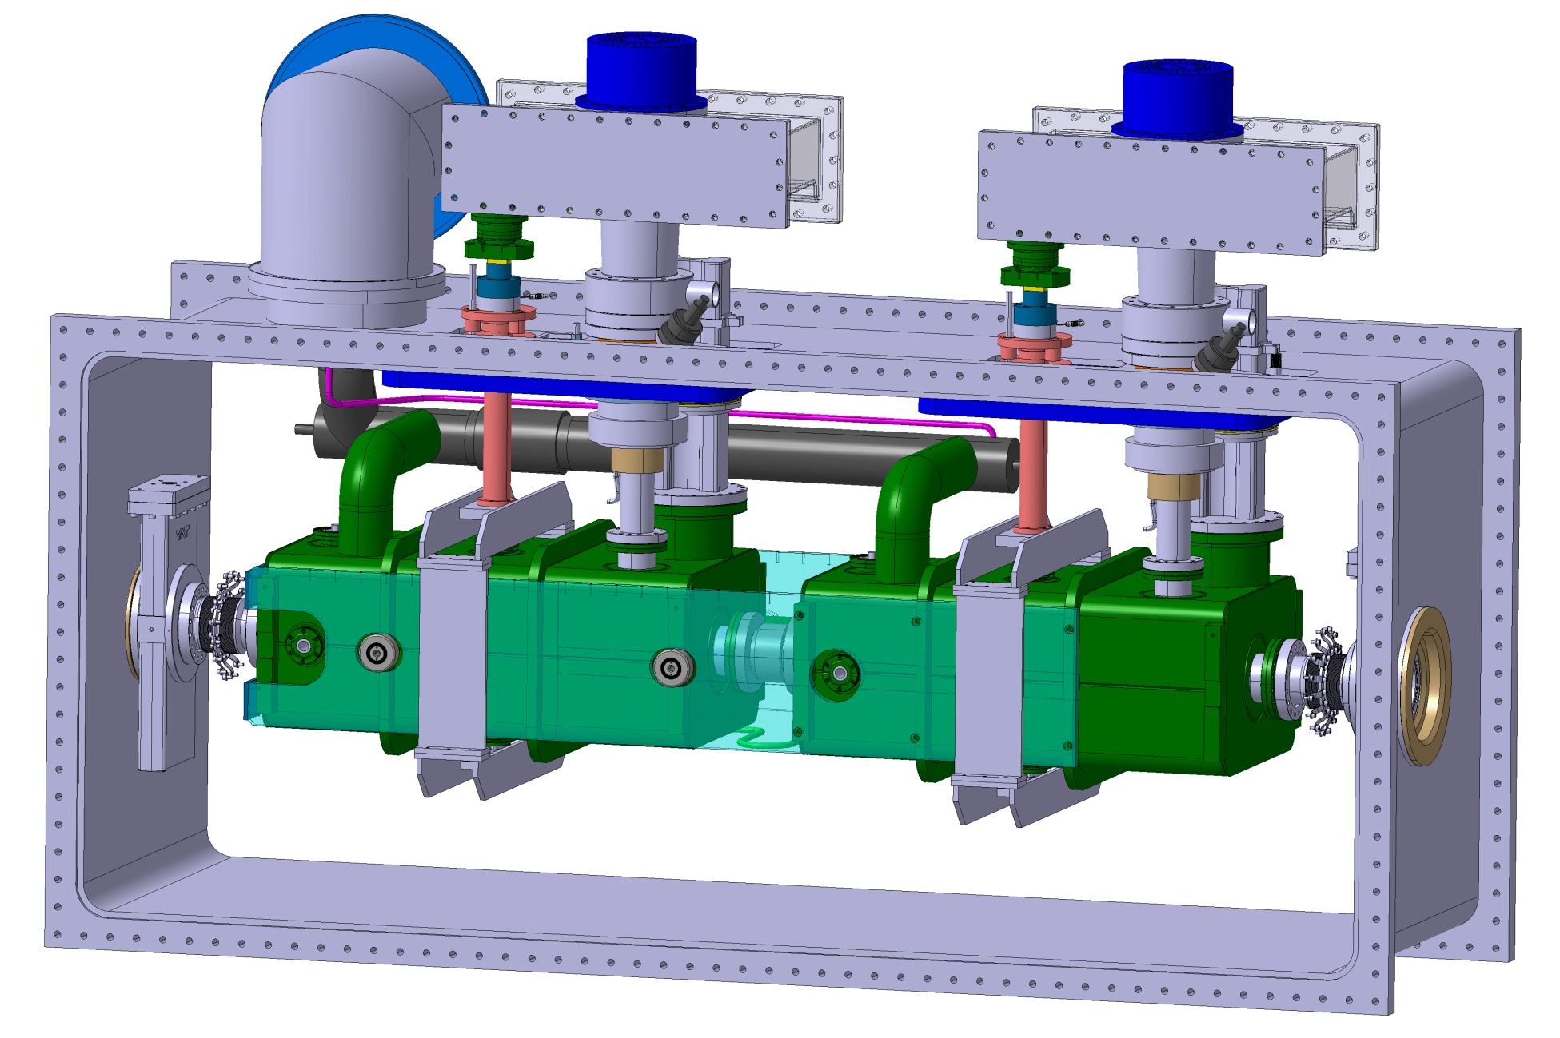
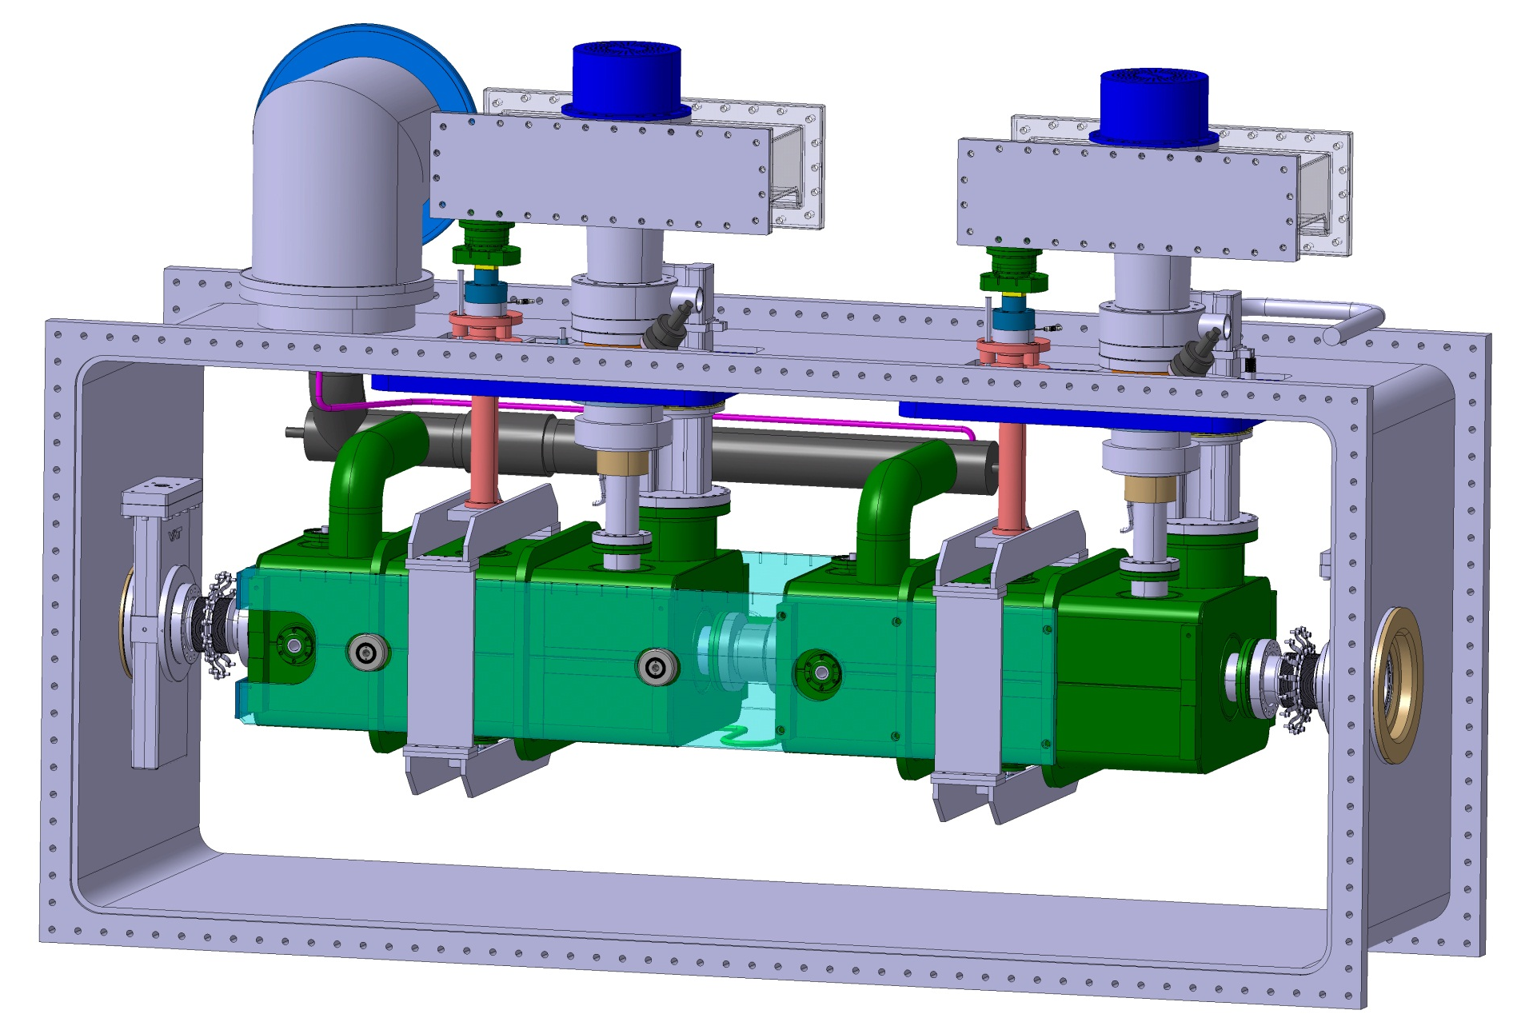
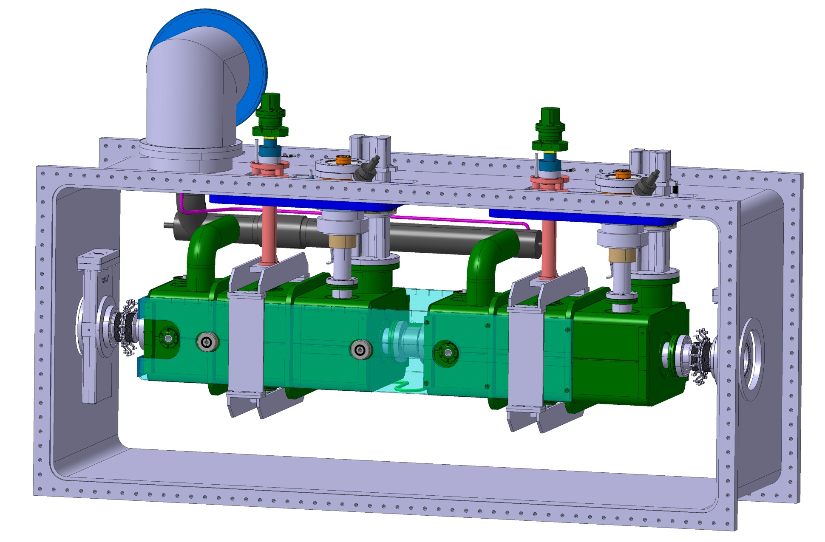
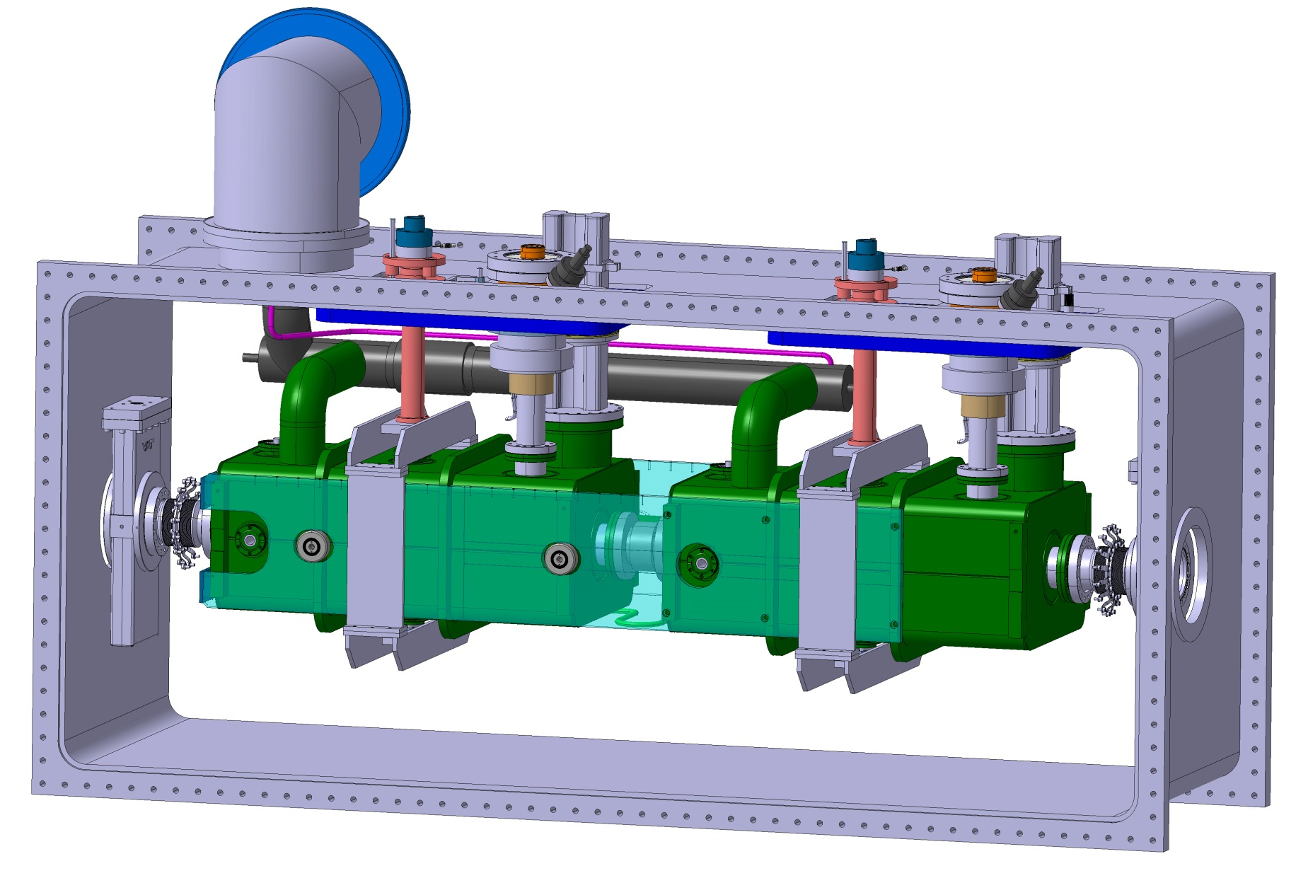
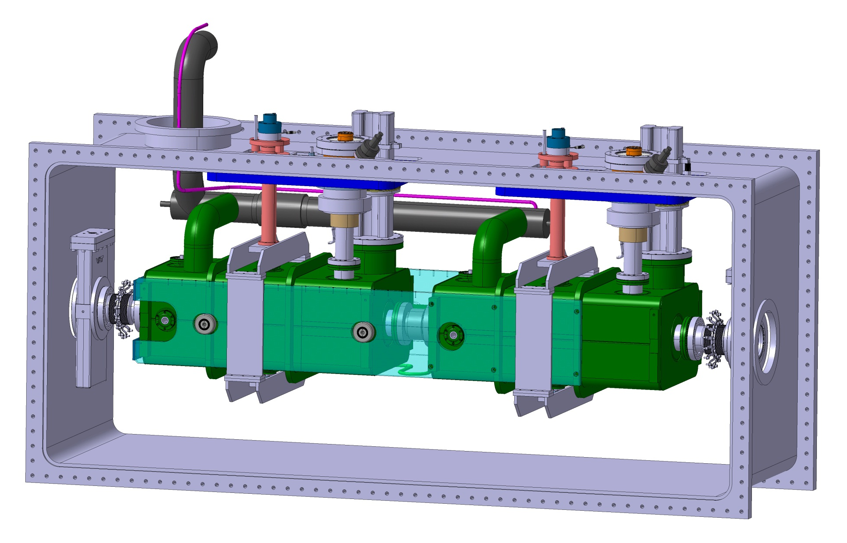

Cryomodule Connections

Slide 28
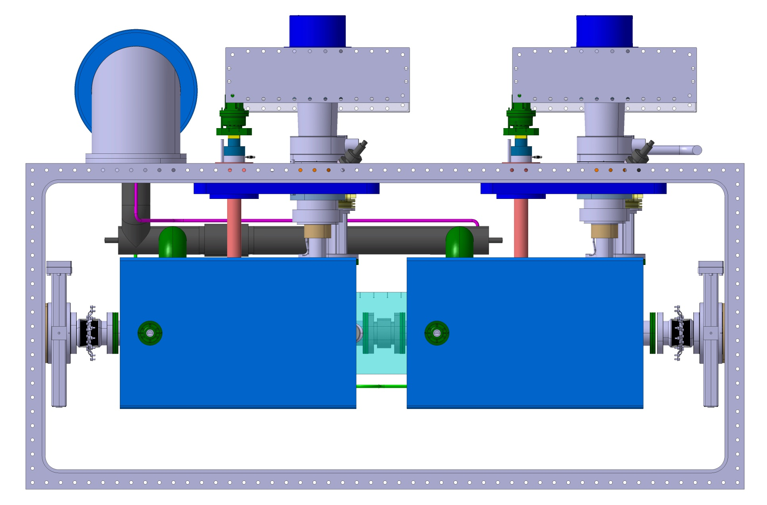
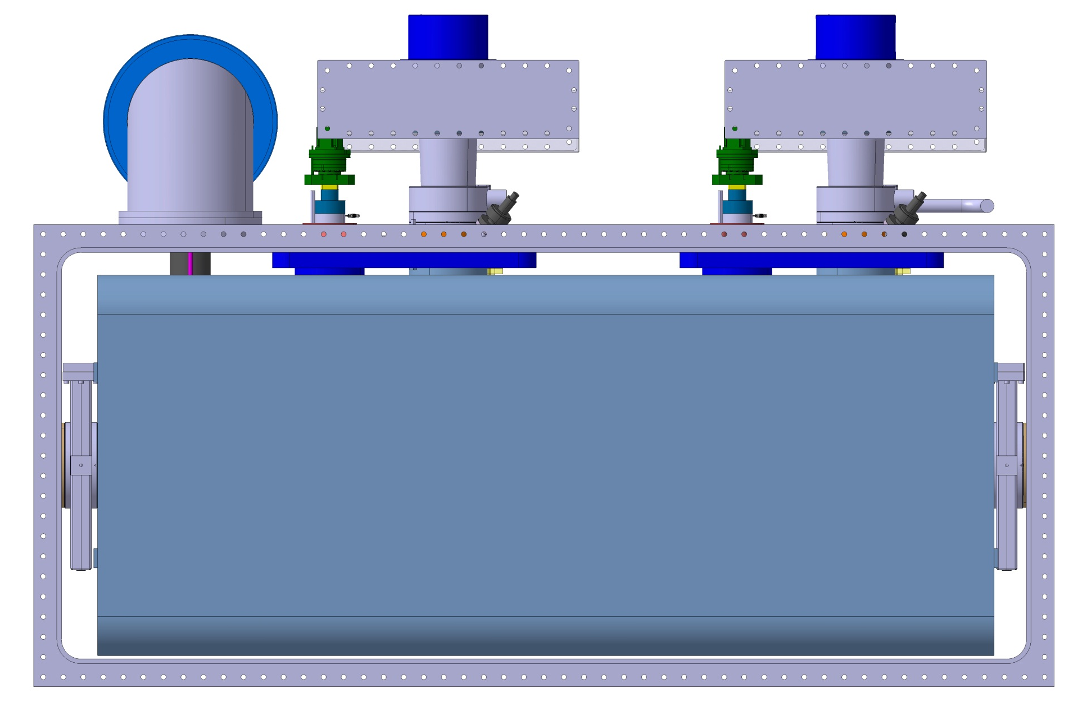
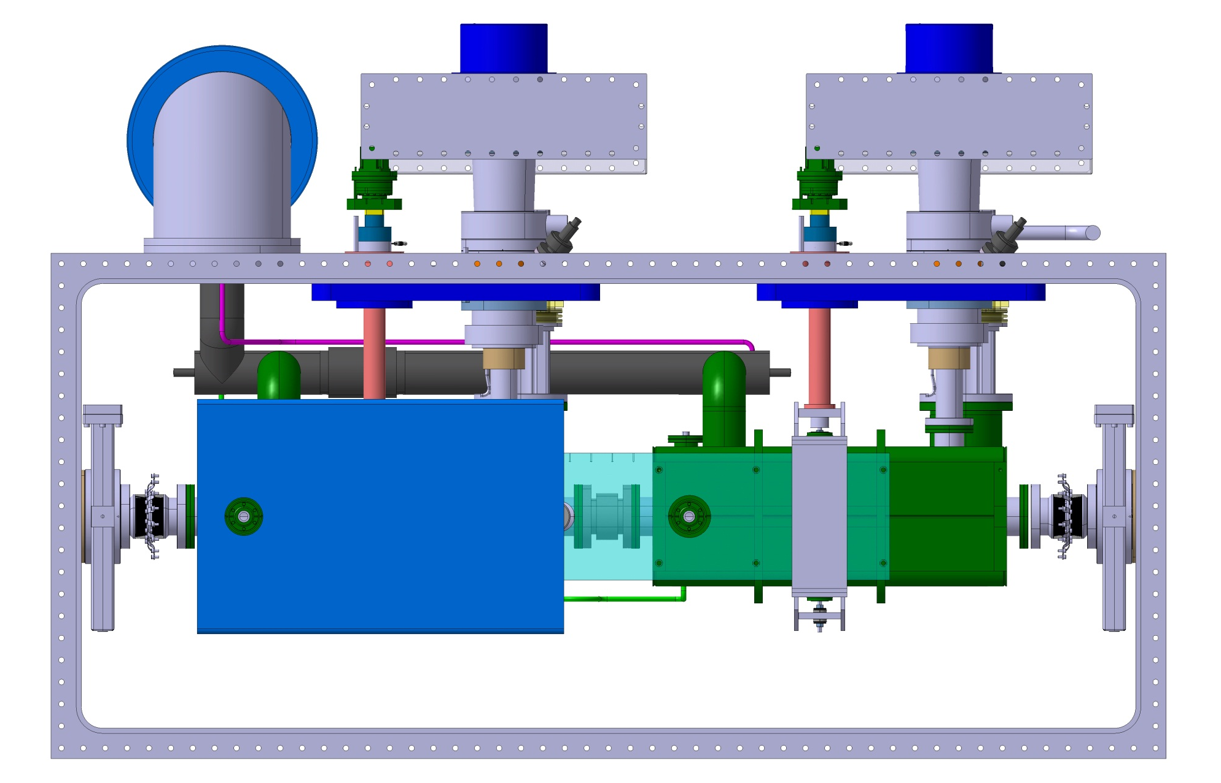
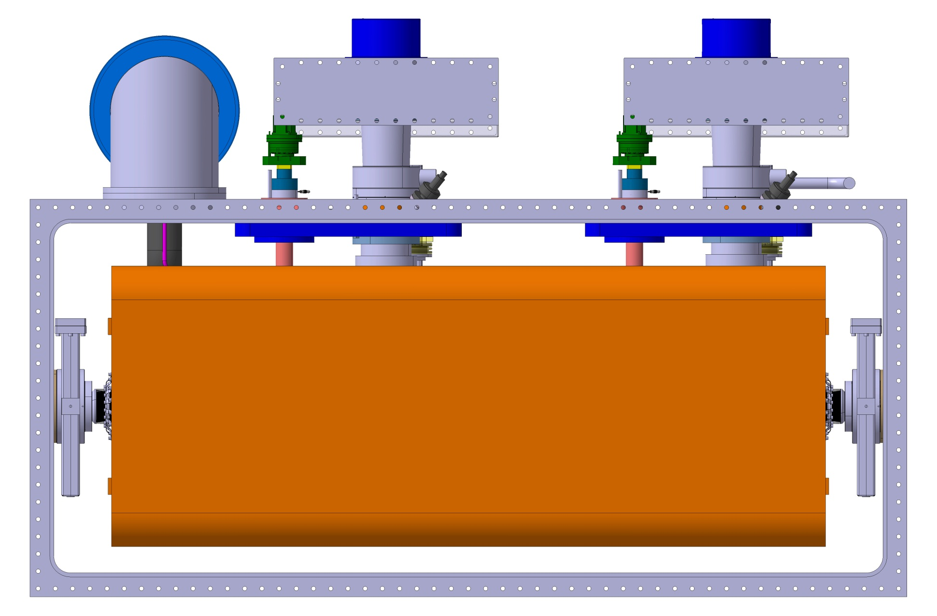
Shielding

Slide 29
Heat Losses
Updated April 2014 by CERN
 |  | Coax HOM coupler |  | Waveguide HOM coupler
 |  | at 2K (W) | at 80K (W) | at 2K (W) | at 80K (W)
STATIC | Radiation | 0.7 | 35 | 0.7 | 35
 | CWT | 3 | 12.6 | 3 | 12.6
 | Support | 0.8 | 5 | 0.8 | 5
 | FPC | 4 | 100 | 4 | 100
 | Instrumentation | 1 | 0 | 1 | 0
 | HOM/Pick-up | 4.4 | 20 | 8.8 | 120
 | Tuner | 0.3 | 10 | 0.3 | 10
 | Static total | 14.2 | 182.6 | 18.6 | 282.6
DYNAMIC | Deflecting | 6 | 0 | 6 | 0
 | FPC | 5 | 20 | 5 | 20
 | HOM/Pick-up | 2.8 | 10 | 1.9 | 10
 | Beam current | 0.5 | 0 | 0.5 | 0
 | Dynamic total | 14.3 | 30 | 13.4 | 30
TOTAL |  | 28.5 | 212.6 | 32 | 312.6

Slide 30
Summary
Helium vessel and cavity meet the mechanical stability requirement.
A common cryomodule design achieved.
Both coaxial and wave guide cavities fit in the one cryomodule.
Fast development and improvement in the peripherals.
Continuing effort on reducing the heat loss.

Slide 31
Acknowledgement
Mark Wiseman, Ed Daly and Joe Preble at Jefferson Lab for their helpful advice.

Slide 32
Back Up Slides

Slide 33
Back Up Slides
STATIC
rad | 0.1 W/m2 measured in LHC; |  |  | 1.7 W/m2 measured in LHC;
 | 4.1 m2 surf ODU cav + connex + biphase |  |  | 5 m2 surf ODU ecran thermique
 | 0.2 W buffle noir (0.5 W/m2) |  |  | 25 W buffle noir (90 W/m2)
supp | add 3rd support for ODU 0.2W
 | add reinformcement for fpc 0.2Wx2 for supporting system
fpc | wall thickness 3 mm, L=230mm, Dant = 27 mm
 | Design changed) | 4W is already comprehensive of copper coating and radiation
 | from a 300K hook, and it's also quite conservative (it's more likely 3.5 W and 70W
 | to the 80K circuit
hom/lom/pick-up | add 1W/hom x 4 and 0.2W/pickup; HOM cable: 0.2 mm thickness, 2m length, thermalized
 | both inner and ext. 5W/HOM to 80K
tuner | coax system, D1=35 mm and D2=40mm, thickness 1 mm, L=350 mm, TITANIUM, WITH
 | INTERCEPT, 0.075W/tube x 4 tubes
DYNAMIC
fpc | Radiation from 200C from hook 2Wx2 (total RF losses to the hook 180W).
 | Going down to 100 W, radiation losses ~0.8Wx2. Going down to 60W, radiation losses ~0.5Wx2 (value considered)
hom | 0.7W/coax HOM for RF losses at 2K; Additional load/HOM induced by manufacturing error not considered (might be important)
 | Heat to 80K for copper not so much higher than heat to 2K
 | because kcu much higher around 2K!
STATIC
rad | 0.1 W/m2 measured in LHC; |  |  | 1.7 W/m2 measured in LHC;
 | 4.1 m2 surf ODU cav + connex + biphase |  |  | 5 m2 surf ODU ecran thermique
 | 0.2 W buffle noir (0.5 W/m2) |  |  | 25 W buffle noir (90 W/m2)
supp | add 3rd support for ODU 0.2W
 | add reinformcement for fpc 0.2Wx2 for supporting system
fpc | wall thickness 3 mm, L=230mm, Dant = 27 mm
 | Design changed) | 4W is already comprehensive of copper coating and radiation
 | from a 300K hook, and it's also quite conservative (it's more likely 3.5 W and 70W
 | to the 80K circuit
hom/lom/pick-up | add 1W/hom x 2 and 0.2W/pickup; HOM cable: 0.2 mm thickness, 2m length, thermalized
 | both inner and ext. 5W/HOM to 80K; 2xCHIMNEY: 200mm L, 2mm thick --> 3.2x2W, 2x60W to 80K
tuner | coax system, D1=35 mm and D2=40mm, thickness 1 mm, L=350 mm, TITANIUM, WITH
 | INTERCEPT, 0.075W/tube x 4 tubes
DYNAMIC
fpc | Radiation from 200C from hook 2Wx2 (total RF losses to the hook 180W).
 | Going down to 100 W, radiation losses ~0.8Wx2. Going down to 60W, radiation losses ~0.5Wx2 (value considered)
 | 0.7W/coax HOM for RF losses at 2K; Additional load/HOM induced by manufacturing error not considered (might be important)
hom | Heat to 80K for copper not so much higher than heat to 2K
 | because kcu much higher around 2K! waveguide 2x0.25W

Slide 34
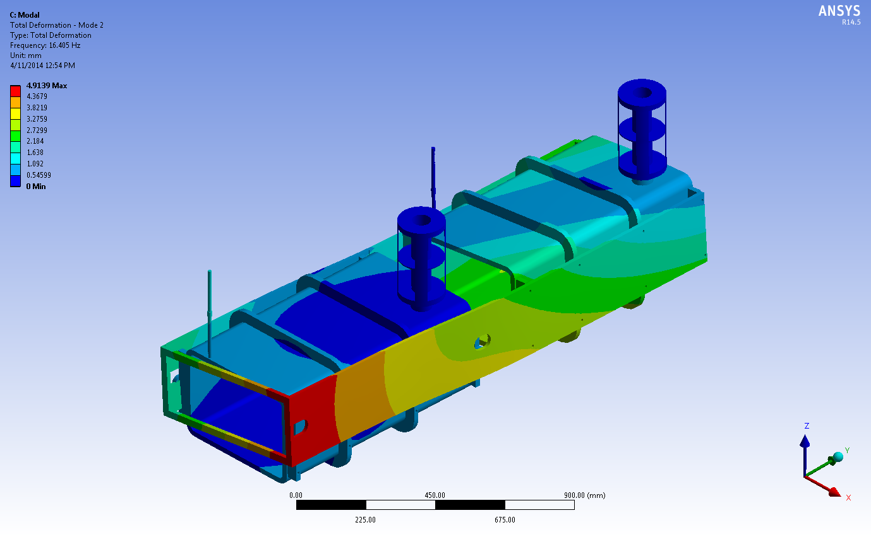
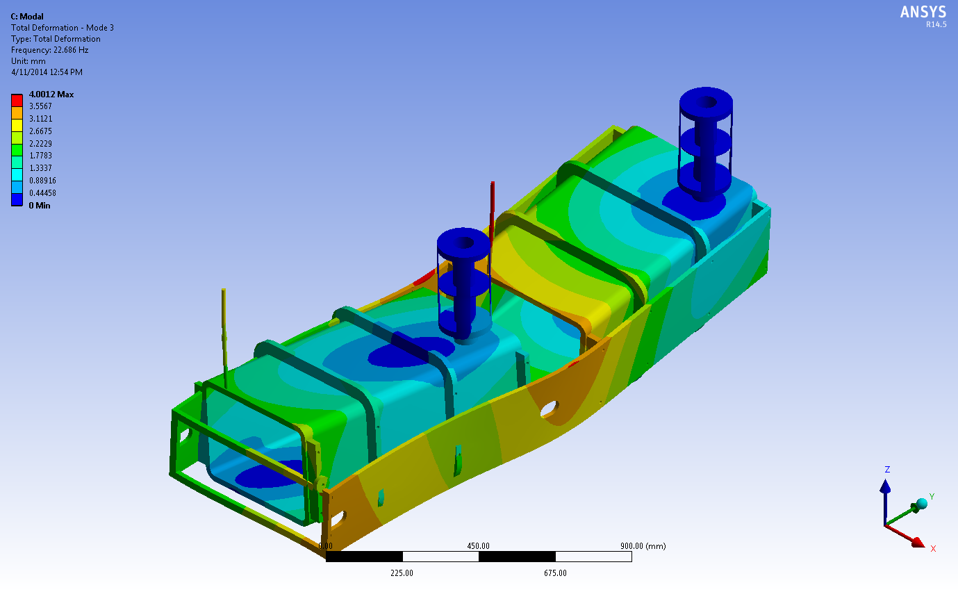
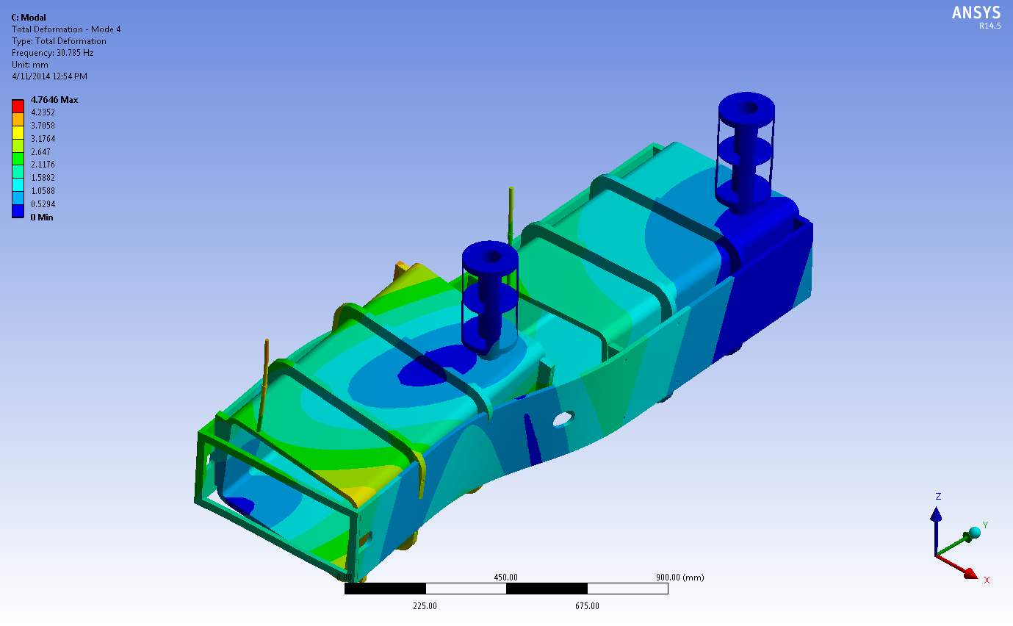
Cryomodule Modal Analysis
Tom Nicol/Fermilab
Case 14 1st mode 10 Hz
1st mode 16 Hz
Case 14: Latest side rail design without free ends connected
1st mode 23 Hz
1st mode 31 Hz

Slide 35
Cryomodule Support Analysis
Summary
Very little difference between any of these cases (except for case 6 which has no thermal load).
Most of the deformation is due to thermal contraction.
All result in almost 3 times more load on the upstream coupler than downstream.
The table below summarizes the deflections for all cases.
 | Total defl (mm) |  | ux (mm) |  | uy (mm) |  | uz (mm) |  | Fz (N)
 | min | max | min | max | min | max | min | max | US | DS
Case 1 | 0 | 2.81 | -0.25 | 1.07 | -0.33 | 2.73 | -0.52 | 0.80 | 1929 | 935
Case 2 | 0 | 2.78 | -0.22 | 0.90 | -0.22 | 2.65 | -0.35 | 0.81 | 2040 | 828
Case 3 | 0 | 2.94 | -0.17 | 1.12 | -0.40 | 2.79 | 0.00 | 1.13 | 2162 | 778
Case 4 | 0 | 3.09 | -0.15 | 1.09 | -0.35 | 2.86 | 0.00 | 1.13 | 2738 | 741
Case 5 | 0 | 2.90 | -0.17 | 1.10 | -0.33 | 2.75 | 0.00 | 1.13 | 2140 | 792
Case 6 | 0 | 0.70 | 0.00 | 0.44 | 0.00 | 0.11 | -0.61 | 0.14 | 2125 | 806

Slide 36
Cryomodule Modal Analysis
Summary
Case 14: Latest side rail design without free ends connected.
Case 14a: Same as case 14, but with all sliding surfaces bonded.
Case 14b: Same as case 14, but with vertical hangers removed (coupler support only).
Case 15: Same as case 14, but with free ends connected.
Case 15a: Same as case 15, but with vacuum vessel end of vertical hangers fixed in (x,y,z).
 | Modes and frequencies (Hz)
 | 1 | 2 | 3 | 4 | 5 | 6
Case 14 | 10.09 | 16.65 | 22.26 | 30.85 | 37.78 | 44.85
Case 14a | 23.82 | 37.93 | 45.03 | 68.70 | 102.73 | 110.99
Case 14b | 9.06 | 10.09 | 15.10 | 17.74 | 22.53 | 30.88
Case 15 | 10.36 | 16.41 | 22.69 | 30.79 | 37.45 | 44.77
Case 15a | 11.29 | 14.48 | 23.45 | 31.30 | 37.59 | 44.98

Slide 37

Interfaces
Coax HOM coupler
2630 mm

Slide 38

Interfaces
Waveguide HOM coupler
2630 mm

Slide 39

Cryomodule Design
Waveguide HOM coupler

