Slide 1
Cavity Specifications, Fabrication Requirements & Interface to CERN
Ofelia Capatina
on behalf of the CERN specification team

Slide 2
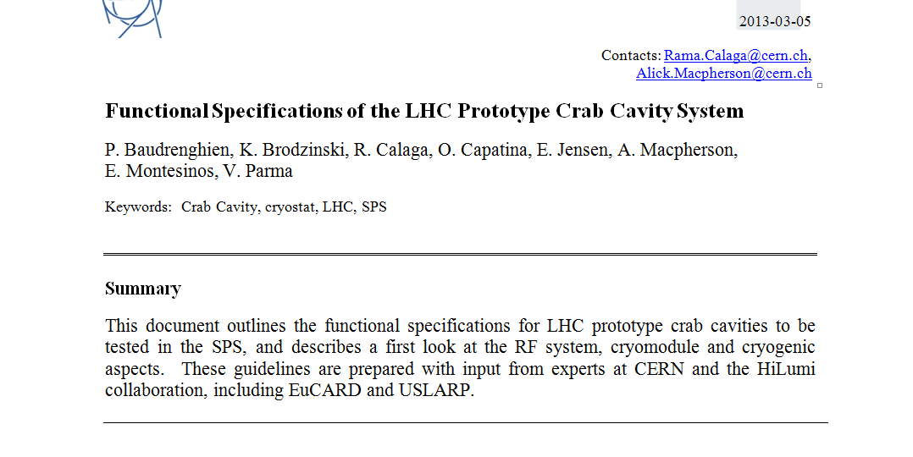
Specifications
https://espace.cern.ch/HiLumi/WP4/Lists/Team%20Discussion/AllItems.aspx

Slide 3
Specifications
Functional spec issued beginning of 2013; part of the information has to be updated
For the review the ranking criteria document includes up to date information

Slide 4

General
SM18 area
Cold tests and clean room facilities – cold test of cryomodules prior tunnel installation
SPS BA4 (vertical or horizontal crabbing)
One or two cryomodules with 2 identical cavities to be tested before LS2
LHC Point 1 (vertical crabbing)
4 cavities / IP side/ beam
to be installed during LS3
LHC Point 5 (horizontal crabbing)
4 cavities / IP side/ beam
to be installed during LS3

Slide 5
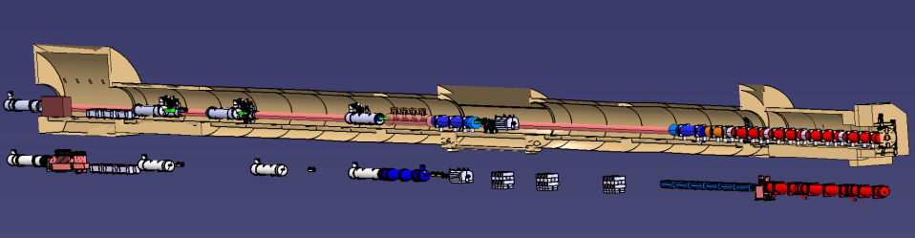
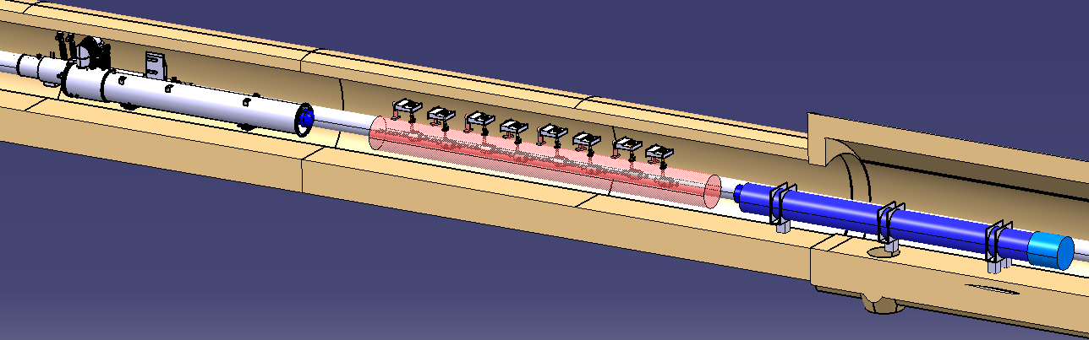
General
LHC environment
4 cavities / IP side / beam between D2 and Q4
=>
Total 32 cavities in LHC
Paolo Fessia

Slide 6
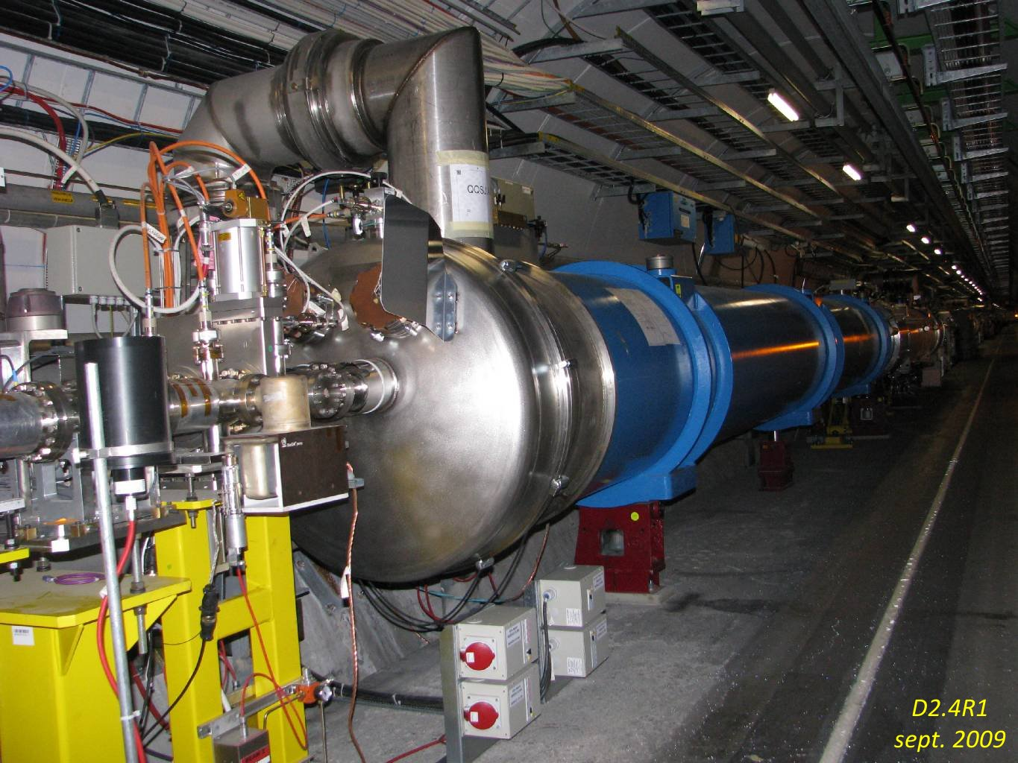
General
LHC environment

Slide 7
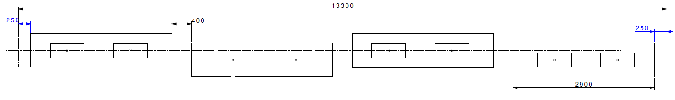
General
LHC layout
  4 cryomodules x 2 cavities each / IP side

Slide 8
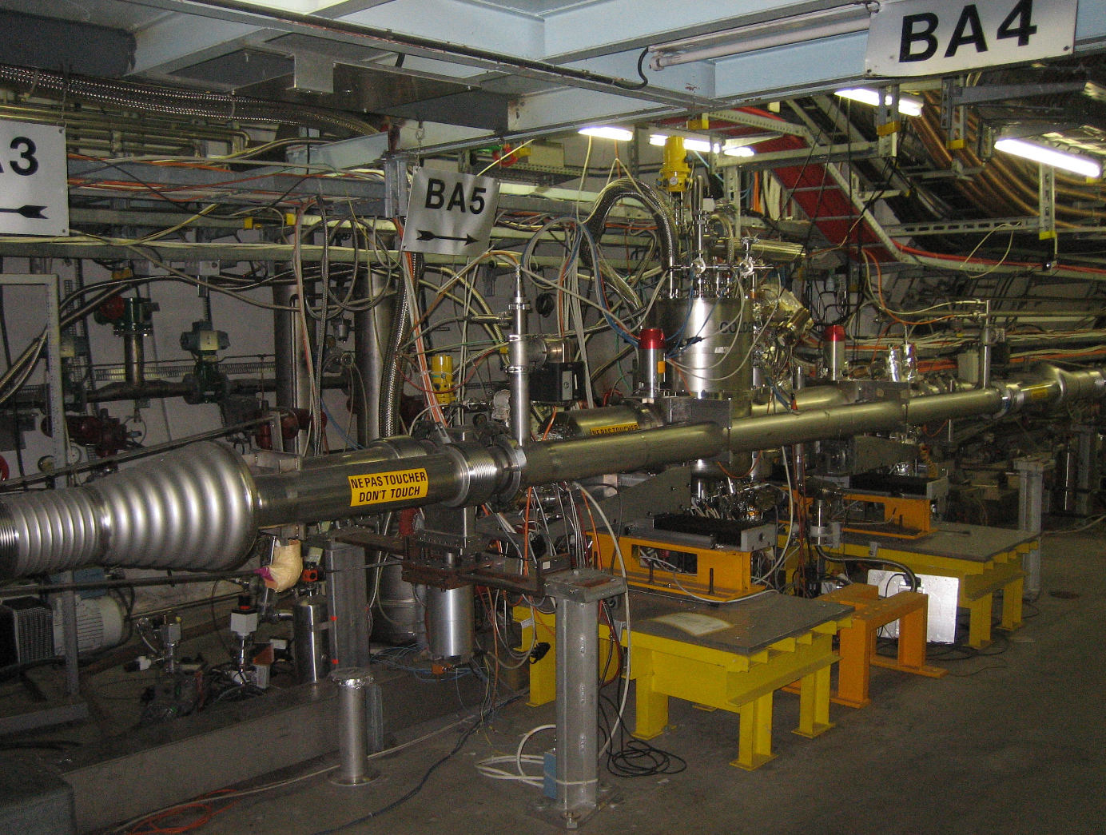
General
SPS environment
Alick Macpherson talk tomorrow

Slide 9
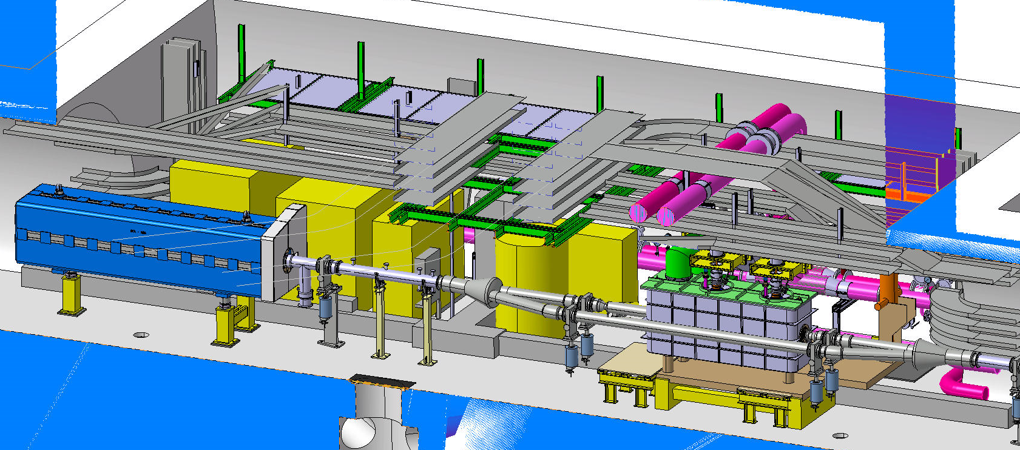
General
SPS environment

Slide 10
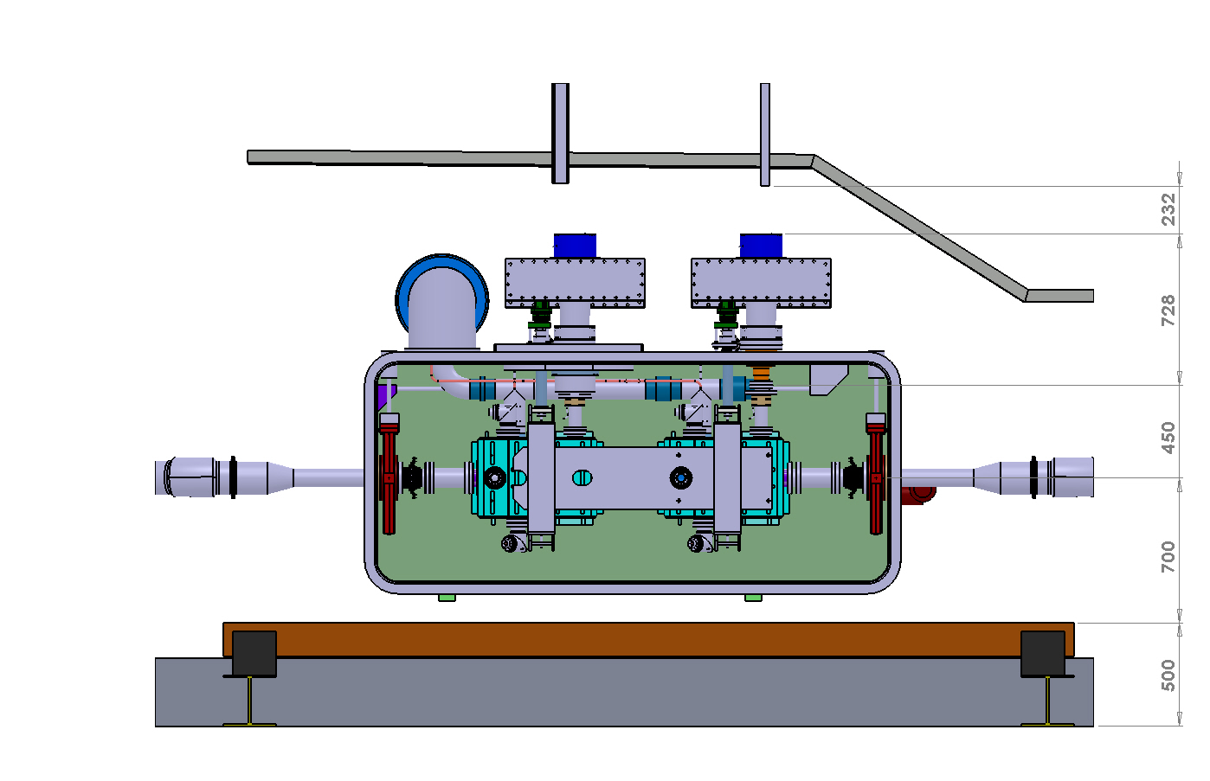
General
SPS environment

Slide 11
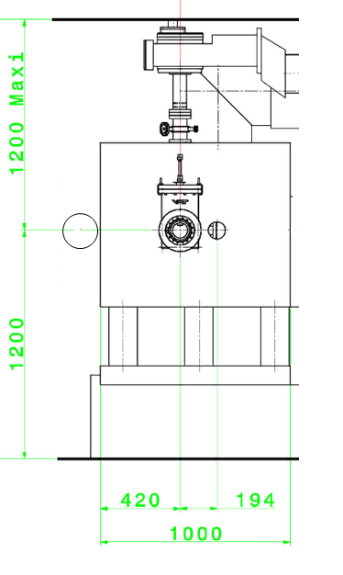
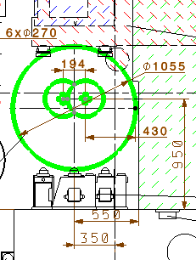
General
LHC configuration
SPS configuration

Slide 12
Plans for SPS
More details Alick, Erk’s talk tomorrow
SPS :
    2 (identical) cavities in a cryomodule
    3 different cryomodules under design
Timeline until 2018
  Very tight schedule with no time buffer to meet end 2016/2017 installation of 1st cryomodule to be tested in SPS

Slide 13
Plans for SPS
Bare cavities for SPS designed to be the same as for the LHC
Dressed cavity for SPS tests design as much as possible compatible with LHC
Conceptual design of SPS cryomodule for the 3 cavities
  2 identical cavities in 3 different cryomodule
  Effort to standardize interfaces, basic choices in-between the 3 cryomodules
The 3 SPS cryomodules could be tested in SM18 (if no down-selection since then)
1 or 2 cryomodules to be tested in SPS, after test in SM18
SPS cryomodule design as much as possible compatible with the LHC

Slide 14
Plans for cavities manufacturing
SPS Cavities manufacturing:
  Cavities designed in US have planned US budget for the manufacturing of 4 units of Minimum Function Assemblies
  Cavities designed in UK have not planned budget yet
  What, who, how, when

Slide 15
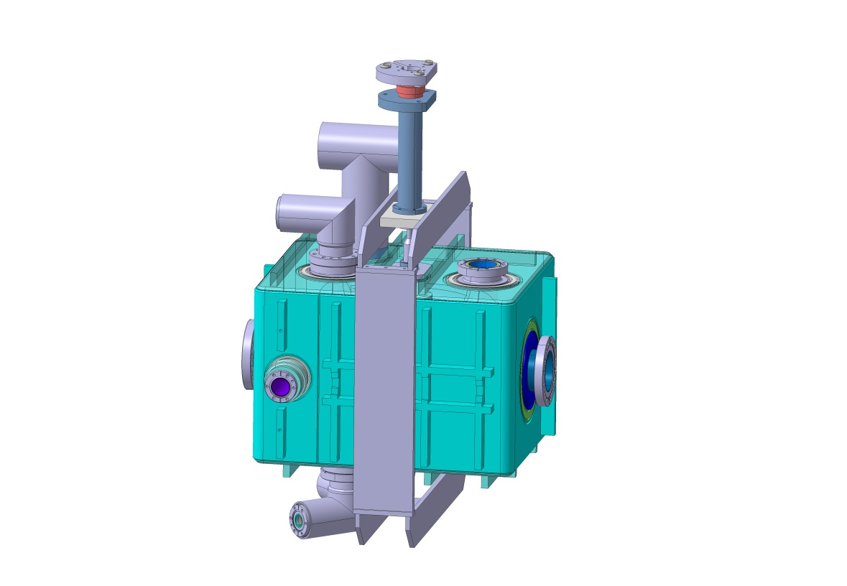
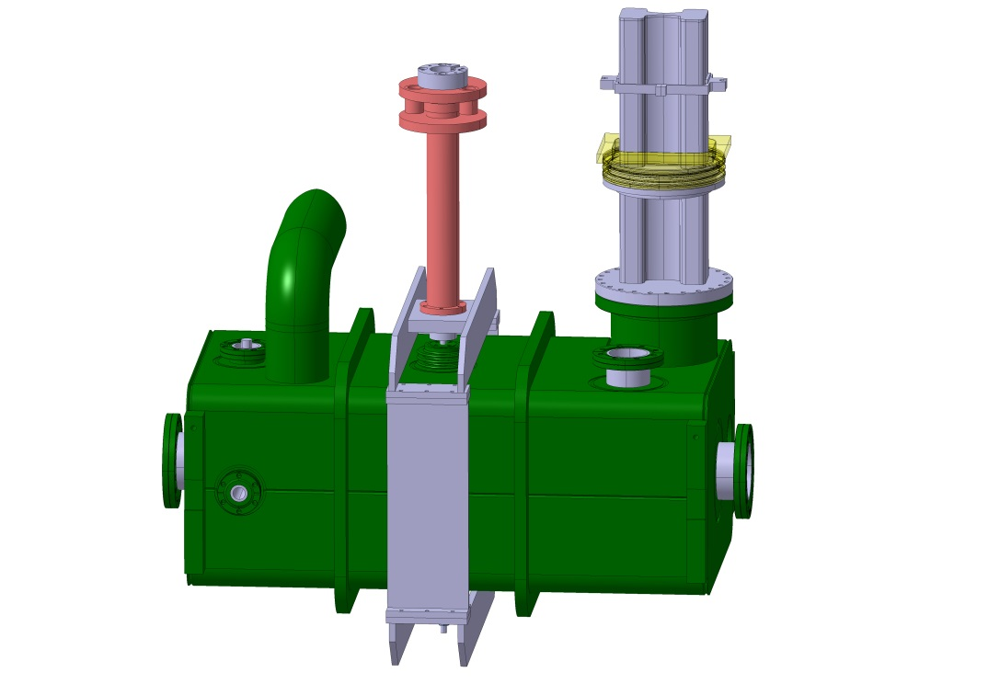
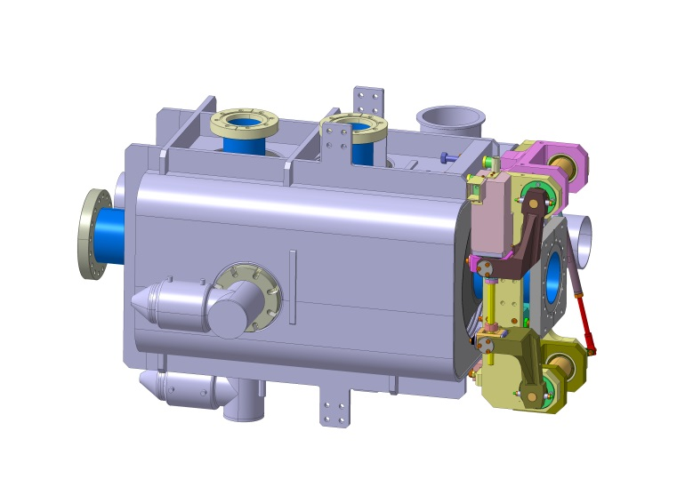
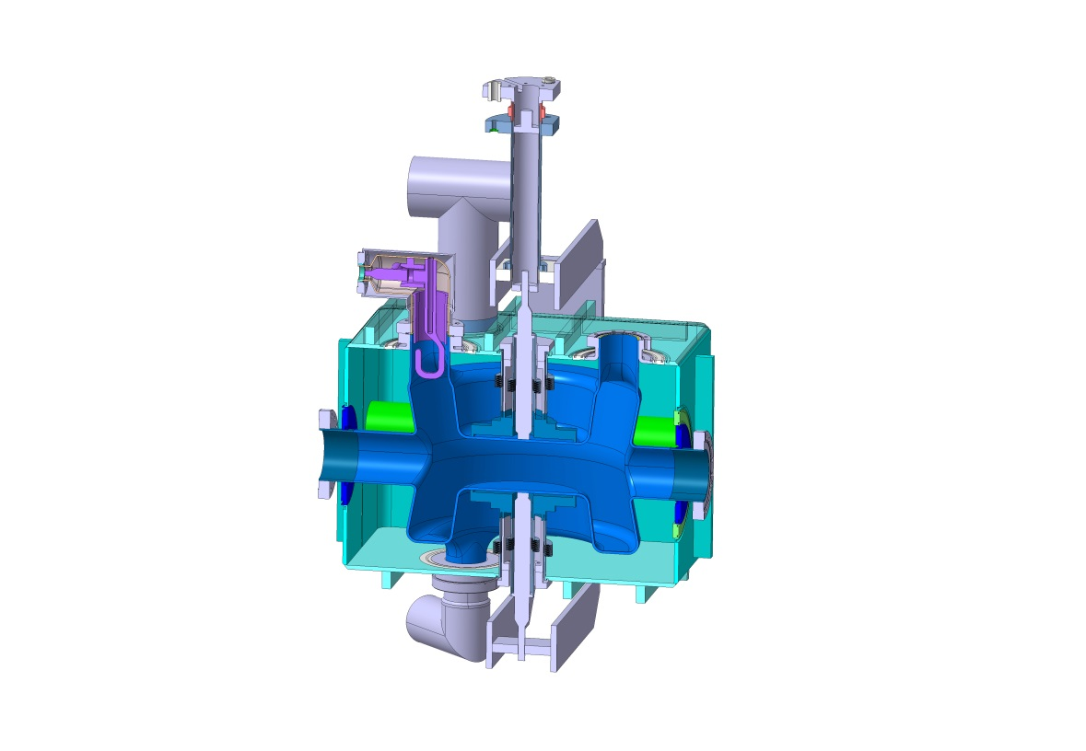
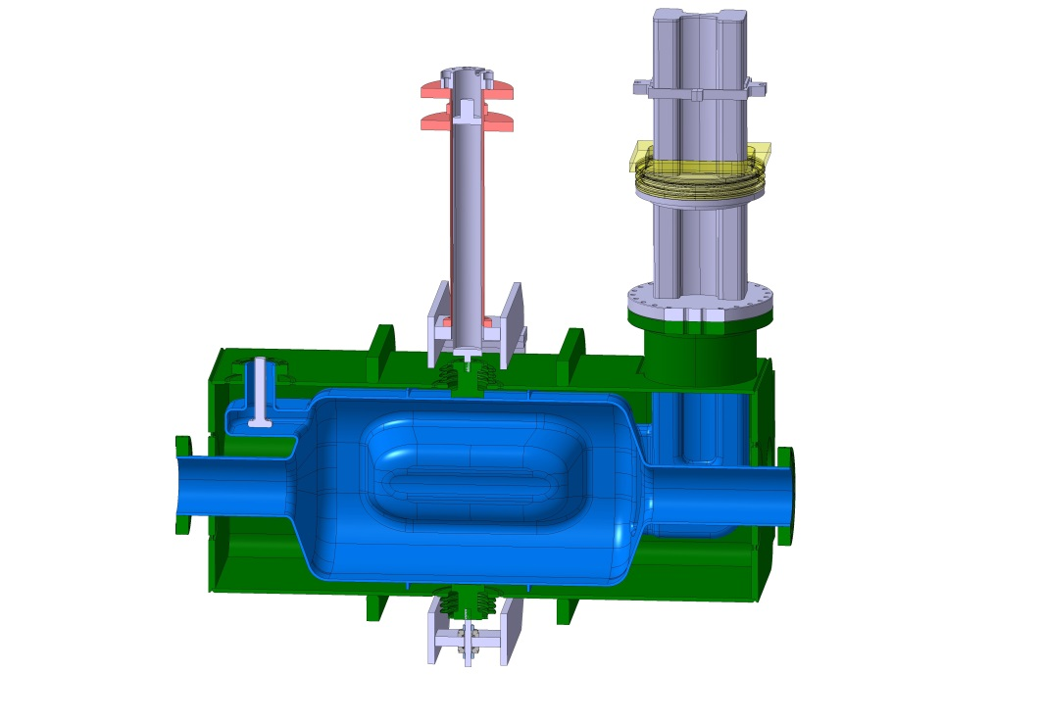
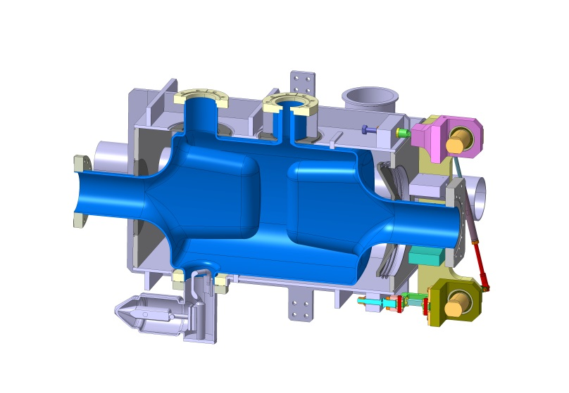
SPS Cavities – Minimum Function Assemblies
Helium tank, HOM couplers and tuner
are part of cavity MFA since
their behaviour determine
cavity operation behaviour
4-rod (UK) | RF Dipole (ODU) | Double ¼-wave (BNL)

Slide 16
SPS Cavities MFA - who
Niowave:
  Will build 2 x 2 Minimum Function Assemblies
CERN :
  In charge of the detailed specification for manufacturing / documentation
  Engineering support for design and manufacturing
LARP :
  Tom Nicol (FNAL) will be the collaboration linkman for the follow-up of the production at Niowave premises
  Provide cavities processing and cold low-power tests prior to delivery to CERN
UK: TBD based on the outcome of this review

Slide 17
SPS Cavities MFA - how
Pressure equipment:
  Have to comply with Safety regulations at CERN, based on compliance with European Pressure Equipment Directive (PED)
  Considered “special equipment” at CERN

Slide 18
SPS Cavities MFA - how
ASME / PED requirements:
  The usability of the ASME code is being analysed at CERN.
  ASME will be accepted if complemented with specific procedures that will make it compliant with EN standards.
  The specific procedures will be provided by CERN.
HL-LHC Standards and Best Practices Workshop at CERN 11-13 June 2014

Slide 19
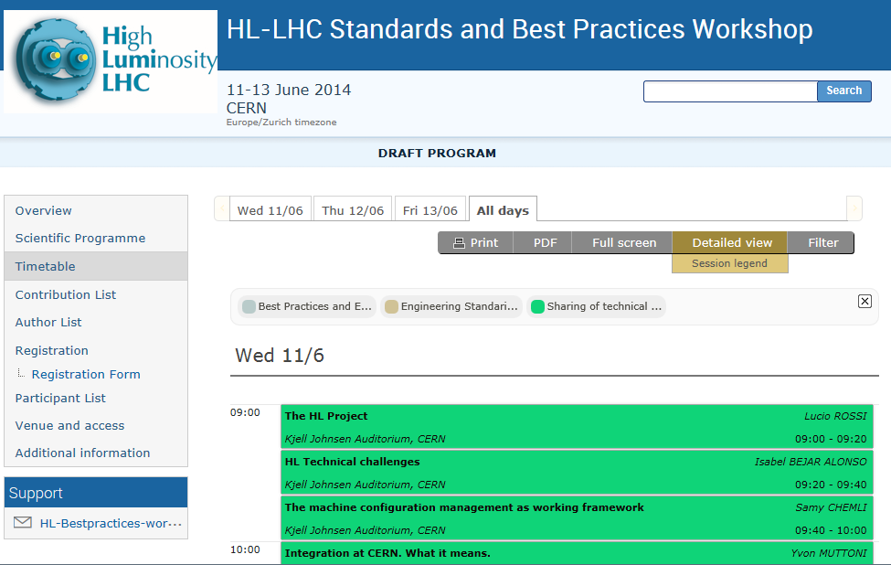
SPS Cavities MFA - how

Slide 20
SPS Cavities MFA - how
Draft manufacturing specification in EDMS:
https://edms.cern.ch/document/1378509/1

Slide 21
SPS Cavities MFA - how
3D models will be provided to Niowave by the Collaboration
Kick-off meeting after manufacturing drawings (ISO standards + metric system) + manufacturing plan issued by Niowave
  Detailed definition of hold points during manufacturing process with associated documentation required

Slide 22
SPS Cavities MFA - how
The supply shall include:
  Schedule and manufacturing strategy including Quality Control plan
  Fabrication drawings done according to ISO standards
  All required raw material except stainless steel
  Sample test
  RF measurements of intermediate assemblies and complete cavities as well as required tooling for these measurements
  Mechanical tuning of the cavities to ensure required final frequency
  Leak-tightness assessment
  Complete design, manufacture and inspection file for each unit produced, including:
    Material certificates for base material and welding consumables
    Welding and brazing procedures qualification records
    Welders and welding operators qualifications
    Non-destructive testing personnel qualification
    Records of thermal treatments
  Non-destructive testing and dimensional control reports
  Pressure tests, procedures and report
  Non conformities
  Packing and Shipping

Slide 23
SPS Cavities MFA - when
RF surface of cavities already delivered to Niowave
3D models of cavities + interfaces to helium tank to be delivered to Niowave by end of May
Helium tank, tuner and HOM final design to be delivered by September
Start processing and cold tests of MFA mid-2015
MFA ready for assembly in cryomodule by Jan 2016

