Slide 1
HL-LHC &
Crab Cavities
Lucio Rossi - CERN
HL-LHC Project Leader
Crab Cavity International Review, BNL, 5-6 May 2014

Slide 2
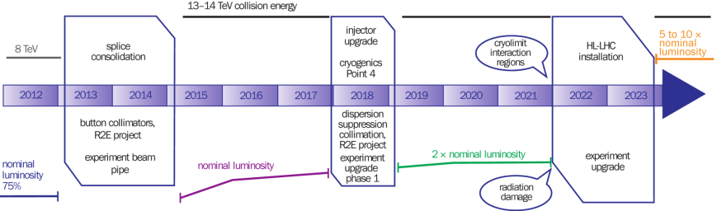
The CERN 10-year plan
(approved early 2011 – just modified, see later)
0.75 10³⁴ cm⁻²s⁻¹
50 ns bunch
high pile up ∼40
1.5 10³⁴ cm⁻²s⁻¹
25 ns bunch
pile up ∼40
1.7-2.2 10³⁴ cm⁻²s⁻¹
25 ns bunch
pile up ∼60
Technical limits (experiments, too) like :

Slide 3
Recent modification to the LHC plan
Big chance to install CC in SPS!
Install New Cryo in IP4,
(install CC in IP4 _ NOT beasline) Preparation for CC in LS3
The extra time is just what is needed to to make possible CC in LS3: we should not miss the opportunity

Slide 4
Goal of High Luminosity LHC (HL-LHC) as fixed in November 2010
The main objective of HiLumi LHC Design Study is to determine a hardware configuration and a set of beam parameters that will allow the LHC to reach the following targets:
A peak luminosity of 5×10³⁴ cm⁻²s⁻¹ with levelling, allowing:
An integrated luminosity of 250 fb⁻¹ per year, enabling the goal of 3000 fb⁻¹ twelve years after the upgrade.
This luminosity is more than ten times the luminosity reach of the first 10 years of the LHC lifetime.
CC are an essential ingredient to obtain this goal:
First for performance ! CC are critical to increase peak lumi!
Second as method of levelling
Third to improve the data quality by reducing pile up density

Slide 5
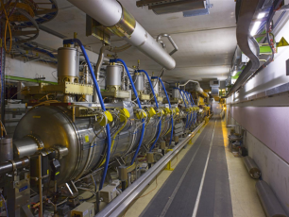
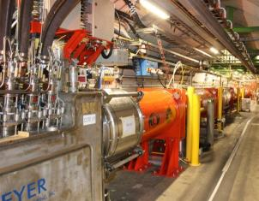
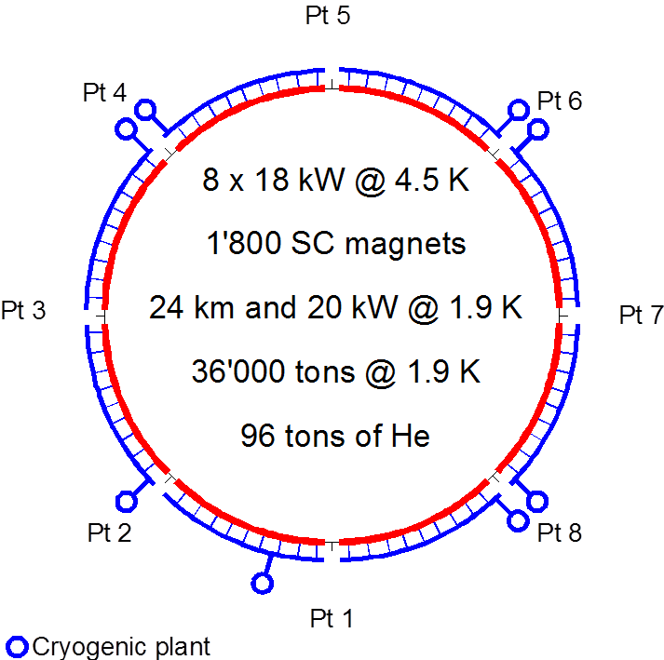
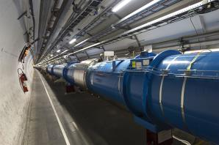
Technical bottlenecks
Cryogenics P4
IT
IT
RF
RF
Never good to couple RF with Magnets !
Reduction of availabe cryo-power and coupling of the RF wiht the Arc (thermal cycle requires > 2 months and many tests)
IT
IT
IT
IT
IT
IT

Slide 6
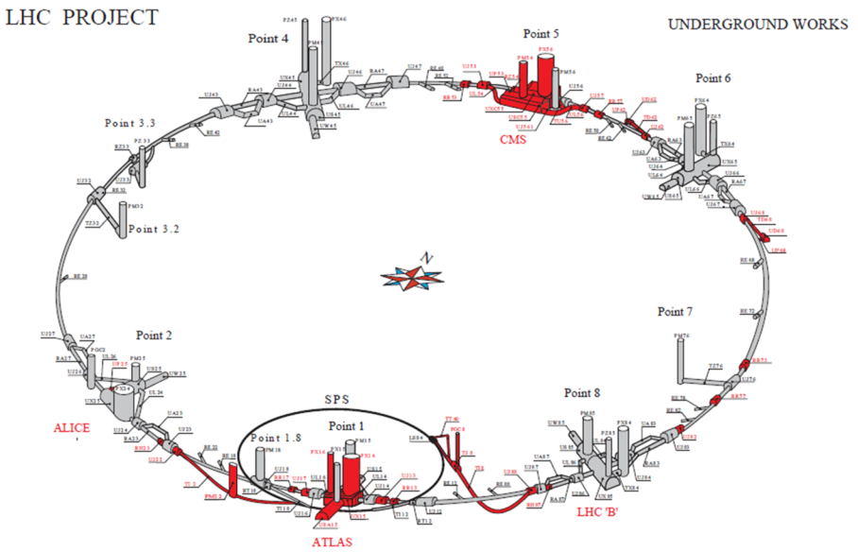
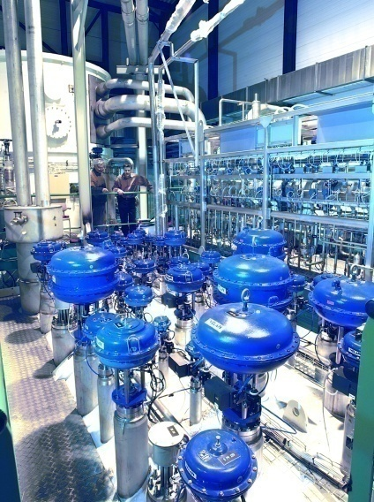
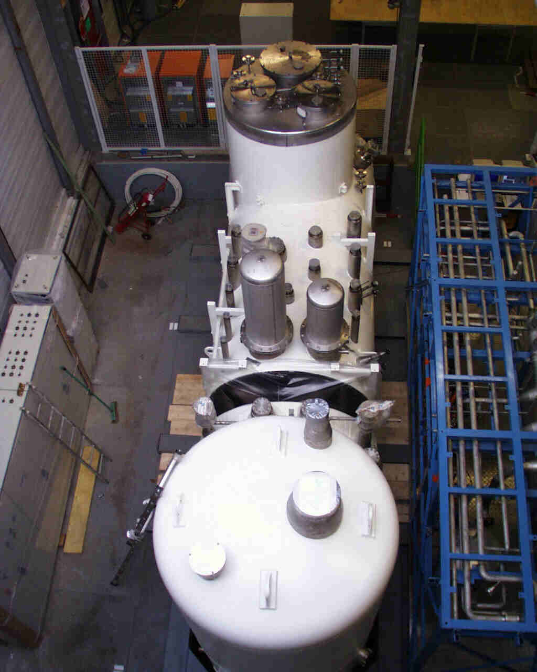
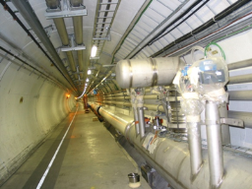
IT cryoplants and new LSS QRL
Availability: separation New Inner Triplets (and IPM in MS) from the arc cryogenics.
Feeding of CCs and new MS magents
Keeping redundancy for nearby arc cryoplant
Redundancy with nearby Detector SC Magnets cryoplant

Slide 7


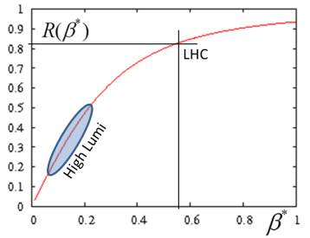
Controlling the burning rate: common effort of Magnets and CC
Beam current
energy
Beam size
ε_{n}is already below «nominal»
Further reduction is limted by brightness (we want N_{b} as large as possible)
So making effective β* reduction si critical for HL-LHC
With CC

Slide 8

Parameters (PLC web page)
Parameter | nominal​ | 25ns​ | 50ns
N_{b} | 1.15E+11 | ​2.2E+11 | ​3.5E+11
n_{b} | ​2808 | ​2808 | ​1404
N_{tot} | 3.2E+14 | 6.2E+14 | 4.9E+14
beam current [A] | ​0.58 | 1.11 | 0.89
x-ing angle [μrad]​ | 300 | 590 | 590
beam separation [σ] | 9.9 | 12.5 | 11.4
β* [m] | 0.55 | ​0.15 | ​0.15
ε_{n} [μm]​ | 3.75 | ​2.50 | 3
ε_{L} [eVs]​ | 2.51 | ​2.51 | ​2.51
energy spread​ | ​1.20E-04 | ​1.20E-04 | ​1.20E-04
bunch length [m] | ​7.50E-02 | ​7.50E-02 | ​7.50E-02
IBS horizontal [h] | ​80 -> 106 | 18.5 | 17.2
IBS longitudinal [h] | 61 -> 60 | 20.4 | 16.1
Piwinski parameter | ​0.68 | 3.12 | 2.85
Reduction factor 'R1*H1‘ at full crossing angle (no crabbing) | ​0.828 | 0.306 | 0.333
Reduction factor ‘H0‘ at zero crossing angle (full crabbing) | 0.991 | 0.905 | 0.905
beam-beam / IP without Crab Cavity | 3.1E-03 | ​3.3E-03 | 4.7E-03
beam-beam / IP with Crab cavity | 3.8E-03 | 1.1E-02 | 1.4E-02
Peak Luminosity without levelling [cm⁻² s⁻¹] | 1.0E+34 | 7.4E+34 | 8.5E+34
Virtual Luminosity: Lpeak*H0/R1/H1 [cm⁻² s⁻¹] | 1.2E+34 | 21.9E+34 | 23.1E+34
Events / crossing without levelling | ​19 -> 28 | 210 | 475
Levelled Luminosity [cm⁻² s⁻¹] | - | ​5E+34 | 2.50E+34
Events / crossing (with leveling for HL-LHC) | *​19 -> 28 | 140 | 140
Leveling time [h] (assuming no emittance growth) | - | 9.0 | 18.3
https://espace.cern.ch/HiLumi/PLC/default.aspx

Slide 9
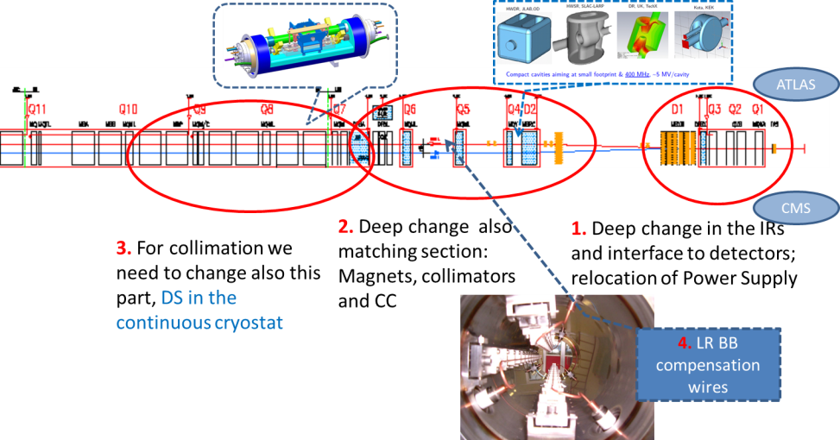
The critical zone around IP1 and IP5
1.2 km of LHC !!

Slide 10
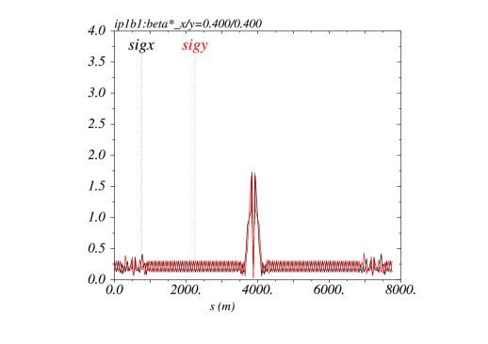
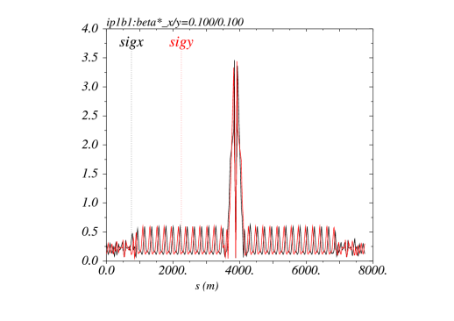
The Achromatic Telescopic Squeezing (ATS) scheme
Small β* is limited by aperture but not only: optics matching & flexibility (round and flat optics), chromatic effects (not only Q’), spurious dispersion from X-angle,..
A novel optics scheme was developed to reach un-precedent β* w/o chromatic limit based on a kind of generalized squeeze involving 50% of the ring
(S. Fartoukh)
β*= 40 cm
β*= 10 cm
The new IR is sort of 8 km long !
Beam sizes [mm] @ 7 TeV from IR8 to IR2 for typical ATS
“pre-squeezed” optics (left) and “telescopic” collision optics (right)

Slide 11
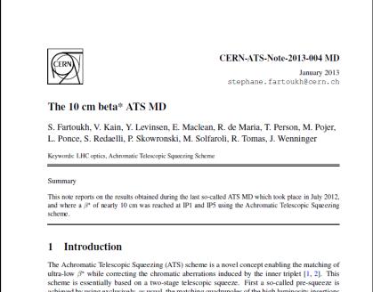
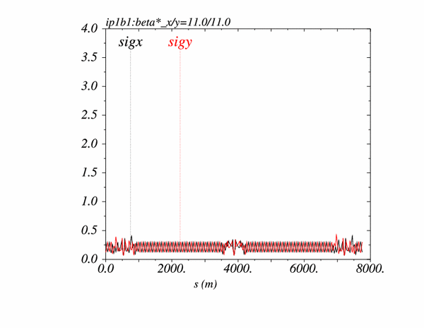
The Achromatic Telescopic Squeezing (ATS) scheme (2/2)
→ Proof of principle demonstrated in the LHC down to a β∗ of 10-15 cm at IP1 and IP5
S-. Fartoukh

Slide 12
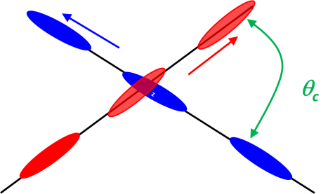
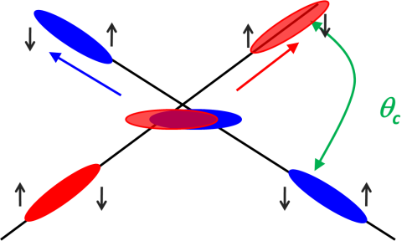
Effect of the crab cavities
RF crab cavity deflects head and tail in opposite direction so that collision is effectively “head on” and then luminosity is maximized
Crab cavity maximizes the lumi and can be used also for luminosity levelling: if the lumi is too high, initially you don’t use it, so lumi is reduced by the geometrical factor. Then they are slowly turned on to compensate the proton burning

Slide 13
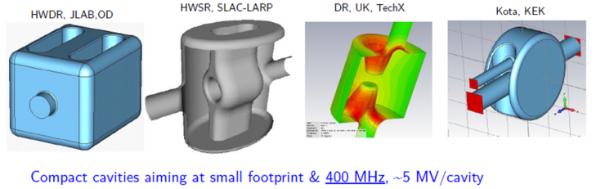
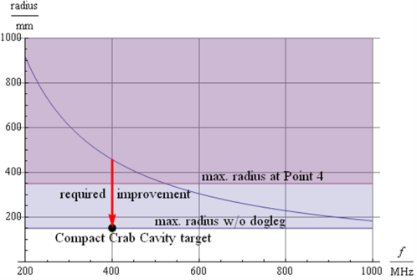
Crab Cavity, for p-beam rotation at 10-100 fs level!
Elliptical type CC has been tested first in KEK 2008
Compact Crab Cavity (CCC)
Are really COMPACT!

Slide 14
Situation: from drawings to reality…
LARP-BNL
LARP-ODU-JLAB
UniLancaster-CI-CERN

Slide 15


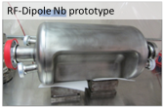
And excellent results: RF dipole > 5 MV
¼ w and 4-rods also tested (1.5 MV) cleaning & vacuum issues: new test under way
2 K result
4.2 K result
Quench
Initial goal was 3.5 MV
however ΔV > 5-6 MV would ease integration
JP Delahayen
We need downselection, and ASAP: but not too early!
5

Slide 16
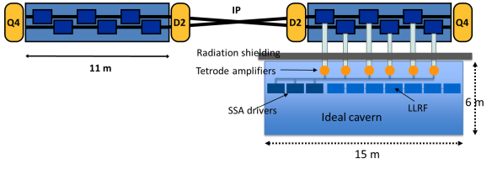
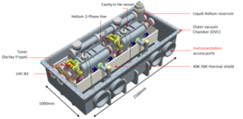
Crab Cavities for fast beam rotation
new baseline: 4 cavity /cyomodule !
4x2 beams x2 sides cavities per IP; 32 in total
TEST in SPS under preparation (A. MacPherson)

Slide 17
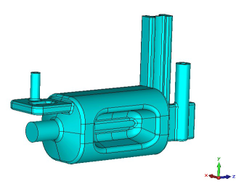
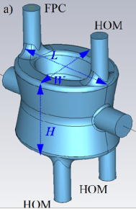
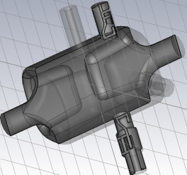
Latest cavity designs toward accelerator
Coupler concepts
RF Dipole: Waveguide or
waveguide-coax couplers
Double ¼-wave: Coaxial couplers with
hook-type antenna
4-rod: Coaxial couplers with different antenna types

Slide 18
New SCRF harmonc system: 800 MHz or 200 MHz ?
Imporntant but should not take out attention form CC !!!
P4
800 MHz to square the bunch under study.
200 MHz system recently proposed : more prominsing! But really compatible with CC ?

Slide 19
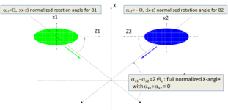

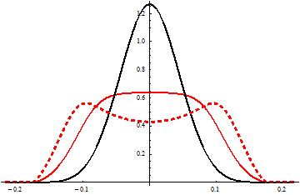
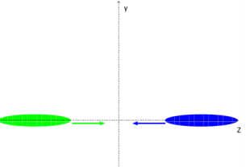
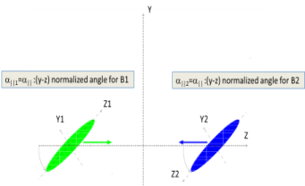

The Crab-kissing (CK) scheme for pile-up density shaping and leveling (S. Fartoukh)
Crab-kissing & variants:
CC also in ||-plane
Baseline: CC in X-plane “only”
$\frac{∂μ}{∂z}$ [mm⁻¹]
z [m]
... Work on-going together with the machine experiments
(S. Fartoukh, A. Valishev, A. Ball, B. Di Girolamo, et al.)

Slide 20
Consideration on CC and possible choice
CC, like any important hardware has a back up plan.
LRBB compensating wires may partially recovery the loss due to possible absence of CC.
However CC is the most straightforward tool to reach our goal and today the CC are in the baseline (not yet for the LRBB wires).
Especialy in presence of a possible increase of the levelling value (∼ 7.5 10 34 ?) the advantage of CC is even accentuated.
If they works, at the end we want to have BOTH CC and LRBB wires!

Slide 21



Collaboration: the long way
DOE Nb3Sn R&D
2000
LARP
generic
FP6
CARE
Nb3Sn
The HL-LHC project formally started in 2010; however it is the focal point of 20 years of converging International Collaboration
2005
CERN-KEK R&D
LARP
HiField quads
FP7
sLHC PP
(INJ)
FP7
EuCARD
HiField Dip
Start effort on CC
2010
CERN-KEK D1 design
LARP
Demo
sLHC INJ implem.
today
FP7 DS
Hi-Lumi LHC
M
2015
Construction
Injector
upgrade
HL-LHC commissioning
2023

Slide 22






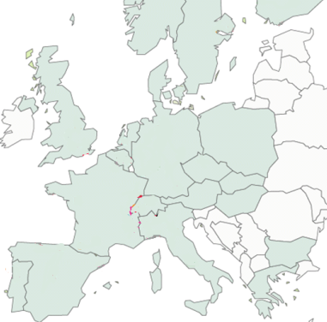












High Luminosity LHC Participants

Slide 23
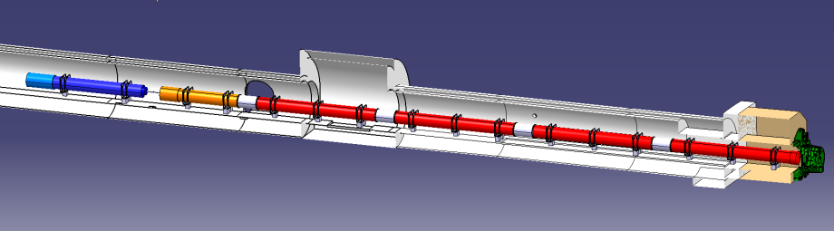




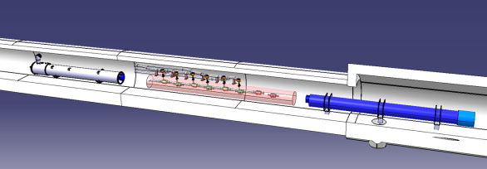


In-kind contribution and Collaboration for HW design and prototypes
ATLAS
CMS
Q1-Q3 : R&D, Design, Prototypes and in-kind USA
D1 : R&D, Design, Prototypes and in-kind JP
MCBX : Design and Prototype ES
HO Correctors: Design and Prototypes IT
Q4 : Design and Prototype FR
CC : R&D, Design and in-kind USA
CC : R&D and Design UK

Slide 24
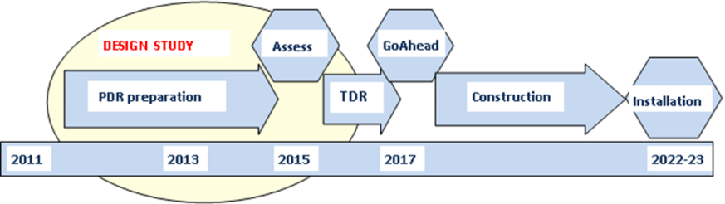
Implementation plan
All WP active, from diagnostics to Machine Protection;
Integration started with vigour as well as QA (workshop soon)
Cryo, SC links, Collimators, Diagnostics, etc. starts in LS2 (2018)
Proof of main hardware by 2016; Prototypes by 2017
Start construction 2017/18 from IT, CC, other main hardware
IT String test (integration) in 2019-20; Main Installation 2022-23
Though but – based on LHC experience – feasible
Cost: 810 MCHF (Material, CERN accounting). Now fully funded (wiht in-kind).

