Slide 1
4-Rod Design and PoP Test Results
G. Burt & B. Hall

Slide 2



Cavity Design Team
Testing team
R. Calaga (CERN)
A. MacPherson (CERN)
Plus many others
Cavity manufacture
Niowave
G. Burt (CI-Lancs)
B. Hall (CI-Lancs)
D. Doherty (CI-Lancs)
C. Hill (STFC)
T. Jones (STFC)
N. Templeton (STFC)
P. McIntosh (STFC)
P. Goudket (STFC)
S. Pattalwar (STFC)
H. Wang (JLab)
B. Rimmer (JLab)
L. Turlington (Jlab)

Slide 3
Initial Studies for a Compact CC
CEBAF separator cavity is:
  499 MHz,
  2-cell, 8 rods
  ~λ long
  ∼0.3 m diameter,
  can produce 600kV deflecting voltage (on crest) with 1.5kW input RF power.
Q_{cu} is only ~5000 (structure wise), the stainless steel cylinder only takes less than 5% of total loss.
The maximum surface magnetic field at the rod ends is ~8.2 mT.
Water cooling needed on the rods.
If Nb used for this type of cavity, the V⊥ is ≈ KEKB CC.
Microphonics and fabrication issues to be resolved.

Slide 4
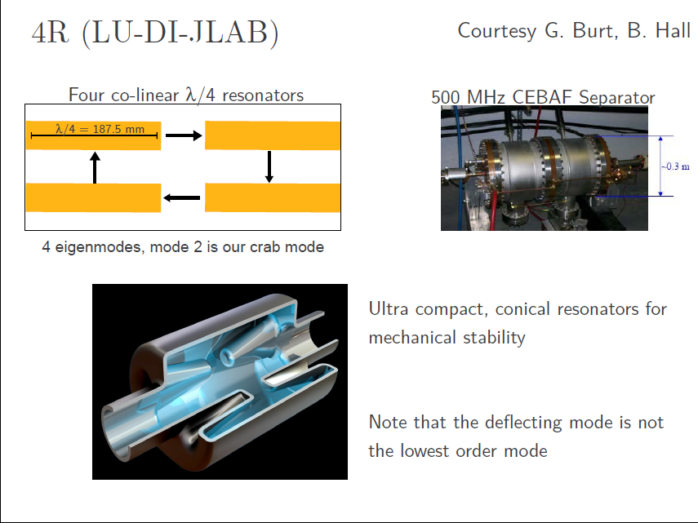
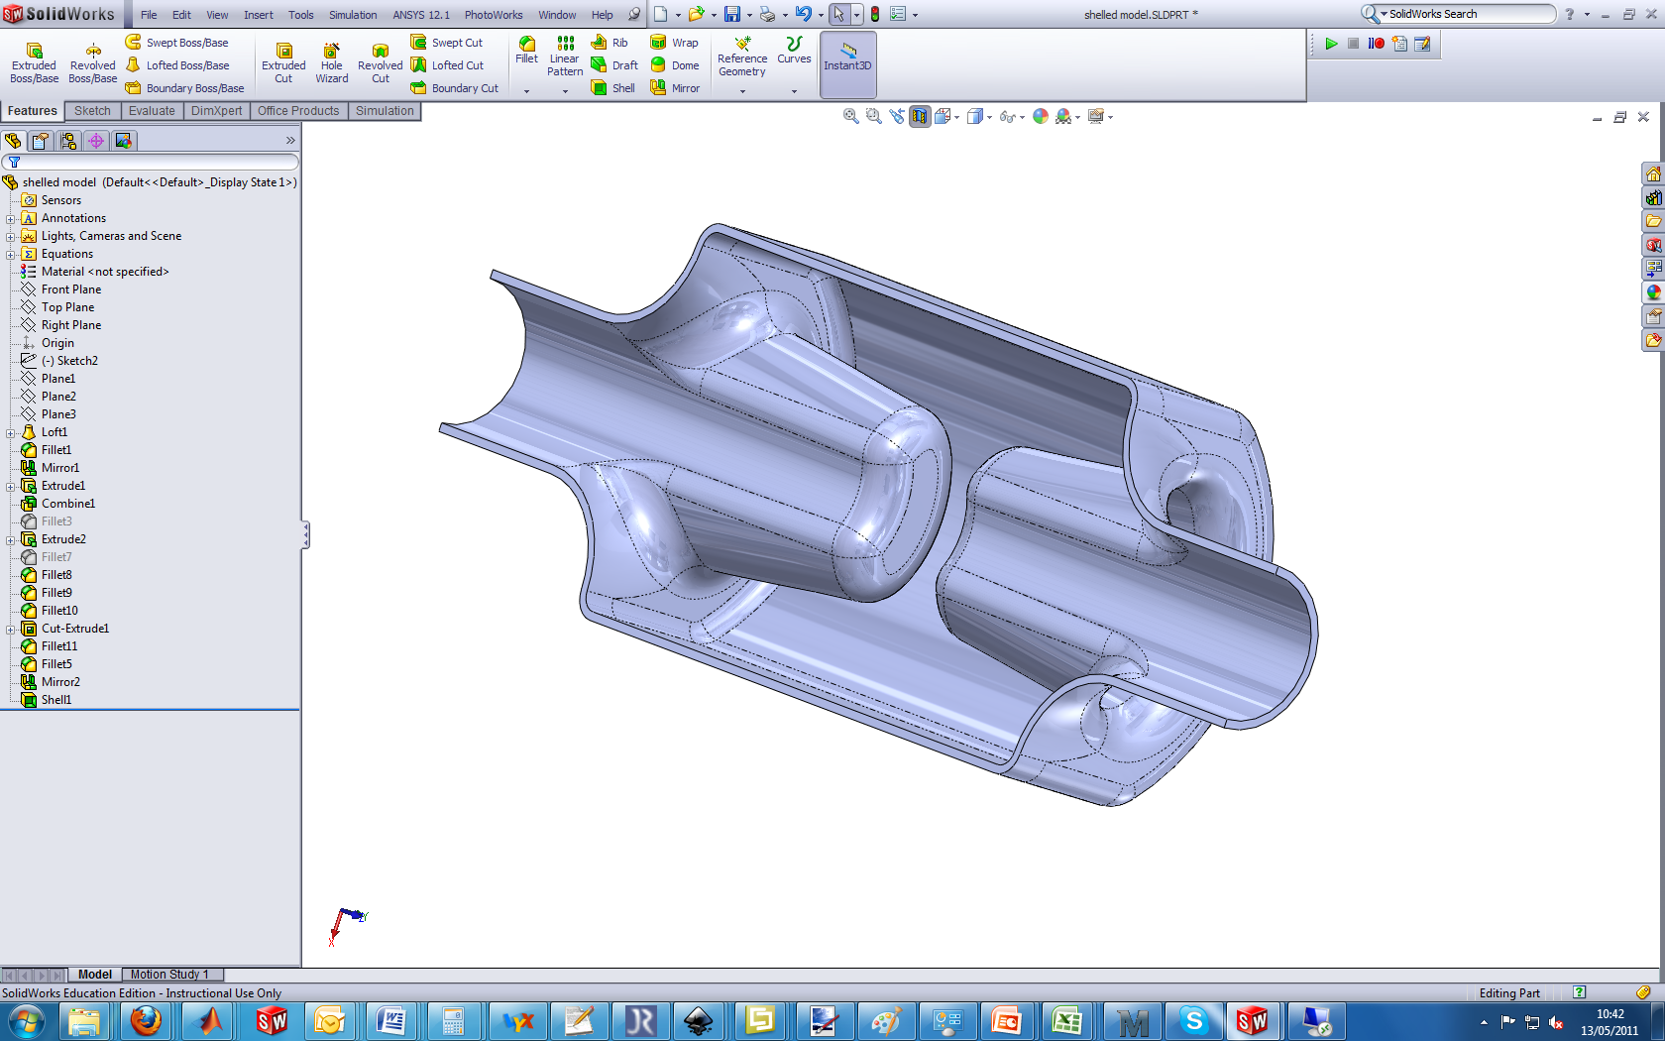
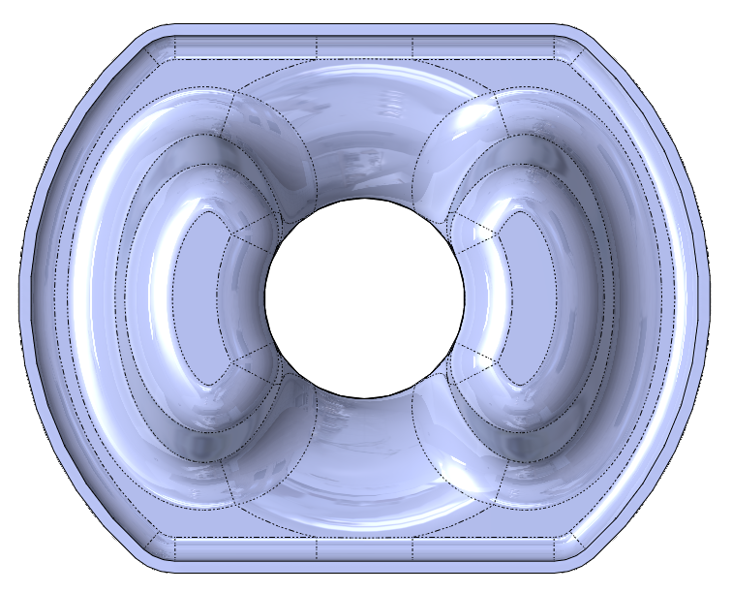
4R crab cavity – Cockcroft - Jlab
To make suitable we increased the separation between the rods and made the rods wider.
This meant they were close to the outer can.

Slide 5
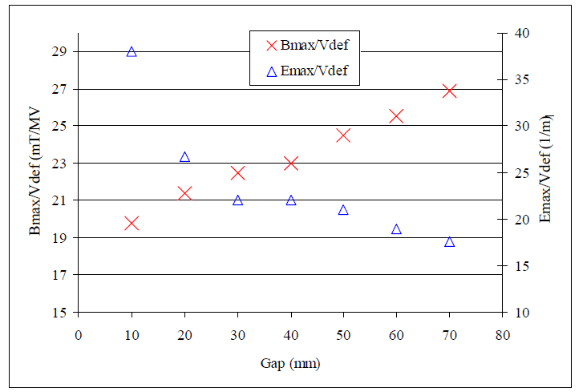
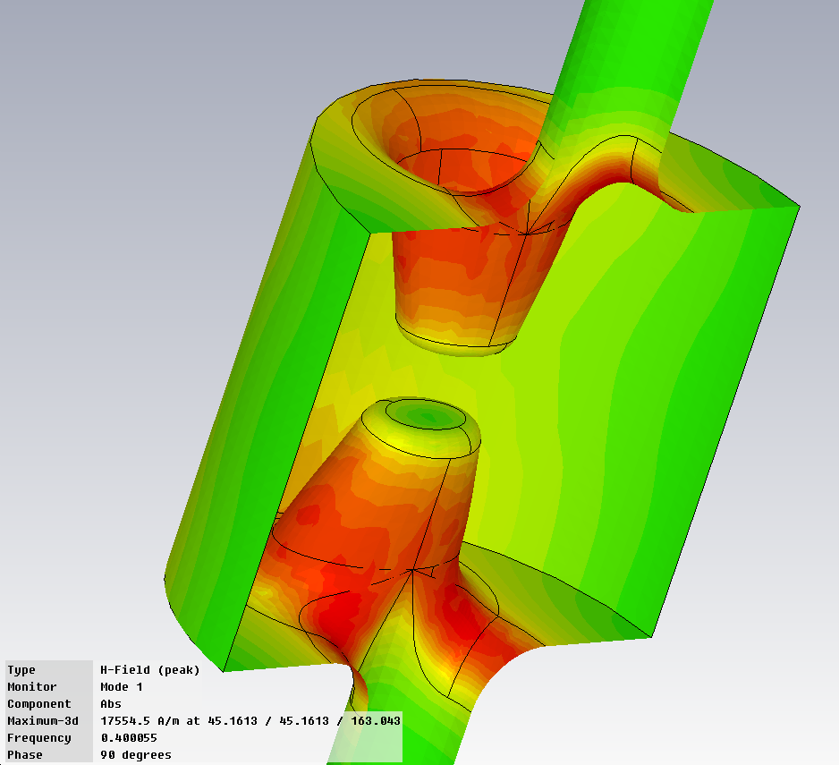
Optimisation of cavity
Unlike other crab designs, the 4 rod cavity has high electric fields.
Cavity rod shape has been optimised to keep E and B field within tolerable limits.
Lancaster Eng. Postgrad Review 2009

Slide 6
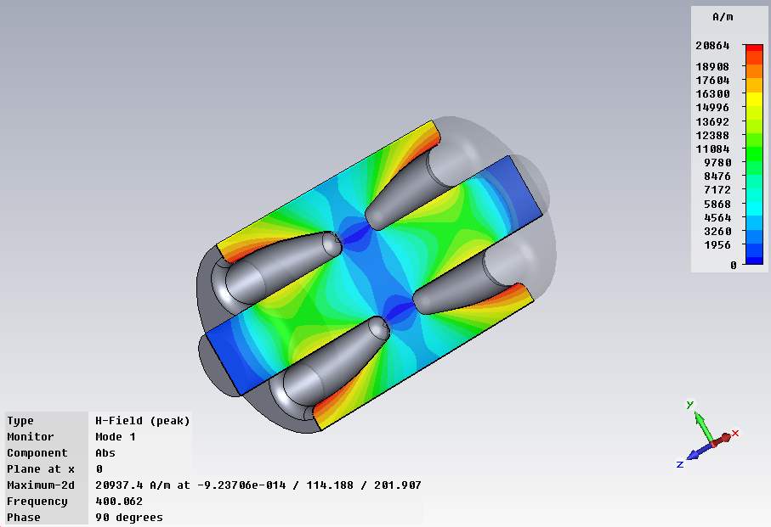
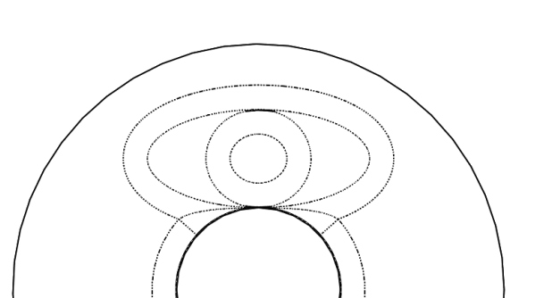
B_{max} vs. Elliptical Base
Further decreases in surface magnetic field can be made by using an elliptical base.
Oval breadth allows increase in rod base size without disproportionate increasing interaction with outer can
Small breadth leads to field enhancement down the side of the rods

Slide 7
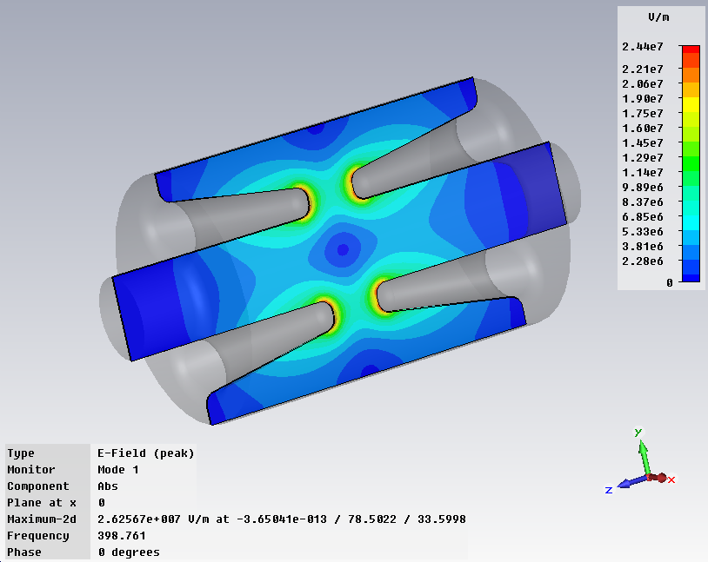
E_{max} vs. Tip width
Tip mostly concerned with electric field.
A sharp tip will cause field enhancement.
Increased tip width decreases peak surface electric field but also will decrease deflecting field.

Slide 8
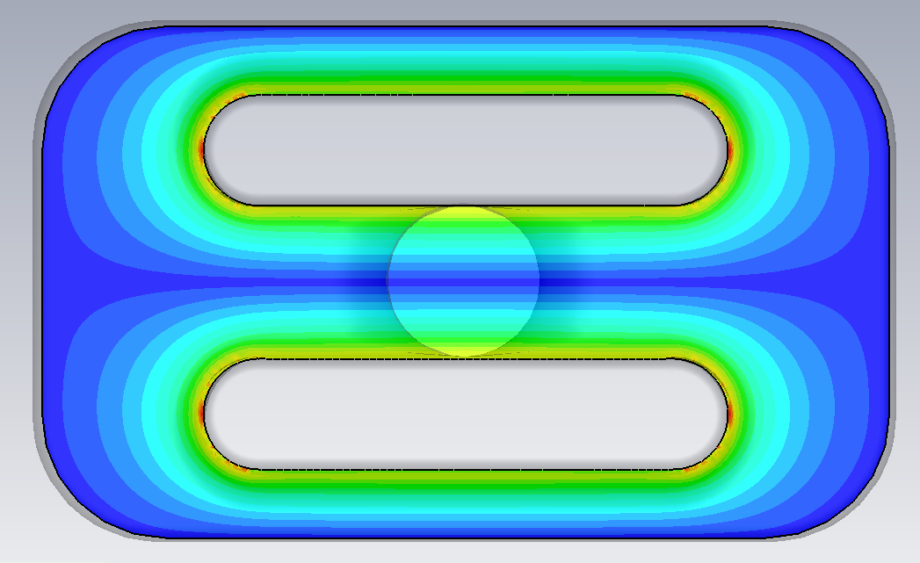
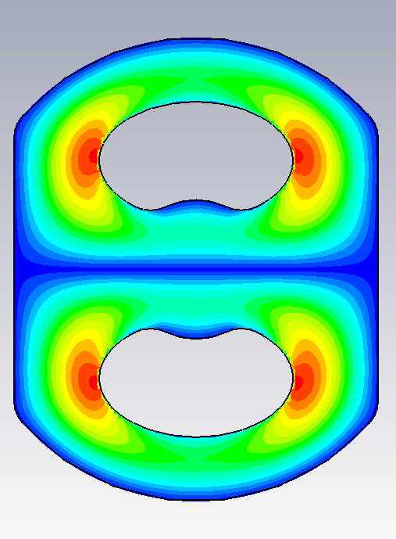
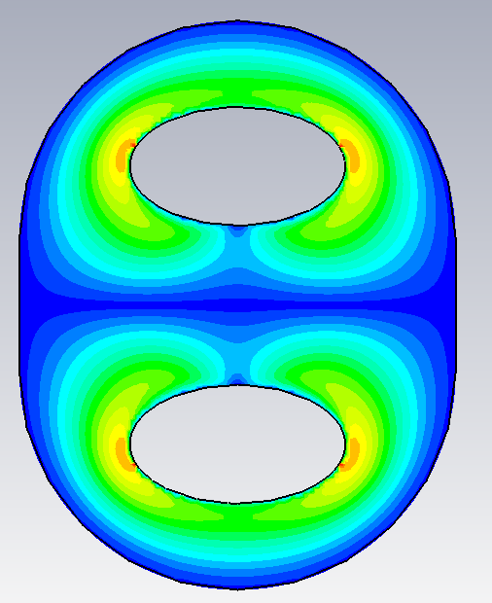
Kidney shaped rods
Wide rods give pure dipoles but oval rods have strong sextupole components. Making the rods kidney shaped can compensate for this.

Slide 9
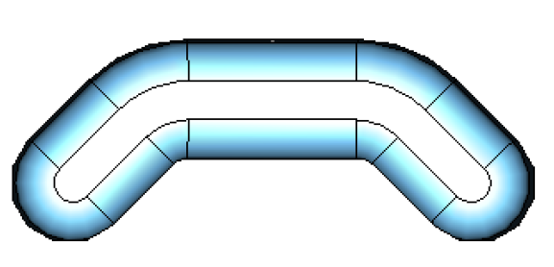
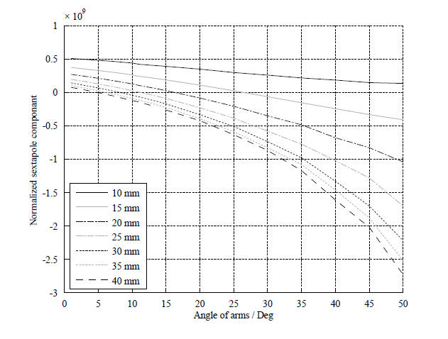
Sextupole Component
Due to symmetry the 4R cavity doesn’t have even components to the crab kick (monopole, quadrupole, octopole etc)
The dominant error term comes from the sextupole component (m=3).
The m=3 term of a simplified shape was studied.
It can be seen that the m=3 term can be reduced to zero by simply modifying the angle of the focusing electrodes

Slide 10
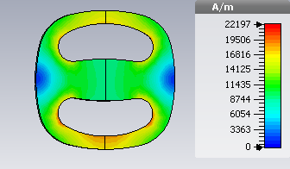
R/Q for LOM and crabbing mode vs rod width
Making the rods wider reduces the R/Q of the LOM and operating mode but does increase the peak magnetic field a bit.

Slide 11
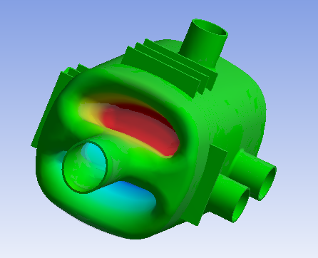
Tunability vs Rod width
To provide good LOM damping the rods must be close to the outer can (to have high B field), so the rod width and can width are linked.
The force required to tune the cavity is strongly dependant on the can width. A wider can (and hence wider rods)
The deflection for 5 kN increases by 50% for the new 280 mm diameter can over the only 240 mm can.

Slide 12
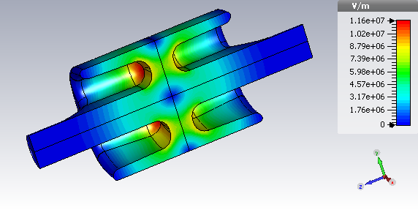
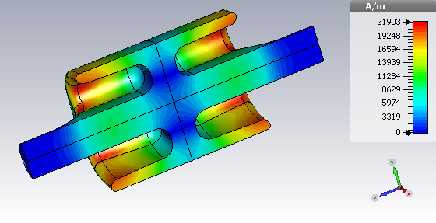
Final Cavity Shape
Trade off in Electric vs. Magnetic field performance due to changed rod shape
Cavity still fits in all LHC scenarios and has tolerable fields at the design gradient.
E field
Emax @3.4MV | 32.7 MV/m
Bmax @3.4MV | 77.5 mT
Transverse R/Q | 580 Ohms
B field
Notes:
Low magnetic fields to stop quench
Low e field to stop field emission

Slide 13
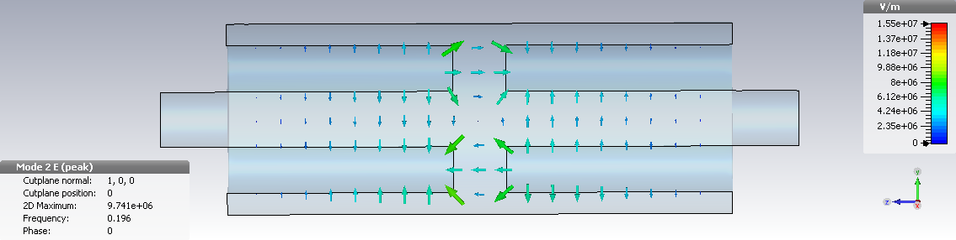
200 MHz option
The frequency is only dependant on the longitudinal length hence lower frequencies are not an issue.
If the LHC does go down to 200 MHz (which is an option) then the 4 rod cavity is still an option.
Emax at 6 MV ~36 MV/m
Bmax at 6 MV ~ 80 mT

Slide 14
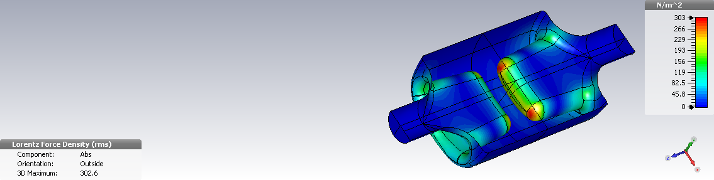
Lorentz force detuning
Most of the force is at the tip of the rod with some at the base, the force on the outer can is negligible.
The pressure is around 2.4 kN/m² but this has a negligible effect on the cavity frequency (less than tuner resolution) due to the location of the force.

Slide 15
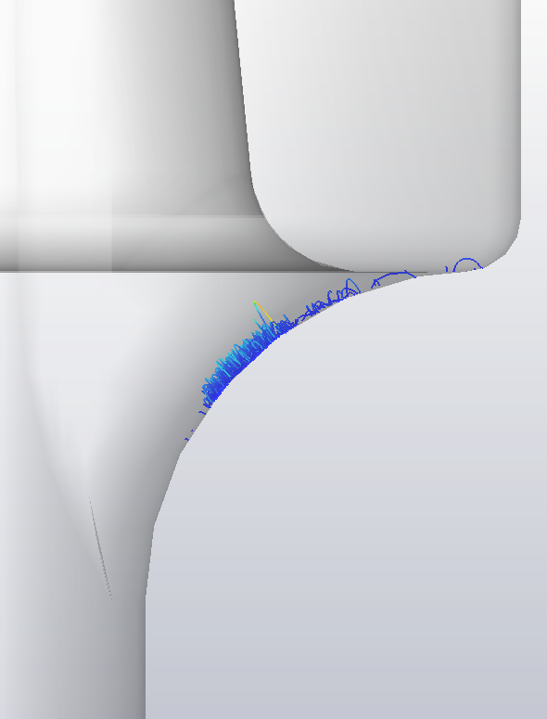
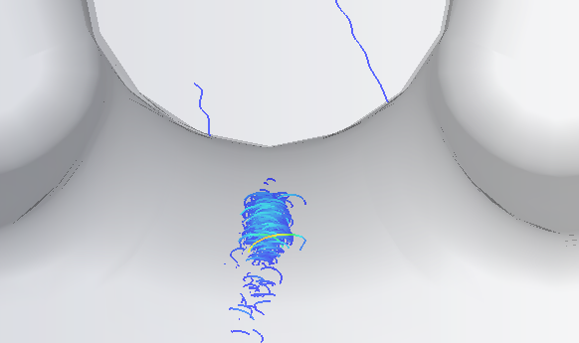
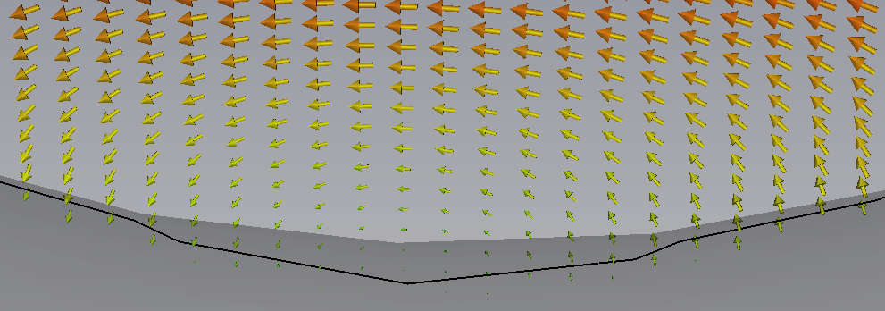
Multipactor Trajectories
Multipactor on the beam pipe was found on the beam pipe at ~1.6MV.
Same multipacting was seen on KEKB crab cavity.
Methods of removing the multipactor are being looked into, including;
  Altering the beam pipe shape,
  Adding ridges to disrupt local field patterns.

Slide 16
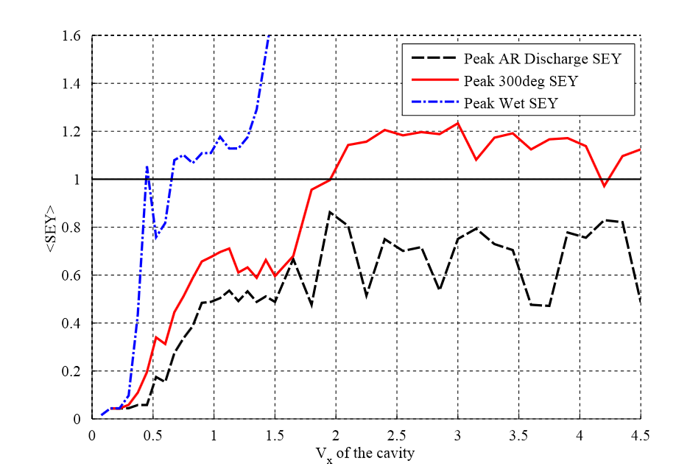
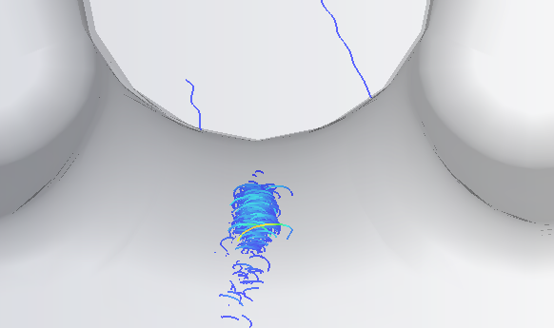
Multipactor
Multipactor on the beam pipe was found on the beam pipe at ~2 MV.
Same type of multipacting was seen on KEKB crab cavity.
Studies with processed surface SEY shows it can be processed through

Slide 17
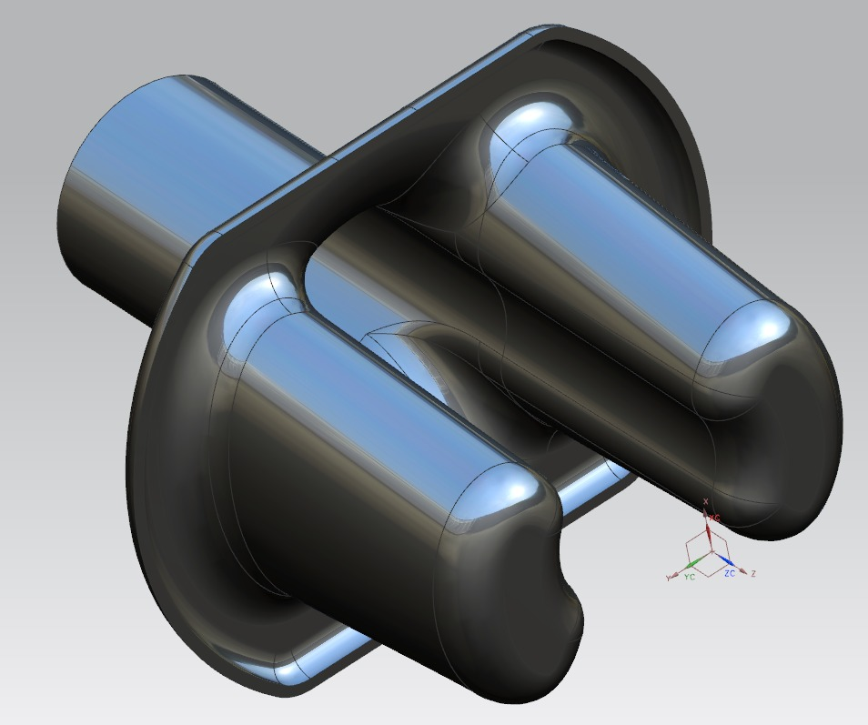
Manufacture of the proof-of-principle cavity
Cavity design is an earlier design with narrower rods.
Consider to make major parts from solid
  Wire EDM pre-forms from ingot
  Machine all surfaces
  Add beam pipes and can
This allows any material thickness or even a variable thickness. Also stiffeners can easily be added.
This could also allow fine detail to be added to avoid multipactor (like the ridges suggested by SLAC for the 800 MHz elliptical cavity)
However a substantial lump of Nb ingot is required (£50k worth)

Slide 18
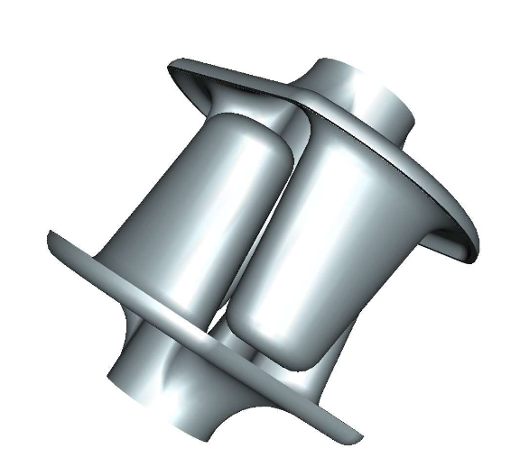
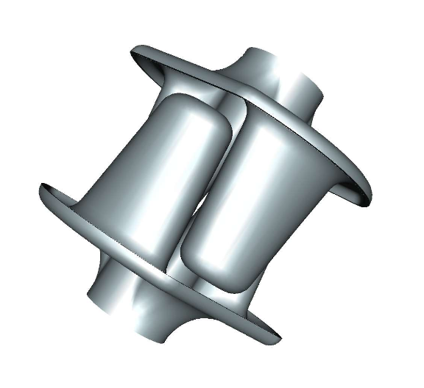
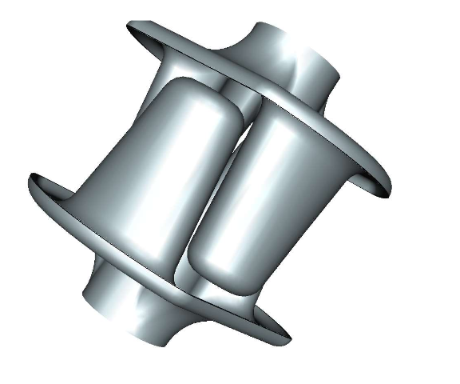
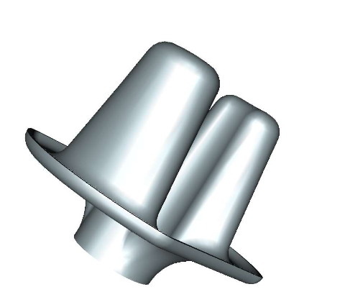
Wire EDM cutting to separate the electrode blocks

Slide 19
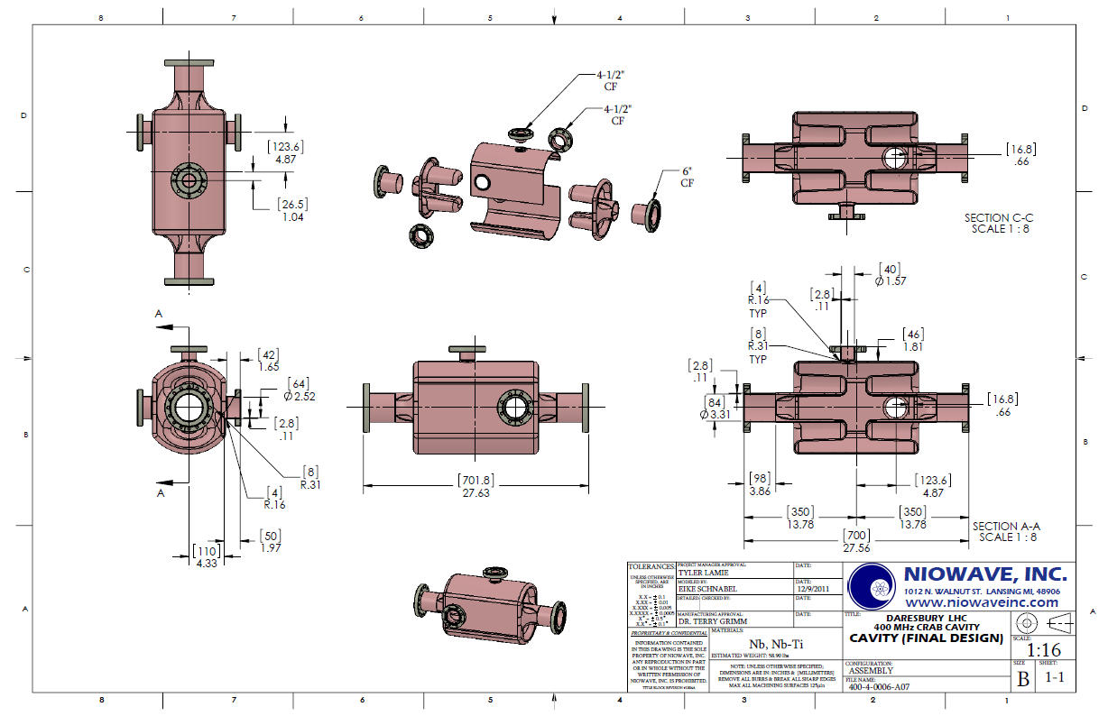
Mechanical Design

Slide 20
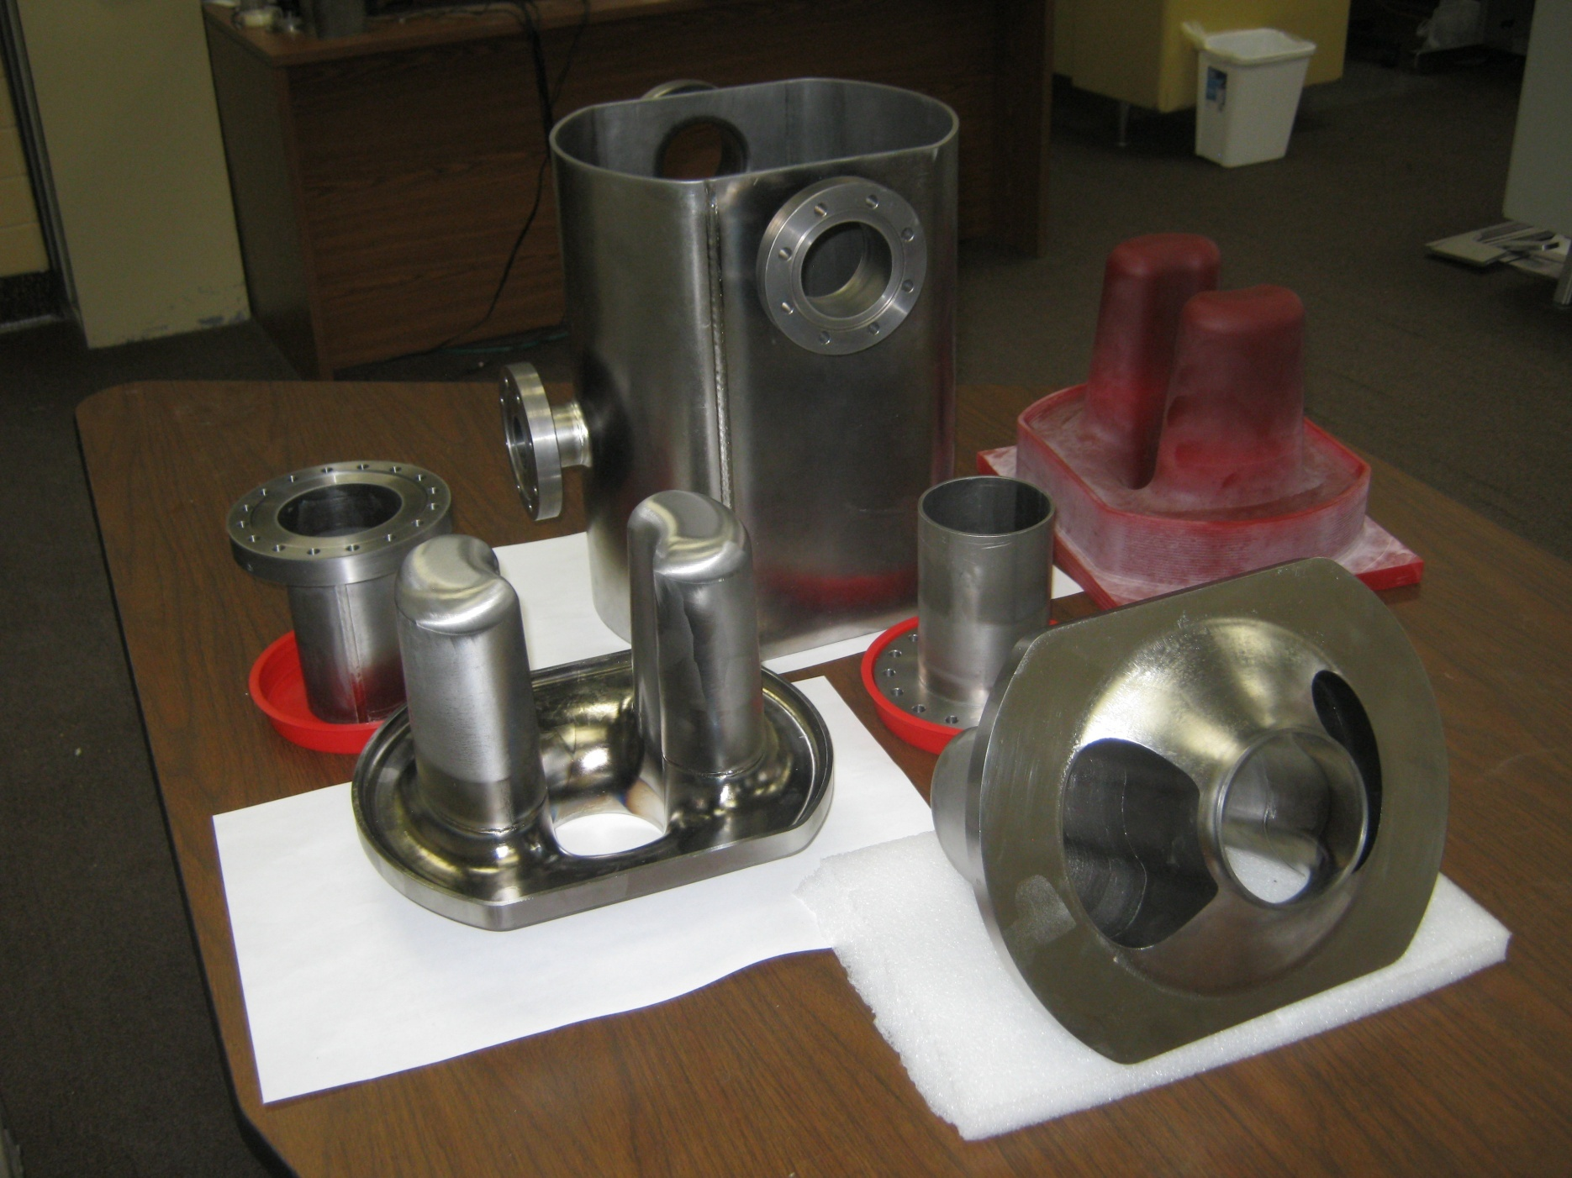
Parts after trimming and final polishing

Slide 21
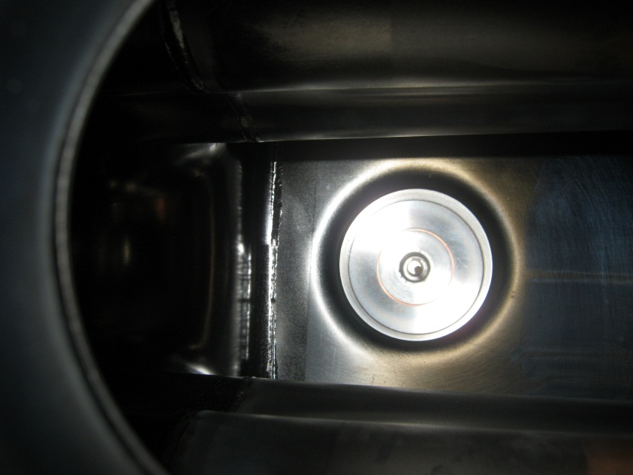
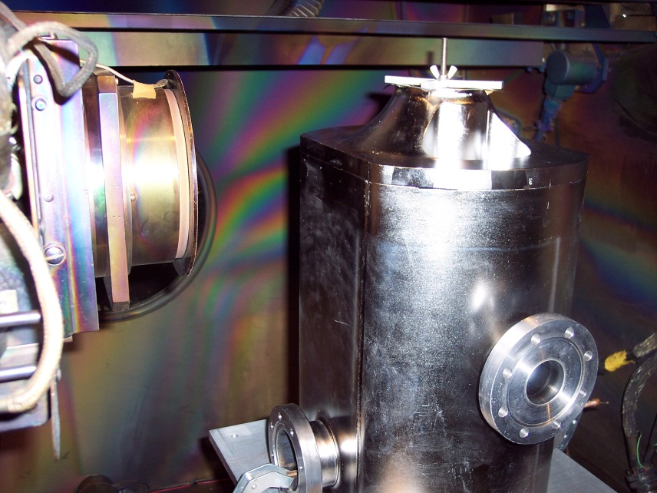
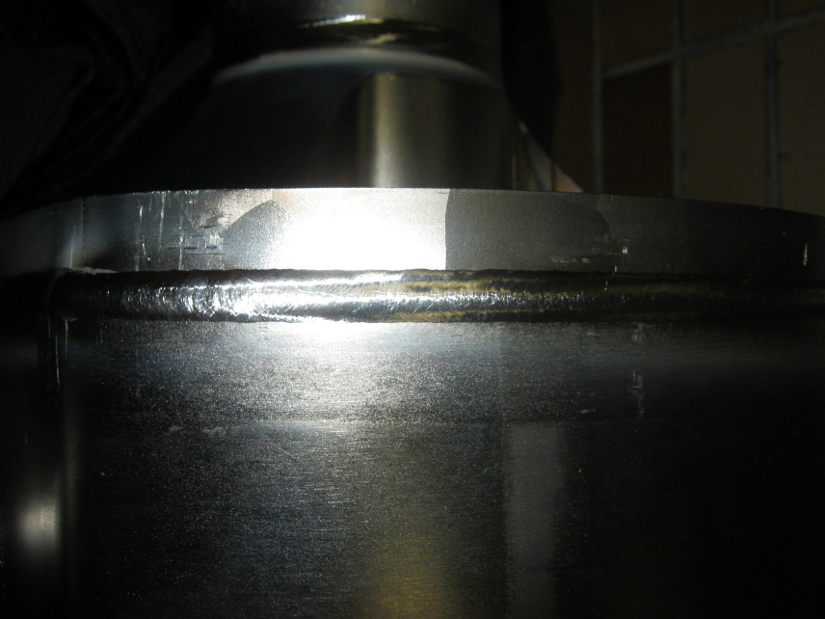
Cavity Welding
All components inspected for surface imperfections prior to etch.
20 micron etch on all weld joints.
Weld Chamber pumped down to 3.7x10⁻⁵ torr before welding.
Surface temperature of all welded components below 160ºF when chamber opened.
All weld seems visually inspected before removing components from chamber.
Post weld cavity leak check performed using copper gaskets, and conflat blanks.
No detectable leaks found (minimum detectable leak of 1.0x10⁻¹⁰ torr ℓ/s)

Slide 22
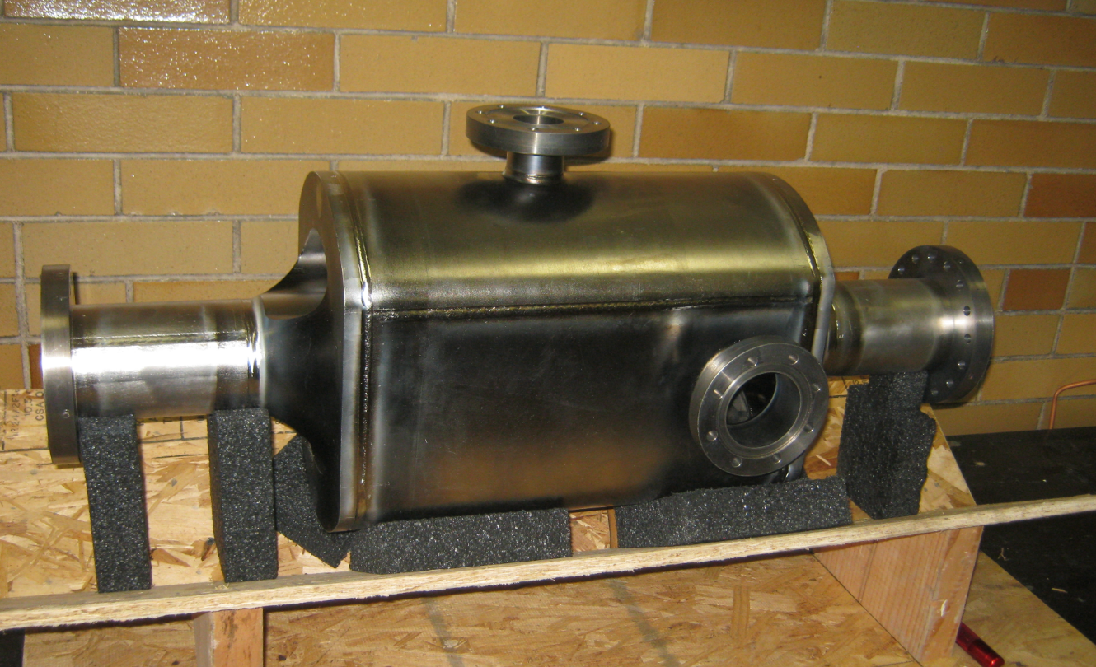
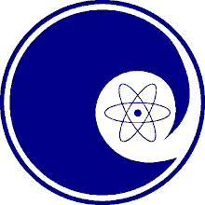
4 Rod prototype built
NIOWAVE

Slide 23
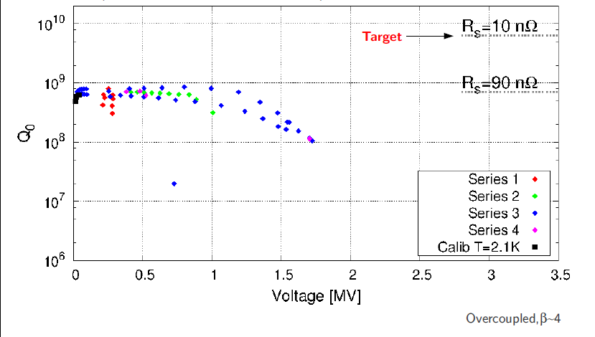
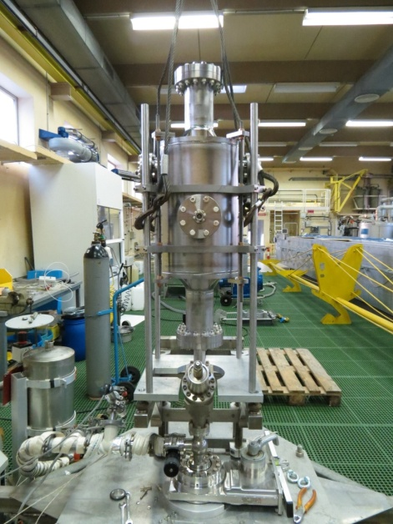
1st Tests
The first test were performed March 2013.
Cavity was not etched after bakeout hence had some surface contamination.

Slide 24
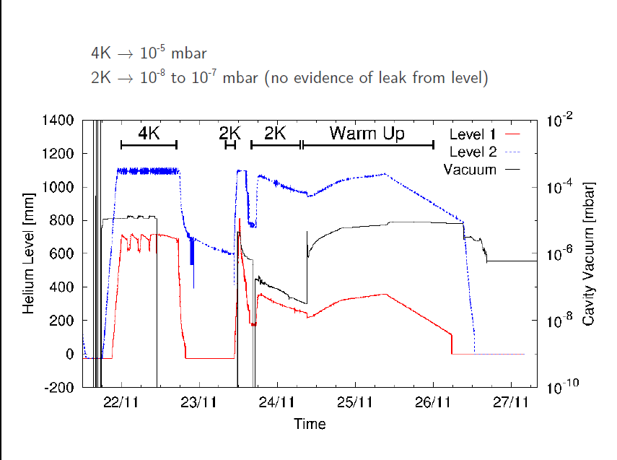
Cavity Vacuum

Slide 25
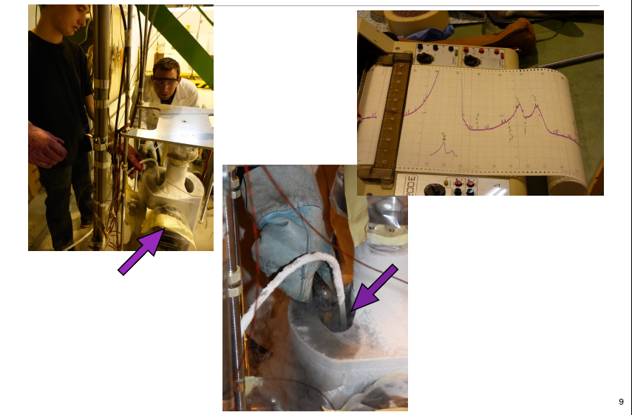
Leak Tests

Slide 26
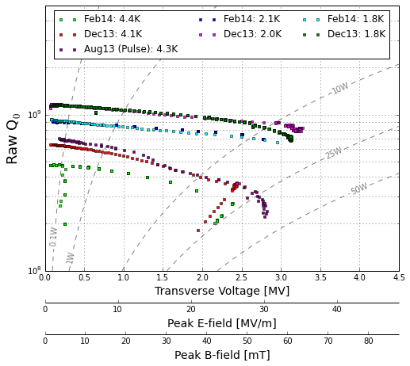
2nd Test results
Cavity reached operating gradient but has a high residual resistance.

Slide 27
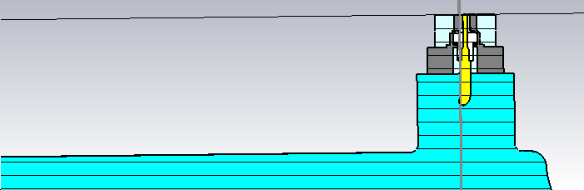
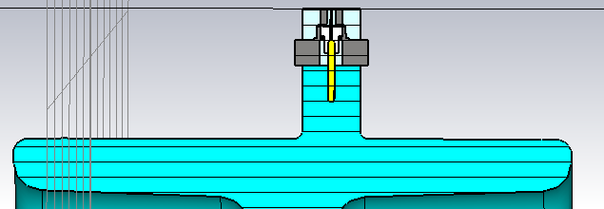
Stainless Steel FPC
We recently discovered that the couplers had accidentally been made from stainless steel instead of copper. To test the effect we simulated a cavity with no losses other than the couplers in frequency domain using the same methods as in the vertical test.
Copper
Q₀= 7.189E9
R_{s} = 8.3 nOhms
Stainless Steel Q₀=2.737E9
R_{s} = 22.0 nOhms

Slide 28
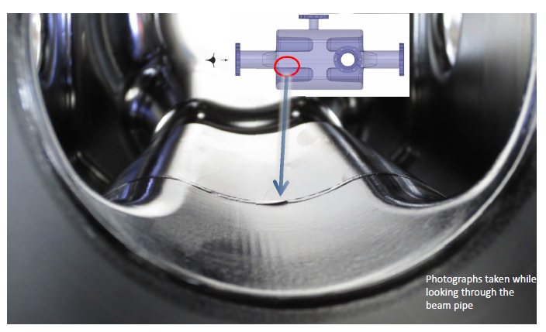
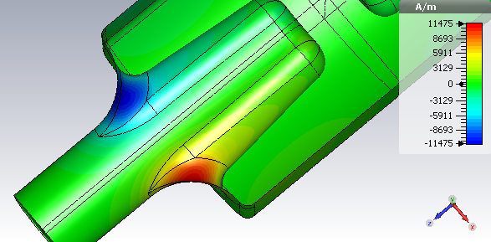
Cavity welds
A mistake was made in machining the rods. To fix this Niowave cut it off and welded a new one on.
The magnetic field has a longitudinal component on the weld which is not ideal.

Slide 29
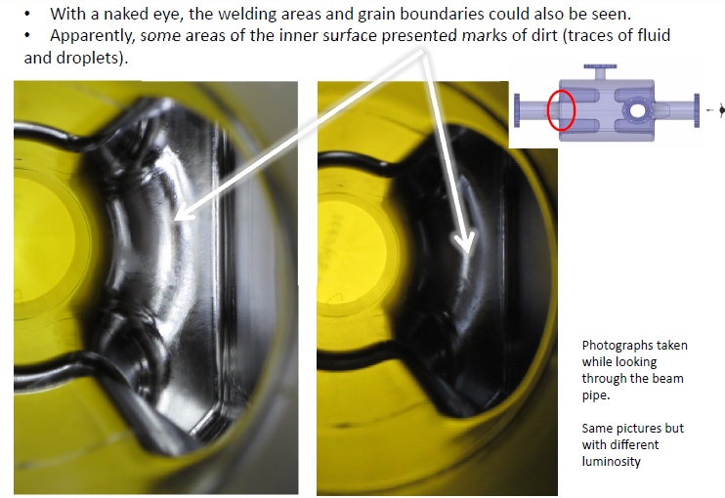
Endoscope
The HPR wand didn’t reach the end of the cavity as it is too short and the cavity is not assembled in a clean room.

Slide 30
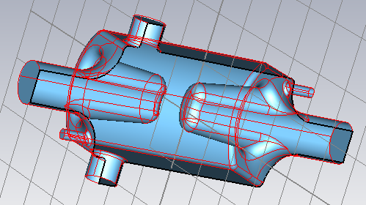
HPR through side ports
The cavity has two demountable couplers opposite each other on the side of the cavity
This will allow a HPR want to go through the cavity allowing line-of sight for cleaning most of the cavity surface

Slide 31
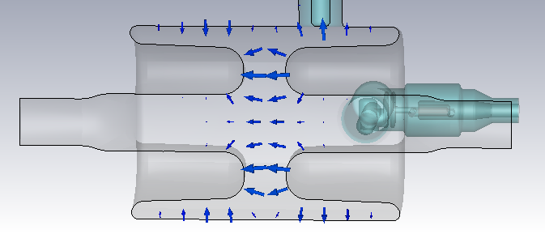
Lower Order Mode
The four rod crab cavity has a monopole mode at a frequency of 370 MHz which is below the operating frequency of 400 MHz hence this is a lower order mode (LOM).
This adds some complication in coupling to this mode.
As mentioned earlier wide rods are used to reduce the R/Q of this mode to 45 Ohms (inc factor of 2).
Also its frequency has been designed to be far from any beam harmonics.

Slide 32
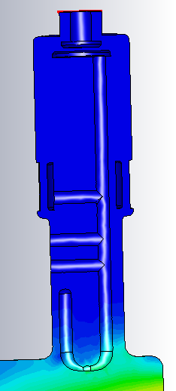
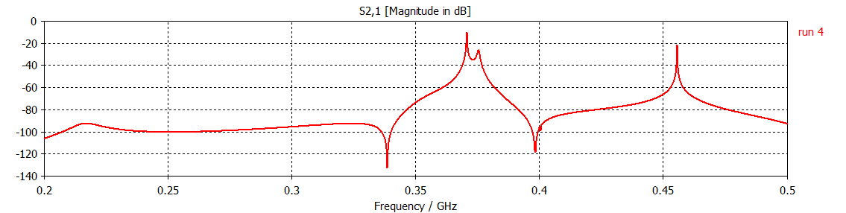
LOM coupler
Two methods are used to reject the crabbing mode.
  The coupler is positioned in both electric and magnetic field nulls for the crabbing mode
  A notch filter is used as well, it only needs to slightly reduce the power so doesn’t have to be on tune.
The LOM coupler also damps most of the monopole modes

Slide 33


Horizontal HOM coupler
The horizontal HOM coupler is primarily to damp the harmonics of the operating mode mostly between 1 GHz -1.2 GHz and at 0.65 GHz.
It uses a BNL low pass filter but with compensation at 440 MHz to pick up a low R/Q mode in the crab passband.
Also has to damp a few TE modes trapped
modes between the rods at 1.2 GHz.

Slide 34

440 MHz mode
We also have a mode similar to the operating mode where the two sets of rods have the same polarity.
It has a R/Q of 1 Ohm.
Coupling to this mode, like the LOM, is difficult as its close to the operating mode which must be filtered out.
Either we have an extra special coupler to damp this mode in a region where the crabbing mode has no field or the HOM coupler needed modifying. Both are being investigated.

Slide 35


New Horizontal HOM
To coupler strongly to the 440 MHz mode we add a resonance between a suporting stub and a capacitive gap.
The downside is the coupler has a series of narrowband resonances.
Need to ensure the other HOM coupler is sufficiently broadband to damp all missing modes.
The design is also slightly easier to manufacture

Slide 36


Extra HOM Coupler
Alternatively we could use an extra HOM coupler to damp the 440 MHz mode.
By placing it in the cavity centre we can a simpler coupler.
The other two HOM couplers could then be simple broadband couplers.
The downside is we need 5 couplers.

Slide 37


Vertical HOM coupler
This mode picks up the higher frequency TE and TM modes in the vertical plane.
It is in a low field position for the operating mode.
The filter is after the bend to save space.
It again uses the BNL low-pass
filter.
Note: S-parameter is shown through a cutoff waveguide.

Slide 38

Frozen design April 2014
All modes are damped but current design needs 2 HOM couplers, a LOM coupler plus a 440 MHz mode coupler.
Mechanical design was performed without the extra HOM coupler
Currently working to reduce number of HOM couplers to 2 plus LOM coupler.

Slide 39
Impedance (update)
Impedance Limits
All modes up to 2 GHz are damped to the required impedance
CST throws in a few spurious non-existent modes in the couplers
Have calculated all 3 components for each mode.

Slide 40

Couplers affect on Multipoles
 | no couplers | couplers
b0 | 0.00E+00 | -3.62E-05
b2 | 0.00E+00 | -6.66E-02
b3 | -1.30E+01 | -2.20E+00
b4 | 0.00E+00 | -5.80E+02
b5 | -1.12E+05 | -1.59E+05
 | at 10 MV
The wider rods are much more like pure dipoles.
b0 is just the monopole field, converting to a magnetic field doesn’t really make sense but we keep the same notation for simplicity
Ez is non-zero on axis, this is the horizontal HOM coupler moving the electrical centre slightly.
We can make the rods slightly asymmetric to cancel this effect.

Slide 41


Peak fields on couplers
The LOM and vertical HOM are positioned so they see very little of the crabbing mode.
The horizontal HOM see’s some electric field which might need modifying but the magnetic field is also very low.

Slide 42

Heat load on FPC
The magnetic field on the FPC is very low meaning that we only dissipate 45 watts on the inner conductor.

Slide 43


Heat load on couplers
The heat load on the couplers due to the crabbing mode is under 1 watt.
This is because none of the couplers are in a high B field region.

Slide 44

LOM mode heating
As a worst case senerio we include the losses if the LOM has 100 mJ of stored energy (we expect less than 1 mJ).
We assume Rs=200 nOhms
The LOM inner conductor only heats up by a degree or two and the heat load is around 100 mW.
The heat load on the outer can is high if made of stainless so this will need to be superconducting (for 1 mJ load is 3 W if stainless)
This means 80K intercept will have to be further along the cable.

Slide 45
Heat Loads
If the HOM/LOM couplers are kept superconducting the heat loads are very low.
This is because only one coupler is in a position to couple to the crabbing mode.
This means we can probably get away with copper strapping the HOM couplers to 2-4K.
Dynamic Losses
 | 8K niobium | cu
Rs | 200 nOhm | 5m Ohm
HHOM Can 1 | 3.51E-01 | 8.78E+03
HHOMcan 2 | 1.77E-02 | 4.42E+02
HHOM inner 1 | 3.78E-01 | 9.45E+03
HHOM inner2 | 2.15E-02 | 5.38E+02
VHOM can 1 | 8.93E-03 | 2.23E+02
VHOM can 2 | 3.66E-06 | 9.15E-02
VHOM inner 1 | 5.06E-03 | 1.26E+02
VHOM inner 2 | 1.67E-05 | 4.17E-01
LOM inner | 4.30E-03 | 1.07E+02
LOM can 1 | 6.60E-03 | 1.65E+02
LOM can 2 |  | 0.001607
LOM can 3 |  | 2.68E-06
FPC |  | 45.22
Total | 1.3 Watts at 2K

Slide 46
Conclusion
The 4 rod cavity is a suitable candidate for HL-LHC (400 MHz or 200 MHz)
The PoP cavity reaches somewhere between 3MV-3.5 MV, but has a high residual resistance due to stainless steel components.
The gradient is limited by a weld that will not be used in the final design.
We have a working set of couplers with very low heat loads but we think we can reduce the complexity greatly with a bit more time.

