Slide 1
RF Dipole Cavity SPS Prototype Engineering
Crab Cavity System External Review
BNL, 5-6 May 2014

Slide 2
Prototype engineering is a collective work of
Zenghai Li (SLAC)
CERN Engineering Team
Tom Nicol (Fermilab)
ODU

Slide 3
Outline
Prototype design approach
Basic dimensions
Cavity characteristics
Lorentz force detuning
Pressure sensitivity
Tuning sensitivity
Modal responses
Fabrication and processing
Fabrication plan
Frequency recipe
Inspections and measurements during fabrication
Couplers and tuner
Helium vessel (Cryomodule talk tomorrow)

Slide 4
Design Approach
EM design optimization
Structural check
Determine cavity thickness
/stiffeners
Lorentz force detuning, Tuning sensitivity, and pressure sensitivity study
Stiffening optimization
Helium vessel design
Structural study including Helium vessel
Cavity
HOM Ports
Wave guide/
High pass filter
Down select by power requirement
/recommendation

Slide 5
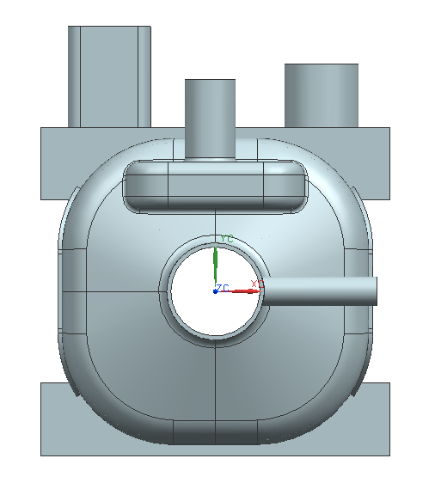
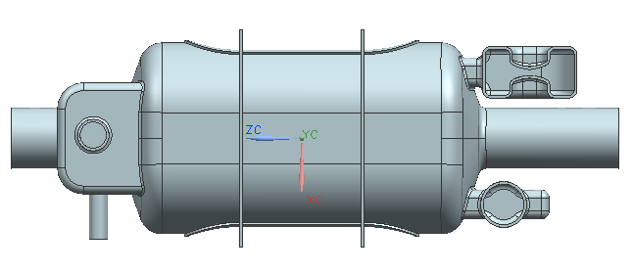
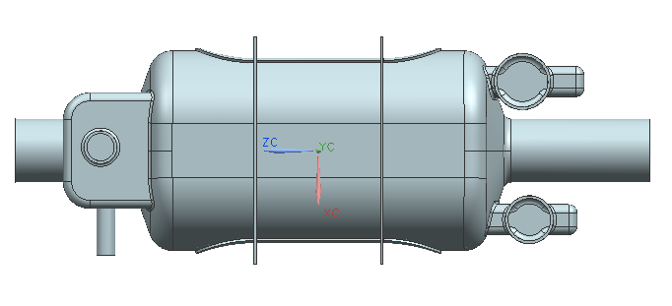
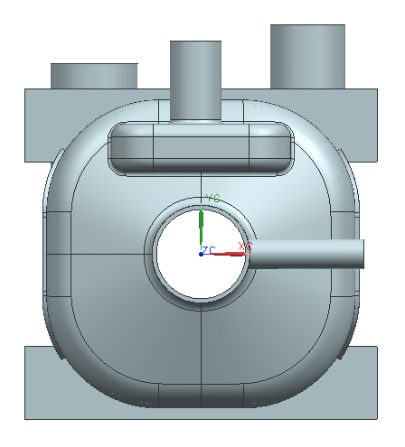
Basic Dimensions
Dimensions at room temperature
546 mm
310 mm

Slide 6
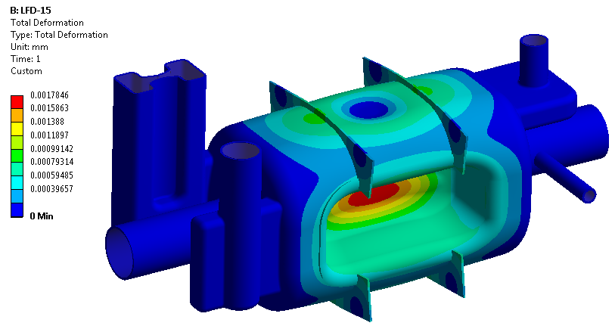
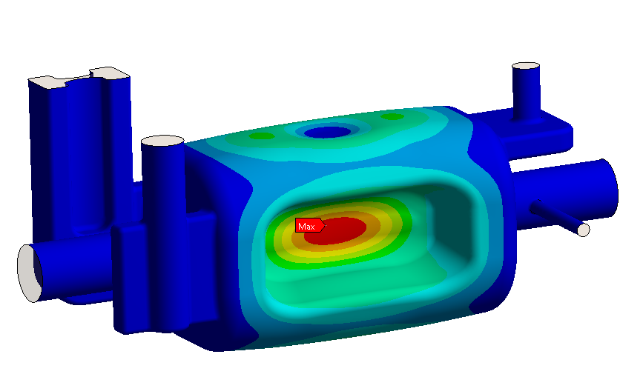
Prototype Characteristics
γνῶθι σεαυτόν
Lorentz force detuning : -4.2 kHz at 3.4 MV transverse voltage
Tuner in place
Deformation of the cavity due to Lorentz force
Deformation of the inner volume due to Lorentz force
The simulation agrees with the test results of 400 MHz Pop crab cavity and 499 MHz JLAB deflecting cavity.
400MHz: Simulated -117.3 Hz/(MV/m)², Tested -121.94 Hz/(MV/m)²
499MHz: Simulated -52.4 Hz/(MV/m)², Tested -57.7 Hz/(MV/m)²

Slide 7
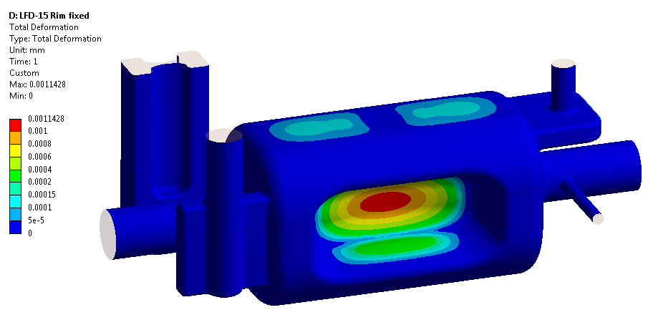
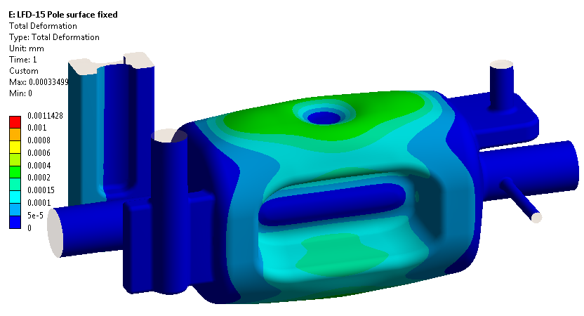
Prototype Characteristics
Reduction of Lorentz force detuning
Rims fixed by connecting to the Helium vessel
Pole surfaces fixed
LFD -1.6 kHz/3.4MV
LFD -0.5 kHz/3.4MV
Given the available tuning range, these options were not pursued.

Slide 8
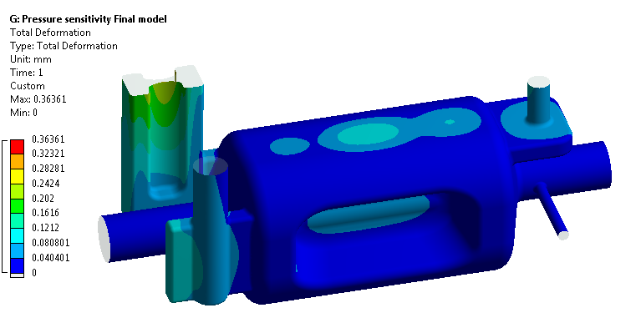
Prototype Characteristics
Pressure sensitivity : -60 Hz/mbar
Cavity inner volume deformation due to 1 bar pressure

Slide 9
Prototype Characteristics
Mechanical mode : Other factors in the environment will change the mode drastically.
First mode ~ 300 Hz
Under 23 torr external pressure
All ports fixed
First mode ~ 100 Hz
Under 23 torr external pressure
HOM wave guide loose

Slide 10
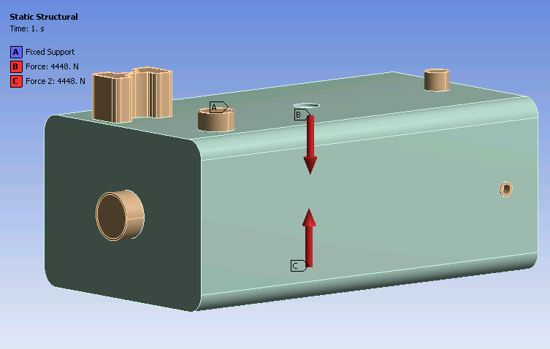
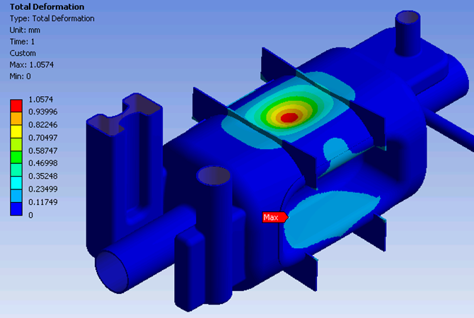
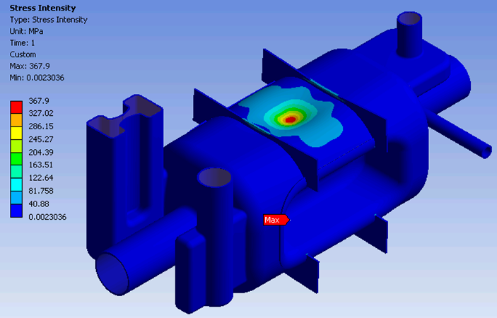
Characteristics – Tuning Sensitivity
Bonded connections
Tuning force (N) | Tuning range (kHz) | Deformation each side (mm) | Peak Stress Intensity (MPa) | Sensitivity* (kHz/mm)
4448 | 730 | 1.057 | 368 | 690
1500 | 240 | 0.357 | 124 | 680
* Sensitivity of tuner stroke 345 kHz/mm

Slide 11
Tuning Range
Tuning force (N) | Tuning range (kHz) | Deformation each side (mm) | Peak Stress Intensity (MPa) | Sensitivity (kHz/mm)
4448 | 730 | 1.057 | 368 | 690
1500 | 240 | 0.357 | 124 | 680
Minimal tuning force and induced stress (yield strength 580 MPa at 2K) → Wide tuning range
Cavity detuning
LFD -4 kHz
Helium pressure fluctuation (1 mbar at 2K) -60 Hz
Fabrication tolerance (assumed) +/-500 kHz
May not need a warm tuning
More tuner details in cryomodule talk

Slide 12
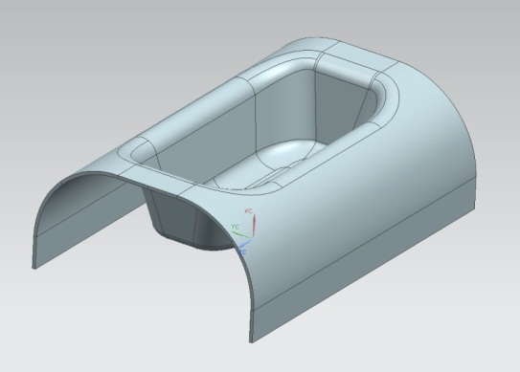
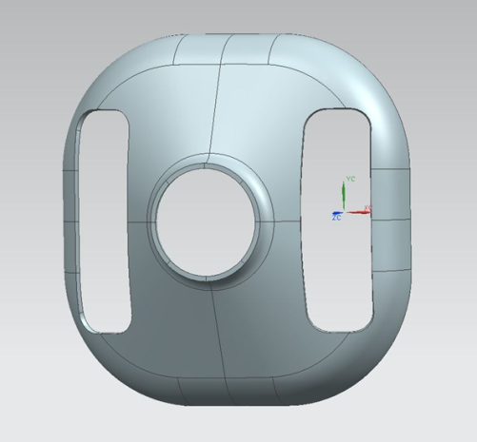
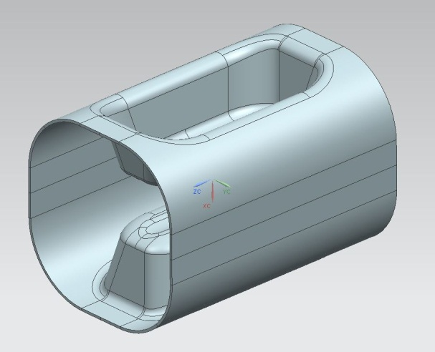
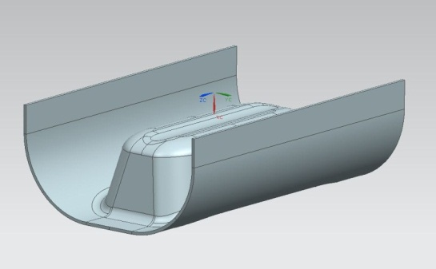
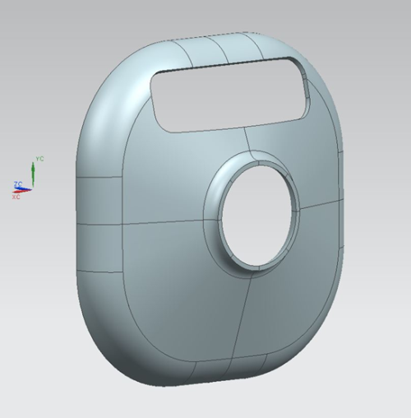
Fabrication Cavity Welding
Main body
End cap design identical for both waveguide and coax
End caps

Slide 13
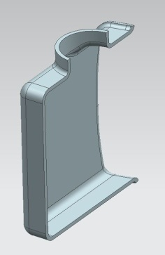
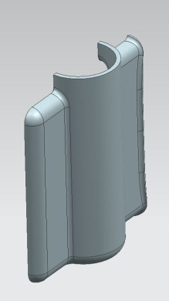
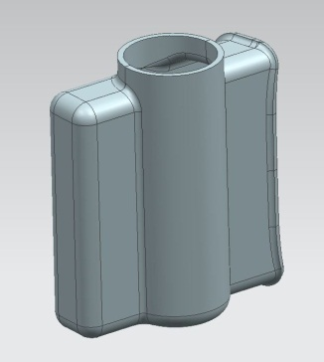
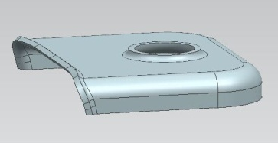
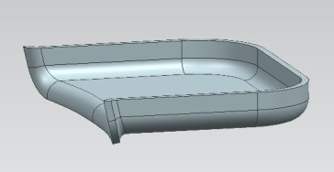
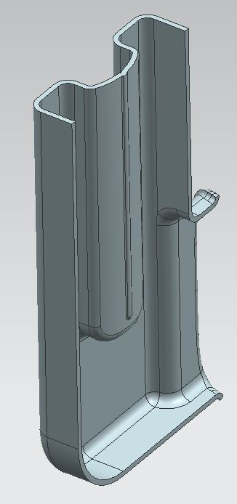
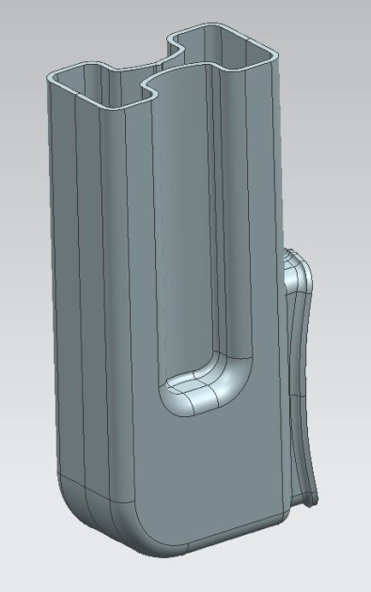
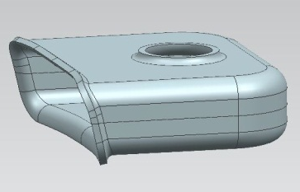
Fabrication Cavity Welding
FPC WG
V HOM WG
H HOM WG

Slide 14
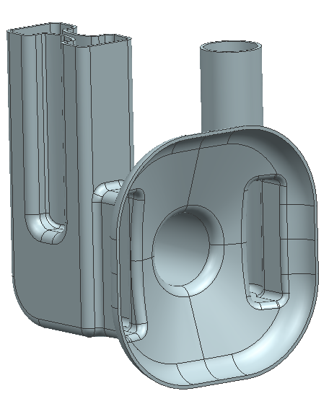
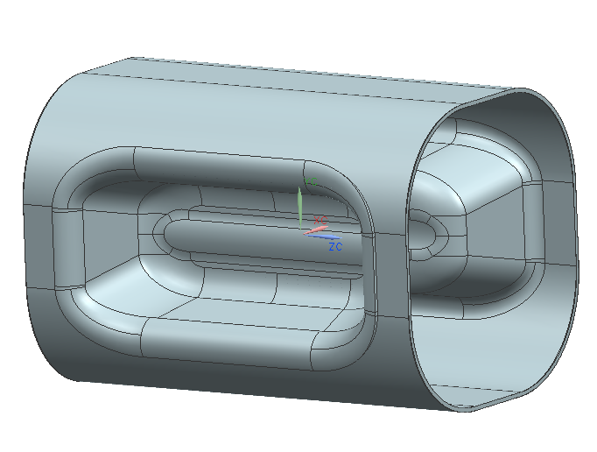
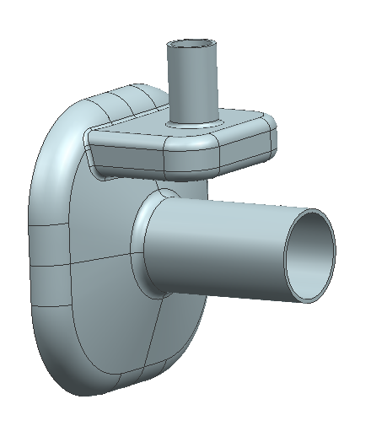
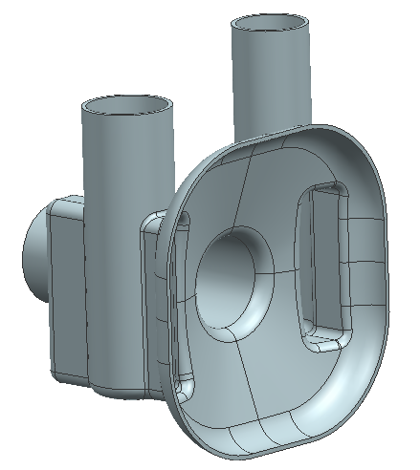
Fabrication Final Welding
Final welding
Frequency measurement before welding to meet the target frequency
0.25 mm weld shrink allowance at two final seams equivalent to +520 kHz frequency change

Slide 15
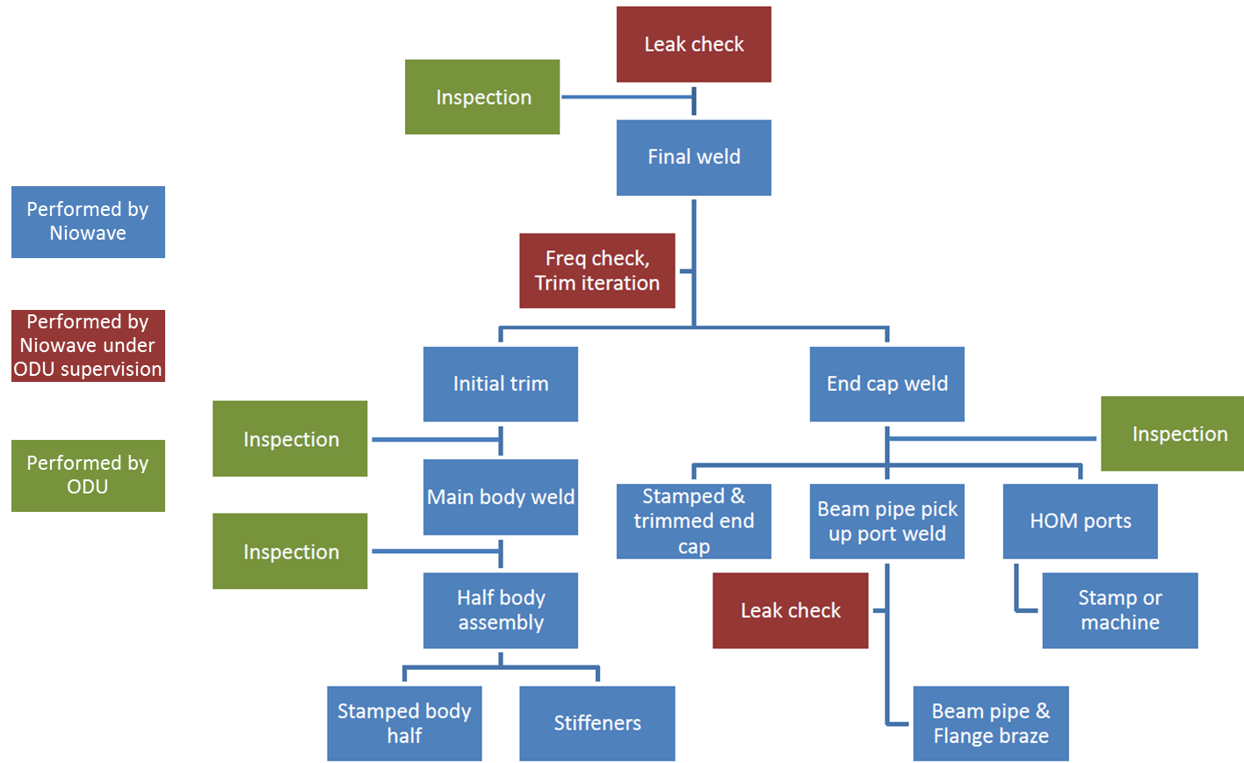
Fabrication Plan

Slide 16
Bare Cavity Processing and Testing Plan
Fabrication of Parts
Performed by Niowave
Welded Cavity
EP Parts
Bulk BCP
Welded Cavity
Performed by ODU
Heat Treatment
Light BCP
Cavity processing will be integrated with the cavity fabrication plan
HPR
RF Testing

Slide 17
Frequency Recipe
 | Frequency (MHz) | Frequency Shift (kHz)
Welded Cavity (At room temp in air) | 400.032
After Bulk BCP Processing in air | 399.969 | – 63.0
Bulk BCPed Cavity in Vacuum (dielectric constant adjusted) | 400.087 | + 118.0
Cooled Down Cavity at 2K (Detuned by half tuning range of 100 kHz) | 400.660 | + 573.0
Operational SPS Cavity (tuned) | 400.760 | + 100.0
400.760 MHz is a mid value of SPS frequency range through 120-450 GeV energy.

Slide 18
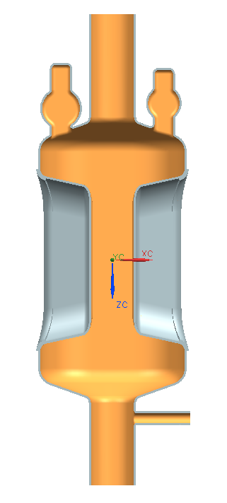
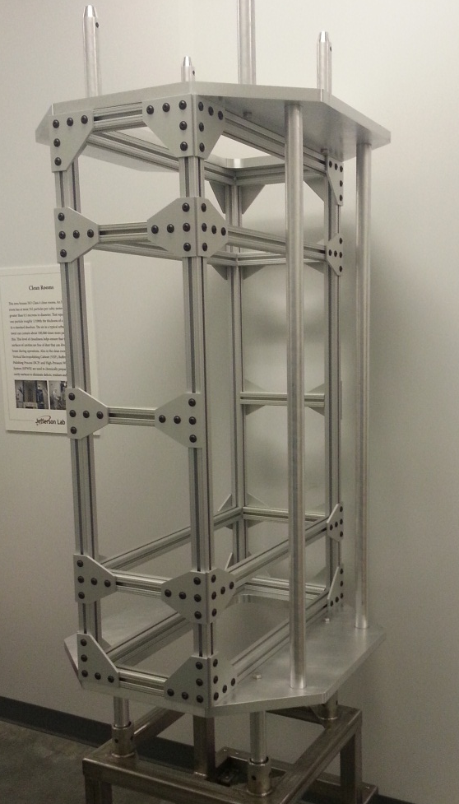
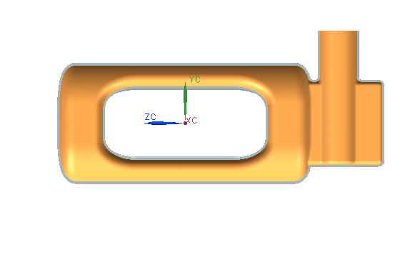
Cavity Cleaning
Manual HPR each port
Use Teflon guiding sleeve
Cavity and wand secured in the cage
Multi purpose mounting cage
Final HPR in the vertical cabinet

Slide 19
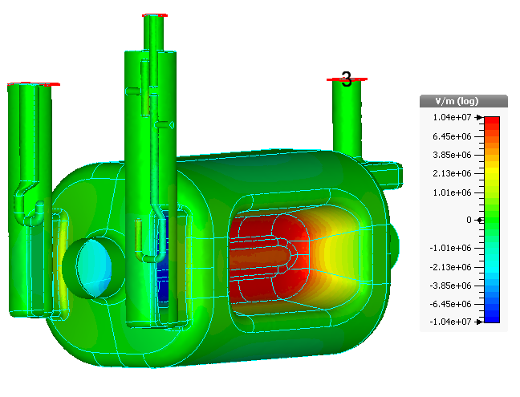
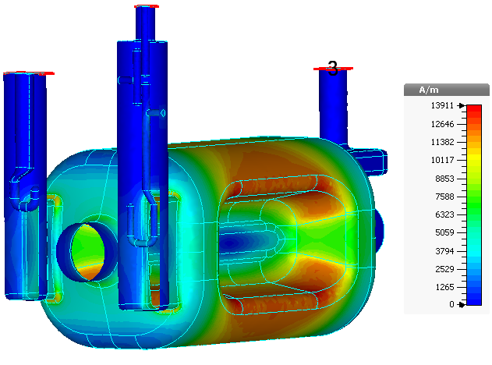
Surface Fields
Low surface field at coupler location: no enhancement
Low surface field in coupler

Slide 20
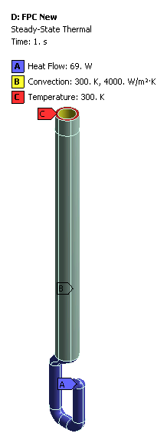
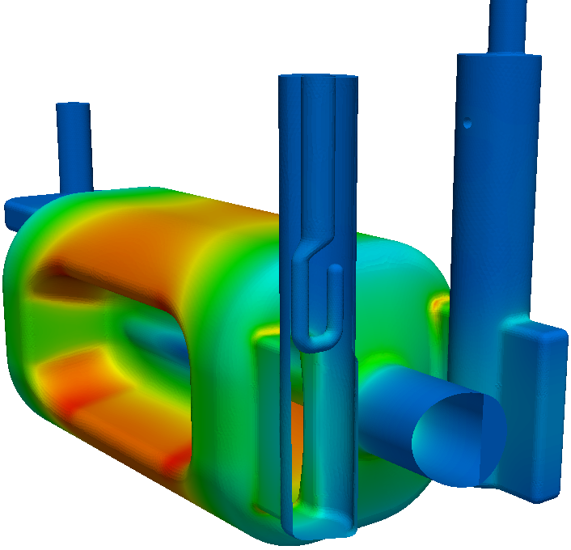
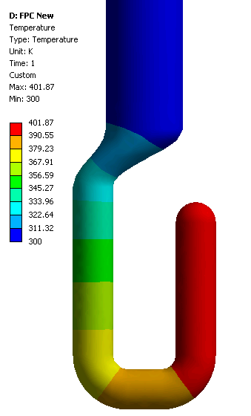
Couplers
FPC
Surface Magnetic Field
69 W
Copper
Water cooling through the channel

Slide 21
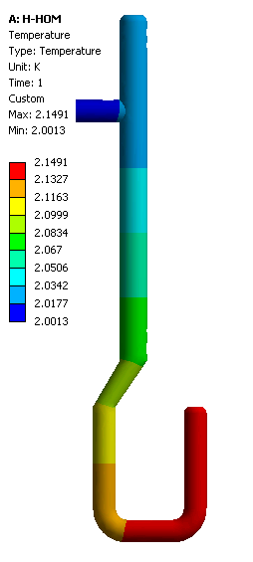
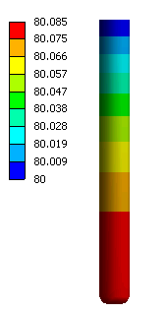
Couplers
H-HOM
Fundamental mode
Conductive cooling from helium return header

Slide 22
Couplers
H-HOM
HOM
80K heat stationed
Copper
Conductive cooling from helium return header, 2K
Not shown in the CAD model
Niobium

Slide 23
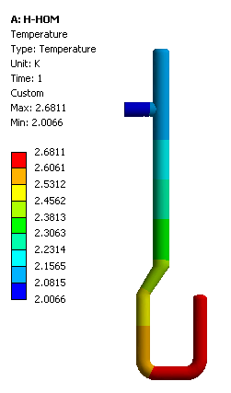
Couplers
H-HOM
Assumption of power dissipation
5 mW at 10 nΩ from 200 W HOM power
Max 80.8 K
1 W
5 mW
Max 2.2 K
Max 2.7 K
5 mW

Slide 24
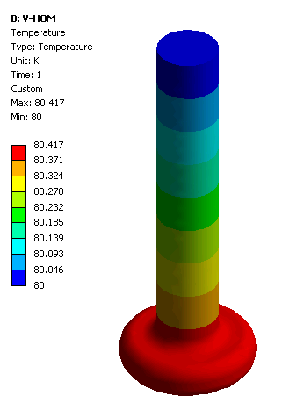
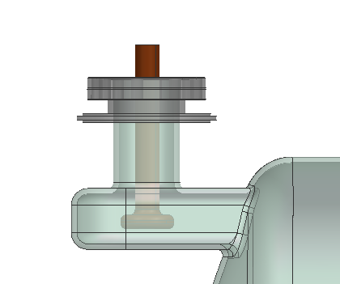
Couplers
V-HOM
Assumption of power dissipation
0.5 W at 5.2 mΩ from 200 W HOM power
Copper
80K heat stationed
0.5 W
V-HOM does not couple to the fundamental mode but it sees some field but negligible.
Max 80.4 K
FPC

Slide 25
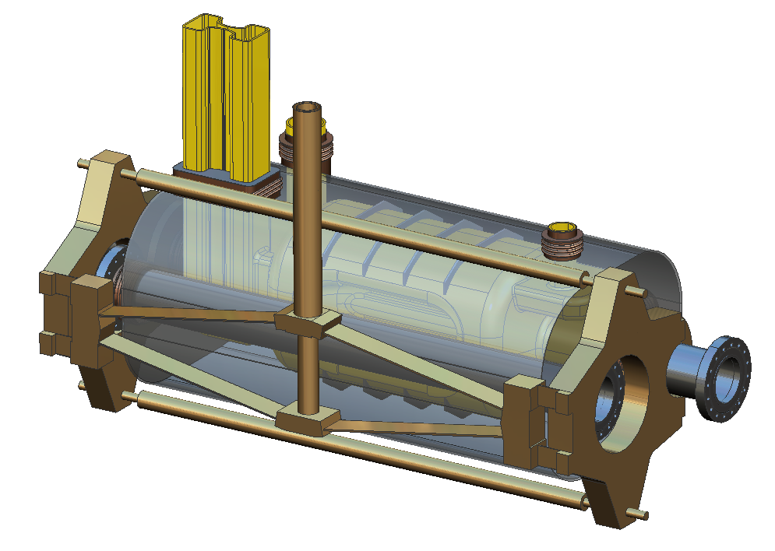
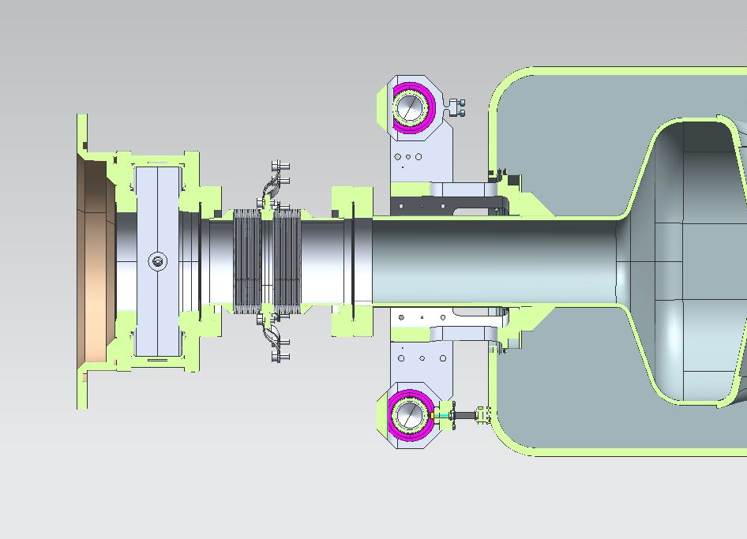
Tuner Design Evolution

Slide 26
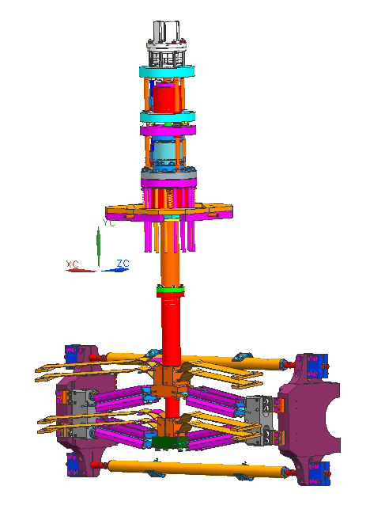
Tuner Concept
Objective
Meet the spatial constraint, cryomodule dimension decreased considerably.
Deform cavity symmetrically, no electrical center change
Adequate force and resolution
JLAB tuner

Slide 27
Tuner Design Conclusion
Tuning range and resolution
1000 micro-steps or better for the motor
160 reduction factor for the harmonic gearbox
1mm displacement per turn for the roller screw
Resolution better than 0.01 micron
Translates to 7 Hz resolution
Range minimum +/- 700 kHz
Small required force adds no structural constraints to the tuner components and to the cavity.

Slide 28
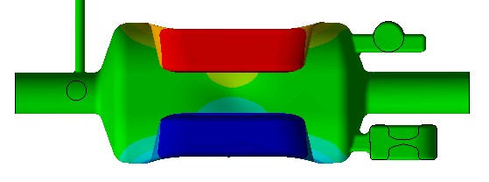
Tuner Effect on Pole Surfaces
X axis
Extract the deformation of the center line of the pole surfaces
Directional deformation after tuning 1500N
WG side FPC side
Conclusion
The deformation on pole surfaces is not symmetric.
The maximum difference on deformation is about 2 micron.
→ Mechanical center shift about 2 microns at 200 kHz tuning range

Slide 29
Summary
Prototype design meets the functional specification.
Two valid options of HOM coupler.
Tuning system exceed the requirements in tuning range and resolution also providing tuning capability of vertical crabbing.
Calculated level of power dissipation (fundamental and HOM) on couplers requires simple cooling solutions.
Detailed fabrication, processing and test plan are in place.
We will still work hard to improve in every front.

Slide 30
Acknowledgement
Joe Matalevich at Jefferson Lab for the advice on tuning system

Slide 31
Back Up Slides

Slide 32
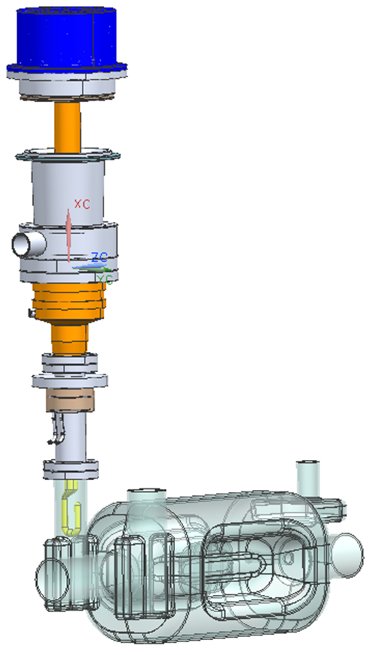
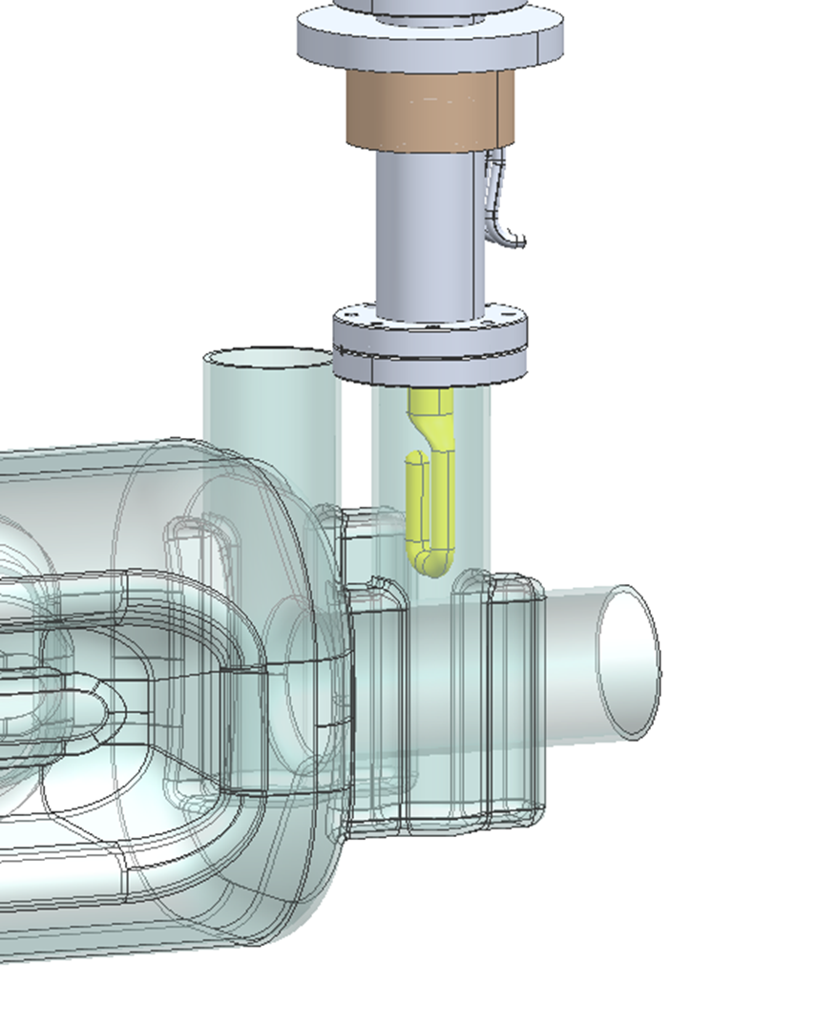
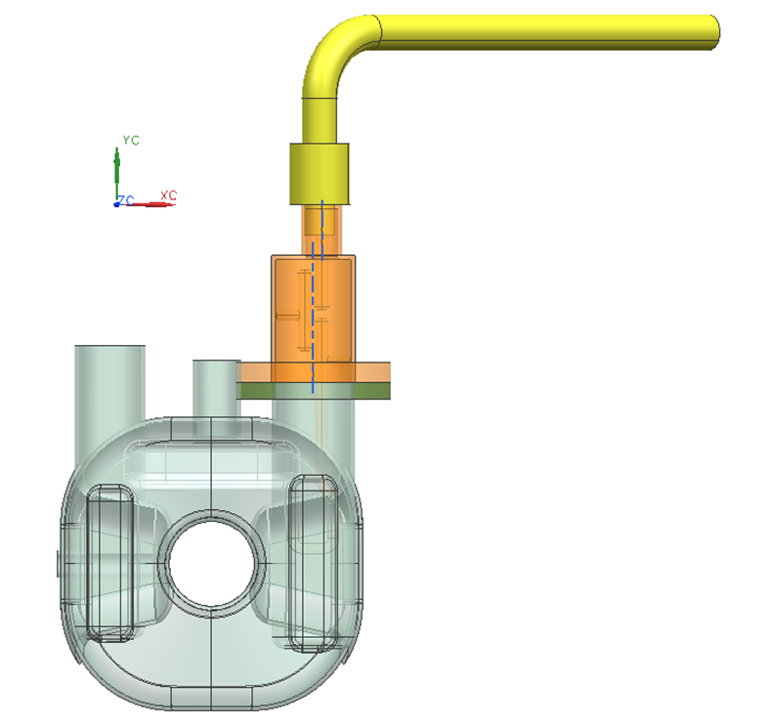
Back Up Slides

Slide 33
Couplers
Copper
Niobium
Copper
Copper
72 mm
V-HOM
FPC
H-HOM

Slide 34
Couplers
FPC

Slide 35
Couplers
2.5K heat stationed

Slide 36
Structural Analysis
0. 33.717 45.679 33.207 2.7638 33.384
8.3333e-002 33.717 43.776 31.95 2.5468 32.091
0.16667 33.717 41.873 30.76 2.3297 30.867
0.25 33.717 39.969 29.644 2.1127 29.719
0.33333 33.717 38.066 28.611 1.8957 28.658
0.41667 33.717 36.163 27.671 1.6787 27.692
0.5 33.717 34.26 26.833 1.4617 26.832
0.58333 33.717 32.356 26.107 1.2447 26.089
0.66667 33.717 30.453 25.503 1.0277 25.473
0.75 33.717 28.55 25.029 0.8107 24.994
0.83333 33.717 26.646 24.693 0.5937 24.659
0.91667 33.717 24.743 24.501 0.37673 24.473
1. 33.717 22.84 24.456 0.15987 24.442
1.0833 33.717 20.936 24.559 5.8142e-002 24.565
1.1667 33.717 19.033 24.808 0.27457 24.839
1.25 33.717 17.13 25.199 0.49151 25.261
1.3333 33.717 15.226 25.725 0.7085 25.822
1.4167 33.717 13.323 26.378 0.9255 26.515
1.5 33.717 11.42 27.149 1.1425 27.328
1.5833 33.717 9.5165 28.028 1.3595 28.252
1.6667 33.717 7.6132 29.006 1.5765 29.275
1.75 33.717 5.7099 30.072 1.7935 30.389
1.8333 33.717 3.8066 31.218 2.0105 31.583
1.9167 33.717 1.9033 32.436 2.2275 32.849
2. 33.717 3.1696e-013 33.717 2.4446 34.179
2.0833 33.717 1.9033 35.054 2.6616 35.565
2.1667 33.717 3.8066 36.442 2.8786 37.001
2.25 33.717 5.7099 37.875 3.0956 38.482
2.3333 33.717 7.6132 39.348 2.8392 39.893
2.4167 33.717 9.5165 40.856 2.518 41.328
2.5 33.717 11.42 42.396 2.1969 42.799
2.5833 33.717 13.323 43.965 1.8757 44.301
2.6667 33.717 15.226 45.559 1.5546 45.833
2.75 33.717 17.13 47.175 1.2334 47.39
2.8333 33.717 19.033 48.813 0.91228 48.97
2.9167 33.717 20.936 50.469 0.59115 50.572
3. 33.717 22.84 52.142 0.2701 52.194
3.0833 33.717 24.743 53.831 5.2332e-002 53.832
3.1667 33.717 26.646 55.533 0.37257 55.487
3.25 33.717 28.55 57.248 0.69366 57.157
3.3333 33.717 30.453 58.975 1.0148 58.84
3.4167 33.717 32.356 60.712 1.3359 60.535
3.5 33.717 34.26 62.459 1.6571 62.241
3.5833 33.717 36.163 64.214 1.9782 63.958
3.6667 33.717 38.066 65.978 2.2994 65.684
3.75 33.717 39.969 67.75 2.6206 67.419
3.8333 33.717 41.873 69.528 2.9417 69.162
3.9167 33.717 43.776 71.313 3.2629 70.913
4. 33.717 45.679 73.104 3.584 72.671

Slide 37
Tuning effect

