Slide 1
Double Quarter Wave Crab Cavity
−Cavity Design and Vertical Tests
Qiong Wu
on behalf of the DQWCC team
May 5, 2014

Slide 2
Outline
Proof of Principle (PoP) Double Quarter Wave Crab Cavity (DQWCC)
  Cavity Design
  Vertical Tests
  Lorentz Detuning and Pressure Sensitivity
  Thickness and Profile Measurements
  Bead-pulling Tests
  Summary
SPS DQWCC
  Cavity Design
  Couplers
  Lorentz Detuning
  Frequency Table
  Summary

Slide 3
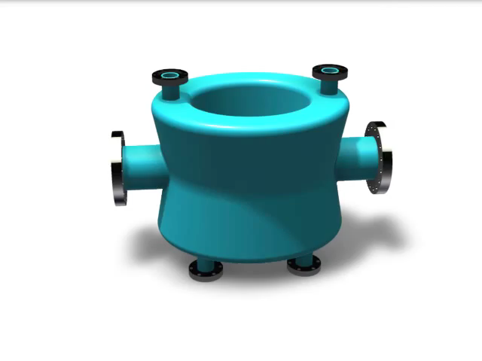
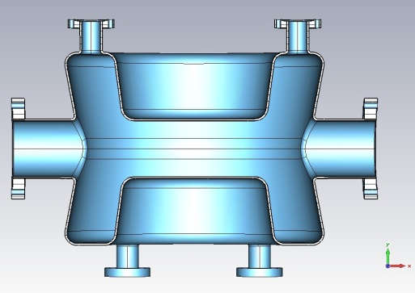
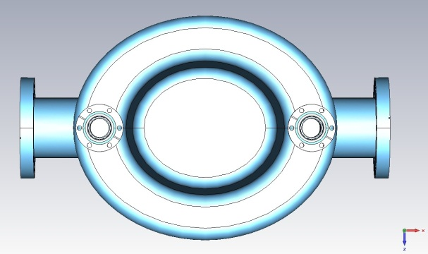
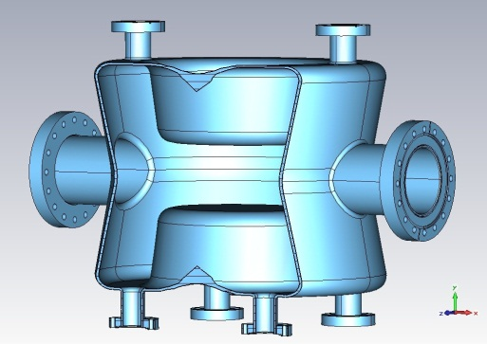
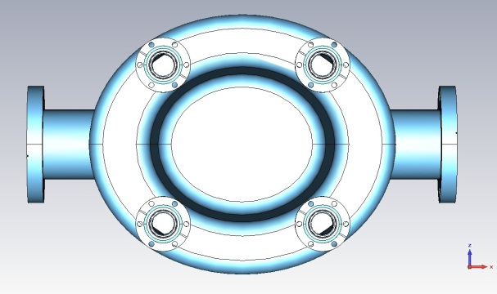
PoP DQWCC
 | Crabbing (fundamental) mode freq. | 1st HOM | Cavity length | Cavity width | Cavity height | Aperture | Deflecting voltage
Unit | MHz | MHz | cm | cm | cm | cm | MV
DQWCC | 400 | 579 | 38.2 | 14.7 | 14.6 | 8.4 | 3.3

Slide 4
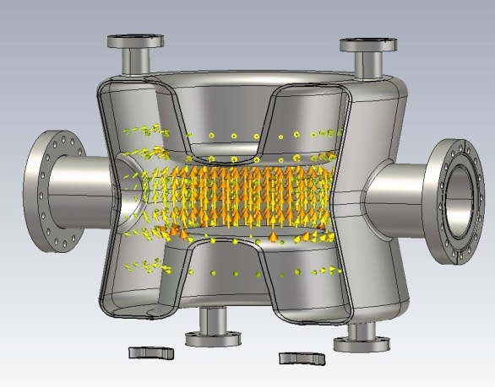
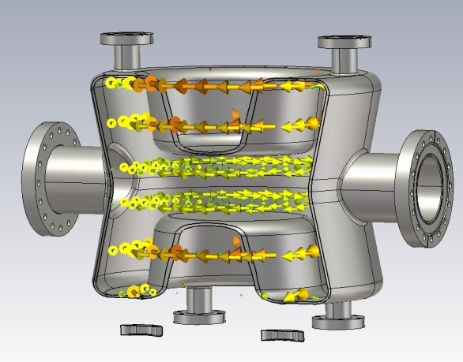
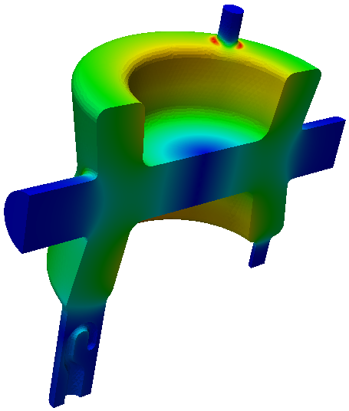
Cavity Parameters
 | Unit | DQWCC
Fundamental Mode Frequency | MHz | 400
Nearest Mode Frequency | MHz | 579
Vertical Deflection Voltage | MV | 3.3
Rt/Q (Fund. Mode) | Ohm | 400
Epeak | MV/m | 44
Bpeak | mT | 60 on cavity 79 on port blending
Energy Content | J | 12
Peak field on port blending region. Improved in SPS prototype cavity design, see later slides.
Electric field (top) and magnetic field (bottom) of the fundamental mode.

Slide 5
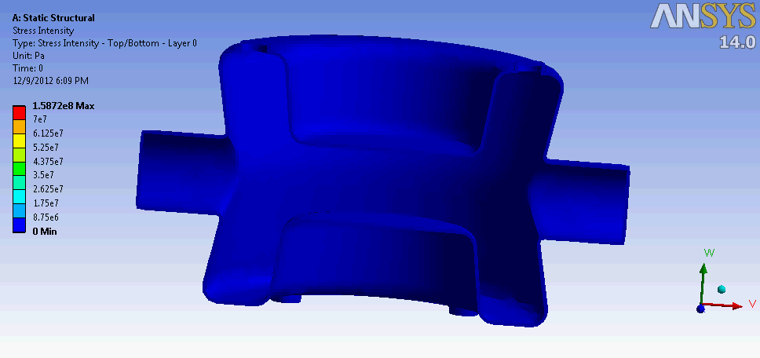
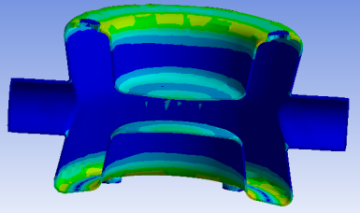
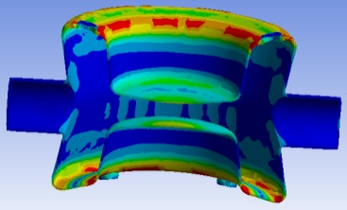
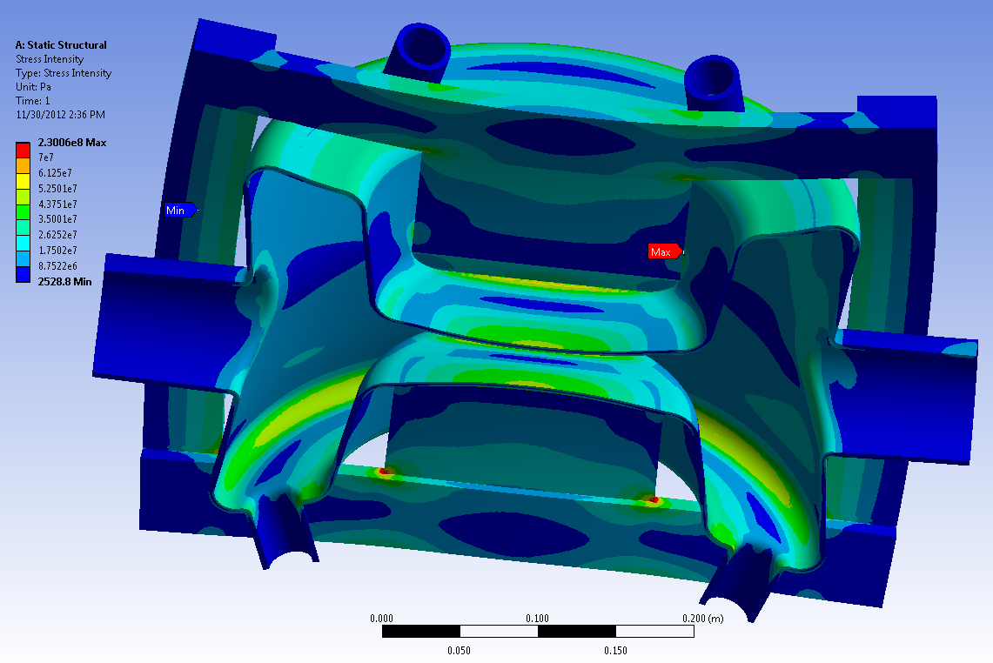
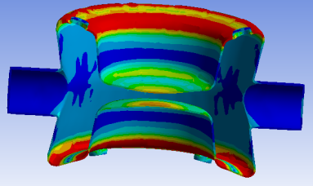
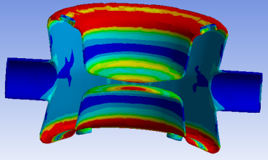
Cavity Stress Analysis
Pressure: 2e5 Pa (2 bar) outside, vacuum inside. Requirement for PoP Cavity.
Fixed Support: One side of beam port.
Stiffening plates and frames are added to the cavity for vertical cold tests.
The material for stiffening components can be either Nb or Ti.
Bare cavity without stiffening frame
Cavity stress with stiffening frame

Slide 6
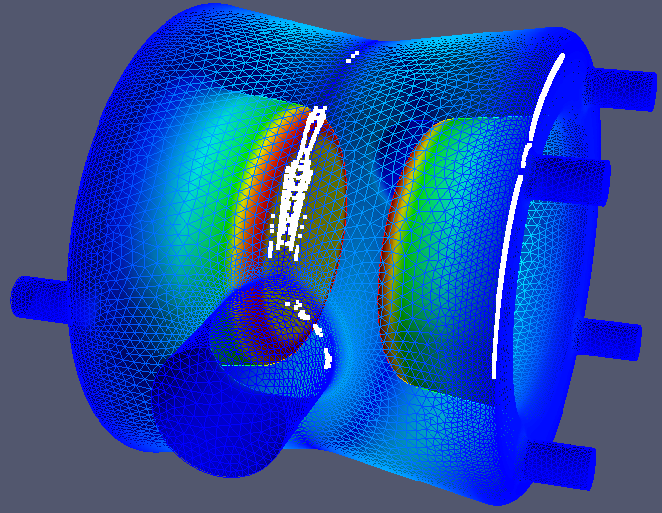
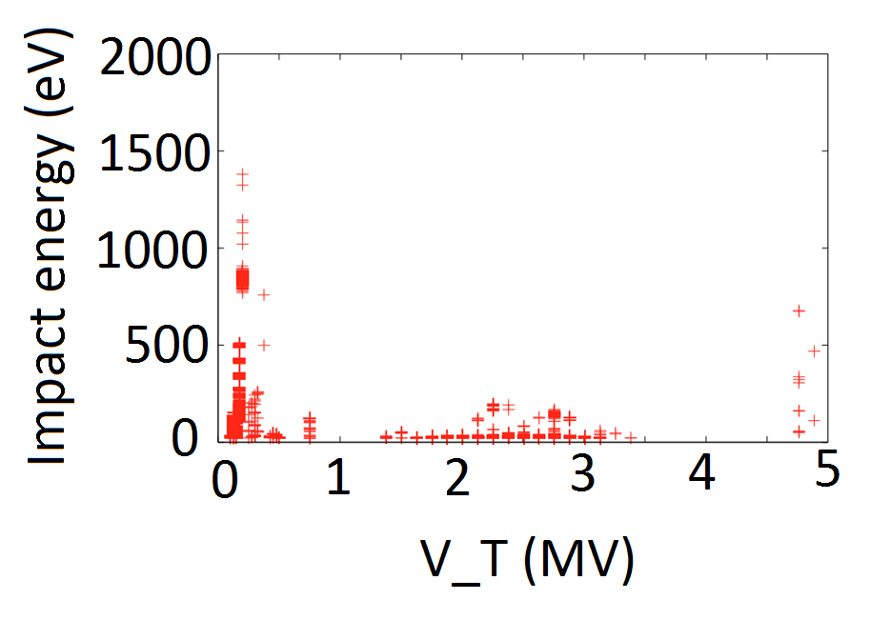
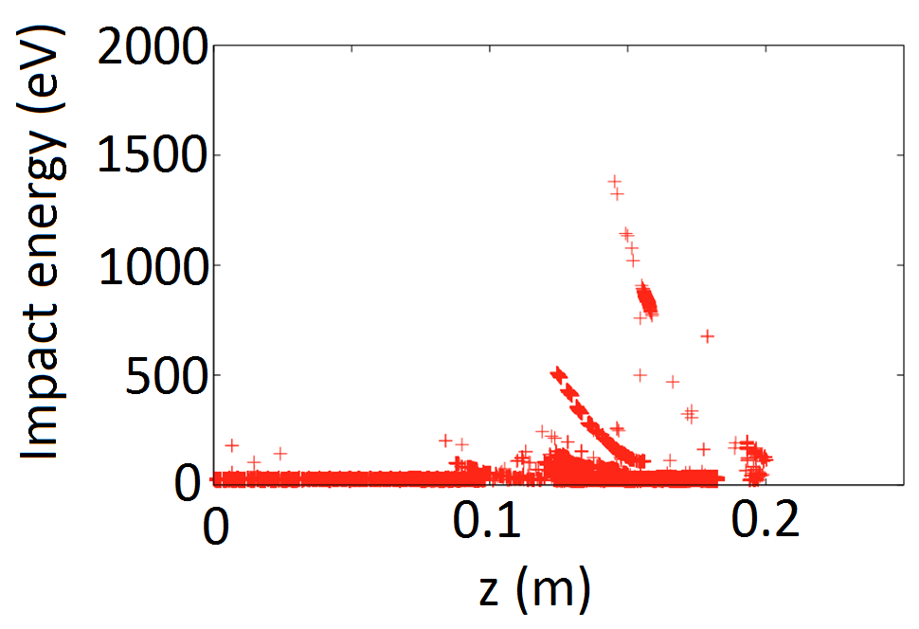
Multipacting
© Z. Li @ LARP/HiLumi CM20
Small multipacting (MP) region was found around the waist of the cavity at ~0.1 MV of deflection voltage. Verified and easily processed during vertical tests.

Slide 7
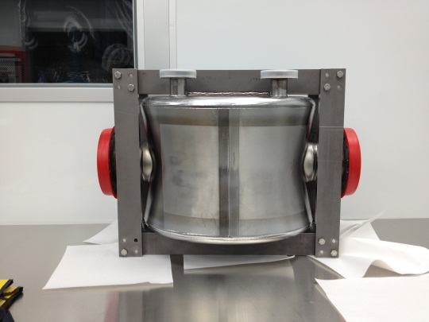
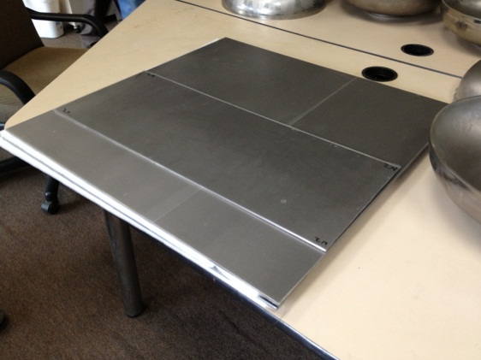
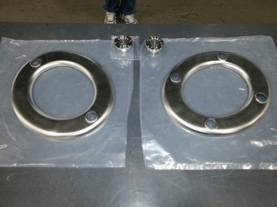
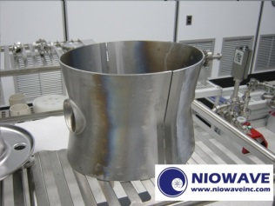
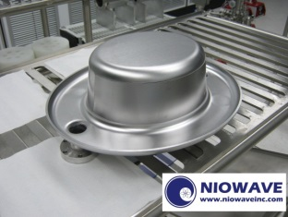
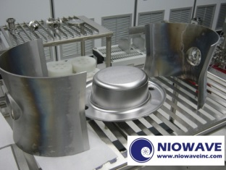
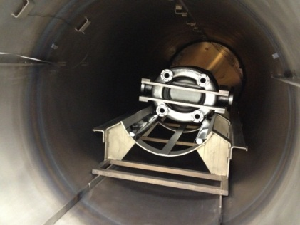
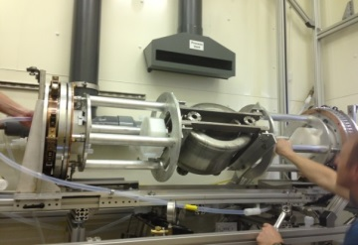
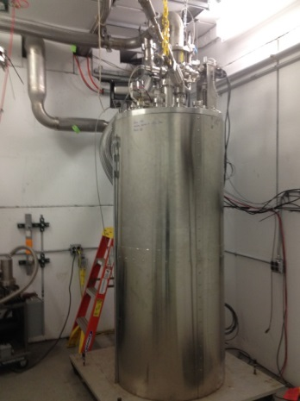
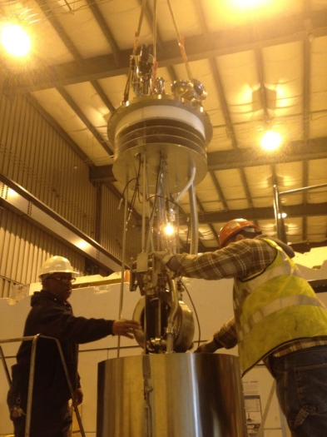
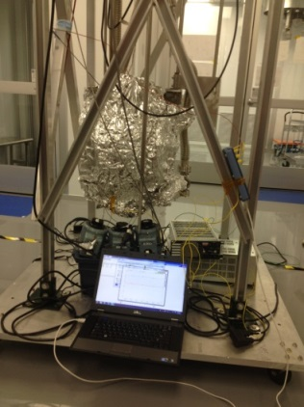
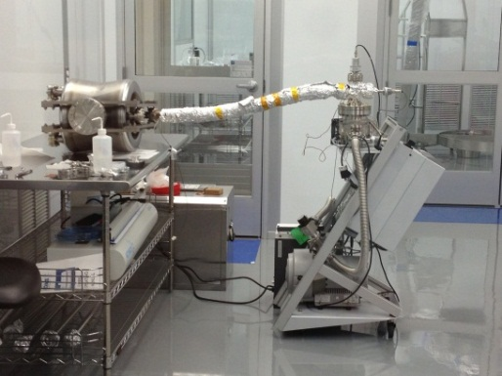
Fabrication and Preparation
Test I
Test II

Slide 8
PoP cavity test results (1st)
1st cold test done in June 2013.
Multipacting (MP) was found for the region of 0.07-0.16 MV and was easily conditioned through. The MP did not come back after the conditioning.
Q₀ measured at 3×10⁸.
Q₀ did not improve by cooling down from 4.2 to 2 K.
V_{t} reached 1.34 MV, limited by the RF power amplifier.
Further chemistry cleaning and niobium plated flanges helped decrease the heating issue in the cavity.

Slide 9
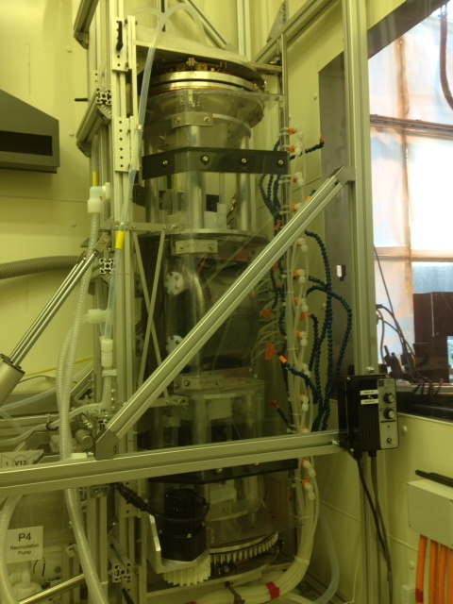
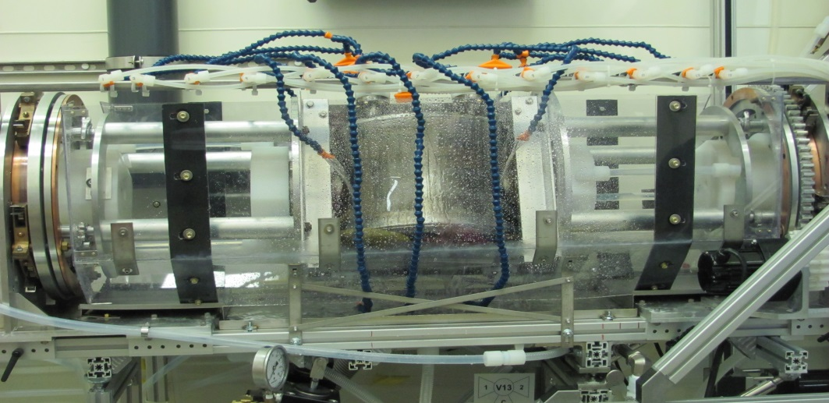
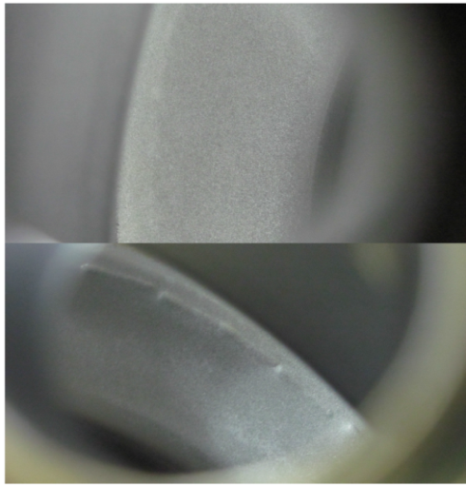
Surface treatment @ ANL
The cavity is under a water curtain for cooling during BCP.
The surface treatment of BCP and HPR at ANL. Carried out by M. Kelly, R. Murphy, T. Reid, S. Gerbick of ANL and S. Verdu-Andres, B. Xiao of BNL.
Rotating structure in vertical position for cavity rinsing.
Surface appearance after ANL BCP and HPR

Slide 10
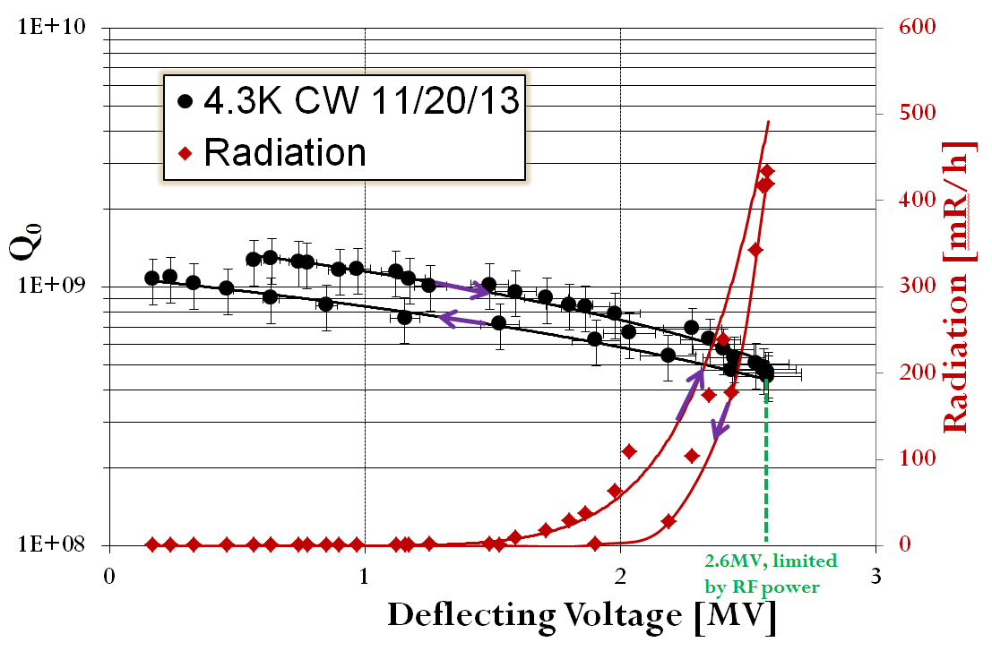
PoP cavity test results (2nd)
CW @ 4K
No multipacting was found.
Q₀ was measured at 10⁹ range.
Radiation started to increase at 1.5 MV
Heating on the beam pipe flanges causes Q₀ decrease.
V_{t} reached 2.6 MV, limited by the RF power amplifier.
After subtracting loss on Cu FPC with Q at 2.82e10, applies to all results.
© B. Xiao@ CC13

Slide 11
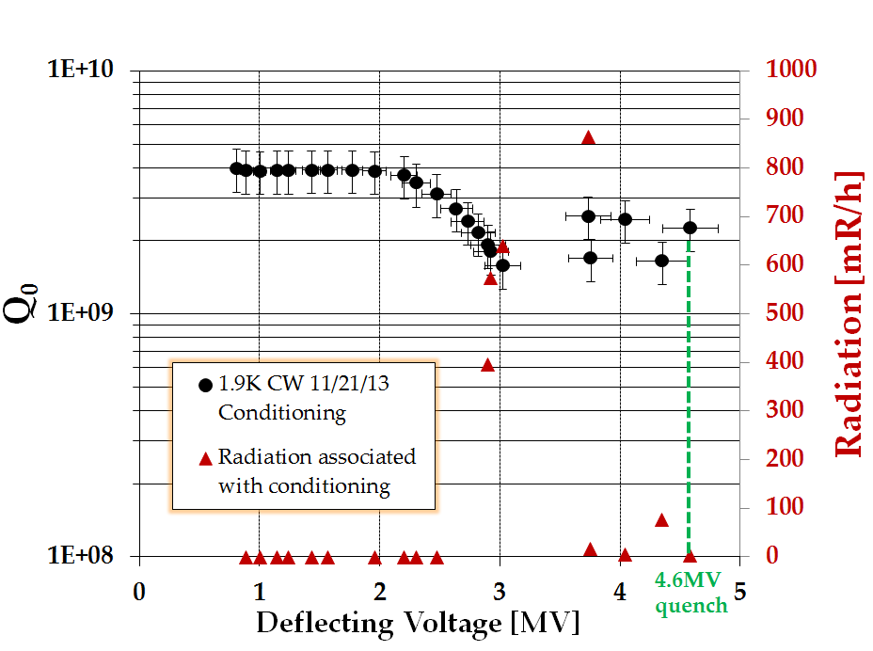
PoP cavity test results (2nd)
CW @ 2K
Q₀ reached 3e9 at low field. The requirement is above 1e10.
Q₀ decreases starting from 2MV, associating with high radiation.
Q₀ got recovered after ~30 minutes conditioning.
Radiation is lower than 15mR/h after the conditioning.
Reached 4.6MV kick in CW with Q₀ above 2e9, limited by quench.
Temperature increase on both beam pipe flanges and pickup port blending area.
© B. Xiao@ CC13

Slide 12
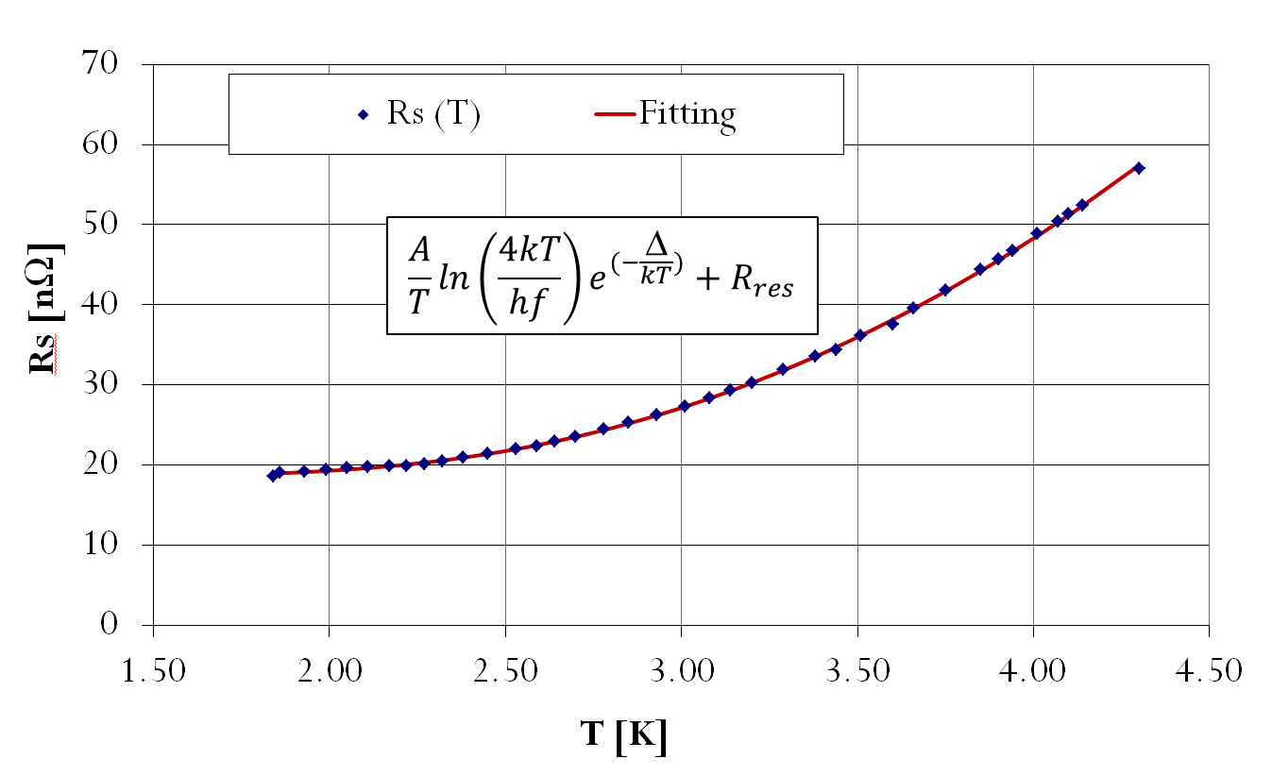
Resistance Measurement
Second Cold Test: 4.3K ~ 1.9K
Low field measurement
Geometry factor: 85
Rs at 4.3K: 57nΩ
1.9K: 18.6nΩ
SuperFit result:
R_{res}: 18.3nΩ
Δ/kT_{c}: 1.87
A: ~1212.77nΩ•K
© B. Xiao@ CC13

Slide 13
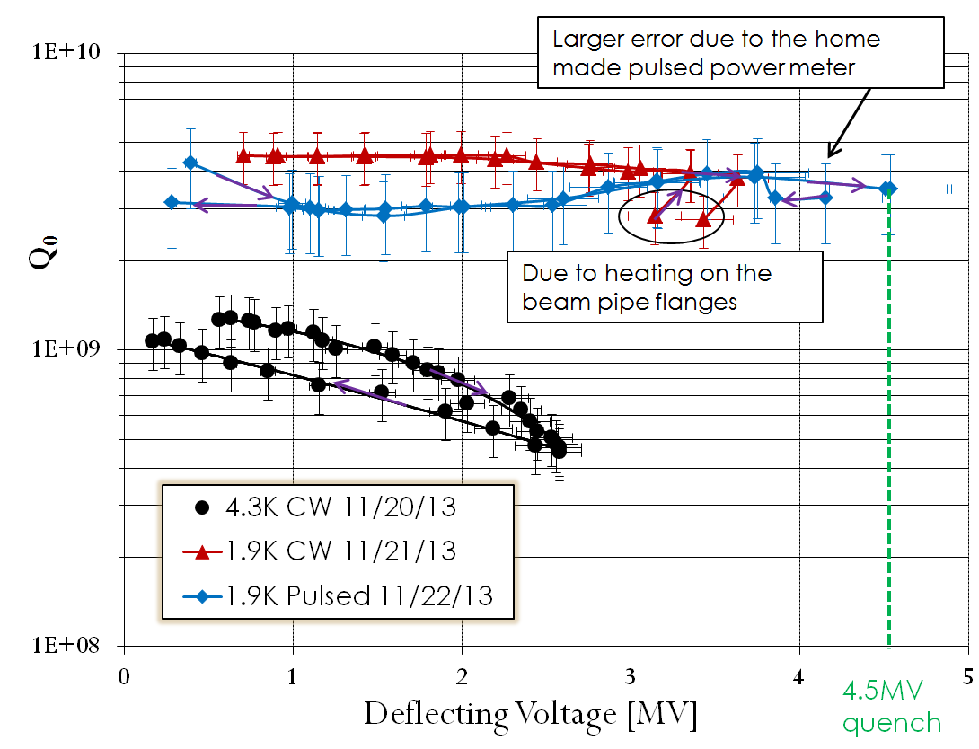

PoP cavity test results (2nd)
Pulsed @ 2K
Q₀ at around 3~4.5e9.
In CW mode, temperature of beam pipe flanges increase.
Reached 4.5MV kick in pulsed mode, limited by quench, consistent with conditioning test.
Temperature increase on pickup port blending area.
Quench field at ~110mT, with peak E field at 52.8MV/m
© B. Xiao@ CC13

Slide 14
Lorentz Detuning &
Pressure Sensitivity
Pressure sensitivity: -252Hz/mbar
Lorentz detuning: -202 Hz/MV^2
Measured during second vertical test with stiffening frame.

Slide 15
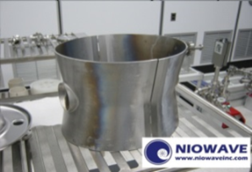
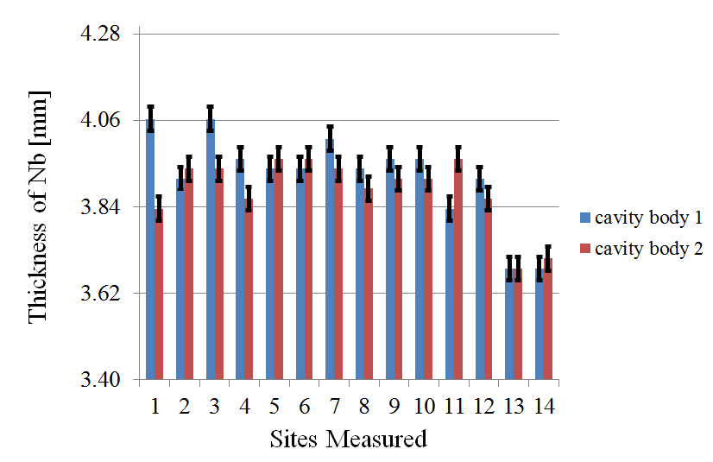
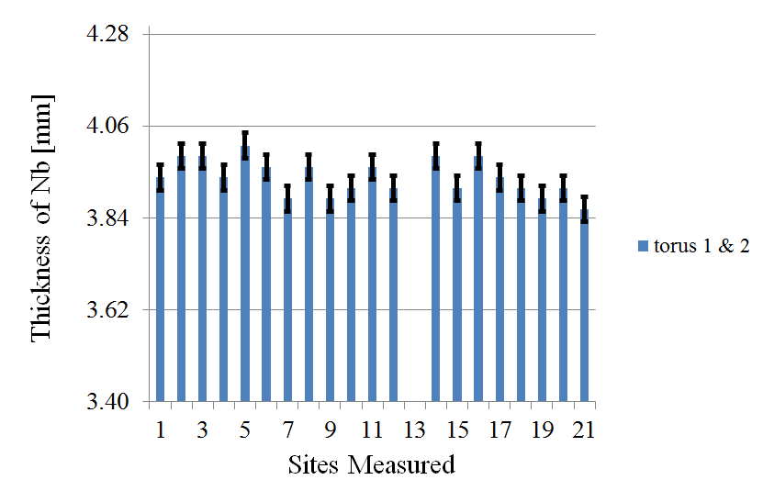
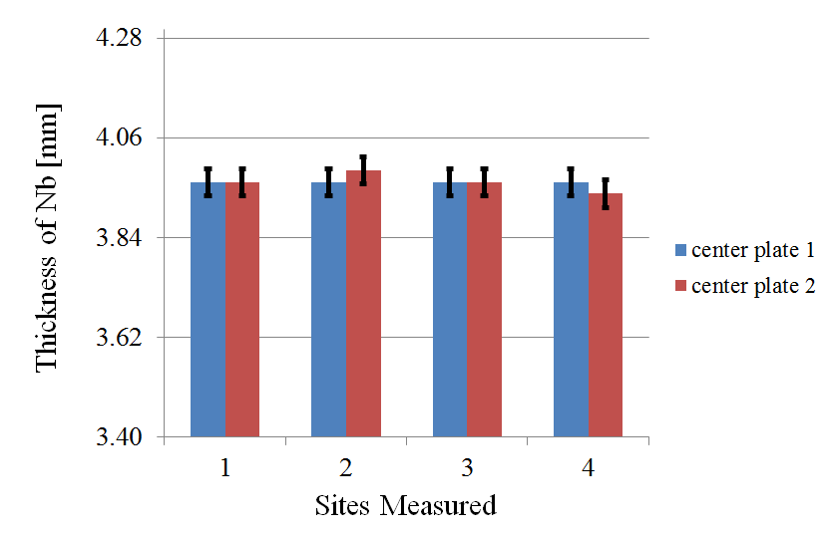
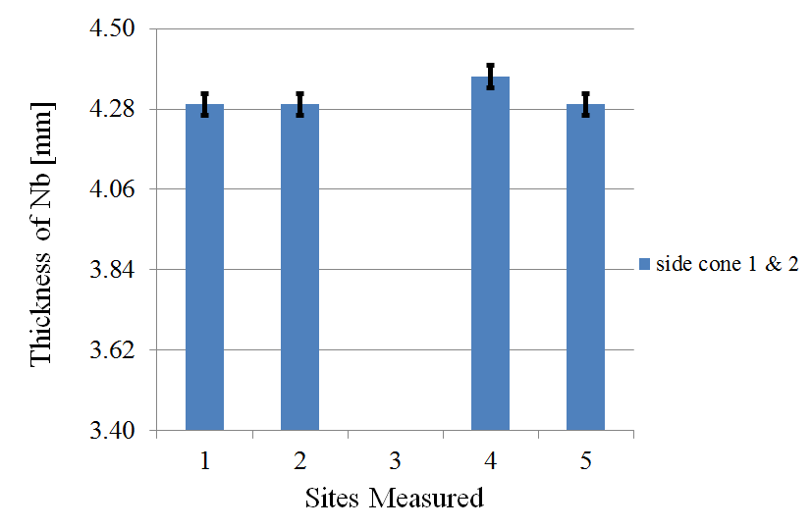
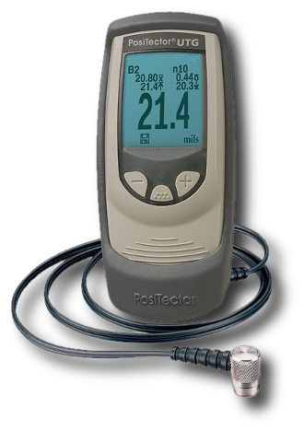
Thickness Measurement

Slide 16
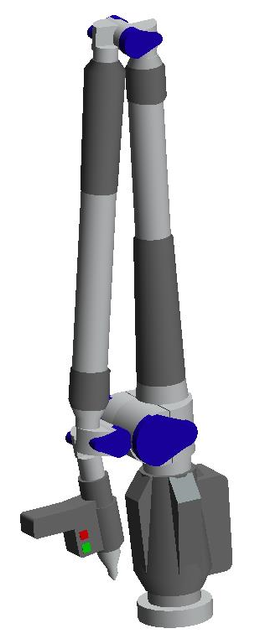
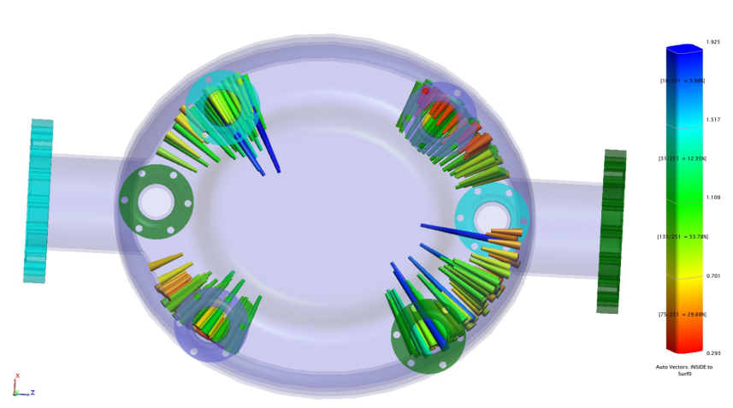
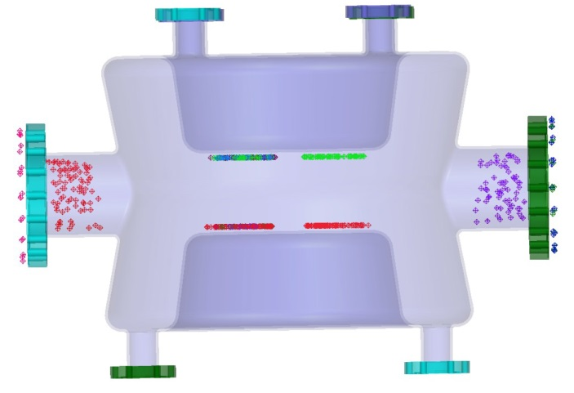
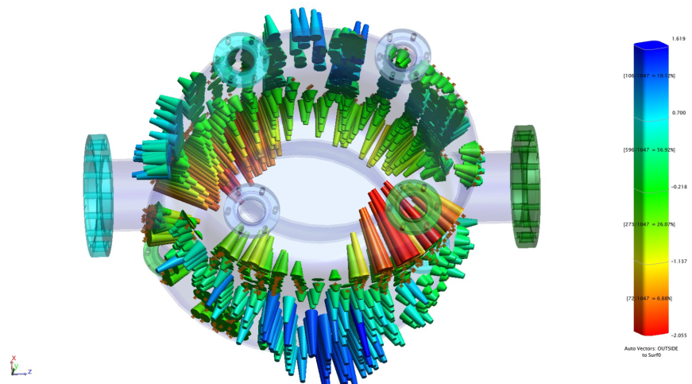
Profile Measurement
Unit: mm
1.9
0.3
inside surface
1.2
An 8 ft Faro arm was used to measure the profile of the cavity inner and outer surface. The resolution of the measurement is 0.1~0.2 mm.
-0.3
outside surface

Slide 17
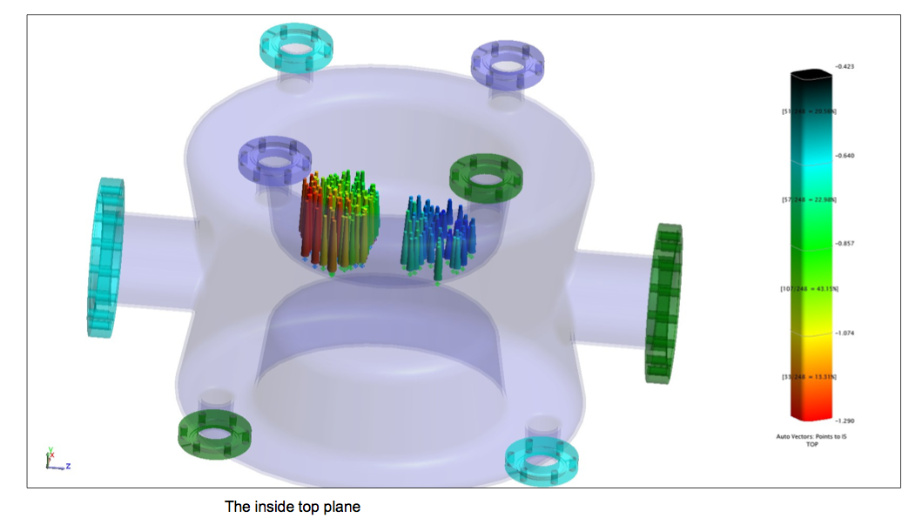
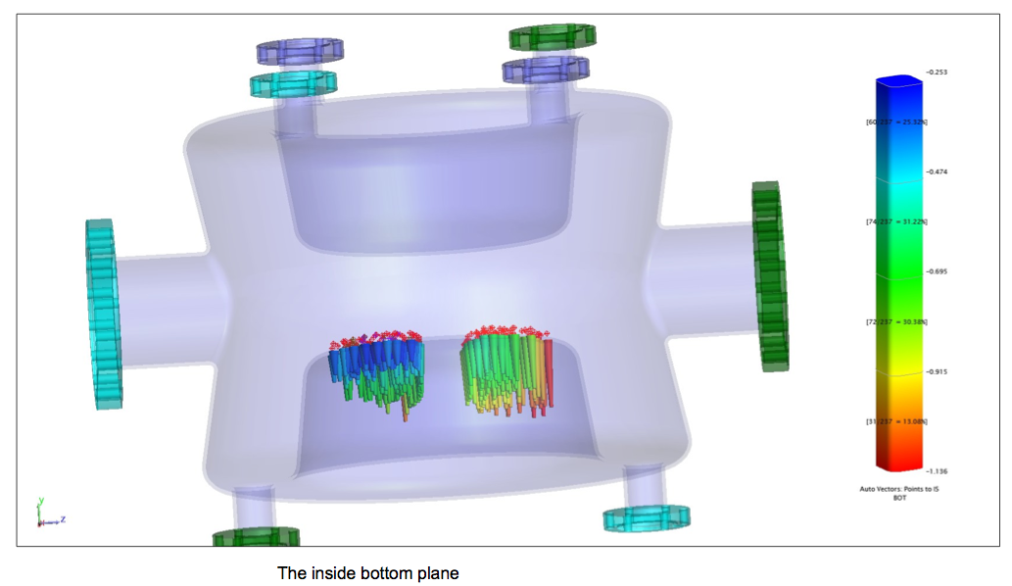
Profile measurement in the center plates
Unit: mm
-0.42
The two center plates have a small tilted angle to the beam axis.
-1.29
-0.25
-1.14

Slide 18
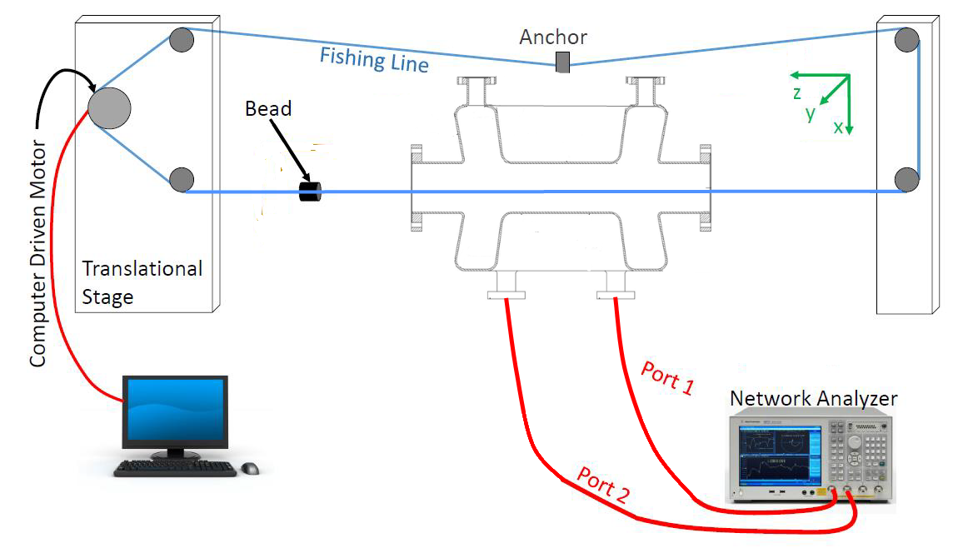
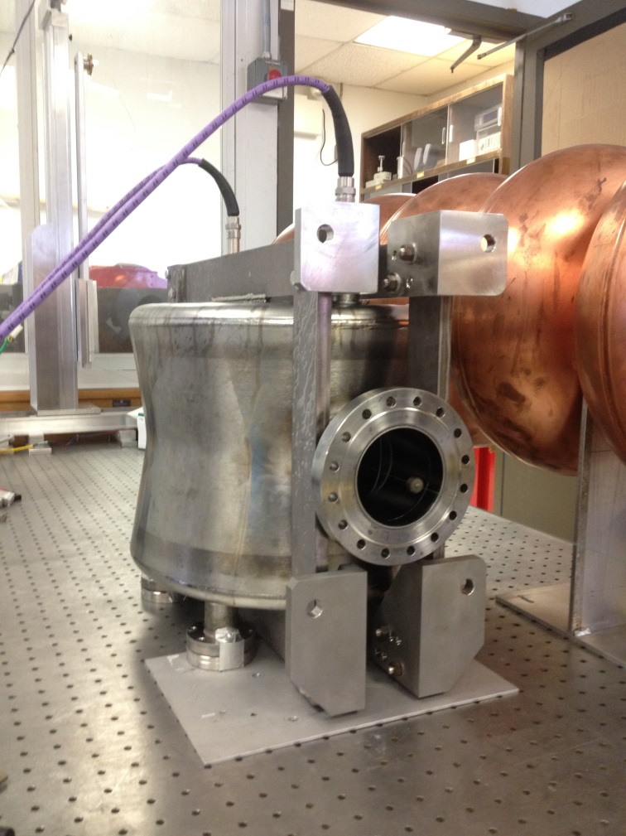
Bead Pull
Setup
The bead-pulling experiment was done with 0.2 mm longitudinal step size, and 0.7 mm transverse step size.
Bead type | Length [mm] | Radius [mm]
Micarta (dielectric) | 1.5 | 4
Copper | 2 | 4

Slide 19


Bead Pull
Electric field vertical scan
(-35 mm ~ +35 mm)
Electric field horizontal scan
(-35 mm ~ +35 mm)
The bead pulling results shows fairly well agreement with simulation along center of the gap. Deviation started to show when the measurement is close to the two center plates. This is due to the two plates are not absolute parallel and resolution limitation from the bead size.

Slide 20


Field Distribution
Scan Along Deflection (vertical)
Scan Perpendicular to Deflection (horizontal)
Above compares the fundamental mode field simulation vs measured with bead pulling with scans in both vertical and horizontal direction along cavity axis. Top: simulation, Bottom: measured.
Multipole | DQWCC | Unit
b₂ | 0 | mT m/m
b₃ | 1070 | mT•m/m²
b₄ | 0 | mT•m/m³
b₅ | -0.1×10⁶ | mT•m/m⁴
b₆ | 0 | mT•m/m⁵
b₇ | 7×10⁶ | mT•m/m⁶
To address higher order mode components in the cavity deflecting field due to asymmetry, the multipolar components are list on the left. The cavity voltage is 10 MV for the table.
Ref: P. Baudrenghien, et. al., Functional Specifications of the LHC Prototype Crab Cavity System, P5

Slide 21
Summary
-- PoP cavity
The PoP cavity has confirmed our design concept by achieving 4.6 MV of deflecting voltage in vertical test.
The PoP cavity has measured modest Lorentz detuning with simple stiffening mechanism.
Various measurements has been done to the PoP cavity for further understanding of the cavity characteristics.
The cavity was calculated with fairly small multipolar components.

Slide 22





Prototype For SPS
194 mm
140 mm
Cavity
wall
4 mm
He vessel
wall
Based on our experience with the PoP cavity, the cavity for SPS installation has been optimized into a more compact design with lower surface field.
The cavity has capability of adopting the option of having helium vessel excluding the adjacent beam pipe.
Adjacent beam
pipe wall
3 mm
R 42mm

Slide 23


Cavity Parameters
MODES
Fundamental frequency (crab mode frequency) | f₀ | 400 | MHz
First HOM frequency | f₁ | 580 | MHz
FIGURES OF MERIT
Transversal R/Q | R_{t}/Q | 430 | Ohm
Geometry factor | G | 89 | Ohm
FIELDS
Maximum peak surface electric field* | E_{max} | 40.7 | MV/m
Maximum peak surface magnetic field* | H_{max} | 70.9 | mT
Deflecting Gradient* | V_{t}/L_{cavity} | 9.5 | MV/m
OTHER
Field center offset | 𝒪_{field} | 0.22 | mm
Stored energy* | U | 10 | J
f(0)
Electric field
Magnetic field
* For deflection voltage of 3.34 MV

Slide 24

Improvement in SPS Design
The FPC port diameter was determined by CERN according to the cooling needed for the coupler. Then all ports were selected to be at the same dimension to minimize the field asymmetry.
Quench for SPS DQWCC extrapolated to
About 5.2 MV deflecting voltage using the measured quench voltage of the demo cavity (~ 14% higher voltage).

Slide 25




Multipacting
No multipacting site was observed by ACE3P simulation within the cavity body. Weak signs of multipacting discovered at the blending of the HOM coupler port.

Slide 26




Fabrication Tolerance
Per 1 mm fabrication error
The two most sensitive geometry parameters for the cavity are height and waist, which gives 0.5% and 0.3% change in frequency with 1 mm of fabrication error.

Slide 27



Couplers
All couplers for DQWCC have hook shape antennae for well coupling with magnetic field.
All couplers are detachable from cavity with easy installation.
Cooling is considered along with RF design. Active cooling is provided for higher-order mode (HOM) couplers and fundamental mode coupler (FPC) to the connection to the bending of the hook antennae. Thermal analysis were done for each coupler ensuring sufficient cooling.
HOM coupler with high pass filter (Nb): To be discussed in Binping Xiao’s presentation
FPC hook (Cu): Qext ^{f(0)} = 4.8x10⁵, 40 kW power supply is enough to feed the cavity
Pick-up antenna (Cu): Qext ^{f(0)} is 1.6x10¹⁰, extracts about 1.5W of fundamental mode.

Slide 28


FPC thermal analysis for hook and gasket
Bpk=10mT
 |  | LATEST NEW VERSION Increased f_{m} to enlarge coupling. Hook does not need to penetrate so deep into port tube.
Q_{ext}^{FPC} | -- | 4.87e5
P₀^{FPC} | W | 106
Surface current (A/m) scaled to 1.038MV deflecting voltage
FPC hook and gasket thermal loss at 3.34 MV deflecting voltage is 106 W with Qext of the FPC slightly below 5e5. An elliptical cross section of the hook was adopted to achieve better thermal conduction.

Slide 29

FPC cooling
Cooling for FPC will be provided through double tube channels running straight down from the center inductor. With active water cooling to before the bending of the hook, the FPC with external Q of 5e5 will have the peak temperature of 90°C. Radiation loss to the 2K helium bath is 0.8W.

Slide 30





Lorentz Detuning
mesh
E-field
H-field
Lorentz detuning:
-346 Hz/ (MV)²
ports fixed but free central plates
(worst case scenario)
-0.17 Hz/ (MV)²
ports and entire central plates fixed
(best case scenario)
Deformation
The maximum deformation due to Lorentz force at 3.34 MV deflecting voltage is 3µm. The asymmetry on the top and bottom plate is due to coupler port location difference.
0
Unit: µm
3

Slide 31
Frequency Studies
Shift | Ports | Central plates | Δf
Helium pressure | Fixed by vessel
 | Fixed by vessel | Fully fixed by tuner | 0.1 Hz/mbar
300K → 2K | Fixed FPC; other ports are free | Free | -573 kHz
 | Fixed FPC; other ports free | Fully fixed by tuner | -672 kHz
Lorentz detuning | Fixed by vessel, except pickup | Free (worst case scenario) | –346 Hz/(MV)^2
 | Fixed by vessel, except pickup | Fixed | 0.02 Hz/(MV)^2
BCP (210 μm) |  |  | +170 kHz
Vacuum to air |  |  | -133.3 kHz
Generated for frequency check points before operation in SPS. The cavity will operate at 400.79 MHz under 2 K.

Slide 32
Summary
--Prototype cavity
The prototype cavity design for SPS test is completed.
The FPC design has achieved coupling requirements with a manageable thermal loss. HOM coupler will be discussed in the following presentation (Binping Xiao).
The SPS cavity uses the helium vessel as stiffening frame, and shows good tolerance for Lorentz Detuning.

Slide 33
Back-up

Slide 34





Profile measurement
The thickness of the PoP cavity was verified after the vertical tests. The equipment used is a ultrasonic thickness detector with sensitivity of 0.01 mm and accuracy of 0.03 mm.

Slide 35
All sites measured on 3 mm Nb port extension tubes. 1-12 are from 6 small coupler ports, and 14-17 are from 2 beam pipes. Two sites per tube.

Slide 36




Residual magnetic field measurement
Sensors
Inserted into the dewar from a conflat flange port
Unit: μT
Direction: | x | y | z
Outside the Dewar, without shielding: | 2.5 | 21 | -3.7
Outside the Dewar, with shielding: | 0.17 | 2.9~3.5 | 0.25
Into the Dewar, distance to the reference level [inch]
5 |  | -161.8
10 |  | 27.3
15 | -3 | 38.7 | -2.3
20 | -0.96 | 19.7 | -0.1
25 | -0.13 | 5.48 | 0.1
30 | -0.13 | 2.28 | 0.1
35 | -0.08 | 1 | 0.06
40 | -0.03 | 0.57 | 0.03
45 | -0.01 | 0.5 | 0.02
47 | -0.02 |  | 0.02
50 |  | -1.2
53 | 0.02 |  | -0.07
56 |  | 0.55
Reference level
50 inches
Magnetic shielding layers attached
Maximum residual magnetic field between 40" and 56“ is ~1.2 μT. (Ref: crab cavity shielding requirement in LHC tunnel 1 μT)
Residual magnetic field induced residual surface resistance: 2.3 nΩ

Slide 37

Fabrication Tolerance
Frequency sensitivity to machining tolerances
(*) Cavity with no tubes
(**) Cavity with no tubes. Model must be modified to sweep the parameter under study so that more than one parameter does not change with the sweep.
(***) Cavity with tubes.
Geometric parameter |  |  | Nominal value used for study | Unit | df [MHz] per unit | df/f₀ [%] per unit
Waist | * | Rmi | 138 | mm | -1.22 | 0.3
Length | * | L1 | 344 | mm | 0.32 | 0.08
Height | * | HT | 97 | mm | -2.13 | 0.5
Center plate distance | ** | APER | 84 | mm | -0.49 | 0.12
Beam pipe diameter | ** | BPD | 84 | mm | -0.21 | 0.05
Port tube diameter | *** | fpcod | 62 | mm | -0.00013 | <<<
Blending central plates | * | b2 | 20 | mm | 0.59 | 0.15
Blending radius beam pipe | * | b3 | 10 | mm | 0.01 | 0.003
Blending top edges | * | b4 | 15 | mm | 0.39 | 0.10
Blending center outer can | * | b5 | 84 | mm | -0.002 | 0.0005
Blending port-cavity interface | *** | b8 | 40 | mm

Slide 38


Multipoles in SPS Cavity
To address these higher order components, the transverse kick for a particle traversing the cavity can be expressed a summation of its multipolar components:
$$∆p_{⊥}\left(r,φ\right)=\frac{1}{c}\int_{0}^{L}{F_{⊥}dz=\sum_{n=1}^{∞}{∆p_{⊥}^{(n)}\left(r,φ\right)}}$$
Transforming this into a magnetic kick for ultra-relativistic particles is useful to express in same units as magnetic multipoles with an essential difference being that RF multipoles are complex in nature.
$$B^{(n)}=\frac{1}{ec}F_{⊥}^{(n)}=\frac{nj}{ω}E_{acc}^{(n)}$$
Ref: A. Grudiev et al., Study of Multipolar RF Kicks from the Main Deflecting Mode in Compact Crab Cavities for LHC, in the proceedings of the IPAC12, New Orleans, 2012.

