Slide 1
UK 4Rod Cavity for SPS tests
Thomas Jones, STFC, Daresbury Laboratory
05/05/2014

Slide 2
Contents
Helium vessel conceptual design
Vessel manufacture
Couplers
Thermal contraction
Pressure
Tuning
Lorentz force detuning

Slide 3
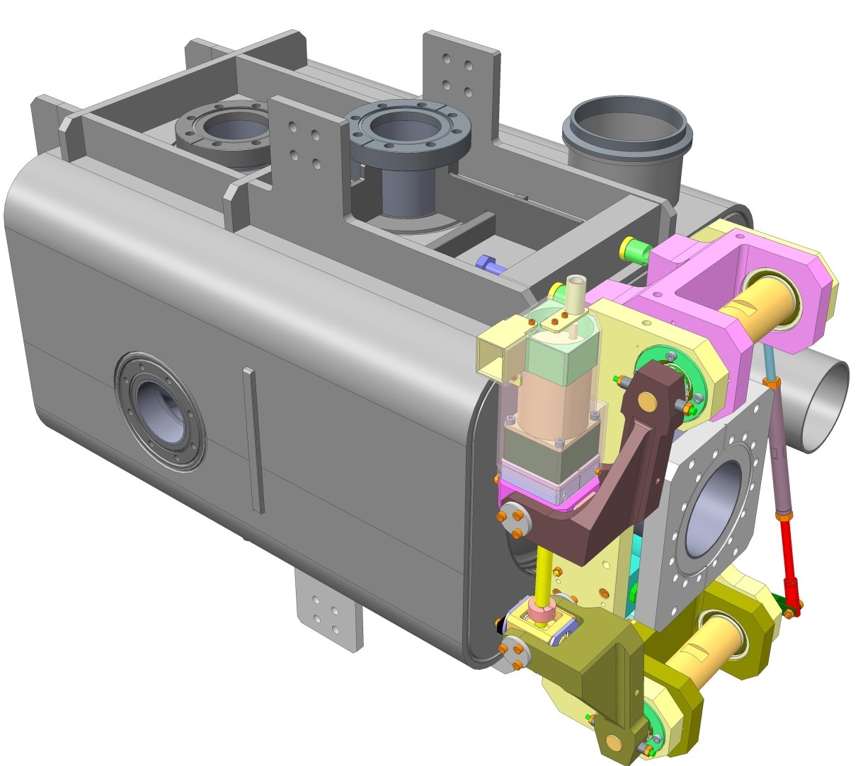
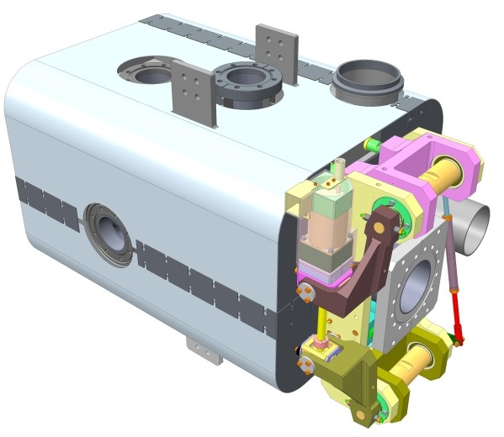
Helium vessel conceptual design
Input coupler port
Inter-cavity support connection
Stiffening ribs
Gr 2. Titanium to 316 stainless steel transition piece
Helium Vessel made from Grade 2 Titanium
Additional beam tube required for LHC installation
Cryoperm (magnetic shield)
312mm
194mm
550mm
UK 4 Rod Cavity
Modified Saclay II tuner

Slide 4
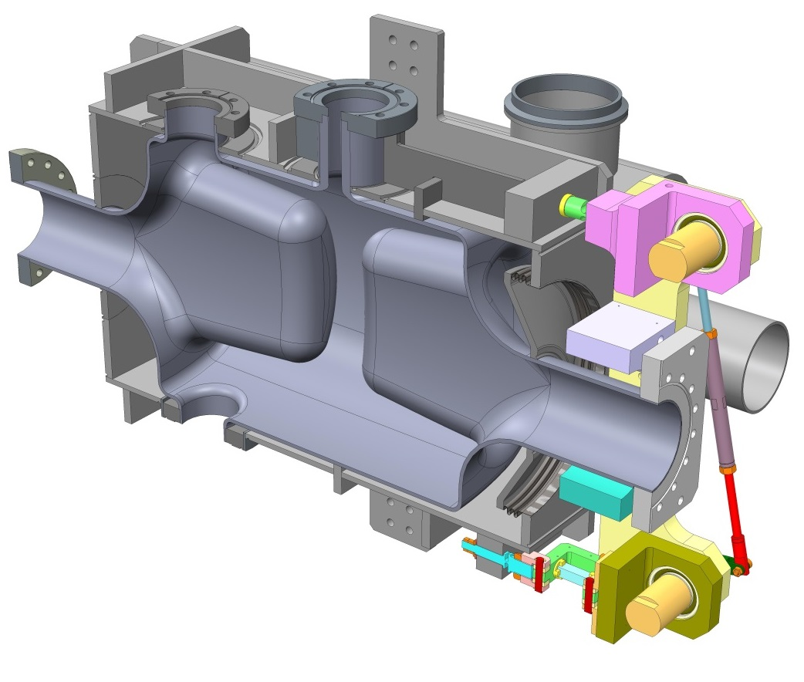
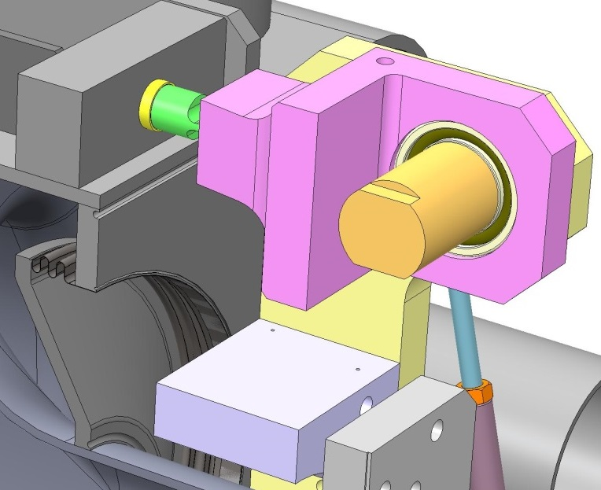
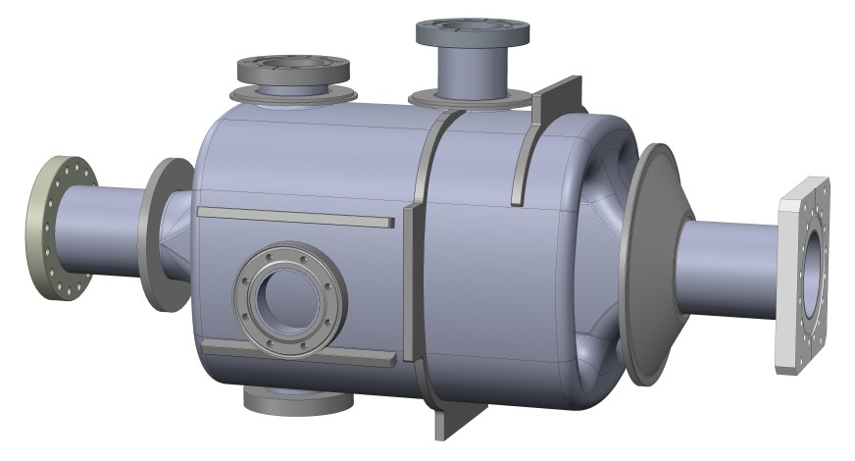
LOM coupler port
Titanium bellows to allow cavity compression when tuning
Vertical HOM coupler port
Nb-Ti transitions e-beam welded during cavity manufacture.
Bare cavity prior to He vessel installation
Cavity stiffening ribs with 3 titanium vessel connections to reduce tuning force on ports
Rectangular flange required for tuner.

Slide 5
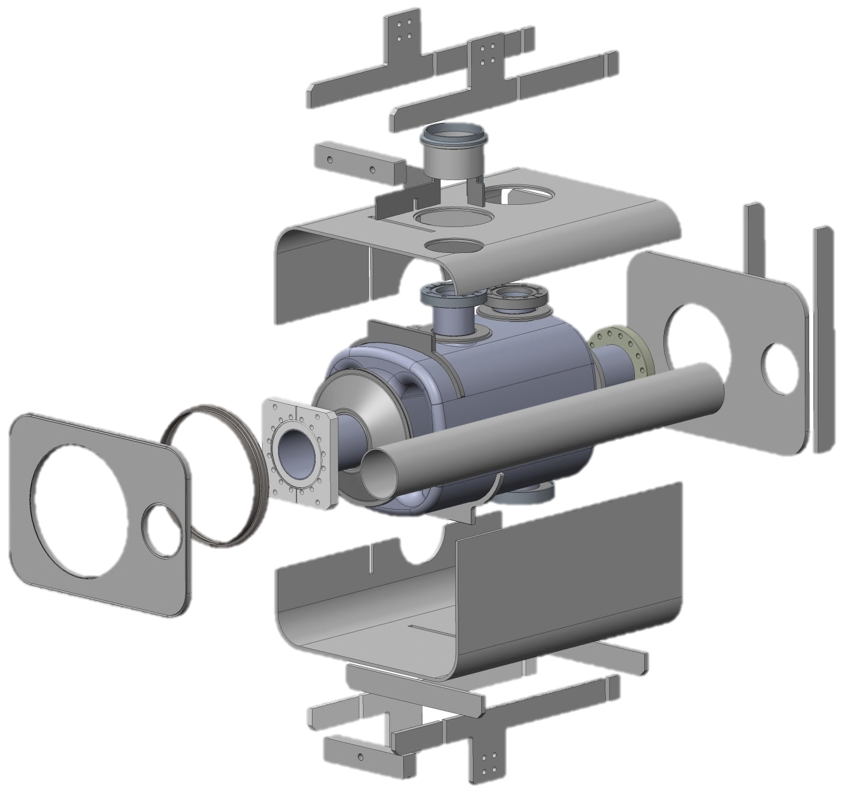
Vessel Manufacture
All joints in Helium vessel to be TIG welded
Bent 6mm thick Grade 2 Ti sheet
Bellows for tuning flexibility
10mm thick Grade 2 Titanium End plates
Dummy Beam pipe for LHC
30mm thick Grade 2 Ti
Mounting blocks for tuner
40mm deep x 10mm thick
Grade 2 Ti Stiffening ribs

Slide 6
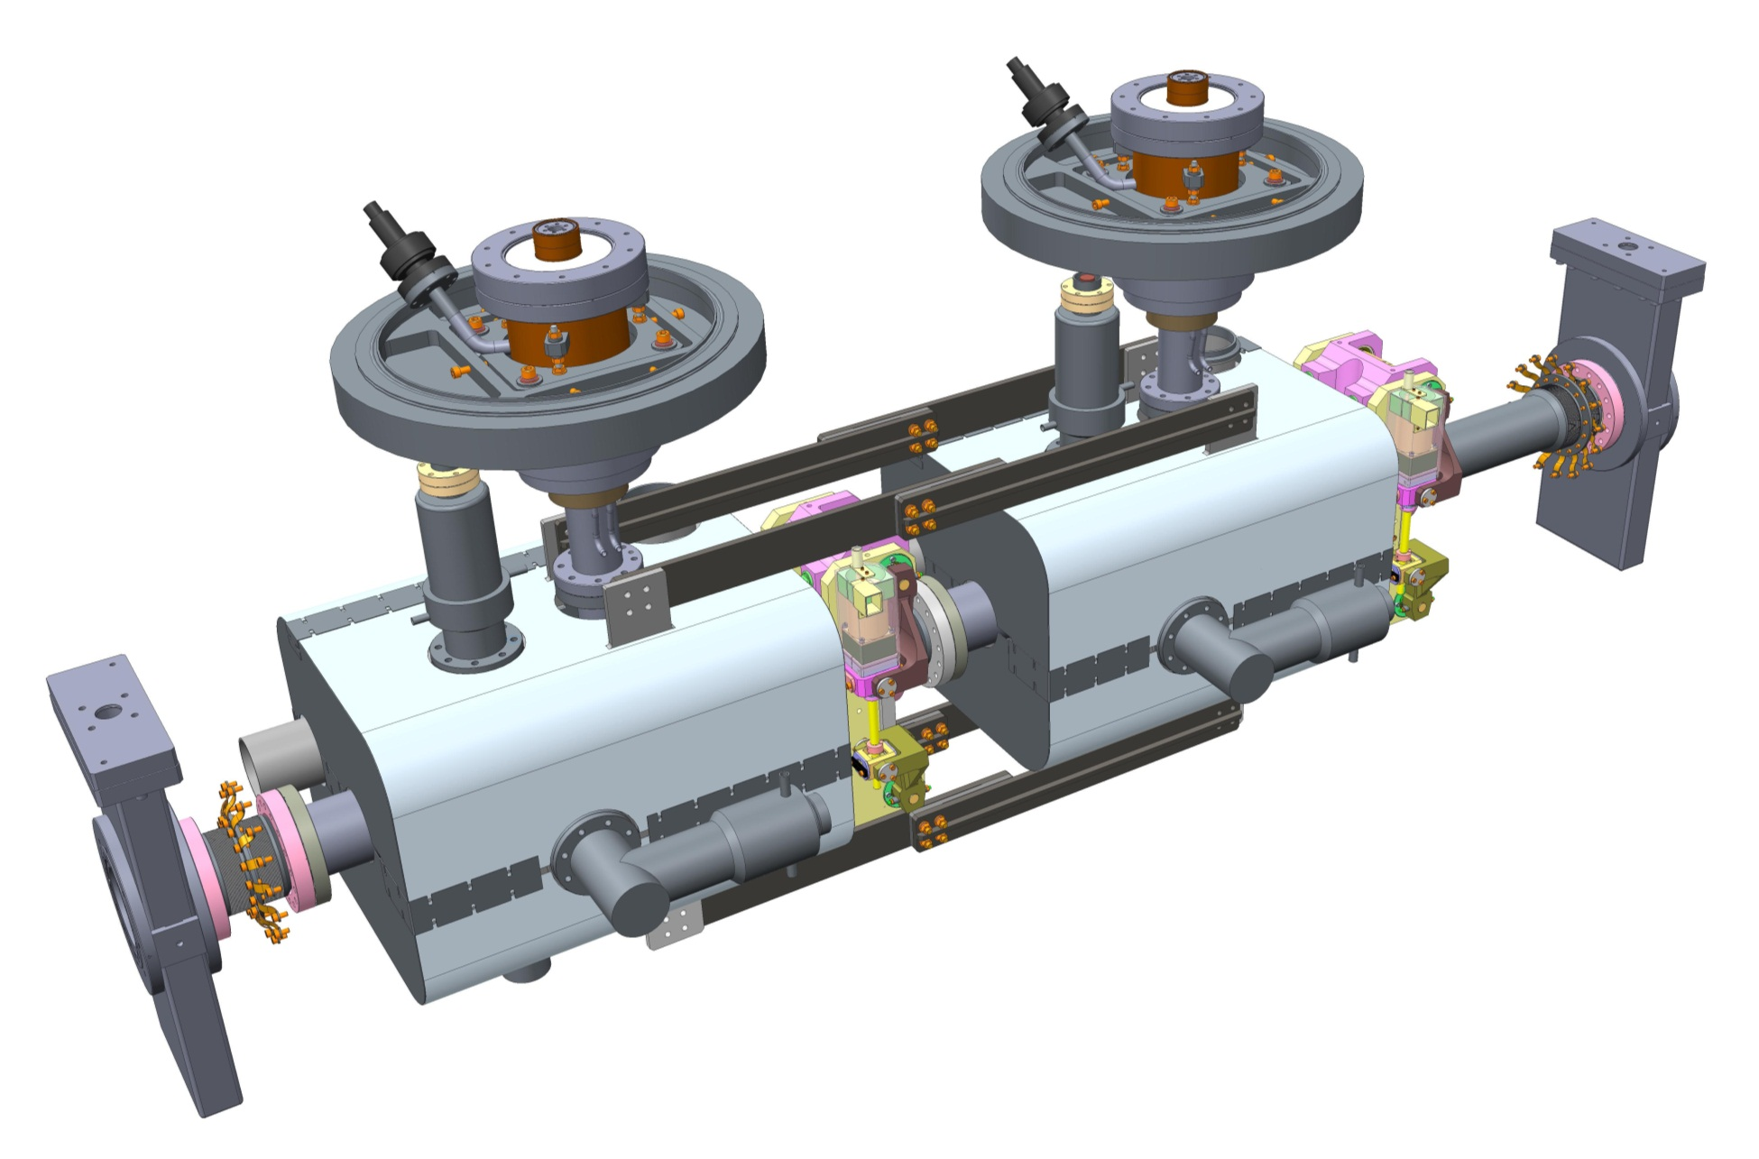
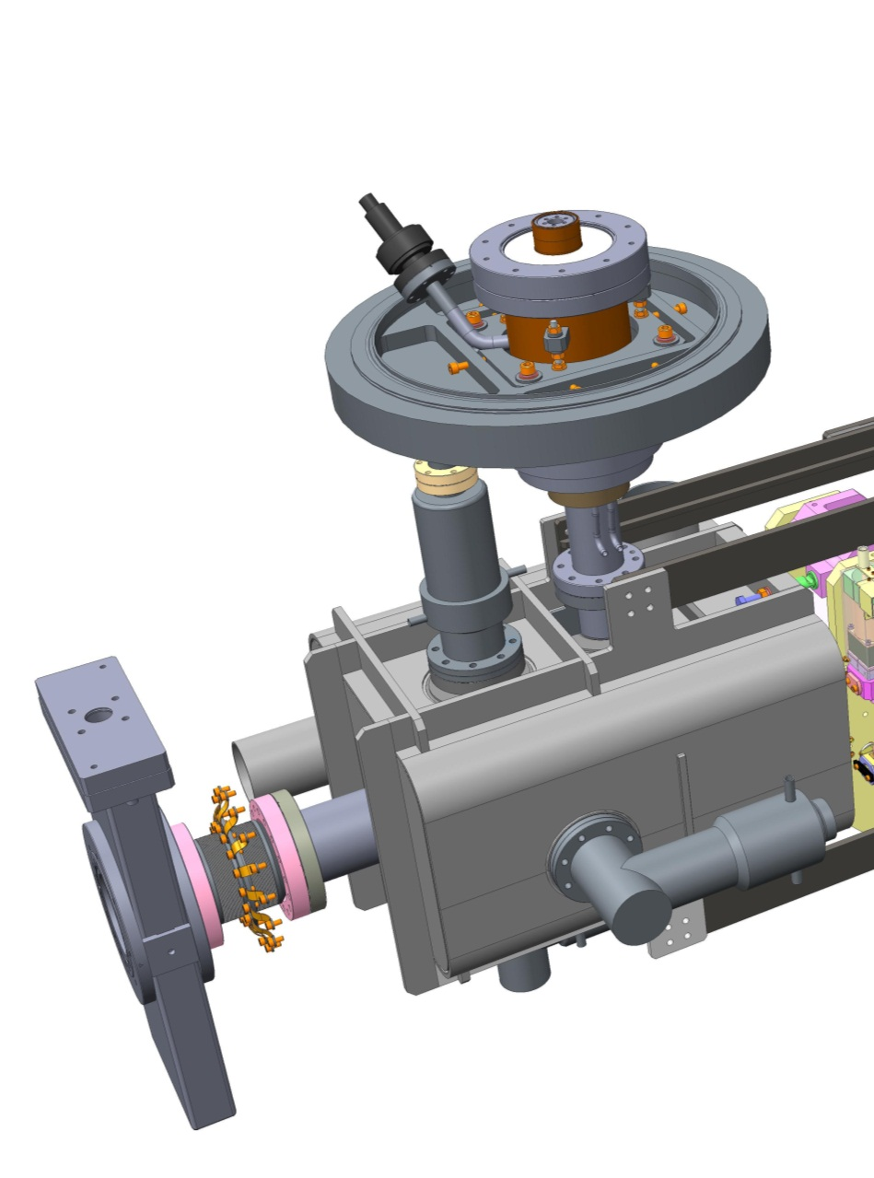
Cavity String
FPC support system
Fundamental Power Coupler
LOM absorber
Cavity in Helium Vessel
End lever tuning system
1mm thick Cryoperm magnetic shielding
Inter-cavity support
In vacuum all metal valve
Horizontal HOM absorber
Total mass supported by outer wall of FPC = ~250Kg
Vertical HOM absorber
2K – 300K transition bellows with 80K intercept
Further details in my Cryomodule presentation tomorrow

Slide 7
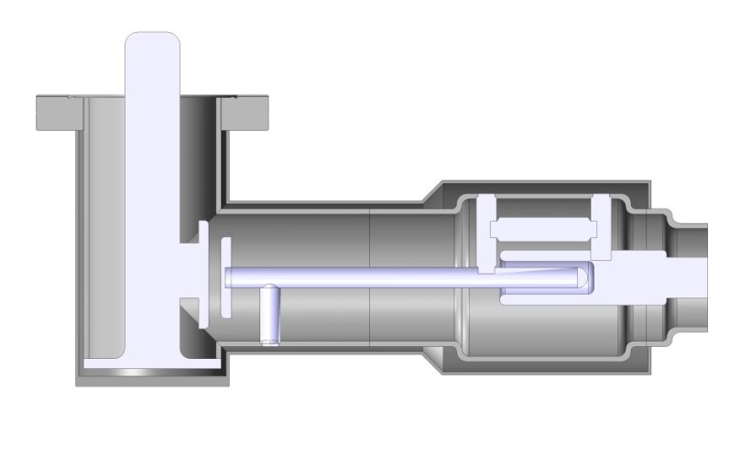
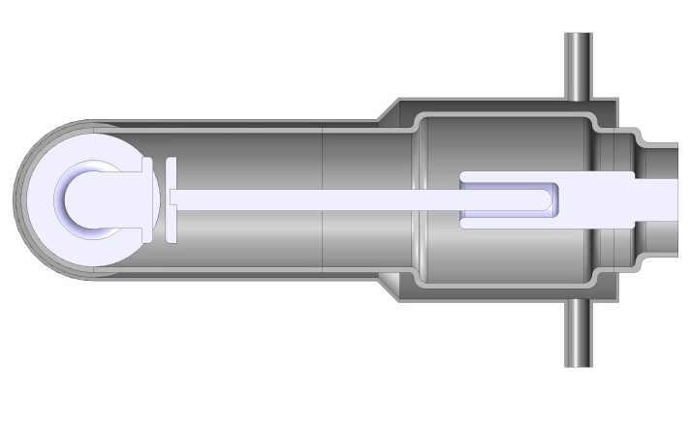
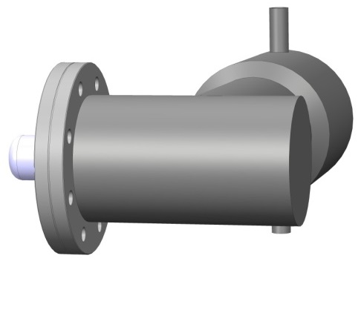
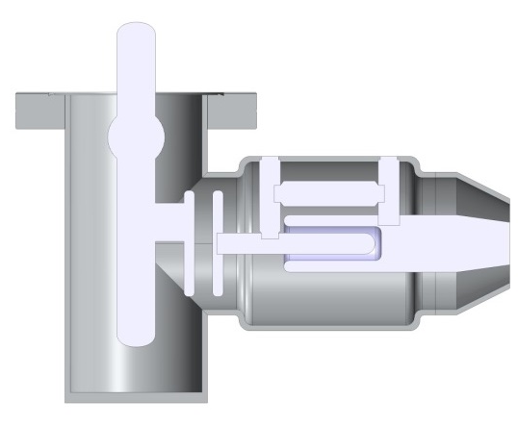
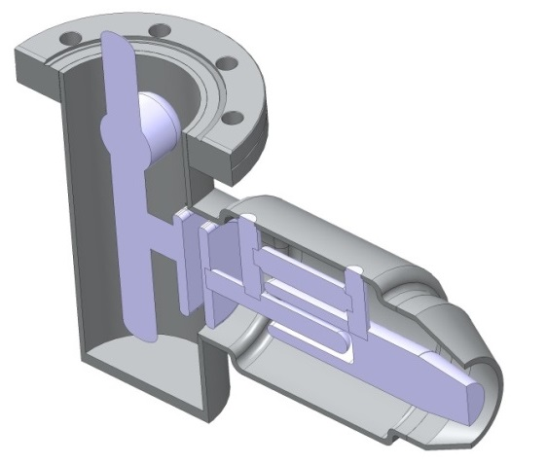
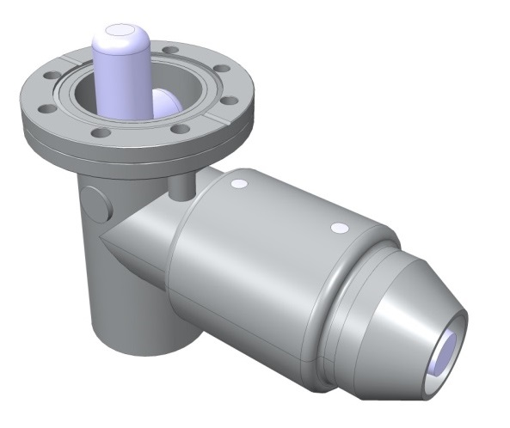
HOM Couplers
Could drill here to give additional cooling if required
2-Phase Out
LHe bottom fill
Horizontal HOM coupler
Less cooling required therefore copper strapping will be used from outer conductor to cavity Helium vessel
2 holes require slotting to give access for bolts
Vertical coupler

Slide 8
Horizontal HOM
Outer conductor attached to cavity is fixed at 2K
Inner conductor Rs=5 n Ohms
All else Rs=200 n Ohms
No static load included, assume cable will be sufficiently long and have 80K intercept to reduce heat leak to a minimum

Slide 9
Vertical HOM
Outer conductor attached to cavity is fixed at 2K
Inner conductor and 2nd outer conductor Rs=5 n Ohms
All else Rs=200 n Ohms
No static load included, assume cable will be sufficiently long and have 80K intercept to reduce heat leak to a minimum

Slide 10
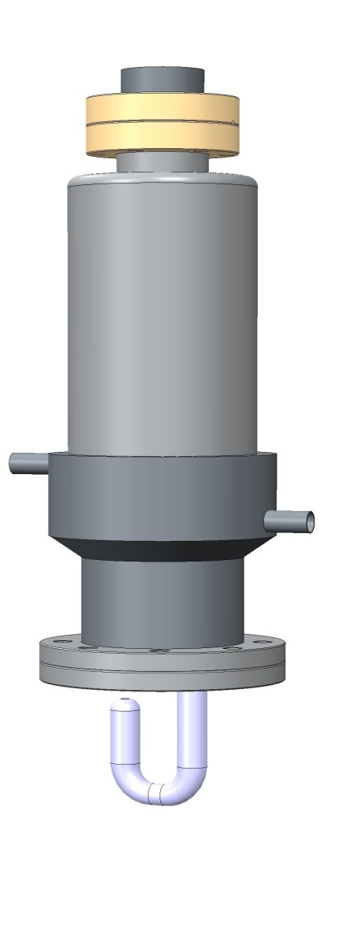
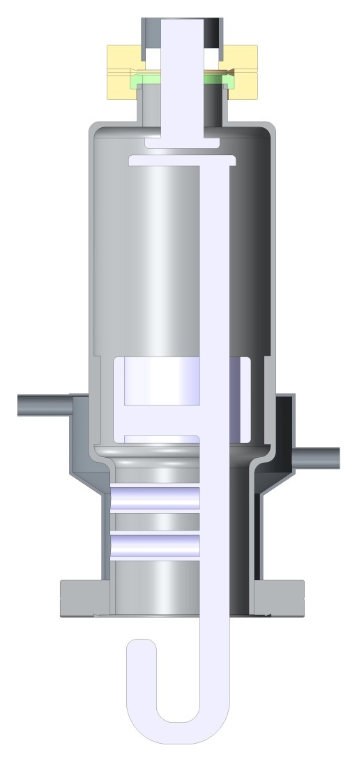
Low order mode coupler
Connection to CERN cable (details to be added)
Various thickness gaskets can be used here to account for cooldown/manufacturing tolerances.
A clamp will be used here to give tuning
Tubes used for stubs to give additional cooling
2-Phase Out
LHe bottom fill
Copper straps could be used from He bath to outer can, if required

Slide 11
LOM coupler inner
Outer conductor in location of helium vessel is fixed at 2K
Assume far end is at 40K due to static loads through cable.
Inner conductor Rs=200nOhms which represents the worst case resistance.

Slide 12
LOM coupler
Outer conductor in location of helium vessel is fixed at 2K
Assume far end is at 40K due to static loads through cable.
Inner conductor Rs=200nOhms which represents the worst case resistance.

Slide 13
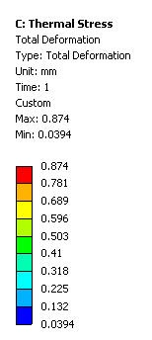
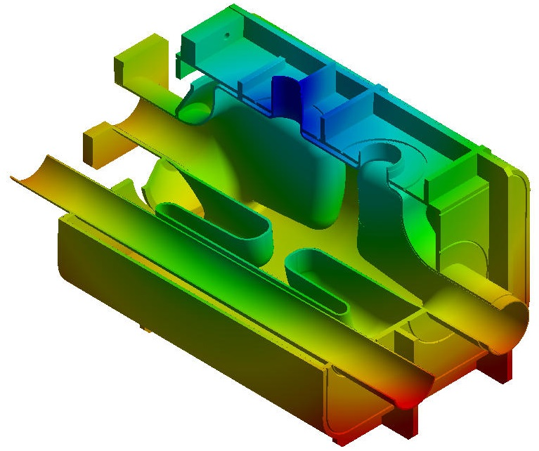
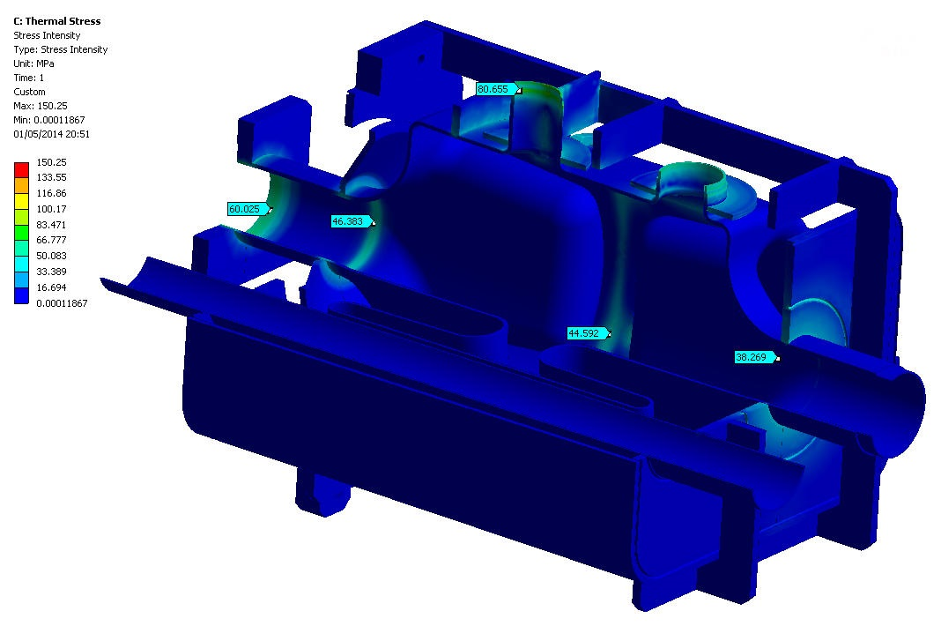
Thermal Stress
Analysing contraction during cool down from room temperature to operation, 295K to 2K
Maximum Stress Intensity = 150MPa at cavity side wall – rib interface
Maximum Deformation = 0.87mm which agrees with integrated ΔL values.
Nb-Ti flange used, stress if using 316LN SS is far higher (~400MPa)

Slide 14
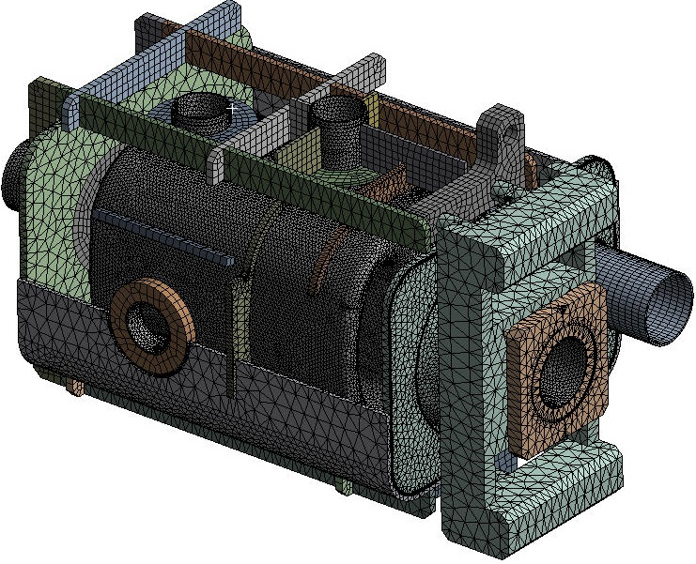
Pressure vessel analysis – Mesh, Load and Boundary conditions
CF flanges and 2 phase line removed to simplify FEA.
Fixed in all directions/rotations
Outer He vessel modelled as Grade 2 Titanium Young’s modulus 113GPa
Poisson’s ratio 0.342
Cavity modelled as Niobium Reactor grade Type 1, UNS R04200. Young’s modulus 100GPa, Poisson’s Ratio 0.4
0.18MPa applied to all internal surfaces, to simulate a 1.8 Bar (abs) required by CERN safety code.
Bellows removed to simplify analysis.
Stainless steel tuner representation

Slide 15
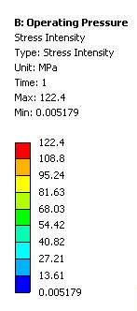
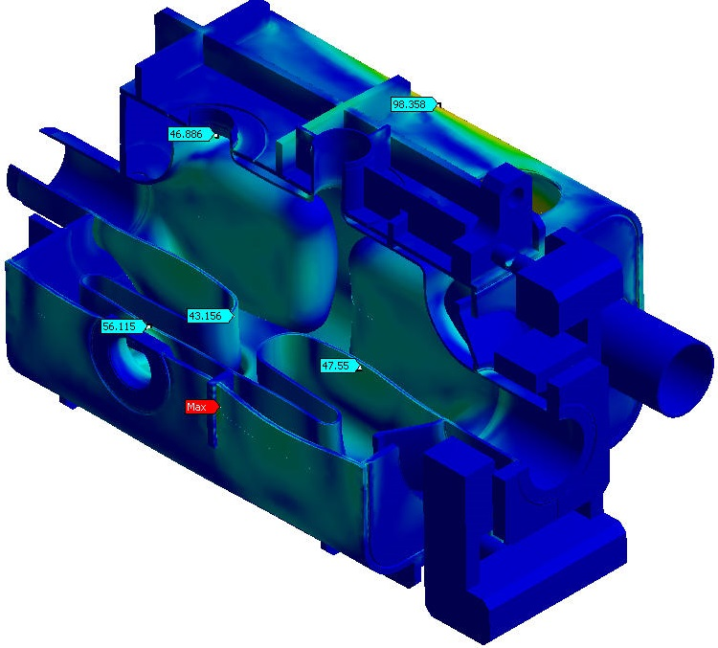
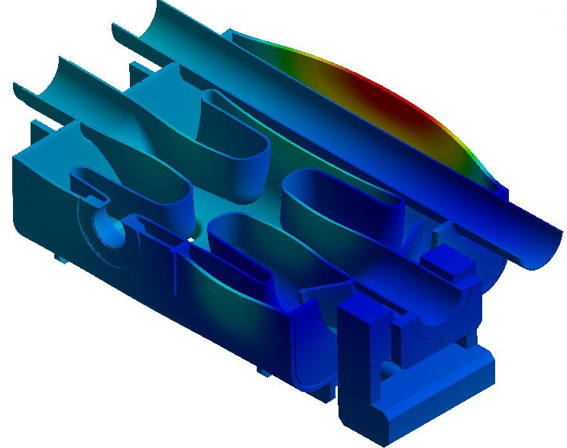
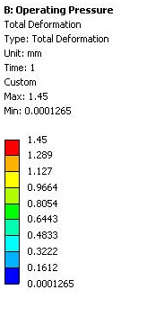
Pressure vessel analysis – Results
Max General Primary Stress is 48MPa in the cavity and max Local Primary Stress is 55MPa in the ports. Both comply with BS EN 13458-2 (A1) regarding Elastic Stress analysis of Cryogenic Vessels for operating conditions.
Largest deformation in cavity 0.47mm (shown below). RF simulations show 70KHz per mm deflection in this region, therefore cavity pressure sensitivity is 18Hz/mbar. ((0.47/1.8) x 70)
The maximum stress in the model is 122MPa but this occurs in the Grade 2 Titanium vessel which has a Yield Strength of 275MPa (Allowable 183MPa). The largest deformation at 1.8bar (abs) in the Ti vessel is 1.45mm.
Ref : BS EN13458-2:2002 Cryogenic Vessels – Design, fabrication, inspection & testing

Slide 16
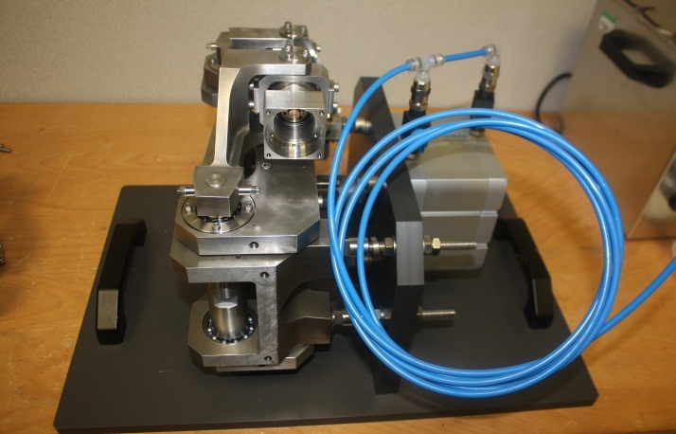
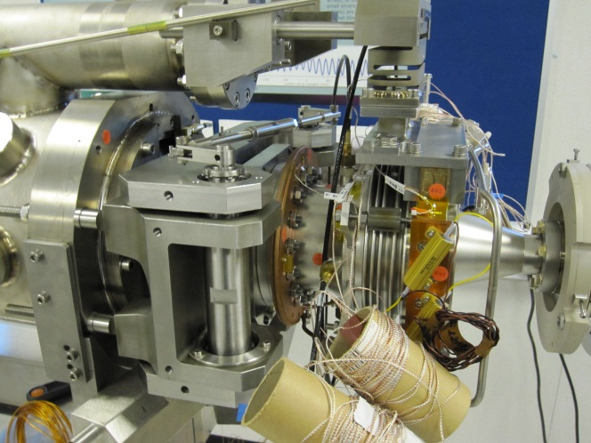
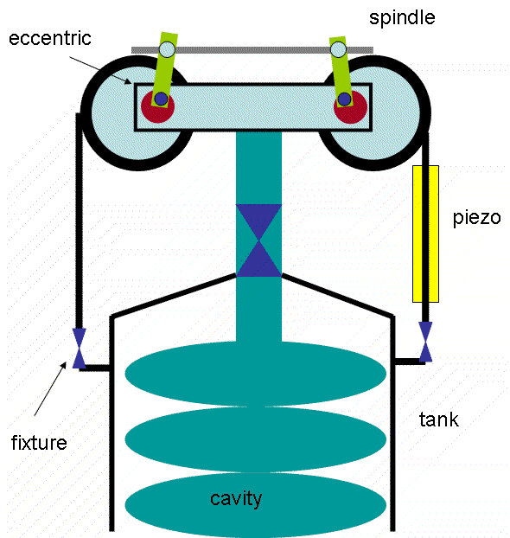
Tuning with Saclay II design
Modified Saclay II tuner installed on DICC module built at Daresbury.
Stiffness test of modified Saclay II design at Daresbury.
Experience with tuner and piezo active tuning system gained on Daresbury International Collaborative Cryomodule project.
Current tuner design tested to 7KN with ~25μm average deflection.
Tuner has been modified to increase stiffness for increased width.
Above images ref: Oliver Kugeler, ERL07, Daresbury, May 21-25

Slide 17
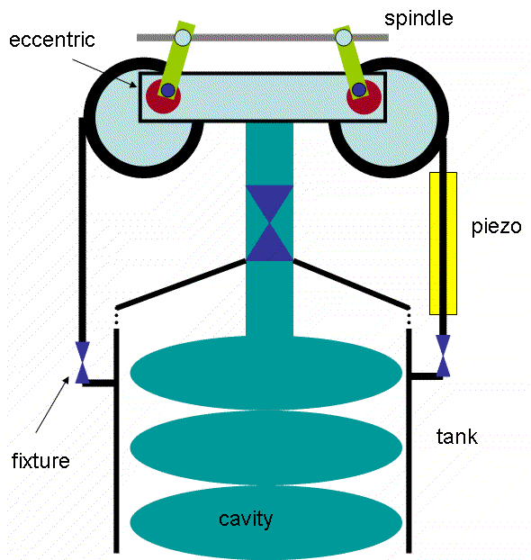
Tuning with Saclay II design
Modified Saclay II tuner installed on DICC module built at Daresbury.
Stiffness test of modified Saclay II design at Daresbury.
Experience with tuner and piezo active tuning system gained on Daresbury International Collaborative Cryomodule project.
Current tuner design tested to 7KN with ~25μm average deflection.
Tuner has been modified to increase stiffness for increased width.
Above images ref: Oliver Kugeler, ERL07, Daresbury, May 21-25

Slide 18
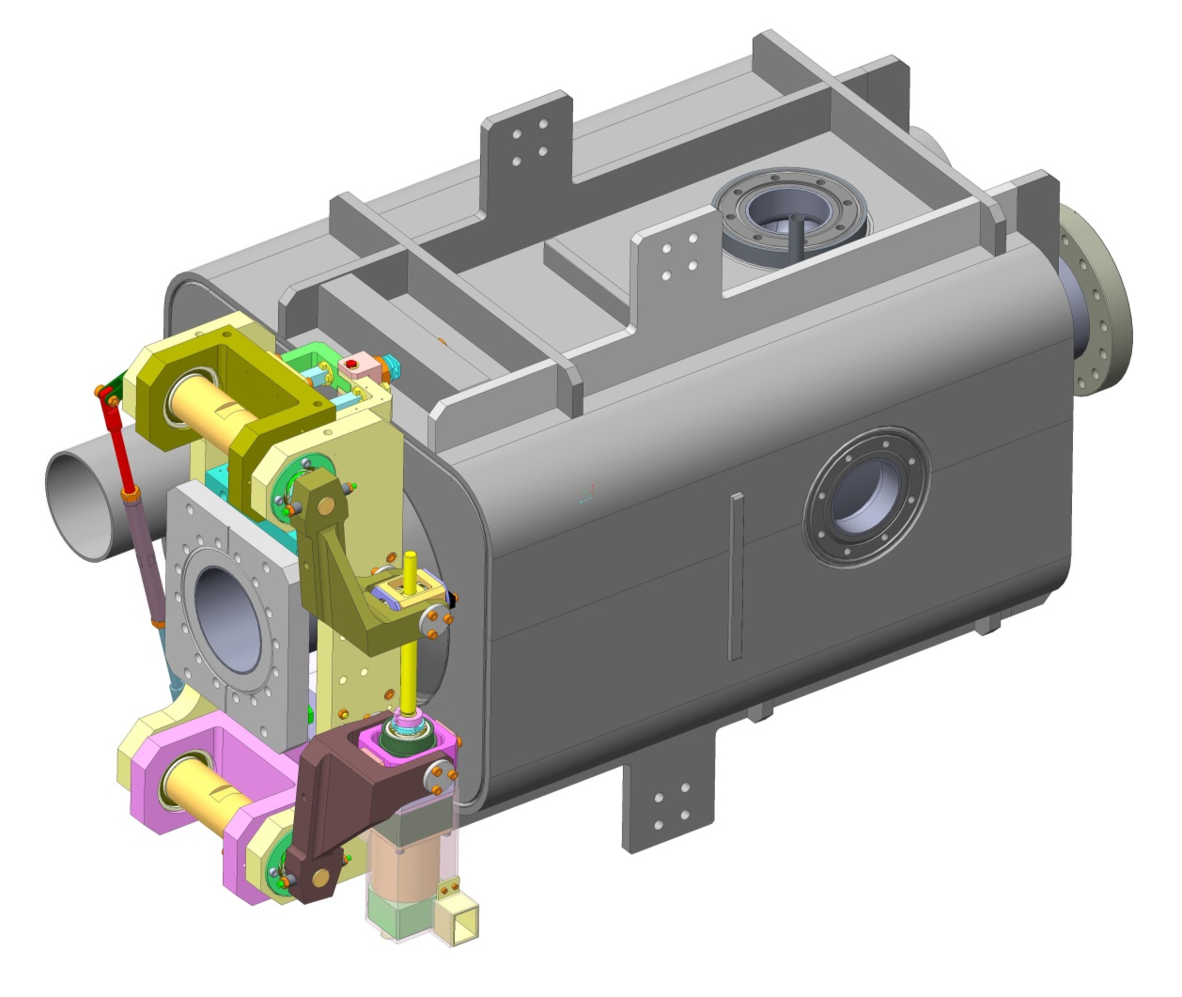
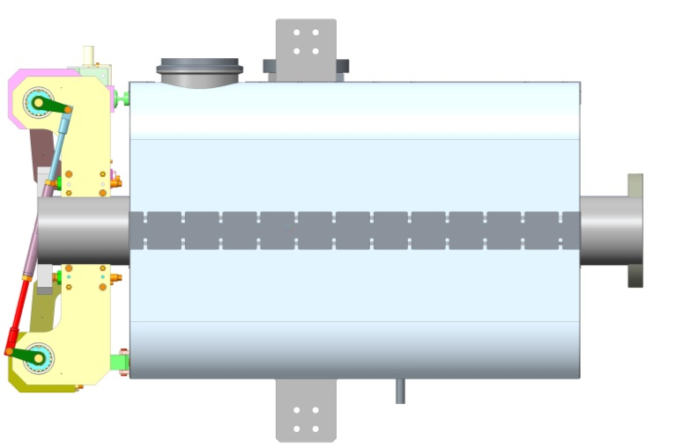
Saclay II design integration
Ribs support He vessel under tuning loads
Piezo units
The cavity has been thinned in certain regions to increase tuning range and limit the force required by the tuners whilst remaining within the pressure code.
Eccentric cam
Tuner width increased to suit He Vessel geometry
Stepper motor in its own magnetic shield
Studs between tuner and flange can be used to allow for thermal contractions.

Slide 19
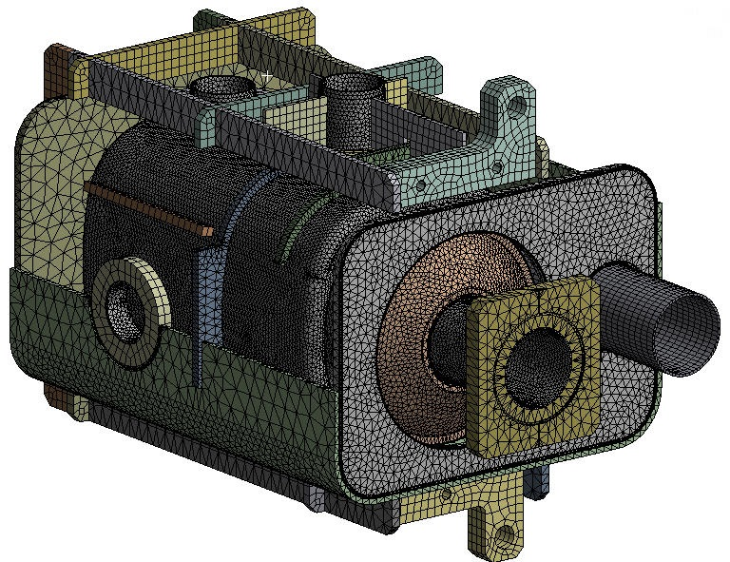
Tuning analysis – Mesh, Load and Boundary conditions
Fixed in all directions/rotations
Top wall not shown for clarity, but used for FEA.
3500N applied here
7000N applied here
Active tuning is only in one direction as Piezos need to always be in compression.
Material properties at 2K used
3500N applied here

Slide 20
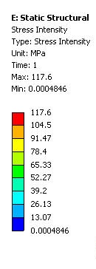
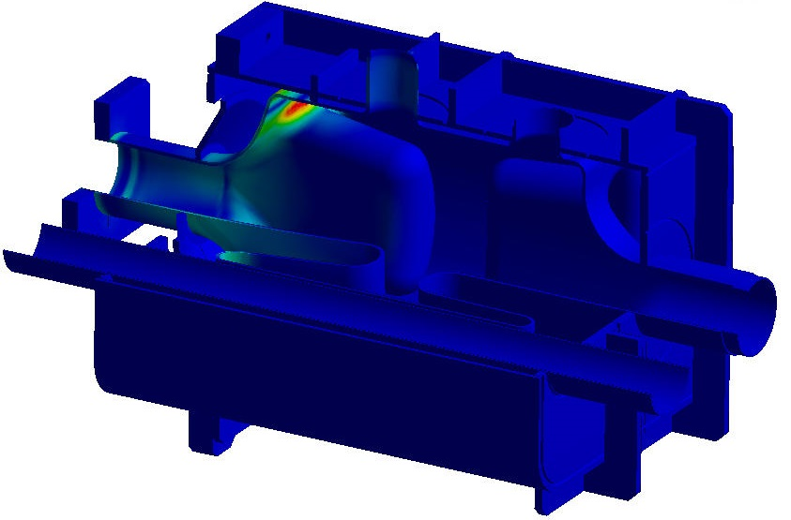
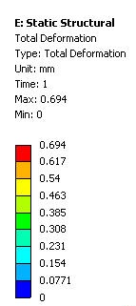
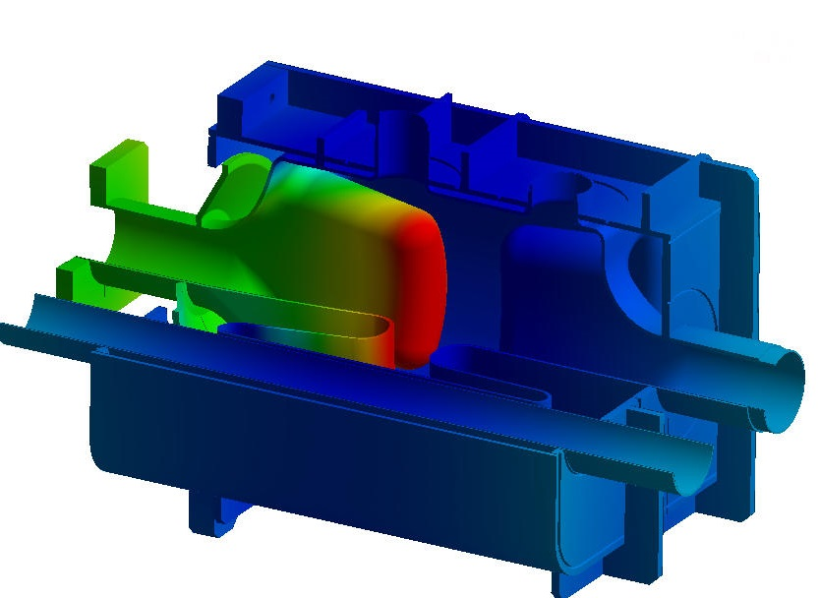
Tuning analysis – Results
The maximum stress intensity with 7kN load is 117.6 MPa.
The FERMILAB Summary of Niobium material properties states that the acceptable stress limit for Nb at 2K is 137MPa.
The danger with using this limit is that if the tuner ‘sticks’ at cryogenic temperatures when the module warms up and the yield stress of Nb returns to 75MPa the cavity will be plastically deformed.
This, however, may not be a disadvantage as it can be used to permanently tune the cavity.
The total deformation is 0.69mm.
This result gives a cavity stiffness of 10.1kN/mm.

Slide 21
Tuning analysis – Cavity Stress Intensity

Slide 22
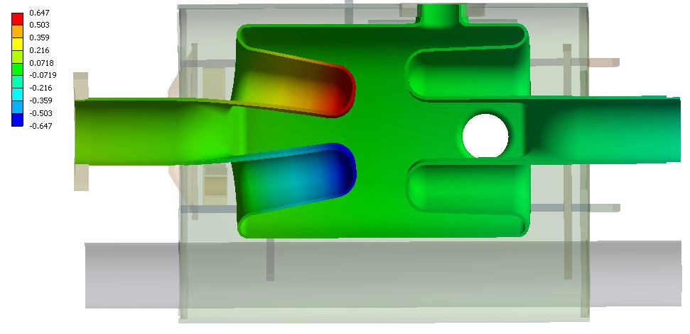
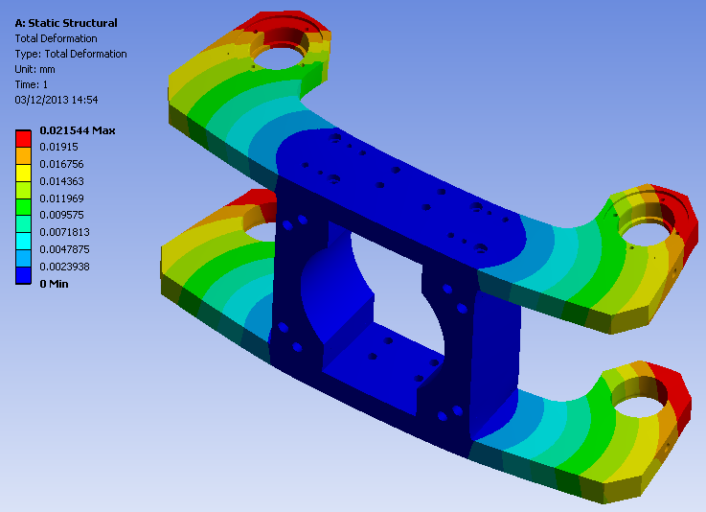
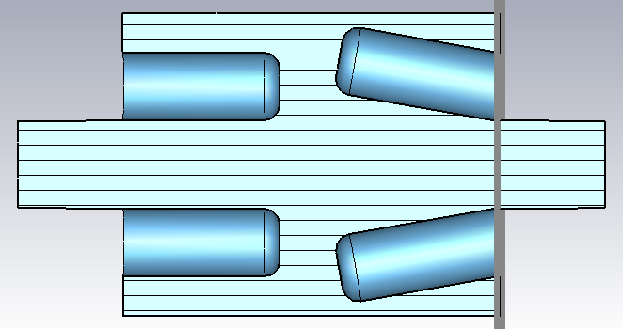
Tuning analysis – Results
7000N on Tuner
frame gives 21.5μm maximum deformation.
Maximum lateral movement is 647 μm. This reduces to 625 μm once the tuner stiffness is considered.
Tuner stiffness is 320kN/mm.
Frequency tuning was studied in a simplified model. The frequency shift per mm of transverse offset is 0.3 MHz/mm so tuning range with current design is +188 kHz.
Tuning range required by specification is +/-60kHz, therefore this design is acceptable with some additional capacity.

Slide 23
Tuning analysis – Cavity Deformation

Slide 24
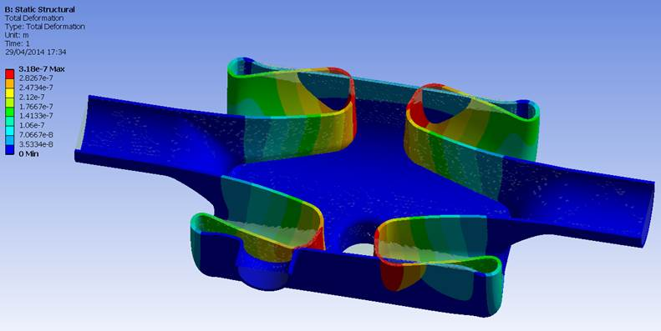
Lorentz force detuning
303 Nm² at Vt=1.21 MV therefore ~2380Nm² at operating voltage of 3.4 MV.
Most of the force is at the tip of the rod with some at the base, the force on the outer can is negligible.
The force acts upon geometrically stiff regions therefore the Lorentz detuning of the cavity is very low at +408Hz.
The detuning is within the cavity bandwidth and resolution of the tuner.
Rods deform by 0.318µm due to Lorentz forces

Slide 25
Conclusions and Further work
The concept for the dressed UK 4 Rod cavity has been further developed.
The concept uses a TIG welded grade 2 Titanium Helium tank with Nb-Ti transition pieces e-beam welded to the cavity.
This is to minimise stress induced on cool down but also has the advantage of saving weight, therefore minimising the load on the cavity string support.
Concepts for HOM and LOM couplers have been developed and initial thermal calculations performed. Losses are very low therefore cooling the couplers should not be an issue. Interfaces with CERN COAX cable need to be added.
The cavity has been reinforced, and is therefore now suitable for 1.8 bar CERN pressure requirements. Cavity pressure sensitivity is 18Hz/mbar.
The cavity has been optimised for tuning and initial analysis shows that the use of a modified Saclay II type tuner is viable.
The anticipated tuning range is +188kHz which meets specification.
Lorentz force detuning is low at 408Hz which is within the cavity bandwidth and tuner resolution.

