Slide 1
HL-LHC Crab Cavity Manufacturing
Terry Grimm
May, 2014
Niowave Project: 13-0017

Slide 2
Outline
Background
Project scope
Double Quarter Wave Cavity
RF Dipole Cavity
Helium Jackets with ports
Tuners (or tuner ports)
HOM damping ports
FPC port
Design
Preliminary Models
QA and Documentation
Drawing, Design, Material Certifications, Manufacturing, and Equipment Procedures
Schedule
Action items

Slide 3
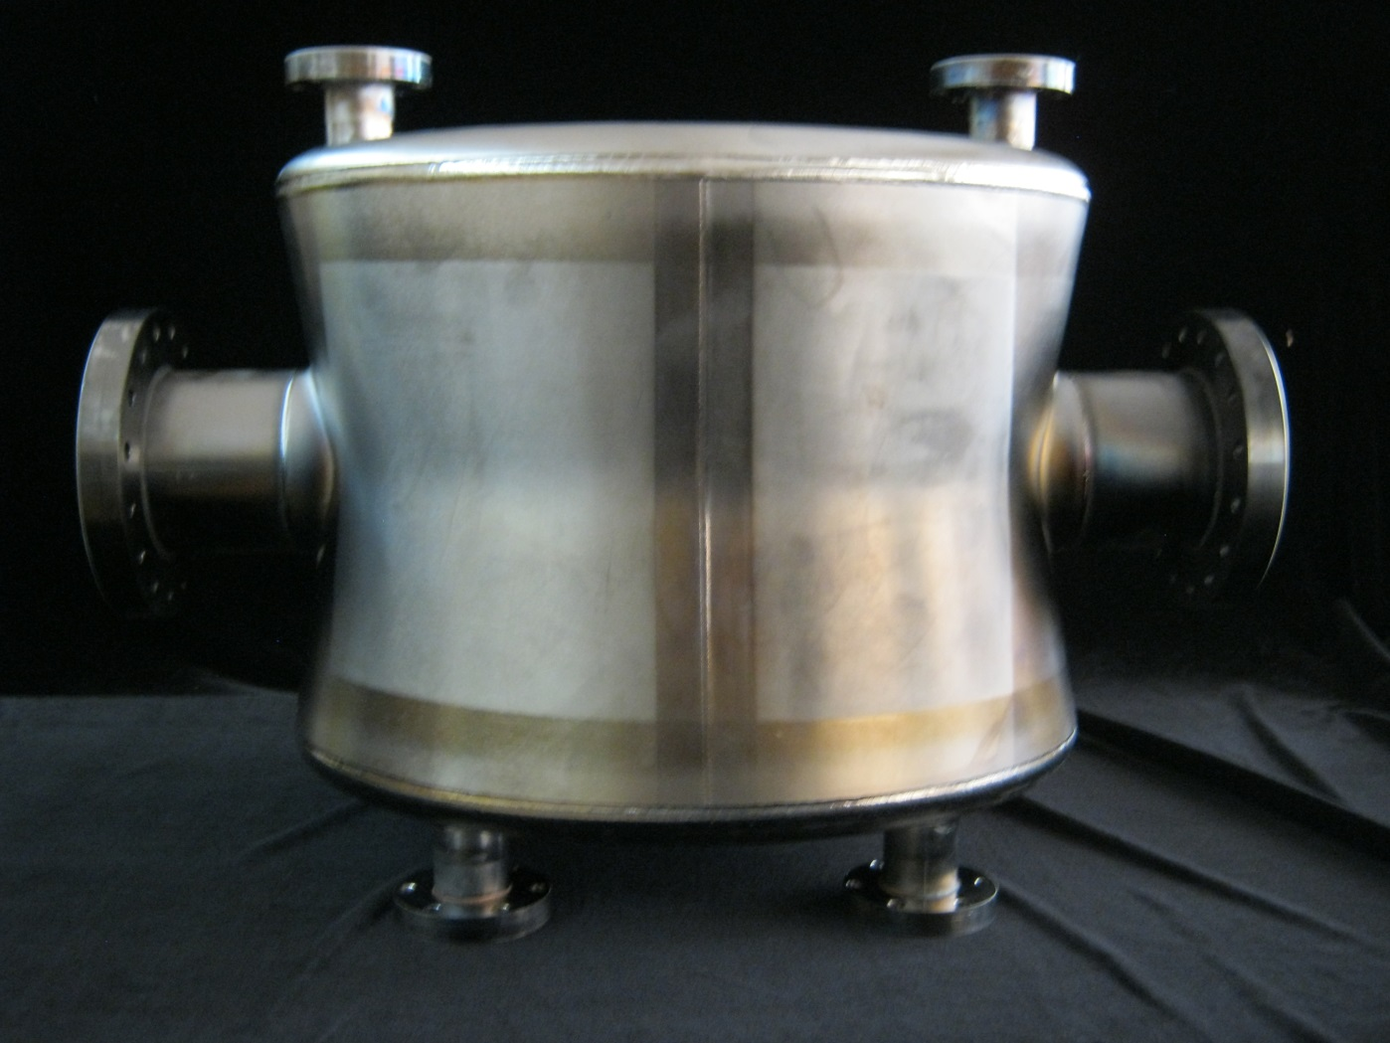
Double Quarter Wave Cavity
BNL 400MHz DQW Cavity

Slide 4
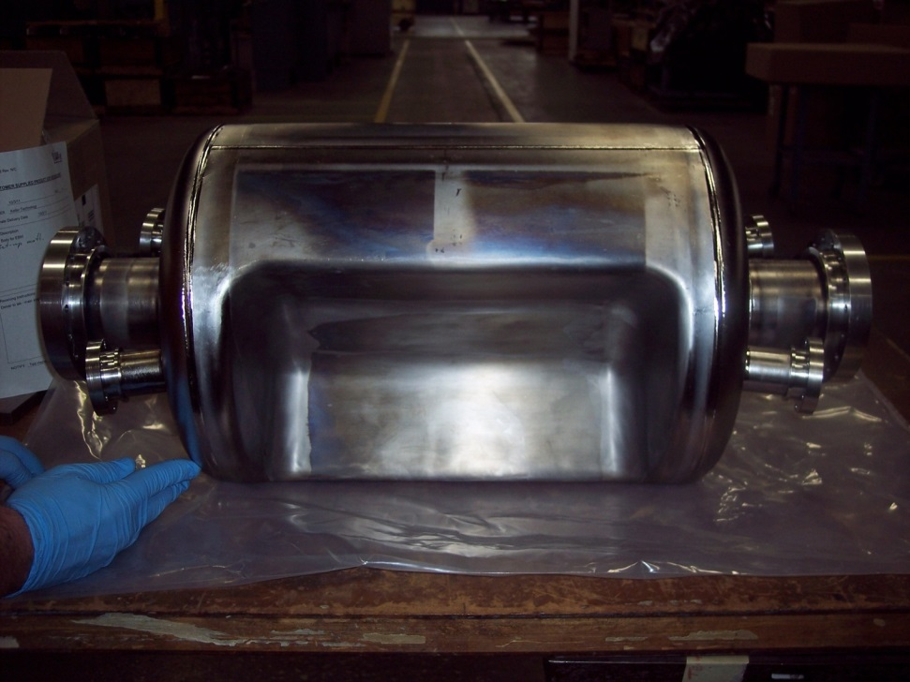
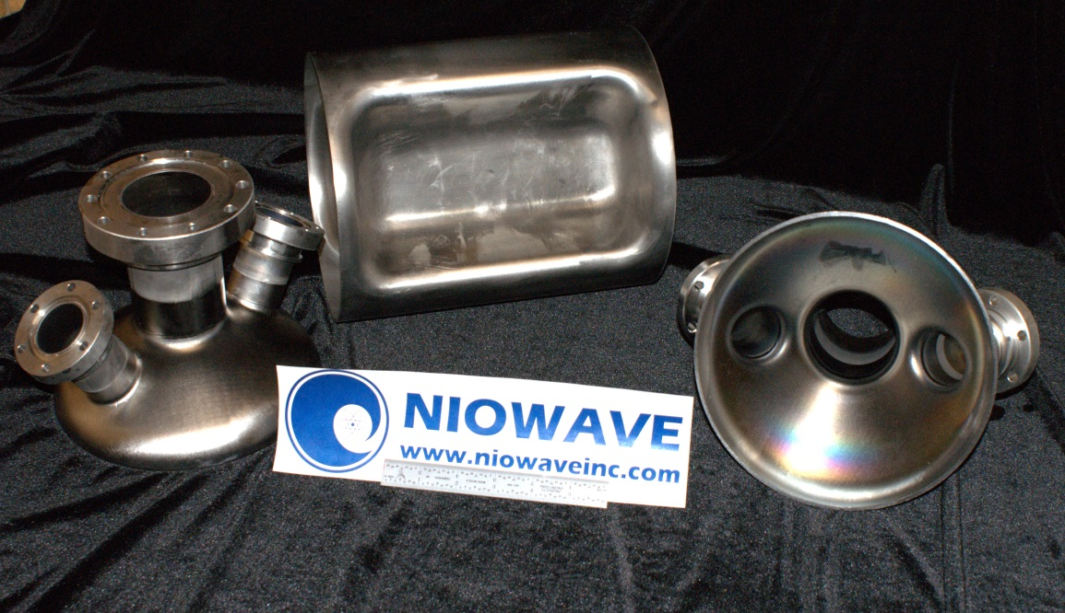
RF Dipole Cavity
ODU 400 MHz RF Dipole Cavity
JLab 750 MHz RF Dipole Cavity

Slide 5
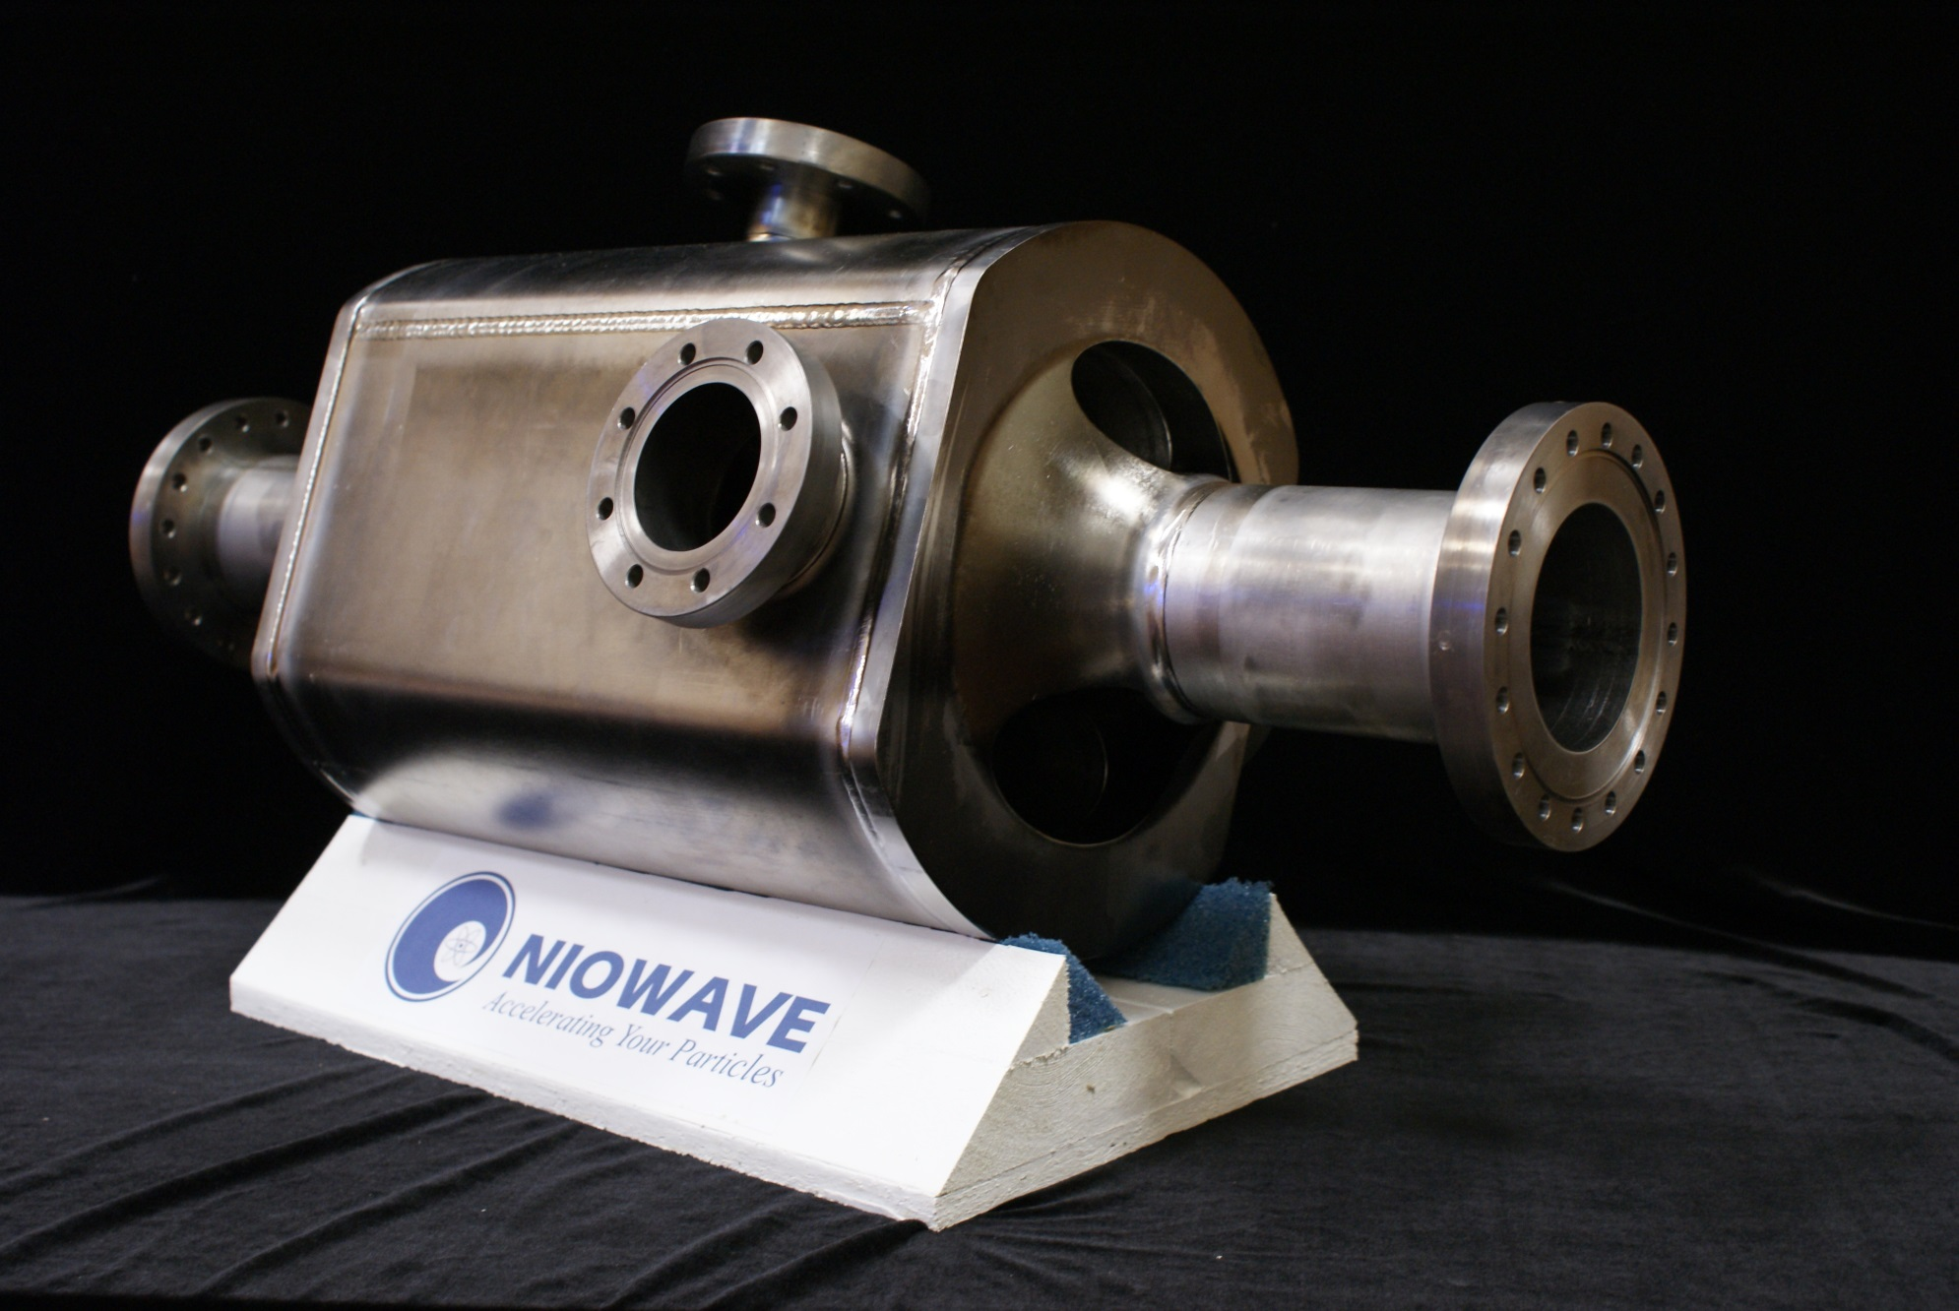
4 Bar Cavity
Daresbury 4 Bar Crab Cavity
Add picture of 4 Rod Cavity

Slide 6
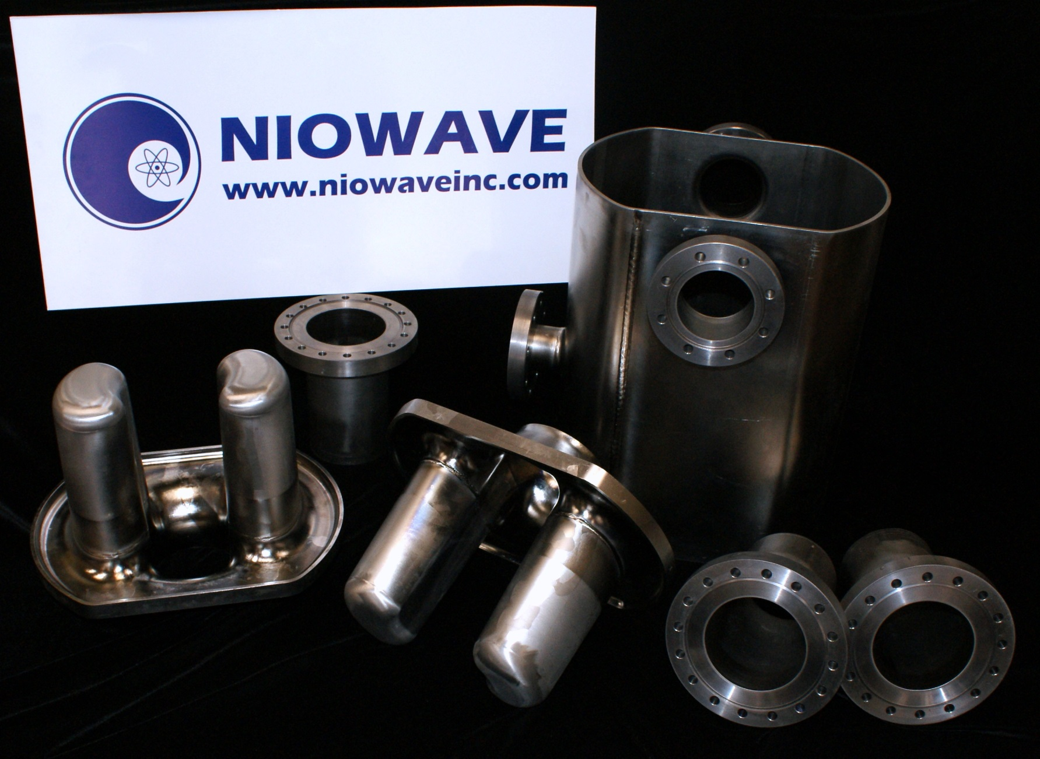
4 Bar Cavity
Daresbury 4 Bar Crab Cavity Components

Slide 7
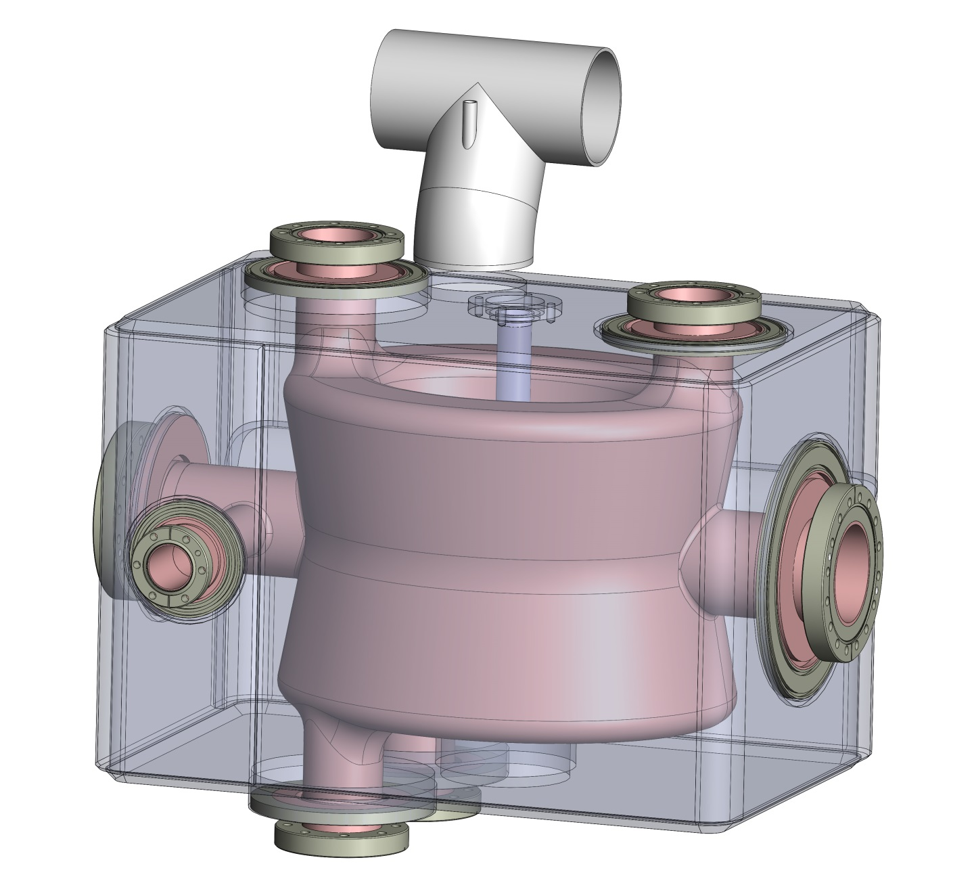
DQW Project Scope
Tuner
Pickup Port
DQW Cavity
Helium
Jacket
FPC/HOM Ports

Slide 8
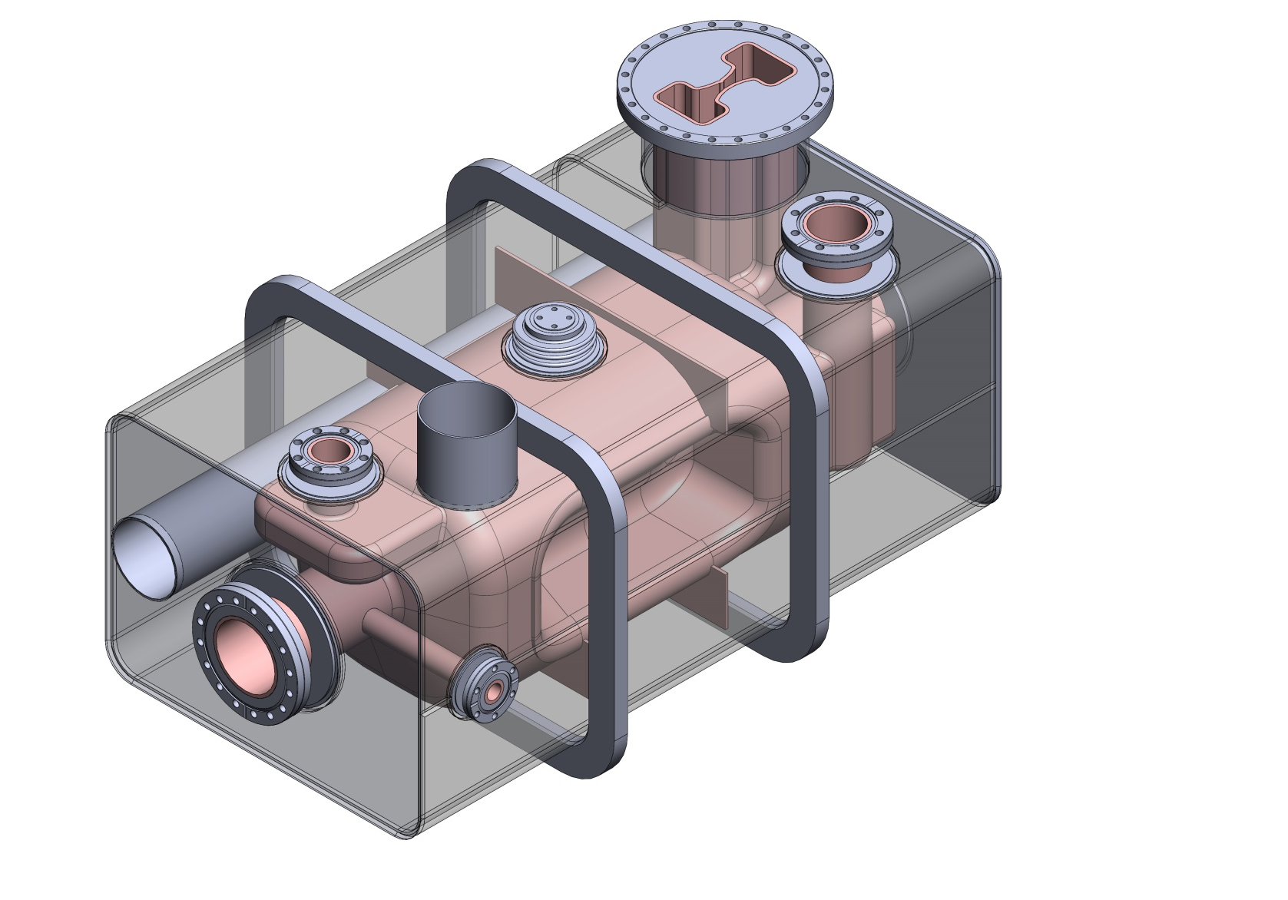
RFD Project Scope
HOM Port
FPC Port
Helium
Jacket
RFD Cavity

Slide 9
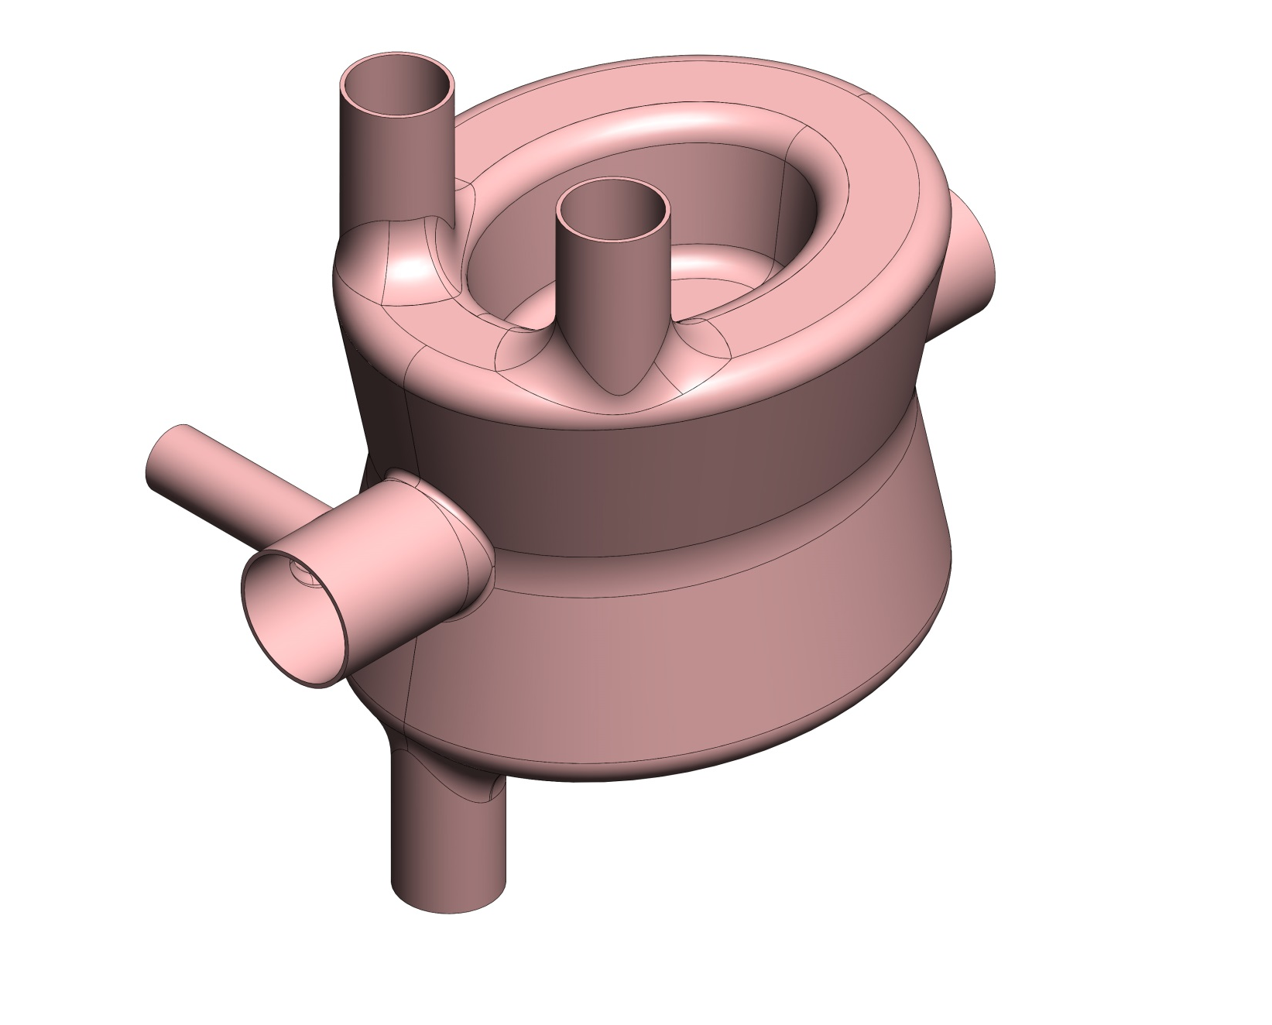
DQW Solidworks Model [1]

Slide 10
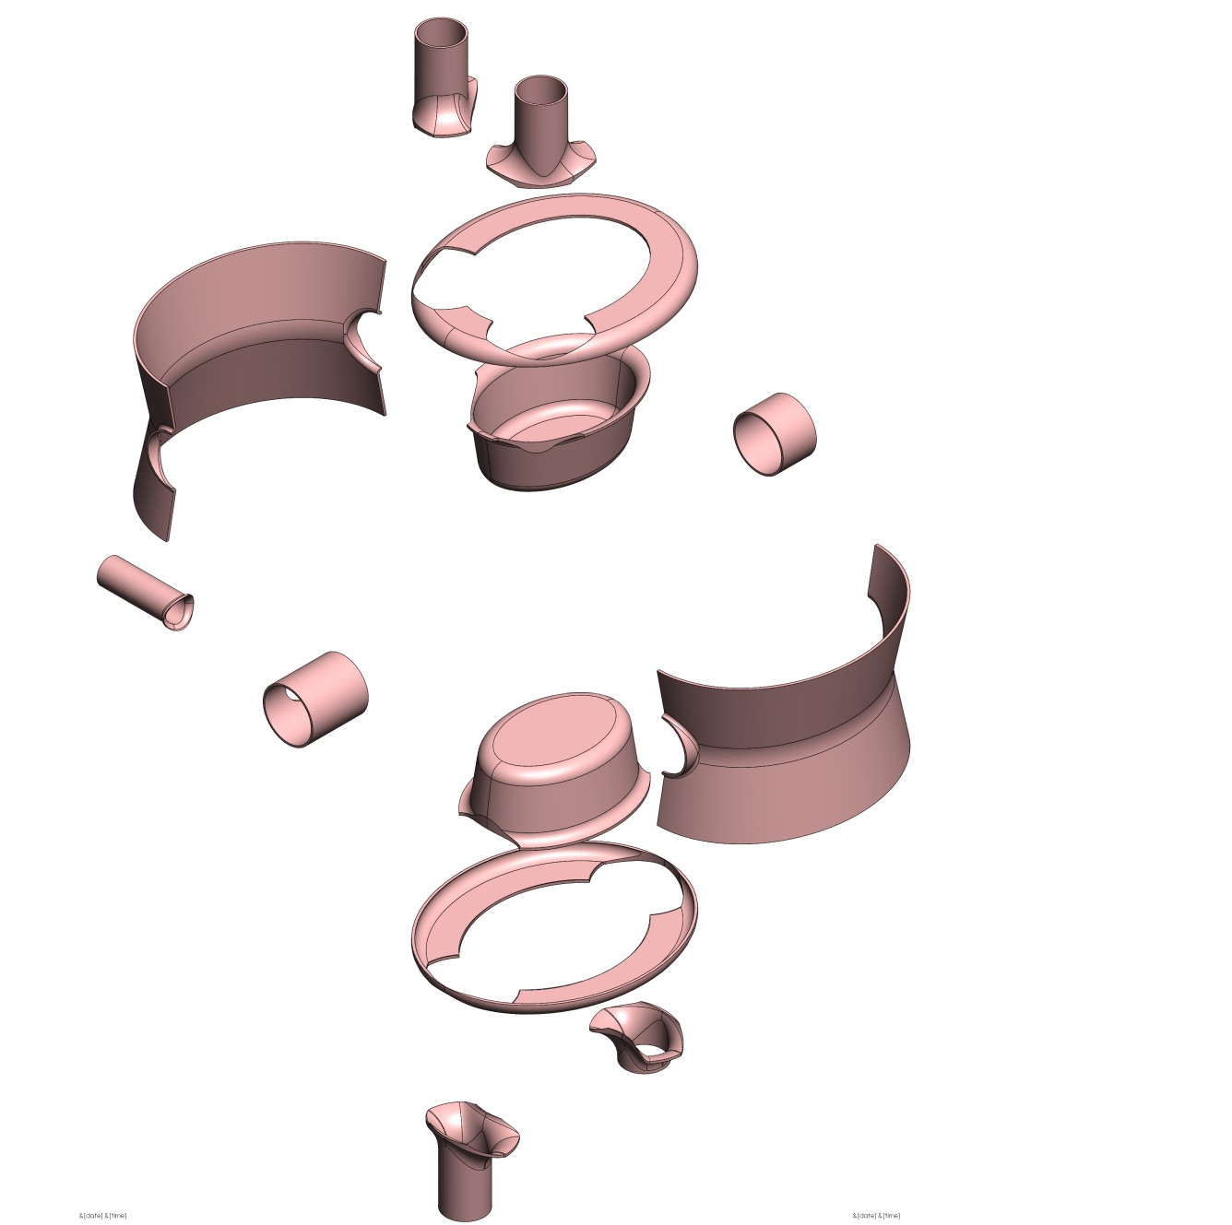
DQW Exploded Cavity View

Slide 11
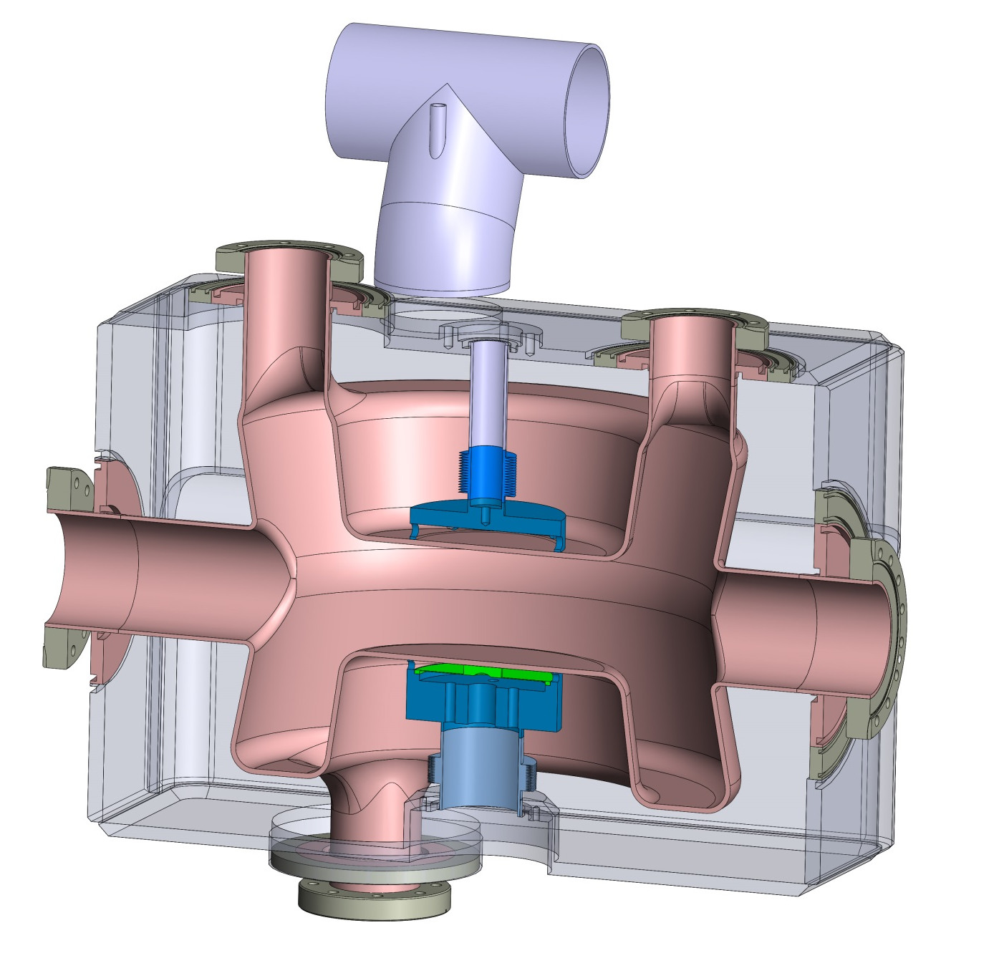
DQW Solidworks Model [2]

Slide 12
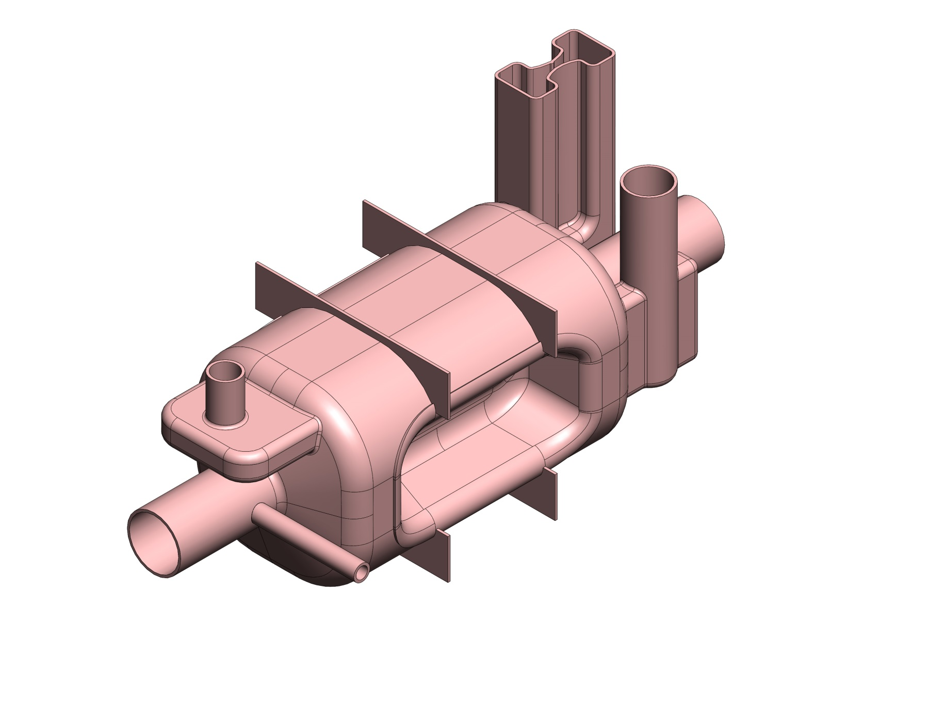
RFD Solidworks Model [1]

Slide 13
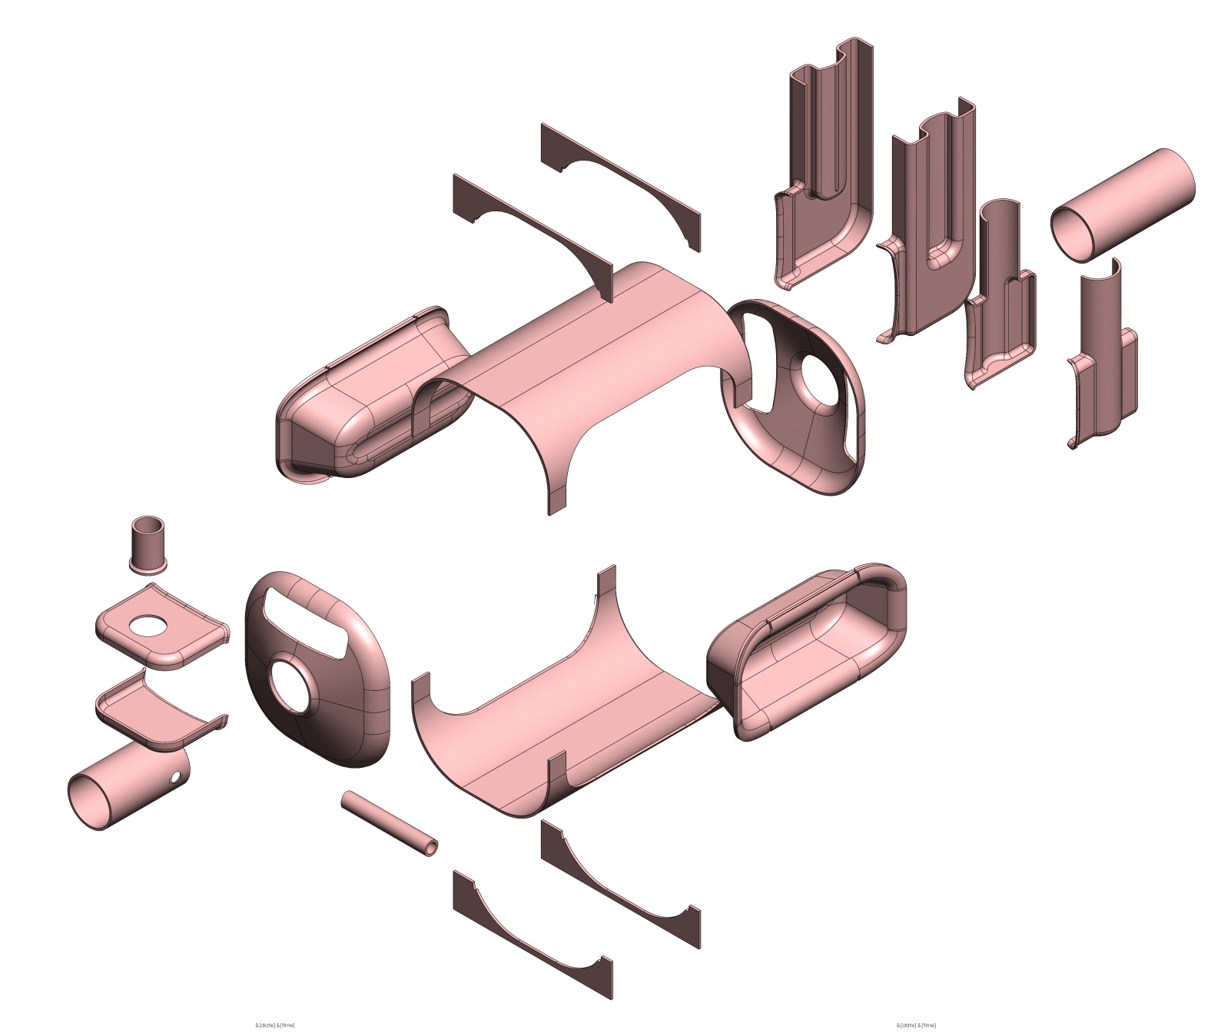
RFD Cavity Exploded View

Slide 14
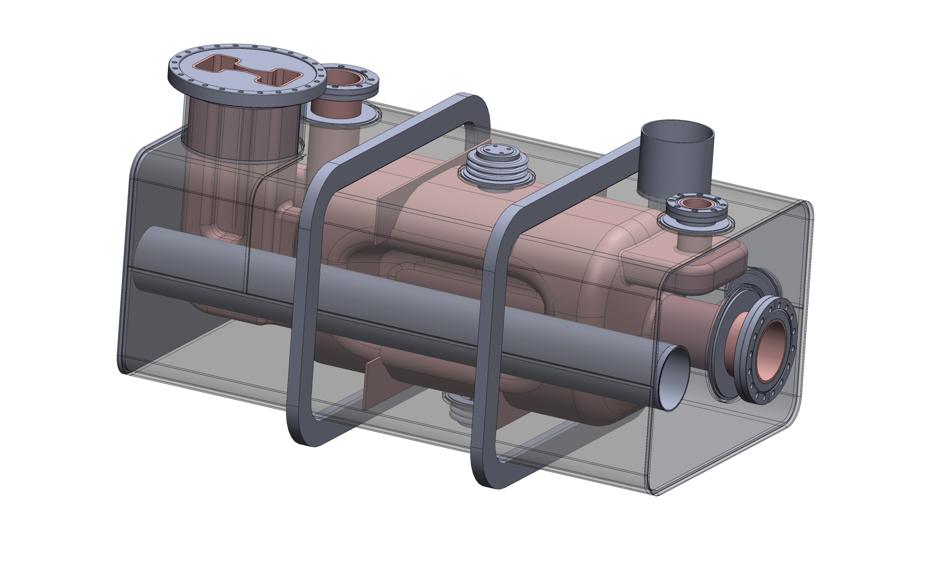
RFD Solidworks Model [2]

Slide 15
Quality Assurance and Documentation Program
Drawings & Design Procedures
Material Certifications
Manufacturing Procedures
Equipment Procedures

Slide 16
Drawings & Design Procedures
Standards
ISO 128-1:2003 (Graphical representation of objects on technical drawings)
ISO 129-1:2004 (Indication of dimensions and tolerances)
4 stage print sign-off procedure
Modeled By
Checked By
Project Engineer/Manager Approval
Manufacturing Approval

Slide 17
Shop Print Example

Slide 18
Engineering Change Notice

Slide 19
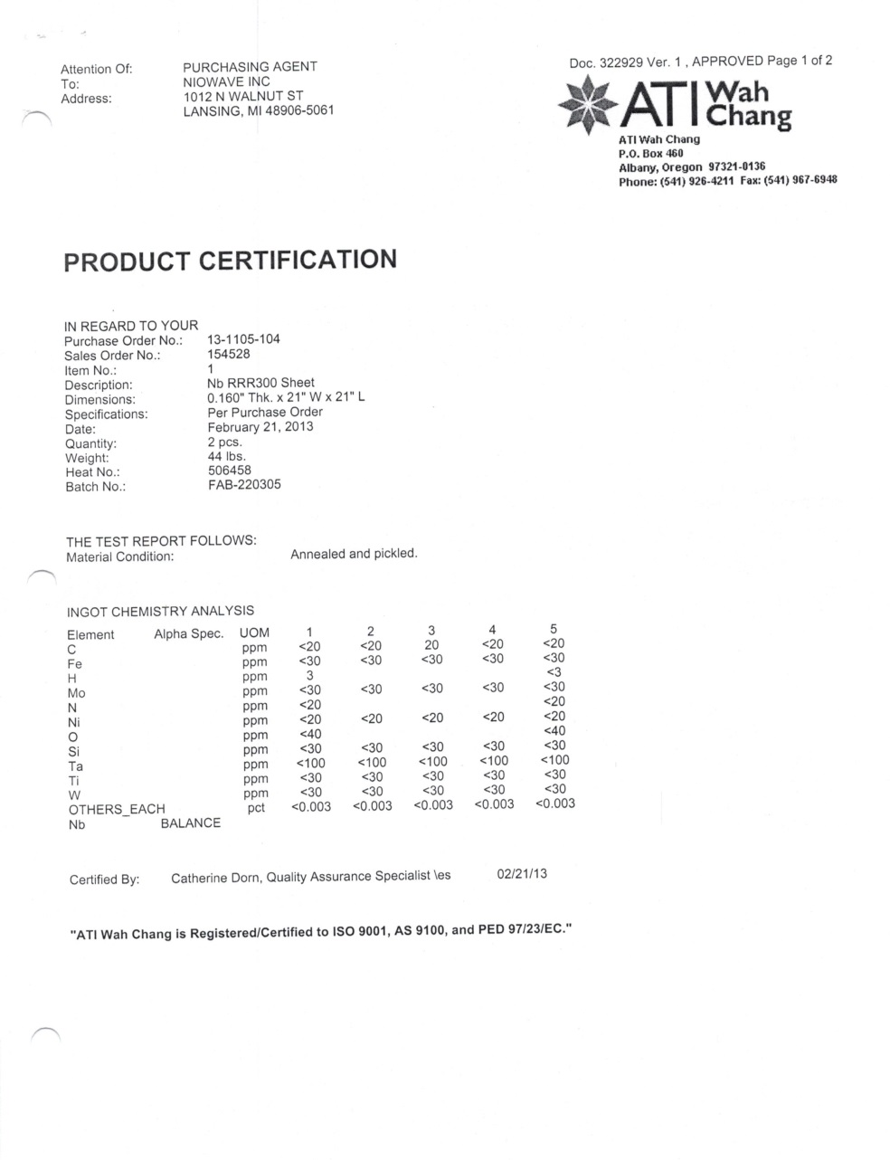
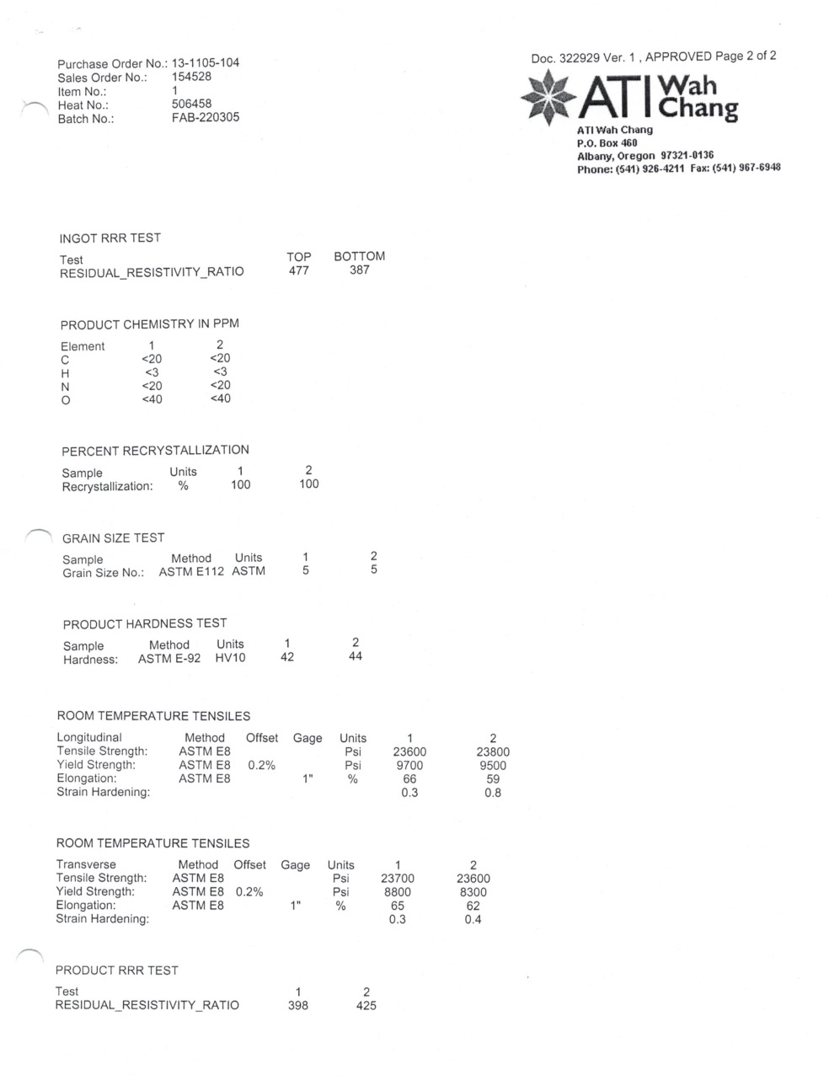
Material Certifications

Slide 20
Manufacturing Procedures
Process Sheets (Travelers)
Weld Documentation
Weld Matrix
Weld Data Sheets
Weld Inspection Reports
Final Inspections/Tests

Slide 21
Process Sheet Example

Slide 22
Weld Matrix Example

Slide 23
Weld Data Sheet Example

Slide 24
Example Inspection Results

Slide 25
Equipment Procedures
Calibrating Machinery
Measuring Equipment
Coordinate Measuring Equipment
Electron Beam Welding
Class 100 Cleanroom

Slide 26
Calibrating Machinery
Machinery travel and positioning is verified by dial indicator gages during setup
Fixtures and vises are “squared in” for using the dial indicator
Machine travel increments are verified by the operator during this squaring process
CNC Machine work tables are leveled with a precision machine level
Coolant is drained, refilled, and concentration levels measured every 6 months

Slide 27
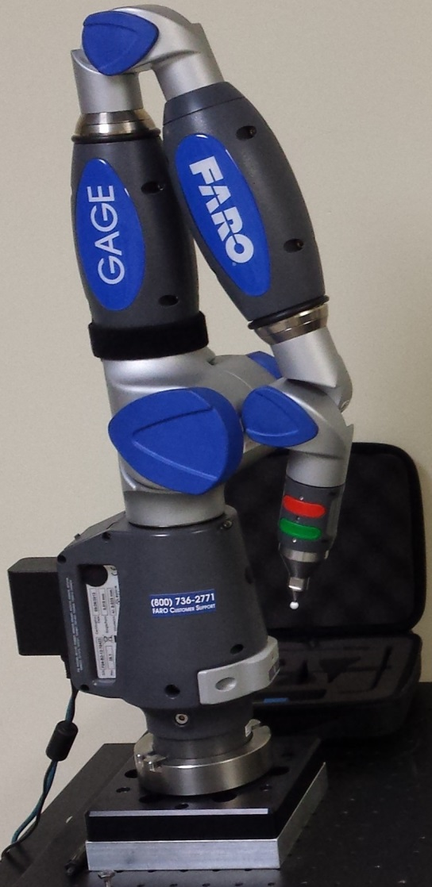
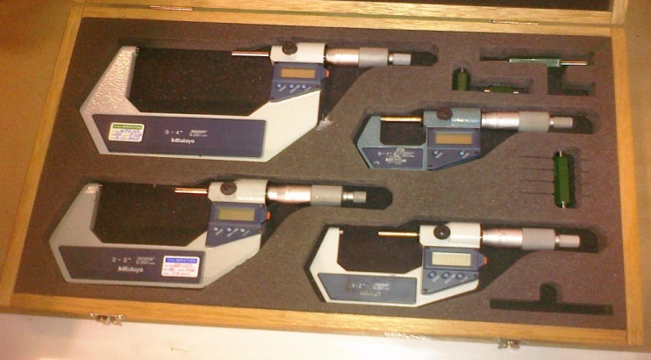
Measuring Equipment
Faro Gage for all Niobium components
Calipers and micrometers to measure other components
All equipment is certified upon purchase and verified by measuring gage blocks and gage pins.

Slide 28
Electron Beam Welding

Slide 29
Class 100 Cleanroom Cert.

Slide 30
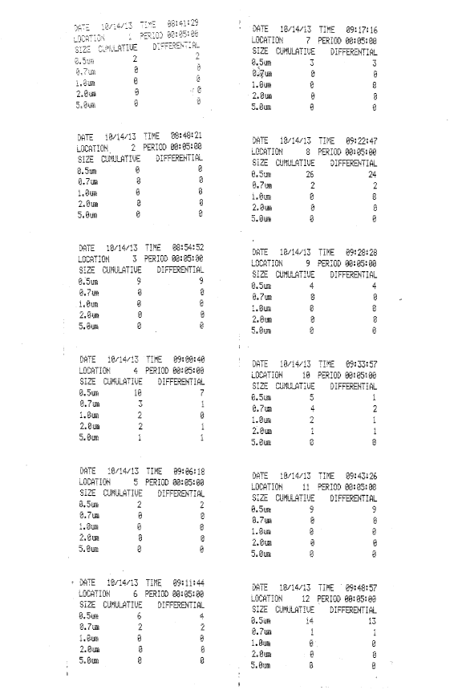
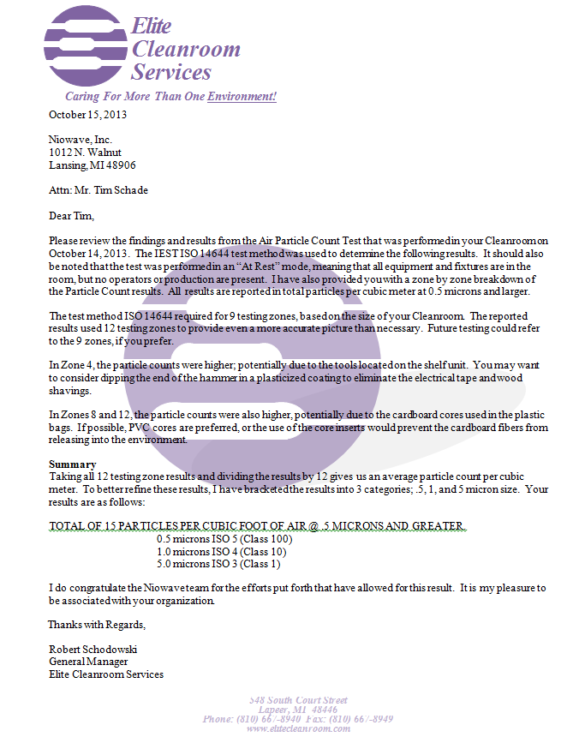
Class 100 Cleanroom Particle Count

Slide 31
Schedule

Slide 32
Action Items
Niowave
……
BNL
……
Jlab
……
DOE
……
CERN
……

