Slide 1
Double Quarter Wave Crab Cavity Helium Vessel
Silvia Verdú-Andrés
on behalf of the DQWCC team
May 5, 2014

Slide 2
Outline
Conceptual design of the helium vessel and tuning system for the SPS DQWCC
Introduction
Overview: dimensions, weight, He volume
Cavity stiffening, pre-tuning and tuning systems
Helium vessel and tuning system: assembly sequence, connections and interfaces, materials and joints
Mechanical studies
Helium pressure load
Tuning system load
Mechanical frequency for first natural mode
Summary

Slide 3
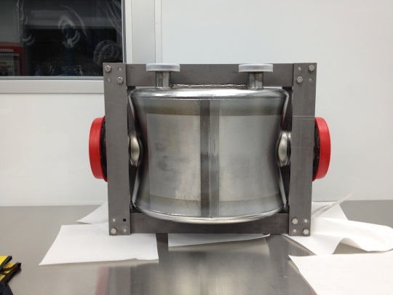
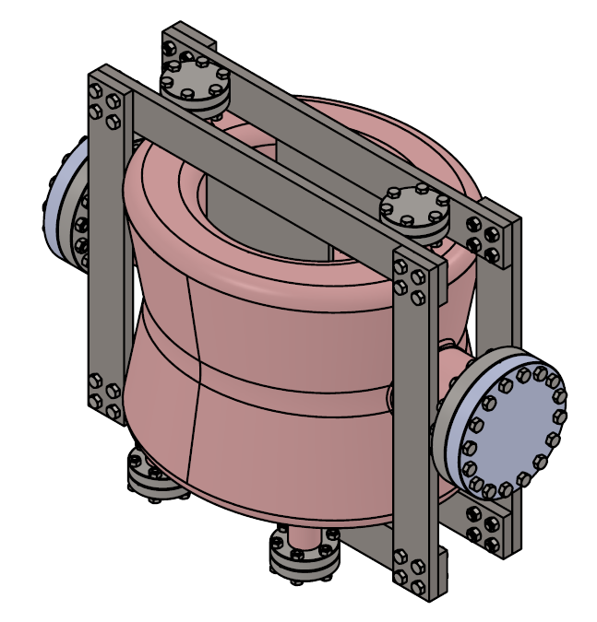
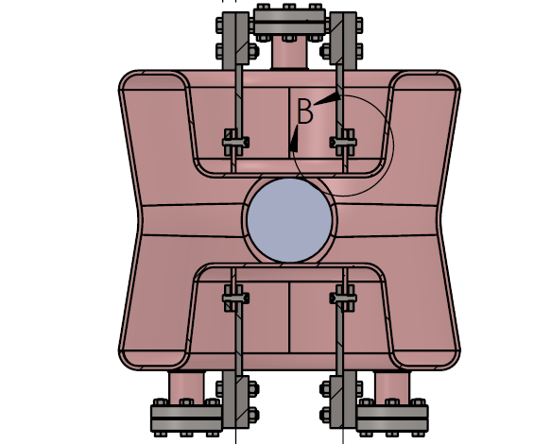
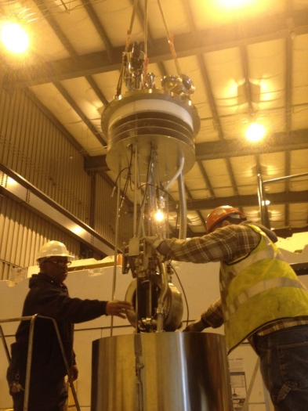
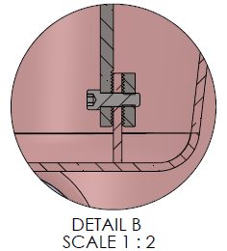
From the PoP cavity…
PoP cavity with
stiffening frame →
Stiffening frame in Ti
Nb to Ti transition by serrated surface plus SS bolts
SS bolts and pins at frame connections
going into dewar for
cold testing at BNL →
Notes:
Limited helium volume

Slide 4
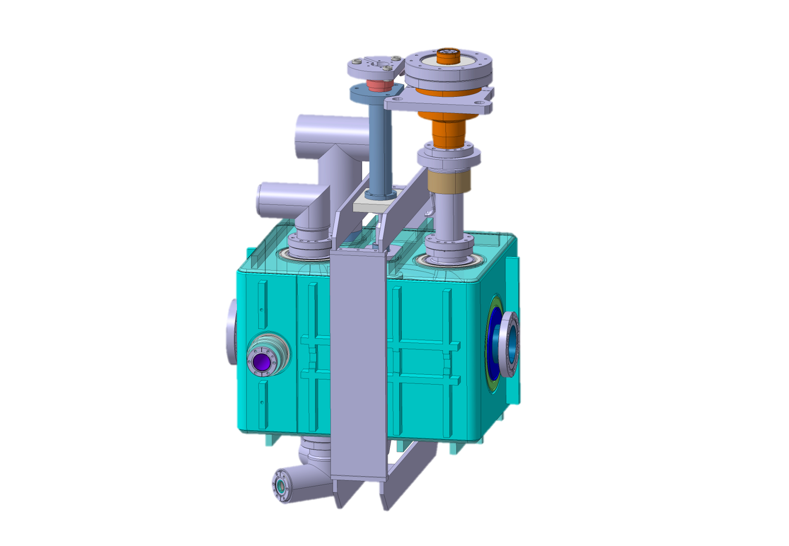
… to the SPS dressed cavity
The helium vessel as:
helium container
cavity stiffener
3) host for tuning system

Slide 5
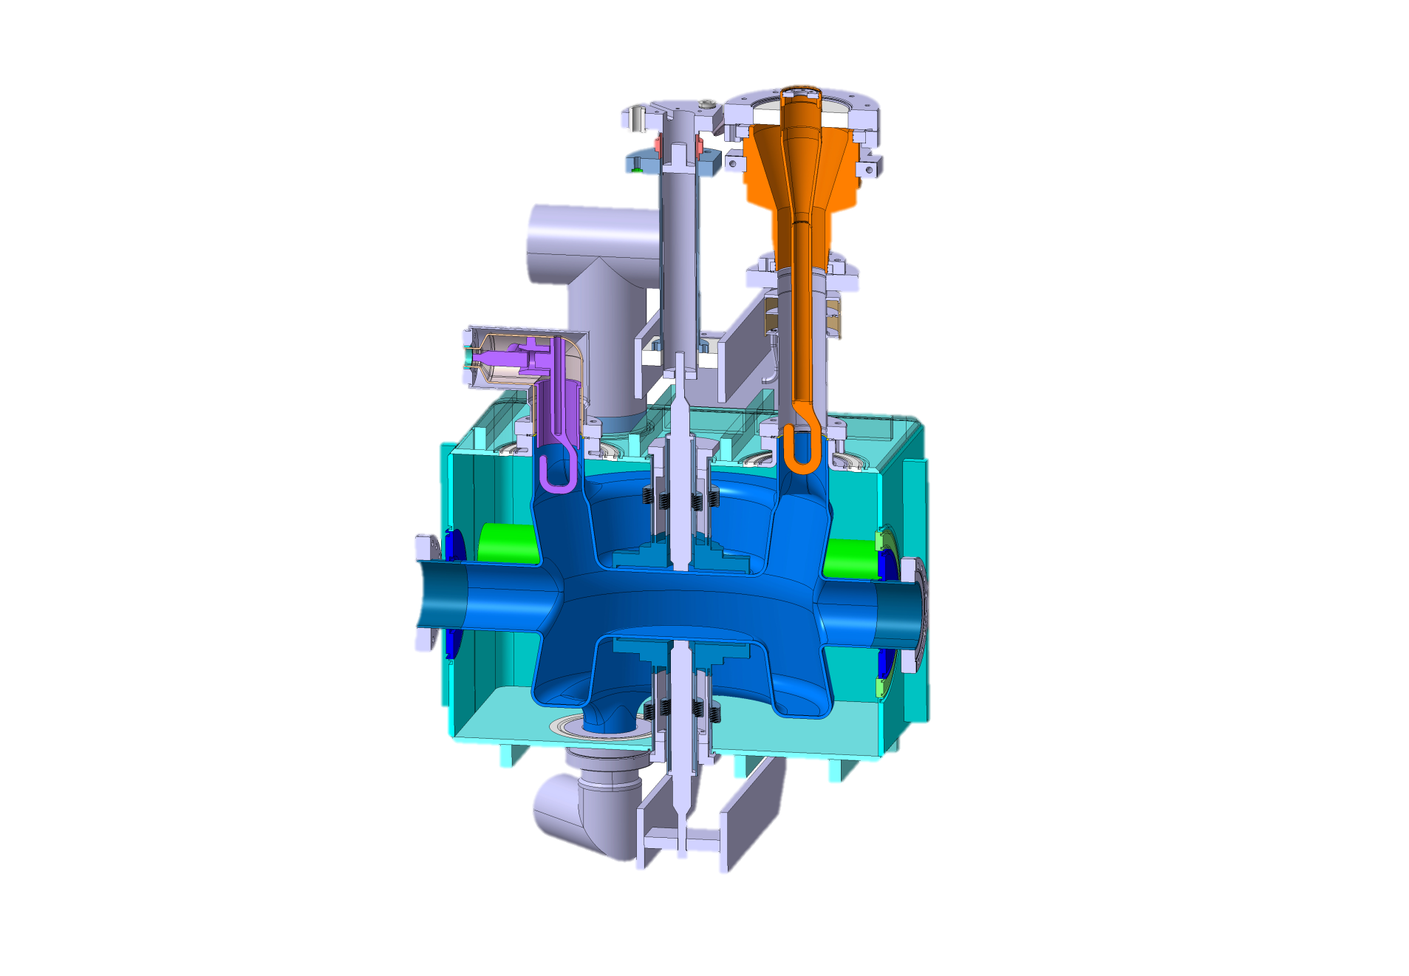
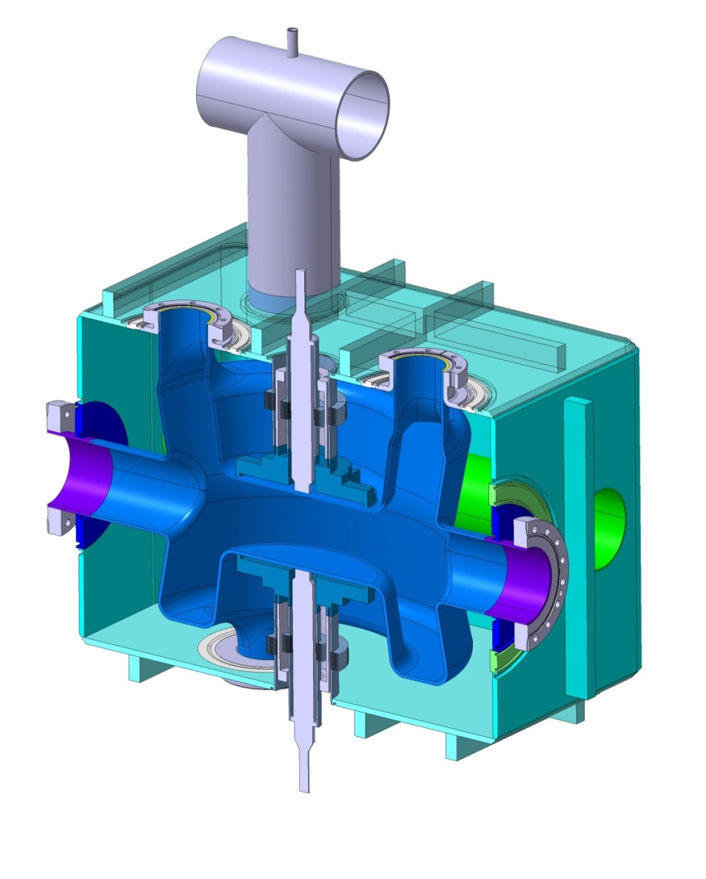
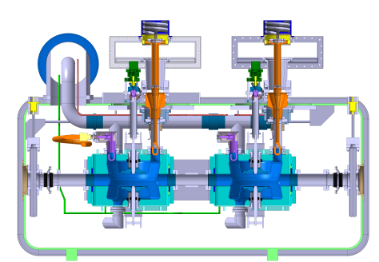
The helium vessel concept
1) helium container
PU
He capacity: | 38 liters*
Weight: | 96kg
Ribs for additional
vessel stiffening
Cryo
jumper
PU
HOM
Adjacent beam pipe through the vessel
FPC
390mm
470mm
beam
HOM
660mm
Tuner + stiffening
Integration into cryomodule →

Slide 6
The helium vessel concept
1) helium container
FPC
Cryo
jumper
HOM
Adjacent beam pipe through the vessel
beam
PU
Ribs for additional
vessel stiffening
HOM
Tuner + stiffening
All helium – vacuum interfaces welded for best vacuum tightness
Prep rings for eventual disassembly
Clearance to access to ports

Slide 7
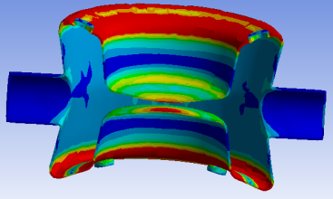
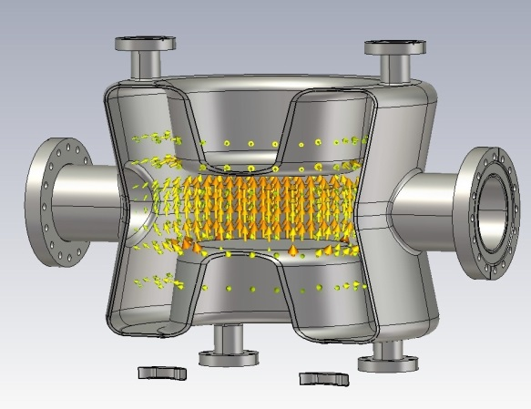
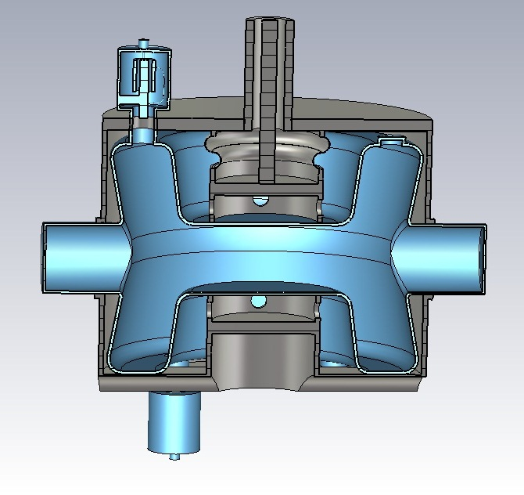
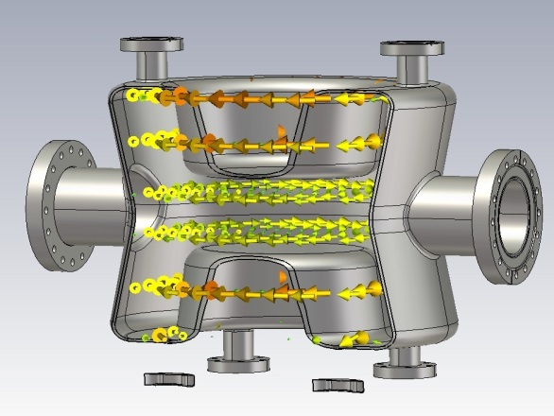
The helium vessel concept
2) cavity stiffener
f₀
E-field
Bare cavity without stiffening
from Qiong Wu´s slides on the PoP DQWCC
H-field

Slide 8
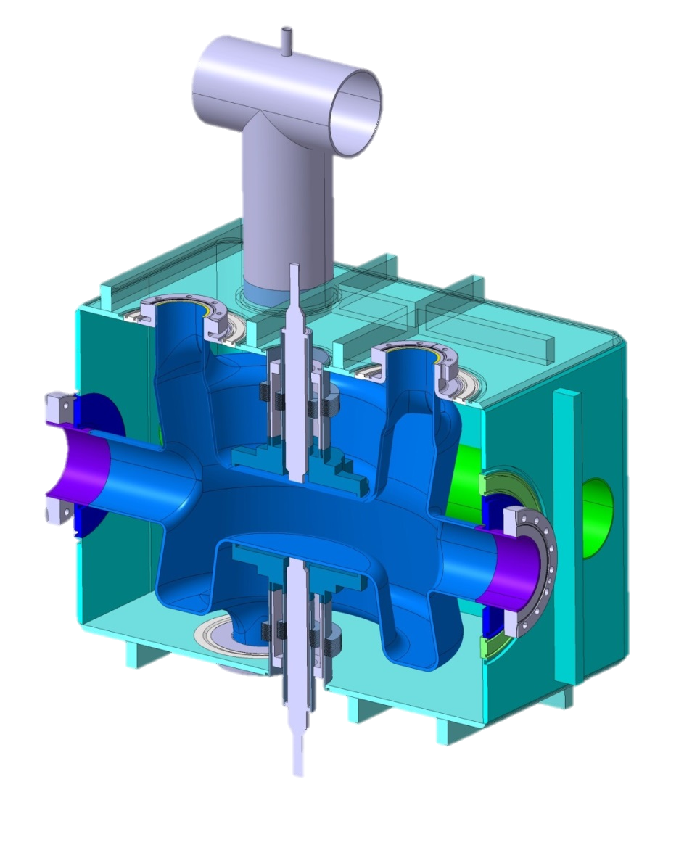
The helium vessel concept
2) cavity stiffener
All port connections are rigid except from pickup
PU
HOM
FPC
Stiffening during cooling down and pressure changes
beam
Combined function:
tuning + stiffening
on central plates
HOM
Helium vessel in Titanium
Titanium and Niobium similar thermal expansion coefficient
→ rigid connections for all ports but pickup

Slide 9
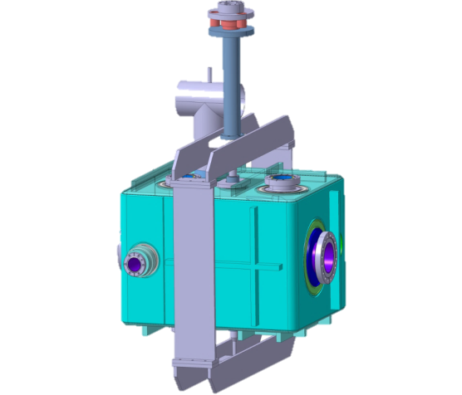
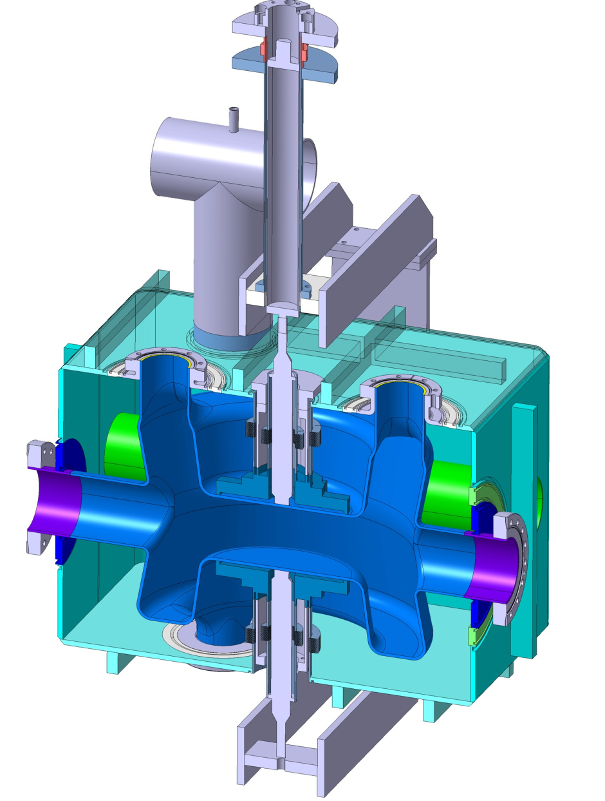
The helium vessel concept
3) tuning system
Piezo outside vessel
→ larger tuning range
f₀
E-field
Symmetric
actuation onto both
central plates
H-field
Tuning by actuation
on central plates
Combined function:
tuning + stiffening
→ Tuning actuator: tomorrow’s presentation by John Skaritka

Slide 10
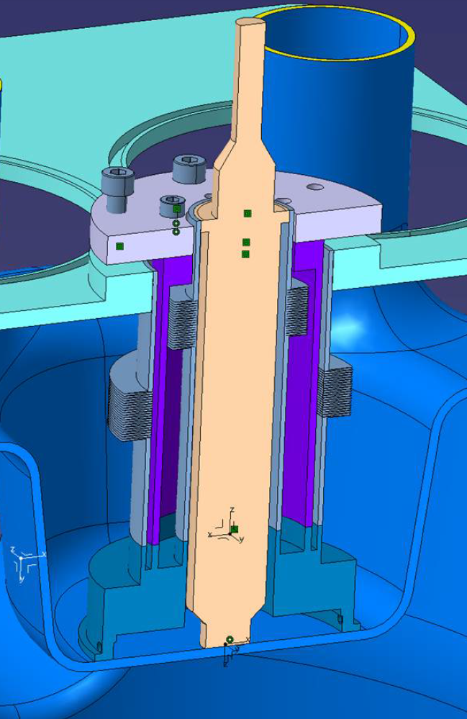
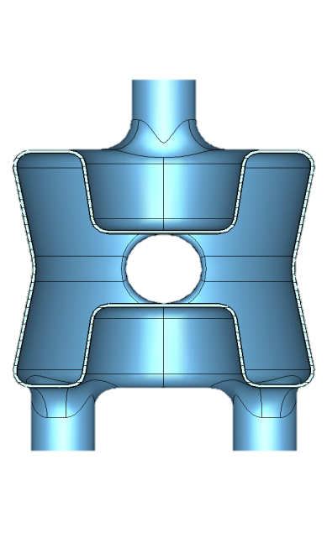
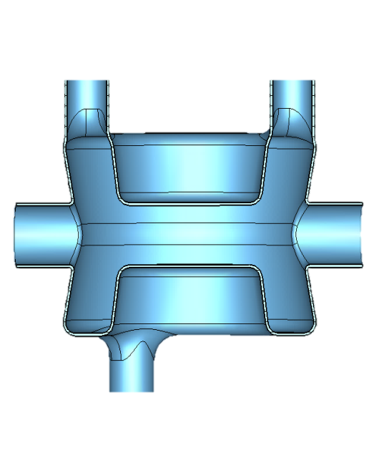
Pre-tuning system
Nicer
cross-section to show pre-tuning with bolts to be fixed onto helium vessel top plate??
Pre-tuning
(during assembly of cavity-vessel)
for machining tolerances
0.49 MHz/mm
-1.2MHz/mm
-2.1 MHz/mm
pre-tuning
0.59 MHz/mm
← Helium →
← Helium →
0.39 MHz/mm

Slide 11
Tuning system
Tuning
(slow) push-pull ~ 0.5mm
for cavity transparency, freq drift along SPS energy range and suppression of coupled bunch instabilities
(fast) piezo ~ 30 μm
for Lorentz detuning and microphonics
Symmetric
actuation onto both
central plates
Tuning sensitivity: 1.6 MHz/mm
Notes:
Piezo tuning system could be preloaded during assembly.
- 1000 micro-steps or better for the motor
- 160 reduction factor for the harmonic gearbox
1mm displacement per turn for the roller screw
which gives an expected resolution of better than 0.01 micron. We will have to test it to validate it.
The range of the mechanism with the motor is of several mm. The range of the piezo is in the order of 30 microns (piezo with "infinitely" small resolution).

Slide 12
Cavity tuning
*Tuning sensitivity by acting on central plates: fine - 1.6 MHz/mm;
 | Expected frequency shift [kHz] to cover due to… |  | Required deformation* [mm] | Actuation force | Max. stress on cavity
Pre-tuning | Machining tolerances (assume 0.1mm for sensitive dimensions) | Hundreds of kHz | ~0.5 | -- | --
Slow tuning (push-pull) | Freq drift along SPS energy range (120→450 GeV) | +60 | 0.22 | 1.1 kN (247 lb_{F}) | 110 MPa (15700 psi)
 | Suppression of coupled bunch instabilities | ±21.7
 | Cavity transparency | ---
Fast tuning (piezo) | Lorentz detuning | -3.465 | Max. tuning system travel = 30μm Max. freq correction = 48kHz
 | Microphonics Freq sensitivity to pressure: 0.1 Hz/mbar Expected pressure instability during operation is about 1 mbar
Notes:
Lorentz detuning: -3.465 kHz/10J (nominal operation)
Piezo tuning system could be preloaded during assembly.

Slide 13
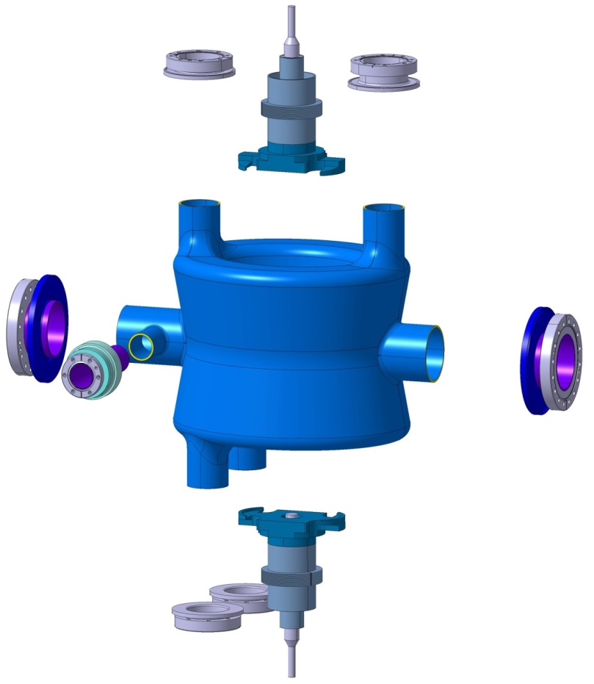
Cavity assembly
1

Slide 14
Cavity assembly
1
FPC tube: SS 316LN flange for FPC tube
Beam pipes: SS 316LN flange,
Nb tube, Ti adaptor
Ti
HOM tube: NbTi flange welded
to Ti adaptor and Nb tube
brazed
welded
Notes:
HOM: NbTi flange welded to Ti adaptor and Nb tube

Slide 15
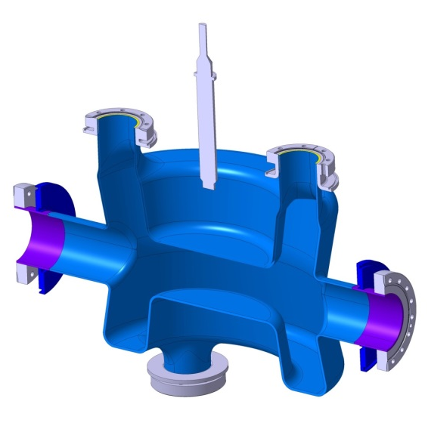
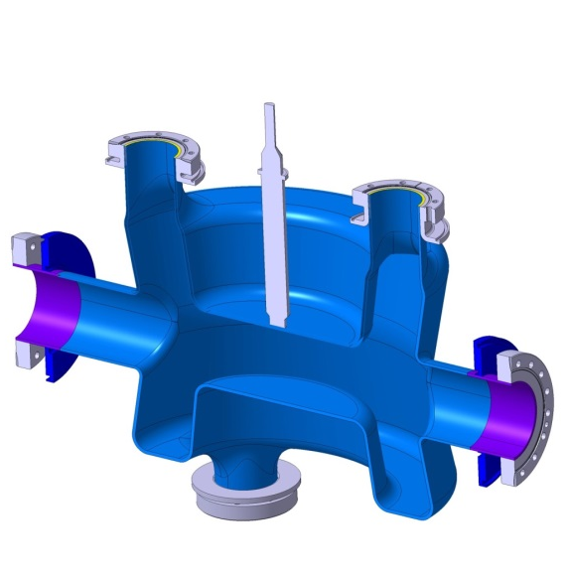
Tuning system assembly
Ti rod
1
2
brazed
welded

Slide 16
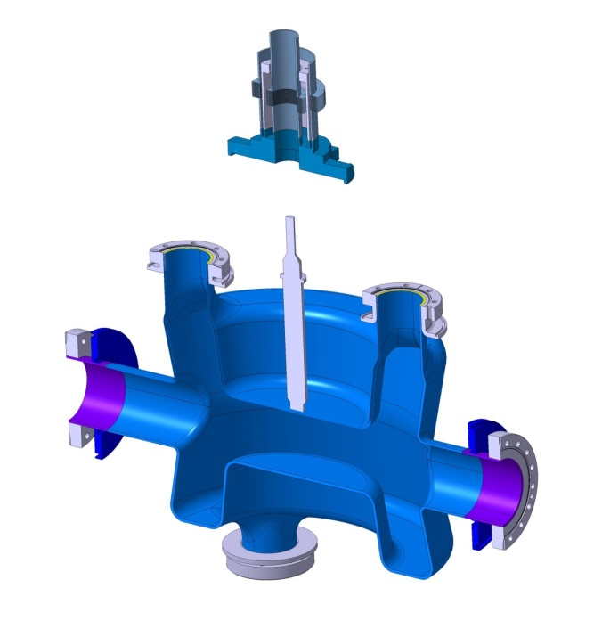
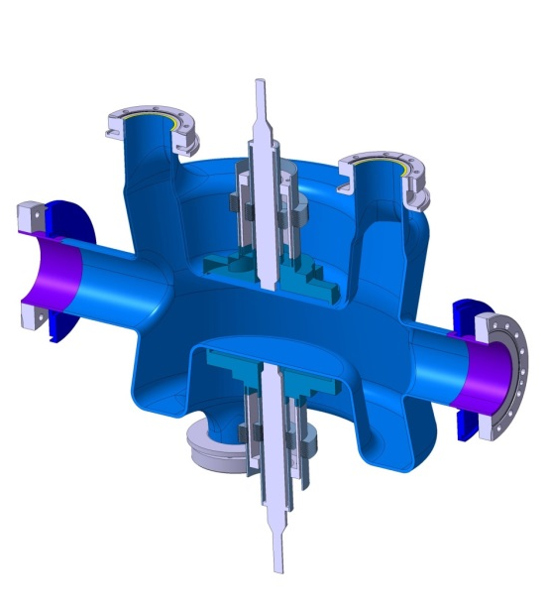
Tuning system assembly
1
2
Ti
housing
3
brazed
welded

Slide 17
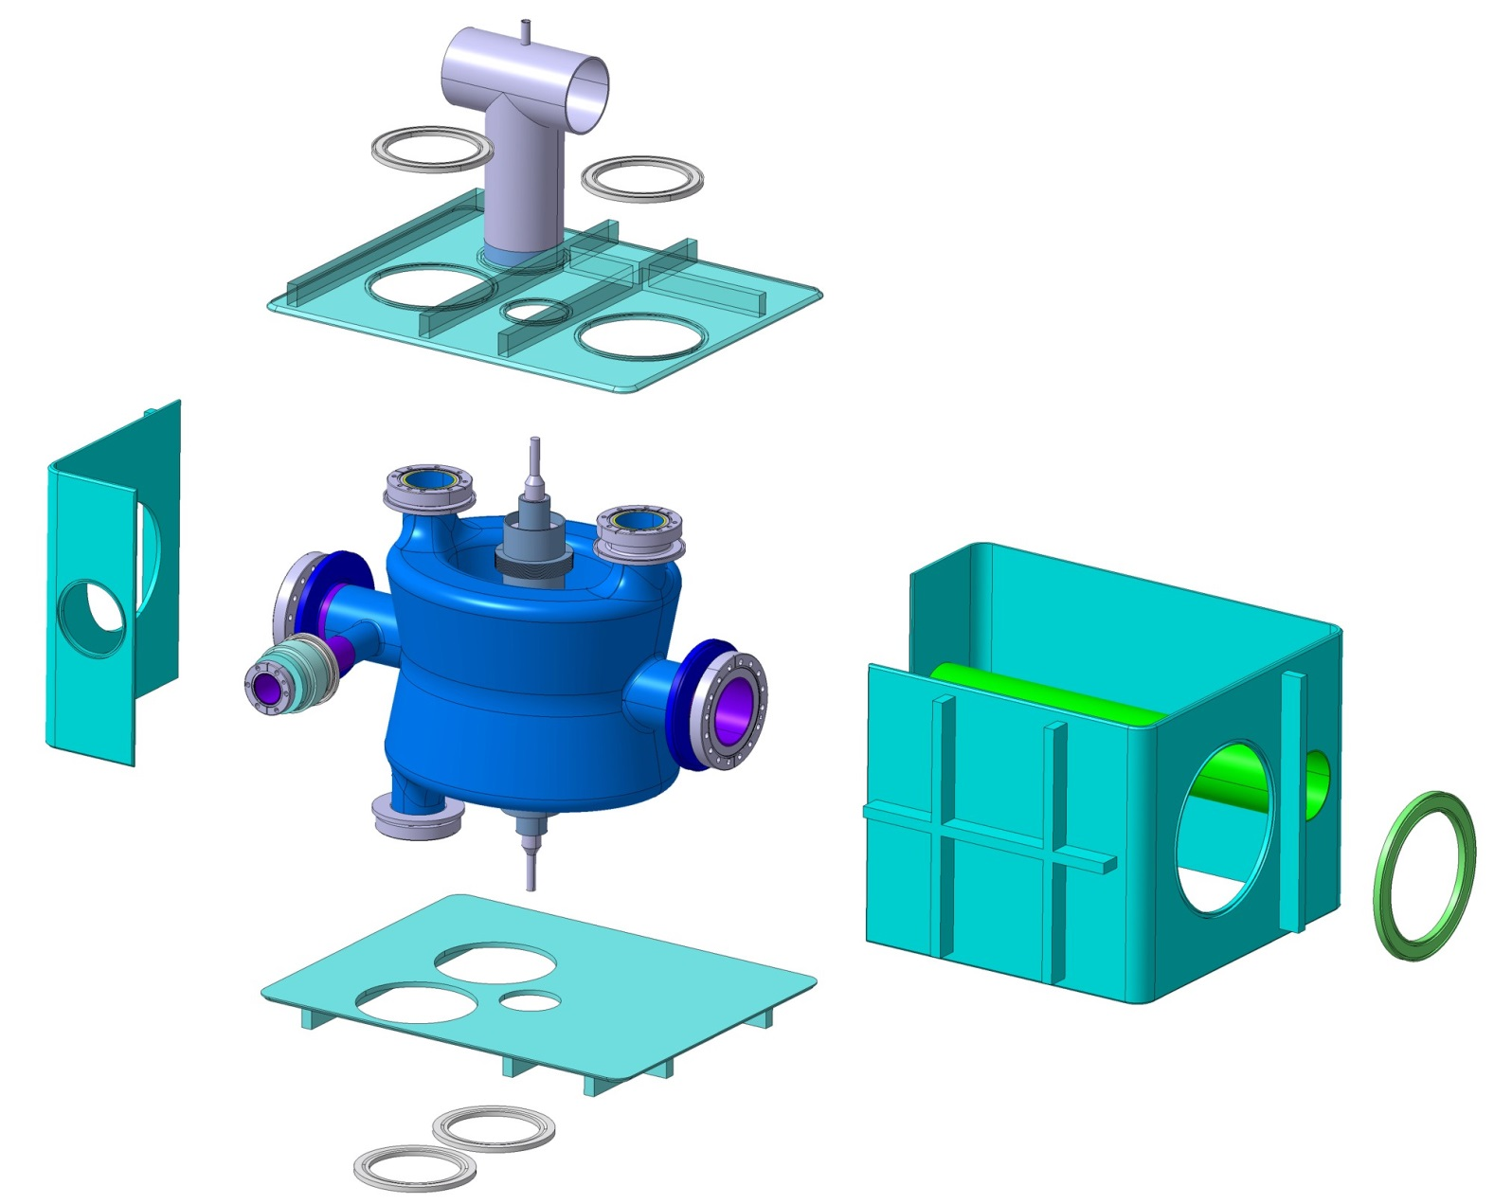
Helium vessel assembly
Ti prep ring
Cryo tube in SS – H ; Ti-V
4
2
Ti vessel
Integrated section of adjacent beam pipe
1
Ti
prep ring
brazed
welded
3
Notes:
Grade 2 titanium
Which is the material for adjacent beam pipe???

Slide 18
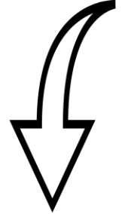
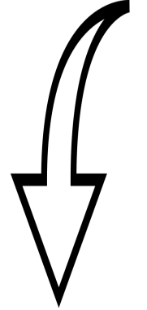
Cooling and heat-stationing
Heat-stationing
for tuning frame
Heat-stationing
for tuning tube
Helium chamber
for HOM filter
He
Heat load table:
tomorrow’s presentation
by John Skaritka

Slide 19
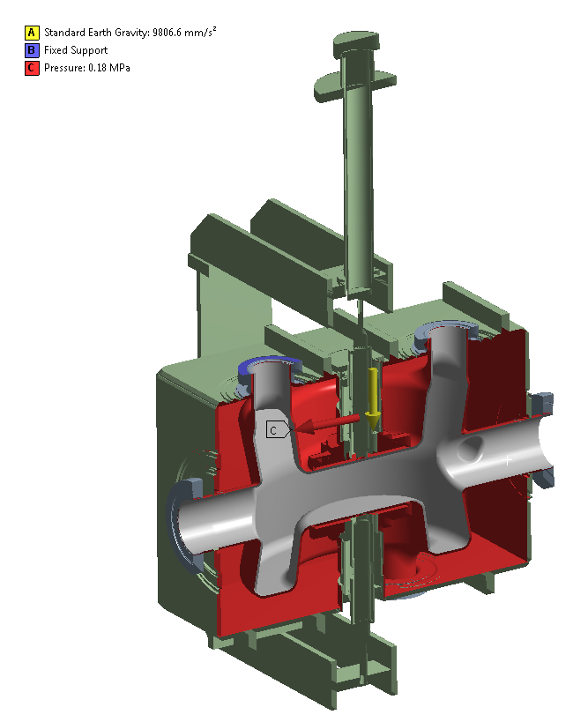
Helium pressure load
Study settings:
Internal pressure 1.8 bar (abs): max. allowable pressure
Safety coefficient of 1.5 on material properties (EN13445).
Tuning mechanism blocked from the top
(relative movement of inner conductors)
Connection to the cryomodule via the FPC flange
Gravity taken into account
Gravity

Slide 20
Helium pressure load – deformation and stress
DEFORMATION
Pressure load:
Maximum deformation
in titanium vessel.
This deformation is mainly due to gravity effect and will be much improved by adopting an inter-cavity support system. This will play a role on meeting the alignment budget.
Design complies with specs for stress linearization studies on most deformed regions
DEFORMATION (zoom)
Gravity:
Lowers down assembly rigidly connected by the FPC flange by less than 1mm.
attachment to the actuation system

Slide 21
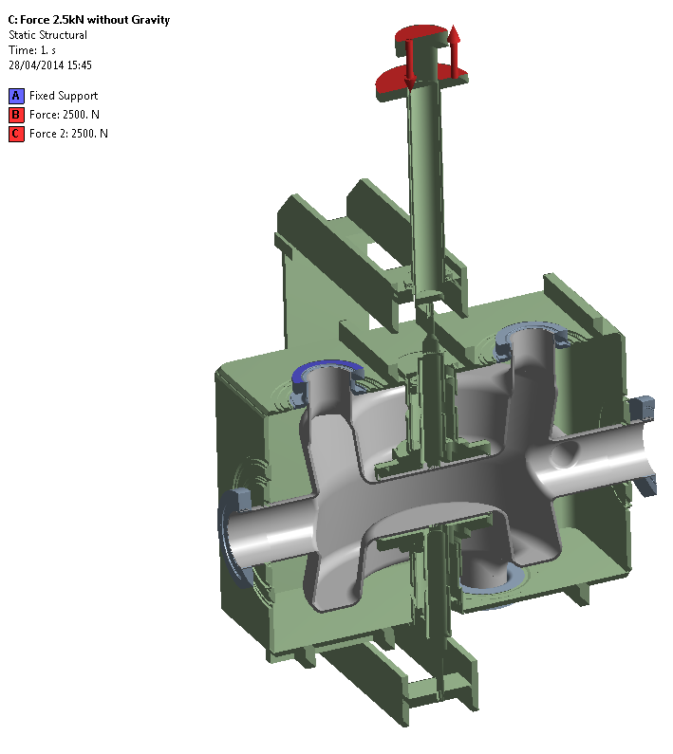
Mechanical stresses due to tuner actuation
No gravity taken into account, only tuning force of ‘250 kgf’

Slide 22
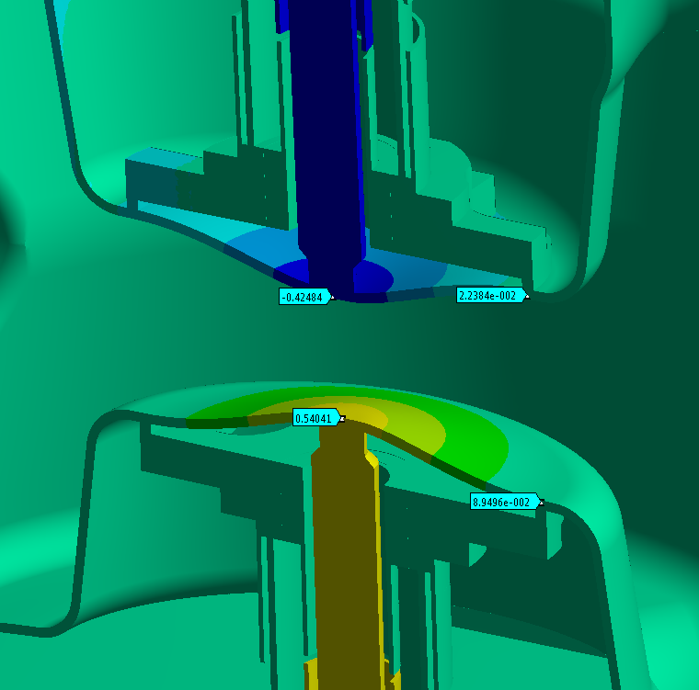
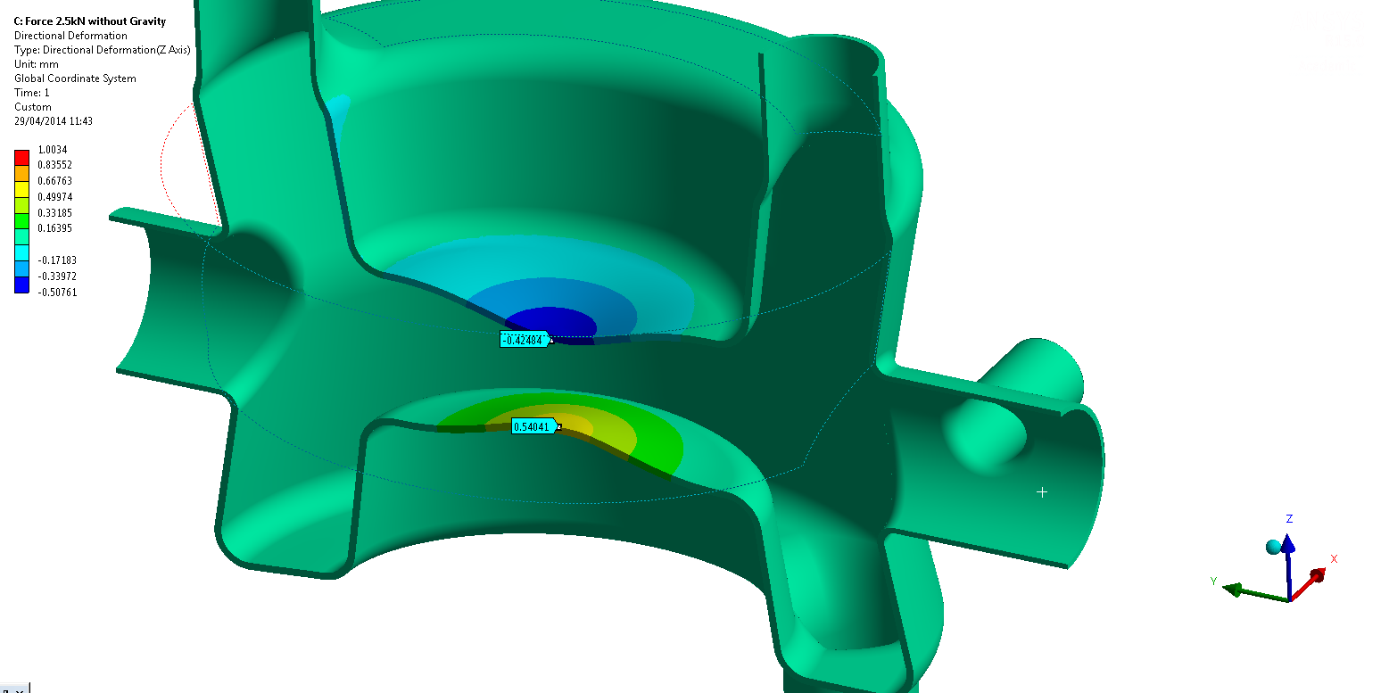
Tuning system load –
deformation
DEFORMATION
freq range ~ 0.8 MHz
force: 2.5 kN or 562 lb_{F}
Tuning system designed such that equal force
is delivered to the inner conductors.
Small difference of 0.12mm due to port asymmetry.
Notes:
Due to the unbalance in ports connected to each of the conductors, the stiffness of the cavity is not the same for both sides. Since the force is symmetrical, the deformation is not. This is why we see a small difference of 0.12mm between conductors.
Gravity can compensate this effect by unbalancing the forces (would result in more deformation on the top inner conductor).

Slide 23
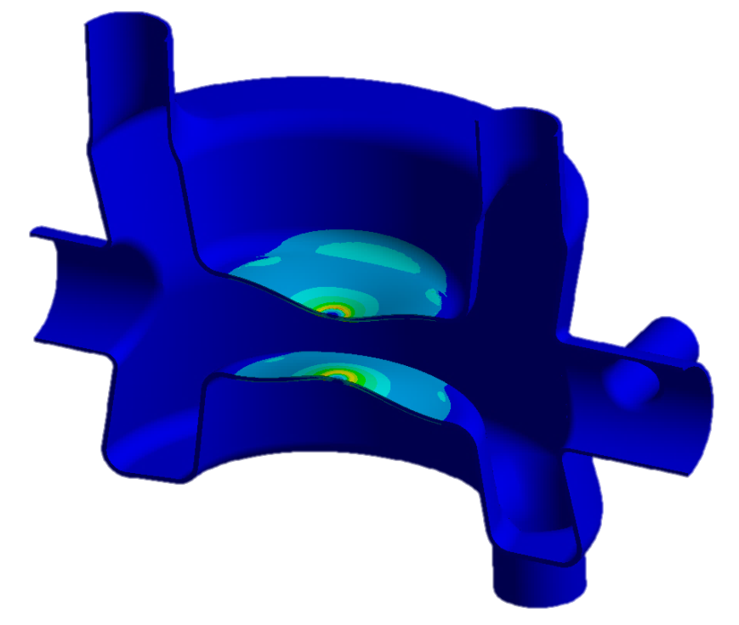
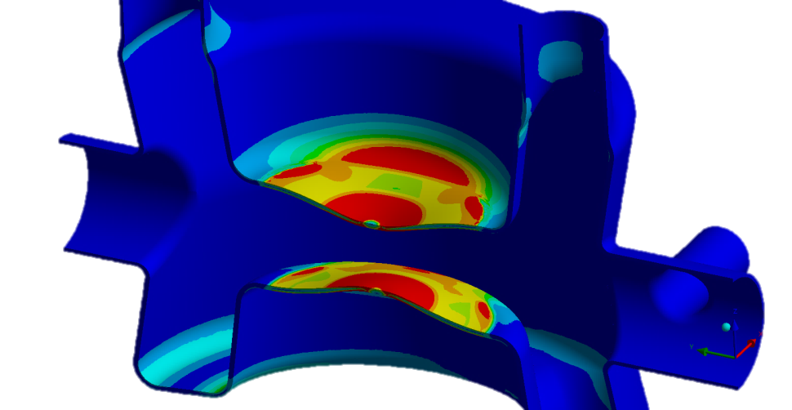
Tuning system load - stress
Tuning at cold:
max. stress of 248 MPa < (1.5x400MPa)
[max. stress of 35700 psi < (1.5x58000psi)]
Tuning at room temperature: plastic deformation

Slide 24
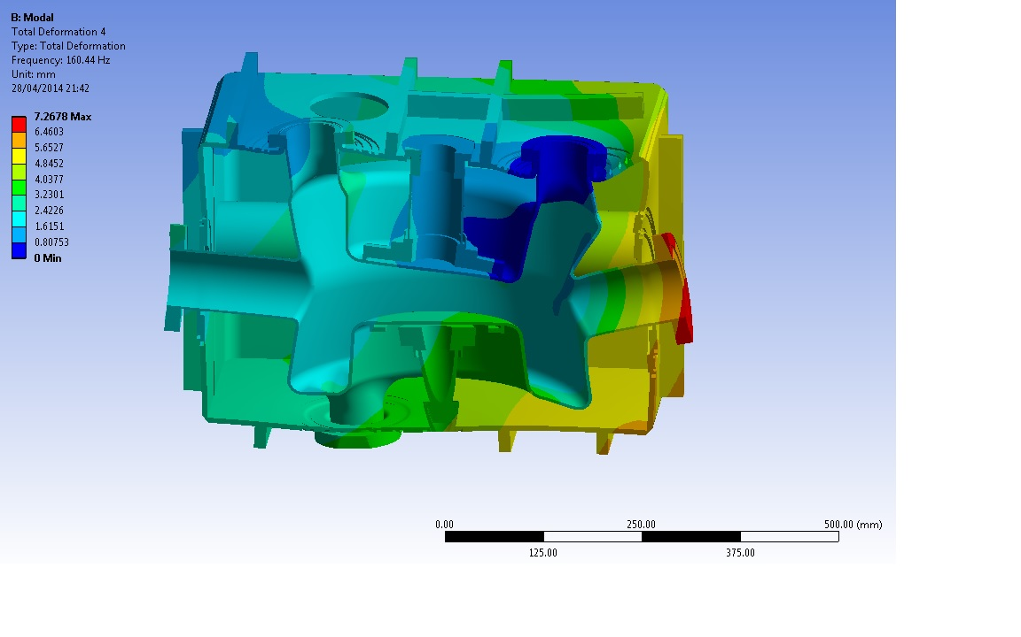
Mechanical natural frequency
The mechanical frequency of the first natural mode of the cavity is about 160Hz.

Slide 25
Integration into cryomodule
→ Cryomodule: tomorrow’s presentation by John Skaritka

Slide 26
Summary
Compact vessel for compact cavity
Dedicated vessel design to:
minimize liquid helium leak chances (all helium-vacuum interfaces welded)
ease assembly, particularly the access to cavity ports
ease disassembly (prep rings)
Robust vessel design. Helium vessel and tuning system provide enough stiffening.
Appropriate stiffening of the cavity provided by rigid connection of cavity ports to vessel and tuning system
Manifold tuning : pre-tuning + push-pull + piezo

Slide 27
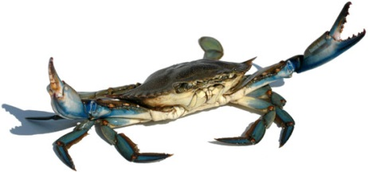
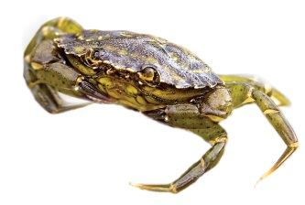
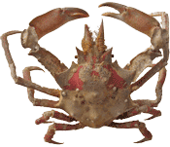
The SPS Double-Quarter Wave Crab Cavity
BNL
Sergey Belomestnykh, Ilan Ben-Zvi, Carlos Marques, John Skaritka, Silvia Verdú-Andrés, Binping Xiao, Qiong Wu
CERN
Luis Alberty, Rama Calaga, Ofelia Capatina, Federico Carra, Giuseppe Foffano, Norbert Kuder, Raphael Leuxe, Thierry Renaglia
SLAC
Zenghai Li
Notes:
Long Island Blue Claw Crab
European Green Crab.
Graceful Kelp Crab, Pugettia gracilis (shell with large lateral teeth; found only from the Aleutian Islands to Monterey, California.

Slide 28
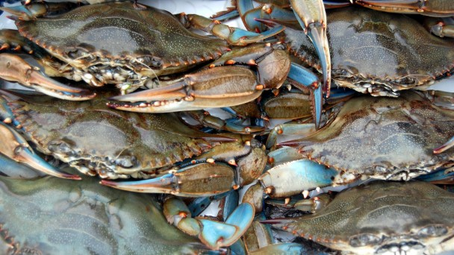
Thanks for your attention
Long Island Blue Claw Crabs
ready for crabbing SPS beam
Notes:
Crab integration

Slide 29
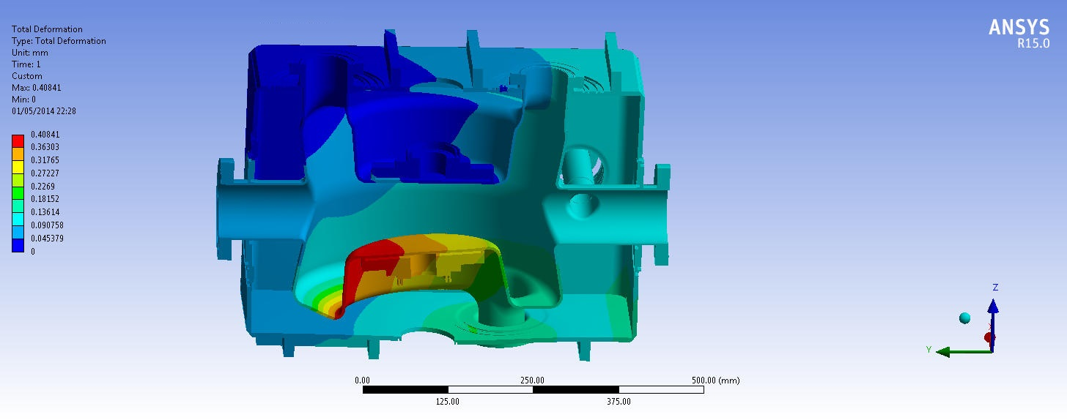
Coarse tuning
Notes:
El "coarse tuning no es simetrico. El sistema actua muy bien como refuerzo y fine tuning pero a lo mejor para el pre-tuning podríamos utilizar esto con poco range (0.1-0.2 mm).

Slide 30
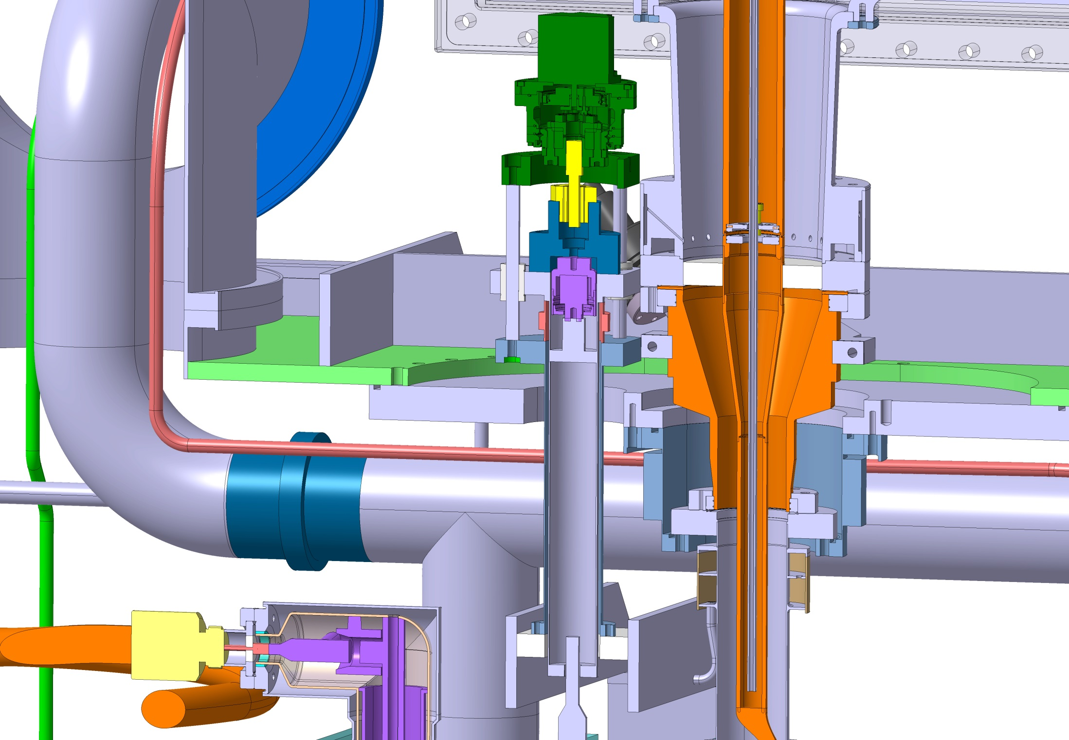
Motor (stepper)
Harmonic gearbox
Roller screw
Piezo
Bellow
Tuning actuation will be linked by bellow to vacuum tank

Slide 31
Mechanical stresses
Helium pressure
300 K → 2K
Actuation of tuning system

Slide 32
Mechanical stresses
Helium pressure
300 K → 2K
Actuation of tuning system
Helium

Slide 33
Load case 1 – total def. cavity only
This deformation is mainly due to gravity effect and will be much improved by adopting an inter-cavity support system. This will play a role on meeting the alignment budget.

Slide 34
The dressed cavity has been assessed to the maximum allowable pressure that can occur during cool-down, 1.8bar. The increase of stiffness given by the helium vessel and the tuning mechanism makes that no additional reinforcement is needed;
The stress levels observed are higher than the maximum allowable stress defined taking into account the material properties and the relevant safety factor, but detailed stress linearization analysis allows to validate the existing design;
The effect of gravity will be compensated by an inter-cavity support strategy.

Slide 35
Mechanical stresses
Helium pressure
300 K → 2K
Actuation of tuning system

Slide 36
Mechanical stresses
Helium pressure
300 K → 2K
Actuation of tuning system

Slide 37
Mechanical stresses due to tuning system actuation
cavity is @ cold, tuning is done from the top actuator;
Constrains (fixed boundaries, etc)
Load(s) and number of cycles (if applies)
Max. stress allowed
Picture of initial constrains and loads
Picture of mesh
Picture of stress value and deformation arrows
Design elements incorporated to counter-act load effects
Young modulus and Poisson’s ratio

Slide 38
Frequency shifts – simulation settings
Shift | Ports | Central plates | Δf
Helium pressure | Fixed by vessel
 | Fixed by vessel | Fully fixed by tuner | 0.1 Hz/mbar
300K → 2K | Fixed FPC; other ports are free | Free | -573 kHz
 | Fixed FPC; other ports free | Fully fixed by tuner | -672 kHz
Lorentz detuning | Fixed by vessel, except pickup | Free (worst case scenario) | –346 Hz/(MV)^2

