Slide 1
SPS Crab Cavity Validation Run (2017-2018)
Alick Macpherson
BE-RF-SRF
Acknowledgments
Marton Ady, Vincent Baglin, Philippe Baudrenghien, Krzyzstof Brodzinski, Rama Calaga, Ofelia Capatina, Frederic Galleazzi, Erk Jensen, Antoine Kosmicki, Phoevos Kardasopoulos, Pierre Maesen, Eric Montesinos, Ghislain Roy, Benoit Salvant, Rogelio Tomas, Giovanna Vandoni.

Slide 2
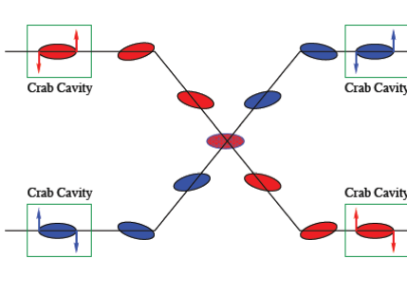
Overview
The SPS Installation and Integration Issues
Beam Issues, and Beam time requests
Schedule and planning
Purpose of the SPS crab cavity validation program
Validate Crab cavity design for proton beams
Validate Crab cavity invisibility to proton beams when not on resonance
Validate operational functionality & Machine protection mechanisms
Overall goal => set inputs for final design

Slide 3
General Overview
Baseline parameters
Voltage = 3.4 MV/cavity
Frequency = 400.79 MHz
Cavity aperture: 84 mm diameter
Operating Temperature= 2 K
$Q_{L}=5∙{10}^{5}$(assuming $R/Q=400$)
RF power = 40 kW tetrode/cavity
Crab cavity prototypes
3 designs being taken forward to the SPS test
SPS Crab Cavity Cryomodule
2 cavities installed in 1 cryomodule
cavities of same type
3 different cryomodules
should be interchangeable

Slide 4
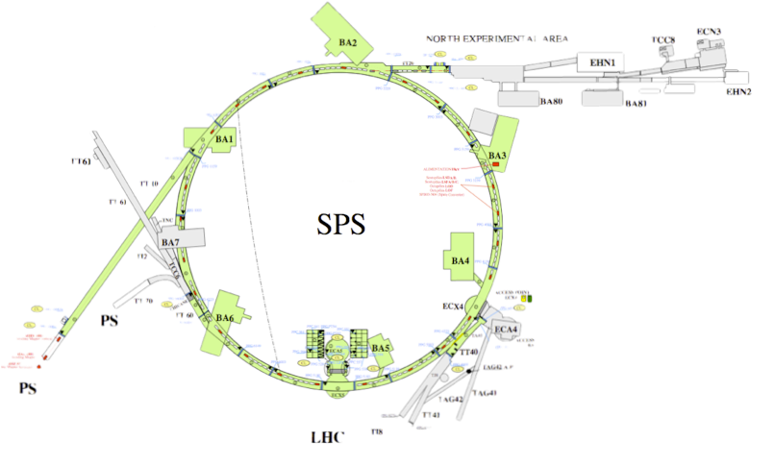
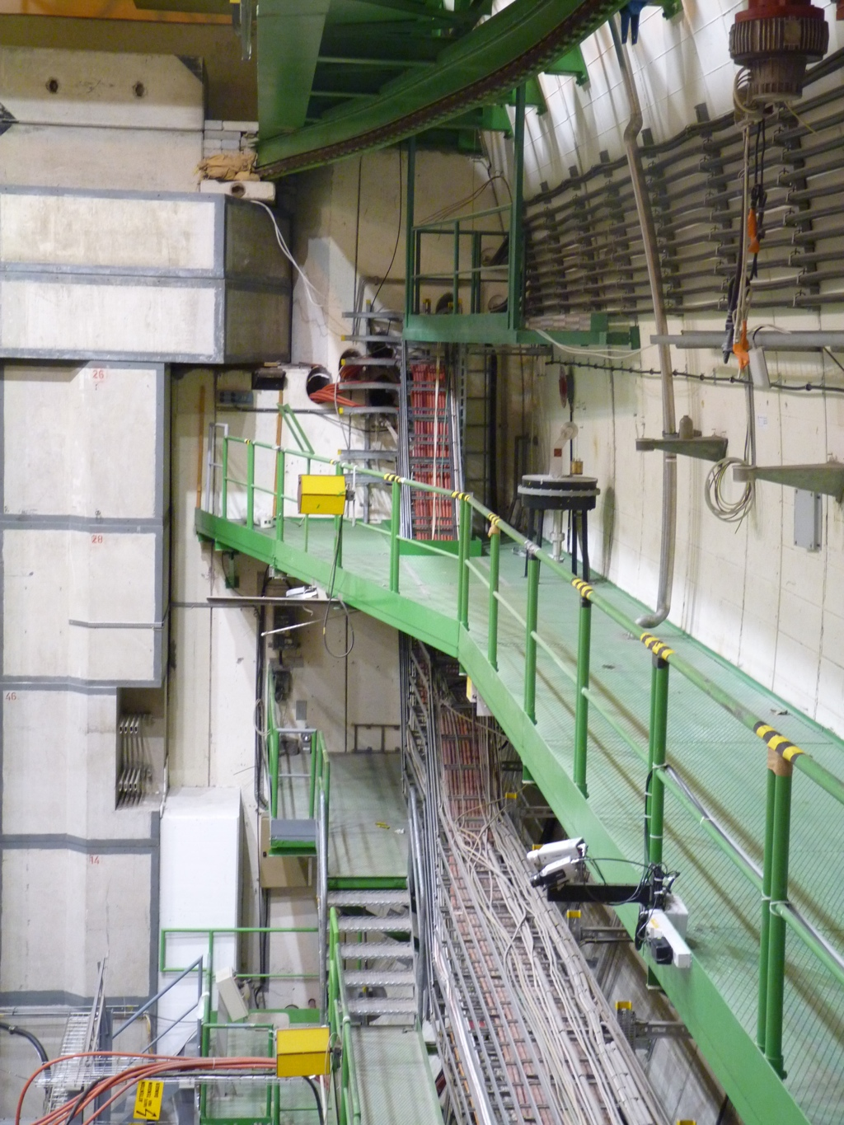
Crab Cavities in the SPS
SPS Pt 4
Alcove
ECA4
ECA4
Cryogenics Infrastructure: Only SPS Pt 4 is feasible
LLRF ~35 m away: Experimental cavern (ECA4) accessible with beam
Location Availability: Space is not free end of 2015
Limited access to SPS zone after SPS long shutdown (2013-2014)
Features: Location just upstream of SPS Extraction pt for LHC beam 2

Slide 5
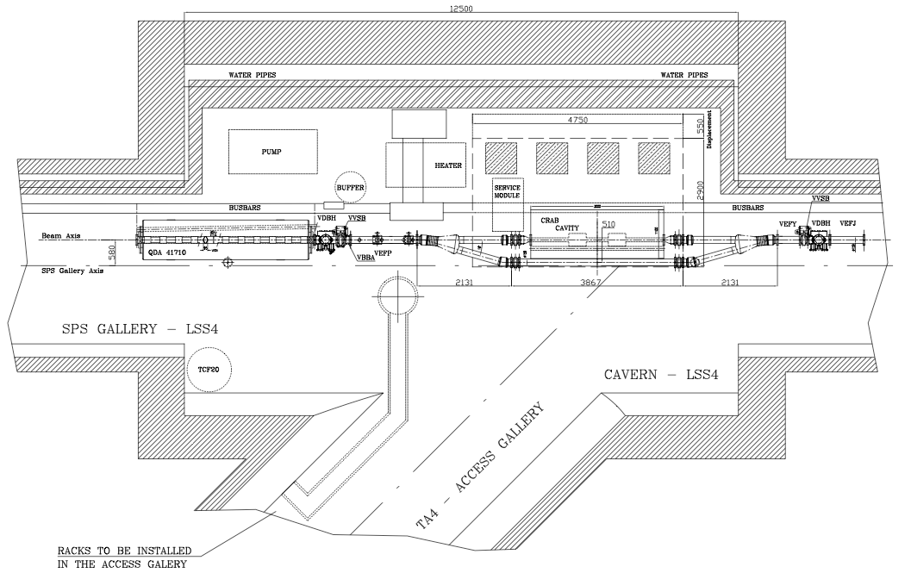
LSS4: Simplified View
LLRF
ECA4( 35m)
Cryo
RF Power
CCM
TCF20
N2

Slide 6
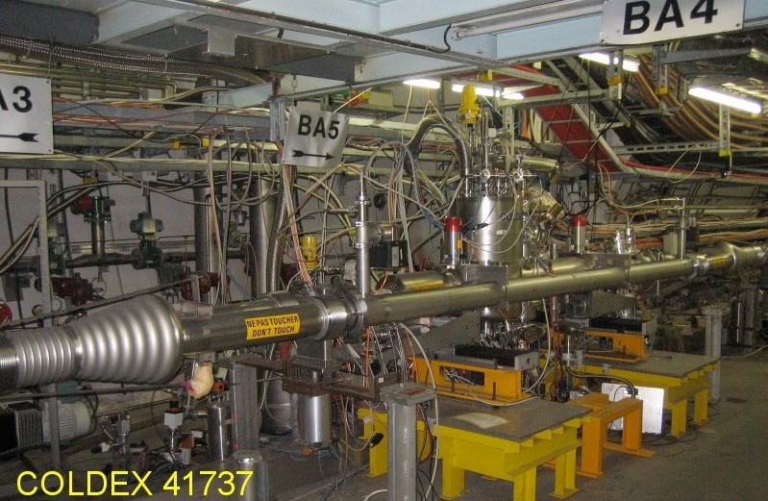
SPS LSS4: As it is now

Slide 7
SPS LSS4: Crab Integration
Crab Cavities cannot be installed until COLDEX Installation removed
COLDEX must be de-installed by end of 2015
LSS4 Alcove: This is now (again) a cryogenic installation.

Slide 8
SPS Integration Issues
SPS operation must be independent of crab operational availability
Crab Cavity module switchable from in-beam to out-of-beam position
Need to increase opening angle of Y-chamber => New Y-chamber design
CM Movement: In out of beam line
Cryomodule: moved with cavities cold and helium tanks full
Duration: less than 20 mins. Acceleration: less than 0.2g
Safety requirement: Movement is a remote operation
3000 mm
Dummy LHC Beam Pipe
510 mm
16º
SPS Bypass

Slide 9
Y-Chamber Redesign
Model | Z_{II} (mOhms) | Zx (kOhms/m) | Zy (kOhms/m)
Baseline 12 Degree | 2.8 | 0.33 | 0.31
16 Degree | 3.73 | 0.27 | 1.67
16 Degree Undulations | 3.69 | 0.41 | 0.53
Ellipsoid | 1.65 | 0.25 | 0.85
Proposed | 0.43 | 0.21 | 0.85

Slide 10
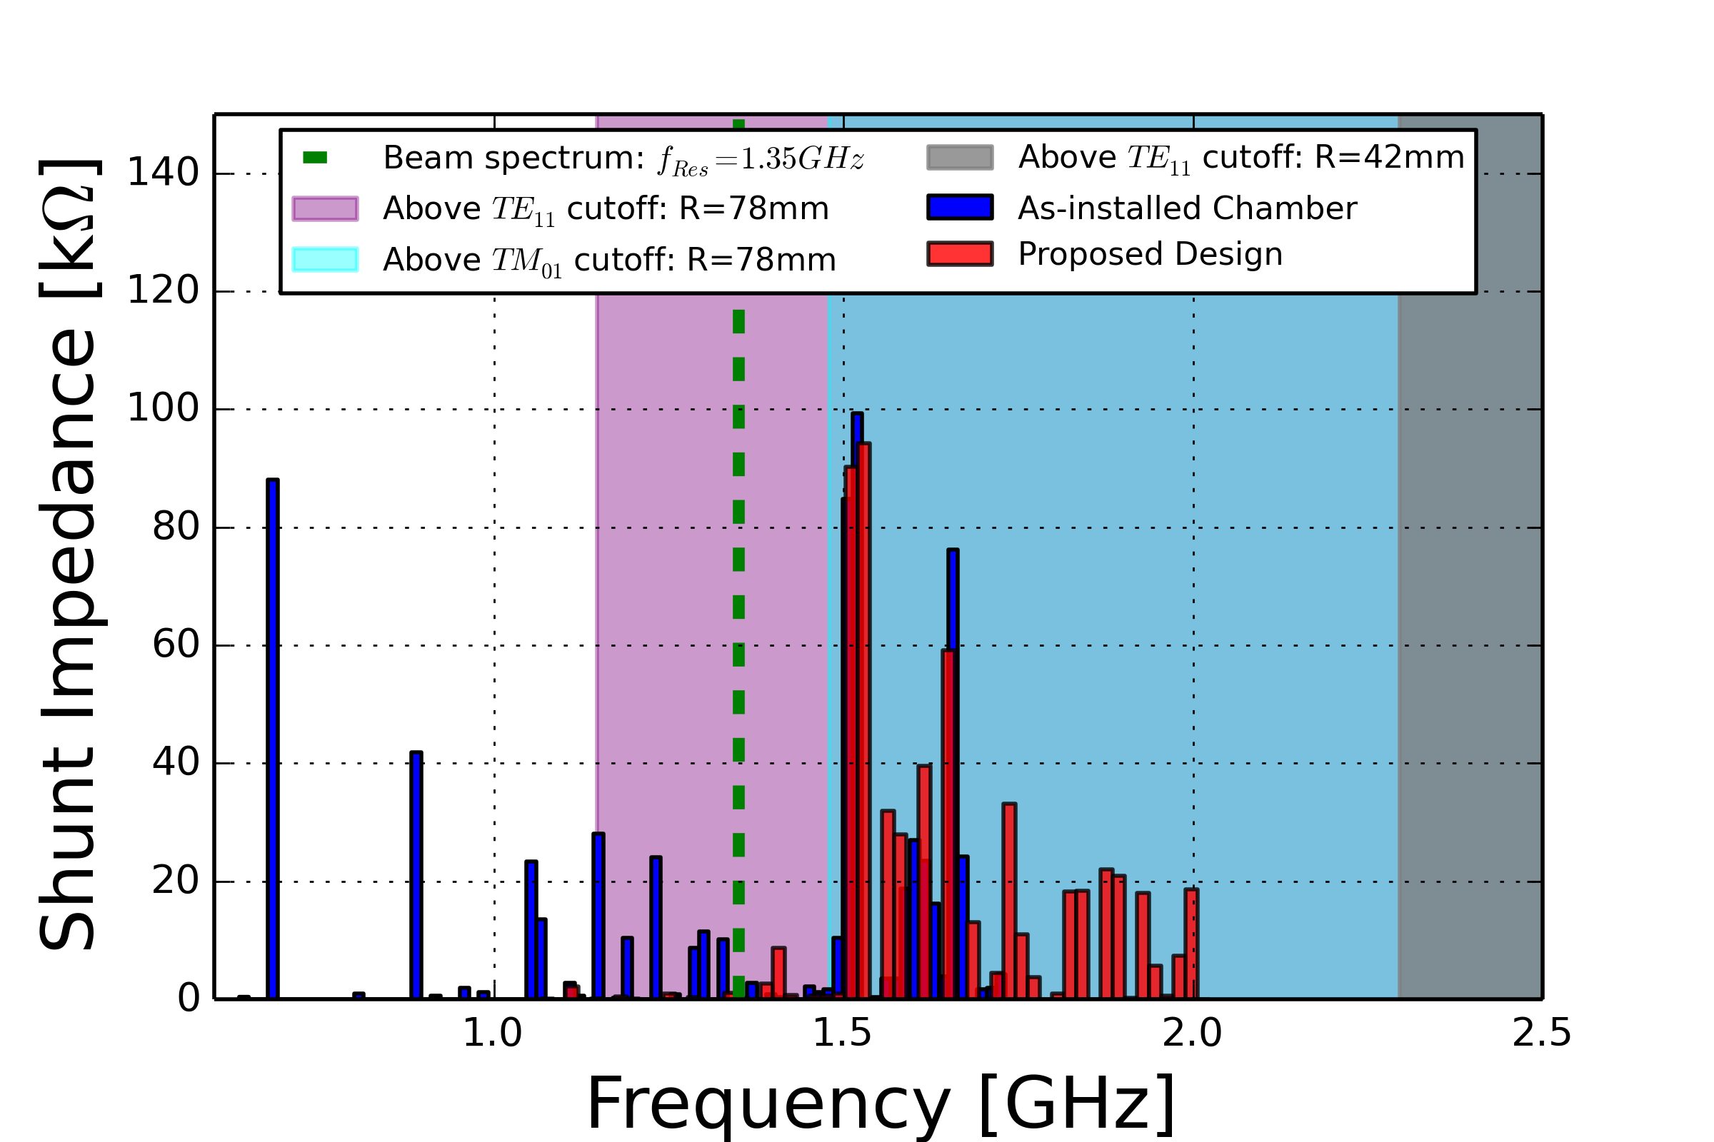
Y- Chamber: Changes in shunt impedance
Simulations:
Phoevos Kardasopoulos
Propagating modes
No significant impedances within beam spectrum ($<1.5 GHz$)
Propagating modes do not reach cavity due to aperture reduction
Propagating modes into SPS reduced wrt existing design
Design endorsed by Impedance Working Group

Slide 11
Integration Space
Vertical constraints: 700 mm (max) between beam axis and top of table
Magnet Busbar + shielding + support Table
Top
Out of Beam
Front:
Installation
In Beam
1250 mm
1200 mm
500 mm
Integration constraints: https://edms.cern.ch/document/1360083

Slide 12
Integration Space
Vertical constraints: 700 mm (max) between beam axis and top of table
Magnet Busbar + shielding + support Table
Top
Out of Beam
Front
In Beam
1178 mm
1200 mm
500 mm
Integration constraints: https://edms.cern.ch/document/1360083

Slide 13
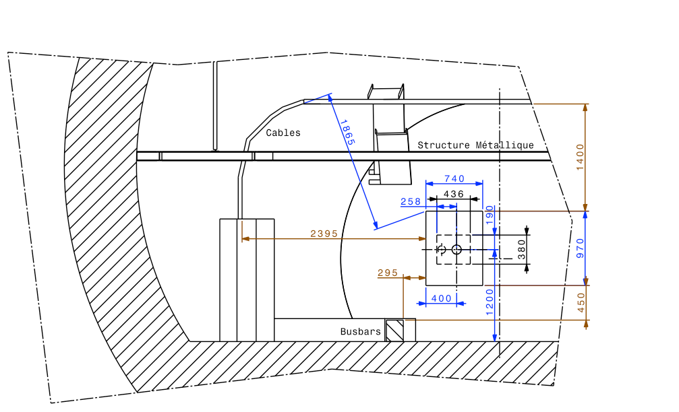
SPS Ambient Magnetic Field
Initial 2D simulation results
consider only main magnet busbars
use worst case scenario:
Identify most critical position.
Pt A: Outer surface of cryomodule
Pt B: Outer surface of He Vessel
Cavity specifications require a ambient magnetic field $<1 μT$
With busbar shield, cryomodule shield factor = 200 (achievable)
10mm busbar shielding to be installed (2015)
B
A
To be confirmed by measurement in September 2014
 | In-Beam Stray field [mT] |  | Out-of-Beam Stray field [mT]
Busbar shielding | Pt A | Pt B | Pt A | Pt B
Stainless steel (or no cover) | 0.4 | 0.2 | 0.6 | 0.3
Constructional steel, 2 mm thick | 0.3 | 0.2 | 0.4 | 0.2
Constructional steel, 10 mm thick | 0.1 | 0.1 | 0.2 | 0.1
Details: https://edms.cern.ch/document/1377806

Slide 14
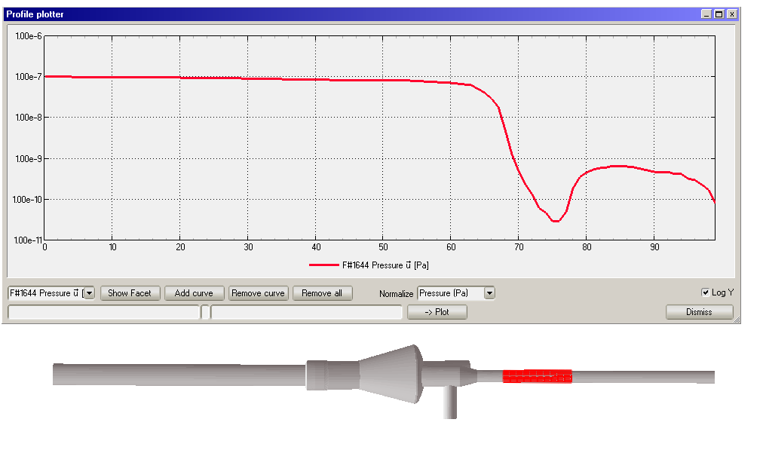
Beam Line Around the Cryomodule
Vacuum Conditions: Required case operational conditions = 10⁻¹⁰ mbar
Present SPS vacuum conditions: ~ 10⁻⁹ - 10⁻⁸ mbar
Crab Cavity cryo module should not cryo pump the SPS beam line
Vacuum infrastructure + Standard RF warm-cold transition at CM
Require: NEG Coating or cold trap or baked aCarbon on each side of CM
Differential pumping: Implemented at beam pipe transition diameter
With some beam line modification PCavity <10⁻¹⁰ mbar is achievable
Example: Cryo Trap
Pressure [Pa]
Pressure drop:
2 orders
Cryo trap: Transmission ratio
 | No cryotrap | 0.5m cryotrap | 1.0m cryotrap
No pump | 100% | 1% | 0.55%
With pump | 10% | 0.55% | 0.2%
Cryotrap

Slide 15
Vacuum Considerations
Present Situation
Sector 431
V2
DCUM 41737
OUT
Vacuum gauge
V3
DCUM 41753
COLDEX
Circulating beam
V1
DCUM 41731
IN
V4
DCUM 41757
Vacuum gauge
Sector 430
Vacuum gauge
Isolated beam pipe zone
NEG or cold trap or aCarbon
What is foreseen
Sector 431
Differential pumping
Vacuum gauge
OUT
Vacuum gauge
CRAB
Circulating beam
V1
DCUM 41731
IN
V4
DCUM 41757
Vacuum gauge
Sector 430
Vacuum gauge

Slide 16
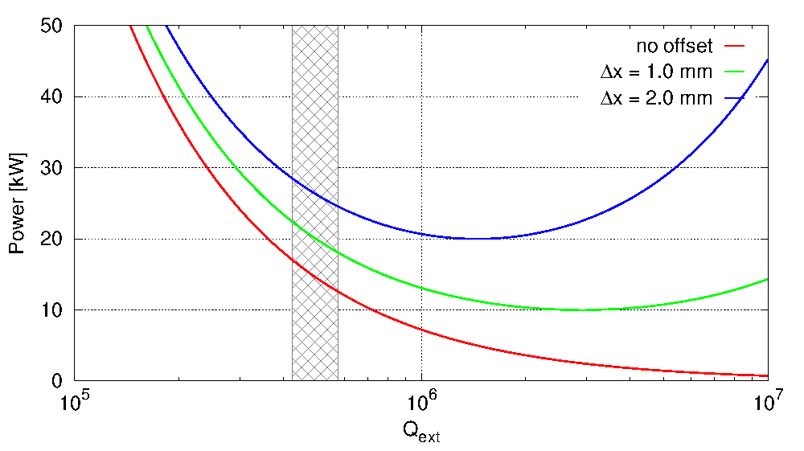
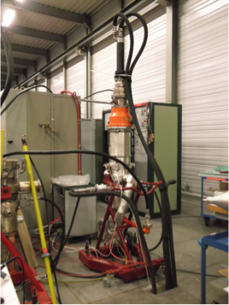
RF Power and Orbit Drifts
Tetrode Power vs Beam offset
Beam position in Cavity:
Crab Tetrode
Should provide 40 to 50 kW (to be tested)
Power constraints => beam must stay centred
SPS closed orbit drift in ramp up to 6mm
Correctors at SPS Pt 4 in interlock chain
complicates orbit centering
Slow orbit drift to be countered by support table adjustment, driven by LLRF
Support Table no longer simple

Slide 17
SPS Validation Program: 5 Steps
Cavity setup, conditioning, beam injection and initial cavity operation
Long Term Effects: Coasting Beam [120 -270 GeV]. Low Intensity
Single + multi-bunch + trains: Emittance growth, Dispersion etc
Short Term Effects: Cycling Beam: [26-450 GeV]. Low intensity
Direct crabbing measurements: Head tail monitor
Global and Local Crabbing schemes
Machine Protection Issues and Quench studies
High Intensity Studies
Impedance Studies and Invisibility of detuned cavities
Cavity operation with beam: Cryo limit of 8-12 hrs operation
Each MD step: 3 slots of 8hrs of beam => 24 hours of beam per cavity
Test of 2 cavities: 10 days of dedicated MD time spread over 2 years
This is ~1/3 of allocated SPS MD beam time

Slide 18
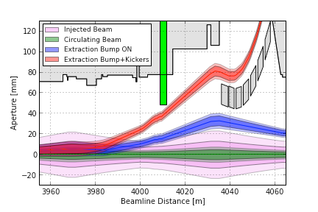
SPS Beam
Crab cavities need dedicated MD time
LHC beams:
cannot be in when LHC beam extracted
SPS Fixed Target:
large beams at injection & slow extraction
Coasting Beam: Both crab dispersion and long term emittance growth
E_Beam > 120 GeV to distinguish crab effects from natural emittance growth
LHC Beam
6σ
SPS Natural Emittance Growth Measurements
Energy [GeV] | Intensity [x 10¹¹] | Tunes Qx/Qy | RF Voltage [MV] | dεx/dt [%/hr] | dεy/dt [%/hr]
55 | 1 | 0.13/0.18 | 3 | 140-370% | 57%
120 | 0.5 (12b) | 0.13/0.18 | 2.0-4.0 | 100-300% | 40-90%
120 | 0.1 | 0.13-0.33 | 2.0-4.0 | 18% | 17%
270 | 0.4 | 0.13/0.18 | 3 | 20-23% | 14-24%
What’s changed after LS1? => participate in MDs in 2015

Slide 19
LLRF Operation
400MHz RF
Operation:
RF is ON
Strong RF feedback + tune controls
Cavities are on-tune at all time.
Filling, ramping or operation with transparent crab cavities
Cavities kept on-tune with small voltage (0.5 MV?) + active tuning system
Effect on beam nullified by counter-phasing the cavities
RF feedback is used with on-tune cavity to provide stability and keep the beam induced voltage zero if the beam is off-centered.
When crabbing is required (at flat top)
Drive counter-phasing to zero.
Degree of local crabbing controlled by synchronously changing voltage or phase in both cavities.
Global feedback
Cavity Controller
Cavity Controller
TX
TX
Phase PU

Slide 20
Machine Protection
Closed Orbit with global deflection
LHC beam: 450 GeV, Cavity Voltage: 3 MV
Worst Case: In-phase cavities kicking the centre of the beam
Closed orbit at 90º phase advance: ~1mm offset, no amplitude growth.
Interlock Strategy:
Hardwired Interlocks: Inputs into BIS (Beam Interlock System)
Interlock on vacuum valves
Software interlocks: Inputs into SIS (Software Interlock System)
Table Position (In/Out of beam positions)
Power load on tetrodes
LLRF Mitigations and Interlocks
LLRF FB loop: Timescale of $𝒪(10 \text{μs}\text{)}$ ➔ Time for quench mitigation actions
SPS test to validate cavity mitigation schemes for failures/quenches
TX fault: machine operation can continue if cavity detuned above RF freq.

Slide 21
Schedule Issues
SPS Crab Validation Run: 2017 and 2018
SPS Crab schedule: Available Online
Please see http://kiwi.web.cern.ch/kiwi/Crab_SPS/index.html

Slide 22
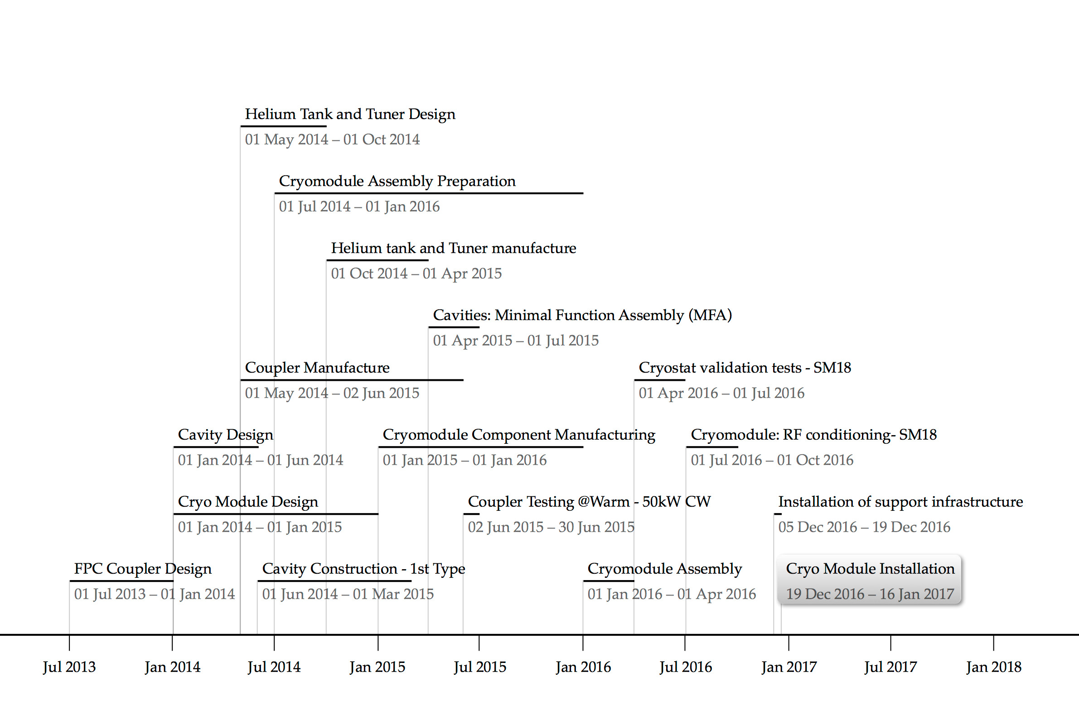
Schedule: Cavity + CryoModule TimeLine

Slide 23
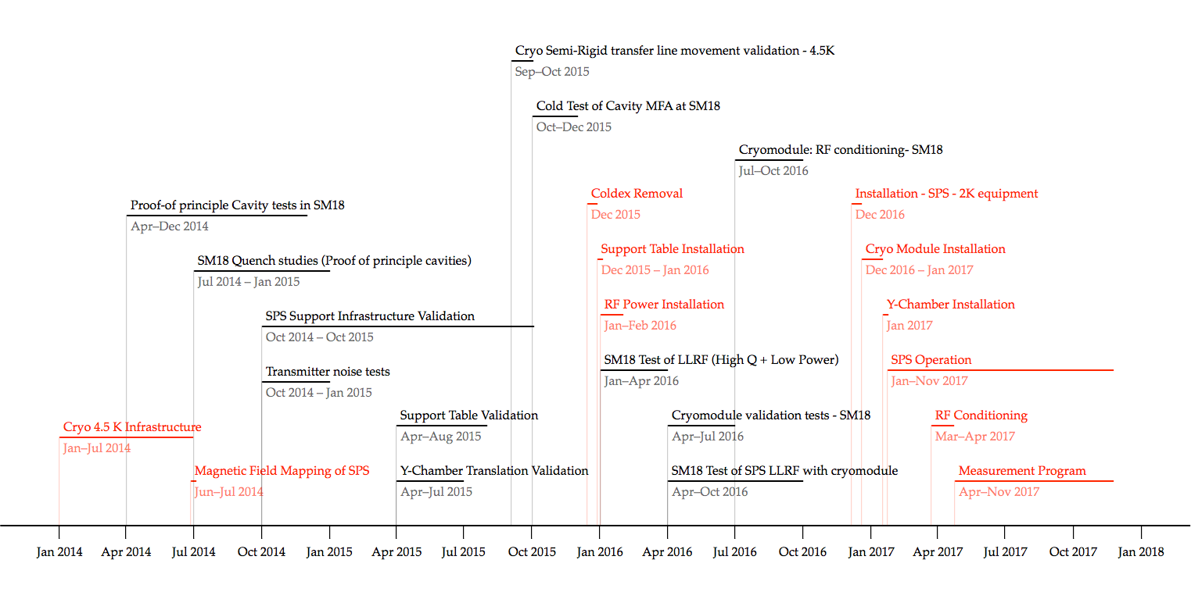
Schedule: SM18 + SPS
SM18:
CavityTesting, Cryo Module assembly and testing, Infrastructure validation
SPS
Preparation of Infrastructure, Validation of Services, Operations Interface
SM18 Activities
SPS Activities

Slide 24
SM18 RF Test facility
M9 Bunker: Horizontal Tests
LHC cryomodule
HIE-ISOLDE cryomodule
And later: FCC 400 MHz project
M7 Bunker: Horizontal Tests
CRAB cryomodule
SPL half cryomodule
And later: 800 MHz project
M7
V3
V4
SM18 RF Area

Slide 25
Summary Comments
Integration
Integration of Crab infrastructure ongoing. Alcove space fully used
2015-2016 Christmas stop must be used to remove COLDEX
SPS Beam Time
Crab Cavity Validation needs dedicated SPS MD time
Initial estimates of MD time request: 5 x 24 hrs per cavity
MD program must include:
Crab functionality, cavity invisibility, LLRF op, failure mitigation
LLRF conceptual design now advancing
Planning and schedule
2015-2016 Christmas stop: installation of crab infrastructure in SPS
1st Crab Cryomodule installed 2016-2017 Christmas stop
2 Cryomodule Installation periods (Xmas stops): can’t hot swap modules
Use 2016 for cryomodule “sector test” in SM18

Slide 26
Integration: Cryo Module Interfaces
3 different cryomodule: Evolving toward consistent interfaces
Designs not finalised yet, but should be harmonised and made consistent
Simplifies support table design, cryomodule exchange, alignment steps
Support Table functionality becoming more complex
Once cryo module design is frozen, support table design can be finalised
Example: Cryomodule designs as of week 18 2014
Relative Position of power coupler wrt crab cavity reference position
Cryomodule | Longitudinal Distance Between Couplers | Transverse offset wrt beam axis | Height (beam axis to centre of waveguide)
DQW | 900 mm | 0 mm | 960.45 mm
RFD | 1050 mm | -113 mm | 944.94 mm
4-Rod | 890.4 mm | 25 mm | 939.85 mm

