Slide 1
RF Operational Aspects
P. Baudrenghien, R. Calaga CERN BE-RF
T. Mastoridis, Cali. Poly. State Univ., San Luis Obispo

Slide 2
The ACS and CC systems

Slide 3
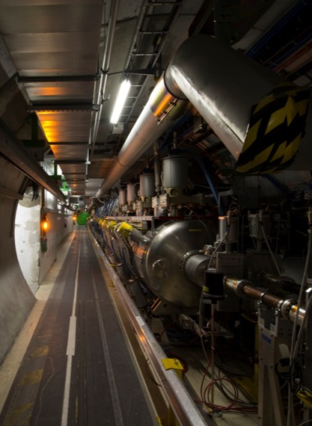
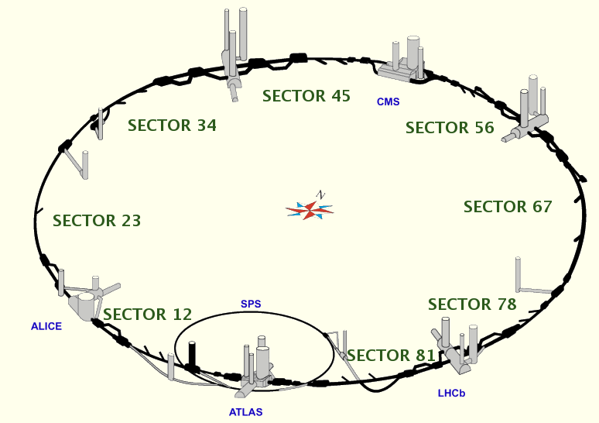
LHC layout
Main (ACS)
RF system in pt4
Crab Cavity RF in pt5
Main (ACS)
RF system in pt4
Crab Cavity RF in pt1

Slide 4
The accelerating (ACS) system (IP4)
Link to CC B1
Link to CC B2

Slide 5
The Crab Cavity systems (IP1 and IP5)

Slide 6
RF power, tolerable beam offset and choice of loaded Q

Slide 7
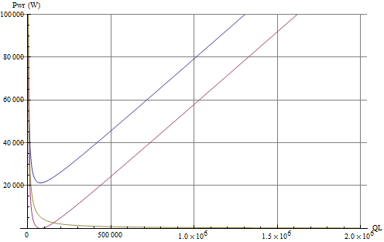
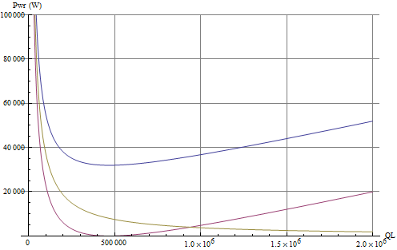
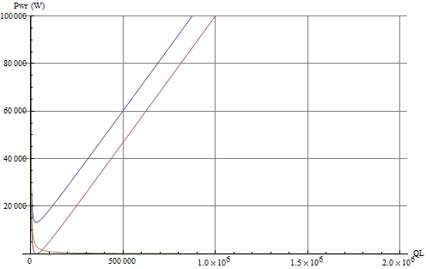
RF Power vs. Q_{L} for various RF voltages and beam offsets
During filling and ramping, we need voltage for tuning only. We would use counterphasing. We can tolerate much larger beam offsets.
During physics, we need 3 MV/cavity. Assuming a maximum of 1 mm beam offset, the required power is below 40 kW if we choose loaded Q in the 200k-1M range (above).
R/Q = 300 Ω. 1.11 A DC current, 1 ns 4σ bunch length with Cos² longitudinal profile (2 A RF component of beam current). Cavity on tune.

Slide 8
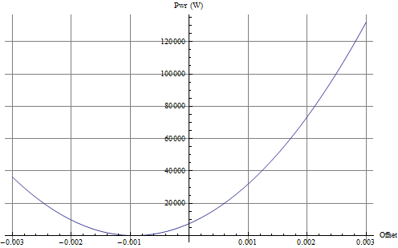
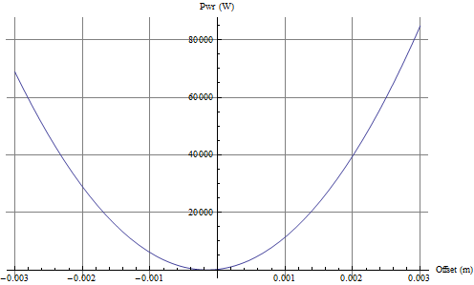
RF Power vs. Offset
Q_{L}=500000 R/Q = 300 Ω. 1.11 A DC current, 1 ns 4σ bunch length with Cos² longitudinal profile (2 A RF component of beam current). Cavity on tune.
With 80 kW, we can tolerate 2 mm offset during physics (3 MV) and 3 mm during filling (0.5 MV).

Slide 9
Impedance issues, fundamental mode
Case 1: Idling cavity (RF OFF)

Slide 10
NB resonator, transverse
Transverse impedance of a transverse mode
The damping rate and tune shift of coupled-bunch mode l (rigid dipole only) can be computed from the cavity impedance
With ω=(p M+l) ω_{rev}+ω_{b}.

Slide 11
NB resonator, transverse
With 25 ns bunch spacing (M=3564), for a resonance around 400 MHz, with a BW much below 40 MHz, the infinite sum reduces to the two terms (p= ±10 -> p M ω_{rev} = ± ω_{RF})
The damping rate is computed from the difference between real impedance on the two ±(l ω_{rev}+ω_{b}) sidebands of the ω_{RF}
For example, with Q_{b}=64.3, the damping rate of mode l=-64 is computed from the difference between the real part of the impedance at ±0.3 ω_{rev}
Negative damping rate -> instability

Slide 12
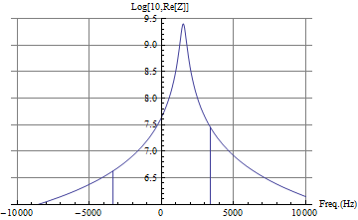
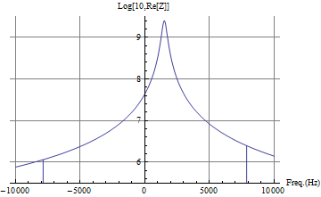
Cavity idling and detuned
With a positive non-integer tune (Q_{h}=64.3, ω_{b}/ω_{rev} above an integer), the cavity should be tuned above the RF frequency to make the mode l=-64 stabilizing
L=-64 stable
L=-65 unstable
-
+
+
-
offset from f_{RF}
offset from f_{RF}
Real part of the cavity impedance with 1.5 kHz detuning (log scale)
Left: mode l=-64. The damping rate is computed from the difference in Real[Z] evaluated at +0.3 Frev and -0.3 Frev. STABLE
Right: mode l=-65. The damping rate is computed from the difference in Real[Z] evaluated at -0.7 Frev and +0.7 Frev. UNSTABLE but very low growth rate

Slide 13
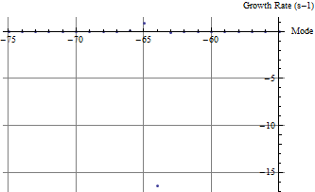
L=-65 small growth rate
L=-64 large
damping rate
Growth rate (per cavity) with cavity parked idling at 1.5 kHz detuning. Assuming beta function at location of crabbing equal to average
For stability, the optimal is a zero or small positive detuning: cavity tuned above betatron line
If we can keep the cavity properly detuned, the impedance at the fundamental is not a serious problem for stability. The damping time of the ADT is in the order of 1 ms at 7 TeV (damping rate 1000 s⁻¹).

Slide 14
But…
The detuning amplitude should be set to keep the beam induced kicks (for an off-centered trajectory) within reasonable bounds. The beam will self-induce a crabbing voltage
With a cavity on-tune, the beam induced voltage is in quadrature with beam current. It produces a crabbing that propagates through the full ring -> losses by collimation of the tails
Off-tune, the beam-induced voltage is smaller but in phase with the bunch -> transverse kick of the bunch core!
Finally, how do we guarantee precise tuning without RF drive?
Detuning (Hz) | Induced voltage (V) | Phase (deg)
0 | 2.5 MV | -90
1000 | 1 MV | -22
2000 | 0.5 MV | -11
4000 | 0.25 MV | -6
8000 | 0.125 MV | -3
Voltage in phase with bunch will kick the core of the bunch. Closed Orbit distortion of bunch core. Can be problematic.

Slide 15
Impedance issues, fundamental mode
Case 2: RF feedback ON

Slide 16
RF feedback
In physics, with the crabbing on, we must have an active RF feedback for precise control of the cavity field
Widely used regulation system
Principle: Measure the voltage in the cavity, compare it to the desired voltage and use the error to regulate the drive of the power amplifier
Very efficient to compensate for unknown perturbations: Tune fluctuations, mechanical vibrations, beam loading
RF or Direct Feedback

Slide 17
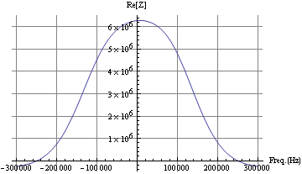
RF ON, Feedback ON
The RF feedback reduces the peak cavity impedance and transforms the high Q resonator into an effective impedance that covers several revolution frequency lines
The actual cavity tune has no big importance for stability anymore
The growth rates and damping rates are much reduced, and we have no more dominant mode
Comparison of the modulus of the cavity impedance without and with RF feedback.
Real part of the effective impedance with RF feedback. Reduced from 2.5 GΩ/m to 6 MΩ/m

Slide 18
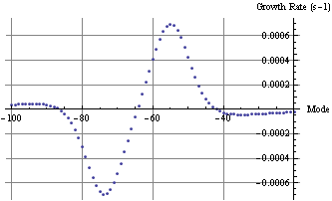
Growth rate (per cavity) in physics, with RF feedback
Left: cavity on tune
Right: cavity detuned by -100 Hz
Assuming beta function at location of crabbing equal to average
With RF feedback ON the growth rates are 3 orders of magnitude smaller than with a cavity idling and detuned at + 1.5 kHz.

Slide 19
Operational scenario

Slide 20
Operational scenario
The RF is ON, with strong RF feedback and tune controls at all time. Cavities are on-tune at all time.
During filling, ramping or operation with transparent crab cavities, we keep them on-tune with a small field requested for the active Tuning system. As the crabbing kick is provided by three cavities we use counter-phasing to make the total field invisible to the beam. The RF feedback is used with the cavity tuned to provide stability and keep the Beam Induced Voltage zero if the beam is off-centered. We can use the demanded TX power as a measurement of beam loading to guide the beam centering.
ON flat top we drive counter-phasing to zero. Any luminosity leveling scheme is possible by synchronously changing the voltage or phase in each crab cavity as desired.

Slide 21
Machine Protection
Fast failure of one Crab Cavity
Mechanisms
Can the LLRF help?

Slide 22
Mechanism for fast failure
Case 1:
The “predictable” case: A problem with power hardware supplying one cavity (such as TX trip, arcing in waveguide, circulator or load,…) resulting in switching off the TX. The cavity stored energy will flow out, through the waveguide and circulator, and will be dissipated into the circulator’s load. The cavity field will decay to zero with a time constant τ
With a Q_{L} equal to 5 10⁵, the time constant is 400 μs. Assuming three cavities with a total voltage of 12 MV, and a single TX trip, the field would drop from 12 MV to 10.5 MV in the three turns delay (267 μs) until the beam dump is fired

Slide 23
Mechanism for fast failure (cont’d)
Case 2:
In the case of a quench, the stored energy is dissipated in the cavity walls and the main coupling (Q_{L}) has no effect on the field evolution. Once the Nb is normal-conducting we have Q₀=5 10³ and τ= 4 μs. With an He bath at 2 degree K, the propagation of the local quench should be slow, and observable as a rise in demanded TX power that we would use to trigger the beam dump. Lessons must be learnt from the SM18 and SPS tests.
Case 3:
In the case of an arc in the main coupler, the stored energy will be dissipated through the arc. Again lessons must be learnt from the SM18 and SPS tests.
Better understanding of the field evolution in case of a quench and arcing needed

Slide 24
LLRF mitigation: Coupled feedback
The LLRF can help minimizing the losses during the 3 turns transient till the beam is dumped. The idea is to implement a coupled feedback, acting on all CC cavities, and keeping crabbing and un-crabbing equal
In the case of a crabbing cavity trip, it would ramp the un-crabbing voltage down, tracking the total crabbing voltage

Slide 25
The Crab Cavity systems (IP1 and IP5)

Slide 26
RF noise

Slide 27
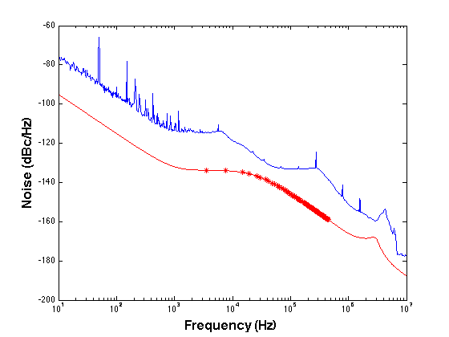
Phase noise measured in the LHC ACS cavities
The beam will strongly respond to RF phase noise in narrow frequency bands at (nω_{rev}+ω_{b} )
The tune spread (mainly caused by beam-beam) brings decoherence that results in transverse emittance growth and drop in luminosity
Simple formulae have been derived relating CC noise power spectral density and emittance growth
A realistic optimization of the LLRF (red curve) would lead to 5%/hour emittance growth caused by phase noise, with the transverse damper active (10 turns damping time)
Amplitude noise has less effect for short bunches but it is not compensated by the transverse damper. It would lead to an extra 2.5%/hour growth
Simulation of phase noise in the CCs after optimization
Single sideband phase noise Power Spectral Density (dBc/Hz). The betatron bands are marked by red dots.
More on CC RF noise in T. Mastoridis talk on Thursday (LARP collaboration meeting)

Slide 28
SPS tests

Slide 29
In the SPS we will
Set-up the strong RF feedback
Measure RF noise and optimize LLRF for minimal transverse emittance growth (see T. Mastoridis talk on Thursday)
Learn on the field evolution following a quench and
Try to detect the propagation of the quench from the expected rise in demanded TX power
Qualify the “coupled-feedback” idea. We have 2 CCs in the SPS.
Test the RF gymnastics:
Reproduce filling and ramping conditions, with low cavity voltage, large beam offset and precise counter phasing
Then move to physics conditions: center the beam using the demanded TX power as
Measure the impedance of the cavity at the fundamental. Confirm the calculations of instability growth rates

Slide 30
Conclusions

Slide 31
Conclusions
Operation with idling CCs is not preferred. The beam induced crabbing voltage could result in larger collimation losses
We propose to keep RF ON and cavity on-tune during filling and ramping, with a small voltage (0.5 MV?), and counter phasing to make this invisible to the beam. With 80 kW RF power we can accept offsets of 3 mm
During physics the RF power can deal with 2 mm offset (at 3 MV)
With RF feedback ON, the RF power measurement is used to drive the beam centering
The impedance at the fundamental is not a problem, thanks to the RF feedback
We have formulas for the transverse emittance growth caused by RF noise, and ideas on a LLRF architecture that minimizes it. The aim is to reduce the RF phase and amplitude noise so that the resulting transverse emittance growth does not exceed 5-10% per hour (with the transverse damper active). See T. Mastoridis talk on Thursday.
We plan on monitoring the demanded TX power to detect a local quench while it propagates to the full cavity
The coupled-cavity feedback will minimize the losses following a single cavity trip
The SPS tests are essential to guide the LLRF design

Slide 32
Thank you for your attention

Slide 33
Backup slides

Slide 34
RF feedback
Widely used regulation system
Principle: Measure the voltage in the cavity, compare it to the desired voltage and use the error to regulate the drive of the power amplifier
Very efficient to compensate for unknown perturbations: Tune fluctuations, mechanical vibrations, beam loading
But you cannot react before a perturbation is measured, processed and correction is applied to the cavity via the TX
So performances are limited by the loop delay
RF or Direct Feedback

Slide 35
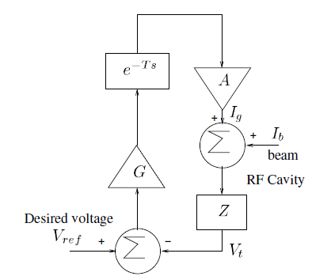
Analysis
A cavity near the fundamental mode can be represented as an RLC circuit
With the feedback loop, the cavity voltage is
A large gain G.A means good reduction of the perturbations (noise and beam induced voltage). Stability in presence of the delay T will put a limit. Outside its bandwidth the cavity is purely reactive and its impedance can be approximated
RF or Direct Feedback

Slide 36
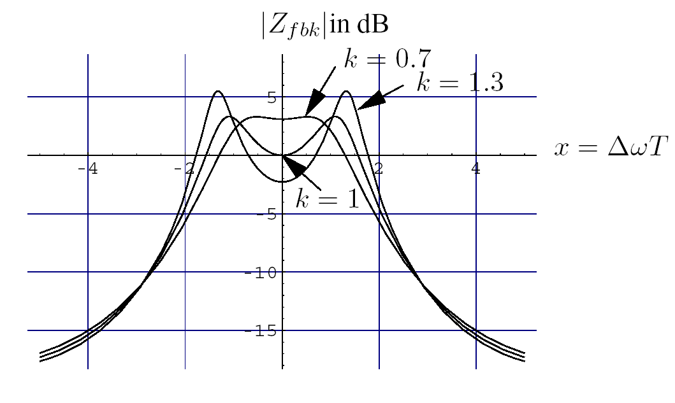
To keep a 45 degrees phase margin the open-loop gain must have decreased to 1 when the delay has added an extra -45 degrees phase shift, that is at Δω=π/(4T)
Flat response will be achieved with
leading to the effective cavity impedance at resonance
and the 2-sided closed loop BW with feedback
The final performances depend on Loop delay T and cavity geometry R/Q. It does not depend on the actual Q
Lesson: Keep delay short and TX broadband to avoid group delay
Closed Loop response for varying gains. K=1 corresponds to the maximal gain. The optimally flat is obtained for k=0.7

