Slide 1

Impedance aspects of
Crab cavities
R. Calaga, N. Mounet, B. Salvant*, E. Shaposhnikova
Many thanks to
F. Galleazzi, E. Métral, E. Jensen, A. Mc Pherson, P. Kardasopoulos,
S. Verdu Andres, C. Zannini
* Benoit.Salvant@cern.ch

Slide 2
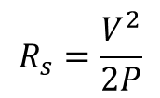
Summary
It would be useful to collect all updates on geometries and resonant parameters of all crab cavities, which is not the case so far.
Impact of 2 crab cavities on SPS beam impedance seems limited.
Impact on LHC beam impedance is predicted to be significant in both longitudinal and transverse planes (16 cavities + very large transverse beta functions), despite the large effort to minimize the impact by the design teams.
We have to admit that there are a lot of unknowns concerning what will limit us for HL-LHC, and setting impedance limits is therefore tricky.
Current longitudinal limit for all new LHC hardware is set to 200 kΩ (conservative for modes above 600 MHz). Current transverse limit is set by checking the impact of the new hardware on beam dynamics.
In all this talk (and in general for collective effects at CERN), we are working with the so-called circuit convention :
$$R_{s}=\frac{V^{2}}{2P}$$

Slide 3
Agenda
Context
  LHC impedance
SPS crab cavity tests
  Impedance of the new Y chamber
  Impedance of the crab cavities
  Power expected from resonant modes
LHC operation
  Longitudinal stability limits
  Contribution compared to the LHC model
  Power expected from resonant modes
Summary

Slide 4
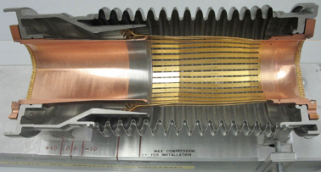

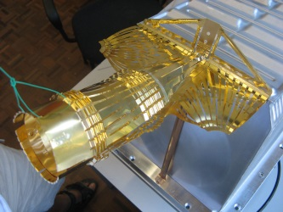
Context: minimizing the beam impedance of the LHC
LHC optimized for low impedance and high intensity beams
From the design phase, the LHC has been optimized to cope with high intensity beams and significant effort and budget were allocated to minimize the impedance of many devices and mitigate its effects
Some examples:
  Tapers (11 degrees) and RF fingers for all collimators
  Conducting strips for injection kickers MKI
  Dump kickers MKD outside of the vacuum pipe
  RF fingers to shield thousands of bellows
  Avoid cavity-like objects
  Wakefield suppressor in LHCb
  Avoid sharp steps between chambers and limit tapers to 15 degrees
  ferrites and cooling in all kinds of devices (ALFA, TOTEM, TDI, BSRT, etc.)
Consequence: small LHC impedance allowed maximization of luminosity to the experiments before LS1.
For comparison:
Orders of magnitude | SPS | LHC (injection) | improvement
Length | 7 km | 27 km | [/m length]
Effective longitudinal impedance | 5 Ohm | 0.9 Ohm | by a factor ~200
Effective transverse impedance | 20 MOhm/m | 2 to 4 MOhm/m | by a factor ~40

Slide 5
Context: impedance acceptance criteria
A lot was learnt in the recent years on assessing impedance and how it affects the beam
→ ongoing area of R&D in many labs and criteria are bound to evolve.
Many new simulation tools and analytical tools:
  Codes to predict impedance and beam dynamics in more realistic conditions (in presence of e.g. many bunches, chromaticity, octupoles, damper, dipolar/quadrupolar impedances, beam-beam effects) → HEADTAIL, DELPHI, NHT, COMBI, PySSD
Longitudinal instabilities have not been limiting LHC so far.
Several transverse instabilities already observed in LHC, both single bunch and multibunch, which means that there the margins may be tight to reach HL-LHC parameters
→ transverse impedance reduction studies of the collimator on-going
→ potential mitigations by colliding early in the squeeze are studied
Need to see the situation at ~6.5 TeV after LS1, and even more after the injectors upgrade in LS2 to see where we really stand with respect to intensity limitations

Slide 6
Agenda
Context
  LHC impedance
SPS crab cavity tests
  Impedance of the new Y chamber
  Impedance of the crab cavities
  Power expected from resonant modes
LHC operation
  Longitudinal stability limits
  Contribution compared to the LHC model
  Power expected from resonant modes
Summary

Slide 7
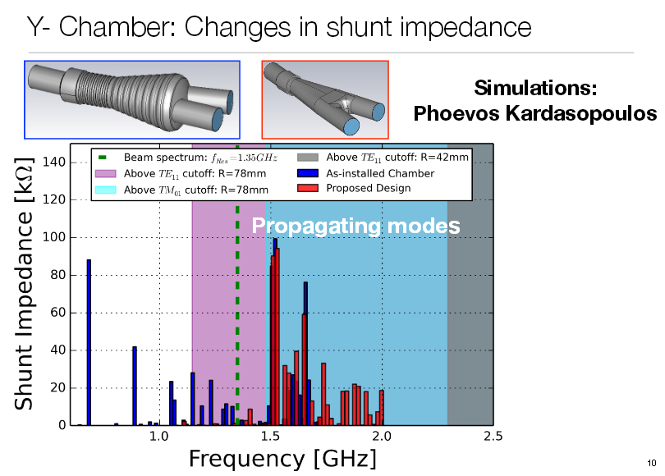
Improvement of the Y chamber design
See A. Mc Pherson
MSWG meeting May 2nd 2014
Link
And P. Kardasopoulos
CERN impedance meeting
April 14th 2014
link
→ Modes pushed to much higher frequencies, major modes now above cutoff

Slide 8
Impedance of the crab cavities during operation
Latest information I have: crab cavities are incompatible with all production beams (LHC, Fixed target and even AWAKE) and therefore can be used only during dedicated beam tests
However, let’s check:
Damped longitudinal modes of ~100 kOhm between 700 and 900 MHz would be similar to the previous modes of the Y chamber
Other transverse modes at very high frequency for the SPS, and still small compared to the SPS effective impedance (20 MOhm/m - broad due to kickers).
Longitudinal and transverse effective impedance of one crab cavity is small (~3 kOhm/m)
→ Impact of two crab cavities not expected to be a critical issue for SPS operation with LHC beam
→ therefore, crab cavities not expected to limit significantly the dedicated MD beams (if modes well damped)
HOM Coupler Optimization & RF Modeling, Zenghai Li, LHC-CC13

Slide 9
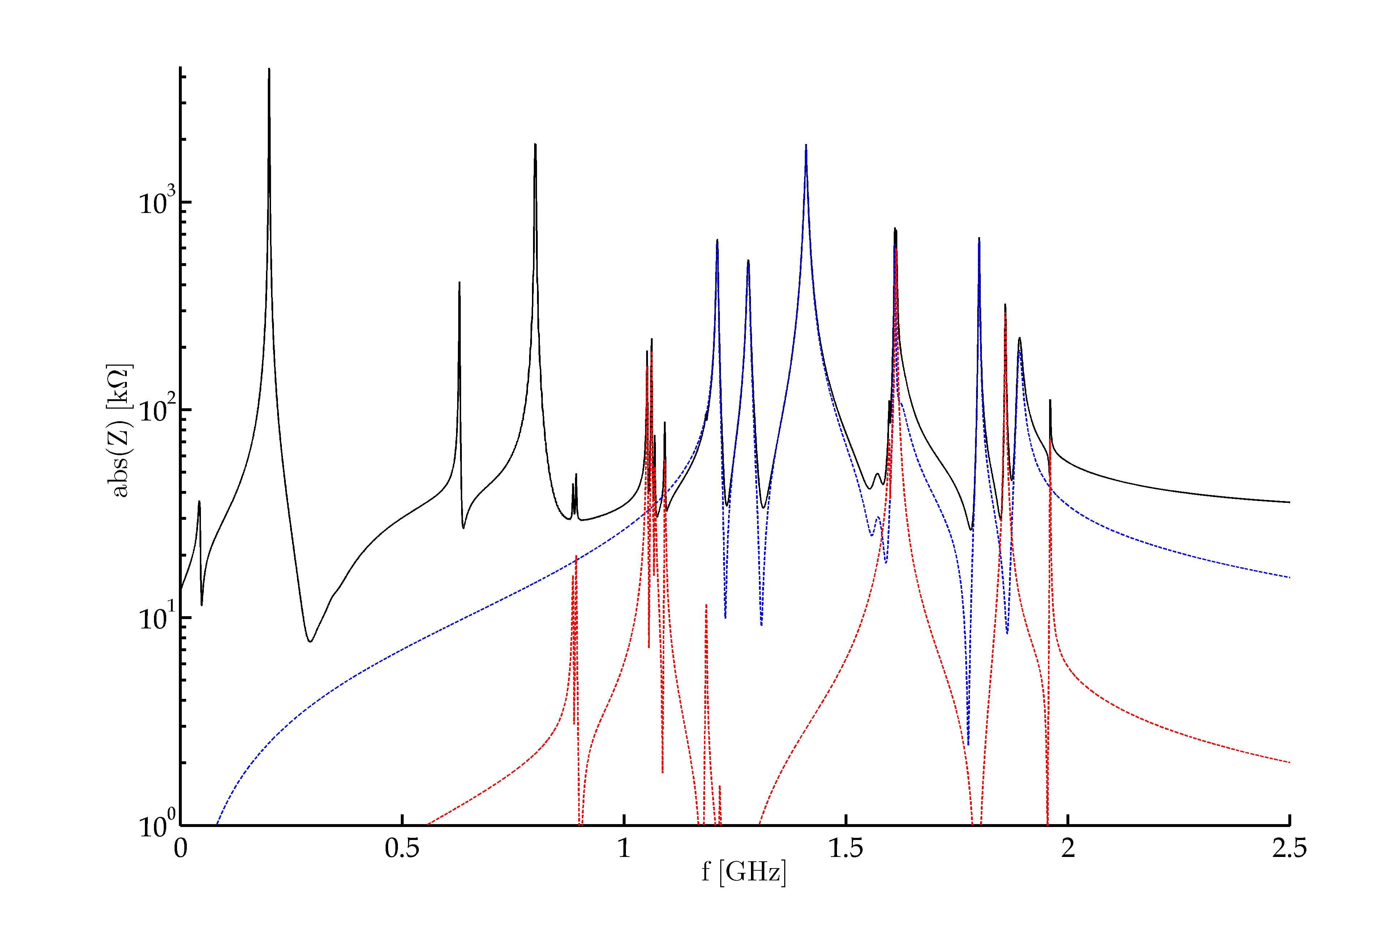
Total 2013 SPS Longitudinal Impedance Model (II)
200MHz TWC
Blue – Flanges
Red – BPMs
Black – Total
800MHz TWC
630MHz TWC HOM
SPS longitudinal impedance model (J. Varela)

Slide 10
Agenda
Context
  LHC impedance
SPS crab cavity tests
  Impedance of the new Y chamber
  Impedance of the crab cavities
  Power expected from resonant modes
LHC operation
  Longitudinal stability limits
  Contribution compared to the LHC model
  Power expected from resonant modes
Summary

Slide 11
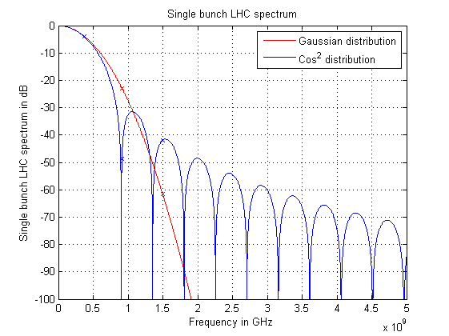
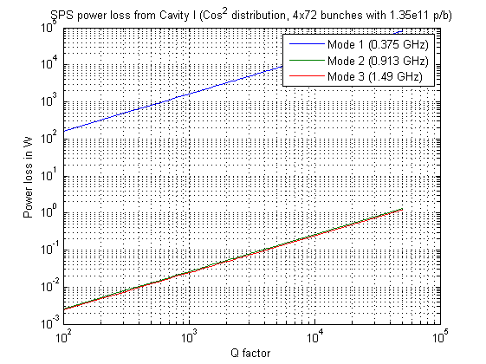
Power from SPS beam: cavity I (Lancaster)
1.6 ns bunch length, 4x72 bunches with 1.35e11 p/b
realistic before LS2, could get worse after
worst case scenario (also on beam spectrum line)
With Q=1000, power loss for the worst mode (375 MHz with R/Q= 22 Ohm) is ~2 kW
Only longitudinal modes looked at
Using Ploss=(2*(M*Nb*e*frev)^2*h(f)^2*R/Q*Q;

Slide 12
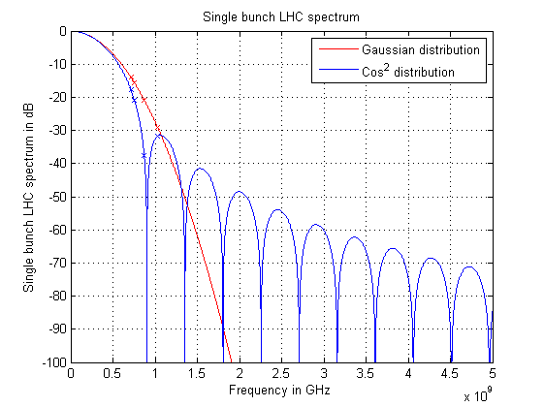
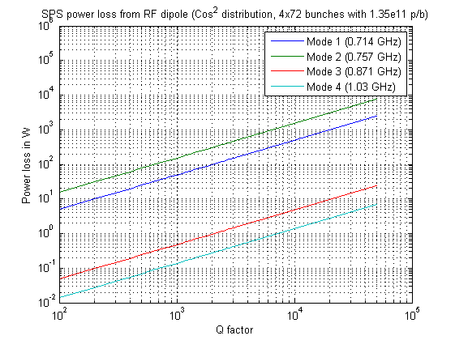
Power from SPS beam: RF dipole
1.6 ns bunch length, 6x72 bunches with 2.2e11 p/b
realistic before LS2, could get worse after
worst case scenario (also on beam spectrum line)
With Q=1000, power loss for the worst mode (757 MHz, R/Q~100 Ohm) is ~200 W
Only longitudinal modes looked at

Slide 13
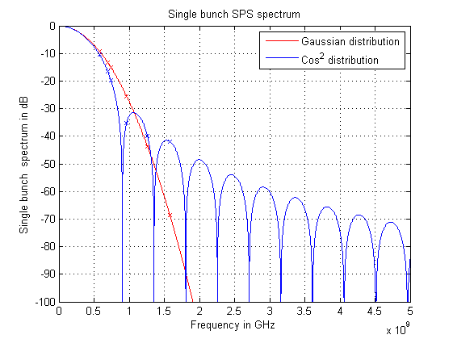
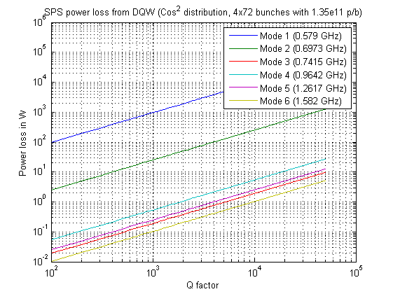
Power from SPS beam: DQW
1.6 ns bunch length, 6x72 bunches with 2.2e11 p/b
realistic before LS2, could get worse after
worst case scenario (also on beam spectrum line)
With Q=1000, power loss for the worst mode (579 MHz and R/Q~57 Ohm)
is ~1 kW (worst case)
Only longitudinal modes looked at

Slide 14
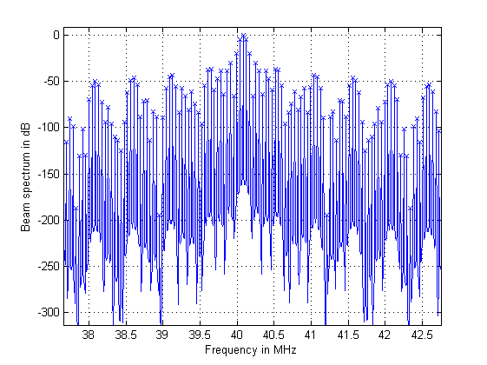
Off resonance effect
Normalized SPS beam spectrum for 25 ns beam (288 bunches)
Very strong reduction
in beam spectrum if 0.5 MHz
away from resonance
Also developed by E. Metral
at IBIC 2013 and R. Calaga et al in
a note
Already put in place by designers
to avoid beam harmonics at 20 MHz
These worst case power values should be avoided
→ Will there be a way to tune modes away from resonance in case it happens?

Slide 15
Agenda
Context
  LHC impedance
SPS crab cavity tests
  Impedance of the new Y chamber
  Impedance of the crab cavities
  Power expected from resonant modes
LHC operation
  Longitudinal stability limits
  Contribution compared to the LHC model
  Power expected from resonant modes
Summary

Slide 16
Requests for shunt impedance of resonant modes
History of requests for maximum longitudinal shunt impedance added to LHC at a given frequency:
  E. Shaposhnikova (CC10 workshop)
  → 200 kOhm limit for ultimate intensity, 1 ns, 2.5eVs at 7 TeV relaxed beyond 600 MHz as (τ f_{r})^{5/3}
  A. Burov (CC11 workshop)
  → 2.4 MOhm limit for ultimate intensity, 1.1 ns at 7 TeV
  B. Salvant based on A. Burov’s model (HiLumi 2012 workshop)
  → 1.7 MOhm limit for 2.2e11 p/b, 1 ns at 7 TeV
  Need convergence of theoretical models and guidance of macroparticle simulations
  Ongoing heavy work (N. Mounet):
    Impedance model with and without additional resonant modes
    DELPHI and HEADTAIL simulations to assess intensity limits (already available for transverse impedance)
  Current limit for current installation into LHC set to max Rs~200 kOhm per resonant mode up to 1.5 GHz (agreed with BE/RF-BR).
  This limit is known to be conservative (in particular it could be relaxed beyond 600 MHz with f^{5/3}

Slide 17
Longitudinal impedance limit for coupled bunch instabilities
Many parameters can/will change for the chosen options of HL-LHC:
    Higher bunch and beam intensity (2748 bunches with 2.2e11 p/b)
    200 MHz or 800 MHz ? Longitudinal emittance? Bunch length?
Until the parameters are clearer, this limit shall continue to be enforced.
  With 16 identical cavities per beam, this would mean a limit of 12 kΩ per cavity
    Possibility to use two sets of different cavities to increase the threshold by a factor 2.
    Suggestion by E. Shaposhnikova to detune and spread all longitudinal modes of the cavities on purpose
    Limit would then be back to 200 kΩ per cavity.
Worst longitudinal mode | Cavity I (Lancaster) | Cavity II (ODU) | Cavity III (BNL)
Frequency (MHz) | 375 | 772 | 577
R/Q (Ω) | 22 | 100 | 57
Min Q to reach 12 kOhm/cavity | 545 | 120 | 211
Min Q to reach 200 kOhm/cavity | 9000 | 2000 | 3500
Required separation Δf>f/Q (MHz) | 0.04 | 0.4 | 0.2
→ Would this detuning be feasible for many cavities? Is it foreseen?

Slide 18
Agenda
Context
  LHC impedance
SPS crab cavity tests
  Impedance of the new Y chamber
  Impedance of the crab cavities
  Power expected from resonant modes
LHC operation
  Longitudinal stability limits
  Contribution compared to the LHC model
  Power expected from resonant modes
Summary

Slide 19
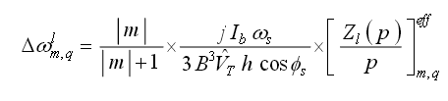
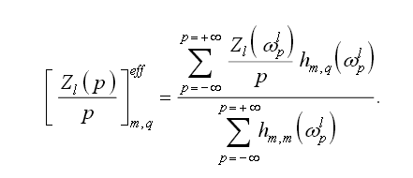
Crab cavity simulations and importing into LHC impedance model
Crab cavities have large resonances
  simulated through eigenmode solver → f, R, Q
Is there anything besides the resonances?
  Effect on synchrotron and betatron tune shift would come from effective longitudinal and transverse impedances
Complex tune shifts
Effective impedance
Potential well distortion
single bunch instabilities
Integral of
spectrum * impedance Z/n
Effective impedance
need for accurate description
of the frequency behaviour
down to low frequencies and
up to the max beam frequency
for mode 0
Sacherer formula, in E. Métral, Overview of single-beam coherent instabilities in circular accelerators 2004

Slide 20
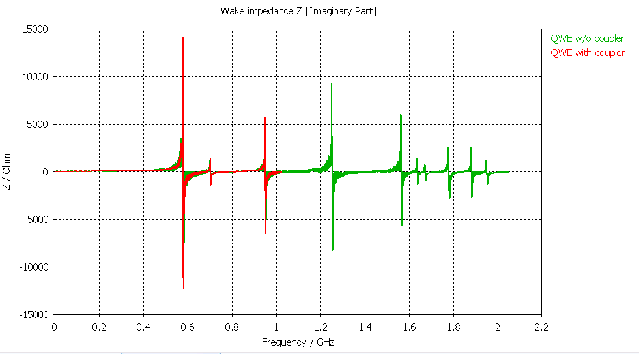
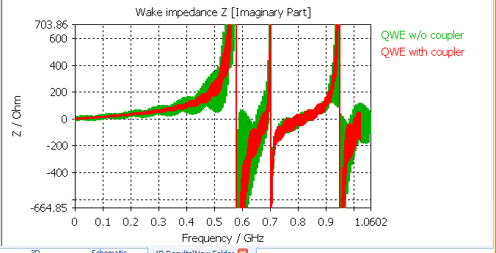
Crab cavity simulations and importing into LHC impedance model
Crab cavities have large resonances
  simulated through eigenmode solver → f, R, Q
Is there anything besides the resonances?
  Effect on synchrotron and betatron tune shift would come from effective longitudinal and transverse impedances
  Simulated through wakefield solver → ex: QWE cavity
(Z/n)^{eff} ~2.2 mOhm for 1 cavity
(Z/n)^{eff} ~36 mOhm for 16 cavity
16 crab cavities per beam would add 40 % of the total LHC impedance (below 500 MHz).
Is that acceptable for LHC beam stability?
How to account for both correct resonance parameters and correct effective impedance?

Slide 21
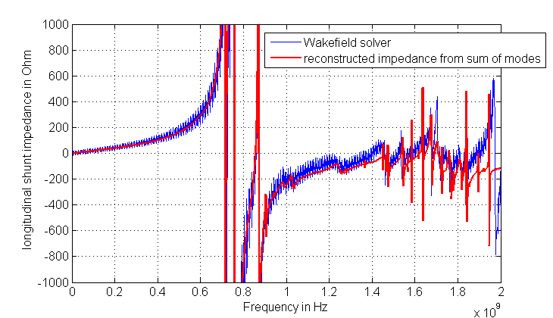
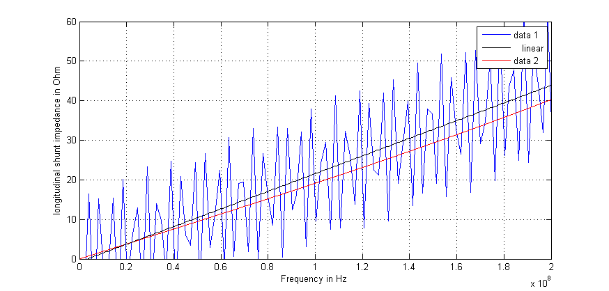
Is there anything besides the resonances?
  Question triggered at the last crab cavity workshops: are the f, R, Q resonator modes enough to represent the impedance curve at all frequencies?
  obvious problems with dispersive materials, filters, feedback, resistive wall, maybe even waveguide ports.
  OK for the case of bare cavities? Example of RF dipole cavity
Rather good agreement
→ only ~10% from Z/n low frequency slope missing
→ Where is the missing part?
Numerical error? Higher frequency modes? Non Lorentzian modes? Impact of couplers?

Slide 22
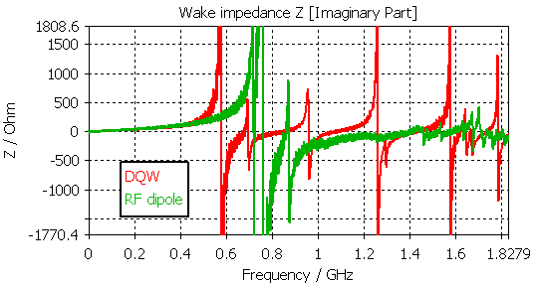
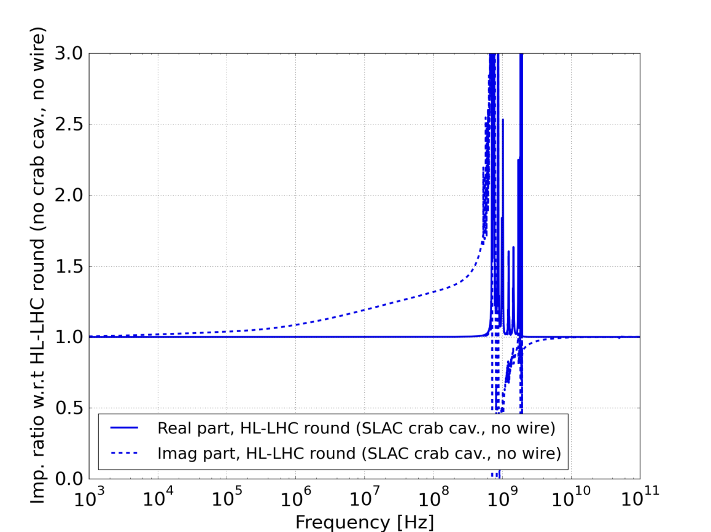
Example of RF dipole
→ ratio of increase of impedance
→ Significant impact of crab cavities on impedance model below first accelerating mode
(all of them have similar Z/n)

Slide 23
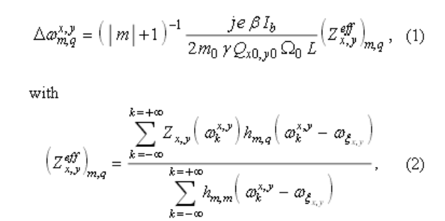
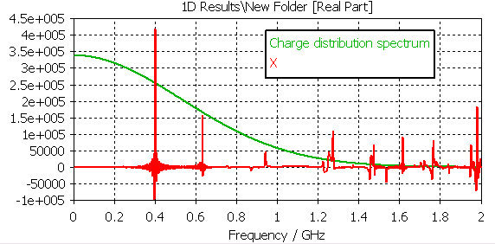
Transverse impedance
E. Métral, Overview of single-beam coherent instabilities in circular accelerators 2004
Complex tune shifts
Effective impedance
Single bunch instabilities
Headtail, TMCI
Integral of
spectrum * impedance
Effective impedance
need for accurate description
of the frequency behaviour
down to low frequencies and
up to the max beam frequency
for mode 0
Impedance in Ohm/m

Slide 24
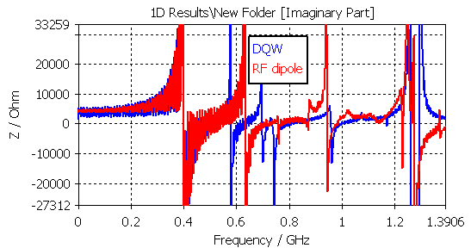
DQW and RF dipole comparison for transverse impedance
Beam displacement= 5 mm
Z^{eff} ~ 20 Ohm/5 mm=4 kOhm/m for 1 cavity
Z^{eff} ~ 30 Ohm/5mm*16=100 kOhm/m for 16 cavities (<Zx+Zy>)
Which is 5% compared to the total LHC impedance at injection (~2 MOhm/m)
However, beta in collisions can be of the order of 4 km → Z^{eff} ~ 100e3 *4000/70= 5 MOhm/m for 16 cavities
16 crab cavities per beam would add 25 % of the total LHC impedance (below 400 MHz).
Is that acceptable for LHC beam stability?
How to account for both correct resonance parameters and correct effective impedance?
Need to disentangle between driving and detuning terms of the transverse impedance

Slide 25
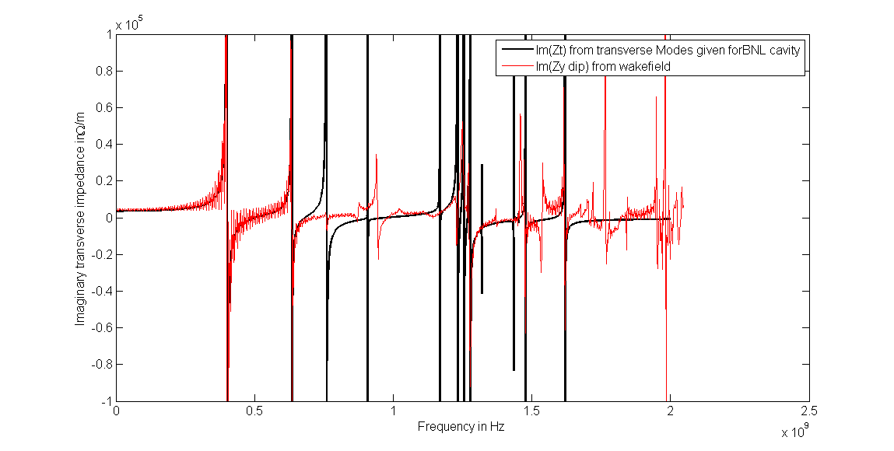
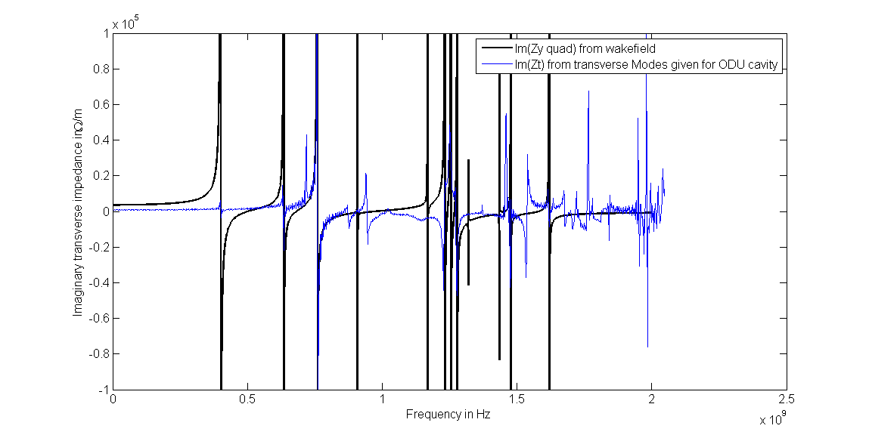
Need to distinguish between driving and detuning impedance
Driving impedance is linked to the exciting particle’s position → coherent effect (tune shift)
Detuning impedance is linked to the particle that feels the wakefield
→ incoherent effect (tune spread)
→ Can be obtained from wakefield solvers. How about eigenmodes?
Comparison with driving impedance (RFdipole)
Comparison with detuning impedance (RF dipole)
driving
mode
driving
mode
detuning
mode
Frequency in GHz
Frequency in GHz
→ Driving and detuning impedances (also called dipolar and quadrupolar) have very different
impact on transverse beam dynamics and should be disentangled
→ Transverse dipolar impedance below the first deflecting mode misses 15% to 20%
of the impedance

Slide 26
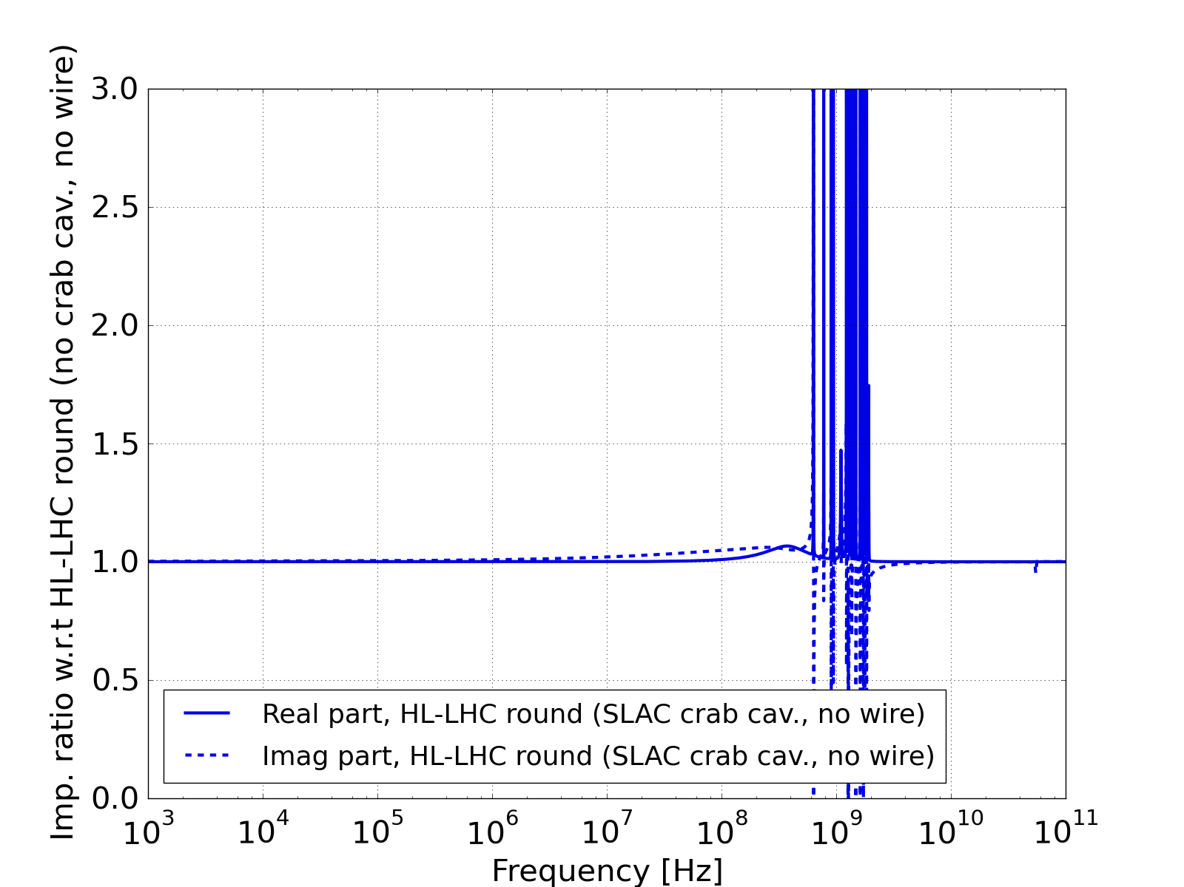
Contribution of crab cavity to LHC transverse impedance model
Impact of RF dipole cavity (deflecting mode kept, but damped to Qext=1)
N. Mounet et al
(Preliminary)
noticeable on the current LHC model, but impact below first deflecting mode smaller than expected. To be checked.
Impact on beam dynamics?

Slide 27
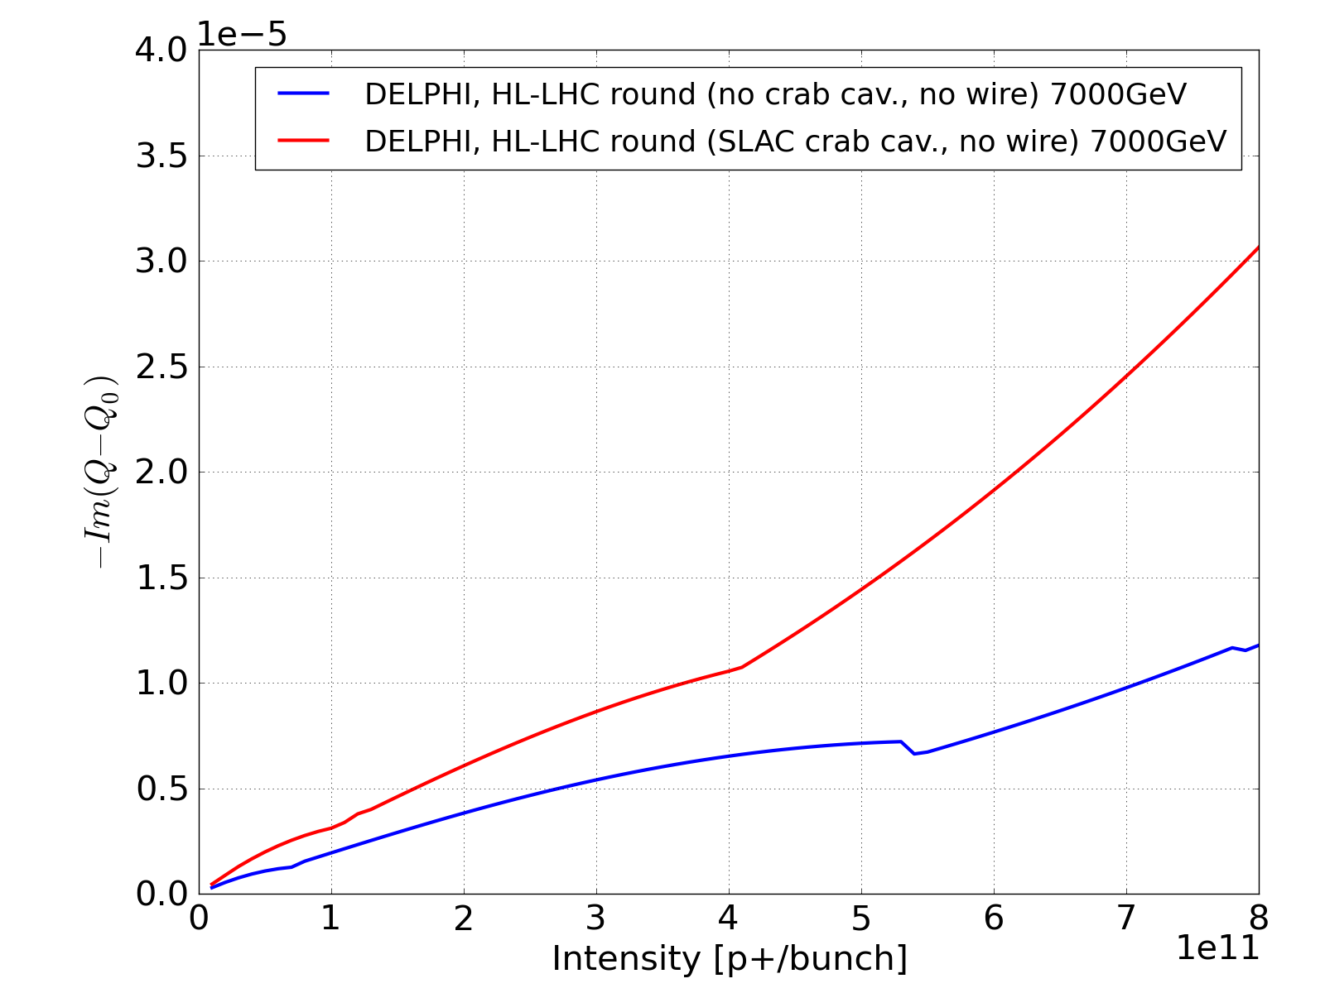
Impact on beam dynamics (preliminary): growth rates
DELPHI computations by N. Mounet
Single bunch, Q’=15
50 turns damper
Instability Growth rate vs intensity
With and without crab cavities
→ Impact on single bunch transverse instability growth rate is not small (~factor 2)

Slide 28
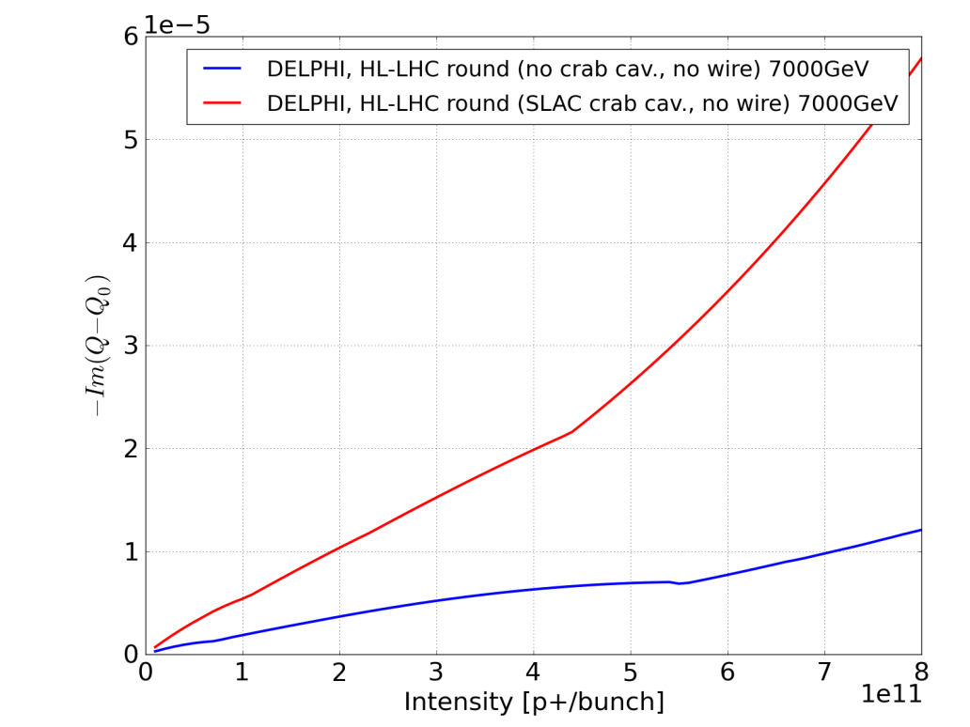
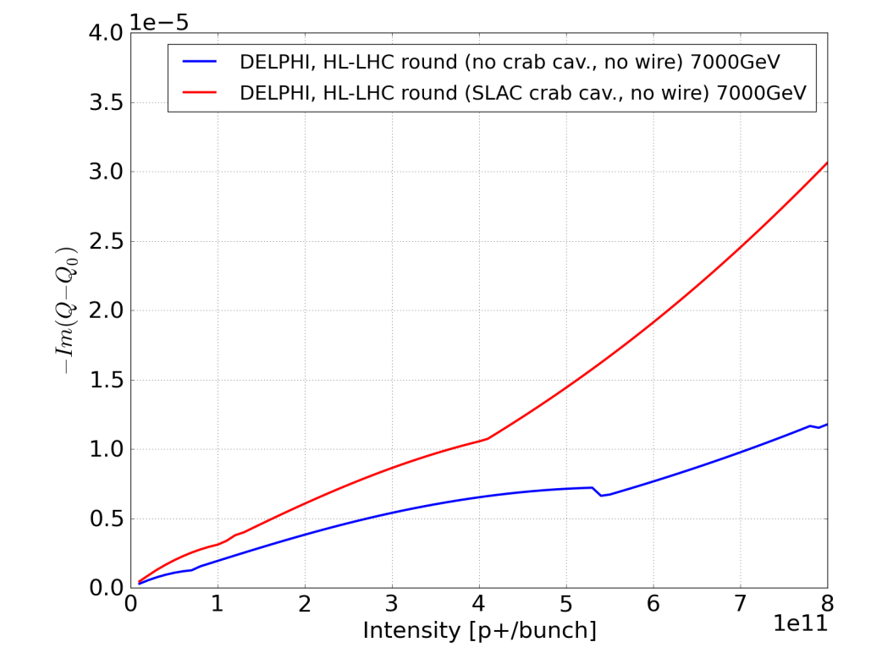
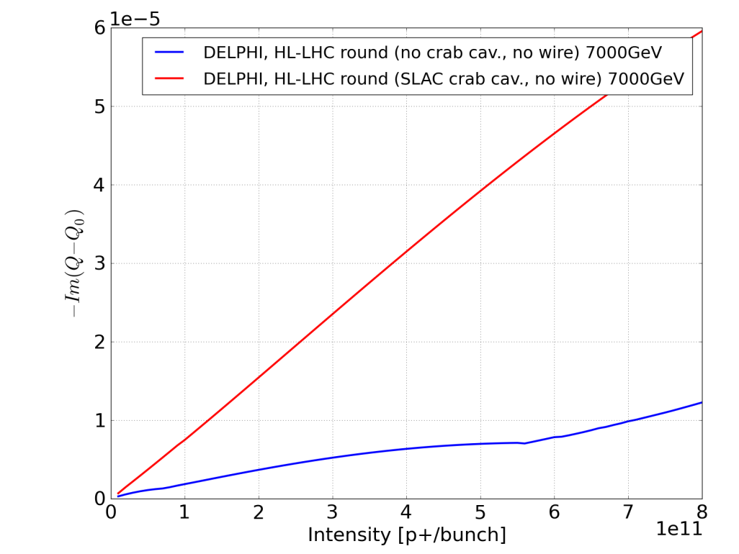
Impact on beam dynamics (preliminary): growth rates
50 ns beam, Q’=15
50 turns damper
Instability Growth rate vs intensity
With and without crab cavities
Single bunch, Q’=15
50 turns damper
25ns beam, Q’=15
50 turns damper
→ It gets worse for multibunch (factor 3 to 5)

Slide 29
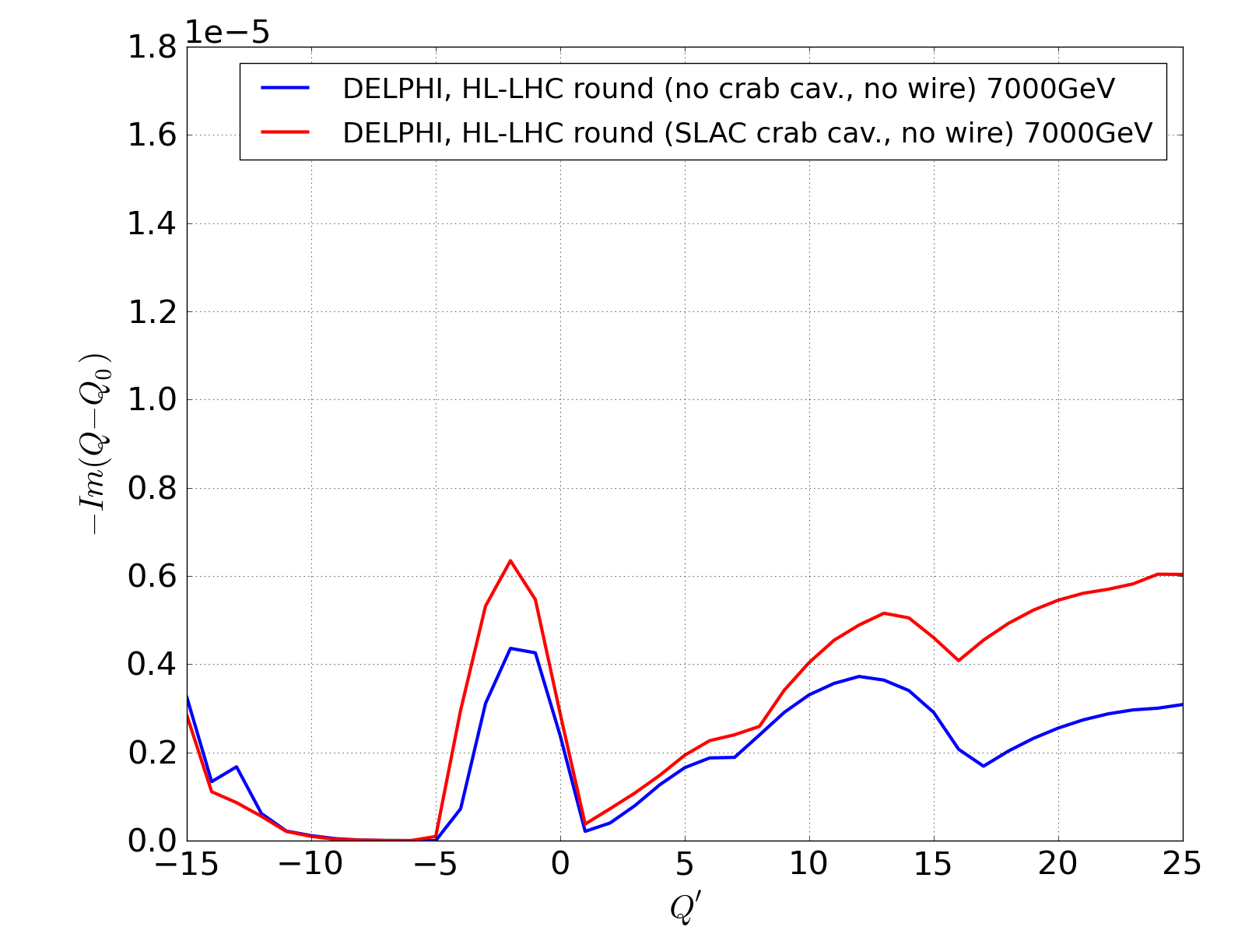
Impact on beam dynamics (preliminary): growth rates
Instability Growth rate vs chromaticity
With and without crab cavities
Single bunch, Q’=15
50 turns damper
→ Impact on single bunch transverse instability growth rate is not small (up to factor 2)

Slide 30
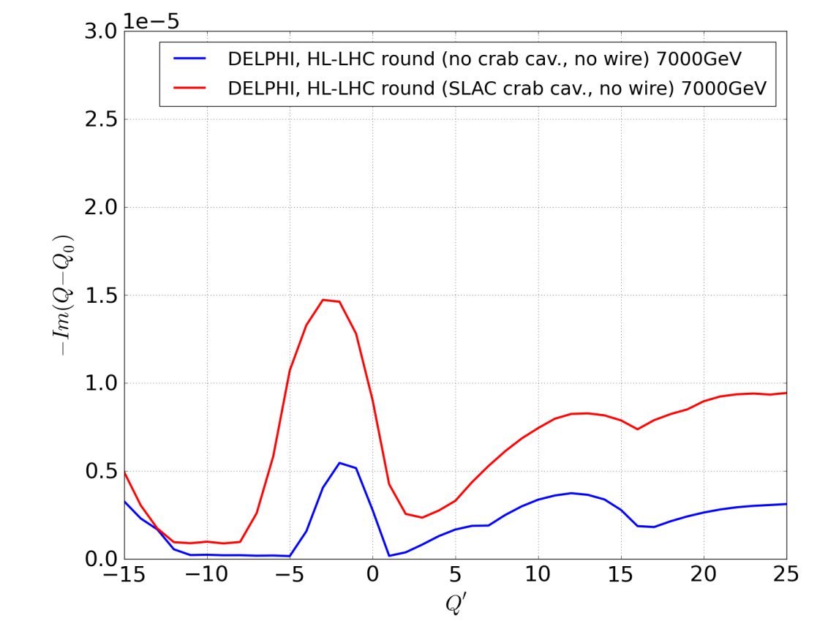

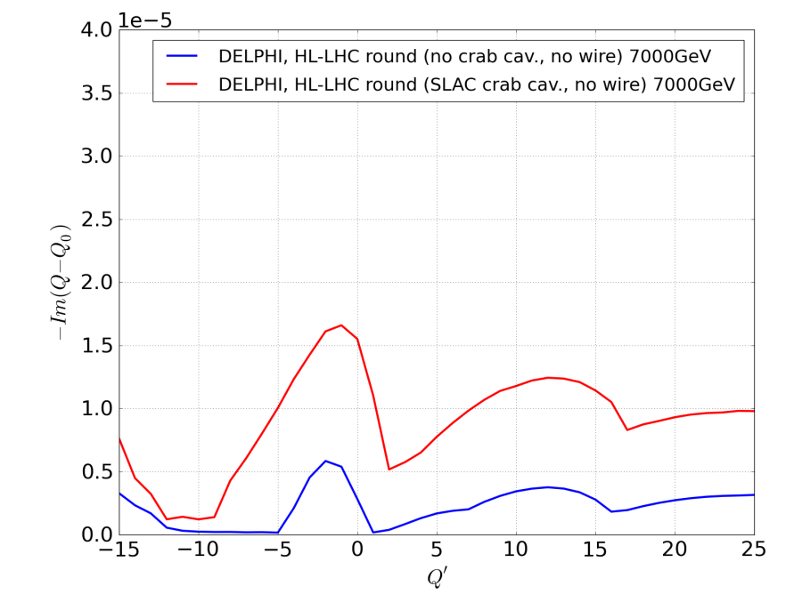
Impact on beam dynamics (preliminary): growth rates
Instability Growth rate vs chromaticity
With and without crab cavities
50 ns beam, Nb=1.5e11 p/b
50 turns damper
Single bunch, Nb=1.5e11 p/b
50 turns damper
25ns beam, Nb=1.5e11 p/b
50 turns damper
→ It gets worse for multibunch (factor 3 to 5)

Slide 31
Significant impact predicted on transverse beam stability, even when modes are well damped.
Further studies to confirm and identify which mode(s) is responsible or whether it is due to the aggregated R/Qs.
Will that be a problem for HL-LHC?
  We were limited by such instabilities in mid-2012, but mitigations have been put in place.
  Already very significant effort by designers to damp Qext as much as possible
  We have to accept the fact that crab cavities will come at the cost of higher impedance and be prepared to implement more mitigation measures (e.g. collide and squeeze, spreading of transverse modes).
  For instance, In this high-β region the impact of striplines is expected to also be significant for instance.
  The potential loss of LHC performance due to crabs (if any) should be weighted with the potential gains when the decision of installation should be taken

Slide 32
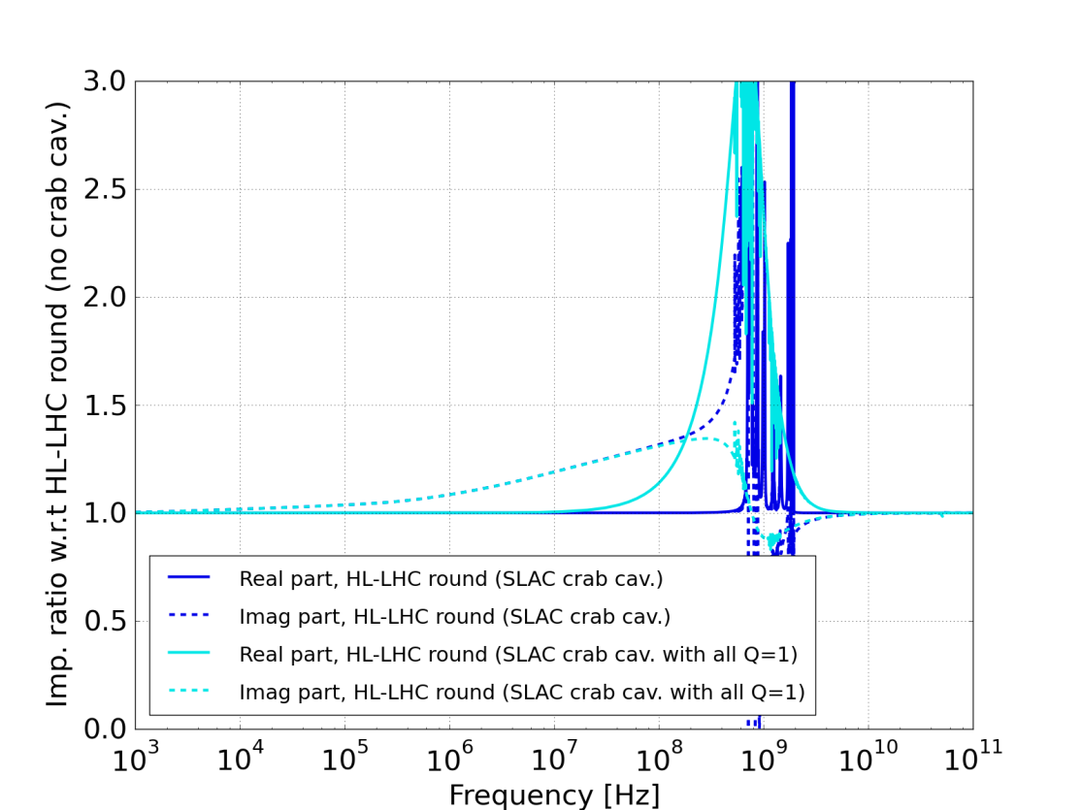
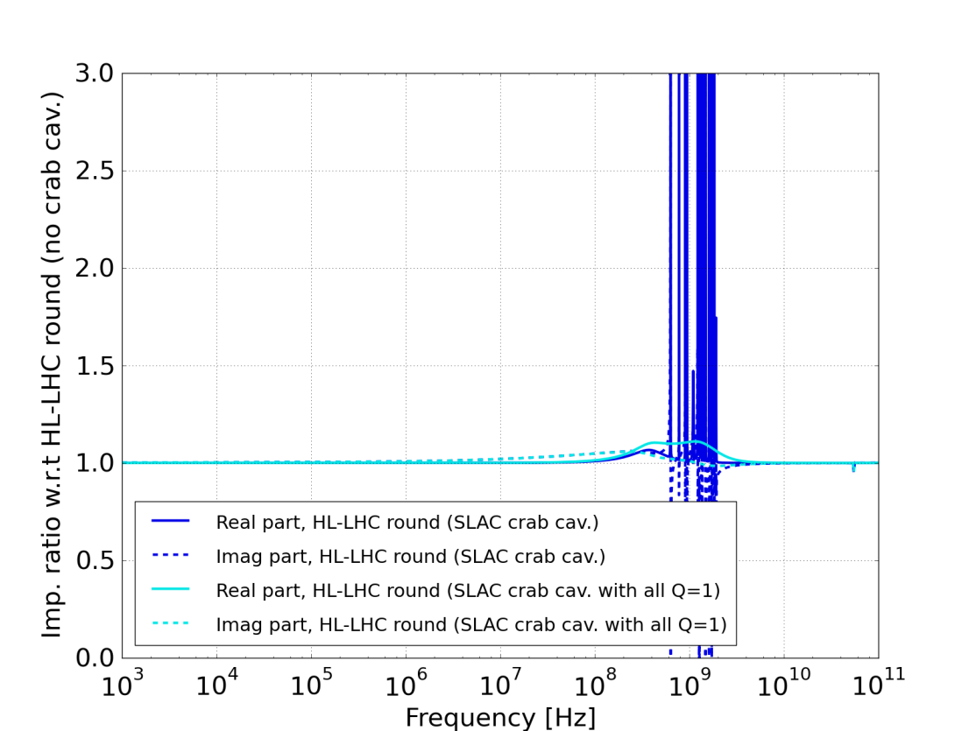
Efect of Damping all modes
Longitudinal Transverse

Slide 33
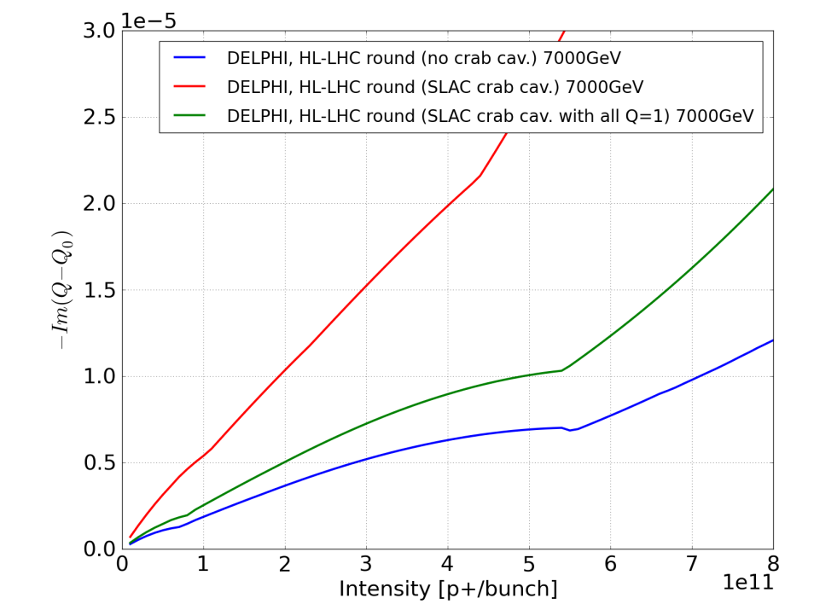
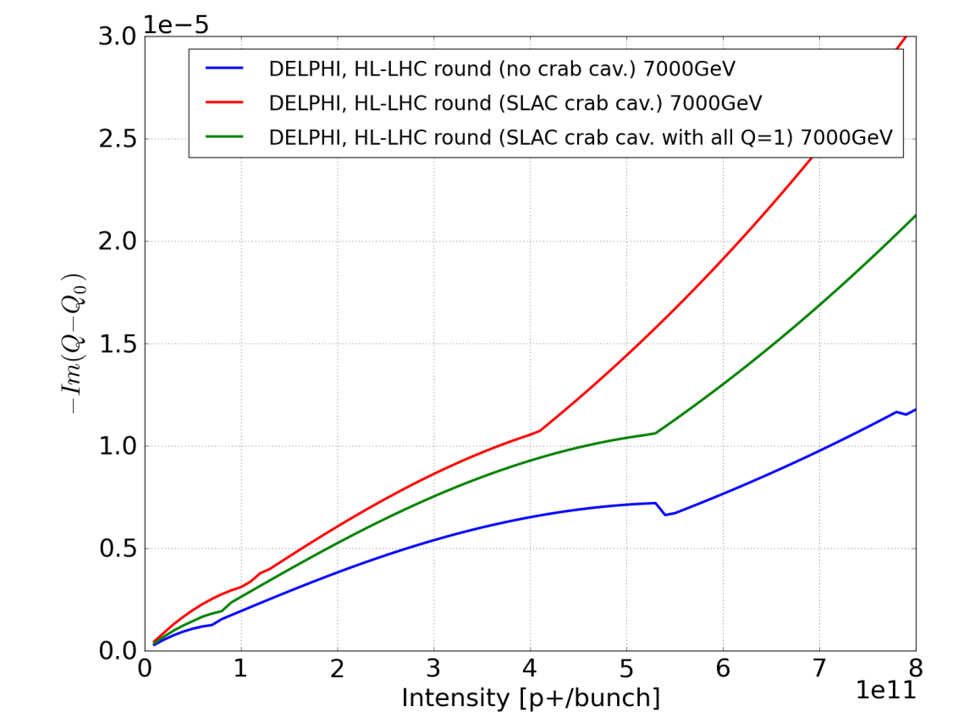
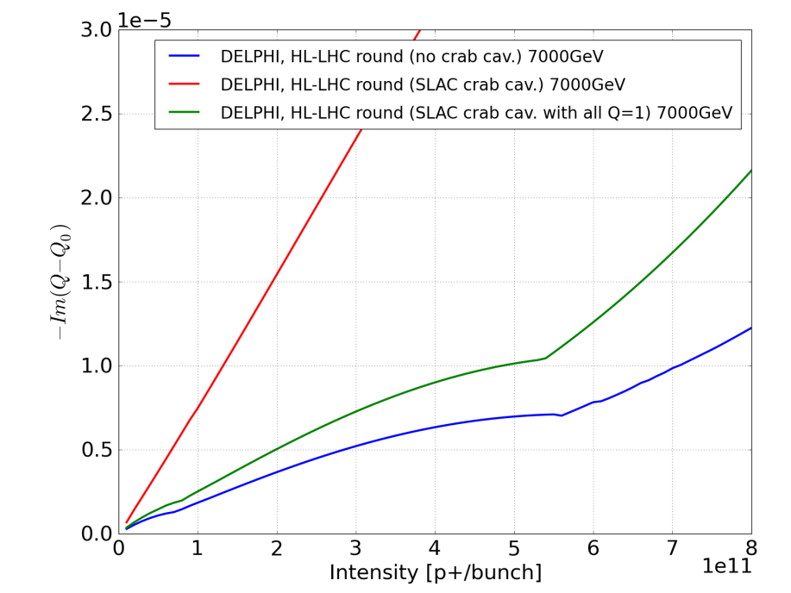
Impact on beam dynamics (preliminary): growth rates
50 ns beam, Q’=15
50 turns damper
Instability Growth rate vs intensity
With and without crab cavities
Single bunch, Q’=15
50 turns damper
25ns beam, Q’=15
50 turns damper
→ It gets worse for multibunch (factor 3 to 5)

Slide 34
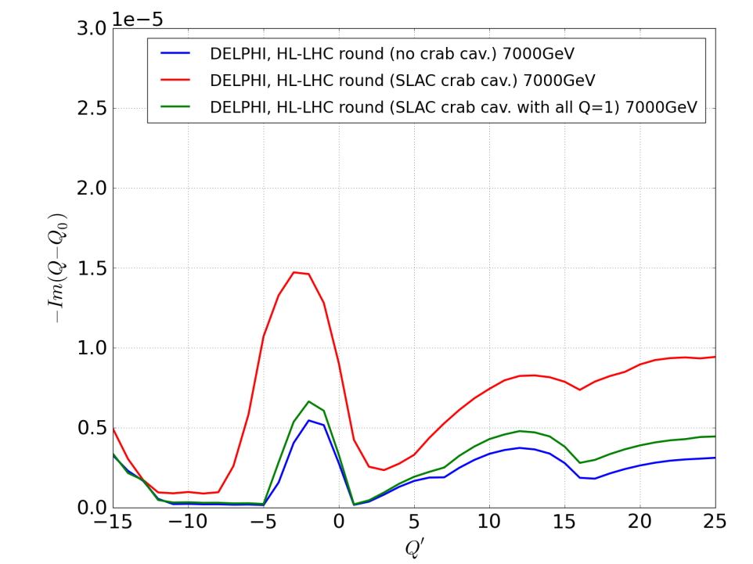
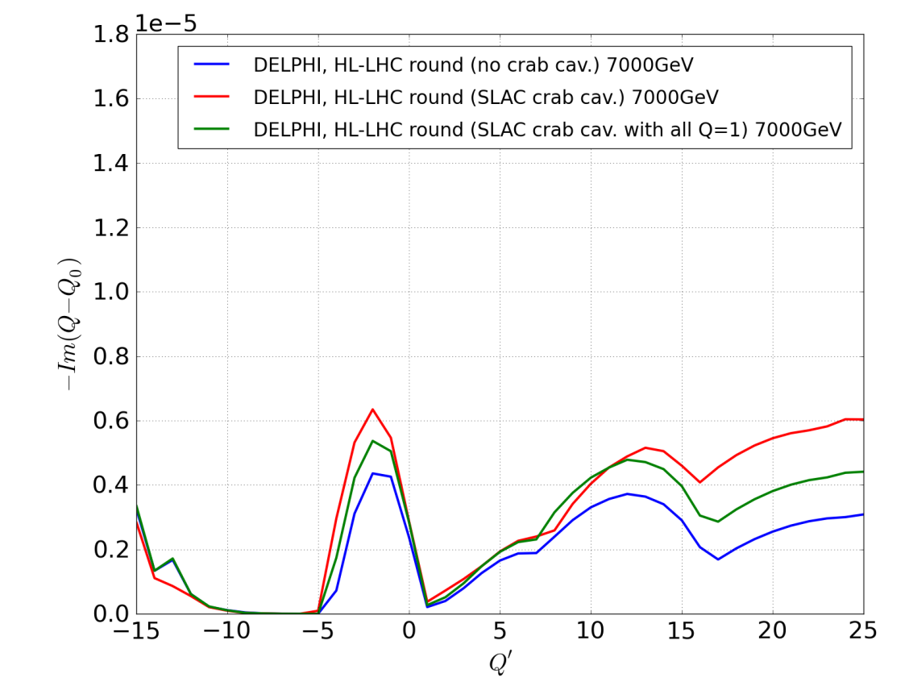
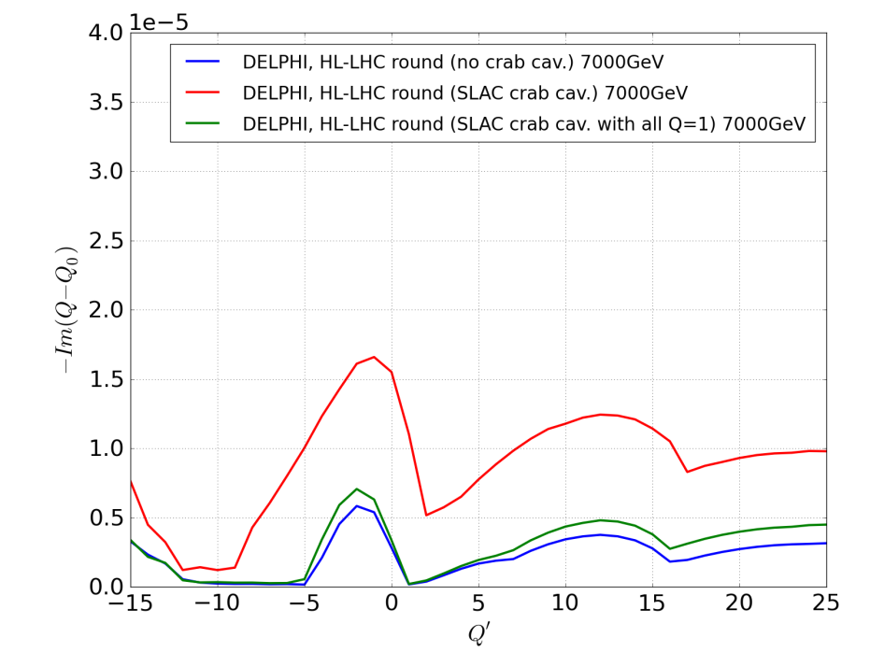
Impact on beam dynamics (preliminary): growth rates
Instability Growth rate vs chromaticity
With , without crab cavities and with damped
crab cavities
50 ns beam, Nb=1.5e11 p/b
50 turns damper
Single bunch, Nb=1.5e11 p/b
50 turns damper
25ns beam, Nb=1.5e11 p/b
50 turns damper
→ It gets worse for multibunch (factor 3 to 5)

Slide 35
Agenda
Context
  LHC impedance
SPS crab cavity tests
  Impedance of the new Y chamber
  Impedance of the crab cavities
  Power expected from resonant modes
LHC operation
  Longitudinal stability limits
  Contribution compared to the LHC model
  Power expected from resonant modes
Summary

Slide 36
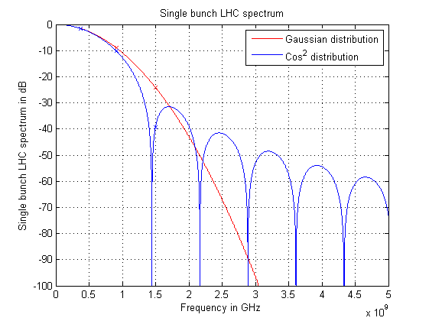
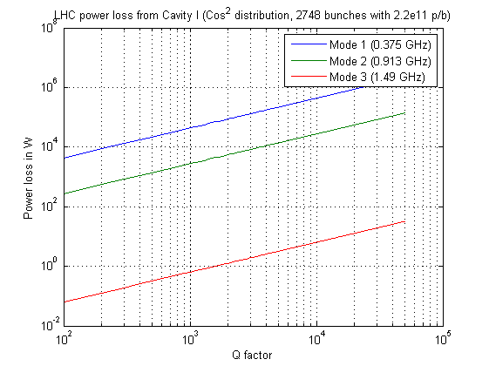
Power from LHC beam (cavity I, Lancaster)
1 ns bunch length, 2748 bunches with 2.2e11 p/b
worst case scenario (on beam spectrum line)
→ With Q=1000, power loss for the worst mode (375MHz) is ~40 kW

Slide 37
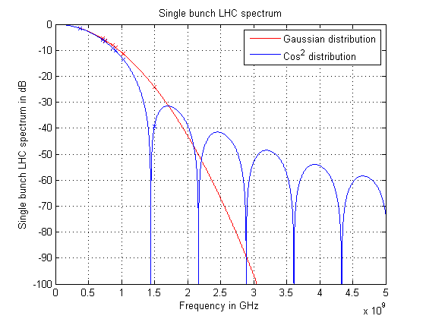
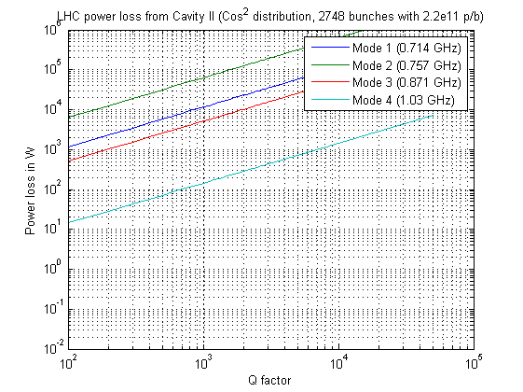
Power from LHC beam (cavity II, ODU)
1 ns bunch length, 2748 bunches with 2.2e11 p/b
worst case scenario (on beam spectrum line)
→ With Q=1000, power loss for the worst mode (772MHz) is ~10 kW

Slide 38

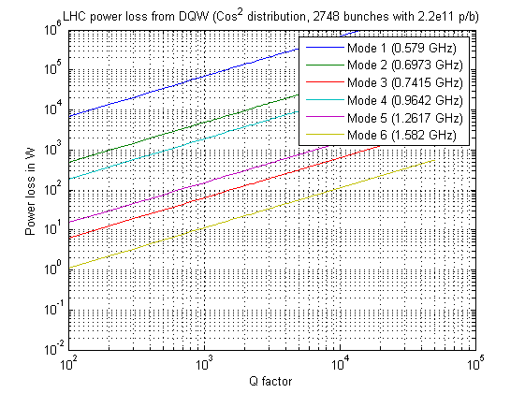
Power from LHC beam (cavity III, BNL)
1 ns bunch length, 2748 bunches with 2.2e11 p/b
worst case scenario (on beam spectrum line)
→ With Q=1000, power loss for the worst mode (570MHz) is ~70 kW
→ Significant decrease since last CC13 workshop for all cavities!

Slide 39
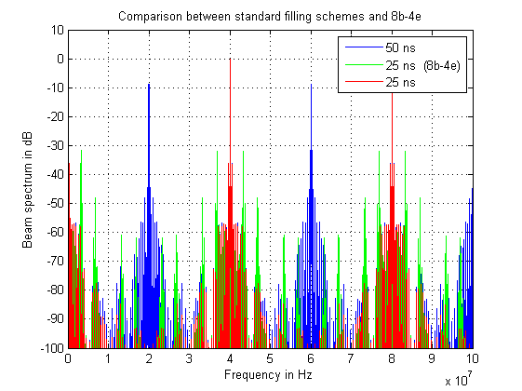
Potential beam spectra after LS1
Example: 8b+4e filling scheme is not as symmetric as the regular schemes
→ Larger sidebands

Slide 40
Agenda
Context
  LHC impedance
SPS crab cavity tests
  Impedance of the new Y chamber
  Impedance of the crab cavities
  Power expected from resonant modes
LHC operation
  Longitudinal stability limits
  Contribution compared to the LHC model
  Power expected from resonant modes
Summary

Slide 41
Summary
It would be useful to collect all updates on geometries and resonant parameters of all crab cavities, which is not the case so far.
Impact of 2 crab cavities on SPS beam impedance seems limited.
Impact on LHC beam impedance is predicted to be significant in both longitudinal and transverse planes (16 cavities + very large transverse beta functions), despite the large effort to minimize the impact by the design teams.
We have to admit that there are a lot of unknowns concerning what will limit us for HL-LHC, and setting impedance limits is therefore tricky.
Current longitudinal limit for all new LHC hardware is set to 200 kΩ (conservative for modes above 600 MHz). Current transverse limit is set by checking the impact of the new hardware on beam dynamics.
In all this talk (and in general for collective effects at CERN), we are working with the so-called circuit convention :
$$R_{s}=\frac{V^{2}}{2P}$$

Slide 42
Thank you for your attention

Slide 43
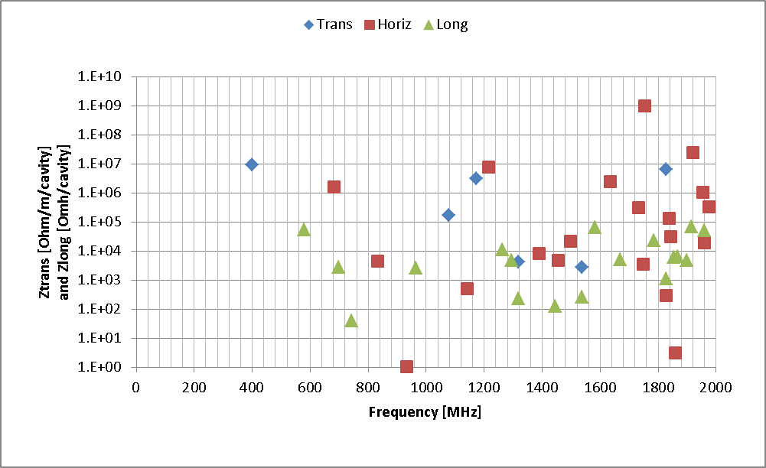
News since December
Table of HOMs provided for QWE (Silvia from BNL)
Table of HOMs provided for DQWCC (but main transverse deflecting mode missing)
What about the third option?
QWE cavity
Still some questions to be answered

Slide 44
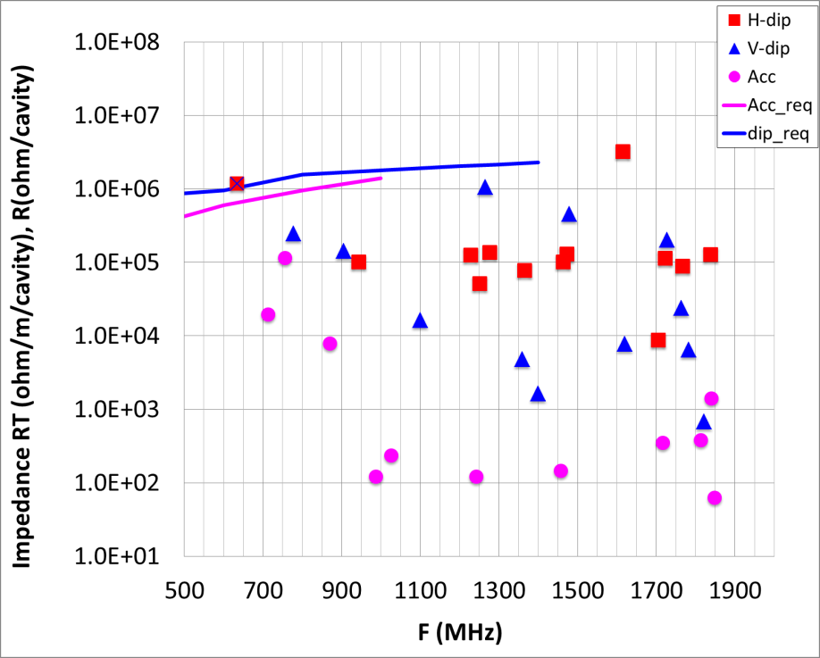
Shunt impedances: QWE vs RF dipole
→ Longitudinal modes all below 100 kOhm
→ Some transverse modes of the order of 10 MOHm/m (per cavity), impact to be checked by DELPHI

Slide 45
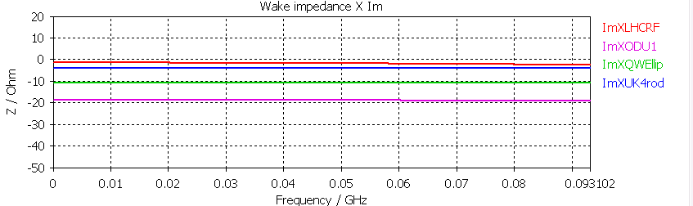
Low frequency transverse impedance of crab cavities
(16 per beam)
 | 1 cavity Zx in Ω | 1 cavity Zy in Ω | 1 cavity <Z>= (Zx+Zy)/(2*d) in Ω/m | 1 cavity Zeff=<Z>*β/<β> in Ω/m | 16 cavity Zeff=<Z>*β/<β> in Ω/m
LHCRF | 6 | 2 | 800 | 800 | 6.4E+03 (8 cav)
BNL | 18 | 10 | 2800 | 93E03 | 1.5E+06
ODU | 10 | 19 | 2900 | 97E03 | 1.6E+06
UK | 25 | 4 | 2900 | 97E03 | 1.6E+06
In collisions, β =4km and <β> =120 m is the average beta at the collimators, main
impedance source which is not changing with the new optics.
At injection, 16 cavities represent 2.5% of the full LHC impedance, in collisions 6%

Slide 46
Impedance model (from Nicolas)
Added the QWE transverse modes (no additional broadband contribution added)
Crosschecks ongoing to confirm that we can use the transverse R/Qs directly.
→ issue of the

Slide 47

Comparison between list of modes and wakefield

Slide 48

Comparison between eigenmode and wakefields

Slide 49

Comparison between Eigenmode and Wakefields
Good agreement for low frequency.
Could be reasonable to sum all the resonator modes also for low frequency

Slide 50


Effect of vertical impedance
Current issue: we model the modes as resonators and the sum of R/Qs from the table
do not match the low frequency imaginary impedance from wakefield.
Also: modes beyond the deflecting modes are very different. To be understood.

Slide 51

Effect of horizontal impedance

Slide 52
Conclusions
Adding resonators in the model could be consistent for transverse plane
Need for more crosschecks before the review

Slide 53




Slide 54

Low frequency longitudinal impedance of crab cavities (8 or 12 per beam) - preliminary
3D models from
R. Calaga
Q. Wong
B. Hall
S. De Silva
 | For 1 cavity Z/n (mOhm) | for 12 cavities Z/n (mOhm)
LHCRF | 1.7 | 14 (8 cavities)
BNL | 1.8 | 22
ODU | 2.2 | 26
UK | 2.4 | 29
To be compared to the current LHC budget
of 90 mOhm
Very large contribution (20% to 30%) to be followed up with BE/RF-BR

Slide 55
Low frequency transverse impedance of crab cavities
(8 or 12 per beam) - preliminary
 | 1 cavity Zx in Ω | 1 cavity Zy in Ω | 1 cavity <Z>= (Zx+Zy)/(2*d) in Ω/m | 1 cavity Zeff=<Z>*β/<β> in Ω/m | 12 cavity Zeff=<Z>*β/<β> in Ω/m
LHCRF | 6 | 2 | 800 | 800 | 6.4E+03 (8 cav)
BNL | 18 | 10 | 2800 | 93E03 | 1.1E+06
ODU | 10 | 19 | 2900 | 97E03 | 1.2E+06
UK | 25 | 4 | 2900 | 97E03 | 1.2E+06
In collisions, β =4km and <β> =120 m is the average beta at the collimators, main
impedance source which is not changing with the new optics.
At injection, 12 cavities represent 2% of the full LHC impedance, in collisions 4%

Slide 56
Ideas
Very significant efforts by cavity designers to reduce Qext, and push modes to higher frequencies.
How far from the beam harmonics should be the HOMs?
even if modes below the set limit, not clear that we will be able to reach the expected HiLumi parameters
→ stripline BPMs are already creating issues in IR
→effort of designers are not in vain
→ should be ready to implement solutions to mitigate the very high beta functions.

