Slide 1

Crab cavities cryogenics
– constraints and solutions
Crab Cavity review
– Brookhaven National Laboratory, USA
5-6 May 2014
K. Brodzinski
on behalf of cryogenic team at CERN

Slide 2
Contents
Cryogenics for SPS
  Cryogenic circuits
  Heat load and cooling capacity discussion – new heavy constrain
Cryostat design
  Cryostat circuits and instrumentation
  SM-CM interface first concept
  Pressures, protection and safety, operation aspects
Cryogenics for LHC - concept for LHC P1 and P5
Conclusions

Slide 3
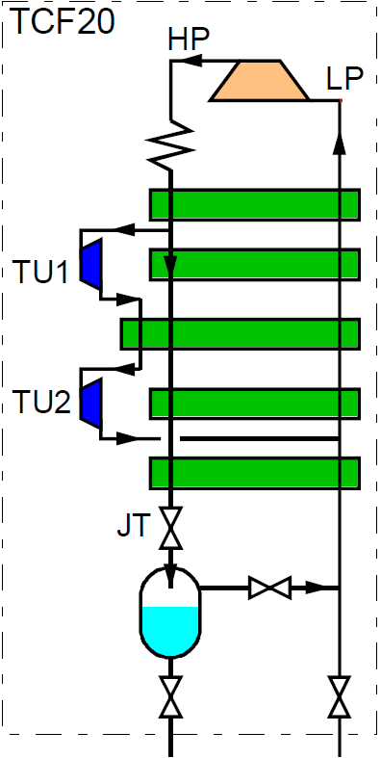
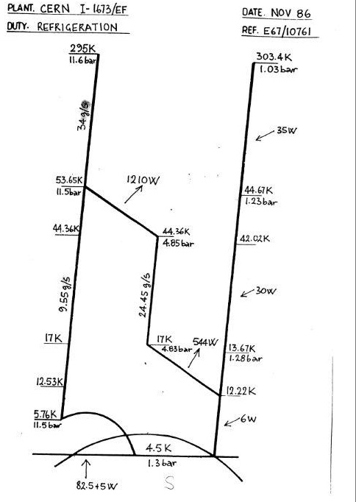
Cryogenic infrastructure in SPS BA4
Crab cavity cooling at 2 K ➔ TCF20 cryoplant used in pure liquefaction
TCF20 means 20 l/h = 0.7 g/s of LHe, expected max.1.5 g/s with LN2 boost
TCF20 T-S Diagram
Guaranteed capacity in refrigeration mode: 87.5 W @ 4.5 K
(i.e. isentropic equivalent to ~0.85 g/s of liquefaction)
CC x 2
black –> existing 4.5 K
red –> to be constructed 2 K
The cold box is OK and will run for COLDEX until end of 2015 but has not sufficient capacity for CC testing in liquefaction mode !

Slide 4
Consequence
Regarding 2 K refrigeration
Second source of LHe
Draft version
Buffer tank
Service module
R
EH
TT
From LN2
precooler
JT
CC cryostat
Screen
PT
LT
Coupler/HOM/LOM intercept
CWT
CWT
CC x 2
black –> existing 4.5 K
red –> to be constructed 2 K
Screen
EH
TT

Slide 5
Heat load 1/2
Equipment | Heat load | Source of capacity
Service module | ~2.5 W @ 4.5/2K ~30 W @ 80 K | Cold box -> 0.13 g/s LN2
Buffer tank | ~1.5 W @ 4.5 K | Cold box -> 0.08 g/s
Transfer lines | ~4 W @ 4.5 K | Cold box -> 0.21 g/s
Cryo module static | ~14 W @ 2 K 223 W @ 80 K | Cold box -> 0.68 g/s LN2
Cryo module dynamic | ~11 W @ 2K | Buffer -> 0.5 g/s
Total static: | ~22 W | Cold box -> ~1.1 g/s
CC Annual review,
CERN, December 2013
Equipment | Heat load | Source of capacity
Service module | ~2.5 W @ 4.5/2K ~30 W @ 80 K | Cold box -> 0.13 g/s LN2
Buffer tank | ~1.5 W @ 4.5 K | Cold box -> 0.08 g/s
Transfer lines | ~4 W @ 4.5 K | Cold box -> 0.21 g/s
Cryo module static | ~18.6 W @ 2 K 286 W @ 80 K | Cold box -> 0.9 g/s LN2
Cryo module dynamic | ~13.4 W @ 2K ~30 W @ 80 K | Buffer -> 0.6 g/s LN2
Total static: | ~26.6 W | Cold box -> ~1.32 g/s
Current estimation
0.6*1.5=0.9 g/s
1.32*1.5=1.98 g/s
R. Bonomi, O. Capatina, F. Carra, V. Parma, K. Brodzinski
5

Slide 6
Consequence
Regarding 2 K refrigeration
Second source of LHe
Draft version
Buffer tank
Service module
R
EH
TT
From LN2
precooler
JT
CC cryostat
Screen
PT
LT
Coupler/HOM/LOM intercept
CWT
CWT
CC x 2
black –> existing 4.5 K
red –> to be constructed 2 K
Screen
EH
TT
The cryogenics is to be upgraded to higher capacity – it will cost money and time

Slide 7
Solutions for BA4 cryo capacity
storage
TCF20’ CNRS CB
max. 2.1 g/s (for indication: 0.12 g/s -> 150 L buffer filling time of ~40 h)
BA4
TCF20
max. ~1.5 g/s with boost
1:
Comments:
Additional time needed to remove old CB and install new one or add new one to the installation
Still well limited with the new CB in case of replacement, potential problems with integration and handling of flush from the buffer in case of new CB adding
CryoLab
TCF50
max. ~3 g/s with boost
storage
TCF200 (w/o comp.)
max. 7 g/s
BA4
2:
Comments:
Additional time needed to remove old CB and install new one
CryoLab affected with availability and additional work, new compressor for TCF200 is to be bought
Both options require additional money, manpower and time to perform the mechanical work at BA4 after end of COLDEX operation and before CC SPS testing (~min. 1 month – to be precisely calculated).
State of the Art is required for the cryo module design.
7

Slide 8
Heat load 2/2
Summary (assuming cold box capacity of 3 g/s):
Total Static: 1.98 g/s
Dynamic: 0.9 g/s
Total Static + Dynamic = 1.98+0.9=~2.9 g/s < 3 g/s -> run without buffer is theoretically possible
For security reasons we plan to install 150 L dewar for dynamic heat load compensation
The aim is to design the system in a such a way to provide cooling capacity for at least 8 hours of operation /day (refilling of the dewar will be done during the nights).
8

Slide 9
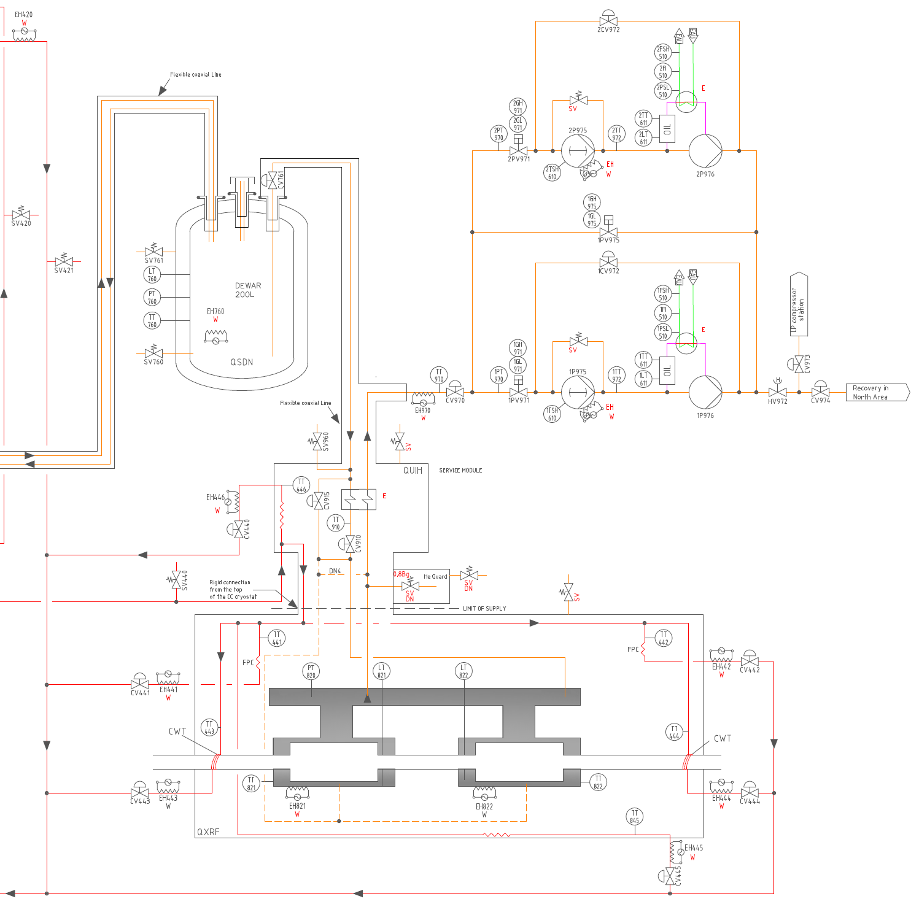
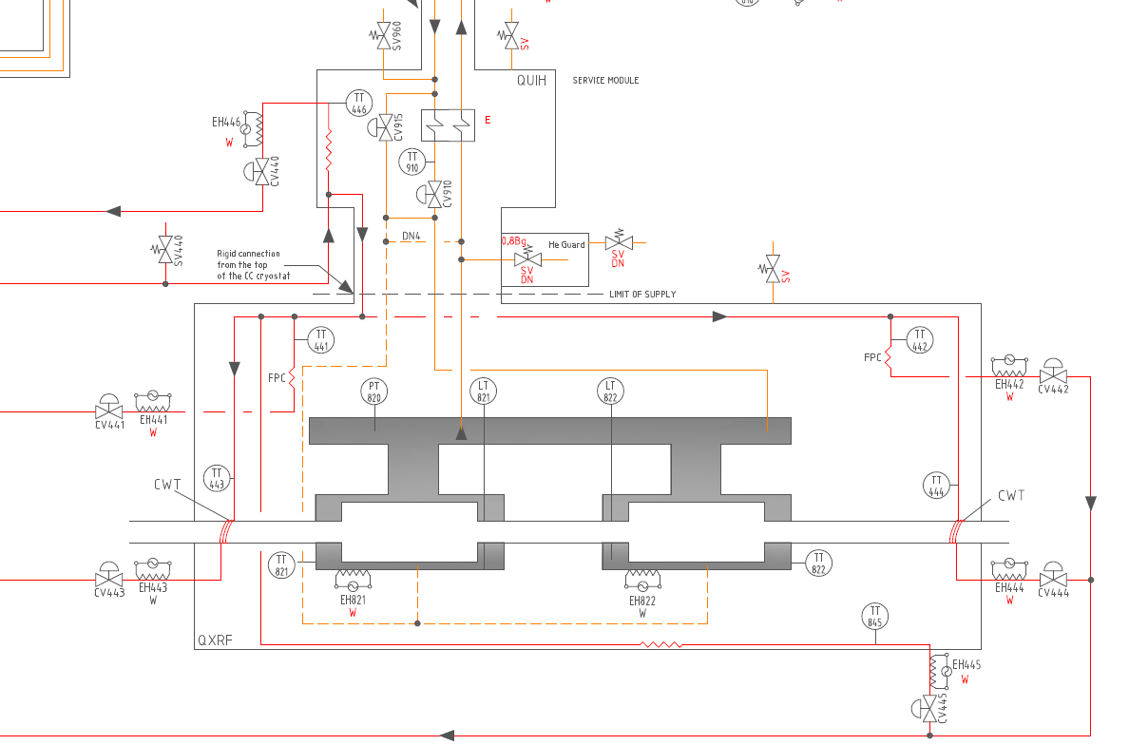
Process and instrumentation
Draft version - still some discussions are needed with module builders to match with the final design

Slide 10
Safety devices
Assembly of cavity with helium tank have to be designed to withstand pressure of at least 2.6 bar (deltaP of 2.6 bar) without plastic deformation at ambient temperature.
Design pressure for the cryostat assembly should be based on installed safety devices according to design rules (cryostat equipped with a safety valve set at 1.8 bara* and a rupture disc set at 2.2 bara*, possibly one device could be installed … - analysis underway)
both safety devices will be installed in the way to avoid potential projection of helium towards the passages or transport areas (deflectors installation to be analyzed, preliminary position for the rupture disc and safety valve have been proposed on transfer line close to the cryostat interface),
Both safety devices should protect the cavity and the cryostat from pressure rise causing plastic deformations,
Both safety devices should be equipped with appropriate helium guards.
sizing of the devices -> to be done
SV @ 1.8 bara
cryostat interface
SKETCH
thermal screen at ~80 K
Rupture disc @ 2.2 bara
common pumping collector
helium tank
CWT
crab cavity
CWT
Power coupler intercept
* Value compatible with recommendations given by T. Peterson on December 2012 Fermilab meeting

Slide 11
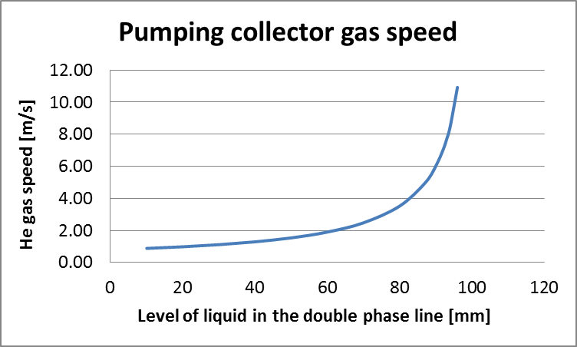
Pumping collector sizing
Requirements: gas speed lower than 5 m/s*, min 50 mm for level regulation, additional buffer
for ~ 20 min of operation, compatibility with safety devices for pressure limit requirements.
Indications: Diameter of 100 mm (recommended) allows for:
return gas speed below 5 m/s up to ~90 mm of liquid level in the collector (operation regulation level to be set at ~50 mm of LHe in the collector),
buffer volume for transients/unexpected process perturbations (half filled collector allows for ~15-20 min of operation assuming collector length of ~1.6 m and 30 W of thermal load),
compatibility with safety valves sizing is still to be checked !
* Value compatible with recommendations given by T. Peterson on December 2012 Fermilab meeting
Liquid level
100 mm
maxi: 5 m/s
~87 mm
Regulation
~50 mm
87
0 mm
* Calculation done assuming: collector diameter of 100 mm, He mass flow = 3 g/s, GHe temp = 2 K, GHe press = 20 mbar.

Slide 12
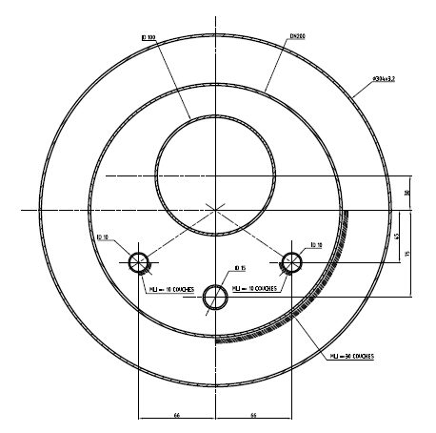
SM to CM interface 1/2
ID100
DN200
304x3.2
30
ID10
ID10
45
ID15
75
66
66

Slide 13
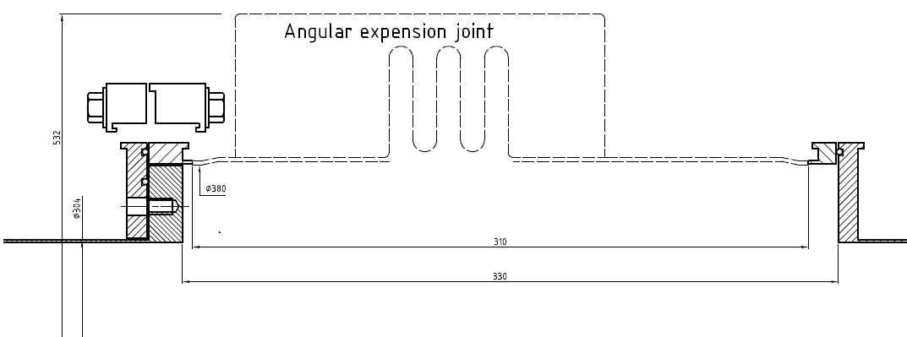
SM to CM interface 2/2
Concept of Service Module to Cryo Module jumper connection
SM
CM
~530
ambient
304
380
vacuum
310
330
The internal lines will be equipped with flexible hoses on SM side,
the connection concept study is underway, 3D model with necessary dimensions should be ready by end of June.

Slide 14
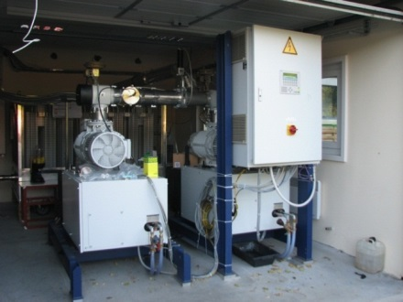
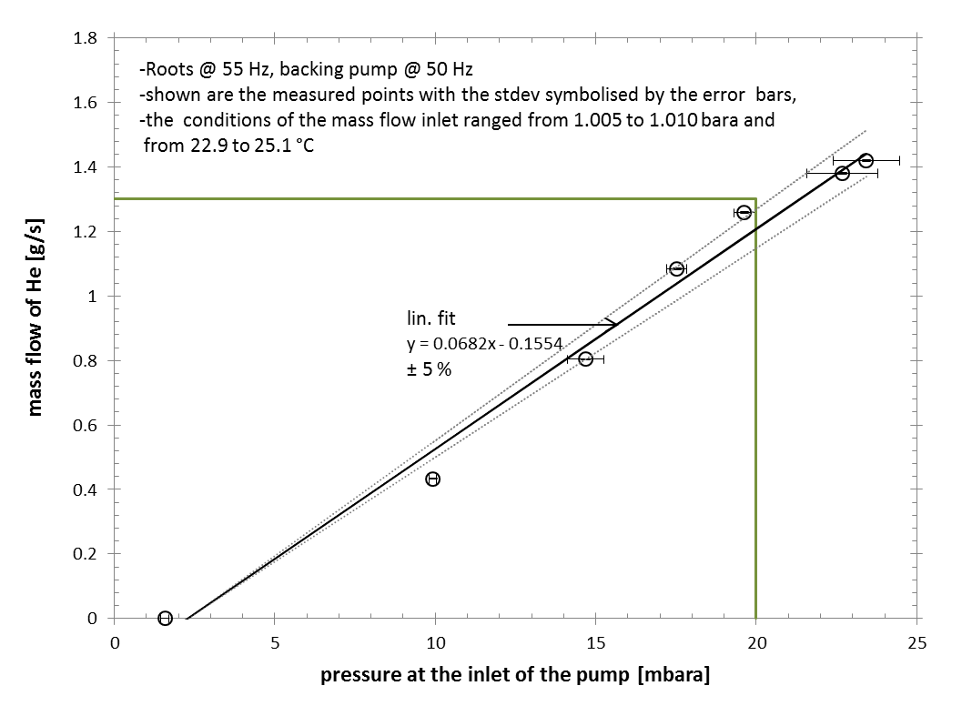
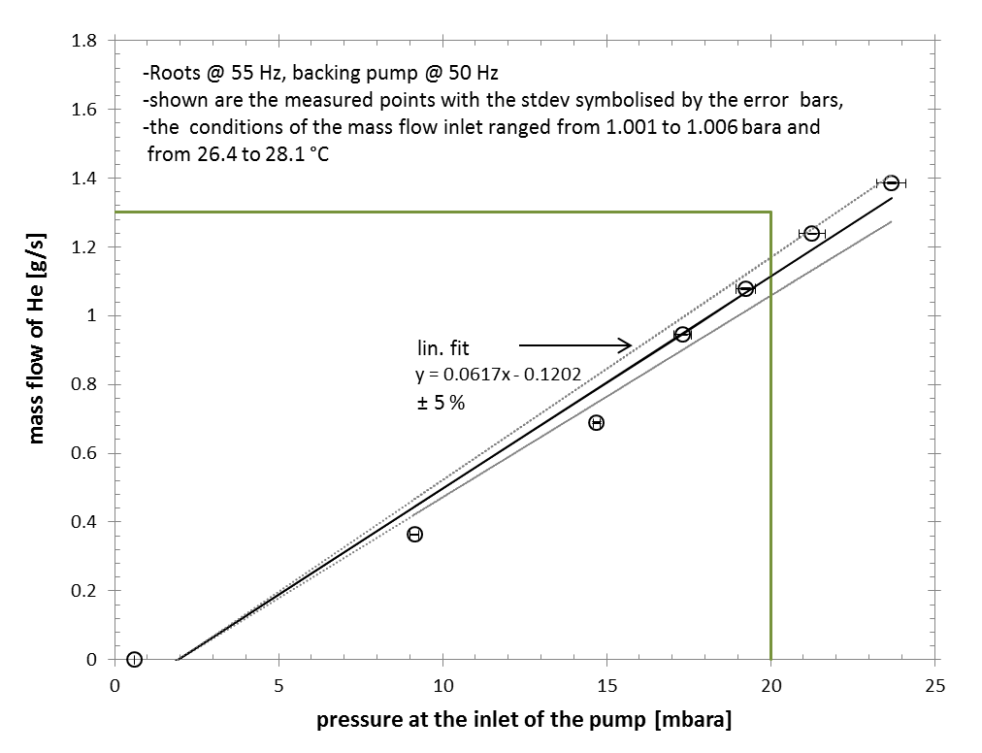
2 K helium pumps
OK for CC SPS test
The check shows that assuming inlet pressure of 20 mbar two pumping units are capable to pump ~2.3 g/s of helium, what gives ~3.5 g/s at 30 mbar (2 K saturation)

Slide 15
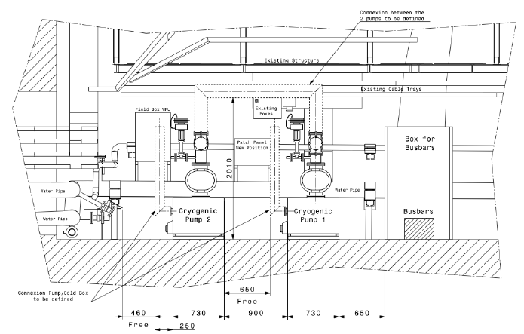
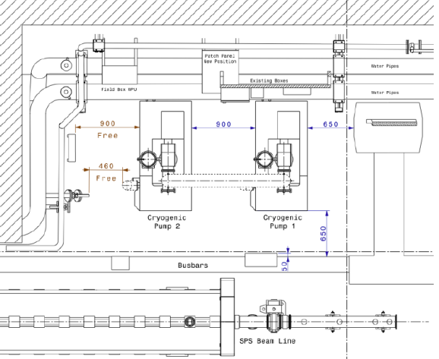
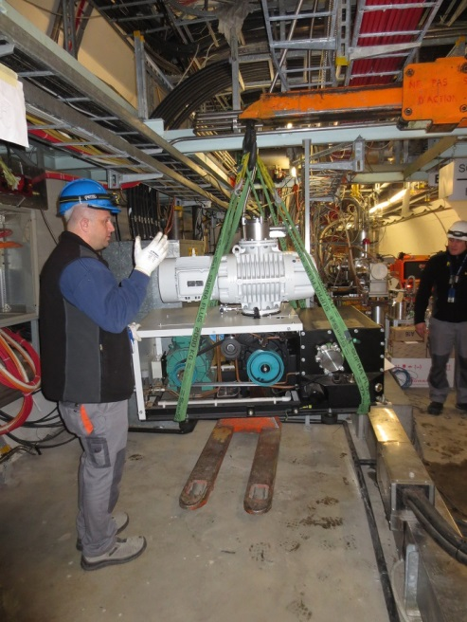
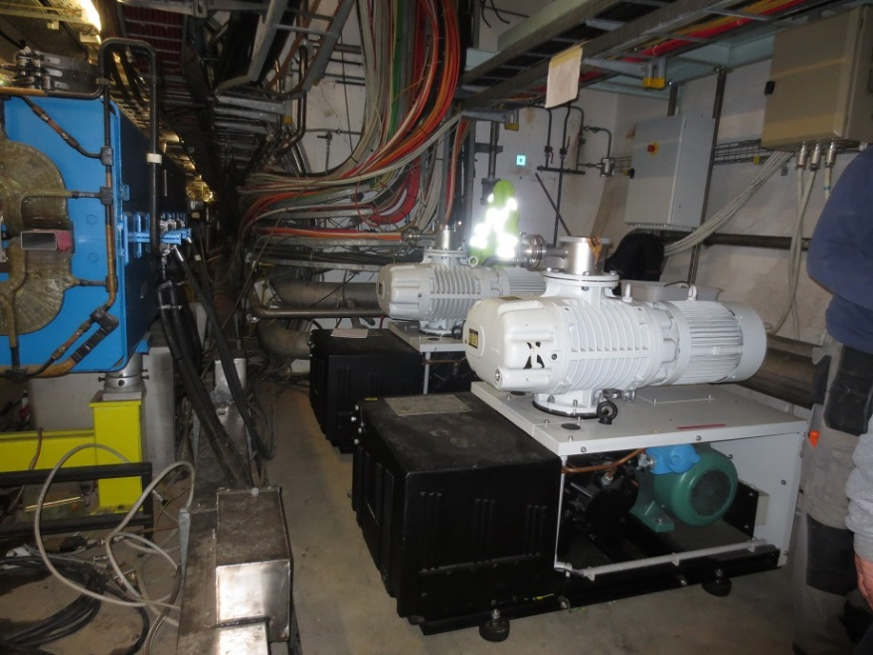
2 K helium pumps installation at BA4
The 2 K helium pumps have been installed in the SPS cavern at BA4 end of April 2014.
The related utilities connection will follow and will be operational by end of June 2014.

Slide 16
Cryostat operation – first approach
Pressures – safety :
The cavity should be designed to withstand external pressure of 2.6 bara (deltaP = 2.6 bar) at ambient temperature without plastic deformation,
Design pressure for the cryostat should be based on installed safety devices according to design rules (cryostat equipped with a rupture disc set at 2.2 bara and safety valve set at 1.8 bara)
  both safety devices should be placed on the cryostat in the way to avoid potential projection of helium towards the passages or transport area (deflectors installation to be analyzed),
  Both safety devices should protect cavity and cryostat from pressure rise causing plastic deformations
Operating pressure during the cool down can oscillate between 1.2 and 1.5 bara – estimation,
Normal operation pressure will be set at ~ 30 mbara (for 2 K cooling)
Cool down – stable operation – warm up:
Cool down will be done with direct filling of LHe to the cavity cryostat, roughly estimated cool down time is ~ 1 day
Stable operation availability can be affected by impurities in the system or unexpected utilities cut.
Warm up of the cavities will be done by evaporation of helium and warm gas circulation
16

Slide 17
New cryogenic infrastructure at P1 and P5
L. Tavian_Daresbury 2013
1 warm compressor station (WCS) in noise insulated surface building
1 upper cold box (UCB) in surface building
1 cold quench buffer (QV) in surface
1 or 2 cold compressor boxes (CCB) in underground cavern
2 main cryogenic distribution lines
2 interconnection valve boxes with existing QRL
Suitable for cryogenics to have a common cryostat for 2 or 4 CC in one module. Supply and pumping lines architecture is being studied -> it will result in number of jumpers (consideration of tunnel slope is mandatory).

Slide 18

Conclusions
The existing BA4 cryogenics has to be upgraded to higher cooling capacity – additional money, manpower and time will have to be allocated – study on SPS unavailability during the work has to be studied, replacement is to be done after COLDEX run is completed,
Service Module to CC Cryo Module interface design is underway – to be defined with 3D model by end of June 2014,
2 K pumping units – capacity test done -> 2 units transported and installed in SPS,
Remaining components of the infrastructure are to be ordered and built until end of 2015,
Cryogenic safety and risk analysis has to be done for SPS BA4 prior to operation,
Close collaboration with regular working sessions is needed to merge between CERN requirements and the modules suppliers.
Thank you! Questions?

