Slide 1

Cryomodule Design Approach
Shrikant Pattalwar
Accelerator Science and Technology Centre
STFC Daresbury Laboratory, UK
CC Design Review , May 5-7, 2014, BNL

Slide 2
Acknowledgements
This presentation is on behalf of the members of the Global WP4 team
STFC ASTeC, Technology, University of Lancaster
CERN Various Departments
LARP ODU, JLAB, BNL, FNAL

Slide 3
Contents
Requirements
Design evolution
Common design approach
Work in Progress
Conclusion

Slide 4
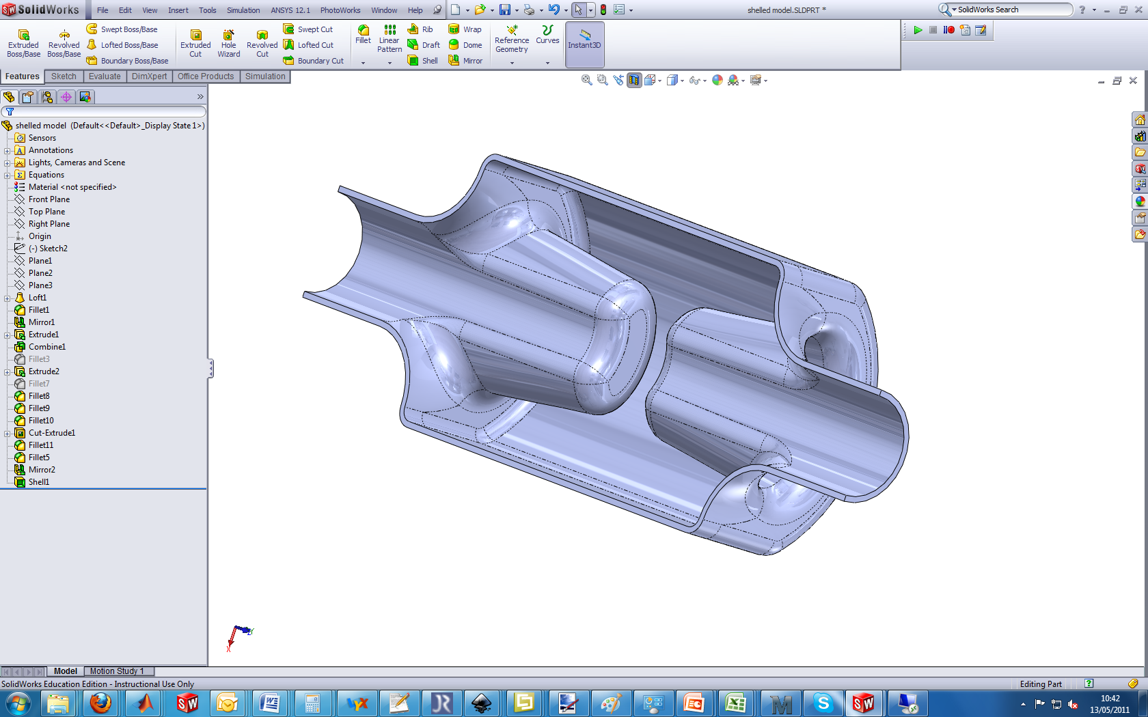
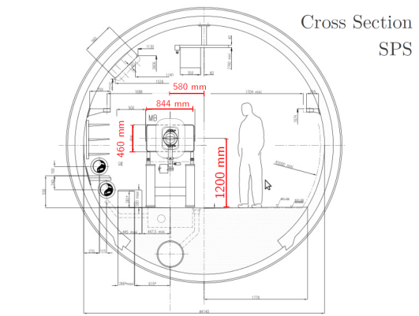
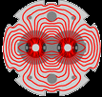
Requirements
Requirements for the cryomodule are influenced by various Factors
Operating Temperature
Magnetic shielding
Helium Vessel
Couplers and Interfaces
Tuner mechanism
Dynamic Heat Load
….
Two beam pipes
Heat load due to beams
Helium Vessel Geometry
Internal Layout
….
External Geometry
Third beam pipe ( SPS Bypass)
Couplers
Integration with Infrastructure
Operation
1. Cavity
2. LHC
3. SPS Layout
Presentations by
Subashini De Silva, Hye Kyoung Park, Graeme Burt, Tom Jones,
Silvia Verdu Andress, Qiong Wu, Binping Xiao, John Skaritka
Alick Mcpherson,
Ofelia Capatina Eric Montesinos

Slide 5
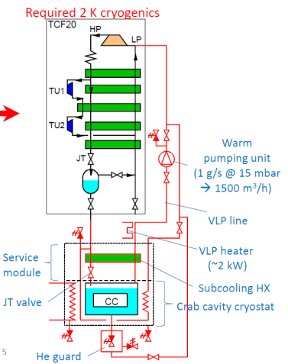
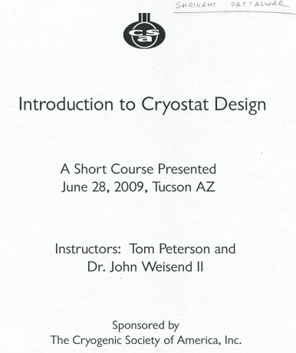
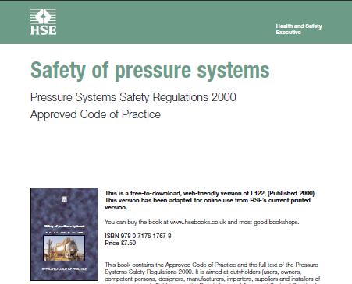
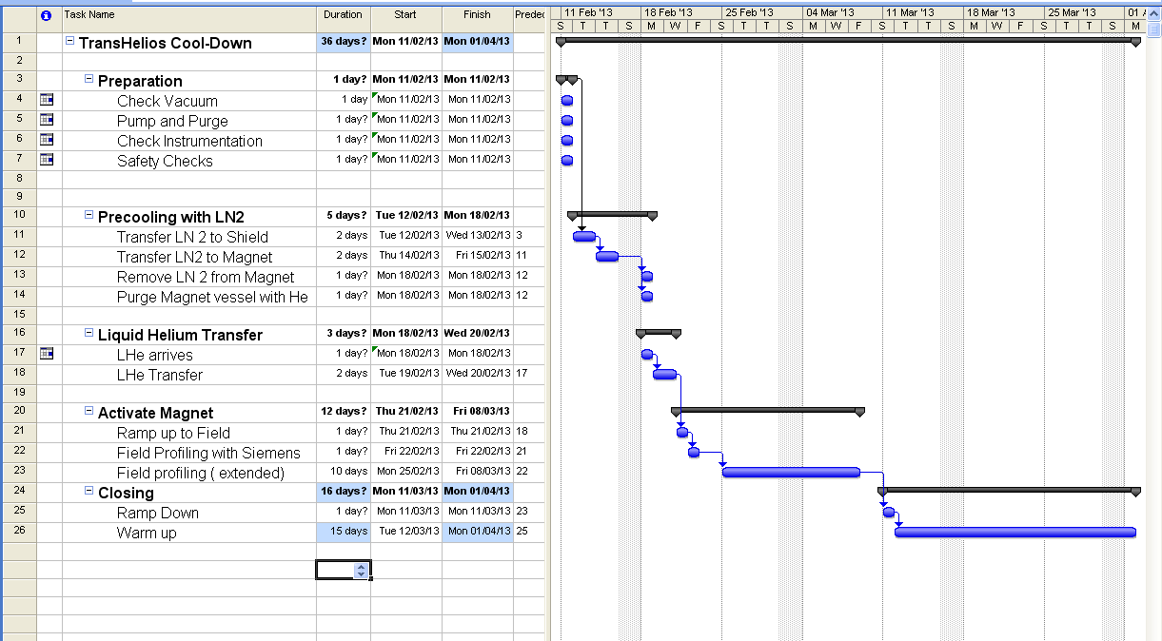
Requirements continued
Cooling Capacity at various temperatures
Cooling Processes
Ports and Interfaces
Operating modes
Mechanical Design
Safety and Pressure Relief
Volumes, pipe sizes
Methods of QC/QA
4. Cryogenic Services
5. Regulations and
directives
6. Other
Intermediate Tests (SM18)
Assembly Procedures
Instrumentation
Cost
R&D needs
Krzysztof Brodzinski
Alick Mcpherson, Ofelia Capatina

Slide 6
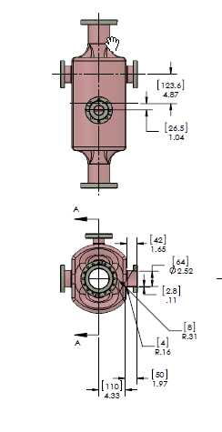
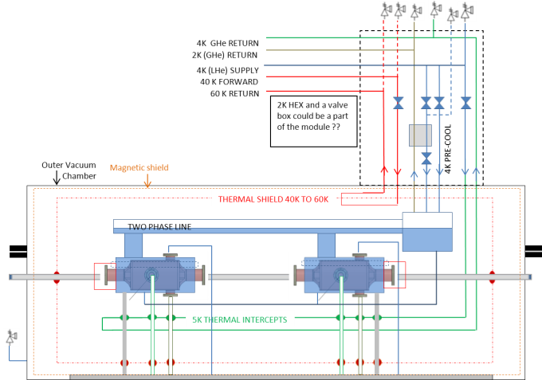
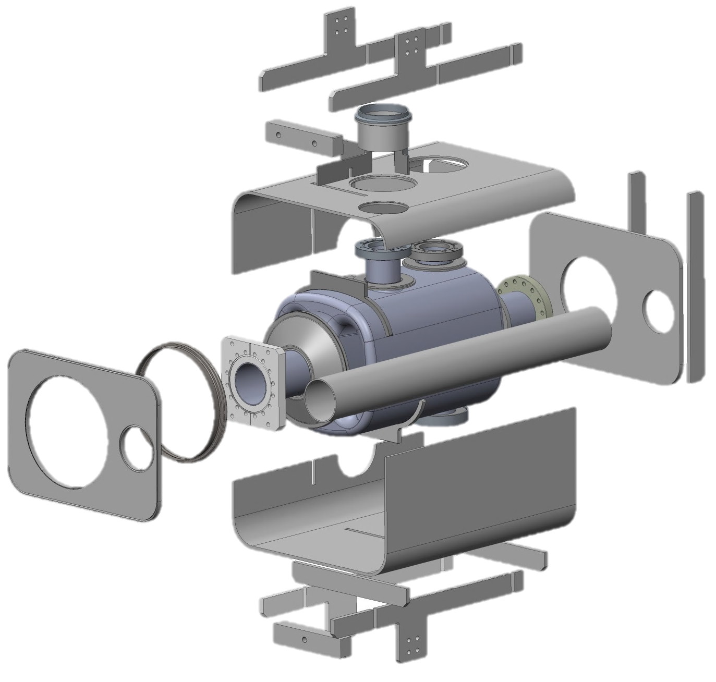
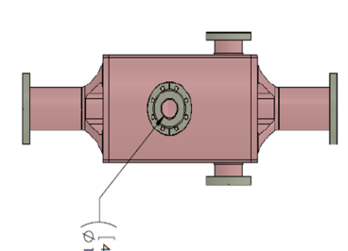
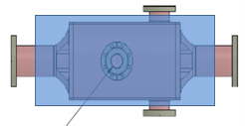
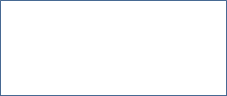
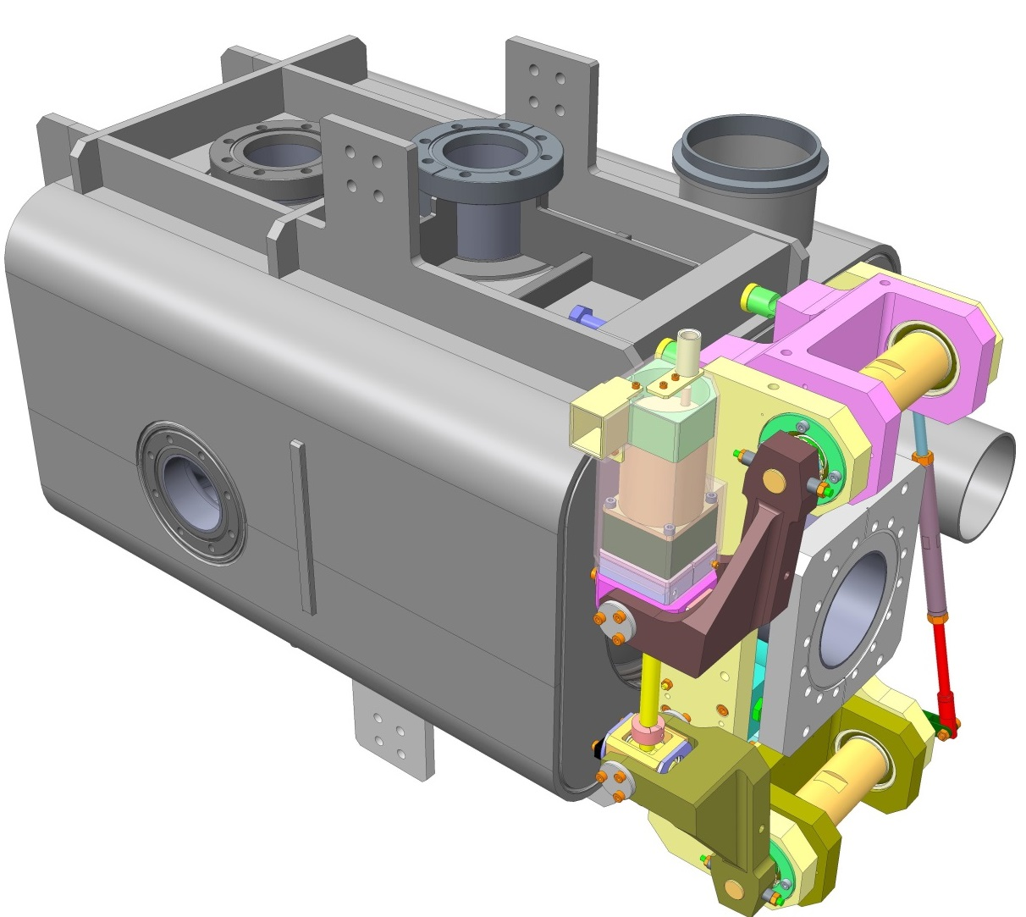
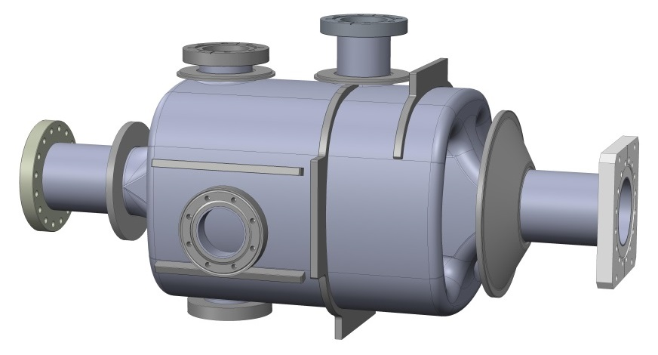
Helium Vessel
4R -Cavity
4R-Cavity in He Vessel
Parts of the Vessel
LHC (dummy) beam pipe
SPS beam pipe
Saclay-II type tuner

Slide 7
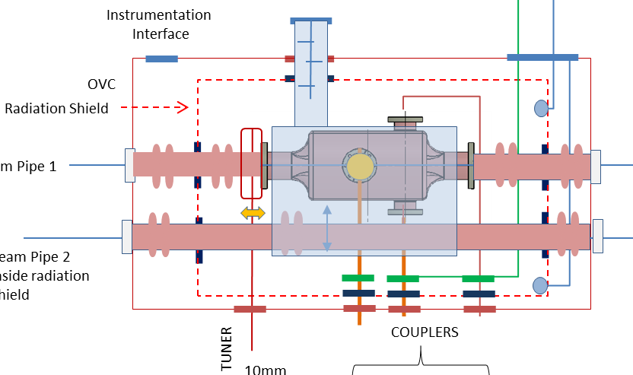
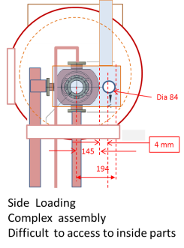
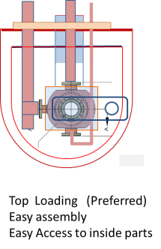
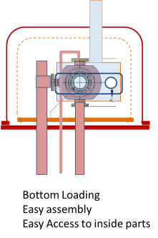
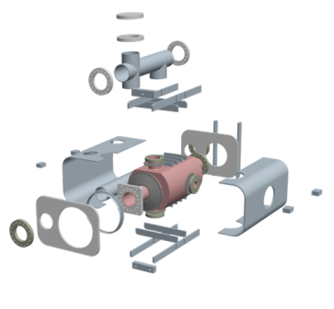
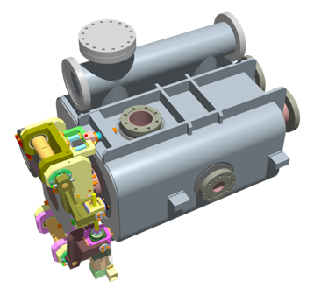
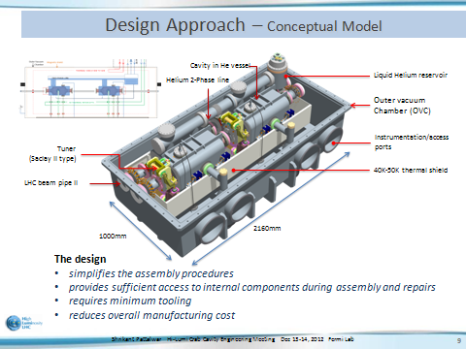
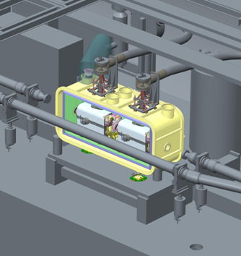
Cryomodule Design Evolution
Dec 2011
Requirements for SPS tests released
March 2013
Dec 2012
Dec 2013

Slide 8
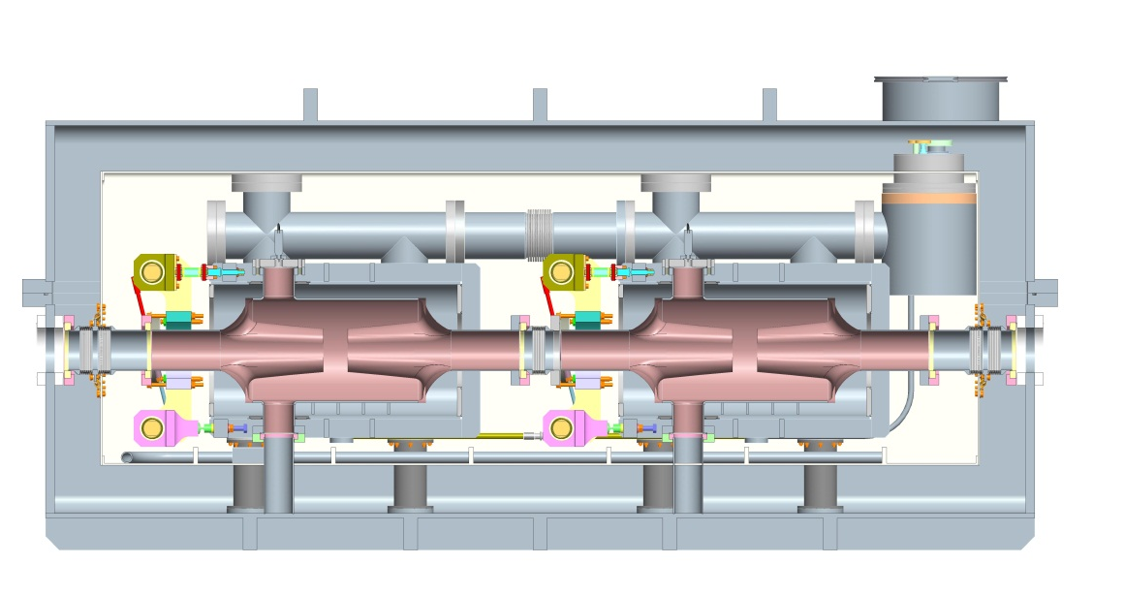
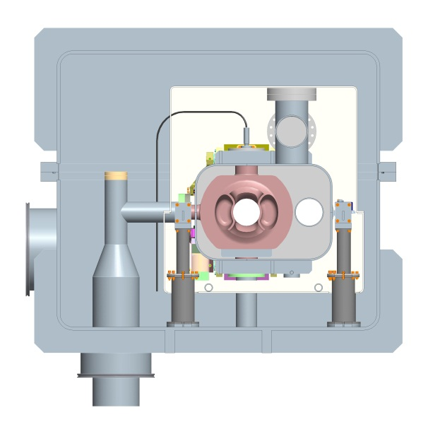
Design Evolution- Compatibility with SPS
2160mm
1000mm
413mm
1000mm
Low order mode coupler
High order mode coupler
RF input coupler
Triple tube cavity support system
Gap in ribs left for SPS by-pass line

Slide 9
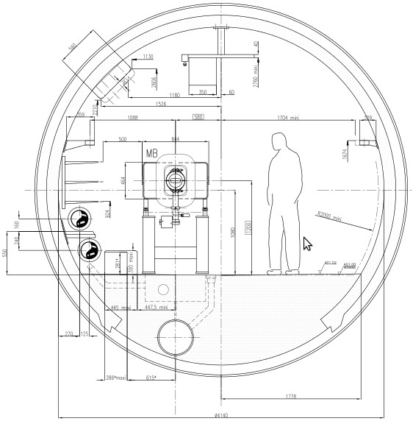
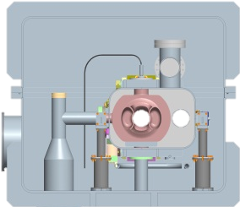
Design Evolution- Compatibility with SPS
413mm
1000mm
1000mm
1200mm

Slide 10
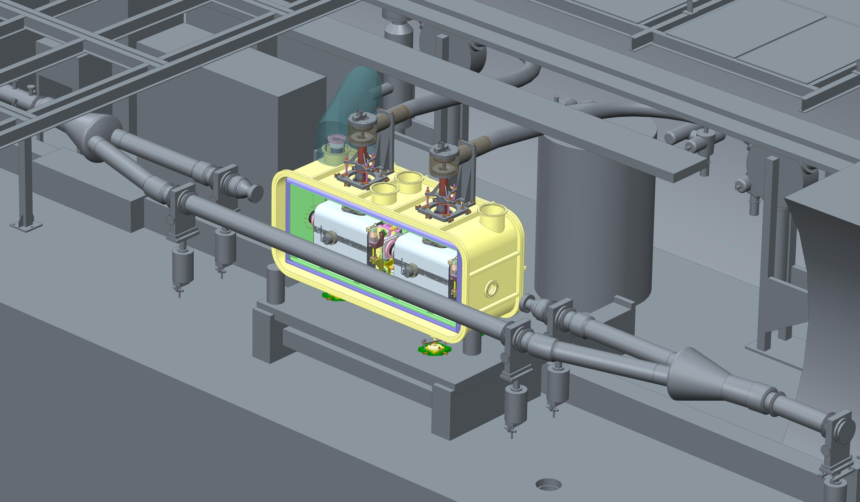
Cryomodule in SPS
RF Input
The design appraocah
simplifies the assembly procedures
provides sufficient access to internal components during assembly and after installtion
reduces overall manufacturing cost
Cryo services
Sliding support table
Conclusion
First level constraints defined by SPS layout have been successfully overcome

Slide 11
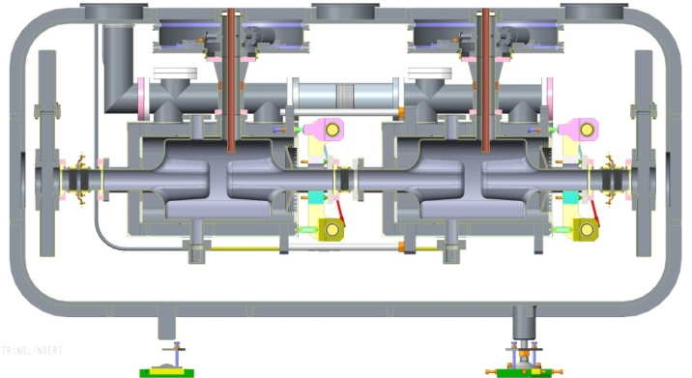
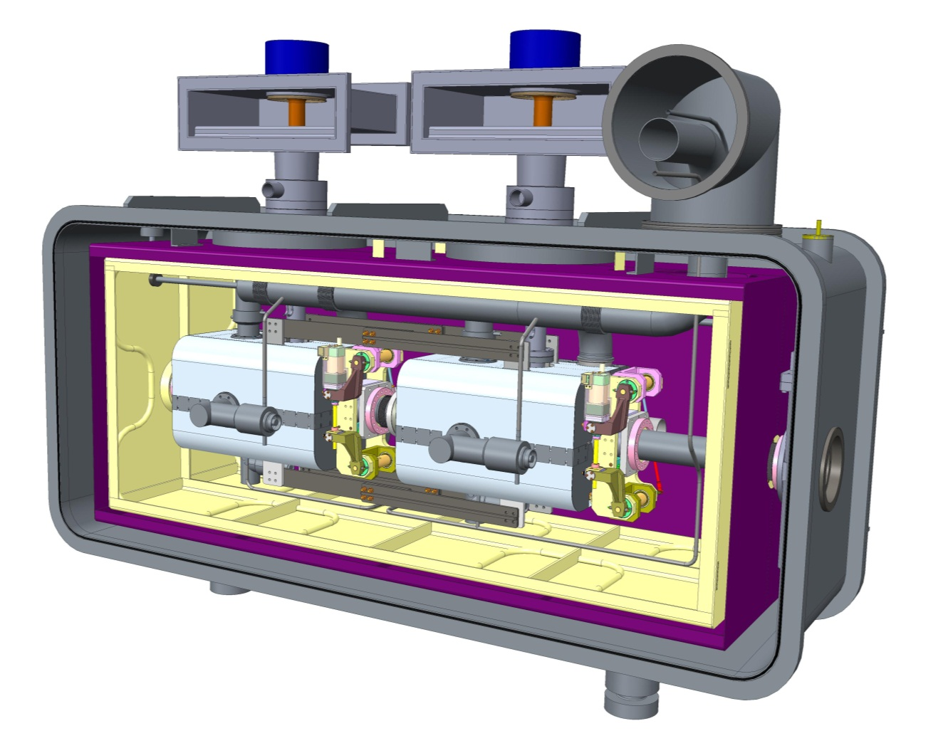
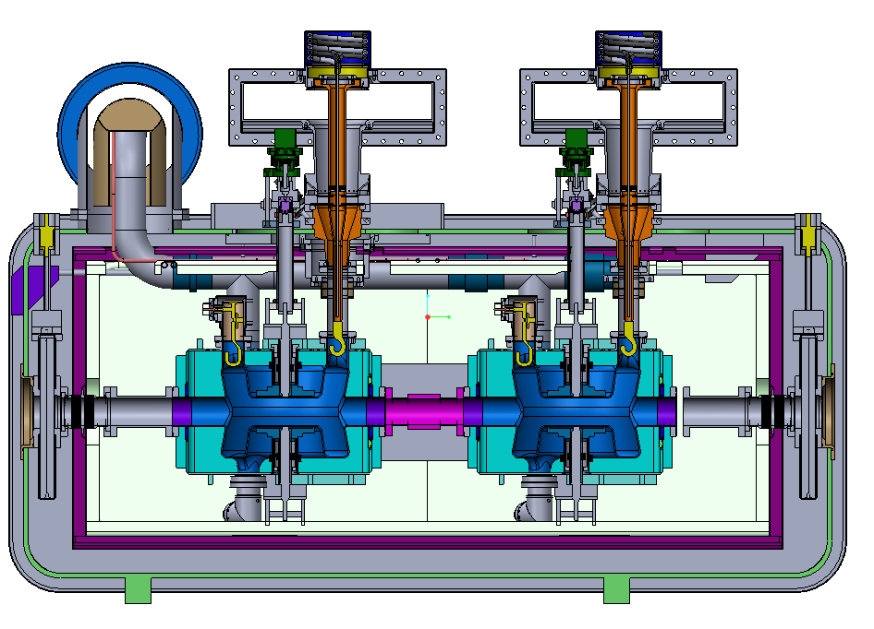
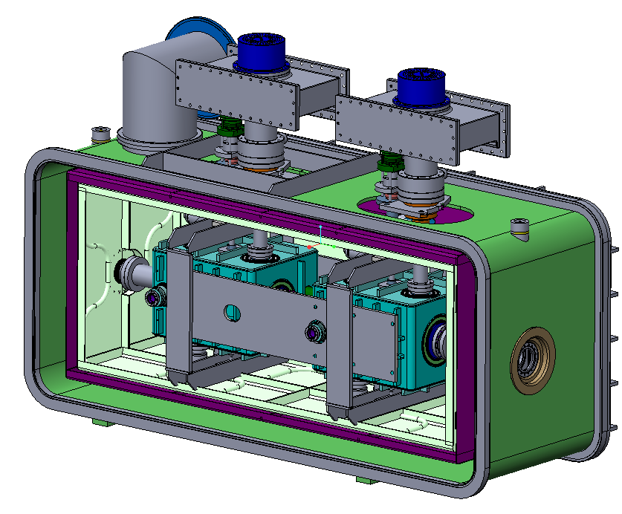
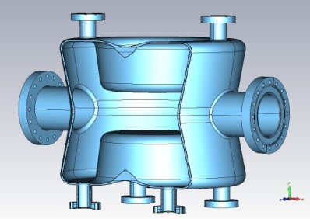
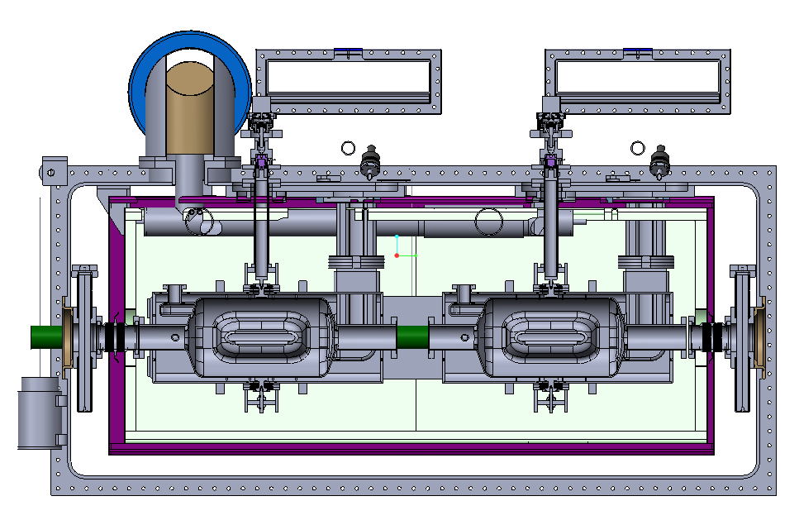
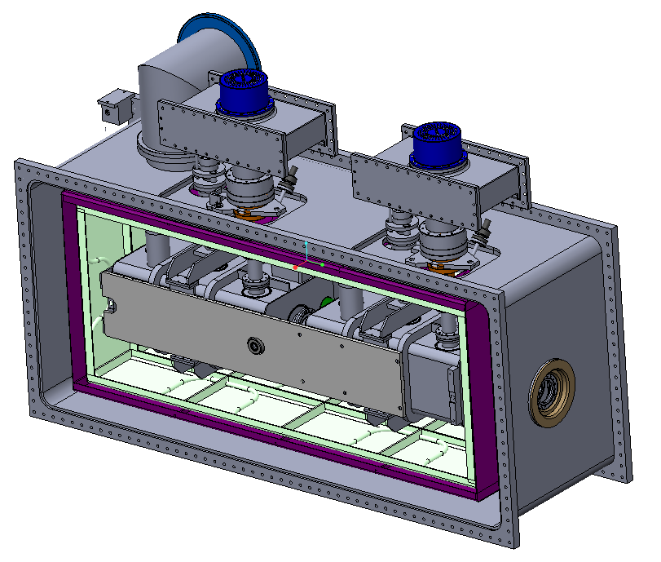
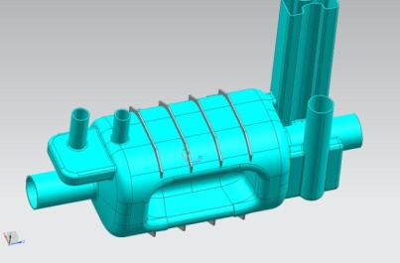
Common Design Approach
4-Rod
Double QW
Dipole

Slide 12
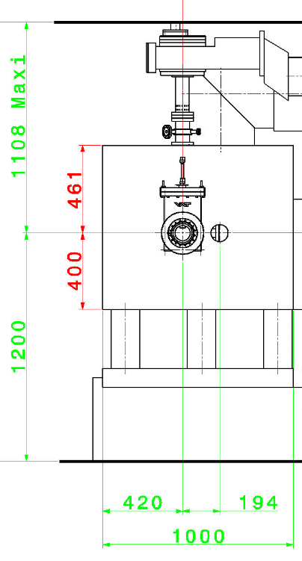
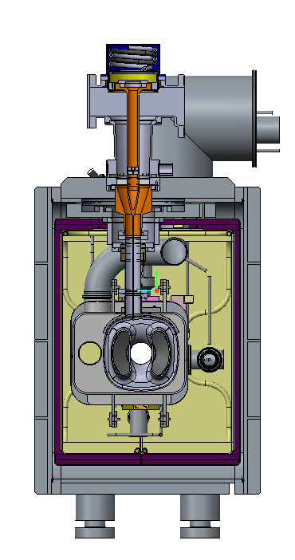
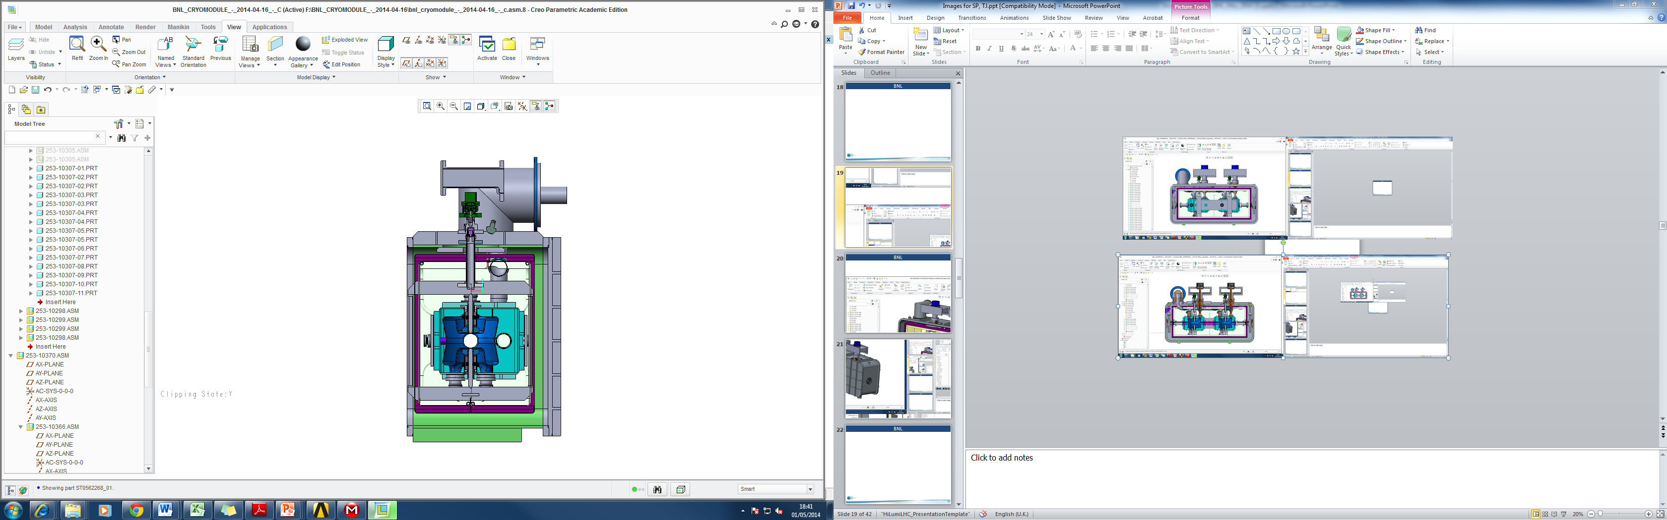
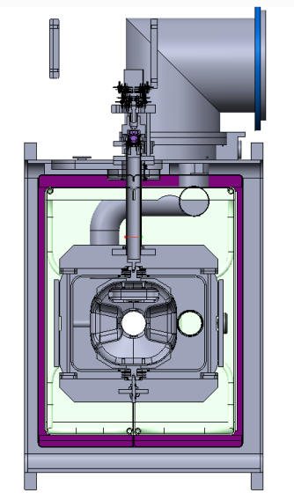
Common Design Approach
Requirements
4-Rod
Dipole
Double QW
1200
Conclusion
First level constraints defined by SPS layout have been successfully overcome

Slide 13
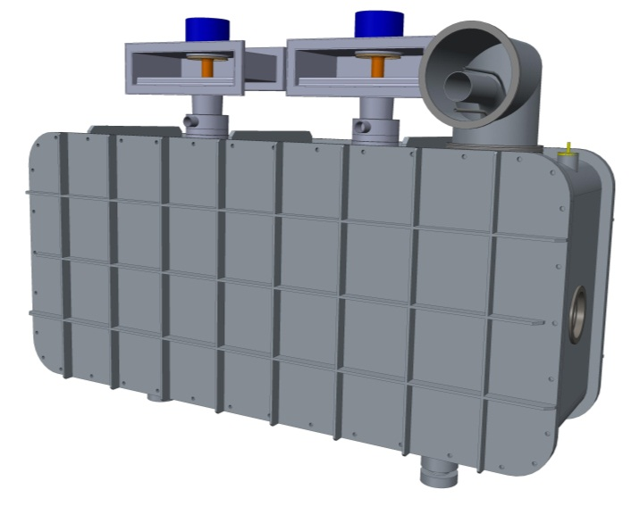
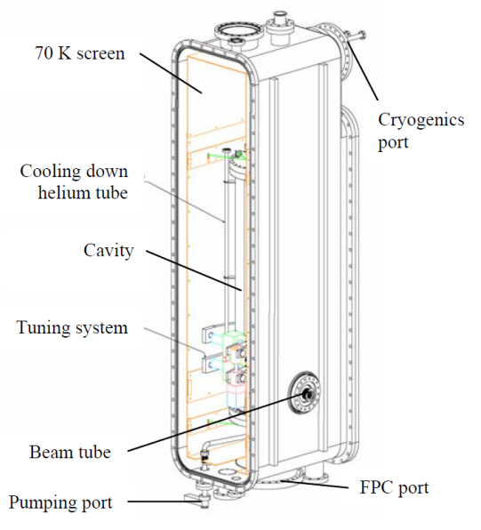
Cryomodule Concepts 2nd Iteration - detail design studies
Fundamental power used for supporting
Cryogenics interface
1720mm
Outer Vacuum Chamber
2590mm
860mm
SPIRAL 2 Quarter wave resonator cryomodule (Bernaudin et al.)
2mm thick Mu
Metal Magnetic shield
1050 Aluminium
Thermal shield (80K)
Additional length added to module to allow compatibility with other cavities.
Module positioning system
Same as used on other SPS equipment.
Ref : Design of the Low-Beta, Quarter-wave Resonator and its Cryomodule for the SPIRAL 2 Project. Bernaudin et al.

Slide 14
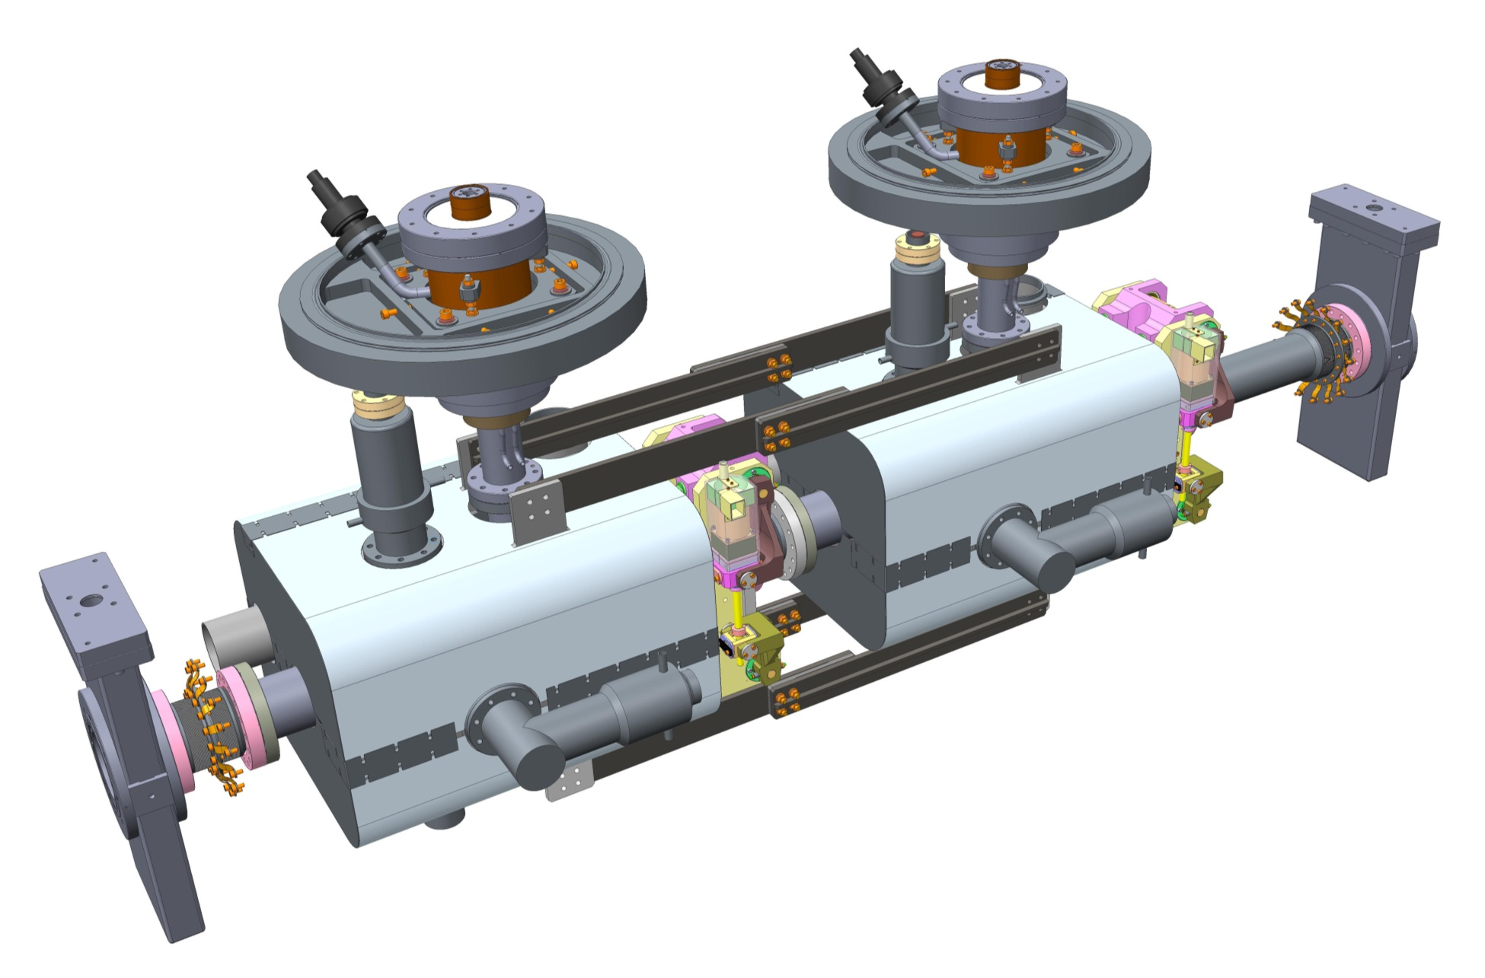
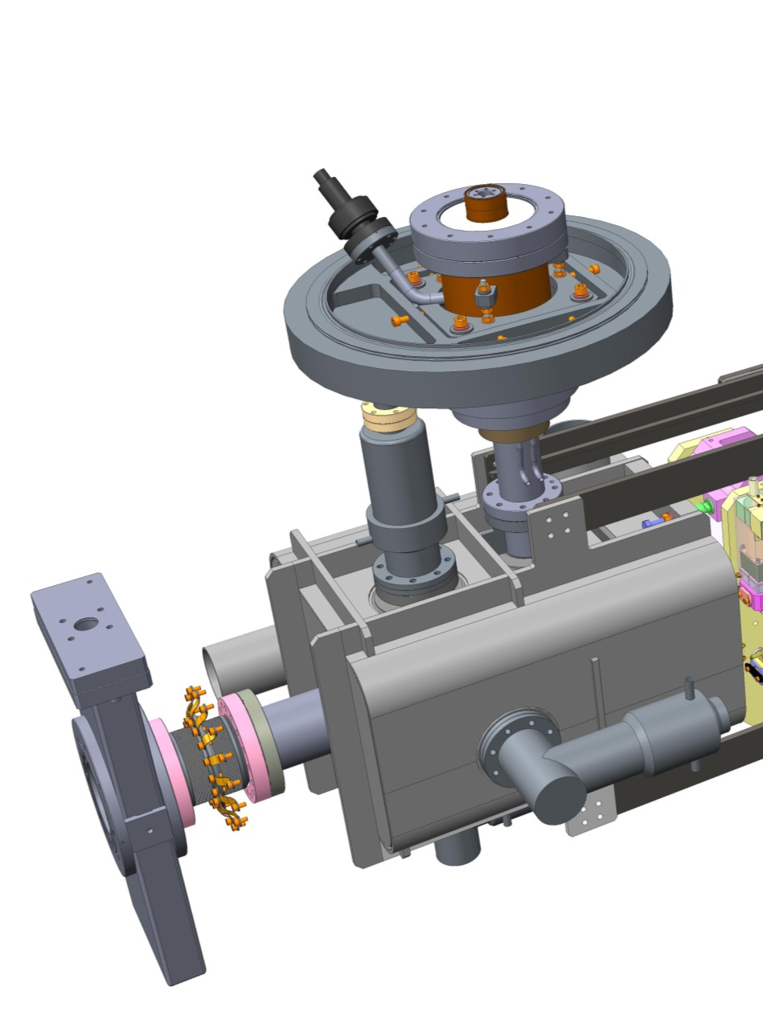
Cavity String
Common Design Features
Fixed (Reference) Points
Fundamental Power Coupler used as a support for cavity string
Tuner
1mm thick Cryoperm magnetic shielding
Inter-cavity support
Horizontal HOM absorber
Vertical HOM absorber
Common Features
2K – 300K transition bellows with 80K intercept
Differences

Slide 15
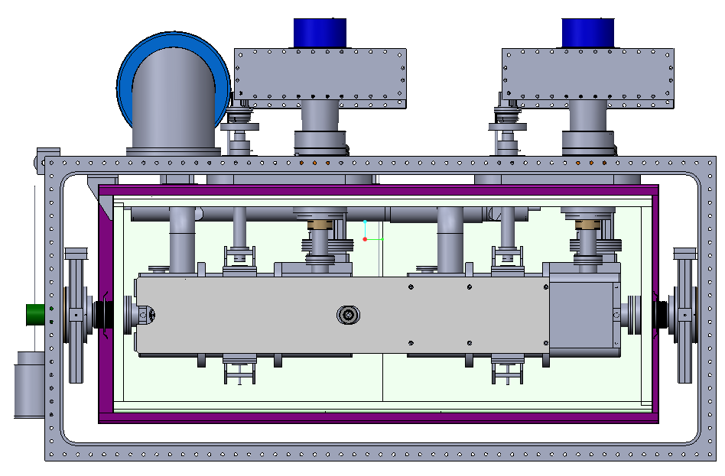
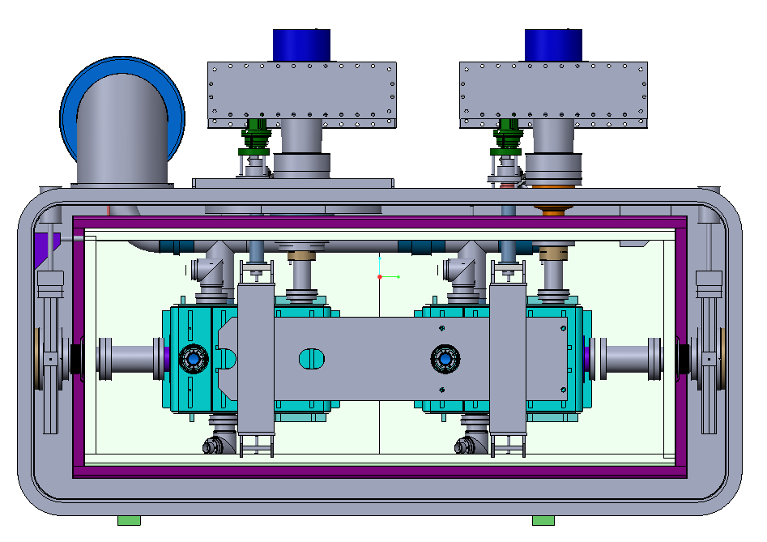
Common Design Approach
DIPOLE
Coupler Locations
DQW
Inter cavity Supports,

Slide 16
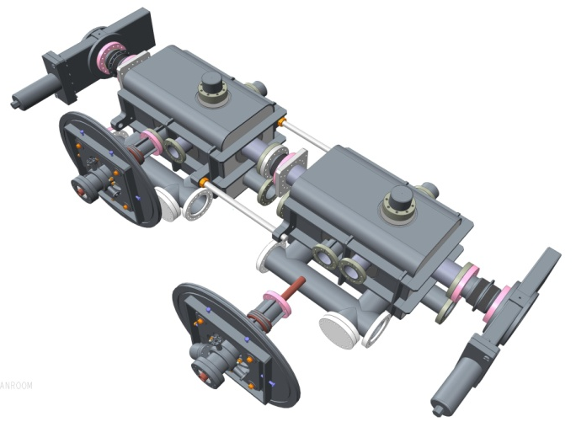
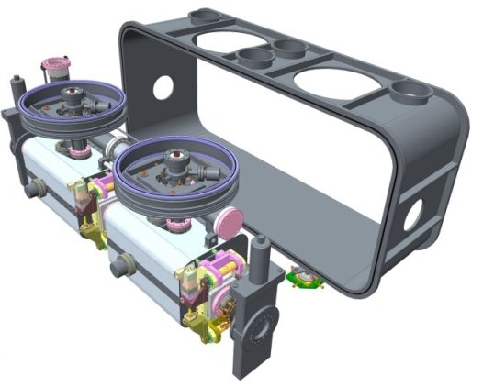
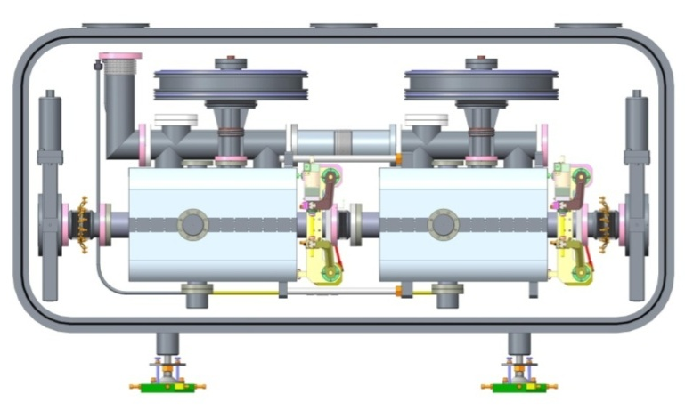
Common Assembly Sequence
Clean Room Operations
Assemble cavity string
Couplers assembled at 90º
Beam pipe closed with gate Valves
Outside the clean Room
Load the cavity String from Side
4. Lift and assemble
with top plate of the vacuum chamber
Align the string
with the vacuum chamber

Slide 17
Key Common Features
FPC used as a fixed point reference
FPC used as the main mechanical support for the cavity string
OVC, Thermal shield, Magnetic shield (identical only conceptually, but different dimensionally)
External Interfaces (Cryo, RF, vacuum, ....)
Diagnostics, Instrumentation
Alignment scheme (Not yet addressed)
Assembly and test processes

Slide 18
Key Differences
FPC Coupler Locations
Designs for LOM, HOM couplers and Interfaces
Designs for Tuners and Interfaces
Which means
Cryomodules for individual cavities are not interchangeable
Every sub assembly will have to be manufactured separately
.........
Benefits of Common Approach
Savings due to sharing of design and development efforts
Common procedures for qualification tests in SM-18
Installation, Commissioning and Operations etc.
Compliance with PED and general safety regulations

Slide 19
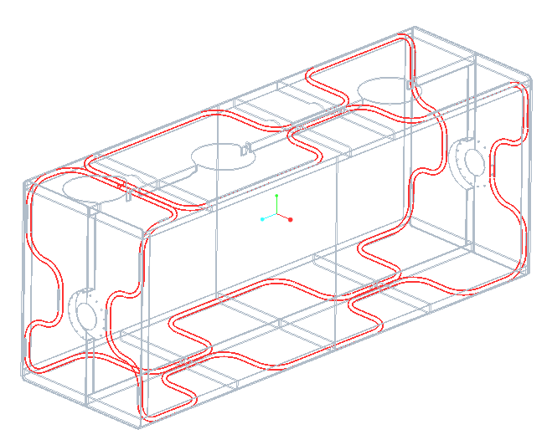


Thermal Shield (Cooled by LN2)
Consists of two main sub assemblies
Flexures optimised for maximum stiffness at 1W heat leak – 2mm thick x 40mm chosen
Flexure mounts arranged such that they create a fixed point at the centre of the shield.
Thermal shield “Window frame”
Aluminium alloy tubing
80K thermal shield (Al)
Removable side panels (fitted during initial assembly
Work performed by Manchester University undergraduate Andy May
More details on thermal and mechanical analysis by Tom Jones

Slide 20



Magnetic Shield
Outer Mag Shield ( mu metal)
Aiming to achieve 1 μT at the cavity
Inner Mag Shield (Cryo perm)
Welded Joints
He vessel

Slide 21

Heat Load Budget
This is still ‘work in progress’ but we have an idea of what we will have to deal with !

Slide 22

Cryomodule Schematic (P&ID)
Couplers for
HOMs are superconducting requiring active cooling with LHe
Andy May (ASTeC)

Slide 23


Cooling Circuit (80K) - 1
Two schemes under consideration :
1. Evolving from Cryomodule design
2. Evolving from Cryo-services design
Active cooling with thermo siphon for H > 5W
Radiation Shield, FPC, LOM, …
Conduction cooling for H < 5W
Beam Pipe, Instrumentation cables , ….
LN2 consumption
3 l/hr
Can be
outside CM
level probe
Radiation Shield Top
>5W
>5W
Total > 5W
< 5W
< 5W
Radiation Shield bottom
Isolation Chamber

Slide 24

Cooling Circuit (80K) - 2
Control over individual intercepts
K Brodzinski

Slide 25

Compliance with Regulations - PED
Category 0 for LHC
Category 1 for SPS Cryomodule
Max operating Pressure
Max Pressure
5 bar??
LHe Volume
Max He pressure
0.43 barG
Max pipe diameter (ID) < 25 mm
Maximum LHe volume < 100 L
Maximum Operating Pressure 0.8 barG

Slide 26
Work In Progress
Cooling schemes for Coupler Intercepts for HOMs and LOMs at 80K (Common LN2 bath? or individual flow control?)
Magnetic Shield (attenuation to 1 micro-T)
(1 mu metal shield at RT + one cryoperm shield around He vessel)
Alignment
Assembly tooling
Integration with Cryogenics (Pipe sizes, welded and demountable joints)
Compliance with Safety , Pressure Vessel Regulations etc.
Tests at SM-18
........................
........................

Slide 27
Conclusion
First level constraints defined by SPS layout have been successfully overcome
A common (concept) design approach for cryomodules for all the tree cavity types has been developed
Remaining issues are well understood and solutions are being worked out through collaborative efforts

Slide 28

Thank You

