Slide 2
Tutorial Structure
Short introduction to Fun4All
Example 0: Implementing Jaroslav’s Luminosity Monitor with least modifications
Using Fun4All for real
Example1: Implementing simple Detector in Fun4All
Example 2: Momentum resolution of configurable Si+TPC
Example 3: Adding your detector to a full detector implementation
List of other things you can do with it
HELP!!!!!
Future

Slide 3
What is assumed
Basic C++ knowledge (what is a base class and virtual methods)
Basic familiarity with root (what is a root macro, drawing histograms from ntuples)
Currently ROOT5 and ROOT6 are supported with ROOT5 being phased out
Can run our software, either via your rcf account or on your laptop/desktop:
https://github.com/EIC-Detector/Singularity
Some familiarity with git (what is a repository, git clone)
You definitely want a github account

Slide 4
Brief History of Fun4All
Development started in 2002, in use by PHENIX from 2003 on (reconstruction and analysis of Run3 data)
Needed to get many subsystems who developed their code independently and without coordination under one umbrella
Development driven by reconstruction and analysis needs – not by “beauty” or some abstract design considerations (or “rules”)
Modularity is key – components can be added/modified/removed without having to modify bits and pieces all over the place
Plenty of functionality added over the years, some of them waiting to be rediscovered
2011 Adding Geant4 as subsystem
Split from PHENIX in 2015, lots of cleanup and modernization
Code in
https://github.com/sPHENIX-Collaboration/coresoftware/tree/master/offline/framework

Slide 5
What does it do for us
Read input files (many different types)
Write output files (different types, automatic saving of selected data objects)
Somewhat manages the Node Tree - our storage for data objects (more later)
Call the analysis/reconstruction modules in the order in which they were registered (correct ordering is responsibility of the user)
Make snapshots at any state of the reconstruction/analysis
Access to calibrations
Fun4All has been our workhorse for 16 years, running raw data
reconstruction, analysis, simulations and embedding

Slide 6
Structure of our framework Fun4All
You
Fun4AllServer
Input Managers
Node Tree(s)
Output Managers
DST
DST
Raw Data (PRDF)
Raw Data (PRDF)
Analysis/Reconstruction Modules
HepMC/Oscar
HepMC
EIC smear
Calibrations
Histogram Manager
Empty
Root File
PostGres DB
File
That’s all there is to it, no backdoor communications – steered by ROOT macros

Slide 7
Simulations
GEANT4 based (no GEANT3, no virtual Monte Carlo)
Fully integrated into our analysis chain as Reconstruction Module
Modular design – all detectors are self contained
Configured with Root macros
Generic detectors (boxes, cylinders, cones) exist
EIC-sPHENIX subdetectors fully implemented
8 years of development
Used for published EIC detector concepts:
https://arxiv.org/pdf/1402.1209.pdf (2104)
An EIC Detector Build Around The sPHENIX Solenoid (2018)
Tutorials:
https://github.com/sPHENIX-Collaboration/tutorials

Slide 8
G4 program flow within Fun4All
Modular: Each detector is its own entity providing the flexibility needed for complex setups
Fun4AllServer
Geant4
Event generator (input file, single particle, pythia8)
PHG4Reco
Initializes Geant4 before detectors are added
The processing is done by chaining up modules. At every step the state of the Node Tree can be saved and the analysis can pick up where it left
Node tree
Interface Detector 1
Construct() → Geometry
Stepping Action (Hit extraction)
Generic detectors like boxes, cylinders, cones exist and can be configured on a macro level
Interface Detector 2
Construct() → Geometry
Stepping Action (Hit extraction)
Digitisation
Raw Data
RCdaq
Common reco for raw and simulated data
Setup
Tracking,Clustering
calls
Jet Finding, Upsilons, Photons,…
dataflow
Output Files

Slide 9
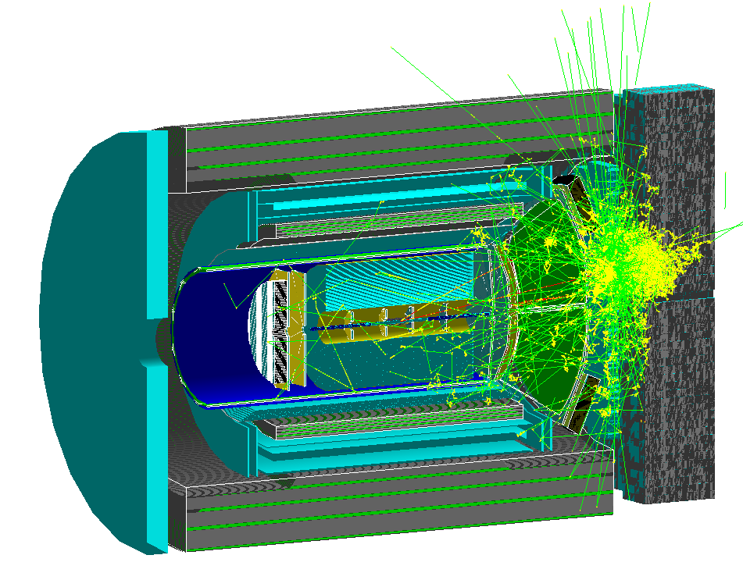
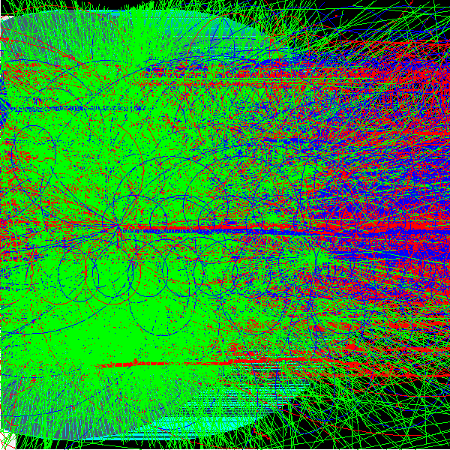
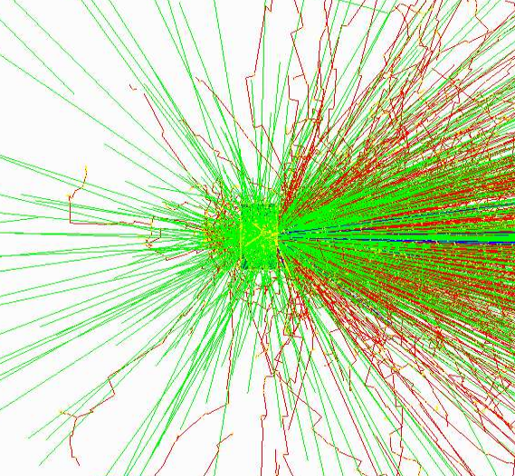
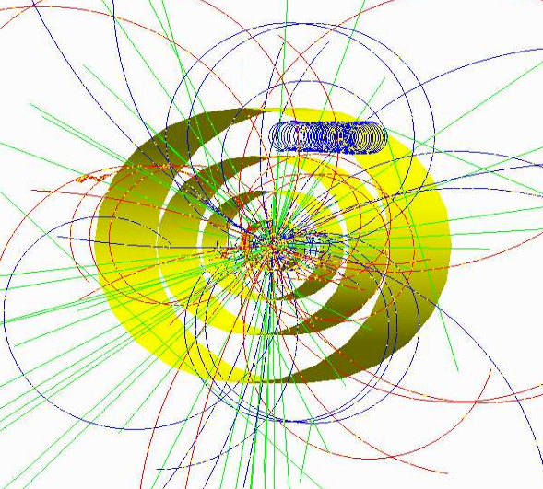
Currently implemented event generators
Via Eic-Smear interface (e-p/e-A)
PYTHIA
DPMJet
PEPSI
gmc_trans
Djangoh
Milou
Rapgap
LEPTO
Via Fun4All
Hijing
Pythia6
Pythia8
Sartre
Jetscape (needs work)
Generic HepMC 2/OSCAR
Single Particle Generators
Embedding in existing events
Very peripheral heavy ion collision from hijing
Sarte as seen by EIC detector
10 GeV Au on
water phantom
(NSRL)
Pythia8 in a 6 layer silicon detector mockup and 2T field
Full Truth information preserved: anything can be traced back to the input particle

Slide 10
Distribution
OS image (rcf SL7 distribution) in singularity container
Libraries and 3rd party packages installed in cvmfs – central maintenance of packages
Dedicated EIC cvmfs volume: /cvmfs/eic.opensciencegrid.org
Set up environment:
source /cvmfs/eic.opensciencegrid.org/x8664_sl7/opt/sphenix/core/bin/eic_setup.sh -n
Set up local install area:
source /cvmfs/eic.opensciencegrid.org/x8664_sl7/opt/sphenix/core/bin/setup_local.sh <install area>

Slide 11
How to build a package
We use autoconf/automake (configure) to build our code
This does put some files into your source area, be careful what you commit
Each package (directory) is build by itself
You only have to build the package you are working on
Keep your source, build and install areas separately, but use common install area
Source1 in <srcdir1>
build1 in <builddir1>:
<srcdir1>/autogen.sh –prefix=<installdir>
make install
One install area in <installdir>
Source2 in <srcdir2>
build2 in <builddir2>:
<srcdir2>/autogen.sh –prefix=<installdir>
make install
Use the full path so the debugger
can find the source file
If you use a private install area, you need to tweak your environment (.csh for cshell):
source /cvmfs/eic.opensciencegrid.org/x8664_sl7/opt/sphenix/core/bin/setup_local.sh <install area>

Slide 12
Example 0: Jaroslav’s Luminosity Monitor
Project: GEANT4 based simulation, uses hand made ROOT TTrees to save output
Goal: Keep code changes to an absolute minimum, not re-implement using Fun4All features
Approach: Using Fun4All-G4 Detector as simple wrapper
Changes needed:
removal of detector and sensitive detector inheritance
storing of physical volumes for lookup in stepping action
propagating root TTree downstream
replace DetectorConstruction.cxx by G4LmonDetector interface
Dropped G4 messenger
Drop input reader (replace by eic-smear interface?)
20 lines changed in cxx files, 8 in include files (+some missing declarations)
Original code:
https://github.com/adamjaro/lmon
Fun4All based Code:
https://github.com/EIC-Detector/Fun4All-lmon

Slide 13
Example 0: Jaroslav’s Luminosity Monitor
Cut and paste commands from https://www.phenix.bnl.gov/WWW/publish/phnxbld/EIC/tutorial/example0.html
Shell commands:
source /cvmfs/eic.opensciencegrid.org/x8664_sl7/opt/sphenix/core/bin/eic_setup.sh -n
git clone https://github.com/EIC-Detector/Fun4All-lmon
cd Fun4All-lmon/source
mkdir build
cd build
../autogen.sh -prefix=$HOME/myinstall
make install
source /cvmfs/eic.opensciencegrid.org/x8664_sl7/opt/sphenix/core/bin/setup_local.sh $HOME/myinstall
cd ../../macros
root.exe
Or at the Root prompt:
.x Fun4All_Lmon.C(-1)
.L DisplayOn.C
PHG4Reco *g4 = DisplayOn();
Fun4AllServer *se = Fun4AllServer::instance();
se->run(1);
At the Root prompt:
.x Fun4All_Lmon.C(-1)
.L Display.C
PHG4Reco *g4 = QTGui();
And on the G4 cmd line:
/Fun4All/run 1
Alt F7 to move large G4 window in windows virtual box
Hint: Root understands tab expansion

Slide 14
What’s in it for Jaroslav?
Access to all implemented generators
He can keep using everything he developed downstream, no changes to his output
Less code to maintain

Slide 15
What’s in it for Jaroslav?
Access to all implemented generators
He can keep using everything he developed downstream, no changes to his output
Less code to maintain

Slide 16
What’s in it for Jaroslav?
He can start playing with the big kids, detectors are added on the macro level, no change in any other code needed
The fine print:
The stepping action does not put any objects on our node tree
This does not include the detector into any analysis chain
There are overlaps (the vacuum box) which need to be dealt with
Our world is filled with G4_Air, need to add a vacuum system

Slide 17
Using Fun4All for Real

Slide 18
G4 program flow Example 0
Modular: Each detector is its own entity providing the flexibility needed for complex setups
Fun4AllServer
Geant4
Event generator (input file, single particle, pythia8)
PHG4Reco
Initializes Geant4 before detectors are added
Node tree
Interface Detector 1
Construct() → Geometry
Stepping Action (Hit extraction)
Generic detectors like boxes, cylinders, cones exist and can be configured on a macro level
Output File
Setup
calls
dataflow

Slide 19
G4 program flow within Fun4All
Modular: Each detector is its own entity providing the flexibility needed for complex setups
Fun4AllServer
Geant4
Event generator (input file, single particle, pythia8)
PHG4Reco
Initializes Geant4 before detectors are added
The processing is done by chaining up modules. At every step the state of the Node Tree can be saved and the analysis can pick up where it left
Node tree
Interface Detector 1
Construct() → Geometry
Stepping Action (Hit extraction)
Generic detectors like boxes, cylinders, cones exist and can be configured on a macro level
Interface Detector 2
Construct() → Geometry
Stepping Action (Hit extraction)
Digitisation
Raw Data
RCdaq
Common reco for raw and simulated data
Setup
Tracking,Clustering
calls
Jet Finding, Upsilons, Photons,…
dataflow
Output Files

Slide 20
GEANT steps
GEANT propagates particles one step at a time. The step size is
determined by the physics processes associated with the current
particle or when a boundary between volumes is crossed
After each step the user stepping method is called with a pointer
to the current volume which has access to the full information
(energy loss, particle momentum at beginning and end of step, …)

Slide 21
Our G4Hits (you’ll hear us talking about them a lot)
In our stepping method we add the energy loss in each volume and
store the entry and exit coordinates and time (and subdetector specific info like ionization energy, light output,…)
G4Hit
We also keep the ancestry for G4Hits so any hit can be traced back to a primary particle. To reduce size we do not store particles which do not leave G4Hits and are not in the ancestry of a particle which created a G4Hit

Slide 22
Access to Data Objects, understanding our Node Tree
PHCompositeNode
PHDataNode
TOP
PHIODataNode
RUN
DST
PAR
PRDF
FIELD_CONFIG
PHG4INEVENT
FIELD_MAP
G4GEOPARAM_PIPE
PIPE
G4GEO_PIPE
PIPE
PIPE
G4HIT_PIPE
CYLINDERGEOM_PIPE
MVTX
G4GEO_MVTX
MVTX
G4GEOPARAM_MVTX
MVTX
G4HIT_MVTX
G4GEO_INTT
G4GEOPARAM_INTT
G4HIT_ABSORBER_TPC
INTT
CYLINDERGEOM_INTT
INTT
TPC
G4CELLPARAM_INTT
G4HIT_TPC
G4CELLGEO_INTT

Slide 23
The Node Tree
The Node Tree is at the center of the sPhenix software universe (but it’s more or less invisible to you). It’s the way we organize our data and make them accessible to modules
It is NOT a Root TTree
We have 3 different Types of Nodes:
PHCompositeNode: contains other Nodes
PHDataNode: contains any object
PHIODataNode: contains objects which can be written out to DST
PHCompositeNodes and PHIODataNodes can be saved to a DST and read back
This DST contains root TTrees, the node structure is saved in the branch names. Due to Roots limitations not all objects can become PHIODataNodes (e.g. anything containing BOOST). This needs to be revisited with Root 6.
We currently save 2 root trees in each output file, one which contains the eventwise information, one which contains the runwise information
Input Managers put objects as PHIODataNodes on the node tree, output managers save selected PHIODataNodes to a file.
Fun4All can manage multiple independent node trees

Slide 24
The Node Tree
Node Tree under TopNode TOP
TOP (PHCompositeNode)/
DST (PHCompositeNode)/
PHG4INEVENT (PHDataNode)
PIPE (PHCompositeNode)/
G4HIT_PIPE (IO,PHG4HitContainer)
MVTX (PHCompositeNode)/
G4HIT_MVTX (IO,PHG4HitContainer)
INTT (PHCompositeNode)/
G4HIT_INTT (IO,PHG4HitContainer)
TPC (PHCompositeNode)/
G4HIT_ABSORBER_TPC (IO,PHG4HitContainer)
G4HIT_TPC (IO,PHG4HitContainer)
CEMC_ELECTRONICS (PHCompositeNode)/
G4HIT_CEMC_ELECTRONICS (IO,PHG4HitContainer)
CEMC_SPT (PHCompositeNode)/
G4HIT_CEMC_SPT (IO,PHG4HitContainer)
G4HIT_CEMC (IO,PHG4HitContainer)
G4HIT_ABSORBER_CEMC (IO,PHG4HitContainer)
HCALIN (PHCompositeNode)/
G4HIT_ABSORBER_HCALIN (IO,PHG4HitContainer)
…
TOP: Top of Default Node Tree
Creation and populating of other
node trees is possible (used for
embedding)
You will see this printout of the node tree whenever the processing starts
Print it from the command line with
Fun4AllServer *se = Fun4AllServer::instance();
se->Print("NODETREE");

Slide 25
The Node Tree
Node Tree under TopNode TOP
TOP (PHCompositeNode)/
DST (PHCompositeNode)/
PHG4INEVENT (PHDataNode)
PIPE (PHCompositeNode)/
G4HIT_PIPE (IO,PHG4HitContainer)
MVTX (PHCompositeNode)/
G4HIT_MVTX (IO,PHG4HitContainer)
INTT (PHCompositeNode)/
G4HIT_INTT (IO,PHG4HitContainer)
TPC (PHCompositeNode)/
G4HIT_ABSORBER_TPC (IO,PHG4HitContainer)
RUN (PHCompositeNode)/
FIELD_CONFIG (IO,PHFieldConfigv1)
PIPE (PHCompositeNode)/
G4GEOPARAM_PIPE (IO,PdbParameterMapContainer)
CYLINDERGEOM_PIPE (IO,PHG4CylinderGeomContainer)
MVTX (PHCompositeNode)/
G4GEOPARAM_MVTX (IO,PdbParameterMapContainer)
INTT (PHCompositeNode)/
G4GEOPARAM_INTT (IO,PdbParameterMapContainer)
…
DST and RUN Node: default for I/O
DST – eventwise
RUN - runwise
Objects under the DST node are reset after
every event to prevent event mixing. You
can select the objects to be saved in the
output file. Subnodes like SVTX are saved
and restored as well. DST/RUN nodes can
be restored from file under other TopNodes
ROOT restrictions apply:
Objects cannot be added while running to
avoid event mixing
You will see this printout of the node tree whenever the processing starts
Print it from the command line with
Fun4AllServer *se = Fun4AllServer::instance();
se->Print("NODETREE");

Slide 26
The Node Tree
Node Tree under TopNode TOP
TOP (PHCompositeNode)/
DST (PHCompositeNode)/
PHG4INEVENT (PHDataNode)
PIPE (PHCompositeNode)/
G4HIT_PIPE (IO,PHG4HitContainer)
MVTX (PHCompositeNode)/
G4HIT_MVTX (IO,PHG4HitContainer)
RUN (PHCompositeNode)/
FIELD_CONFIG (IO,PHFieldConfigv1)
PIPE (PHCompositeNode)/
G4GEOPARAM_PIPE (IO,PdbParameterMapContainer)
CYLINDERGEOM_PIPE (IO,PHG4CylinderGeomContainer)
MVTX (PHCompositeNode)/
G4GEOPARAM_MVTX (IO,PdbParameterMapContainer)
INTT (PHCompositeNode)/
G4GEOPARAM_INTT (IO,PdbParameterMapContainer)
PAR (PHCompositeNode)/
FIELD_MAP (PHDataNode)
PIPE (PHCompositeNode)/
G4GEO_PIPE (PHDataNode)
…
Users can add their own PHCompositeNodes
Under the TOP Node. But then resetting the
objects is their responsibility.
The PAR node hold more complicated geometry
Objects which we do not want to save on DST
You will see this printout of the node tree whenever the processing starts
Print it from the command line with
Fun4AllServer *se = Fun4AllServer::instance();
se->Print("NODETREE");

Slide 27
The Node Tree
Node Tree under TopNode TOP
TOP (PHCompositeNode)/
DST (PHCompositeNode)/
PHG4INEVENT (PHDataNode)
PIPE (PHCompositeNode)/
G4HIT_PIPE (IO,PHG4HitContainer)
HCALIN (PHCompositeNode)/
G4HIT_ABSORBER_HCALIN (IO,PHG4HitContainer)
G4HIT_HCALIN (IO,PHG4HitContainer)
G4CELL_HCALIN (IO,PHG4CellContainer)
TOWER_SIM_HCALIN (IO,RawTowerContainer)
TOWER_RAW_HCALIN (IO,RawTowerContainer)
TOWER_CALIB_HCALIN (IO,RawTowerContainer)
CLUSTER_HCALIN (IO,RawClusterContainer)
BBC (PHCompositeNode)/
BbcVertexMap (IO,BbcVertexMapv1)
TRKR (PHCompositeNode)/
TRKR_HITSET (IO,TrkrHitSetContainer)
TRKR_HITTRUTHASSOC (IO,TrkrHitTruthAssoc)
TRKR_CLUSTER (IO,TrkrClusterContainer)
TRKR_CLUSTERHITASSOC (IO,TrkrClusterHitAssoc)
…
Type of Node is given (IO is PHIODataNode)
Class of Data IO Object is given
(you will need to know this when accessing the data)
You will see this printout of the node tree whenever the processing starts
Print it from the command line with
Fun4AllServer *se = Fun4AllServer::instance();
se->Print("NODETREE");

Slide 28
The Node Tree
Node Tree under TopNode TOP
TOP (PHCompositeNode)/
DST (PHCompositeNode)/
PHG4INEVENT (PHDataNode)
PIPE (PHCompositeNode)/
G4HIT_PIPE (IO,PHG4HitContainer)
MVTX (PHCompositeNode)/
G4HIT_MVTX (IO,PHG4HitContainer)
INTT (PHCompositeNode)/
G4HIT_INTT (IO,PHG4HitContainer)
TPC (PHCompositeNode)/
G4HIT_ABSORBER_TPC (IO,PHG4HitContainer)
G4HIT_TPC (IO,PHG4HitContainer)
CEMC_ELECTRONICS (PHCompositeNode)/
G4HIT_CEMC_ELECTRONICS (IO,PHG4HitContainer)
CEMC_SPT (PHCompositeNode)/
G4HIT_CEMC_SPT (IO,PHG4HitContainer)
G4HIT_CEMC (IO,PHG4HitContainer)
G4HIT_ABSORBER_CEMC (IO,PHG4HitContainer)
HCALIN (PHCompositeNode)/
G4HIT_ABSORBER_HCALIN (IO,PHG4HitContainer)
G4HIT_HCALIN (IO,PHG4HitContainer)
…
Caveat: You loose ownership once an object is put on the node tree. Fun4All deletes the node tree when cleaning up. Deleting nodes is not supported (if you give me a good reason I’ll work on that)
You will see this printout of the node tree whenever the processing starts
Print it from the command line with
Fun4AllServer *se = Fun4AllServer::instance();
se->Print("NODETREE");

Slide 29
Your Analysis Module
You need to inherit from the SubsysReco Baseclass
(offline/framework/fun4all/SubsysReco.h) which gives the methods
which are called by Fun4All. If you don’t implement all of them it’s
perfectly fine (the beauty of base classes)
Init(PHCompositeNode *topNode): called once when you register the module with the Fun4AllServer
InitRun(PHCompositeNode *topNode): called whenever data from a new run is encountered
Process_event (PHCompositeNode *topNode): called for every event
ResetEvent(PHCompositeNode *topNode): called after each event is processed so you can clean up leftovers of this event in your code
EndRun(const int runnumber): called before the InitRun is called (caveat the Node tree already contains the data from the first event of the new run)
End(PHCompositeNode *topNode): Last call before we quit
If you create another node tree you can tell Fun4All to call your module
with the respective topNode when you register your modue

Slide 30
Okay, How do I navigate the Node Tree which is in every argument????
You need to know the name of the node and the class of the
object you want (e.g. some PHG4HitContainer version in the
node called G4HIT_HCALIN (that’s where the Fun4All printout
of the Node Tree comes in handy)
topNode of the node tree your
module is registered with
#include <g4hit/PHG4HitContainer.h>
#include <fun4all/getClass.h>
Myanalysis::process_event(PHCompositeNode *topNode)
{
PHG4HitContainer *g4hits = findNode::getClass<PHG4HitContainer>(topNode,”G4HIT_HCALIN”);
if (g4hits)
…
}
Caveat: getClass will return the first node of a given name, if you have
have multiple identically named nodes you need to search differently

Slide 31
Example 1: A simple Detector with Hardcoded Geometry
Yes – it is a box with a half pipe hole
Github location:
https://github.com/EIC-Detector/g4exampledetector
g4exampledetector/simple/source
g4exampledetector/simple/macros
Ntuple code (example 1a, 1b):
https://github.com/sPHENIX-Collaboration/coresoftware/blob/master/simulation/g4simulation/g4histos/G4HitNtuple.cc

Slide 32
Example 1: A simple Detector
Cut and paste commands from https://www.phenix.bnl.gov/WWW/publish/phnxbld/EIC/tutorial/example1.html
Shell commands:
source /cvmfs/eic.opensciencegrid.org/x8664_sl7/opt/sphenix/core/bin/eic_setup.sh -n
git clone https://github.com/EIC-Detector/g4exampledetector
cd g4exampledetector/simple/source
mkdir build
cd build
../autogen.sh -prefix=$HOME/myinstall
make install
source /cvmfs/eic.opensciencegrid.org/x8664_sl7/opt/sphenix/core/bin/setup_local.sh $HOME/myinstall
cd ../../macros
root.exe
At the Root prompt:
.x Fun4All_Example01.C(-1)
.L Display.C
PHG4Reco *g4 = QTGui();
And on the G4 cmd line:
/Fun4All/run 1
Alt F7 to move large G4 window in windows virtual box

Slide 33
Example 1: A simple Detector
Cut and paste commands from https://www.phenix.bnl.gov/WWW/publish/phnxbld/EIC/tutorial/example1.html
Shell commands:
source /cvmfs/eic.opensciencegrid.org/x8664_sl7/opt/sphenix/core/bin/eic_setup.sh -n
git clone https://github.com/EIC-Detector/g4exampledetector
cd g4exampledetector/simple/source
mkdir build
cd build
../autogen.sh -prefix=$HOME/myinstall
make install
source /cvmfs/eic.opensciencegrid.org/x8664_sl7/opt/sphenix/core/bin/setup_local.sh $HOME/myinstall
cd ../../macros
root.exe
p⁻ in center of simple detector
At the Root prompt:
.x Fun4All_Example01.C(-1)
.L Display.C
PHG4Reco *g4 = QTGui();
And on the G4 cmd line:
/Fun4All/run 1
Alt F7 to move large G4 window in windows virtual box

Slide 34
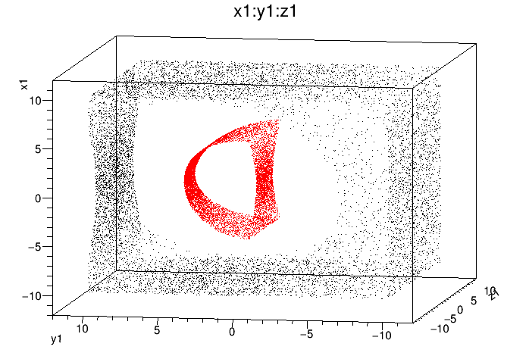
Example 1a: Geometry Verification with a Geantino Scan
Cut and paste commands from https://www.phenix.bnl.gov/WWW/publish/phnxbld/EIC/tutorial/example1a.html
After all those rotations and translations, how do you verify that the detector position is actually where you think it should be???
Shell commands:
root.exe
G4Hit
At the Root prompt, run 10000 events:
.x Fun4All_G4_Geantino.C(10000)
Entry hits (inner side)
Shell commands:
root.exe HitNtuple.root
Exit hits (outer side)
At the Root prompt:
hitntup->Draw("x1:y1:z1")
hitntup->SetMarkerColor(2);
hitntup->Draw(“x0:y0:z0“,””,”same”);
Absolute Coordinates (cm)
Geantino: Non interacting Geant particle, Geant4 introduced charged Geantinos. Discovery announcements typically on April 1st

Slide 35
Example 1c: Saving and Reading Chain Snapshot
Cut and paste commands from https://www.phenix.bnl.gov/WWW/publish/phnxbld/EIC/tutorial/example1b.html
Shell commands:
root.exe
Note:
no analysis code dependence in Fun4All_G4_Dst.C
No Geant4 dependence in Fun4All_Read_Dst.C
→ Dst’s can be created and read independently without having all code
At the Root prompt, run 10000 events:
.x Fun4All_G4_Write_Dst.C(10000)
Shell commands:
root.exe
At the Root prompt, run all events:
.x Fun4All_Read_Dst.C(0)
Exit hits (outer side)
Shell commands:
root.exe HitsFromDst.root
Entry hits (inner side)
At the Root prompt:
hitntup->Draw("x1:y1:z1")
hitntup->SetMarkerColor(2);
hitntup->Draw(“x0:y0:z0“,””,”same”);
Absolute coordinates (cm)
Ntuple code: https://github.com/sPHENIX-Collaboration/coresoftware/blob/master/simulation/g4simulation/g4histos/G4HitNtuple.cc

Slide 36
Example 2: Fast Momentum Resolution Estimate during Design Stage
What are the first questions any tracking design has to answer?
What is the momentum resolution?
What is the distance of closest approach?
Can you do better?
Do you have any idea how much this costs??? How about fewer layers?
Welcome to our full GEANT4 simulation with Kalman Filter reconstruction and vertexing.
Put a detector together from simple shapes in a ROOT macro (cylinders, boxes)
Pick your particle and a couple of energies
tell the tracking the error on the hits and run
Wash, rinse, repeat until you(r boss) like(s) the result

Slide 37
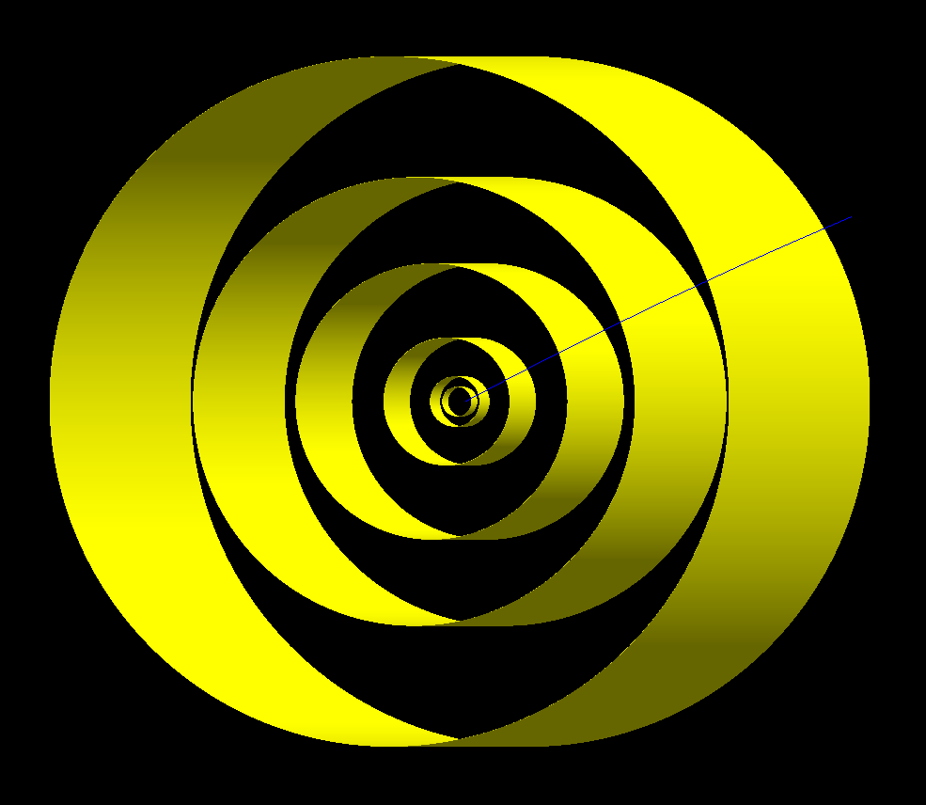
Example 2: Fast Momentum Resolution Estimate during Design Stage
Cut and paste commands from https://www.phenix.bnl.gov/WWW/publish/phnxbld/EIC/tutorial/example2.html
Shell commands:
source /cvmfs/eic.opensciencegrid.org/x8664_sl7/opt/sphenix/core/bin/eic_setup.sh -n
git clone https://github.com/sPHENIX-Collaboration/tutorials
cd tutorials/Momentum
root.exe
Let’s have a look at a
6 layer silicon detector
Radii/Thickness (in cm):
2.71, 0.02
4.63, 0.02
11.765, 0.0625
25.46, 0.032
41.38, 0.032
63.66, 0.032
Using 4GeV/c positrons
At the Root prompt:
.x Fun4All_G4_Momentum.C(-1)
.L DisplayOn.C
PHG4Reco *g4 = QTGui();
And on the G4 cmd line:
/Fun4All/run 1
Root macro in github:
https://github.com/sPHENIX-Collaboration/tutorials/Momentum/Fun4All_G4_Momentum.C

Slide 38
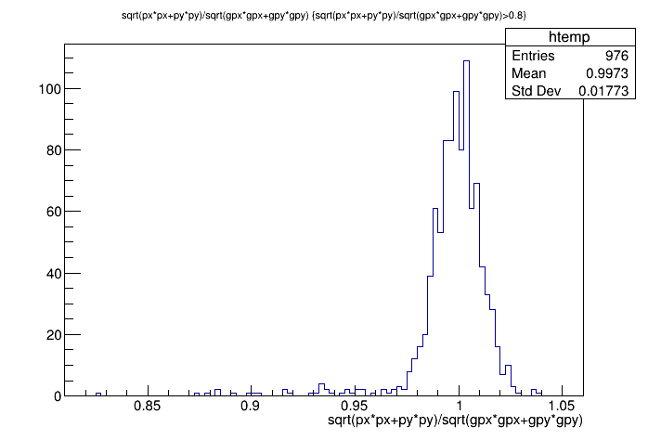
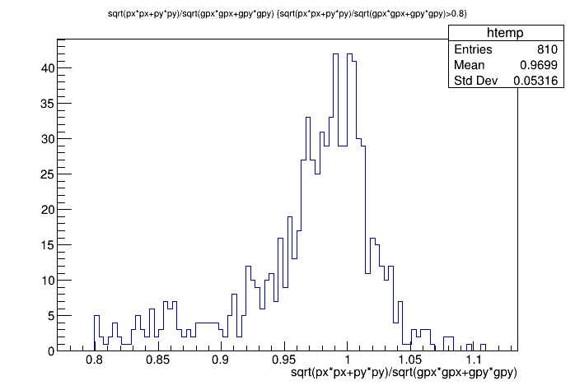
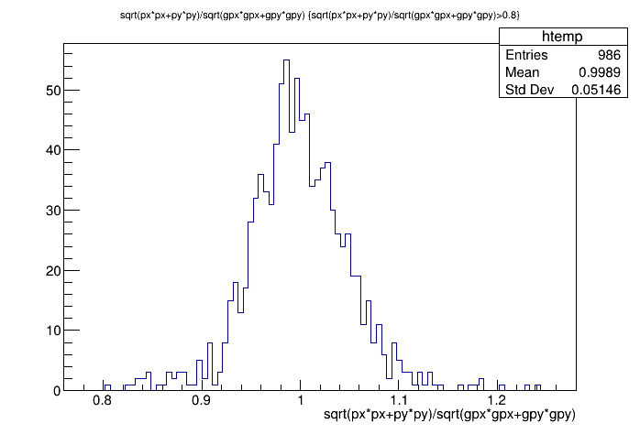
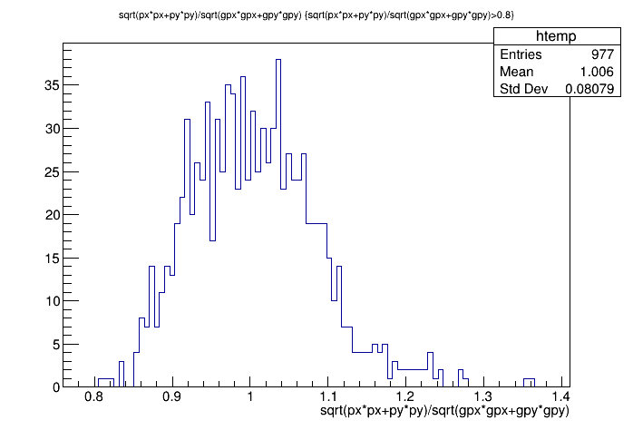
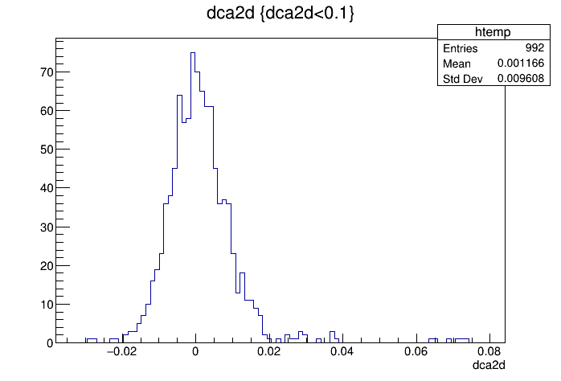
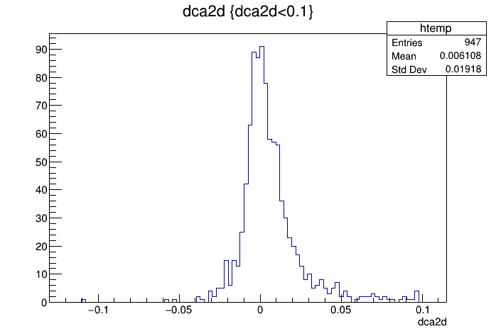
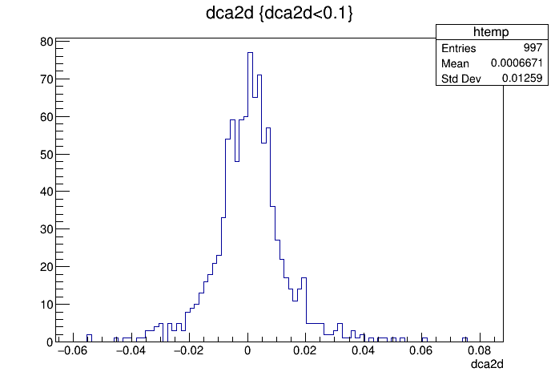
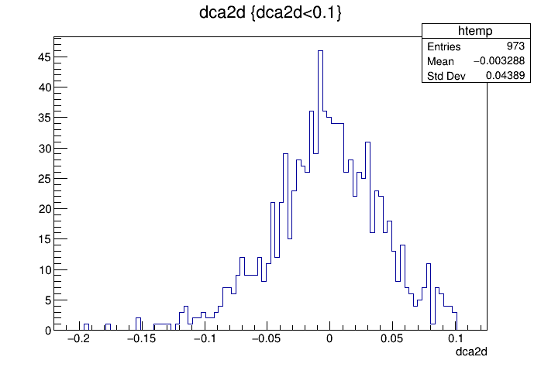
Example 2: Fast Momentum Resolution Estimate during Design Stage
Positrons @ 4GeV/c at midrapidity
Nominal
X10 Si thickness
½ layer radius
1/10 resolution
Reco(p_{t} )/Input(p_{t} )
dca2d

Slide 39
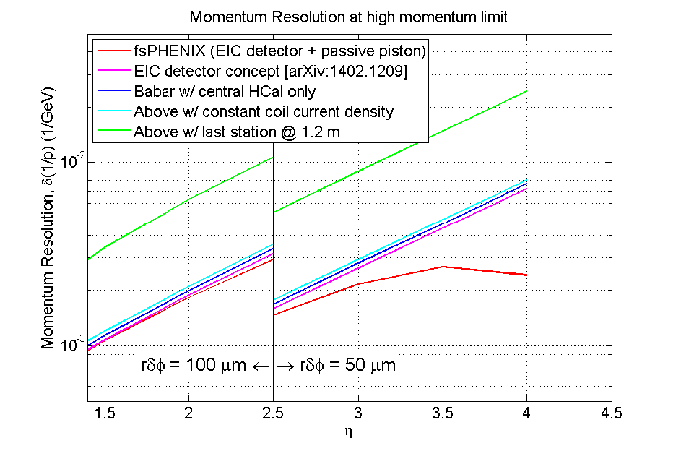
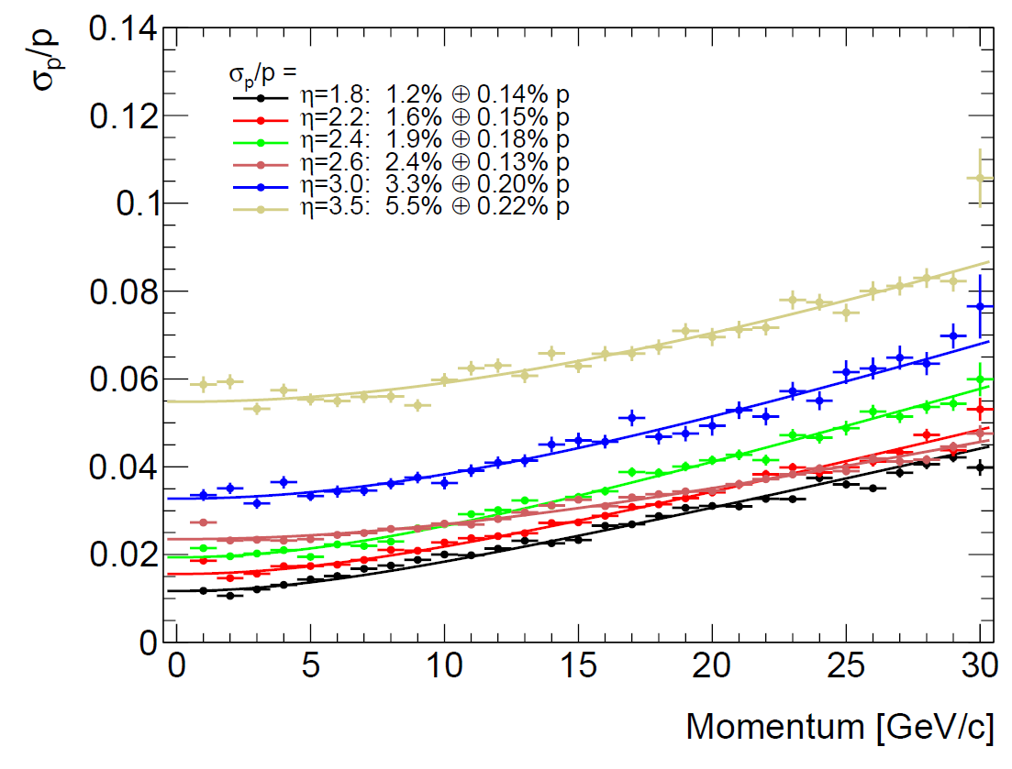
Example 2: Fast Momentum Resolution Estimate during Design Stage

Slide 40
Example 2: Fast Momentum Resolution Estimate during Design Stage
This prospect is meant to motivate you to learn about programming loops and running batch jobs

Slide 41
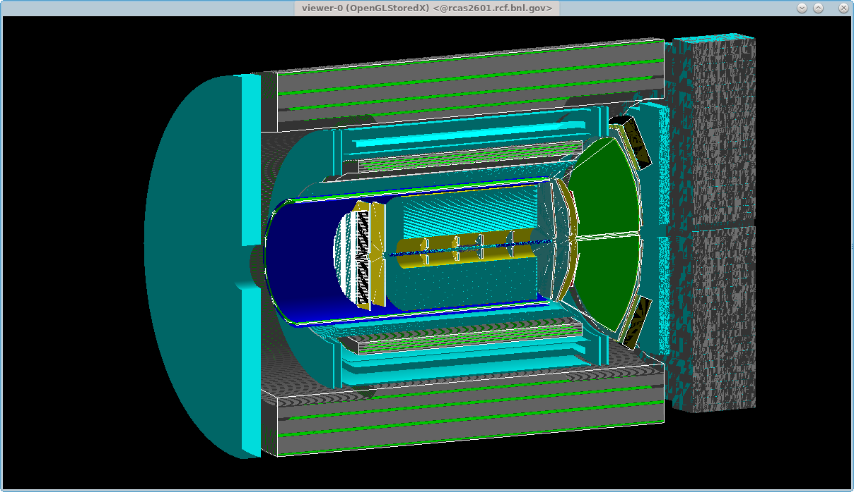
Example 3: Adding detectors to existing setups
Cut and paste commands from https://www.phenix.bnl.gov/WWW/publish/phnxbld/EIC/tutorial/example3.html
Shell commands:
source /cvmfs/eic.opensciencegrid.org/x8664_sl7/opt/sphenix/core/bin/eic_setup.sh -n
source /cvmfs/eic.opensciencegrid.org/x8664_sl7/opt/sphenix/core/bin/setup_local.sh $HOME/myinstall
git clone https://github.com/sPHENIX-Collaboration/macros
cd macros/macros/g4simulations
root.exe
At the Root prompt:
.x Fun4All_G4_EICDetector.C(-1)
.L DisplayOn.C
PHG4Reco *g4 = DisplayOn();
g4->ApplyCommand("/vis/viewer/panTo 0 100 cm")
QT is way to slow for more complex detectors but you are welcome to try
PHG4Reco *g4 = QTGui();

Slide 42
Example 3: Adding detectors to existing setups
Now open G4Setup_EICDetector.C
Now open G4Setup_EICDetector.C and add 4 lines:
After line 27:
#include <g4lmondetector/G4LmonSubsystem.h>
R__LOAD_LIBRARY(libg4lmondetector.so)
After line 310 (before the truth subsystem):
G4LmonSubsystem *lmon = new G4LmonSubsystem("LumiMon");
g4Reco->registerSubsystem(lmon);
The fine print:
The stepping action does not put any objects on our node tree
This does not include the detector into any analysis chain
There are overlaps (the vacuum box) which need to be dealt with
Our world is filled with G4_Air, need to add a vacuum system

Slide 43
HELP!!!!!!!
Future Documentation:
https://eic-detector.github.io
Mattermost chat (BNL hosted open source slack). It is a public channel. Rcf accounts can subscribe, non BNL accounts need invite:
https://chat.sdcc.bnl.gov/eic/channels/fun4all-software-support
Last resort:
Send mail to or Chris Pinkenburg (pinkenburg at bnl.gov) and/or Jin Huang (jinhuang at bnl.gov)

Slide 44
Final Remarks
This was just a small selection of our capabilities
Fun4All was already used to simulate and design a new collider detector
Fun4All was used for published EIC detector concepts
Synergy: Collaboration with an existing experiment ensures long term support and warm bodies to work on it
Reuse existing code (tracking, clustering, calibrations,…)
Read and reconstruct raw data from a commonly used daq
EIC specific detectors can go into their own repository (https://github.com/EIC-Detector)
EIC cvmfs volume: /cvmfs/eic.opensciencegrid.org
EIC specific 3rd party libraries can be installed there
Users can use their own repository and just link against Fun4All in cvmfs
Distribution in cvmfs and singularity container run on most platforms (including OSG)
Congratulations – you made it!

Slide 45
You have gone too far
Backup Zone

Slide 46
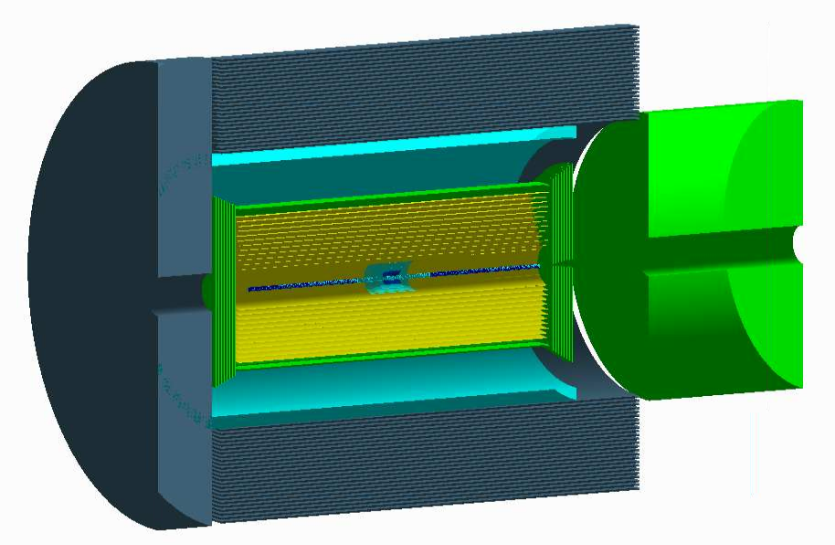
Partial JLEIC reverse engineered from g4e
https://gitlab.com/jlab-eic/g4e/
Two days of work (mostly spend on re-familiarizing how we do this)
Only one Box detector (vtx) needed actual cut and paste coding
Just too lazy to look into our generic boxes
Forward/backward only container volumes
Forward/Backward pieces missing
VTX, 6 layers Si
CTD, 12 layers Si
DIRC
sPHENIX beampipe
Hadron Endcap (250cm Fe)
CLEO Magnet
Hcal (25 Cylinders Fe, no scintillator)
8 layer GEM tracker
Electron Endcap (60cm Fe)

